Slide 1
A medical and multi-disciplinary in-air transport beam line for the 70 MeV protons from the INFN-LNL cyclotron
Dr Roberto Catalano and Dr Giada Petringa
Istituto Nazionale di Fisica Nucleare – Laboratori Nazionali del Sud (Italy)
G.A.P. Cirrone, G. Cuttone,
Istituto Nazionale di Fisica Nucleare - Laboratori Nazionali del Sud (Italy)
G. Russo, F. Cammarata
CNR – Istituto di Bioimmagini e Sistemi Biologici Complessi

Slide 2
The LNS activity in the framework of beam facility
Collaboration with Best Cyclotron
2002
2017
2018
2019
2020
2025
The INFN-LNS activity on beamline realization for clinical proton beams
Second improvement of Ion irradiation facility @LNS (high intensity)
First improvement of Ion irradiation facility @LNS (light ions modulation)
First proton therapy treatment @CATANA
ELIMED installation
I-LUCE facility
Double ring implementation @TIFPA
How can LNS contribute to the future research program with the high power cyclotron of SPES-LNL?

Slide 3
Activity @LNS with conventional proton beams

Slide 4
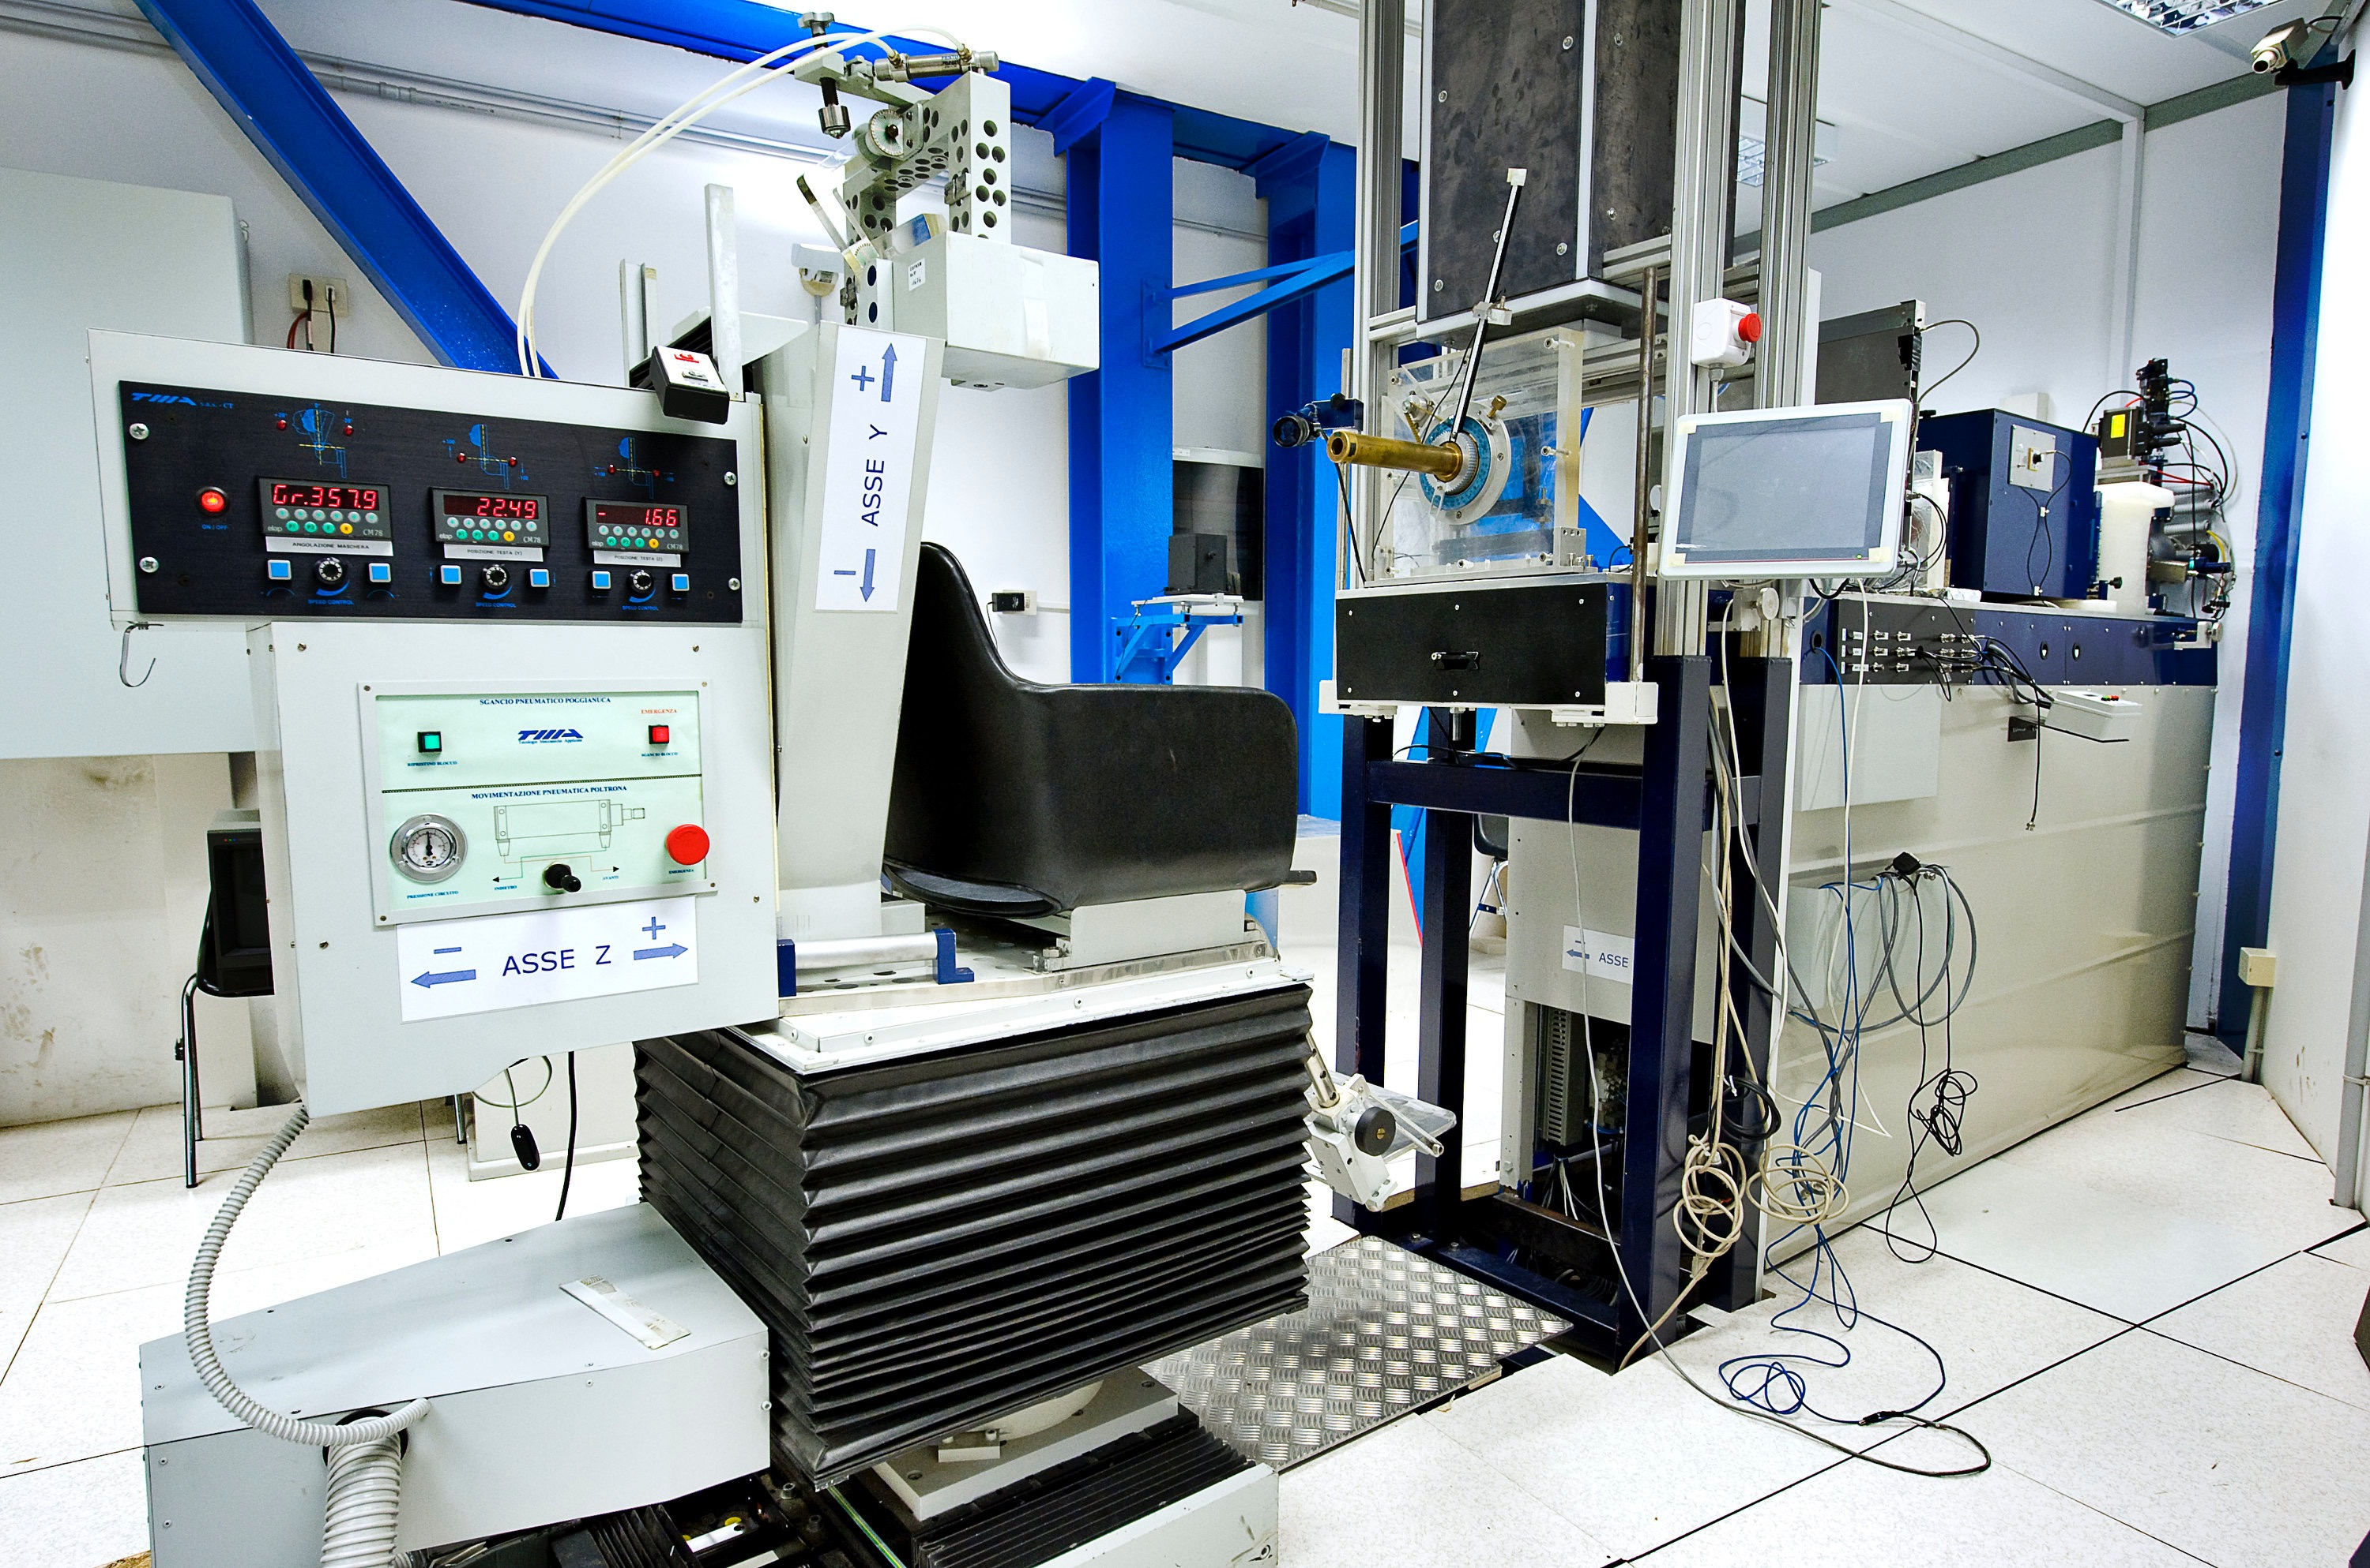
CATANA @LNS-INFN
Centro di AdroTerapia ed Applicazioni Nucelari Avanzate
Mainly dedicated to proton irradiation (eye melanoma treatments)
First Italian proton therapy facility
First Patient treated on March 2002 (about 400 treated)
Passive proton beam line
Modulated 62 MeV protons
Dosimetry and radiobiology experiments
Collimated beams up to 35 mm (lateral homogeneity ≈ 3%)
Cuttone et al. EPJ 126 (2011)

Slide 5
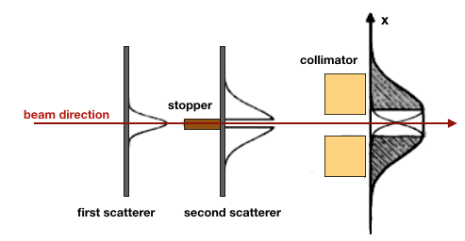
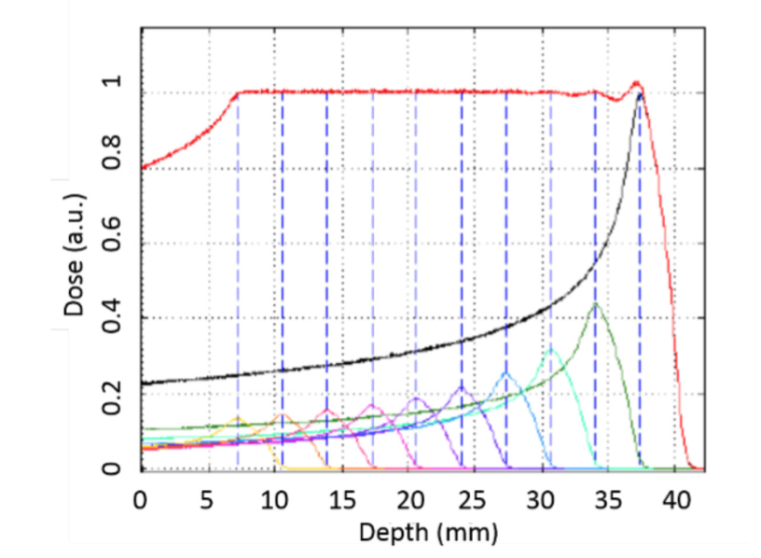
CATANA @LNS-INFN
A passive proton beamline
1
3
Scattering System
2
4
Modulation System
Collimator

Slide 6
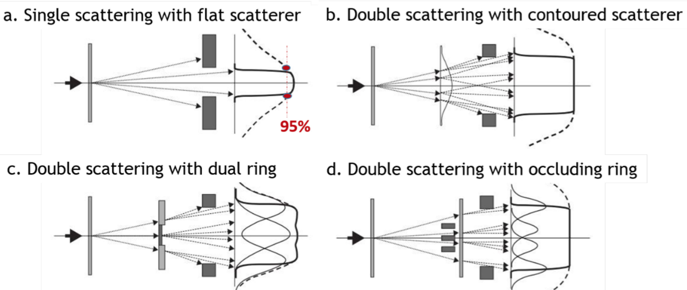
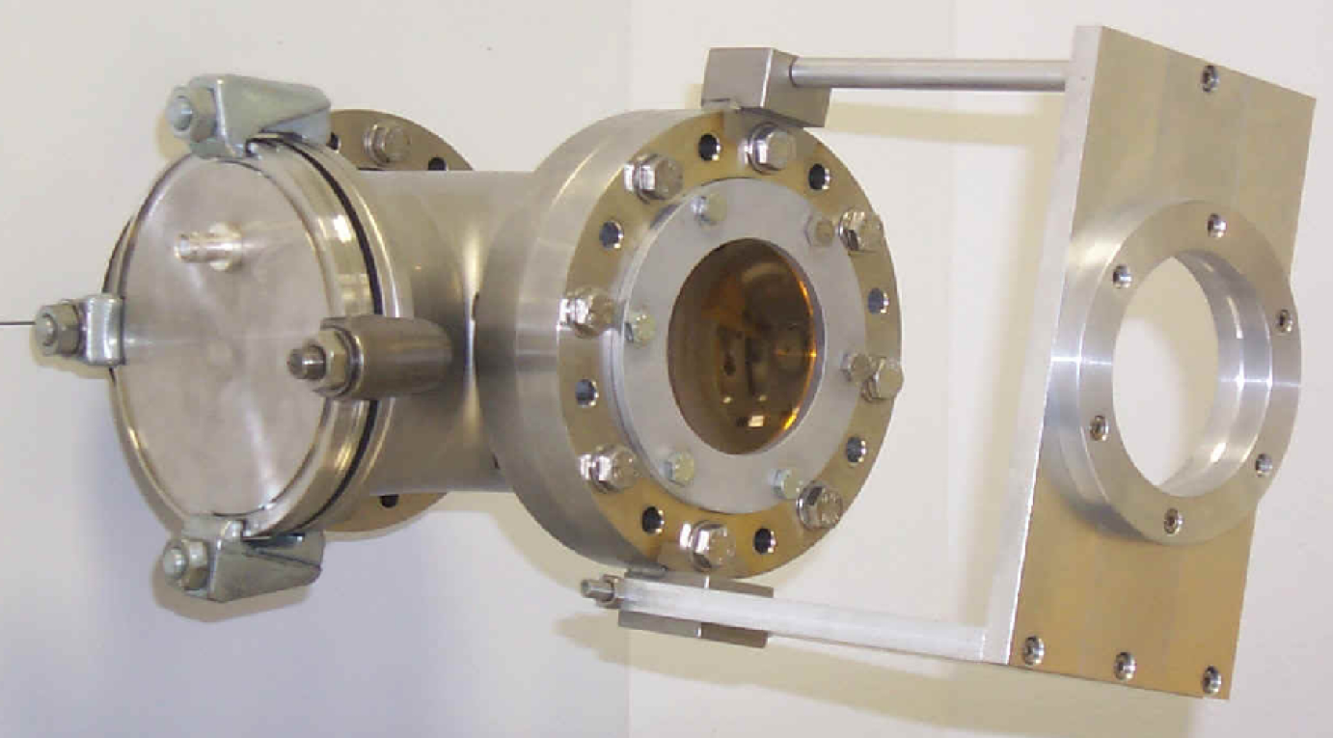
CATANA @LNS-INFN
Scattering system
SEM
Gaussian beam → Clinical beam
Double Scattering system with one occluding central stopper
15um Ta
20um Ta
brass

Slide 7
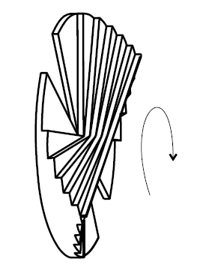
CATANA @LNS-INFN
Modulation system
Range shifter + modulator (homogeneity along Z direction)
The dose in the SOBP can be expressed as the superimposition of many Bragg curves expressed as:
where B_{i}(x,y,z) is a Bragg curve that can be determined experimentally and analytically; w_{i} is the optimized weight determining the modulator shape, and accounting for the contribution of each peak i to the final SOBP. The weights can be obtained by the minimization of a cost function, Q, defined as:

Slide 8
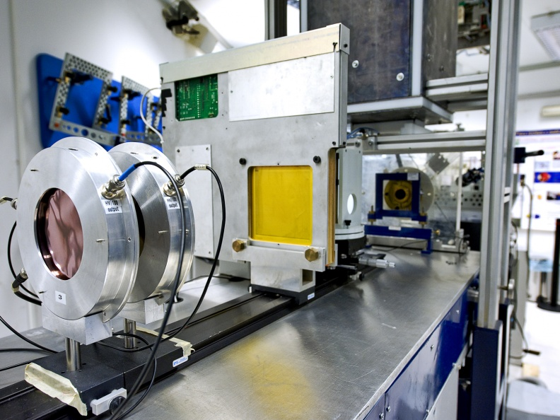
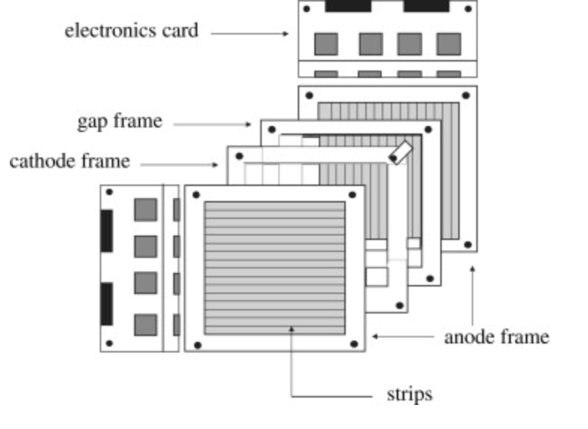
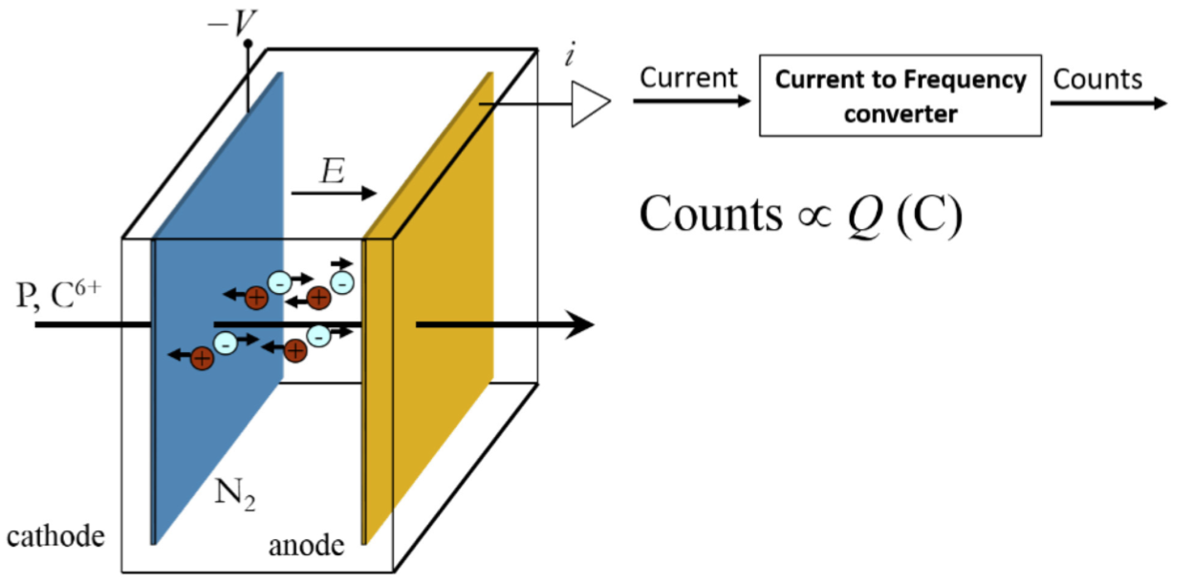
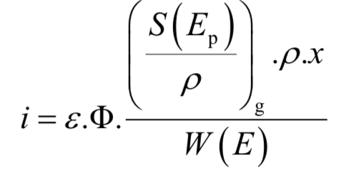
CATANA @LNS-INFN
Online Monitor system
Multistrip ionization chambers detector to monitor online the beam geometry (position and uniformity)
In-trasmission ionization chambers
mass electronic stopping power
gas density
beam flux
mean free path in the gas
collection efficiency
mean energy needed to produce an ion pair for a charged particle of energy E

Slide 9
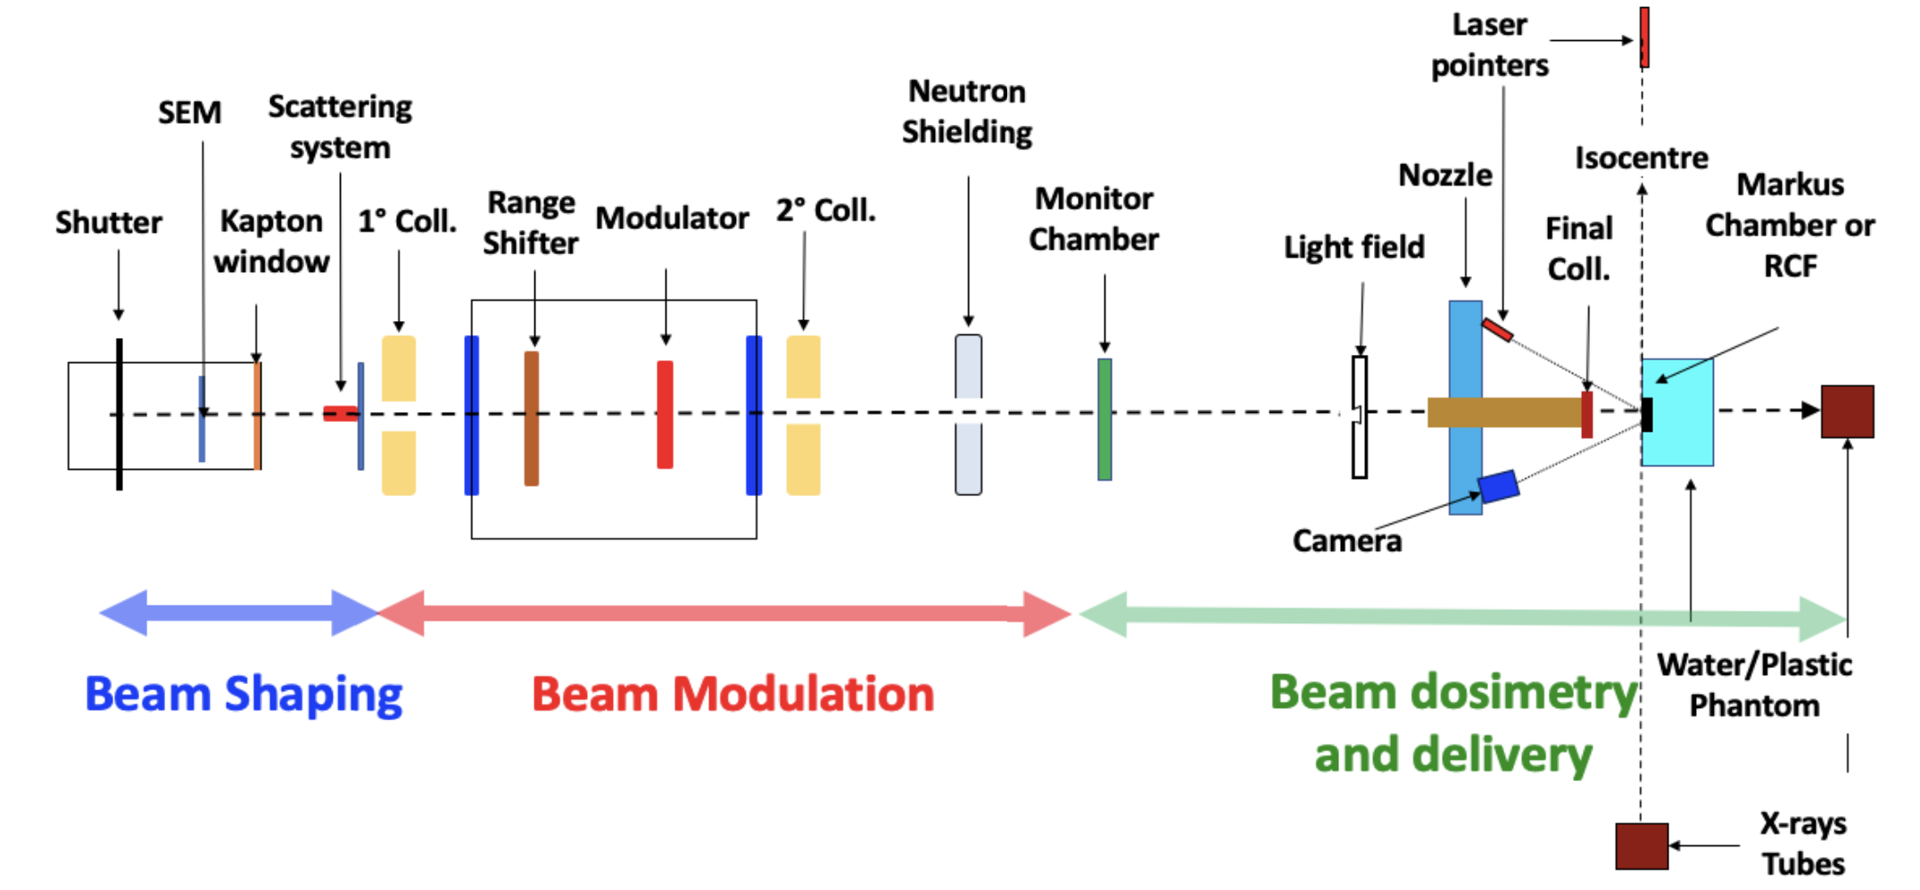
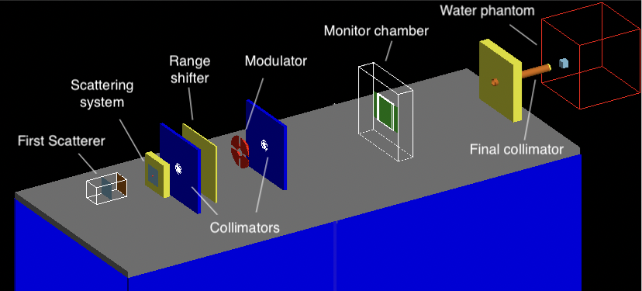
Feasibility study of a new beamline
Collaboration with the
Best-Cyclotron company
to realize a beamline to treat ocular melanoma with commercial cyclotron (both low and high intensity beams)
A new monitor chamber for both low and high intensity beams

Slide 10
Ion irradiation facility @LNS
0 degree beamline
Beamline dedicated to dosimetric tests and radiobiological experiments with ion beams of 62 MeV/n:
- 4He
- 12C
- 16O
Irradiation point
Modulation system for ions (Ridge and Ripple fliters)
Secondary Emission Monitoring (SEM) for scattering and beam fluence
In-transmission
ionization chamber

Slide 11
Ion irradiation facility @LNS
Modulation system

Slide 12
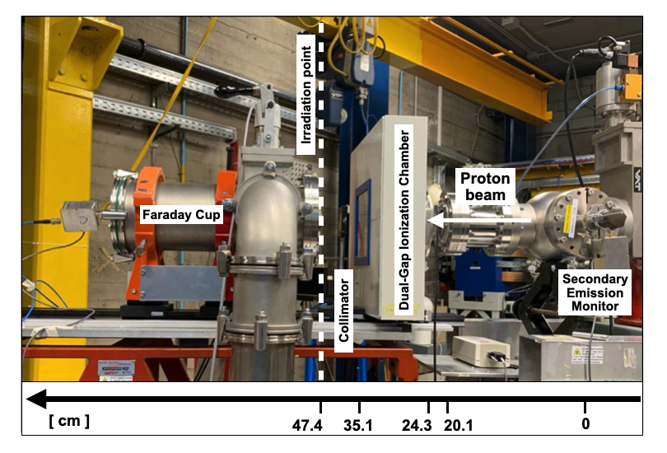
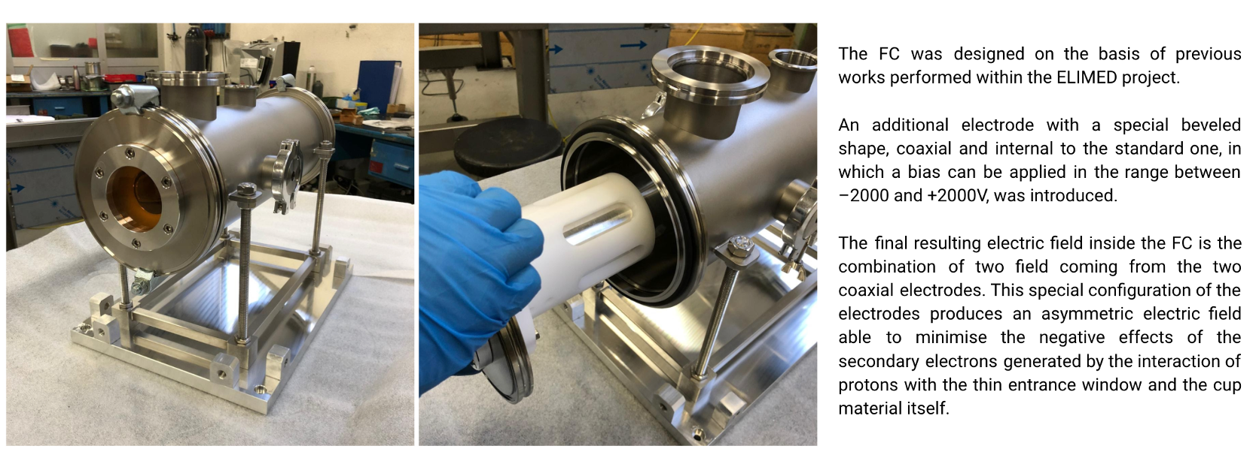
Ion irradiation facility @LNS
Irradiation setup for high intensity proton beams (absolute dosimetry)
Faraday cup
The cylindrical symmetry of the electric field provided by the external electrode is broken due to the presence of the internal one.
The resulting effect is a strongly asymmetric electric field, characterized by a significant transversal component able to maximize the deflection of the secondary electrons genera-ted by both the entrance window and the cup.

Slide 13
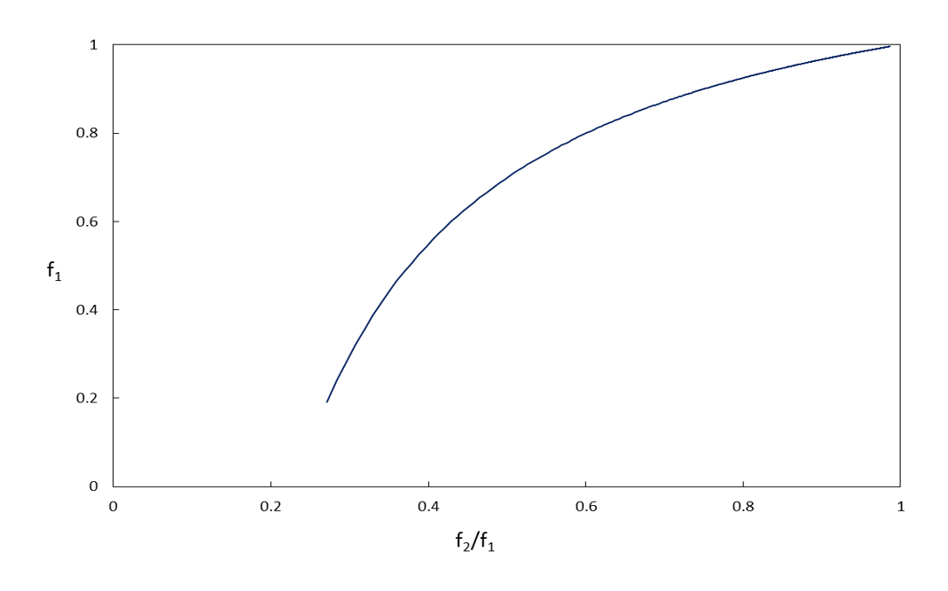
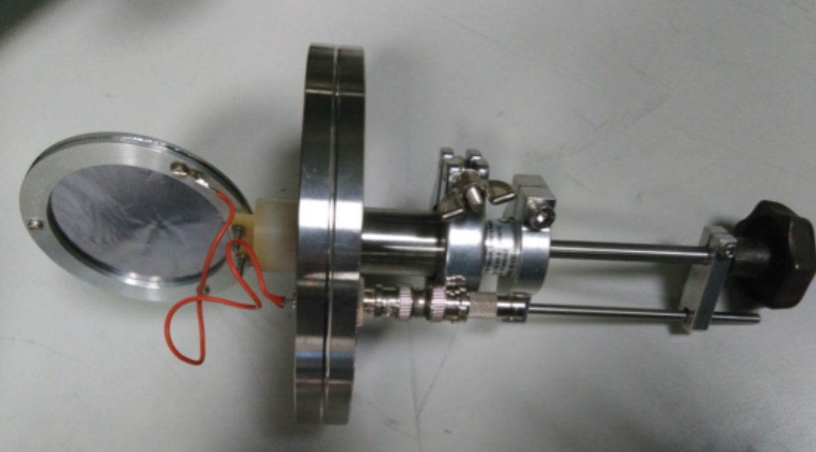
Ion irradiation facility @LNS
Irradiation setup for high intensity proton beams (relative dosimetry)
Specifically designed for high
intensity beams
Efficiency of chamber 1 can be determined
Determined by the measured ratio of the currents
f₁ = Efficiency of the chamber 1
Secondary Emission Monitoring
Dual-gap ionization chamber
f₂/f₁ = efficiency ratio
15um Tantalum foil
Insulator PMMA frame
Charge integration for normalisation purposes
Scattering foil for beam diffusion
Two adjacent IC, gaps of 5 mm and 10 mm, independently biased (maximum applied voltage ± 1000 V and ± 2000 V, respectively)
Anode: thin layers of 5 µm of copper and 2 µm of nickel, deposited on a 25 µm layer of kapton
Cathode:12 µm-thick layer of aluminized mylar

Slide 14
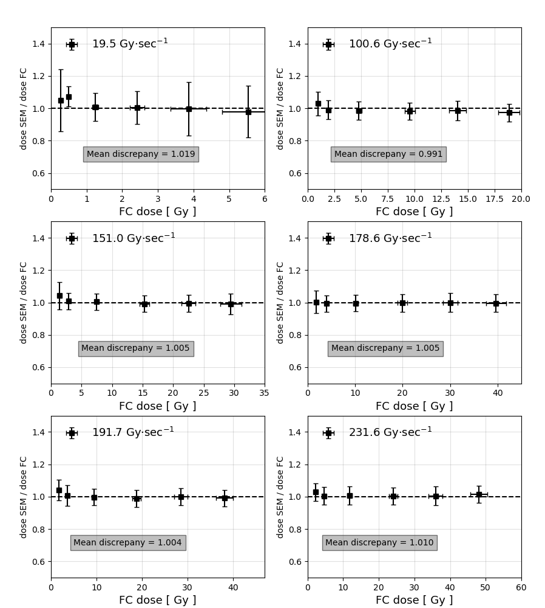
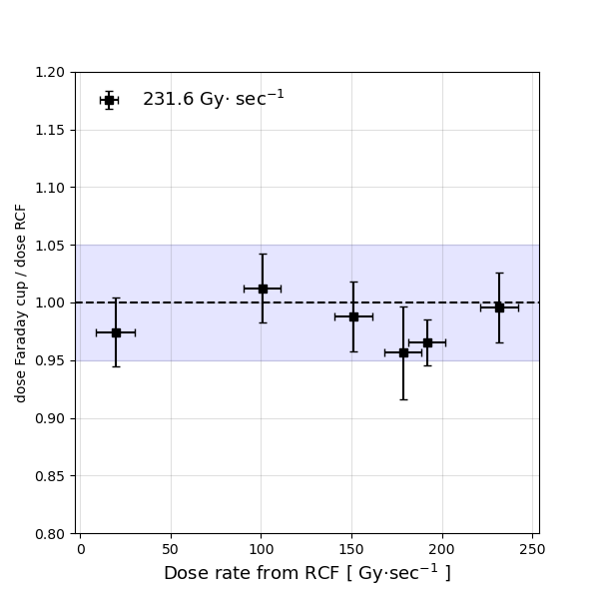
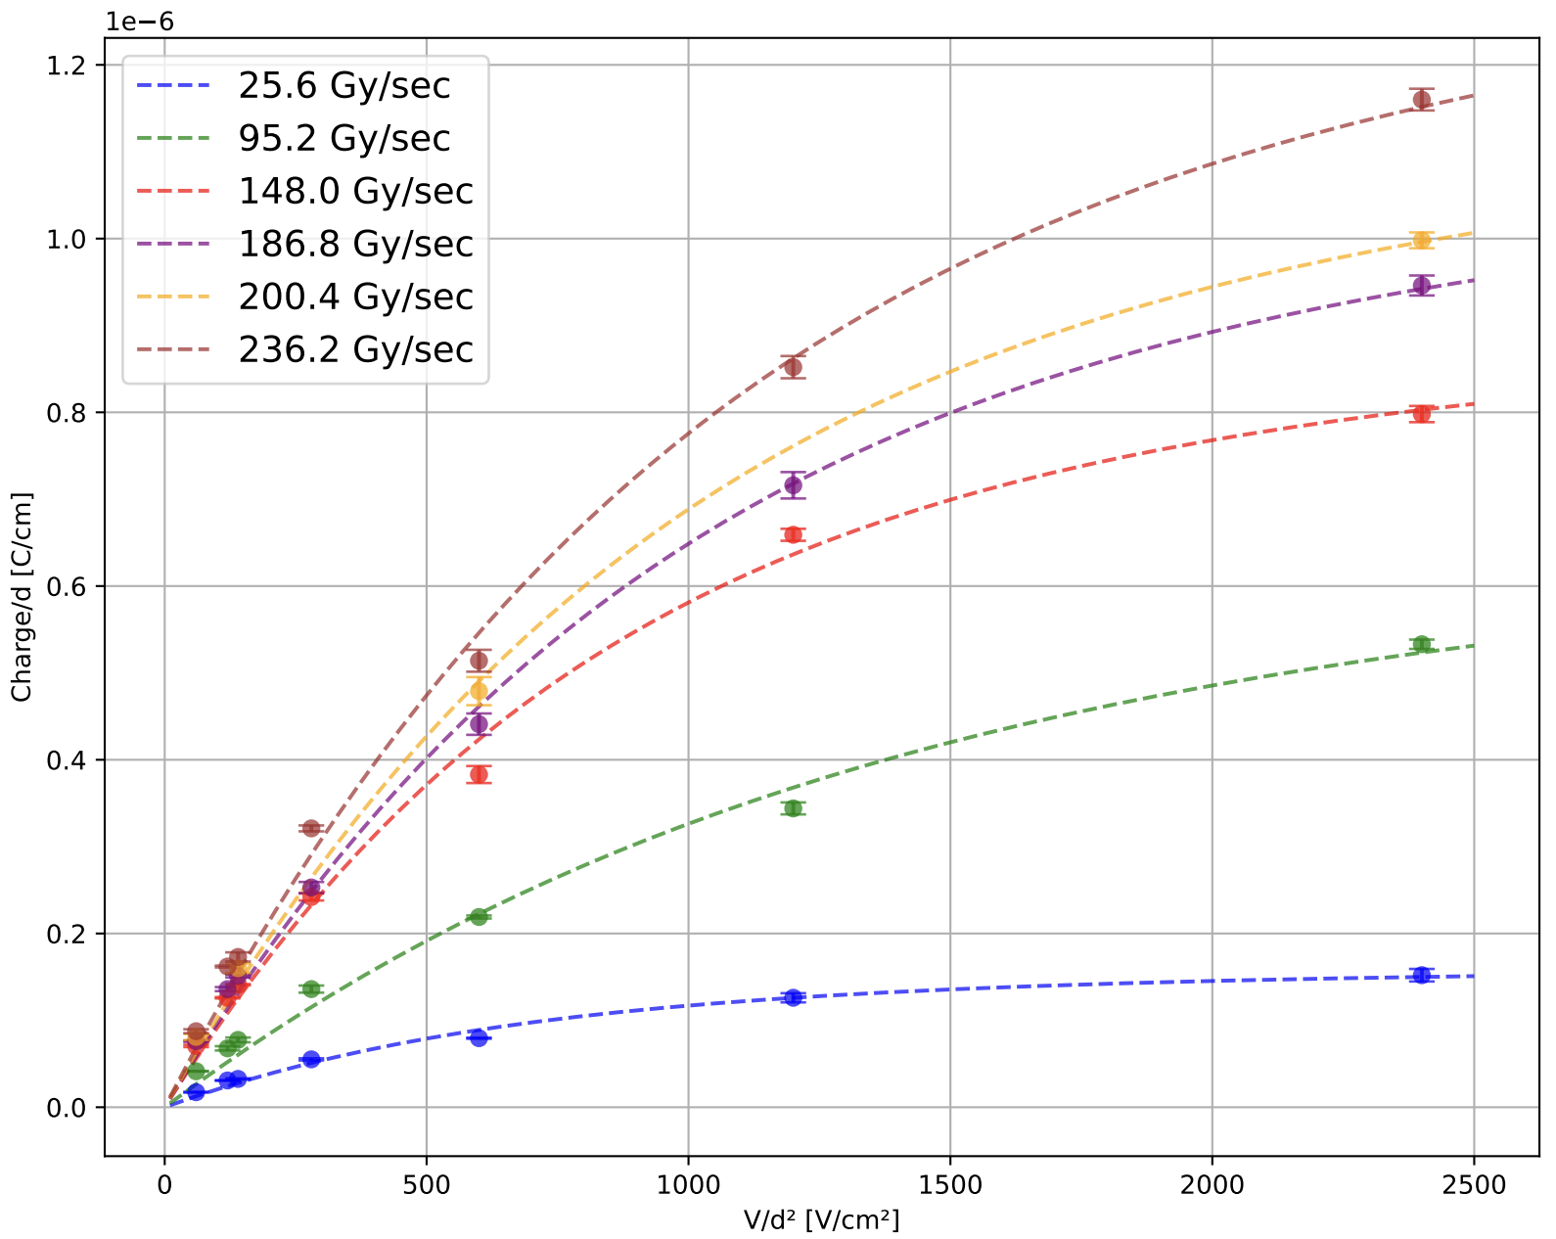
Dosimetric test with flash beams
SEM
Instantaneous current [nA] | 5 - 50
Pulse duration [ms] | 10 - 200
Instantaneous dose rate [Gy/s] | 20 - 230
Beam spot shape and size [mm2] | Squared, 9.8 x 9.8
Nominal energy [MeV] | 60 ± 0.5
FC
DGIC

Slide 15
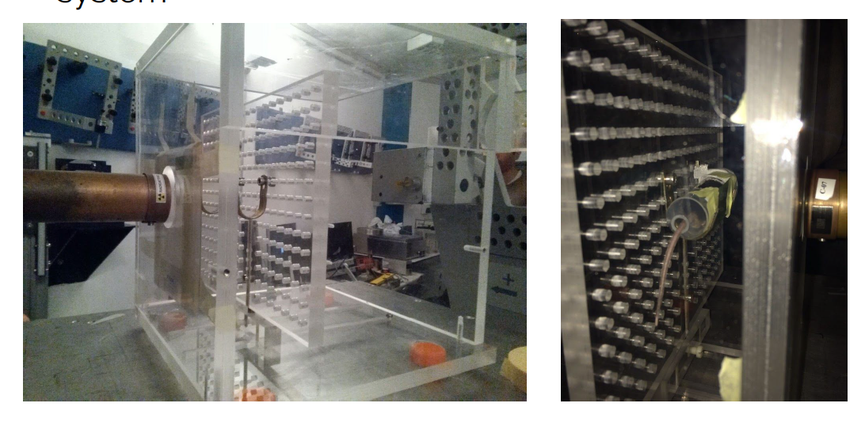
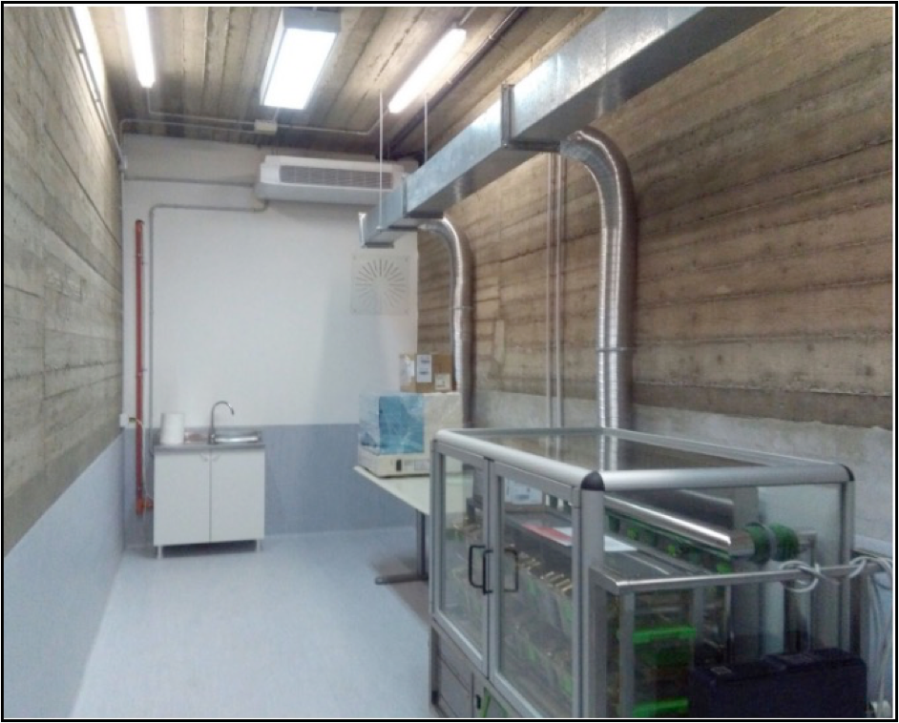
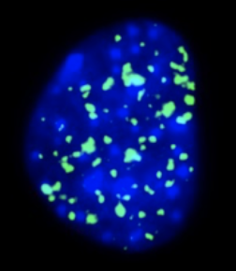
Biological sample irradiation @LNS
In-vitro positioning system
Analysis pre and post irradiation
In-vivo positioning system
Small animals storage
Types of equipment into the Bio-Lab:
Laboratory Hood
Inverted microscopy
Centrifuge
Incubator
-80°C for storage of biological samples
Dewar for long term storage of different cellular batch

Slide 16
Collaboration with TIFPA’s group and ELI-BEAMLINES

Slide 17
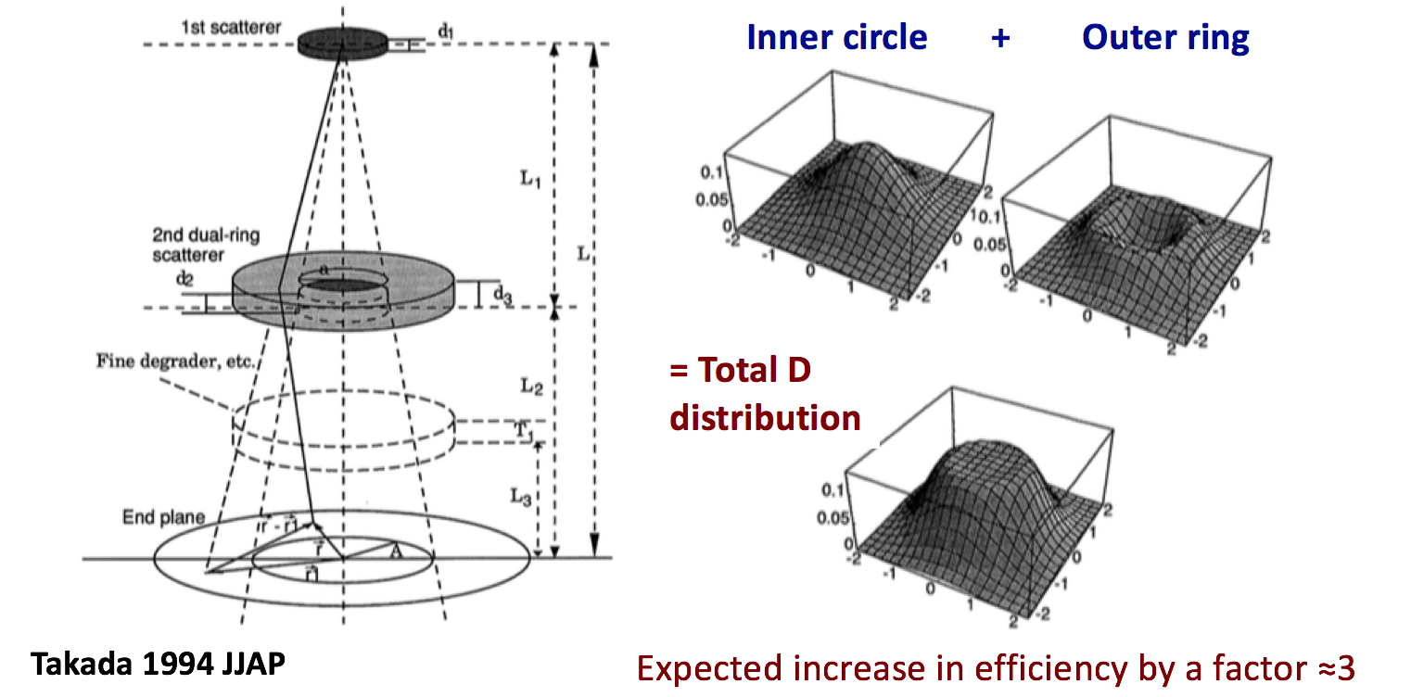
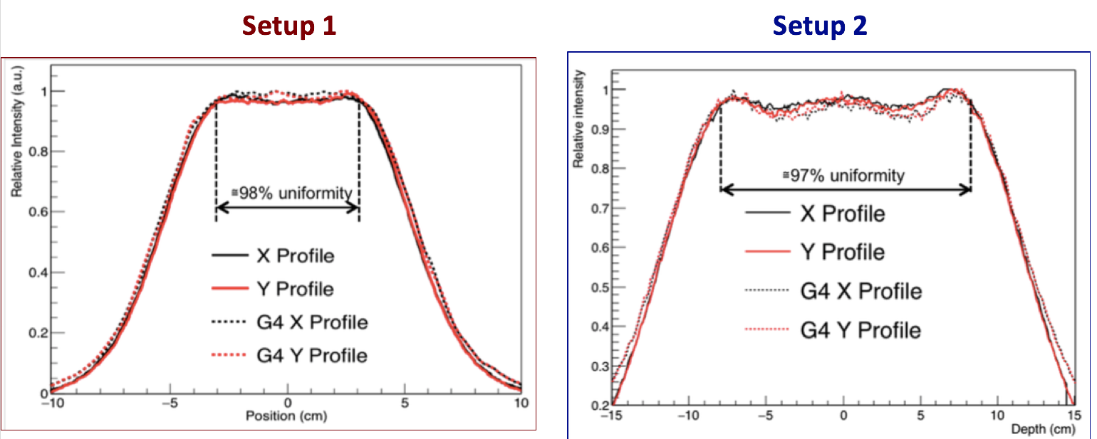
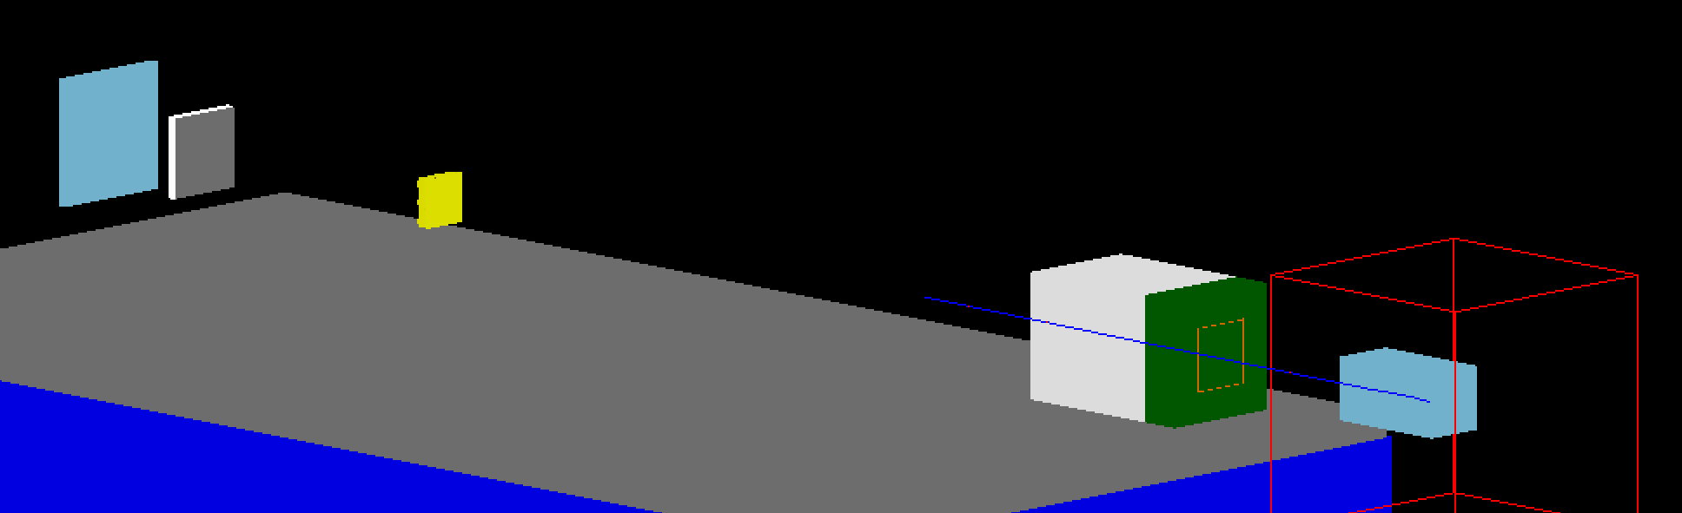
Irradiation facility @TIFPA
Monitor
Chamber
Ridge
filter
collimator
Scattering
System
F. Tommasino et al.,A new facility for proton radiobiology at the Trento Proton Therapy centre: design and implementation”,Physica Medica, 10.1016/j.ejmp.2019.02.001
pre-collimator

Slide 18
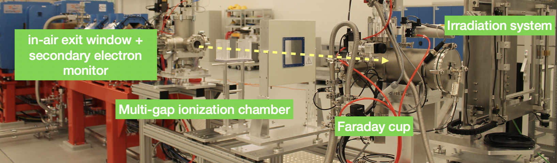
Dosimetric system for high intensity proton beams
- A set of a 5 PMQ allows to focus the particle beam and provide a rough energy selection
The ESS consists of four electromagnetic dipoles and a slit; it was designed to select protons with energies up to 300 MeV and heavier ions with energies up to 60 MeV per nucleon
Downstream the ESS, the ion beam is transported into the final beam shaping section, consisting of two resistive quadrupoles and two steerers for a fine focusing and alignment of the ion beam
ELIMAIA Beamline | L3 HAPLS | L4 ATON
Peak power | ≥1 PW | 10 PW
Energy in pulse | ≥30 J | ≥1.5 kJ
Pulse duration | ≤30 fs | ≤150 fs
Rep rate | 10 Hz | 1 per min
Supplier | LLNL | National Energetics
ELI-Beamlines | Compressor, short pulse diagnostics, controls & timing systems | Compressor design, OPCPA design, short pulse diagnostics, timing system

Slide 19
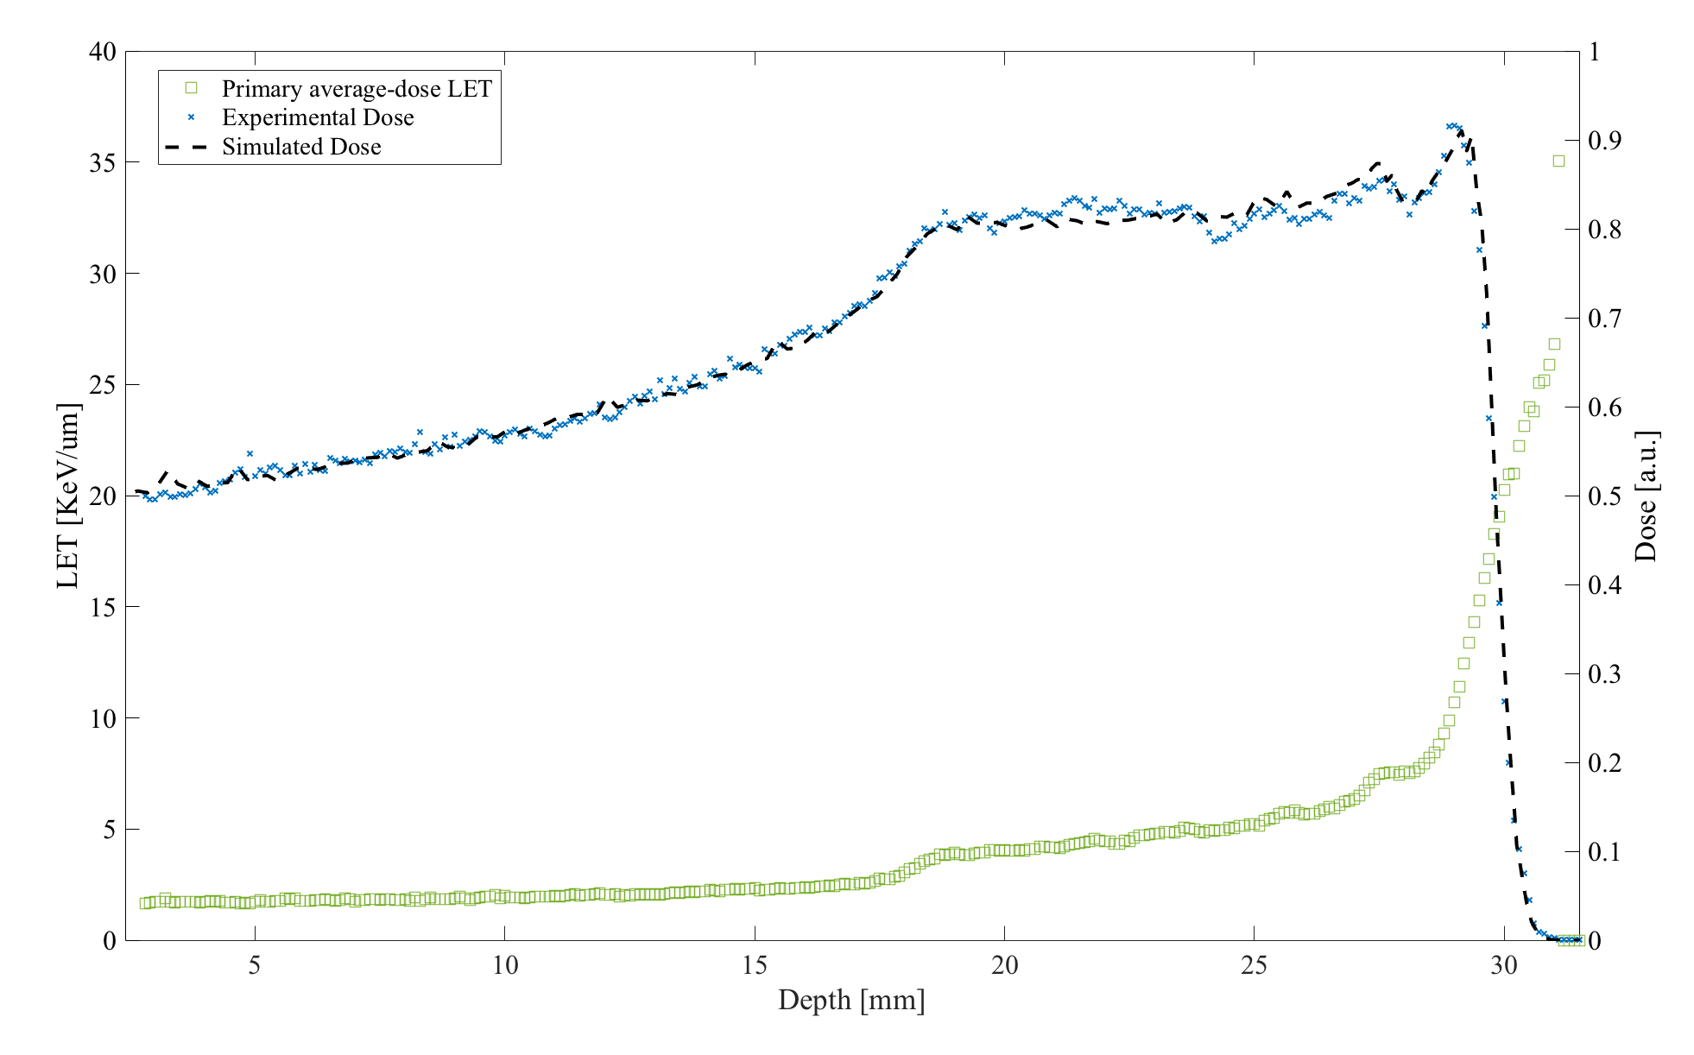
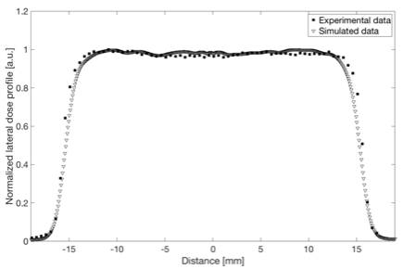
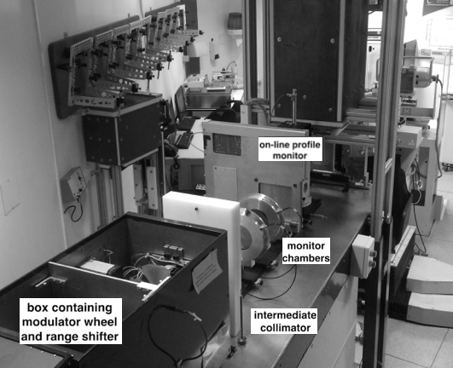
Monte Carlo Simulation for beamline design
Monte Carlo simulations for beamline design
A dedicated Geant4 application was develo-ped to optimize and realize the beamlines:
CATANA (LNS)
Ion irradiation facility (LNS)
Best Cyclotron beam line
ELIMED (ELI)
I-LUCE (LNS)

Slide 20
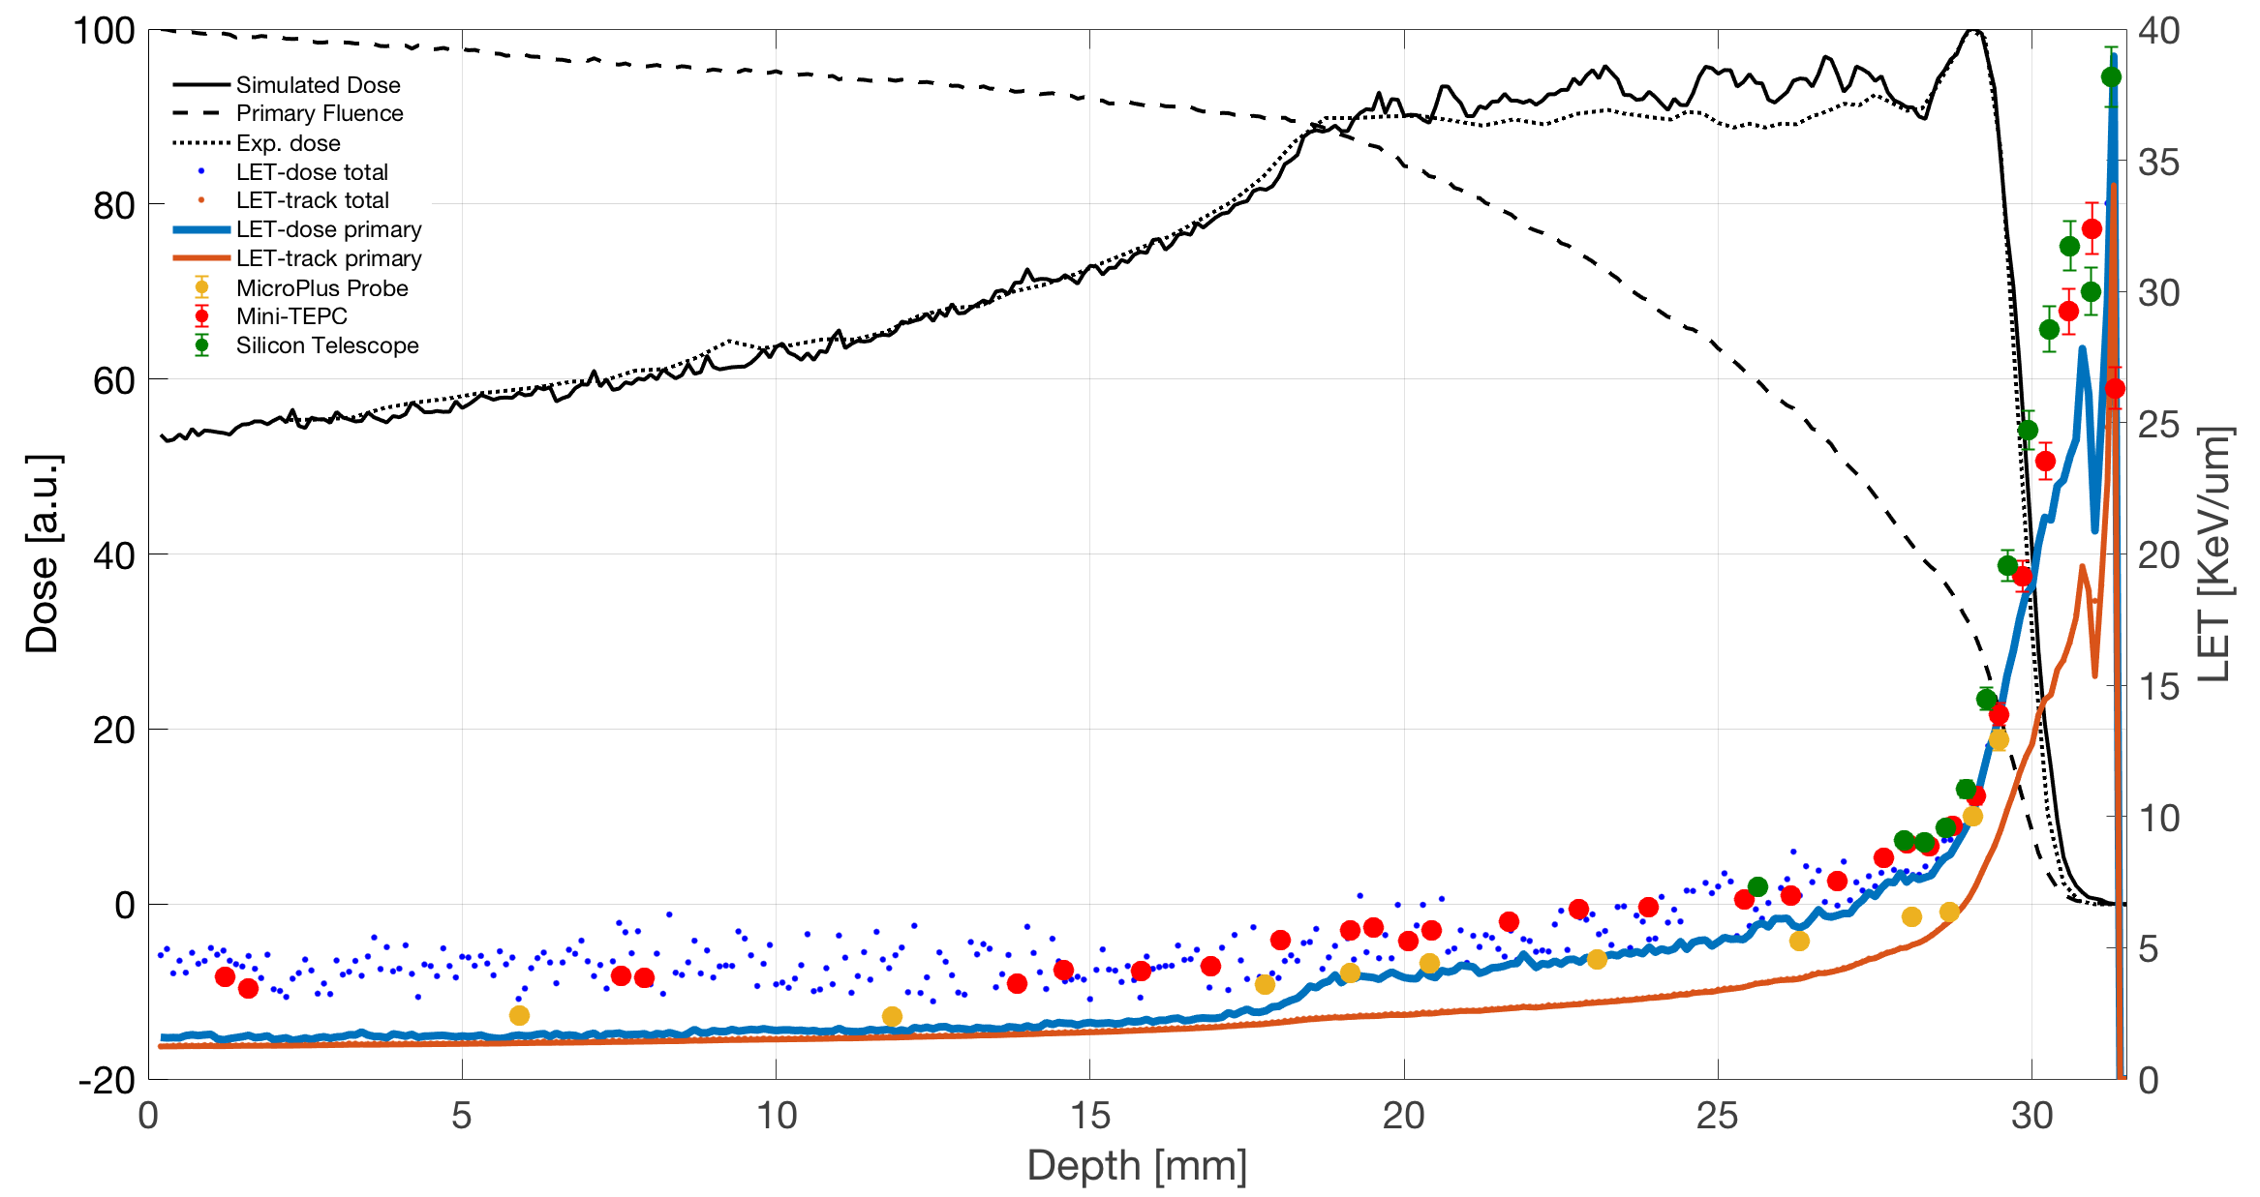
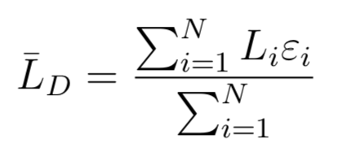
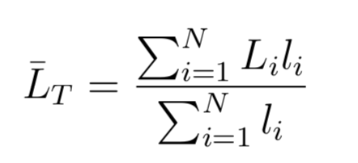
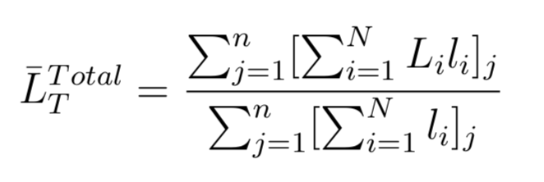
Monte Carlo Simulations for dosimetric and microdosimetric purposes: LET and RBE
Open source G4 Monte Carlo codes
Hadrontherapy: Geant4-based application specifically developed to address typical needs related to the proton and ion therapy
Radiobiology: Geant4-based application realized for dosimetric and radiobiological applications of proton and ion beams
Microdosimetry (INFN, Section of Catania)
20
LET-dose
LET-track
Silicon Telescope at the isocenter position of the CATANA protontherapy facility
MicroPlus probe at the isocenter position of the CATANA protontherapy facility
Mini-TEPC at the isocenter position of the CATANA protontherapy facility

Slide 21
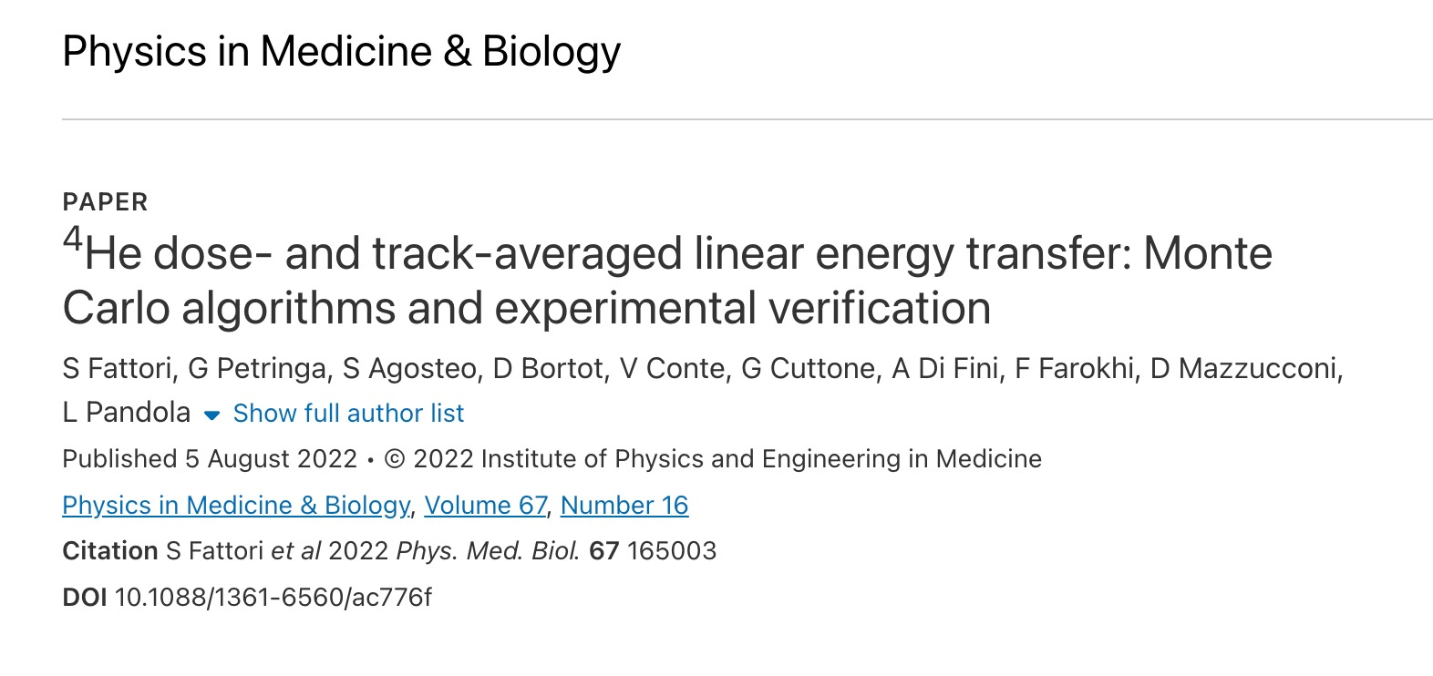
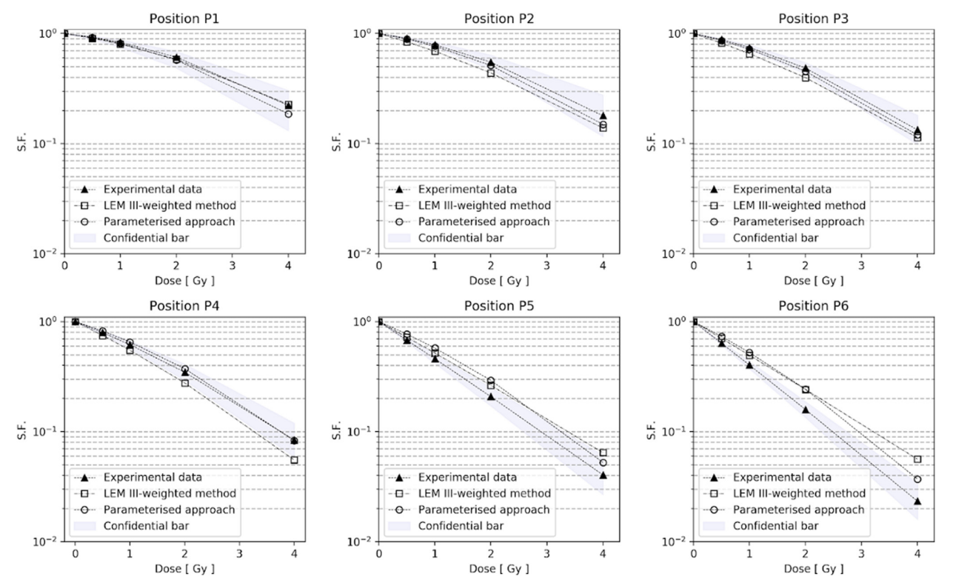
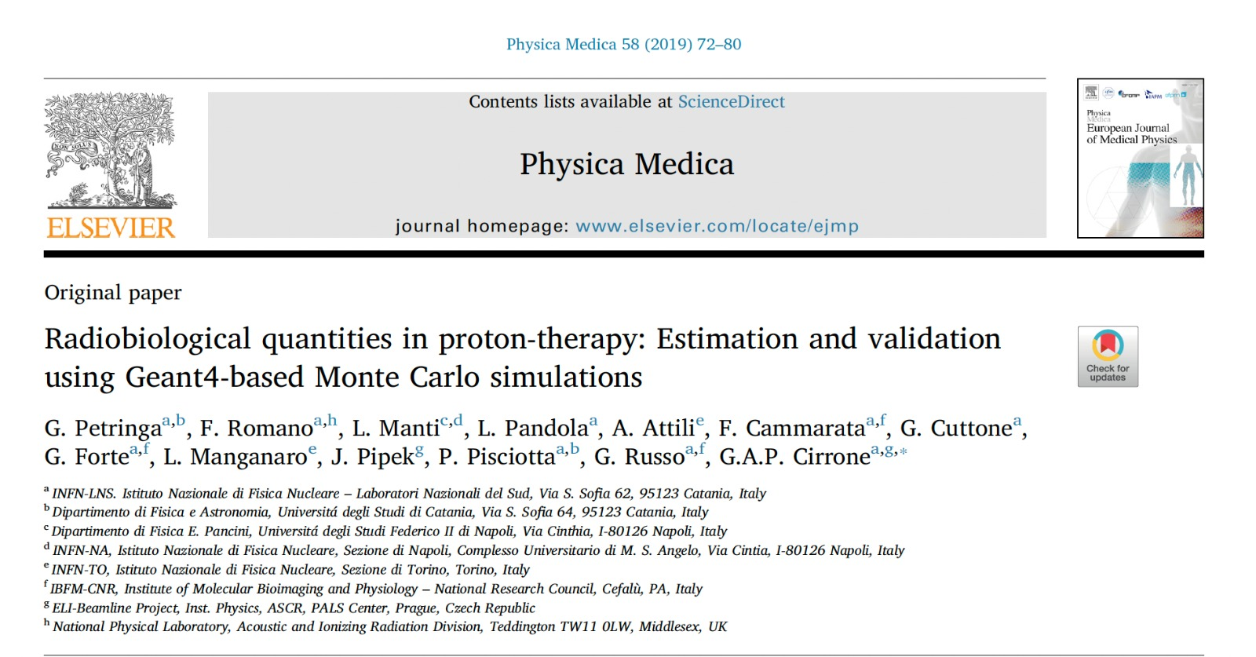
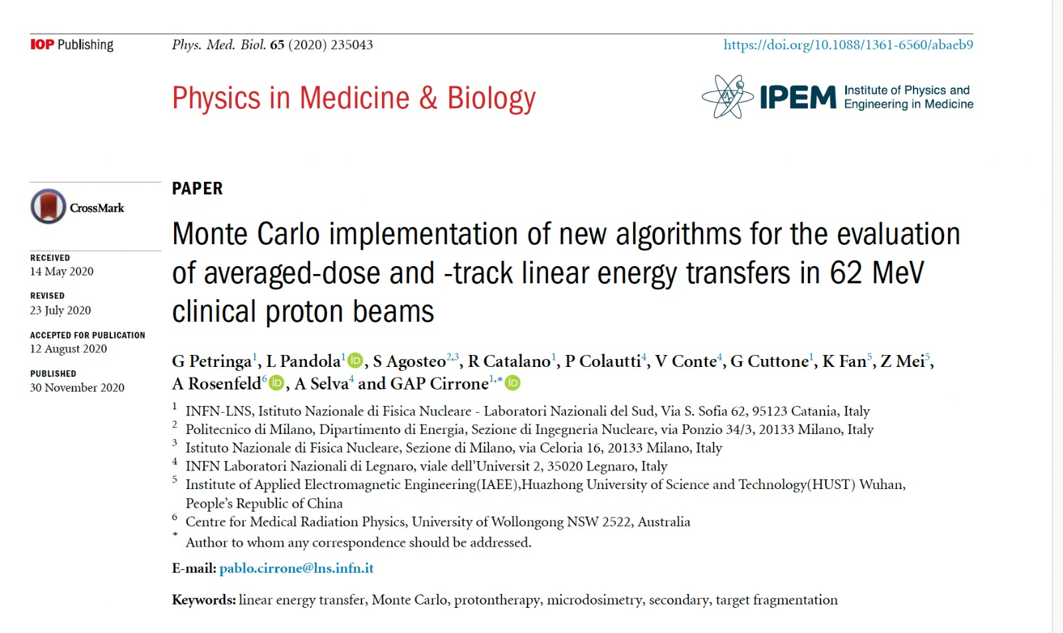
Monte Carlo Simulations for dosimetric and microdosimetric purposes: LET and RBE
Experimental survival data of the U87 cells irradiated in six different positions along the 62 MeV proton pristine Bragg peak

Slide 22
Current activity in the framework of I-LUCE

Slide 23
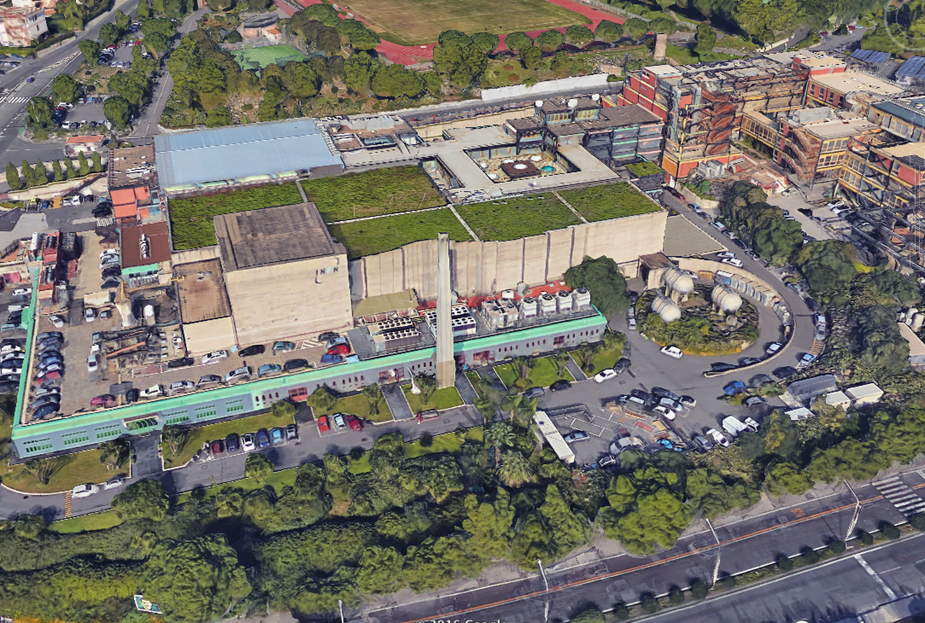
Offices
Exp beamlines
Laser-area
Tandem
Cyclotron

Slide 24
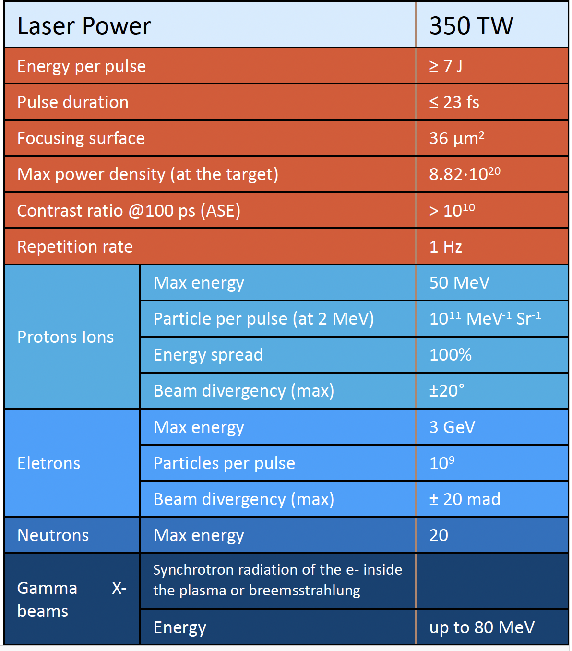
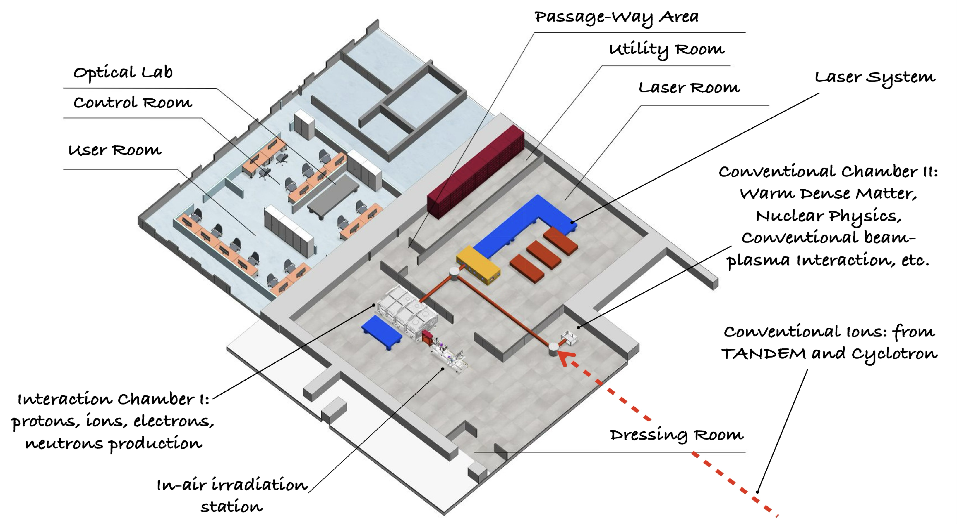
I-LUCE (INFN-Laser Induced radiation production)
Two laser systems (L1 and L2)
Three laser outputs
Three experimental stations (ES1, ES2 and ES3)
1J+/23fs/45TW
7J+/23fs/320TW
9mJ/100fs/1 kHz

Slide 25
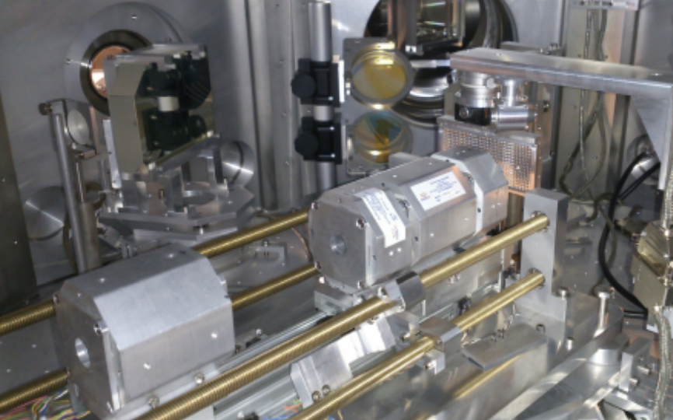
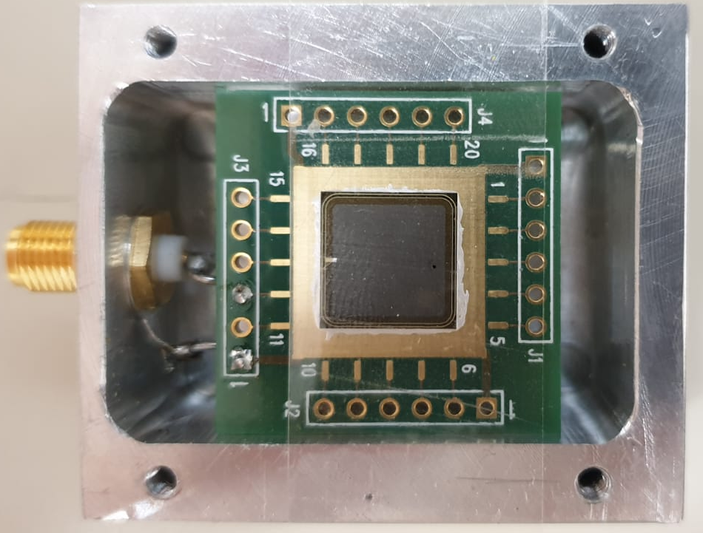
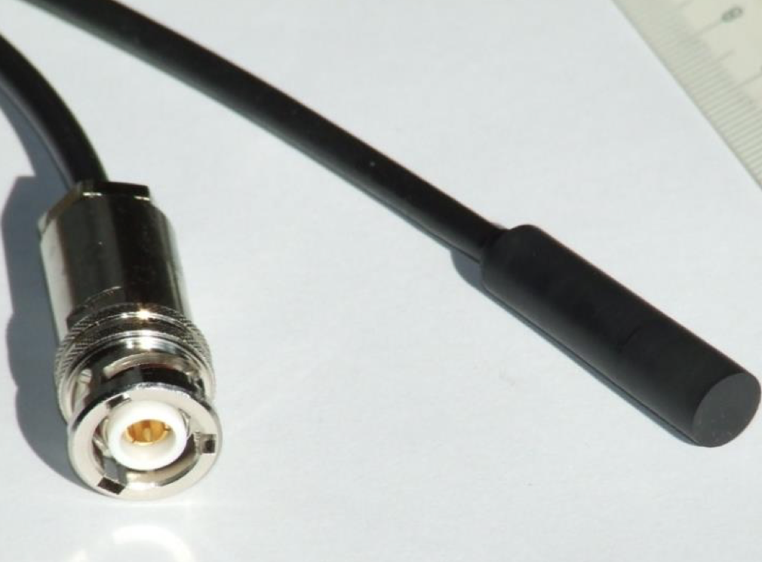
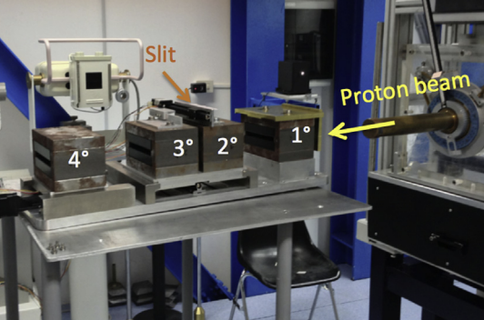
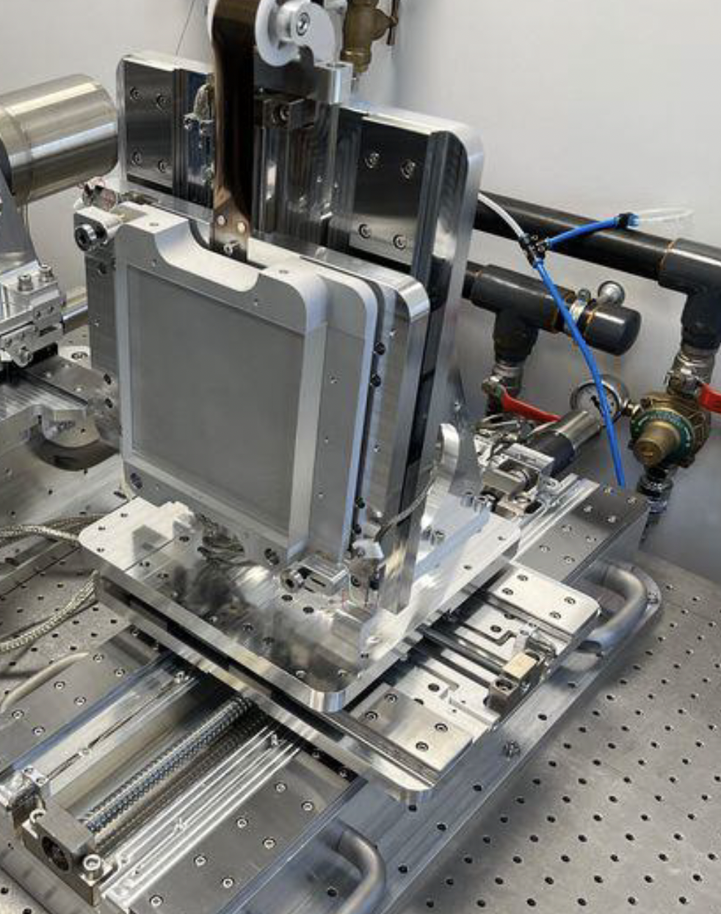
Transport beamline and diagnostic for ion beams
Transport System
Diagnostic System
ES2
Permanent Magnet Quadrupoles
Scintillator
SiC & Diamond
Transport System
Dosimetric System
Dosimetric System
SEM
ICT
Energy Selection System
Target System
Max energy | 50 MeV
Particle per pulse | 10¹¹ MeV⁻¹ Sr⁻¹
Beam divergence | ± 20°
Transport up to 30 MeV with an energy resolution
of 5 %
Up to 900 targets
Max rep rate: 3 Hz
1 um resolution in Z
EMP compatible
Faraday cup

Slide 26
How can we contribute?
By providing our expertise in the design and implementation of proton transport lines in air.
By performing Monte Carlo simulations to optimize proton transport in air.
By supplying monitoring and dosimetric systems for both low- and high-intensity proton beams, in continuous and pulsed modes.
By offering the readout electronics developed for all dosimetric and beam monitoring systems.
By supporting the development of a dedicated irradiation system for biological samples.

Slide 27
Thanks to everyone
F. Abubaker, C. Altana, A. Amato, S. Arjmand, D. Bandieramonte, D. Bonanno, F. Cammarata, R. Catalano, G.A.P. Cirrone,
G. Cuttone, F. Farokhi, S. Fattori, M. Guarrera, A. Hassan, A. Kurmanova, C. Manna, N. Macaluso, A. Miraglia, M. Musumeci,
D. Oliva, A.D. Pappalardo, G. Petringa, L. Raffaele, D. Rizzo, G. Russo, A. Sciuto, J. Suarez, S. Tudisco, M. Tringale

