Slide 1
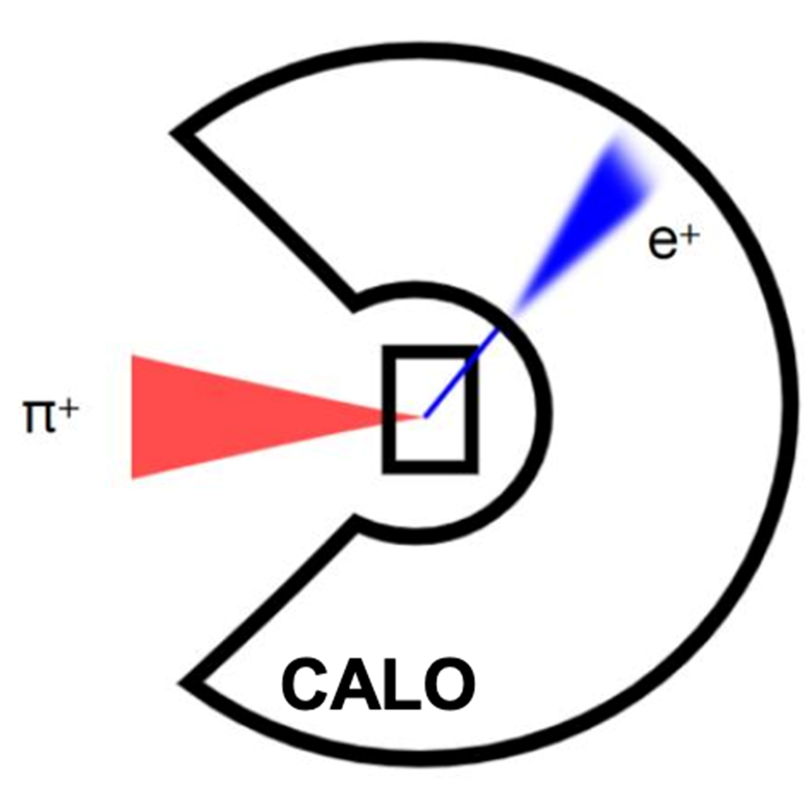
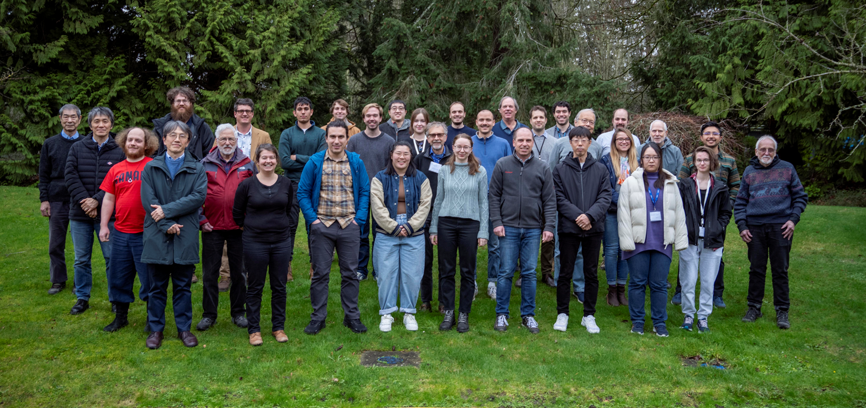
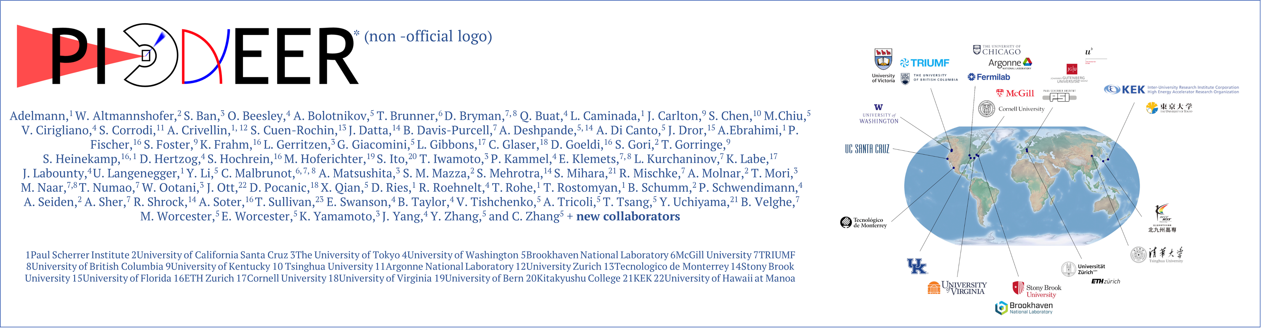
PIONEER: A next-generation rare pion decay experiment
David Hertzog / University of Washington
Physics Goals
Experimental Concept and Innovative Solutions
Technical Progress and Status
Some of us at a recent meeting in TRIUMF
FCCP 2025
Notes:
Abstract: The fundamental principle of
Flavor Universality is a centerpiece of the Standard Model of Particle
Physics. PIONEER is a new experiment set to challenge this principle
by studying the rarest decays of the charged pion. With this new
apparatus, we aim to improve the rare pion decay measurements up to
15-fold over the current ones and probe the Standard Model at energy
scales beyond the reach of colliders. Our experiment design benefits
from past-generation experiments and employs emergent technologies in
tracking and calorimetry. In this talk, I will discuss the physics
case of the experiment, review its conceptual design and present the
ongoing R&D effort toward building the detector for the first phase of
the project. I will also describe the additional physics goals, which include exotic searches and, in a slightly reconfigured setup, a measurement of pion beta decay to determine Vud in a theoretically clean manner.

Slide 2
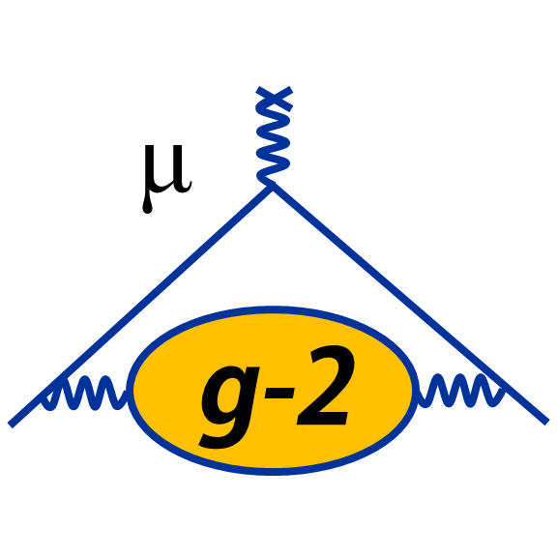
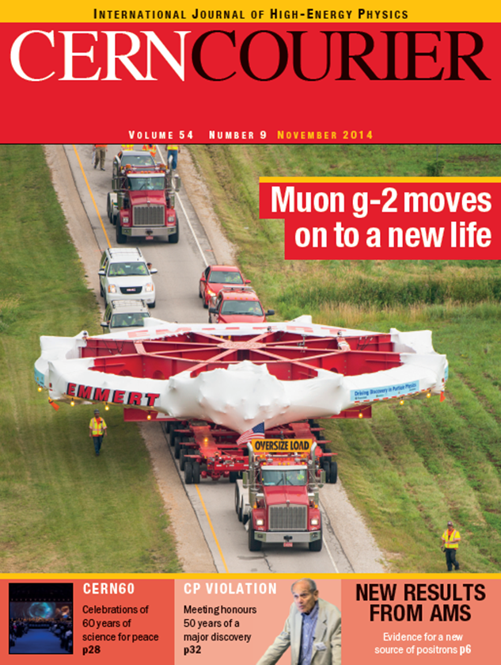
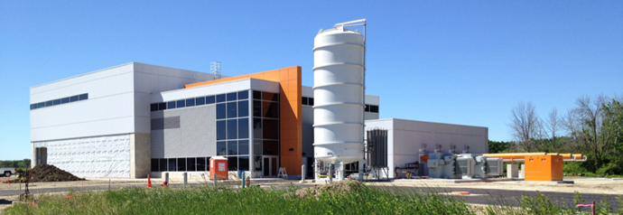
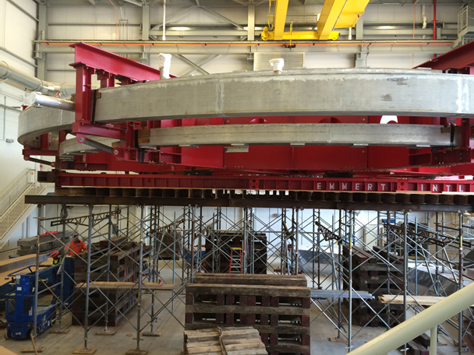
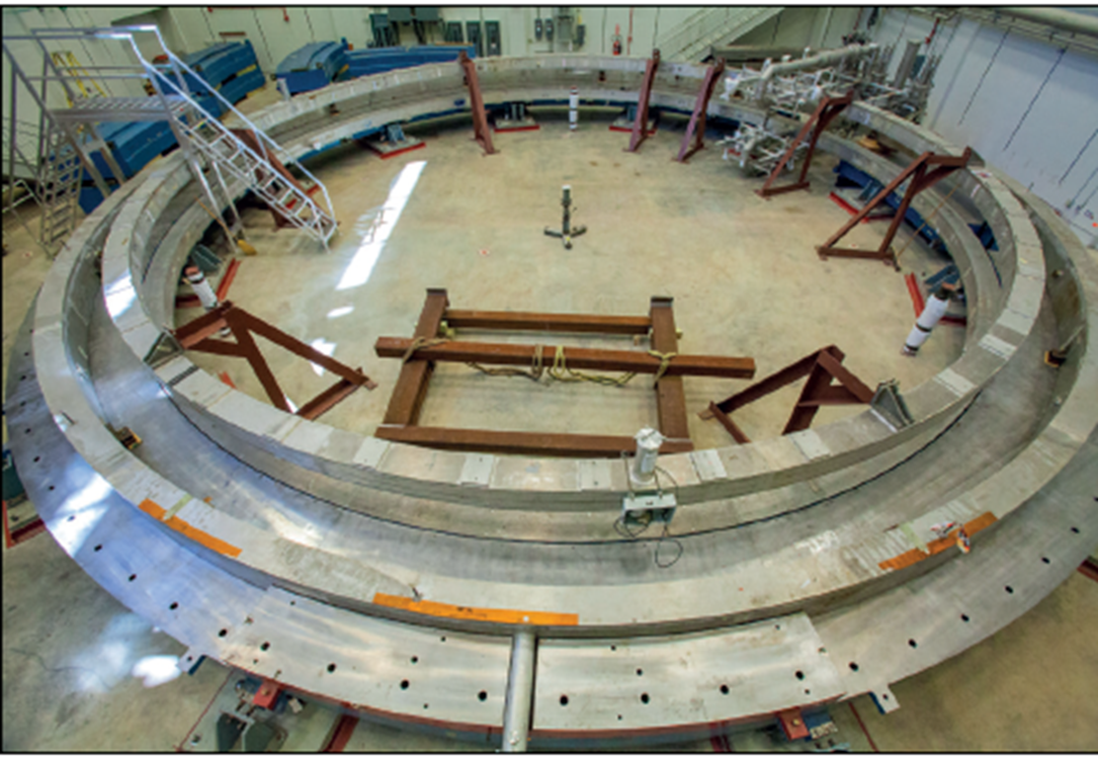
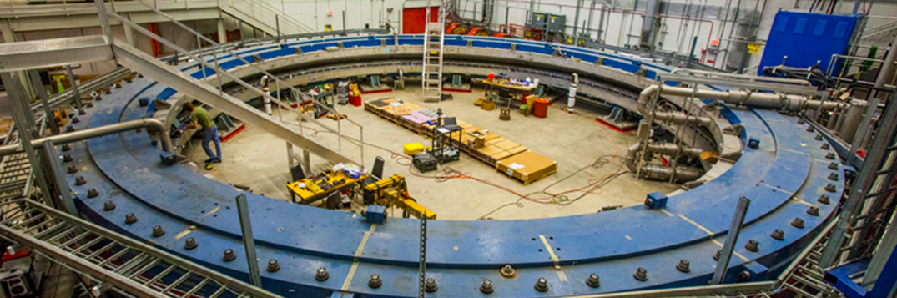
Next Generation Muon (g-2)
Goal δa_{μ} ~ 140 ppb
FCCP in 2015 !! It all turned out quite well
David Hertzog, University of Washington
for the E989 Muon (g-2) Collaboration
FCCP2015 Flavor Changing and Conserving Processes

Slide 3
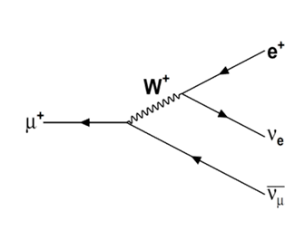
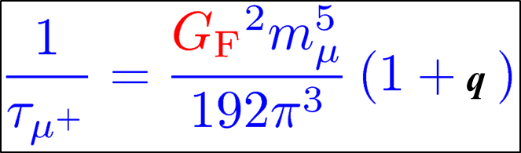
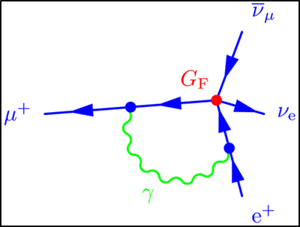
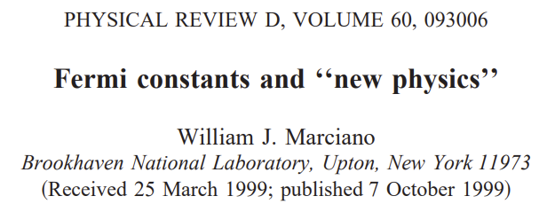
Lepton Flavor Universality
The weak interaction bare gauge couplings among leptons are the same e / μ / τ
The weak-interaction “strength” is associated with the Fermi Constant, G_{F}
Muon decay provides the most precise measurement
  Technically it determines G_{μ}, which is usually just called G_{F} … because we believe in LFU
G_{F}(MuLan) = 1.166 378 7(6) x 10⁻⁵ GeV⁻² (0.5 ppm)
PRL 106, 041803 (2011)
Phys. Rev. D 87, 052003 (2013)
Questioning the validity of what others took to be true…

Slide 4
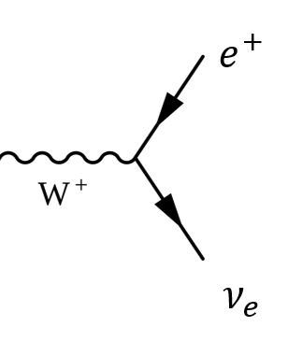
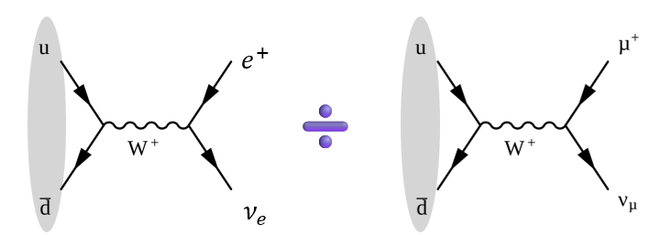
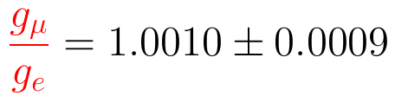
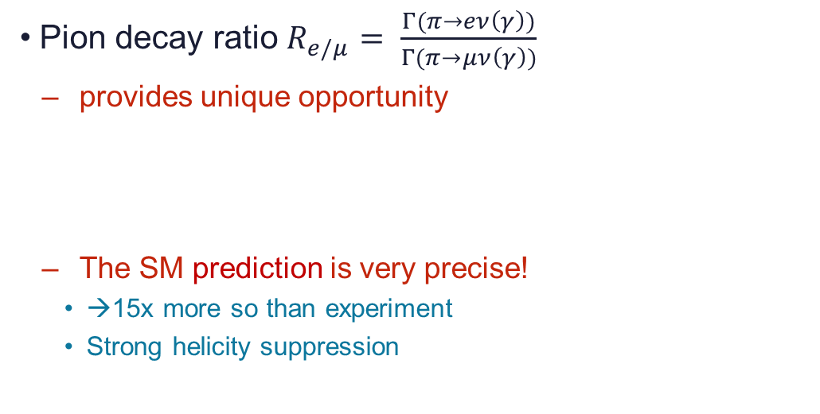


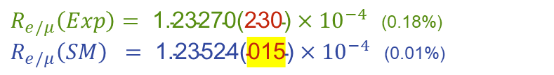
Physics Case I: Precision Test of Lepton Flavor Universality
Gauge coupling the same for all flavors
  PIONEER will test this fundamental principle to 0.01%
Pion decay ratio $R_{e/μ}= \frac{Γ(π→eν\left(γ\right))}{Γ(π→μν\left(γ\right))}$
  provides unique opportunity
  The SM prediction is very precise!
    →15x more so than experiment
    Strong helicity suppression
$R_{e/μ}\left(Exp\right)=\text{ 1.23270}\text{(}\text{230}\text{)}×{10}^{−4}$ (0.18%)
$R_{e/μ}\left(SM\right) =\text{ 1.23524}\text{(}\text{015}\text{)}×{10}^{−4}$ (0.01%)
$$g_{e}$$
$$g_{μ}$$
PIENU at TRIUMF
Cirigliano & Rosell
$$=1.23524(015)×{10}^{−4}$$
LFU
‘Helicity suppression’
term: ~2.3 x10⁻⁵
Phase space term: ~ 5.5
Fully computed at NLO
O(10⁻⁴) uncertainties at NNLO
Notes:
Anderson and Neddermeyer, 1936, nearly 90 yrs

Slide 5
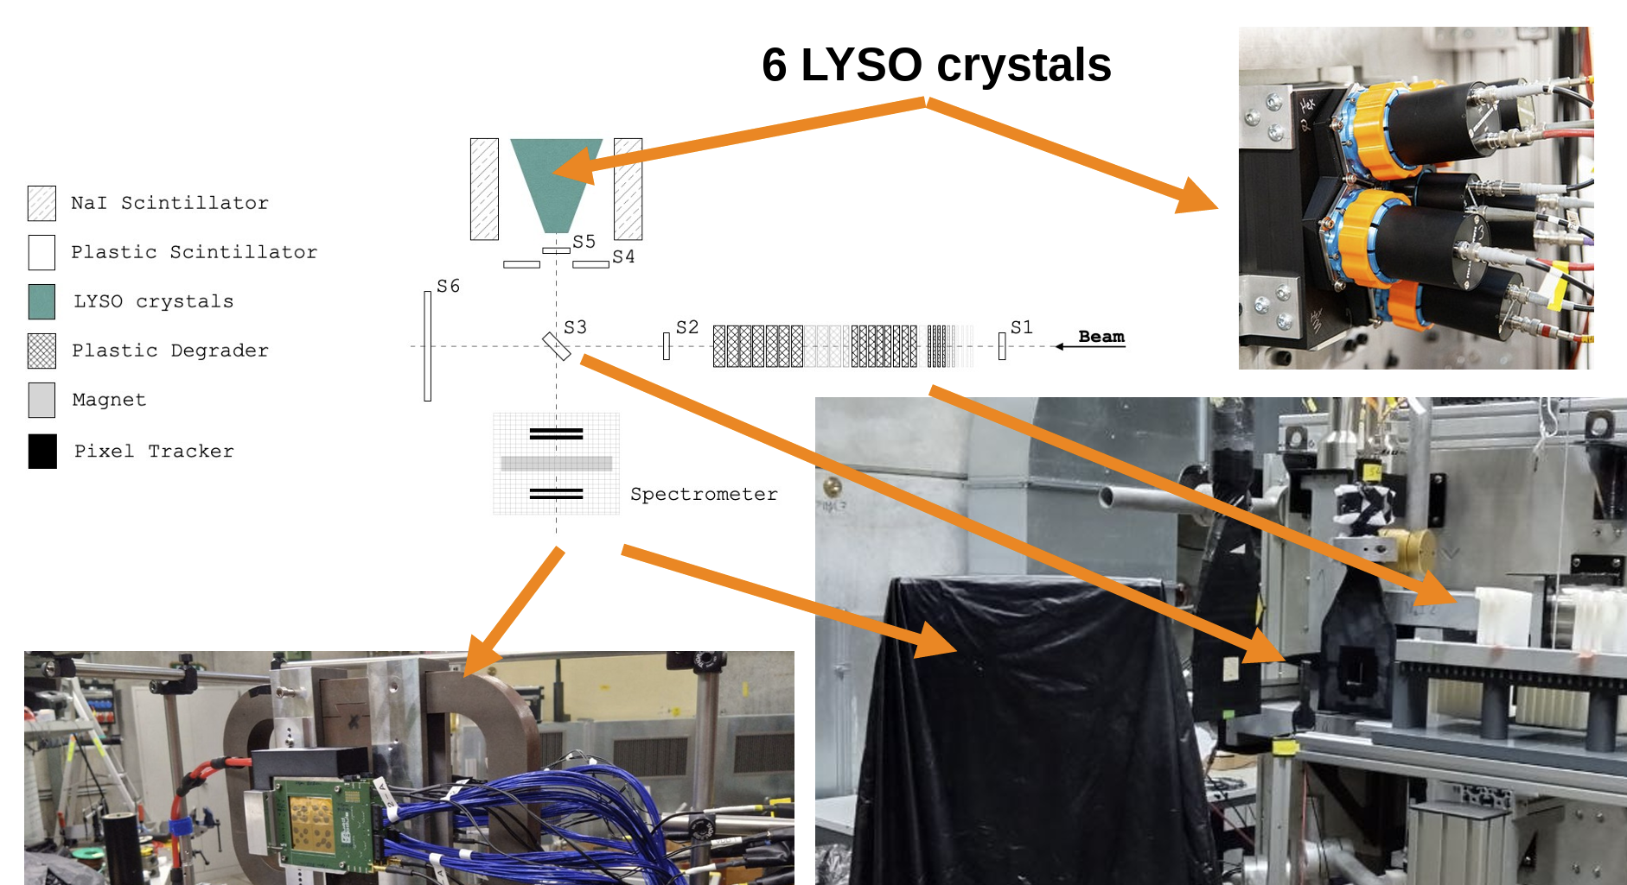
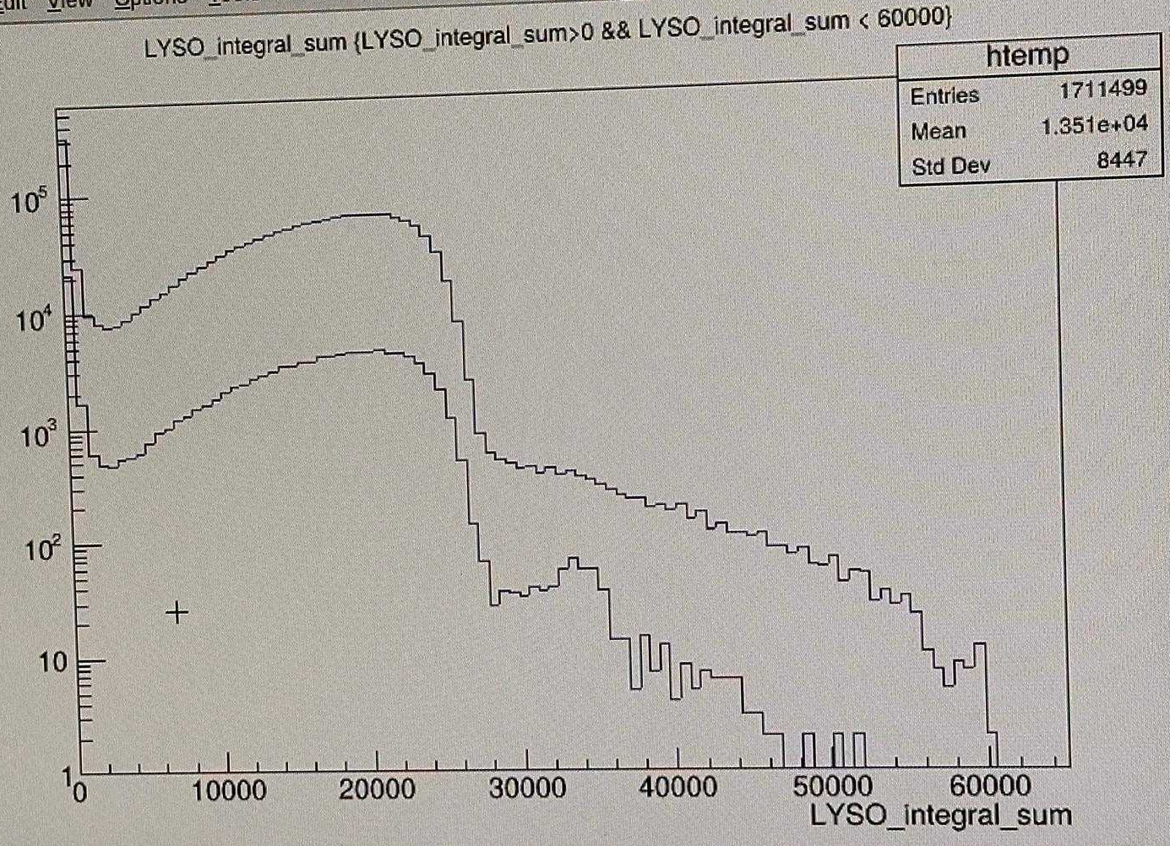


The π ◊ e ν decay was first discovered in 1958, but these days, one can even make a rough measure as a “Student Exercise”
September 2025
$$π→eν(γ)$$
$$π→μν\left(γ\right)→eνν$$
Univ. Heidelberg, Mainz, and ETH Zurich Practicum at PSI

Slide 6
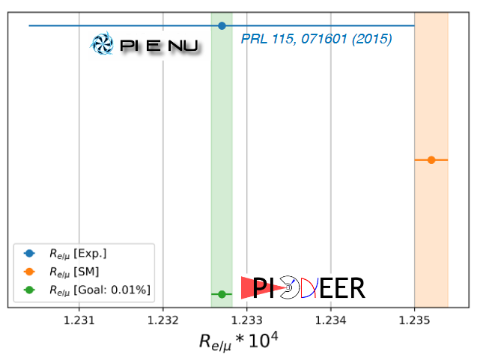
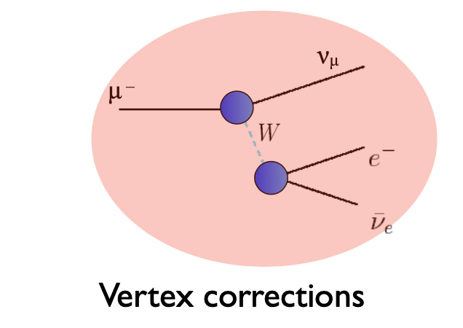
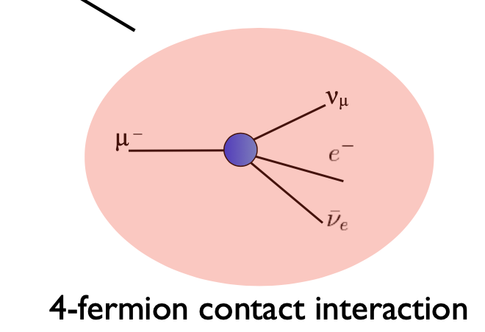
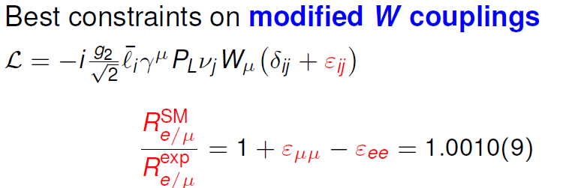
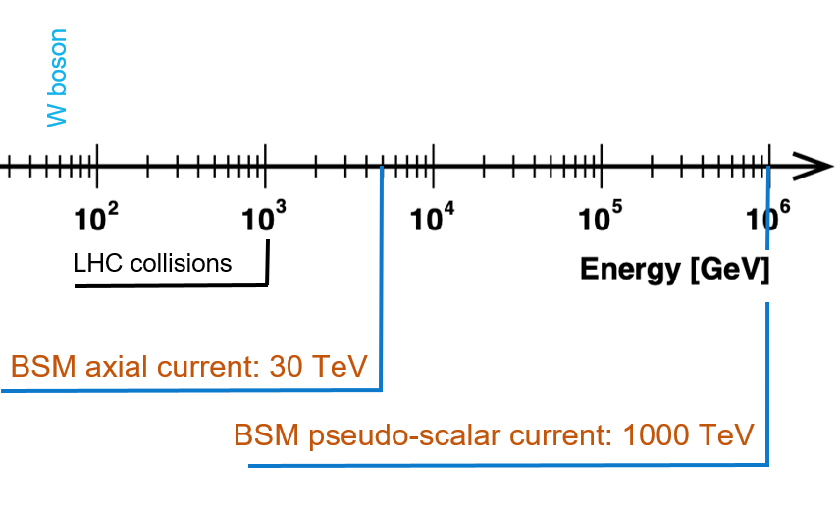

In our case, we aim for 10⁻⁴ precision on this rare ~10⁻⁴ branch
  Most sensitive test of LFU
  Many BSM scenarios exist, SMEFT
    $Wlν$ coupling, 4-fermion operators
  sensitive to very high mass scales
    also T and S currents

Slide 7

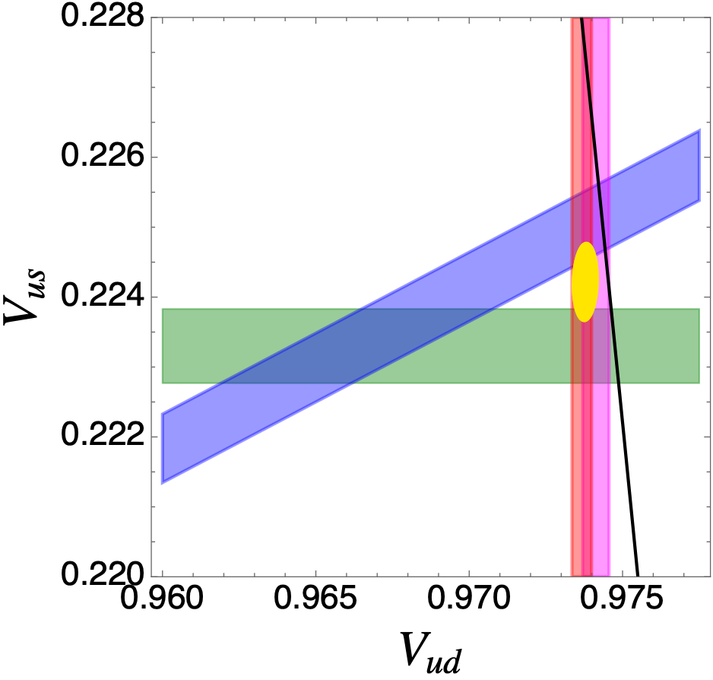
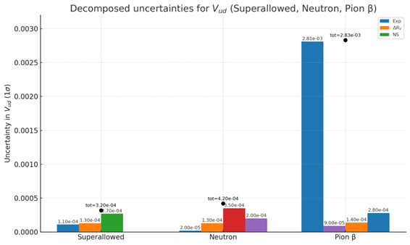

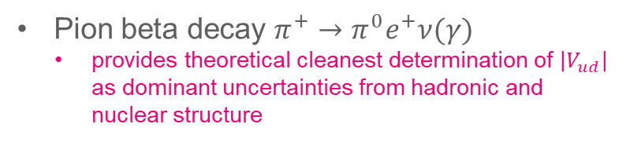
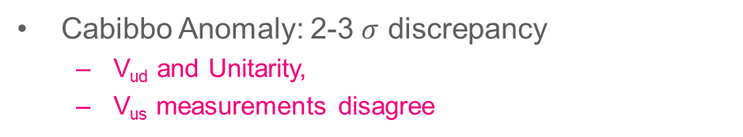
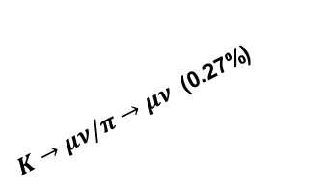
Physics Case II: Testing CKM Unitarity
Tensions in the first row CKM unitarity test
Cabibbo Anomaly: 2-3 $σ$ discrepancy
  V_{ud} and Unitarity,
  V_{us} measurements disagree
Cirigliano et al. PLB 838 (2023) 137748
Pion beta decay $π^{+}→π^{0}e^{+}ν(γ)$
  provides theoretical cleanest determination of $\left|V_{ud}\right|$
  as dominant uncertainties from hadronic and nuclear structure
1σ ellipse (PDG)
PiBeta doi.org/10.1103/PhysRevLett.93.181803
$K→μν/π→μν$ (0.27%)
$K→πℓν$(0.27%)
A big improvement needed to be competitive
Unitarity
0⁺→0⁺ (0.030%)
Neutron (0.050%)
These are actually smaller

Slide 8
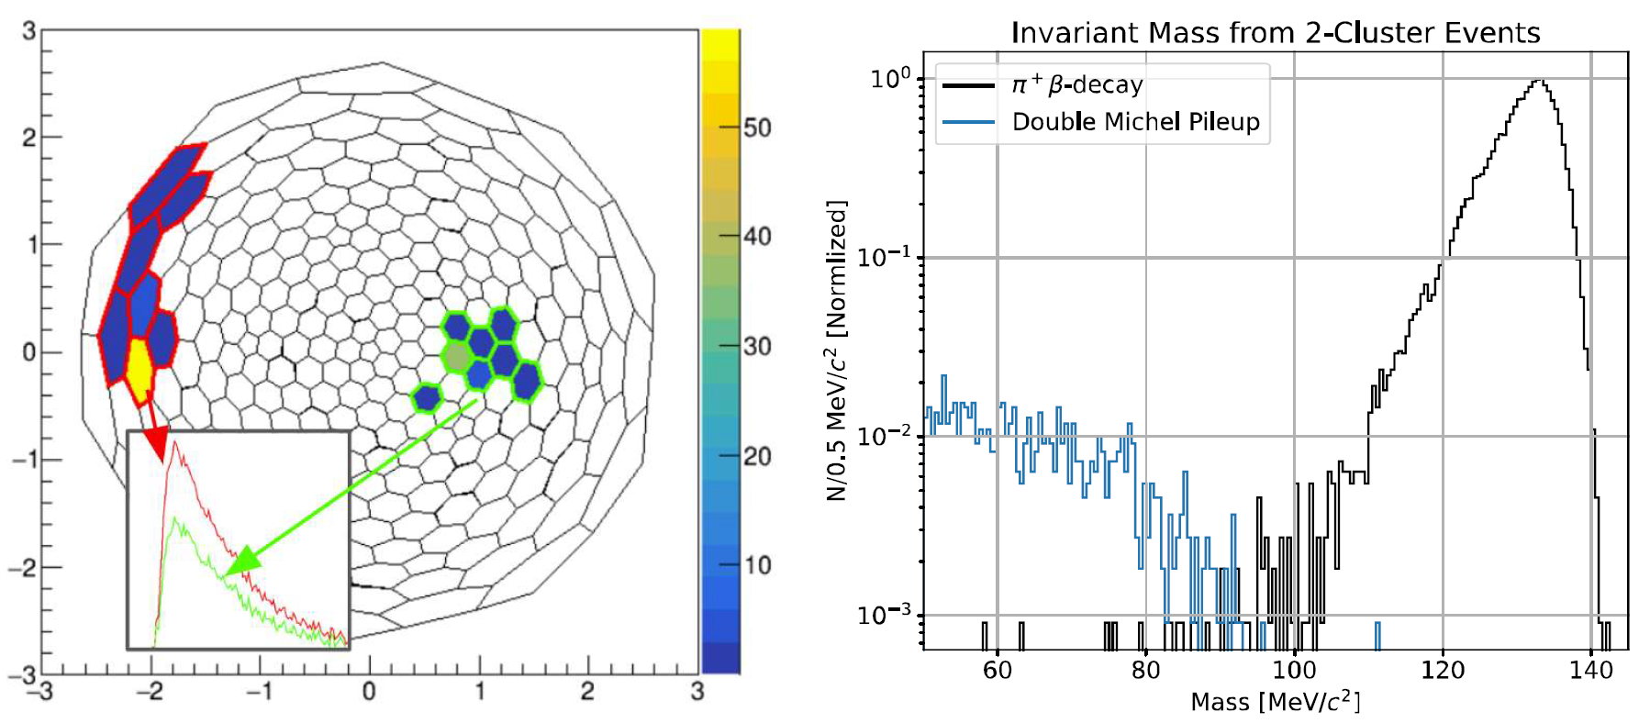
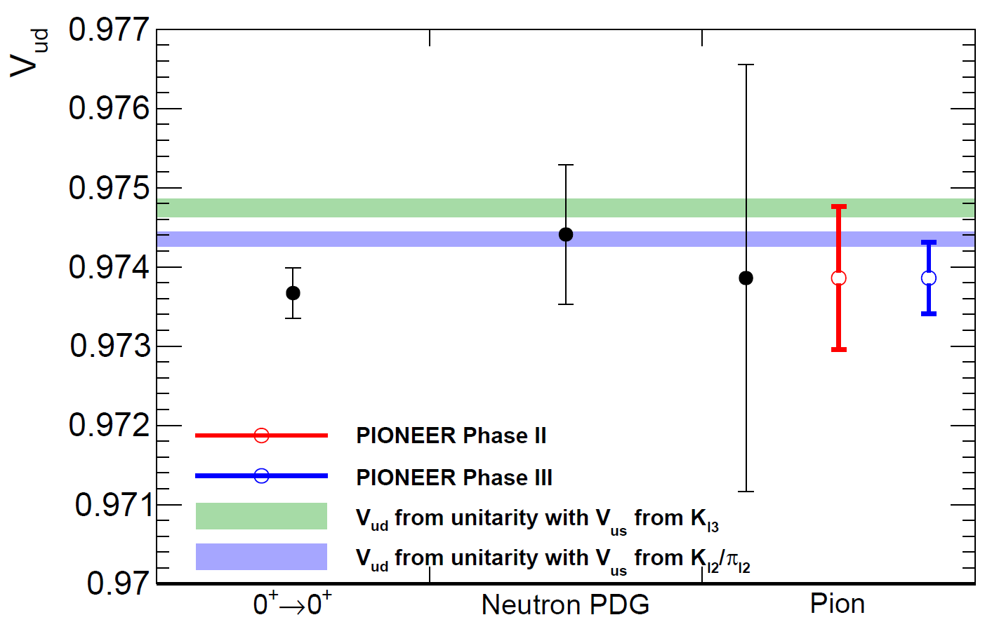
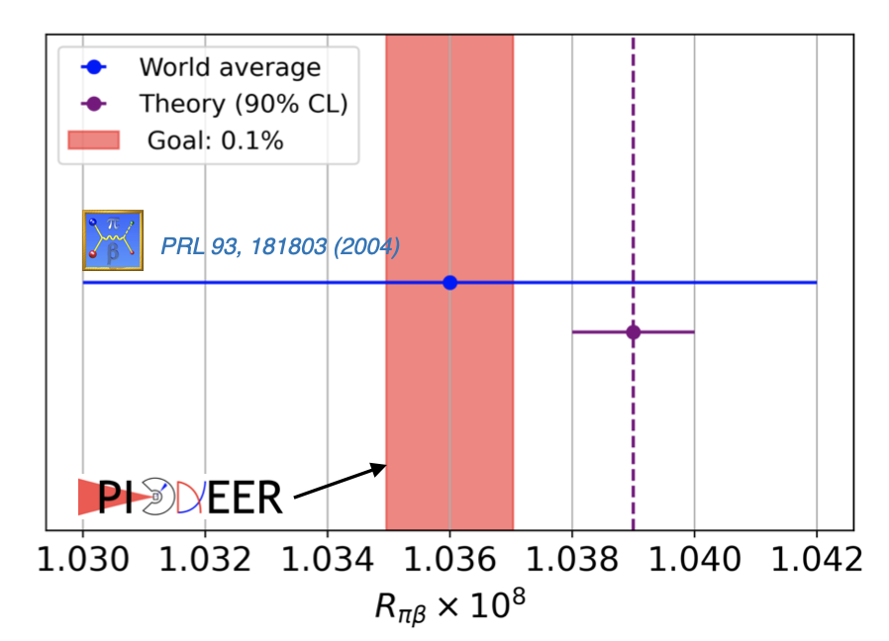


PiBeta concept with PIONEER’s LYSO calorimeter option
Method
  two back-to-back gammas $π^{0}→γγ$
  high beam rate required: 10⁷ $π/s$ @ 85 MeV/c
Phase III goal
${ V}_{ud}$ PIONEER sensitivity projection
  3 and 6-fold improved measurement (Phase II,III)
  Simplest beta decay process in
  theoretical pristine $\overline{q}q$ system
  Competitive probe with completely
  different error budget
PIONEER Phase III
PIONEER Phase II
PDG24

Slide 9
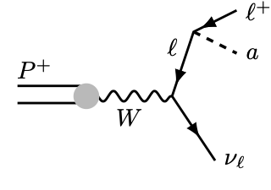
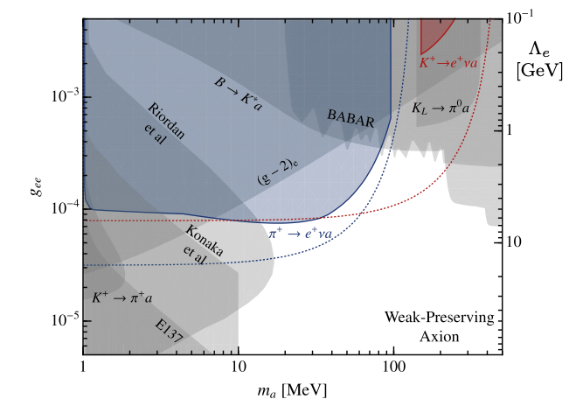

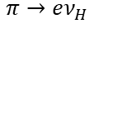
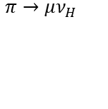
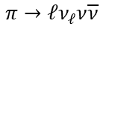


Physics Case III: Search for Weakly Coupled Physics:
PIONEER will collect an unprecedented set of pion decays (surpassing existing sample by at least a factor 10)
Excellent opportunity to search for feeble interactions producing new particles in the pion decay
Recent development with
Lepto-philic axion-like particles
Will appear as a modification of the energy spectrum lineshape in the calorimeter spectra (bump or shape)
Many signatures explored by TRIUMF PIENU
$$π→eν_{H}$$
Physical Review D 97(7) 072012 (2018)
Physics Letters B 798 134980 (2019)​
Phys. Rev. D 102, 012001 (2020)​
Phys. Rev. D 101, 052014 (2020)​
Phys. Rev. D 103, 052006 (2021)​
$$π→μν_{H}$$
$$π→ℓν_{ℓ}ν\overline{ν}$$
$$μ→eX$$
$$π→eνX$$
W. Altmannshofer, J. Dror, and S. Gori
Phys. Rev. Lett. 130, 241801
Goal of PIONEER
Increase reach of the global search program for feeble interactions
(ie ALPs, heavy neutrinos, …) by an order of magnitude in the 10—100 MeV range

Slide 10
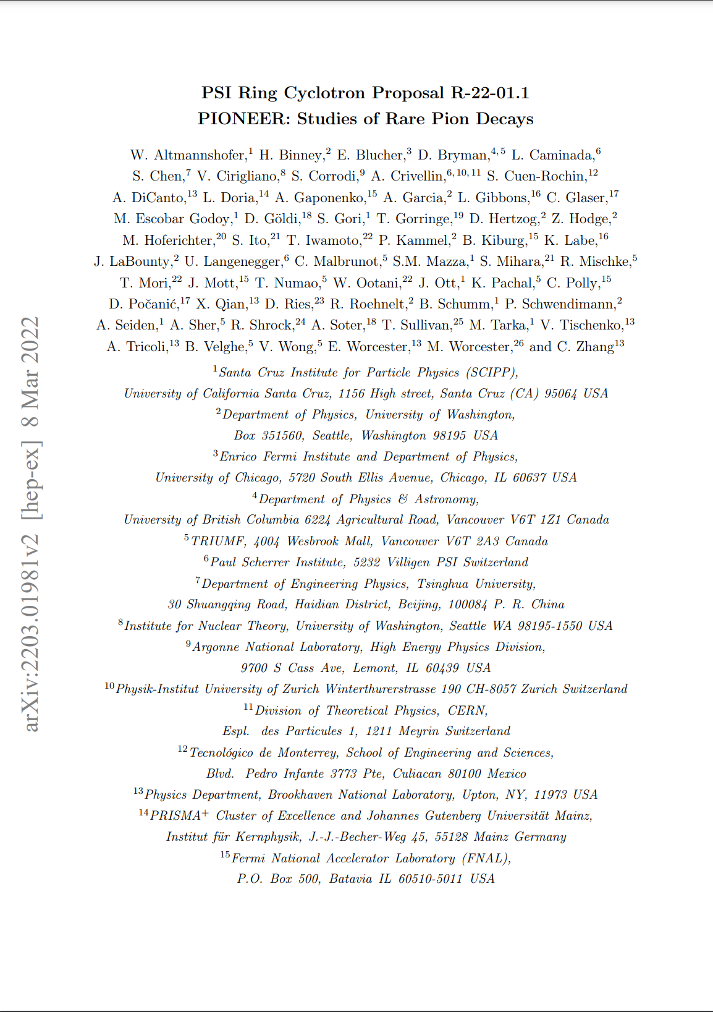
PSI Approved Proposal Jan. 2022
Has become a high-priority experiment at PSI
Since the proposal, we have been very actively designing and simulating the experiment
I will share some progress

Slide 11
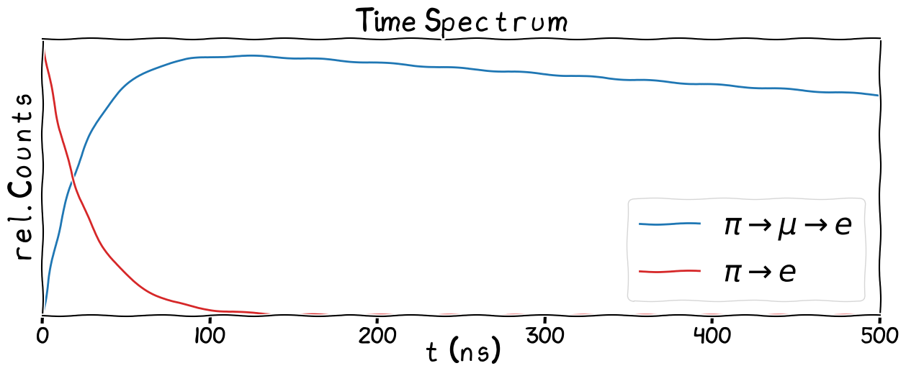
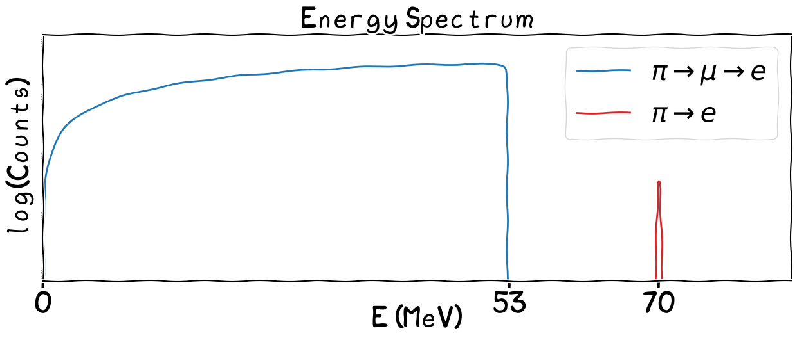

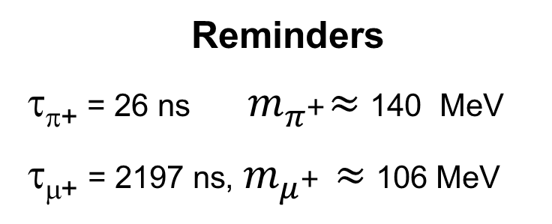




Pion decay (at rest) related to measuring
$$\frac{Γ(π→eν\left(γ\right))}{Γ(π→μν\left(γ\right))}$$
Reminders
τ_{π+} = 26 ns${ m}_{π^{+}}≈$ 140 MeV
τ_{μ+} = 2197 ns, $m_{μ^{+}}≈$106 MeV
π⁺ stop at t =0
$$π^{+}→μ^{+}ν$$
$E_{e}<\frac{m_{μ}}{2}≈$53 MeV
99.99%
1.23e-4
$$π^{+}→e^{+}ν$$
$E_{e}= \frac{m_{π}}{2}≈$ 70 MeV
11

Slide 12
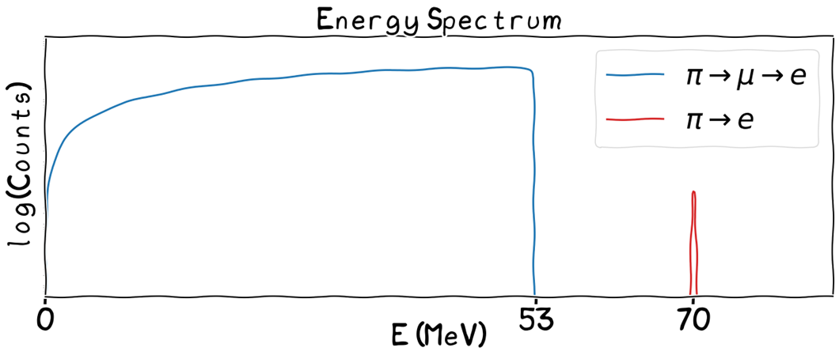
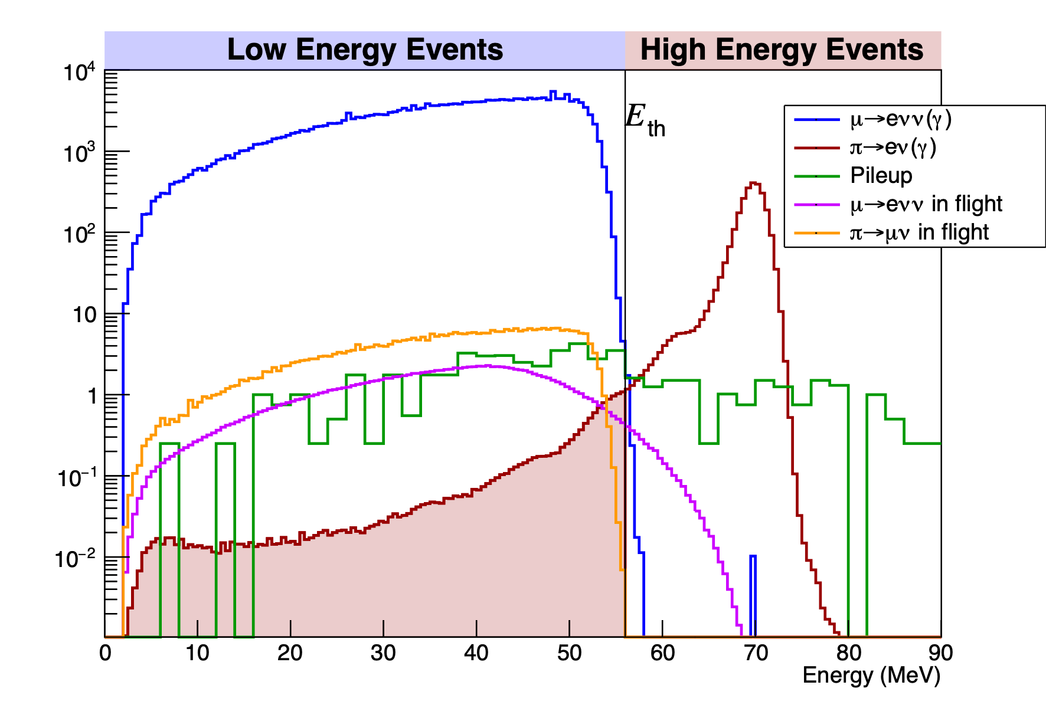
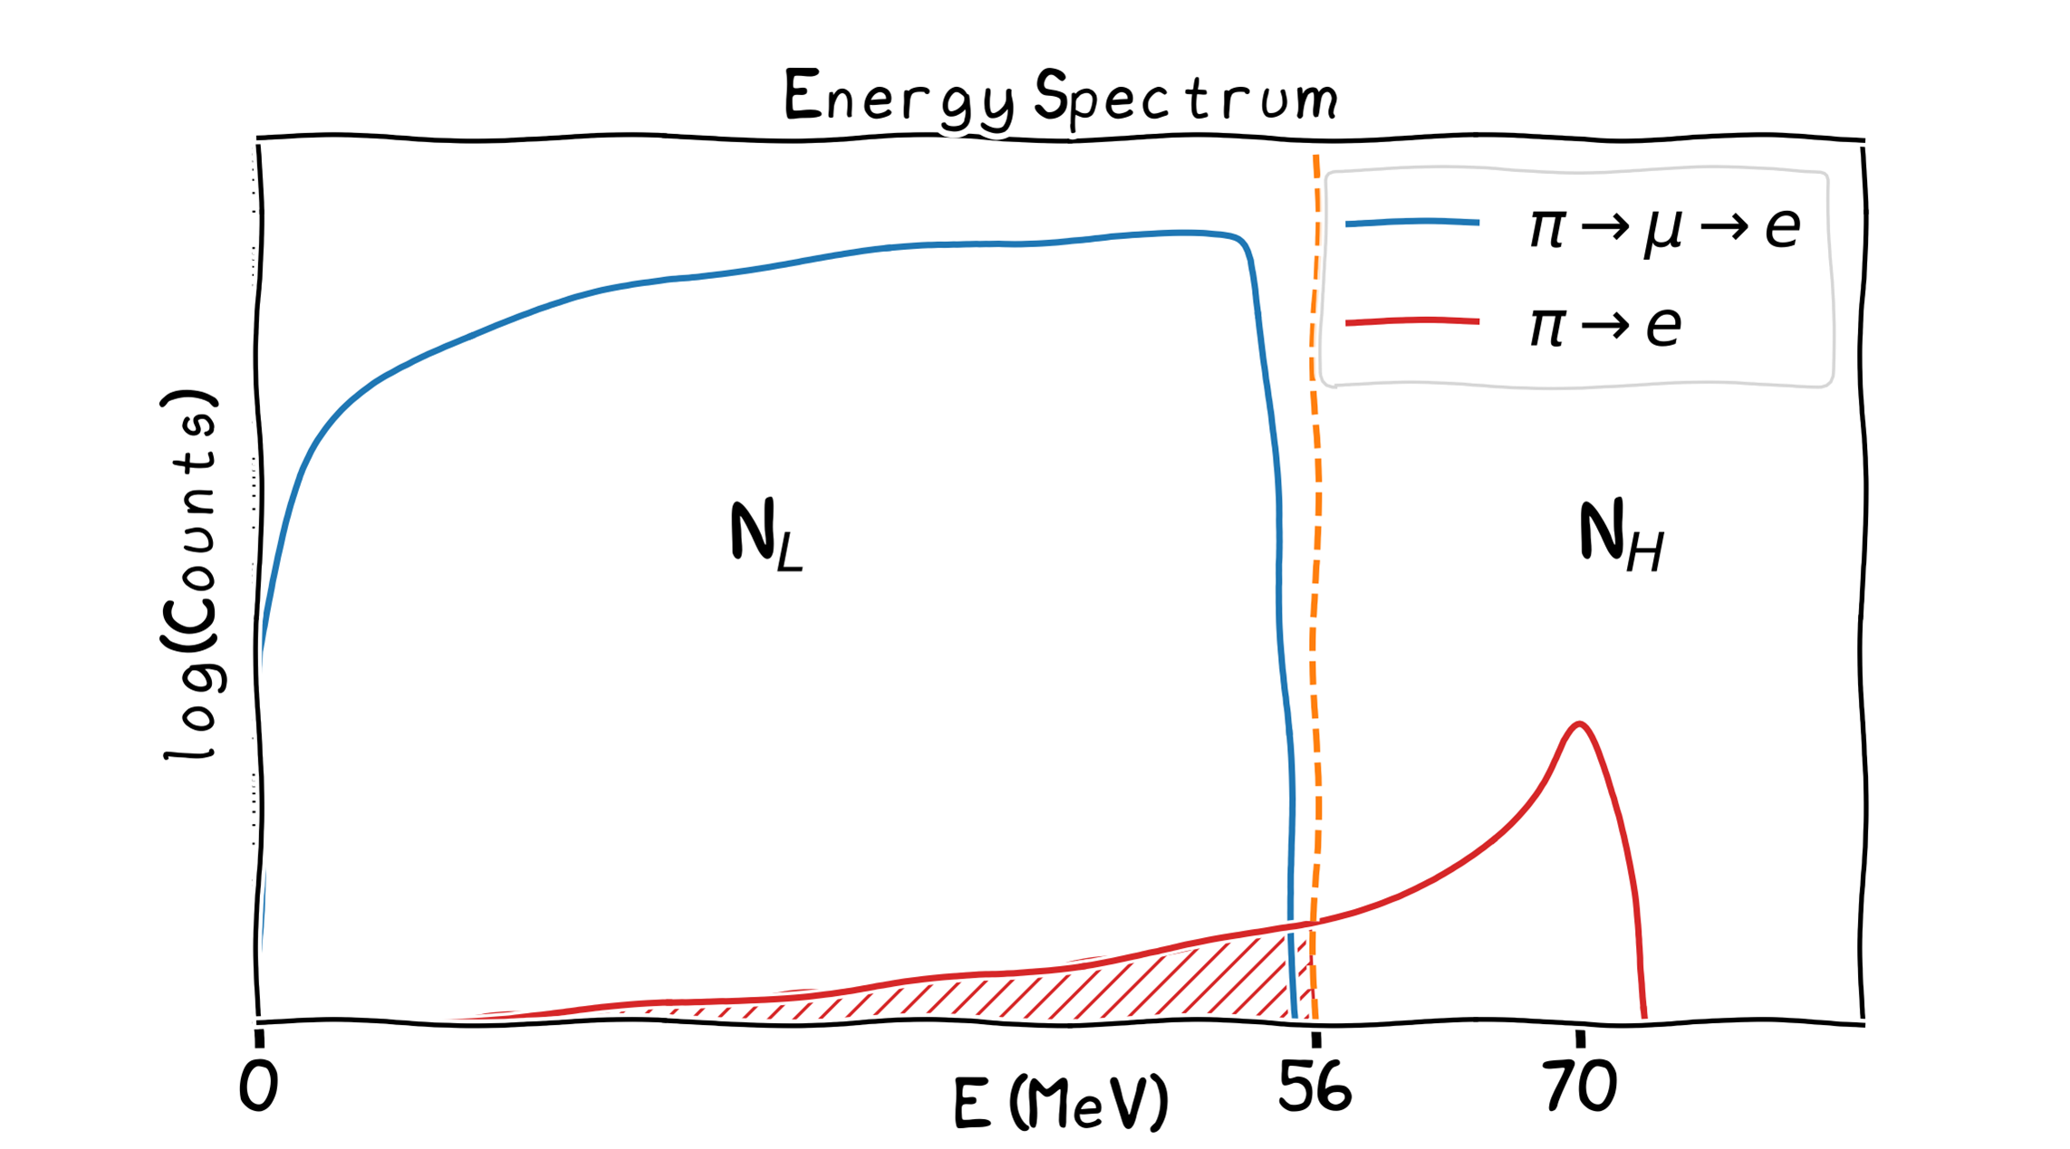

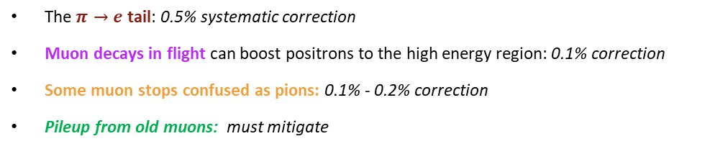

The ideal and realistic e⁺ energy spectrum:
Realistic e⁺ spectrum in the time window (5 – 35) ns after π stop
Define $E_{\text{thr}}=56\text{MeV}$ and count events above and below threshold
$$R_{e/μ}=\frac{Γ(π^{+}→e^{+}ν(γ))}{Γ(π^{+}→μ^{+}ν(γ))}≈\frac{N_{H}}{N_{L}}$$
The $π→e$ tail: 0.5% systematic correction
Muon decays in flight can boost positrons to the high energy region: 0.1% correction
Some muon stops confused as pions: 0.1% - 0.2% correction
Pileup from old muons: must mitigate
Finite resolution and incomplete energy collection in the calorimeter result in a tail
$$R_{e/μ}=\frac{N_{π−e}(E>E_{th})}{N_{π−μ−e}}×(1+c_{tail})×R^{ε}$$

Slide 13





Why so challenging?
Identify the 1 in 10⁴ π->e decays, with a misidentification factor below 1 part in 10⁴
While the decay times and positron energies are different, the physics processes in the detectors are energy dependent
  scattering, annihilation, Bhabha probabilities
Need high statistics,
  Large and uniform acceptance
  High beam rate (pileup)
Strategy
  Innovative imaging target and high-resolution, fast calorimeter
  MC – data comparisons in great detail
Analyses are being developed in advance with highly realistic simulation framework
  Classic “Rule Based”
  Advanced Machine Learning techniques
$$π→μ$$
$$π→e$$

Slide 14


Two previous-generation Pion Decay Experiments: PIENU and PEN/PIBETA
Limitations and lessons learned to design “next-gen”
CsI
3π CsI
12 X₀
0.8π
NaI(Tl)
19 X₀
@TRIUMF
@PSI
NaI: excellent resolution, but slow so rate limited
Shower leakage in single crystal depends on angle
Small overall acceptance
Calorimeter depth too small to resolve tail
Uneven crystal performance

Slide 15



In any analysis, one must determine from a Master Formula:
$$R_{e/μ}=\frac{N_{π−e}(E>E_{th})}{N_{π−μ−e}}×(1+c_{tail})×R^{ε}$$
All vs polar angle θ
$N_{π−e}(E>E_{th})$ = Counts in the “high bin” … above ~56 MeV
$N_{π−μ−e}$ = Counts in the “low bin” (Michel decays) … below ~56 MeV
$c_{tail}$ = π⁺ → e⁺ events that deposit less than 56 MeV in the Calo
$R^{ε}$ = the acceptance ratio (vs θ). Quite critical because the positron energies from π⁺ → e⁺ and π⁺ → μ → e⁺ events differ significantly (especially at the low end)

Slide 16

PIONEER experimental strategy:
65 MeV/c DC positive pion beam @ 300 kHz
Stop in a segmented imaging target
Measure positron energies from π−> e and π−>μ−>e with a high-resolution calorimeter
Record “region of interest” both before and after the stop
Generic diagram

Slide 17







Approved to use the high-rate pion piE5 beam at PSI
piE5 @ PSI - World’s Brightest Stopped Pion Beam
  Now: Fundamental muon physics: MEG II, Mu3e
Our 2023 measurements of existing beam
  Rate: 300k π/s stopped in ATAR: ok at 65 MeV/c
  Momentum bite: ∆p/p <2%: marginal
  Spot size: <2 cm FWHM: not yet achieved
  µ,e less than 10% π: needs second focus extension
Y
X
Pions at 65 MeV/c have
  β = 0.42
  Decay length (cβγτ) L = 3.6 m
π,μ,e
π
μ
Pion survival fraction from Separator to Target
e
A challenging work in progress to design these elements
18% left
0 1 2 3 4 5 m

Slide 18





Key development for PIONEER: LGAD-based Active TARget
Highly segmented and instrumented.
48 planes of 20 mm x 200 $μ$m x 120 $μ$m strips
4800 channels
ATAR provides 5D track information
3D position (x,y,z).
Time: 100 ps single hit / few ns pulse pair resolution
Energy in each strip: MIPs to heavily ionizing pion and muon tracks distinguished
100 Strips
48 Layers

Slide 19


(TI)* Low Gain Avalanche Diodes (LGAD)
Silicon Diodes: p-n junction separated by an intrinsic layer (undoped)
LGADs: additional highly doped layer generates a very high electric field → avalanche effect
Signal amplification allows for thin sensors and very good timing resolution
Gain mechanism can saturate for large energy deposit and introduces an angle dependency. We are studying this carefully
ATAR Demonstrator: 16-planes to be tested in 2026 with TI-LGAD sensors from FBK, FAST3 amplifiers, and SAMPIC 6 GSPS digitizers
*trench-isolated to avoids cross talk to neighboring strips

Slide 20





The ATAR has a deep connection to Italy !
TI LGADs
FAST3
amplifier

Slide 21


Pion processes in ATAR
R_{π} (65 MeV/c) ~ 4 mm, (stops in center region)
R_{μ} (4.1 MeV) ~ 0.8 mm
Example Event Display
6.6 mm
Marker size ∝ Edep
X
y
z
z
* Represents Bragg peak with large energy deposit

Slide 22






How these processes will appear in ATAR
R_{π} (65 MeV/c) ~ 4 mm, (stops in center region)
R_{μ} (4.1 MeV) ~ 0.8 mm
DTAR/Trig
“MIP”
dE/dx ~ 50 keV / 120 um-thick sensor
Bragg peak
Bragg peak
e⁺ “MIP”
e⁺ “MIP”

Slide 23






Minimizing the low-side tail is part of Calorimeter design
#X0, depth containment
R_{M}: lateral containment
12 X0 (like PEN)
2 R_{M}
2 R_{M}
PIENU single large crystal
(their data & simulation)

Slide 24


What calorimeter might work in [0 – 70] MeV range?
Common features
  High light yield (>30,000 γ/MeV)
  “Fast” 40 ns decay time
  Both aim at resolution <2%
  Both aim at good timing
Significant differences (LYSO/LXe)
  Segmented → 311 PMTs ~420 nm
  Single volume → 1650 VUV sensors
  Density (see scaled pics)
  Data load (LXe >100 higher)
  LYSO is slightly radioactive
${120}^{∘}$ Fid. Volume
The original idea
(TRIUMF and Japan exploring)
Since then …
(SJTU, ETH Zurich, UW exploring)

Slide 25










LYSO R&D very promising …
Lutetium–yttrium oxyorthosilicate (LYSO):
By weight: 73% Lutetium, 18% Oxygen, 6% Silicon, ~0% Cerium (dopant), 3% Yttrium
X₀ = 1.14 cm , R_{M} = 2.07 cm
Decay time = 40 ns
Light yield 30,000 γ/MeV
λ_{peak} 420 nm -> conventional PMTs
Radioactive (< 1 MeV constant rumble)
Non hygroscopic, negligible temperature dependence, radiation hard
Tested 10-array
  Nucl.Instrum.Meth.A 1075 (2025), 170320
LYSO
NaI(Tl)
1.52% @ 70 MeV
goal
Tested 6 full-sized, tapered crystals (August, 2025)
achieved
LYSO
I am sharing work our group is helping to lead on LYSO but PIONEER has not finalic will share some progress we’ve made with LYSO here (but decision is not made!)

Slide 26




Connection of Calo and ATAR hardware to main systematic: The Tail Correction
$π→e$ events with energy below $56 \text{MeV}$ occur ~ ($5×{10}^{−7}$) of the time
$π→μ →e$ events with energy below $56 \text{MeV}$ occur 99.9% of the time
Signal $π→e$ event:
Highly ionizing pion stop
MIP positron
Defined by pion lifetime alone
Background $π→μ →e$
Highly ionizing π and μ stops
MIP positron
Defined by both muon and pion lifetimes
Timing and energy alone give 10⁴ suppression
Measure to 1%
Suppress by 10⁷

Slide 27

Pivot to our developing analysis methods: 3 essential tasks

Slide 28

Basic steps involve finding the tracklets
π enters → t₀
t₀
t₁
t₂
time
π → μ at t₁
μ → e at t₂
For most events, time separation is clear and events “behave”

Slide 29

Including the more challenging ones for topological reasons or owing to important sub-dominant processes
In a classic “Rules-based approach”
Do these tracklets all belong to the same sequence?
What about those old muon decays?
t_{𝜋}
In this approach, we look for
Time grouped hits
Patterns to match
Energy deposits vs expected
Final directional fits to establish θ/φ of positron
And do our best to fit and classify
t_{e}
t_{𝜇}

Slide 30



Advanced AI/ML techniques that adapt to the event topologies based on extensive training
Omar Beesley (UW)
Which particle(s) is responsible for this track?
“Transformer” based network
Here:
Adapts questions based on the context of the witness (hits, etc) and what is learned from other hits, etc.
Weighs the relevance of information based on previous experiences
Picks up on subtle information requiring details from aspects of the event
Dynamic weighting: identifying Bragg peaks, grouping time-coincident hits, and leveraging 4D detector data to infer 5D trajectories. Unlike traditional models that rely on distribution moments and outliers, transformers explicitly learn relationships between hits
Neural network without attention:
Here,
Fixed sets of questions about event
Likely gives same time & weight to each statement.
But is capable of picking up on details requiring understanding of many things at once
→
This approach struggles with subtle conclusions because of its inflexibility in asking questions and weighting the relevance of different testimonies

Slide 31


An example of how a Rules based approach can differ from our AI/ML approach in the prediction of the Pion stop location in the ATAR for both Pienu and Michel events
Omar Beesley (UW)
The muon track is incorrectly appended to the pion track so the pion stop is wrong
The AI model, as figured out how not to make this error

Slide 32

Status of PIONEER: A next-gen campaign
Fundamental R&D on LGADs and Calorimeters
2026 Test beam desires
  piE5 Phase Space
  16-Plan ATAR Demonstrator
  Large LXe prototype (if funding is realized)
Significant work ongoing on electronics, triggering, digitizers, & DAQ
PSI shuts down in 2027 and much of 2028.
We are seeking Euro collaborating groups to join this campaign and take leadership in any of these areas I’ve mentioned

Slide 33


(some from the) PIONEER Collaboration
  A next generation rare pion decay experiment

Slide 34

The types of events we will encounter … (I am making it look easy here; it’s not)
Signatures
  DAR decay at rest
  DIF decay in flight
5D tracker will provide
  (x,y,z,t,E)
We have launched a major effort to develop reconstruction programs to identify these channels
  “Conventional” track finding / pattern finding / track fitting
  Machine learning, where we help guide the programs through the different choices

Slide 35



Rare Pion Decays: History
$$R_{e/μ}=\frac{Γ(π→eν(γ))}{Γ(π→μν(γ))}$$
The $π→eν$ branching ratio is so small that for a while the process was excluded
$\text{BR}(π→μν)≈0.9998770$, meaning ~1 out of every 10⁴ pions decay to an electron
Lokanathan and Steinberger (1955):
Range telescope at Columbia Nevis cyclotron: $R_{e/μ}<1.2×{10}^{−4}$ (90% CL)
Anderson and Lattes (1957):
Magnetic spectrometer at Chicago cyclotron: $R_{e/μ}<1.3×{10}^{−5}$ (90% CL)
→ Causing a lot of confusion…

Slide 36





Rare Pion Decays: History
$$R_{e/μ}=\frac{Γ(π→eν(γ))}{Γ(π→μν(γ))}$$
Discovery… CERN in early years
CERN circa 1958
~ 40 $π→eν$ events

Slide 37




Processes that create the energy spectrum & ATAR identification capability
Critical component, develop based on emergent 5D tracker technology (x, y, z, t, E)
  provide unprecedented topological info on pion decay vertex
  suppress $π→eν$ by 6-orders of magnitude to measure tail
(Not yet adding in the effect from pileup from beam and old muons)
Specifications
  5-D tracking
    20x20x6 mm³
    x,y 200 μm, z 120 μm
    $Δ$t ~ 200 ps, pulse pair 2 ns
    $σ_{E}<10\%$
PIONEER specific
  5000 channels
  dynamic range several 100
      MIPS 40 keV – μ (4000 keV)
  minimal cross talk
  minimal dead material
R_{π} (65 MeV/c) ~ 4 mm,
R_{μ} (4.1 MeV) ~ 0.8 mm

Slide 38






Physics Case III: Search for Weakly Coupled Physics:
Heavy Neutrinos, Dark Sector
$π→eν, π^{+}→π^{0}eν$
  highly suppressed in SM
  but not for weakly coupled “massive” particle
2-body decays
  peak searches in $π^{+}→$ $e^{+}ν_{h}$
3-body decays: $π→Xeν$, $π→Xμν$
X could be a scalar, axion like particle, vector, …
possible decay modes: $\text{X}→e^{+}$ $e^{−}$, $\text{X}→γ$ $γ$,
PIENU also searched for
  $π^{+}→$ $μ^{+}ν_{h}$, $μ^{+}→$ $e^{+}X$, $π^{+}→$ $l^{+}ν X$
  PIONEER: typical 10-fold improvement in
  10-100 MeV range expected
Altmannshofer, Dror, Gori
PRL 130, 241801 (2023)
Preliminary
Altmannshofer, Giffin, Gori, Jackson, Luong
In preparation

Slide 39





Energy resolution with “bench” sources on single crystals
511 keV
(this is why they are used in most PET scanners now)
PMT
LYSO
Na22
Co-60
Na-24*
  1.38, 2.76 MeV
NaI
2γ implies coincidences of lower energy lines
1.17 & 1.33 MeV
(Resolution is sigma of a Gaussian)
2.76 MeV
(2γ sum)
(2γ sum)
(2γ sum)
*15 hr half life made by bombarding 18 MeV deuterons on Al button

Slide 40



Energy and timing resolution of a 10-array
Energy
LED flashes all crystals; ΔT between them
Timing
@CENPA, with improved PMT bases
1.52% @ 70 MeV
goal
achieved
Crystal to crystal in beam, same event
Measurements of a LYSO crystal array from threshold to 100 MeV
Nucl.Instrum.Meth.A 1075 (2025), 170320

Slide 41




Design of a Tapered Array for PIONEER
Characteristics of interest
311 19 X₀ (217 mm) length crystals w/ 8 different shapes
LYSO
Stainless mount + spacer
Cyanoacrylate used to glue crystals to stainless
PMTs + compression

Slide 42


Test beam 4 weeks ago…
“Online” very preliminary results
1.97% energy resolution measured at 70 MeV
NaI(Tl)
LYSO

Slide 43
Then, a subset of events with NO π−>μ−>e should reveal lineshape
2 R_{M}
2 R_{M}

Slide 44







Pion Beta Decay … historical
PiBeta Experiment at PSI
Interestingly, in the same PRL issue as the R_{e/μ} measurement, the next article is:
Two back-to-back photons Very low energy positron
(0.56%)
PiBeta doi.org/10.1103/PhysRevLett.93.181803

