Slide 1

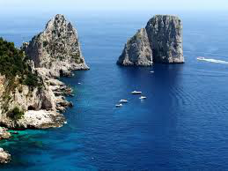

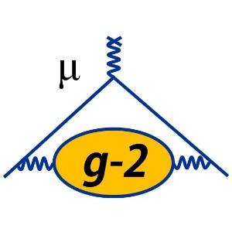


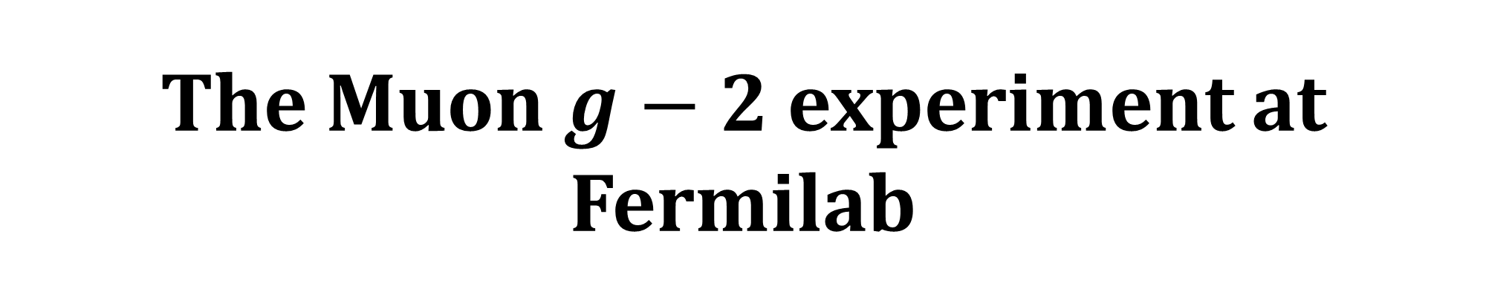
The Muon $g−2$ experiment at Fermilab
FERMILAB-SLIDES-25-0115-PPD
Lorenzo Cotrozzi, University of Liverpool
on behalf of the Muon g-2 collaboration
2025/09/29 | FCCP2025 | Capri

Slide 2
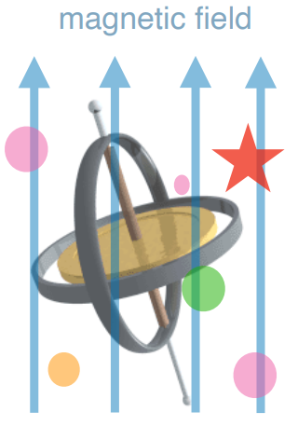
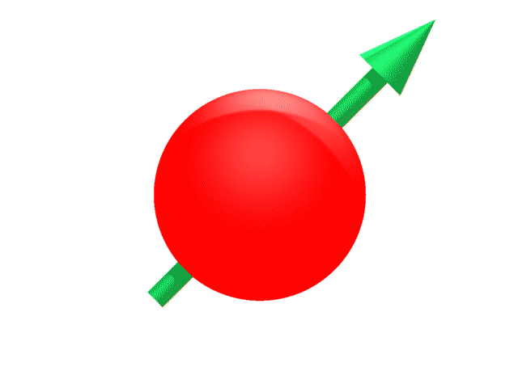
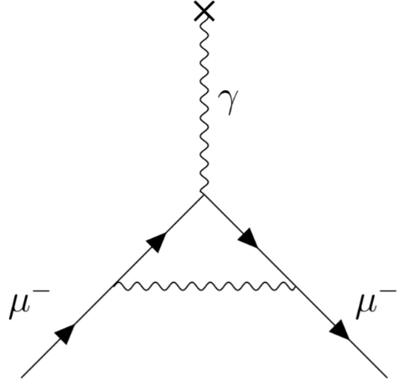

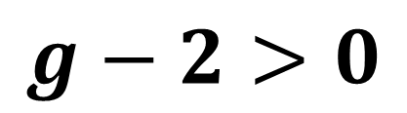

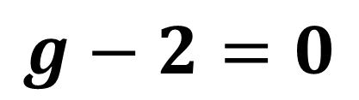
What is «$g−2$»?
Particle with spin in magnetic B-field: $\vec{μ}≡g\frac{e}{2m}\vec{S}$ → $τ=\vec{μ}×\vec{B}$, $U=−\vec{μ}⋅\vec{B}$
Dirac’s prediction for spin-$\frac{1}{2}$ charged particles: $g=2$
Radiative corrections in Quantum Field Theories: $g≠2$
Kusch and Foley’s measurement/
Schwinger’s prediction:
(1948, electron $g_{e}−2$)
$\frac{g_{e}−2}{2}≡a_{e}≈0.00116$
1st order QED term: $\frac{α}{2π}$
universal to all leptons: $e$, $μ$, $τ$
$$g−2>0$$
$$g−2=0$$

Slide 3
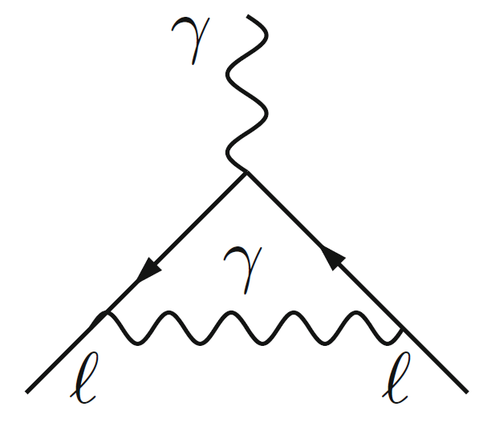
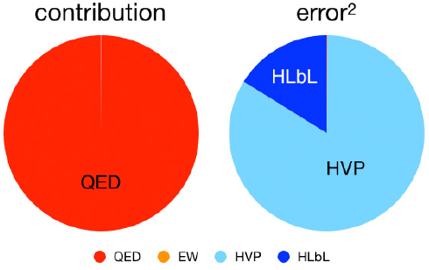
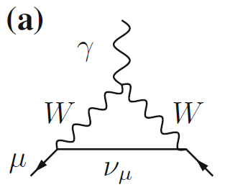
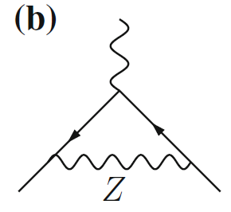
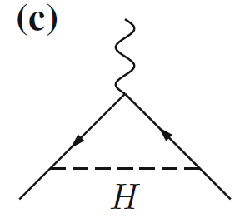
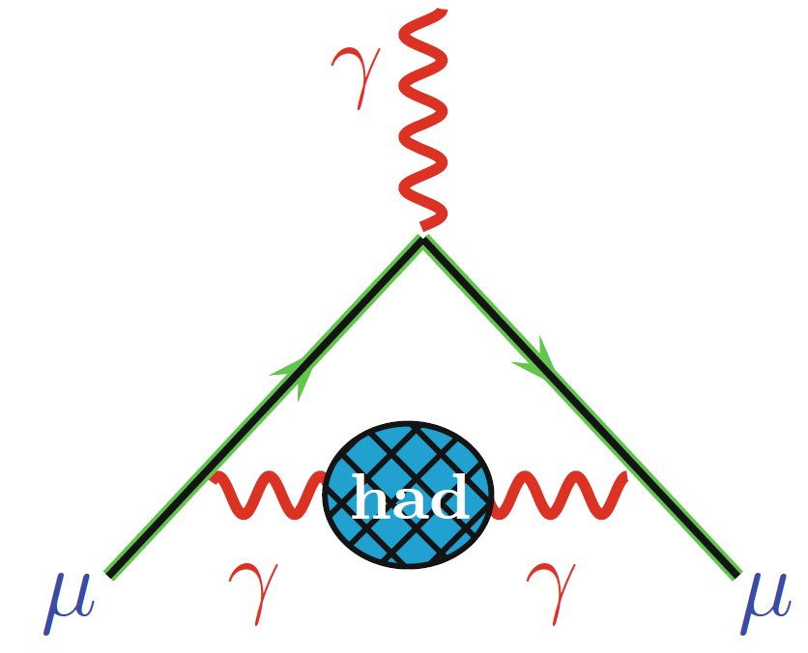
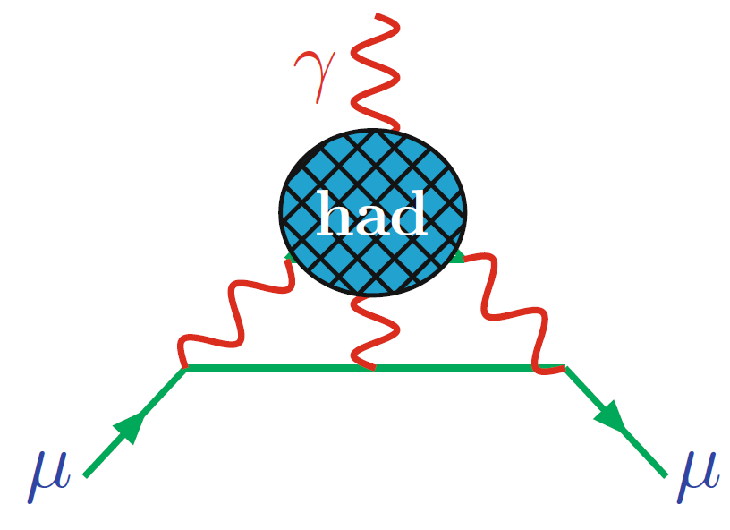
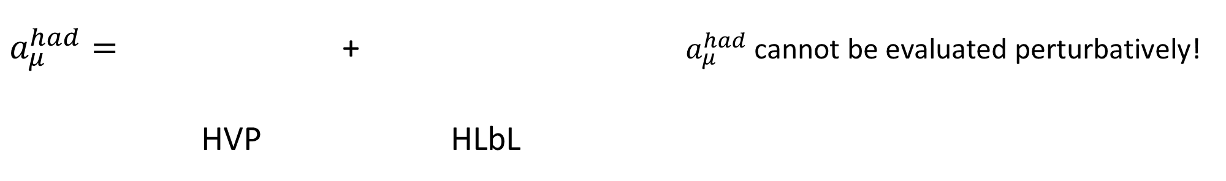
SM prediction of ${\left(g−2\right)}_{μ}$
$a_{μ}≡\frac{g_{μ}−2}{2}$ $a_{μ}^{SM}=a_{μ}^{QED}+a_{μ}^{EW}+a_{μ}^{had}$
$a_{μ}^{QED}=$ + over 14’000 diagrams
$a_{μ}^{EW}=$ + + + …
$a_{μ}^{had}=$ + $a_{μ}^{had}$cannot be evaluated perturbatively!
HVP HLbL
QCD dominates the uncertainty

Slide 4
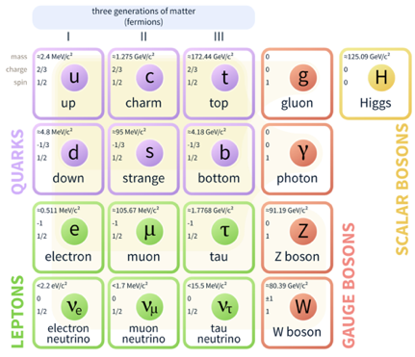
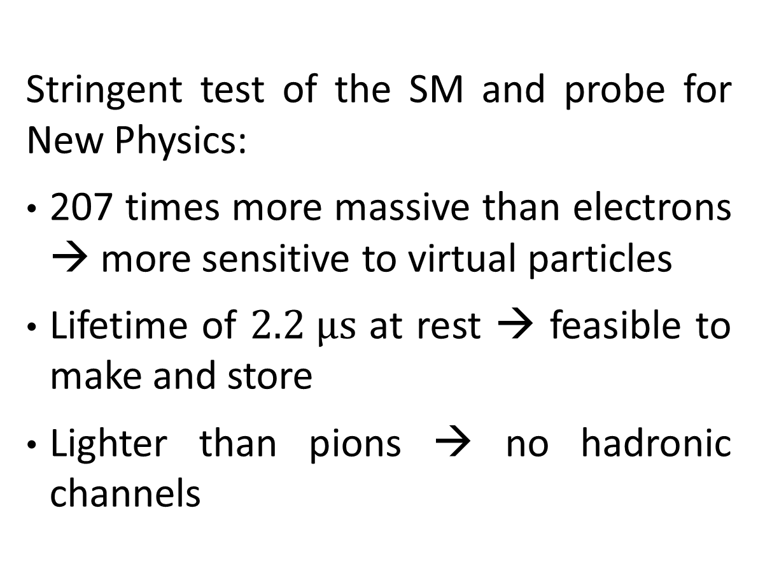
Why did we measure the muon $g−2$?
Stringent test of the SM and probe for New Physics:
207 times more massive than electrons → more sensitive to virtual particles
Lifetime of $2.2 μs$ at rest → feasible to make and store
Lighter than pions → no hadronic channels

Slide 5
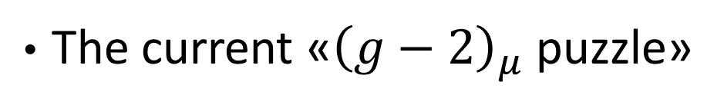
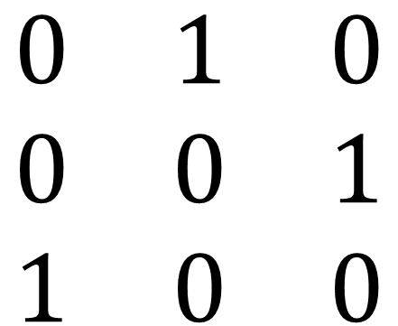
Outline
Past
Present
Future
Goals and design
Improvements over 6 years
$$\begin{matrix}0 & 1 & 0 \\ 0 & 0 & 1 \\ 1 & 0 & 0\end{matrix}$$
The current «${\left(g−2\right)}_{μ}$ puzzle»
BSM analyses at FNAL
Incoming pieces of the puzzle

Slide 6
A snapshot in time

Slide 7
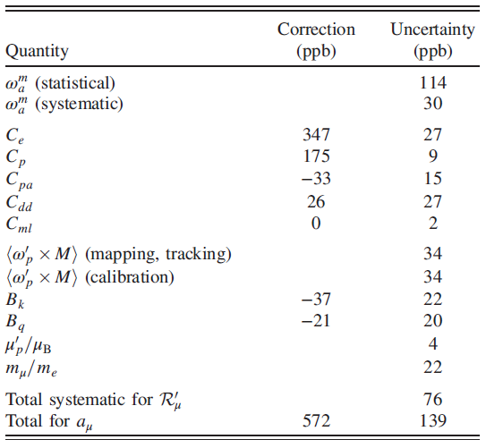
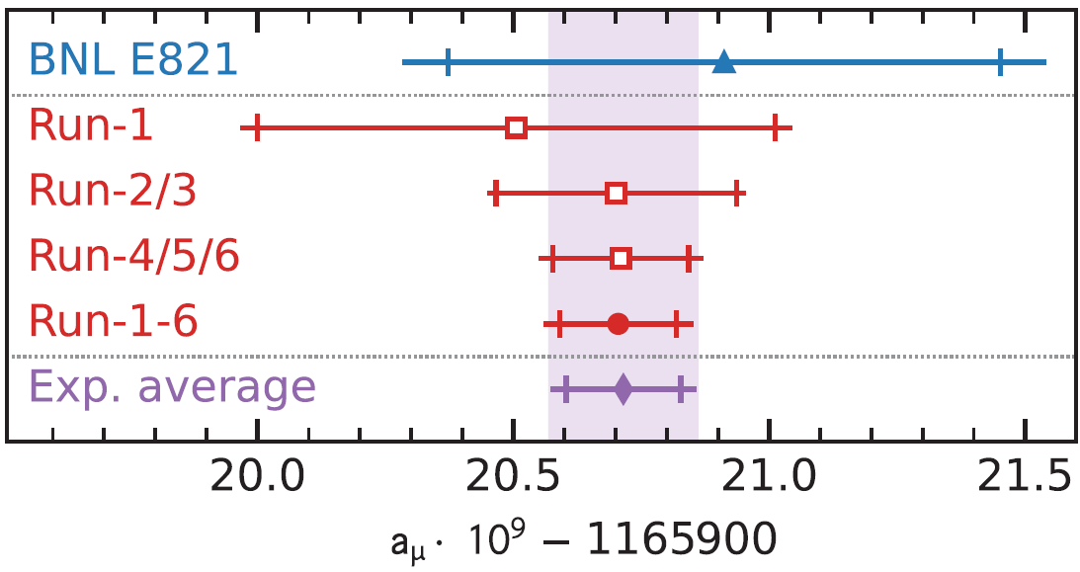
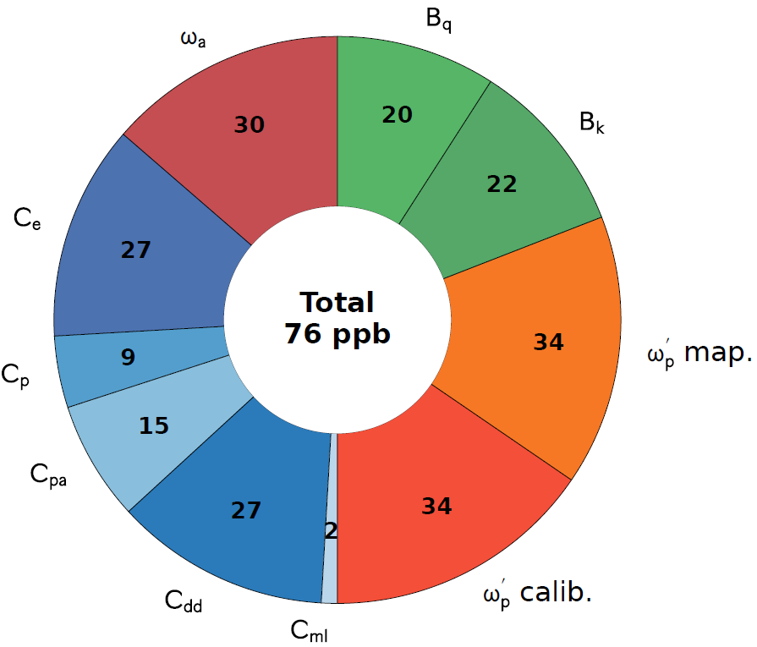

The final g-2 result
Excellent agreement between Run-4/5/6 and previous Fermilab/BNL results
Combination: $a_{μ}^{exp}\left(World Average\right)=116592071.5\left(14.5\right)×{10}^{−11}(124 ppb)$
$∼$ evenly distributed systematics
Phys. Rev. Lett. 135
(2025) 10, 101802

Slide 8
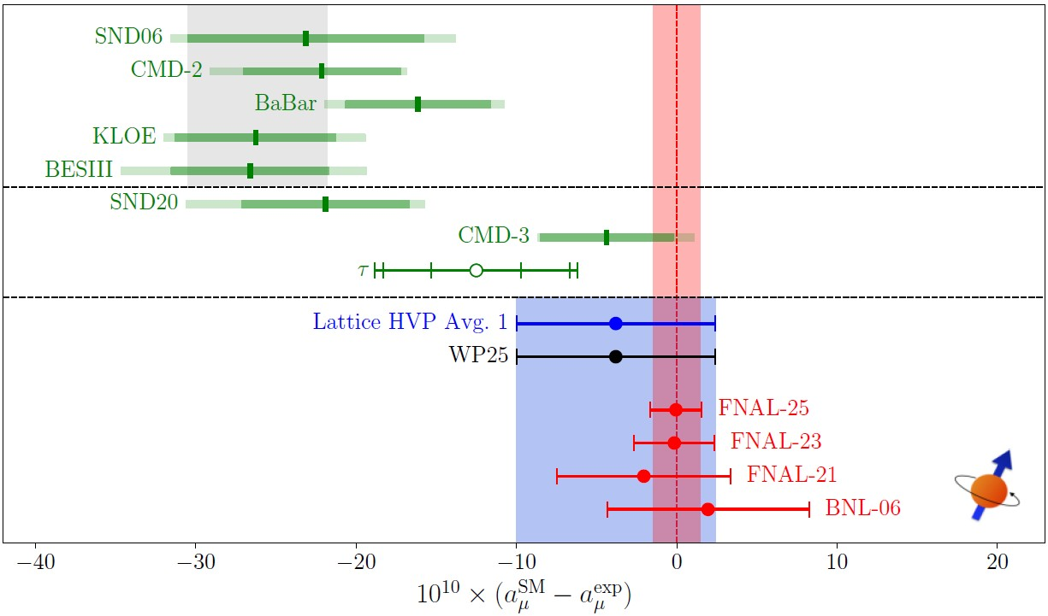
Comparison with theory
In the White Paper 2025, the Muon g-2 Theory Initiative recommended a value based solely on Lattice for HVP-LO while tensions are being resolved. See several talks about this today.
Phys. Rept. 1143 (2025) 1-158

Slide 9
Future inputs to the puzzle

Slide 10
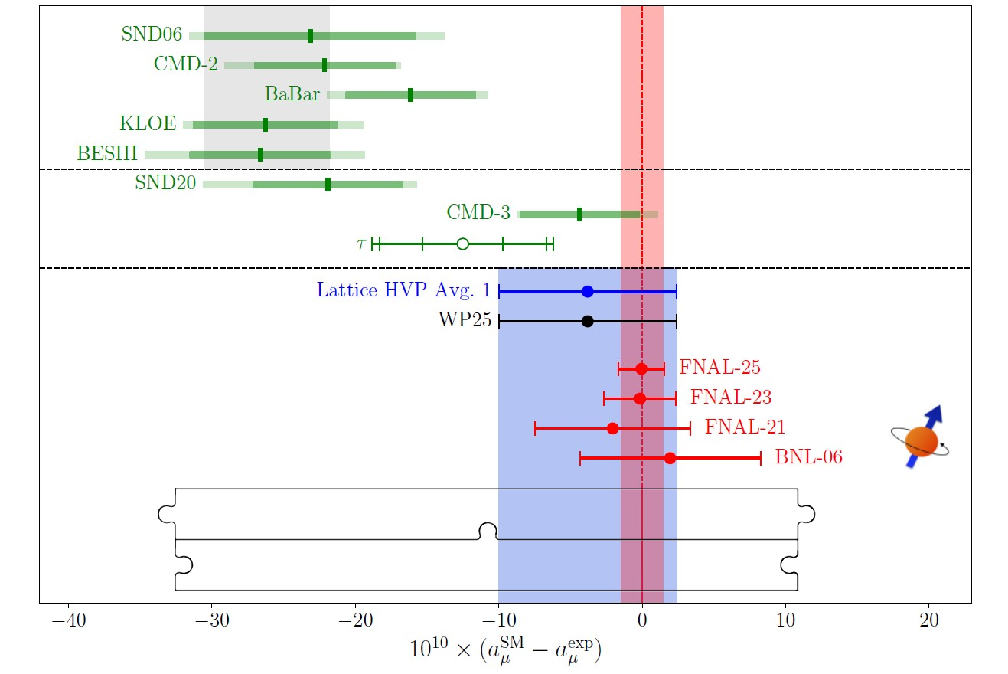


The future «Muon $g−2$ puzzle»
Hopefully will be resolved: more points (some already shown at latest T.I. workshop, see e.g. talk today), improved MC generators, …
New independent measurements: see talks today and tomorrow

Slide 11
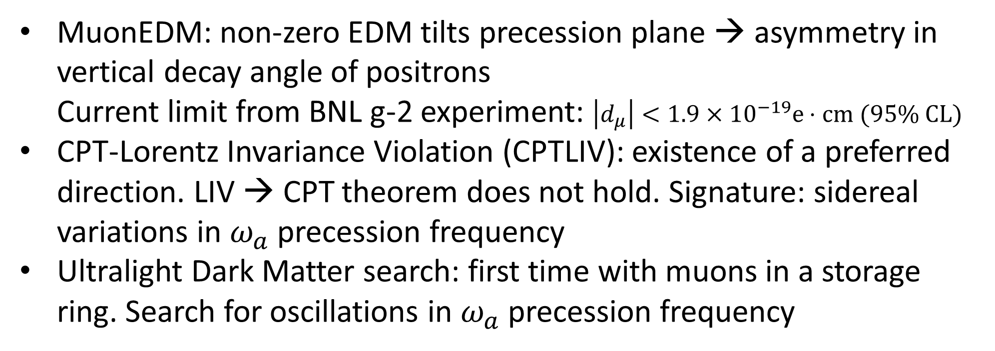
Further searches with FNAL g-2 data
MuonEDM: non-zero EDM tilts precession plane → asymmetry in vertical decay angle of positrons
Current limit from BNL g-2 experiment: $\left|d_{μ}\right|<1.9×{10}^{−19}e⋅cm (95\% CL)$
CPT-Lorentz Invariance Violation (CPTLIV): existence of a preferred direction. LIV → CPT theorem does not hold. Signature: sidereal variations in $ω_{a}$ precession frequency
Ultralight Dark Matter search: first time with muons in a storage ring. Search for oscillations in $ω_{a}$ precession frequency
PRD 102, 115018 (2020)

Slide 12
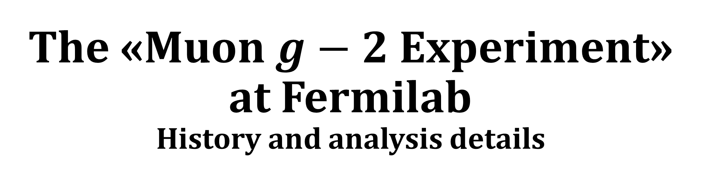
The «Muon $g−2$ Experiment» at Fermilab
History and analysis details

Slide 13
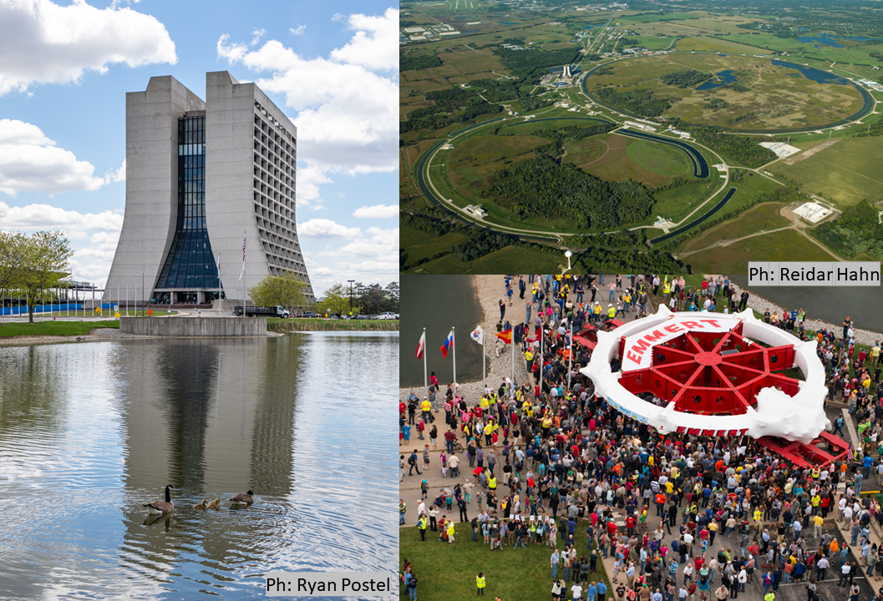
Fermilab Muon Campus

Slide 14
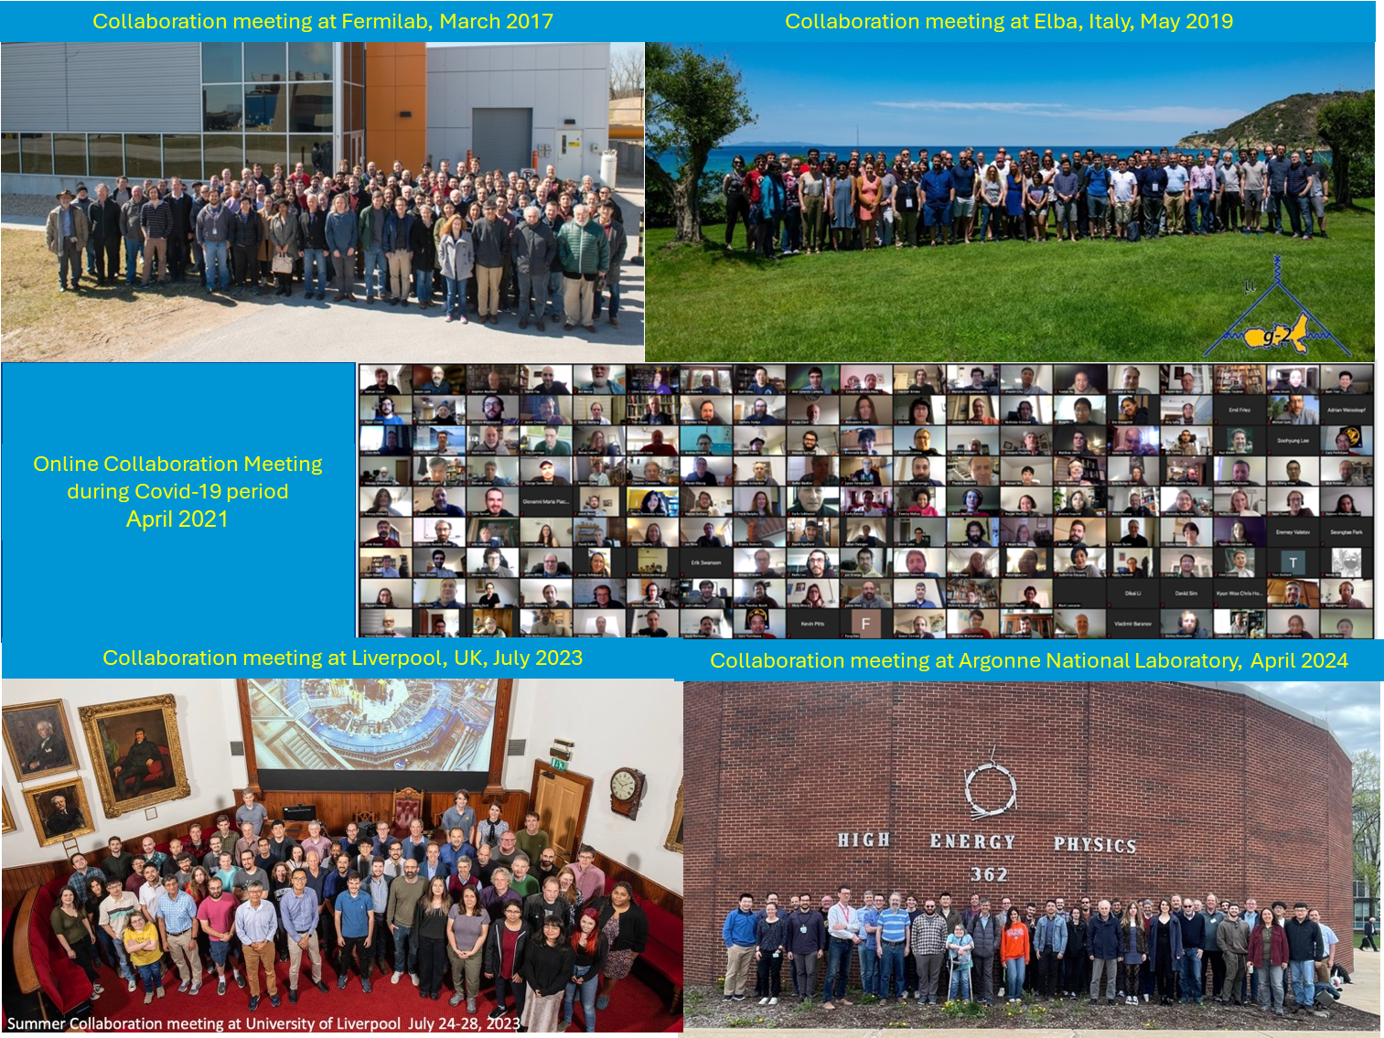
The collaboration

Slide 15
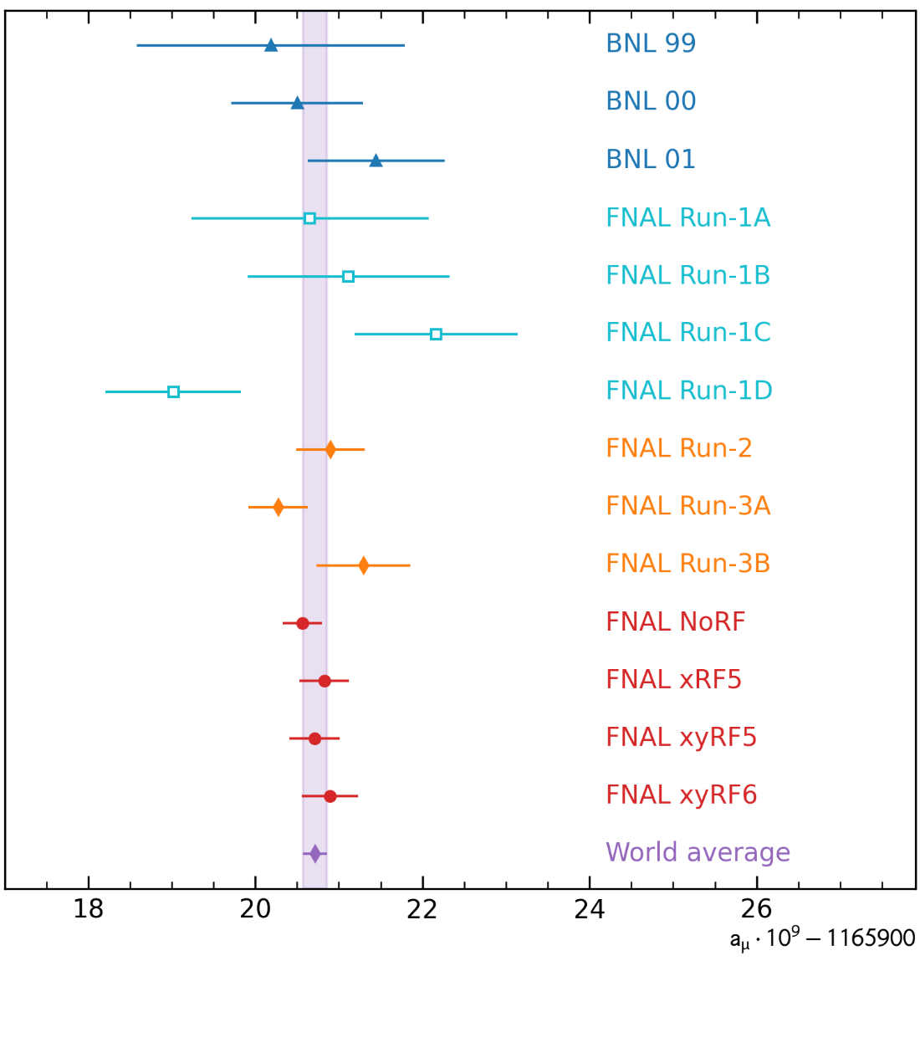
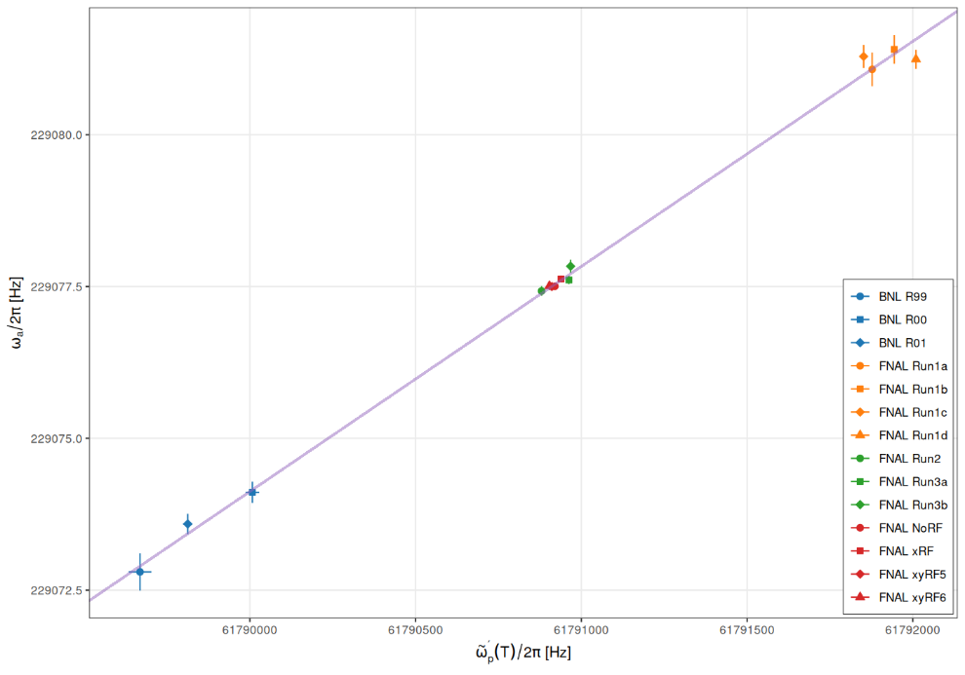
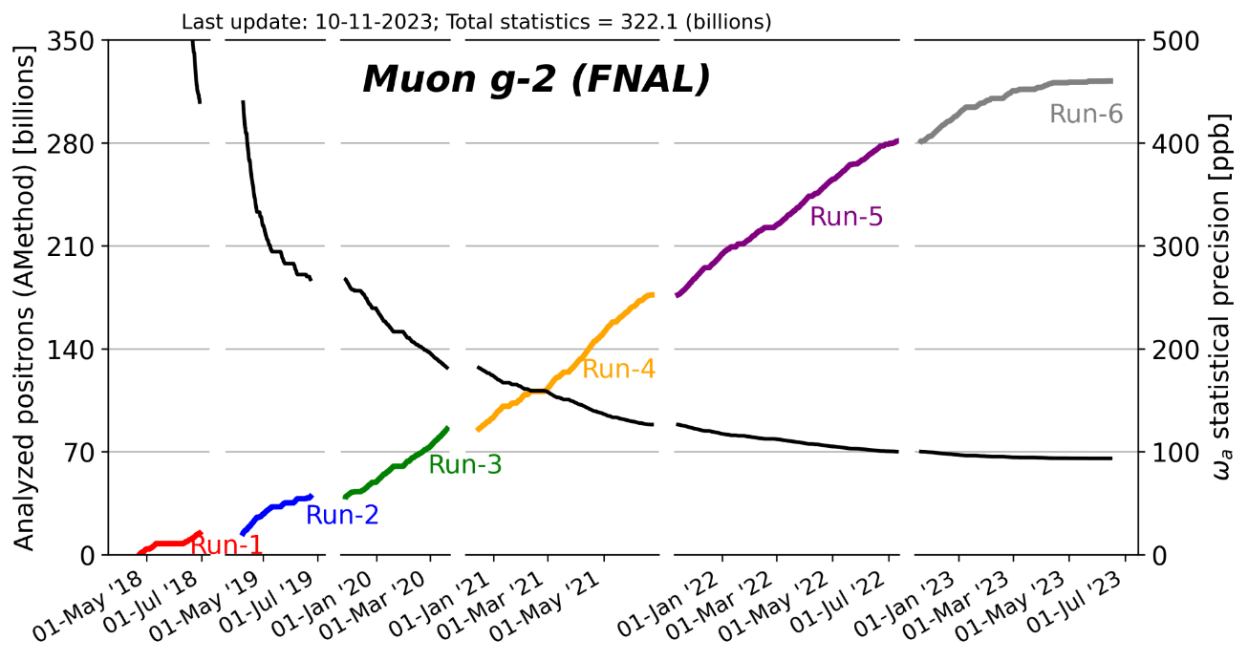
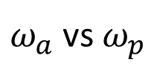
Consistency of FNAL g-2 results
$ω_{a}$ vs $ω_{p}$

Slide 16
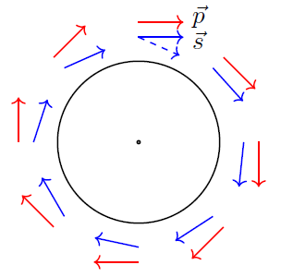
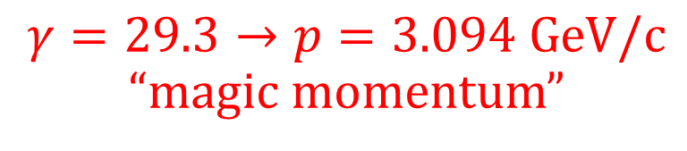
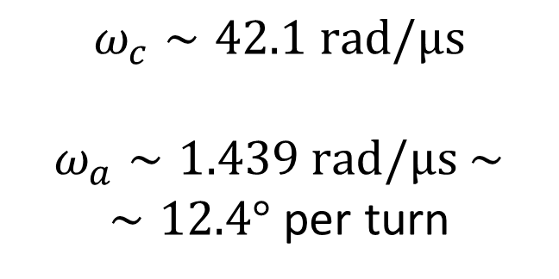
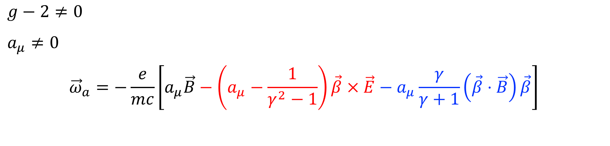

Anomalous spin precession in a B-field
$$g−2≠0$$
$a_{μ}≠0$
$${\vec{ω}}_{a}=−\frac{e}{mc}\left[a_{μ}\vec{B}−\left(a_{μ}−\frac{1}{γ^{2}−1}\right)\vec{β}×\vec{E}−a_{μ}\frac{γ}{γ+1}\left(\vec{β}⋅\vec{B}\right)\vec{β}\right]$$
$→$ spin precesses with anomalous frequency ${\vec{ω}}_{a}={\vec{ω}}_{spin}−{\vec{ω}}_{c}$
$γ=29.3→p=3.094 GeV/c$ “magic momentum”
$$ω_{c}∼42.1 rad/μs$$
$ω_{a}∼1.439 rad/μs$ $∼$
$∼12.4°$ per turn
$$\vec{β}⋅\vec{B}=0$$

Slide 17
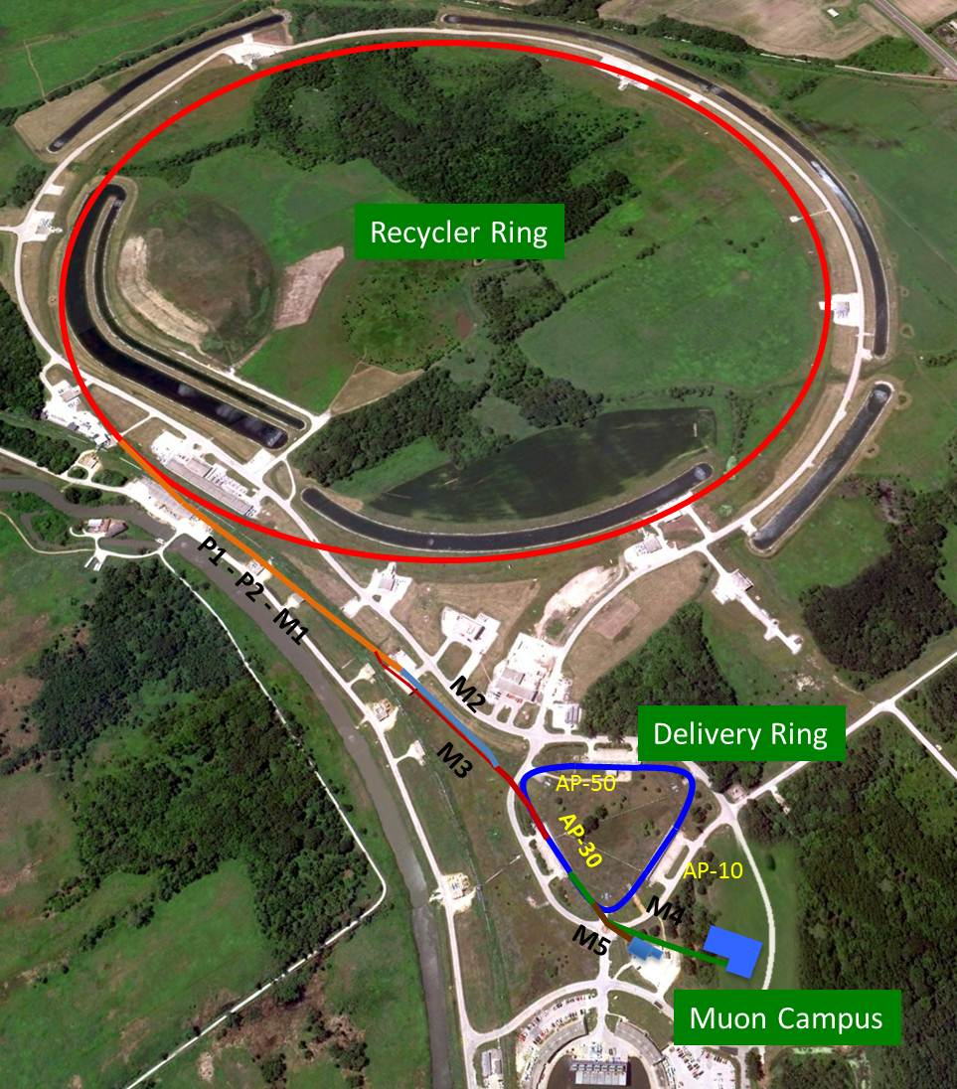
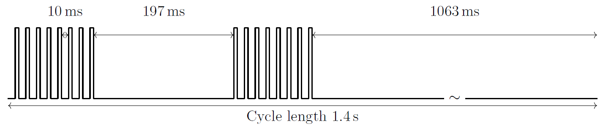
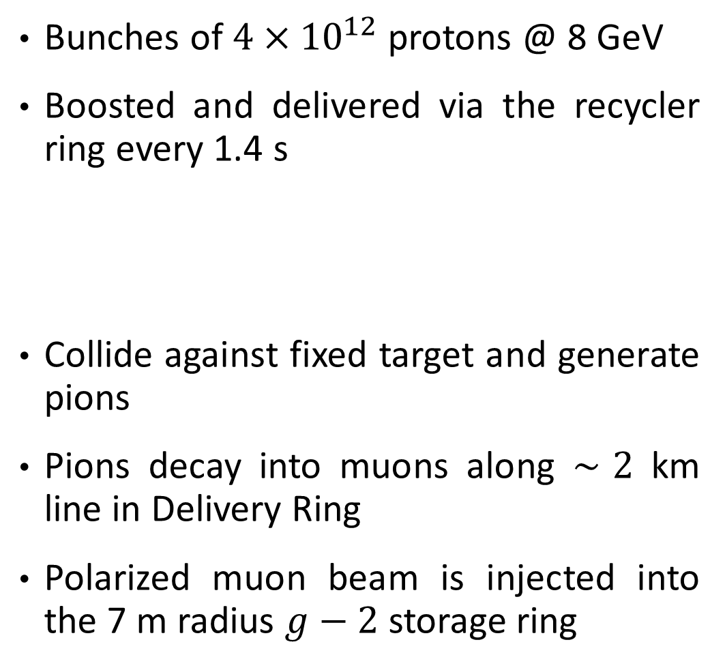
FNAL accelerator complex
Bunches of $4×{10}^{12}$ protons @ 8 GeV
Boosted and delivered via the recycler ring every 1.4 s
Collide against fixed target and generate pions
Pions decay into muons along $∼2$ km line in Delivery Ring
Polarized muon beam is injected into the 7 m radius $g−2$ storage ring

Slide 18
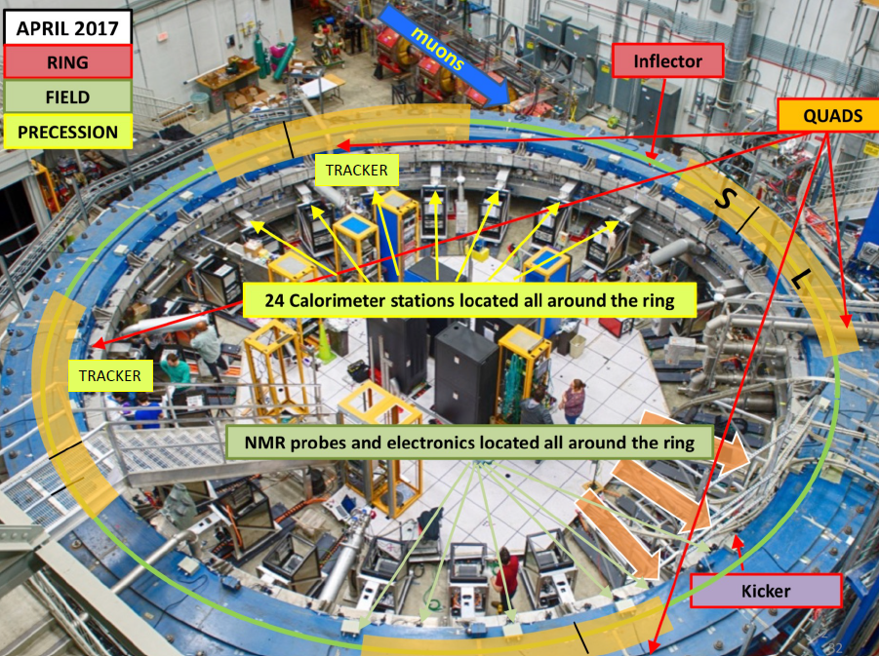
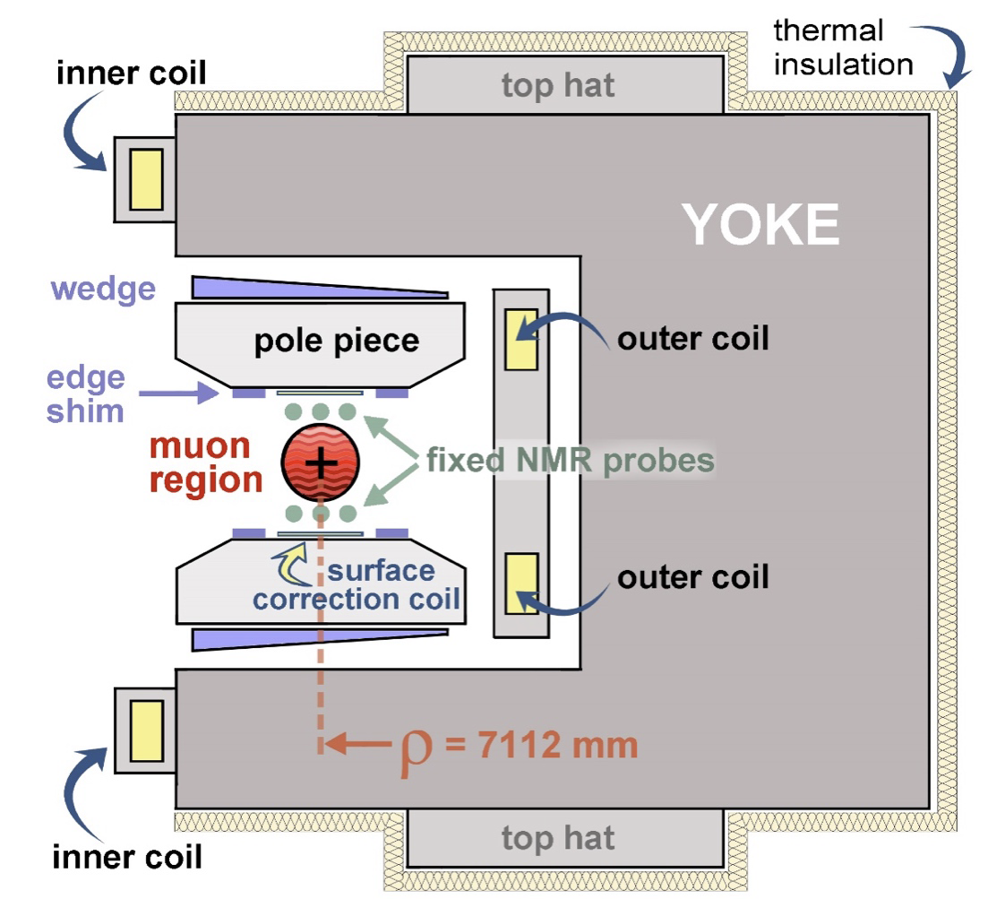
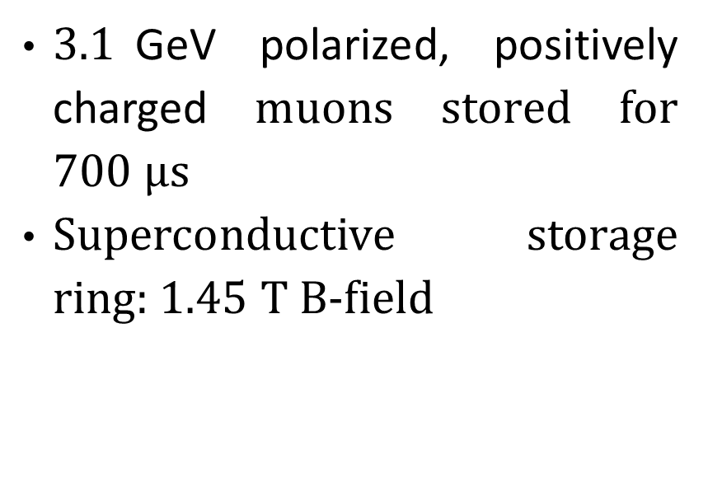
Subsystems of the experiment
$3.1$GeV polarized, positively charged muons stored for $700 μs$
Superconductive storage ring:$1.45$ T B-field

Slide 19
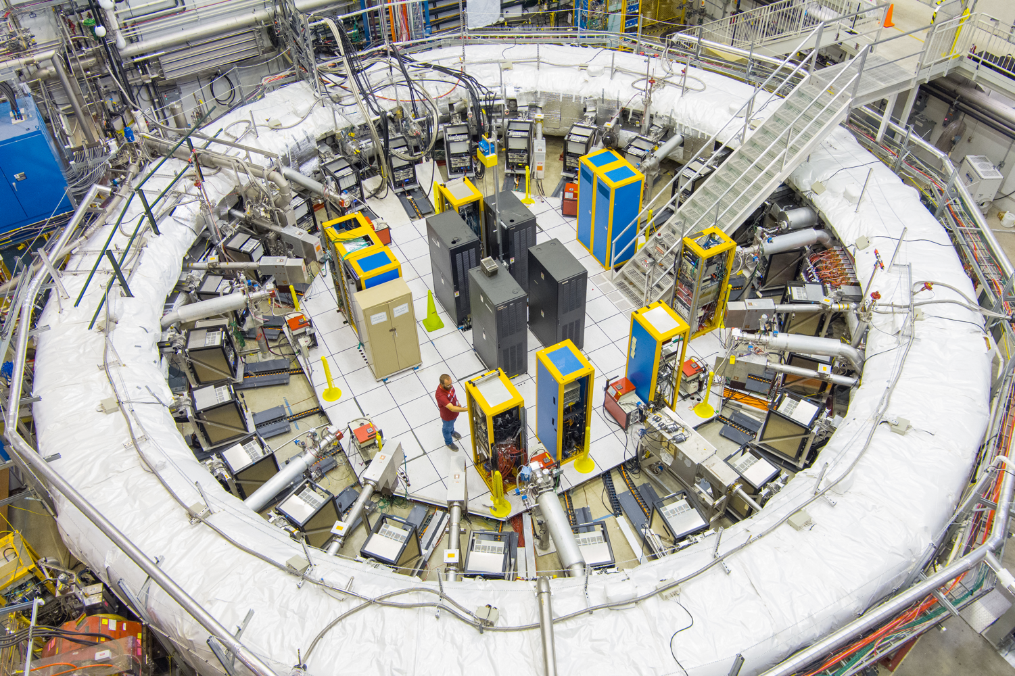
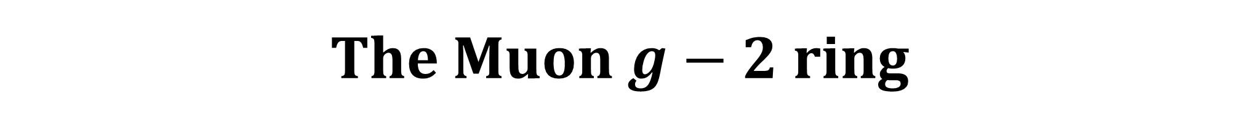
The Muon $g−2$ ring

Slide 20
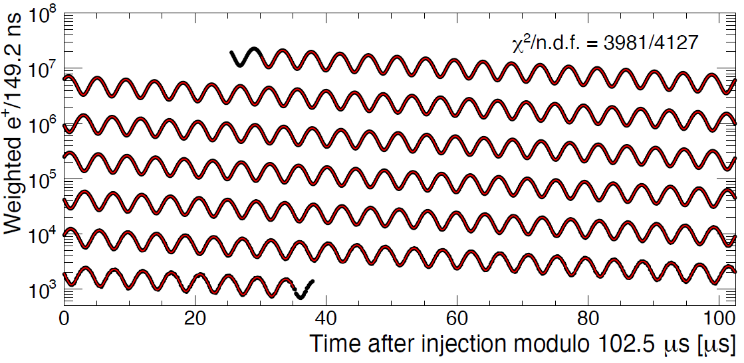
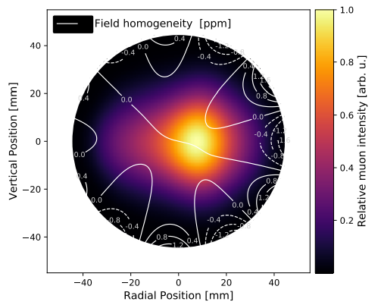





Master formula for $a_{μ}$
  $$a_{μ}=\frac{ω_{a}}{{\tilde{ω}}_{p}^{′}}×\frac{μ_{p}^{′}}{μ_{B}}\frac{m_{μ}}{m_{e}}$$
External factors, known to 25 ppb
Make spin precess slower (E-field, vertical motion)
Make phase change within $700 μs$
  $$\frac{ω_{a}}{{{\tilde{ω}}^{′}}_{p}}=\frac{ω_{a}^{m}}{{{\tilde{ω}}^{′}}_{p}^{m}}×$$
corrections for effects that…
Are synchronous to the muon injection so induce transient magnetic fields
$m$=Measured values

Slide 21


Principle of $ω_{a}$ measurement
Weak decays violate parity:
  polarized muon beam
  preferred high-energy $e^{+}$ direction
Correlation in the lab frame between $e^{+}$ energy spectrum and $ω_{a}$ phase ($α$)
«Wiggle plot»: count high-energy $e^{+}$ over time, for about $700 μs$ (muon lifetime is $∼64 μs$ in the lab)

Slide 22




Detectors
24 e.m. calorimeters
Measure (E,t) of $e^{+}$
Each made of $6×9$ PbF₂ crystals, $15X_{0}$, read out by large-area SiPMs
$e^{+}$ generate electromagnetic shower, SiPMs detect Cherenkov light ($n=1.8$)
2 straw tube trackers
Each has 8 modules and 32 planes
50:50 Argon:Ethane at 1 atm pressure
Extrapolate decay vertex location to
measure beam distribution

Slide 23



$ω_{a}$ analysis in a nutshell
Count positrons and subtract pileup
1.
2.
Fit wiggle plots with many parameters to account for beam dynamics effects

Slide 24





$ω_{p}$ (field) analysis in a nutshell
Nuclear Magnetic Resonance (NMR) probes: placed on trolley for special runs, every 2 or 3 days between muon fills
17 petroleum jelly NMR probes
2D field maps (~9000 points)
Azimuthally-Averaged
Variation < 1 ppm
378 fixed NMR probes monitor field during muon storage at 72 azimuthal locations
Calibration with respect to shielded protons in a spherical sample

Slide 25



Beam dynamics and field transients
  $$\frac{ω_{a}}{{{\tilde{ω}}^{′}}_{p}}=\frac{ω_{a}^{m}\left(1+C_{e}+C_{p}+C_{pa}+C_{dd}+C_{ml}\right)}{⟨{ω^{′}}_{p}×M⟩\left(1+B_{k}+B_{q}\right)}$$
$C_{e}$: $\vec{E}$ field, muon momentum distribution
$C_{p}$: muon vertical betatron amplitude
$C_{pa}$: time-dependent phase and acceptance
$C_{dd}$: spread of muon lifetimes in the beam
$C_{ml}$: momentum distribution of lost muons
$B_{k}$: eddy currents in the kicker
$B_{q}$: pulsing of electrostatic quadrupoles

Slide 26


Warning: many simplifications ahead

Slide 27



A difficult journey
Recipe for success: strategically proceed step-by-step, constantly stop and re-assess the situation
Preparation: early morning, bus tickets, expectations for a smooth trip from Marina Maggiore to Anacapri
Surprise: not a good idea to climb 900+ steps while carrying three bags and a coat under a 23° sun
Anacapri
Google Maps
says it’s only 40 minutes on
foot!
Shops
B&B
Chairlift

Slide 28
Run-1
- Similar to BNL statistics
- Many improvements on the hardware
- Developed independent analysis methods
- Faulty resistors in the ESQ system: largest systematic needs to be studied from scratch
- Non-ideal kick
- Temperature variations larger than 1°
- Dedicated efforts to study the unexpected findings
- No rush, make sure that things are under control

Slide 29


Run-2/3
- Fixed Quad HV resistors
- Stabilized magnet and hall temperature
- Brought kickers at design HV value
- 4.7 more statistics than Run-1
- Field transients, pileup and systematics related to Coherent Betatron Oscillations were still dominant
- Identified bug in one of $ω_{a}$ reconstructions which enhanced mysterious «residual slow term»
- Improved $ω_{a}$ analysis techniques
- Improved measurement of quadrupole field transients
- Surpassed TDR goal for systematic uncertainty!

Slide 30
Run-4/5/6
- Quad RF reduces beam oscillations (horizontal and vertical)
- Even more statistics allow for even more precise systematic studies
- Much more data to process (collect, reconstruct, analyze)
- CBO and «residual slow term» still dominant; more stable beam means smaller effects to study
- Dedicated task forces
- Simulation and new detector to study time-momentum correlation in beam dynamics
- Identified physics source of residual slow term
- Surpassed overall TDR goal for the uncertainty!
RF

Slide 31



Summary and conclusions
  New $a_{μ}$ experimental world average has unprecedented precision of 124 ppb
  FNAL collaboration now focusing on Beyond SM searches (EDM, CPTLIV, DM)
  We appeared on the PRL Cover twice and were PRL Editor’s Suggestion thrice!
  Theoretical prediction for $a_{μ}$ will hopefully consolidate in the coming years, with new, competitive, independent inputs (HVP dispersive, lattice, tau; MUonE, J-PARC g-2/EDM) → See all talks at this workshop!

Slide 32




THANK YOU FOR
YOUR ATTENTION!
lorenzo.cotrozzi@liverpool.ac.uk
July 2023 collaboration meeting @ Liverpool, UK

Slide 33
Extra: HVP methods

Slide 34







Dispersive method ($e^{+}e^{−}$) for HVP-LO
Optical theorem: Im
$R\left(s\right)$ is data-driven hadronic R-Ratio
20+ years of $e^{+}e^{−}$ experiments: situation is, unfortunately, already unclear
$$π^{+}π^{−}$$
73%
Phys. Rev. D 97.11 (2018)
Phys. Rept. 1143 (2025) 1-158

Slide 35


Lattice QCD method for HVP-LO
Ab-initio calculation of HVP from first principles, approximation of discrete space-time
After WP2020: BMW collaboration published first sub-percent uncertainty
Finn M. Stokes, «Status of HVP from the BMW/DMZ collaboration», 10/09/25
Link to slides at the 8th T.I. workshop
Window observables: excellent agreement in the intermediate window

Slide 36

Extra: BSM searches at FNAL Muon $g−2$

Slide 37


Slide 38


Slide 39


Slide 40
Extra: beam dynamics and field transient corrections

Slide 41


Slide 42


Slide 43


Slide 44

Extra: $ω_{a}$ backup

Slide 45



$ω_{a}$ analysis flowchart

Slide 46



Reconstruct $e^{+}$ events
Pulse fitter identifies traces on crystals
Clustering algorithms reconstruct total time
and energy of positron hit
Better algorithms reduced pileup after Run-1
Pulse fitter
Pileup dominated Run-1 systematics
Run-1: 35 ppb
Run-2/3: 7 ppb
Un-physical

Slide 47




Improved pileup correction since Run-1
(example for «local» method)
T
S
For each T (Trigger) cluster that we find:
Search for coincidence $e^{+}$ in S (Shadow) window, after 149.2 ns
Superimpose the two clusters and pass to reconstruction algorithm
If not resolved: merge them and build pileup
After Run-1: also searched for triplets (2 shadows)

Slide 48





Example of new method to subtract pileup
T
S
For each T (Trigger) cluster that we find:
Search for coincidence $e^{+}$ in S (Shadow) window, after 149.2 ns
Superimpose the two clusters and pass to reconstruction algorithm
→If not resolved: merge them and build pileup
Finally: subtract merged event and add single events

Slide 49






Methods for $ω_{a}$ analysis
T-Method:
Greater threshold: wider $ω_{a}$ oscillations
Lower threshold: more positrons
Compromise: $∼1.7$ GeV
A-Method:
Extract asymmetry (oscillation amplitude) as function of positron energy → $A\left(E\right)$
Weight each positron event with $A\left(E\right)$
$σ_{ω_{a}}$(A-Method)$∼90\%{ σ}_{ω_{a}}$(T-Method)
$y_{th}=E/3.1$GeV
$$\frac{1}{σ_{ω_{a}}^{2}}$$

Slide 50







Ratio method wiggle plots
Randomly split positrons in 4 groups
Shift two groups in time by $±$ half precession period $T_{a}/2$. Recombine:
$$V(t)$$
$$U(t)$$
$$R\left(t\right)=\left[V\left(t\right)−U\left(t\right)\right]/[V\left(t\right)+U(t)]$$
It gets rid of muon lifetime and normalization $N_{0}$ in fit function. Any «slow» effect is highly reduced!

Slide 51


“Ratio” A-Method, new in Run-2/3
Weight each positron with asymmetry function (like A-Method)
R: $\left\{V\left(t\right);U\left(t\right)\right\}$ → RA: $\left\{\overline{V}\left(t\right)=\sum_{E}{A\left(E\right)}V\left(E,t\right);\overline{U}\left(t\right)=\sum_{E}{A\left(E\right)U\left(E,t\right)}\right\}$
R: $\frac{V\left(t\right)−U\left(t\right)}{V\left(t\right)+U\left(t\right)}$ → RA: $\frac{\overline{V}\left(t\right)−\overline{U}\left(t\right)}{\overline{V}\left(t\right)+\overline{U}\left(t\right)}$
Statistical uncertainty on $ω_{a}$ is minimized
Exponential due to muon lifetime is cancelled
Reduces the sensitivity of $ω_{a}$ to most «slow
effects», such as SiPM gain fluctuations!
A-Method
RA-Method

Slide 52










$ω_{a}$ fit
5-parameter fit
$$N\left(t\right)=N_{0}e^{−\frac{t}{γτ_{μ}}}\left[1+A\cos\left(ω_{a}t+φ\right)\right]$$
FFT of residuals
Muon losses over time
Coherent betatron oscillations (CBO)

Slide 53


Radial and vertical motion of the beam
Field index: $n$ (quad voltages)
Radial motion of the beam: $ω_{x}=ω_{c}\sqrt{1−n}$
CBO is the aliased frequency $ω_{CBO}=ω_{c}−ω_{x}$
CBO period of about 2.7 $μs$

Slide 54


CBO model: amplitude vs time
CBO dominated Run-1 systematics: 38 ppb.
Around 21 ppb on average after Run-1!
$CBO\left(t\right)=1+A_{CBO}\cos\left(ω_{CBO}t+φ_{CBO}\right)×e^{−t/τ}$ →Decoherence
Muons are an ensemble: betatron oscillations decohere over time
Sliding window fits to determine good or bad envelopes: more statistics→more studies than Run-1; also input from tracker data
… and many other models tested in dedicated task force; different methods explored, etc…

Slide 55



CBO model: frequency vs time
CBO dominated Run-1 systematics (38 ppb).
Now reduced to 21 ppb!
Exponential relaxation of CBO frequency
Run-1: faulty ESQ resistors enhanced this effect 10 times!
Sliding window fits to determine lifetime and constrain it in $ω_{a}$ fits
→
Run-1
Run-2/3

Slide 56
Extra: Run-1 → Run-2/3

Slide 57



Injection and muon storage
Inflector cancels main dipole field and injects at $∼$8 cm radially away from nominal orbit
3 fast magnetic kickers provide 10 mrad kick and place muons in orbit
8 Electrostatic Quadrupoles (ESQ) focus in the vertical direction
1.
2.
3.

Slide 58



Run-2/3 improved running conditions
Before Run-2: fixed faulty resistors in 2/32 quadrupole plates → better storage, more stable beam oscillations and reduced systematics
After Run-2: added thermal insulation to ring → less variable magnetic field
Mid Run-3: upgraded kicker cables for optimal kick → more centered beam
Run-1
Run-2
Run-3
Vertical beam width change

Slide 59
Extra: Run-2/3 → Run-4/5/6

Slide 60



$ω_{a}$ fit and FFT of residuals
Run-2/3
Run-4/5/6
CBO peaks
Vertical motion peaks
Final fits include all oscillations
$$N\left(t\right)=N_{0}e^{−\frac{t}{γτ_{μ}}}\left[1+A\cos\left(ω_{a}t+φ\right)\right]×CBO\left(t\right)×VW\left(t\right)×…$$

Slide 61


$ω_{a}$ analysis teams (red = new methods w.r.t. Run-2/3)
Run-2/3 | I | II | III | IV | V | VI | VII
Pulse fitting & clustering | Local | Local $Δt′$ | Local «ITA1» | Local $Δt′$ | Global | Global | Q
Pileup subtraction | Shadow | Empirical | «Semi» empirical | Empirical | Empirical | Empirical | -
Analysis methods | T, A | T, A | T, A, RT, RA | T, A, RT, RA | T, A, RT | T, A | Q, RQ
Run-4/5/6 | I | II | III | IV | V
Pulse fitting & clustering | Local $Δt′$ | Local «ITA2» | Local | Global | Q
Pileup subtraction | Empirical | «Semi» empirical | Empirical | Empirical | -
Analysis methods | T, A, RT, RA | T, A, RT, RA | T, A | T, A, RT, RA, ST, SA | Q, RQ

Slide 62


Two Run-4/5/6 “Task forces”
To address major Run-2/3 $ω_{a}$ systematics
2. Residual slow term
Early-to-late effect in $ω_{a}$ fits, $∼20$ ppb systematic in previous results
Effect smaller than ${10}^{−4}$(laser calibration level) but due to phase-shifted oscillation at $ω_{a}$ it led to larger sensitivity than orig. estimated → Physics issue identified! And studied in UW labs
Applied new correction to take this into account
1. CBO treatment and systematics
Quad RF off → on: CBO much reduced, but higher statistics helped us to parametrize it better
New frequency components showed up in FFT of wiggle plot residuals
New models, new methods to parametrize CBO or the entire fit function, new studies

Slide 63



Gain-Like Detector Effects
Effective threshold changes
over time
Laser system to correct the gain on 10⁻⁴ –level
$$ω_{a}$$

Slide 64



Gain-Like Detector Effects
New! Sensitive also below 10⁻⁴ if
Rate & Energy dependent
Time constant $\sim 1/ω_{a}$
Correction shows $ω_{a}$-behavior
but out of phase
Time-dependent phase-change
Fitted $ω_{a}$ sensitive to such effects
$$ω_{a}$$
*noRF dataset

Slide 65



Laser-based gain monitoring system
Built by INFN/CNR-INO: time synchronization and calibration of 1296 SiPMs on timescales from ns to days/weeks. Gain changes dominated $ω_{a}$ systematics at BNL: exceeded goal of 20 ppb at FNAL.
Standard operating mode:
Sync pulse: time synchronization at $∼50$ ps
In-Fill pulses: monitor rate-dependent gain changes at ${10}^{−4}$ during $700 μs$ of $μ^{+}$ beam
Out-of-Fill pulses: monitor stability over days
Notes:
OOF would be 10^-3

Slide 66






SiPM gain calibration
In-Fill: sag in power supply due to initial injection splash.
Recovery timescale of front-end electronics: $𝒪$(10 $μs$).
Short-term: consecutive positron hits within $𝒪$(100 ns).
After the first hit, the recovery time of pixels reduce the gain experienced by the second hit.

Slide 67

Residual Slow Term
known in Run-1: “early-to-late effects” 10-22 ppb uncertainty
better understood in Run-2/3: split into reconstruction & detector part with
“Possible sources […] changes in gain, acceptance, or
reconstruction over the duration of a fill.” 5-14 ppb uncertainty
Run-4/5/6: New! Identified physical explanation
  Detector effect due to preceding positron hits (rate dependent):
  20-40 ppb effect, ~25ppb uncertainty
New! 36 pbb uncertainty
Positron Hit
Time
Calorimeter in lab for dedicated measurements
* electronics board dependent

Slide 68


Symptoms of Such An Effect | Toy MC Example
The shape induced by the ITDP effect matches the real IFG residuals

Slide 69

Extra: $g−2$ blinding and unblinding procedures

Slide 70


Blinded analysis
Hardware: main clock is tuned at $(40−ε)$ MHz
Offset only known to two scientists external to the
collaboration
Software: each $ω_{a}$ analyzer applies their own, secret offset to their results

Slide 71




Example: Run-2/3 unblinding
Software unblinding
Hardware unblinding

