Slide 1
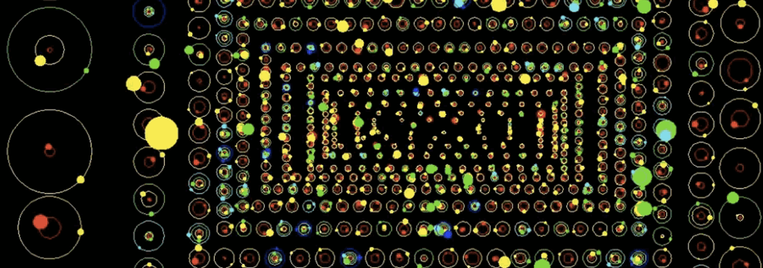
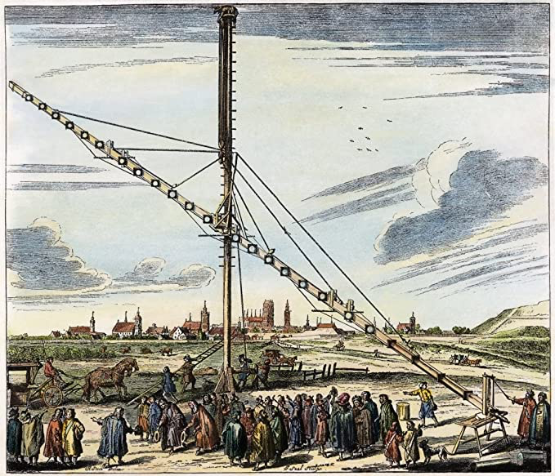
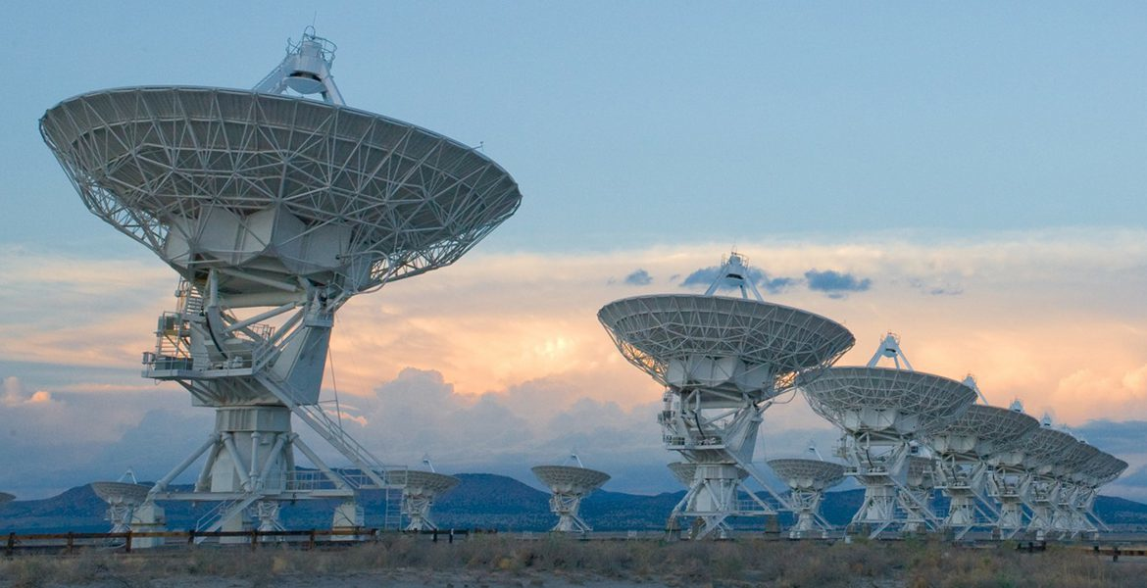
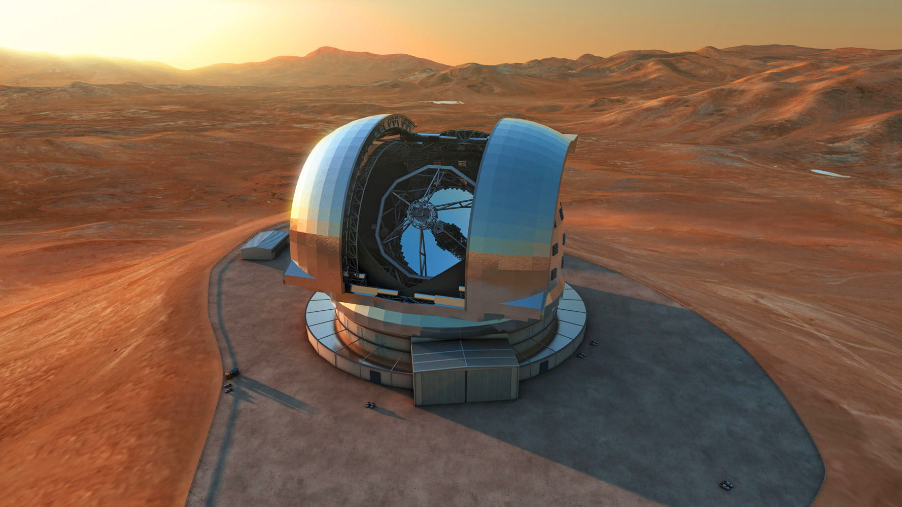
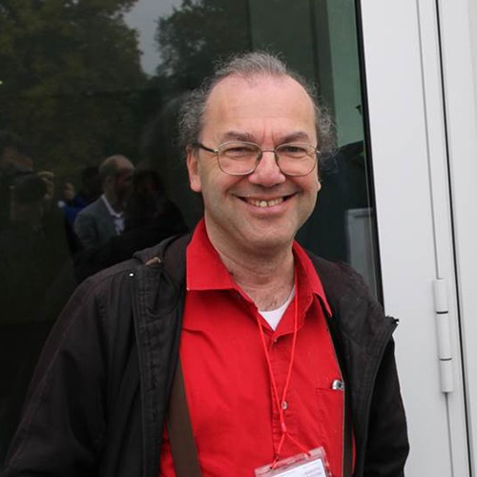
Conceiving, developing and exploiting
new technologies for astronomy
Gran Sasso National Laboratoy (LNGS)
TECH-FPA PhD Retreat 2025
Roberto Ragazzoni INAF
UniPD
L’Aquila
February 19th, 2025

Slide 2
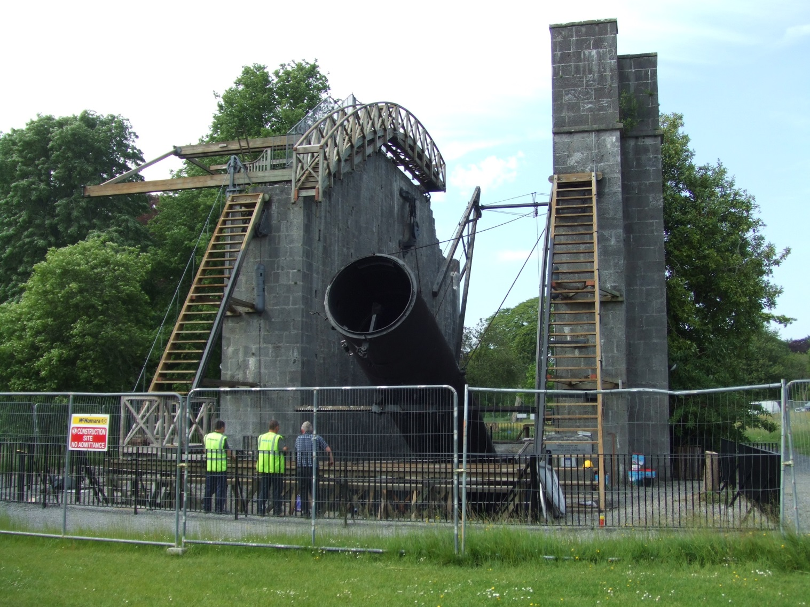
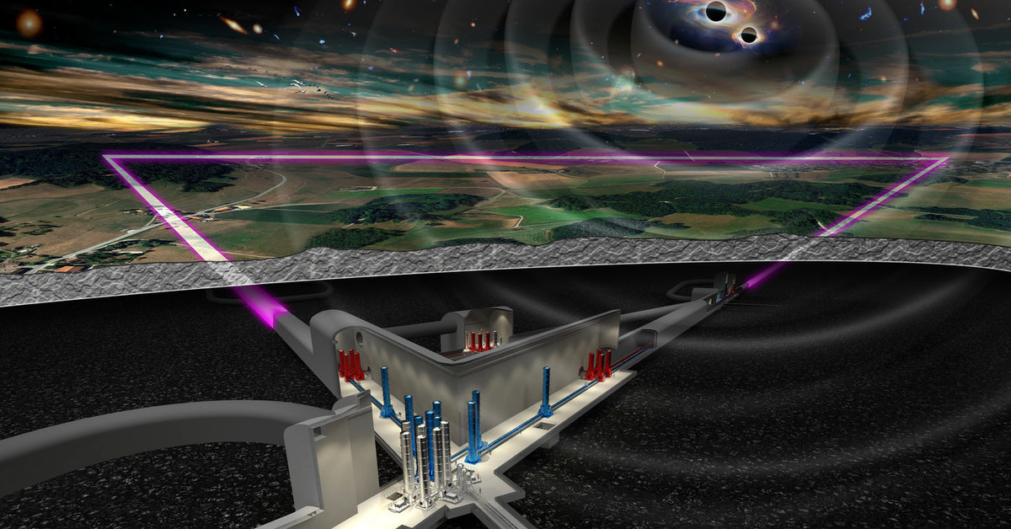
Scratching the unknown through technology
From the times of Galileo Galilei new technological development brought to breakthrough into astronomical research…
As in scientific research, technological development can be wildly unpredictable and follow unexpected paths…
It ranges from simple ideas (let’s make it longer, not… really, better larger…) to completely different such to appears incomprehensible on a century timescale…

Slide 3
Even simple ideas requires a lot of tech dev
Making a larger telescope…
Larger single dish mirrors that maintain their shape
Larger single thin dish that are actively kept in shape
Larger apertures through to assembly of various actively cophased tiles
Making flexible apertures in space kept in shape by centrifugal forces or laser pressure…!!
Let’s detect the photons arriving on the focal plane
Through chemical reactions
Through the photoelectric effect
Through electron jumps in silicon
Exciting superconducting loops
Let’s make a picture of the unseen face of the Moon just going there

Slide 4
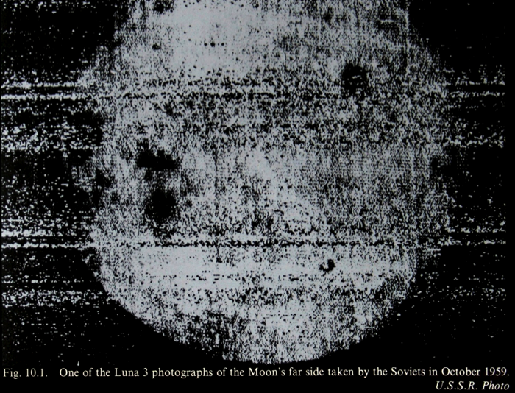

Slide 5
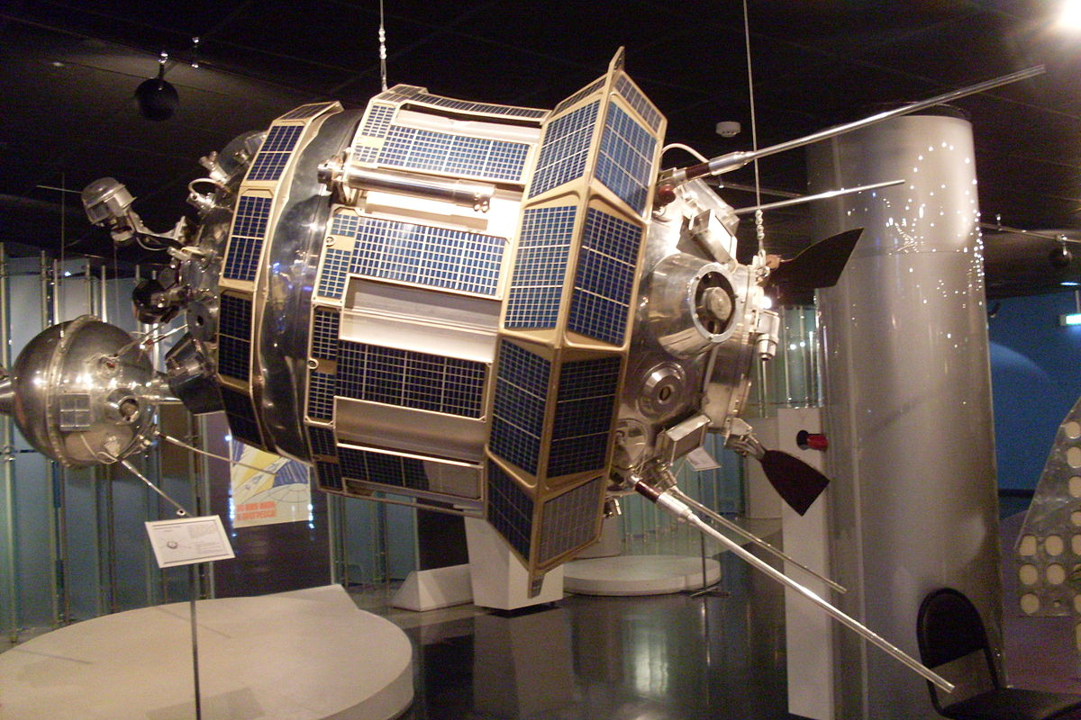

Slide 6
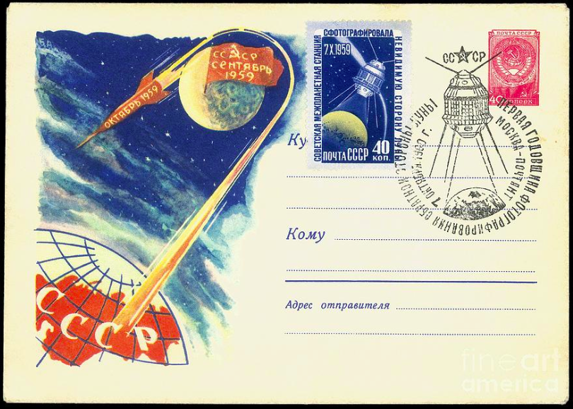

Slide 7
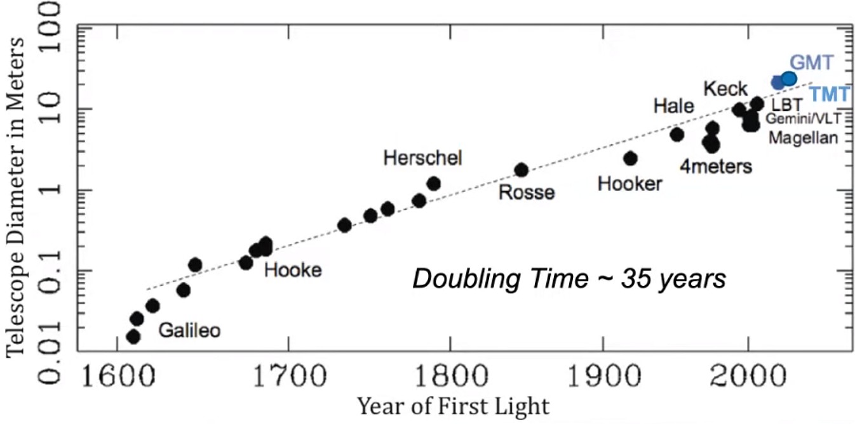
Size of telescopes vs. time…

Slide 8
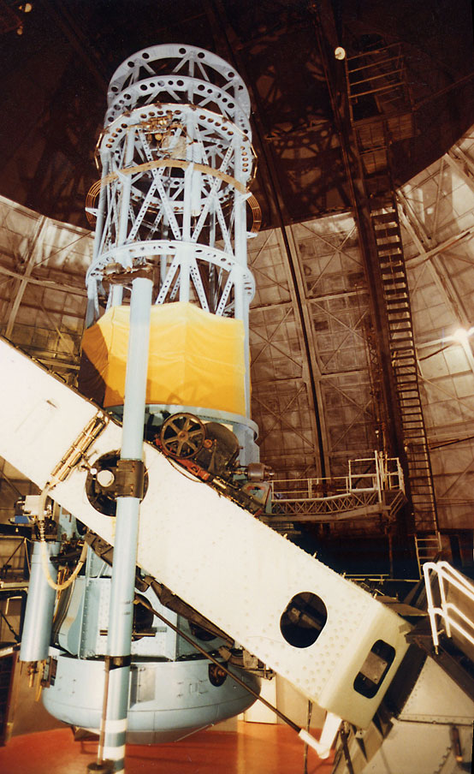
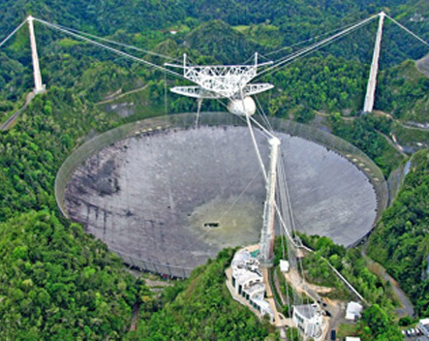
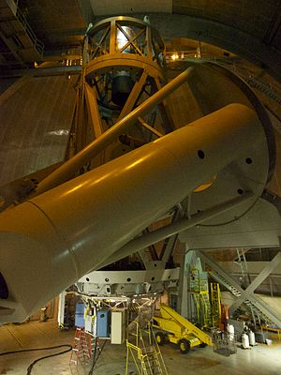
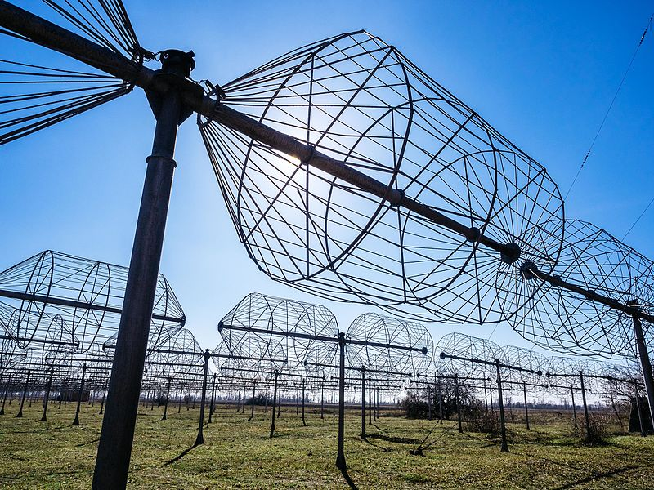
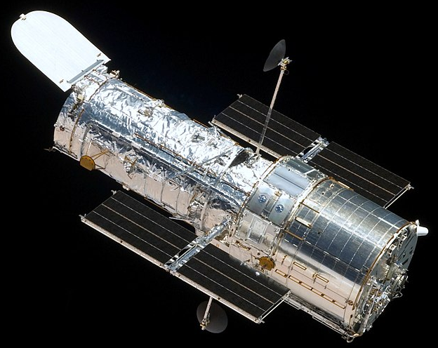
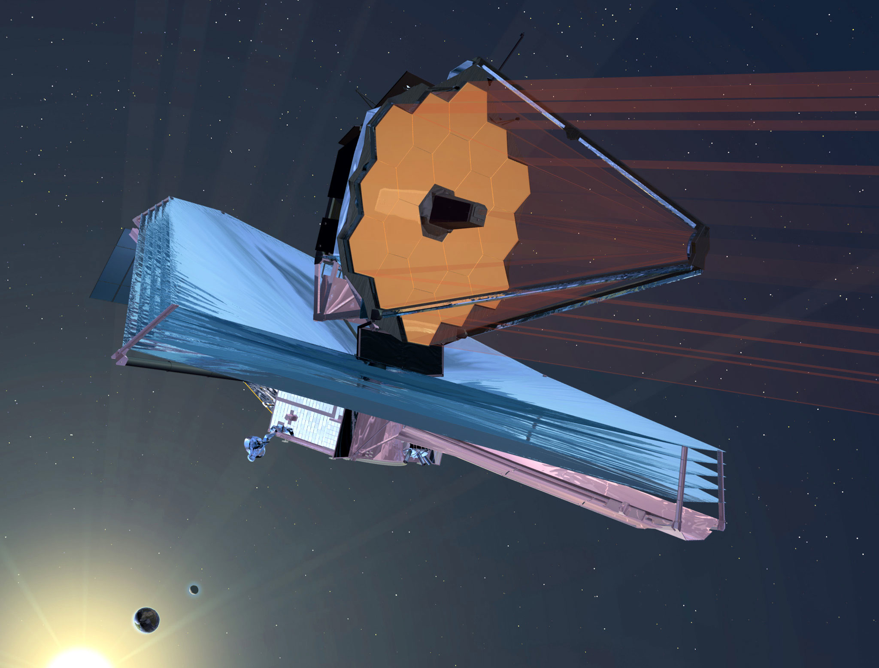
1999
VLT
4x8.2m
1963
Arecibo
2028(?)
First light of ELT (?)
1920
1930
1940
1950
1960
1970
1980
1990
2000
2010
2020
2030
1930
Radiotelescope
2004
LBT
1990
Hubble
Space
Telescope
1917
Mount Wilson
2.5m mirror
1949
Telescopio Hale 5.2m
on Mount Palomar
2021
JWST

Slide 9
So, today which is the largest telescope on Earth?
LBT: 2 monolithic mirros, each 8.4m (surface quivalent to a 11.9m diameter)
VLT: 4 monolithic mirrors, each 8.2m (surfa ce quivalent to a 16.4m diameter)
Keck: 2 segmented mirrors each ~10m (surface equivalent ~14m diameter)

Slide 10
Conceiving new technologies for astronomy
Starting from a new challenge
I want to look for chlorophyll in an exoplanet…
I want to look a SN while it explodes…
I want to measure the expansion of the Universe directly…
Expanding current technical (or fundamental) limits
Better astrometry…
Better angular resolution…
Better field of view coverage…
Exploiting novel technologies conceived elsewhere
Radio astronomy, CCDs, computing…
Synthetic aperture…
Quantum technologies…

Slide 11
The factor 2 (or 20% improvement) syndrome
Some new ideas looks like they improve the existing situation by a certain amount…
Such an improvement depends upon the assumptions and the science case…
Usually the assumptions reveals later to be a simplification of the reality or simply based on badly estimated figures…
The actual science case is usually a bit more complex than the way it has been described…
Complexity is usually not seriously considered (also because doing that is… uh… a complex issue…!!)
Quality of the components is assumed to be better than what can finally be afforded…
The final outcome is that often the 20% or factor 2 vanish or gives just a marginal gain…!!!

Slide 12
Understanding the science case can makes the difference
There has been eras in which what was to be measured or discovered was unknown…
The perturbation on the CMBR
Hot jovians (or even just exoplanets)
Dark something (if any)
In some cases the threshold to open a new era of measurements is very well known
Astrometric detection of exoplanets
Spectral signature in exoatmosphere during transits
The angular size of Schwarzschild radii of BH candidates
In the first case improvements can lead to nothing or Stocholm’s trips
In the second case improving with a certain margin at least will produce finding papers…

Slide 13
Ideas promising to expand by orders of magnitude are the best (but must be scrutinized carefully)
Yes, I know, I am a genius, but why the hell no one had such idea before…??
Maybe someone had such an idea… is my search in the literature complete…??
Does this idea depends upon the availability or the cost of components today…??
Is this idea taking advantage from some other new findings…??
Is this violating some fundamental rules…?? And if so how much solid is this rule, and there is an explanation on how is “violated”..??
If all above fails, yes, I am a genius…!!!

Slide 14
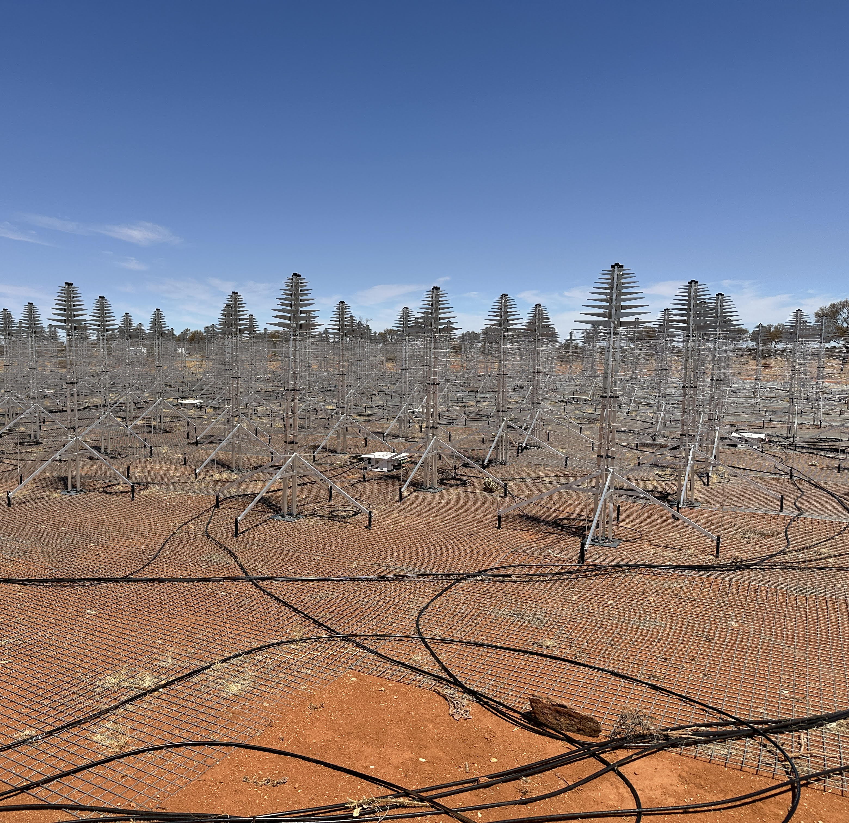
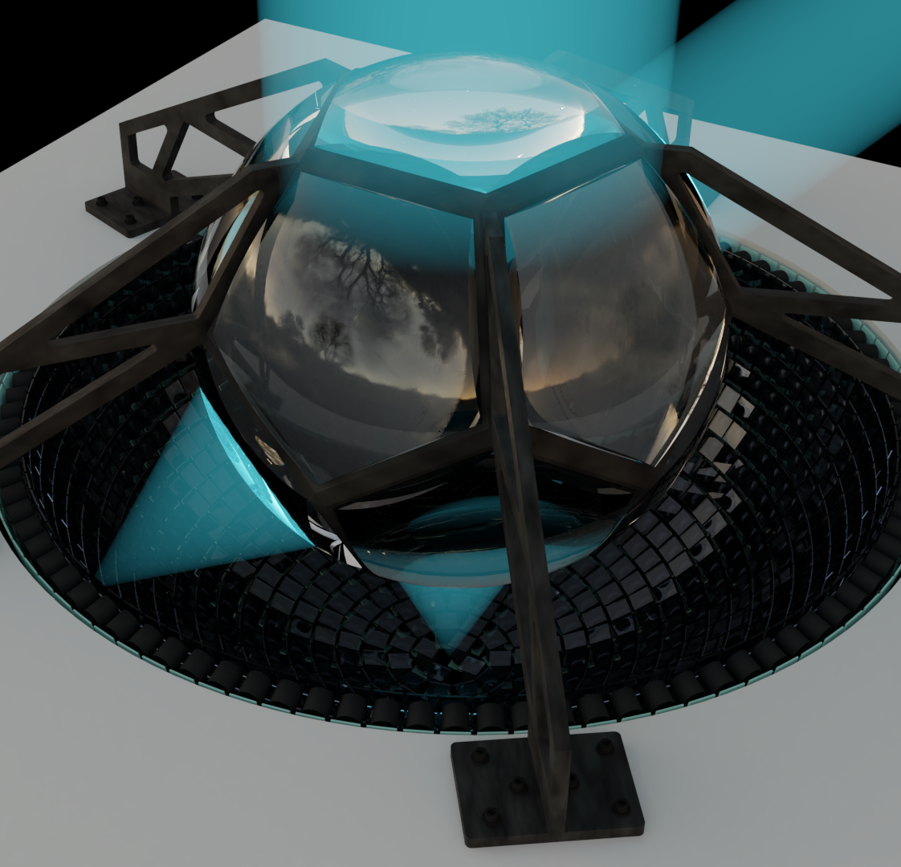
Telescopes that do not look as telescopes…

Slide 15
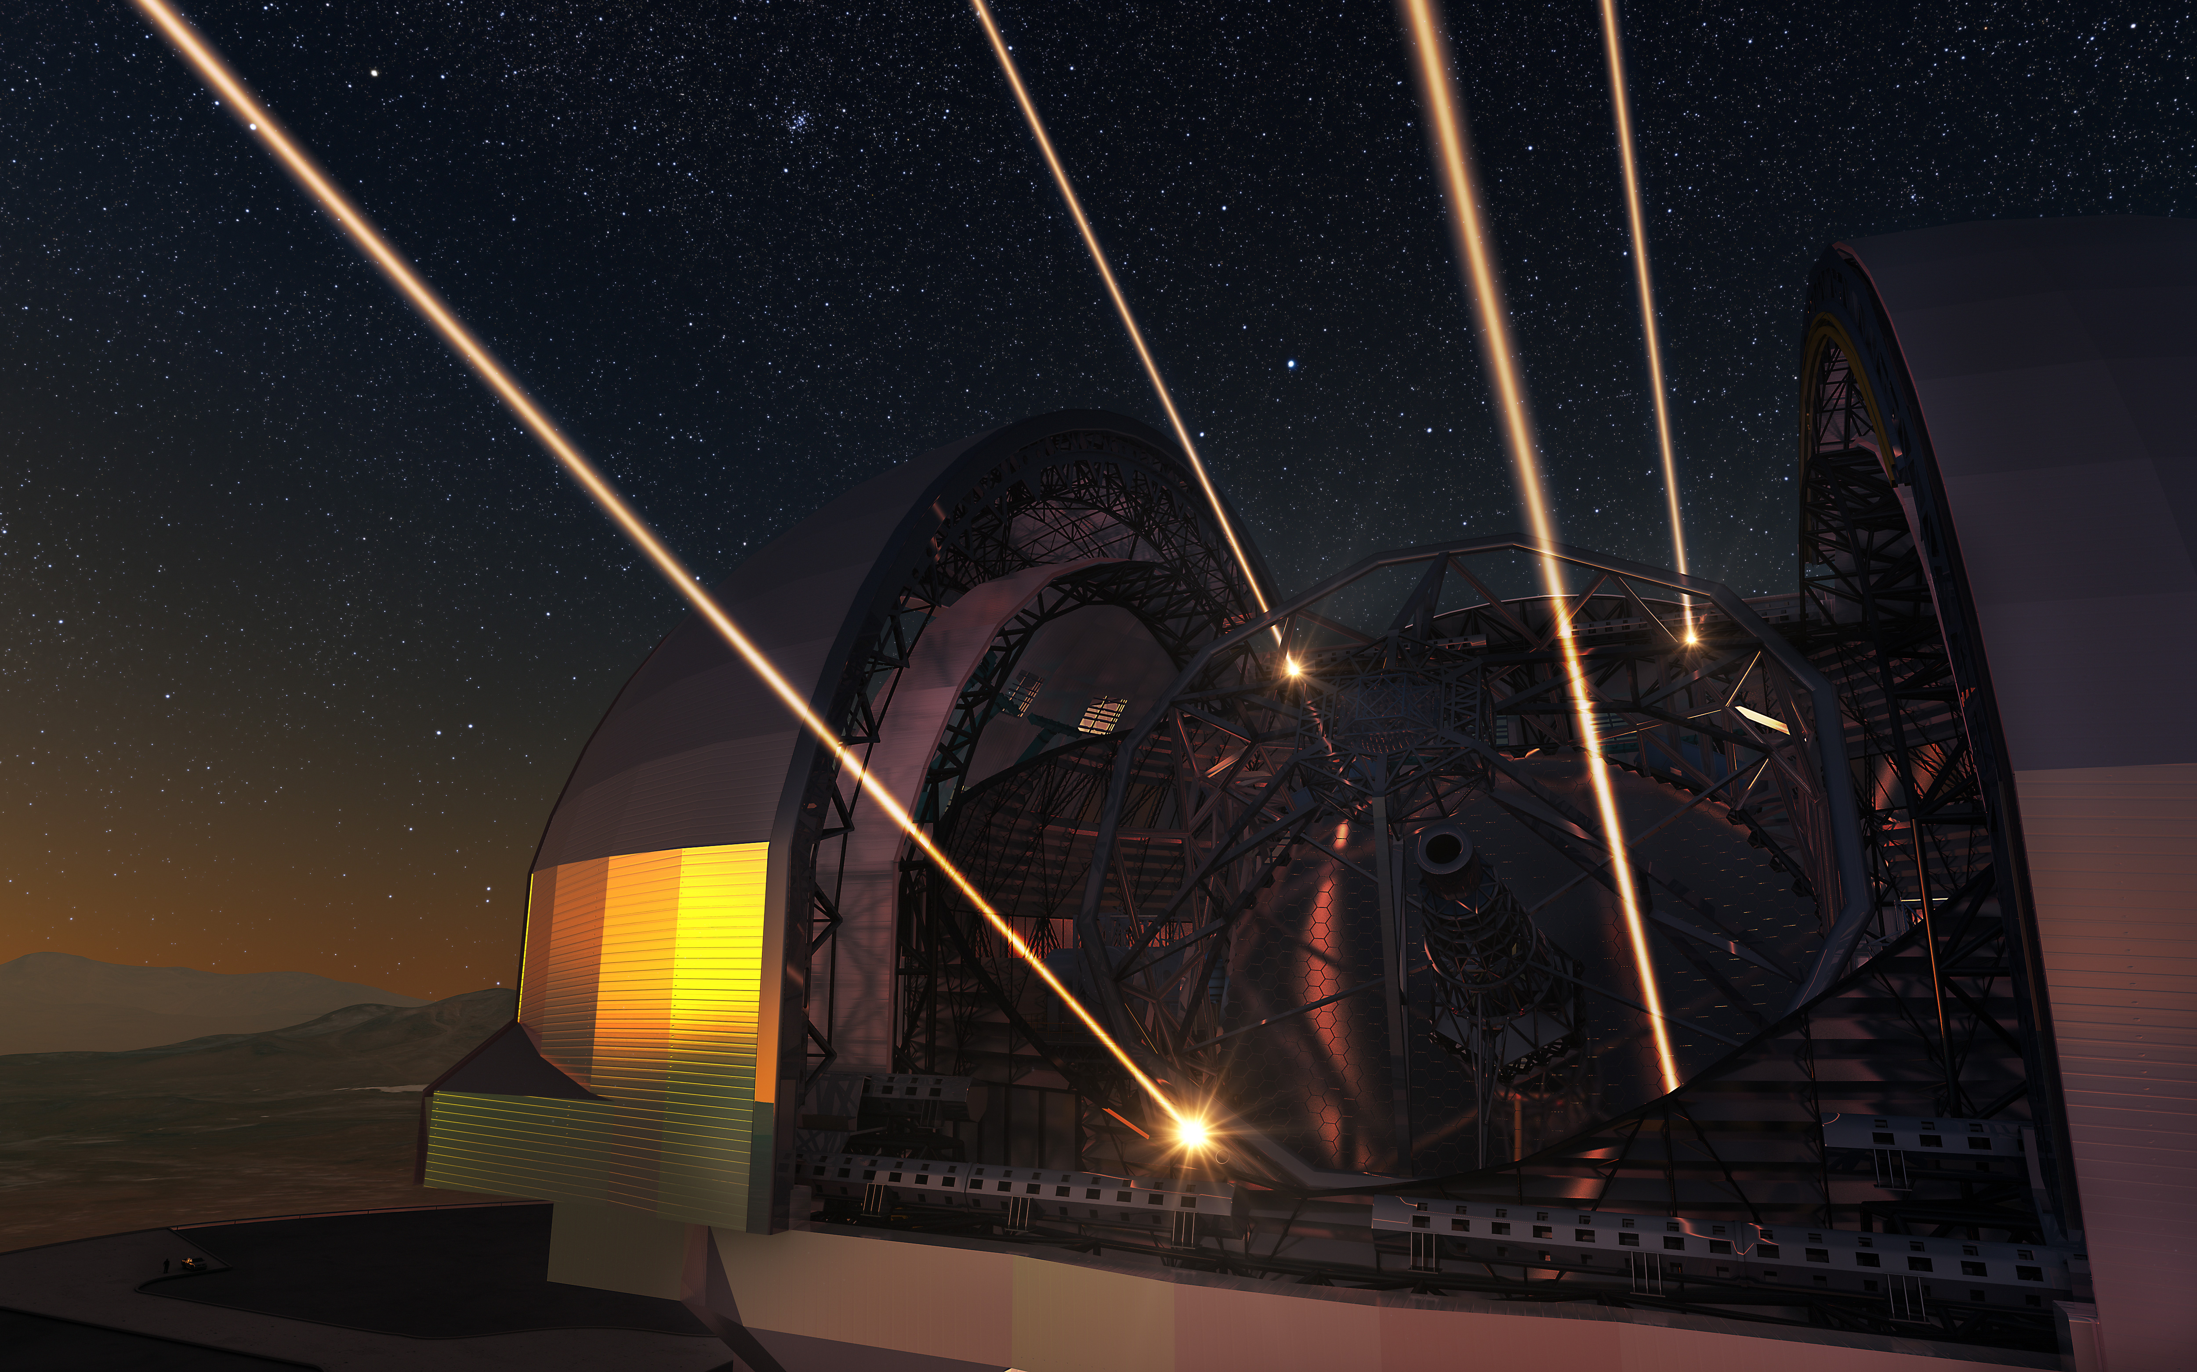
Telescopes that fire multiple lasers in the sky

Slide 16
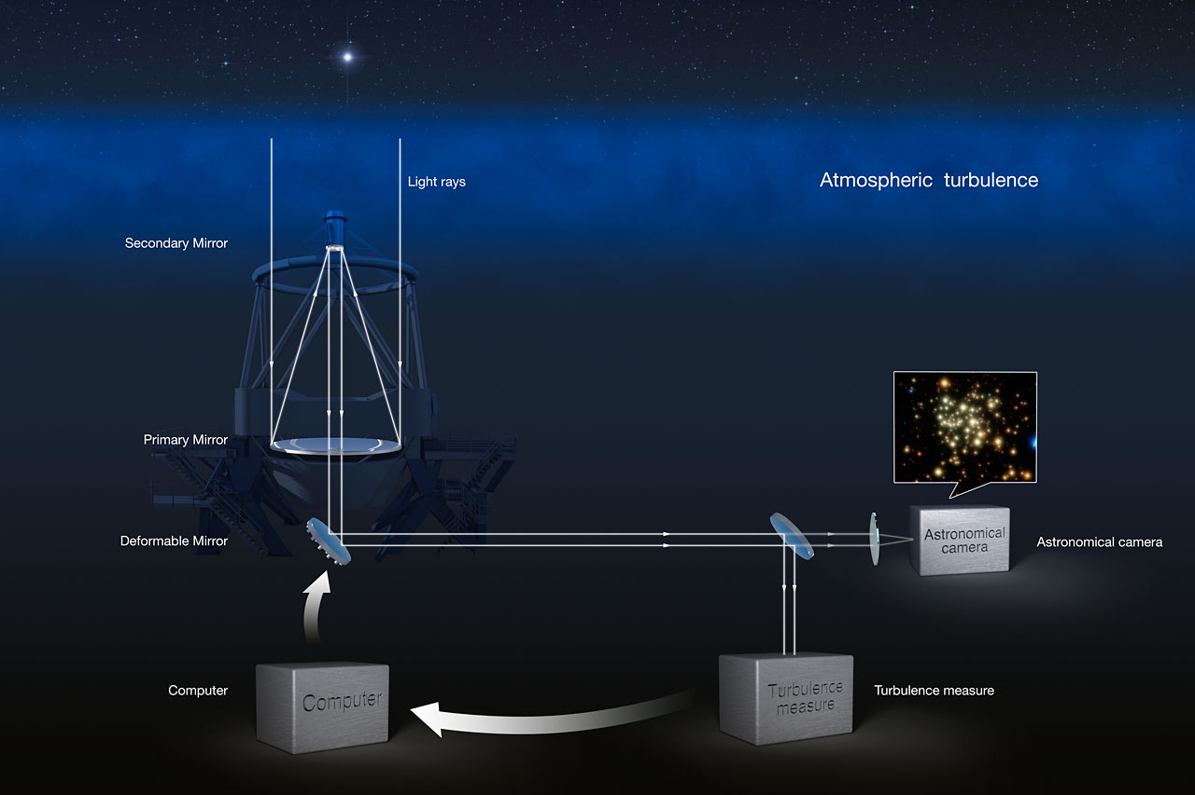

Slide 17
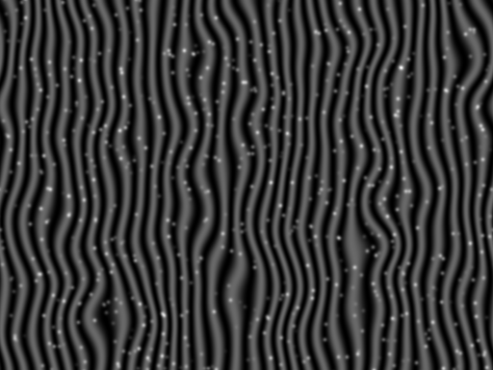
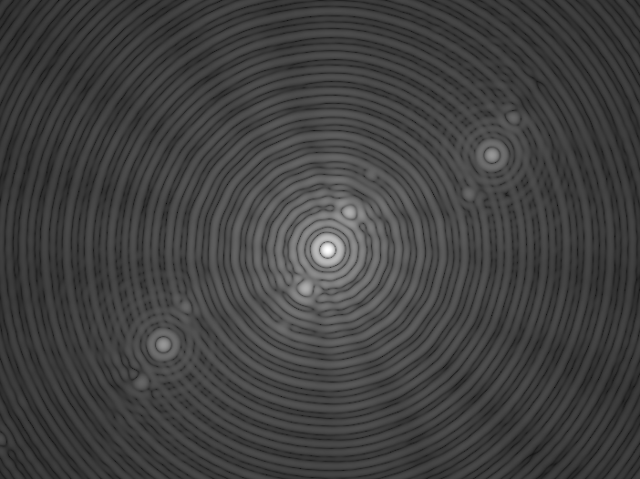
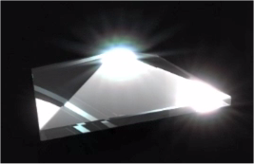
(Un)Conventional WaveFront Sensing in Astronomy
Roberto Ragazzoni
INAF – Astronomical Observatory of Padova (Italy)
Proudly former Humboldtian at MPIA Heidelberg

Slide 18
Knowing history in order to write new chapter
So, you should know how existing WFS works....
Shack-Hartmann
Pyramid (a former unconventional WFS)
Shearing (in the very early days of AO)
Smartt (or point diffraction)
Curvature (a la Roddier)
And how currentyly (un)conventional WFS works
Bin Hole WFS
Yet Another WFS (a first derivative WFS based on polarimetry)
3-side pyramid
Conical WFS
Z-invariant
Ingot
Dark WFS
Multiple Spatial WFS
(Un)Conventional WaveFront Sensing – Ragazzoni 2019

Slide 19
Taking advantage of new tech/regimes...
Detector whose RON is zero (or very close to...) – like with L3CCD
Regime of Strehl close to 1 – In today state of the art XAO
Monocromaticity of the reference – With LGSs
With ELTs halos of low Strehl PSF’s are really very faint
Computing power follow Moore’s law (so, why one need anymore a linear WFS?)
New scientific problems, like exoplanets detection or characterization (leading to a grown interest in bright end single reference XAO)
(Un)Conventional WaveFront Sensing – Ragazzoni 2019

Slide 20
Taxonomy
 | Wheel | Propeller
Water
Ground
Air
(Un)Conventional WaveFront Sensing – Ragazzoni 2019

Slide 21
Taxonomy
 | Wheel | Propeller
Water
Ground |  | ???
Air | ???
(Un)Conventional WaveFront Sensing – Ragazzoni 2019

Slide 22
Taxonomy
 | Wheel | Propeller
Water
Ground
Air
(Un)Conventional WaveFront Sensing – Ragazzoni 2019

Slide 23
Taxonomy
 | The Wavefront itself | The first derivative | The laplacian
With the detector in the focal plane | Phase Diversity/Fienup… | Shack-Hartmann | Scintillation from an extended source..???
With the detector in the pupil plane | Smartt | Pyramid G.O.D. Y.A.W. | Curvature (Roddier)
With the detector “in between” | Well… actually the AO for LBC works in this way (Wilson…) | ??? | Fractional Fourier Trasnform,…???
(Un)Conventional WaveFront Sensing – Ragazzoni 2019

Slide 24
However, remember that...
A WaveFront Sensor invented for a certain application could become better/worse under other conditions;
You will probably would like to validate through:
Simulations
Laboratory Experiments
On sky operations (and a lot of people will consider this only at this stage)
You will still need to promote it in order to get it widespread
A WaveFront Sensor invented with a certain range of intended applications or using a certain classes of devices could become much more appealing under new kind of these...
And this mean that old (and maybe forgotten) WaveFront Sensors could become interesting today or tomorrow...
(Un)Conventional WaveFront Sensing – Ragazzoni 2019

Slide 25
However, remember that...
Whatever device
A WaveFront Sensor invented for a certain application could become better/worse under other conditions;
You will probably would like to validate through:
Simulations
Laboratory Experiments
On sky operations (and a lot of people will consider this only at this stage)
You will still need to promote it in order to get it widespread
A WaveFront Sensor invented with a certain range of intended applications or using a certain classes of devices could become much more appealing under new kind of these...
And this mean that old (and maybe forgotten) WaveFront Sensors could become interesting today or tomorrow...
(Un)Conventional WaveFront Sensing – Ragazzoni 2019
Whatever device
Whatever device

Slide 26
And have a lot of fun together with all your collegues

Slide 28
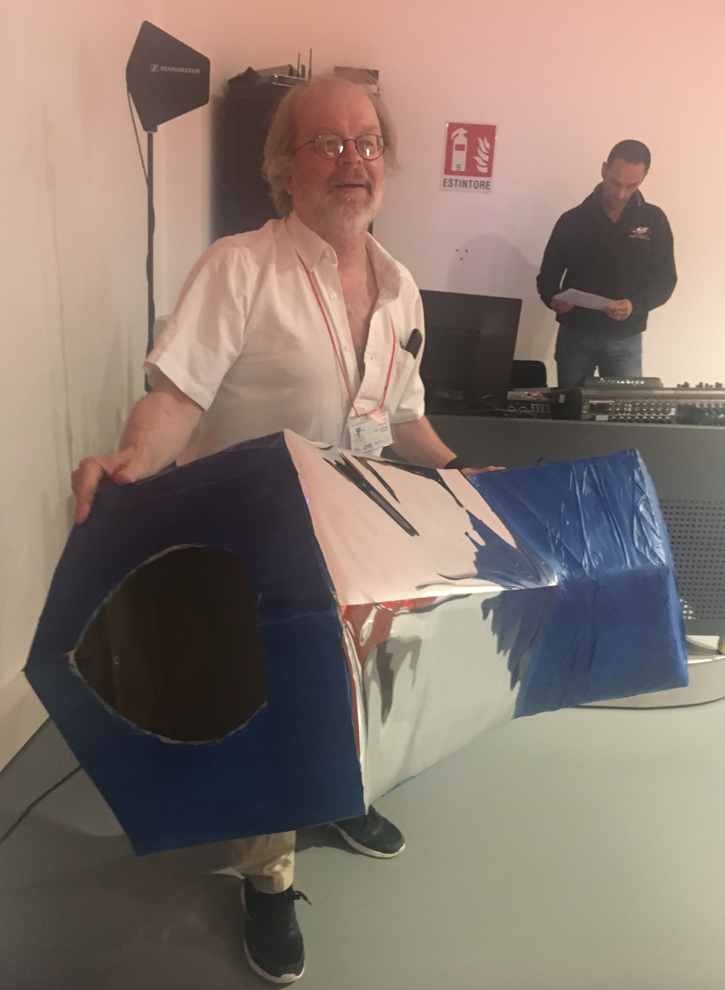
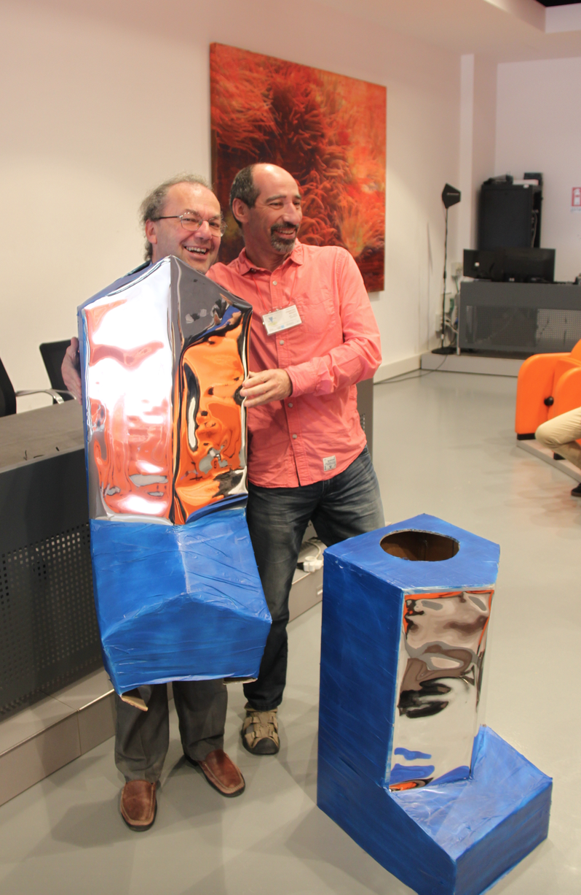

Slide 29
Thanks for your attention And my best wishes for your next new invention…

