Slide 1
Pattern Recognition Development on FPGA through Artificial Intelligence in Harsh Environment
By: Ammad Ul Islam
ammadul.islam@studenti.unipd.it
Supervised By: Prof. Andrea Fabbri Co-Supervised By: Prof. Fabrizio Petrucci

Slide 2
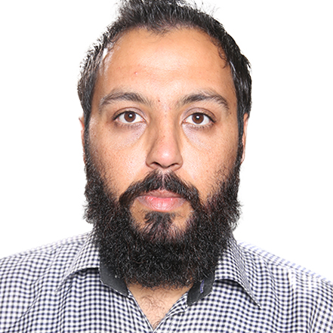
PERSONAL PROFILE
Achievements
BS Telecommunication
Gold Medal
Signal and Image Processing
Study Tour of Scotland for Capacity Building of Young Scientists Sponsored By
HEC & British Council
2015
2018
MS Electrical Engineering
Institute of Space Technology, ISB
Signal and Image Processing
HSI Processing, AI, Document Forensics
2019
Name
Other Achievements
Ammad Ul Islam
Winner of Startup Competition By Sheperd Pie Pakistan for Fenam “A life Saving Product”
Work Experience
PhD 39th Cycle
TECH-FPA(Electronics)
University of Padua
INFN Roma Tre
Pakistan-Korea Information and Communication Technology(ICT), Center of Excellence, CTTI, Engineer
ArcanaInfo: Production of Security System for Gensets of Etisalat UAE Technical Support Engineer
APF(JF-17), PAC Kamra: Test Engineer, Generic Testing Line(GTL) in Production and Testing Group
iVision Artificial Intelligence and Computer Vision Lab, IST: Research Associate

Slide 3
Research Topic
Research Topic
Pattern Recognition Development on FPGA through AI in Harsh Environment
Project Aim
The project aims to implement pattern recognition algorithms based on artificial intelligence on latest generation FPGA devices. The proposed algorithms will be deployed, A dedicated analysis about Total Ionizing Dose(TID) and Single Event Upset(SEU) will be explored to find which kind of damage can happens and developing methodologies to mitigate such damages.
About the Site
Taishan Antineutrino Observatory (TAO): A satellite experiment of Jiangmen Underground Neutrino Observatory (JUNO)
A ton-level, state-of-the-art liquid scintillator detector with high energy resolution.
Measure reactor neutrino spectrum w/ sub-percent E resolution.
Current Task
Acquisition system of JUNO/TAO Experiment Full chain prototype is present in INFN-Roma3 lab
Development of trigger algorithms and noise rejection techniques.
Visit to TAO Site for Commissioning and Real Time Data Acquisition

Slide 4
Research Objectives/Goals
Preprocessing
AI Implementation
Preprocessing of Data collected from JUNO/TAO Experimental Setup
Introducing AI for the detection of Photon event.
01
04
Detection of Event
FPGA Implementation
Denoising of the Data and proposing optimum method for the detection of event peaks in the collected signal.
Research Objectives
Implementation of the Proposed Method on FPGA.
02
05
Expanding to Matrix
Integrating
03
06
Integrating the whole proposed method and finalizing the project.
Proposed trigger algorithms will be Expanded to the whole matrix of 8100 Channels of TAO Detector and testing on the TAO model.

Slide 5
Workflow Overview
Data Preprocessing:
Apply filters (low-pass, wavelet) to clean the signal and remove high-frequency noise.
Use baseline correction to ensure a flat signal base before processing.
SNR and Energy Enhancement:
Implement adaptive filtering and matched filtering to improve SNR.
Use charge integration and PSD techniques to improve energy resolution.
Trigger Development:
Start with threshold-based triggers and refine them by adding dynamic adjustments or multiple trigger stages.
Introduce AI-based models to enhance both SNR and trigger accuracy by training the model with simulated and experimental data to detect true photon events.

Slide 6
Workflow Overview For AI Implementation
AI Implementation
Data Acquisition: Capture photon detection data from the TAO detector.
AI Model: Train a machine learning model (e.g., CNN) to detect photon peaks.
Model Optimization: Optimize the AI model for real-time execution on an FPGA.
FPGA Deployment:
Implement the optimized AI model on FPGA hardware for real-time photon peak detection. Using AI for photon peak detection in the TAO detector, especially with FPGA implementation, could significantly enhance real-time processing efficiency.

Slide 7
Courses and Activities Planning of PhD Year Wise
1st Year
2nd Year
3rd Year
Machine Learning For Physics
High Energy Particle Physics Detectors in Space
Advance Scientific Programming in Matlab
Programmable System on Chip(SoC) for data acquisition and Processing
Research Work and Finalization of Thesis
PhD Educational Week
PhD Kick Off Meeting
Abroad Period
Conferences and Workshops
Talks/Presentations
Conferences and Workshops
Talks/Presentations
Final Presentation

Slide 8
3 Years Planning Gantt Chart
2024
2025
2026
Activity
Progress
1
2
3
4
1
2
3
4
1
2
3
4
Main Tasks
Courses
60%
Pre-Processing
50%
Photon Event Detection
40%
Expanding to Matrix
0%
Thesis Writeup
0%
AI and FPGA Implementation
AI Implementation
10%
FPGA Implementation
0%
Integration
0%
Final Thesis & Presentation
0%
Course Work
Research Objective-1
Research Objective-2
Research Objective-3
Thesis
Research Objective-4
Research Objective-5
Research Objective-6

Slide 9
THANK YOU

