Slide 1
New Optical and RF Over Fiber Technologies for New Generation Radio Telescopes
PhD TFPA - Technologies for Fundamental Physics and Astronomy
Scholarship No#23
Student: Maida Anwar Supervisor: Federico Perini INAF Co-supervisor: Jacopo Nanni UNIBO

Slide 2
Background
Education
Bachelor of Science in Physics, University of Gujrat, Pakistan (2015-2019)
Thesis Title: “First Principles Study of Electronic and Optical Properties of Mg- Doped SrtiO₃ ”
Master of Philosophy in Physics, University of Gujrat, Pakistan (2019-2021)
Thesis Title: “A DFT Study of Lithium Metal Adsorption on S-borophene for the Application of Anode Material”
PhD TFPA - Technologies for Fundamental Physics and Astronomy
Hosting Institution: INAF/IRA

Slide 3
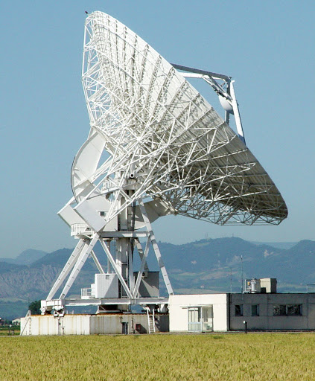
Research Topic and Objectives
Design and Realization of wide band (1-18GHz) radio over fiber systems for the IF downlinks of INAF VLBI antennas (Medicina and Noto)
Starting point:
Full and deep measurement characterization of the RF signal received by VLBI antenna in Medicina with the new Three Band Receiver.
The current optical link purchased for SRT (Sardinia Radio Telescope)
Direction of research: Improvement of the dynamic range from architectural and component perspective
RoF link
ORX
OTX
RoF block diagram

Slide 4
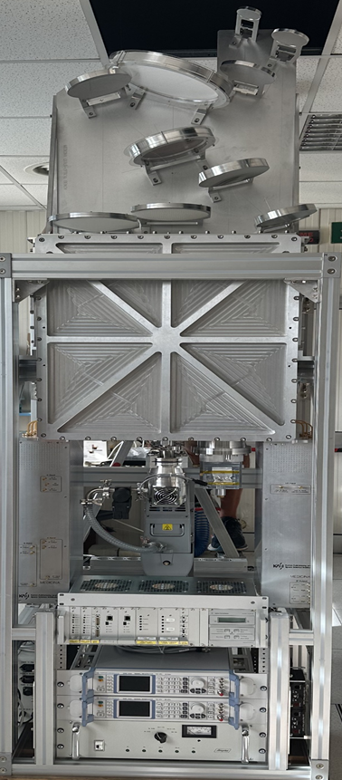
Three Band Receiver
Three band frequencies 18-26 GHz, 34-50 GHz and 80-116 GHz and The IF are 8 (2xK receiver, 2xQ receiver and 4xW receiver) with 2-18GHz band.

Slide 5
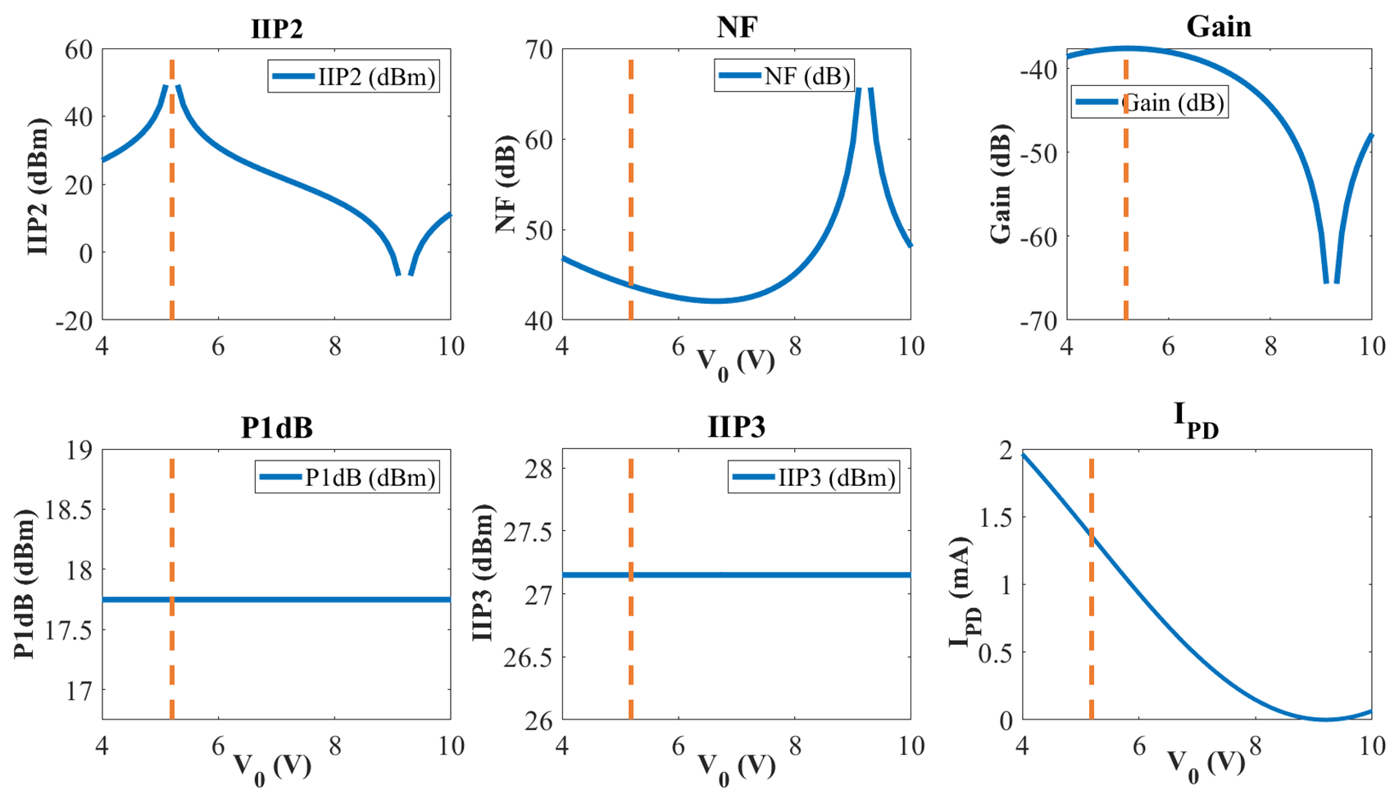
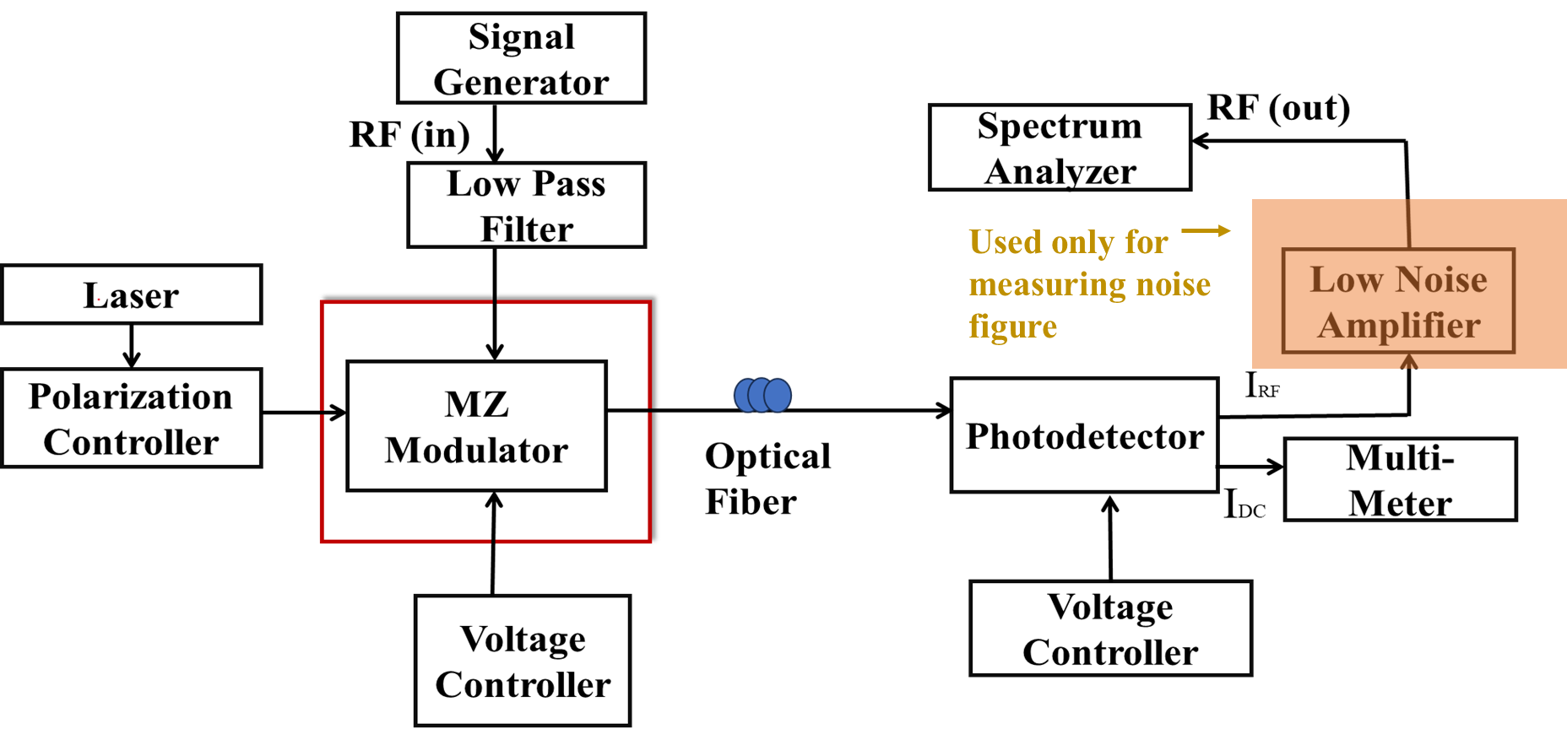
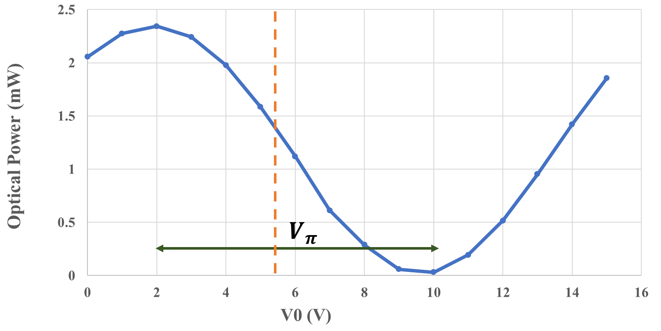
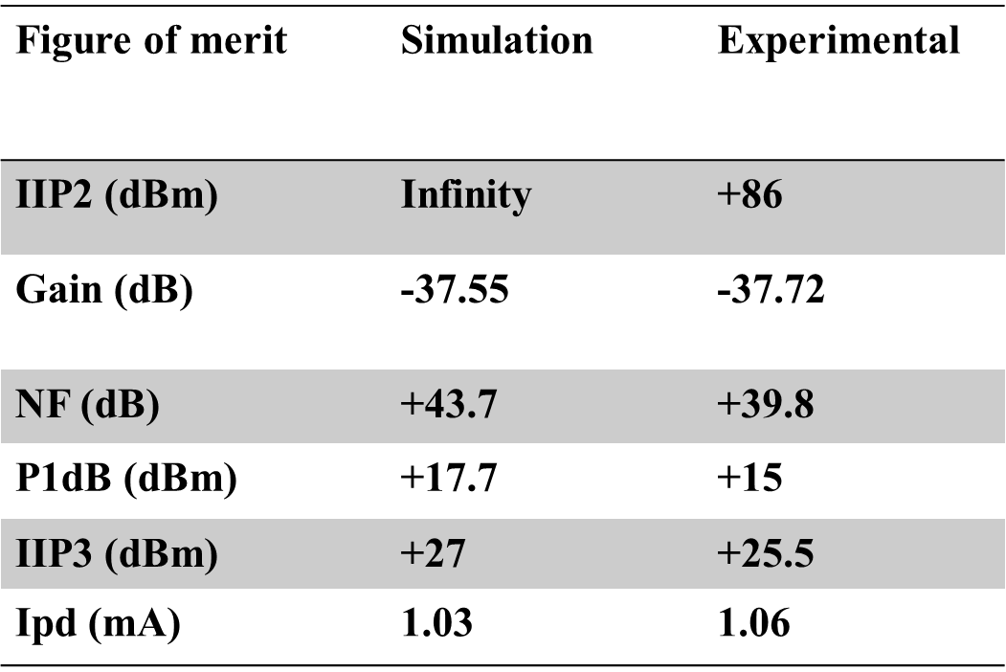
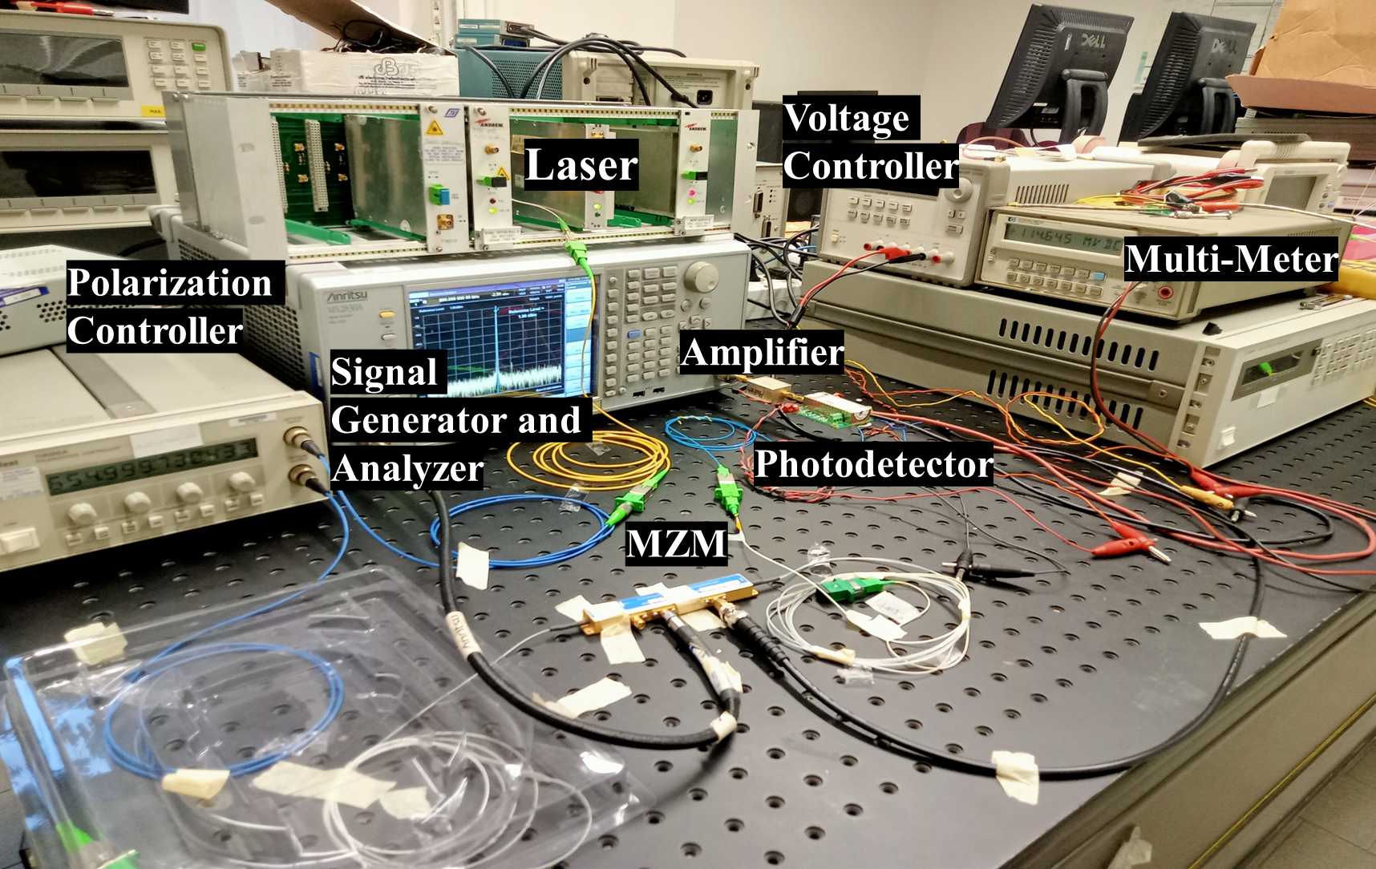
Characterization of Analogue RoF Link based on MZM and Comparison with Numerical Simulation
Simulation results for different Specifications
Voltage behavior of MZM
Block diagram of analogue RoF link
The model seems to be fit with experimental values of
Experimental setup

