Slide 1
Design and Characterization of a Data Acquisition System for High-Energy Physics with Ethernet-based Communication
PhD Student: Fatima Bzeih
Supervisor: Prof. Paolo Musico
University of Genoa and Padua / INFN Genoa
18 February, 2025

Slide 2
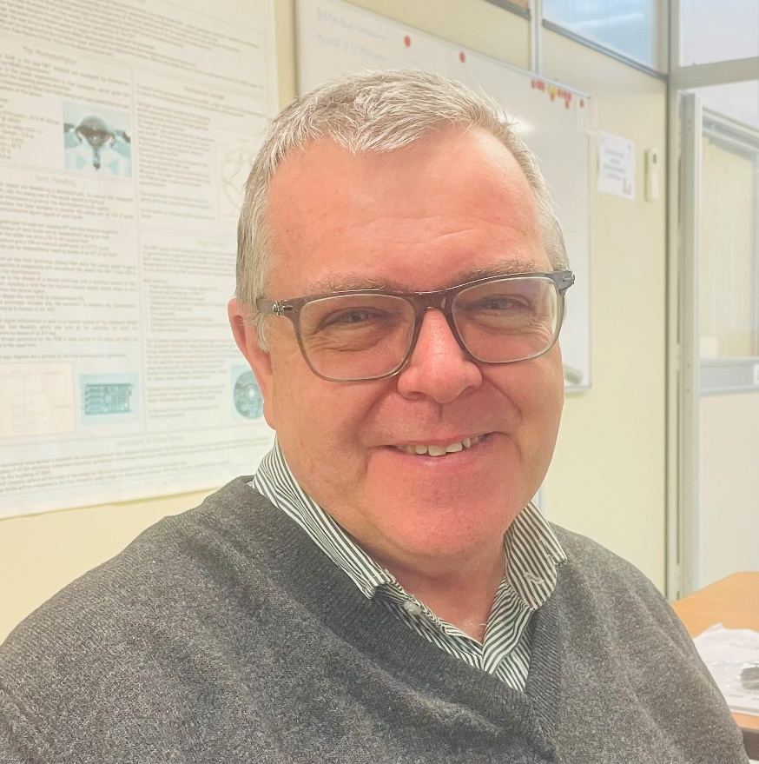
PhD Student
Supervisor
Fatima Bzeih
Master of Science in Electronics Engineering.
Lebanese International University. Graduated: September 2023.
Master’s Thesis: Low Power Design for Adder and Coordinate Rotation Digital Computer.
Partner Institution: University of Genoa, Physics Department and INFN sezione di Genova.
Prof. Paolo Musico

Slide 3
Introduction
Research focuses on developing a new data acquisition (DAQ) system for collecting and managing data in high-energy physics experiments.
The system upgrades the back-end readout electronics for Gas Electron Multiplier (GEM) detectors used in high-luminosity nuclear and particle physics experiments to track charged particles .
The traditional readout system (VME), which has served well in the past, is now facing severe limitations in handling the increasing data rates required by modern experiments.
VME buses, with their maximum data rate of 320 MB/s, struggle to meet the high bandwidth demands of current and future high-luminosity experiments.

Slide 4
Project Objectives
System Design
Replace Legacy VME System
Improve Data Throughput
Develop a scalable, high-performance DAQ board that integrates an FPGA (Kintex-7) with an ADC deserializer, optimized for handling data rates up to 10Gbps using modern protocols while preserving the existing front-end hardware setup, including the widely-used APV25 chip.
Modernize the existing GEM detector readout system by replacing the outdated VME architecture, which has limited data bandwidth, with a more scalable and cost-effective approach.
Achieve significantly greater throughput by using FPGA-based digitization and modern protocols to handle high-speed data acquisition and minimize latency.

Slide 5
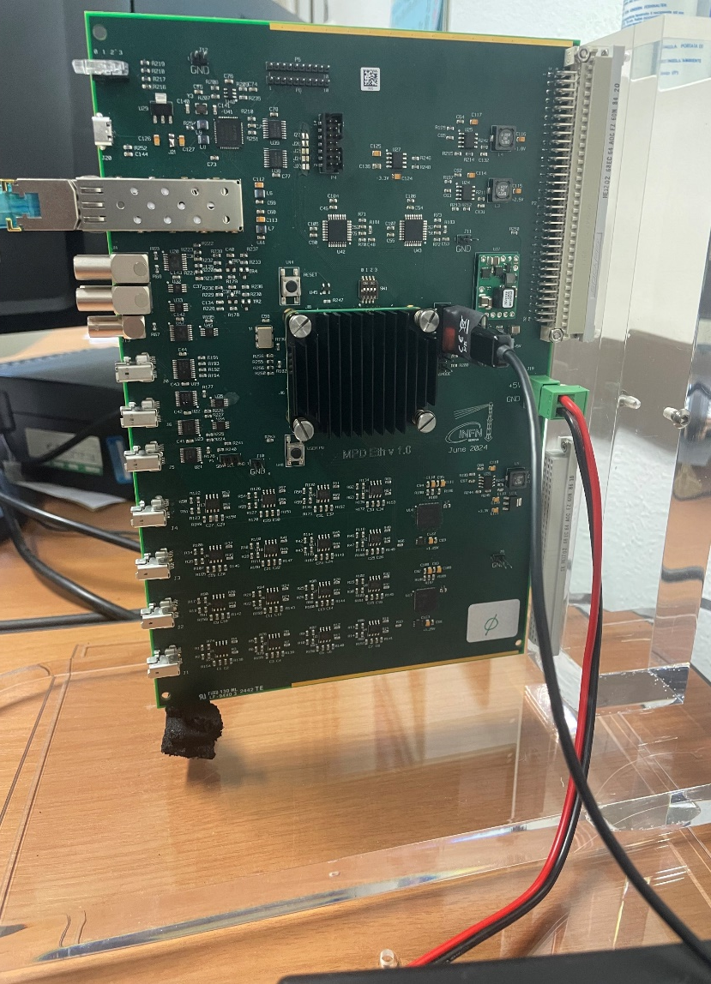
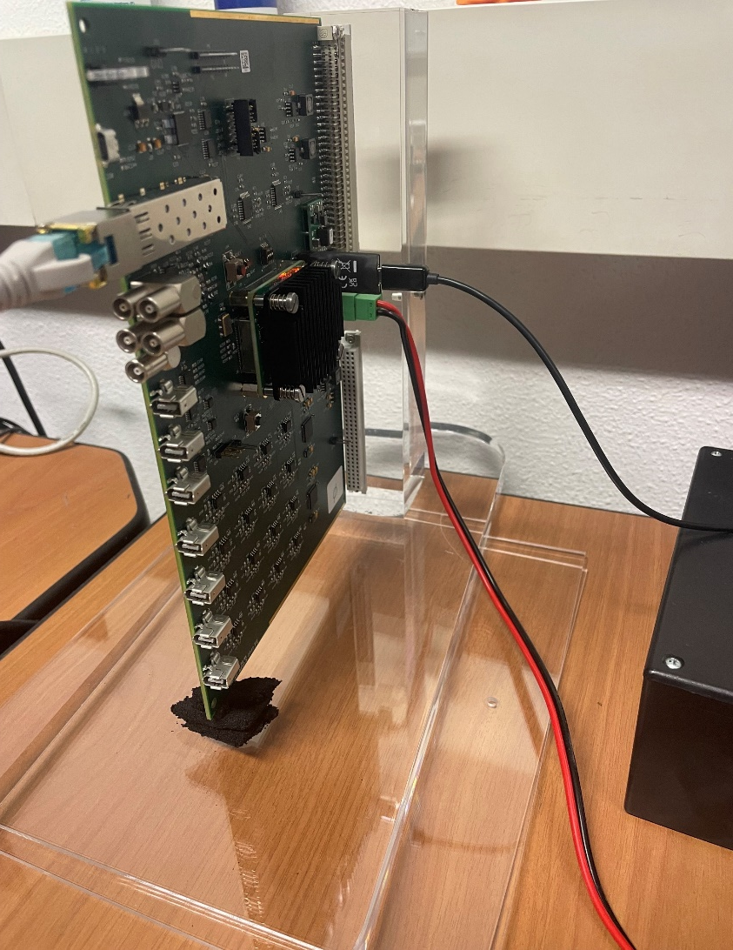
System Overview
Overview of the Solution
A next-generation DAQ system based on FPGA technology and Ethernet communication is proposed to replace the VME-based interface without requiring changes to the APV25 front-end hardware.
This system enables real-time digitization, data packaging, and transfer, offering data rates up to 10Gbps.
The core of the system is an FPGA (Field-Programmable Gate Array), a type of hardware that can process data in real time, allowing for fast data collection and transfer.
How It Works
Detectors data are handled by the existing frontend, digitized on board and sent to the FPGA.
The FPGA collects digitized data, performs online processing, packs data and sends them over an Ethernet connection for storage and analysis. The data are transferred using the TCP/IP protocol, a widely used method for sending data across networks.
This hardware-based TCP implementation ensures deterministic data flow, critical for high-speed, real-time applications in particle physics.
Key Benefits
Higher Throughput: Supports data rates up to 10Gbps, far exceeding the limitations of VME.
Cost Efficiency: Ethernet-based solutions are more affordable and scalable, reducing reliance on bulky legacy hardware.
Simplified Maintenance: Using standard commercial off-the-shelf (COTS) components, the system is easier to integrate and maintain.

Slide 6
Expected Outcomes
Results Obtained So Far
Two boards have been delivered by 10 December 2024.
Ethernet-based Communication: Successfully implemented FPGA-based TCP/IP protocol for 1G Ethernet communication.
A small utility to read/write single word and block of words via TCP has been implemented
Next Steps
Hardware appears functional, but extensive testing is still required.
FPGA code is being developed in parallel with simulation testing.
Software is undergoing testing, closely integrated with FPGA code.
Potential for optimization to enhance trigger rate performance.
10G IP blocks have been procured and are pending testing.

Slide 7
Overall Planning
First Year
1-Literature review
2-Study necessary knowledge like C Language
3-Start with FPGA Programming
4-Implement ADC Deserializer
5-Implement 1G Ethernet Interface
Second Year
1-Utilize Ethernet instead of VME.
2-Set up simulation test bench for it.
3-Start testing when the MPD board will done, then go to Jlab to test it.
5-Attend a summer school
6-Publish the work done in journals and conferences
Third Year
1-Continue testing to get better performance connected to a real installation.
2-Publish the results
3-Thesis Writing
4- Stay abroad
1-Literature review
2-Start with FPGA Programming
3-Implement ADC Deserializer
4-Implement 1G Ethernet Interface
1-Utilize Ethernet instead of VME.
2-Set up simulation test bench for it.
3-Start testing when the MPD board will be ready, then go to JLab to test it.
4-Publish the work done.
1-Continue testing to get better performance connected to a real installation.
2-Publish the results
3-Thesis Writing

Slide 8
Conclusion
In conclusion, the FPGA-based Ethernet DAQ system offers a transformative solution that addresses the critical needs of modern nuclear and particle physics experiments, enhancing data throughput, reducing system costs, and simplifying maintenance.

Slide 9
Thank you

