Slide 1
In-Silico quantum generation of random bit streams
TITLE
the value of unpredictability
Massimo Caccia
Università dell’Insubria & Random Power s.r.l.
massimo.caccia@randompower.eu
I
François Morellet
Random Distribution of 40,000 Squares using the Odd and Even Numbers of a Telephone Directory 1960
Winter retreat of the Graduate School
LNGS, February 17th, 2025

Slide 2
what we do:
1
1
0
1
0
0
Random Power is developing a platform of Silicon based, patent protected, “QUANTUM coin flippers”, generating virtually endless streams of random bits

Slide 3
what for:
Unpredictability to preserve the predictability of our clockwork world
There is definitely a hype about Random bit streams, not only for cryptograhy & authentication but also for gaming, virtual reality, Monte Carlo simulations , Privacy Preservation Procedures and Identity management
The Clockwork Universe
Isaac Newto, Royal Society, and the Birth of the Modern WorldI
by Edward Dolnick - 2011 Harper Collins
to learn more, watch this BBC report:

Slide 4
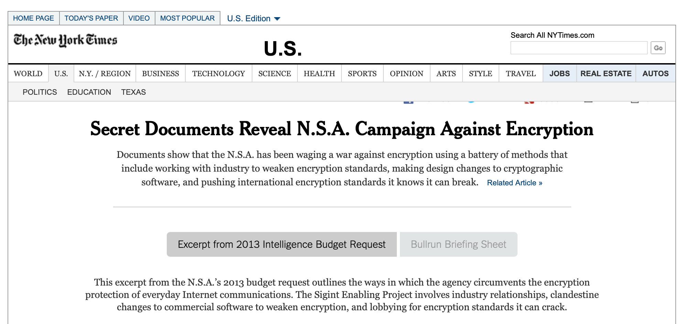
the problem:
Generating REAL, certified and robust randomness is far from being trivial, both using algorithmic solutions and exploiting unpredictable natural phenomena based on classical physics
a 2021 finding on weakness in Randomness generation for IoT:
1951, John Von Neumann [J. Res. Nat. Bur. Stand. Appl. Math. Series 3, 36-38 (1951)]
Anyone who considers arithmetical methods of producing random digits is, of course, in a state of sin.
a 2020 paper by the U.S. Census Bureau:
a 2013 NSA scandal unveiled by the NYT:
a 2023 article on FORBES:

Slide 5
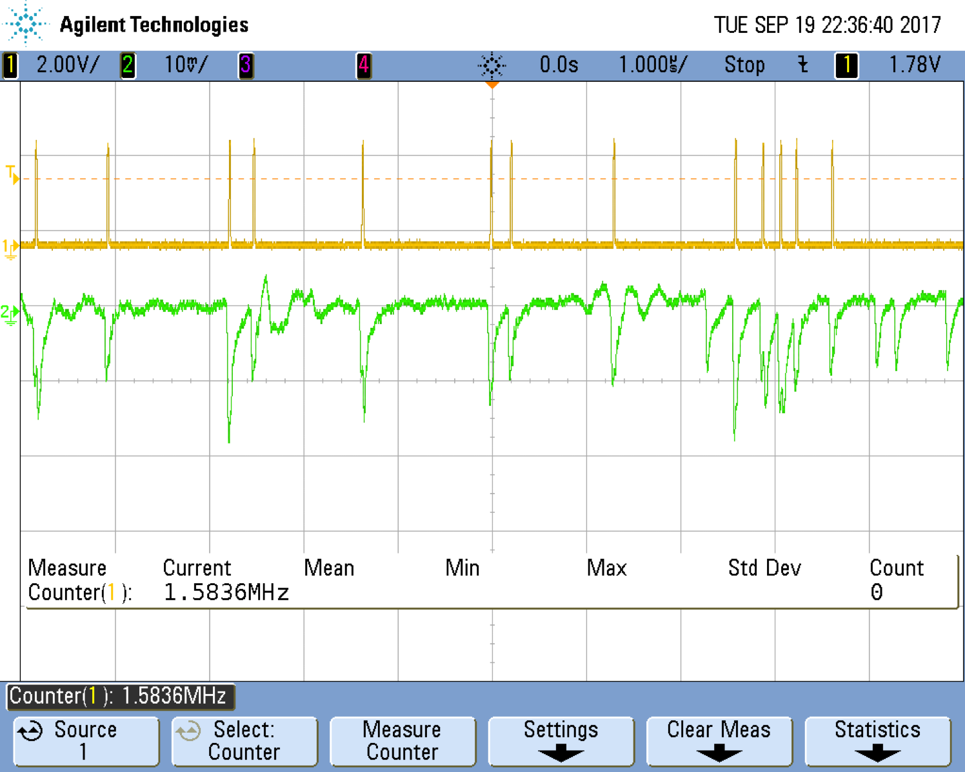
the optimal solution:
RANDOM NUMBER GENERATION BY OBSERVING UNPREDICTABLE QUANTUM PHENOMENA
where unpredictability is secured by the very same laws of Nature.
The very first example: exploiting the unpredictability of Radioactive Decays
Inspired by Forrest Gump, we say:
RADIOACTIVE IS AS RADIOACTIVE DOES
The idea behind is to replace a radioactive source with something safer, more handy, cost effective, simple, robust, providing sequences of pulses mimicking radioactive decays.
the sequence of detected decays can be used to generate random bits with different recipes:
check the parity of the number of pulses in a time window
pre-define the time window in a way that is equally like to have or not to have a single pulse

Slide 6
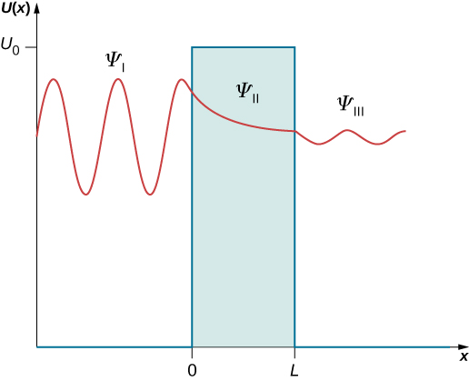
the Random Power way:
A THREE STEP DANCE:
The name of the game is QUANTUM TUNNELING:
Electrons and quantum entities in general are not like a but they rather appear as a :
when they bounce against a [potential] barrier, they can occasionally go through in an unpredictable way.
When this is happening, the “ghost” electron enters a region of high electric field, generating a current pulse by impact ionisation
Courtesy of Ivan Rech, Politecnico di Milano
[50 μm cell size]

Slide 7
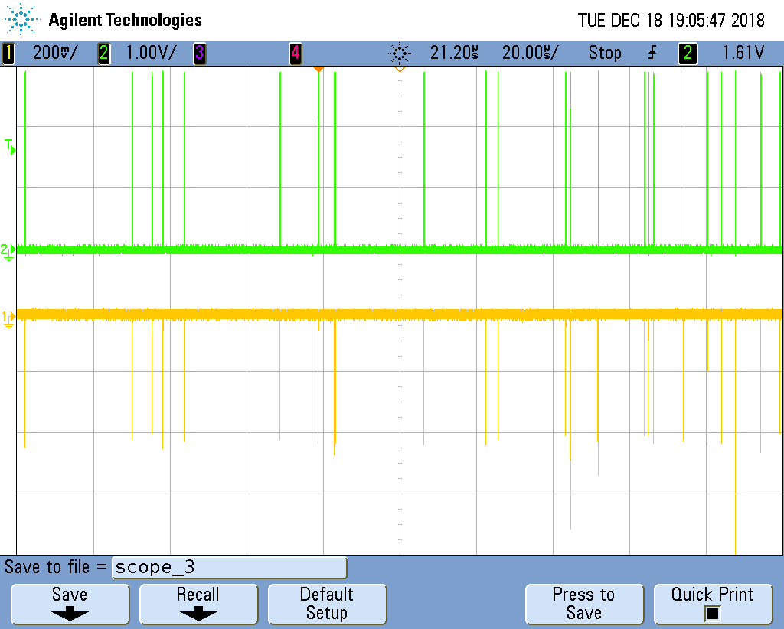
the Random Power way:
A THREE STEP DANCE:
The name of the game is QUANTUM TUNNELING:
Electrons and quantum entities in general are not like a but they rather appear as a :
when they bounce against a [potential] barrier, they can occasionally go through in an unpredictable way.
When this is happening, the “ghost” electron enters a region of high electric field, generating a current pulse by impact ionisation
By time stamping the pulses the analysing the time series, we turn unpredictable occurrence of the pulses into bits
and we embody the principle in a platform of Silicon-based devices

Slide 8
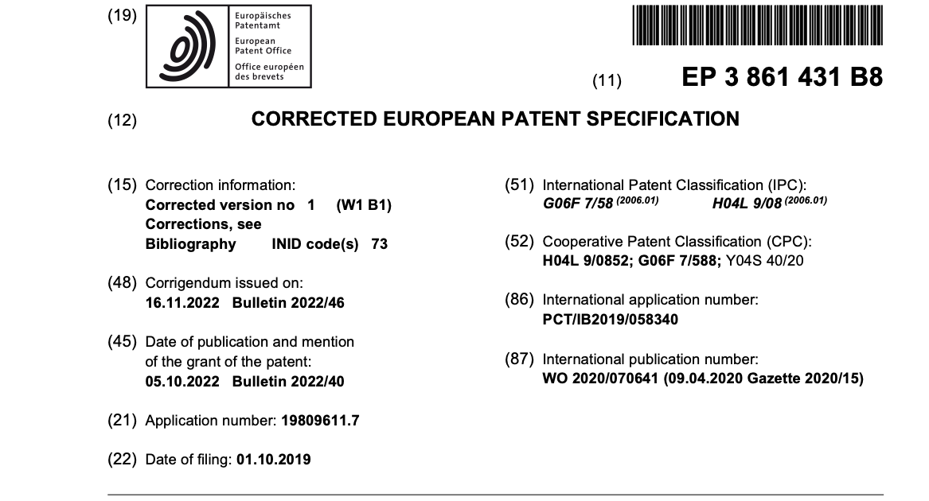
This is the PATENTED essence of
- Italian Patent granted in Sept. 2020
EU patent granted in 2022
Japanese patent granted in 2024
in the examination phase in China, Korea and U.S. (since April 2021)

Slide 9
This is the PATENTED essence of
where the key issues are:
endogenous in-silico seeding of the pulses
self-amplification of the seeds in excess of a factor 1 000 000, making pulse tagging robust
bit extraction through a non parametric local analysis of the time series of pulses
no influence of temperature on the randomness of the occurrences
no need of post-processing to correct left-over bias
maximum bit/occurrence rate = 40% [2 random bits every 5 pulses]
current rate at the 5-10 Mbps rate for every mm² of Silicon sensor
potential to embed the generator into an ASIC [Application Specific Integrated Circuit]

Slide 10
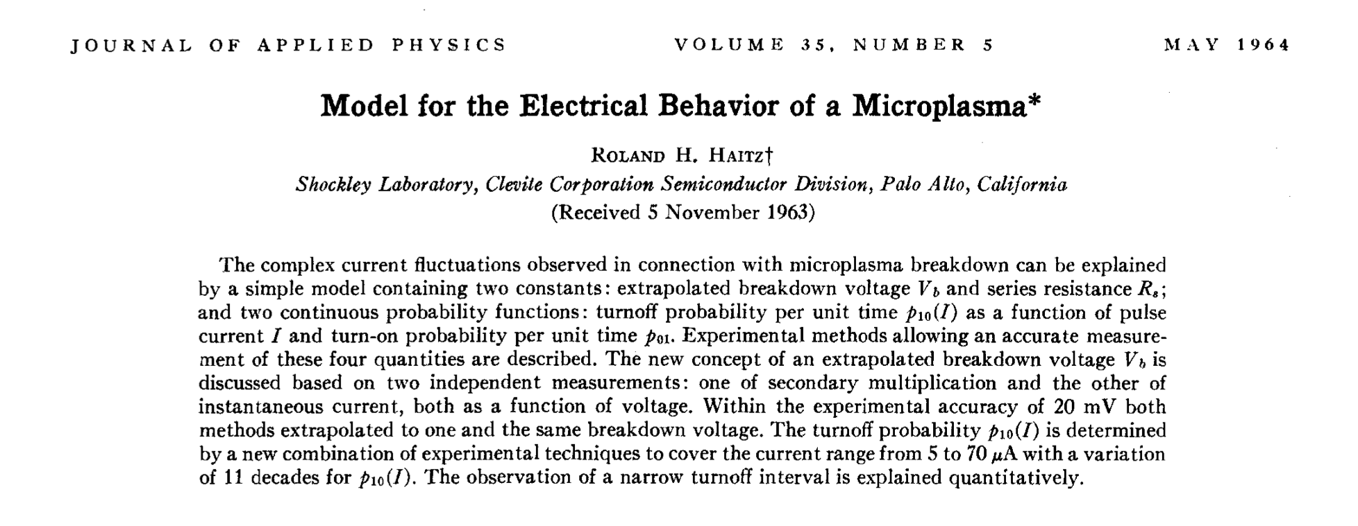
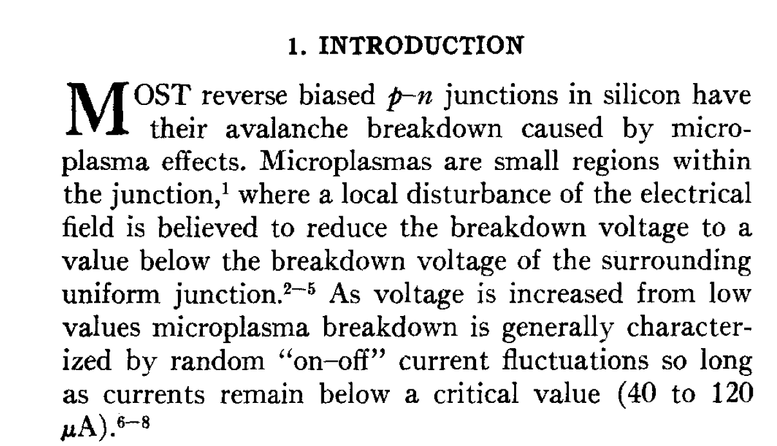
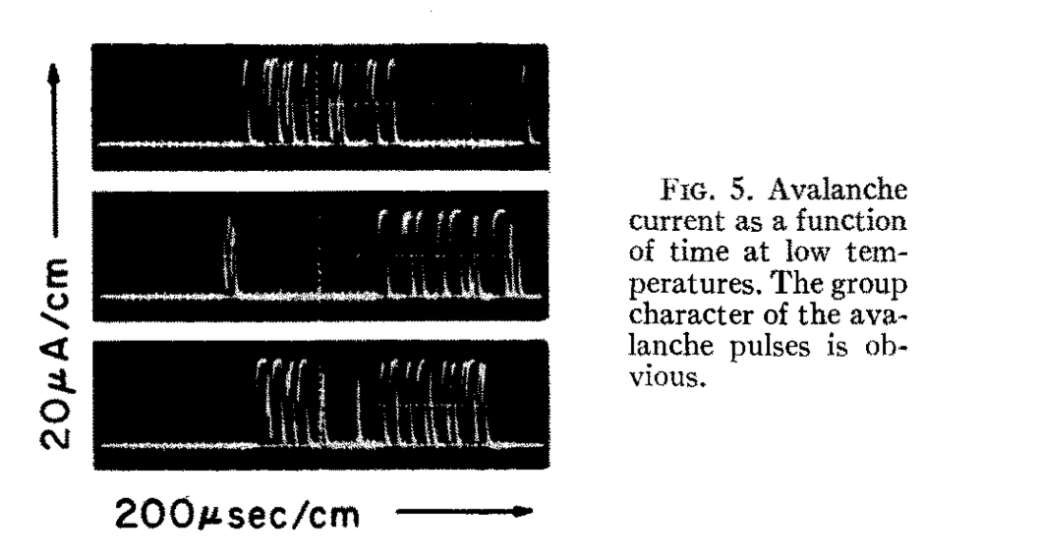
a few notes:
a. Our principle is actually a lesson from the past. This effect was known since the early days of the Silicon technology development:
1
2
from paper
2
from paper
3
3

Slide 11
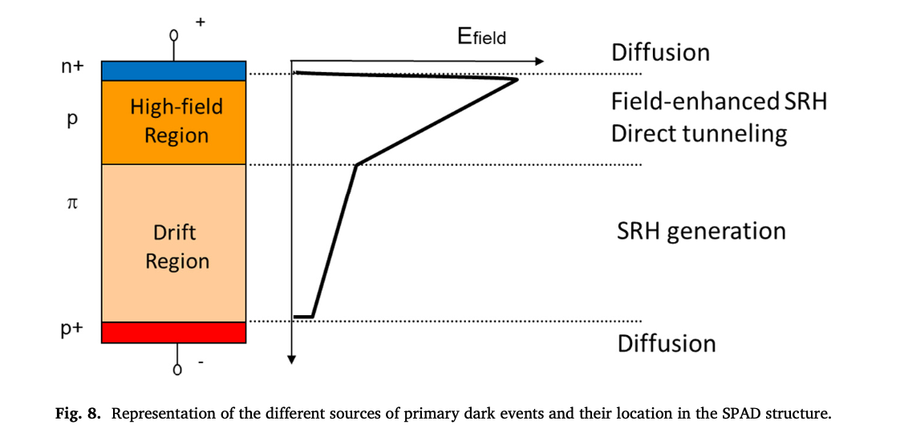
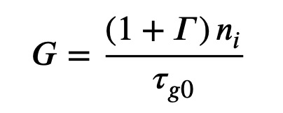
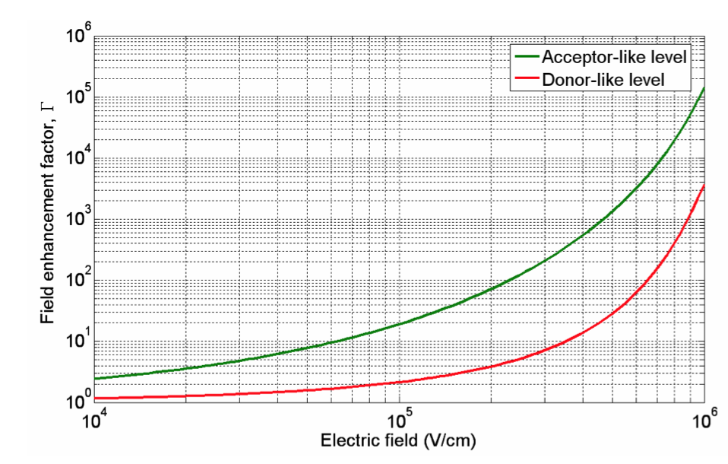
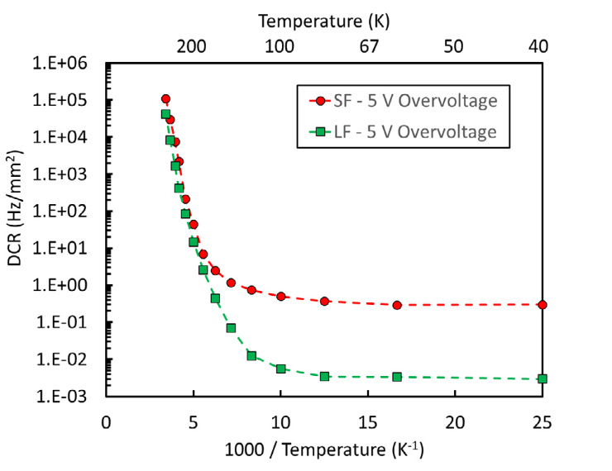
The phenomenology is by now quite well known [even if large uncertainties are still there, requiring somehow a “cook & look” approach]
Thermal generation of carriers by states in the bang-gap (Shockley-Read-Hall statistics), where trapping and de-trapping is increased by the high electric field in the junction. The Generation rate can be written as:
E0 = Fermi level
Et = trapping level
ni = intrinsic carrier concentration
Nt = trapping concentration
σ = trapping cross section
vth = thermal velocity
Γ “boost” by the field
after A. Gola, C. Piemonte, NIM A926 (2019) 2-15
Key issues:
the Pulse Rate is O(1 KHz)/cell, 50 μm pitch (it may be higher for SPAD arrays in CMOS technology)
provided the nature of the “Dark Pulses”, we have a significant dependence on Temperature
forget-me-not: the Over-voltage is affecting the triggering probability
F. Acerbi, et al., IEEE Trans. Electron Devices 64 (2) (2017) 521–526.
Notes:
cosh(x) = 0.5*(e^x+e^(-x))
Tau_g0=generation lifetime = O(70 us)
n_i = O(10^10 cm_3) @300K
When a high electric field is applied to silicon, SRH statistics changes because the rate at which electrons are captured and emitted by a trap is increased significantly by tunneling.

Slide 12
a few notes:
b. The idea flashed as a genuine act of serendipity, while studying the properties of Dark Counts in Silicon Photomultipliers (SiPM)
SiPM may be seen as a collection of binary cells, p-n junctions operated beyond the breakdown voltage [SPAD], fired when a photon in absorbed
[in principle, a NATIVE DIGITAL DEVICE]

Slide 13
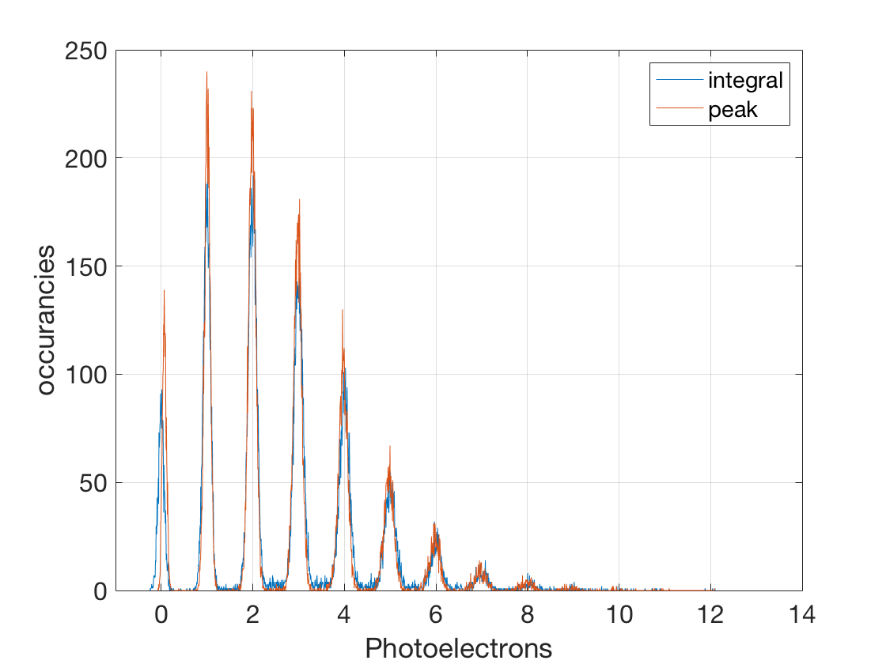
a few notes:
b. The idea flashed as a genuine act of serendipity, while studying the properties of Dark Counts in Silicon Photomultipliers (SiPM)
Two fired cells
Single fired cell
Three fired cells
Vover = 2.5V
No fired cell
histogram of the response to a high statistics of low intensity light pulses

Slide 14
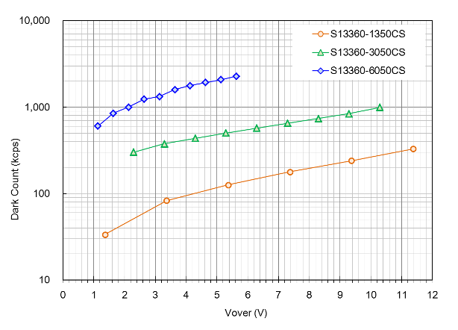
a few notes:
b. The idea flashed as a genuine act of serendipity, while studying the properties of Dark Counts in Silicon Photomultipliers (SiPM)
Dependence of the Dark Count Rate on the Overvoltage (wrt Breakdown) in different HAMAMATSU SiPM

Slide 15
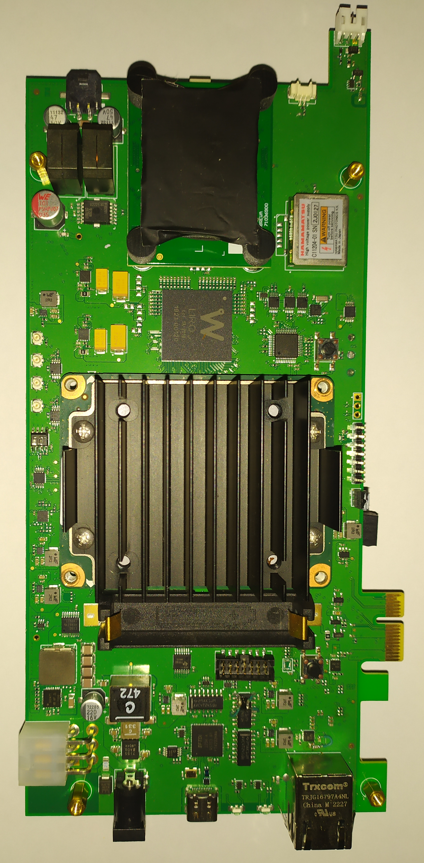
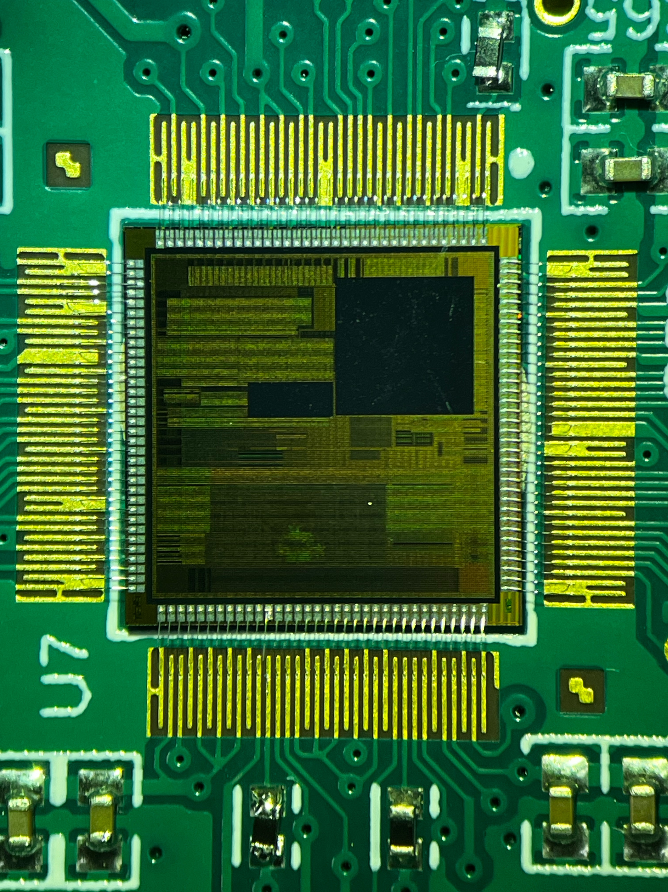
state-of-play:
Three elements of the platform have been developed and will be ready for the market by Q1 2025:
8 cm
31 cm
3.5 cm
11 cm
A single generator board, for qualification and the educational market
A 64 generator computer on a board, for Data Centers (e.g. simulations & AI training)
A full custom ASIC (a chip!) for IoT, Authentication, gaming&gambling

Slide 16
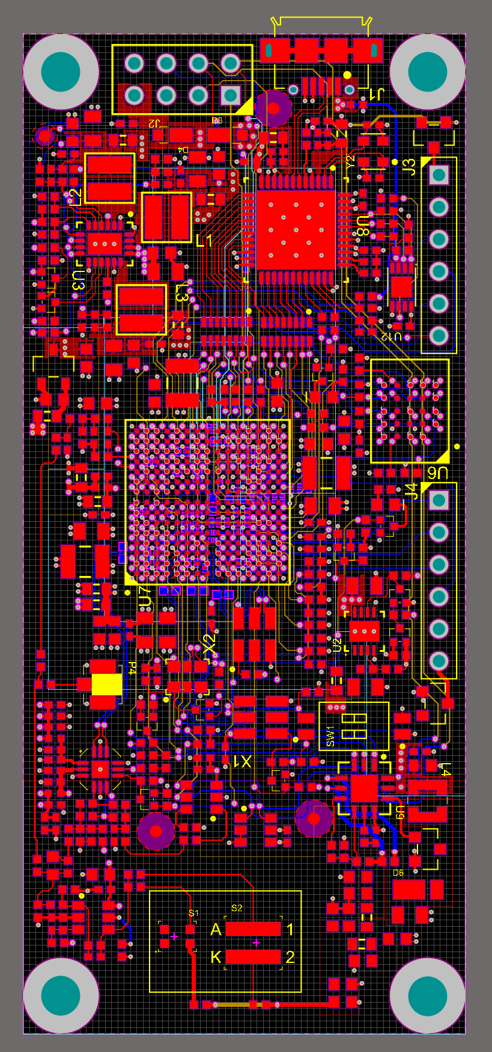
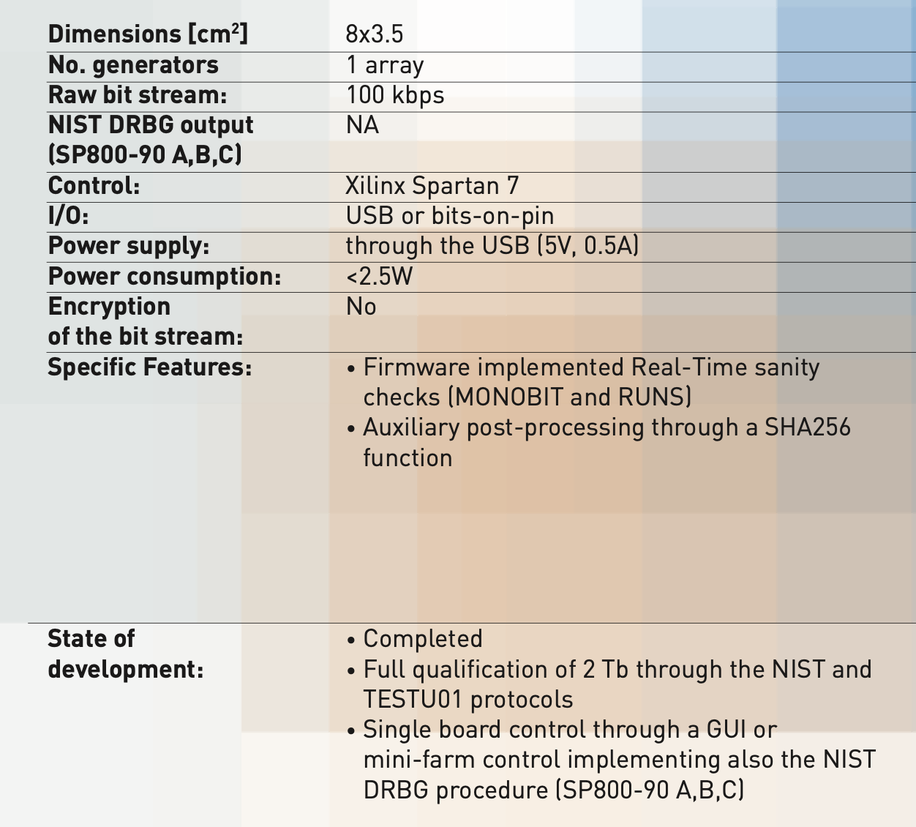
state-of-play:
THE SINGLE GENERATOR BOARD
FPGA TDC inside with 30 ps granularity
8 cm
3.5 cm
Main output of the Phase 1 project (May 2019-Oct.2020)

Slide 17
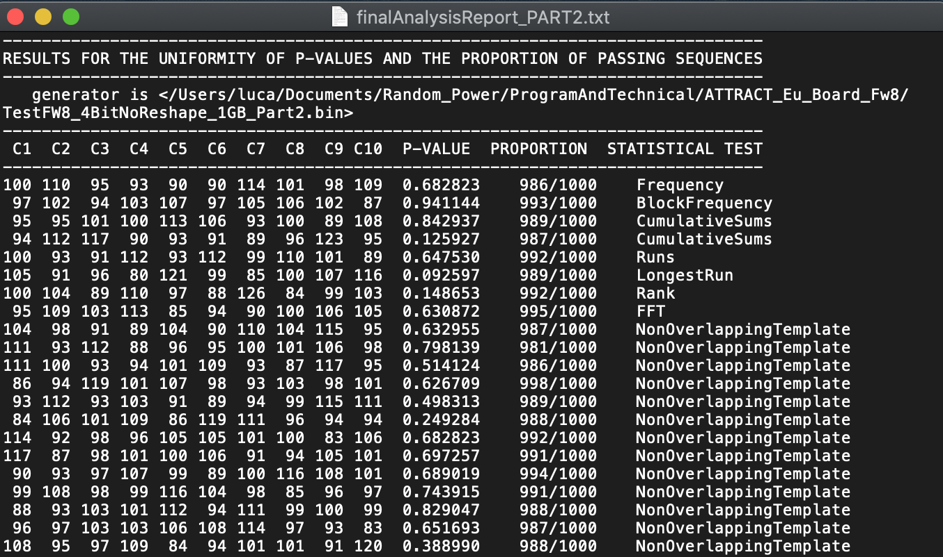
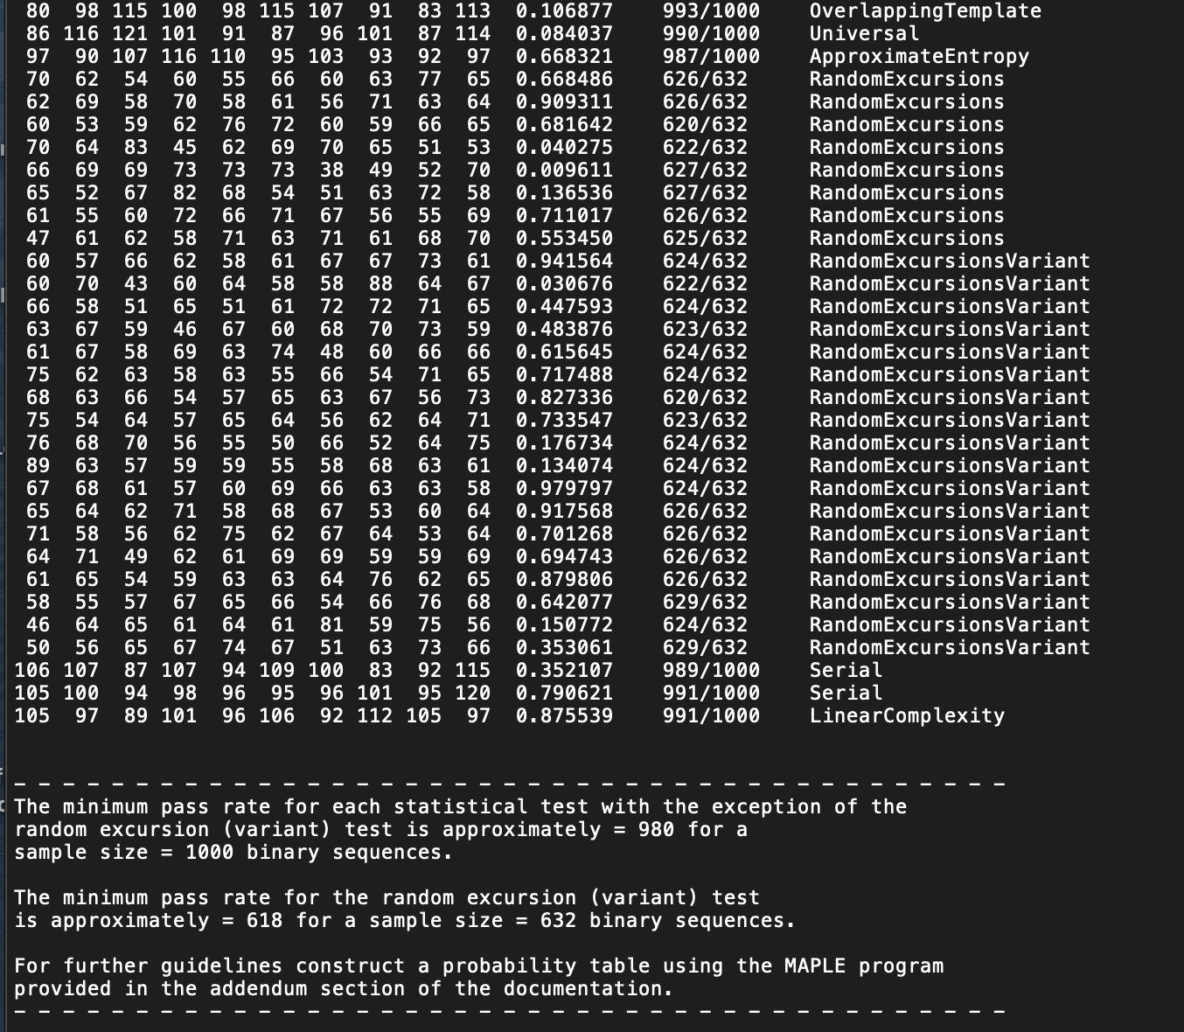
A proto-randomness farm based on 10 boards have been collecting about 1.5 Tb, qualified through the NIST and TESTU01 suites.
Results show that the stream looks extremely “white”, essentially with no failures on the raw data beside what can be statistically expected.
A SHA256 vetted conditioning function firmware implemented
series of tests on non-overlapping templates
Two tests have been implemented in firmware to guarantee real-time sanity checks:
MONOBIT: essentially testing the asymmetries between 0’s and 1’s in a bit string:
1 1 1 1 1 0 1 0 0 1 1 1 0 0 0 1
RUNS: testing the statistics of the number of sequences of identical bits in a string
1 1 1 1 1 0 1 0 0 1 1 1 0 0 0 1
5 bits
1 bit
2 bits
3 bits
3 bits
1 bit

Slide 18
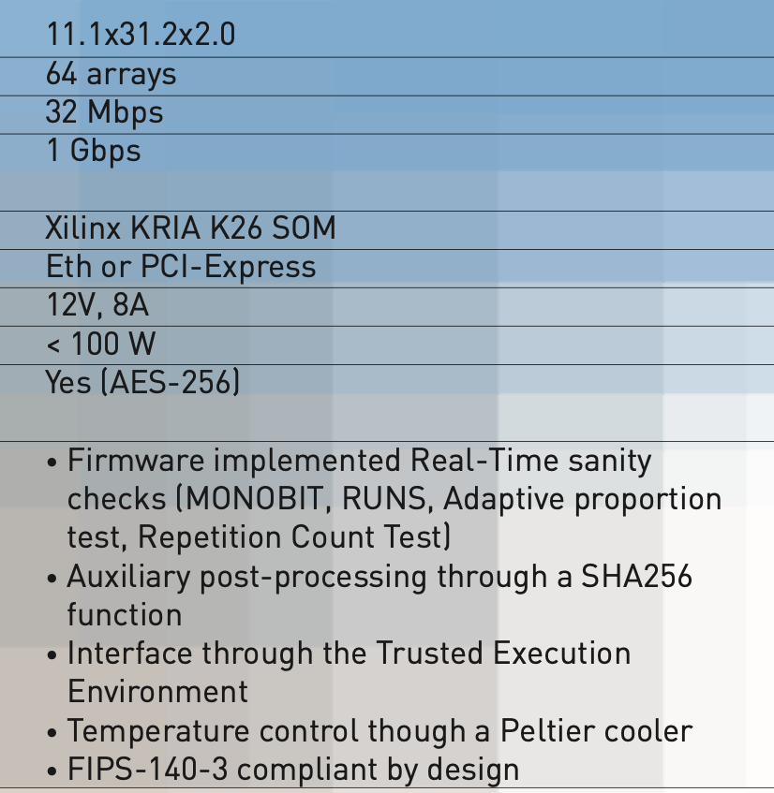
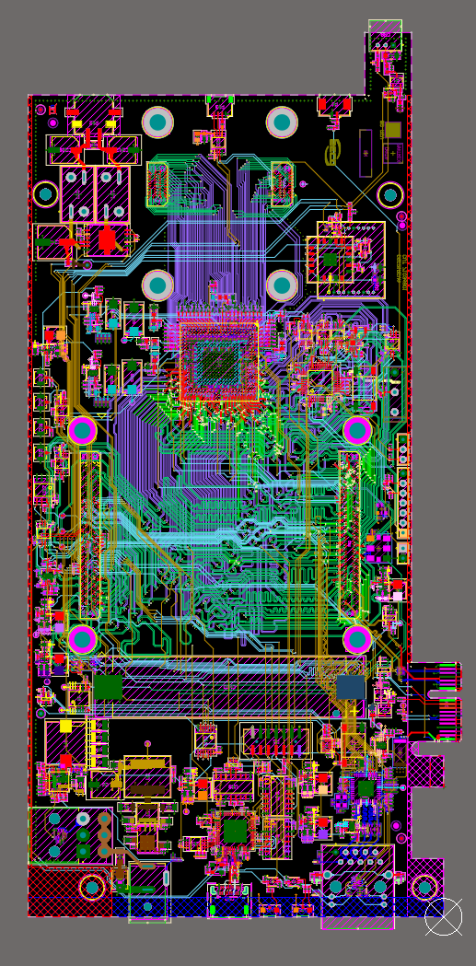
state-of-play:
THE 64 GENERATORS BOARD
20W
64 FPGA TDC inside with 30 ps granularity
31 cm
v1.0 delivered in July 2023, qualified
v2.0, product grade, delivered in September 2024, being qualified
software architecture under development
11 cm
Goal of the Phase 2 project (May 2022-Fall.2023)

Slide 19
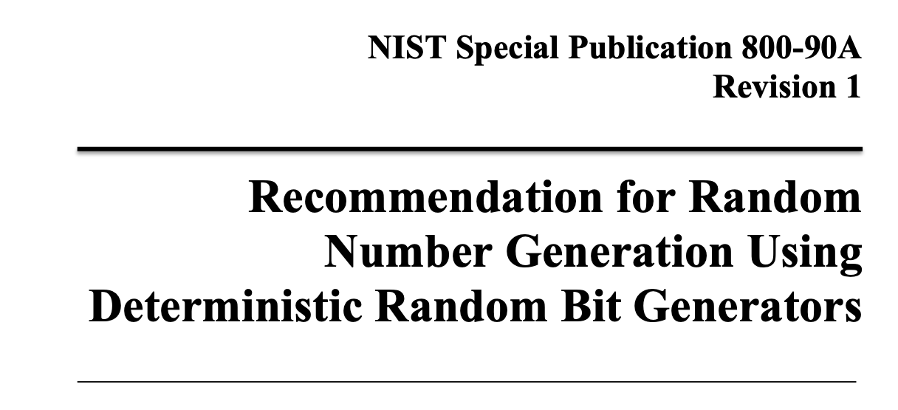
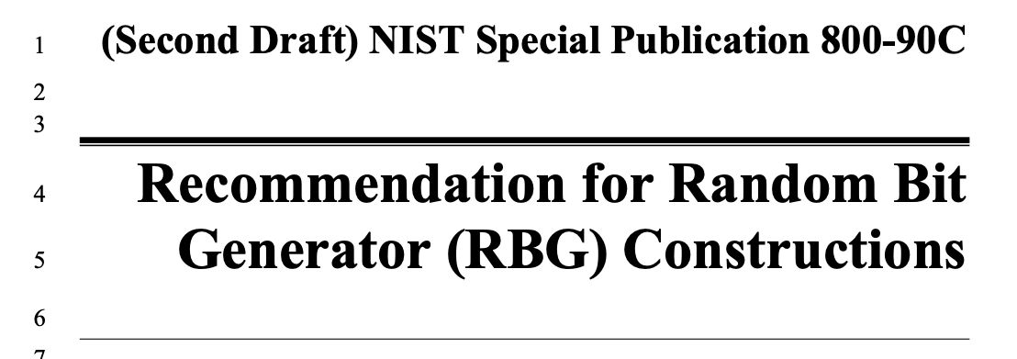
BEYOND A PURE TRUE RANDOM NUMBER GENERATOR (TRNG)
How to design and test entropy sources to be used to feed Deterministc Random Bit Generators (DRBG)
Approved DRBG mechanisms
Construction of RBG from A+B
pre-requisites for entering the programs eventually leading to the FIPS-140-3 certification
impacting on the design of both the ASIC, the multiple generator board and its embodiment in a “system”

Slide 20
GO BEYOND A PURE TRUE RANDOM NUMBER GENERATOR (TRNG)
Queries
Bootstrap
Essentially, the True Random Bits generated by Random Power are used to seed a NIST approved Pseudo Random Bit Generator
when reseeding occurs after EVERY iteration of the Deterministic machine, you obtain the highest level of security, namely Prediction Resistance*
Entropy producer
Entropy consumer
A Deterministic Random Bit Generator (DRBG), as of the NIST recipe
* QUOTING NIST: Prediction resistance means that a compromise of the DRBG internal state has no effect on the security of future DRBG outputs.
Output

Slide 21
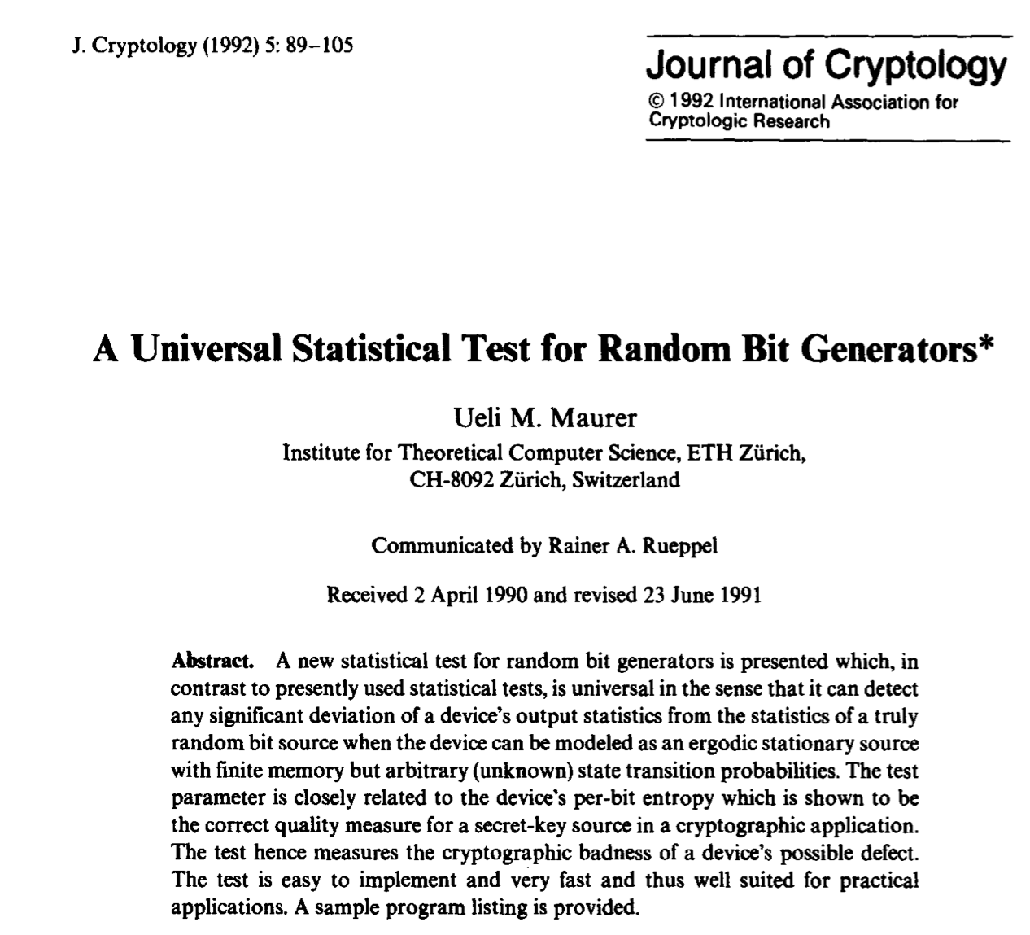
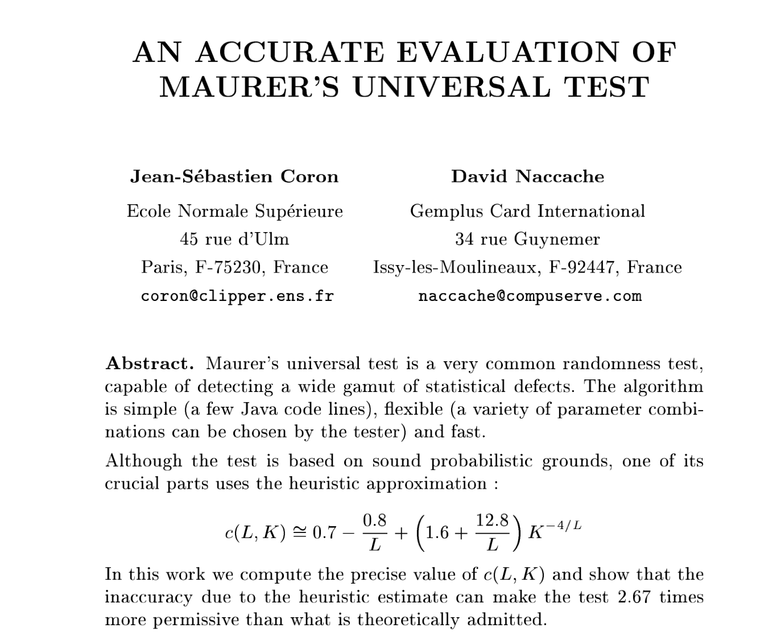
BEYOND A PURE TRUE RANDOM NUMBER GENERATOR (TRNG)
Why this is done? in principle, the majority of the randomness tests qualify the stream against modelled pitfalls but you cannot exclude a priori unknown deviations.
“Universal tests” have been proposed, connected to “compression” algorithms but even Maurer’s test, the most widely known, in its practical implementation can possibly have a reduced diagnostics power:

Slide 22
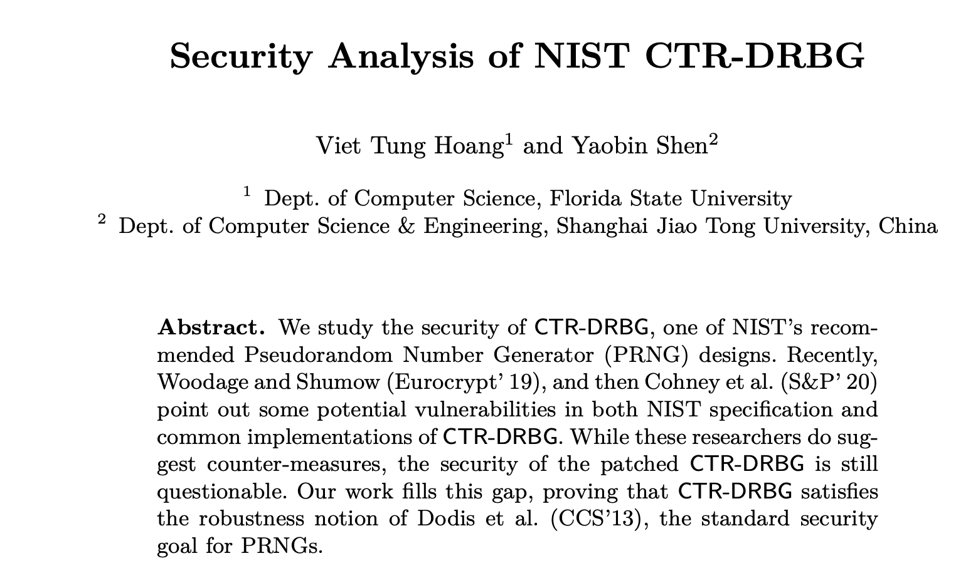
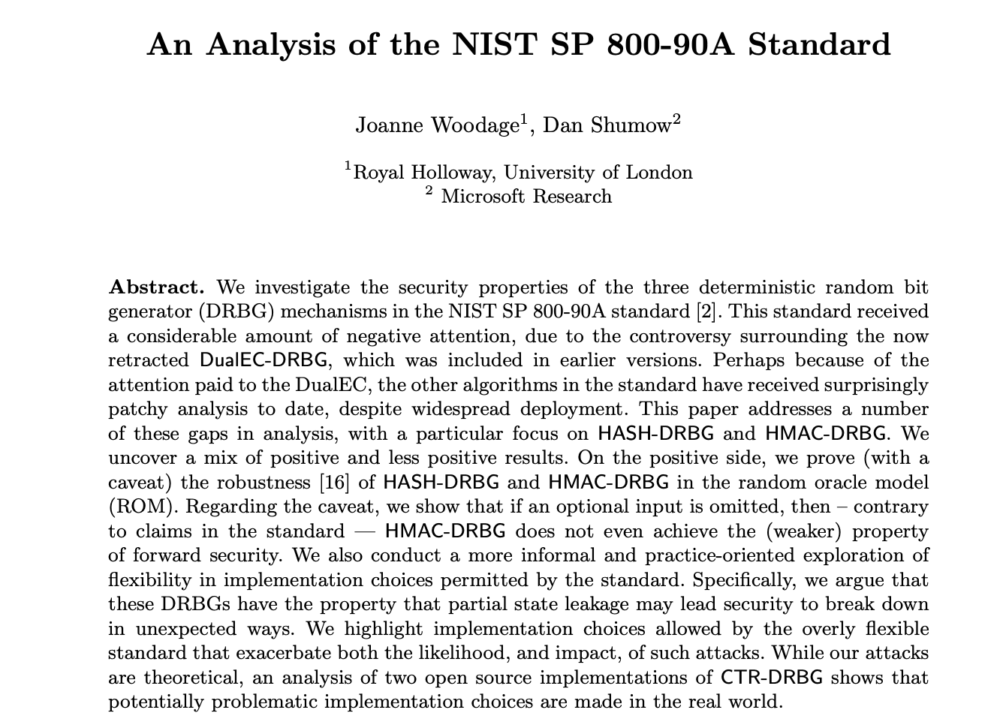
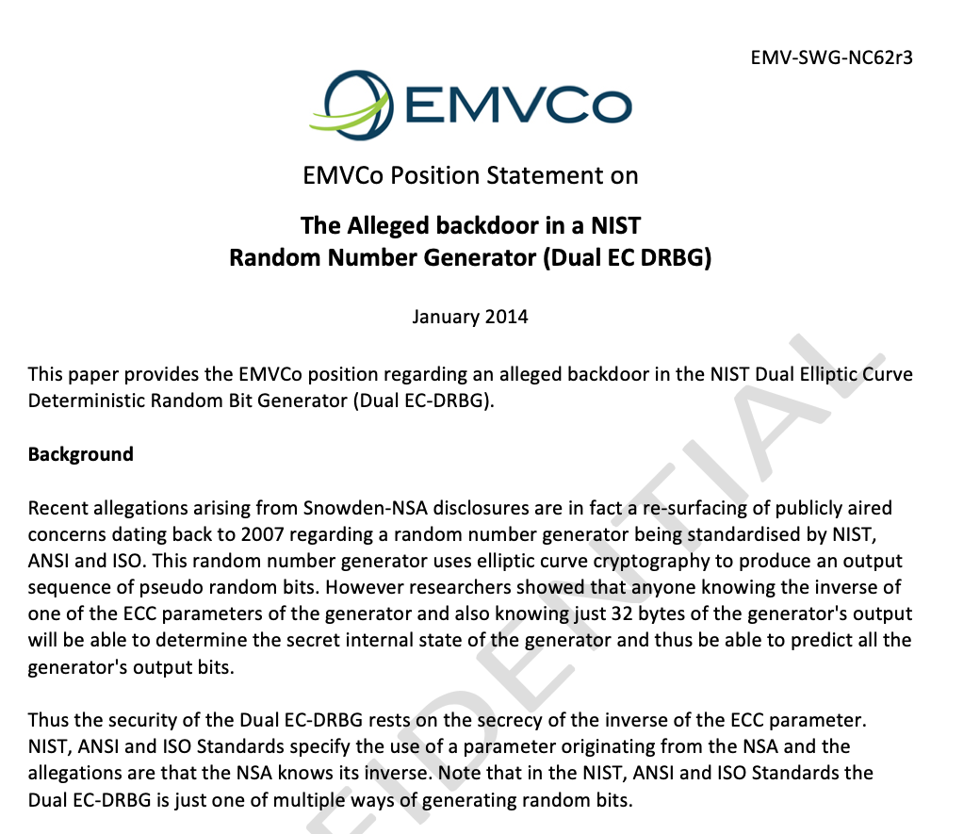
BEYOND A PURE TRUE RANDOM NUMBER GENERATOR (TRNG)
Why this is done? in principle, the majority of the randomness tests qualify the stream against modelled pitfalls but you cannot exclude a priori unknown deviations.
On the other hand, if you can mathematically prove the strength of an algorithm, you can feel relieved. Maybe:

Slide 23
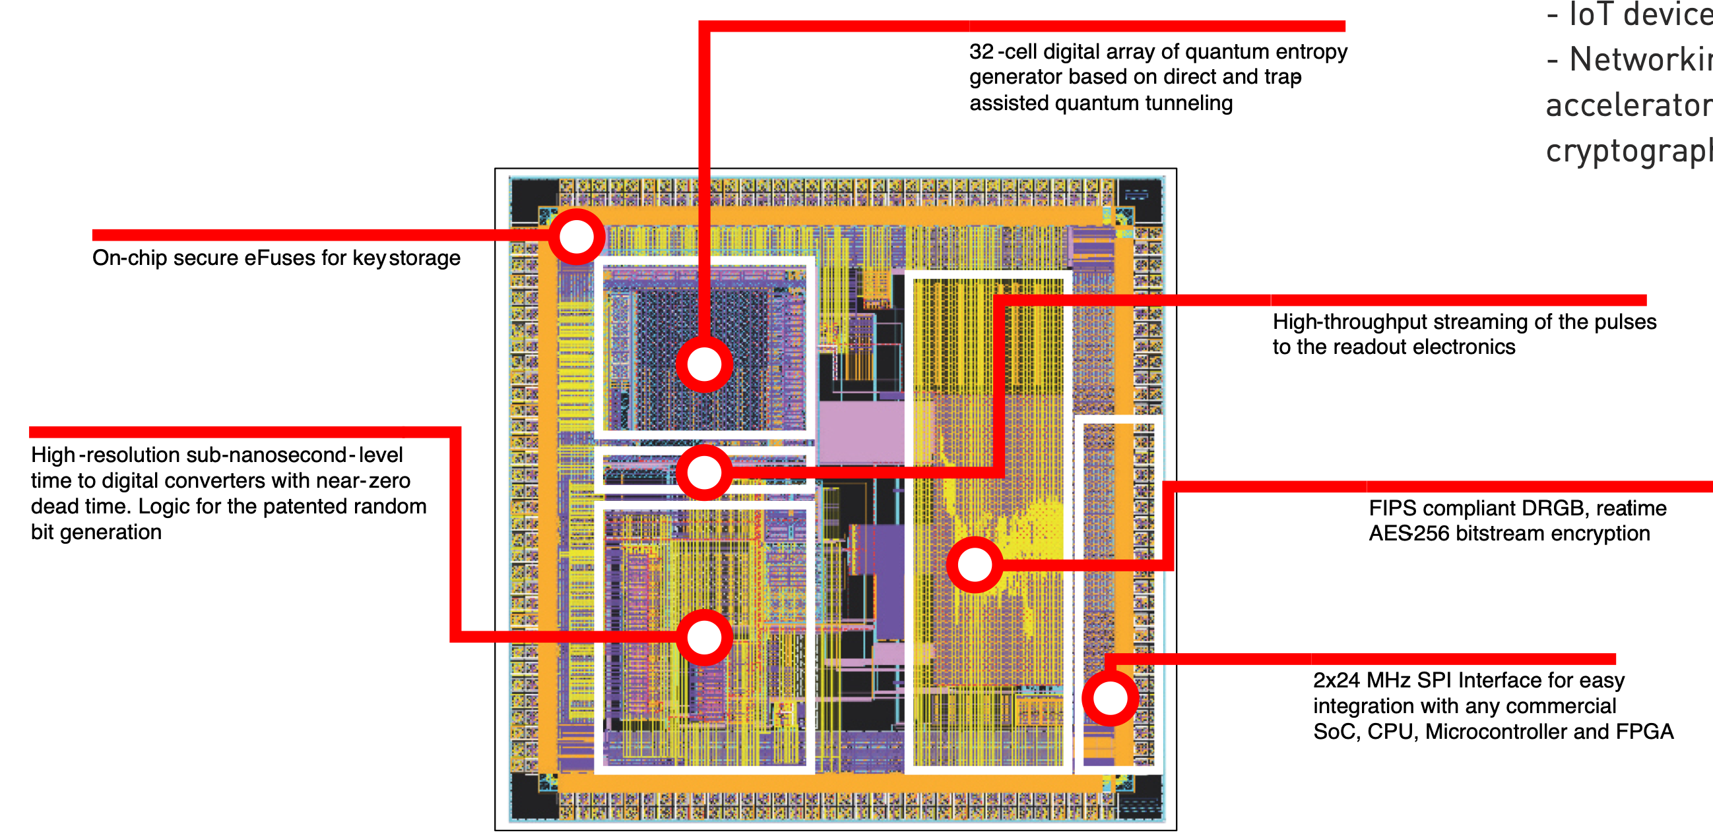
state-of-play:
32x
THE ASIC:
Key generation at 3 levels, starting by a Silicon embedded primary key and a Key Derivation Function
Access though a “crypto-officer” password
AES-256 encryption and authentication of the bit stream
2-8 Mbps
granted
Out-of-the fab in June 2024, result of an engineering run
Full qualification close to completion

Slide 24
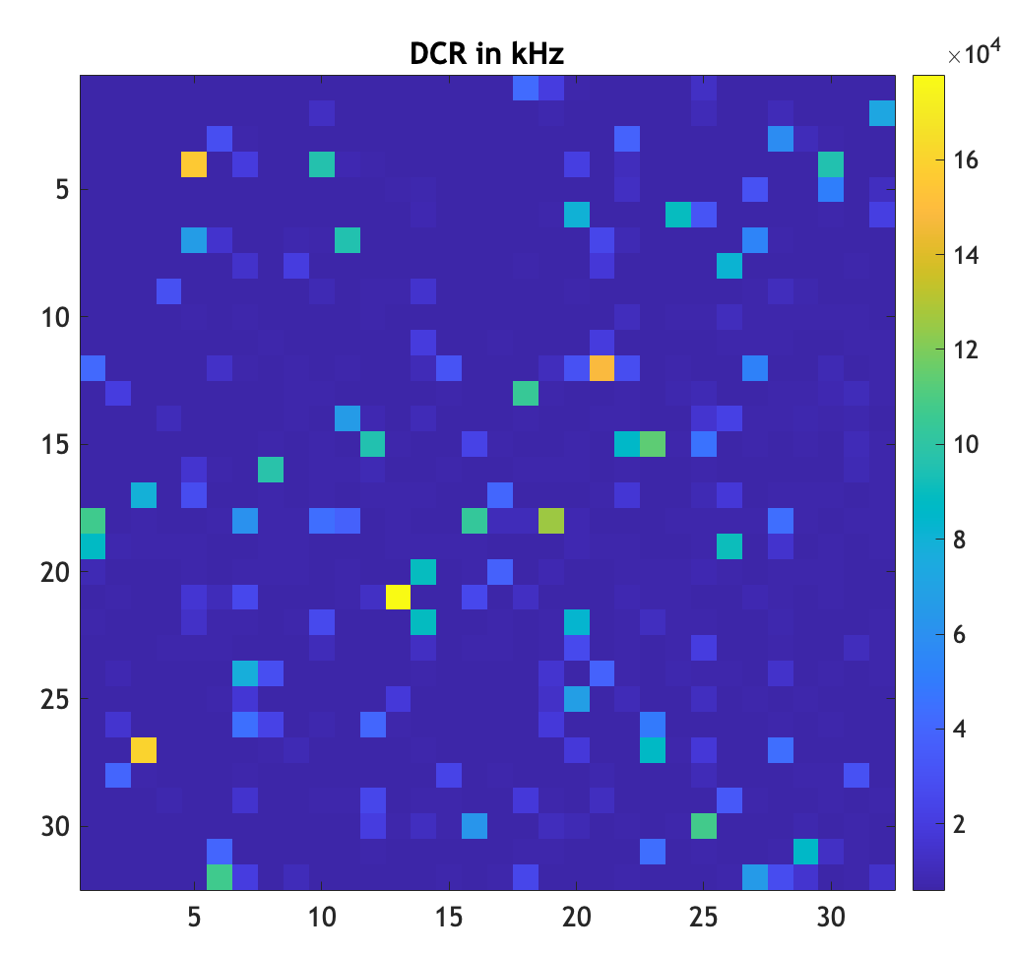
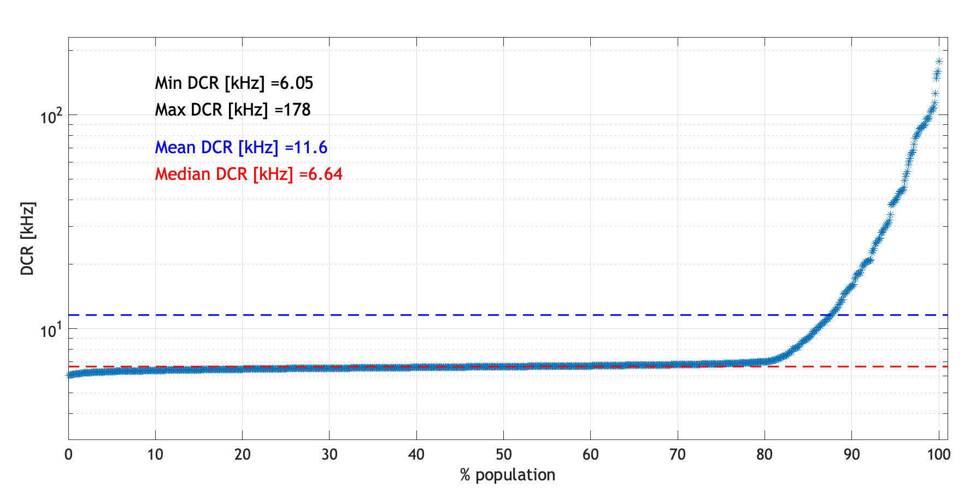
32x
state-of-play:
THE ASIC:
It embodies also:
two different TDC architectures
a two stage mechanism to implement “screamers identification” and a procedure for the rate stabilisation
two NIST validated real-time tests
a DC-DC converter providing the Excess Bias Voltage
circuitry for an automated identification of the breakdown voltage

Slide 25
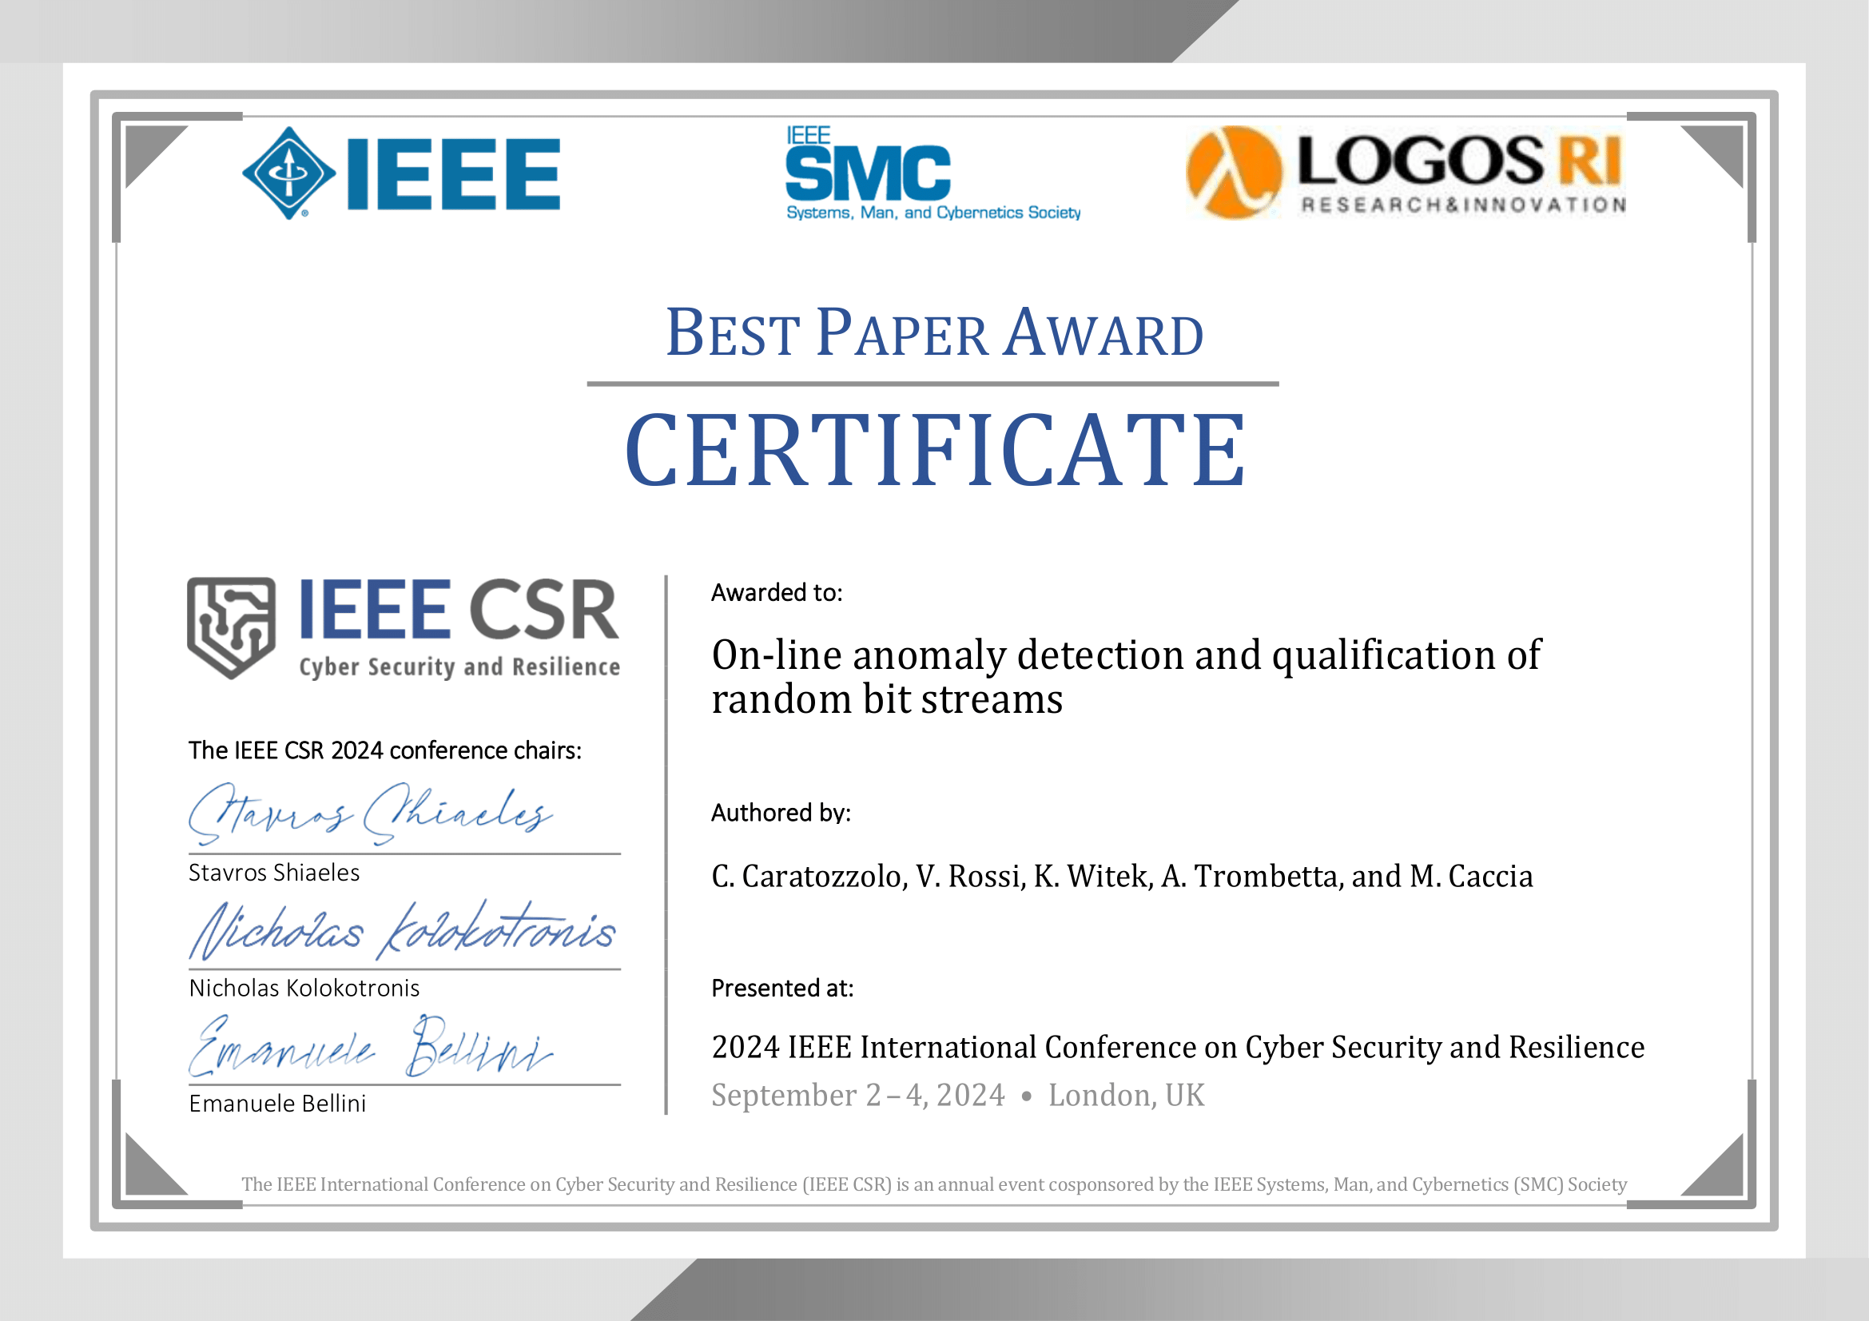
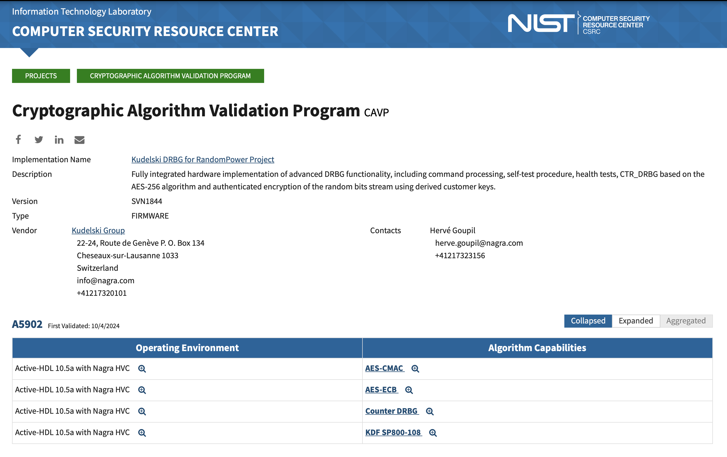
state-of-play:
Beside hardware:
CAVP obtained by NAGRA-Kudelski for Random Power, integrated in the chip and the 64x
available on ArXiv at https://arxiv.org/abs/2409.05543

Slide 26
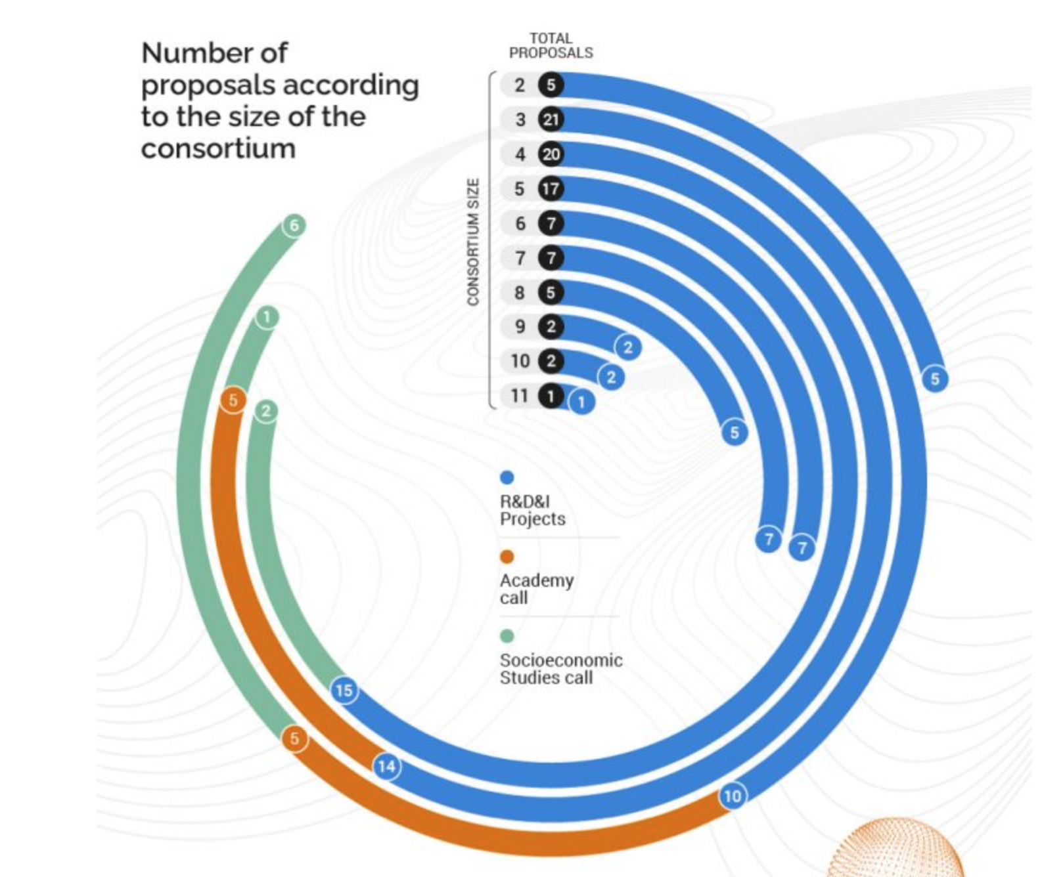
how did we do it?
Essentially, Thanks to the EC
Our consortium:
leading party
18 man-years dedicated to the project

Slide 27
how did we get where we are?
HISTORY & TEAM: pre-incorporation
Approval & kick-off of the ATTRACT Phase 1 proposal (May)
design, commissioning and production of the single generator board;
Unpredictability of the generated random bit sequence is assessed using the NIST standards
2016
2018
2020
2017
2019
The principle at the base of RandomPower emerges, as result of a genuine serendipity event. Initial tests performed with lab equipment
A demo board is designed, commissioned and qualified;
Italian patent filing completed (October)
launch at the CyberSecurity week in Le Hague (October)
submission of the ATTRACT Phase 1 proposal (October) (100 kEUR)
End of the ATTRACT Phase 1 project (October)
Full characterisation of the single generator board
winner of the Start-Cup competition (regional level; 20 kEUR)
winner of two special prizes by investors at PNI, start-up competition at national level
Italian patent granted

Slide 28
how did we get where we are?
HISTORY & TEAM: post-incorporation (2021)
Chip delivery (Q2)
Chip qualification (Q4)
64x board product grade qualification (Q3)
v1.0 of the FIPS compliant sw architecture for the multi-age board
FIPS 140-3 certification started
Business plan v2.0
End of the ATTRACT Phase 2 (fall; Extended by now!
Execution of the next investment round
Engineer co-development of applications
GO TO MARKET!
approval of the ATTRACT Phase 2 proposal (January) (2 MEUR)
kick-off of the ATTRACT Phase 2 (May)
proto-farm commissioned
implementation of the TESTU01 suite, complementing the NIST test (1.5 Tb qualified)
winner of the Falling Walls venture int’l competition (November)
US and EU patent granted
2021
2023
2022
2024
2025
first implementation of real-time sanity checks
company establishment (June)
investment (200 kEUR) by LifTT, our VC (June)
Submission of the ATTRACT Phase 2 proposal (September)
real-time sanity check implemented
design of the multi-gen board completed (April) v1.0
commissioning of v1.0 started (July) ; qualification completed in December
chip submission in mid-September
Engineering of the next investment round (including Exploitation agreements)

Slide 29
Join us, we will be happy to walk with you!
2020-11 Winner of 2 “special prizes”
2020-10 Winner - ICT
2021-06 PoC investment by LifTT, a VC located in Torino (ITALY)
www.randompower.eu
2022-11 winner @the Falling Walls venture competition
for curious people:
here & and there
Established in June 2021
2024-03 Random Power goes to the most important trade fair on IoT technologies, hosted at the SECO booth.
This project has received funding from the ATTRACT project funded by the EC under Grant Agreement 777222
Notes:
To change the image behind the Mock up.
Select the layer - > Right Click -> Send to Back -> Delete the image -> Drag & Drop your Own Picture -> Send to Back (again)

