Slide 1
Sustainable Surface Finishing of Additively Manufactured Metal Components for High-Precision Applications
TECH-FPA PhD Retreat
17 to 21 February,2025
co LNGS
Room "E. Majorana"
PhD Candidate: Ezeaba Tochukwu Emmanuel
Supervisor: Cristian Pira
Co-supervisors: Eduard Chyhyrynets Pietro Rebesan
Circle: 40th

Slide 2
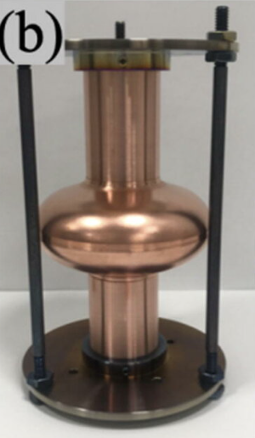
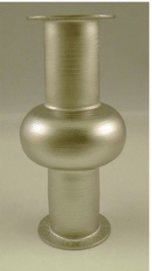
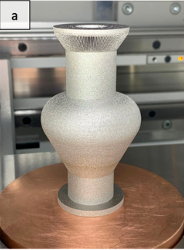
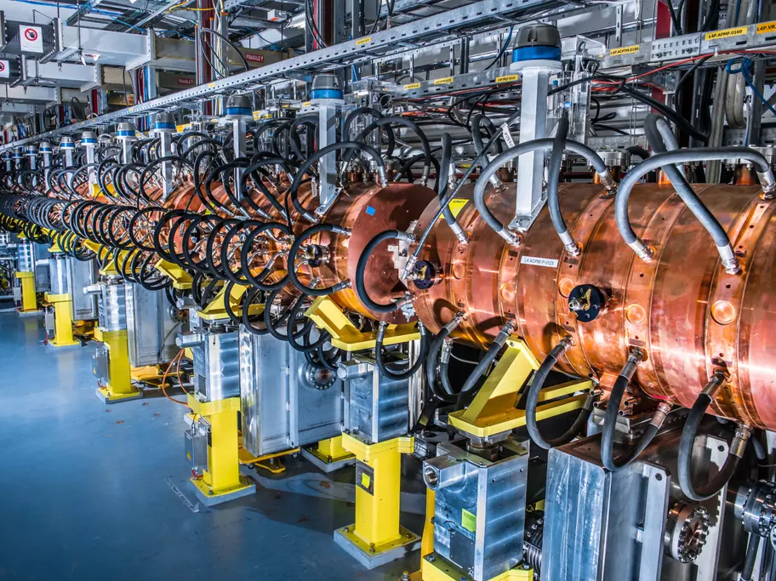
Particle Accelerators
SUPERCONDUCTING RADIOFREQUENCY (SRF) CAVITIES:
Particle Acceleration
Bunching of Particles
Beam Focusing and Shaping
Energy Recovery and Efficiency Enhancement (ERLs)
Phase Space Manipulation

Slide 3
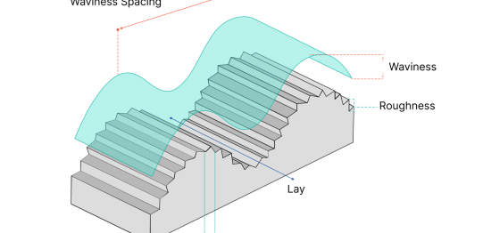
AM Cavity Challenges: High Surface Roughness, which results to: Increased RF Losses Field Emission Lower Breakdown Threshold Reduced Superconducting Performance, etc
Scope: Reduce, if possible, eliminate surface roughness

Slide 4
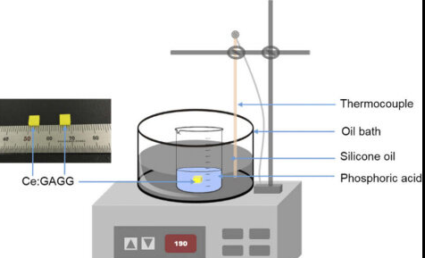
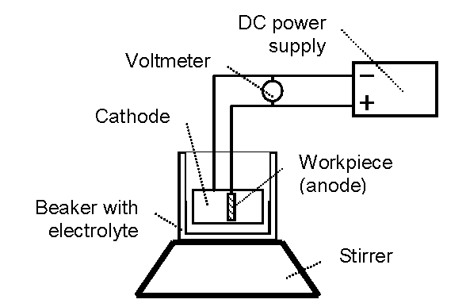
Proposed Solution
SURFACE TREATMENT TECHNIQUE:
Chemical Polishing (CP)
Electrochemical Polishing (EP)
Plasma Electrolytic Polishing (PEP)
Vibro-tumbling

Slide 5
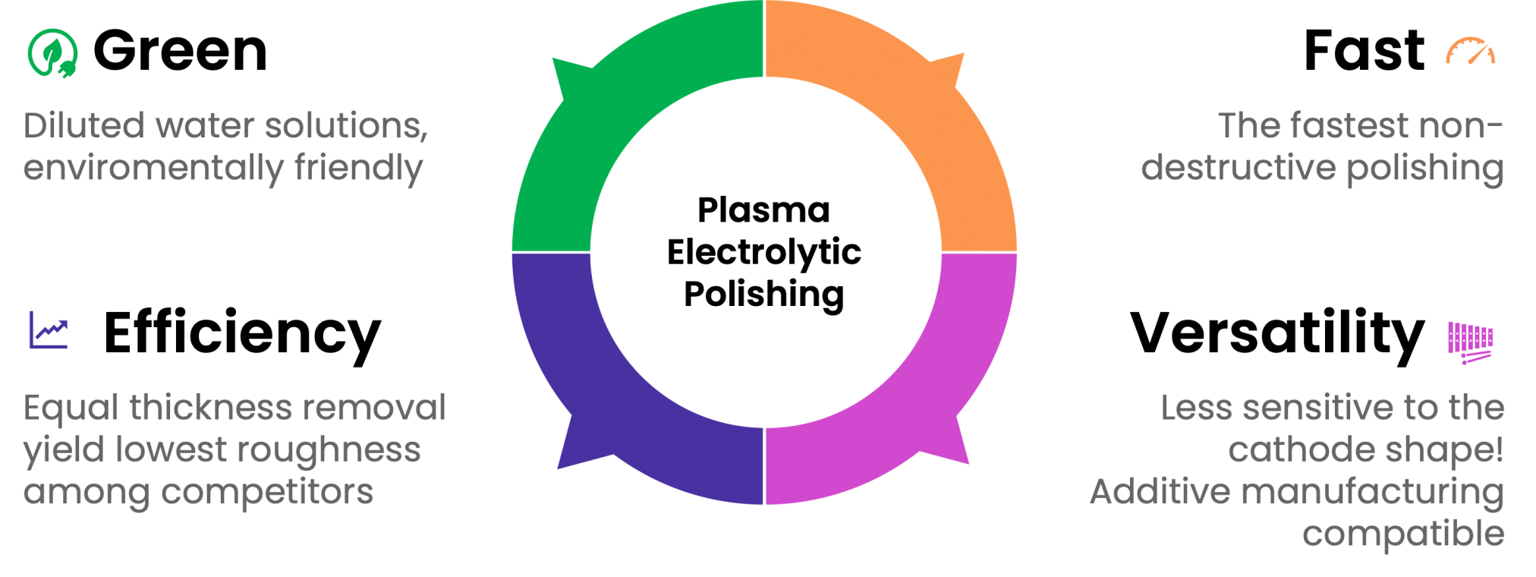
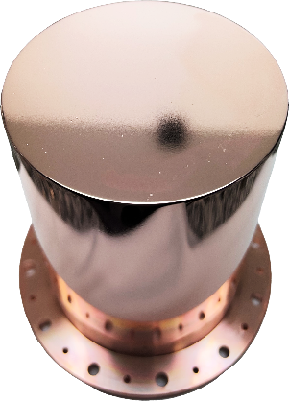
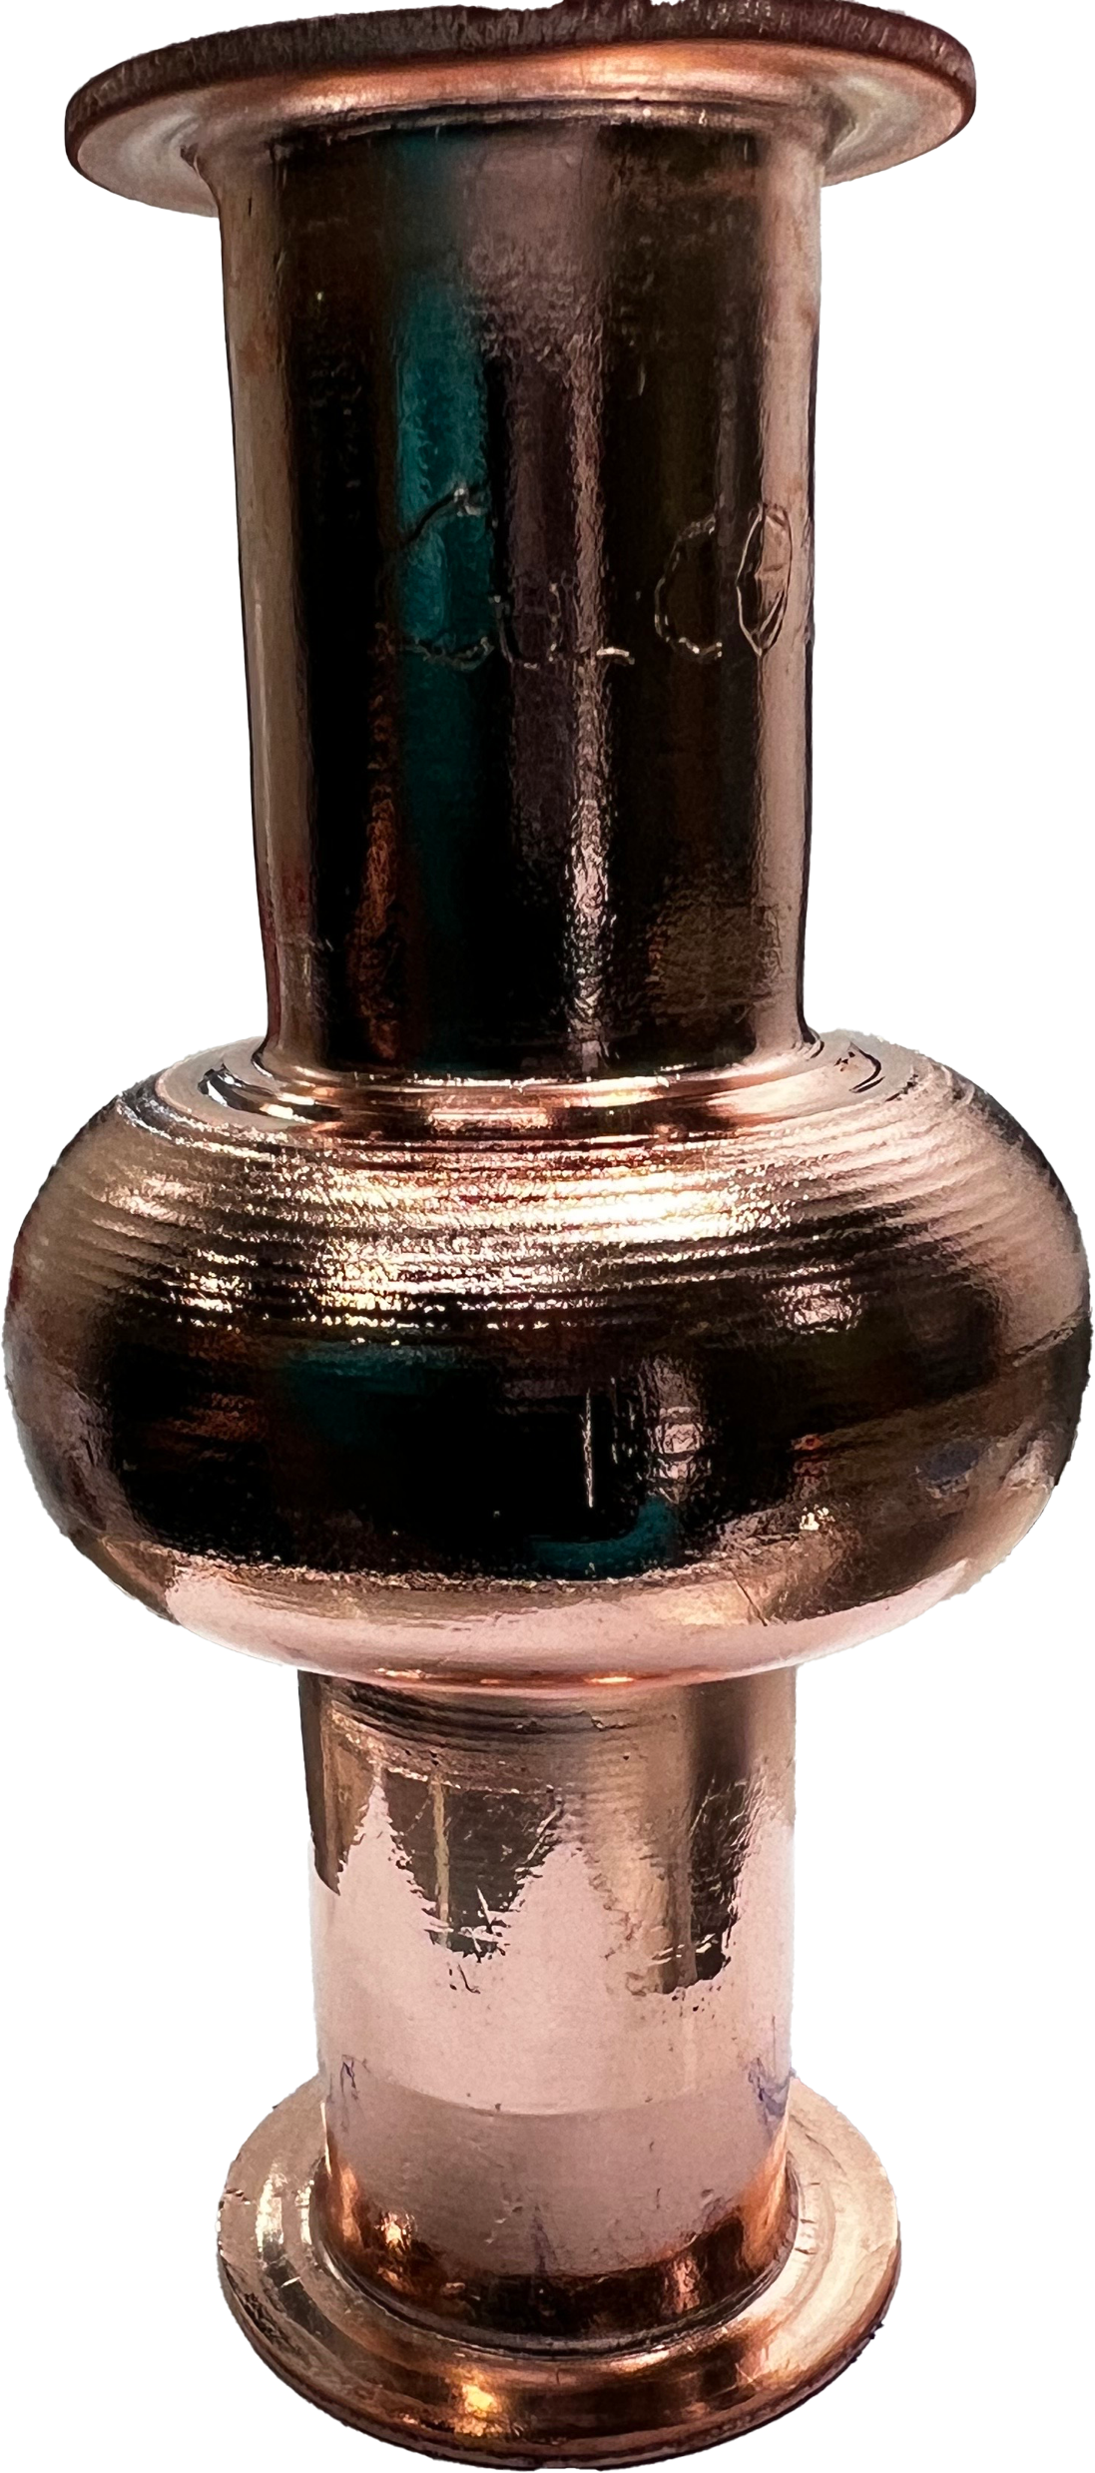
Basics of PEP
No Acids in the chemical bath!
No HF for Nb!
Easier storage
Easier and cheaper wastes proceeding
PEP > BCP > EP
PEP > SUBU > EP
5-30x times faster than EP!
Both micro and macro roughness is improved significantly
Ra ∼ 8 nm!!!

Slide 6
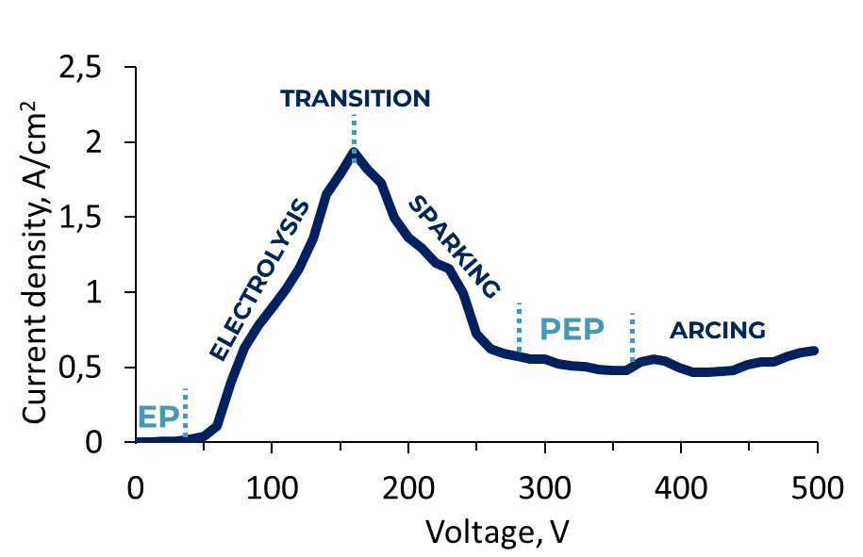
How Does PEP Work?
Electrochemical Cell
High Voltage (300 - 500) Volts
Adequate Current Density
Adequate Temperature

Slide 7
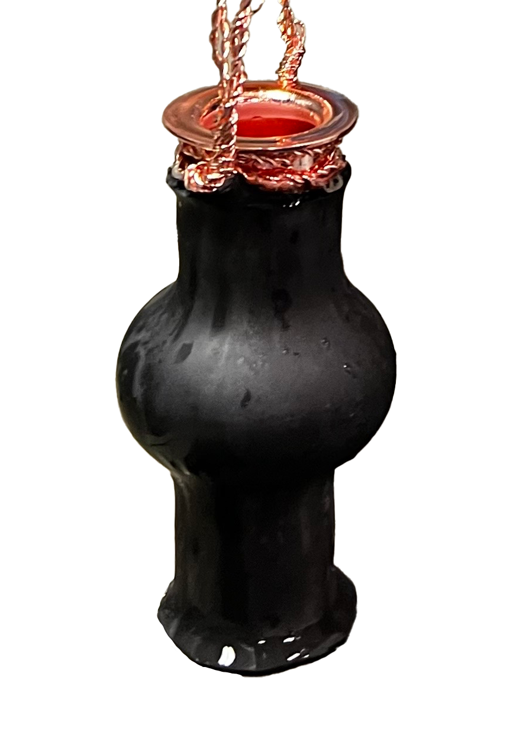
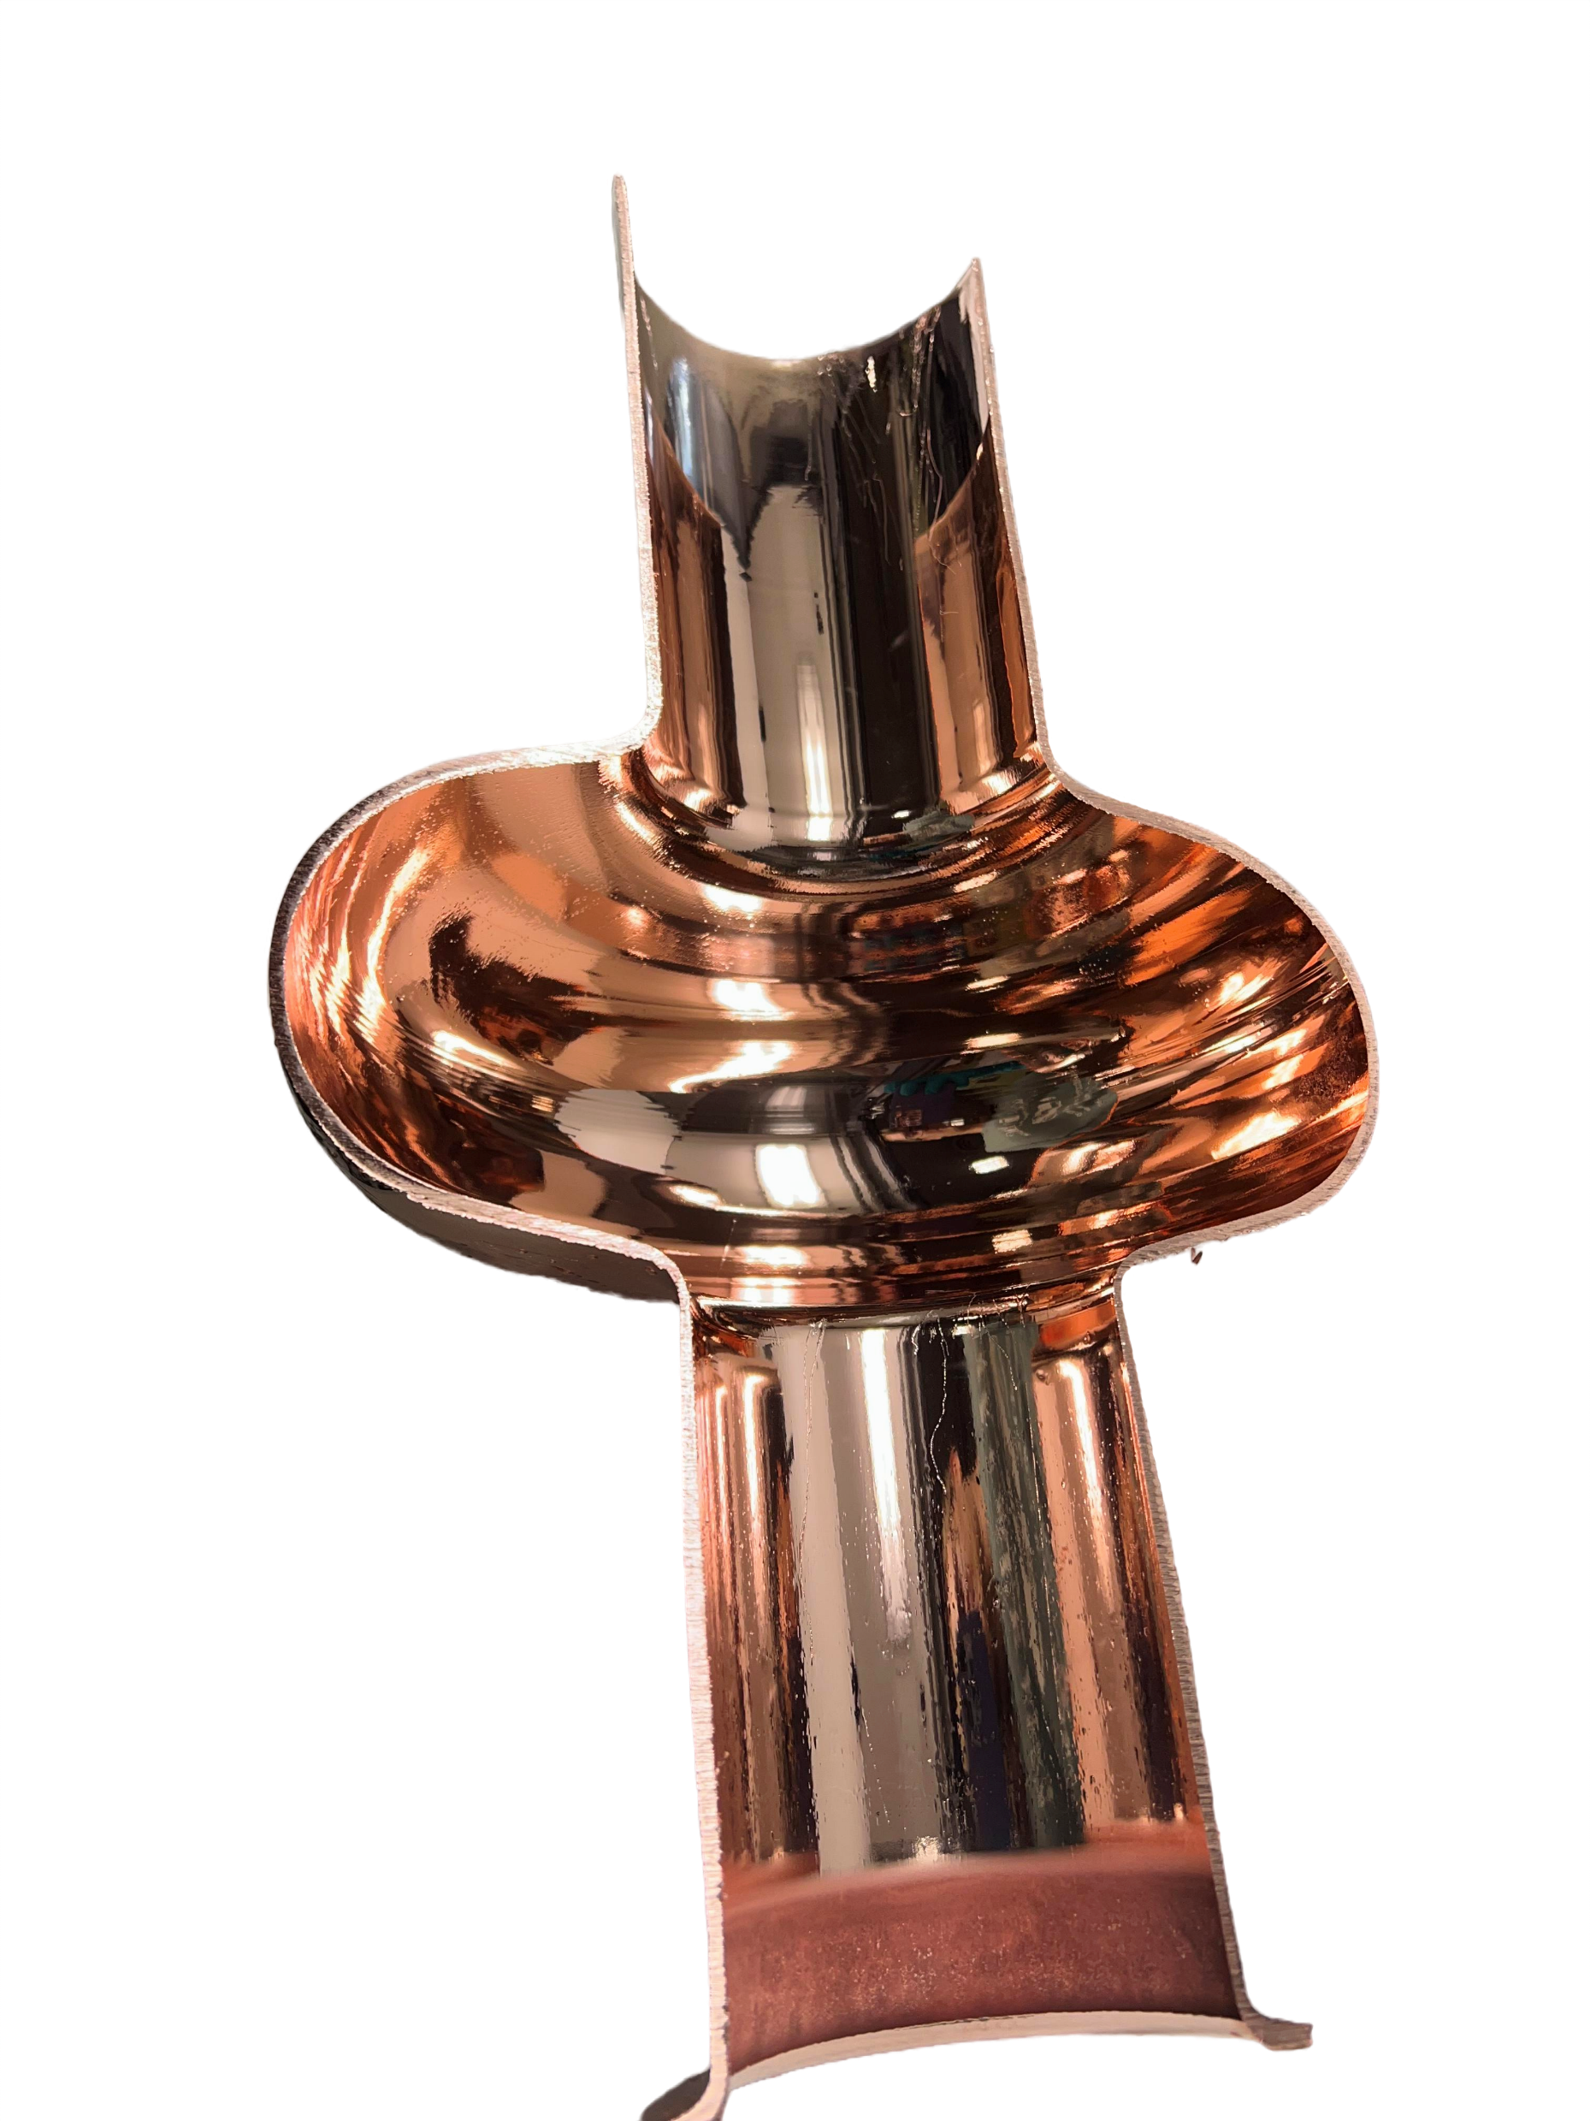
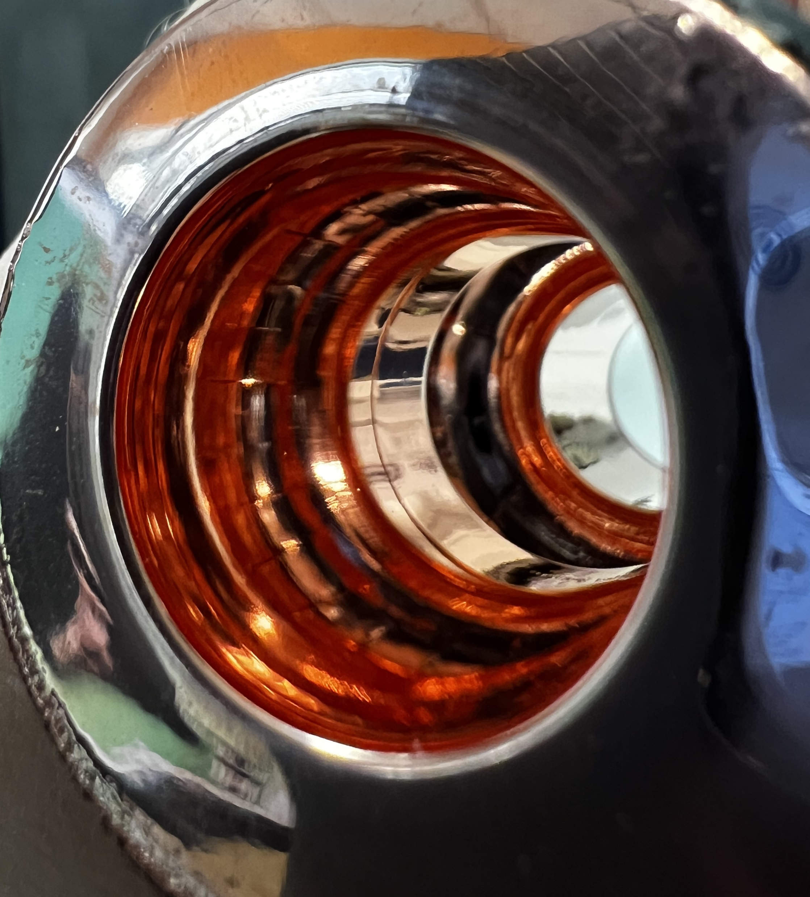
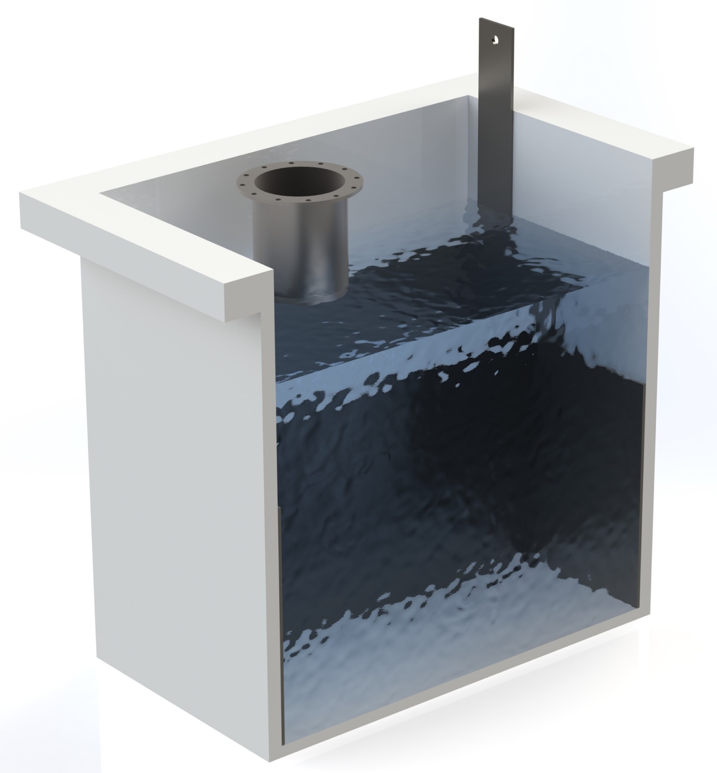
INFN_LNL PEP METHOD
Cathode
E. Chyhyrynets et. al @ SRF’23
6GHz Cavity
1.3GHz Cavity

Slide 8
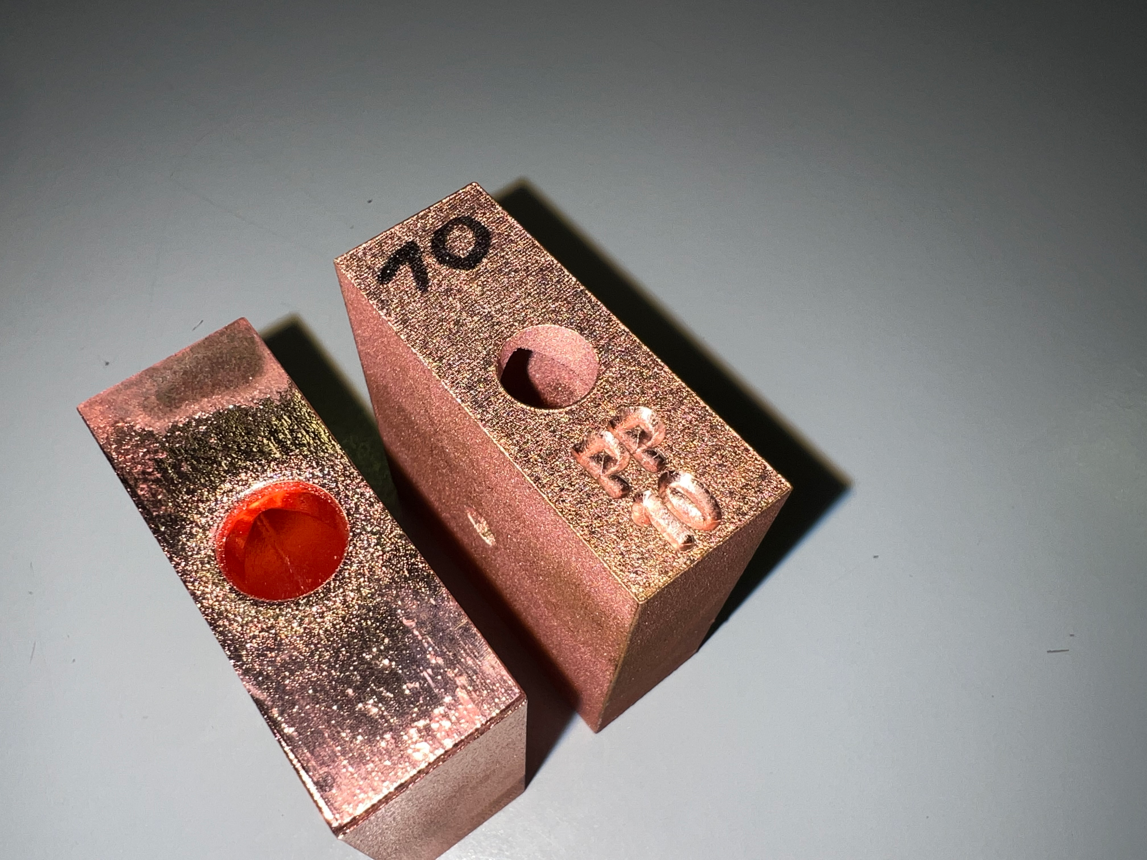
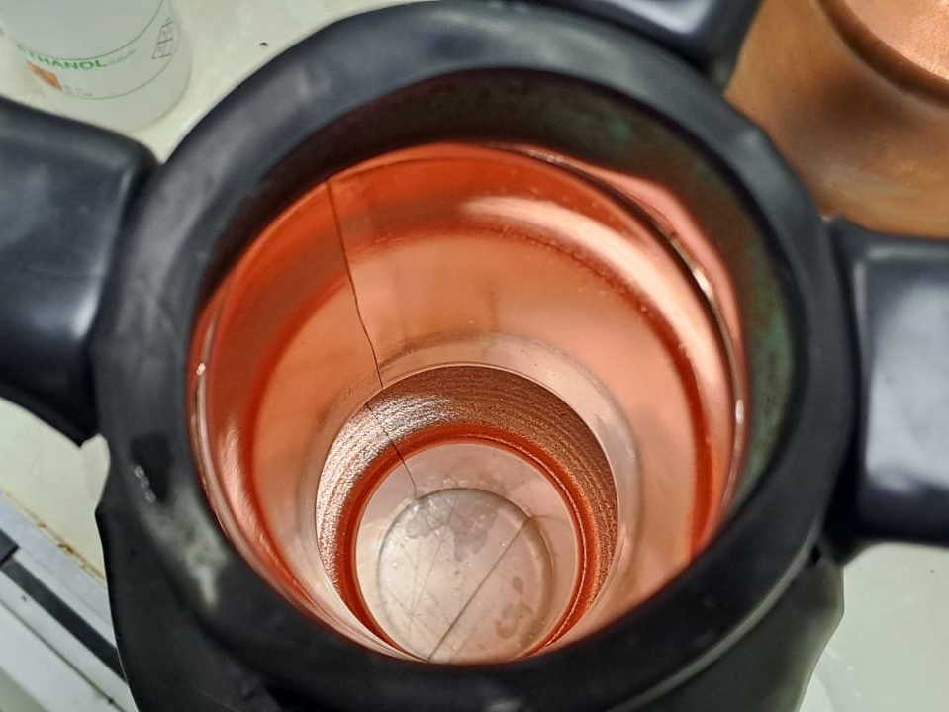
Before & After of some samples

Slide 9
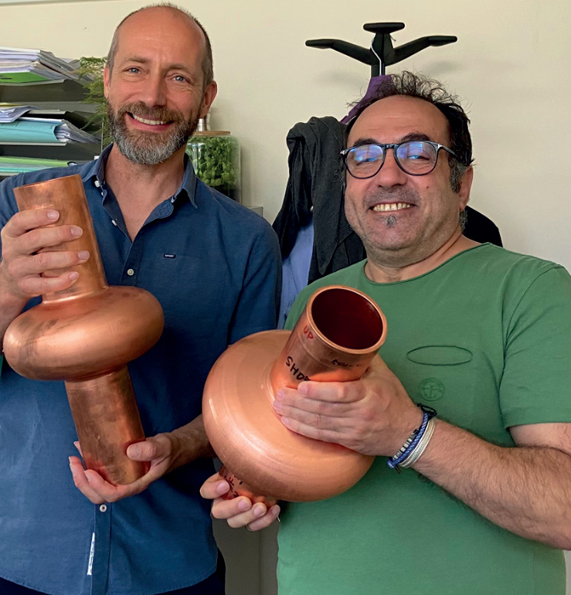
Current Status and Future Steps
6GHz 1.3GHz 400MHz, etc

Slide 10
THANK YOU

