Slide 1
Development and Characterization of Innovative Additively Manufactured Metal Alloys for High and Ultra-High Temperature Applications
Ta-10W
TaWCrV
Alberto Barci

Slide 2
Summary
Introduction to the LPBF process
LPBF of pure Tantalum, analyzing the importance of different process parameters, particularly scanning speed and laser power
LPBF of pure Tungsten, focusing mainly on printing challenges and microcracks
LPBF of Ta-10W, with a comparison to alloys produced using different sintering methods

Slide 3
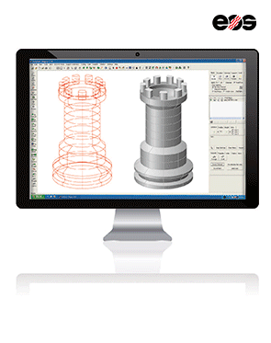
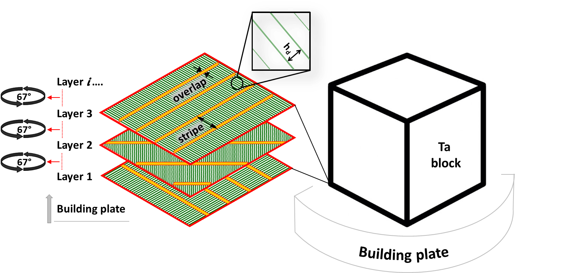
Laser Power Bed Fusion process
Power
Laser
Ta powder
Layer thickness
Ta block
Main parameters:
Laser power
Scanning speed
Layer thickness
Hatching distance
Stripes width
Stripes overlap
Energy density
E_{v}
Power [W] | Speed [mm/s] | Hatch distance [mm] | Layer thickness [mm] | Stripe width [mm] | Stripes overlap [mm] | E_{v} [J/mm³] | Density* [%]
*Archimedes' method

Slide 4
Alloys studied and properties of tantalum and tungsten
 | Ta-10W | TaWCrV
Element | %wt. | %wt.
Ta | 90 | 35-40
W | 10 | 35-40
Cr | - | 12-17
V | - | 8-13
Property | Tantalum (Ta) | Tungsten (W)
Density | 16.65 g/cm3 | 19.25 g/cm3
Melting temperature | 2996 °C | 3410 °C
Hardness | 100 HV | 350 HV
Elastic Modulus (E) | 186 Gpa | 411 GPa
Ultimate tensile strenght (UTS) | 450 MPa | 2000 MPa
Thermal conductivity (k) | 54.4 W/(m*K) | 174 W/(m*K)
Electrical resistivity (p) | 125 nO/m | 52.8 nO/m

Slide 5
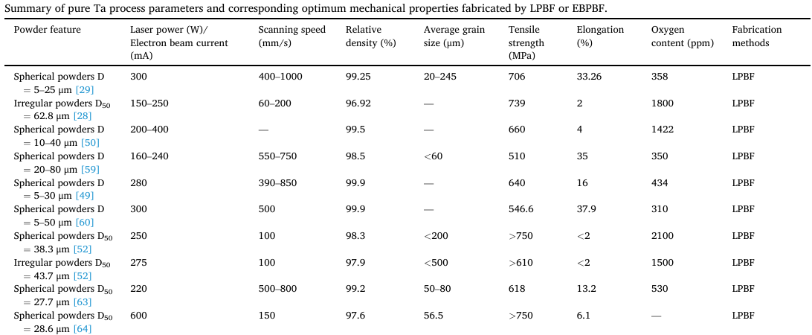
Summary of pure Ta process parameters for LPBF: Zhenyu Yang, Jiangqi Zhu, Bingwen Lu, Yajun Liu, Wenling Shi, Min Liu, Gang Wang, Xingchen Yan, Powder bed fusion pure tantalum and tantalum alloys: From original materials, process, performance to applications, Optics & Laser Technology 177 (2024) 111057, https://doi.org/10.1016/j.optlastec.2024.111057
In the literature, multiple examples of LPBF printing of pure Tantalum can be found.
The printing parameters vary significantly: Laser power: 160-600 W. Scanning speed: 60-1000 mm/s
Final relative densities are very high, reaching up to 99.9%.
No research on thermal and electrical characterization

Slide 6
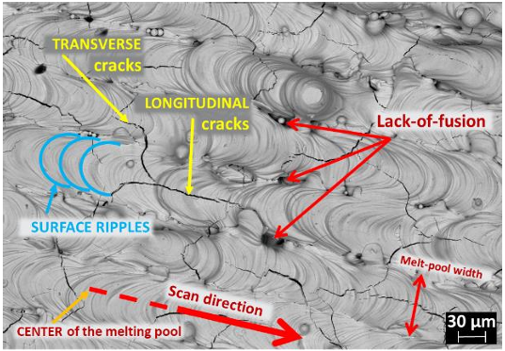
Tungsten - LPBF
Main Challenges in Tungsten printing:
High Melting Temperature (3410°C)
Requires intense laser energy for powder fusion
Difficult to maintain a stable melt pool
High Thermal Conductivity (~174 W/m·K)
Rapid cooling creates high thermal gradients
Leads to thermal stress and microcracks
High Viscosity of the Molten Pool
Reduces flowability, causing "balling" effect
Prevents uniform layer formation
Hardness & Brittleness at Room Temperature
High ductile-to-brittle transition temperature (DBTT: ~200–400°C)
Increases microcrack formation during cooling
Cracking is the biggest challenge in L-PBF Tungsten
Types of Cracks in L-PBF Tungsten​
Longitudinal Cracks: Parallel to laser scanning direction​
Branched/Transverse Cracks: Inclined to the scanning direction

Slide 7
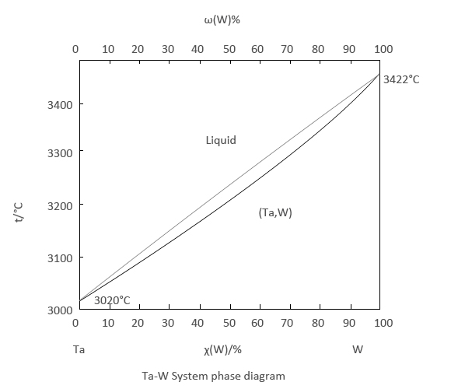
Ta-10W – Applications and properties
Applications: Due to its high density, strength, temperature resistance, and chemical stability, Ta-10W is used in aircraft engines, nuclear reactor shields, and anti-armor systems.
Atomic Compatibility: Tungsten (W) and Tantalum (Ta) have similar electronegativity (Ta: 1.5, W: 1.7) and comparable atomic sizes (Ta: ~0.146 nm, W: ~0.137 nm), enabling them to form a substitutional solid solution.
Potential Challenge: While increasing W content can enhance high-temperature mechanical properties, it may also reduce plasticity at room temperature.
Limited Research: Only one study has been conducted on LPBF printing of Ta-10W so far.

Slide 8
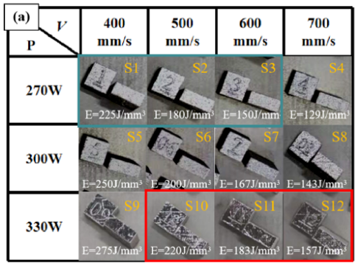
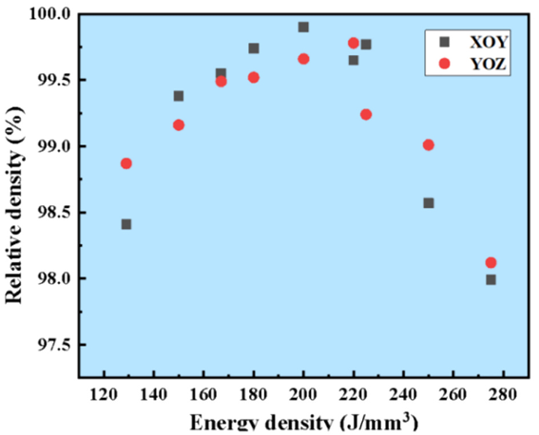
Ta-10W – LPBF: Xuehua Wang, Difei Wang, Yingwei Zhang, Pengting Li, Yi Tan, Lijun Cao, Bin Liu; Characterization of microstructure and mechanical properties of Ta-10W alloy manufactured by laser powder bed fusion; InternationalJournalofRefractoryMetalsandHardMaterials122(2024)106728; https://doi.org/10.1016/j.ijrmhm.2024.106728
Density | >98%
Ultimate tensile strenght | 765 MPa
Yield strenght | 663 MPa
Elongation | 28%
Reduction of area | 66%
High power and speed were used.
Density reaches its maximum at 200 J/mm³.
The measured ultimate tensile strength is higher than that of pure Ta samples.
The fracture surface exhibits a mixture of dimples and tear ridges, indicating a typical combination of ductile fracture and quasi-cleavage fracture.
Top view optical morphology of LPBF fabricated Ta-10W samples at different process parameters
Fracture morphology of the sample made with v=500 mm/s and P=300 W
Relative density graphs at different energy density.

Slide 9
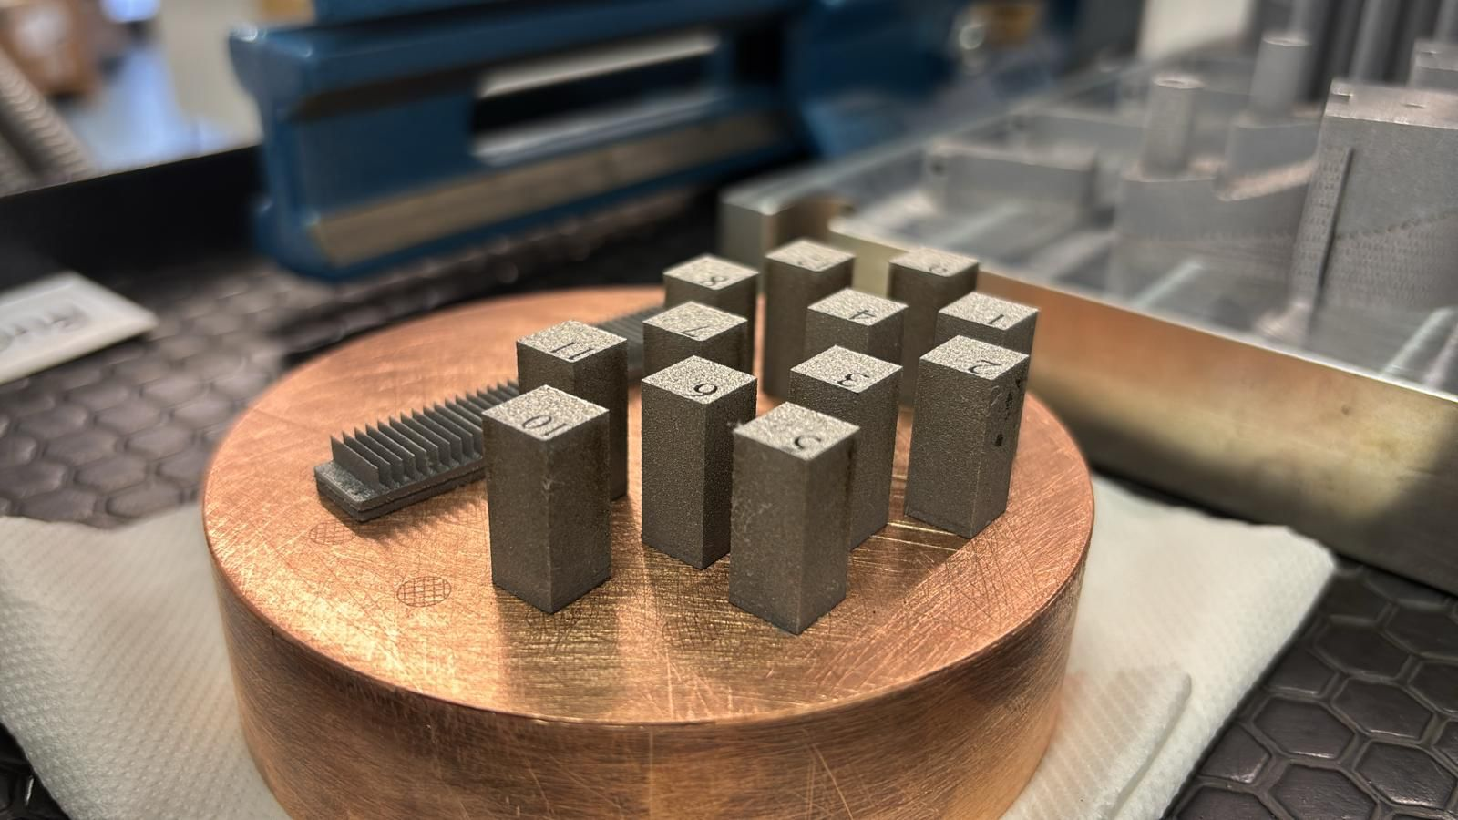
Ta-10W: first samples
The first printing attempts directly on the copper support were stopped after only about 20 layers.
The printing was successful by first creating a 1 mm layer of pure Tantalum and then printing the Ta-10W on top of it.

Slide 10
Future objectives are:
Printing Ta-10W and TaWCrV alloys with high-density parts.
For the Ta-10W alloy, using lower power and speed compared to those reported in the referenced study.
Characterizing the mechanical, electrical, and thermal properties of these two alloys.

Slide 11
Thanks
for the attention

