Slide 1
Advanced design for Additive Manufacturing (DfAM) approaches for cutting-edge applications in Physics and Engineering
TECH-FPA PhD Retreat
17 to 21 February,2025
co LNGS
Room "E. Majorana"
Davide Cester
Supervisor: Serena Graziosi
Co-supervisor: Pietro Rebesan
XL Cicle

Slide 2
Page 2
Agenda
PhD project overview;
Cellular Structures classification;
Design process for AM lattice structures;
Laser Powder Bed Fusion technology;
Defects induced by LPBF process;
Strategies to improve the properties of lattice structures;
Future steps

Slide 3
PhD PROJECT
Page 3
Investigation of the impact of PROCESS INDUCED DEFECTS on mechanical and thermal properties in different cellular structures: building a predictive model to estimate difects’ distribution of given structures based on their measured properties (e.g. E, λ, α).
Design of lattice structures with tailored thermo-mechanical properties, suitable for high temperature applications.
EXAMPLE OF POSSIBLE APPLICATION
The joint of different materials, is a challenge in many nuclear devices, like for example the components for the cooling of divertor (in ITER and DEMO).
Interface between different materials is the most critical zone, expecially when there is a relevant difference on the Coefficient of Thermal Expansion (e.g. W and CuCrZr).
Lattice structures enable to adjust and modify the properties of bulk materials, so
an overall control and understanding of the final properties of the produced components is crucial in these applications.

Slide 4
CELLULAR STRUCTURES
Complex spatial configurations where the volume space is divided by a network of solid and porous phases. According to their connectivity (topology) and pore morphology can be divided in:
Page 4
Foams (stochastic topology and irregular pore morphology)
Lattice cellular materials (non-stochastic topology and regular pore morphology)
2D
OPEN CELLS
CLOSED CELLS
3D
HONEYCOMB STRUCTURE
VORONOI
CUSTOM
STRUT AND NODE
TPMS

Slide 5
DESIGN PROCESS OF ADDITIVE MANUFACTURED LATTICE STRUCTURES
Page 6
In the preliminary phase of functional targets and unit cell size definition, an analytical model based on the impact of geometrical features could be evaluated.
To decide the unit cell sizing, it’s important to take into account manufacturing constraints, like the dimension of the voids for powder removal.
The population of Design space can be uniform or conformal

Slide 6
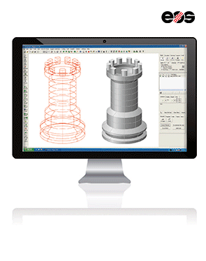
LASER POWDER BED FUSION TECHNOLOGY
Page 7
Additive Manufacturing technology where the metallic powder is melted using a laser beam, in a layer-by-layer process.
DIAM GROUP: ‘DIAM is a workgroup of the INFN Padova section. Its focus is to carry on scientific and technological research on Additive Manufacturing (AM), in particular using Laser Powder Bed Fusion (LPBF) technology’.
ADVANTAGES
DISADVANTAGES
Defects like cracks, spatter, lack of fusion, keyhole;
Residual stresses;
Inner channels depowdering;
Supports removal;
Limited dimensions;
Overall control of the process.
Net - shape process;
Better control and precision on geometries;
No tools needed;
Lower waste of material;
Very complex shapes;
Faster process.

Slide 7
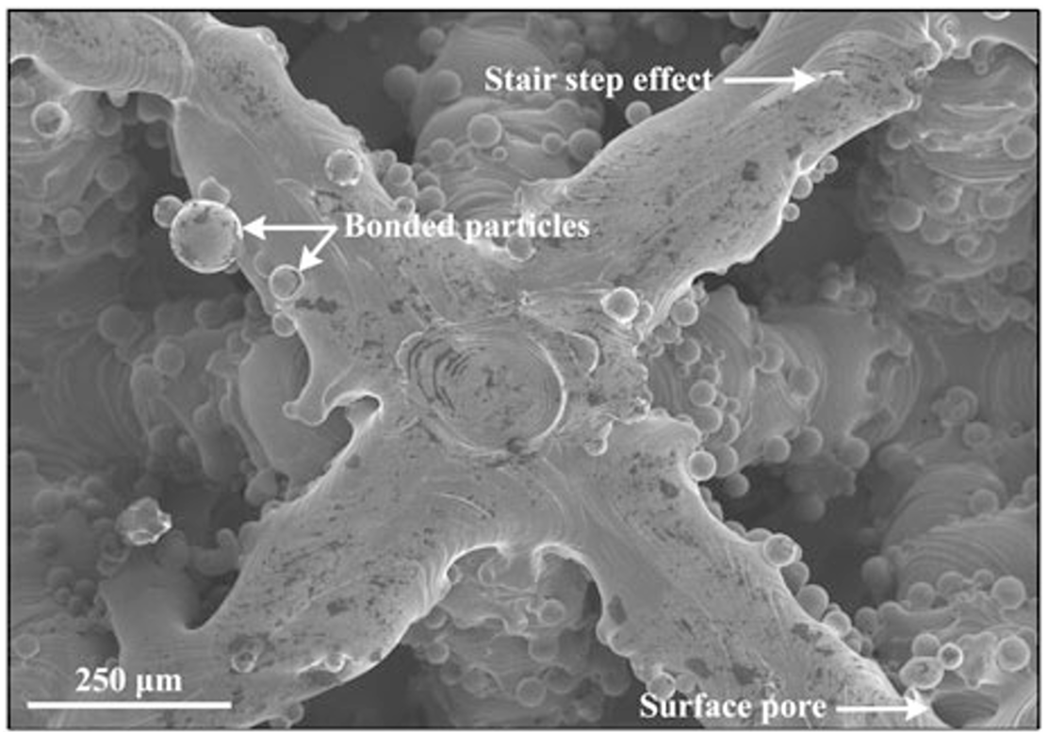
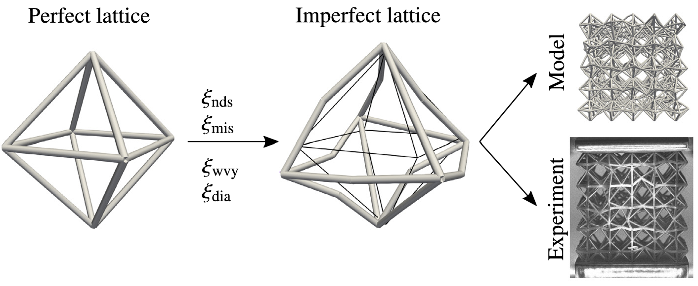
DEFECTS INDUCED BY LPBF PROCESS
Page 8
Defects always arise from Additive Manufacturing processes. These lead to a decreasing on the expected properties of final components.
This problem is one of the culprits preventing lattice structures and metamaterials from their entrance into many real-life applications.
There are GEOMETRICAL and MATERIAL’S defects
It is fundamental also to include defects in CAD models and take them into account during the simulations.

Slide 8
Different strategies can be implemented to improve the behavior of lattice structures... the most common are:
Page 9
1) Introduce a Hierarchical design;
2) Application of Boundary strengthening principles in analogy with polycristals;
3) Topological and structural modification of the lattices depending on external loads;
4) Control on the distribution of the void phase inside the lattice structure;
5) Functionally-graded lattices;
6) Combination of different materials.
(1)
(2)
(4)
(3)
(5)

Slide 9
Future Steps
Page 10
Define a proper set of unit cell types and the material to be used to produce lattices using LPBF technology;
Collect a large set of data from experimental test (to be decided) and simulations on mechanical and thermal properties of representative lattices;
Adjust CAD geometries according to produced lattices and simulate their properties, in order to be able to predict the impact of process-induced defects.

Slide 10
Thank you for the attention

