Slide 1
System engineering
(in astronomical instrumentation)
Marco Riva
(INAF Astronomical Observatory of Milan)

Slide 2
System engineer for multidisciplinary engagment in Fundamental Research in Physics and Astrophysics Marco Riva
TECH-FPA PhD Retreat
17 to 21 February,2025
co LNGS
Room "B. Pontecorvo"

Slide 3
Outline
System engineering
What is system engineering
Why System Engineering?
How system Engineering?
Toward the future
Practical example

Slide 4
System Engineering what is this????

Slide 5
System Engineering what is this????

Slide 6
System: what is a system?

Slide 7
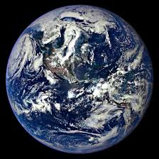
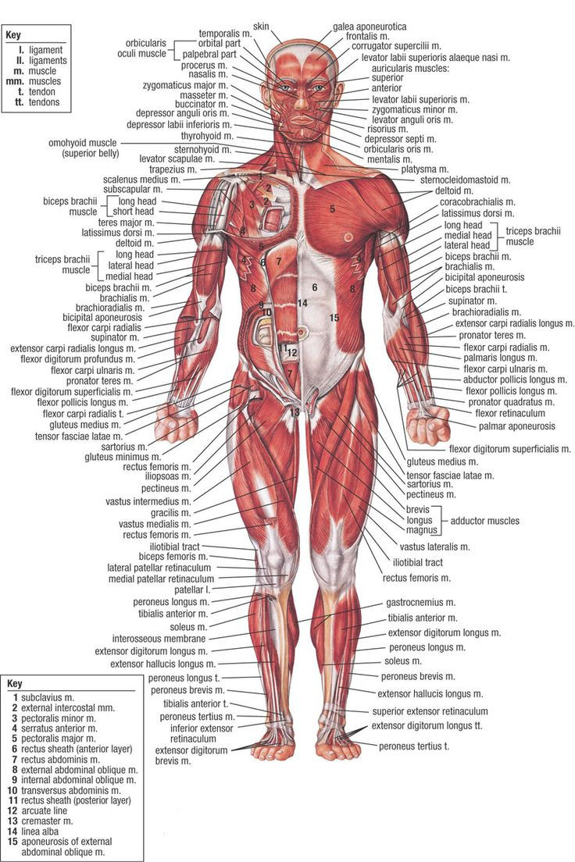
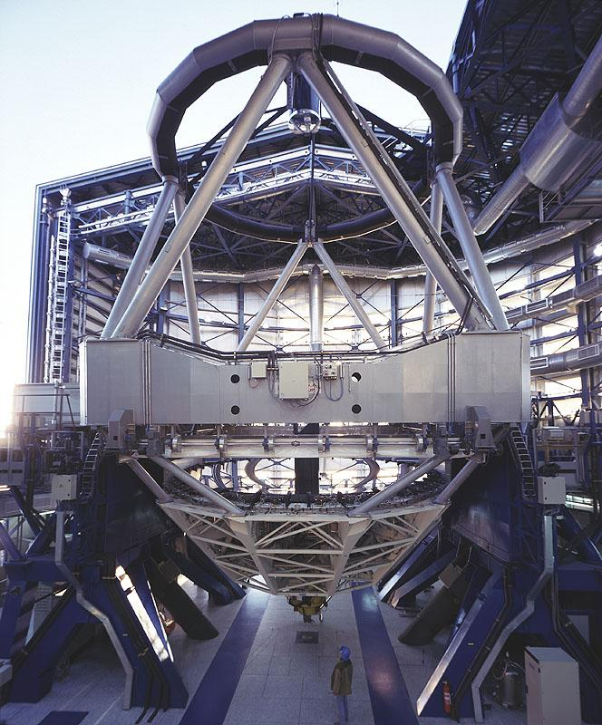
System: what is a system?

Slide 8
Engineered system

Slide 9
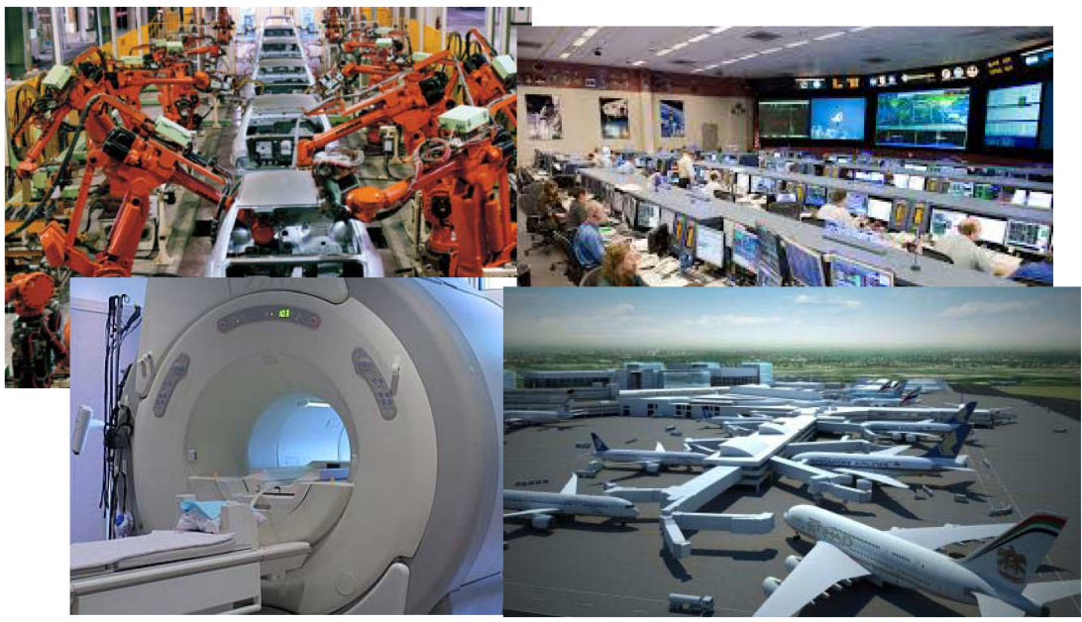
Engineered system

Slide 10
System Engineering what is this????

Slide 11
Need Vision Deilvery
Need: All design begins with a clearly defined need
Vision: all design arise from a creative response to a need
Delivery: all designs results in a system, product or project which meets the need

Slide 12
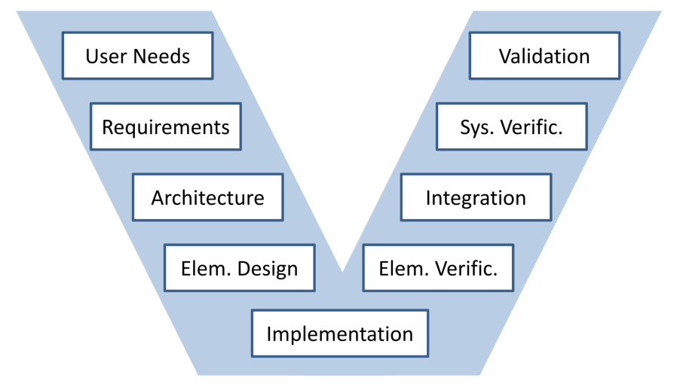
«V» System Development Model
Need

Slide 13
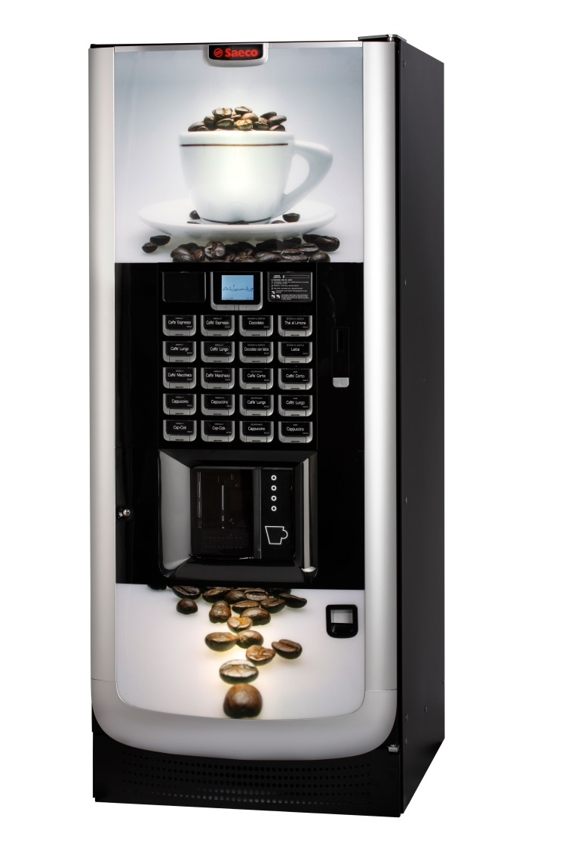
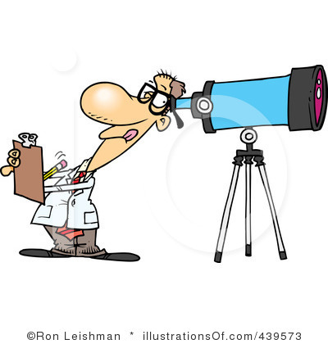
The birth of a project

Slide 14
«V» System Development Model
Need
Vision

Slide 15
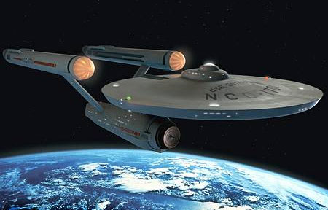
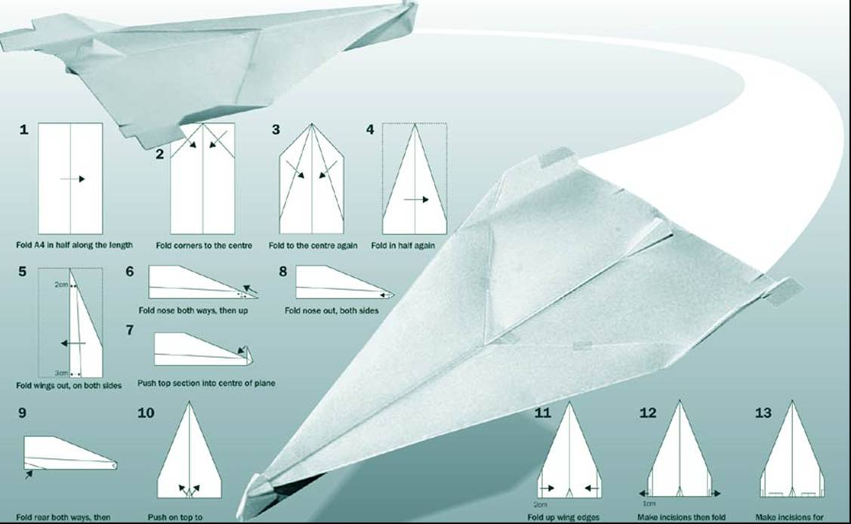
First Iteratcion

Slide 16
«V» System Development Model
Need
Delivery
Vision

Slide 17
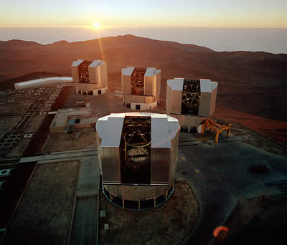
Final result

Slide 18
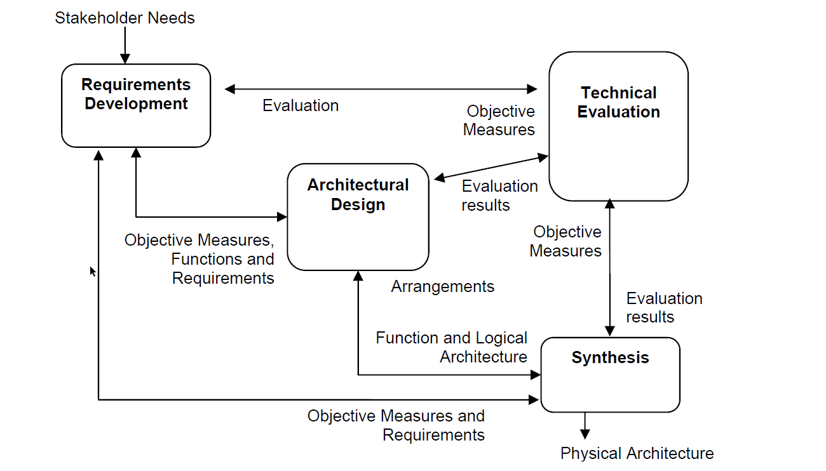
Systematic Design Process Models

Slide 19
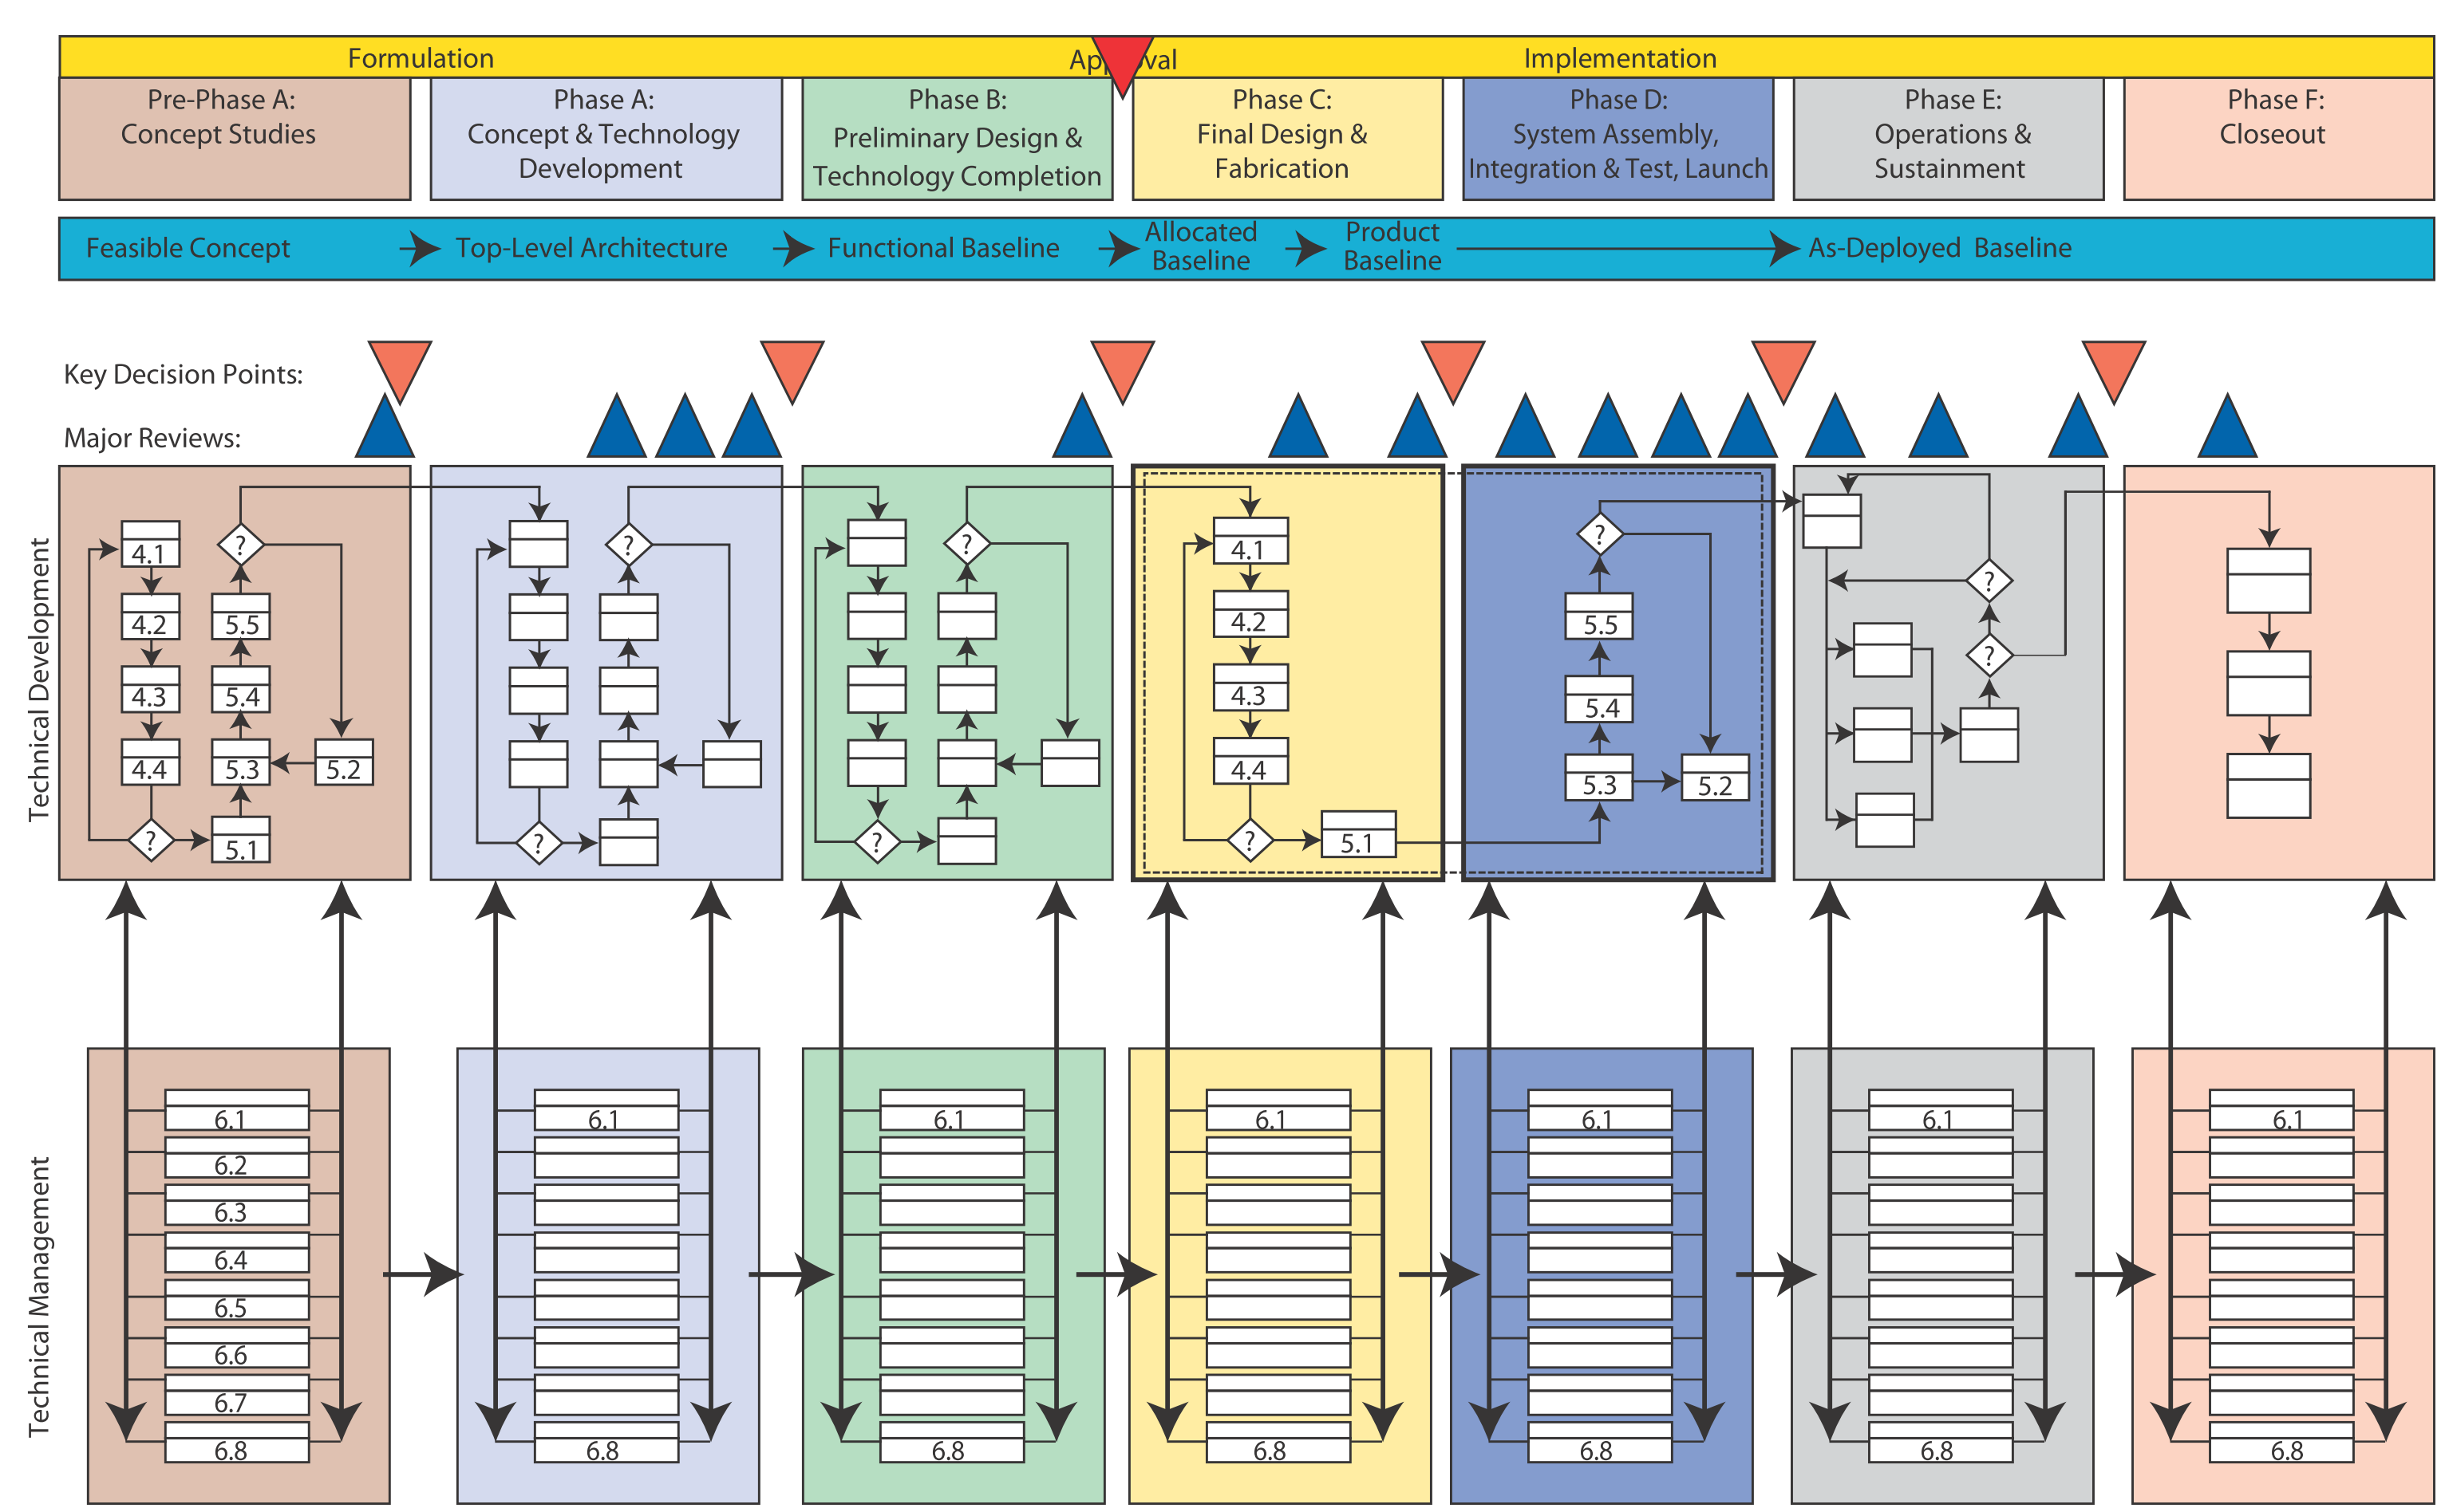
Project phases (NASA view)

Slide 20
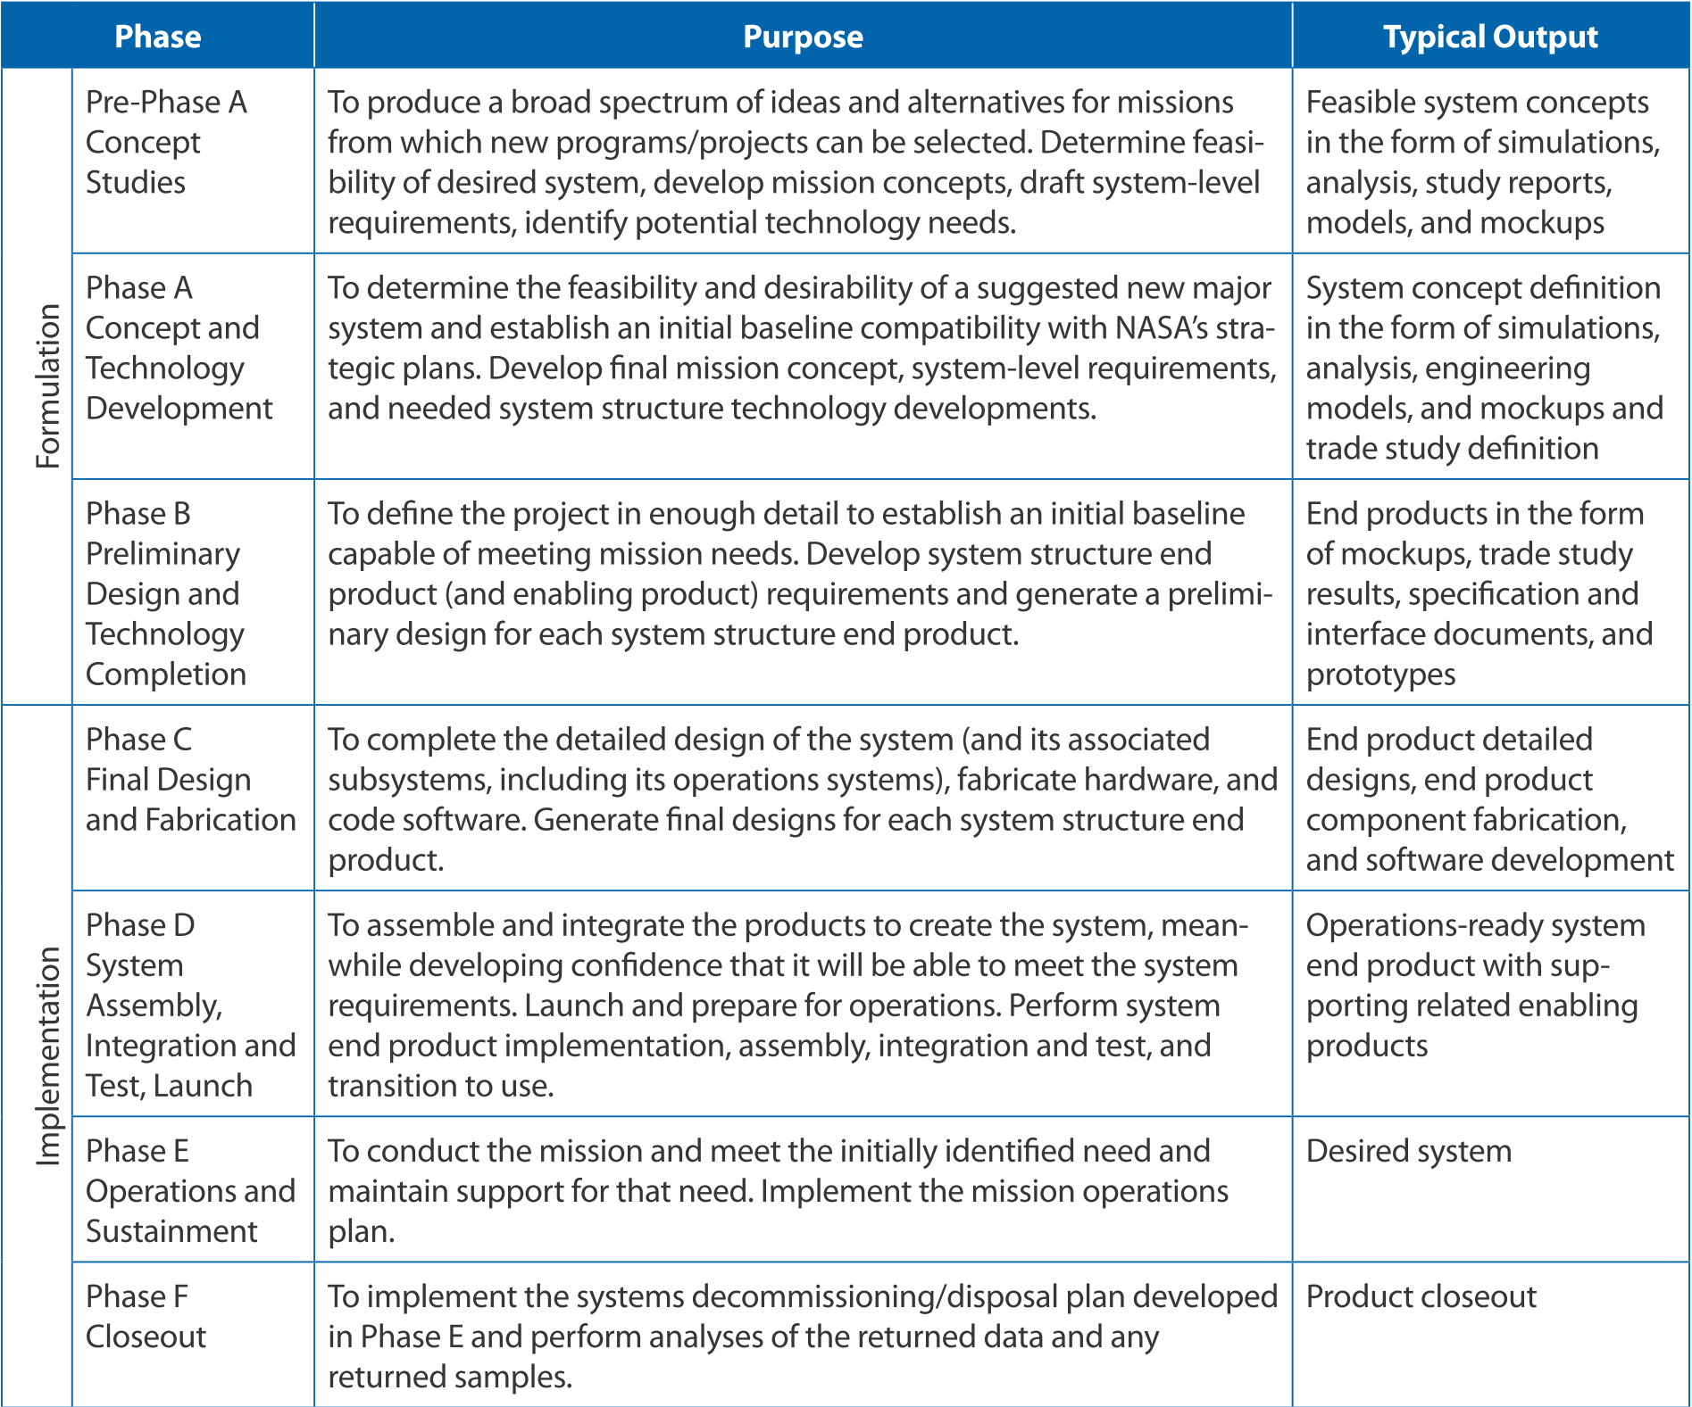

Slide 21
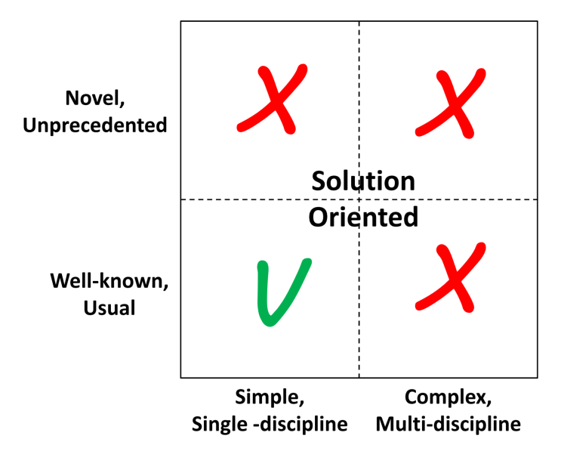
Solution or problem oriented?

Slide 22
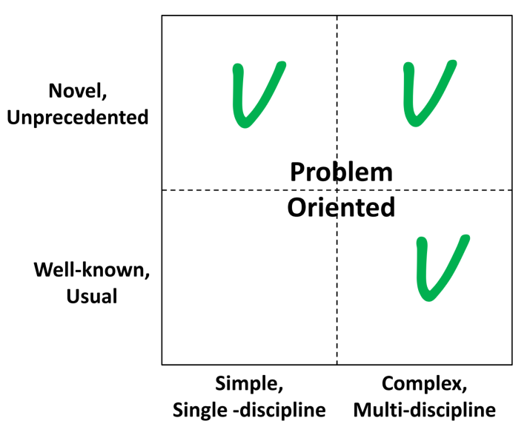
Solution or probelm oriented?

Slide 23
System Engineering why is needed????

Slide 24
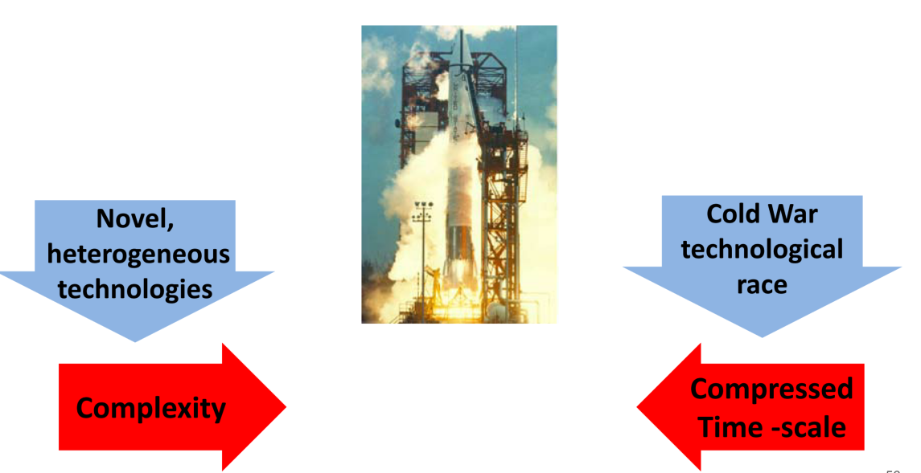
A dangerous mix

Slide 25
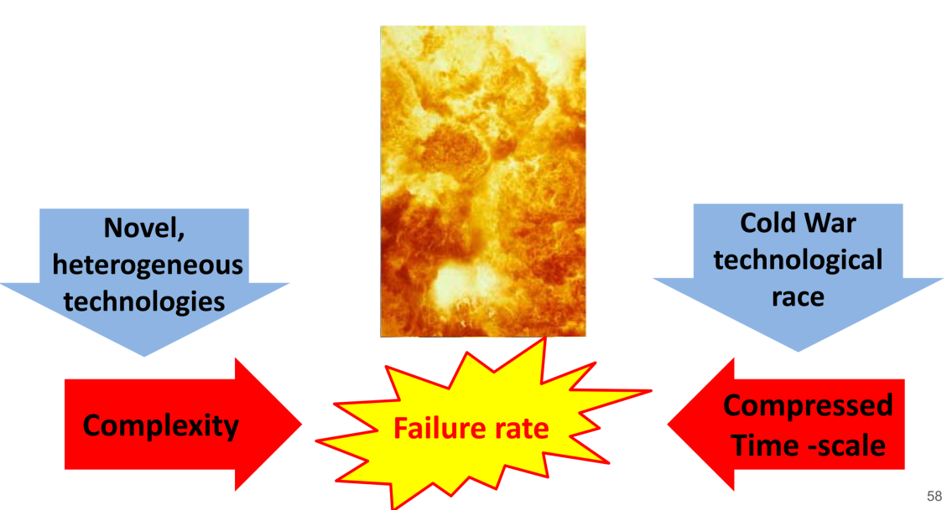
A dangerous mix

Slide 26
System Engineering How is made????

Slide 27
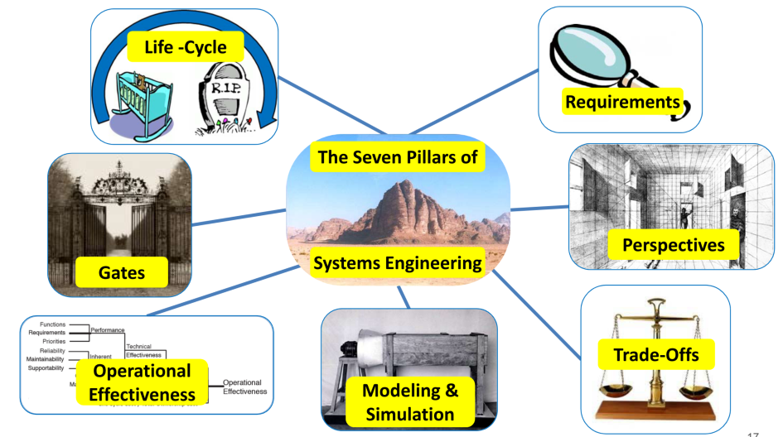
7 «Pillars» of SE

Slide 28
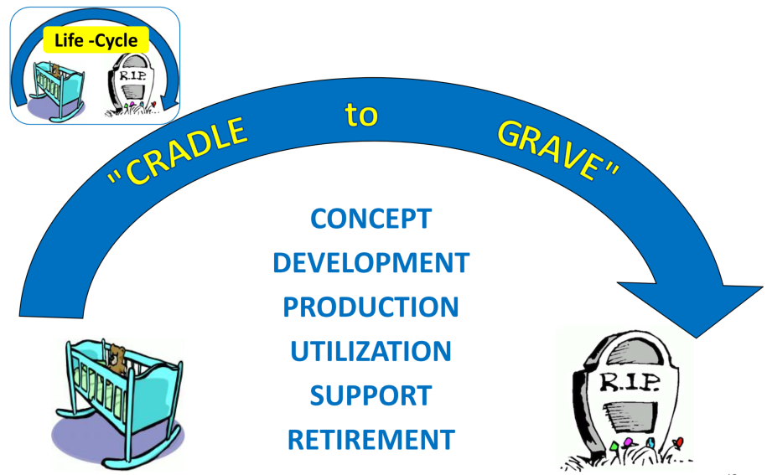
1 - Life Cicle

Slide 29
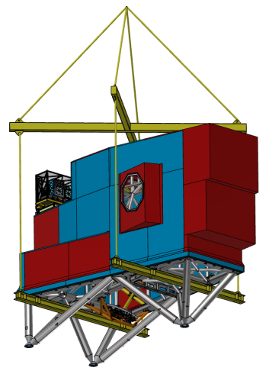
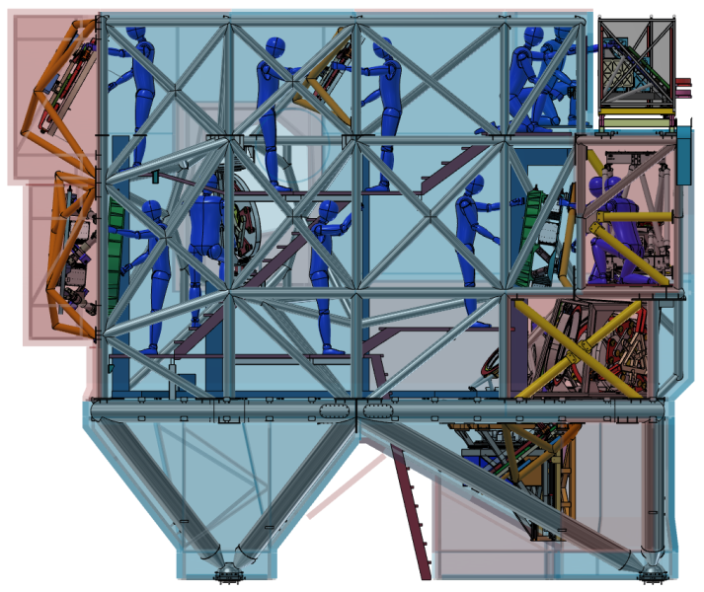
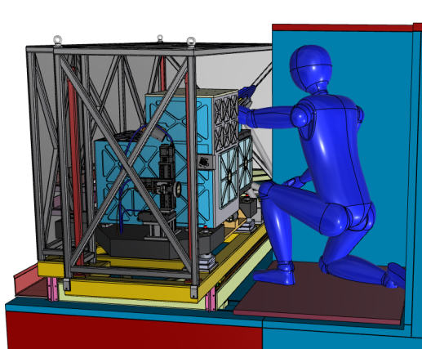
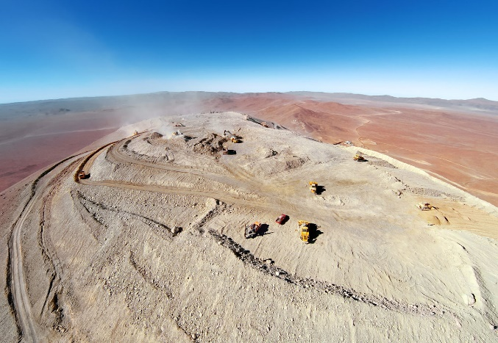
Manufacturing
Handling
Integration Maintenance
Courtesy V.De Caprio
Decommissioning

Slide 30
2 - Gates

Slide 31
Gates in reality
Needs to be held by Experts (aknowledge)!
No conflict of interest!
Intellectual honesty on both sides
Target of the review has to be declared in advance

Slide 32
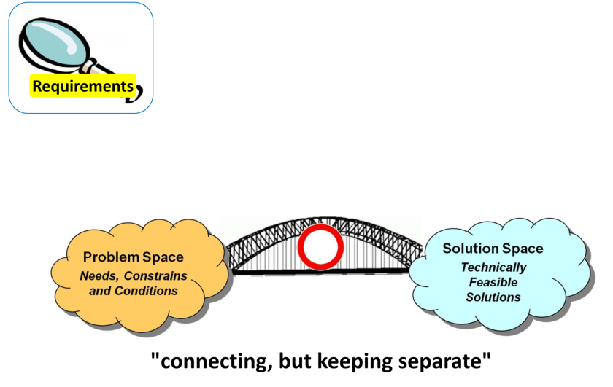
3 - Requirements

Slide 33
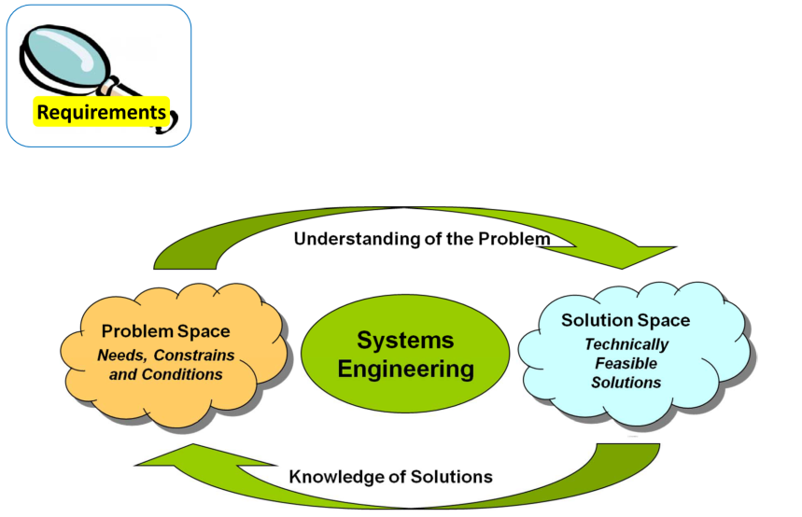
3 - Requirements

Slide 34
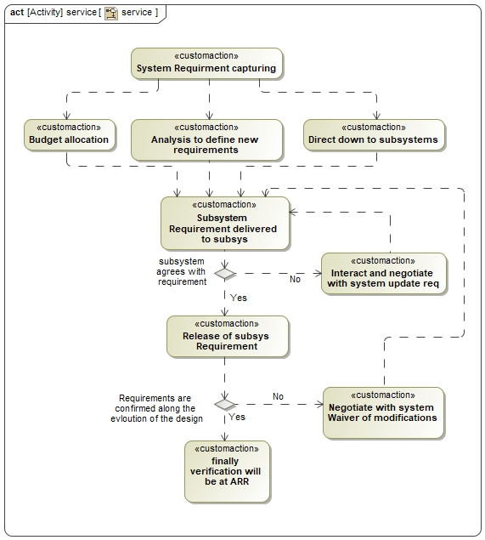
Requirement process

Slide 35
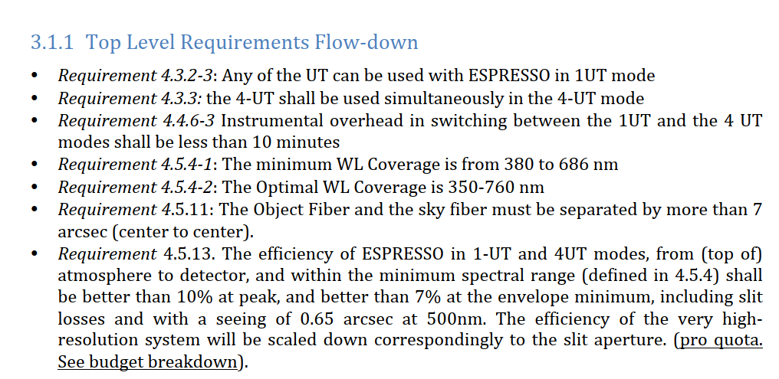
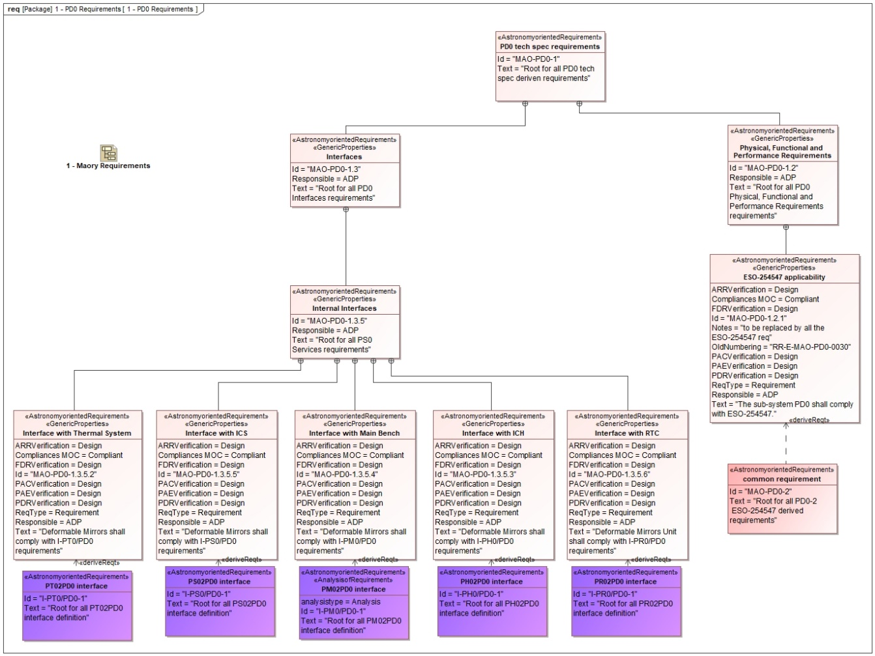
Requirment management

Slide 36
4 - Perspectives

Slide 37
Multiple Technologies
Edge technology for unique products
Optical Engineering
Software Engineering
Thermo/fluido-dynamics
Telescope/ instruments design
Structural Engineering
Electronic Engineering
Science

Slide 38
Multiple Technologies
Adverse Interaction
Optical Engineering
Software Engineering
Thermo/fluidoynamics
Telescope/instruments design
Structural Engineering
Electronic Engineering
Science

Slide 39
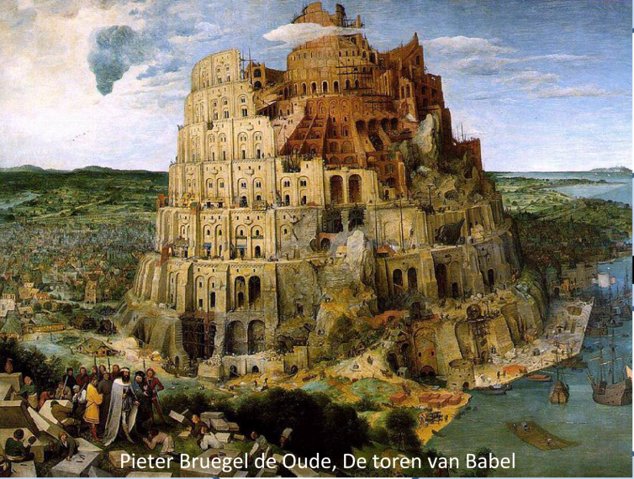
Multiple Technologies
Poor Comunications
Optical Engineering
Software Engineering
Thermo/fluidoynamics
Telescope/instruments design
Structural Engineering
Electronic Engineering
Science

Slide 40
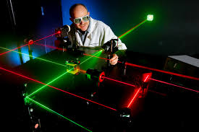
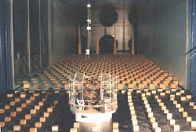
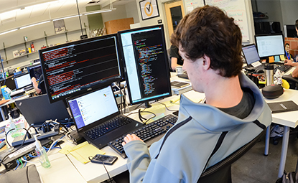
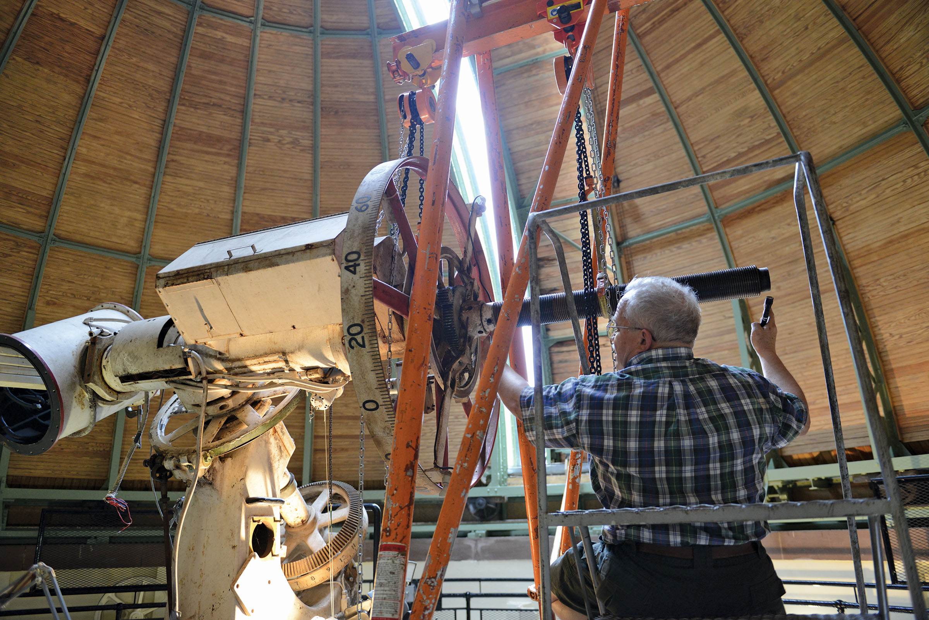
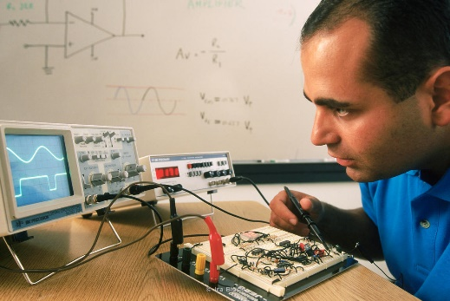
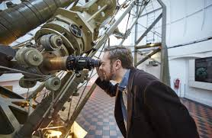
Different Engineering worlds
Optical Engineering
Software Engineering
Thermo/fluidoynamics
Telescope/ instruments design
Structural Engineering
Electronic Engineering
Science

Slide 41
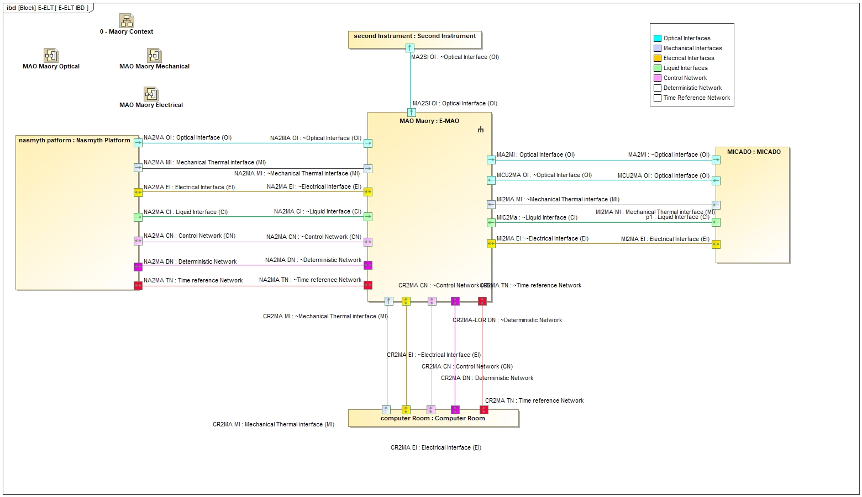
Maory Interface Management

Slide 42
5 – Simulation and modeling

Slide 43
Science module
Atmospheric module
Telescope module
Calibration unit
Front End unit
Fiber Link Unit
Light path
Data & Logic path
Image simulator
1st &2nd order
Detector module
Spectrograph unit

Slide 44
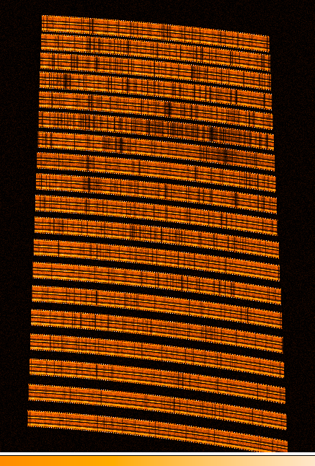
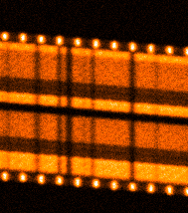
Synthetic Images
Etalon
Object + sky contribution

Slide 46
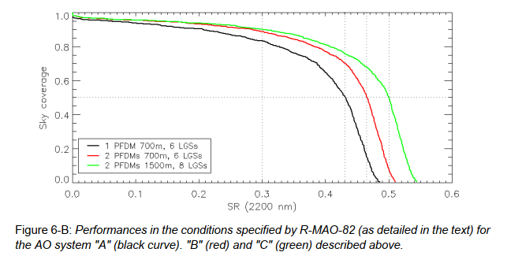
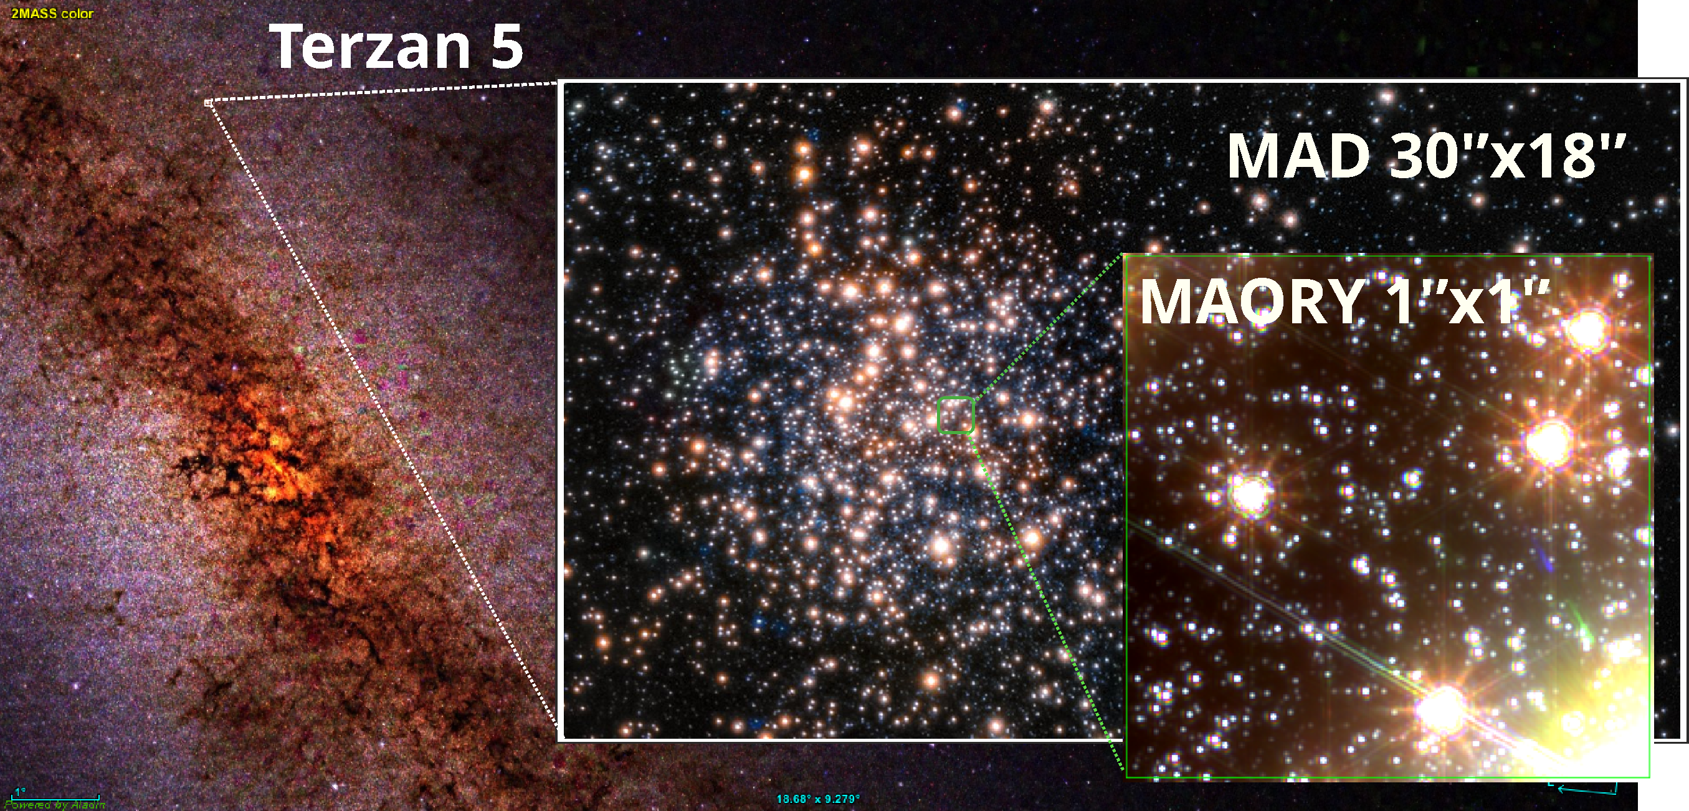
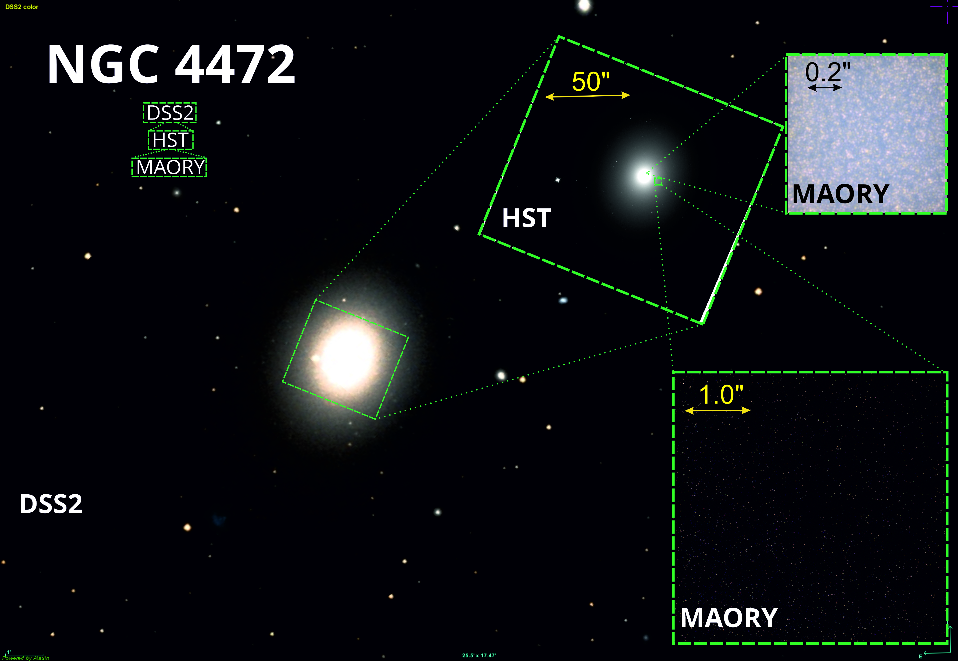
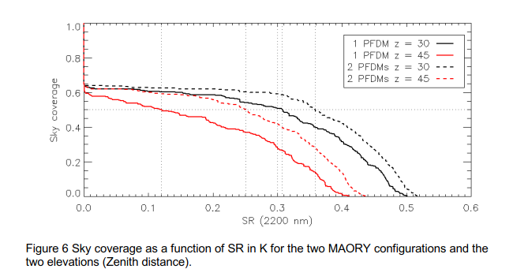
Performance Evaluation and Instrument Layout

Slide 47
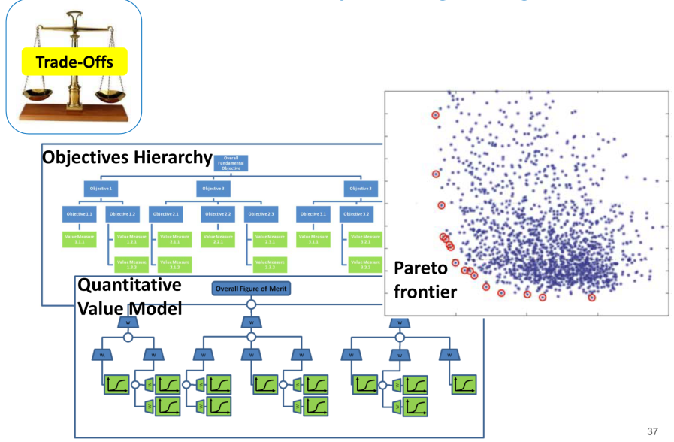
6 – Trade Offs

Slide 48
Comparisons
Comparison at various levels
Items and weights to be selected in advance
Measures of Performance (MOP): measures derived from the dimensional parameters (both physical and structural) and measure attributes of system behaviour. MOPs quantify the set of selected parameters.
Measures of Effectiveness (MOE): measure of how a system performs its functions within its environment. An MOE is generally an aggregation of MOPs.
Measures of Systems Effectiveness (MOSE): measure of how a system of systems performs its mission.
Decision Criteria
Pugh method (- and + no different weights)
Kepner-Tregoe (predefined weights per category)
Analytic Hyerarchy process (take into account interdepndednt weights)
Final Choice is technical?

Slide 49
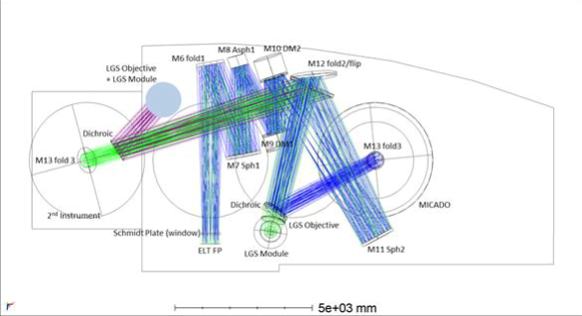
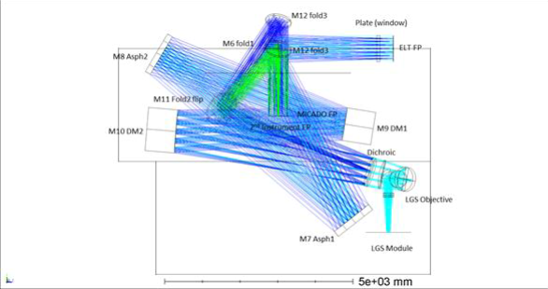
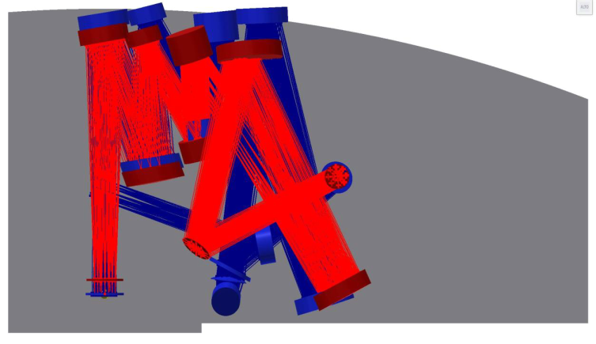
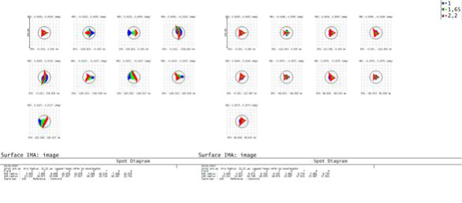
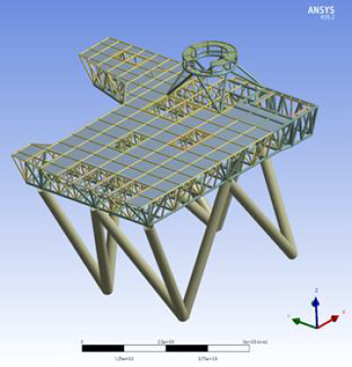
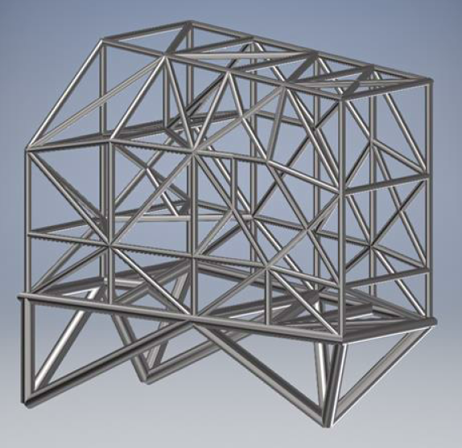
Comparisons

Slide 50
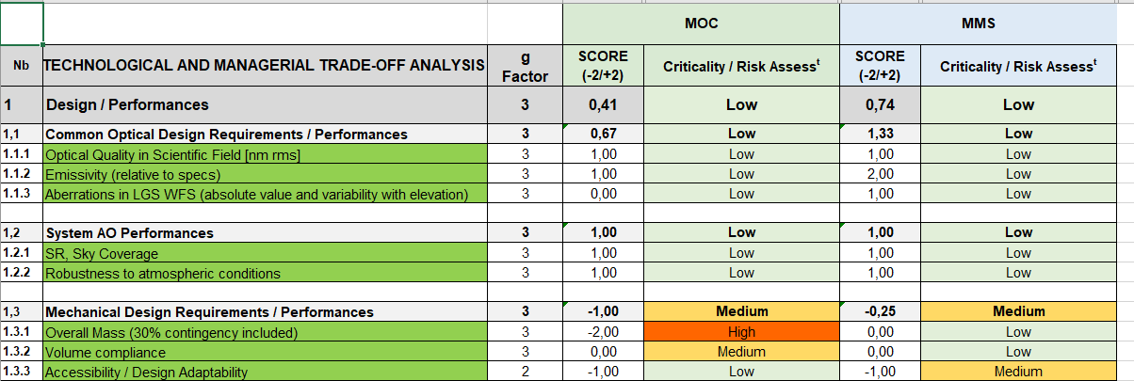

Slide 51
7 – Operational Effectiveness

Slide 52
System Use cases
AIV

Slide 53
System Use cases
Calibrations

Slide 54
System Use cases
Operations
Procedures
Duty Cicles

Slide 55
System Use cases
Maintenance
Procedures
Accessibility

Slide 56
System Engineering the skills

Slide 57
System Engineering compentences

Slide 58
Project Management Or System Engineer?

Slide 59
System Engineering toward the future

Slide 60
Systematic Design Process Models

Slide 61
V shape in practice

Slide 62
From document to model

Slide 63
Model Based System Engineering

Slide 64
MBSE in practice

Slide 65
Thanks!

Slide 66
So what? Let’s work toghether!

Slide 67
System Engineering of Hires @ ELT: a practical example
http://www.brera.inaf.it/utenti/mriva/cameo_hires/

Slide 68
Top level requirement game
The Instrument shall provide a spectral resolution of at least 100000.
The Instrument shall provide at least 2 (3 goal) pixels per resolution element.
The instrument shall provide simultaneous and as complete as possible spectral coverage of the 500-1800 nm wavelengths range. Small gaps in regions of poor atmospheric transmission may be tolerated.
The instrument shall achieve a medium-term stability of accuracy better than 1m/s between 500 and 1800 nm.

Slide 69
Top level requirement game
The Instrument shall provide a spectral resolution of at least 100000.
The Instrument shall provide at least 2 (3 goal) pixels per resolution element.
The instrument shall provide simultaneous and as complete as possible spectral coverage of the 500-1800 nm wavelengths range. Small gaps in regions of poor atmospheric transmission may be tolerated.
The instrument shall achieve a medium-term stability of accuracy better than 1m/s between 500 and 1800 nm.

Slide 71
Top level requirement game
The Instrument shall provide a spectral resolution of at least 100000.
The Instrument shall provide at least 2 (3 goal) pixels per resolution element.
The instrument shall provide simultaneous and as complete as possible spectral coverage of the 500-1800 nm wavelengths range. Small gaps in regions of poor atmospheric transmission may be tolerated.
The instrument shall achieve a medium-term stability of accuracy better than 1m/s between 500 and 1800 nm.

Slide 73
Top level requirement game
The Instrument shall provide a spectral resolution of at least 100000.
The Instrument shall provide at least 2 (3 goal) pixels per resolution element.
The instrument shall provide simultaneous and as complete as possible spectral coverage of the 500-1800 nm wavelengths range. Small gaps in regions of poor atmospheric transmission may be tolerated.
The instrument shall achieve a medium-term stability of accuracy better than 1m/s between 500 and 1800 nm.

Slide 75
Top level requirement game
The Instrument shall provide a spectral resolution of at least 100000.
The Instrument shall provide at least 2 (3 goal) pixels per resolution element.
The instrument shall provide simultaneous and as complete as possible spectral coverage of the 500-1800 nm wavelengths range. Small gaps in regions of poor atmospheric transmission may be tolerated.
The instrument shall achieve a medium-term stability of accuracy better than 1m/s between 500 and 1800 nm.

