Slide 1
Summary about 1st year of PhD and perspectives on 2nd year
Politecnico di Bari, Università di Padova Tutors: Nicola Giglietto, Leonardo Di Venere
S. Camposeo, February 2025, PhD in Technologies for Physics and Astrophysics, Curriculum Detectors, optics and lasers
Graduated in Physics (Astrophysics curriculum, 2023, Lecce)

Slide 2
General resume about activities of 1°year and first months of 2° year
- Courses: Particle detectors in space (S.Loporchio), exam given in April 2024 New technologies for Cherenkov telescopes (S.Loporchio), exam given in July 2024 Scintillators and Silicon photomultipliers (E.Bissaldi), exam given in July 2024 Simulations for scintillator-based detectors (D.Serini), exam given in November 2024 Evolution of active galaxies (F.Ricci, external course), scheduled for February 2025

Slide 3
General resume about activities of 1°year and first months of 2° year
Main Research: Physics + Technological research - Analysis of FermiLAT data (in particular, currently, study of Jupiter as hypothetical source of gamma rays produced by dark matter annihilations); - Study of models describing dark matter capture (Asteria Python package); - Geant 4 simulations ongoing about future APT/ADAPT detectors, running on local High-Performance-Computing system (provided by INFN).
- Other activites: - Kick-off Meeting of PhD students in Padova, July, 2024 - Gravigamma workshop 5th edition, Bari, October, 2024 - Parallel research ongoing regarding planetary science topics.

Slide 4
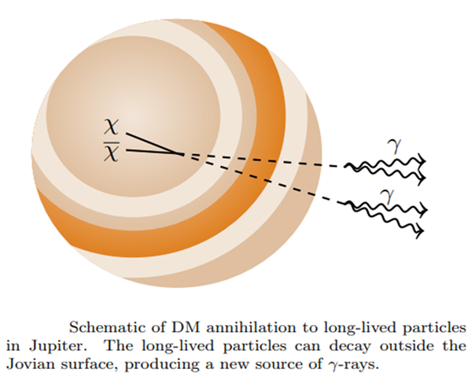
Main Research Activity
Important document for this research is the following paper: First Analysis of Jupiter in Gamma Rays and a New Search for Dark Matter [Rebecca K. Leane and Tim Linden, DOI:10.48550/arXiv.2104.02068]. Besides typical mechanisms (inverse Compton scattering or neutral pion decay), also “exotic” mechanisms of gamma-ray production should be considered.
In particular, annihilation between two DM particles (if they are Majorana particles X=X̄) could yield two scalar mediators $φ$ (with spin 0) and each mediator should fastly decay producing two gamma rays: $X \text{X}\text{̄}→ φ φ → 4γ$ .

Slide 5
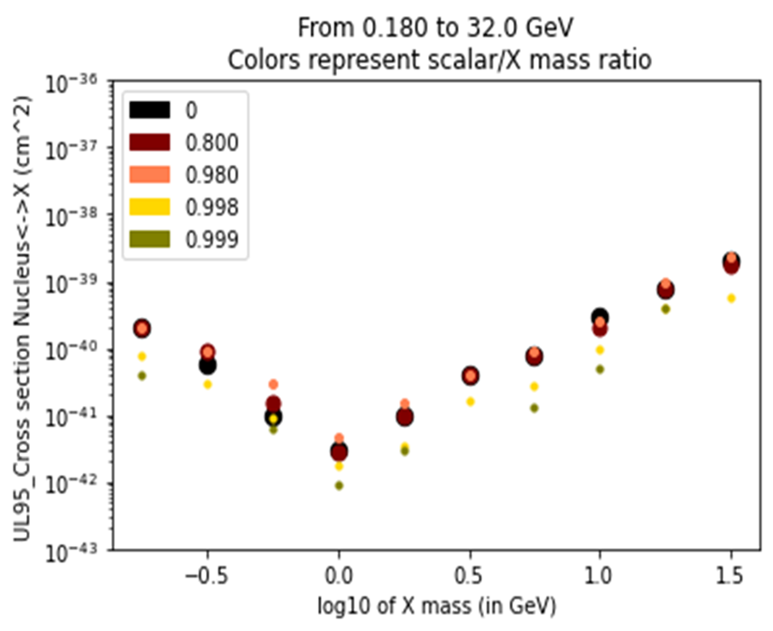
Main Research Activity
Since Jupiter is a moving object in the sky, FERMI-LAT data has been collected in 1200 distinguished steps (each one corresponding to a 0.5 deg path of the planet in the sky). All steps have been stacked through the maximization of total likelihood. Upper limits on gamma ray flux by Jupiter can be translated into upper limits on X-nucleus cross section by exploiting the following equation [S.Profumo, ISBN:978-1786340016] :
$$σ_{X−Nucleus}≤\frac{2πd^{2}}{a_{\left(m_{X}\right)}}∙UL_{Flux}$$ where $a_{\left(m_{X}\right)}$ is related to the capture rate and is computed with Asteria Python Package.
PRELIMINARY

Slide 6
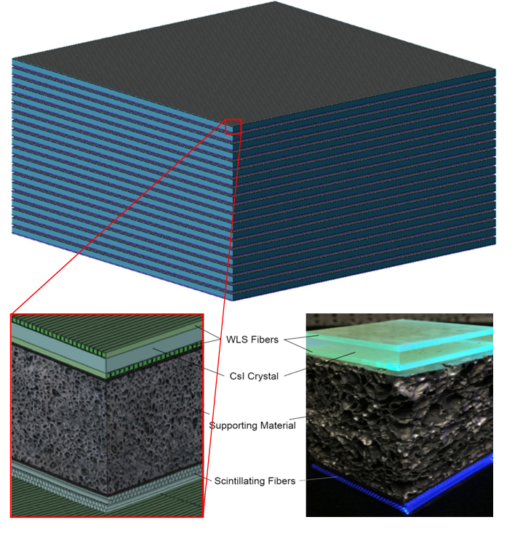
Main Research Activity
In order to improve the indirect search for dark matter, a new big space detector has been designed: its name is APT (Advanced Particle-astrophysics Telescope) and it will efficiently detect photons from 0.3 MeV to few TeV. Indeed this telescope will exploit both Compton scattering and Pair production to detect incoming photons.
Moreover a light version of APT has been designed: its name is ADAPT (Antarctic Demonstrator for APT) and it will fly over Antarctic lands. ADAPT has roughly 1% of APT materials and will be operative for several weeks, giving a demonstration of validity of APT design.

Slide 7
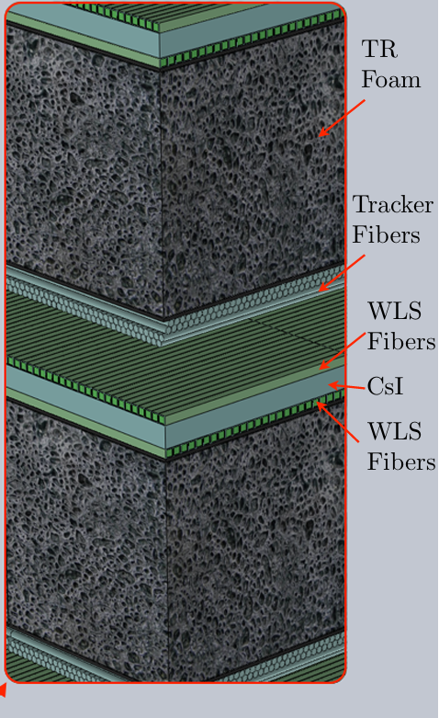
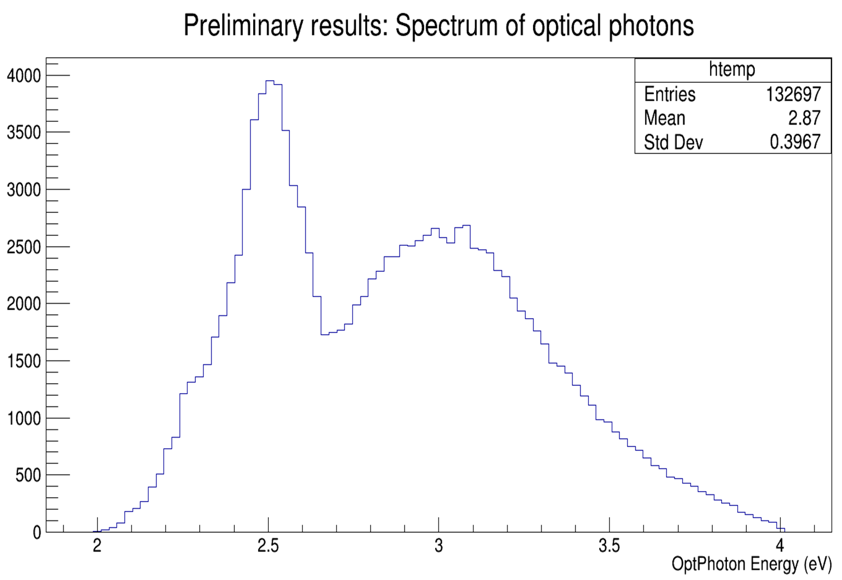
Main Research Activity
ADAPT is made of 4 modules, each containing three layers (Imaging Calorimeter + Supporting material + Tracking fibers).
Both calorimeter and tracking layer exploit scintillation in order to
measure energy and position respectively.
Scintillation is due to scattered electrons or to high-energy electrons/positrons generated by pair production.
On Geant 4 toolkit (running on the HPC system provided by INFN), I am currently performing simulations regarding scintillation optical photons generated inside the calorimeter.

Slide 8
Perspectives on current year (2° Year)
Since all training activities (courses, schools etc.) have been completed, next months will focus on continuation of current research work. In particular, there are two short-term goals: - I will perform simulations (on Geant4) regarding optical photons yield when interactions happen in the edges between tiles (calorimeter is made of 9 tiles); - I will submit a paper containing my results about Jupiter (another paper is already undergoing a peer-review).

