Slide 1
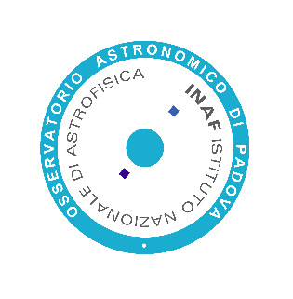
Mohamed Yahia Bournane
Optical Design of MezzoCielo
PhD Retreat 2025

Slide 2
Background
Licence en Physique Fondamental at UST Houari Boumedien - Algiers
Master in Astrophysics and Cosmology at the University of Padova
STUDY OF THE OPTICAL CONFIGURATION FOR THE HAYDN ESA SPACE MISSION
Assegno di ricerca at INAF OAPD
“Design and optical analysis of the MEZZOCIELO very large field telescope”
PhD Retreat 2025

Slide 3
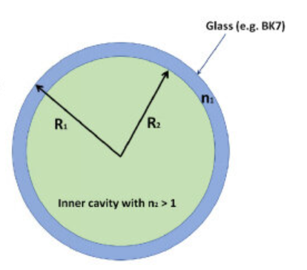
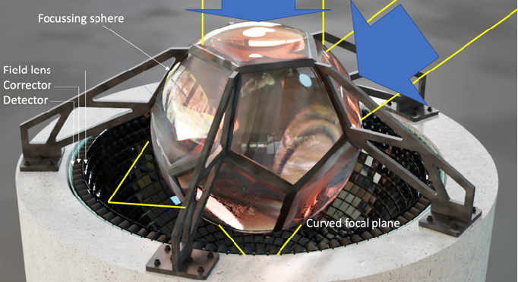
PhD Project Optical Design of MezzoCielo
Monocentric Optical System: Spherical, tessellated design filled with ultra-transparent, low-refractive-index liquid.
Ultra-Wide Sky Coverage: Continuous monitoring over ~10⁴ deg² using mass-produced correcting cameras.
PhD Retreat 2025

Slide 4
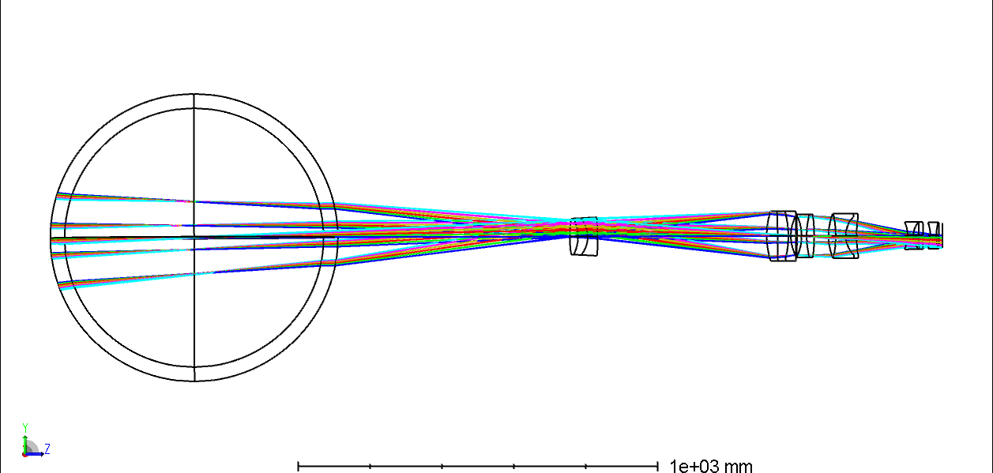
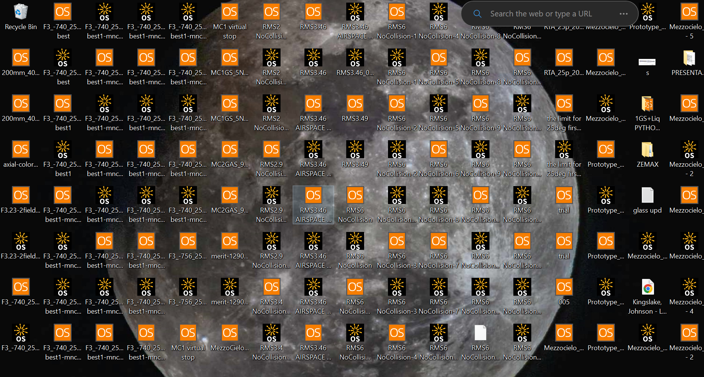
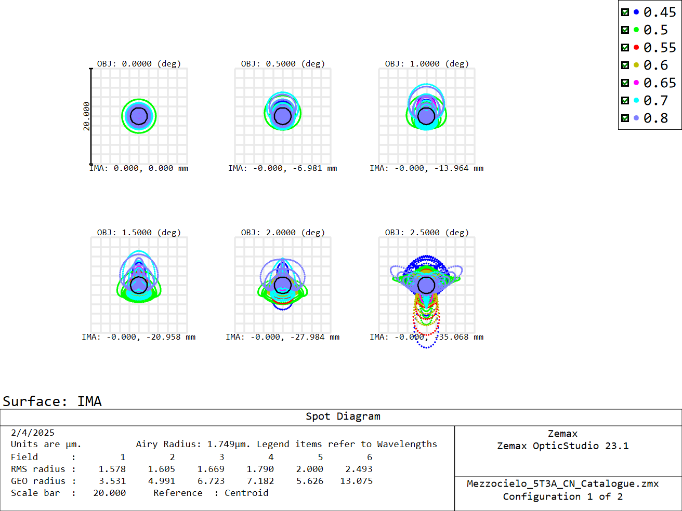
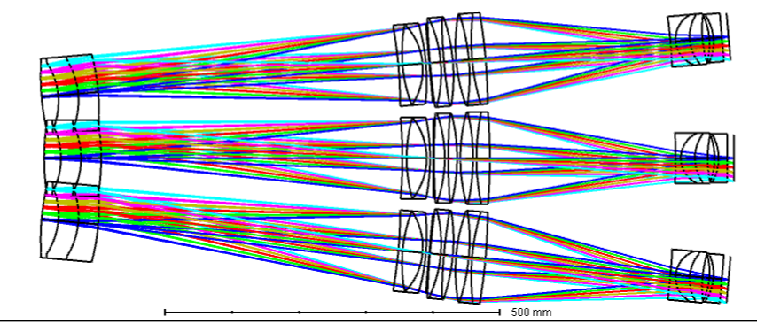
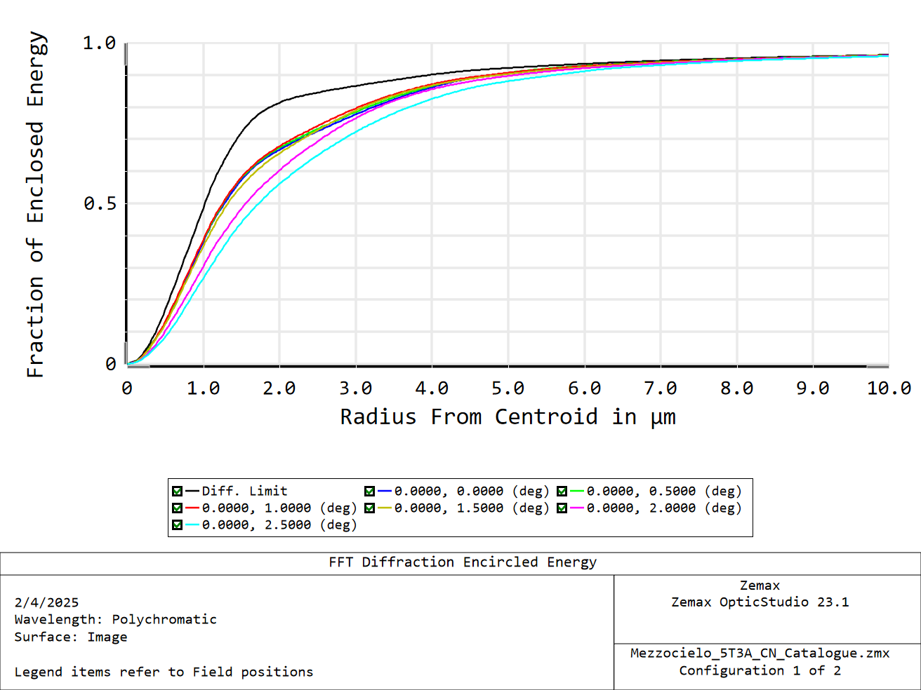
PhD Project Optical Design of MezzoCielo
PhD Project Optical Design of MezzoCielo
Prototype of 800 mm Sphere Diameter (40 mm shell thickness “N-BK7”)
Systematic Approach
Optical Solution
A
Filling Factor 🡪 250 mm Entrance Pupil Diameter 31.25%
Waveband: Monochromatic 500 nm —> [450 – 800 nm]
Field Of View: On-axis —> 2.5 degrees - (Diagonal FoV: 5 deg)
Lens complexity as from singlets —> Doublet & Triplets - Aspheric surfaces
PhD Retreat 2025
B

Slide 5
800 mm Sphere Diameter (40 mm shell thickness “N-BK7”)
31.25% Filling Factor 🡪 250 mm Entrance Pupil Diameter
Waveband: [450 – 800 nm]
Maximum Radial Field Of View: 2.5 degrees - (Diagonal FoV: 5 deg)
Calculated Effective Focal Length to be 800 mm (From ARGUS Array)

Slide 7
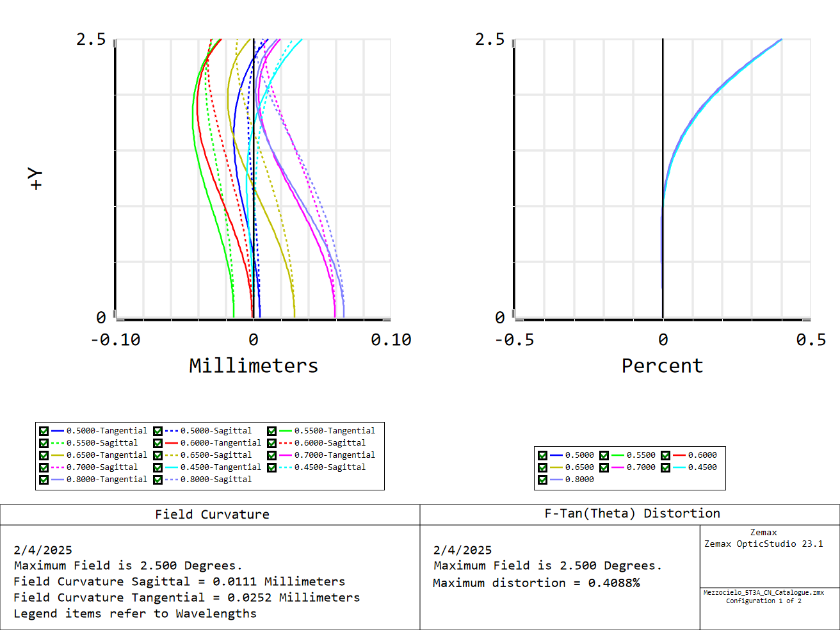

Slide 8
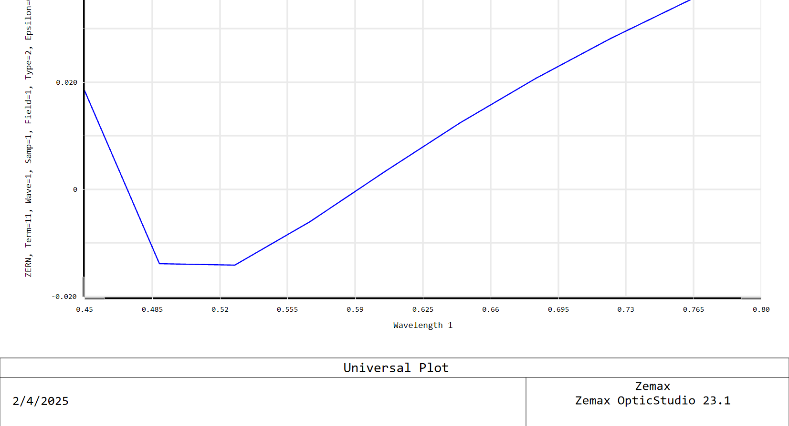

Slide 9
