Slide 1

Development and challenges in accelerators technologies
Luigi Faillace,
INFN-Laboratori Nazionali di Frascati
February 19, 2025
luigi.faillace@lnf.infn.it

Slide 2
Outline
Particle Accelerators and their Perspectives: present, near- and long-term projects
Accelerators in the world today and Main Applications
Brief history of RF accelerators
Main Accelerator types and techniques
  RF linear accelerators: Normal, Super-Conducting and Dielectrics
  Circular accelerators
  Laser, Dielectric and Plasma Wakefield Acceleration→ EuPRAXIA@SPARC_LAB
State-of-the-art and Challenge
Conclusions and Future Developments
luigi.faillace@lnf.infn.it

Slide 3
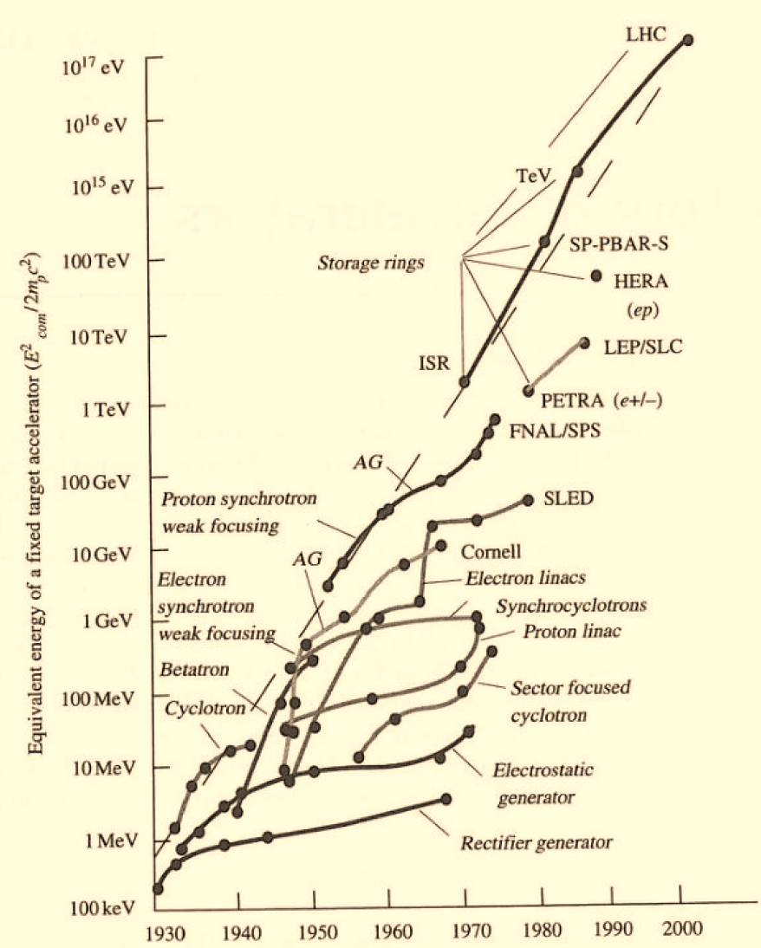
The Livingston Plot (up to early 2000’s)
The goal of Particle Accelerators has been the same since 1930:
To transport charged particle beams in a “stable” fashion by utilizing magnetic fields and increasingly to boost their energy with electric fields.
Each branch → New IDEA & New TECHNOLOGY;
Accelerator evolution, like all exponential growths, cannot be sustainable over a long period

Slide 4
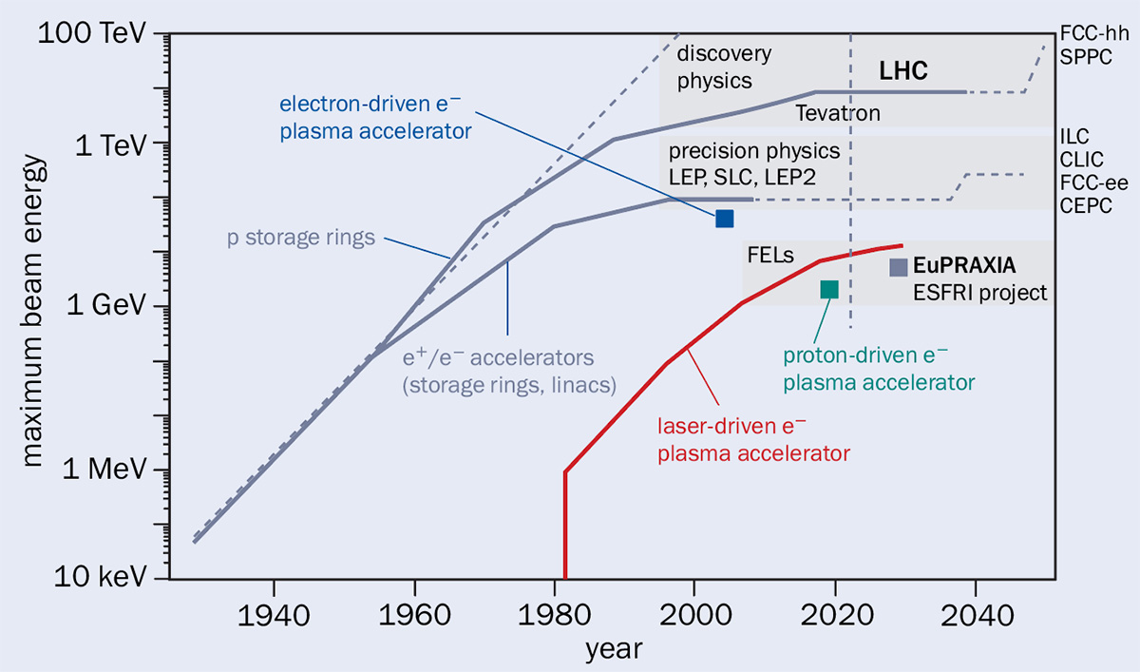
The Livingston Plot (near future)
The goal of Particle Accelerators has been the same since 1930:
To transport charged particle beams in a “stable” fashion by utilizing magnetic fields and increasingly to boost their energy with electric fields.
Each branch → New IDEA & New TECHNOLOGY;
Accelerator evolution, like all exponential growths, cannot be sustainable over a long period
Projection with today established technology (likely FLAT)
HOW to avoid this?
  Short answer, we know what to do.
WHY do we (really) need it?
  Short answer, Yes. Most accelerators in the world work at relatively low energies…. But many planned high-energy machines worldwide.
Major R&D development efforts in:
RF accelerator technology (NC and SC) and Magnets
Dielectric and PLASMA → from «incremental» to «disruptive» innovation!!!
crucial
SUSTAINABLE TECHNOLOGY (Higher power efficiency, Reduction of the overall dimensions)

Slide 5
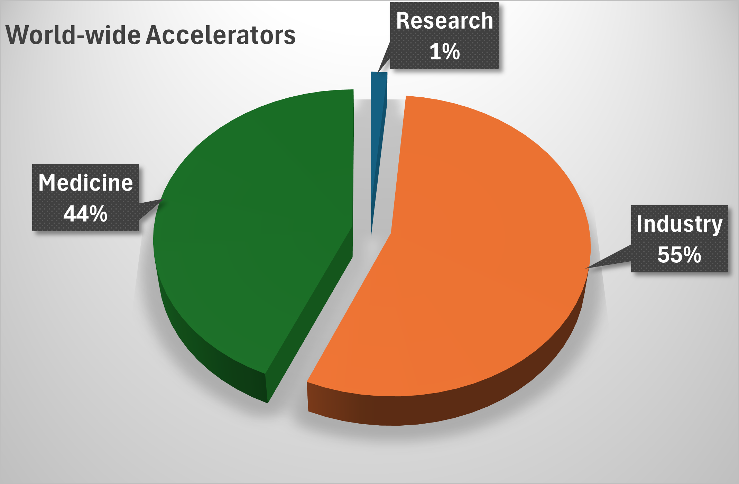
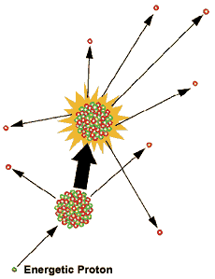
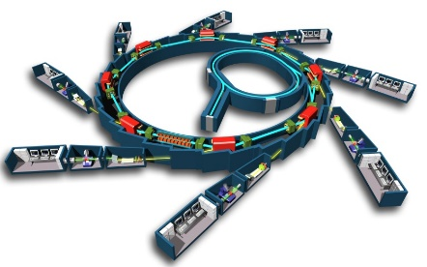
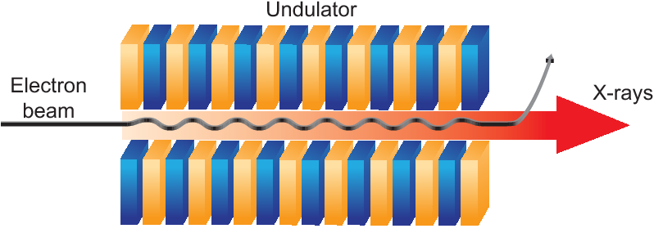
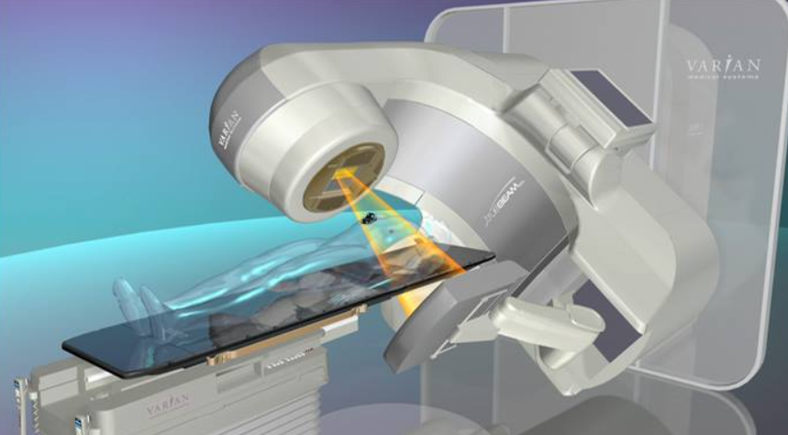
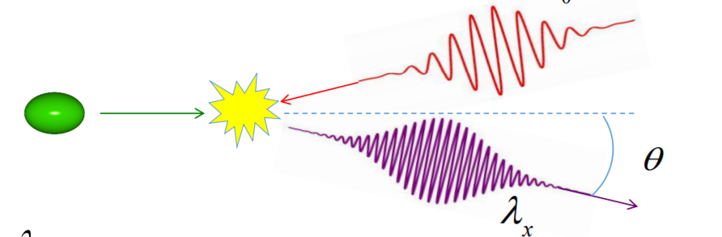
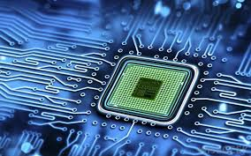
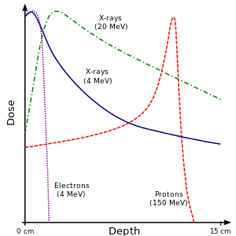
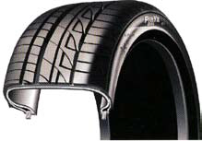

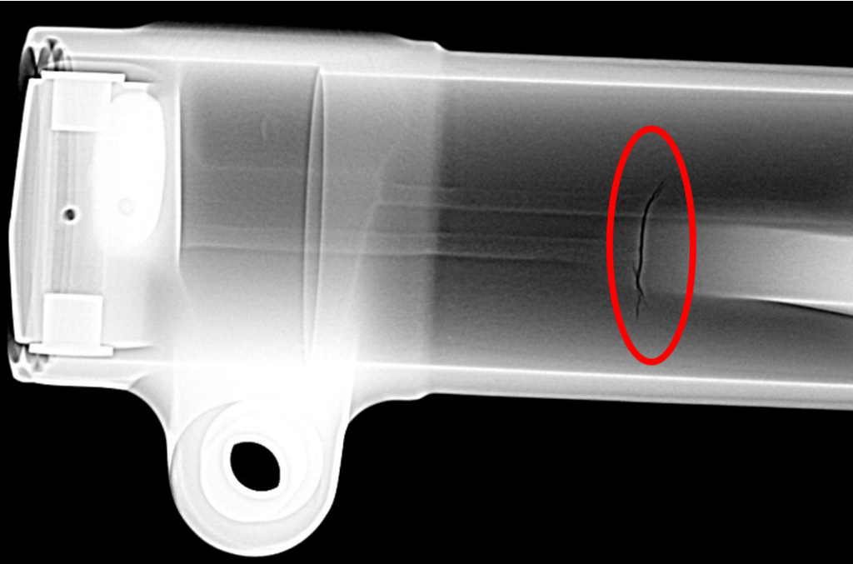
Particle colliders for High energy Physics (HEP) → LHC
Betatrons, Cyclotrons
Light Sources (Syncrotrons, FEL,Compton)
Spallation sources
∼ 40,000…
from Basic Science to Society!
Cancer Radiation Therapy (RT)
Security and Inspection
Radio-isotopes for medical imaging/nuclear medicine
Ion Implantation in Semiconductor Chip
Fabrication/Processing of Polymers
Electron Beam Sterilization of Medical Disposables
Food Processing
Nondestructive testing (NDT)
Environment

Slide 6
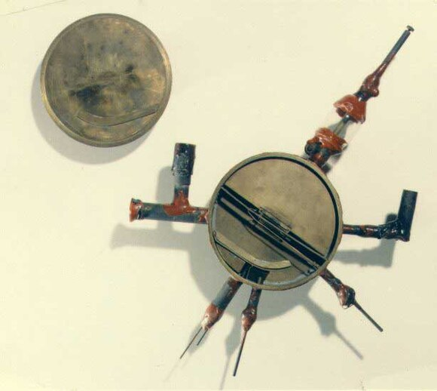
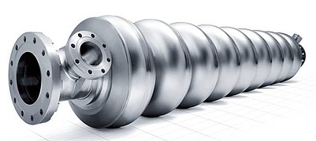
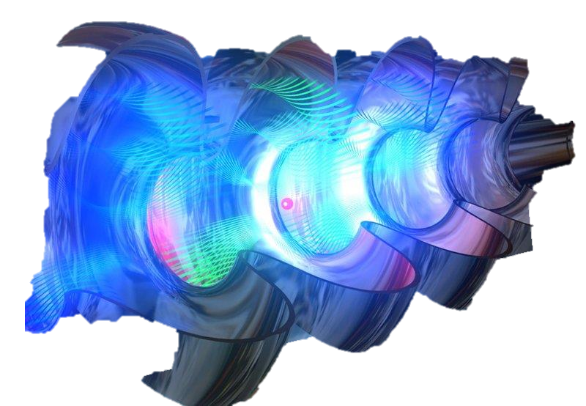
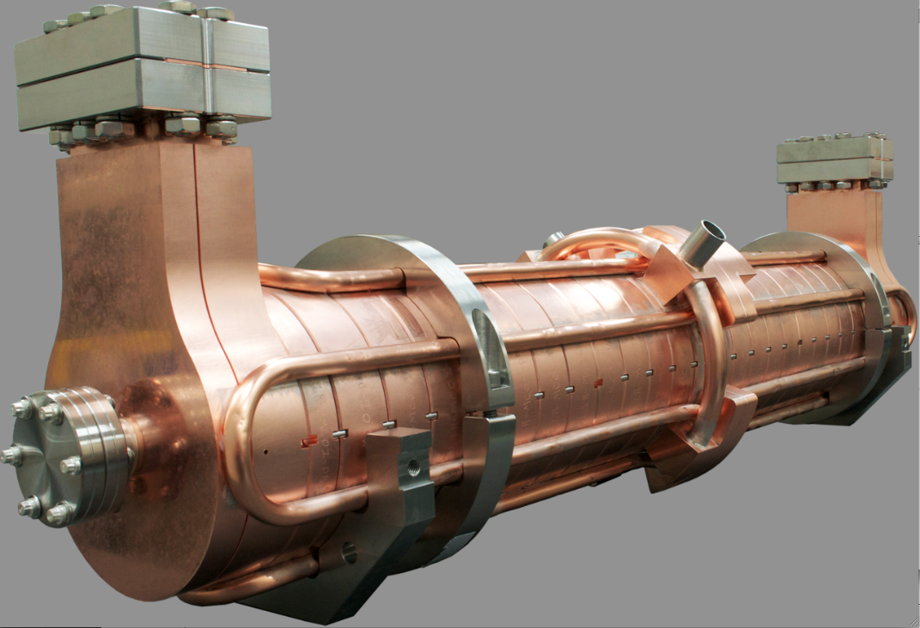
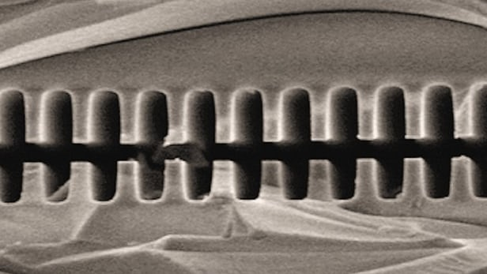
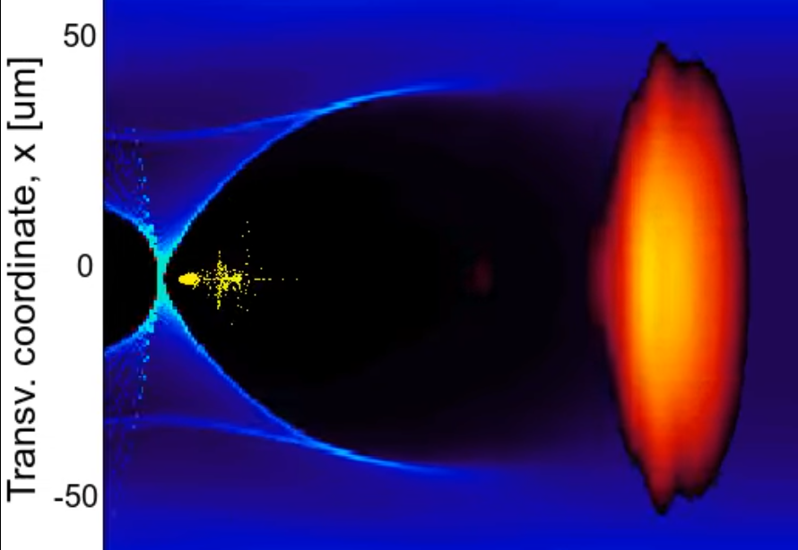
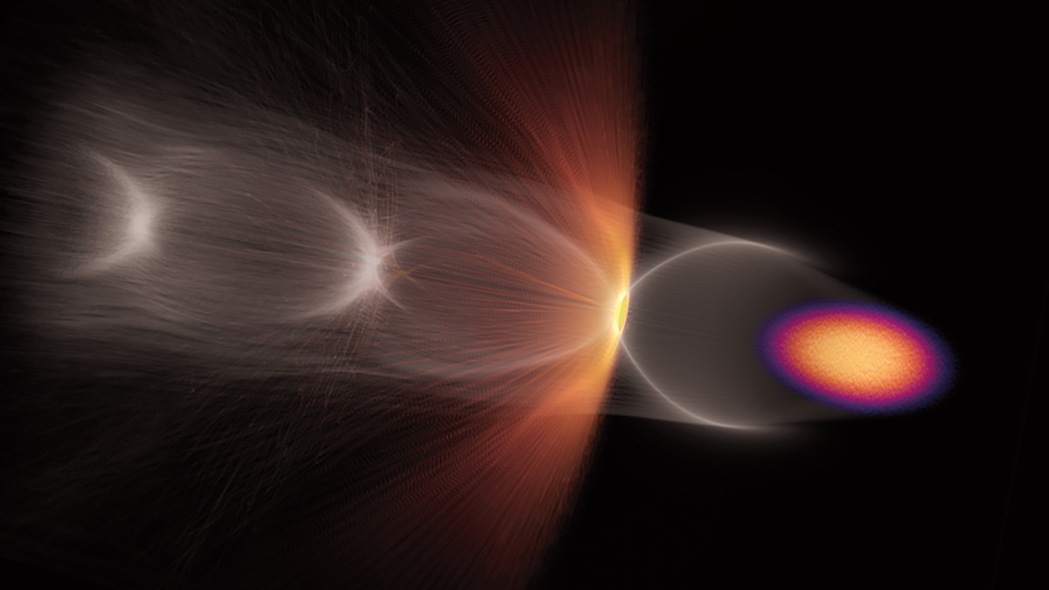
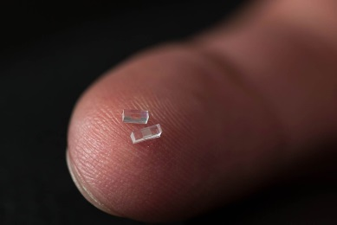
TYPES of particle Accelerators
1- Linear Accelerators (Linacs): Particles travel in a straight line through a series of accelerating cavities. Linacs are used as injectors to larger accelerators and as stand-alone when large beam intensities are required.
2- Circular Accelerators: Particles move in a circular path using magnetic fields, gaining energy with each pass (e.g., cyclotrons, synchrotrons).
e-beam
EM wave
The Lawrence and Livingston cyclotron (13 cm in diameter and accelerated a proton beam to 80 keV)
3- Laser/Dielectric/Plasma Wakefield Accelerators: Utilize waves in plasma or dielectrics to achieve compact, high-energy acceleration.
Metallic (Normal- or Super-conducting) and Dielectric Accelerators
Laser driver
e-beam
driver
Plasma wave
Plasma wave
e-beam
e-beam

Slide 7
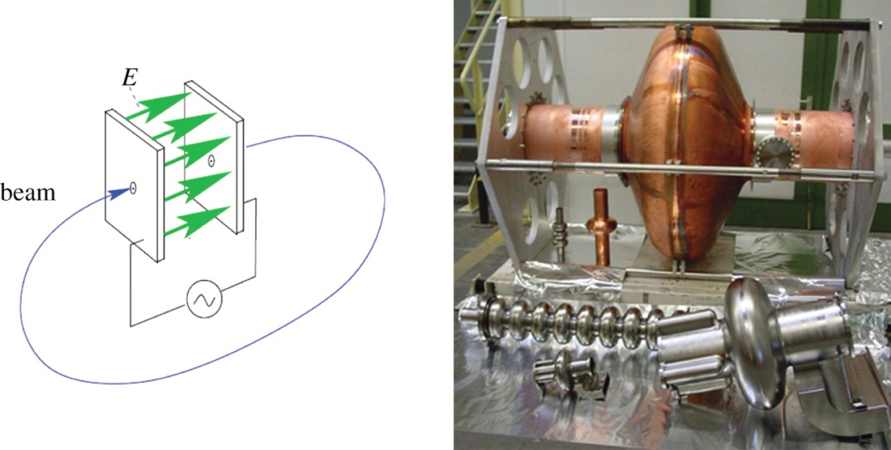
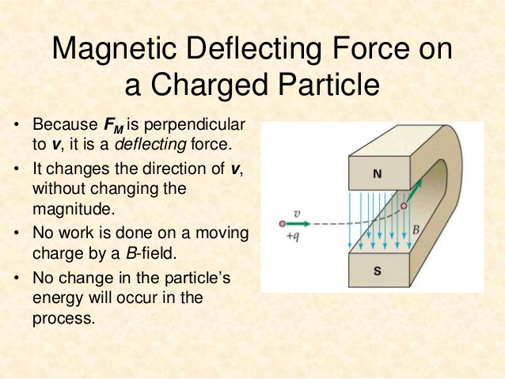
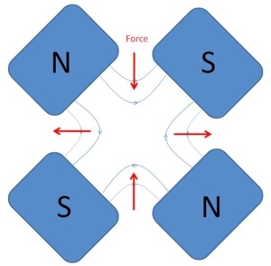
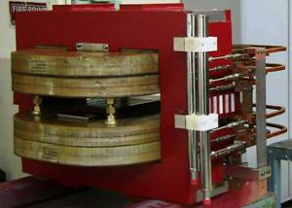
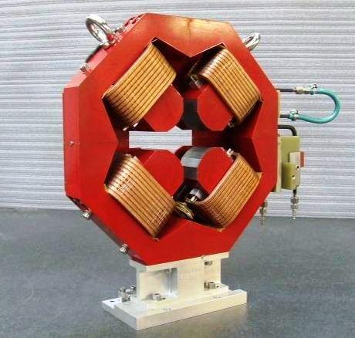
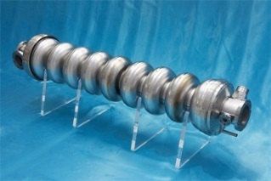
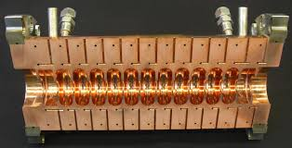
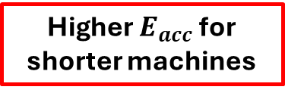
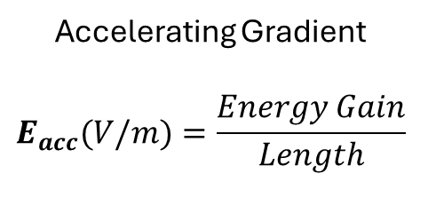
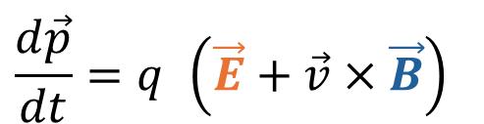
LORENTZ FORCE: ACCELERATION AND FOCUSING
The basic equation that describes the acceleration/bending/focusing processes is the Lorentz Force.
Particles are accelerated through electric fields and are bended and focused through magnetic fields.
$$\frac{d\vec{p}}{dt}=q \left(\vec{E}+\vec{v}×\vec{B}\right)$$
ACCELERATION
BENDING AND FOCUSING
To accelerate, we need a force in the direction of motion
2nd term always perpendicular to motion => no energy gain
Accelerating Gradient
$$E_{acc}(V/m)=\frac{Energy Gain}{Length}$$
Main challenge
Higher $E_{acc}$ for shorter machines
Longitudinal Dynamics
Transverse Dynamics

Slide 8
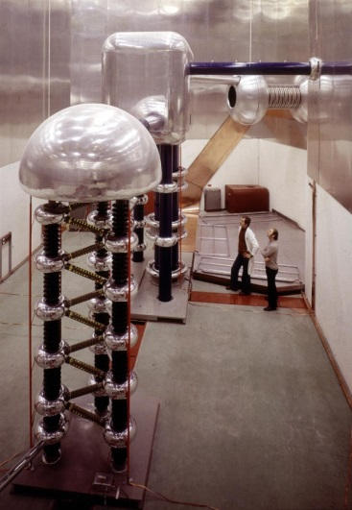
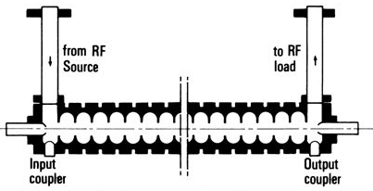
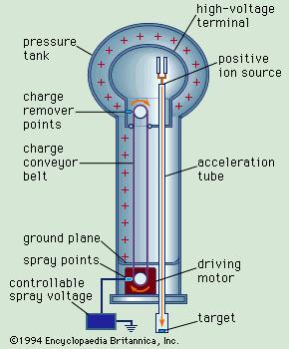
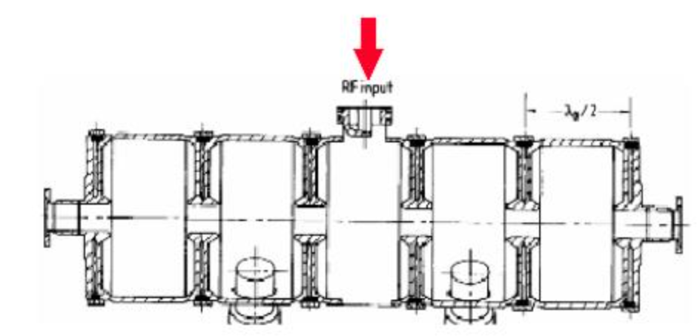
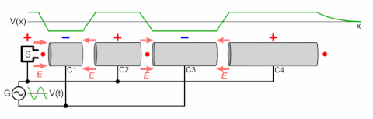
Brief history: from DC to RF Linear Accelerators
DC voltage as large as ∼10 MV can be obtained (E∼10 MeV). The main limit in the achievable voltage is the breakdown due to insulation problems.
TW Linac
SW Linac
EM energy resonates inside cavity
EM energy travels with particle beam
Beam path
the particles are accelerated by the electric field in the gap between electrodes connected alternatively to the poles of an AC generator.
Beam path

Slide 9
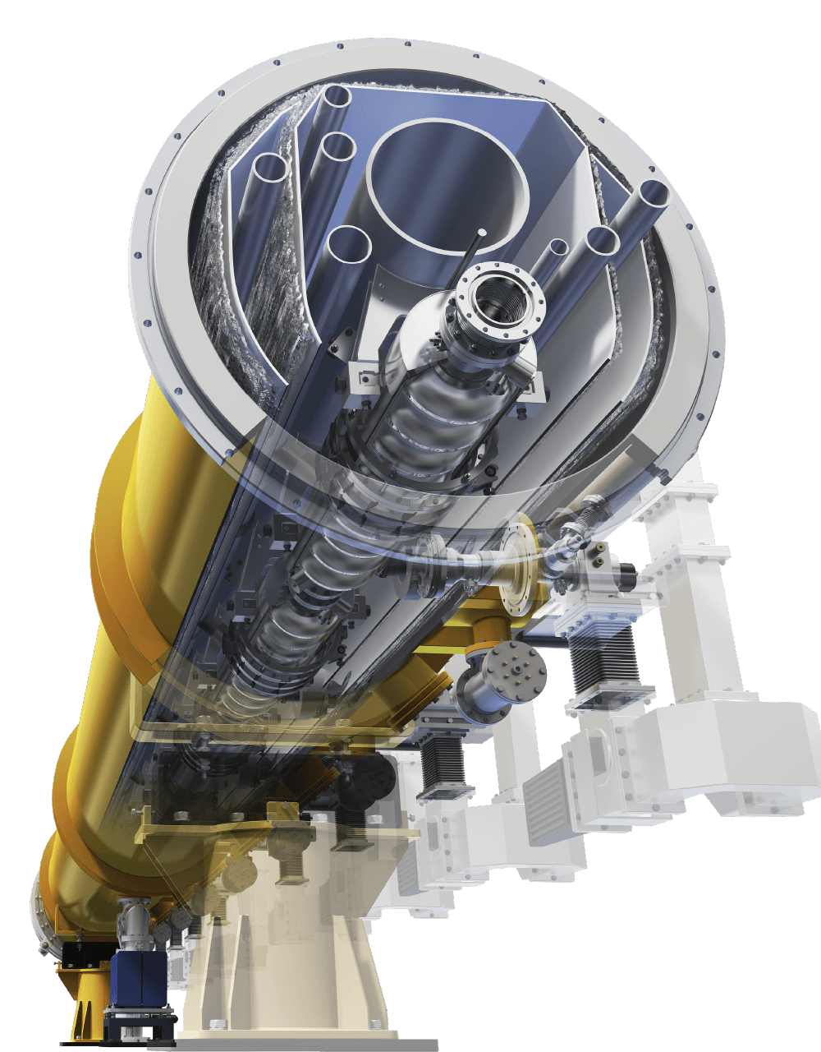
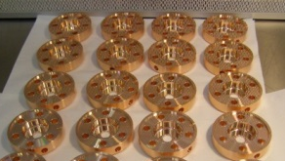
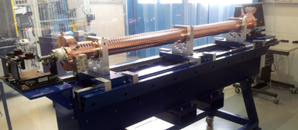
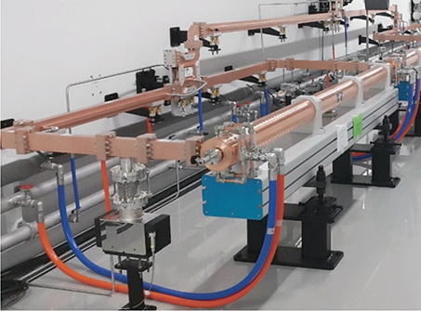
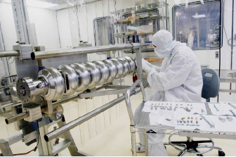
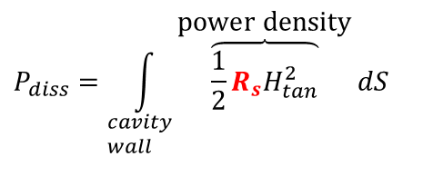
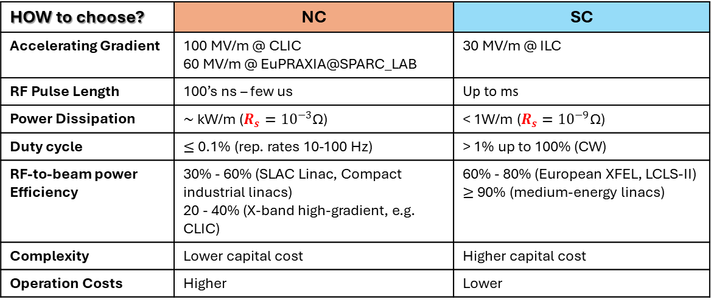
Metallic LINEAR RF ACCELERATORS TECHNOLOGY: NORMAL vs SUPER-CONDUCTING
⇒The cavities (and the related LINAC technology) can be of different material:
copper for normal conducting (NC) RF cavities;
Niobium for superconducting (SC) RF cavities.
HOW to choose? | NC | SC
Accelerating Gradient | 100 MV/m @ CLIC 60 MV/m @ EuPRAXIA@SPARC_LAB | 30 MV/m @ ILC
RF Pulse Length | 100’s ns – few us | Up to ms
Power Dissipation | $∼$ kW/m ($R_{s}={10}^{−3}$Ω) | < 1W/m ($R_{s}={10}^{−9}\text{Ω}$)
Duty cycle | $≤$ 0.1% (rep. rates 10-100 Hz) | > 1% up to 100% (CW)
RF-to-beam power Efficiency | 30% - 60% (SLAC Linac, Compact industrial linacs) 20 - 40% (X-band high-gradient, e.g. CLIC) | 60% - 80% (European XFEL, LCLS-II) $≥$ 90% (medium-energy linacs)
Complexity | Lower capital cost | Higher capital cost
Operation Costs | Higher | Lower
Dissipated power into the cavity walls is related to the surface resistance R_{s} and currents
$$P_{diss}=\int_{\begin{aligned}&cavity \\ &wall\end{aligned}}{\overset{\text{power} \text{density}}{\overbrace{\frac{1}{2}R_{s}H_{tan}^{2}}}dS}$$
copper
niobium
cryomodule
Between copper and Niobium there is a factor 10⁵-10⁶
ambient pressure boiling He
superfluid helium

Slide 10
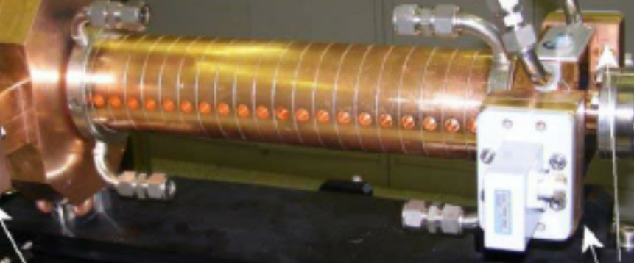
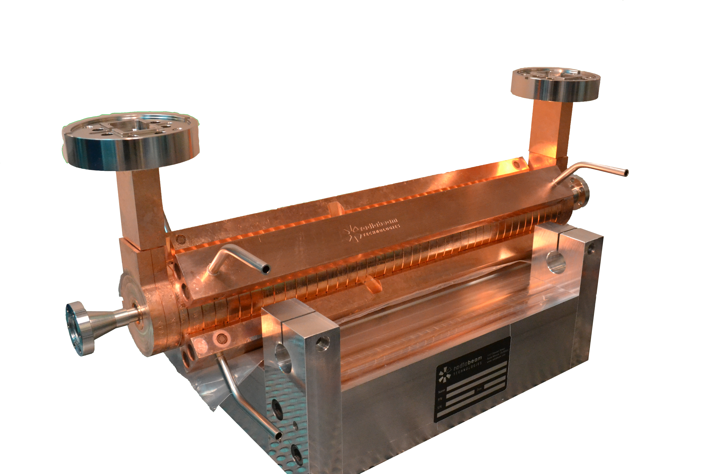
Normal conducting RF structures
State-of-the-art
Cell length ~ 5 cm
Warm Cavities | Accelerating Gradient | Repetition Rate
S-Band (3 GHz) | 15 - 30 MV/m | 50-300 Hz
C-Band (5-6 GHz) | > 50 MV/m | < 100 Hz
X –Band (11-12 GHz) | > 100 MV/m | < 100 Hz
S-band
C-band
X-band
Need to be affordable: cost-effective production/manufacturing
Cell length ~ 2.5 cm
R&D on NC LINACS @INFN-LFN
EuPRAXIA@SPARC_LAB
ASTERIX experiment. Funded by INFN CSN5.
MICRON experiment. Funded by INFN CSN5.
Previously funded experiment by INFN CSN5: DiElectric and METallic Radiofrequency Accelerator (DEMETRA) 2015-2018
Cell length ~ 1 cm
Applications
Research on RF Breakdown Rate and RF Breakdown Physics;
Electron beam longitudinal phase-space manipulation in FELs (EuPRAXIA@INFN-LNF, CompactLight FEL, UC-XEL@UCLA)
Multi-frequency accelerators (S. Tantawi, SLAC)
Development of single and multi-frequency high-power RF klystrons

Slide 11
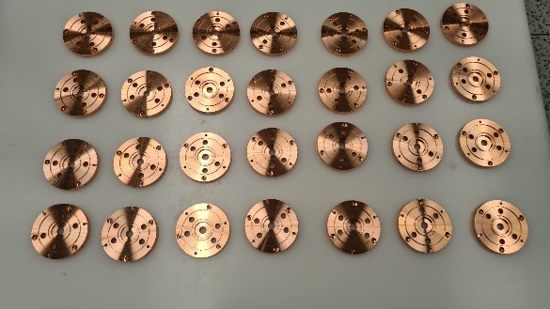
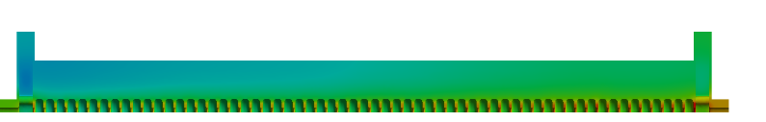
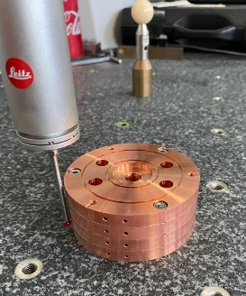
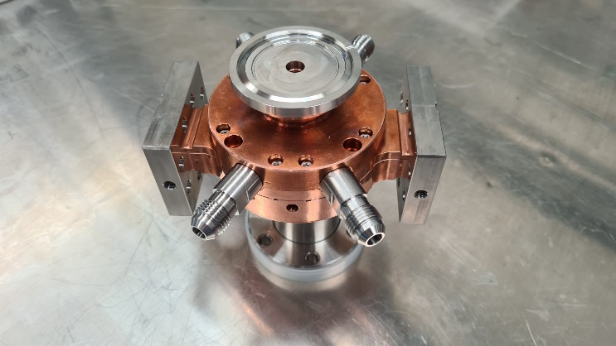
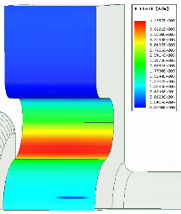
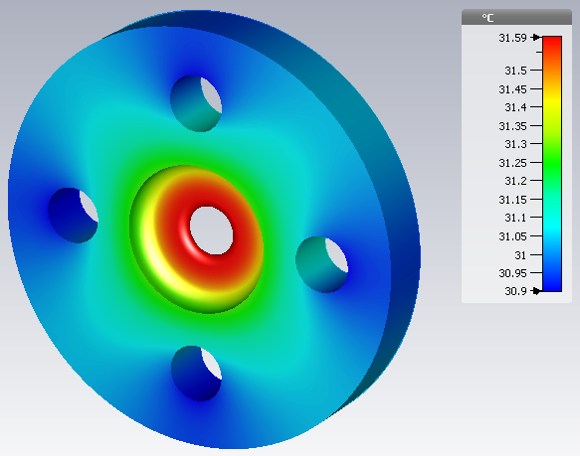










Start-to-end fabrication flow-chart: EuPRAXIA@SPARC_LAB structure
RF and thermo-mechanical design
Engineering
High-precision Machining
Low RF power characterization
Assembly and Brazing
Leak check
RF tuning
High RF power conditioning
Quality control
Bake-out and outgassing
L=90cm, 112 cells
RF coupler
RF cell
L=90cm
20 cells RF prototype
$$E_{acc}(MV/m)$$

Slide 12



Main Operational Limitation: RF Breakdown phenomenon
High accelerating gradient is needed for future accelerators: higher energies in smaller footprint!
The main limitation for a high-gradient structure is RF breakdown phenomenon
RF breakdown arcs take place in the vacuum volume of the accelerating structures with a certain statistical probability that reduces the performance of the accelerator
disturb the trajectory of the beam and its emittance
luminosity loss
possibly beam loss.
Vacuum activity
Visible light
X-rays
Breakdowns in high-gradient linacs can interrupt accelerator operation, leading to downtime.
Hard Cu and hard CuAg have better performance then soft heat-treated copper.
Hard CuAg had record performance for room temperature structures.
New joining techniques: welding.
Dolgashev VA, Faillace L, Spataro B, Tantawi S, Bonifazi R. High-gradient rf tests of welded X-band accelerating cavities. Physical Review Accelerators and Beams. 2021 Aug 10;24(8):081002.

Slide 13

SRF Resonators Families: β < 0.50 & β > 0.50
β = 0.5
by D. Longuevergne (IPN-Orsay)
Courtesy of L. Monaco, D. Sertore, C. Pagani

Slide 14

Towards future large and sustainable machines
For future accelerators, it is important to:
  Increase E_{acc}:
    Target energy reached with less cavity
    Reduce machine length
  Increase Q₀: Quality factor
    Reduce power consumption
    Minimize cryogenic power
$$P_{diss}=\frac{{\left(E_{acc}L\right)}^{2}}{\left(\frac{R}{Q}\right)Q_{0}}$$
sustainability
Courtesy of L. Monaco, D. Sertore, C. Pagani

Slide 15


Bulk Niobium performance increase
To go beyond the standard power rise, a carefull processing of the inner surface of the cavity is mandatory.
Specific processes are necessary to cure Q slope at different accelerating field:
Low T baking. 120 °C
Two–step baking (75 °C + 120 °C)
N infusion at 120 °C
Mid T baking: 300 °C
N doping
J. Halbritter, Proc. SRF’01, Tsukuba, Japan, p. 292
Courtesy of L. Monaco, D. Sertore, C. Pagani

Slide 16


Nb3Sn for operation at higher temperature
Vapor diffusion of Nb₃Sn (T_{c} ∼ 18 K hence small R_{s}) on Nb substrate
  Small R_{s} opens the possibility of using cryocooler, recently demonstrated
Similarities with Nb₃Sn in magnet wire but
  Strict control of impurities
  Can achieve very clean grain boundaries
  Relative smooth surface finishing to avoid
  field enhancement
Single Cell Evolution over the years
9-cell coated cavities
Courtesy of L. Monaco, D. Sertore, C. Pagani
16

Slide 17


Dielectric LINEAR RF ACCELERATORS TECHNOLOGY
DLA Motivations
High accelerating gradients enable compact/miniaturized particle accelerators
schematic overview of the accelerating gradient for different types of accelerators
TARGET
Accelerating Gradient: ~ 500 MV/m - 2 GV/m
Main advantages of DLA:
larger damage threshold of dielectrics in near infrared with respect to metals;
laser-plasma interaction
Dielectric Laser Accelerator (DLA) structures operating at optical wavelengths (~ 1- 5 µm)
on-chip optical-wavelength DLA [1]
THz-driven
DLW LINAC [2,3]
[1] R. Joel England et al., Rev. Mod. Phys. 86, 1337-2014
[2] E. Nanni, et al., Nat Commun 6, 8486 (2015).
[3] F. Lemery, et al.” Commun Phys 3, 150 (2020).
Courtesy of G. Torrisi

Slide 18




From Radio Frequencies to Infrared Light
Simple idea: Use scale-invariance of Maxwell equations and shrink down size of particle accelerators by 4 orders of magnitude.
Replace RF power (cm-wavelength) with laser (um-wavelength)
Material properties are frequency dependent -> dielectrics
Beam dynamics challenges
Parameter | RF | DLA
Power Source | Klystron | laser
Wavelength | 2-10 cm | 1-10 µm
Bunch Length | 1-5ps | 10-100 as
Bunch Charge | 0.1- 4 nC | 1-10 fC
Norm. Emittance | 0.1-1 µm rad | 1-10 nm rad
Rep Rate | 1-1000 Hz | 100 MHz
Material | Metal | Dielectric
Unloaded Gradient | 10-50 MV/m | 1-10 GV/m
[Rasmus Ischebeck, Structure-based accelerators (e.g. ACHIP) and advanced radiation generation schemes, talk @the 2022 EuroNNAc Italy 18- 24 September 2022] [https://agenda.infn.it/event/28376/contributions/178676/
DLA typical parameters
DLA Operating Principle
Courtesy of G. Torrisi

Slide 19



DLA leverages advances in two major areas: solid state lasers + semiconductor fabrication
Not high peak power lasers!
Fabricated using techniques of the integrated circuit industry.
Parameter | DLA Value
Wavelength | 2 µm
Pulse Duration | 100 fs
Pulse Energy | µJ – mJ
Laser Power | 100 W
Rep Rate | 100 MHz – KHz
Laser Efficiency | 30%
Cost/laser | $200k
[Pietro Musumeci, Accelerator on a chip program overview invited talk @ EuroNNAc La Biodola Bay, Isola d'Elba, Italy 18- 24 September 2022] https://agenda.infn.it/event/28376/contributions/179636/
SEM images of DLA prototypes
Available now
“off the shelf”
Solid-state laser
fused silica
silicon
Courtesy of G. Torrisi

Slide 20




Experiments with relativistic beams have demonstrated record gradients and energy gain
SLAC/UCLA: 0.85 GeV/m*
SLAC/UCLA: 0.3 MeV energy gain**
pulse front
tilted laser
E₀
k₀
gradient
800 nm
e-
G_{eff} = 850 MV/m
Interaction length > 500 um
electron energy spectrum
Kerr
saturation
* D. Cesar et al, Communications Physics 1(4), 1-7 (2018)​​
** D. Cesar et al, Optics Express 26 (22), 29216 (2018)
Courtesy of G. Torrisi
Notes:
D. Cesar, S. Custodio, J. Maxson, P. Musumeci, X. Shen, E. Threlkeld, R. J. England, A. Hanuka, I.V. Makasyuk, E. Peralta, K.P. Wootton, and Z. Wu, "Nonlinear response in high field dielectric laser accelerators," Nature Communications Physics 1(4), 1-7 (2018).​​
D. Cesar, J. Maxon, P. Musumeci, X. Shen, R. J. England, K. P. Wootton, and S. Tan, "Enhanced energy gain in a dielectric laser accelerator using a tilted pulse front laser," Opt. Exp. 26 (22), 29216 (2018).

Slide 21



Principle of plasma acceleration
n₀ = 10¹⁶ cm⁻³ λ_{p} = 300 µm
$$ω_{p}=\sqrt{\frac{n_{0}e^{2}}{m_{e}ε_{0}}}$$
Laser-driven plasma Wakefield Accelerator (LWFA):
Drive beam is a laser pulse
Particle-driven plasma wakefield accelerator (PWFA):
Drive beam is high energy electron or proton beam
λ_{p}
Wakefield
λ_{p}
beam
Wave-breaking field
$$\text{E}\text{wb}\left[\text{V}\text{/}\text{m}\right]\text{≈ 100}\sqrt{{\text{n}}_{\text{0}} \left[{\text{cm}}^{\text{−3}}\right]}$$
Courtesy of A. Biagioni

Slide 22




EuPRAXIA_SPARC_LAB
EuPRAXIA@SPARC_LAB (1 – 5 GeV)
Distributed RI
2 FEL Construction Sites
Several Excellence Centers
Particle-driven
wakefield acceleration
EuPRAXIA at
LNF-INFN (Site 1)
FEL
Users
Laser-driven
wakefield acceleration
Plasma module
X-band linac
EuPRAXIA at ELI-Beamlines or EPAC or Pisa or Salamanca…(site 2)
Sparc-like photo injector
Courtesy of A. Biagioni

Slide 23




TRL 5 -Technology validated in lab
Plasma accelerating module
Nominal values
Goal parameters
1.1 GeV (1 GV/m 60cm capillary - density 10¹⁶ cm-3)
100-400 Hz
  Fabrication by machining
  10 increasing diameter
  Density range 10¹⁶ -10¹⁷ cm⁻³
  13 kV with 500 A
  100 Hz rep Rate (nominal value)
10¹⁷
measurement
Courtesy of A. Biagioni

Slide 24
Conclusions and Future Work
Review of main Technologies for Particle Accelerators:
  RF acceleration (normal-, super-conducting and dielectrics)
  Wakefield acceleration.
Main Challenges for all accelerators: Higher Accelerating Gradient and Higher Quality Factor → more compact and sustainable machines.
Future developments: New materials, new geometries, new manufacturing processes, etc.
Size/Footprint
Cost/Budget
Application
What is the acceleator of the future?
It all depends on the required application, available budget and footprint.
Acknowledgements
INFN-Laboratori di Frascati: A. Gallo, D. Alesini, A. Biagioni, TEX (TEst stand for X-band, F. Cardelli, S. Pioli) group; INFN-Milano: L. Monaco, D. Sertore, C. Pagani, D. Giove; INFN-Labratori del Sud: G.Torrisi for their comments and slides.
luigi.faillace@lnf.infn.it

