Slide 1
Einstein Telescope
Jan Harms
Gran Sasso Science Institute
INFN - LNGS

Slide 2
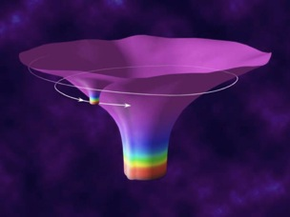
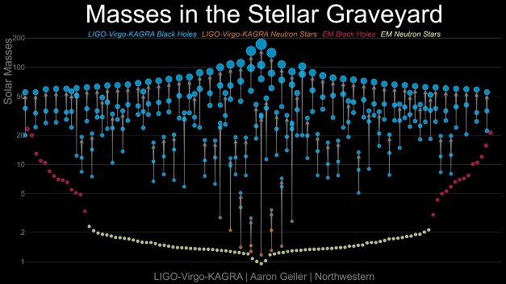
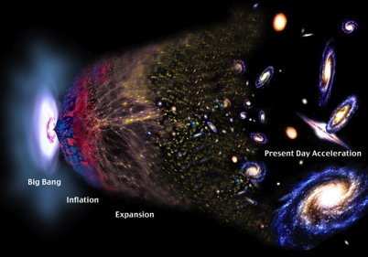
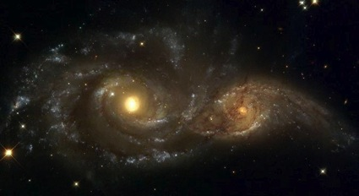
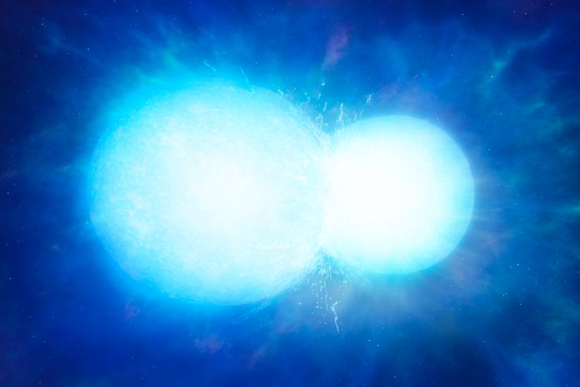
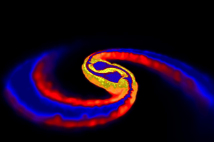
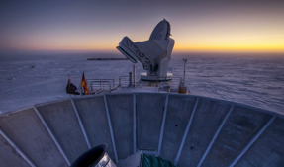
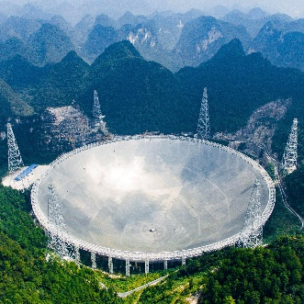

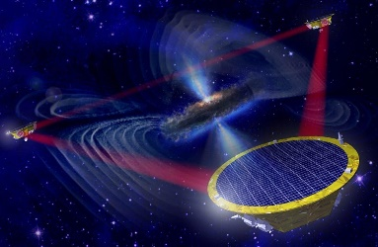
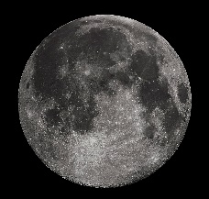
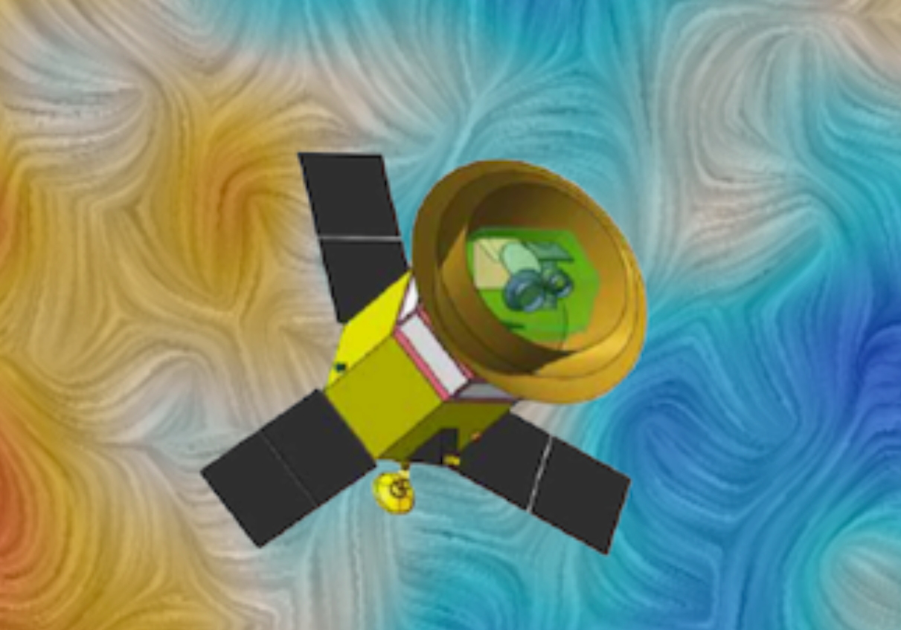
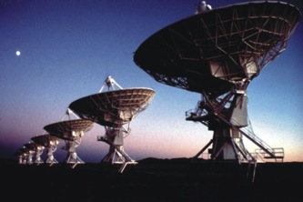
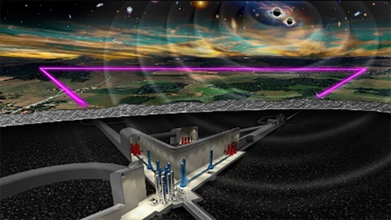
GW Observation Band
Extreme mass-ratio inspiral
Primordial background
Supermassive BH
binaries
White-dwarf binaries
Neutron-star mergers
10⁻¹⁶ Hz
10⁻⁹ Hz
10⁻⁴ Hz
10⁰ Hz
10³ Hz
Microwave background
Pulsar timing
Space detectors
Terrestrial
Missing link

Slide 3
Historical Record of
GW Detector Sensitivity
World’s first GW measurement in 1961:
Oscillations of Earth
Sensitivity GW150914
Today

Slide 4
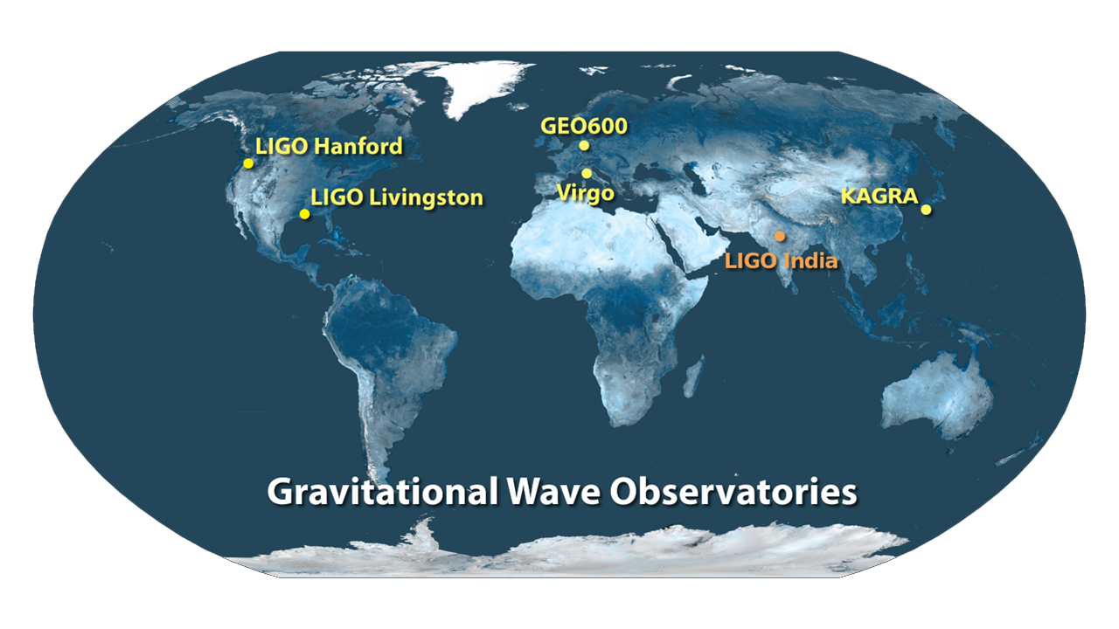

Slide 5
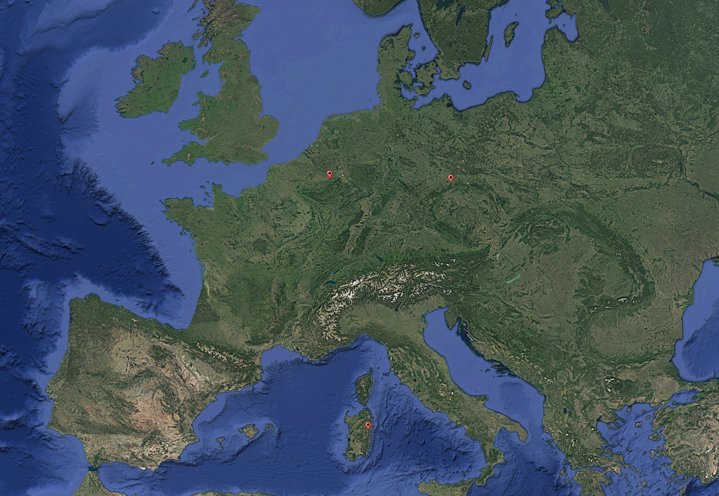
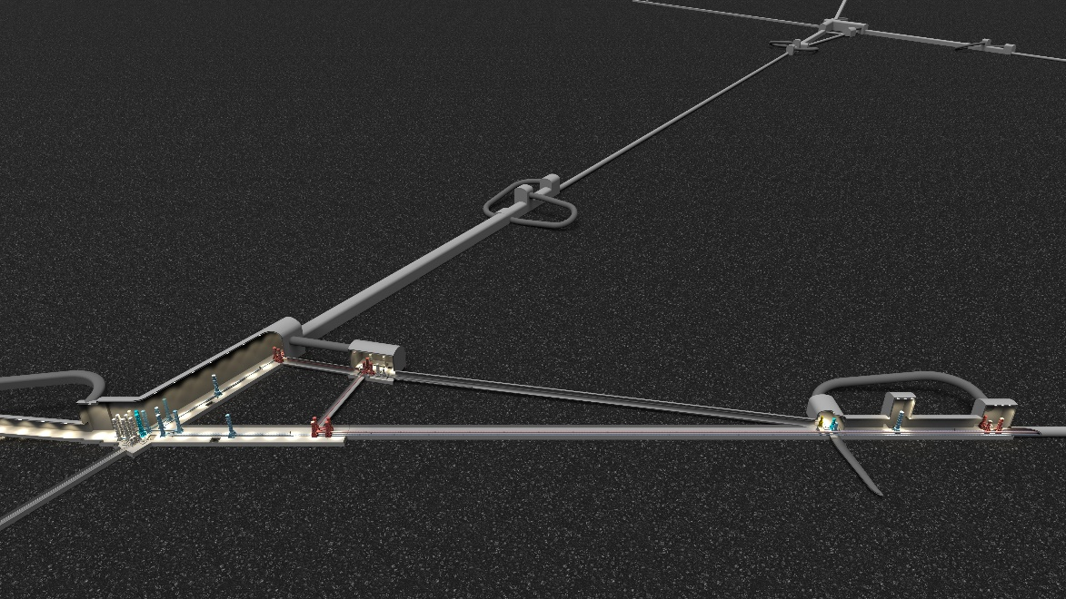
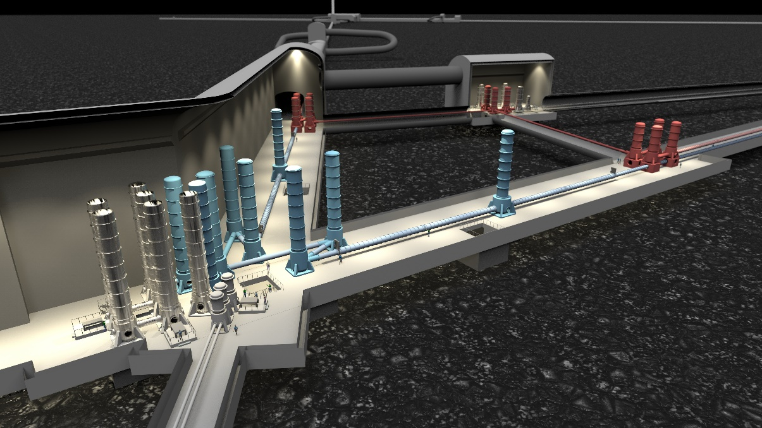
Einstein Telescope
Underground infrastructure (Δ: 10km, L: 15km)
Meuse-Rhine
Saxony
Sardinia
30m
175m
Up to 17m tall suspension systems for core optics

Slide 6
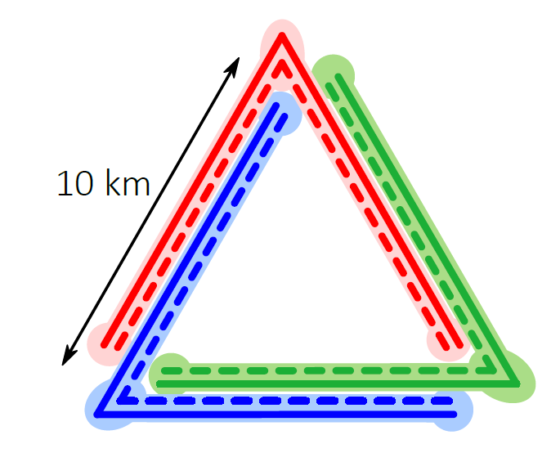
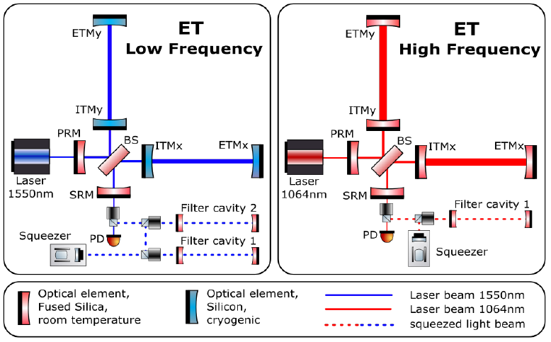
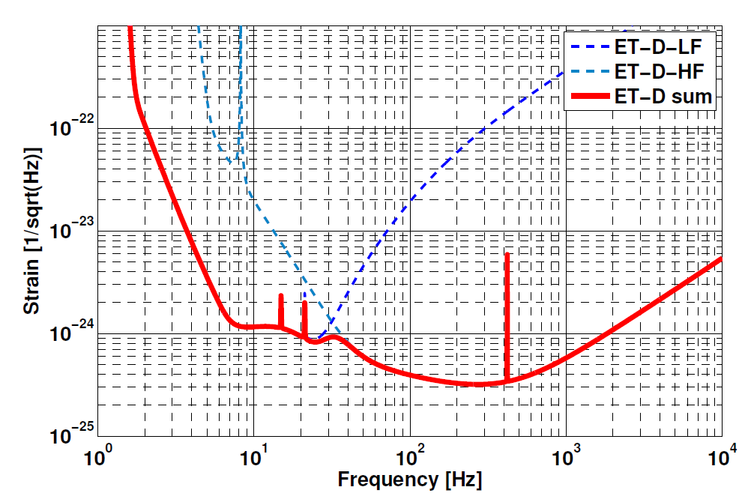
Einstein Telescope as a Xylophone
Each vertex is the center of a pair of interferometers, i.e.,
6 interferometers in total.
Power: 18kW
Temperature: 10-20K
Power: 3MW
Temperature: 290K

Slide 7
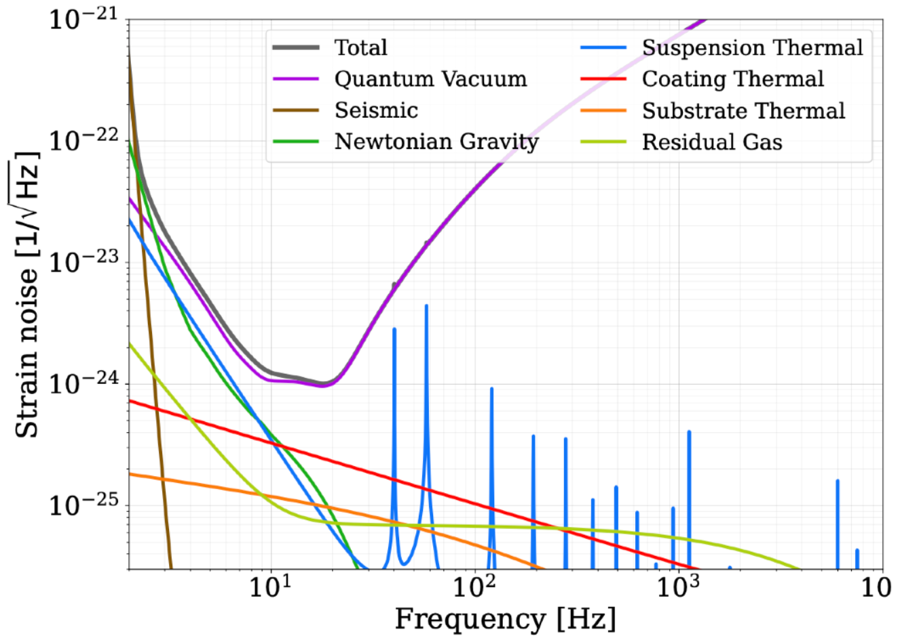
ET Noise Budget

Slide 8
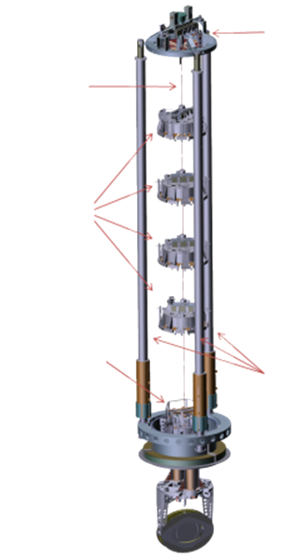
Principles of Seismic Isolation
Virgo Superattenuator
Damping
Lower peak height
Cascaded
Steeper isolation curve
Larger structure
Lower resonance frequency
f ⁻⁴
f ⁻²
Less isolation
More peaks
Difficult to realize
In pratice: use combination of these methods

Slide 9
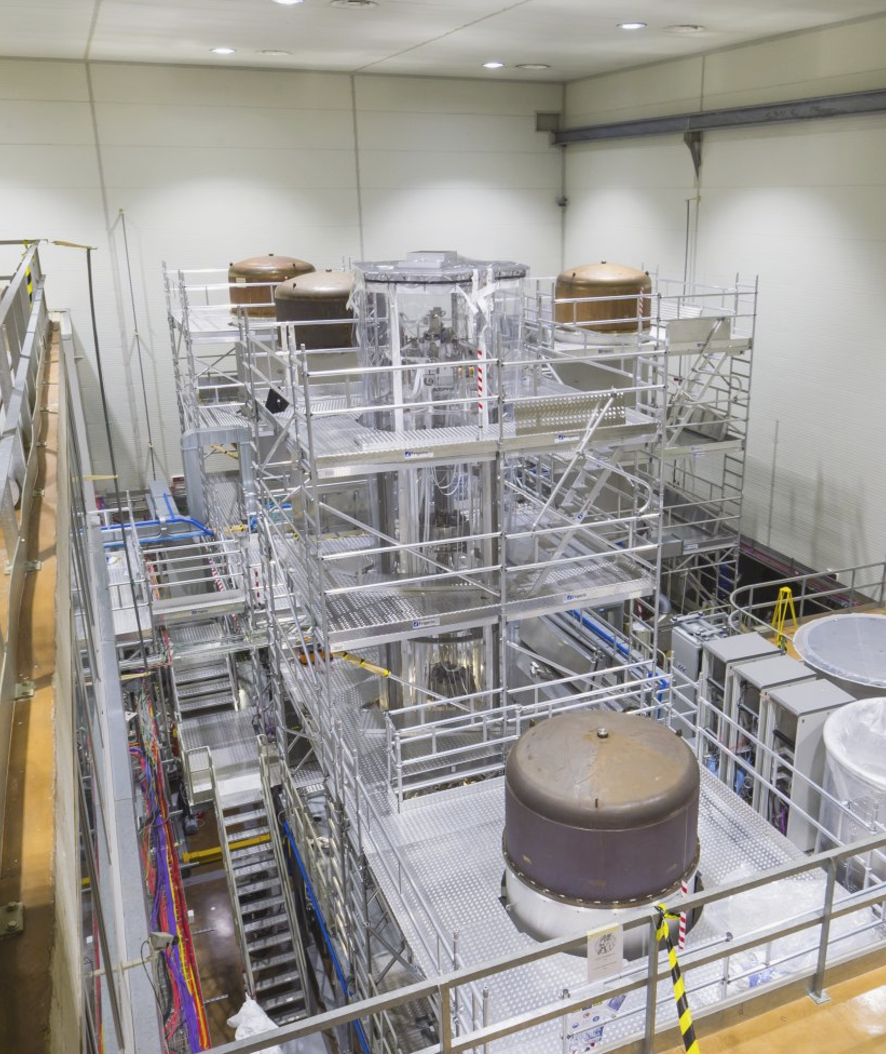
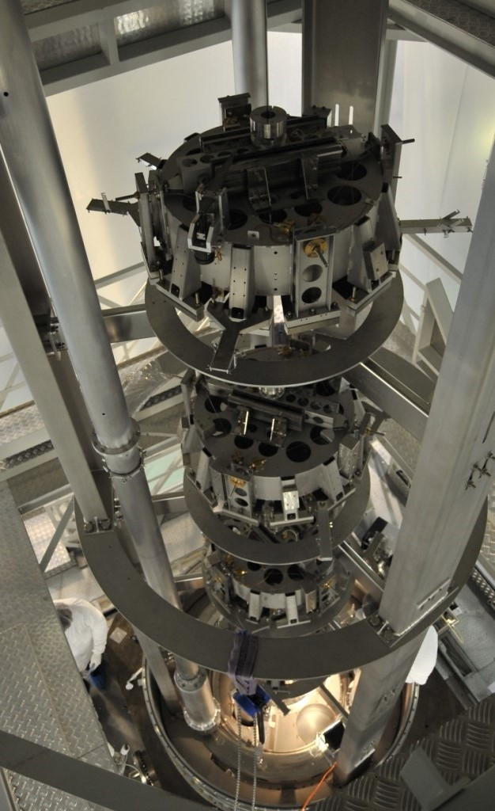
Virgo Superattenuator
An iconic component of the Virgo detector is the superattenuator inside the 10m tall towers.
It is a design choice initially made to enable low-frequency GW observations.

Slide 10

Suspension Towers in ET

Slide 11
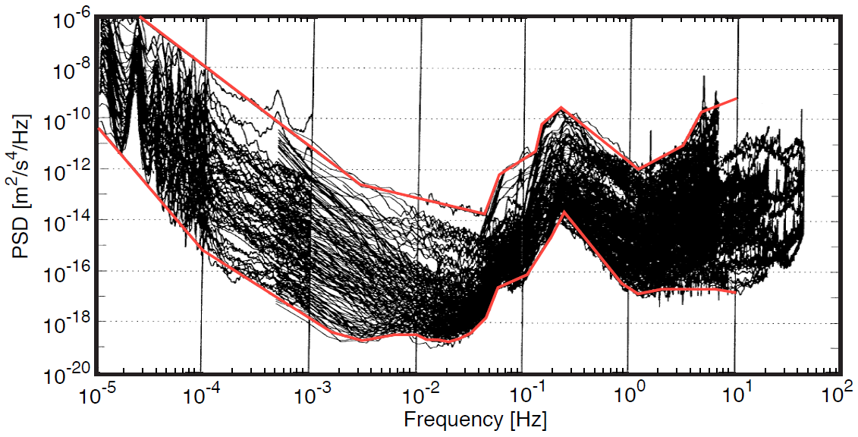
Seismic Background On Earth
Terrestrial high-noise model
Terrestrial low-noise model

Slide 12
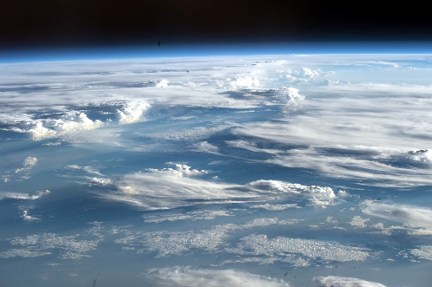
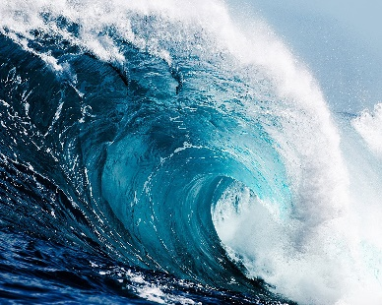
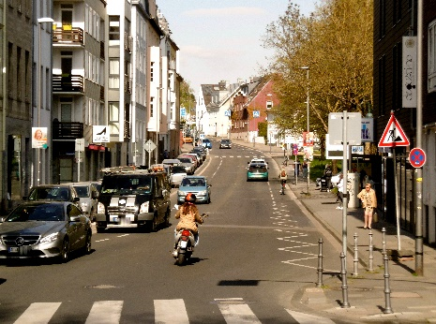
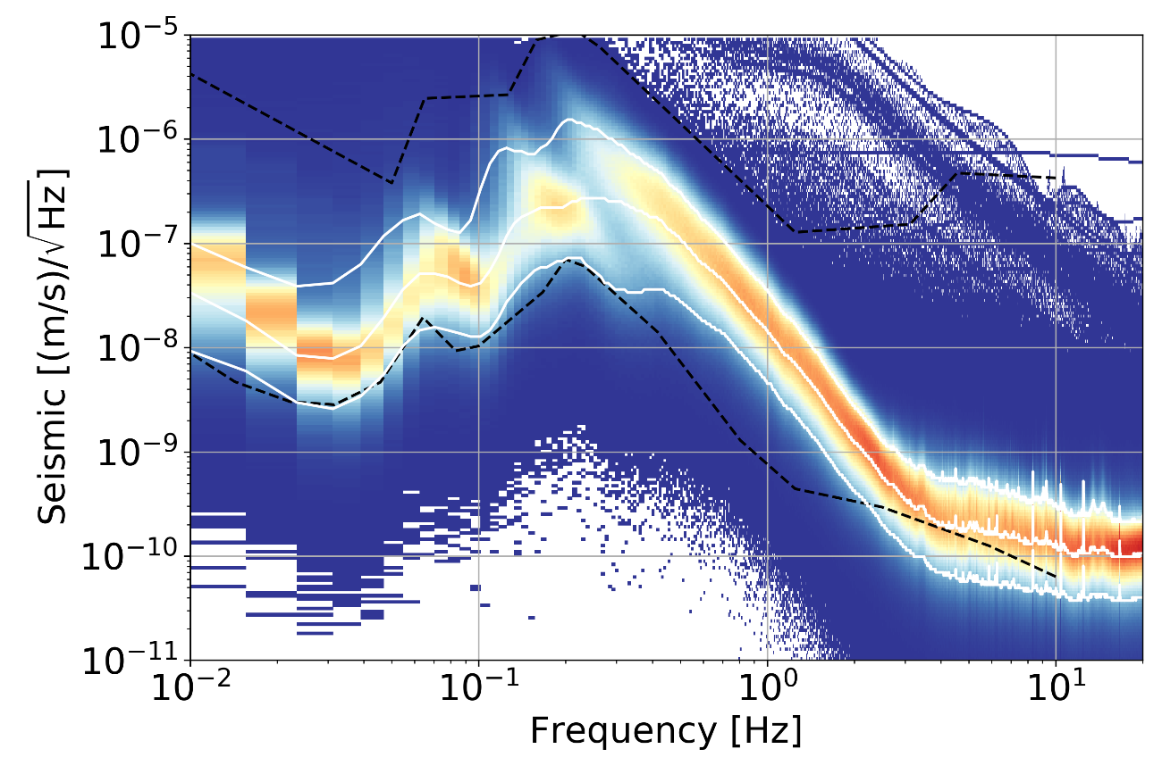
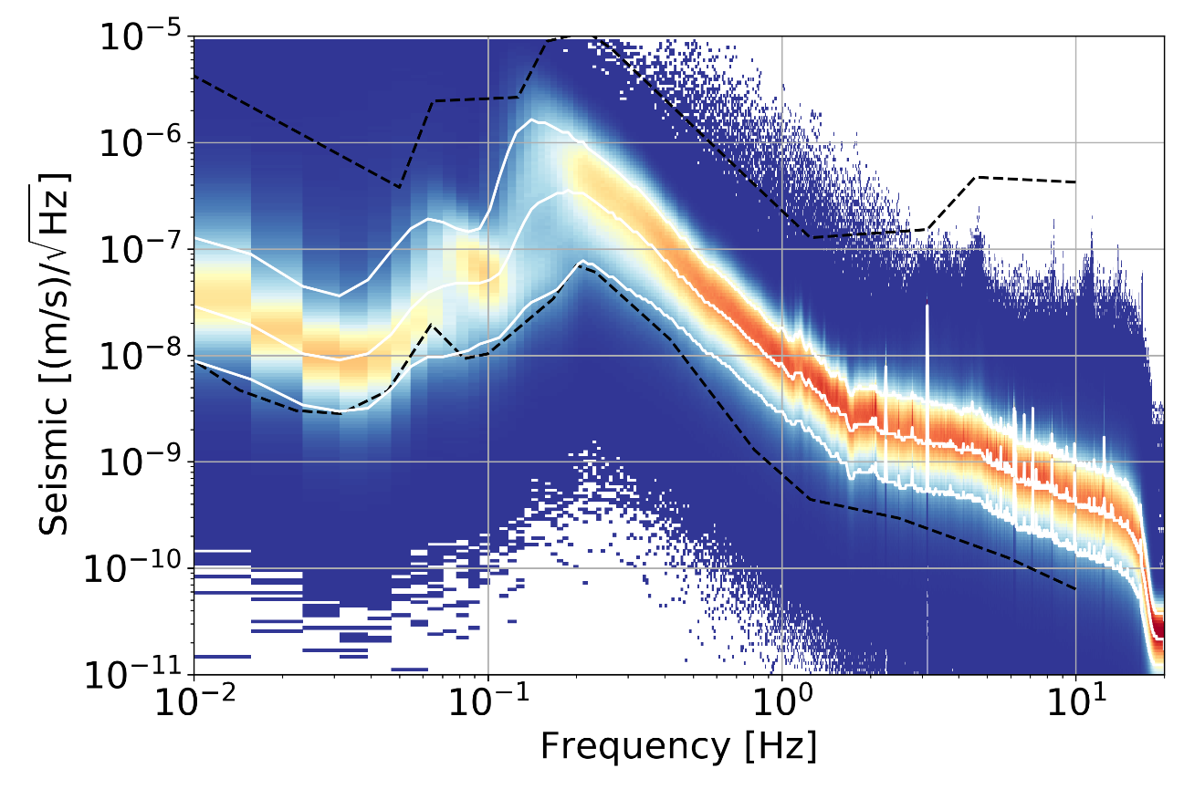
Seismic Noise at ET Candidate Sites
?
Sardinia
Euregio Meuse-Rhine

Slide 13

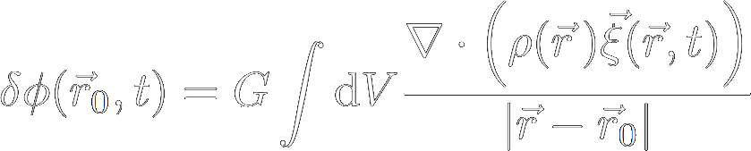
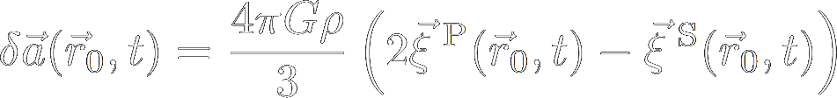
Newtonian Gravitational Noise
1) Density perturbation by a seismic field
2) Associated gravity perturbation
3) Solve for a specific seismic field

Slide 14
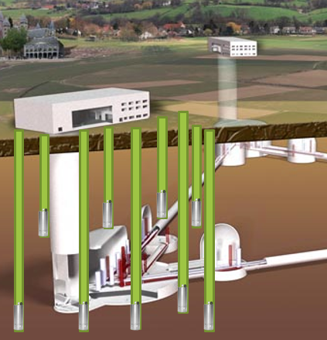
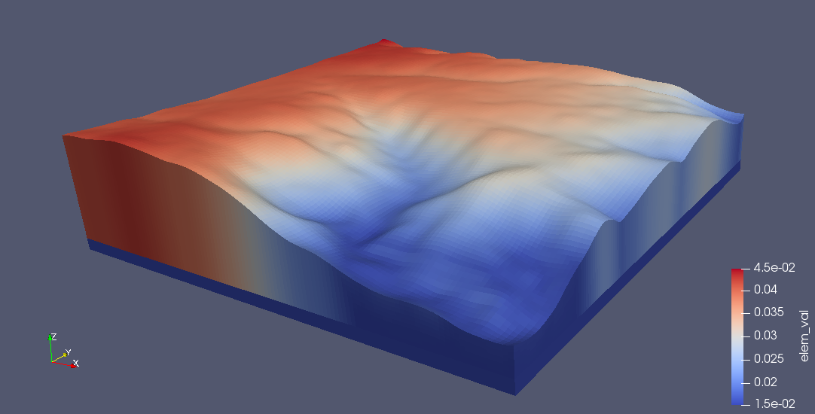
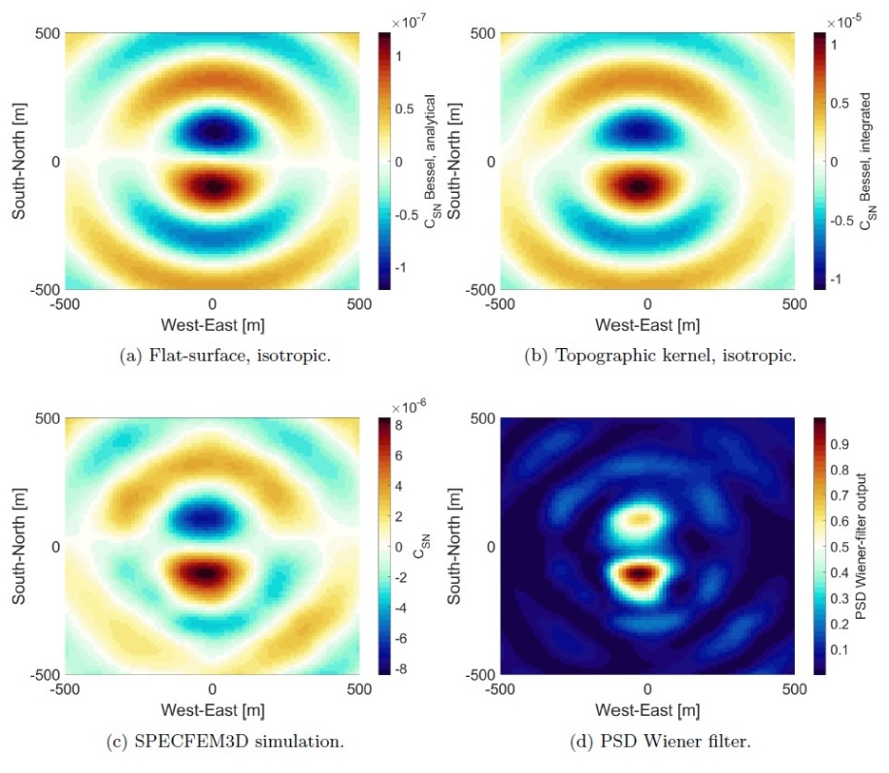
Newtonian Noise Cancellation
Simulations + data for optimization
Sardinia site
Hundreds of borehole seismometers
Probably one can only deploy one seismometer per borehole
High cost, complexity, risk…

Slide 15
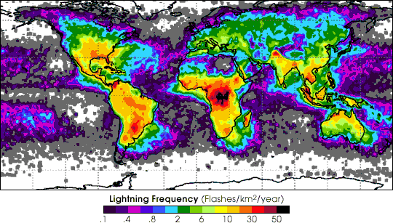
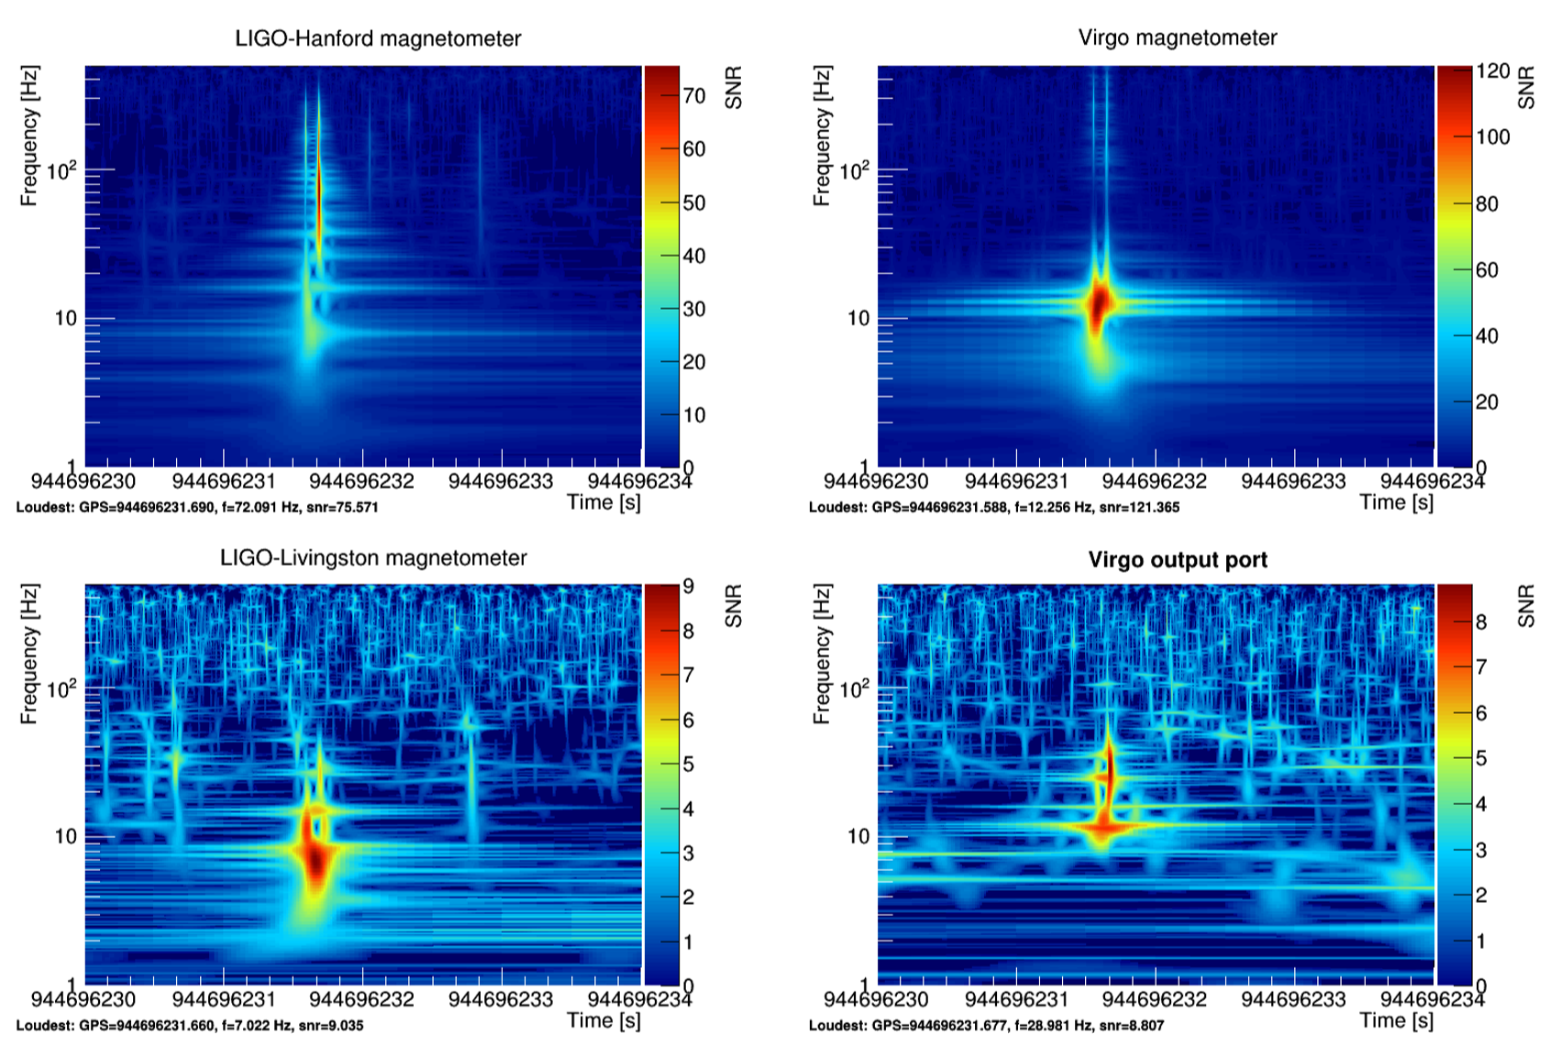
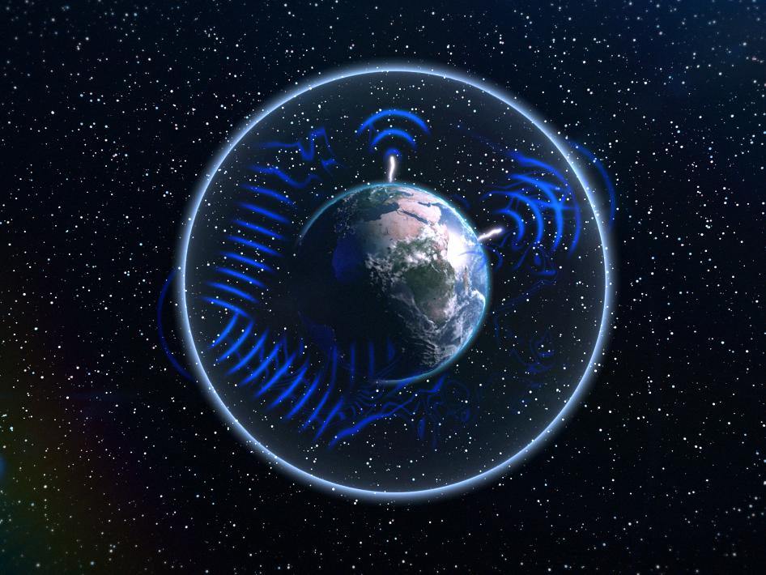
Magnetic Fluctuations
Magnetic disturbances can appear coherently in a global detector network.
Lightning transient can be coincident
Globally coherent disturbances and noise
Schumann resonances

Slide 16
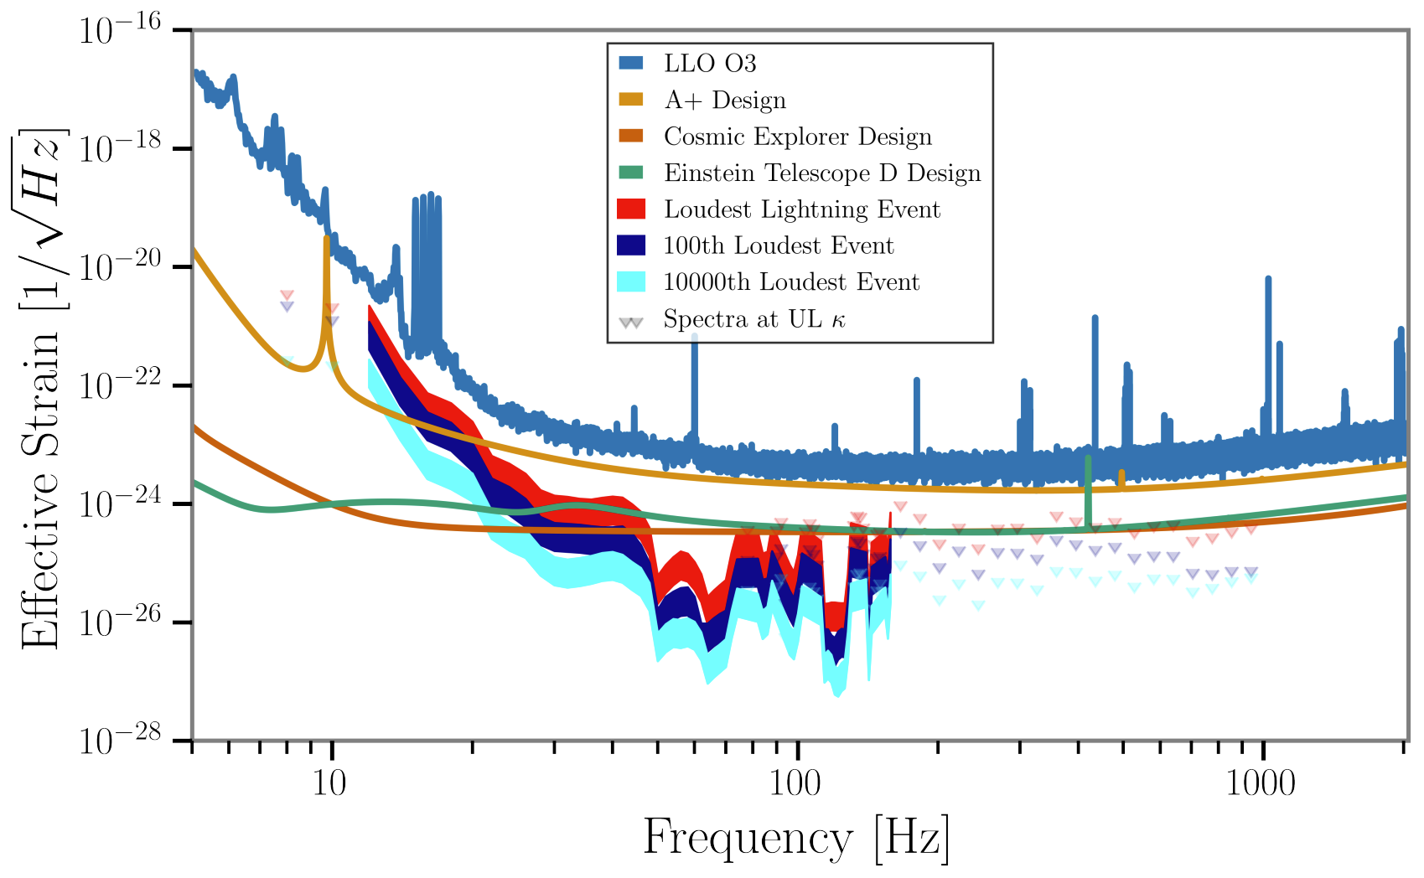
Magnetic Coupling
0.5s PSDs
PRD 107, 022004 (2023)

Slide 17
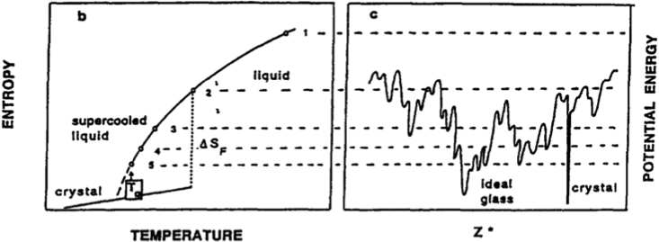
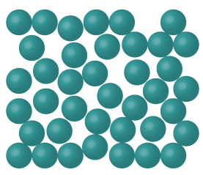
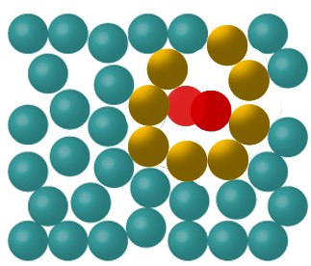
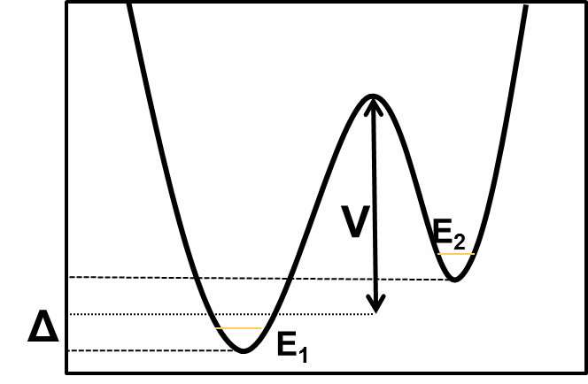
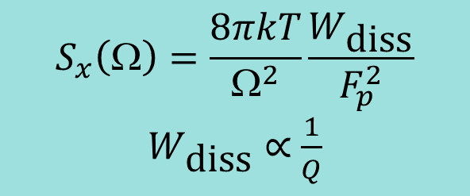
Dissipation and Thermal Noise
Fluctuation-dissipation theorem:
Thermal-noise spectrum proportional to dissipated power
“nearby” minima lead to tunneling or thermally-activated motion of groups of atoms
$$S_{x}\left(Ω\right)=\frac{8πkT}{Ω^{2}}\frac{W_{\text{diss}}}{F_{p}^{2}}$$
$W_{\text{diss}}$ ∝ $\frac{1}{Q}$
Mirror coating stack
τ(T)

Slide 18
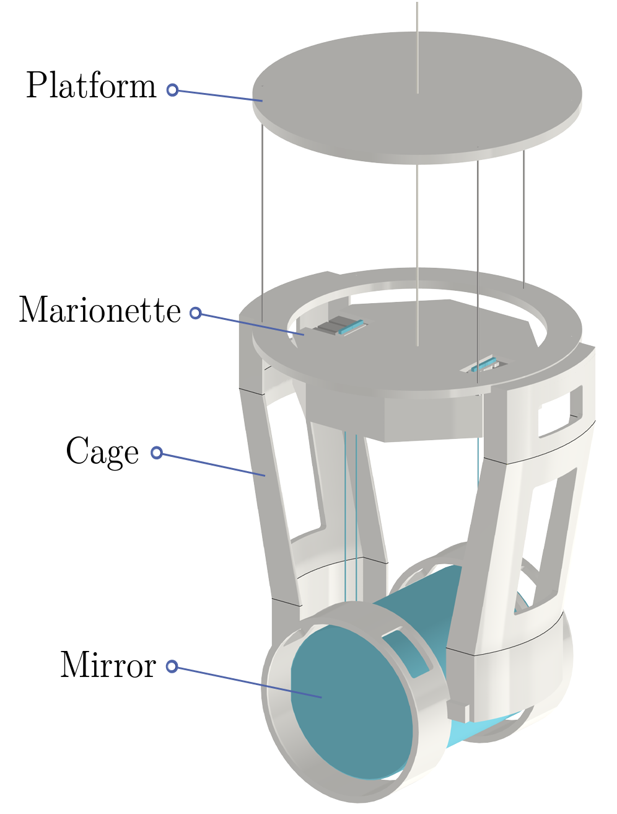
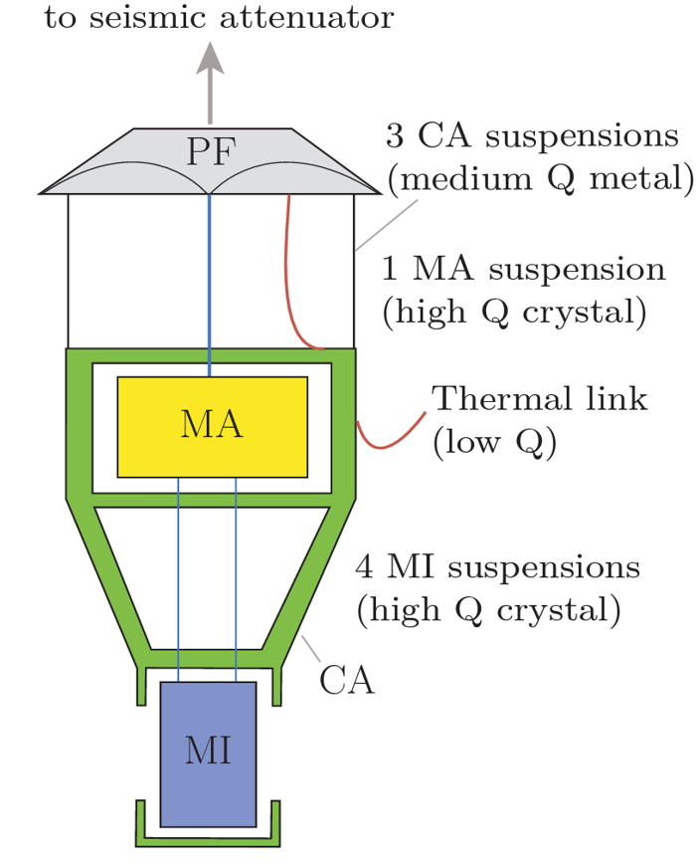
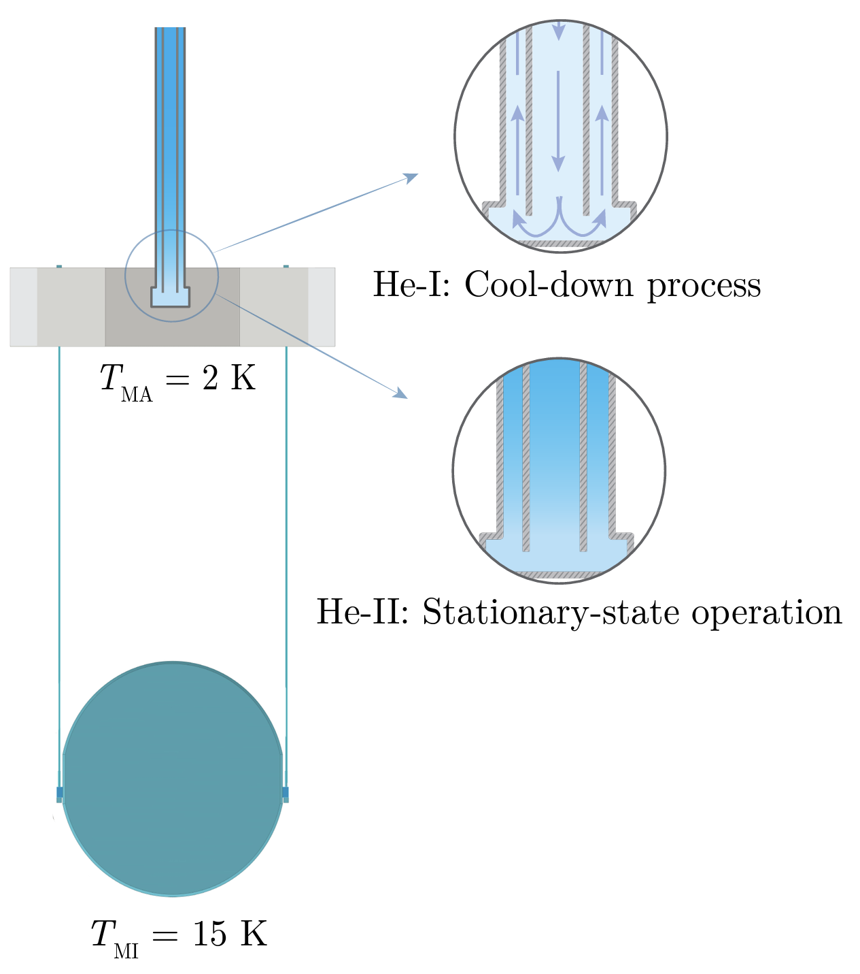
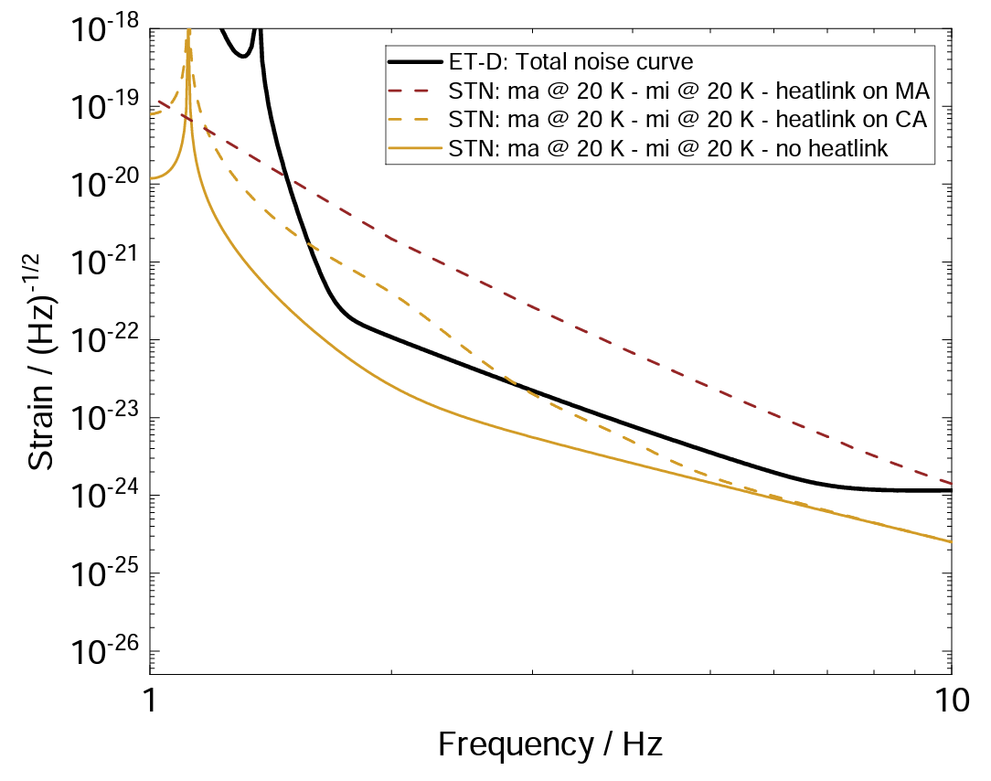
ET Test-mass Cooling
Cooling the ET-LF test masses is a huge technological challenge.
Novel concept: conductive tube for initial He-I cool down, and stationary heat-transport with He-II is under investigation.
Suspension thermal noise

Slide 19
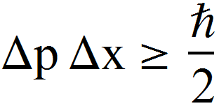
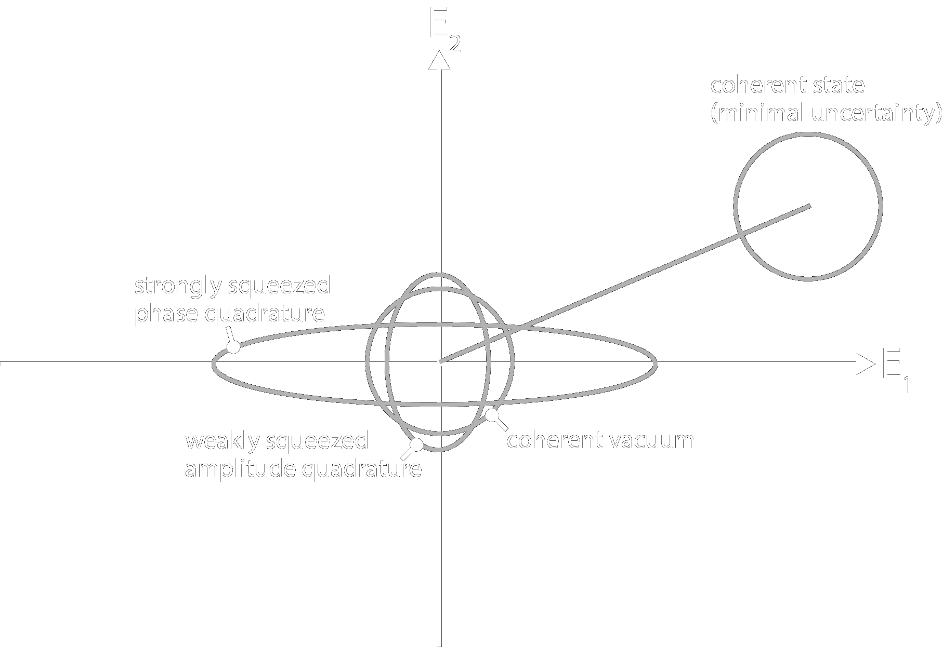


Quantum Optical Noise
Quadratures of the EM field
Heisenberg uncertainty principle
$E(t)=E_{1}(t)cos⁡(ω_{0}t)$+$E_{2}(t)sin⁡(ω_{0}t)$
Fundamental measurement: Counting photons

Slide 20



Quantum Noise in GW Detectors
Culprit:
Where should we manipulate the state of the laser beam?

Slide 21



Squeezed Vacuum Source
Reduced quantum noise at GEO600
Virgo squeezer
Lough et al 2020

Slide 22


CAOS
Facility in Perugia
Building height will be about 20m
Learning how to build and operate ET suspension systems

Slide 23

ETpathfinder
Facility in Maastricht
Dedicated to interferometer operation at cryogenic temperatures.

Slide 24




Facility at LNGS
Dedicated to the development of active seismic isolation and inter-platform control.

Slide 25

Inter-platform Control
ITMY
Lock all suspension platforms into a common motion across the full central vertex of an interferometer
Refer this optically rigid body to the two input masses
ITMX

