Slide 1
Sustainability and Future Accelerators, Where do we stand?
R. Losito, CERN
TECH-FPA PhD Retreat
17-21 february 2025, Laboratori Nazionali del Gran Sasso, L’Aquila (I)

Slide 2
Outline
What is CERN
What is Sustainability in the Accelerator Context
Energy
Site management
Construction of new accelerators
Development of new technologies

Slide 3
Sustainability in a nutshell

Slide 4
Sustainability in a nutshell
Defined in 1987 by the UN Bruntland Commission on Environment and Development:
“Sustainable development is development that meets the needs of present without compromising the ability of future generations to meet their own needs”
Supports the aspiration of the present generation to sustain innovation and development, but also their (our!) responsibility towards future generations!

Slide 5
Sustainable Development Goals The basics
On 25 September 2015, the United Nations General Assembly unanimously adopted Resolution 70/1, Transforming our World: the 2030 Agenda for Sustainable Development, laying out 17 Sustainable Development Goals, aimed at mobilising global efforts to end poverty, foster peace, safeguard the rights and dignity of all people, and protect the planet.
The Goals are inter-related and all countries have agreed to try to meet all of them by 2030.
The Goals serve to coordinate actions by UN agencies, non-governmental groups, businesses and any other entities working on a specific Goal.
Yearly meetings are organised to present the actions undertaken and the progress made.
Each Goal is broken down into defined and specific targets (169 in total) that propose concrete paths to reach each Goal; the targets are all complementary strategies to fulfil their respective Goal.
Each target has then its own indicators, which are the variables that can be measured and assessed to report on the progress made.

Slide 6
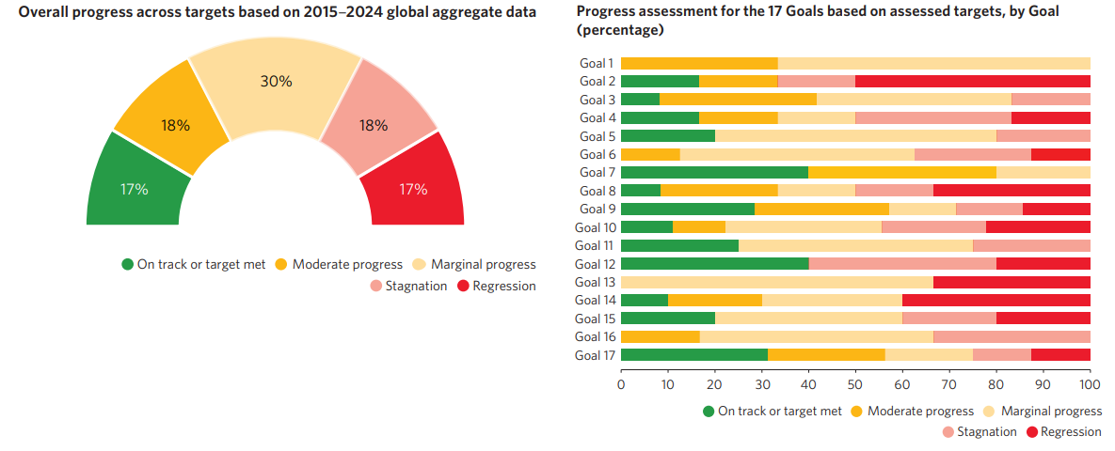
2024 UN Report on SDG

Slide 8
Particle accelerators

Slide 9
The “process” of particle accelerators
Courtesy Prof. M. Seidl, EPFL and PSI

Slide 10
Sustainability in the context of future colliders

Slide 11
What do we mean by “Sustainable Accelerator”
Sustainability Assessment
Accelerators, as any other human activity, make use of natural resources and impact on:
the environment (Costs)
society (Benefits)
economy (Costs and Benefits).
How much Cost is acceptable for the Benefits?
Will future generations have the opportunity to do what they need ?
The accelerator and HEP community have reached a full consensus on the fact that new projects must look at these aspects, in addition to the Scientific case of each proposal
Social
Environmental
Economic

Slide 12
Socioeconomic Benefits to society
Innovation
Web
PET
Hadron Therapy (Tera, MED Austron)
…
Training
More than 40’000 students and ECRs trained in the LHC era…
Dissemination of STEM
150’000/year visitors at CERN, going up to >300’000/year after inauguration of the Science Gateway
Benefit for high tech industry
Every CHF spent by CERN multiply by factor >1 in future turnover of high tech industry.
Science for peace
CERN provides a dream!
Promoter of SESAME Synchrotron light source in Middle East (Giordany): Israel, Palestinians, Iranians, Syrians etc.. United for a science project.

Slide 13
Environment

Slide 14
In order to control you need to measure…
CERN publishes since 2017 environmental reports based on the GRI (Global Reporting Initiative) standards
It includes detailed information about Energy and water supply and effluents management, direct and indirect CO₂ emissions, radiological impact (emissions and waste), conventional waste, Noise.
Measuring allows to establish objectives and allocate funds…

Slide 16
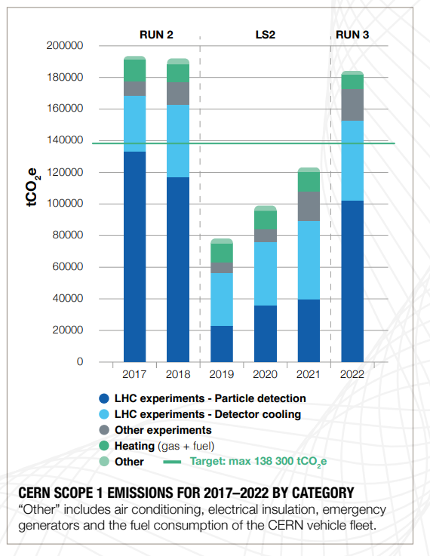
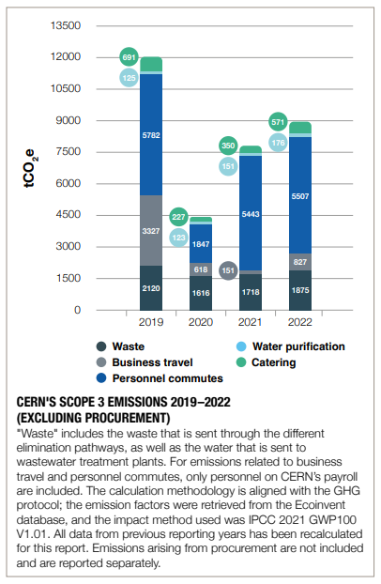
CERN Emissions
Where is it worth acting to reduce our impact?

Slide 17
CERN Emissions: Procurement
Procurement at CERN (O{500 M€/year}) is a relevant part of our indirect contributions to CO₂ eq. emissions
We can act on Scope 1 (will reduce them by 28% before 2030)
In order to reduce Scope 3 and possibly Scope 2 we need to
engage with suppliers,
Integrate Lifecycle assessment in the Design Process
Engage with Energy suppliers towards long-term, renewable or low-CO2 contracts (PPA)

Slide 18
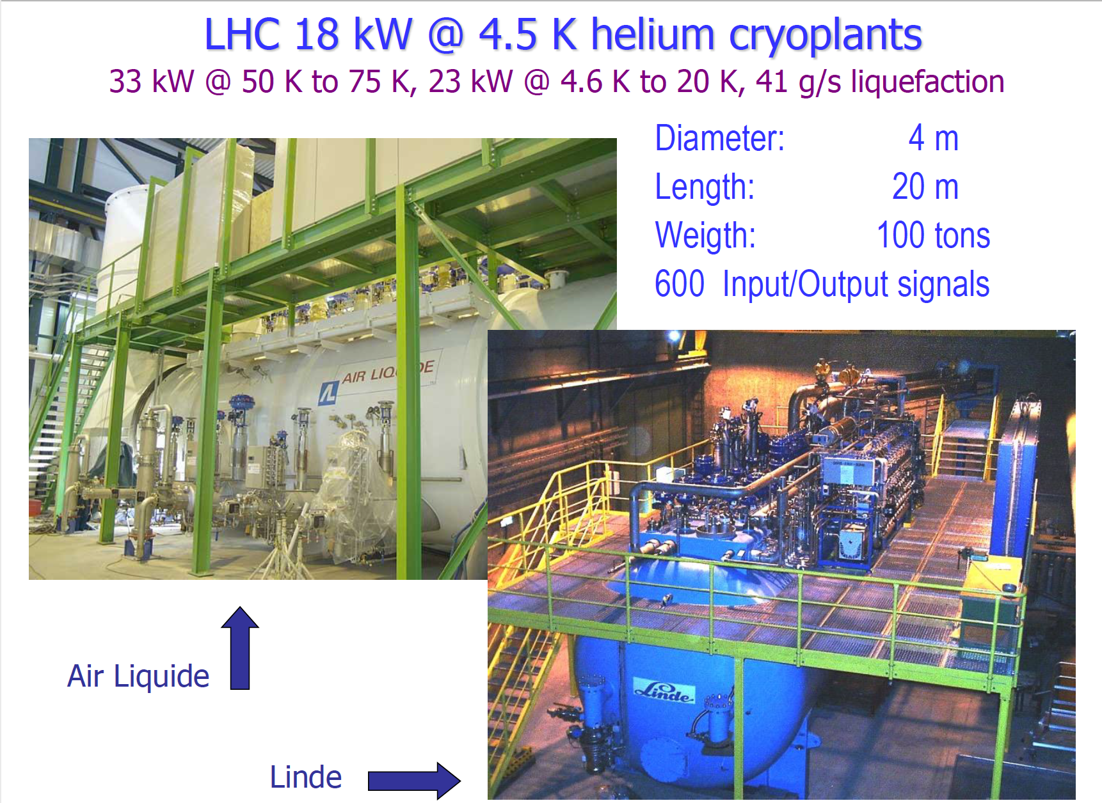
Procurement based on Total Cost of Ownership
New equipment (Cryogenic Refrigerators for HL-LHC)
A set of requirements (performance, technology) to allow industry to provide the optimum for a given scenario:
Adjudication: CAPEX + OPEX (10 years)

Slide 19
Managing Energy

Slide 20
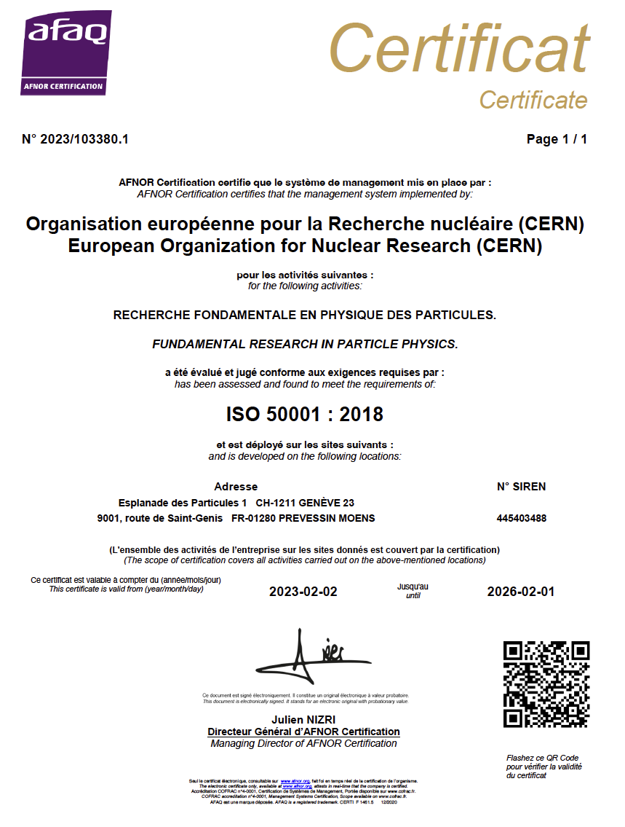
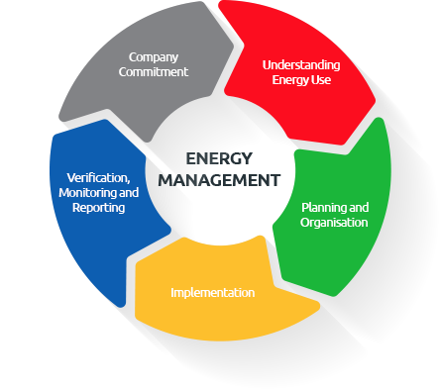
ISO 50001 certification
CERN is the first HEP Laboratory ISO 50001 certified.
Certification implies the establishment of improvement goals, and of continuous monitoring.
The process is not limited to the experts on the field: the line and top management have to be continuously informed of the status of the KPIs and take action.
Electricity consumption and control is managed through an Energy Management Panel, gathering the management of the groups responsible of the most impacting equipment.

Slide 21
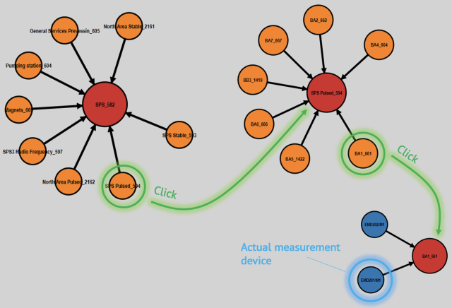
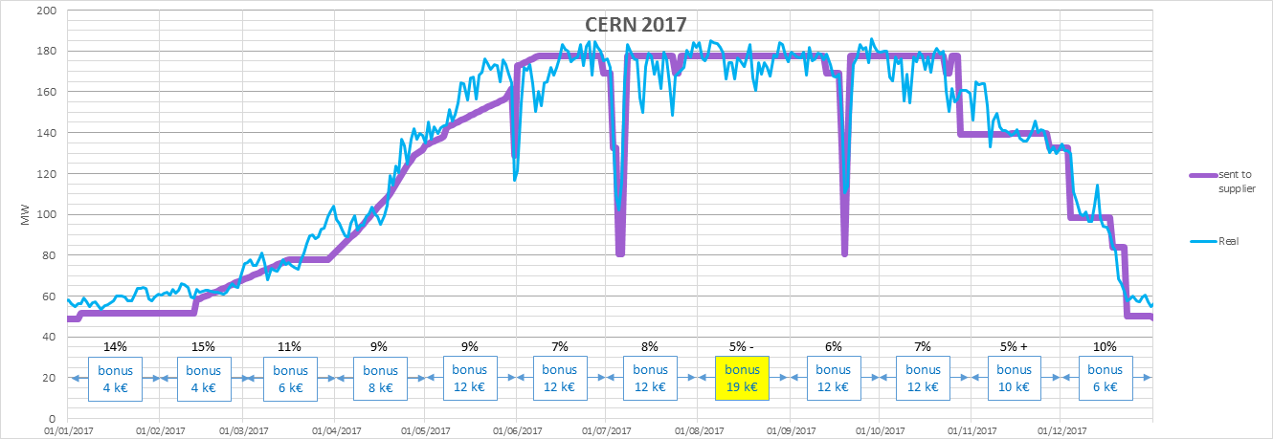
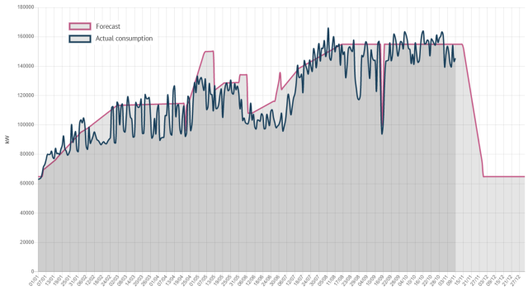
Forecasts & measures
2nd version, integrated in Web-Energy tool to combine forecasts & measures
Measures: global accuracy better than 1% !
Model output sent to Energy Contractor
= model − communication and modelisation delays
2021

Slide 22
Preparing CERN’s future

Slide 23
Preparing CERN’s future
Driven by the 2020 Update of the European Strategy for Particle Physics
Technical and financial feasibility study of a Future Circular Collider (Spring 2025)
Accelerator R&D to develop technologies for FCC and for alternative options
Detector and computing R&D
Maintain and expand a compelling scientific diversity programme
Continue to support other projects around the world, including alternative proposals at CERN

Slide 24
Preparing CERN’s future
Driven by the 2020 Update of the European Strategy for Particle Physics
Technical and financial feasibility study of a Future Circular Collider (Spring 2025)
Accelerator R&D to develop technologies for FCC and for alternative options
Detector and computing R&D
Maintain and expand a compelling scientific diversity programme
Continue to support other projects around the world, including alternative proposals at CERN

Slide 25
Preparing CERN’s future
International Linear Collider
CLIC – Compact Linear Collider

Slide 26
Impact of future projects

Slide 27
Lifecycle assessment
Process to evaluate the impact of a human activity
Long term (~5 - 10 years) vision: every component designed at CERN should integrate LCA from the start of the design process and be optimised
See Int J Life Cycle Assess (2017) 22:138–147) for the ReCiPe Methodology (2016) --- https://doi.org/10.1007/s11367-016-1246-y

Slide 28
rrfr

Slide 29
Technology for Sustainability

Slide 30
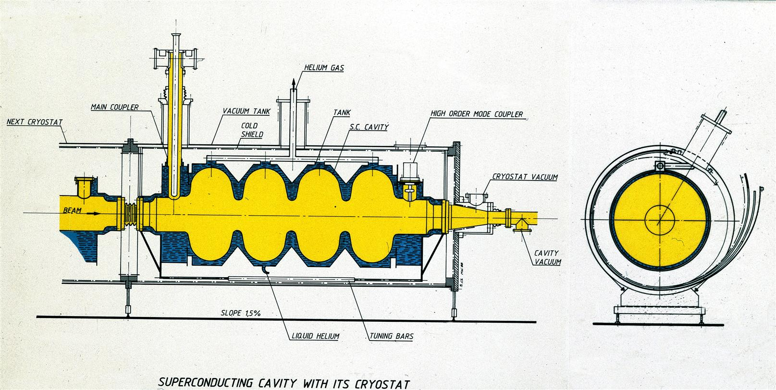
Main Components of a particle accelerator
Magnets
Radiofrequency Cavity

Slide 31
Main Components of a particle accelerator
Detectors
Data Centers

Slide 32
Efficient technologies
Courtesy Prof. M. Seidl, EPFL and PSI

Slide 33
Cryogenics
P_{tot}=P_{diss}+P_{cryo}
Optimum temperature depends on
SC material (LTS, HTS etc…)
Refrigerant
…
300K
Ptot
Cryo
Plant
Grid
PCryo
Pcryo
Pdiss
Pdiss
2K

Slide 34
Superconductivity
Magnets & SC links
RadioFrequency Cavity
Working on several Materials
NbTi: T_{c} ~ 9.2 K; J_{e}=1000 A/ mm² @ 4.2 K, ~ 6 T At CERN used at 1.9 K to have J_{e}=1000 A/ mm² @ ~ 9 T
Nb₃Sn: T_{c} ~ 18.3 K; J_{e}= 1000 A/ mm² @ 4.2 K, ~ 15 T. At CERN used at 1.9 K for the HL-LHC upgrade. Possible to reach high fields (>10 T) at 4.5 K
MgB₂ : T_{c} ~ 39 K, J_{e}= 400 A/ mm² @ 4.2 K ~ 6 T. At CERN used for the HL-LHC SC link cable at 20 K
Bi-2223: T_{c} ~ 108 K; J_{e}= 400 A/ mm² @ 4.2 K ~ 6 T. At CERN used at CERN for current leads. Usable for links up to 77 K (Nitrogen instead of He).
ReBCO: T_{c} ~ 90 K, J_{e}= 1000 A/ mm² @ 4.2 K, > 20 T. At CERN used for development of very high field magnets (>15 T) and in some parts of HL-LHC SC-link. Chosen by Fusion as material for future high field magnets
Bulk Nb: high Q₀ at 2K also at high field. Necessary for linear accelerator that require high gradients.
Nb sputtered on Cu: decent Q₀ at relatively low field (few MV/m) at 4.5k. Used for circular accelerators where high gradients are not necessary
Investigating HTS: no conclusive result today. Only sputtered cavities are possible.

Slide 35
High Efficiency Klystrons

Slide 36
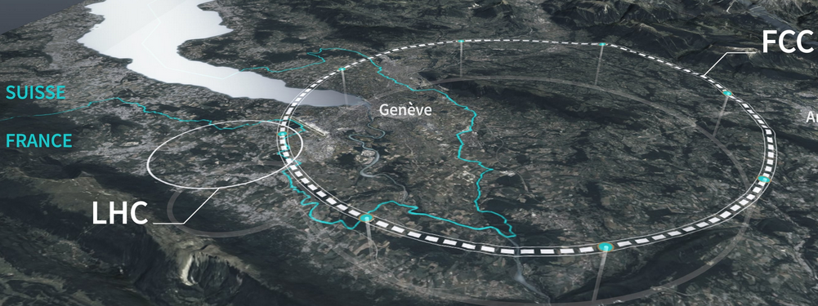
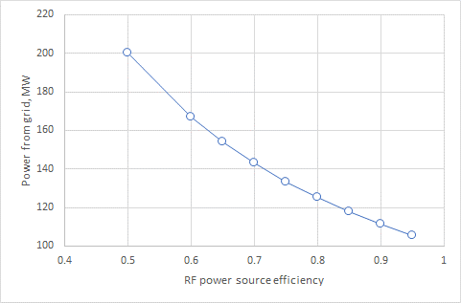
Savings on Grid power required for the large-scale HEP Accelerators
400 MHz, 1 MW klystron for FCC_{ee}
State of the art
2020 and before
HEK project target
2026/27
https://fcc.web.cern.ch/overview
To operate FCC_{ee}, 100 MW Continues Wave RF power is needed to accelerate particles and to compensate for the energy lost into synchrotron radiation.
Improving klystron RF efficiency from 65% in the best existing commercial devices to 85% in the new HE tubes will:
Save 32.2 MWh -> 253 GWh (7000h/year) -> 2.53TWh over 10Y.
Reduce cost and power consumption of power converters and cooling system (environmental impact).
Zaib Un Nisa for CERN & ULAN

Slide 37
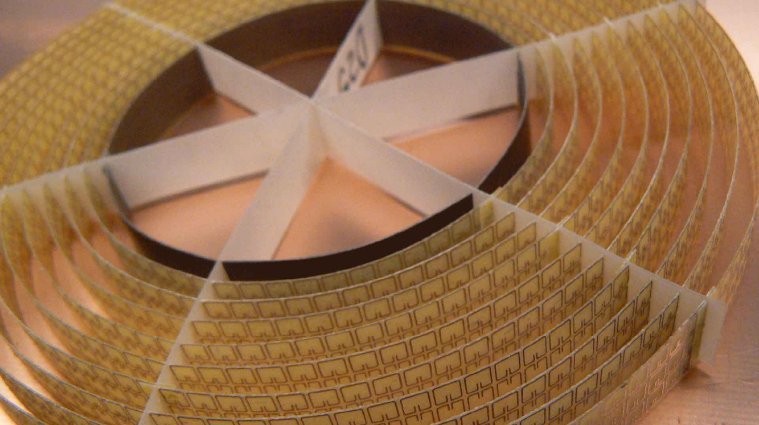
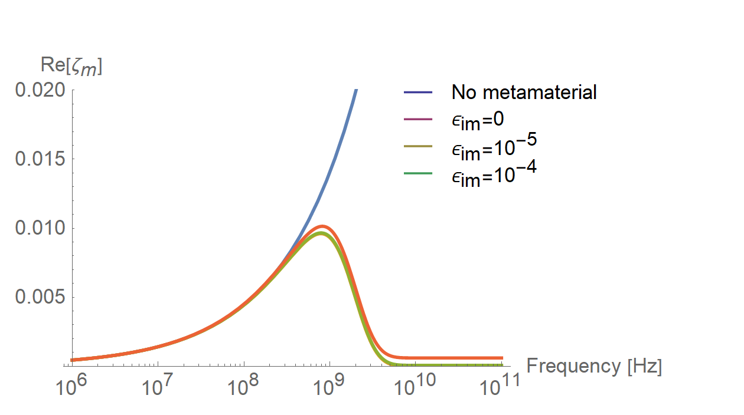
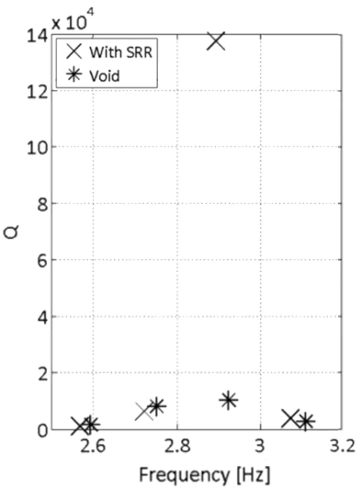
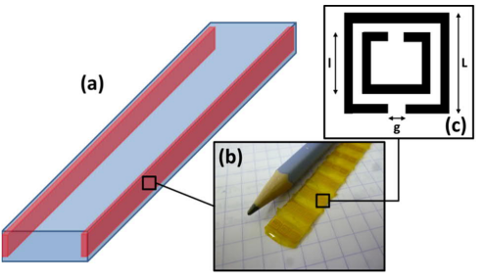
Future accelerator technologies: Metamaterials
Source of the picture
Source of the picture
Meta-conductive regime
Courtesy C. Zannini

Slide 38
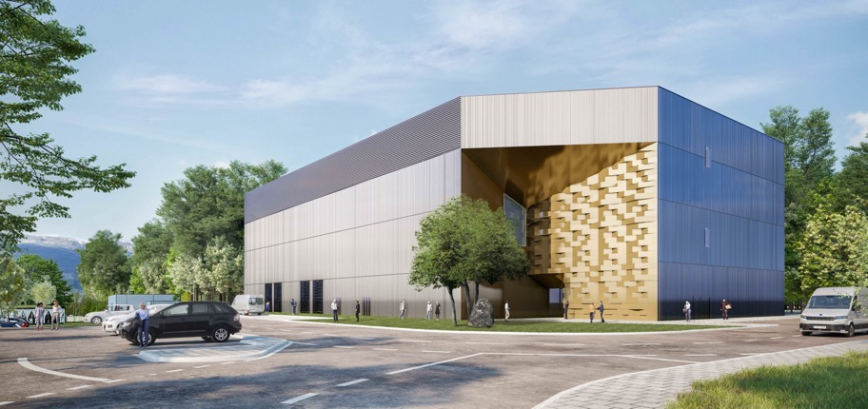
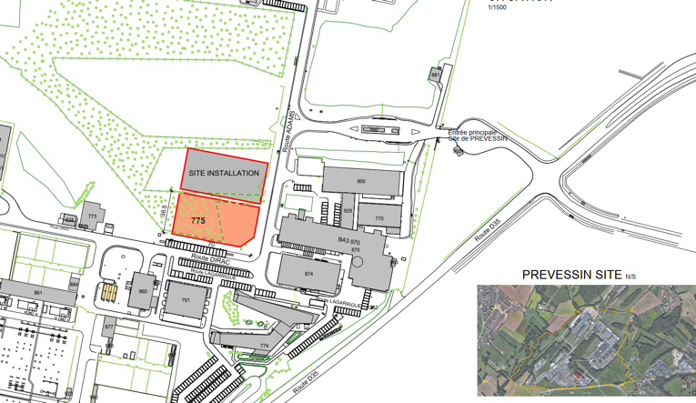
PREVESSIN COMPUTING CENTER
Purpose : The Contract is for the design, construction and 10-year M&O of the building and equipment.
Needs : Initial capacity of 4 MW available for IT equipment with stepwise future increases to 12 MW.
To meet CERN's environmental goals the project incorporates the following considerations :
The PCC is designed to be energy efficient with a target PUE (Power Usage Efficiency) of 1.10 (1.15 contractual)
Optimised water consumption via a recirculation system lowering consumption in hot periods
All cleared vegetation will be reconsolidated
The acoustic study used for design of the building follows CERN commitments
A heat recovery system is foreseen for up to 25% of power produced to be recovered
Green terrace on the roof
CIVIL WORKS EXECUTION :
Building foundations – 80%
Ground level concrete works – 50%
Below slab networks – 25%
TESTING & COMPLETION :
PCC Testing – Mar to Sept 23
Operational from October 23
PREVESSIN HEATING PLANT :
MTP request 2021 and again in 2022
Operational from 2026 if approved in this MTP

Slide 39
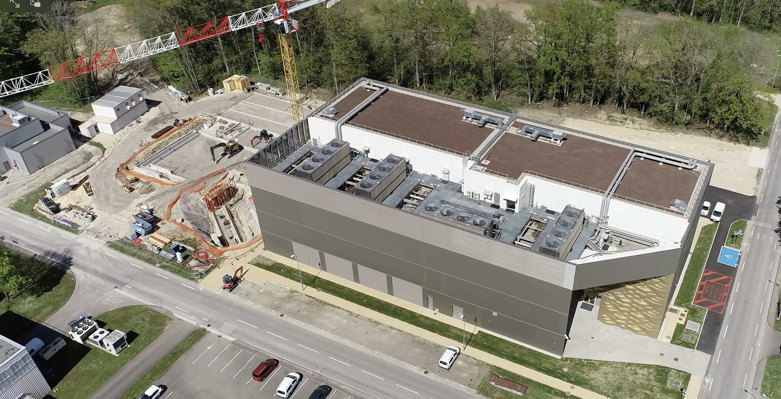
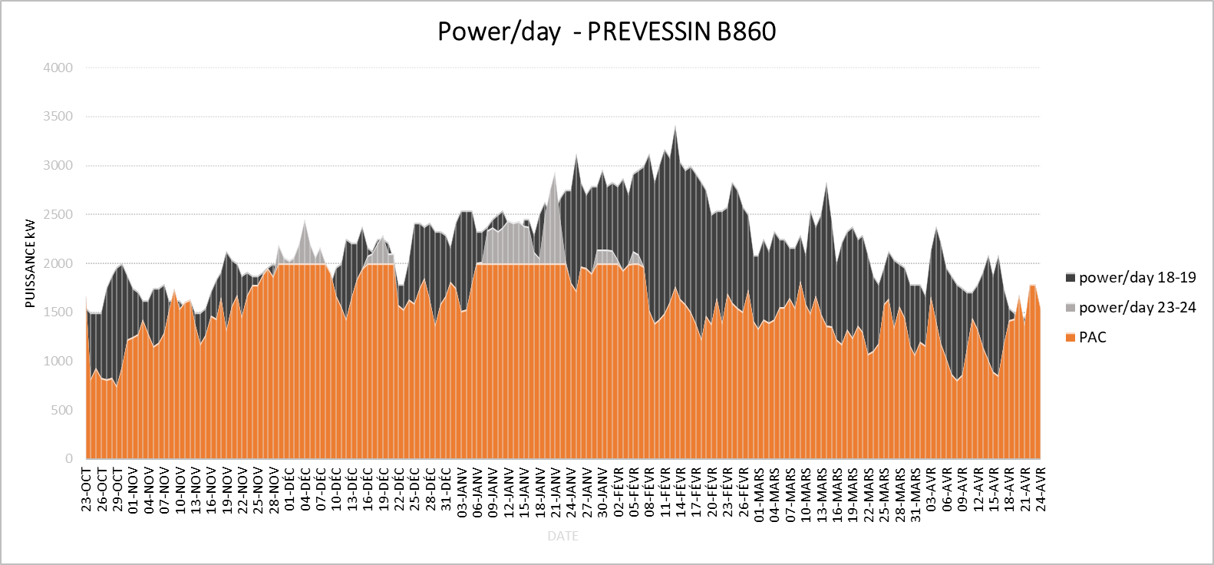
Heat Recovery Plant & Prévessin Data Center
Heating Plant
2025
Sept 2022
PDC (B.774)
Inaugurated February 2024
The new boiler room will include a 2 MW heat pump (with back-up boilers) and the possibility of installing a second heat pump in the future.
The heat pump will cover 60 to 85% of the Prévessin site's heating needs
Estimated reduction in emissions: 1,500 tCO2e from 2027 (80% reduction compared with current emissions in 2023-2024, which have already been significantly reduced compared with 2018)
PAC = 60 - 85%

Slide 40
Thank you for your attention and…
Questions?

Slide 41
SPARE SLIDES

Slide 43
CERN is the world’s biggest laboratory for particle physics.
Our goal is to understand the most fundamental particles and laws of the universe.

Slide 44
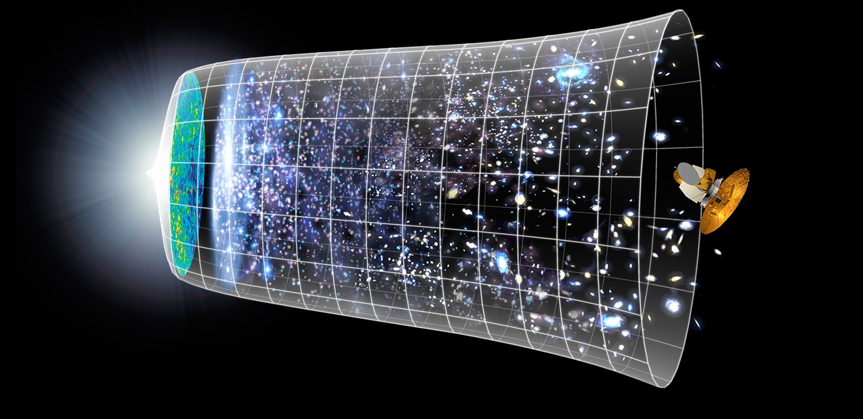
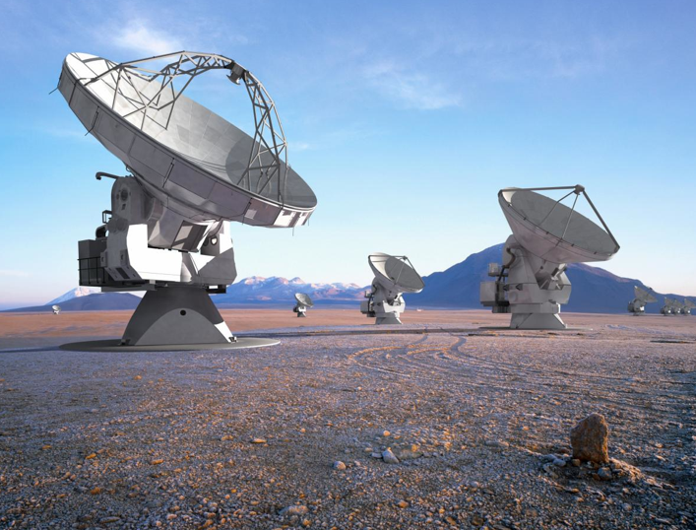
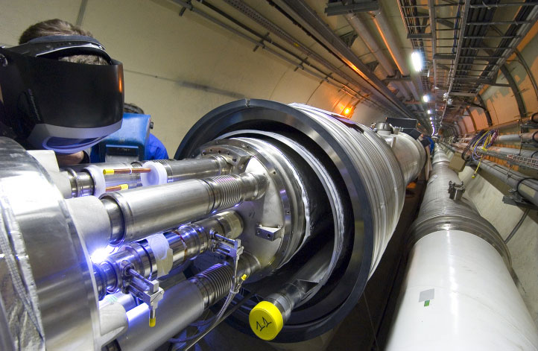
Evolution of the Universe
Telescopes
Big Bang
LHC
380 000 years
13.8 Billion Years
Explore the Universe back to 10⁻¹² s after the Big Bang
Today
10²⁸ cm

Slide 45
Science for peace CERN was founded in 1954 with 12 European Member States
CERN’s annual budget is 1200 MCHF (equivalent to a medium-sized European university)
24 Member States
Austria – Belgium – Bulgaria – Czech Republic Denmark – Estonia – Finland – France – Germany
Greece – Hungary – Israel – Italy – Netherlands
Norway – Poland – Portugal – Romania – Serbia
Slovakia – Spain – Sweden – Switzerland – United Kingdom
As of 31 December 2023
Employees:
2666 staff, 1002 graduates
Associates:
12 370 users, 1513 others
2 Associate Member States
in the pre-stage to membership
Cyprus – Slovenia
8 Associate Member States
Brazil – Croatia – India – Latvia – Lithuania – Pakistan Türkiye – Ukraine
4 Observers
Japan – USA
European Union – UNESCO
Around 50 Cooperation Agreements with non-Member States and Territories
Albania – Algeria – Argentina – Armenia – Australia – Azerbaijan – Bangladesh – Bolivia – Bosnia and Herzegovina
Canada – Chile – Colombia – Costa Rica – Ecuador – Egypt – Georgia – Honduras – Iceland – Iran – Jordan
Kazakhstan – Lebanon – Malta – Mexico – Mongolia – Montenegro – Morocco – Nepal – New Zealand
North Macedonia – Palestine – Paraguay – People's Republic of China – Peru – Philippines – Qatar – Republic of Korea
Saudi Arabia – Sri Lanka – South Africa – Thailand – Tunisia – United Arab Emirates – Vietnam
Notes:
The speaker can highlight CERN’s second mission as stated when it was established: to foster peaceful collaborations between nations that had recently been at war.
Additional information (OPTIONAL)
More than 40% of CERN’s budget is returned to industry through materials, utilities and services

Slide 46
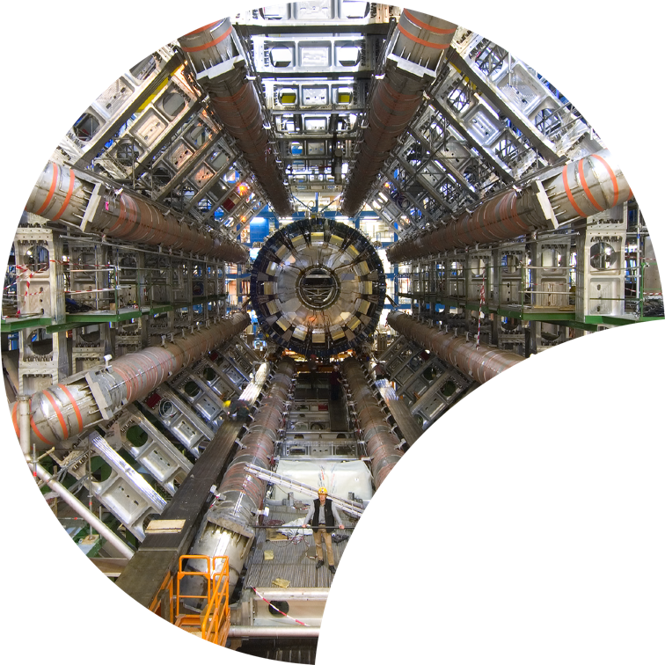
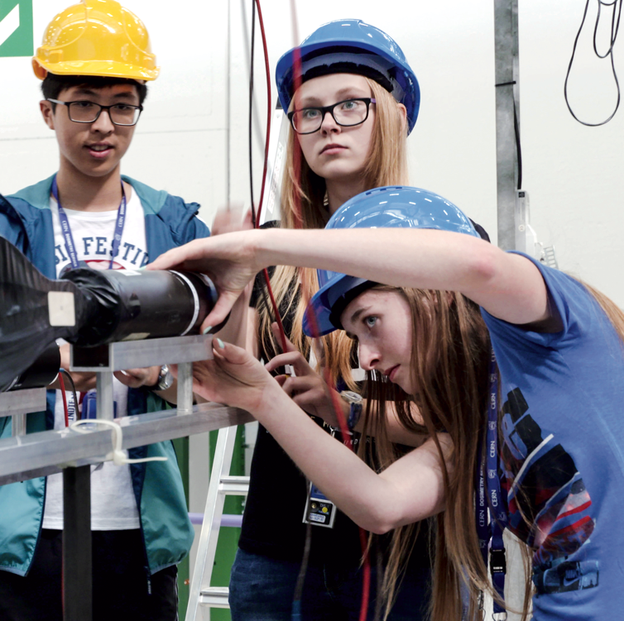
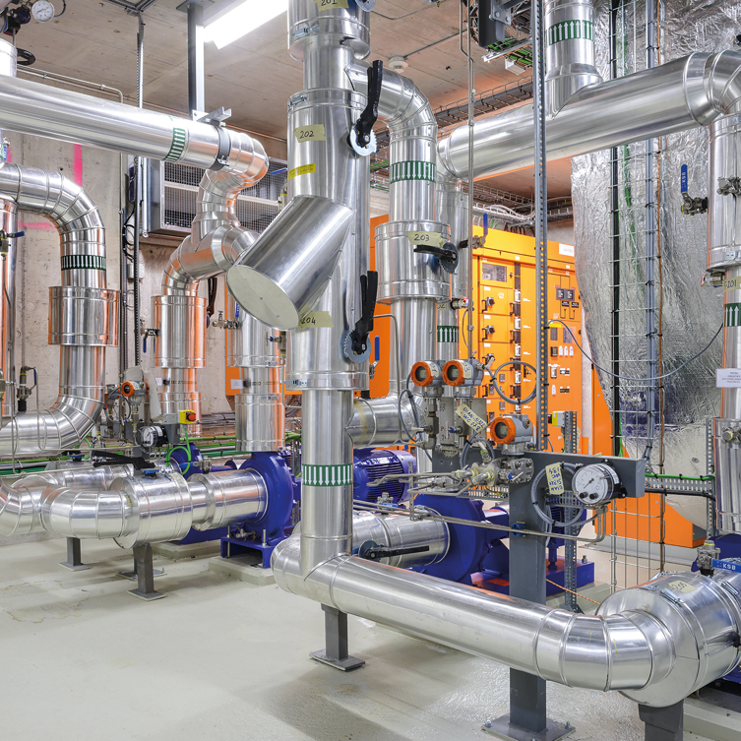
Four pillars underpin CERN’s mission
RESEARCH
EDUCATION & TRAINING
COLLABORATION
TECHNOLOGY & INNOVATION
Notes:
This slide introduces the four pillars that underpin CERN’s mission:
Research: To perform world-class research in experimental and theoretical particle physics; and to provide the particle physics community a range of accelerators that enable that research
Collaboration: To unite people from all over the world in the common goal of advancing the frontiers of human knowledge, in a spirit of equal collaboration and openness
Innovation: To push the technology underpinning accelerators, detectors and computing, to drive innovation in order to transfer knowledge to other scientific and technological areas, for the benefit of society
Education and Training: To train future physicists and engineers, to promote careers in science and engineering, and to foster citizens’ engagement in particle physics and in fundamental research.
FROM THIS POINT FORWARD, THE PRESENTATION IS DIVIDED INTO FOUR SECTIONS: ONE SECTION PER PILLAR

Slide 48
Reducing Scope 3: CERN Environmentally Responsible Procurement Policy
Use Best Value for Money as a powerful tool to drive the attention of bidders on environmental aspects
E.g. adjudicate not only on price, but also on electrical consumption, or water use etc…
Request EPDs where available
On the long term, depending on the maturity of specific markets, introduce “hard”qualification criteria for bidders.
Since a few years already adjudication of energy intensive equipment (e.g. cryogenic or HVAC plants) are adjudicated on the basis of their Total Cost of Ownership (procurement cost plus 10 years operation and maintenance).

Slide 49
Integrate Lifecycle assessment in the design process
“Theory” training available in the internal Learning and Development online platform
Class training on the use of OpenLCA for LCA of typical Components
Subscription of licenses for the most common conversion factor databases.
Final LCA for public reports performed independently by well established consultants to guarantee independent evaluation.

Slide 50
5-years Action plan
 | Energy saved
Cooling and ventilation consolidation projects | 6 GWh/year
75 consolidation projects for buildings | 10 GWh/year
Science Gateway | 200+ MWh/year
Optimisation of Cryo operations mode | 25 GWh/year
Heat recovery projects
Meyrin and Prévessin | 30+GWh/year
Ferney-Voltaire | 20 GWh/year (for the neighbors)

Slide 51
PPA implementation at CERN
Main contract
3+1+1 years
BVFM (flexibility)
Calendar baseload
~ 90%, less?
~ 10%, more?
Aggregator contract
Balancing services
1 to 3 years
PPA-PV contract #1
Physical « as produced »
15 years
PPA-PV contract #2
Physical « as produced »
15 years
Other PPA contracts
To be further studied

Slide 52
Lifecycle assessment: cement and concrete
Construction of a tunnel represent 30 to 50 % of the CO₂ of construction of a new accelerator. It is therefore mandatory to focus on it to abate our footprint
Apart from looking for low-CO₂ cement producers, we are trying to understand the market (we will need a lot of low-CO₂ cement!)
Cement is inherently producing CO₂ :
From Limestone (CaCO₃), through calcination (heating at 1450°C):
CaCO₃ → CaO + CO₂
This represents ~70% of the emissions in the cement production process!!
We think we can reduce by ~40% by 2030 the footprint by adapting our design and re-think the way we operate our facilities.

Slide 53
Roadmap of the European Cement Producers Association (CEMBUREAU)

Slide 54
Scenario for the FCC project (construction during ~10 years from 2030-2041)
Optimisation based on
Decarbonisation of transports
Availability of low-carbon concrete
Use of 100% recycled steel
Potential of Re-use of excavation material
Optimisation of the structure and vegetation of the surfaces
Courtesy J. Gutleberg, M. Benedikt, WSP

Slide 55
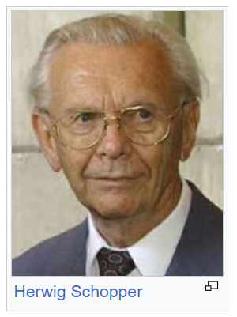
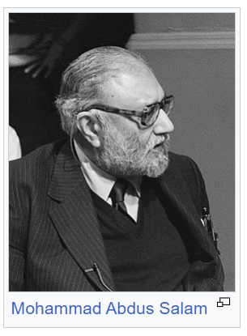

Slide 56
Reducing Scope 3: CERN Environmentally Responsible Procurement Policy
Adopted by CERN directorate in July 2023
Will be implemented following the guidelines of
ISO 20400:2017 – Sustainable Procurement
It is becoming part of our purchasing procedures and, if necessary, of our purchasing rules.
The engagement with suppliers is essential for success

Slide 57
Energy
The size of our installations does not allow us to seriously consider on-site generation of renewable energy
There is not enough offer of renewable energy to cover our entire production
we run 24/7, 365 days a year (with periods of reduced consumption for maintenance)
We therefore rely on the collaboration with our main supplier, EDF, to increase the amount of renewable energy, knowing that the French mix is already quite low in CO₂ eq. emissions

