Slide 1
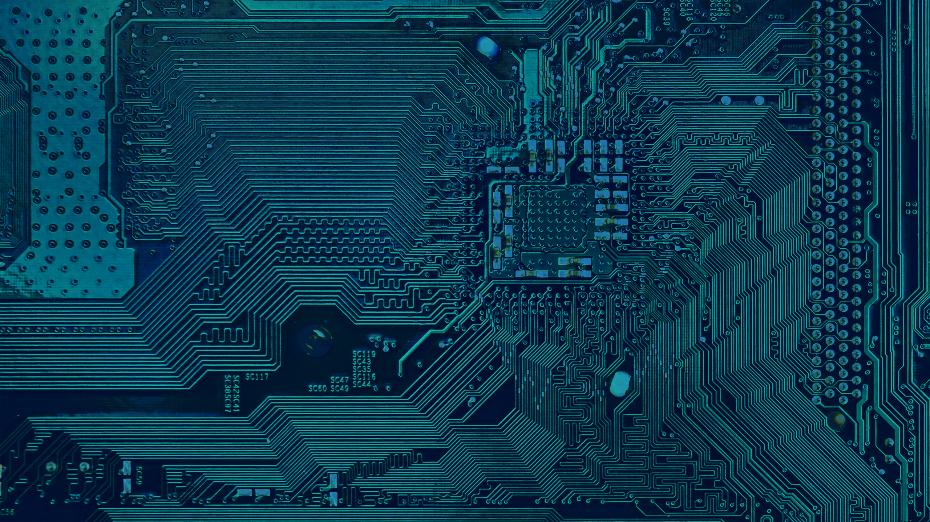


Electronics… WHAT?
TECH-FPA PhD Retreat 2025 – LNGS
A. Rivetti, P. Giubilato

Slide 2
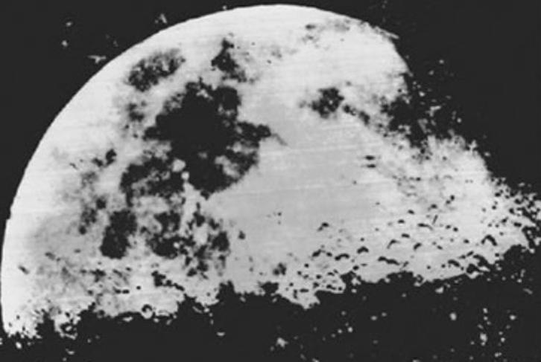
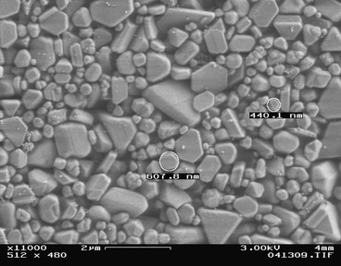
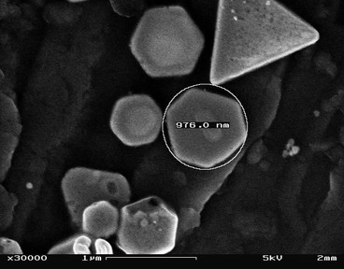
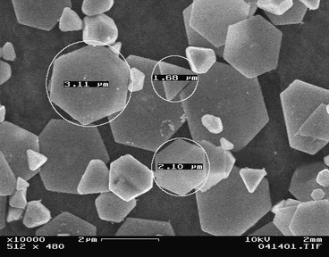
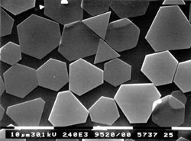
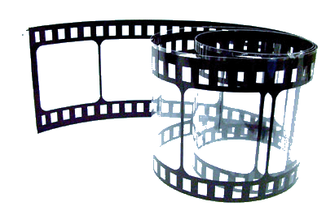
Once upon a time….
50 ISO
0.5 um
100 ISO
1 um
200 ISO
Silver Halides
Pixel
3 um
First known photo of the Moon – 1839 Louis Daguerre

Slide 3
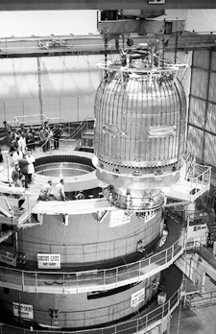
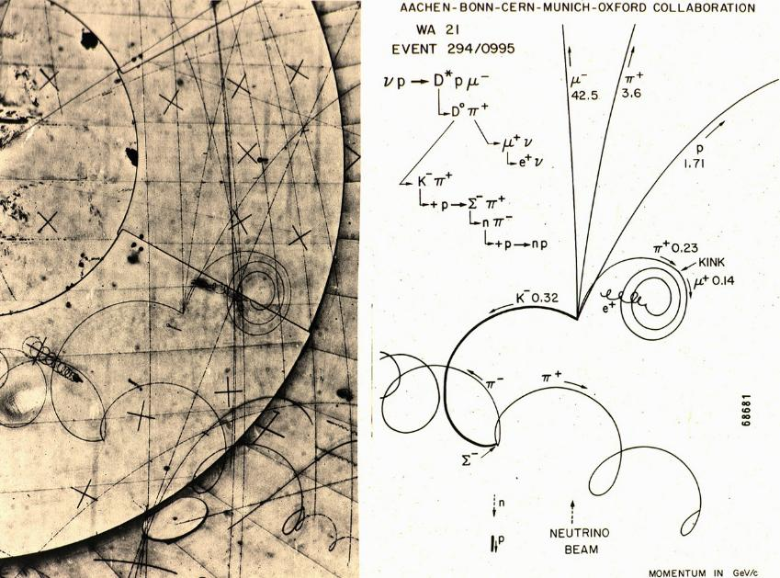
Once upon a time in the lab….

Slide 4
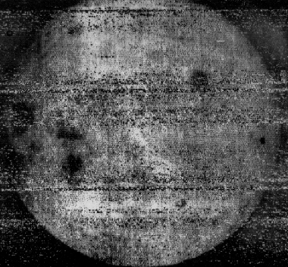
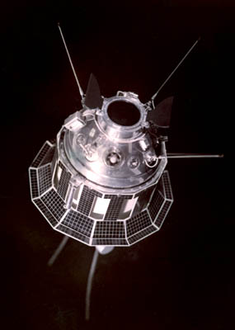
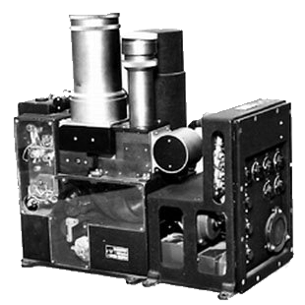
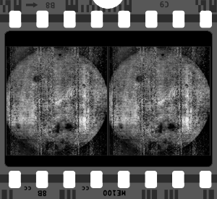

But then you aim for the dark side of the Moon….
Yenisey camera system
Luna 3 - 1959
The dark side of the Moon, first shot

Slide 5
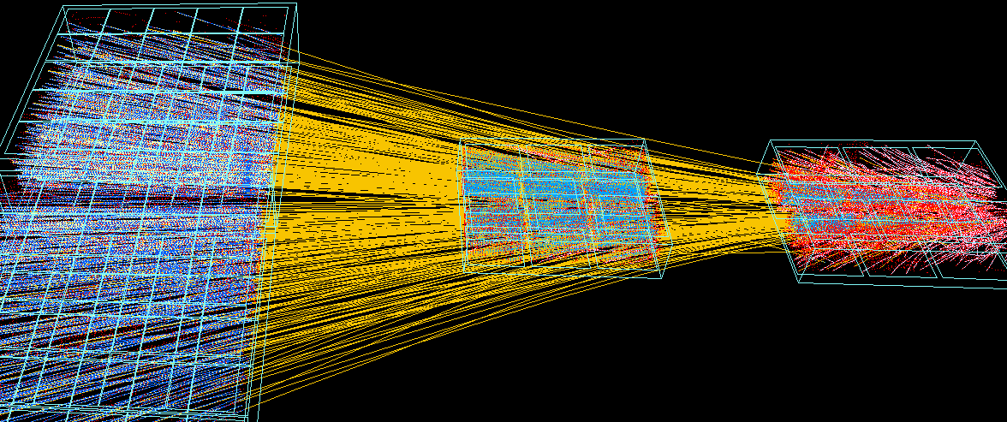
…and high data rate in the lab
NA49 (1994) Main TPCs
Vertex TPCs - Two intermediate size TPC’s (~3m³)

Slide 6
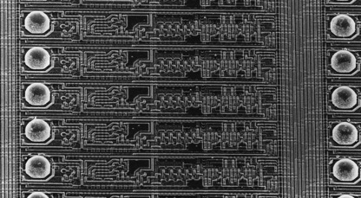
…until the sensor itself becomes electronics
1995 – First hybrid Pixel detector installed in WA97 (CERN, Omega facility)
1996/97 – First Collider Hybrid Pixel Detector installed in DELPHI Silicon tracker (CERN, LEP)
“The silicon micro-pattern detector: a dream?” E.H.M Heijine, Nucl. Instrum. Meth. A 273 (1988) 615
“Development of silicon micropattern detectors” CERN RD19 collaboration, Nucl. Instrum. Meth. A 348 (1994) 399
DELPHI (1996) Silicon Tracker (Mix of Strip and pixels)

Slide 7
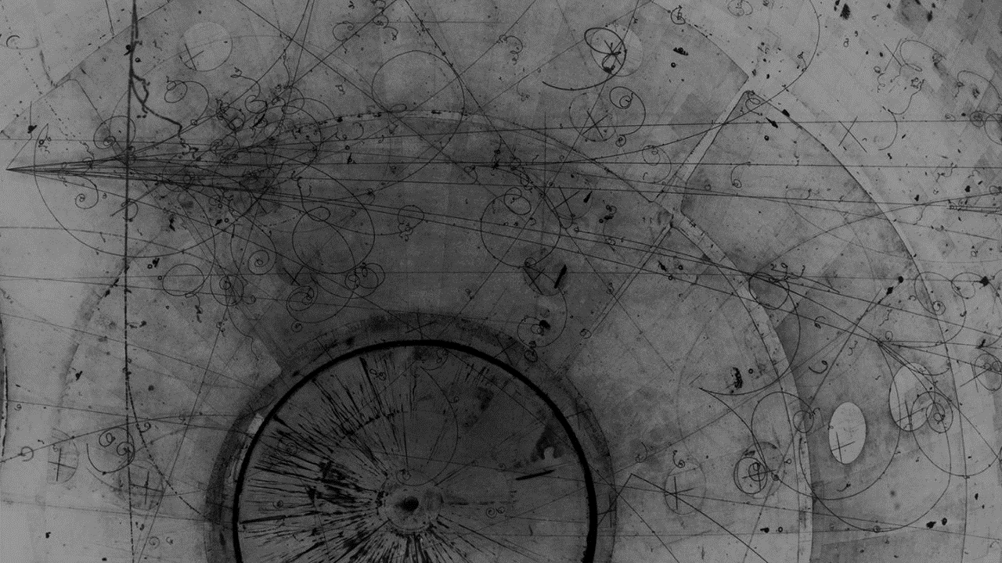
What electronics does is
Collecting and moving information effectively:
reliably
with low power
at high speed
etc…

Slide 8
How do we do it

Slide 9
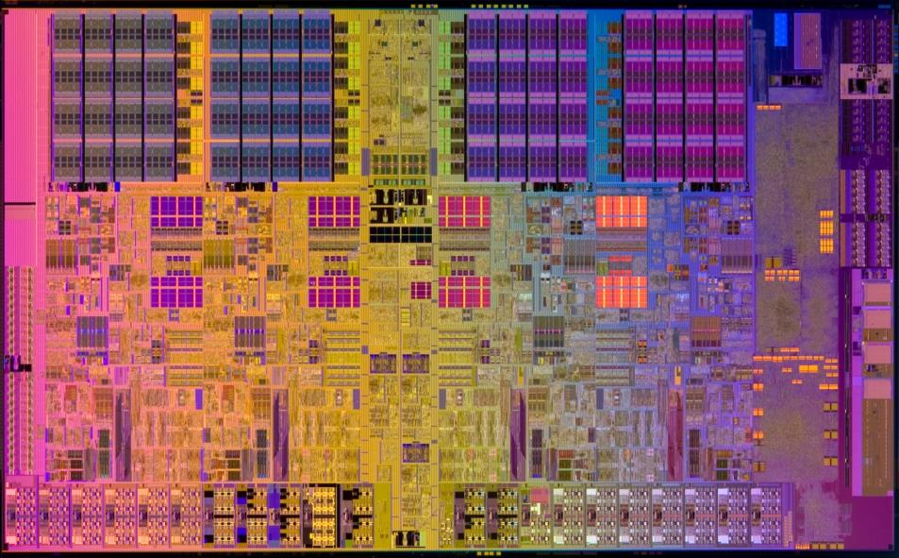
How do we do it?
Think
about
modern art
1 mm

Slide 10
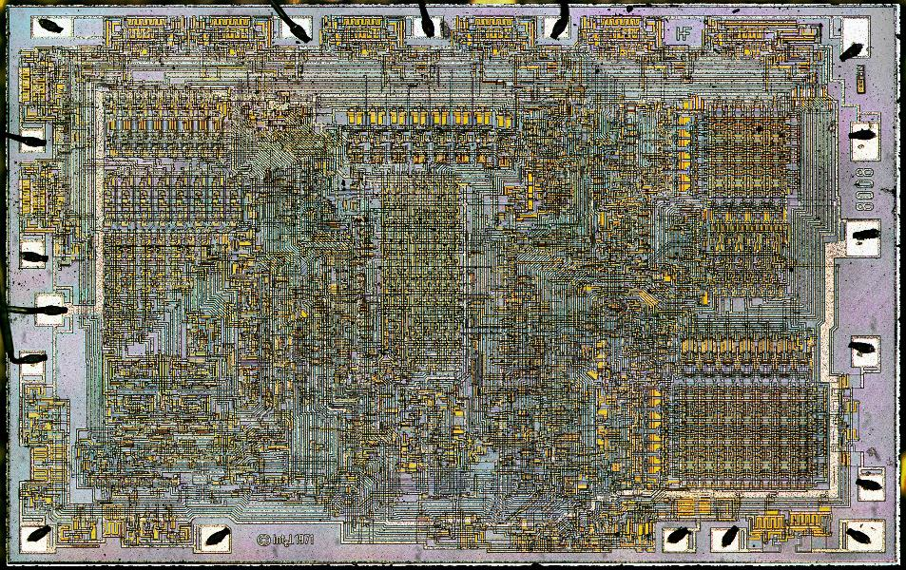
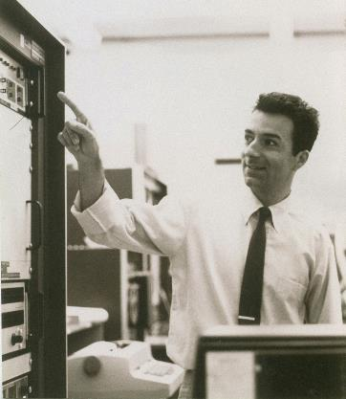
How to move, collect, parse information?
An art
started (among many others)
by an
illustrious
student from Padova:
F. Faggin
10 µm

Slide 11
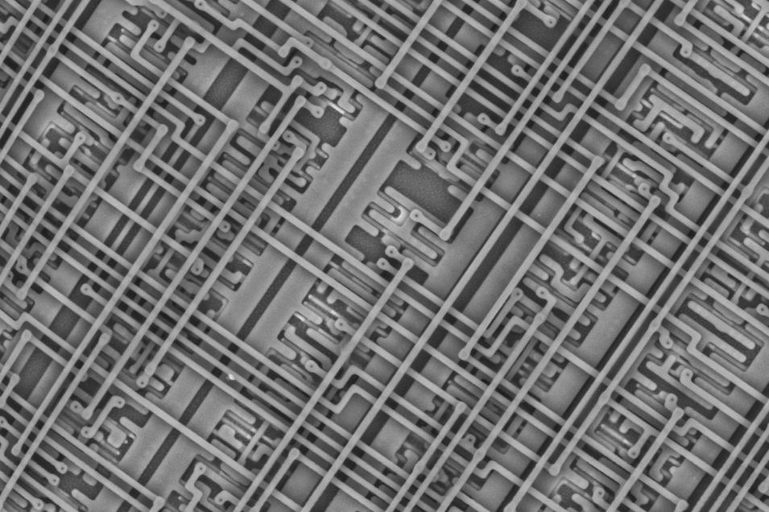
How do we do it?
modern art of
extremely
complex
systems
10 µm

Slide 12
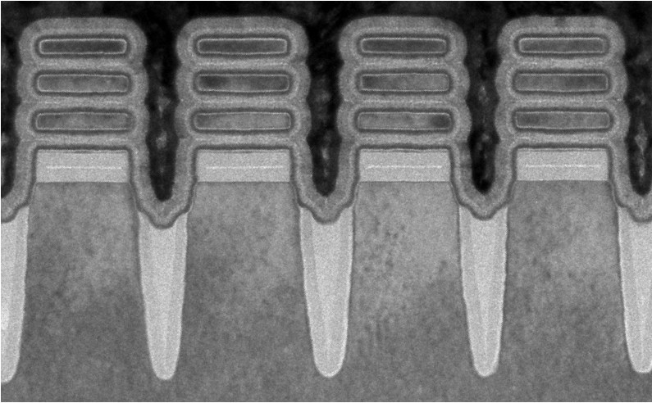
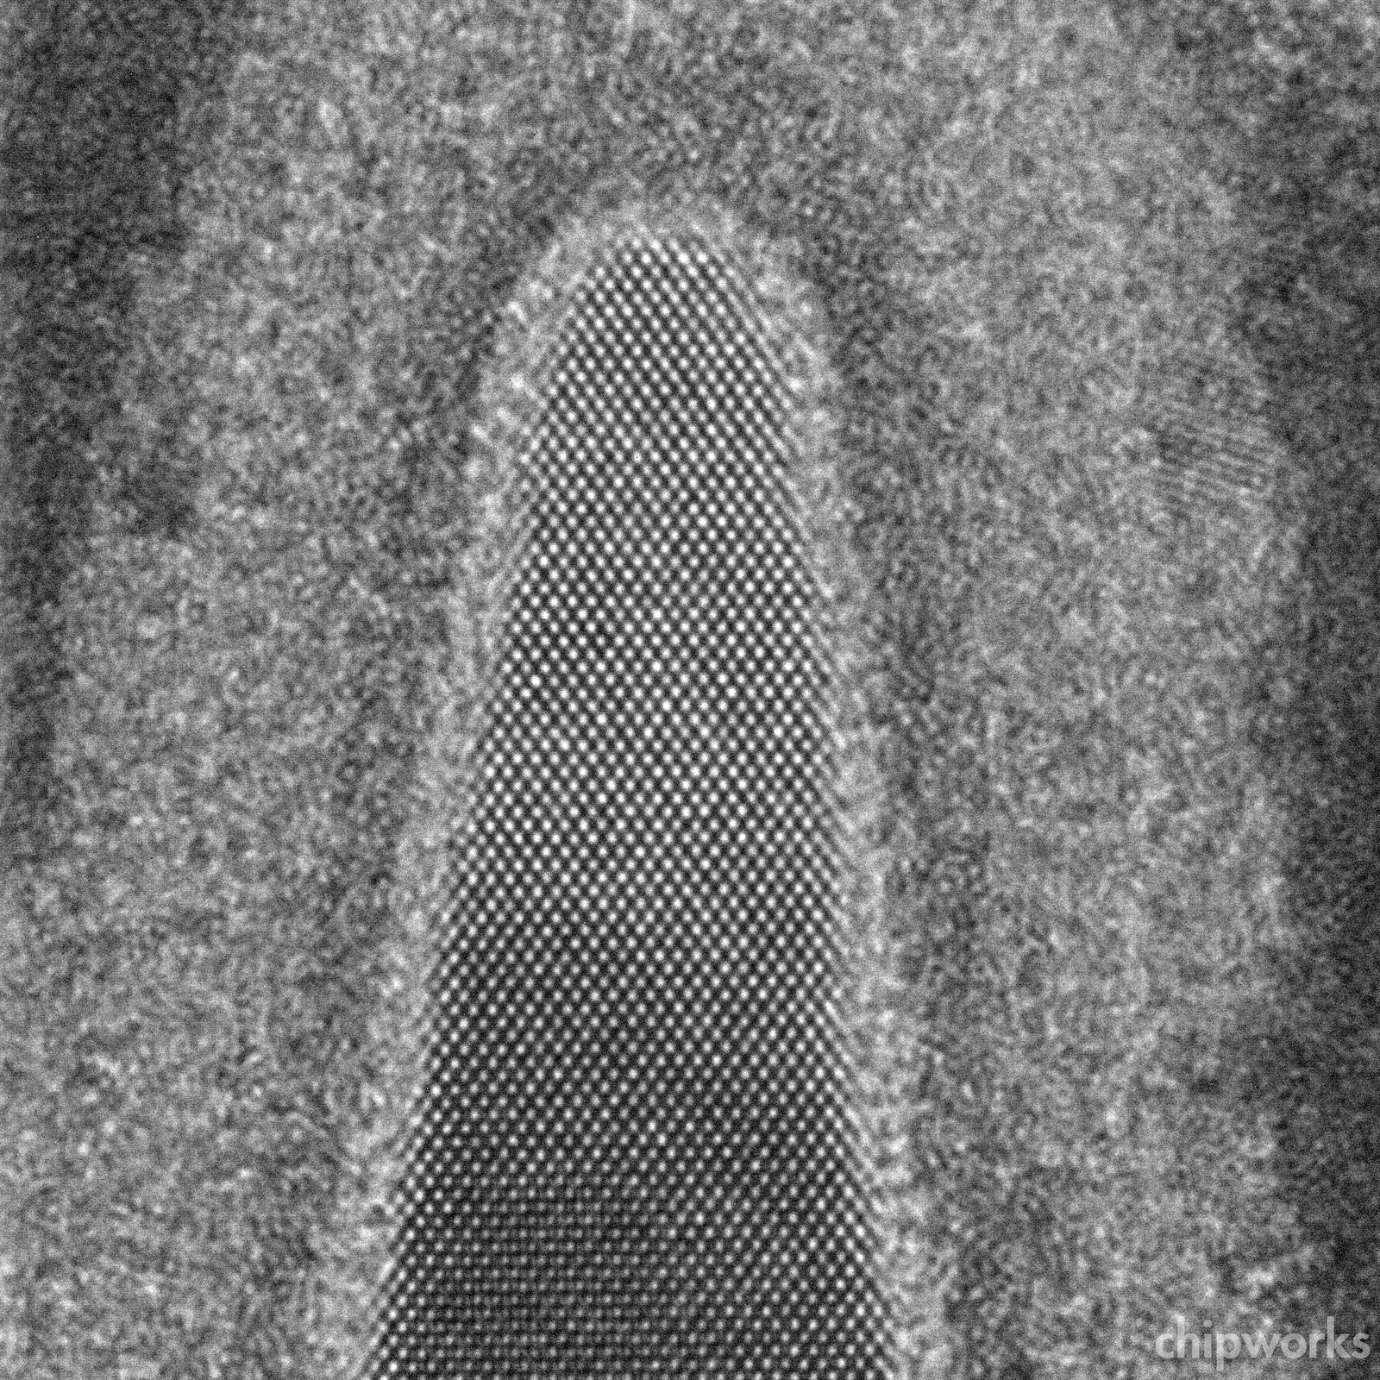
How do we do it?
complex systems
poweredby quantumphysics
10 nm

Slide 13
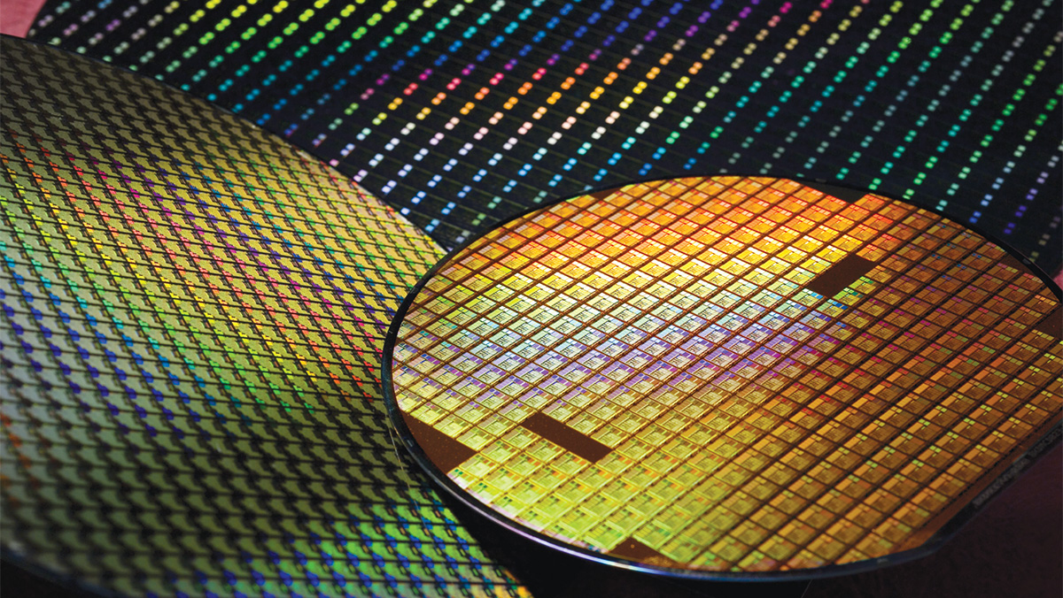
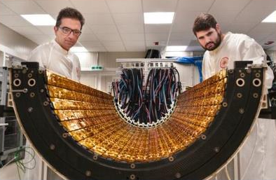
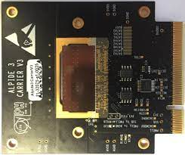
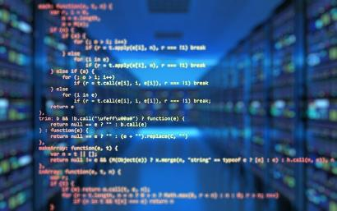
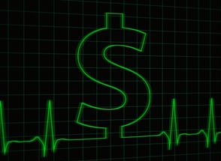
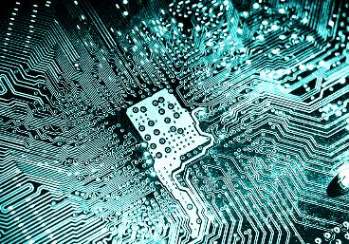
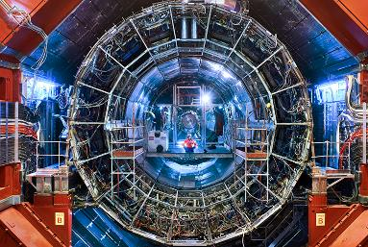
How do we do it
Advanced computing
R&D and prototypes
High-precision Lab work
Silicon wafers are the canvas
Electronic design
Management and planning
Very complex systems

Slide 14
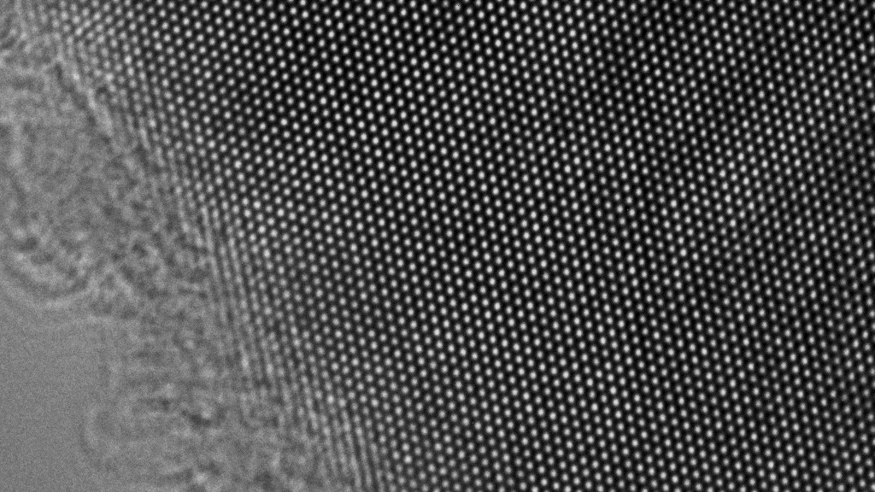

What do we get
$$1 nm$$

Slide 15
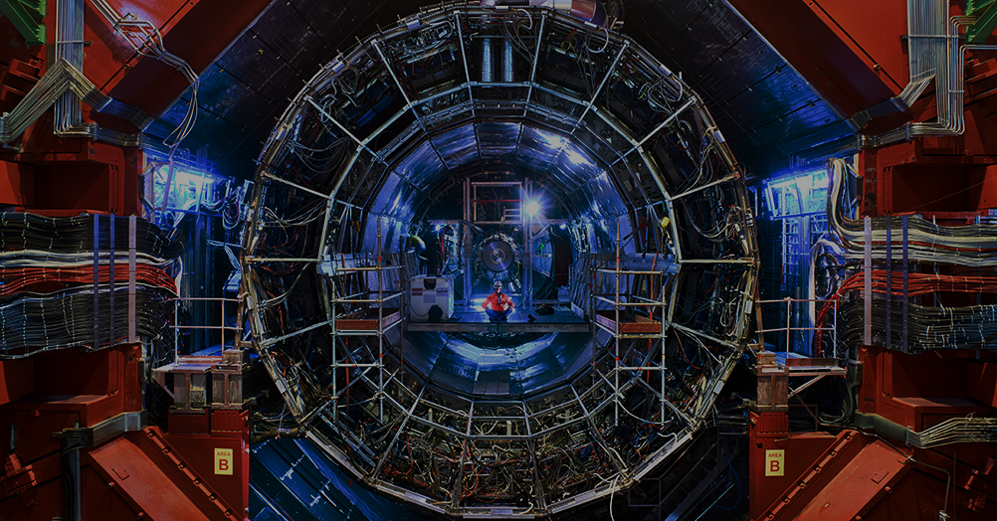
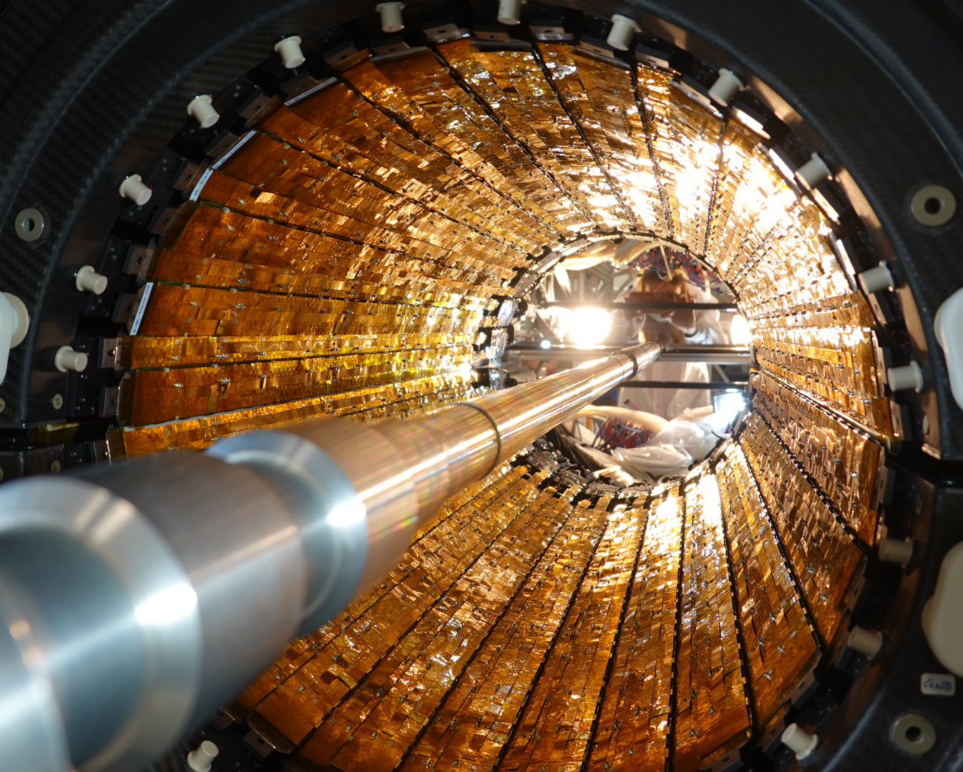
We start some 100m underground to build the most powerful microscopes ever
ALICE ITS2 tracker – 25,000 pixels detectors

Slide 16
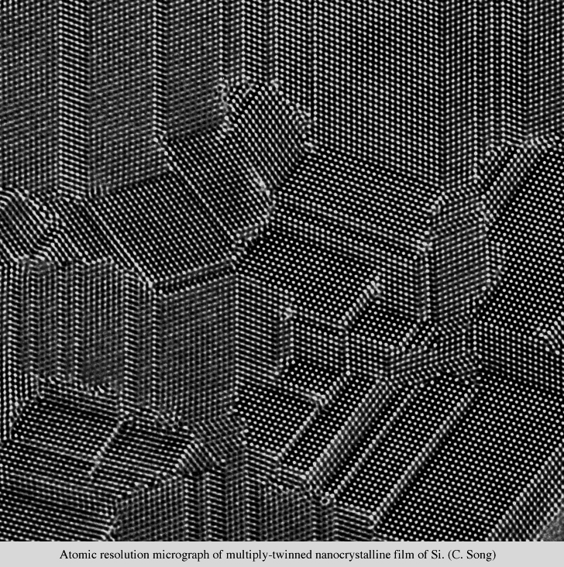
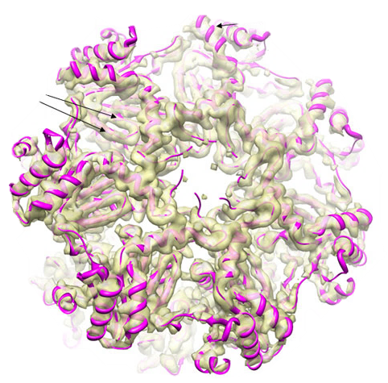
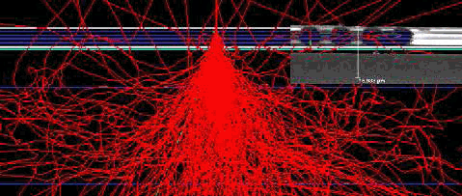
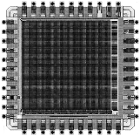
Electron Microscopy (e⁻)
Sub-atomic microscopy made possible by HEP spin-off sensors
200 KeV e⁻ on 50 µm thick device
e⁻ beam
Si lattice – 2.5 ms integration time

Slide 17
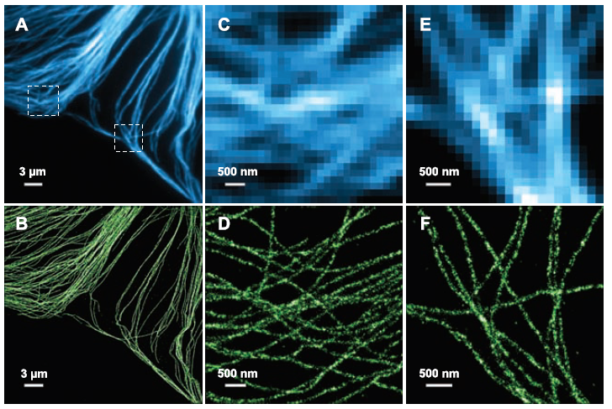
Bioscience (γ)
Photon clustering
allows breaking the diffraction limit
(Nobel Prize 2014)

Slide 18

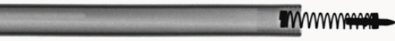
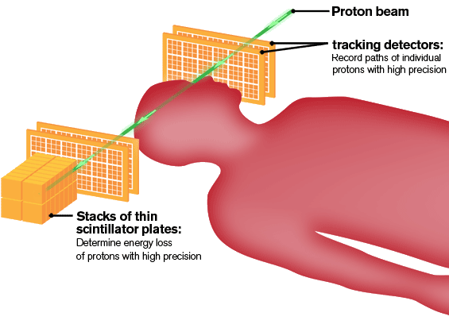
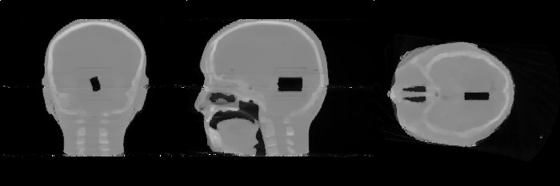
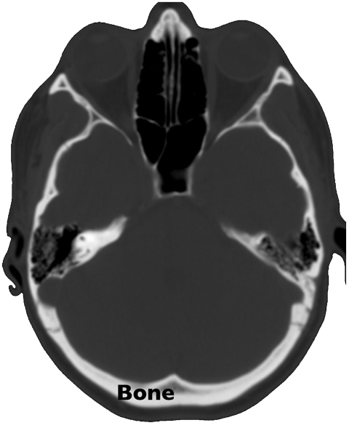
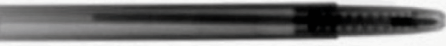
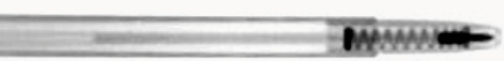
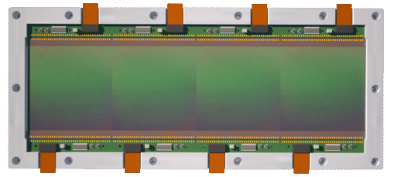
Medicine (γ, p)
Advancing state-of-the-art in medical imaging using protons instead of photons to get better tissues resolution and less dose to the patient.
X-Rays
Proton true trajectory
Protons
Energy
measurement
360°
Protons – different reconstruction
p’
L
p
L’
Large area, low power, thin pixel detector
Entry and exit points + angle
Most Likely Path calculation
With at least 10⁸ tracks (energy loss, exit point & angle, entry point) recorded, we can reconstruct a complete 3D image.
https://mediaspace.unipd.it/media/La+tomografia+-+Percorsi+galileiani+Phd+Edition/1_d1m7vb2o

Slide 19
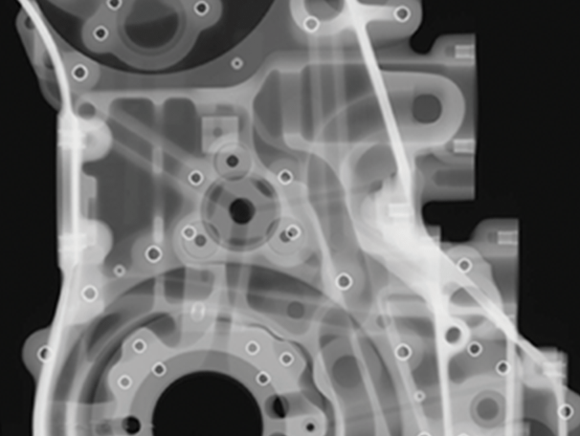
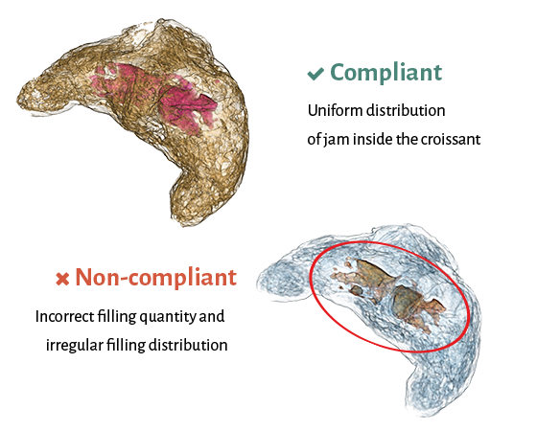
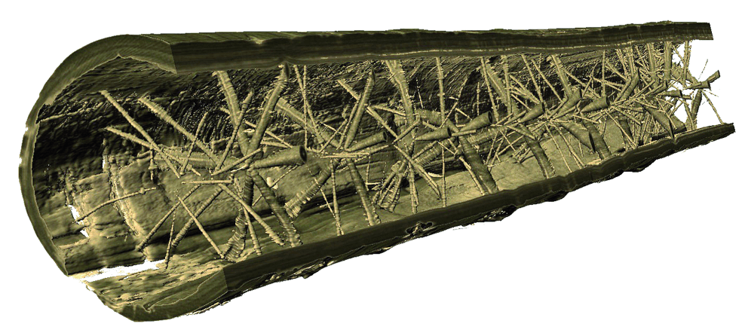
Industry (χ)
X-ray Computed Tomography and imaging help verifying production, food quality and even sawmills!

Slide 20
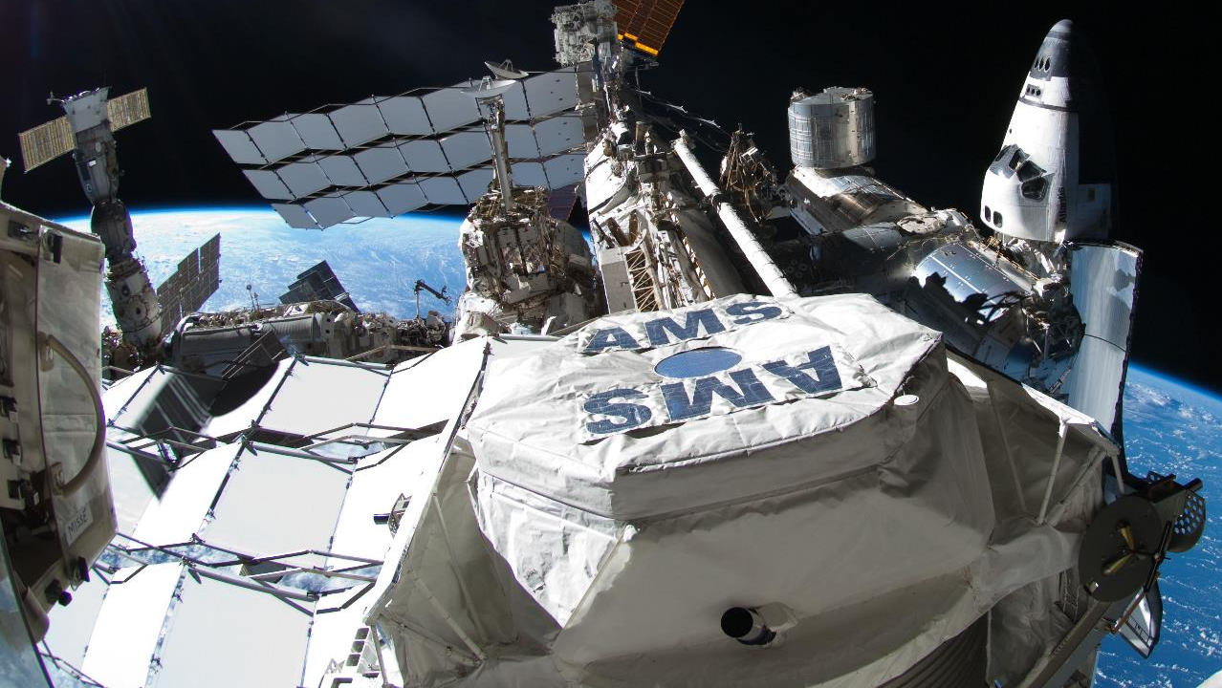
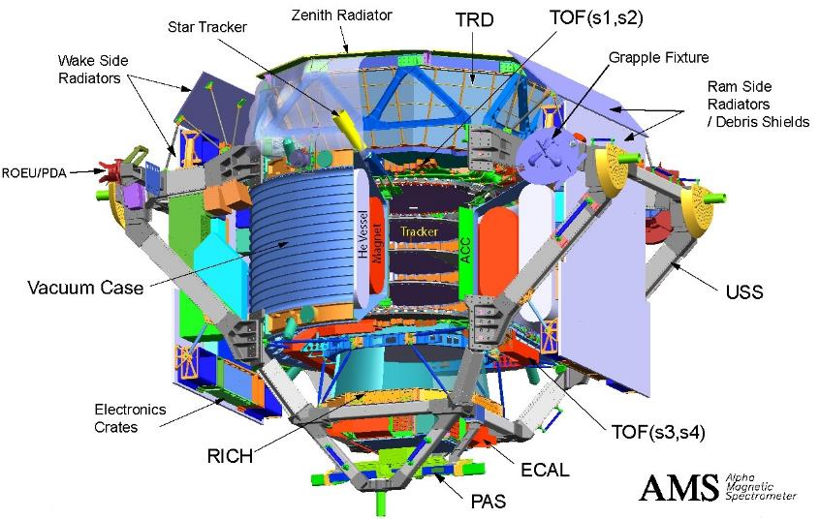
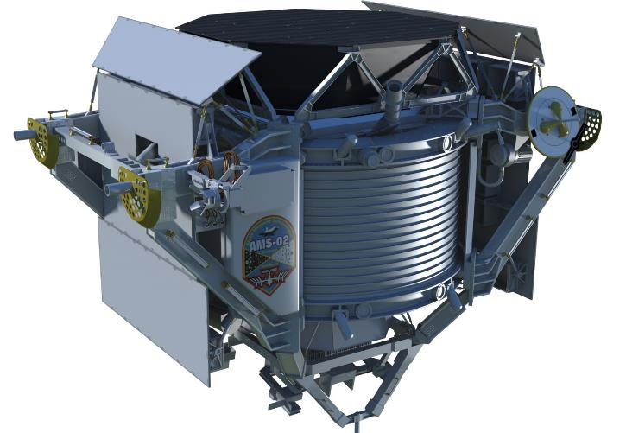

In space (cosmics, γ, and beyond)
Silicon sensors onboard satellites looks at the near and deep space

Slide 21

What else: make these machines surviving
If we want the astronauts back to Earth, better the spaceship survives as well!

Slide 22






Blue-sky research and real-world challenges are deeply interconnected, and electronics moves them all
and beyond (?)
Meter (p)
Millimetes (χ)
Micron (γ)
Nanometer (e⁻)

Slide 23
How to start in electronics?

Slide 24
Possible research topic in the INFN PhD
Analog and digital microelectronics for detector readout
Sensor and detector networks
Radiation damage and radiation tolerant electronics
RF electronics for detectors
Power electronics
Control electronics
Diagnosis and safety for accelerators and detector
Radio communications
…

Slide 25
Courses offered
Several training courses are offered by the partner Universities, INAF and INFN to cover many different aspects of electronics.
Course offered by the PhD cover:
Design of integrated circuits
HDL programming of FPGAs and SoCs
Numerical Simulations with TCADs
Radiation hardness of detectors and electronics,
DAQ systems, from hardware to firmware and software
Cryogenic sensors for astroparticle physics,
Rare events search with TPCs
Cabling and Shielding for low noise applications
Advanced scientific programming with matlab, etc…

Slide 26
Before you really start
It is not uncommon that people start working in electronics with a somehow fragile background
Check in depth the foreseen research program with your supervisor
Understand what you need to know to carry it on effectively
If it does not match…. Don’t panic! Define your learning program
Keep in mind: without a solid background you never get very far…
In case you need to strengthen your basics, there are very useful resources online available from several Universities: eg. MIT Open Course Ware: https://ocw.mit.edu
Do not hesitate to contact for assistance: rivetti@to.infn.it, giubilato@pd.infn.it

Slide 27
In this afternoon electronics session
Something not even considered here: how to exploit noise and randomness by M. Caccia
How to deal with data from your detectors, by D. Falchieri

Slide 28
The end… for now!

Slide 29
Backup

Slide 30

Modern electronics allows to…
Ideas,
Theory,
Design:
Nano & micro systems
To look
at the universe

Slide 31
Is it challenging?
Not (only) theory,
nor (only)
simulation, nor (only) analysis
Must, simply, work!
Extremely complex systems (100+ billion elements) with know-how from multiple fields (math, physics, material science, computer science) to be invented, designed, simulated, produced, tested… and put to work.
You are not measured on publications or conferences!

Slide 32















Disclaimer: that game hurts physicist's pride
70s
80s
90s
00s
10s
Supercomputers moves from custom to consumer technology
Log (Information density)
We play with the leading industries, and they set the rules (and size) of the game

Slide 33


Disclaimer: it’s a bigger game than what you think
Interstellar’s black hole “Gargantua” is not scientifically accurate (as shown in the movie) but the simulation produced 800 TByte of unprecedented quality data, which lead Kip Thorne (Nobel prize 2017) to investigate some unexpected effects (which you cannot see in the movie) about the lensing effect.
Class. Quantum Grav. 32 (2015) 065001
Thorne K S 2014 The Science of Interstellar

Slide 34
What we do: help solving puzzles like this
Position in space
Position in time
Over many m²
Over years
Very little power
Hostile radiation
µm precision
ns, ps
precision

Slide 35












$$B$$
$$π^{+}$$
$$e^{+}$$
$m_{μ}<m_{p}→$ $e^{+}$
$$μ^{+}$$
E$lectric Field \left[V/m\right]$
$$ν$$
M$agnetic field$
E$lectric charge \left[C\right]$
$$\vec{F}=\left(q∙\vec{E}+\vec{v}×\vec{B}\right)$$
S$peed \left[m/s\right]$

Slide 36

But it starts to be difficult…
6.4 TeV ²²S + ¹⁹⁷Au, NA35: analysis of the charged particles becomes impossible
NA35 – The Streamer Chamber Heavy Ion Experiment ~ 1985

Slide 37


What we do: making these machines surviving
Space is full of energetic particles with damaging potential (TID, DDD, SEE): some are deflected when their magnetic rigidity is small enough, others are magnetically trapped in Van Allen belts.
Galactic and extra-galactic cosmic rays
If we want the astronauts back to Earth, better the spaceship survives as well!
Trapped particles
Solar flare neutrons and γ-rays
Solar flare electrons, protons, and heavy ions

