Slide 1
Curriculum Meccanica
TECH-FPA PhD Retreat
17 to 21 February,2025
co LNGS
Room "E. Majorana"

Slide 2
Curriculum Board Members
Antonio Carcaterra - Roma La Sapienza
Fabio D'Anca - INAF
Giuliana Fiorillo - Napoli Federico II
Irene Calliari – UNIPD
Luca Esposito - Napoli Federico II
Paolo Gorla – INFN
Simone Mancin - UNIPD

Slide 3
Topics
Adoption and development of methodology and tehcnologies:
New Materials
Additive manufacturing
Cryogenic
High Vacuum
Metrology
Mechatronics
Multidisciplinary simulations

Slide 4
Students
XXXIX ciclo
  Mehrdad Faraji
  Francesca Valentini
  Lorenzo Sclafani
XL ciclo
  Alberto Barci
  Davide Cester
  Ezeaba Tochukwu Emmanuel
  Chiara Scandaglia
  Moreno Nacca
  Giacomo Voltan

Slide 5
Works on going
Carachteristics of additive manufacturing
  Properties of Materials
  Properties of devices
  Postprocessing
  Extreme applications
Thermal control devices
Damping properties
Adaptive mirrors
Ultrastable optomechanics

Slide 6
Students
XXXIX ciclo
  Mehrdad Faraji
  Francesca Valentini
  Lorenzo Sclafani
XL ciclo
  Alberto Barci
  Davide Cester
  Ezeaba Tochukwu Emmanuel
  Chiara Scandaglia
  Moreno Nacca
  Giacomo Voltan

Slide 7
Corrosion of components made by additive manufacturing for extreme applications
TECH-FPA PhD Retreat
17 to 21 February,2025
co LNGS
Room "E. Majorana"
Mehrdad Faraji
Irene Calliari, Adriano Pepato, Massimiliano Bonesso
Cicle 39

Slide 8
Title and main topic
Corrosion of components made by additive manufacturing for extreme applications
Status Of the activity
Investigated the microstructure and electrochemical behavior of CuCrZr and SS316 additively manufactured by LPBF.
Analysed the impact of build orientation on corrosion performance.
Planning of the next activity
Next Steps: Corrosion-erosion experiments in high-temperature and high-pressure ultra-pure water.
Future Research Abroad: Study the corrosion behavior of Inconel 718 in molten salt at DTU University and Hyme Company (Denmark).
Particular notes
Things I Like: Advanced material characterization, electrochemical analysis, access to cutting-edge facilities.
Difficulties: Challenges in controlling experimental parameters, complex corrosion mechanisms under extreme conditions.

Slide 9
Development and optimization of components for thermal control in the field of nuclear fusion and fundamental research in Physics and Astrophysics through metal additive manufacturing
TECH-FPA PhD Retreat
17 to 21 February,2025
co LNGS
Room "E. Majorana"
Francesca Valentini
Simone Mancin, Adriano Pepato
39° cicle

Slide 10
Title: Development and optimization of components for thermal control in the field of nuclear fusion and fundamental research in Physics and Astrophysics through metal additive manufacturing (AM).
Main topic: Development and optimization of an AM industrial steam generator for high temperatures molten salts (LoCoMoSa project).
Status Of the activity:
  Developed a baseline steam generator design
  Investigation of transition film boiling phenomena and strategies to maintain efficient boiling.
  Investigation on strategies to prevent molten salt solidification.
  Investigation on geometry for improving heat exchanging efficiency
Planning of the next activity (included period abroad)
  Refine design models based on first-year research and future experimental experience
  Abroad period to Purdue University to improve topology optimization code
  Build an experimental setup to:
    Obtain a reliable boiling curve.
    Validate optimization results against empirical data
Particular notes: I like the chance of learning many things in many different fields.

Slide 11

Damping Characterization for High-Sensitivity Disturbance Monitoring in Cryogenic Environments
TECH-FPA PhD Retreat
17 to 21 February,2025
co LNGS
Room "E. Majorana"
Lorenzo Sclafani
Prof. Antonio Carcaterra, Prof. Silvia Milana
Cicle XXXIX

Slide 12

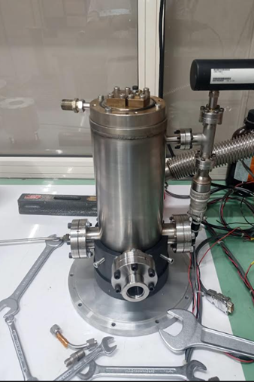
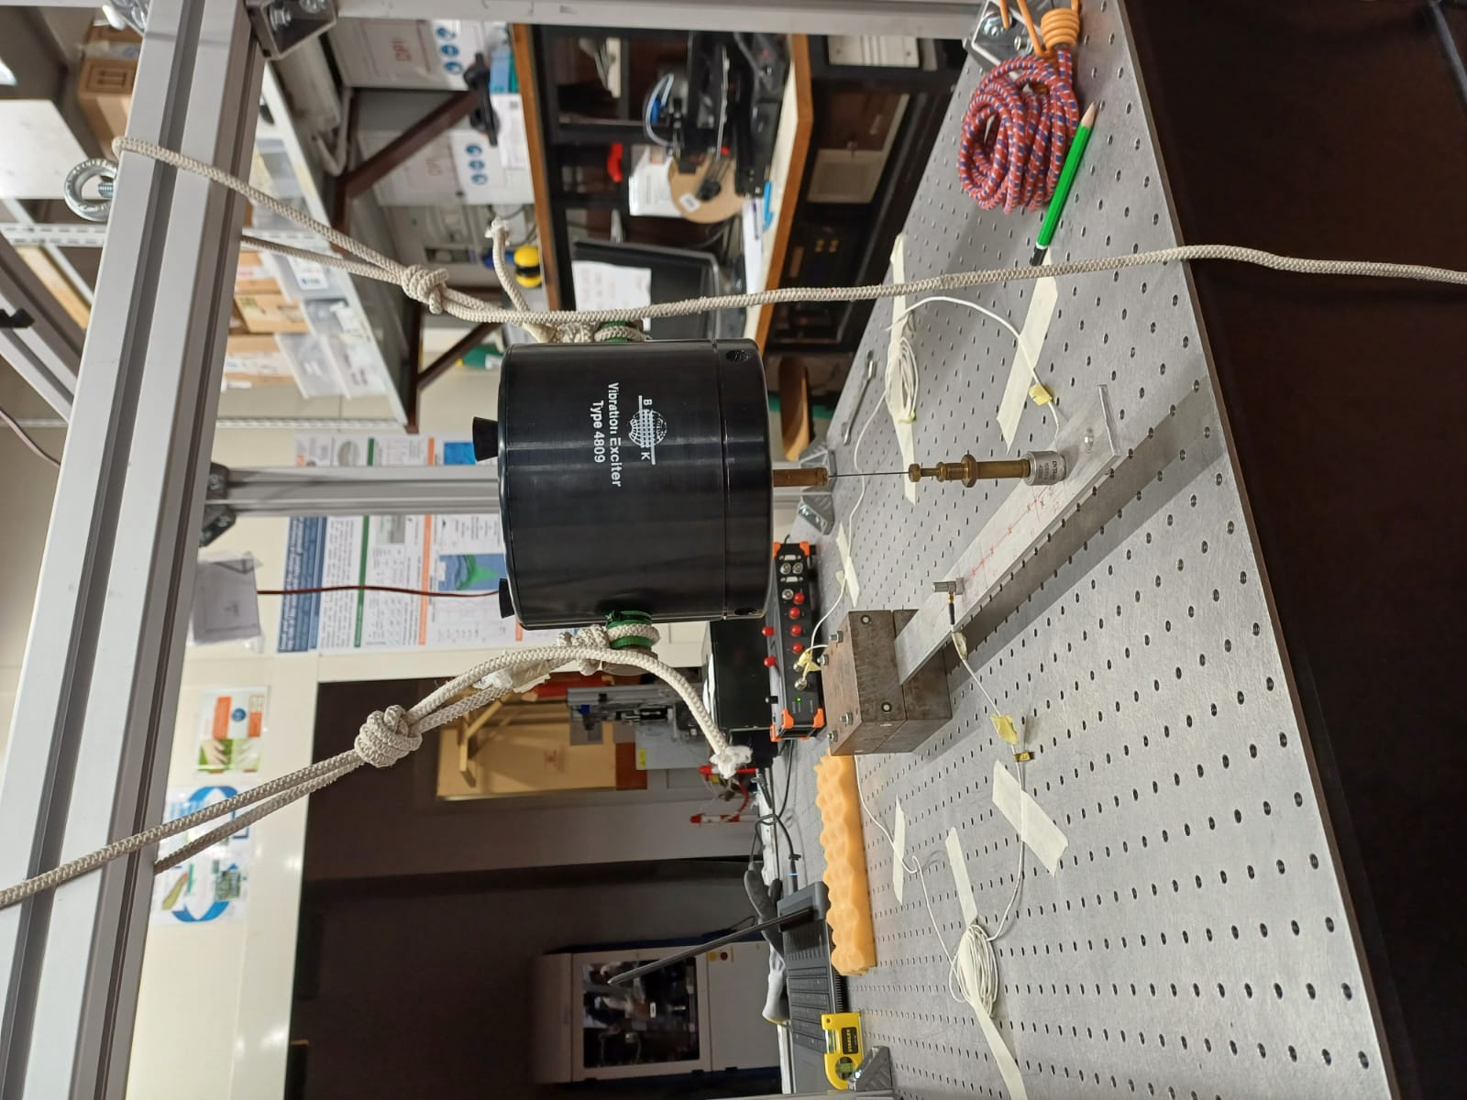

Damping Characterization for High-Sensitivity Disturbance Monitoring in Cryogenic Environments
By characterizing damping at ultra-low temperatures, the project aims to improve the precision and stability of fundamental physics experiments requiring high-sensitivity measurements
Research Topic
Currently
Establishing a benchmark methodology using a world-wide standard (ASTM E756-05) to assess reliability of measurement systems
Preparing a single-stage pulse tube cryostat for vibration measurements using fiber optic sensors
Next activities
Validate model
Period Abroad (6 months, probably from September 2025 at Rensselaer Polytechnic Institute (RPI), Albany, NY – representative: Prof. Adnan Akay)
Extend the study to lower temperatures using a multi-stage cryostat
Until now
Developed a theoretical damping model for a simple beam, using a probabilistic approach, based on the fluctuation-dissipation theorem
Bibliographic research
Doing my required in-company period at Spinitalia srl
Characterize damping of a small cantilever varying Temperature (down to 70K), Pressure and material properties
Personally…
  I really enjoy being in the lab and the experimental approach of my work
  I find it challenging to make decisions when I’m not completely sure. Learning to take the leap despite uncertainty is a valuable skill I’m developing

Slide 13
Students
XXXIX ciclo
  Mehrdad Faraji
  Francesca Valentini
  Lorenzo Sclafani
XL ciclo
  Alberto Barci
  Davide Cester
  Ezeaba Tochukwu Emmanuel
  Chiara Scandaglia
  Moreno Nacca
  Giacomo Voltan

Slide 14
Development and Characterization of Innovative Additively Manufactured Metal Alloys for High and Ultra-High Temperature Applications
TECH-FPA PhD Retreat
17 to 21 February,2025
co LNGS
Room "E. Majorana"
Phd candidate: Alberto Barci
Supervisor: Massimo Pellizzari, Co-supervisor: Pietro Rebesan
XL Cicle

Slide 15
Title: Development and Characterization of Innovative Additively Manufactured Metal Alloys for High and Ultra-High Temperature Applications
Main topic: Tuning of the printing parameters and characterization of the mechanical, thermal, and electrical properties of the Ta-10W alloy and subsequently of the High Entropy Alloy WTaVCr, additively manufactured using Laser Powder Bed Fusion (LPBF) technology, for application in the facilities of the INFN laboratories in Legnaro as part of the HISOL NEXT project.
Status of the activity:
A literature review has been conducted on LPBF printing of pure tantalum, pure tungsten, and the two alloys.
The first test samples of Ta-10W were printed after two failed attempts.
Planning of the next activity:
Characterizing mechanical strength, electrical resistivity, and thermal conductivity, as these studies are generally lacking in the literature for refractory metals printed via LPBF
Period abroad: six months at the University of Innsbruck.
Particular notes: The LPBF printing of the two alloys that are the subject of my PhD is scarcely explored in the literature, which makes working on this topic challenging but also very rewarding.

Slide 16
Advanced design for Additive Manufacturing (DfAM) approaches for cutting-edge applications in Physics and Engineering
TECH-FPA PhD Retreat
17 to 21 February,2025
co LNGS
Room "E. Majorana"
Davide Cester
Supervisor: Serena Graziosi
Co-supervisor: Pietro Rebesan
XL Cicle

Slide 17
Title: Advanced Design for Additive Manufacturing (DfAM) approaches for cutting-edge applications in Physics and Engineering.
Main topic: explore the design freedom given by Additive Manufacturing technologies to design complex lattice structures with tailored mechanical and thermal properties for Nuclear physics applications, taking into account the role of process-induced defects.
Status of the activity: focus on the review of some publications regarding the impact of defects on properties of lattice structures produced using Laser Powder Bed Fusion technology (LPBF); planning the production with LPBF of a first set of representative lattices to measure and define the main defects arising from the process.
Planning of the next activity (included period abroad): Simulations and experimental tests to obtain a predictive model of the impact of these defects on mechanical and thermal properties of lattices. Expand and validate the results also considering more complex structures, in order to manage their final properties. Probably, 6 months period abroad will be spent in Imperial College (London).

Slide 18
Sustainable Surface Finishing of Additively Manufactured Metal Components for High-Precision Applications
TECH-FPA PhD Retreat
17 to 21 February,2025
co LNGS
Room "E. Majorana"
PhD Candidate:
Ezeaba Tochukwu Emmanuel
Supervisor: Cristian Pira
Co-supervisors: Eduard Chyhyrynets
Pietro Rebesan
Circle: 40th

Slide 19
Title and main topic:
Sustainable Surface Finishing of Additively Manufactured Metal Components for High-Precision Applications
Status Of the activity
EP of 6 copper samples ✅
EP of 6GHz copper cavity 🔜
EP of 1.3GHz Copper Cavity 🔜
PEP of 4 copper samples ✅
PEP of 4 6GHz copper cavity ✅
PEP of 1.3GHz copper cavity ✅
PEP of 4 Stainless Steel samples ✅
SUBU of AM 6GHz copper cavity ✅
Planning of the next activity
3D printing of 6GHz copper cavity
3D printing of 6GHz Niobium cavity
EP and PEP of these 6GHz cavities
Q_{f} Measurements of these cavities
Visit to WEAL 3TSystems, Turin
Visit to ASTeC, Daresbury, UK
Likes: Dynamics and Applications of the PEP Technology
Work Environment
Difficulty: Italian Language
EP = El Electrochemical Polishing
PEP = Plasma Electrolytic Polishing
AM = Additively Manufactured
Q_{f} = Quality Factor
✅ = Completed
🔜 = In Progress

Slide 20
Adaptive Optics for Next Generation Space Telescopes
TECH-FPA PhD Retreat
17 to 21 February,2025
co LNGS
Room "E. Majorana"
Chiara Scandaglia
Runa Briguglio, Marco Xompero
XL Cicle

Slide 21
Adaptive Optics for Next Generation Space Telescopes
  How to bring the methodologies of ground-based active and adaptive optics into the context of a space mission and exploit their potential advantages: large primary apertures, high wavefront stability, insensitivity to disturbances, etc.
Status Of the activity
  Literature study, laboratory training, embedding of skills acquired in a company (e.g. thermal simulations)
Planning of the next activity
  Development of a E2E integrated model to simulate mirror deformations, disturbance propagation and correction loop by selecting and varying telescope and active mirror design elements and operating environment correlated heat loads
  (Possible) period abroad during the second year of the PhD program

Slide 22
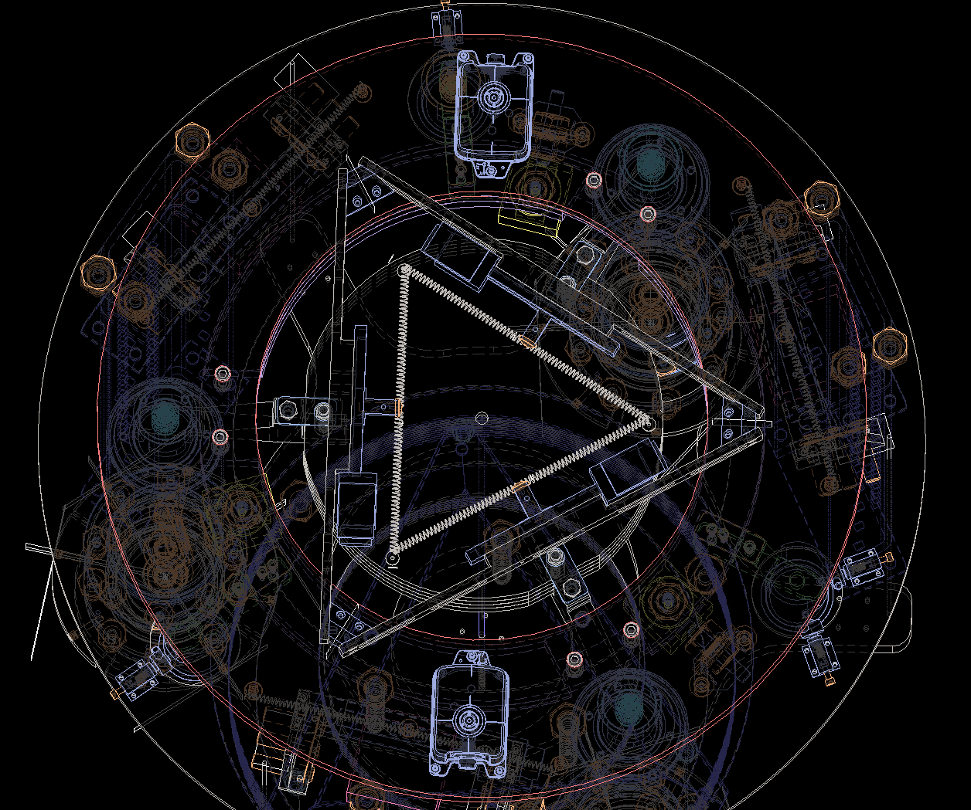
Development of mechanical systems for vibration isolation in Gravitational Wave Detectors and other fundamental physics experiments
TECH-FPA PhD Retreat
17 to 21 February, 2025
co LNGS
Room "E. Majorana"
Ph.D Candidate: Moreno Nacca
Supervisor: Prof. Luca Esposito
Cosupervisor: Eng. Alcide Bertocco
XL Cicle

Slide 23
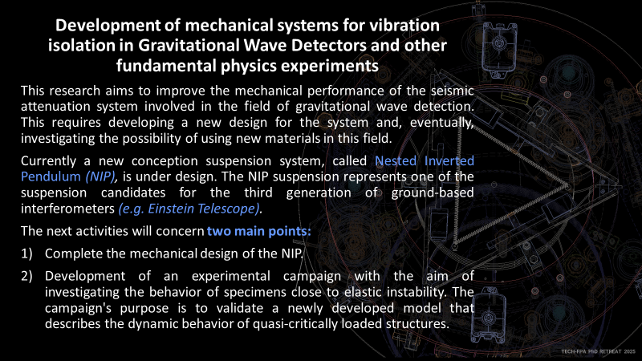

Slide 24
Development, design and testing of metallic components for high-temperature nuclear physics applications produced using additive manufacturing technologies
TECH-FPA PhD Retreat
17 to 21 February,2025
co LNGS
Room "E. Majorana"
PhD candidate: Giacomo Voltan
Supervisor: Dott. Mattia Manzolaro, Co-supervisor: Dott. Michele Ballan
XL Cycle

Slide 25
Title:
Development, design and testing of metallic components for high-temperature nuclear physics applications produced using additive manufacturing technologies
Main topic:
Refractory metals and their alloys are fundamental for the realization of Ion Source components for Stable and Radioactive Ion Beams operating in extreme conditions such as high vacuum and ultra-high temperature. The Laser Powder Bed Fusion Additive Manufacturing technique allows to develop a new generation of ion source components with enhanced performances, repeatability, reliability, overcoming the limitations of traditional manufacturing processes. The aim of the project is to develop and test innovative Ion Source prototypes in collaboration with the SPES facility at LNL.
Status of the activity:
The SPES facility at LNL comprises several machines dedicated to the production, acceleration and study of Stable and Radioactive Ion Beams. Ion Sources are crucial components for such a facility, since they are devoted to the ionization of the atoms of interest, fundamental process to provide them as a beam to the experimental users. In such context, the activities are dedicated to two types of Ion Sources: the first one is the FEBIAD Ion Source, which is the core of an ISOL machine, the second one is the ECR Ion Source, which can act as an injector for a charge breeder. For what concerns the FEBIAD Ion Source, a cathode manufactured by means of LPBF was successfully tested in the SPES ISOL machine, and it was characterized in terms of thermionic emission and ionization efficiency using Stable Ion Beams. Regarding the ECR Ion Source, a FEM Multiphysics modeling was implemented, with the goal of simulating the working conditions of the machine and prepare the studies for a future upgrade.
Planning of the next activity:
For what concerns the FEBIAD, benefitting of the know-how consolidated in the previous years with the LPBF cathode, the activities will start the exploration of new versions of such Ion Source, characterized by more complex geometries, aiming for an enhanced temperature homogeneity during operation and a further simplified assembly. Furthermore, more innovative anode-cathode interfaces will be considered in replacement of the current planar one, with a possible increase on the extracted electron fluxes by thermionic effect, and therefore an augmented ionization efficiency. Regarding the ECR Ion Source, the activities will focus on establish a solid FEM Electro-thermal-structural model, which will act as a starting point for the re-design of some components of the Ion Source’s crucible. Such component is indeed limited in terms of maximum achievable temperature, therefore, it in turns limits the number of elements that can be produced; the re-design of the crucible has the goal of increasing the performances of the Ion Source. All these activities will foresee an extensive use of FEM Multiphysics models, experimental test at high temperature of complete and partial prototypes and evaluation of the component deformation due to thermal stresses during operation. The best prototypes will be eligible for offline and online tests, that will be performed both at the SPES facility and external collaborating partners such as CERN-ISOLDE.

