Slide 1
Adaptive Optics: large deformable mirrors
Roberto Biasi
TECH-FPA PhD Retreat 2025 - LNGS

Slide 2
Outline
Very brief company introduction
Some AO concept
Large, contactless adaptive mirror technology
Motivation for large adaptive mirrors
Technology description and performances
Main deployed und ongoing projects
Other applications besides ground-based astronomy
High-density technology
Conclusions

Slide 3
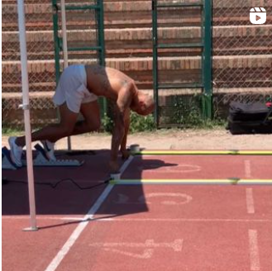
Four Main Business Unit

Slide 4
Where we are, what we do
New premises located in the industrial area of Bolzano-south, South Tyrol
11.000 m²
Electronics labs
Mechanical workshop
Thermal and EMC tests
Optical test areas
Large clean integration room: 400m², 20t overhead crane, large climatic test pit
The internal capabilities cover the entire process of electronic systems design and manufacturing
Hardware design (digital, analog)
Firmware (FPGA, microcontrollers)
Software
Control system design and multiphysics simulation
Prototyping
Integration of complex mechatronics systems
Testing
Production

Slide 5
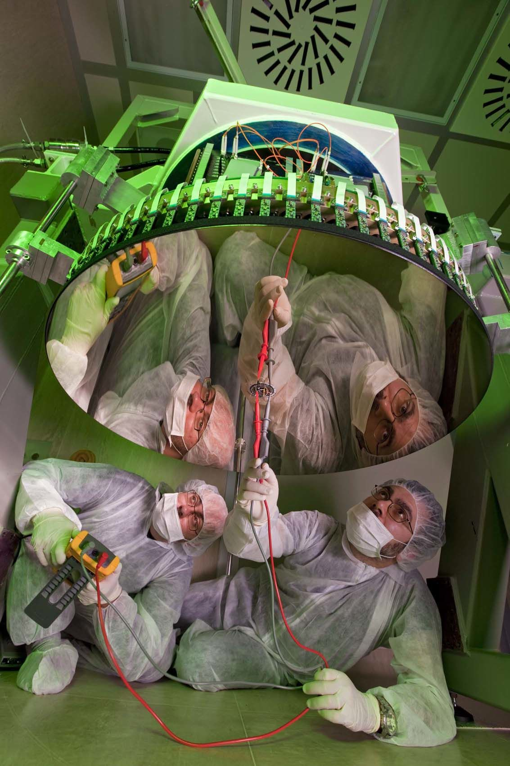
Microgate Engineering
The Engineering division operates mainly in the field of astronomy:
Adaptive optics systems for large telescopes
High performance real-time computers
Motion control systems
Metrology
Optical communication

Slide 6
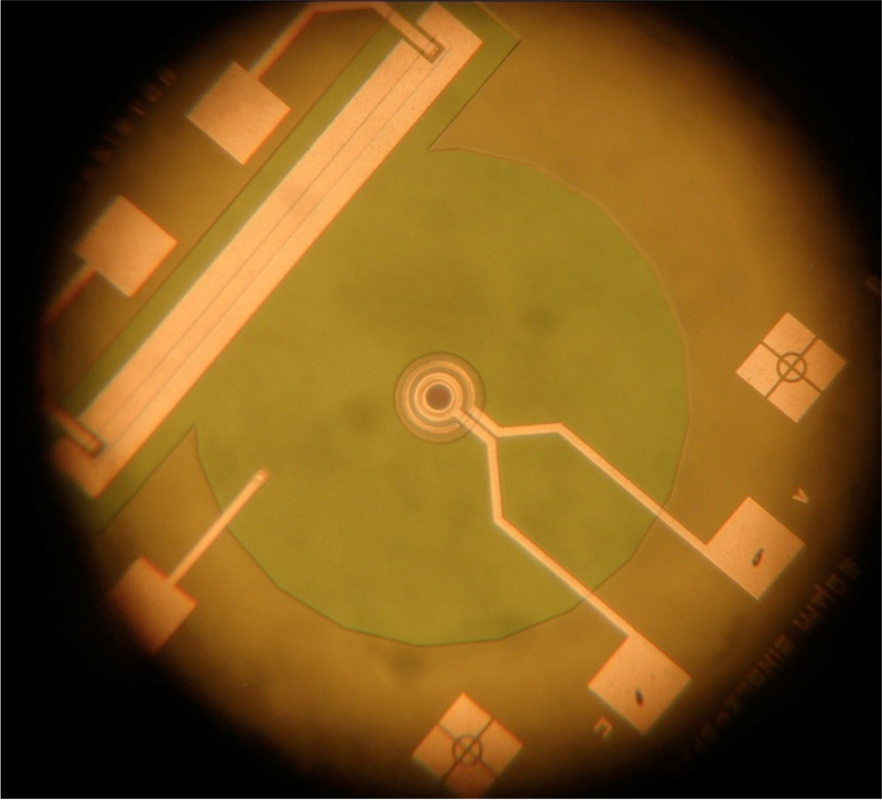
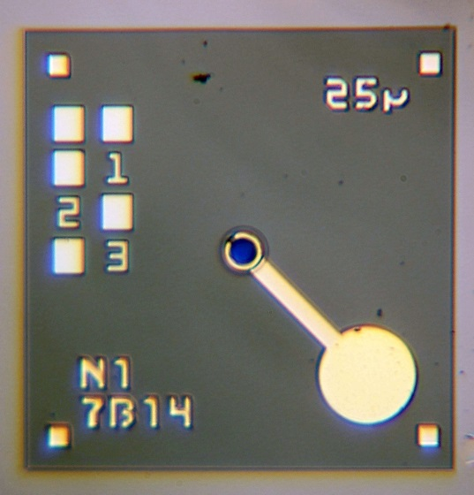
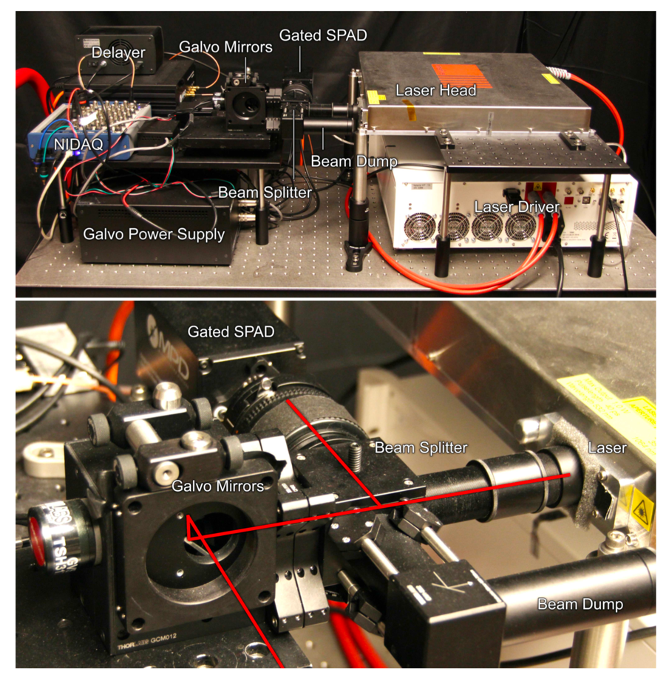
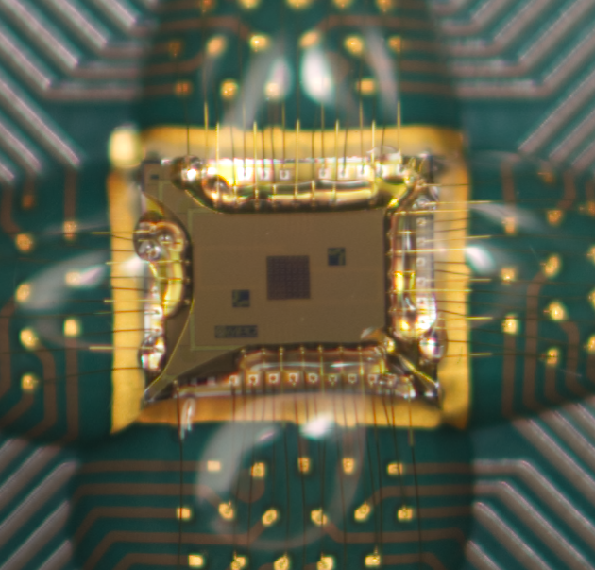
Micro Photon Devices
Micro Photon Devices is a spin-off company of Microgate and Politecnico di Milano established in 2004
Development and production of single-photon counting modules based on Single-Photon Avalanche Photodiodes (SPADs)
Main customers include NASA, QTI, MIT, University of Vienna, Facebook, IIT, Harvard, Stanford, Oxford, Heriot-Watt University
In-house capabilities cover the entire process, from design to production and testing
Single pixels and arrays
Politecnico
di Milano

Slide 7
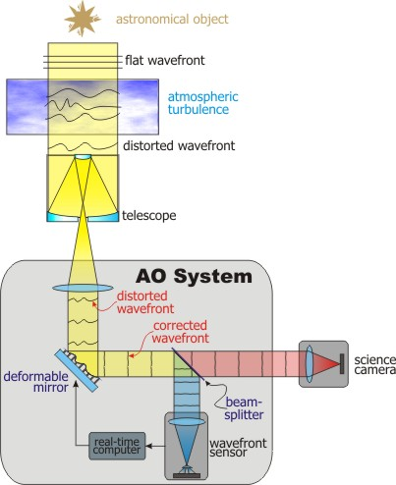
Adaptive optics: what is it?
Adaptive optics is a technology that allows correcting the image blurring typically caused by the atmospheric turbulence. Even if the concept was introduced in 1953 (H.W. Babcock), the first adaptive optics systems for ground-based astronomic telescopes were introduced in the 90’s
Other applications: optical communication, space debris control, medical imaging, high resolution printing systems, military equipment
The adaptive mirror is deformed in real-time, so to compensate the waveform aberrations; a control loop tries to minimize the residual aberration measured by a wavefront sensor.

Slide 8
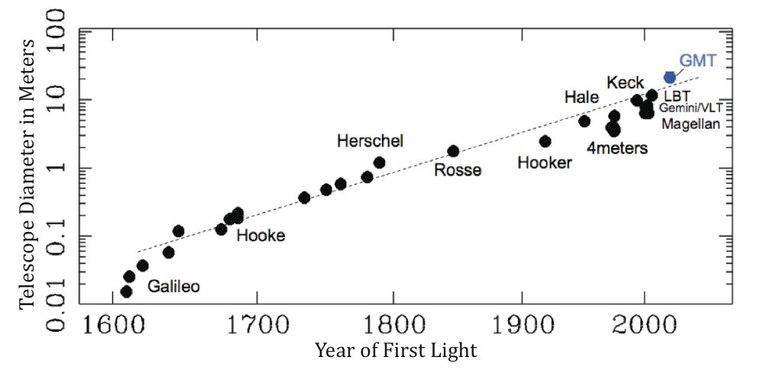
Science and technology motivations
Telescope size 2x every 40 years
Why building larger telescopes?
Larger light collection surface: look at fainter objects $φ∝D^{2}$
Improved angular resolution
$$θ≈1.22\frac{λ}{D}$$
E-ELT
GMT
TMT
But… this only yields for a perfectly corrected telescope… in reality we are limited by:
static and slow aberrations of the telescope
atmospheric turbulence, telescope vibrations
→ active optics
→ adaptive optics

Slide 9
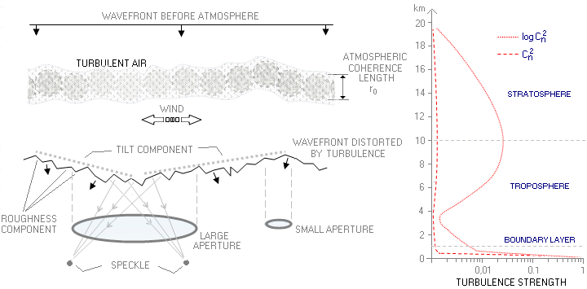
Atmospheric parameters
Atmospheric seeing (FWHM of the PSF) Excellent seeing at primary astronomy sites is rarely below 0.5”
8-m telescope diffraction limit in K: 0.07”
40-m class ELT: 0.014”
Fried Parameter r₀ (atmospheric coherence length)
$r_{0}∝λ^{\frac{6}{5}}$ $r_{0}∝{\left(\cos{ζ}\right)}^{\frac{3}{5}}$
Large telescopes need adaptive optics to exploit their large size!
Actuator spacing (on entrance pupil) ~ 15cm
Greenwood time constant τ₀
Mirror bandwidth ~ 5ms

Slide 10
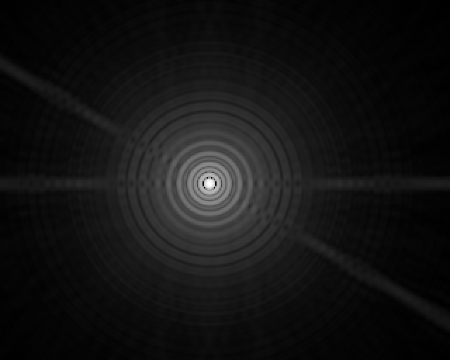
Image improvement through AO
LBT AO – A.Riccardi, 2010
With AO
Theoretical best PSF

Slide 11
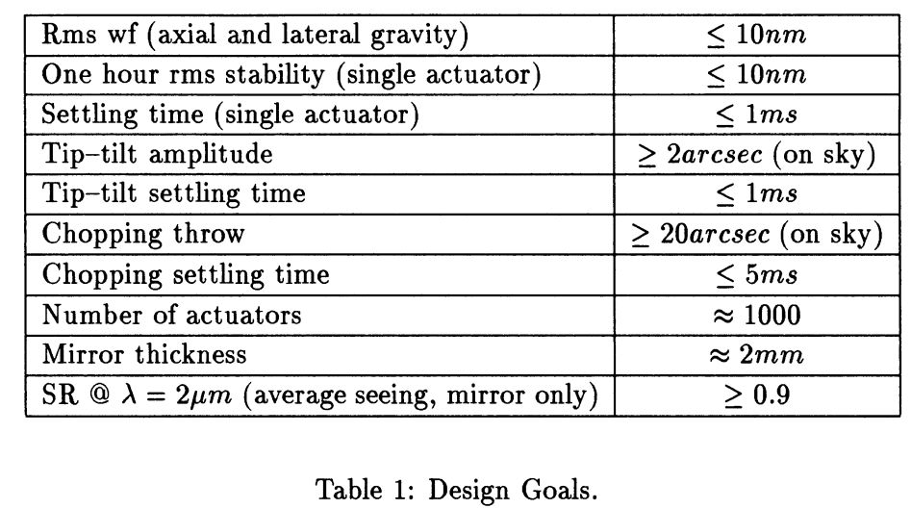
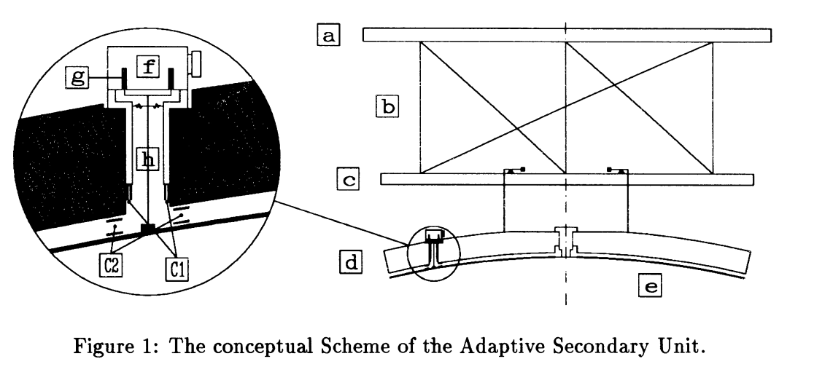
Large, contactless adaptive mirror technology: how it started
The voice-coil based, contactless adaptive mirror has been conceived by Piero Salinari (Osservatorio Astrofisico di Arcetri) in 1993
P.Salinari, C. Del Vecchio and V.Biliotti, A study of an adaptive secondary mirror,” in Proc. ESO Conference, ICO-16 Satellite Conference, Active and Adaptive Optics, August 1993

Slide 12
Italian industry and research team
Electronic design (HW, SW)
Electronics manufacturing
Control design and dynamic
simulation
Integration and test
Integrated mechanical design
Mechanical manufacturing
Opto-mechanical integration
Department of Aerospace Science and Technology
Original concept
Scientific advisor
Optical testing
Control system design
Simulation

Slide 13
Motivation for a large adaptive mirror
Astronomy-related
Adaptive correction on the telescope optical mainstream (typically M2)
All instruments can take advantage of the AO correction
M2 well conjugated with the ground layer, containing most of the turbulence power density
Improved throughput and reduced background/IR emissivity, no added surfaces
Increase of the observation efficiency
Minimize non common path aberrations
General
Reduced power density for high power applications (momentum transfer, industrial lasers)

Slide 14
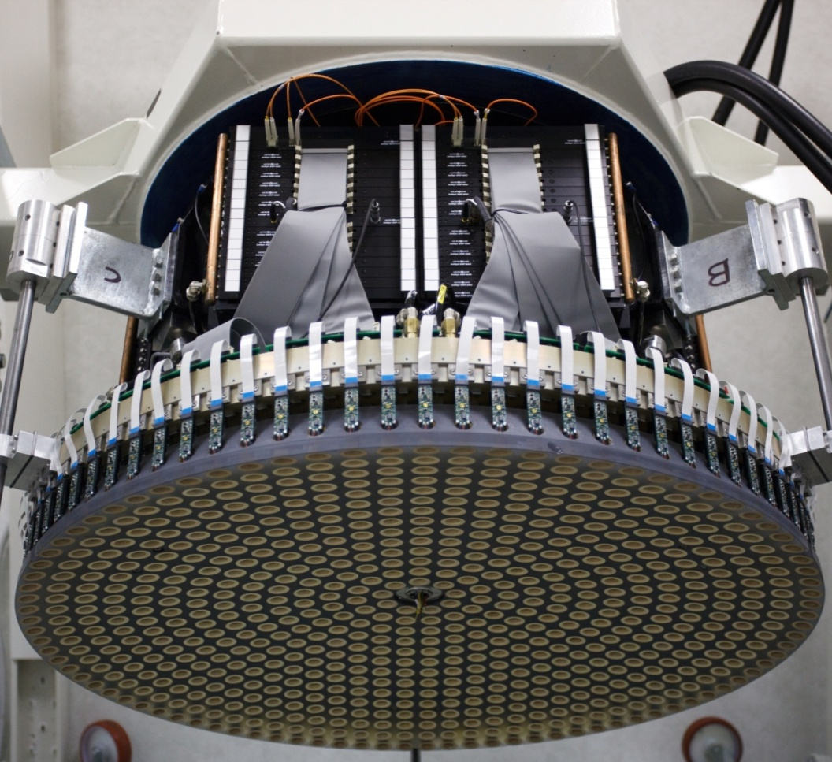
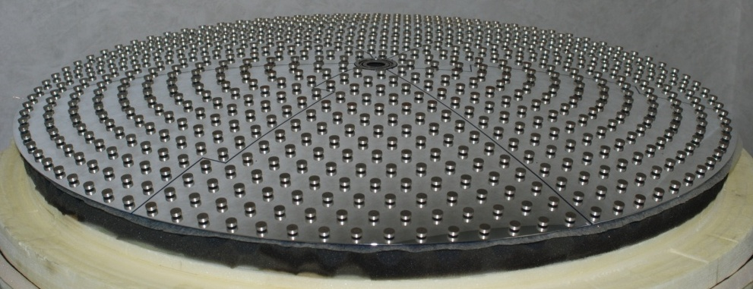
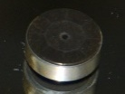
The large, contactless adaptive mirror concept
Control electronics
The thin (<2mm) mirror levitates and is actively and massively controlled by a large number of electromagnetic actuators
The actuators are contactless, only magnetic forces are transferred to the mirror
The distance feedback is provided by co-located capacitive sensors measuring the distance between thin mirror and reference surface
Cold plate
F
Reference body
Capacitive sensor armatures
Magnets

Slide 15
Technology pros and cons
Pros
Technology compatible with fabrication of large DMs, in particular M2:
transmission efficiency
background / IR emissivity
reduced non common path aberration
well conjugated to ground layer
Large stroke
AO + field stabilization + chopping on a single unit
Hysteresis- and friction-free
Very accurate non-AO operation
position feedback to a reference surface
Fail-safe against actuators faults
Cons
Operation requires a complex closed loop
Thin shell
Long and expensive fabrication process
Might require specific handling tools
Not suitable for small, high-density DMs
Power dissipation, also in static conditions

Slide 16
Control concept
Input (typical 500-2000 Hz): deformable mirror shape commands.
Feedback (~80 kHz sampling): control the gap between the mirror and the reference body at each actuation point. Controller with a proportional, integral and pure electronic damping term.
Feedforward (same sampling as input): sum of the static necessary to set the command and a dynamic contribution to compensate in open loop the system dynamics.
Feedforward
RTC
+ -
PI Controller
+
Voice Coil Motors
WFS measurement
DM Cmds
+
Control Forces
-
Electronic Damping
DeformableMirror
Capacitive sensors
Mirror deformation
WFS loop frequency (up to 3kHz)
co-located loop frequency (~ 80kHz)

Slide 17
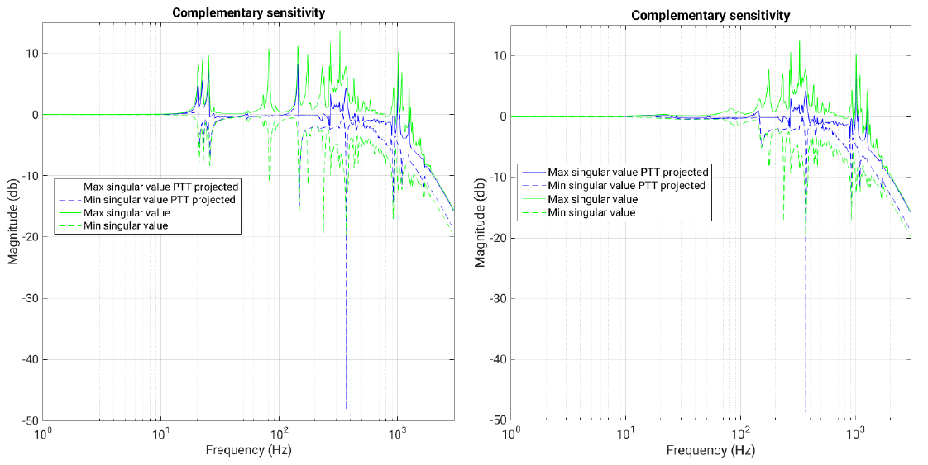
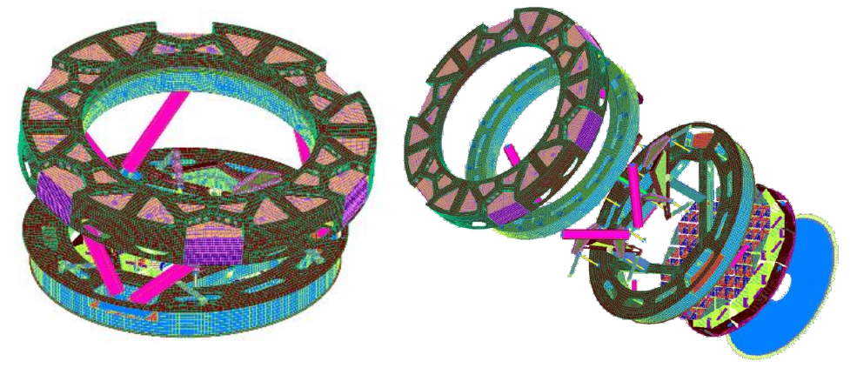
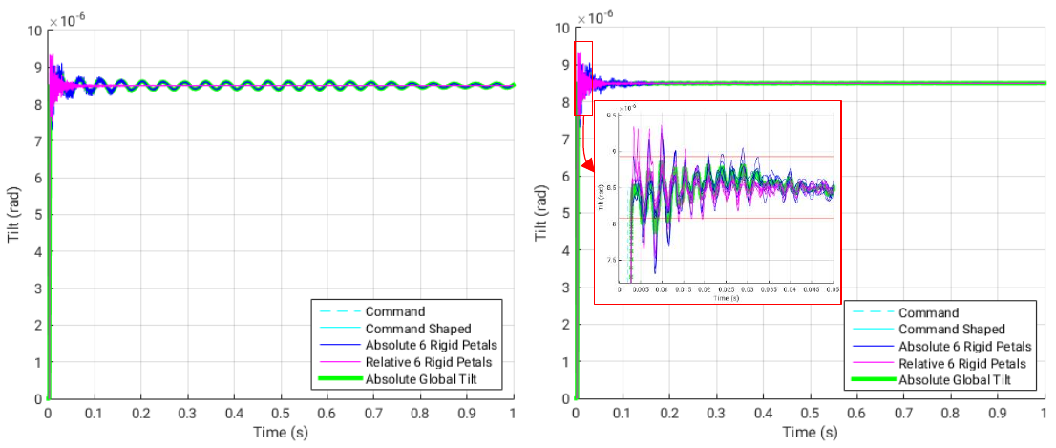
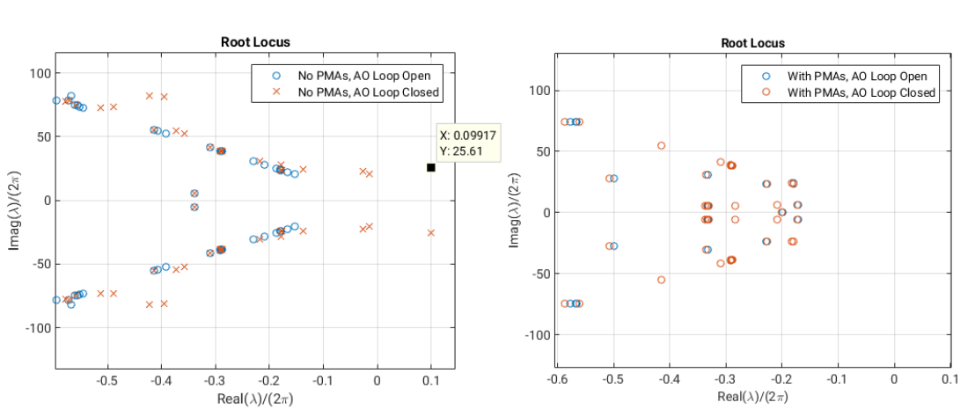
Dynamic simulation
We have developed and continuously improved a comprehensive set of numerical tools capable to analyze the system in all the relevant domains:
Frequency domain → Analysis of frequency responses
Time domain → Simulation of time histories
Laplace domain → Root locus analysis
The simulators are developed in house using different languages/environments and exploiting different hardware architectures:
Matlab, Python, C, C++
CPUs (with multi-thread option), GPUs.
Frequency domain
FEM
ELT-M4 Unit
Time domain
Laplace domain

Slide 18
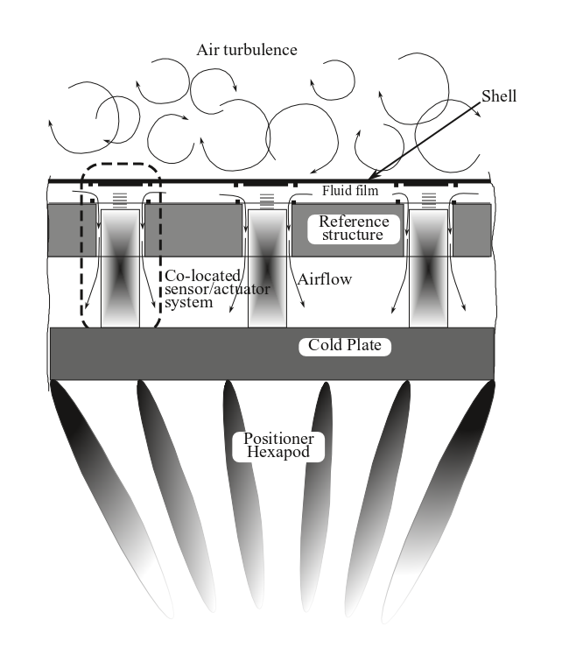
Dynamic simulation
The system modeling is intrinsically multiphysics, covering:
Structural dynamics (usually starting from FEMs)
Fluid dynamics (custom reduced set of Navier-Stokes equations or more simplified models)
Servo controls (inner mirror control loops, telescope optical loop)
Different levels of system modeling, HiFi vs LoFi descriptions: depending on the needs, balance between the analysis accuracy and the computational time and resources
The reliability of all the simulators has been cross-checked through the correlation with experimental results.
Other design aspects (others than dynamic) covered by simulation:
Electromagnetic simulation, e.g. for the VCM design and optimization
System power consumption analysis

Slide 19
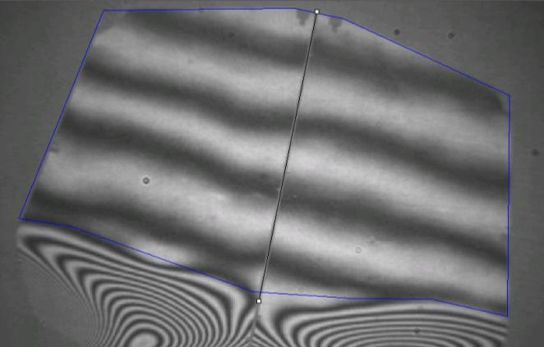
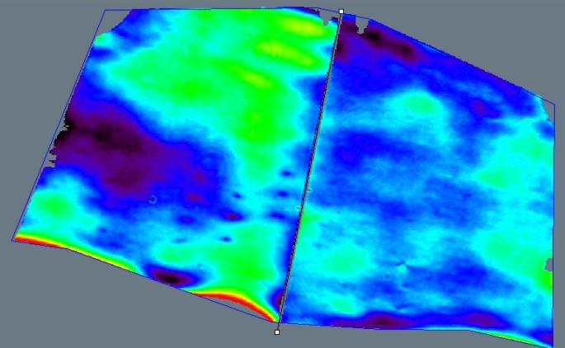
Typical performances
Optical and static
Mirror flatness ~20nm rms WF (typically limited by measurement setup) – adaptive mirror flattened ‘closing a static loop’ with an interferometer – similar performance demonstrated also by segmented systems
Actuators print through in the order of 1 nm rms
‘Blind’ (open AO loop) stability enabled the internal metrology, in the order of 1.5 nm/°C → allows co-phasing of multiple segments
Accurate absolute calibration of the internal metrology, ~ 20 nm ptv over > 100µm stroke, allowing ‘open loop’ correction of quasi-static aberrations
Co-phasing of ESO ELT M4 demonstration prototype segments

Slide 20
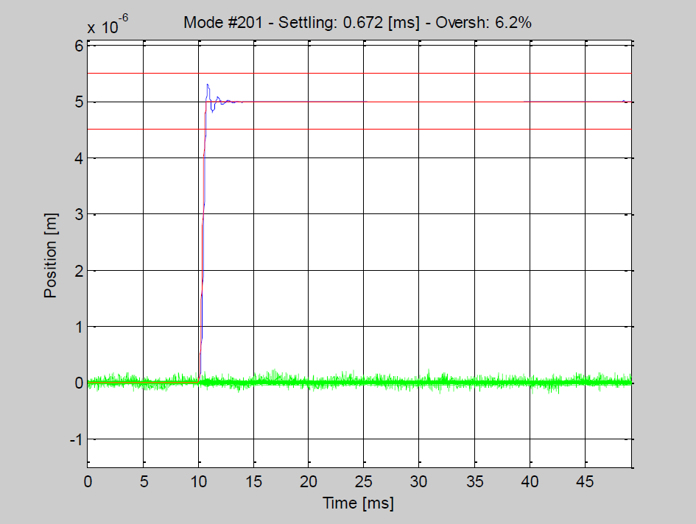
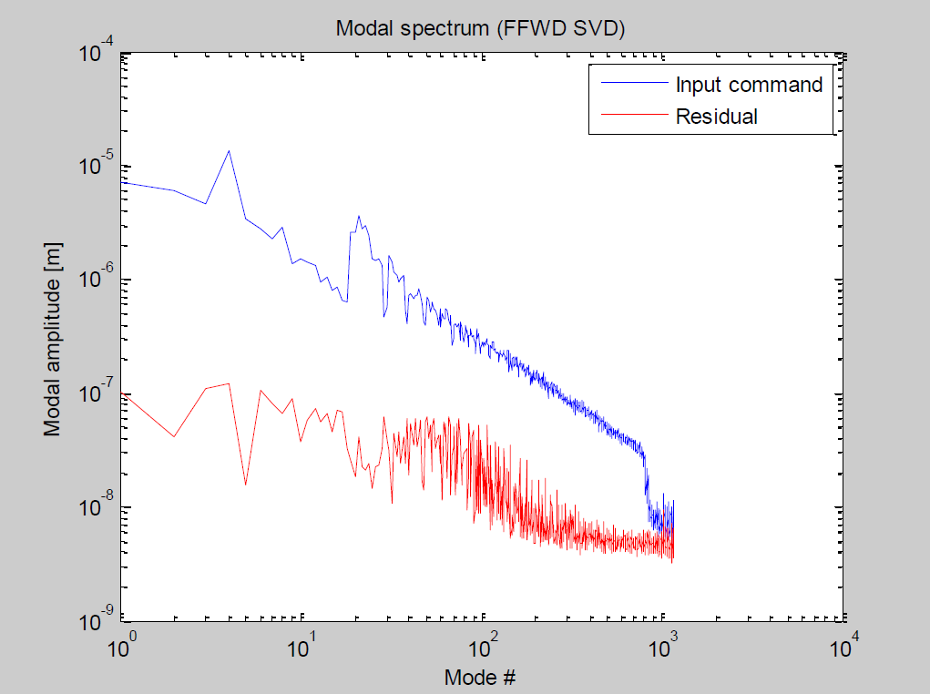
Typical performances
Dynamic and stroke
Settling time < 0.75ms for all corrected modes
Maximum overshoot within 10% of command
Typical wavefront residual error after correction < 40nm rms (median atmospheric seeing, 0.9” @ λ=0.5µm, 20 cm actuators spacing on M1)
Very large stroke, > 100 µm → tip-tilt correction, low order aberrations, chopping …

Slide 21
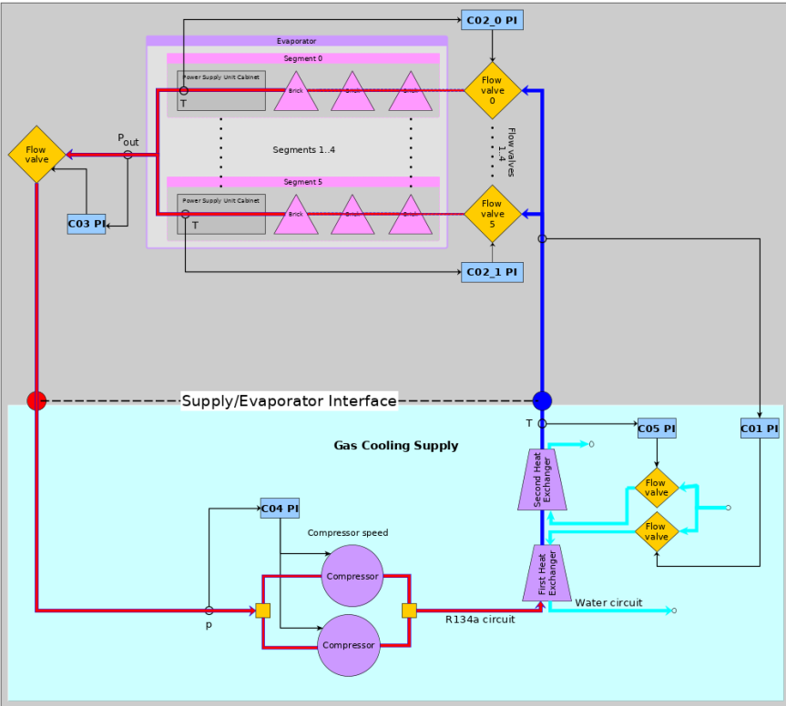
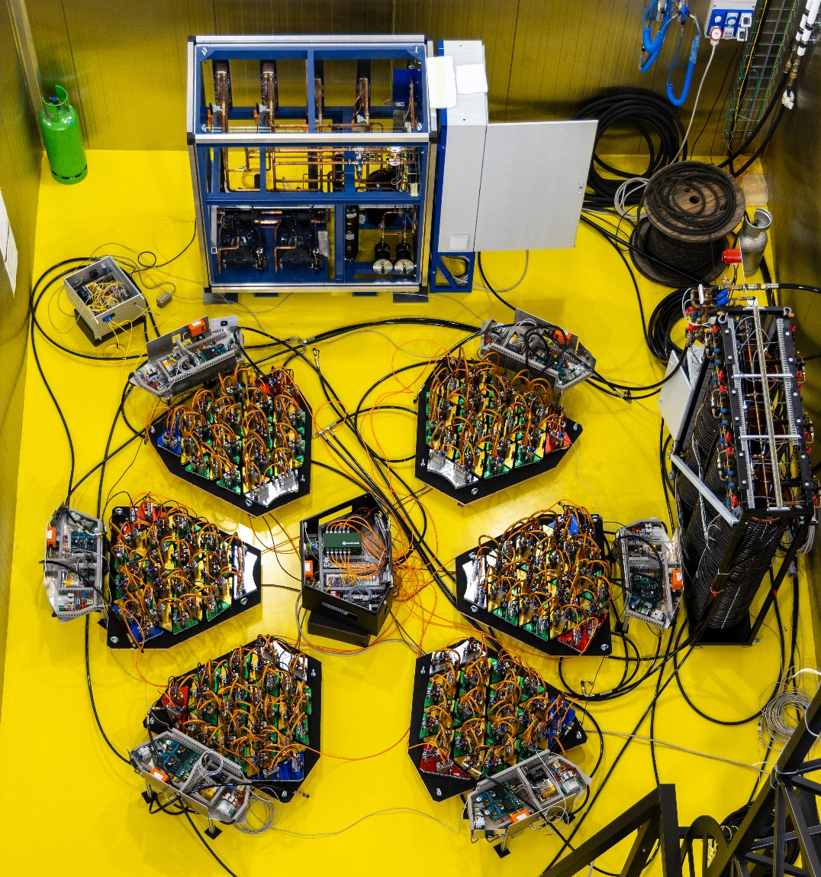
Typical performances
Reliability
Fail safe operation guarantees system operability also in case of actuators failure
No mechanical link/constraint between actuator and mirror
Failure modes allowing minimal impact on operation, e.g. position sensor failure
Specific autonomous systems implemented to assure the safety of the thin shell in case of earthquake or strong wind
Some cooling system failures occurred mainly due to bad operation at telescope level, none being catastrophic. Direct expansion gas cooling implemented in the most recent systems to avoid system damage in case of leakage

Slide 22
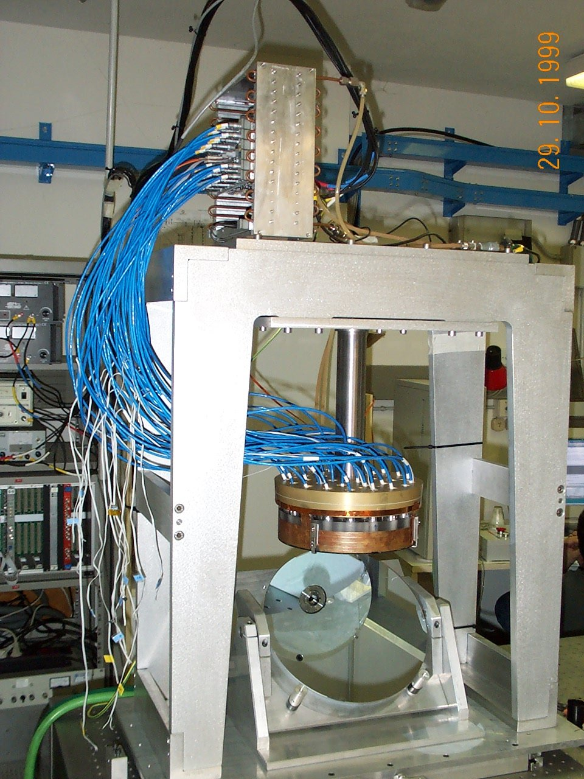
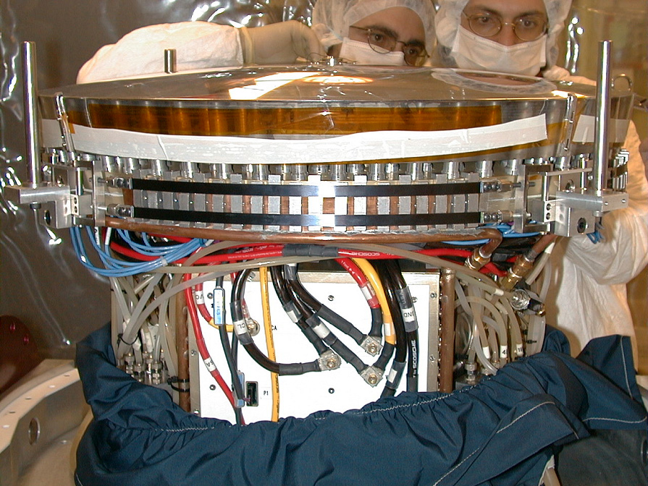
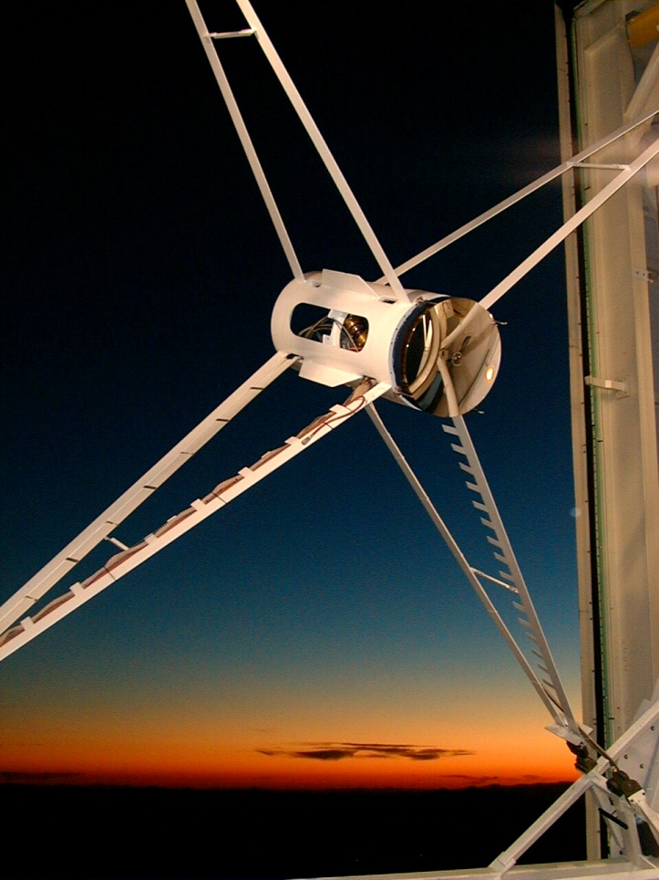
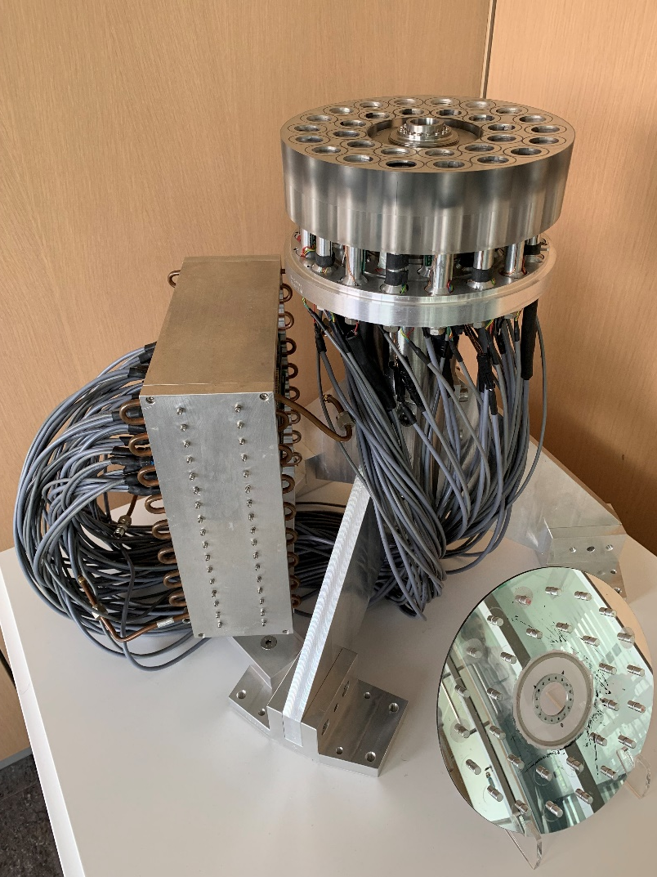
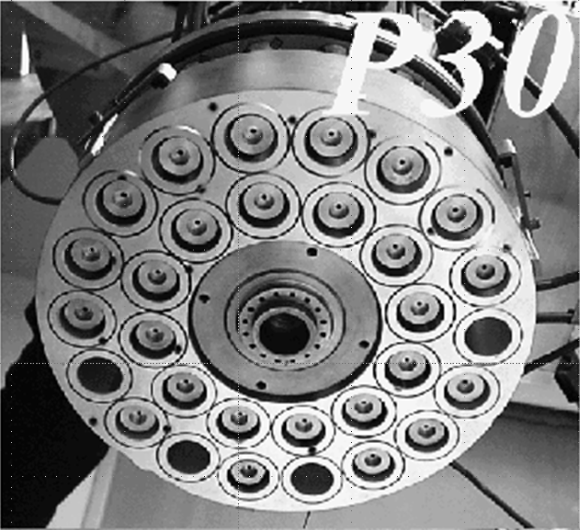
Large, contactless DMs history: the first steps…
@ SPIE International Symposium on Astronomical Telescopes and Instrumentation - KONA 1998
R.Biasi, D.Gallieni MMT adaptive secondary prototype development
G.Brusa, A.Riccardi et al Adaptive secondary P30 prototype: laboratory results
R.Biasi, L.Fini, P.Mantegazza et al Control Electronics for an Adaptive Secondary Mirror
2002 - MMT 336
First adaptive secondary
1997 - Early prototypes
1999 - MMT ASM prototype

Slide 23
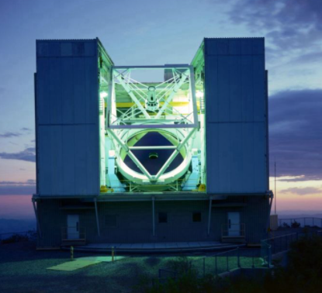
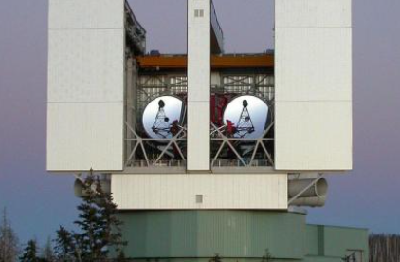
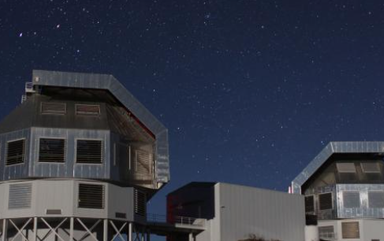
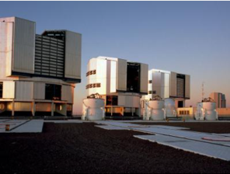
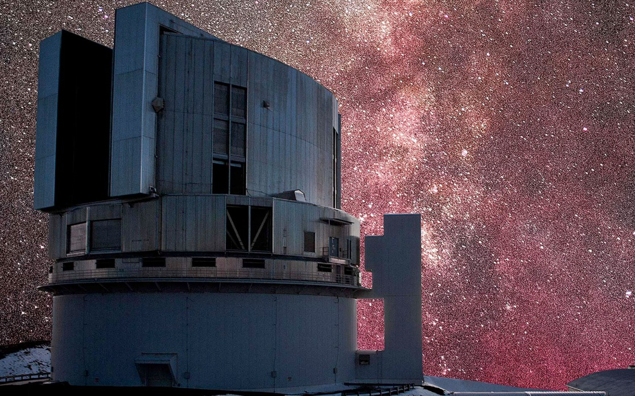
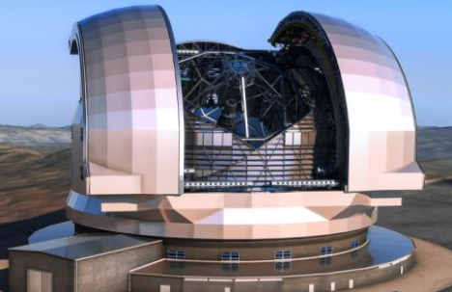
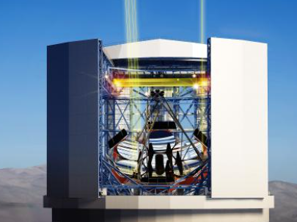
Serving the largest observatories
Major delivered projects
2002
2008
2010
2016
MMT 336 Multiple Mirror Telescope
University of Arizona
Large Binocular Telescope
LBT Corporation
Magellan Baade Telescope
University of Arizona
Very Large Telescope
ESO
Continuous technology improvement (4th generation):
Dynamic and static performances
Reliability
Power dissipation
Follow technological trends (long-term maintainability)
Major ongoing projects (in construction)
2027
2028
2030?
Subaru
Observatory of Japan
ESO –ELT M4 + MORFEO
Giant Magellan Telescope
GMT

Slide 24
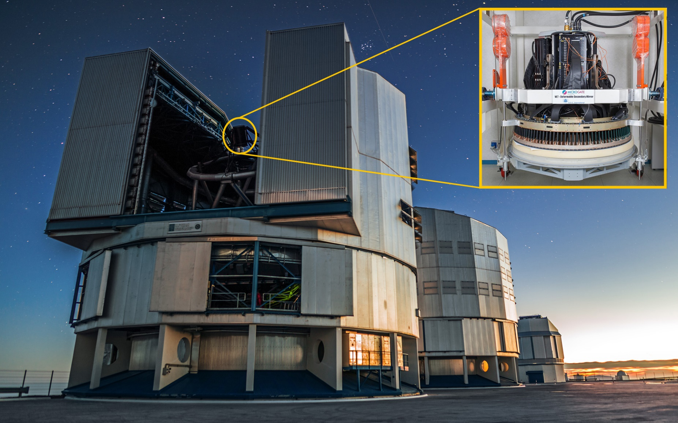
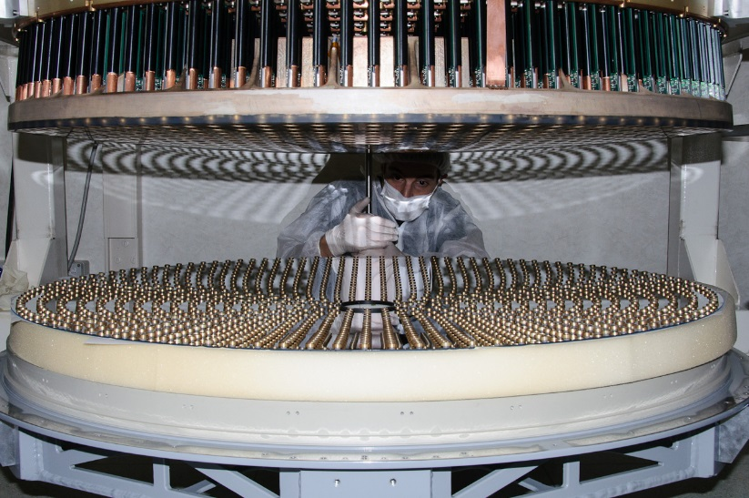
VLT DSM
Very Large Telescope (ESO, Paranal, Chile) UT4
the largest Adaptive Mirror ever built: 1.12 m diameter, 1170 actuators, 29mm spacing
Customer: European Southern Observatory (ESO)
Reliably working on the telescope since early 2016

Slide 25
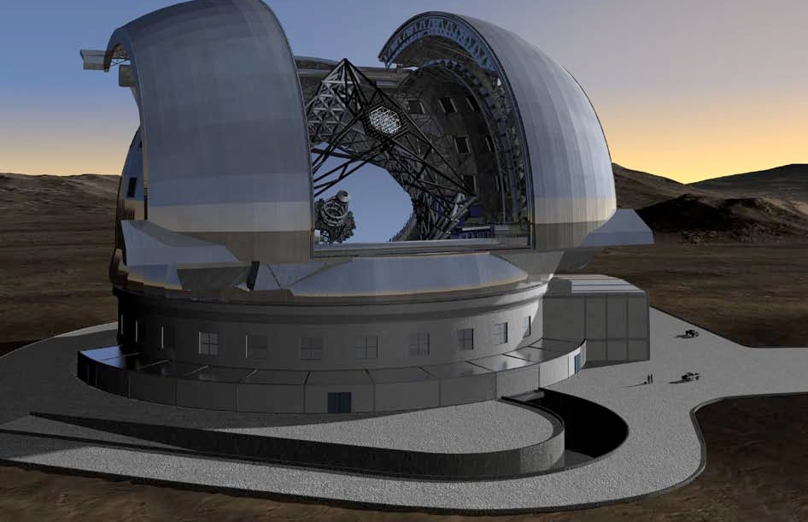
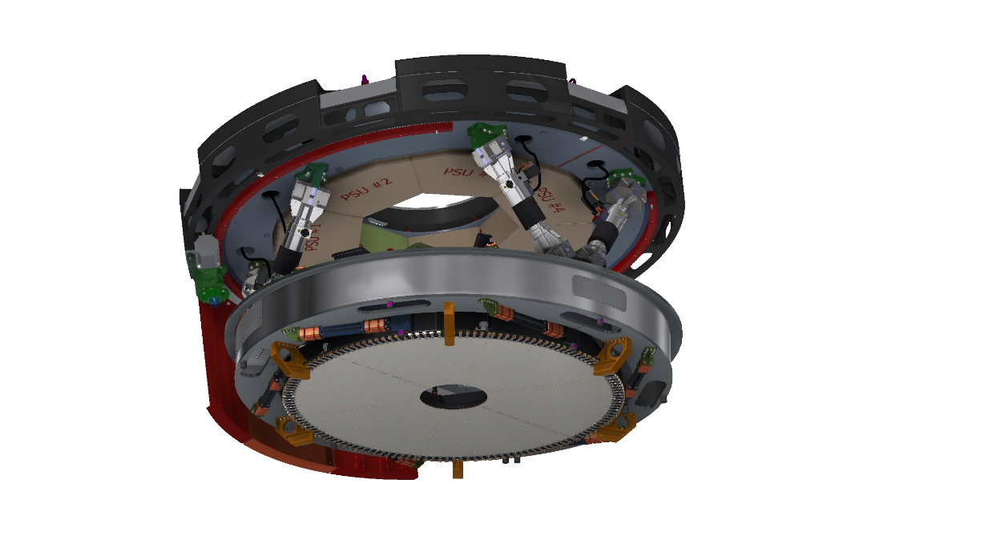
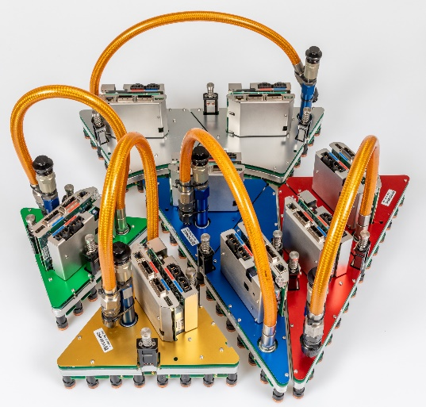
European Extremely Large Telescope M4
Cerro Armazones (Chile)
Primary mirror: 39m
MAIT Kick-off: 2015
First light: 2028
Customer: European Southern Observatory (ESO)
Adaptive M4
2.54m diameter
Segmented thin mirror
Monolithic SiC structural reference body
5352 actuators, 30mm spacing
180 FPGA-based control bricks
On-board computational power: ~1 TMAC/s
https://elt.eso.org/mirror/M4/
https://elt.eso.org/telescope/adaptiveoptics/

Slide 26
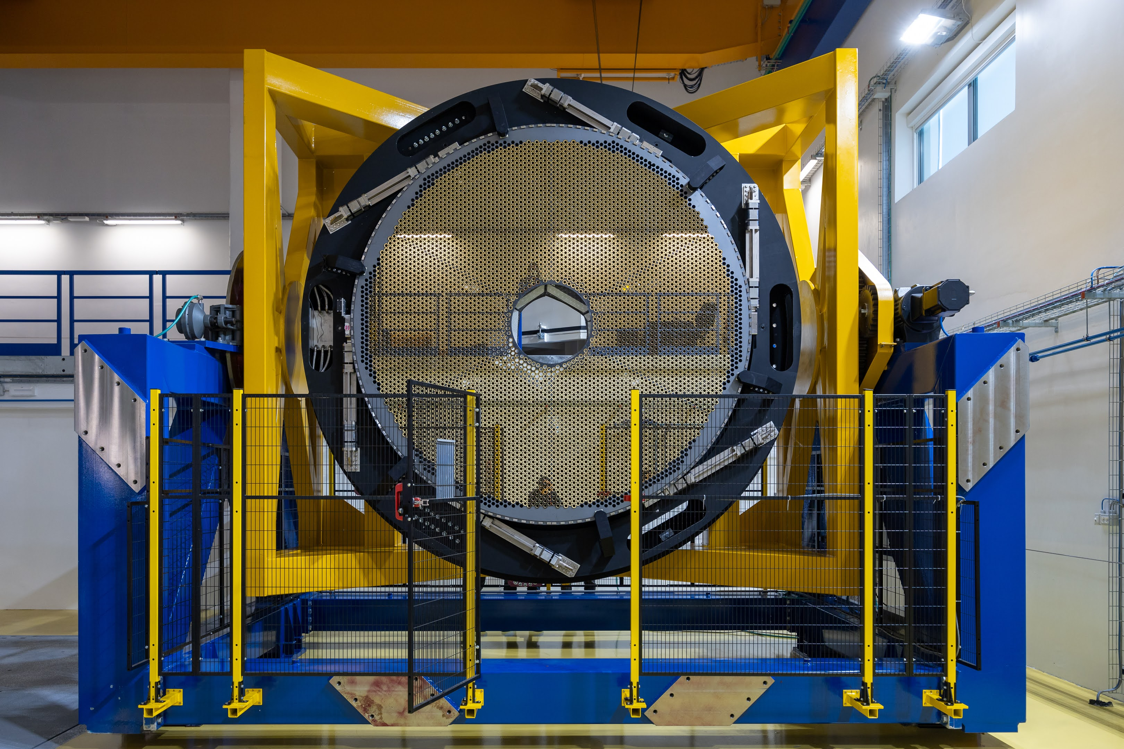
ESO ELT final integration and testing

Slide 27
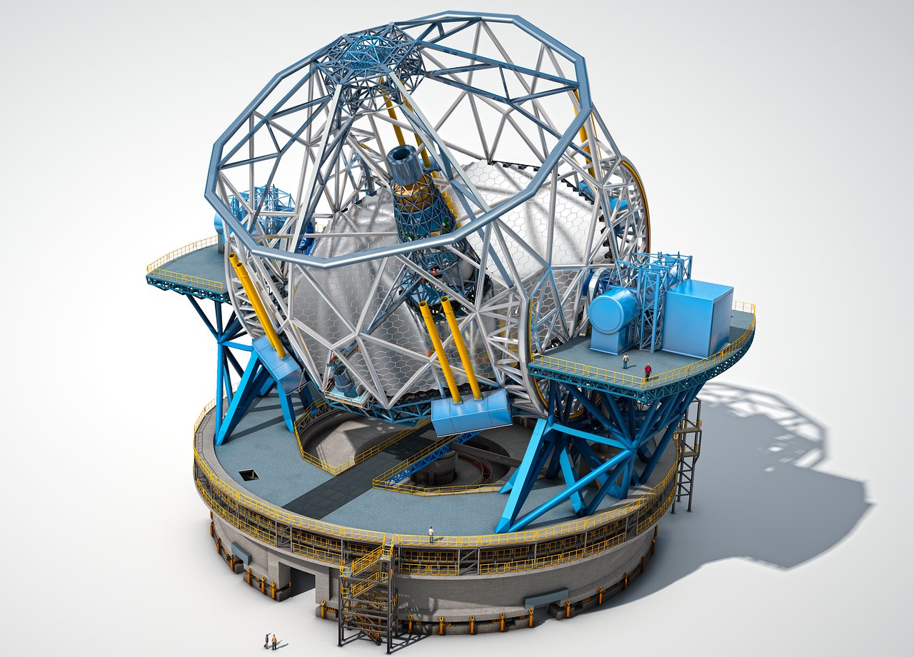
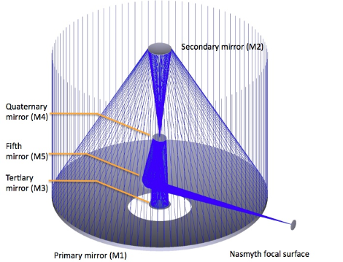
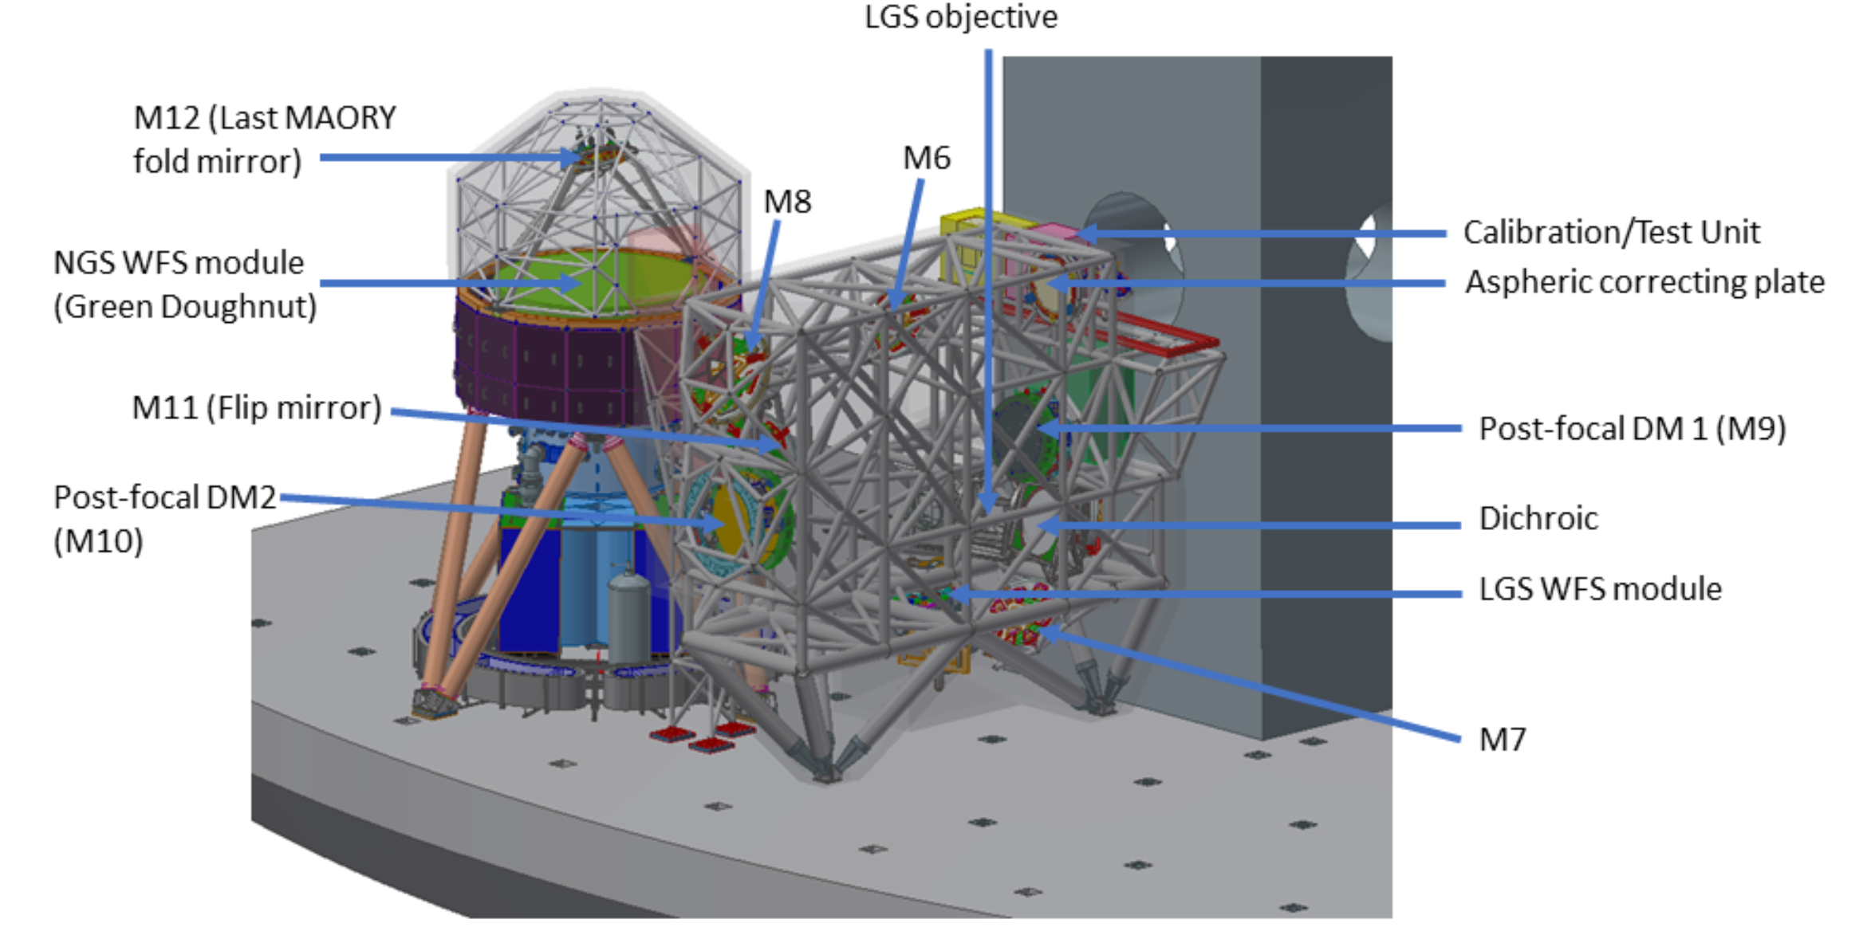
ELT MORFEO Multiconjugate adaptive Optics Relay For ELT Observations
Serving the first-generation instruments of the ESO-ELT:
MICADO (Multi-AO Imaging Camera for Deep Observations)
HARMONY (High Angular Resolution Monolithic Optical and Near-infrared Integral field spectrograph)
M9 – DM1: 0.88m, convex, 928 actuators, 26mm spacing
M10 – DM2: 1.22m, concave, 1225 actuators, 31mm spacing
Very tight ‘blind’ stability requirements, ±25nm in 10 hours
https://elt.eso.org/instrument/MORFEO/

Slide 28
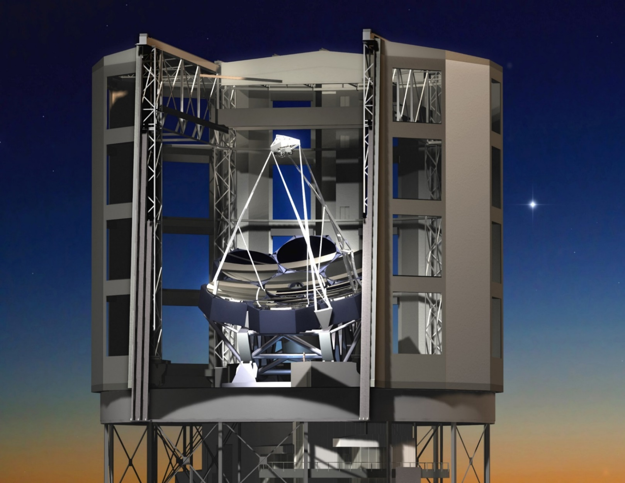
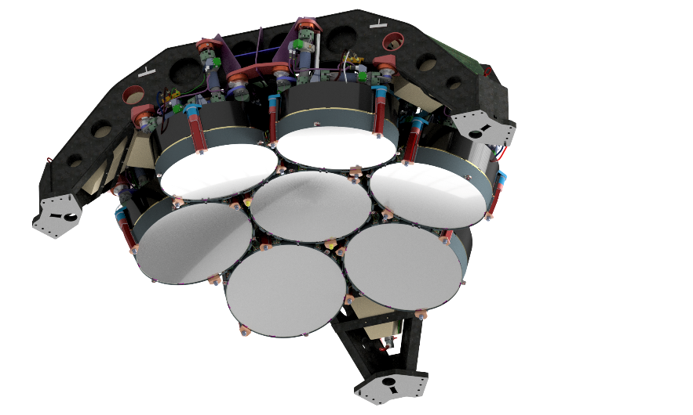
Giant Magellan Telescope (GMT)
Cerro Las Campanas (Chile)
Primary mirror: 7 x 8.4 m (equivalent to 24.5 m)
Final design Kick-off: 2015
First segment MAIT Kick-off: 2021
First light: 2030?
Customer: GMT Organization (USA/AUS/ROK/BRA/CHIL/ISRL)
Adaptive Secondary Mirror
7 independent segments
1.05 m diameter each
7x675 = 4725 actuators, 36mm spacing
Very tight ‘blind’ segments co-phasing requirement, ~60 nm over 120s (interferometric metrology between segments’ RBs)

Slide 29
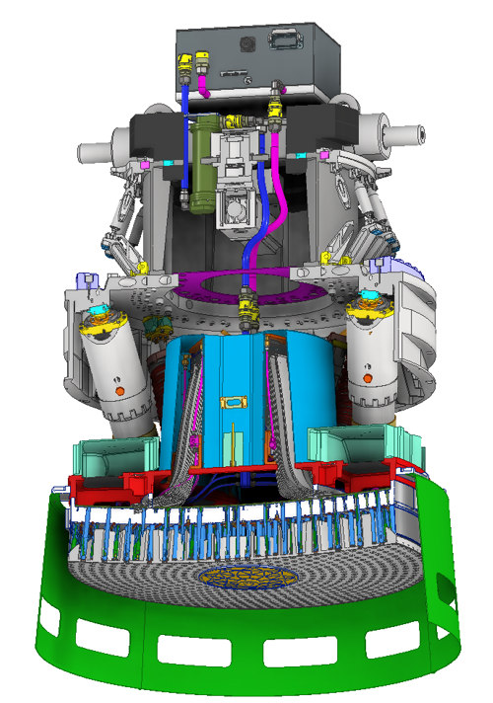
Subaru ASM
Mauna Kea (Hawaii)
Primary mirror: 8.2 m dia
Adaptive secondary: 984 actuators, 1.23 m dia, 35mm spacing
Final design completed early 2022
MAIT Kick-off: March 2022
Delivery in 2026, on-sky 2027
Customer: National Astronomical Observatory of Japan

Slide 30
Other applications: space active optics
LATT (Large Aperture Telescope Technology)
VCM contactless technology adapted to active optics application for space
ESA contract (led by OHB-CGS)
φ 0.4 m, 19 actuator prototype
1.3 mm stroke
Tested thermally and in vacuum
Reached TRL 5
Ongoing activity at INAF-Osservatorio Astrofisico di Arcetri: SPLATT, Segments and Pyramids for Large Aperture space Telescope Technology
R.Briguglio, SPIE2022+ICSO2022 https://sites.google.com/inaf.it/splatt

Slide 31
Other applications: space debris laser ranging and optical communication
ASI – SDLR
Space Debris Laser Ranging Station
Space Debris Laser Ranging Station, with Laser Guide Star assisted adaptive optics
Italian Space Agency - Matera Space Center Giuseppe Colombo
1m telescope, 0.31m adaptive secondary mirror, 84 actuators, 28mm spacing
Laser Guide Star (589nm)
Uplink correction of the ranging laser
Compatible with momentum transfer
Delivery of the full station: June 2026

Slide 32
High Density technology development
The current technology has a ‘physical’ actuators’ spacing limitation @ ~ 23-25mm
Higher density is demanded by several applications, including:
Astronomy, aiming to wide-field correction in the visible
Solar astronomy, optical communication, laser ranging → strong daytime turbulence, low r₀
High power laser applications → reduce power density by correcting on a large pupil, but not too large…
Development ongoing at Microgate and ADS International (AdOptica), aiming to reach 15mm spacing, while keeping the intrinsic key-advantages of the contactless technology
Additional goal: improve actuators efficiency and optimize electronics architecture to reduce on-board power consumption

Slide 33
EST preliminary design
Canary Islands, a first-class site for astronomical observations.
Primary mirror: 4.2 m dia
Adaptive secondary: approx. 2000 actuators, 0.8 m dia
New concept of actuators, higher concentration of actuators on the surface
Preliminary Design ongoing, completed early 2025, including a 169 actuators prototype
Customer: Instituto de Astrofísica de Canarias

Slide 34
Conclusions
The large, contactless adaptive mirror technology has continuously evolved in the past 30 years
Efficiently and reliably operating on the largest astronomic observatories
Units in construction for the next-generation ELTs
Other applications besides astronomy (space, space debris, optical communication, high power lasers)
Higher density technology development in advanced progress

Slide 35
Wenn eine Idee nicht zuerst absurd erscheint, taugt sie nichts.
A.Einstein
Thank you for your attention!

