Slide 1


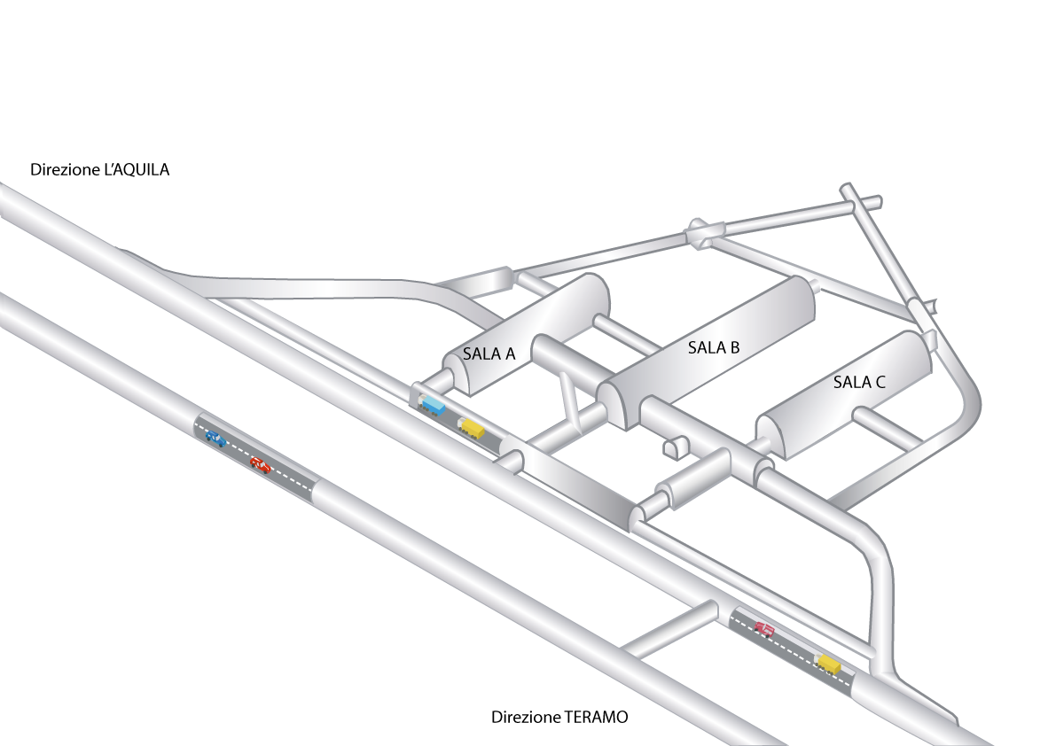
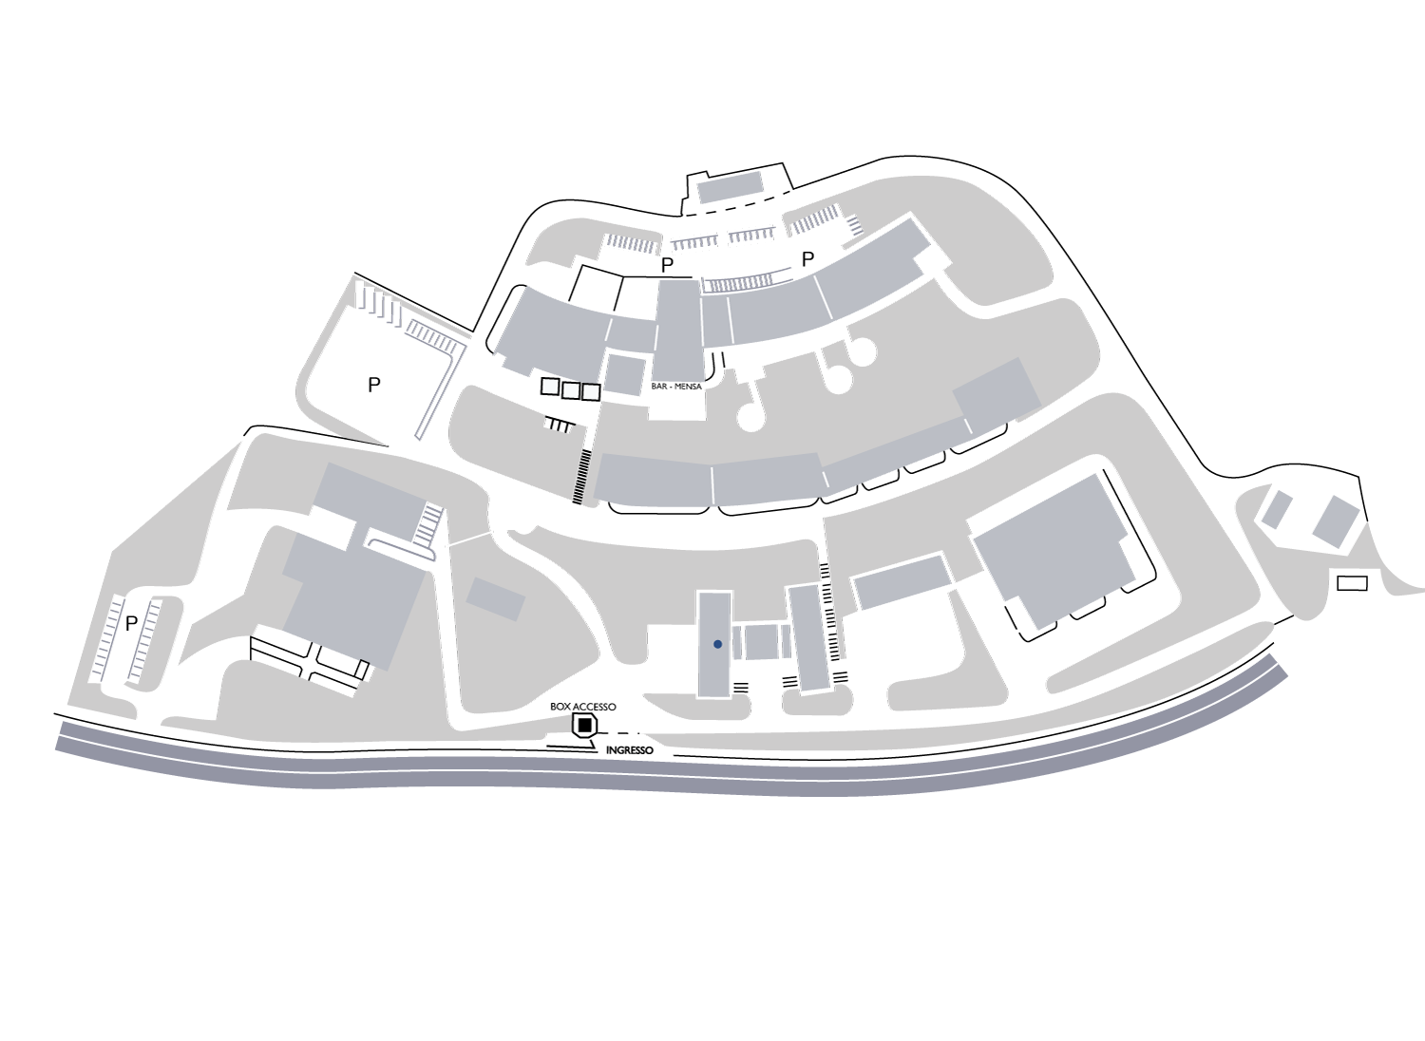


Gran Sasso National Laboratory
Paolo Gorla

Slide 2
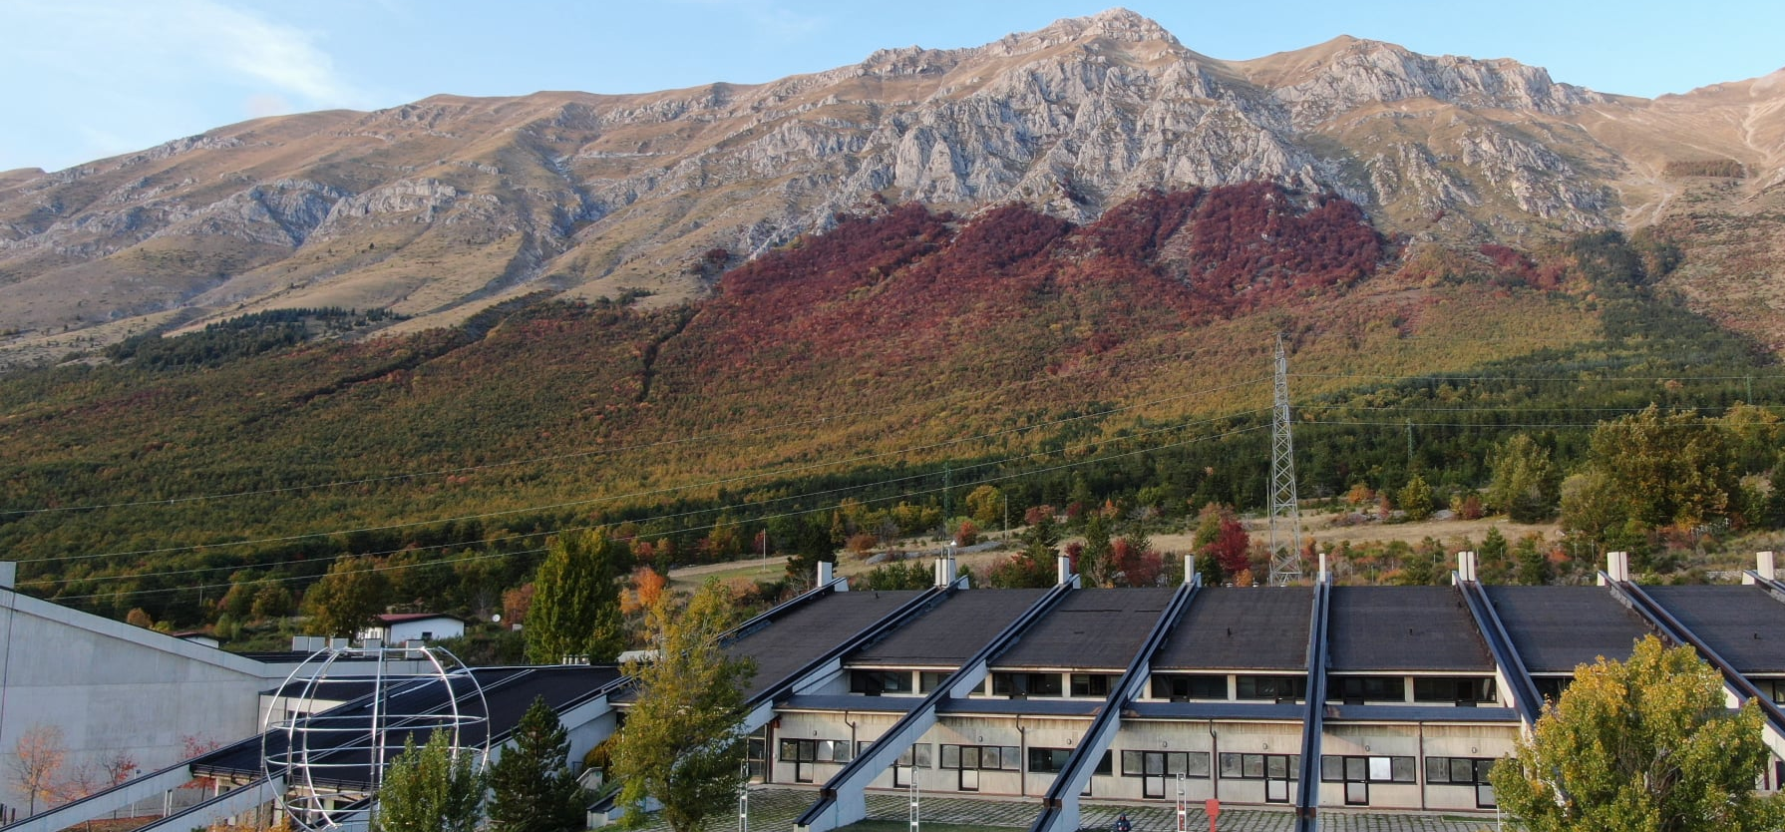
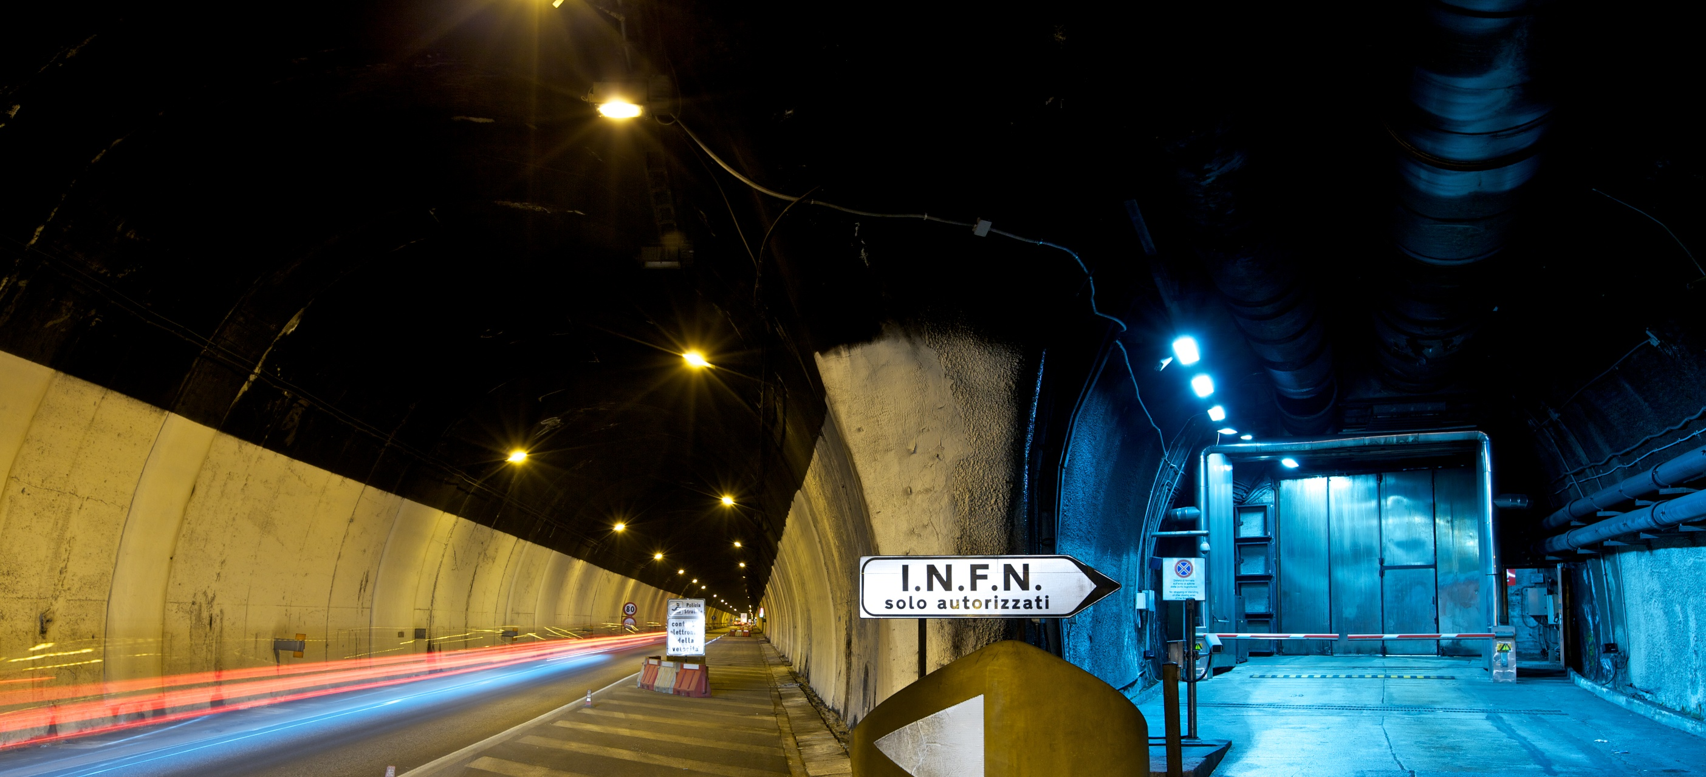
Facilities
External buildings
Underground laboratory

Slide 3
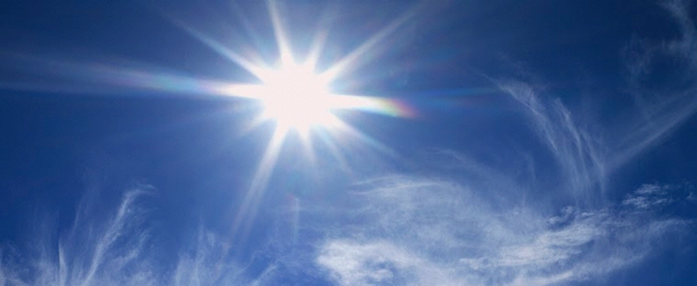
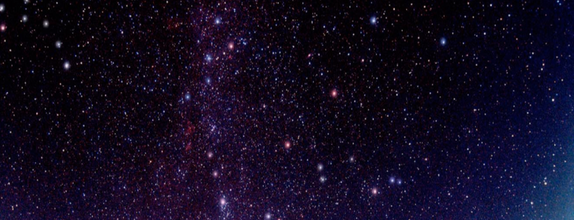
Why can't we see the stars by day?
If we want to see a very small signal (e.g. starlight) we need to get rid of the strongest light sources (the sun)

Slide 4

Why underground?
Underground laboratories are shielded by layers of rock and offer the unique possibility of studying rare physics phenomena in an environment which is almost free from cosmic ray background
Notes:
Siamo tutti attraversati da particelle (ogni secondo circa 200 particelle attraversano una superficie di un metro quadrato):
I raggi cosmici sono un disturbo ineliminabile per un esperimento in superficie in cerca di eventi rari.

Slide 5
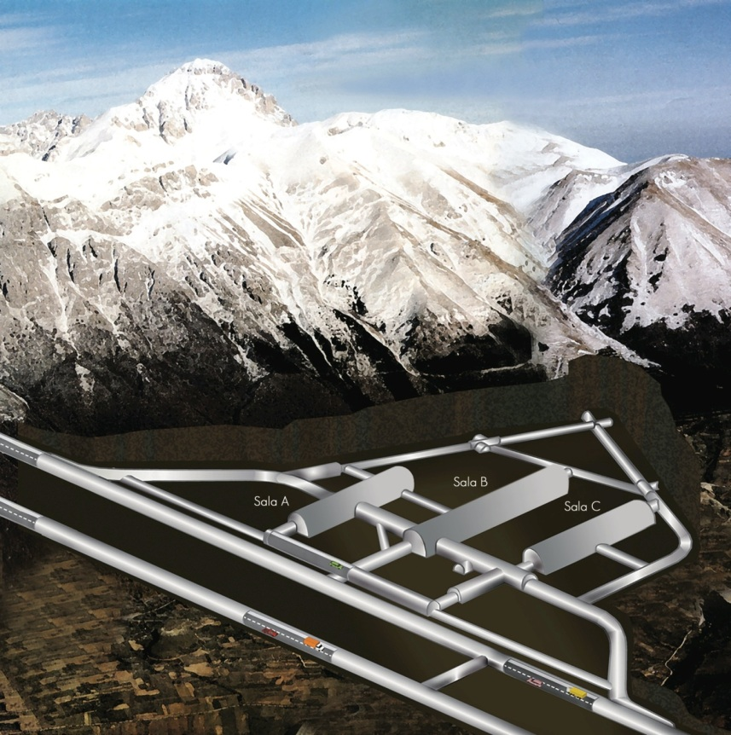

Features of the underground laboratory
1400 m of rock overhead
Cosmic ray flux reduction: 1.000.000
The largest in the world actually running
Underground Surface: 17800 ${\text{m}}^{2}$
Underground Volume: 180000 ${\text{m}}^{3}$

Slide 6




LNGS people
127 staff personnel
Direct connection with LNGS for associated members:
LNGS involved people: 282
(127 staff + 155 associated)

Slide 7
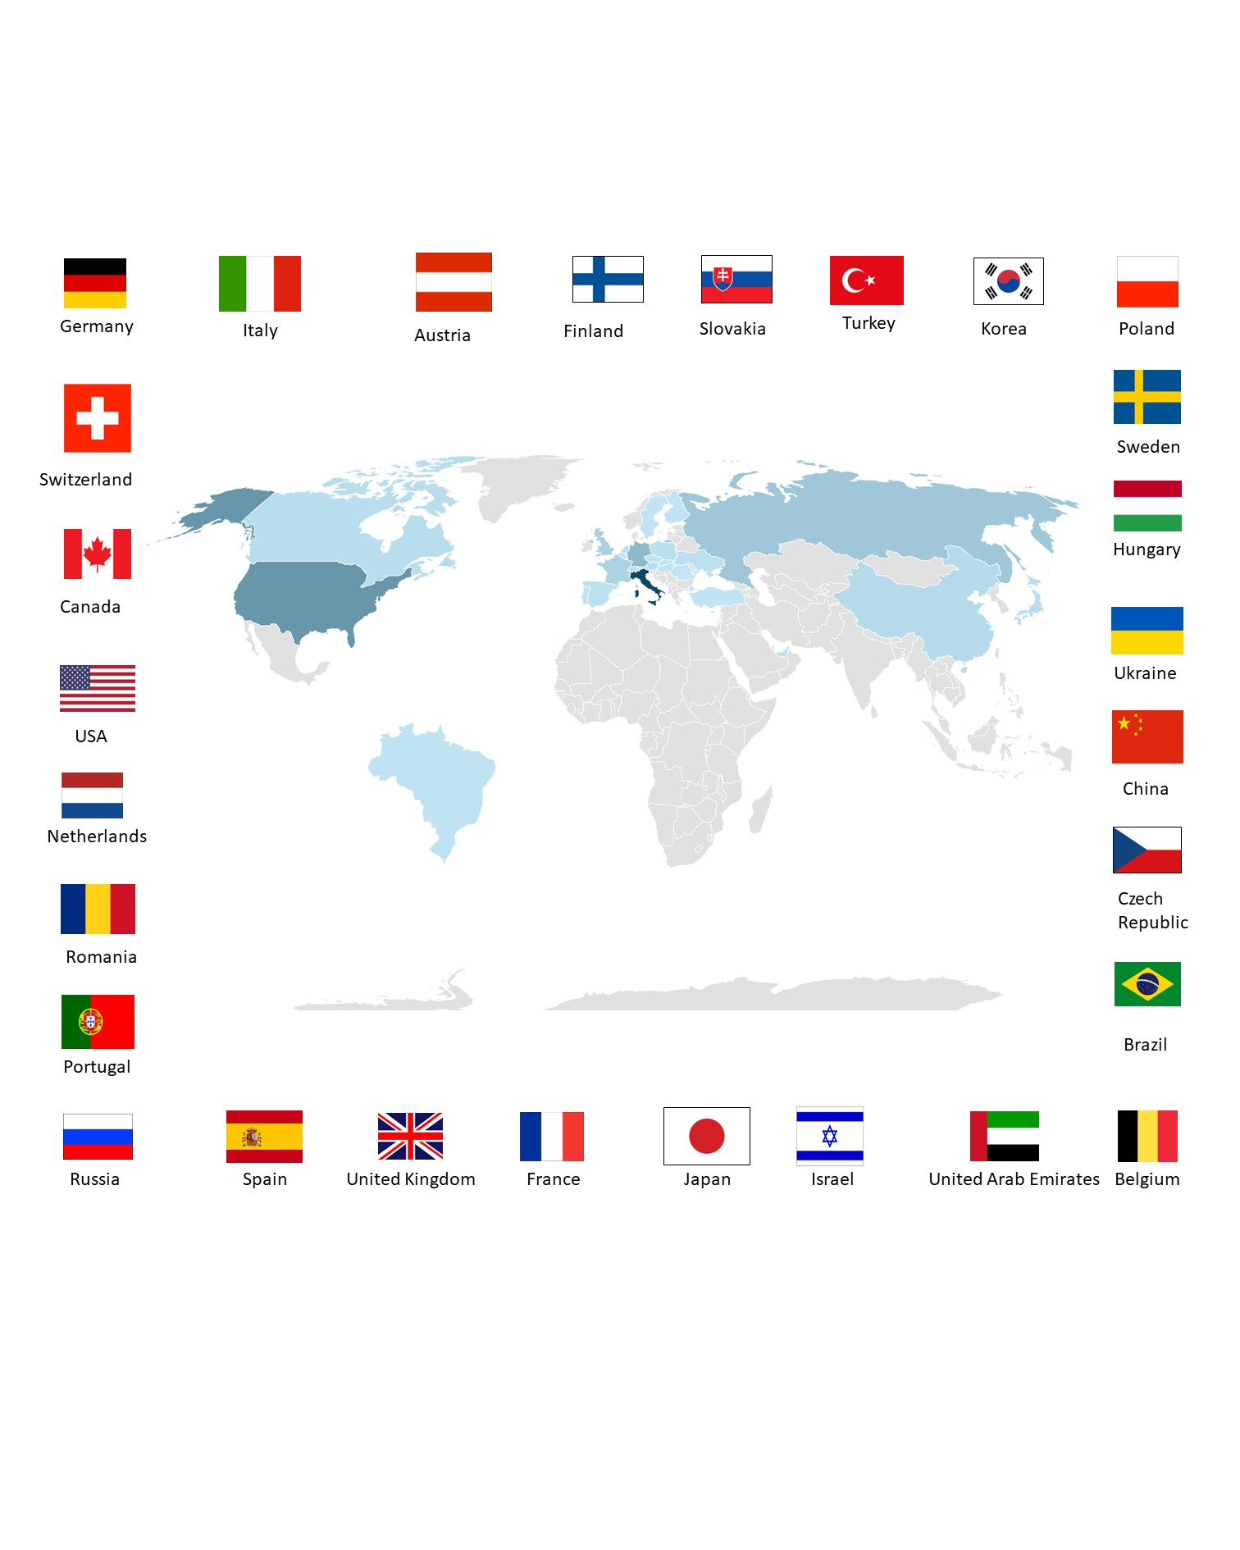
Internationality of the Gran Sasso National Laboratory
Total involved scientists: N. 1334
Italian scientists: N. 482
Foreign scientists: N. 852
Scientific guests: N. 505
Italian guests: N. 295
Foreign guest: N. 210

Slide 8
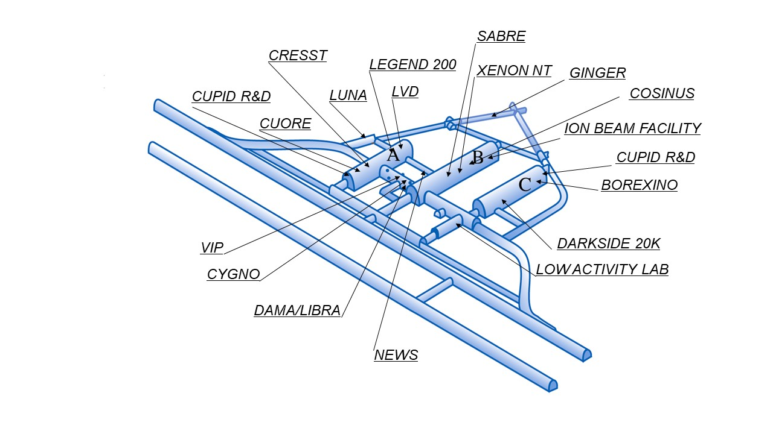
A look inside
The 3 experimental halls measure approximately 100 m in length, 20 m in width and 18 m in height
About 22 experiments in data taking or under construction
The most sensitive laboratory (LOW ACTIVITY LAB) dedicated to the measurement of contaminants in materials

Slide 9
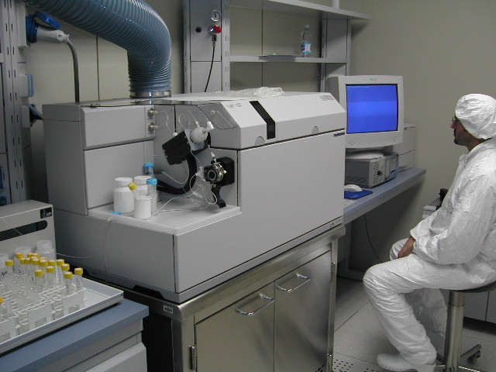
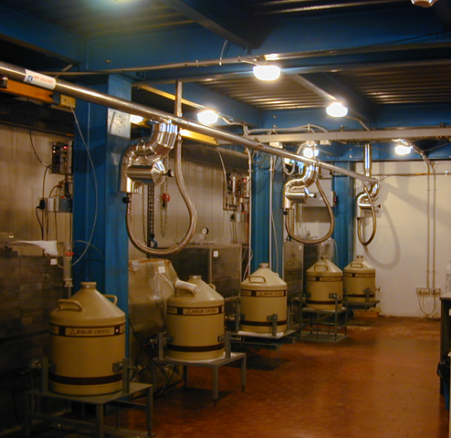




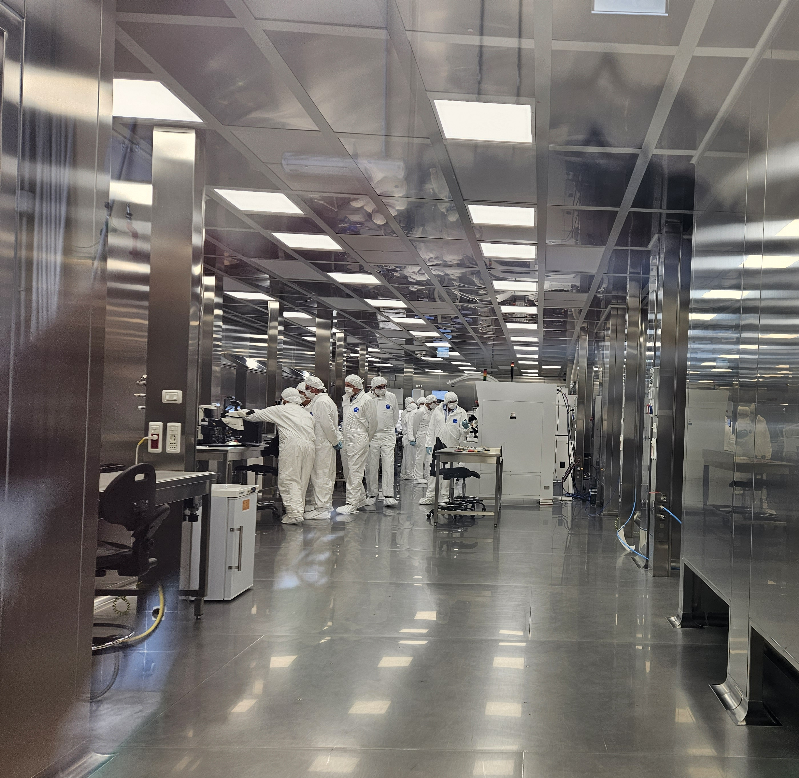

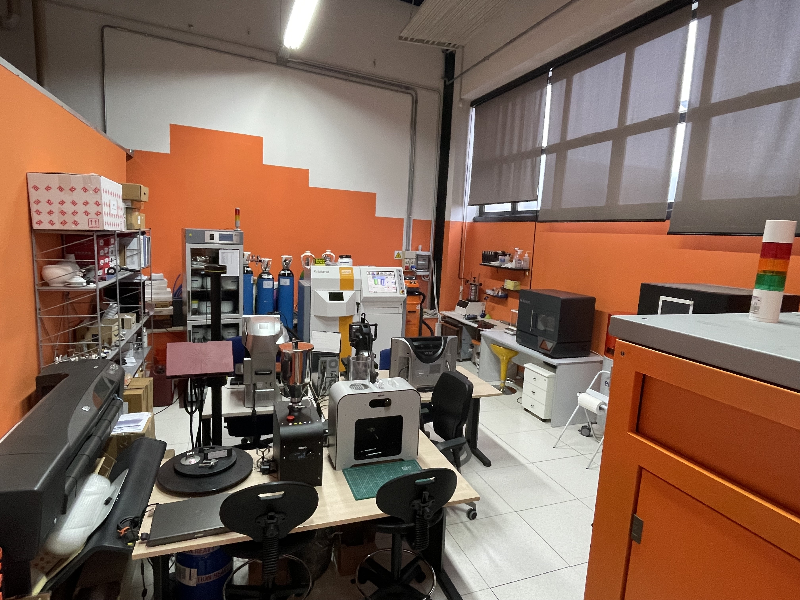






LNGS Users Support and Facilities
Ultra-low background techniques
Chemistry lab and service
Mechanics workshop
Mechanics design & 3D-lab
Electronics
IT
Clean Rooms

Slide 10
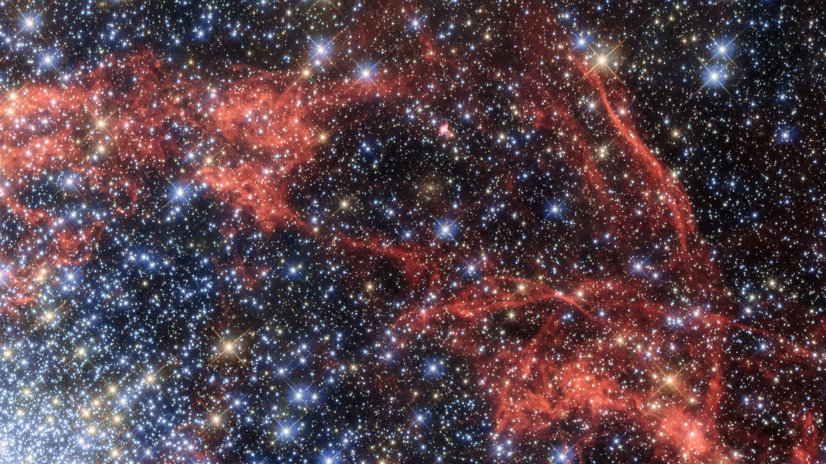
Main research topics: Neutrinos
The messengers of the Universe
Unique behavior in the particle landscape (Majorana neutrino)
They could explain the prevalence of matter over antimatter in the Universe

Slide 11
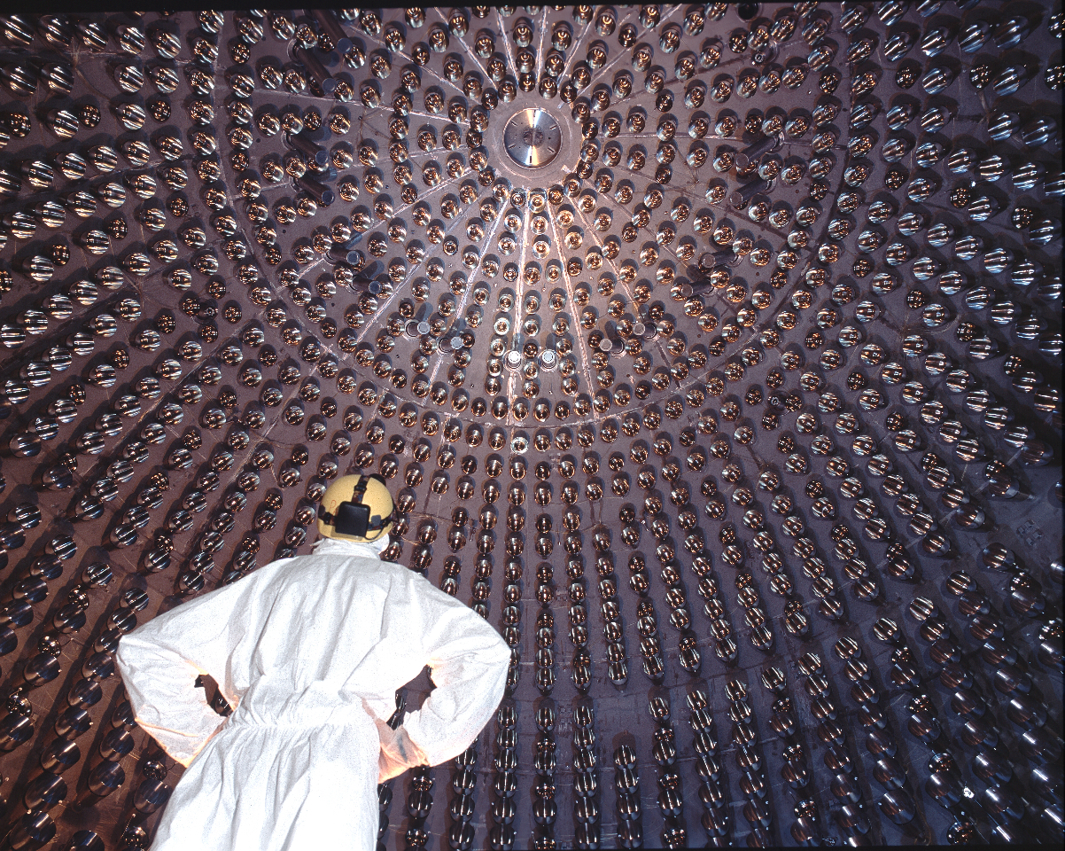
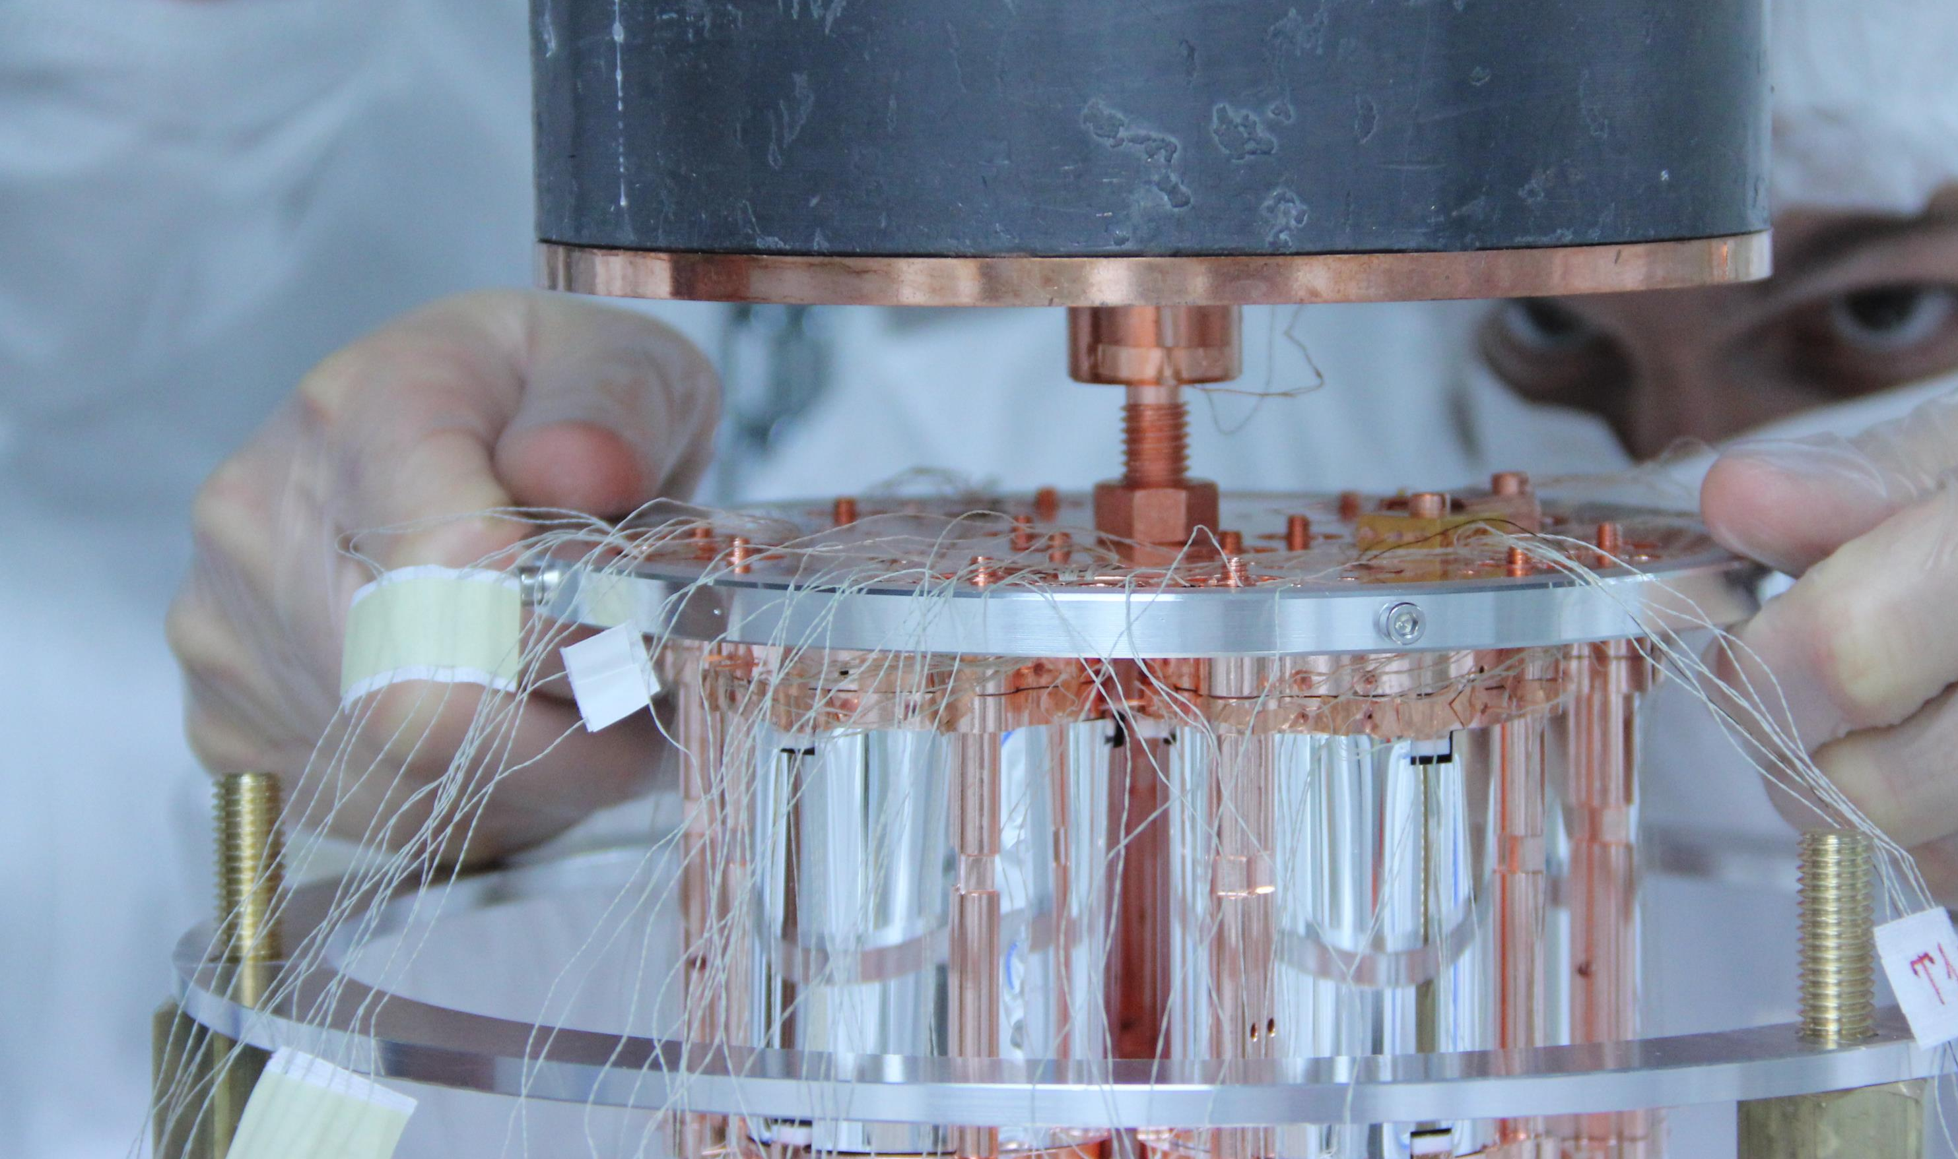

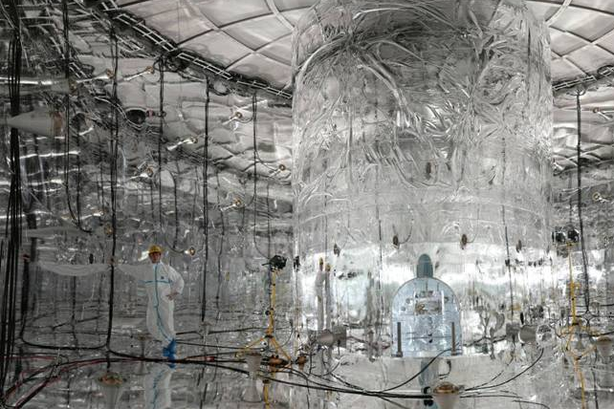
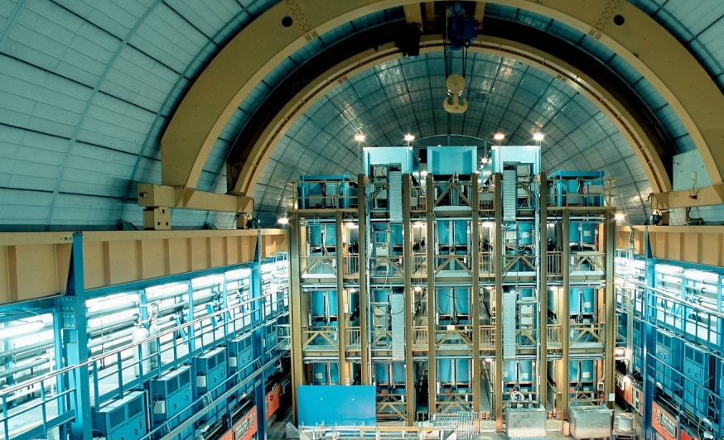

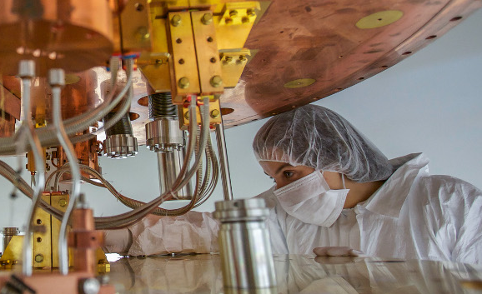
Neutrinos
BOREXINO
LVD
CUORE
GERDA/LEGEND
CUPID

Slide 12
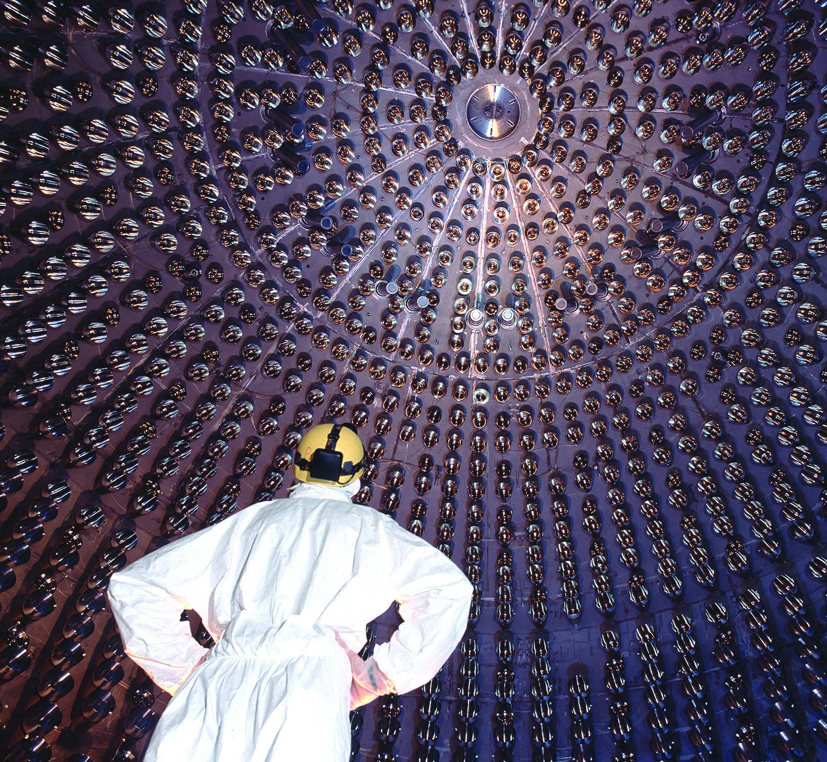
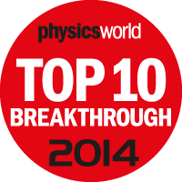
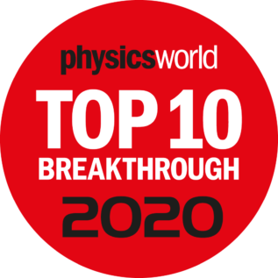
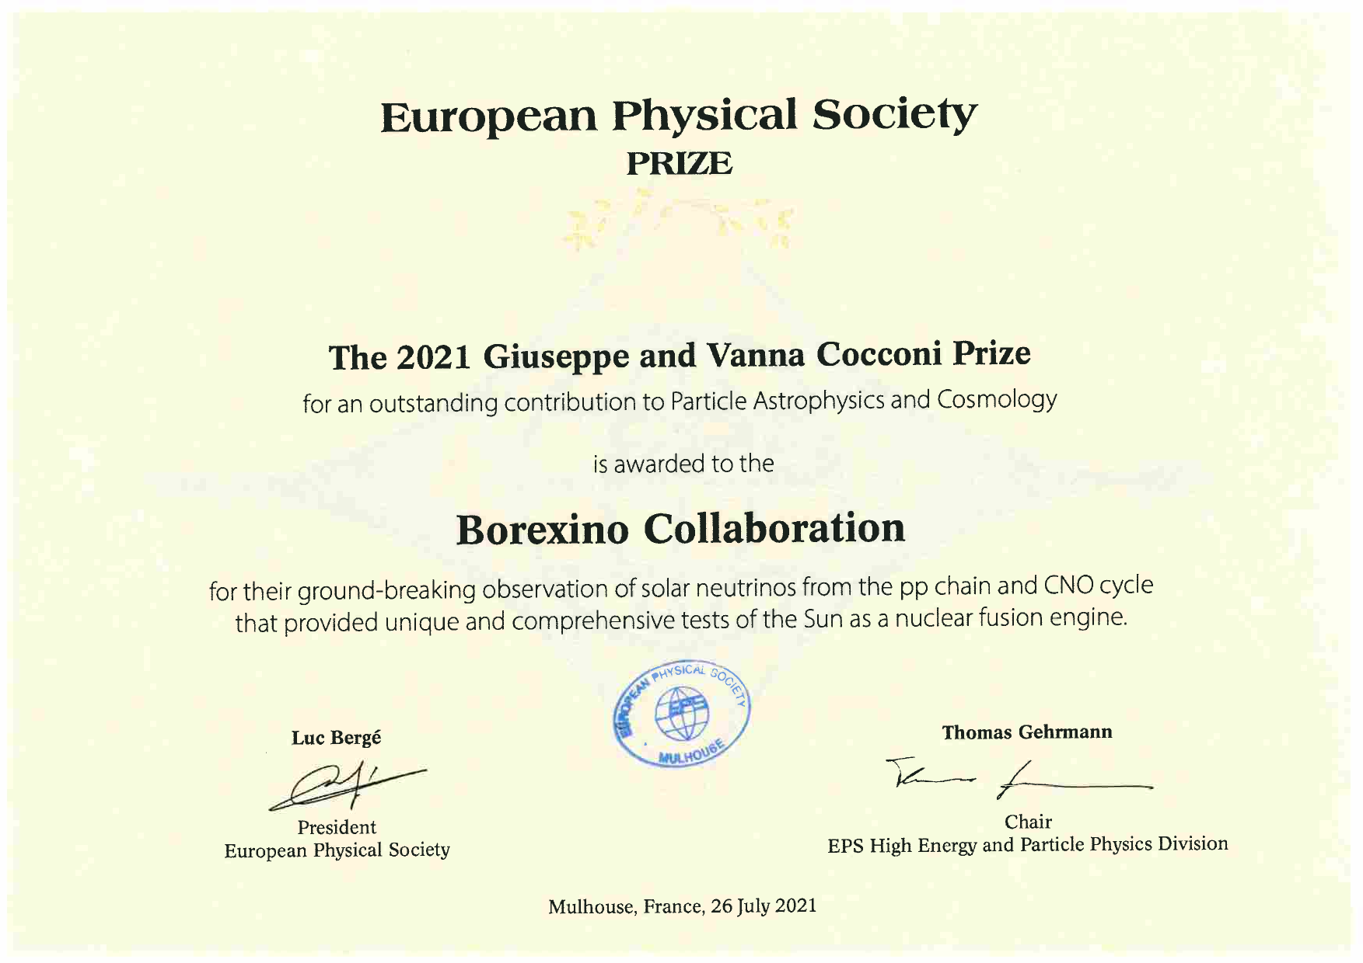

Borexino
Real time neutrino (all flavours) detector
Real-time measurement of pp neutrino
Real-time measurement of Geo-neutrinos

Slide 13
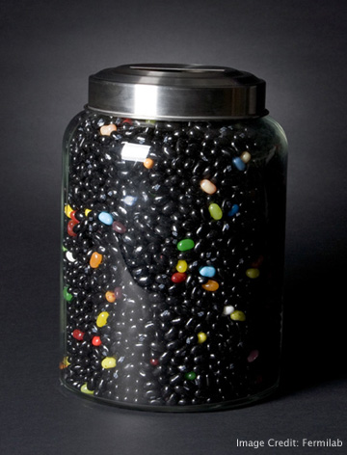
Main research topics: Dark Matter
Ordinary matter is less than 5%
About 27% of the Universe is dark matter
More than 68%, is dark energy
Notes:
La materia oscura (fagioli neri) è circa 5 volte più abbondante della materia visibile (fagioli colorati)

Slide 14
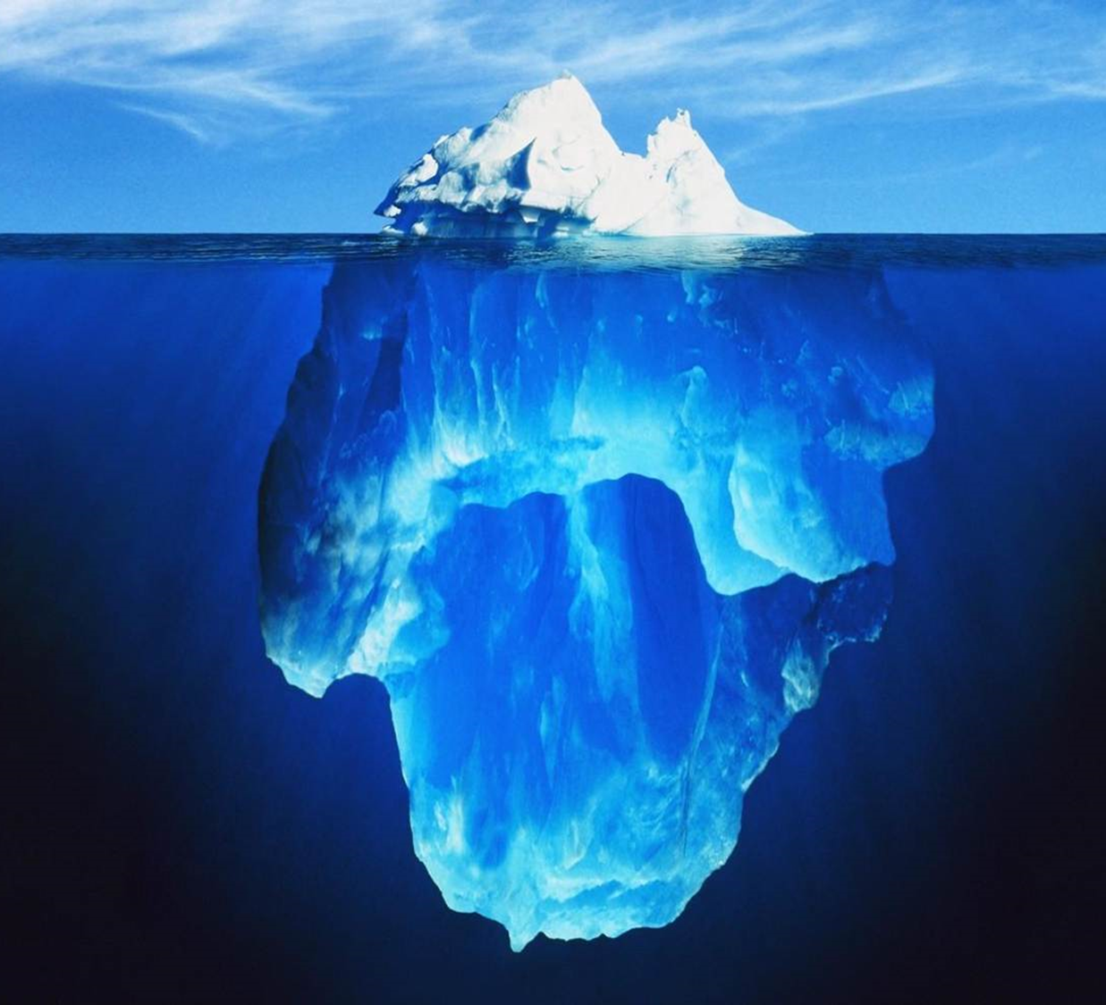
Dark Matter
What we know is just the top of the iceberg

Slide 15
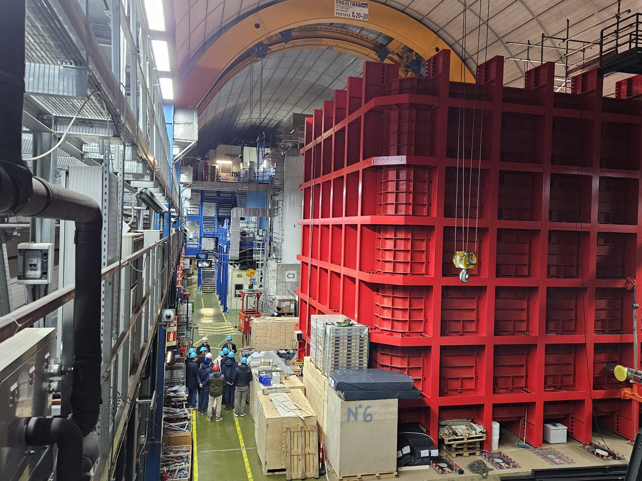
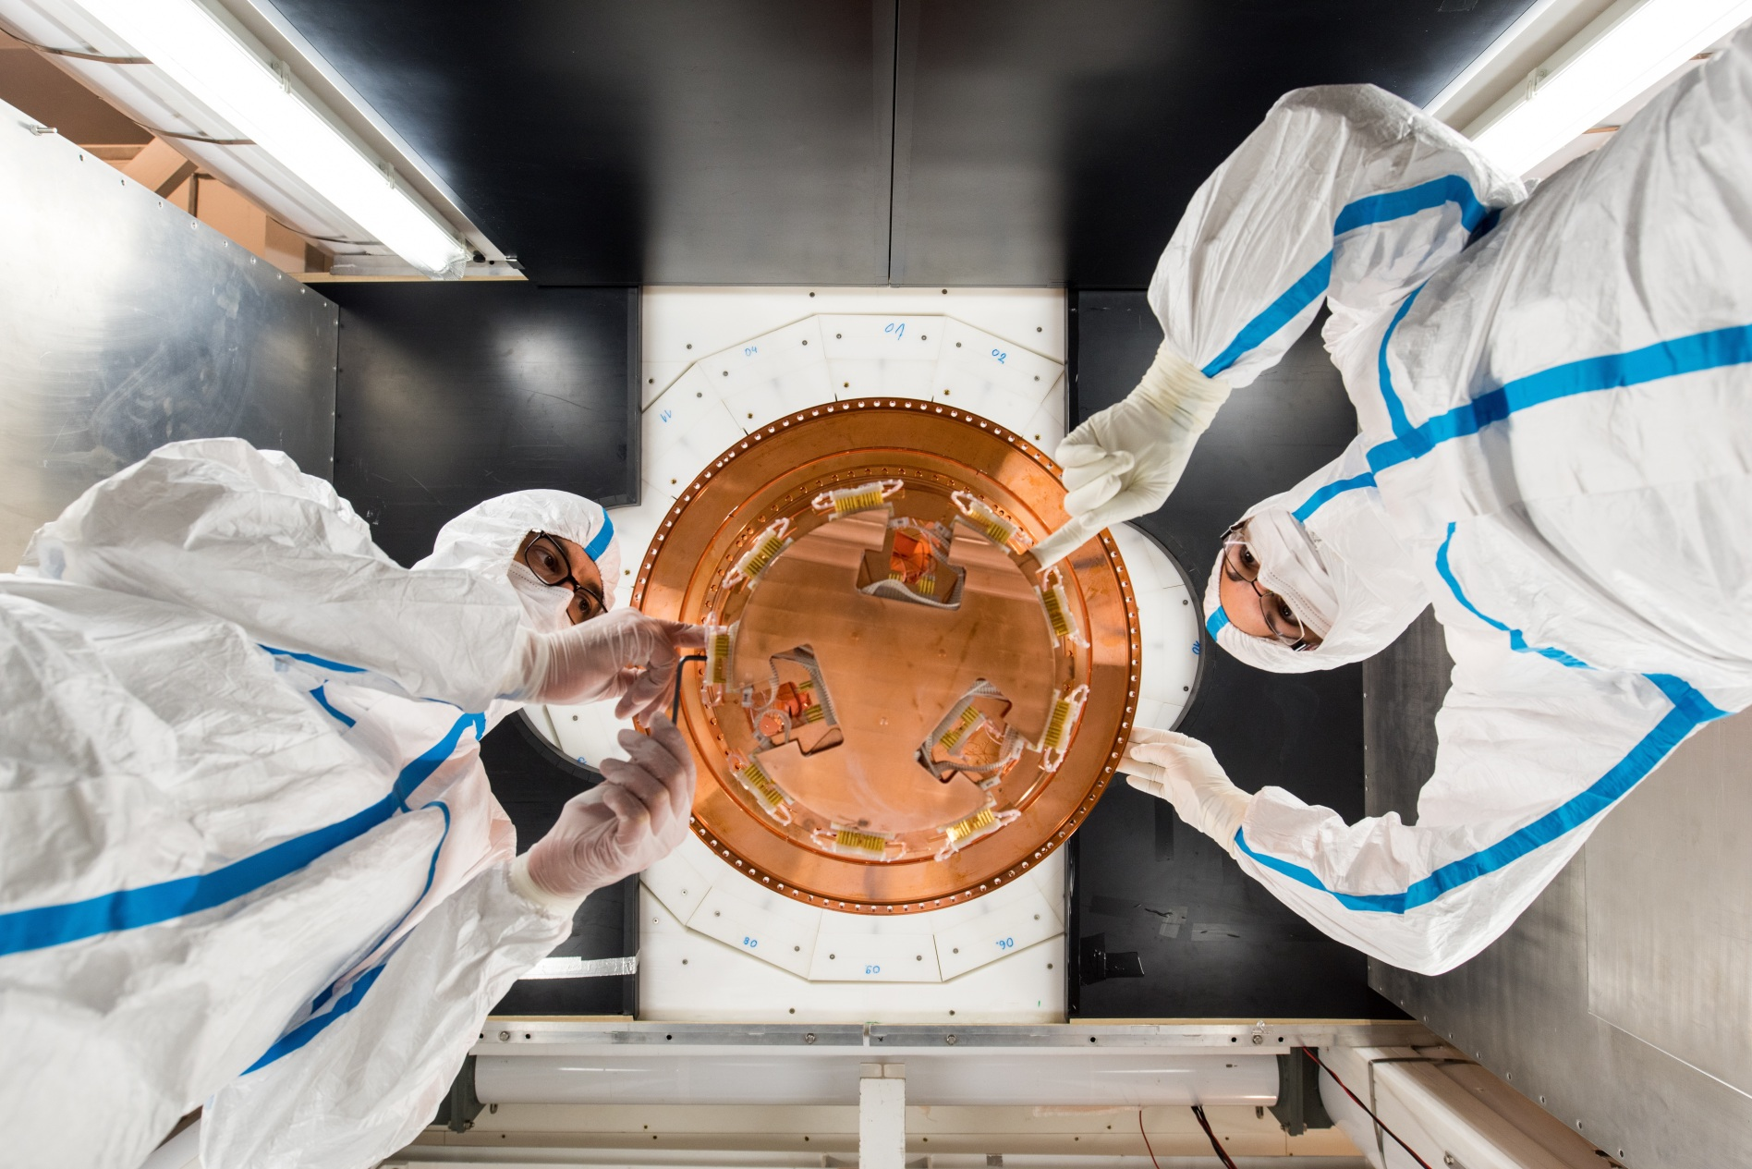

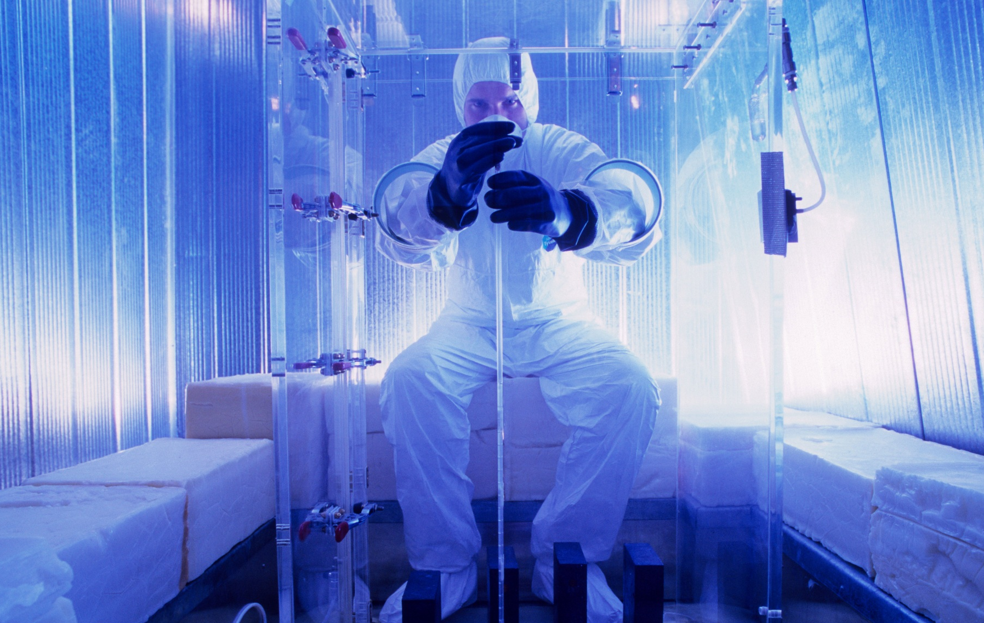

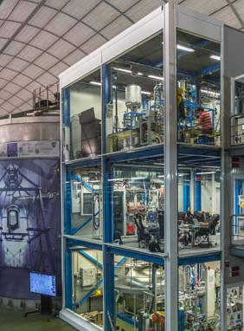

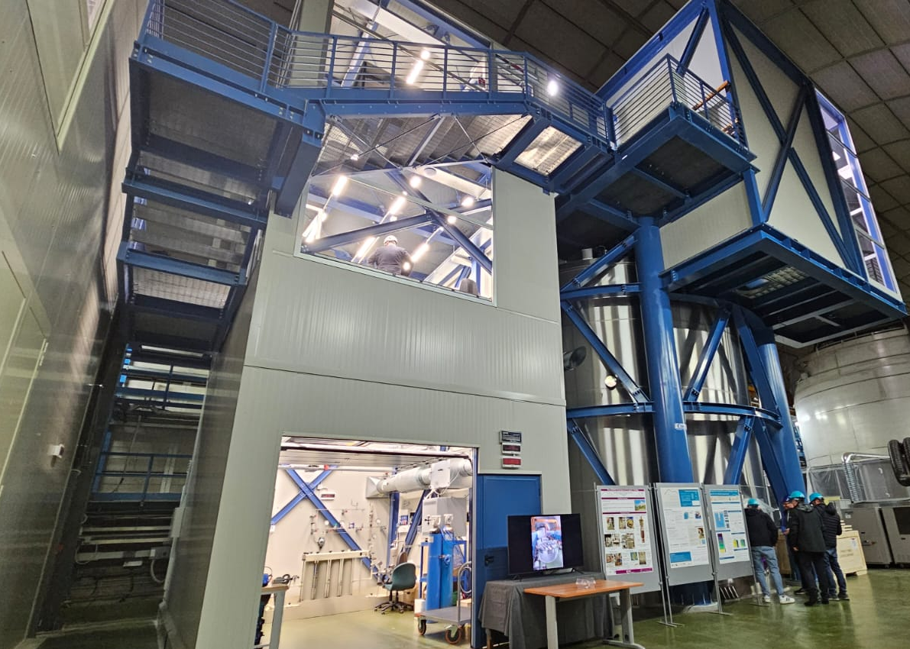



Dark Matter
CRESST
DAMA
DarkSide
XENON
  COSINUS
  R&D: CYGNO, NEWS, SABRE

Slide 16
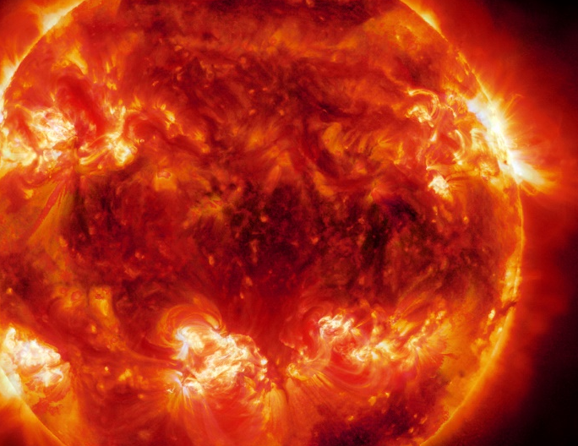
Main research topics: Nuclear Astrophysics
Studying the heart of the stars in underground facilities to answer some fascinating questions
How was star born? How does it evolve? How are produced the elements?

Slide 17
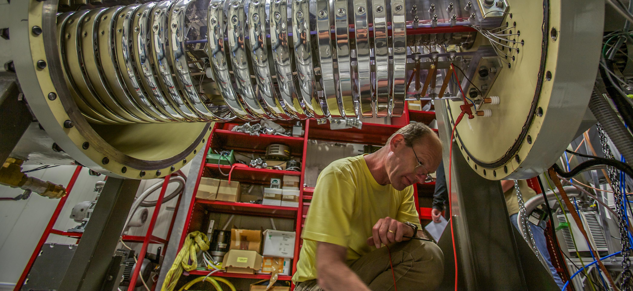

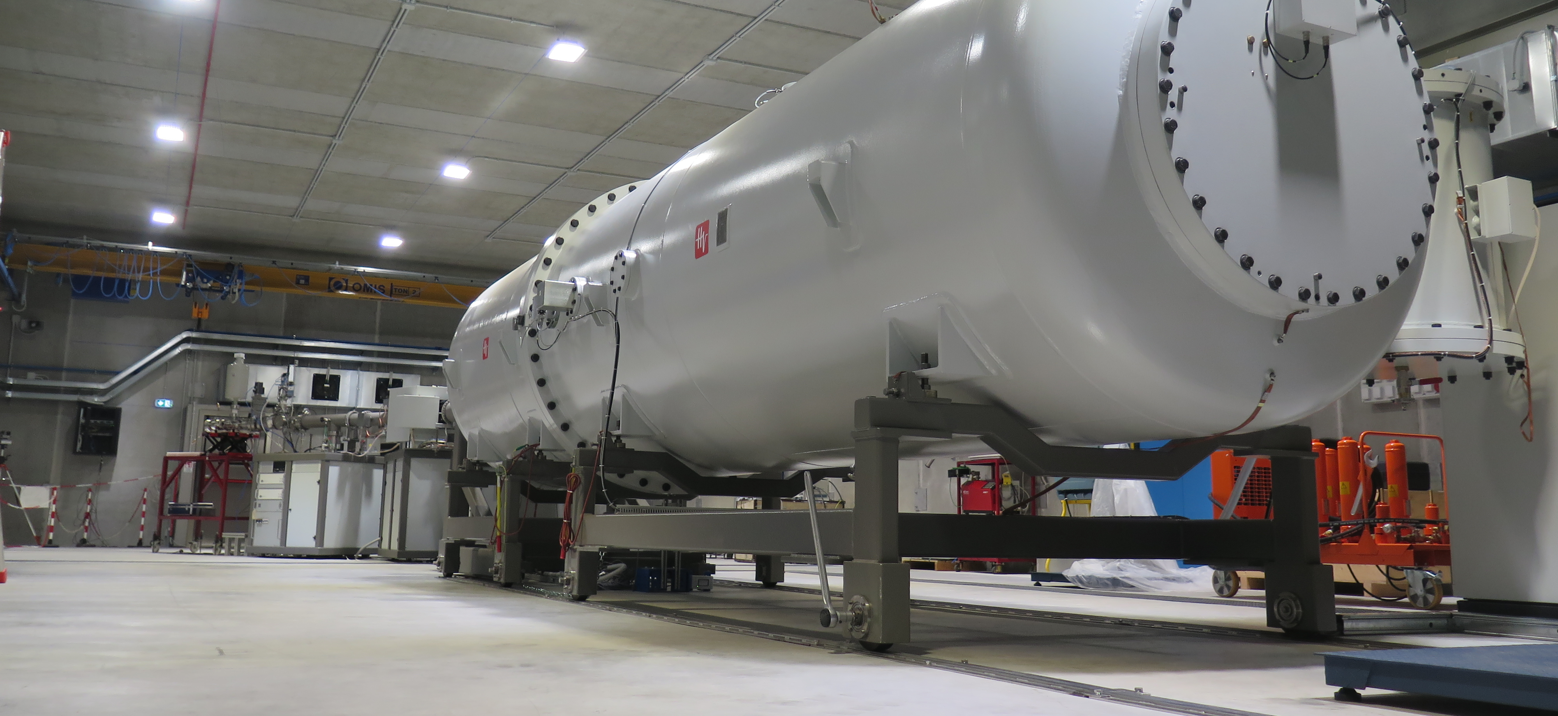

Nuclear Astrophysics
LUNA 400 kV accelerator
3.5 MV Singletron accelerator in the Bellotti Ion Beam Facilty

Slide 18
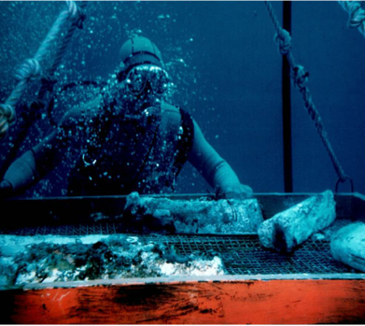
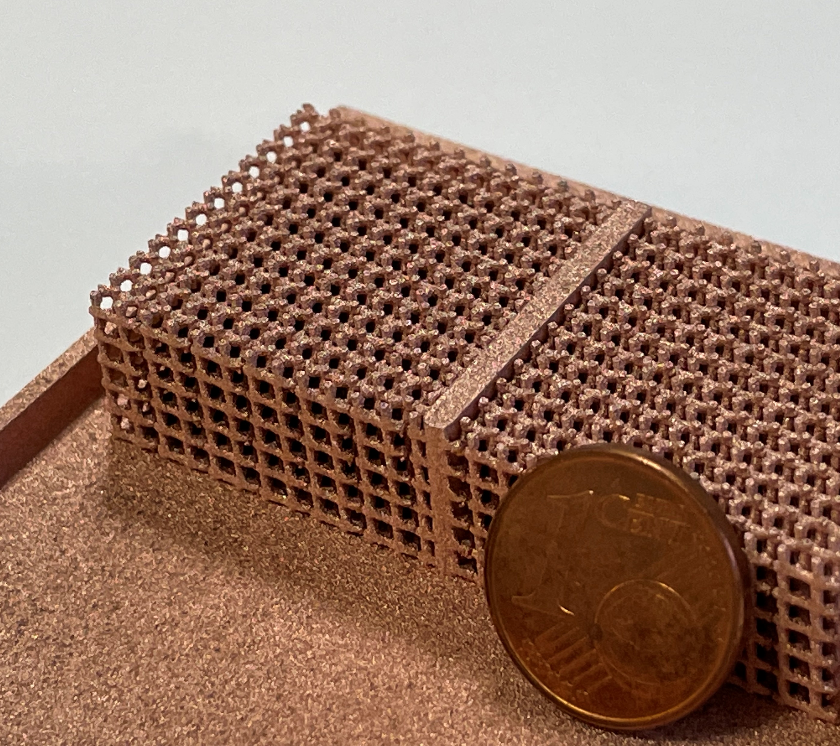
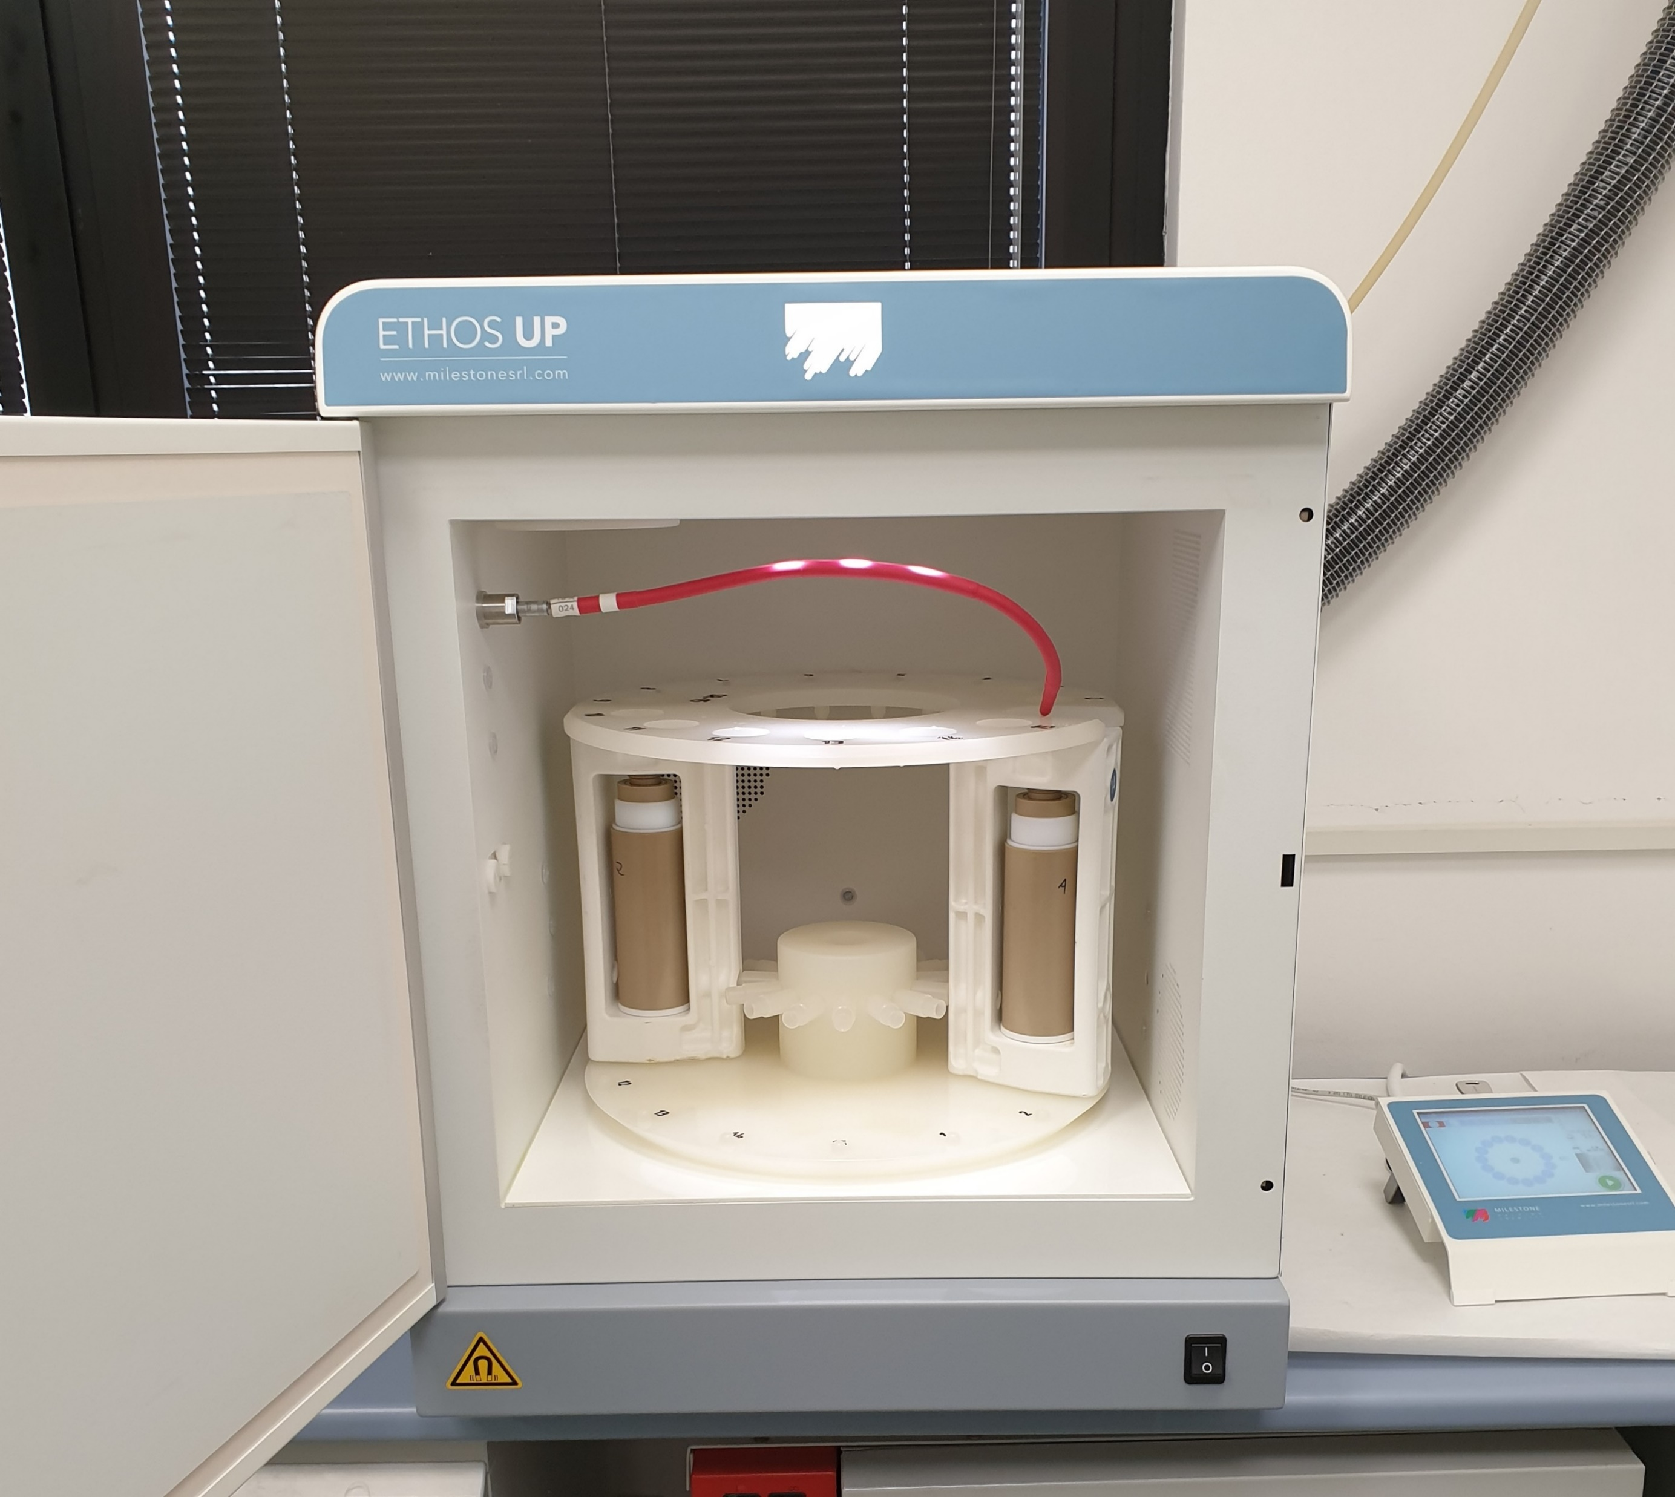
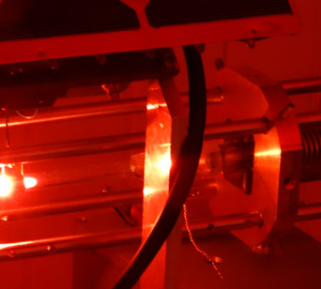
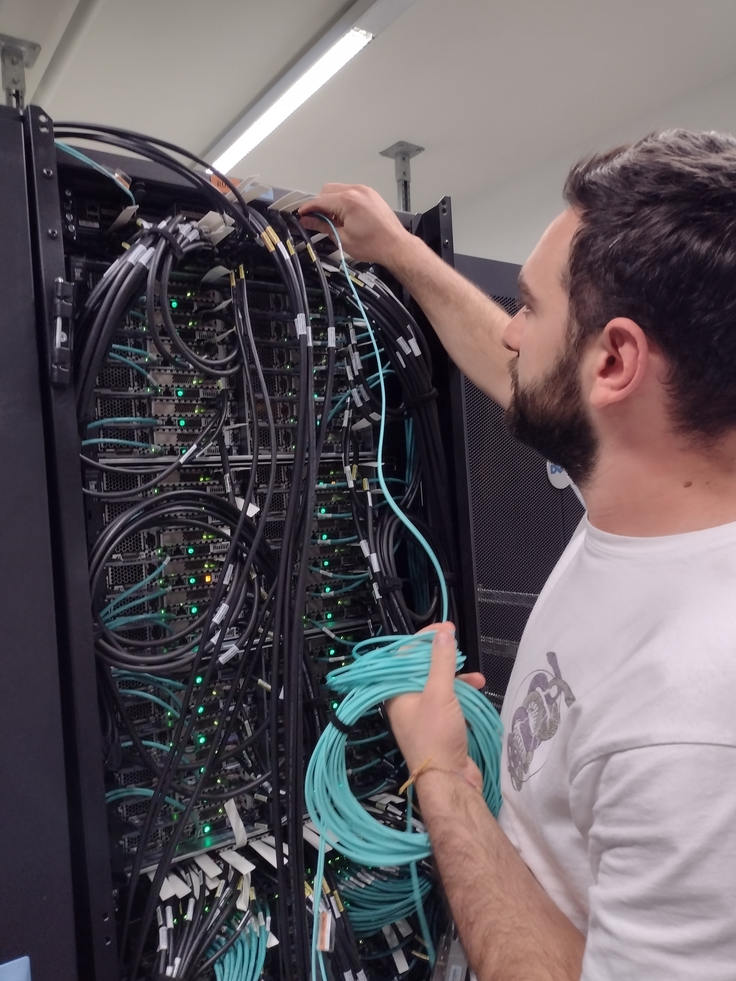

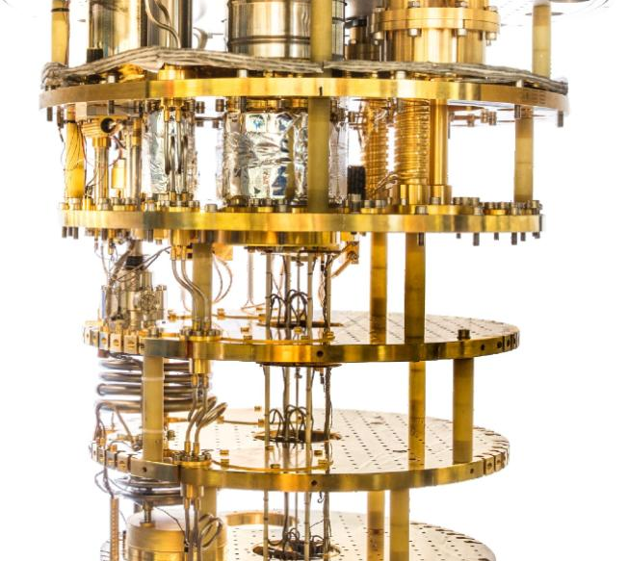



Multidisciplinary and LNGS applications
Cultural Heritage
Additive Manufacturing
Biology
Geophysics
High Performing Computig
Quantum Computing

