Slide 1
PhD students presentations
Retreat at the Gran Sasso Laboratories
17-21 February 2025

Slide 2
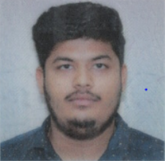
ELECTROTECHNICS AND ACCELERATORS curriculum
Cycle 39°
Gaurav Rajesh Mota - Supervisors: Nicola Pompeo; Enrico Silva
“Surface impedance of superconductors under conditions of interest for fundamental physics: measurements and methods”

Slide 3
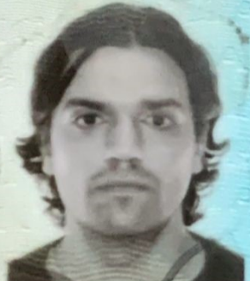
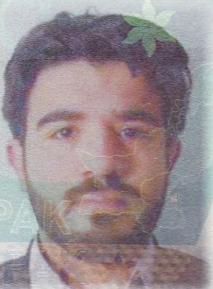
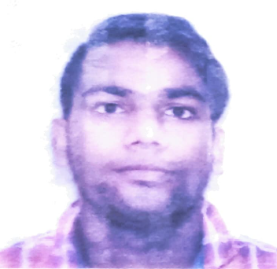
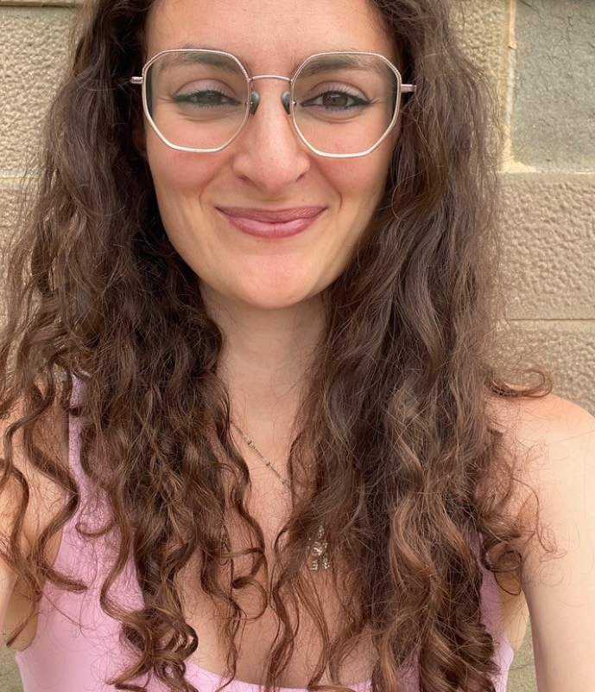
DETECTORS, LASERS AND OPTICS curriculum
Cycle 39°
Salvatore Camposeo - Supervisors: Nicola Giglietto; Leonardo Di Venere
“Studies of reconstruction algorithms for the next generation of MeV-GeV gamma rays satellite missions for the National HPC Center”
Muhammad Ali - Supervisors: Rosamaria Venditti; Salvatore My
“Hadron Calorimeter MPGD-based development for future Muon Collider experiment”
Dhiraj Hiralal Gupta - Supervisors: Andrea Bianco
“Innovative holographic optical elements for modern optical instrumentation”
Maria Bazzicalupo - Supervisors: Lorenzo Busoni; Giulia Carlà
“Technologies for the phasing of segmented pupil optical telescopes”

Slide 4
Tommaso Croci - Supervisors: Arianna Morozzi; Daniele Passeri; Pisana Placidi
“Integrated sensors and read-out electronics technologies development for High Energy Physics experiments”
Michele Verdoglia - Supervisors: Alessandro Cardini; Adriano Lai
“High spatial and temporal resolution pixelated radiation sensors for next generation experiments in fundamental physics”
Gabriel Botogoske - Supervisors: Francesco Di Capua; Ettore Segreto
“Photodetection in cryogenic environment”

Slide 5
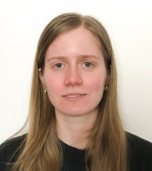
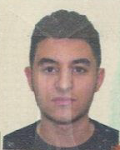
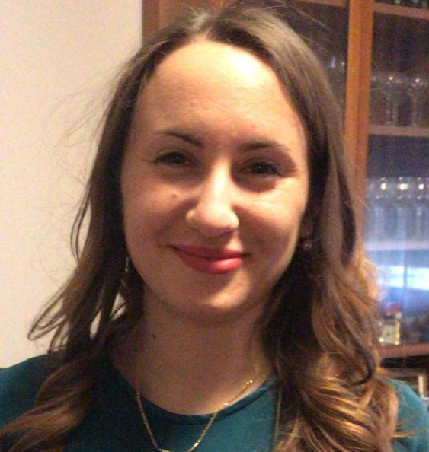
Cycle 40°
Alessandra Zingaretti - Supervisors: Serena Mattiazzo
“Development of CMOS pixel detectors for applications at future colliders”
Mohamed Yahia Bournane - Supervisors: Demetrio Magrin
“Optical Design of MezzoCielo”
Camilla Forza - Supervisors: Gianmaria Collazuol; Alberto Gola
“Study and Characterization of Silicon Photomultipliers with Applications to Large Area Radiation Detectors”
Arbab Imtiaz - Supervisors: Alberto Aloisio; Pierluigi Casolaro
“Characterization of sensors with impedence spectroscopy techniques and noise analysis”

Slide 6
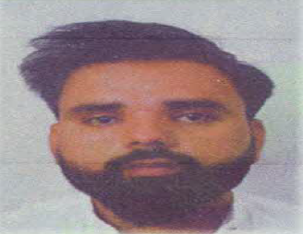
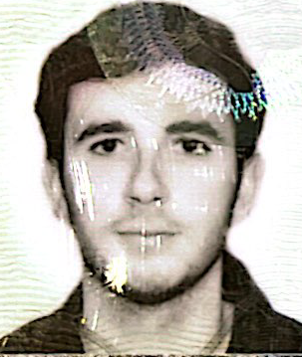
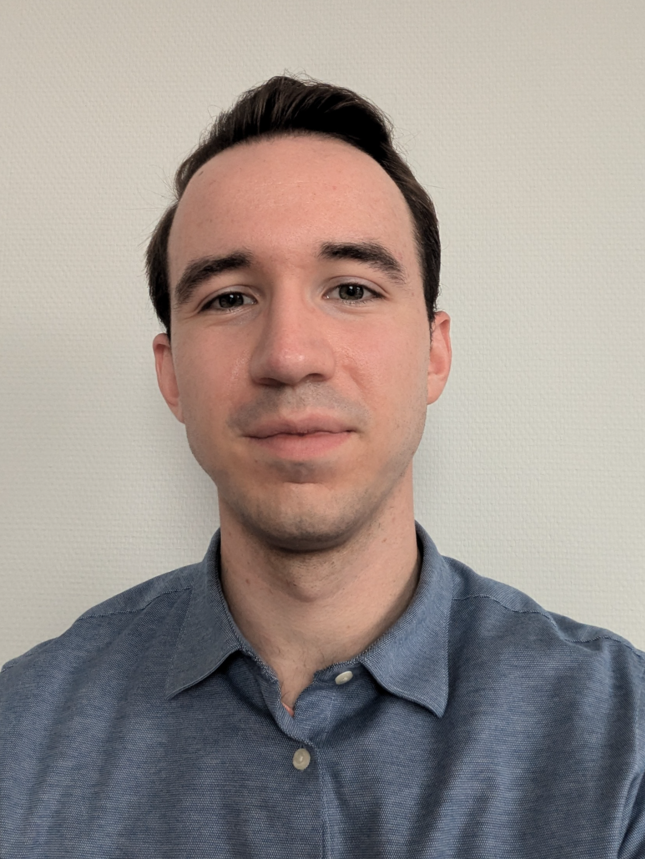
Samiullah Khan - Supervisors: Manuel Rolo; Alberto Tibaldi
“Development and characterisation of CMOS sensors for X-ray imaging in space, medical and industrial applications”
Raja Yasir Mehmood Khan - Supervisors: Lorenzo Pagnanini; Laura Cardani
“Reducing the impacts of natural radioactivity on supernductive quibits with phonon traps”
Felice Nenna - Supervisors: Piet Verwilligen; Federica Simone
“Development of photosensors and readout for the upgrade of the LHCb RICH detector for High Luminosity LHC”
Remon van Gaalen - Supervisors: Maria Bergomi
“Simulations, analysis and procedures definition for alignment, test and calibration of complex Adaptive Optics systems in the framework of the new generation of telescopes”

Slide 7
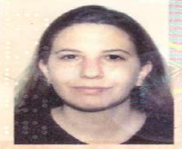
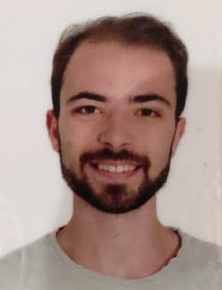
Isabella Sofia - Supervisors: Andrea Chiavassa; Richard White; Federico Di Pierro
“Development and characterization of the Small-Sized Telescope camera for the Cherenkov Telescope Array”
Riccardo Pavarani - Supervisors: Matteo Cadeddu; Francesca Dordei
“Background mitigation techniques and sensitivity studies for cryogenic noble-liquid detectors”
Federico Cittadini - Supervisor: Leonello Servoli
“Development of solid-state detectors for clinical beam dosimetry, both conventional and FLASH modality”

Slide 8
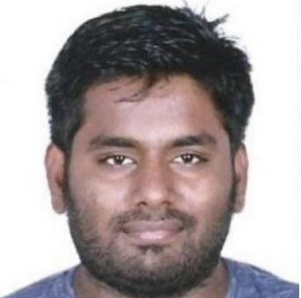
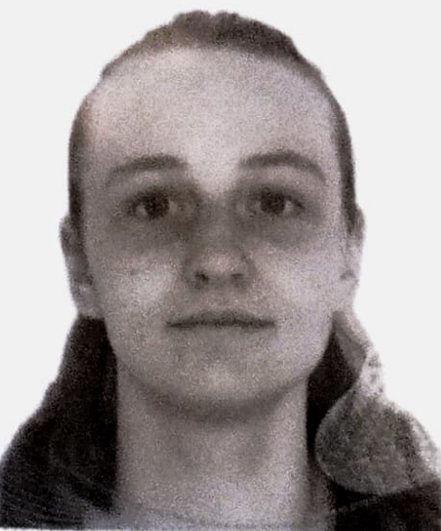
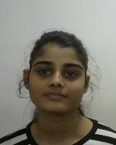
Ajeethkumar Rengarajan - Supervisors: Roberta Sparvoli; Andrea Salamon; Alessandro Gaggero
“Development of superconducting nanowire photon number resolving detectors”
Emma Jane Johnson - Supervisors: Alessandro Cardini; Andrea Contu; Sabyasachi Siddhanta
“Development of innovative interferometer monitoring technologies for Einstein Telescope and the next generation gravitational waves experiments”
Nehete Prajkta - Supervisor: Francesco Quochi
“Optics and thermo-optics of dielectric coatings for gravitational-wave interferometers”

Slide 9
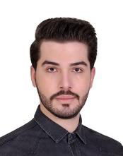
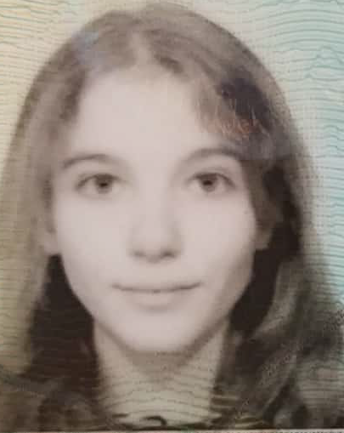
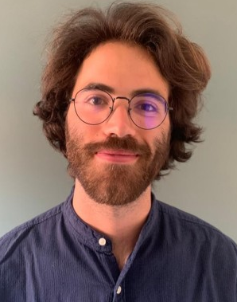
MECHANICS curriculum
Cycle 39°
Mehrdad Faraji - Supervisors: Irene Calliari; Massimiliano Bonesso
“Corrosion of components made by additive manufacturing for extreme applications”
Francesca Valentini - Supervisors: Simone Mancin; Adriano Pepato
“Development and optimization of metal additively manufactured components for the thermal management in the fields of nuclear fusion and fundamental research in Physics and Astrophysics”
Lorenzo Sclafani - Supervisors: Antonio Carcaterra; Silvia Milana
“Mechatronics for fundamental physics experiments”

Slide 10
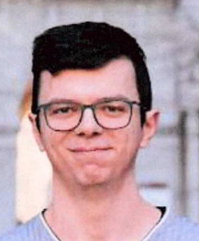
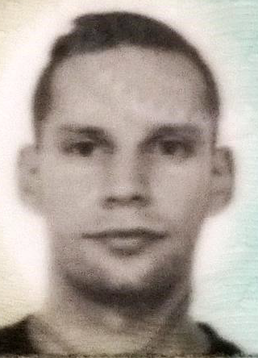
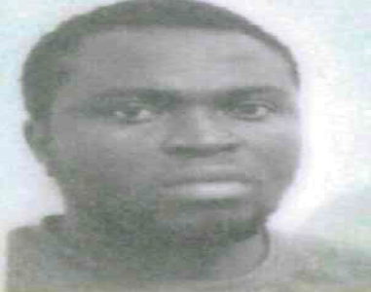
Cycle 40°
Alberto Barci - Supervisors: Massimo Pellizzari; Pietro Rebesan
“Development and Characterization of Innovative Additively Manufactured Metal Alloys for High and Ultra-High Temperature Applications”
Davide Cester - Supervisors: Serena Graziosi; Pietro Rebesan
“Advanced Design for Additive Manufacturing (DfAM) approaches for cutting-edge applications in Physics and Engineering”
Tochukwu Emmanuel Ezeaba - Supervisors: Cristian Pira; Eduard Chyhyrynets; Pietro Rebesan
“Sustainable Surface Finishing of Additively Manufactured Metal Components for High-Precision Applications”

Slide 11
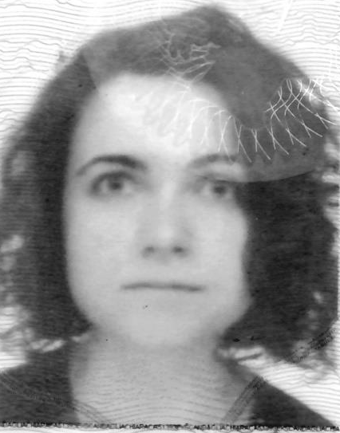
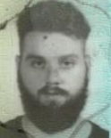
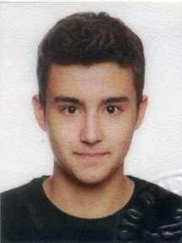
Chiara Scandaglia - Supervisors: Runa Antonio Briguglio Pellegrino; Marco Xompero
“Adaptive optics for next-generation space telescopes”
Moreno Nacca - Supervisors: Luca Esposito; Alcide Bertocco
“Development of mechanical systems for vibration isolation in Gravitational Wave Detectors and other fundamental physics experiments”
Giacomo Voltan - Supervisors: Mattia Manzolaro; Michele Ballan
“Development, design and testing of metallic components for high temperature nuclear physics applications produced by Additive Manufacturing technologies”

Slide 12
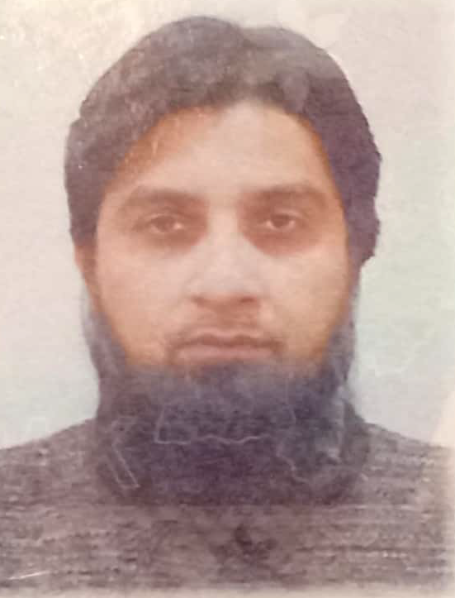
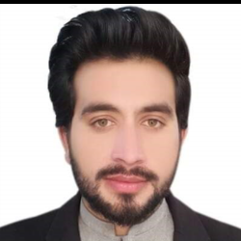
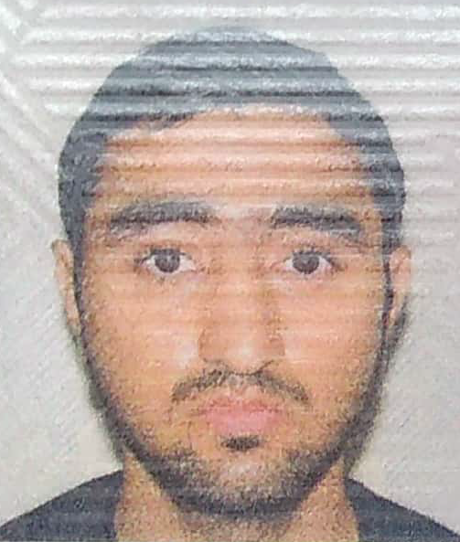
COMPUTING curriculum
Cycle 39°
Muhammad Waqas - Supervisors: Valerio Formato; Valeria Di Felice
“Machine Learning techniques for Big Data analysis in space-borne astroparticle physics experiments”
Saim Ali - Supervisors: Fabio Roberto Vitello; Eva Sciacca
“Analysis of Astrophysical phenomena using efficient and parallelized models on HPC systems”
Neeraj Yadav - Supervisors: Stefano Bagnasco; Sara Vallero; Alessandro Nagar
“Advanced computing systems for Gravitational-wave research”

Slide 13
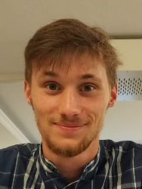
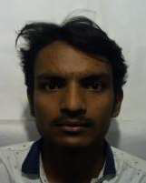
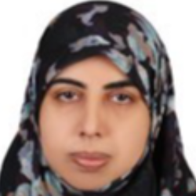
Cycle 40°
Michail Sapkas - Supervisors: Marco Zanetti; Andrea Triossi
“Developing Deep Learning Frameworks in Hardware Devices for Accelerating and Benchmarking Physics Detector Algorithms”
Luca Cortese - Supervisors: Carmelo Arcidiacono
“Application of Artificial Intelligence for PSF Reconstruction in Adaptive Optics”
Ambresh Mahanarayan Mishra - Supervisors: Daniele Gardiol; Dario Barghini
“Development of technologies for observing meteors from the ground and space”
Samina Zuhra - Supervisors: Daniele Martello; Gabriella Cataldi
“Applications of Machine Learning in the Analysis of Photo-Multiplier Waveforms”

Slide 14
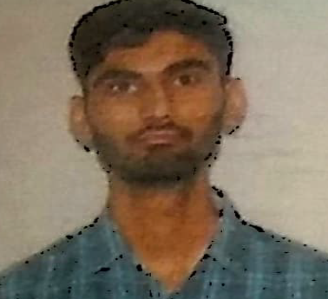
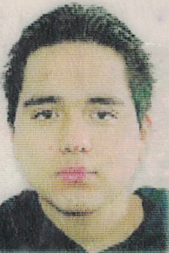
ELECTRONICS curriculum
Cycle 39°
Fatima Bzeih - Supervisors: Paolo Musico; Paolo Gastaldo; Saverio Minutoli
“Design and characterization of a Data Acquisition Board for High Energy Physics Experiment with 1G/10G Copper/Optical Ethernet connection”
Ajay Sharma - Supervisors: Riccardo Campana; Enrico Virgilli
“Definition, development and testing of front-end electronics for high-energy astrophysics detectors”
Ciro Fabian Bermudez Marquez - Supervisors: Flavio Loddo; Francesco Licciulli
“Design of read-out electronics in 28 nm CMOS technology for next generation pixel detectors”

Slide 15
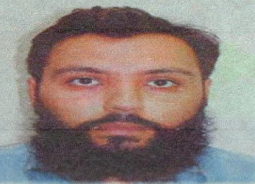
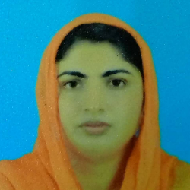
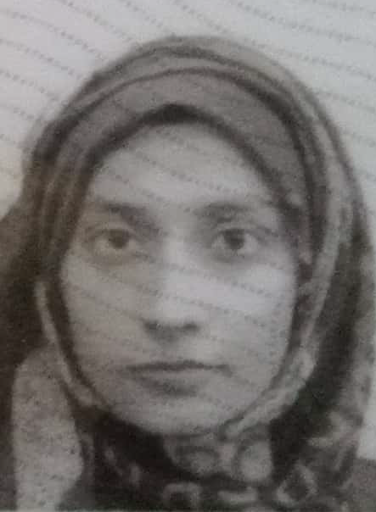
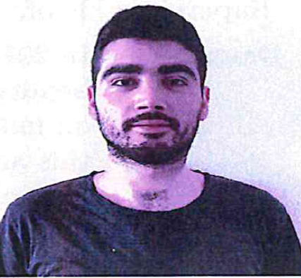
Ammad Ul Islam - Supervisors: Andrea Fabbri; Fabrizio Petrucci
“Image recognition development on FPGA through AI in harsh environment”
Saba Imtiaz - Supervisors: Fabio Muleri; Paolo Soffitta
“Performance study of TimePIX ASICs for 3D track imaging for X-ray Polarimetry in Astrophysics”
Maida Anwar - Supervisors: Federico Perini; Jacopo Nanni
“New Optical and RF Over Fiber Technologies for New Generation Radio Telescopes”
Michele Rignanese - Supervisors: Piero Giubilato; Serena Mattiazzo
“CAP - CMOS Advanced Pixels”

Slide 16
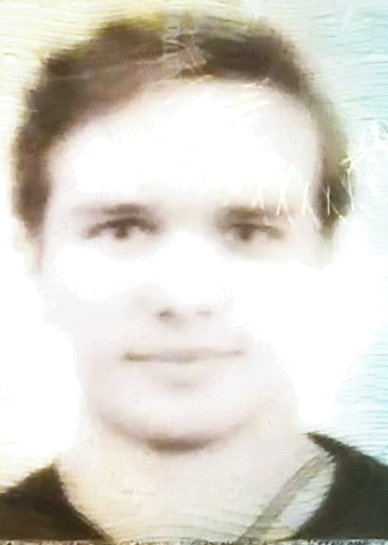
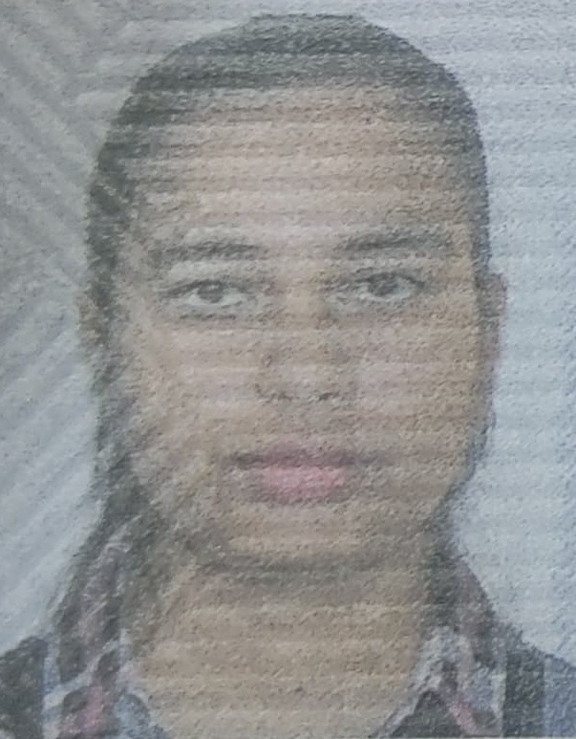
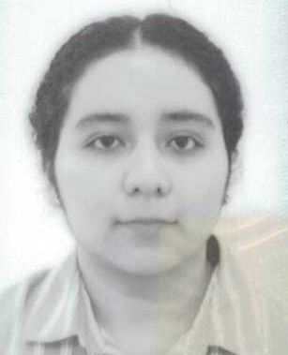
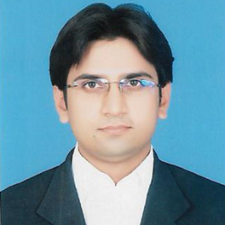
Cycle 40°
Marco Toffano - Supervisors: Marco Bellato; Jean Pierre Zendri
“Development of an ultra low phase noise frequency synthesizer for Gravitational Wave Detectors”
Simran Yadav - Supervisors: Angelo Cotta Ramusino; Nicolo’ Vladi Biesuz
“Development of photosensors and readout for the upgrade of the LHCb RICH detector for High Luminosity LHC”
Julisa Verdejo Palacios - Supervisor: Giuseppe De Robertis
“Development and test of the readout system of advanced particle detectors”
Muhammad Waqas - Supervisor: Andrea Fabbri
“Advanced acquisition system for hadrontherapy”

