Slide 1
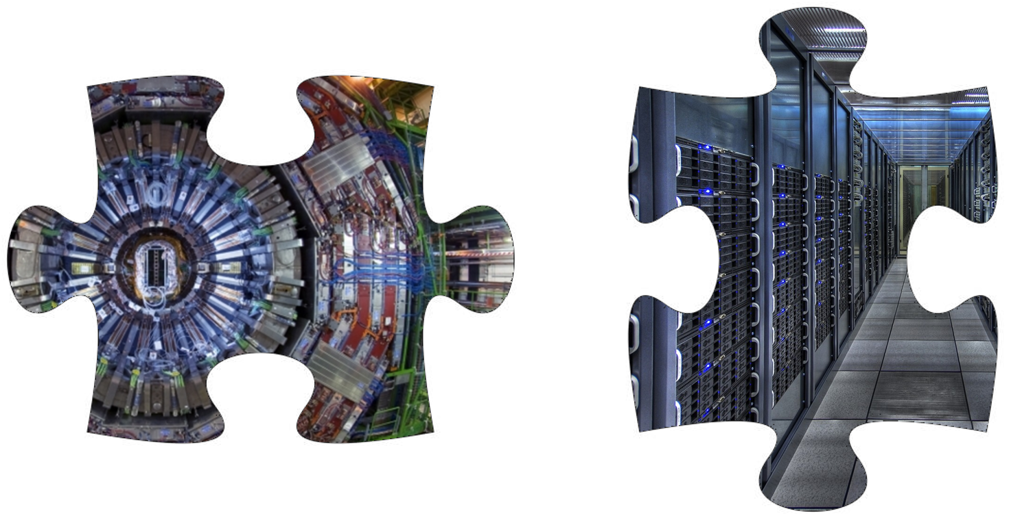
AI - Assisted Co-design for Fundamental Science
Riunione Gruppo 1 – INFN Padova 25/10/2024
Tommaso Dorigo
First researcher @ INFN, Sezione di Padova
Guest Professor @ Luleå Techniska Universitet
President @ Universal Scientific Education and Research Network
Coordinator @ MODE Collaboration

Slide 2
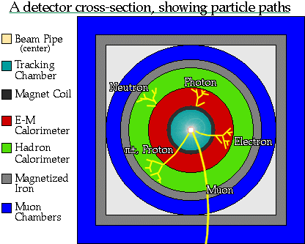
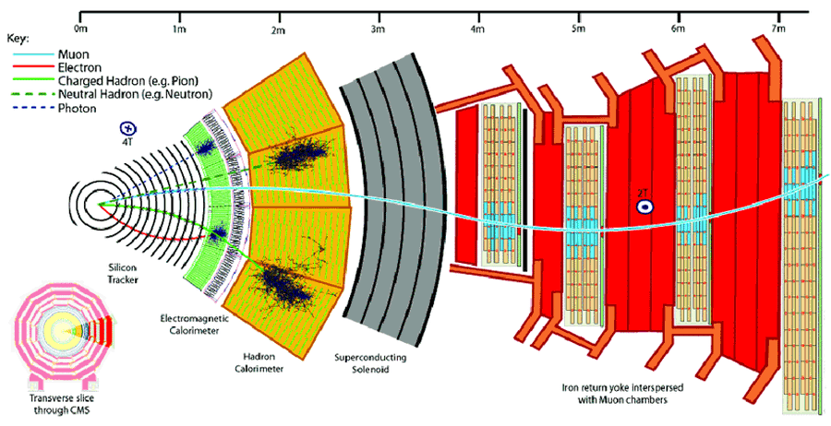
We Are Successful Detector Builders…
1989
In the past 60+ years our community established robust design paradigms, while pushing technologies to their bleeding edge
Some of those deeply ingrained paradigms are not necessarily as motivated today as they once were
- track first, destroy later (dichotomic!)
- redundancy (the opposite of optimality!)
- symmetric layouts (but the relevant physics is not!)
The design space of the biggest projects has grown to transcend our understanding – we cannot think in 10⁵ dimensions
Our demands (luminosity, resolution) are also on the rise, as is the size of the viable technological solutions space (e.g. 3D printing)
2010
2050?
?

Slide 3
We Are Successful Detector Builders…
1989
In the past 60+ years our community established robust design paradigms, while pushing technologies to their bleeding edge
Some of those deeply ingrained paradigms are not necessarily as motivated today as they once were
- track first, destroy later
- redundancy
- symmetric layouts
The design space of the biggest projects has grown to transcend our understanding – we cannot think in 10⁴ dimensions
Our demands (luminosity, resolution) are also on the rise, as is the size of the viable technological solutions space (e.g. 3D printing)
2010
2050?
DO’H!
Who’re you gonna call?

Slide 4
Research Directions in Fundamental Science
Explore higher energy / higher intensity frontier, ensuring we do not miss new physics
Explore the universe with multiple messengers, seeking answers to cosmology riddles
Study matter at extreme densities
Understand neutrinos
Formulate new theories of Nature
Improve calculational tools and prediction power of our theories
Extract sufficient statistics from high-D data
Ensure complete control of uncertainties and type-1 error rates
The above are mostly data analysis tasks. The next customer in line is detector design
In market-driven human activities, co-design of hardware and software is already happening.
Our challenge is to start to do it systematically. If we do not do it, we miss an opportunity, and risk a strong misalignment
Nowadays we are doing all of this and more with deep learning!

Slide 5
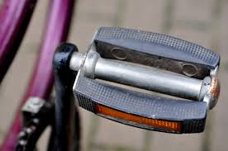
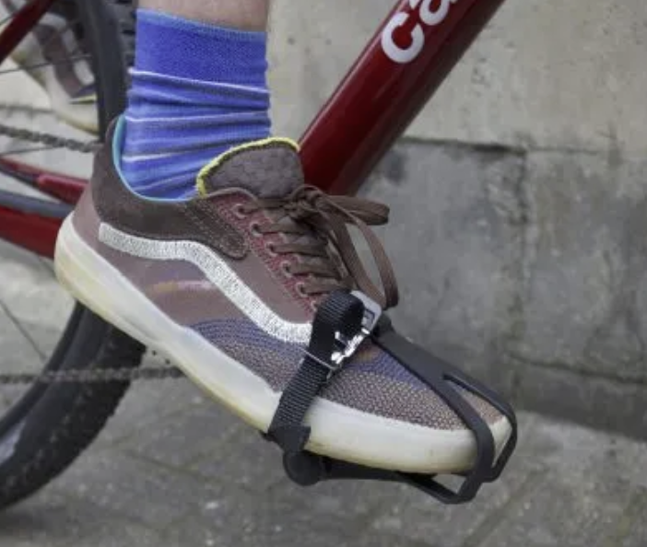
What is Co-Design, Really?
Realizing that the achievement of a goal may require to tailor each part of a system to all others: synergy
Enabling the simultaneous optimization of all parts, to maximize a global utility in a high-dimensional design space: holistic optimization
Bringing together diverse components, technologies, or expertise to create a unified and cohesive system, ensuring seamless interoperability and coordination: integration

Slide 6
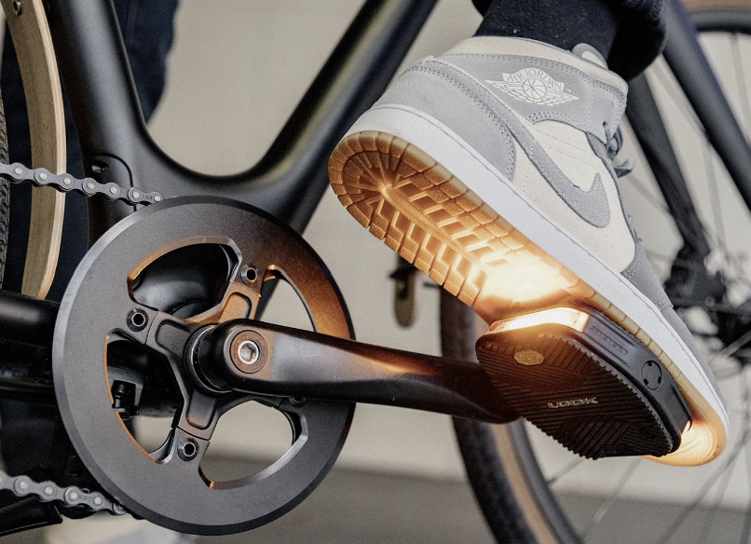
What is Co-Design, Really?
Realizing that the achievement of a goal may require to tailor each part of a system to all others: synergy
Enabling the simultaneous optimization of all parts, to maximize a global utility in a high-dimensional design space: holistic optimization
Bringing together diverse components, technologies, or expertise to create a unified and cohesive system, ensuring seamless interoperability and coordination: integration

Slide 7
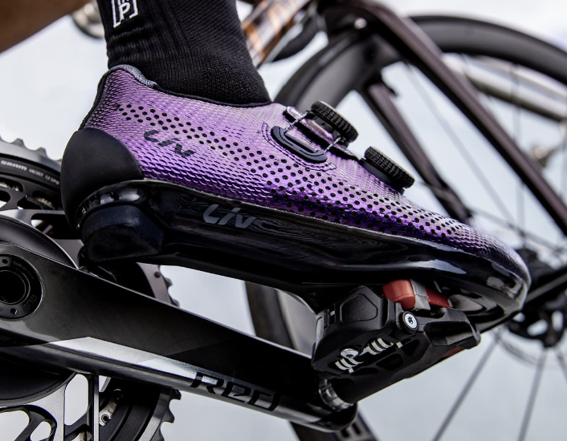
What is Co-Design, Really?
Realizing that the achievement of a goal may require to tailor each part of a system to all others: synergy
Enabling the simultaneous optimization of all parts, to maximize a global utility in a high-dimensional design space: holistic optimization
Bringing together diverse components, technologies, or expertise to create a unified and cohesive system, ensuring seamless interoperability and coordination: integration

Slide 8
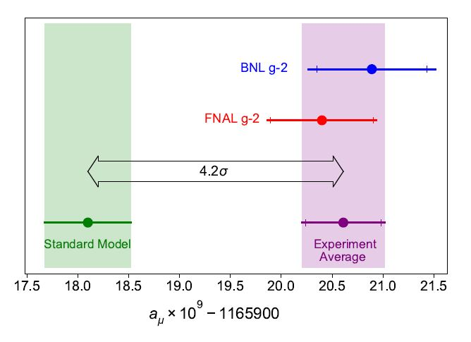
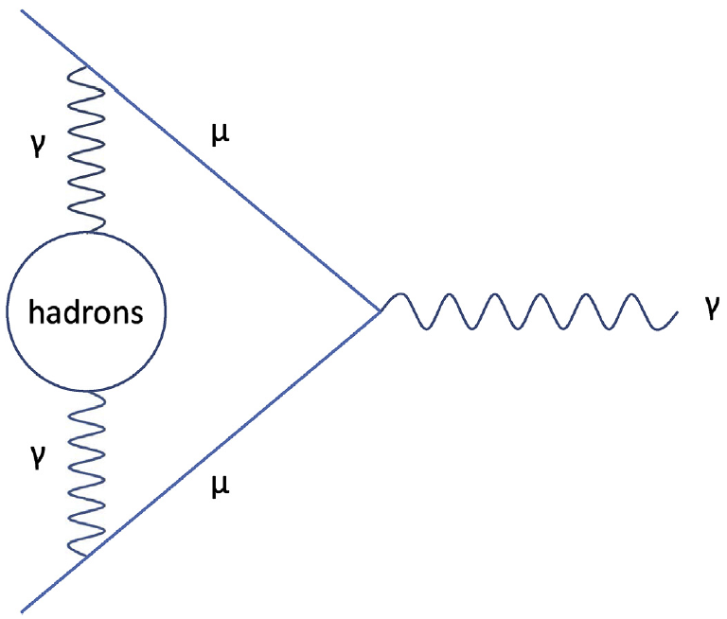
One Example of Geometry Optimization: MUonE
MUonE aims to determine with high precision the probability of elastic muon-electron scattering, as this number may reduce the theory systematics of the g-2 muon anomaly
The experiment must be sensitive to the rate of interactions as a function of momentum transfer, with 10⁻⁴ precision
Above: a long-standing anomaly in the Standard Model, the muon g-2 value
Below: a muon-photon interaction,
with a hadronic quantum loop
Beam
Above: layout of one of 40 1m-long MUonE stations, as per original design proposal

Slide 9
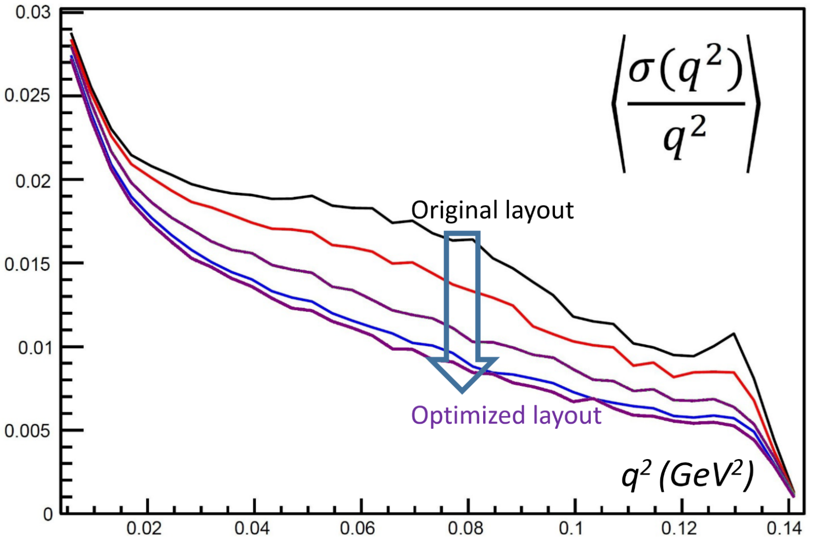
MUonE Optimization
Relevant figure of merit: relative resolution on momentum transfer q²
The original design of the MUonE stations was good, but it failed to exploit the constraining potential of the 3-particle vertex and the strong dependence on geometry of q² resolution (the relevant metric)
A factor of two (!) gain was achieved by discrete optimization scans
Region sensitive to hadronic loop
contributions
Above: relative resolution in event q² for different configurations (the higher, black line is the original proposal by the MUonE coll.)
T. Dorigo, Geometry Optimization of a Muon-Electron Scattering Experiment,
Physics Open 4 (2020) 100022.

Slide 10
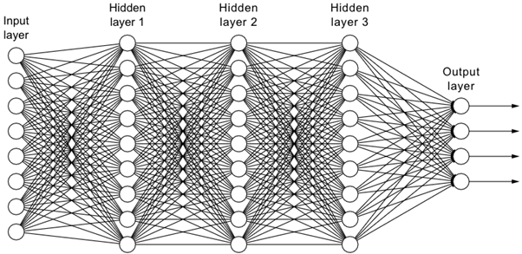
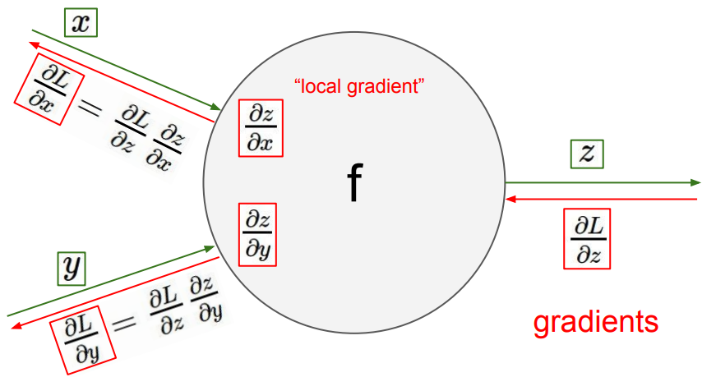
How to Scale?
The MUonE optimization was «easy», because there are 3 particles involved and only few Be and Si layers... O(20) free parameters → Discrete optimization scans were sufficient there.
How to scale to more complex cases?
Use deep learning technologies:
back-propagate the gradient of the utility function to design parameters, update them to improve the utility
Above: a fully connected Neural Network
Below: an optimization can be achieved by “backpropagation”, i.e. exploiting the chain rule of differential calculus, modifying parameters following the gradient of the loss function
Above: relative resolution in event q² for different configurations (the higher, black line is the original proposal by the MUonE coll.)

Slide 11
Scale of Optimization Problems in Physics and Elsewhere
Task | Number of parameters | Year | Status
Typical LHC new physics search | 20-50 | 2012- | OK
MUonE detector station geometry | 20 | 2019-2020 | OK
SWGO Cherenkov tanks layout | O(100) | 2023-2024 | In progress
FDFLC (a future detector for a future large collider) | O(100,000) | ? | Not presently contemplated
AlexNet (for ImageNet challenge) | 62,300,000 | 2012 | OK
kNN for muon energy regression in granular calo | 66,000,000 | 2022 | OK
ChatGPT 3.5 | 150,000,000,000 | 2023 | OK
ChatGPT 4.0 | 1,700,000,000,000 | 2023 | OK

Slide 12
Scale of Optimization Problems in Physics and Elsewhere
Task | Number of parameters | Year | Status
Typical LHC new physics search | 20-50 | 2012- | OK
MUonE detector station geometry | 20 | 2019-2020 | OK
SWGO Cherenkov tanks layout | O(100) | 2023-2024 | In progress
FDFLC (a future detector for a future large collider) | O(10,000) | ? | Not presently contemplated
AlexNet (for ImageNet challenge) | 62,300,000 | 2012 | OK
kNN for muon energy regression in granular calo | 66,000,000 | 2022 | OK
ChatGPT 3.5 | 150,000,000,000 | 2023 | OK
ChatGPT 4.0 | 1,700,000,000,000 | 2023 | OK

Slide 13
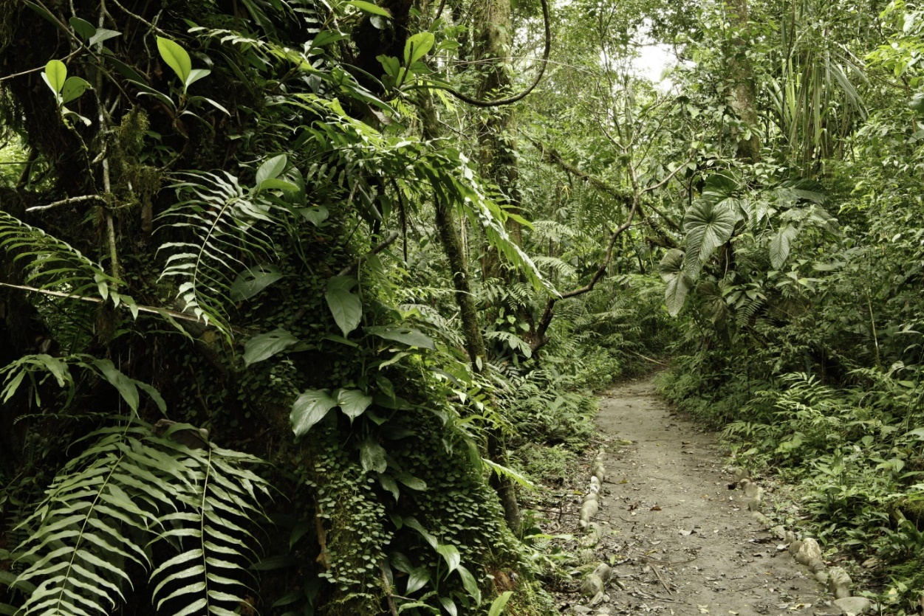
A Walk in the Jungle…
- We need new competences
The detector experts community is largely not enthused by AI
Some parts of the design decisions cannot, and will never, be automated
→ Engage computer scientists in our problems
→ Start easy, prove new technology by targeting low-hanging fruits
→ Pursue “human in the middle” approach

Slide 14
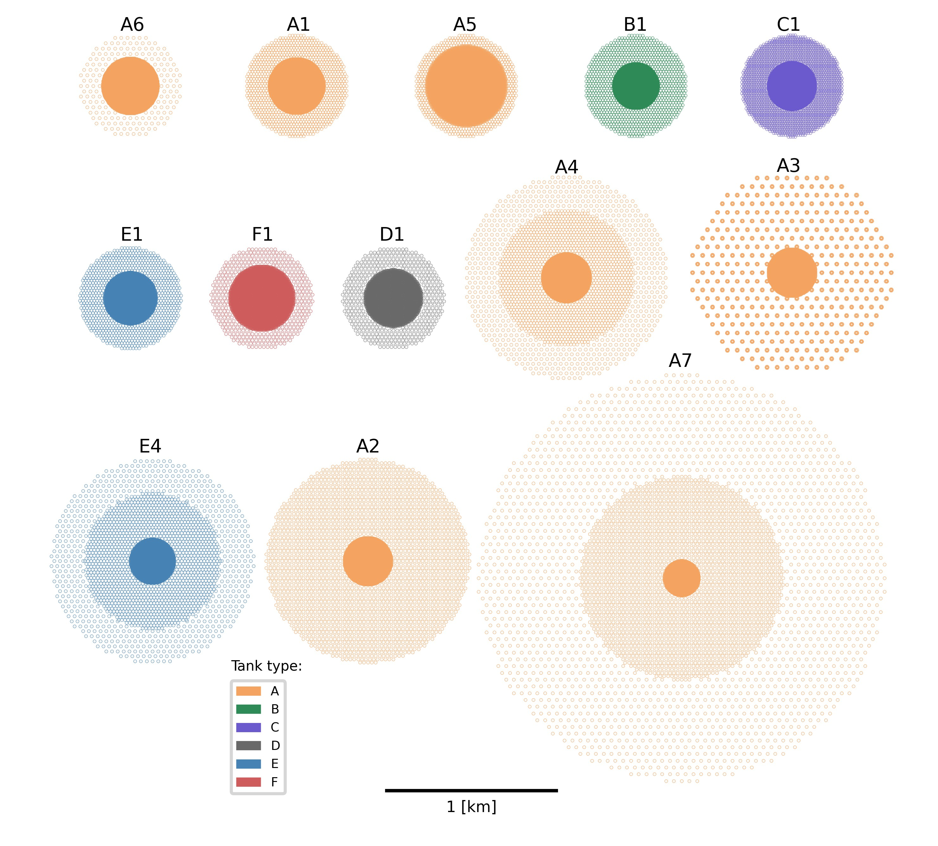
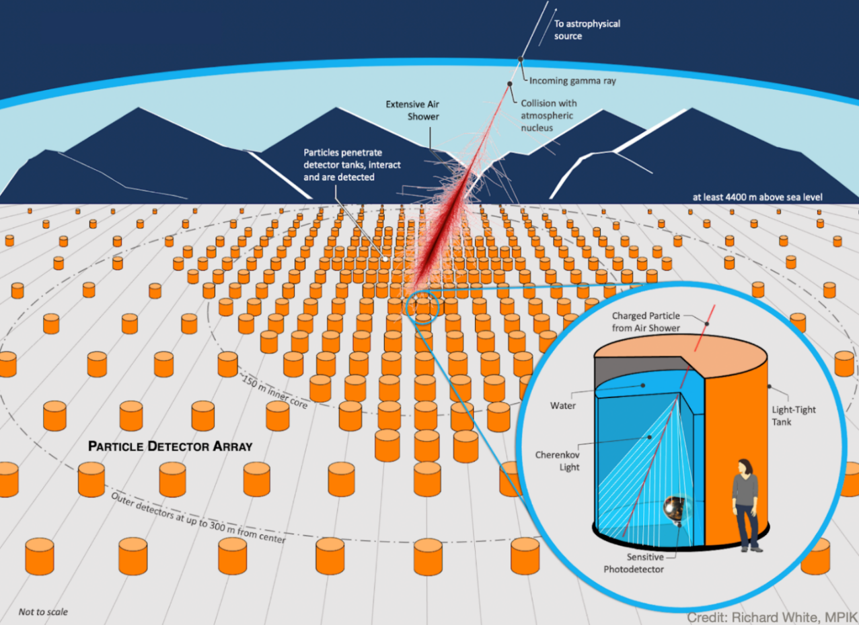
One Medium-Scale Example: SWGO Layout Optimization
Below: the Southern Wide-field Gamma Observatory will
Observe high-energy gamma rays with an array of water
Cherenkov tanks at high altitude in South America
Above: 13 possible layouts of O(6000) detector
tanks considered by the SWGO collaboration

Slide 15
A Fully Differentiable Pipeline
In a nutshell, you:
evaluate a design,
change it in the direction suggested by the gradient of the utility,
repeat.
In case you wondered: no, you cannot do it with Geant4.

Slide 16
Example Optimization Run
T. Dorigo et al., End-to-end optimization of the layout
of a Gamma-Ray Observatory, arXiv:2310.01857
Total utility vs epoch XY positions of tanks Radial distr. of tanks Utility components Log(pointing resolution)
Red: initial, blue:current Red: initial, blue: current
Rel. E resol. vs E Log(pointing res.) vs E Log(E) of showers Azimuthal distribution
Red: initial, blue: current Red:initial, blue: current

Slide 17
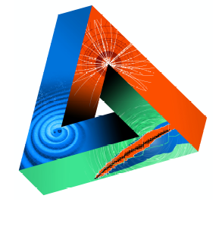
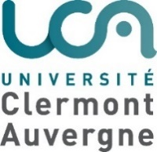
Machine-Learning Optimized Design of Experiments
MODE Collaboration
https://mode-collaboration.github.io
M. Aehle¹⁷, A. G. Baydin⁵, A. Belias¹⁰, A. Boldyrev⁴, K. Cranmer⁸, P. de Castro Manzano¹, Z. Daher², C. Delaere², D. Derkach⁴, J. Donini^{3,26}, T. Dorigo^{1,14,21,26}, P. Elmer¹⁸, F. Fanzago¹, S. Gami²⁷, N.R. Gauger¹⁷, A. Giammanco^{2,26}, C. Glaser¹¹, L. Heinrich¹², R. Keidel¹⁷, J. Kieseler²², C. Krause²⁸, L. Kusch¹⁷, M. Lagrange², M. Lamparth¹², A. Lee²⁵, M. Liwicki²¹, G. Louppe⁶, L. Layer¹, L. Masserano²⁵, F. Nardi^{3,14}, P. Martinez Ruiz del Arbol⁹, F. Ratnikov⁴, R. Roussel²⁰, T. Samui²⁴, F. Sandin²¹, P. Stowell¹⁵, G. Strong¹, M. Tosi^{1,14}, A. Ustyuzhanin⁴, S. Vallecorsa⁷, X.C. Vidal²³, P. Vischia^{13,26}, G. Watts¹⁹, H. Zaraket¹⁶
Sponsored by
1 INFN, Italy
2 Université Catholique de Louvain, Belgium
3 Université Clermont Auvergne, France
4 Laboratory for big data analysis of the HSE, Russia
5 University of Oxford, UK
6 Université de Liege, Belgium
7 CERN, Switzerland
8 New York University, USA
9 IFCA, Spain
10 GSI, Germany
11 Uppsala Universitet, Sweden
12 TU Munchen, Germany
13 Universidad de Oviedo and ICTEA, Spain
14 Università di Padova, Italy
15 Durham University, UK
16 Lebanese University, Lebanon
17 Kaiserslautern-Landau University, Germany
18 Princeton University, USA
19 University of Washington, USA
20 SLAC, USA
21 Lulea University of Technology, Sweden
22 Karlsruhe Institute of Technology, Germany
23 Universidad de Santiago de Compostela, Spain
24 IISER Kolkata, India
25 Carnegie-Mellon University, USA
26 Universal Scientific Education and Research Network
27 NISER, India
28 HEPHY OeAW, Austria
JENAS

Slide 18
A Community is Growing
Some warm signals are coming from different sources:
ECFA, APPEC, NUPECC → JENAA expression of interest for MODE
EUCAIF conference (Amsterdam, Apr 30-May 3 2024, 300 participants) also supported by JENAA → WG2 (chairs Dorigo, Vischia) focuses on co-design with AI
In the US, IRIS-HEP has been sponsoring MODE research in the past 4 years
DRD6 includes MODE co-design ideas in its WP

Slide 19
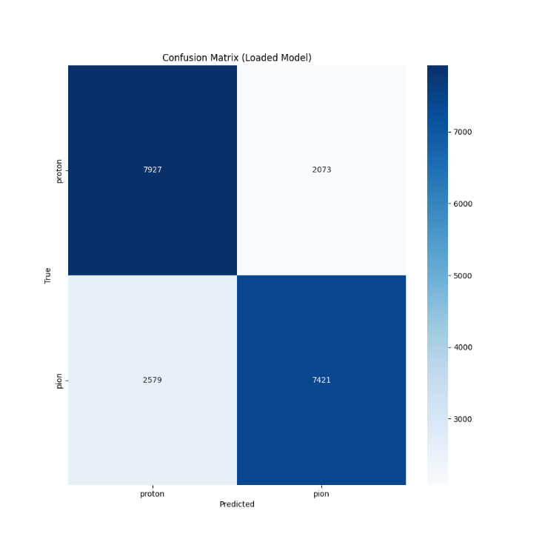
Recent work: Exploring the limits of Calorimetry
In connection with DRD6 activities, we are exploring the boundary of information extraction from granular calorimeters
1) Can we do particle ID in a highly-granular calorimeter?
- What is the largest cell size that retains that information?
2) Can we overcome granularity by having a neuromorphic readout and local processing using nanophotonics?
3) Can we hybridize a tracker and a calorimeter, learning the optimal layout with a diffusion model?
Work by A. de Vita, TD, E. Lupi, X.T. Nguyen, and others, in coll. with LTU, KIT, RPTU

Slide 20
Recent work: Exploring the limits of Calorimetry
In connection with DRD6 activities, we are exploring the boundary of information extraction from granular calorimeters
1) Can we do particle ID in a highly-granular calorimeter?
- What is the largest cell size that retains that information?
2) Can we overcome granularity by having a neuromorphic readout and local processing using nanophotonics?
3) Can we hybridize a tracker and a calorimeter, learning the optimal layout with a diffusion model?
Work by A. de Vita, TD, E. Lupi, X.T. Nguyen, and others, in coll. with LTU, KIT, RPTU
Q
p/π
(1)
K/π
p/K
(2)
Δx
Δx_{crit}

Slide 21
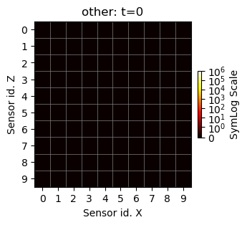
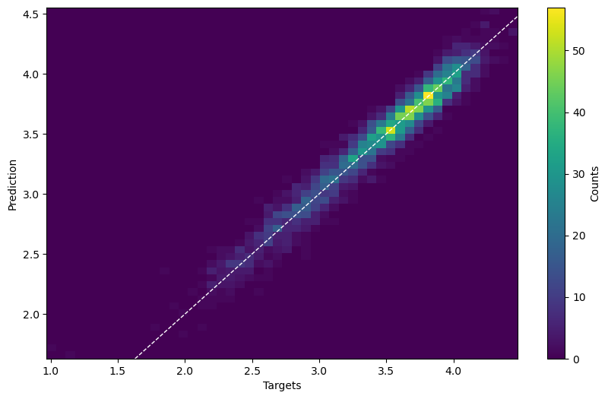
Recent work: Exploring the limits of Calorimetry
In connection with DRD6 activities, we are exploring the boundary of information extraction from granular calorimeters
1) Can we do particle ID in a highly-granular calorimeter?
- What is the largest cell size that retains that information?
2) Can we overcome granularity by having a neuromorphic readout and local processing using nanophotonics?
3) Can we hybridize a tracker and a calorimeter, learning the optimal layout with a diffusion model?
Work by A. de Vita, TD, E. Lupi, X.T. Nguyen, and others, in coll. with LTU, KIT, RPTU

Slide 22
Recent work: Exploring the limits of Calorimetry
In connection with DRD6 activities, we are exploring the boundary of information extraction from granular calorimeters
1) Can we do particle ID in a highly-granular calorimeter?
- What is the largest cell size that retains that information?
2) Can we overcome granularity by having a neuromorphic readout and local processing using nanophotonics?
3) Can we hybridize a tracker and a calorimeter, learning the optimal layout with a diffusion model?
Work by A. de Vita, TD, E. Lupi, X.T. Nguyen, and others, in coll. with LTU, KIT, RPTU

Slide 23
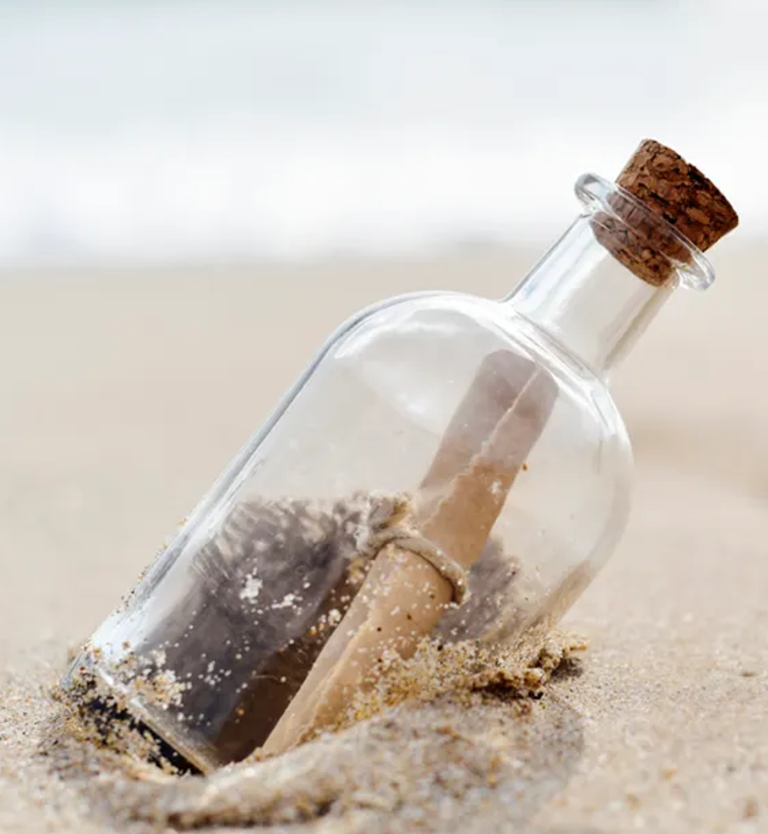
In Summary: A Message to ESPP
An AI revolution is impending on us. It will change everything.
The community should invest resources at all levels to
Foster co-design studies
Facilitate collaboration with computer scientists
Push toward development of trustable differentiable Monte Carlos
Integrate AI in workflows of design strategies
Consider what information-extraction capabilities will be there in 20 years, and adapt detector design to them
INFN should support these activities, and push toward the incorporation of this new transforming technology in the design activities for new experiments
It does not happen overnight – a strategic decision must be taken if we want to
keep INFN at the forefront of detector R&D in the coming decades

Slide 24
Thank you for your time!

Slide 25
Backup

Slide 26
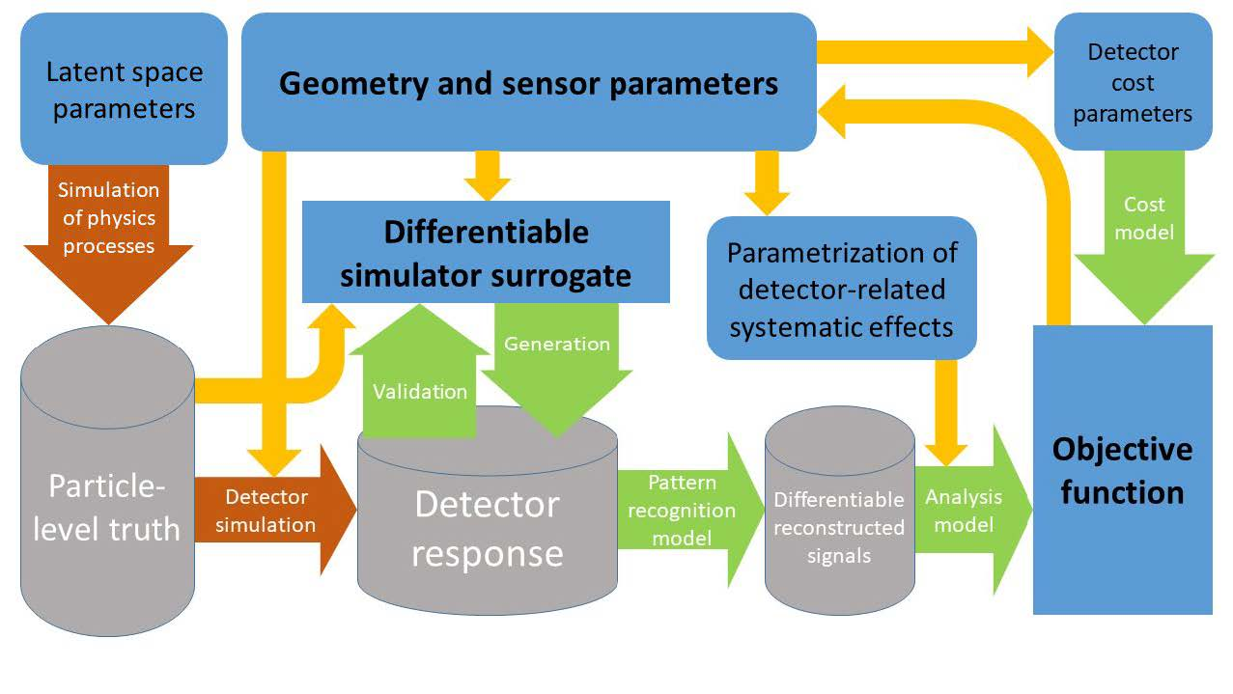
A Generic End-to-end Optimization Pipeline

Slide 27
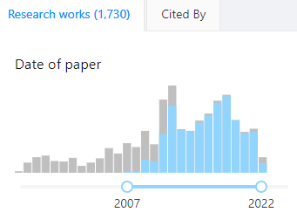
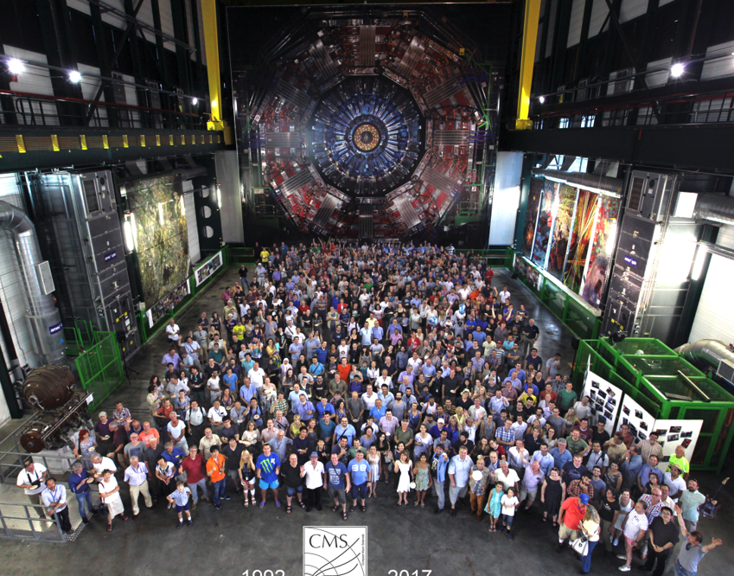
Optimal for What?
The reason why detectors are complex is not only that the studied physics is complex: Science is a demanding job.
We want to study everything and do it better than previously
CMS has over 4000 members, who use the data for a LARGE number of different measurements and searches...
So, what does it mean for a detector to be optimal?
What loss function do we aim to minimize?
Does it make sense to speak of an experiment-wide utility function?
Concerning the last question: I will convince you that it does
Above: publication time of 1125 articles by the CMS collaboration (in blue).
Below: a small fraction of the CMS members

Slide 28
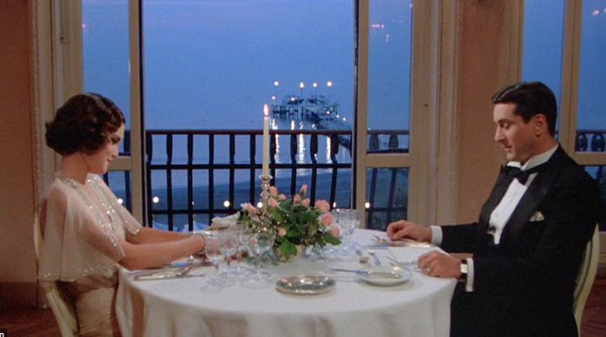
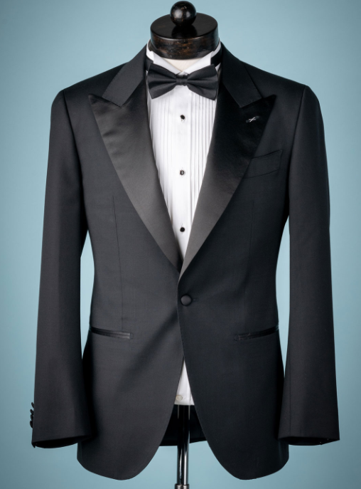
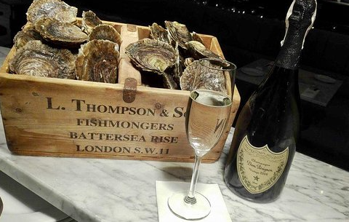
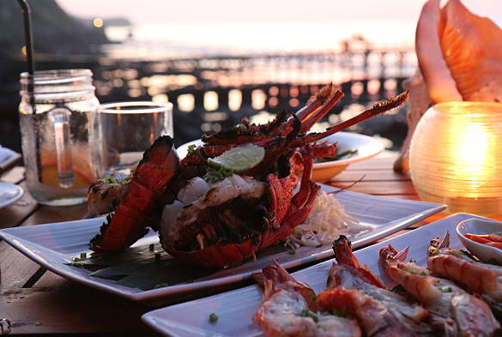
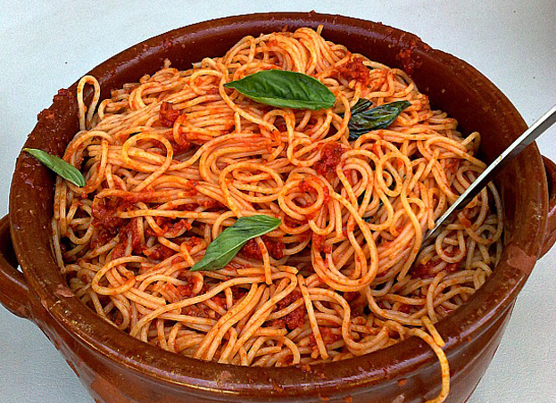
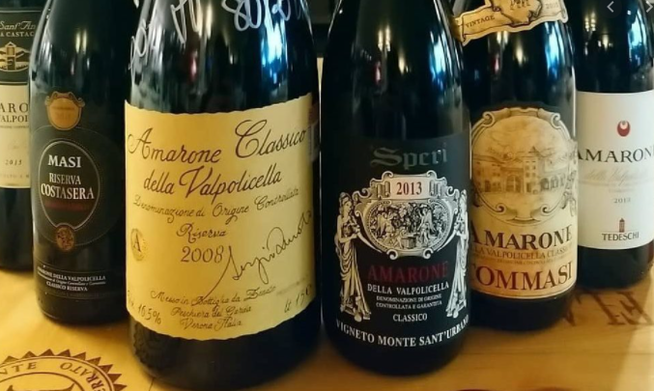
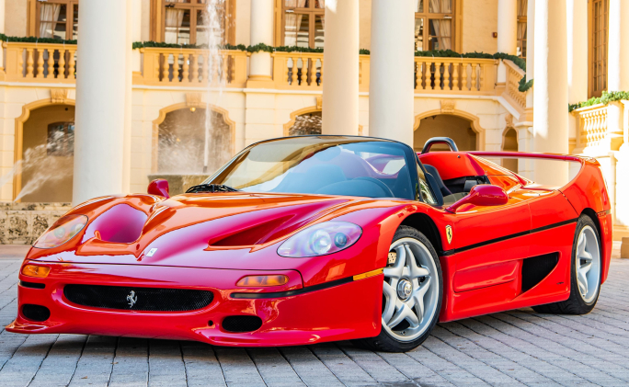
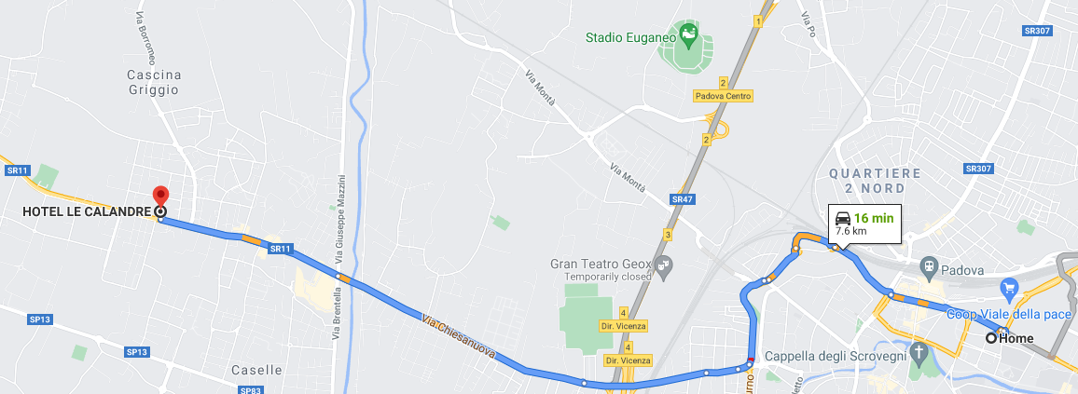
Recipe for a Perfect Dinner
We are not alien to confidently taking complex decisions in a multi-objective space. We actually do it routinely...
Of course, we are not deterred by knowing that the exact form of our optimization target is arbitrary

Slide 29
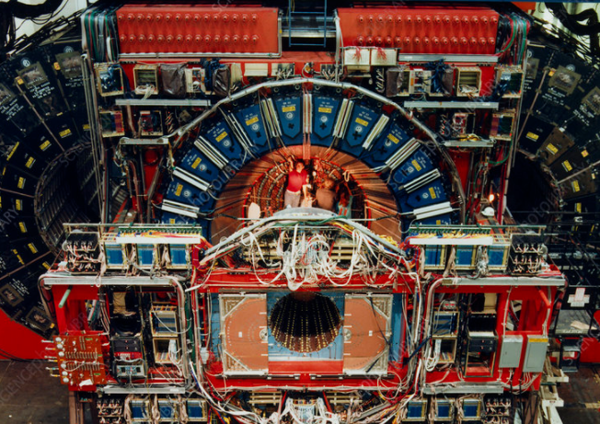
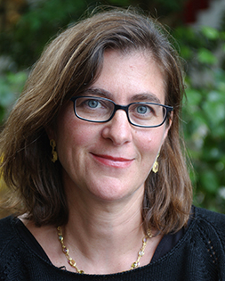
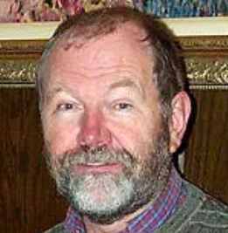
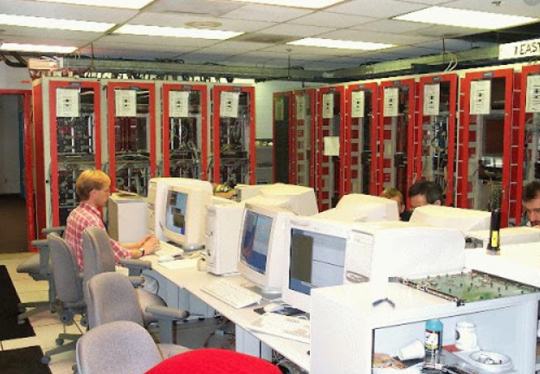
Recipe for a Perfect Trigger
Similarly, we are actually used to create multi-target optimization strategies, e.g. when we allocate resources for the trigger menu of a collider detector.
Consider CDF, Run 1 (1992-96): taking in
a rate of 300 kHz of proton-antiproton
collisions and having to select 50 Hz
of writable data created some of the
most heated scientifically-driven,
rationally motivated, painfully well
argumented, and littered with 4-letter
words debates I ever listened to.
The top quark had to be discovered, but it was not the only goal
of the experiment...

