Slide 1
LHCb plans after Run 4 and contributions from Padova
Padova, 25/10/2024
A. Bertolin on behalf of the LHCb Padova group

Slide 2
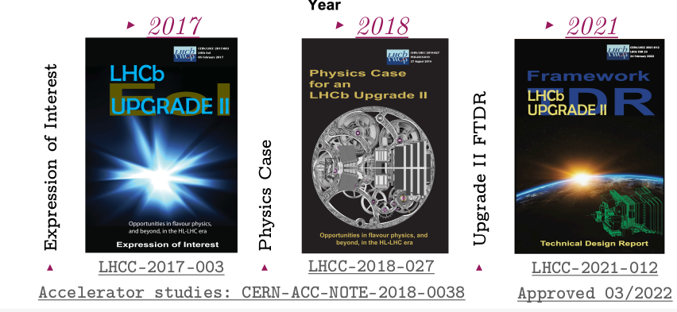
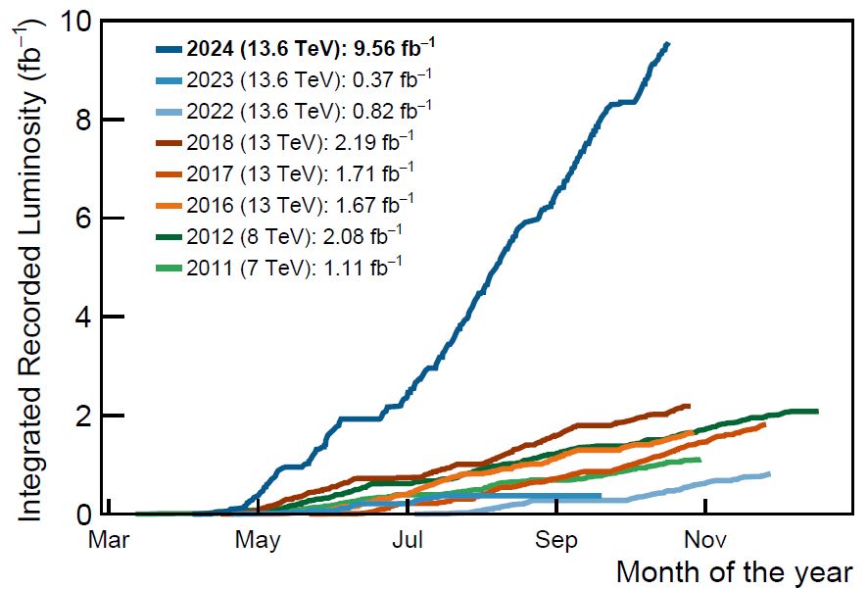
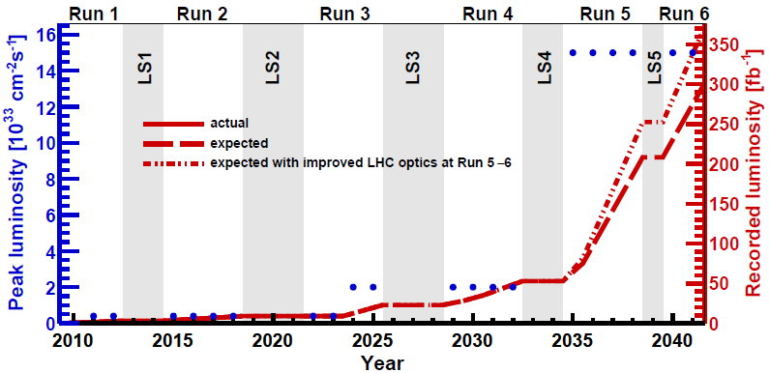
What integrated luminosity LHCb reached so far and what are the prospects
2011 - 2018: 9 /fb (3 /fb Run 1 + 6 /fb Run 2)
2024: 9 /fb !!! efficiency for hadronic B decays x 2 - 3 wrt Run 2
2025 mid 2026: mostly pp running
enhancements + Upgrade II are funded
what’s next ? 300 - 350 /fb !

Slide 3
Physics with LHCb Upgrade II
Number of b hadrons recorded by LHCb will be O(10^14 )
Matched by ATLAS and CMS only for final states with muons
Belle II competitive only for final states with gamma, pi0 or nu
Comparable with FCC-ee
SOME of the physics that can be done ONLY with LHCb Upgrade II
10^-5 precision on charm CPV [deltaACP]
SM extensions with RH currents [b->sgamma]
spectroscopy [tetraquarks, pentaquarks]
rare decays and LFU
fixed target collisions with SMOG
Many results are expected to remain unsurpassed in precision for a considerable time
More details on the Padova interests in the next few slides

Slide 4
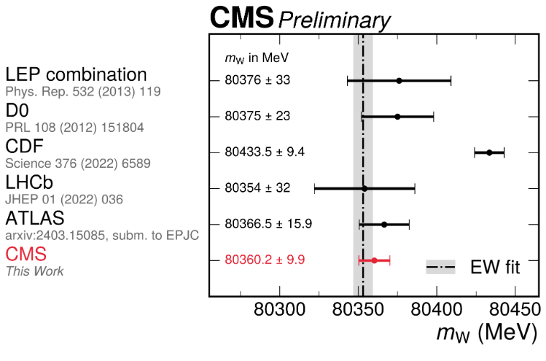
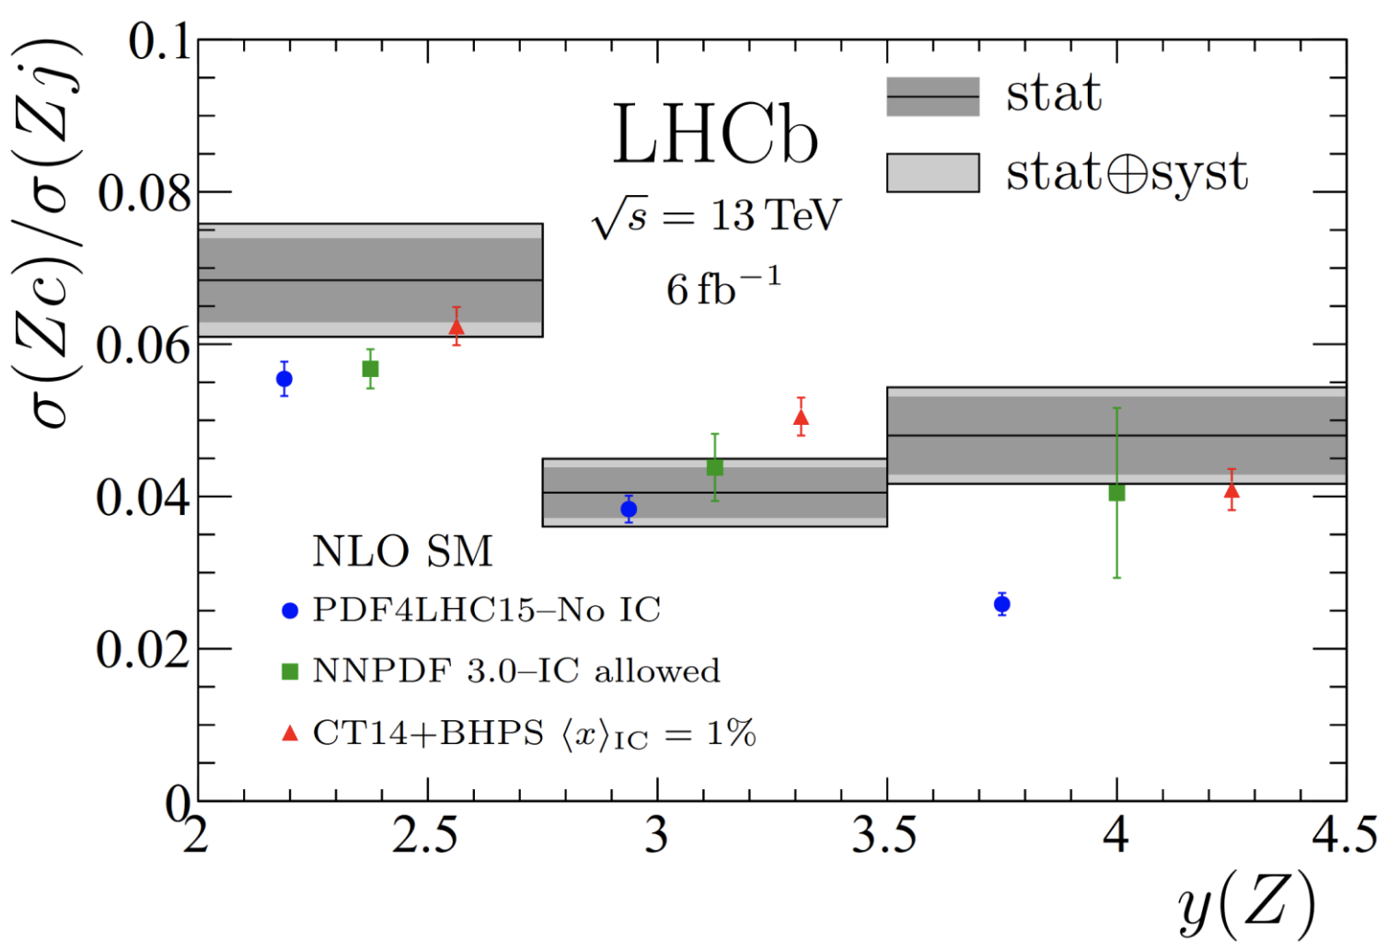
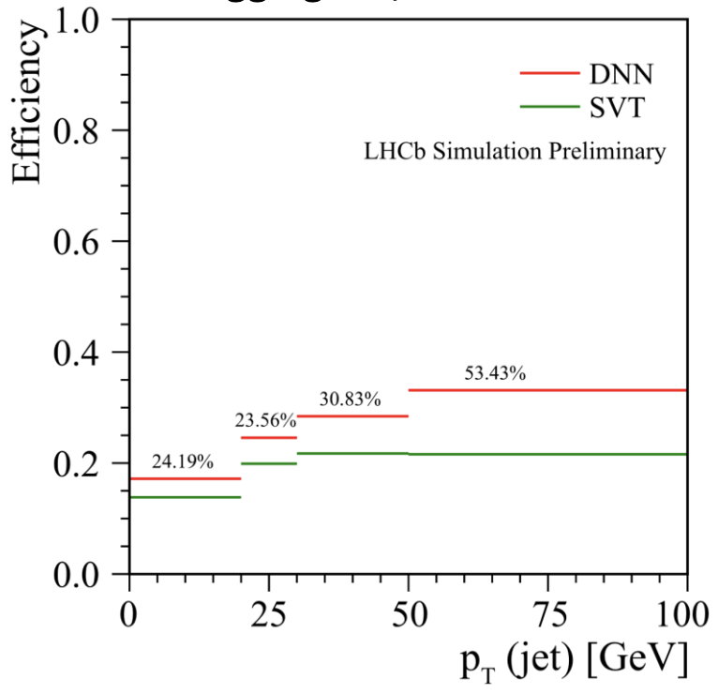
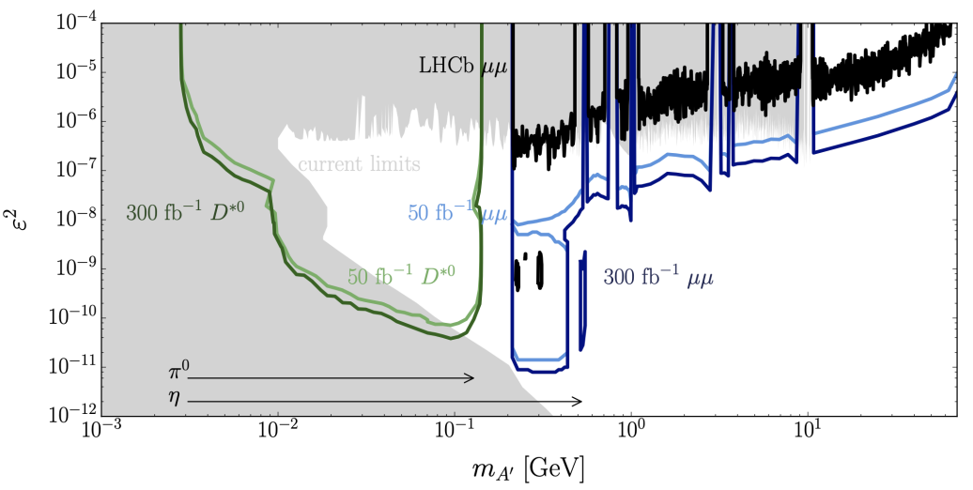
Physics contribution: EW, QCD, Higgs and Exotica
results of W mass fit
results on intrinsic charm using Z+jet events
Important results in QCD and EW sector
Measurements statistically limited!!
LHCb has a very interesting physics case for Run 5!
Possibility to study Higgs decay to charm
High precision on jets substructure
Possibility to investigate double boson scattering in forward region
Searches for ALPs and other DM candidates
new c-jet tagging performance using DNN
expected limits for searches for A’→μμ

Slide 5
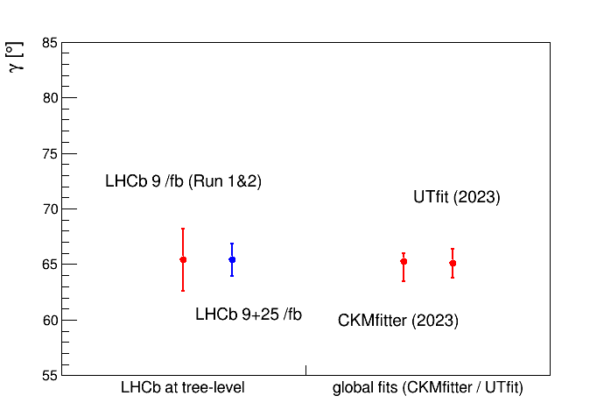
Physics contributions: CKM gamma
https://cds.cern.ch/record/2905625/files/LHCb-CONF-2024-004.pdf
the LHCb gamma combination is obtained from at least 16 independent measurements of tree level decays
at present updated up to the Run 2 data, uncertainty, dominated by statistic, is 4.3 %
not yet the accuracy needed to compare with CKMfitter and UTfit
deviations between these two determination would be a clear indication of physics BSM (due, for example, to new loop contributions)
boosting the statistic to 300 /fb is mandatory to reach a sub-degree accuracy
already a nice step forward in Run 3 with the new calorimeter-less hadronic trigger (x 2 - 3 efficiency boost already reported)

Slide 6
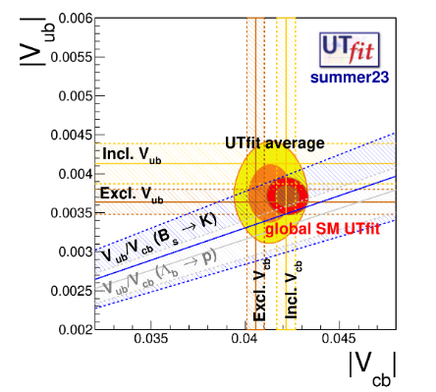
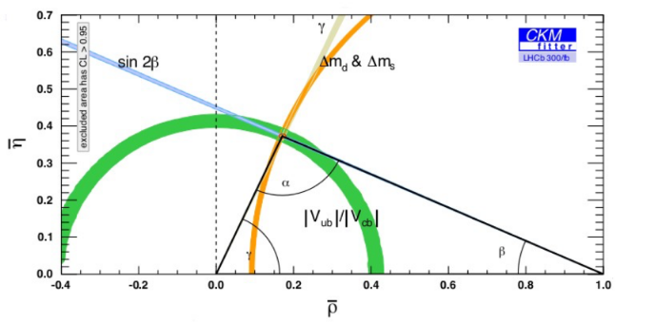
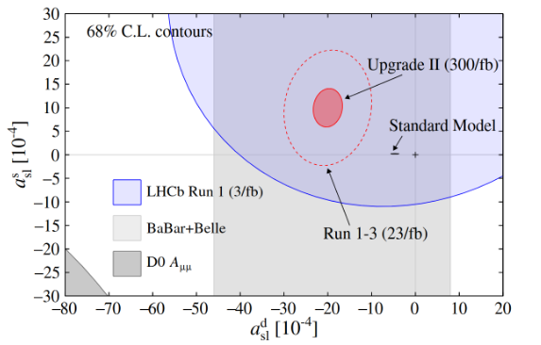
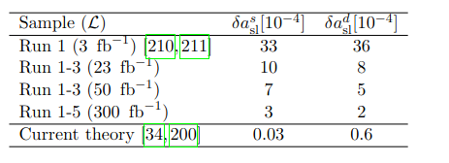
Physic contribution: Measurements of unitarity triangle sides and semileptonic decays
 | https://doi.org/10.48550/arXiv.1808.08865
more accurate determination of |Vub|/|Vcb|,
1 % accuracy
|Vub| measurement using Bc decays
|Vcb| measurement using baryonic decays
semileptonic asymmetries
differential decay rate measurements → new physics

Slide 7
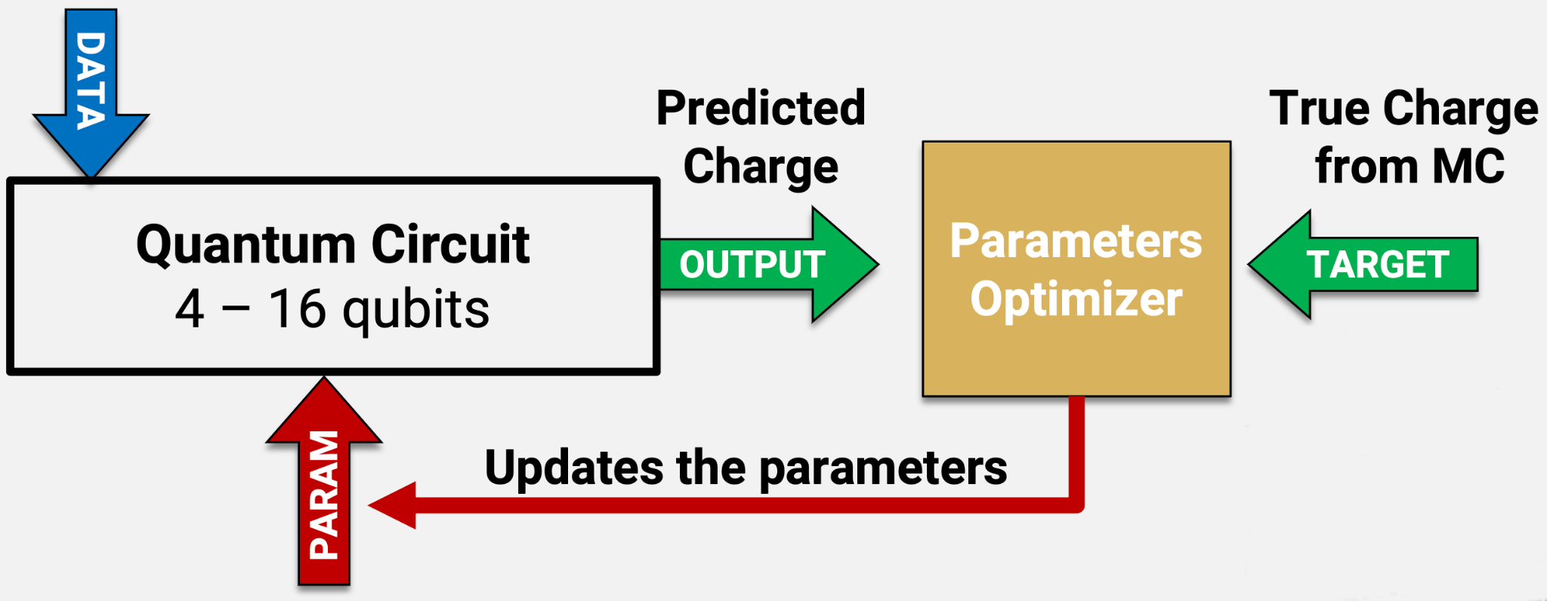
Software contributions: new software technologies
LHCb Padova group is contributing to the usage of new software and analysis technologies to search for new effects or properties in data
Two main areas:
Quantum Computing
Established first exercise of b-jet tagging using Quantum Machine Learning
Now searching for particle correlations to enhance differences due to fragmentation
Analysis facilities & GPUs for analysis
Innovative analysis software by using advanced ML methods already used for b- to c-jets discrimination will be used to study jet sub-structure
exploit PID to investigate strange-tagging

Slide 8
Software contributions: trigger
at present the backbone of the LHCb first level trigger (Hlt1) consist of:
Hlt1TrackMVADecision
Hlt1TwoTrackMVADecision
strongly suspect this will be inadequate for Run 5, investigate the application of some of the new technologies mentioned previously ie advanced ML methods exploiting the full event / information available
at present the LHCb second level trigger (Hlt2) is using mostly exclusive trigger lines reconstructing the beauty meson / baryons decays of interest
rates are kept under control using rather conventional NN algorithms trained on background taken from data
strongly suspect these will be inadequate for Run 5, investigate the application of advanced ML methods

Slide 9
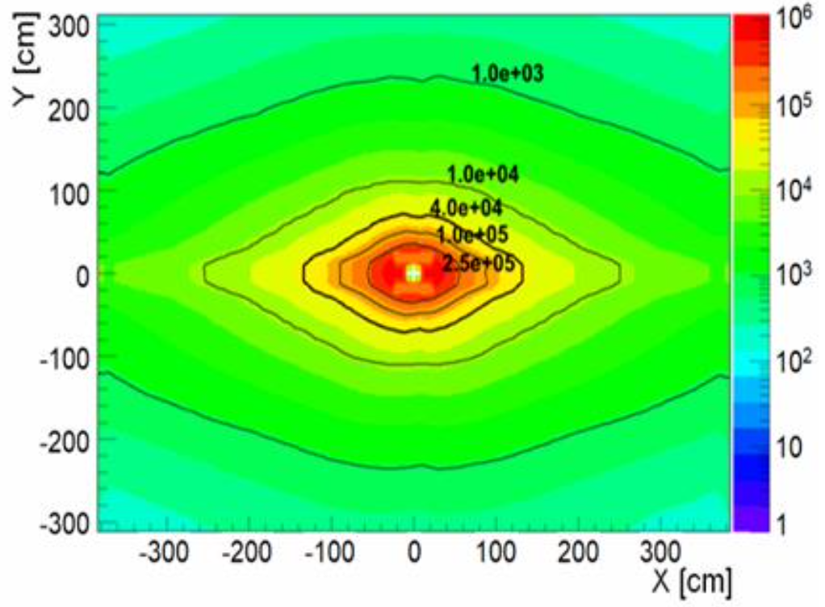
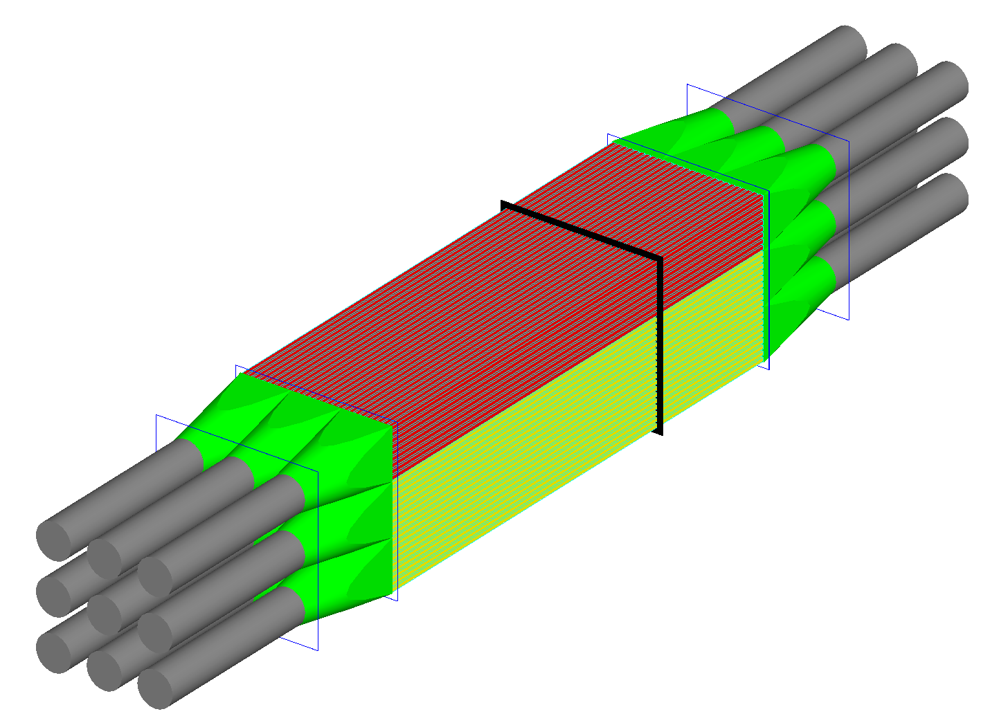
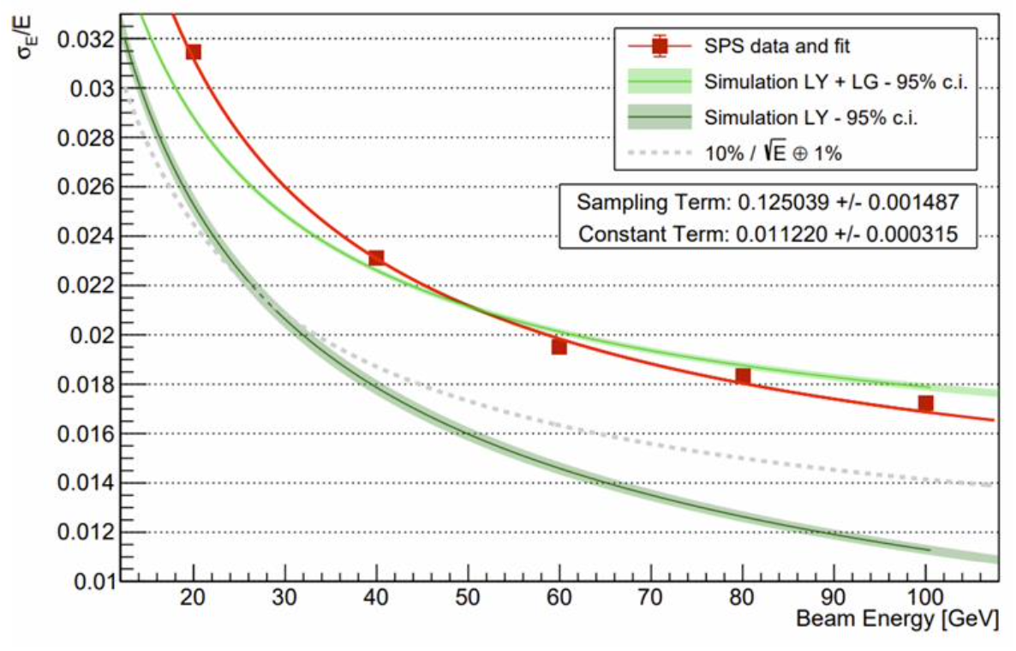
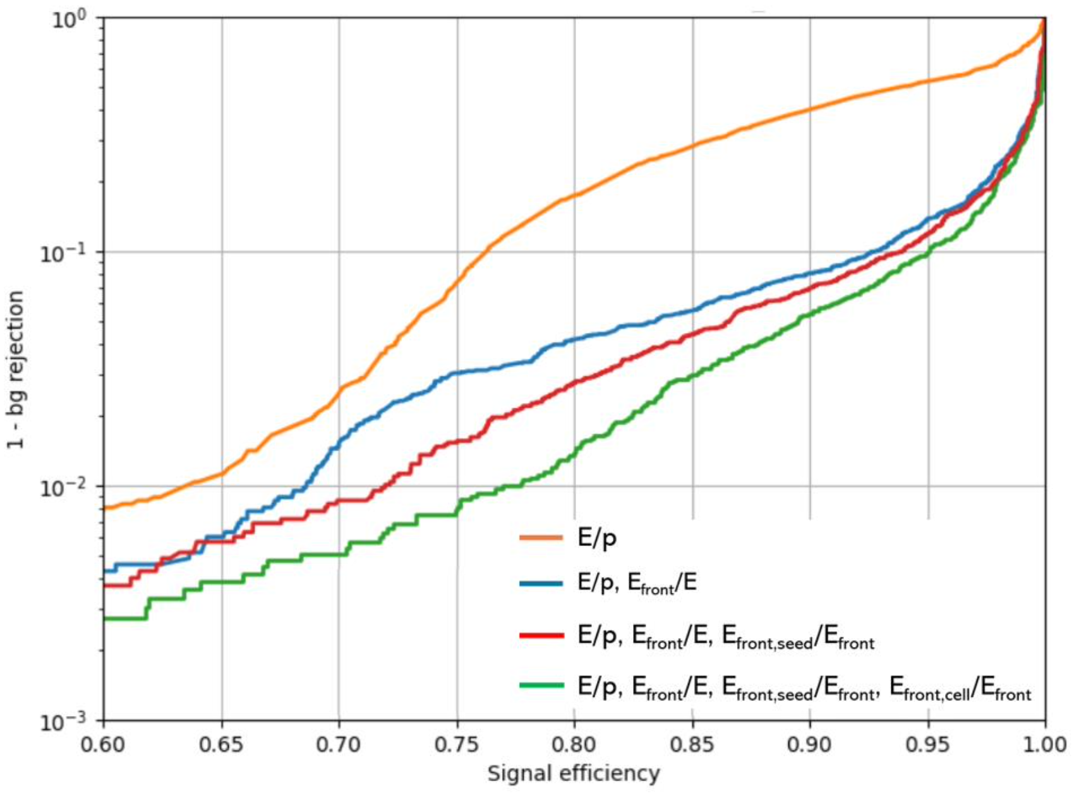
Hardware contribution: ECAL upgrade
expected radiation doses after Run 5
ECAL has to be redesigned to achieve same performance of Run 2, facing new challenges:
Higher pile-up
Higher radiation dose
Intense R&D to develop new Spaghetti Calorimeter modules for ECAL inner region
Padova group interests and contributions:
LHCb detector simulation software development
Analysis of Test-beams data and characterization of modules
online data processing using FPGAs
energy resolution obtained using SPS data during TB campaign
study on electron vs pion discrimination exploiting ECAL longitudinal segmentation

Slide 10
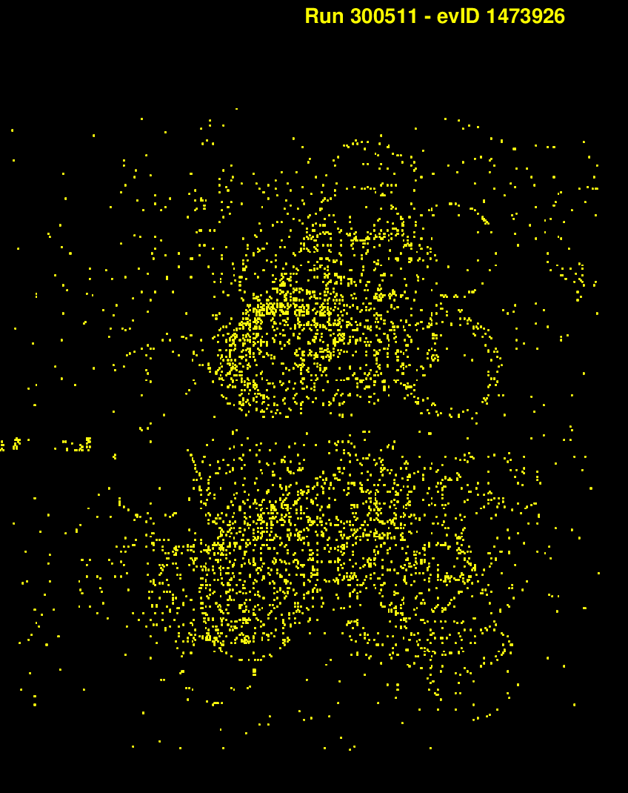
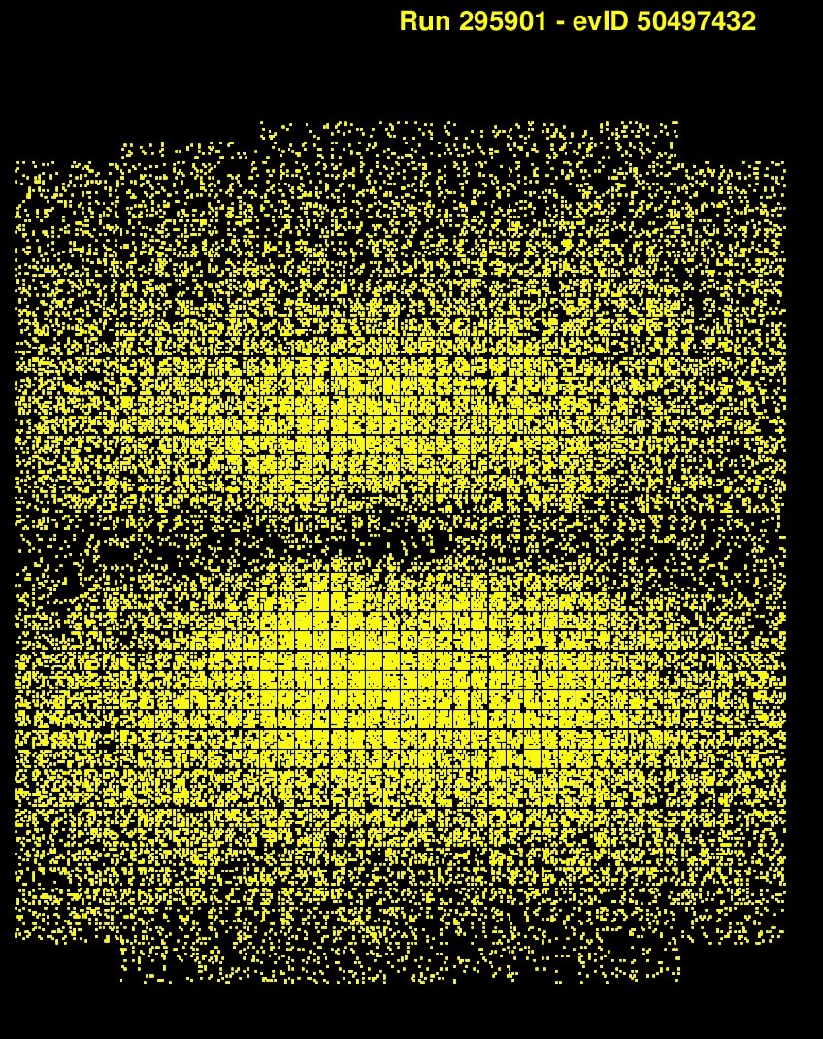
Hardware contribution: RICH upgrade
Hadron particle identification is key to unique LHCb physics capabilities

Slide 11
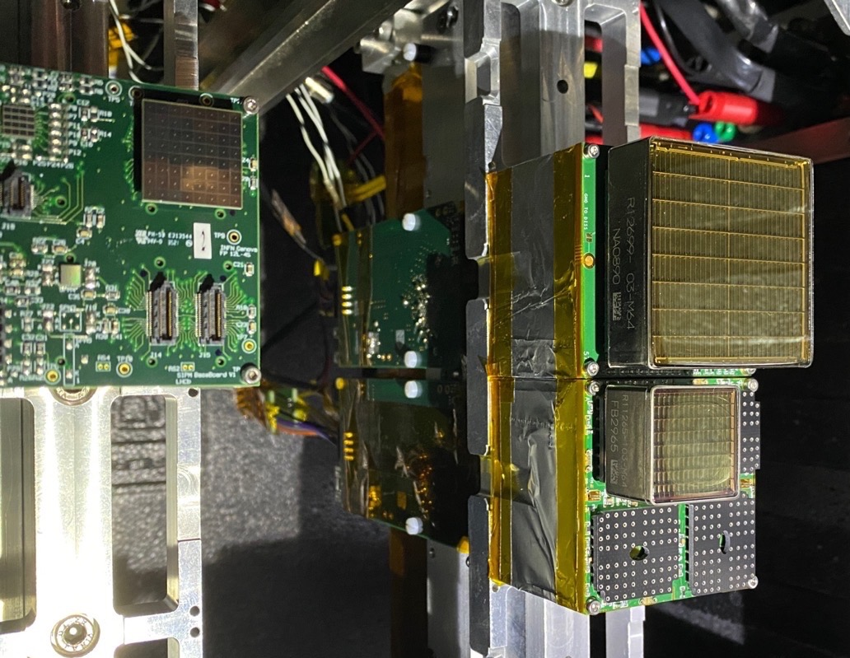
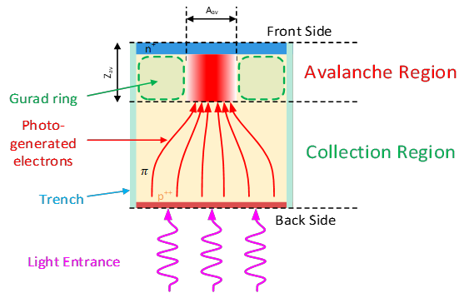
Hardware contribution: RICH upgrade
Hadron particle identification is key to unique LHCb physics capabilities
Timestamping each photon with a few tens of ps resolution to maintain the PID performance with mu~40
Padova interested in the R&D of the time resolved RICH
test beams of the time resolving electronics
R&D on new fast radiation hard SiPM
R&D on cryogenic or local cooling for SiPM

Slide 12
Hardware contribution: RICH upgrade
Hadron particle identification is key to unique LHCb physics capabilities
Timestamping each photon with a few tens of ps resolution to maintain the PID performance with mu~40

Slide 14
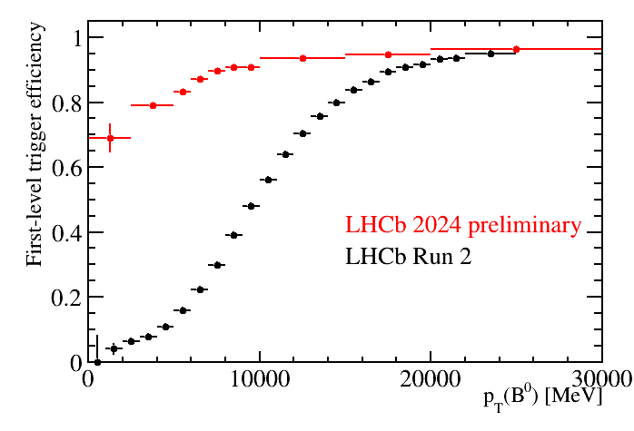
https://lbfence.cern.ch/alcm/figure/details/3573
https://lbfence.cern.ch/alcm/figure/details/3837

