Slide 1
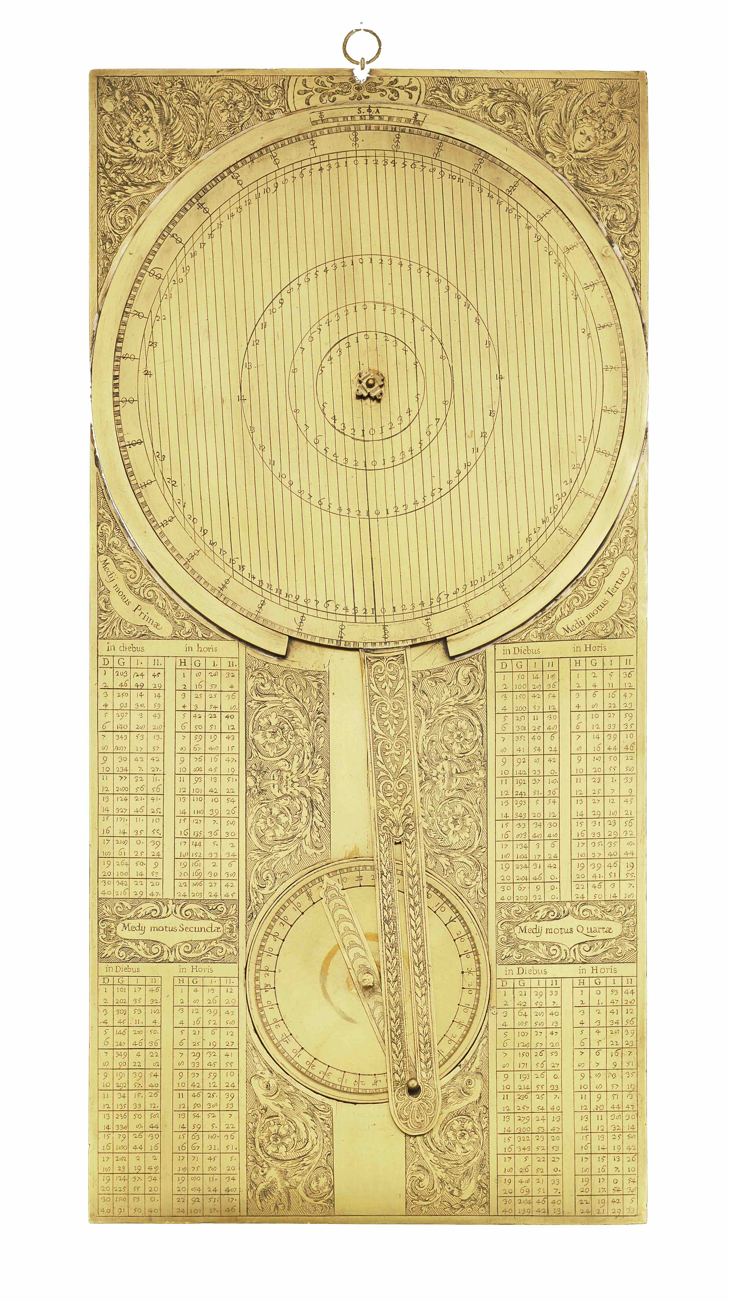
Galileo and satellite navigation
Alessandro De Angelis
Rappresentanza Permanente d’Italia presso le Organizzazioni Internazionali, Paris
Università di Padova e di Lisboa
Frascati, November 2024
Acknowledgements to Michele Camerota, Bill Shea, Giorgio Strano

Slide 2
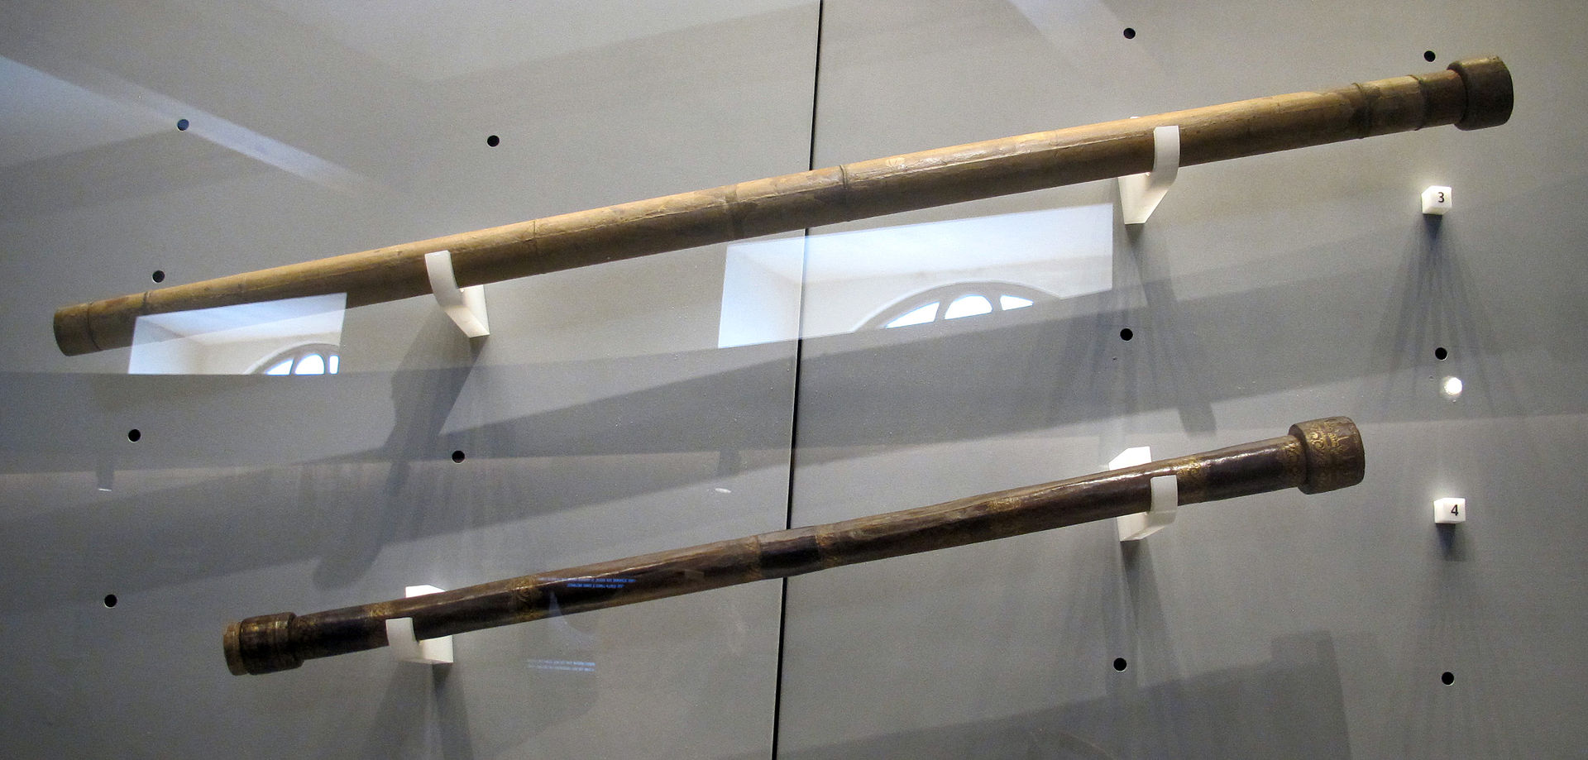
1609: the telescope.
A dutch invention perfected by Galilei
Galileo (1564-1642), a professor in Padova (Venezia) from 1592 to 1610 (the best 18 years of my life), is today mostly known for affirming the Copernican (heliocentric) system.
But he is also the father of experimental science (according to Einstein) and of astronomy (thanks to the telescope, perfected thanks to the superior glassmaking technique of Venezia)
(originals by Galilei)

Slide 3
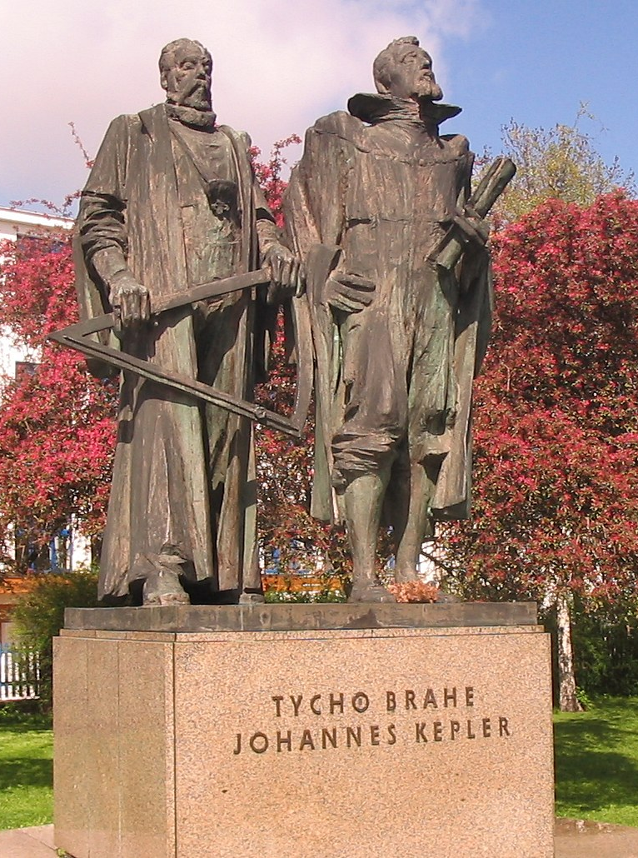
Circa 1600: a golden age for astronomy
Brahe (in Scania, Denmark, Prague), Galilei, Kepler (in Austria, Germany, Prague), Newton
The two last supernovae visible with the naked eye (SN 1572, aka Tycho’s supernova, and SN1604, aka Kepler’s supernova), the 1600 nova, a couple of giant comets
The invention of the telescope, in several versions (Dutch, Galilean, Keplerian, Newtonian)
A stimulating debate on subjects crossing science and religion
International cooperation/competition between scientists

Slide 4
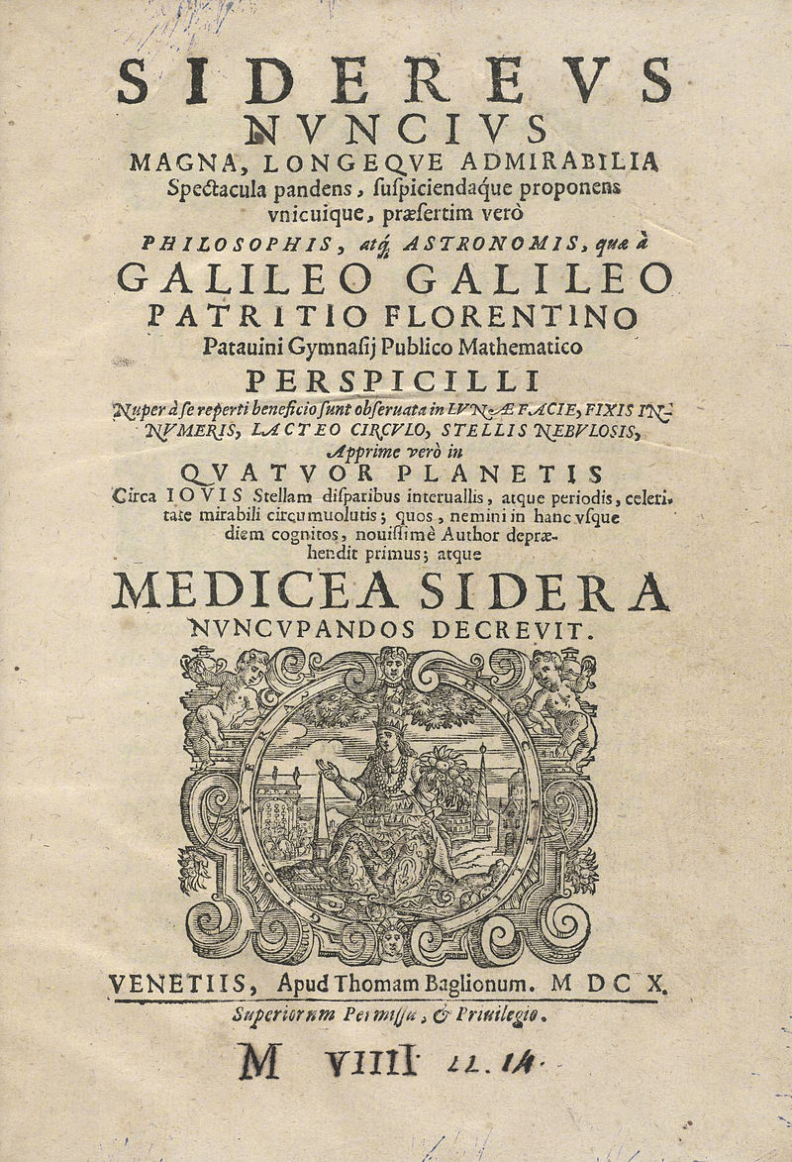
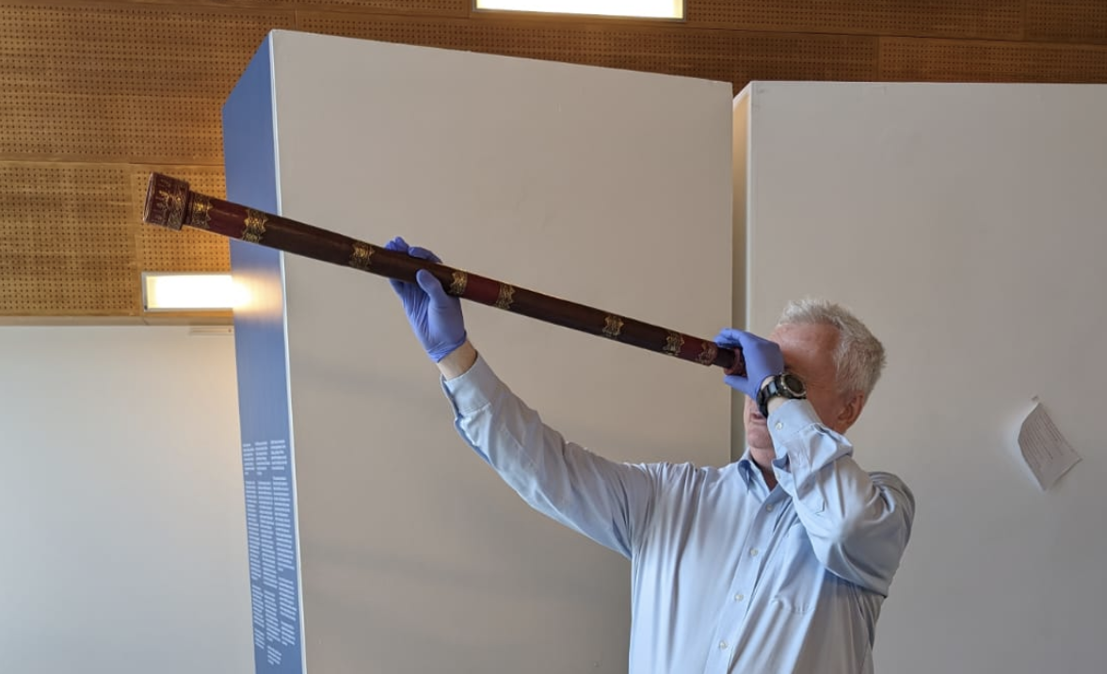
Sidereus Nuncius
Galileo wrote his first book in 1610: Sidereus Nuncius (the title is ambiguous and means “A message from the stars” or “The messenger of the stars”). The book sold like hot cakes
The first scientific work that uses a scientific instrument: the telescope
Galileo quickly became the most popular scientist in the world

Slide 5
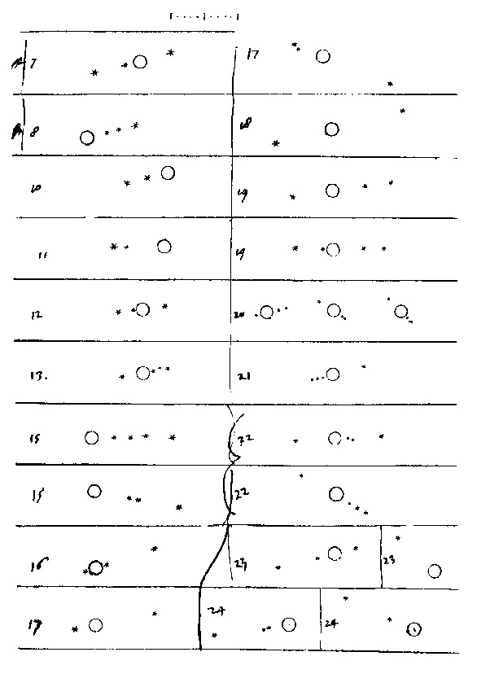
A precise and systematic observer
One of the most important discoveries published in in the Sidereus Nuncius was that Jupiter has 4 large moons orbiting around
  Now you can easily see them around 10pm
Every night from his home in Padua Galileo followed "live" the positions of these moons
The revolution periods are short: about 1.8 days, 3.6 days, 7.2 days, 16 days
  1-2 eclipses per night
(BNC Firenze, Ms. Gal. 50, fol. 70r)

Slide 6
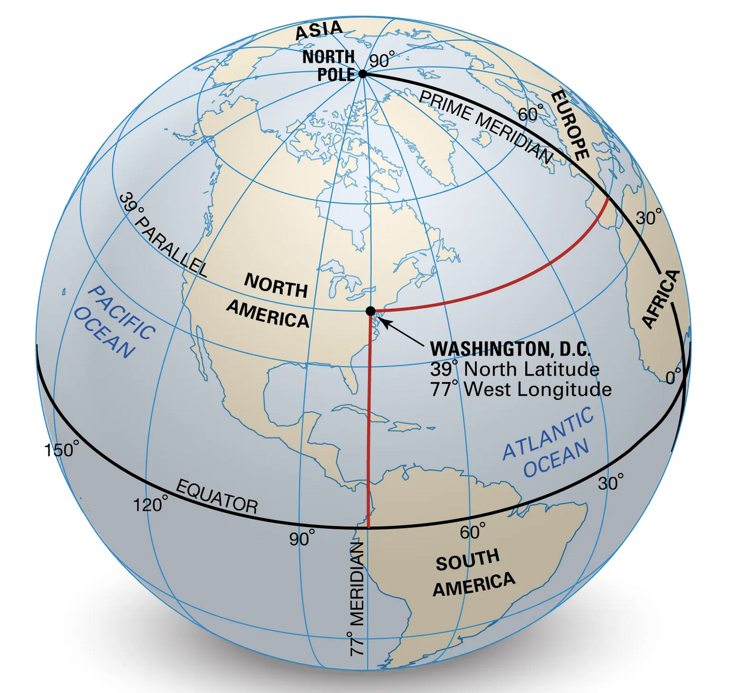
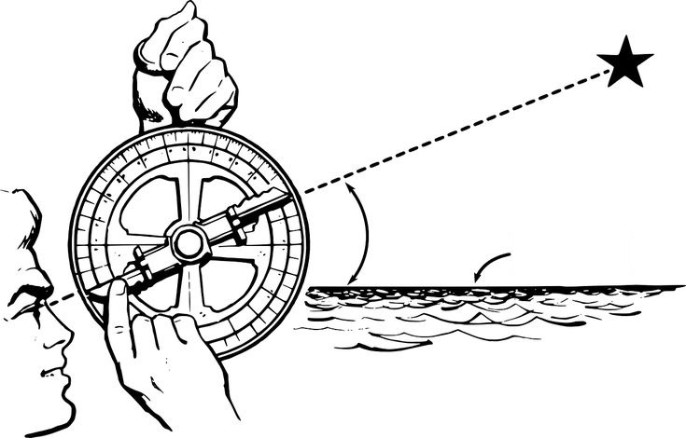
Longitude + Latitude: geolocation
Starting Columbus' voyage in 1492, the issue of obtaining precise geolocation became pressing. You can locate a point on Earth by 2 coordinates: latitude (the angular distance from the Equator) and longitude (the angular distance from a reference meridian)
Measuring latitude is simple (point to the Polar star with a quadrant)
Measuring longitude is difficult: the Earth rotates
Can be done if one compares the local time with an event happening at a fixed time in the Universe, like an eclipse
The eclipses of Jupiter’s moons (1-2 per night) can offer an absolute clock. The biggest problem in the exploration of the world could be solved

Slide 7
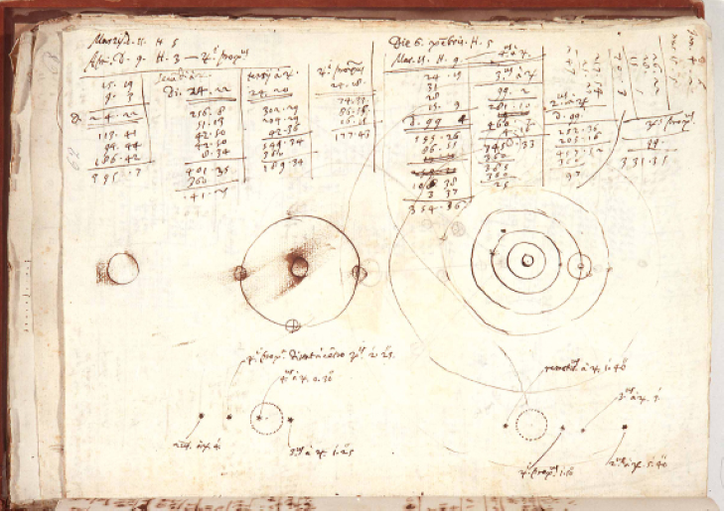
(BNC Firenze, Ms. Gal. 50)

Slide 8
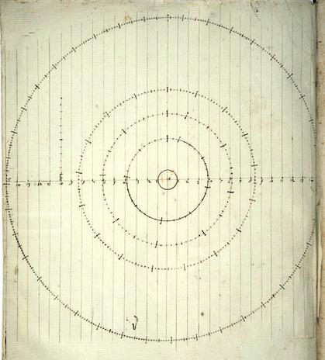
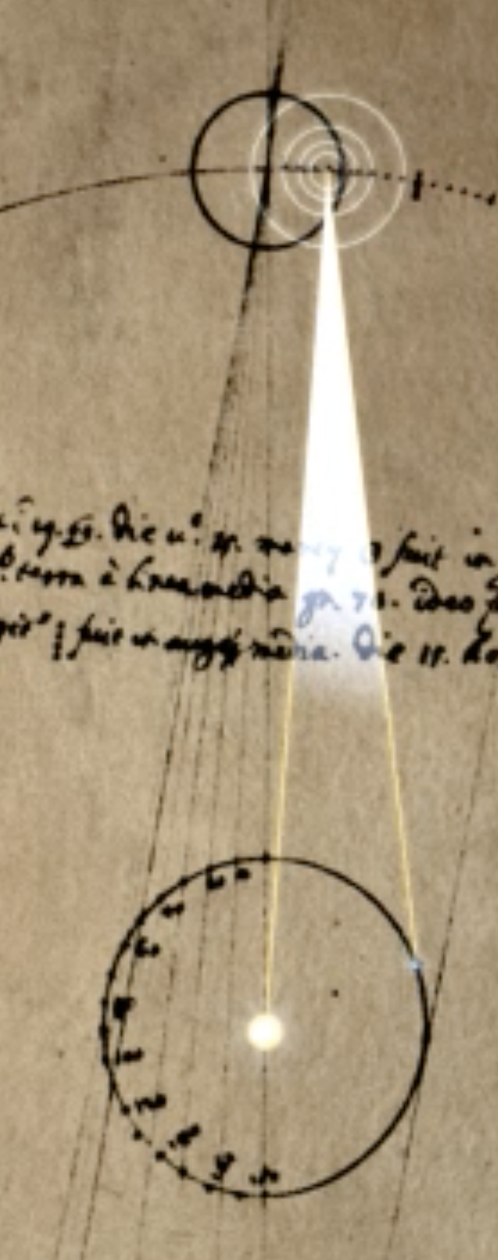
The postions of Jupiter’s satellites
But how to compute the time of the eclipses of Jupiter’s moons?
And how to allow a sailorman to reproduce such a calculation?
In 1612, Galileo stared studying the problem
First, he determined the periods
Second, he calculated the transformations from the Earth’s reference frame to the Sun, and vice-versa
(BNC, Firenze, Ms. Gal. 70)

Slide 9
How to compute it? The jovilabe!
The calculations needed to be made easy
Galileo invented (between 1612 and 1616) a specific analogic computer designed for the calculation: the jovilabe
The original jovilabe by Galileo is lost, but a replica done for the Grand Duke of Tuscany little after Galileo’s death is exhibited at the Museo Galileo in Florence

Slide 10
How to make money out of the idea of geolocation?
Galileo’s lifestyle was very expensive
At the end of 1610, Galileo moved to Florence with the same salary as in Venice (but no teaching)
The king of Spain promised tens of millions of euros at today’s exchange rate to anyone who solved the problem of geolocation
In 1612, Galileo described his invention to the prime minister and to the Florentine ambassador in Madrid, and asked for their help in selling the new technique to the king of Spain

Slide 11
The king of Spain rejects the idea
It took 6 years for Spain to evaluate Galileo’s idea
The Spanish referee, Joao Lavanha, expressed a negative opinion justified by 4 reasons:
  He did not believe that Jupiter’s satellites existed
  Even if they existed, he did not believe that they could be observable
  In any case, it could not be possible to compute their motion
  And even if 1, 2, 3 were wrong, it would not be possible to observe from a ship
On the basis of this report, the king of Spain rejected Galileo’s idea
Galileo appealed, but his appeal was also rejected
  The king of Spain left anyway a small door open

Slide 12
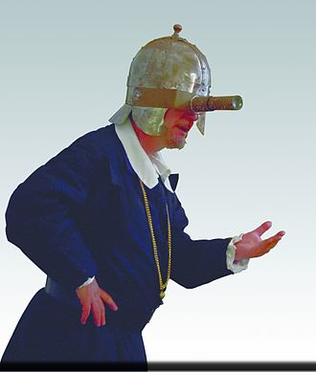
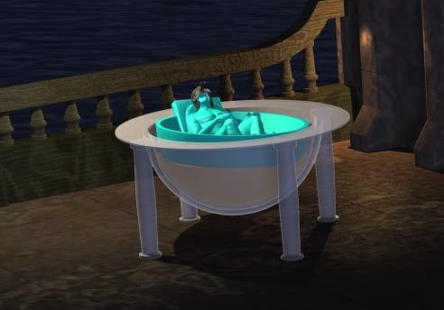
In the meantime, Galileo tries to refurbish his idea: the celatone and the oleodynamic suspension
Galileo was not a sailor. He knew that objections 1, 2 and 3 were wrong, but still he took objection 4 seriously
To make it possible to observe Jupiter from a ship, compensating the ship’s movements, he invented the celatone, a helmet (kind of steadycam) with a telescope on one eye, and the oleodynamic suspension
There is no indication that these inventions ever worked

Slide 13
A second attempt with the Parlament of the Netherlands
In the following years (1628-1636) Galileo was busy with other problems:
  He wrote his Dialogo sopra I due massimi sistemi del mondo
  He faced the famous process for heresy, being condemned to home arrest for life (1633)
  He finalized his last book: Discorsi e dimostrazioni matematiche…
Galileo took up the issue of geolocation again in 1636. This time, he decided to negotiate through intermediaries with the States General of the Netherlands (represeented by the diplomat Constantijn Huygens, father of Christiaan)
In 1637 the technical committee of the Low Countries rewarded Galileo with a precious gold necklace, which the Inquisition forbade him to accept
  4 referees were selected (2 chosen by Galileo, 2 by the Netherlands)
By 1640, all four referees died
In 1642, also Galileo died.

Slide 14
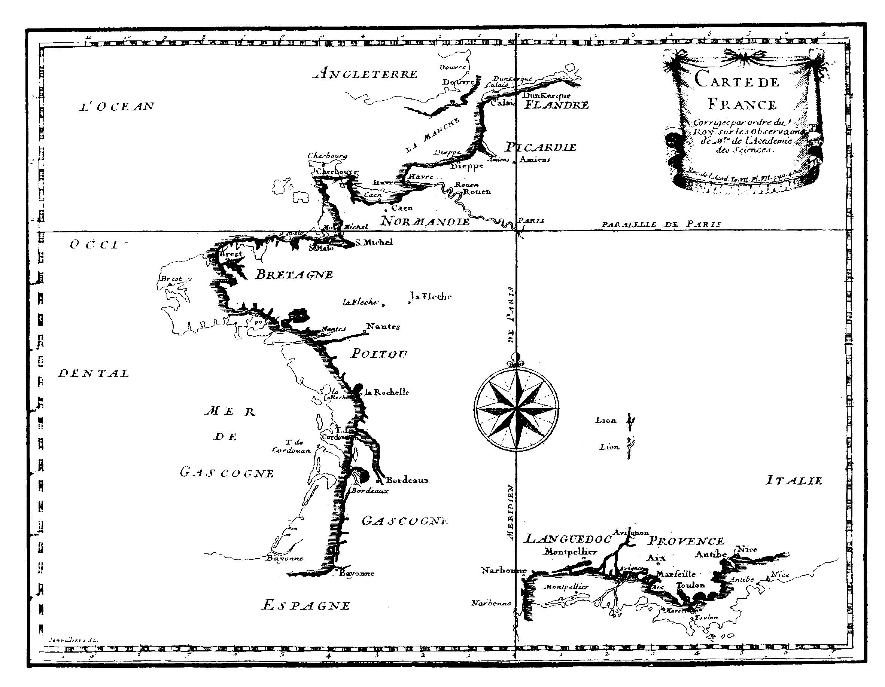
The real end?
Galileo's method later was successfully used, although not from a ship: it became a standard technique in cartography
Giovanni Cassini, a professor in Bologna, was chosen in 1671 as the first director of the Paris Observatory; King Louis XIV, le Roi Soleil, commissioned an accurate map of France. Cassini used Galileo's method
In 1682, he presented his map to the Academy of Sciences in Paris. The difference is significant, particularly along the western coasts
  It seems that Louis XIV commented that astronomers had stolen more land from him than he had gained in all his wars
(Bibliothèque
Nationale
de France -
Richelieu)

Slide 15
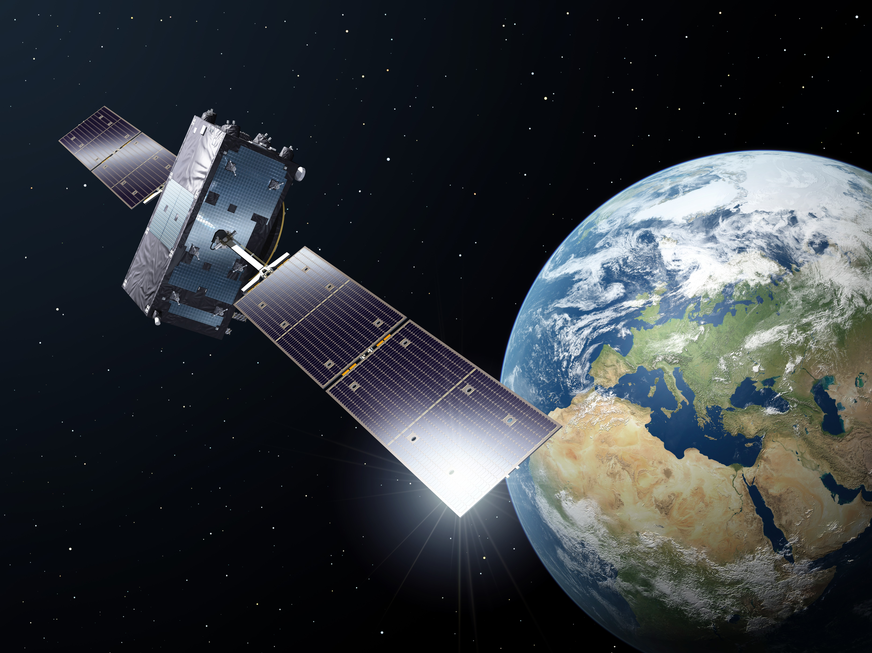
The real-real end (for now)
In 1675, Christiaan Huygens patented a transportable watch
Around 1730, the British clockmaker John Harrison invented a precise transportable watch, allowing a measurement of longitude more practical than Galileo’s
In the beginning of XX century, Marconi’s radiotelegraphy allowed an easier calculation of position, adopted from 1912
Finally, the space era made it possible to actualize Galileo’s idea using constellations of satellites more numerous, closer and better distributed in space than Jupiter’s (1990s - )
A satellite of the Galileo constellation
Credit: ESA

Slide 16
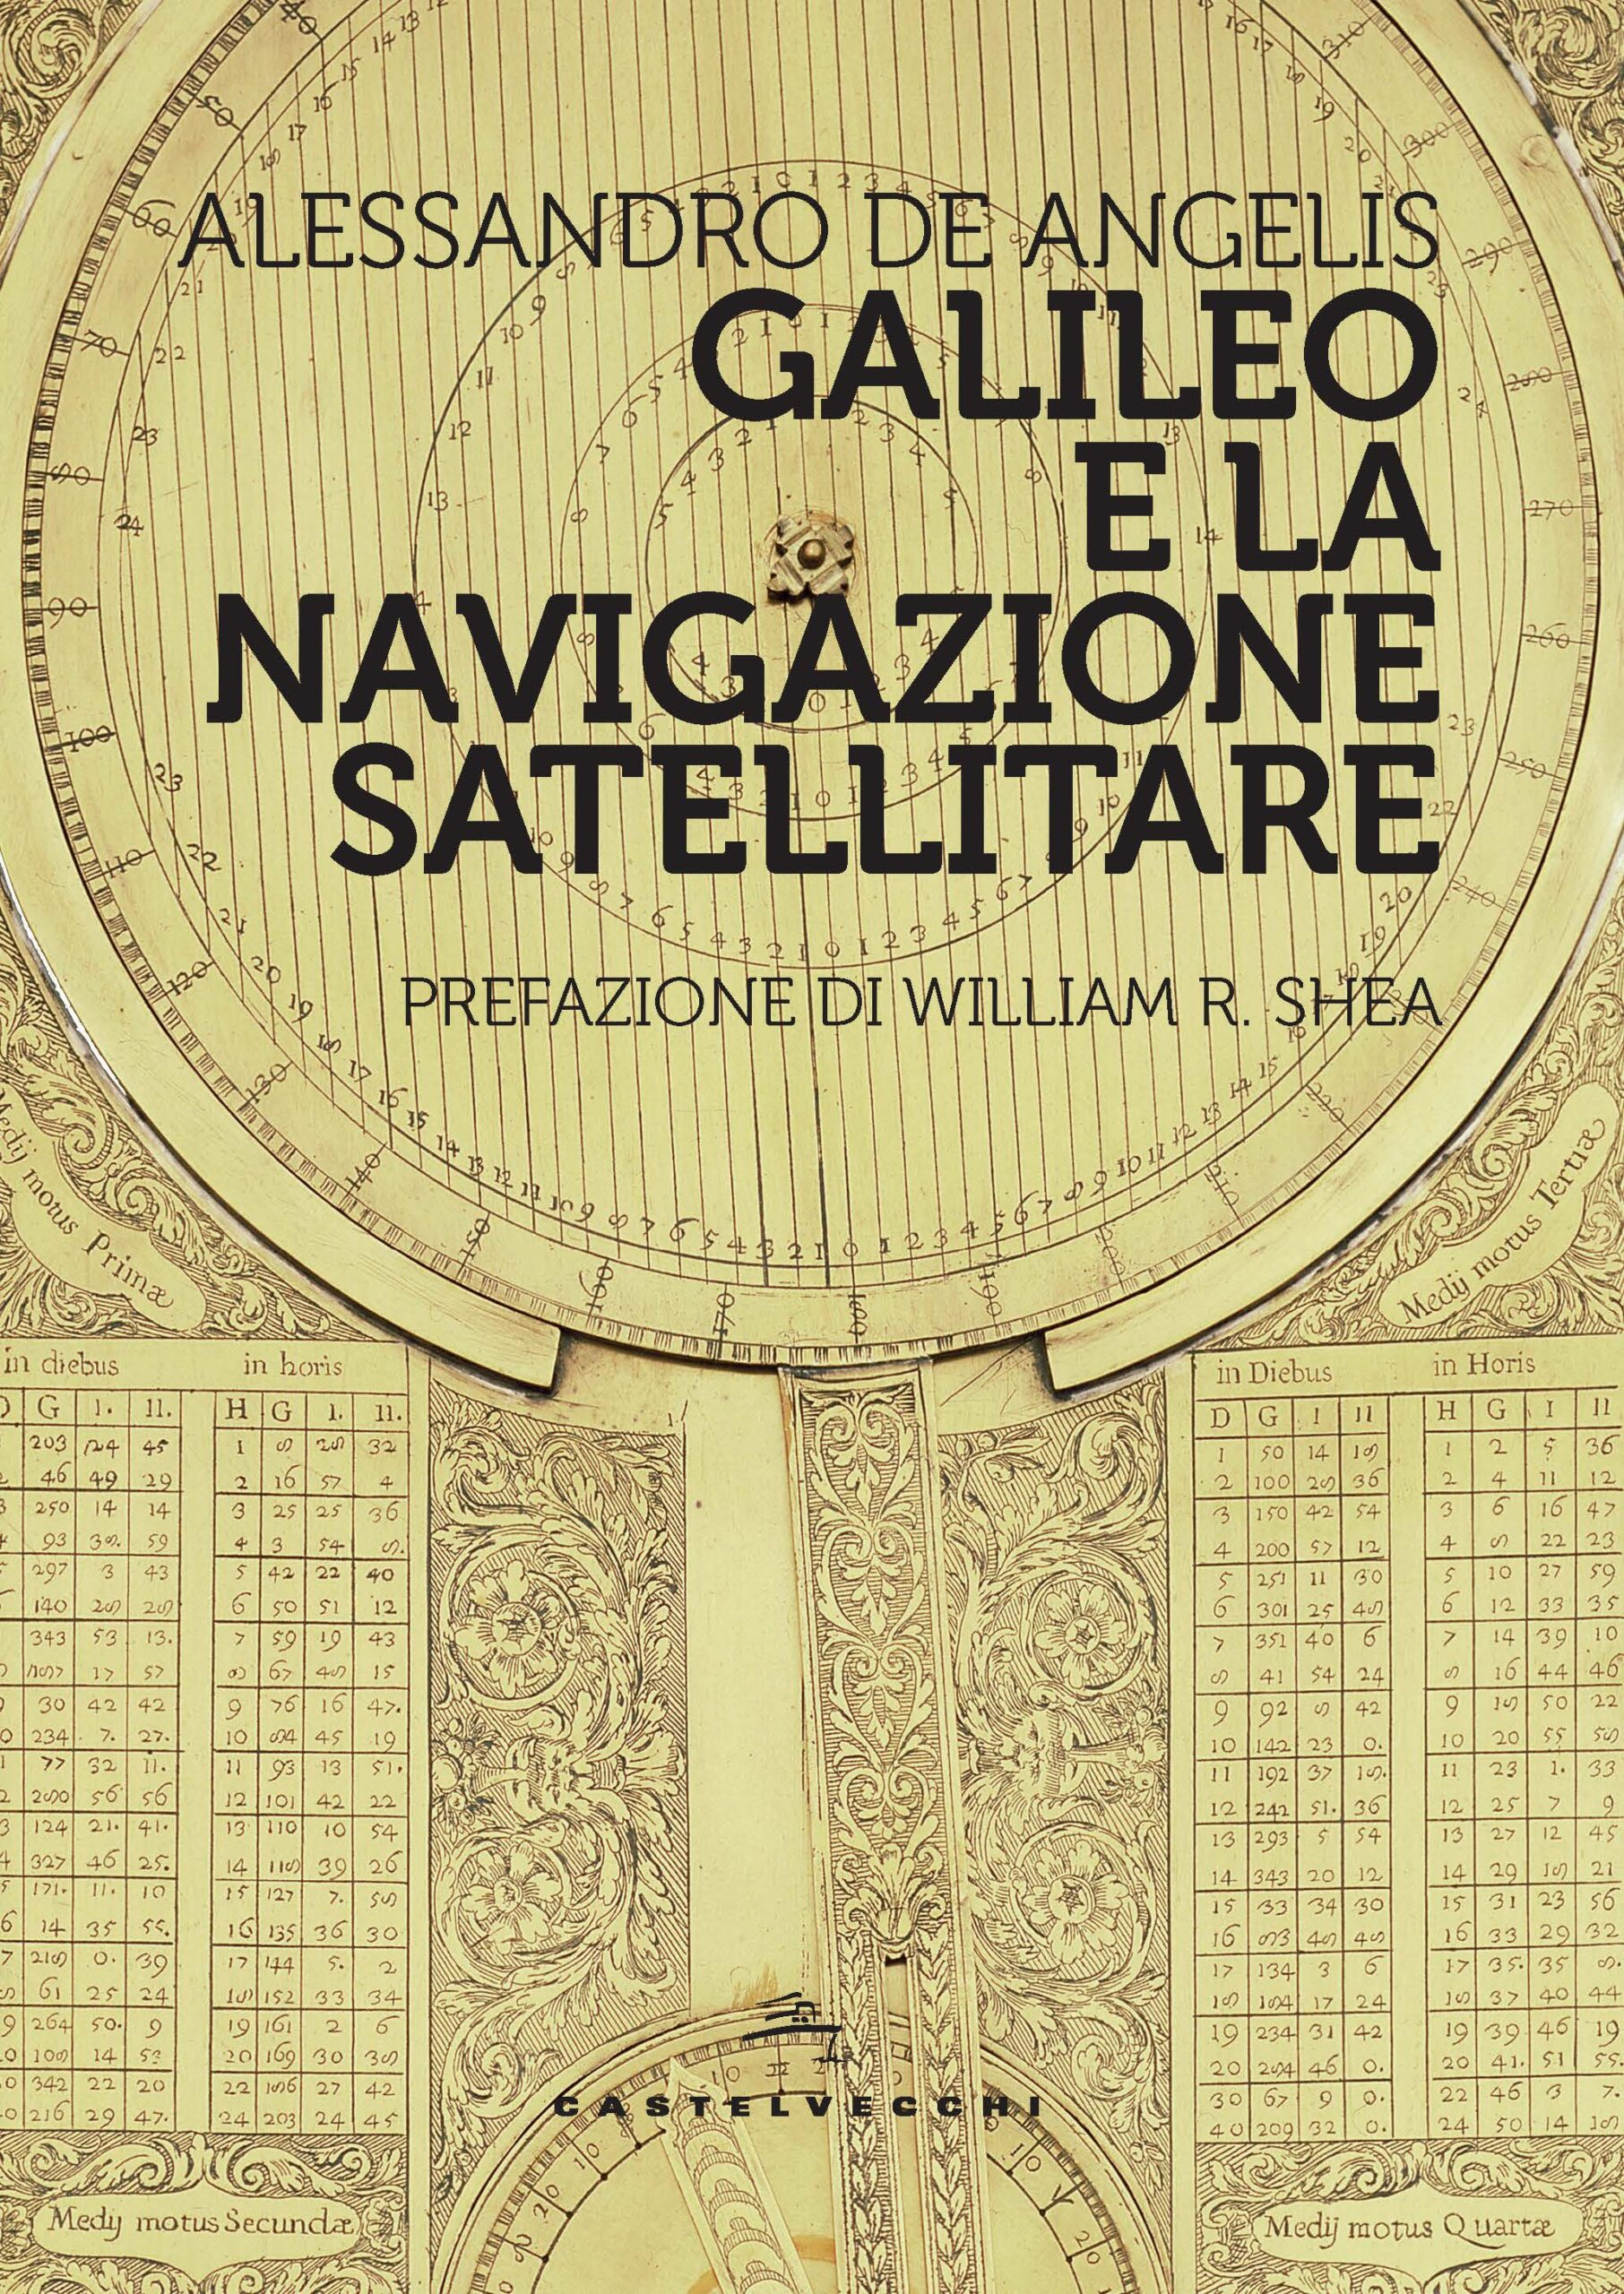
A book and an exhibiton
Paris, June 2024
Prague, October 2024
Amsterdam, December 2024
Canada, Perimeter Institute,
February 2025
…
(Castelvecchi 2024)
(English edition announced, Springer 2025)

Slide 17
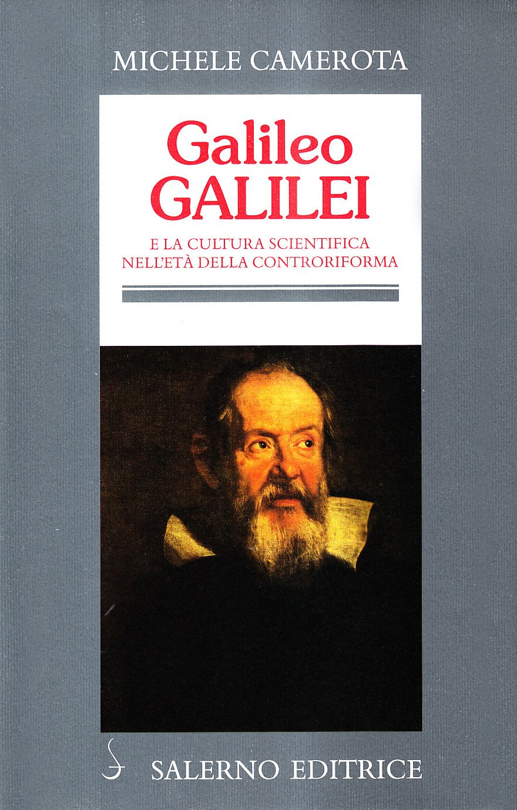
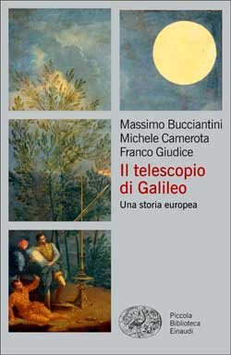
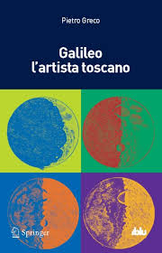
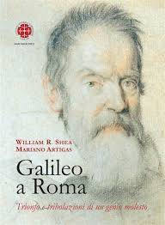
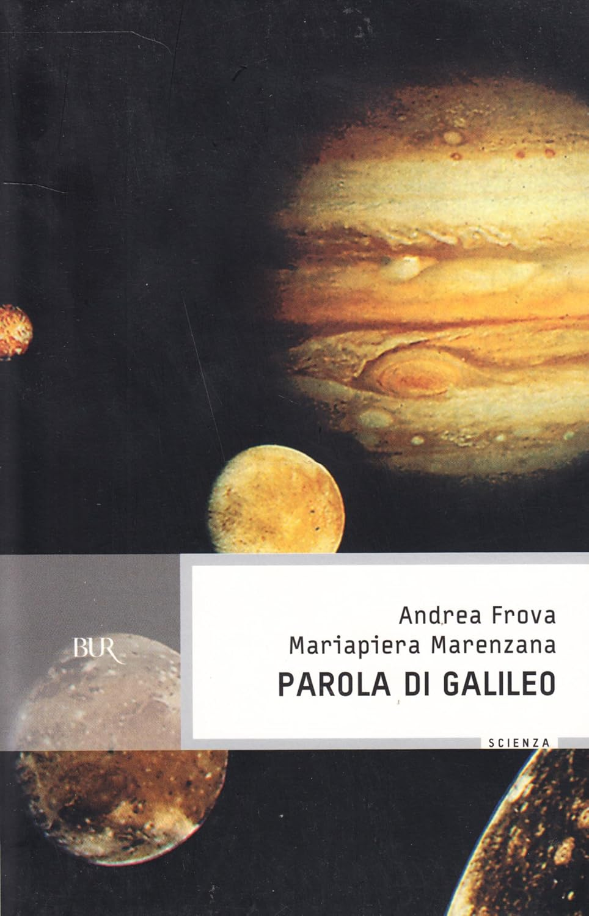
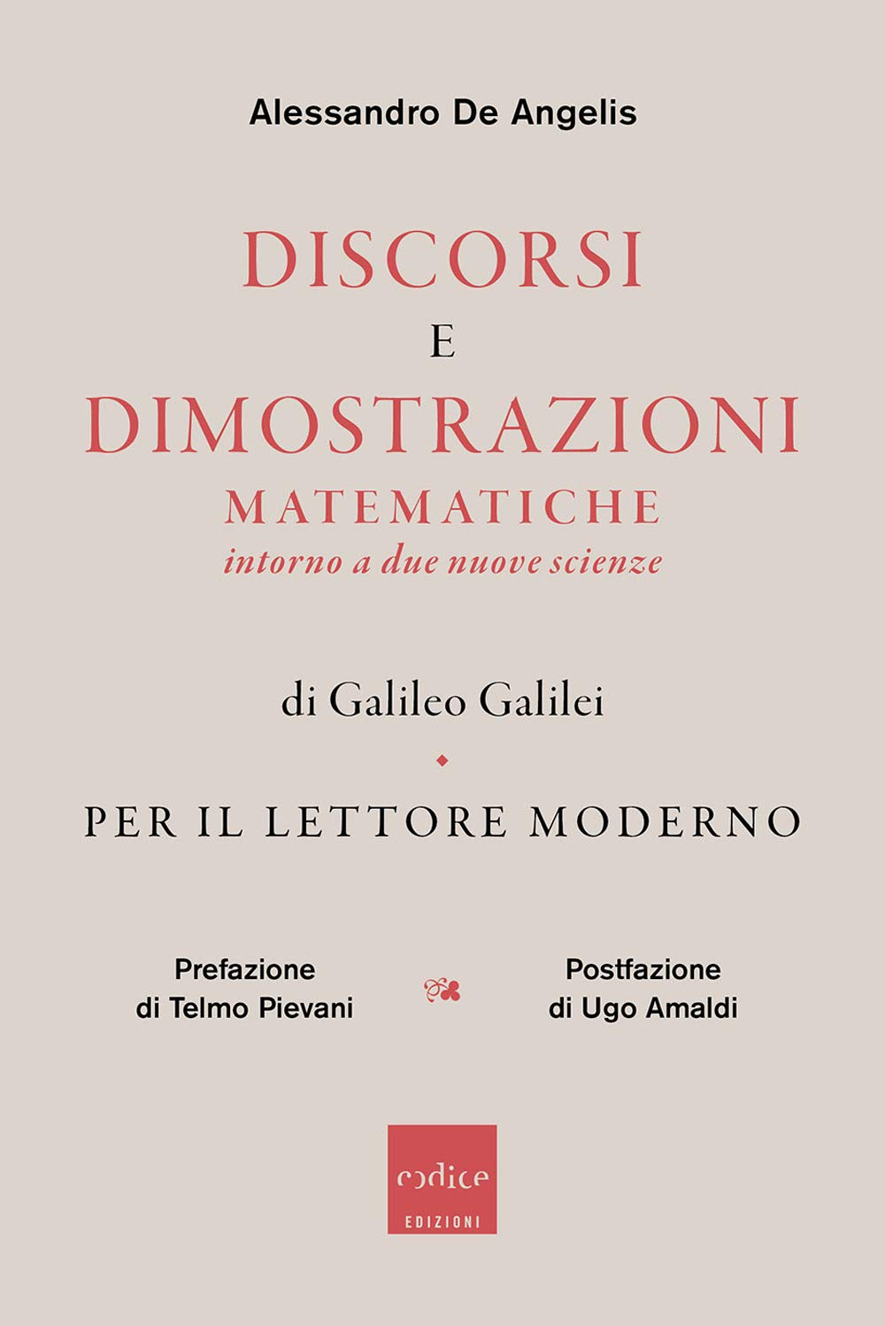
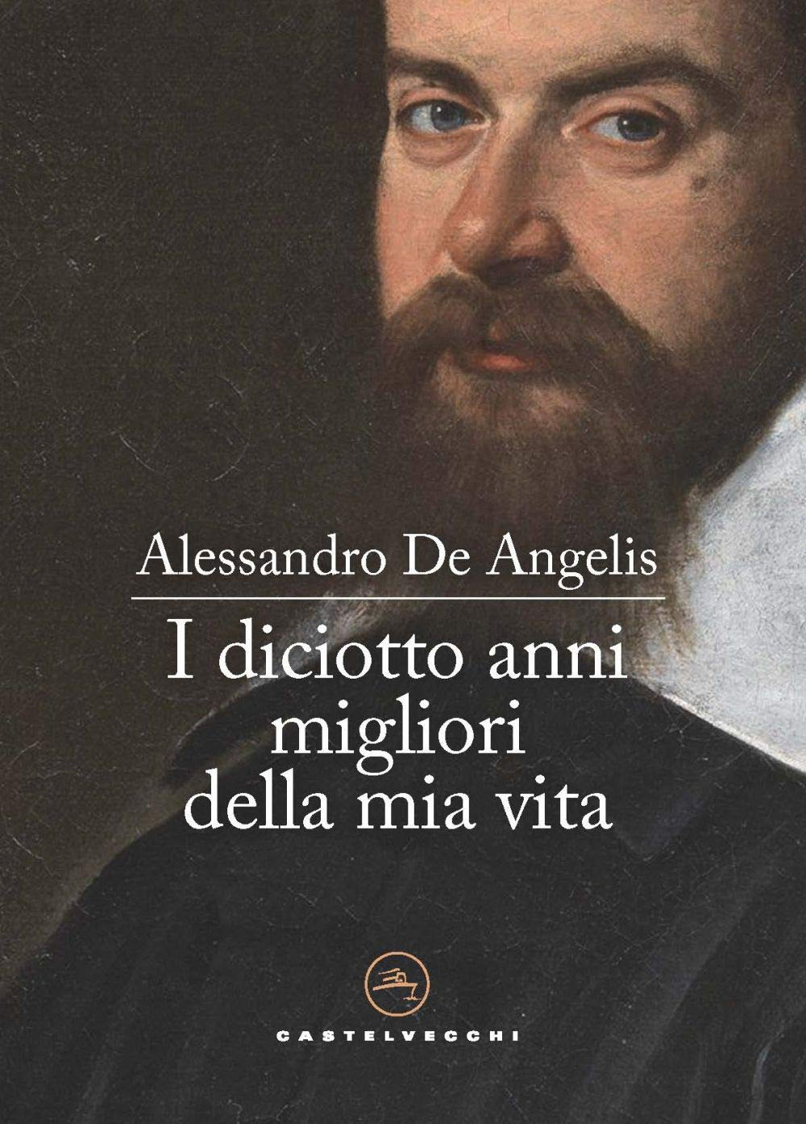
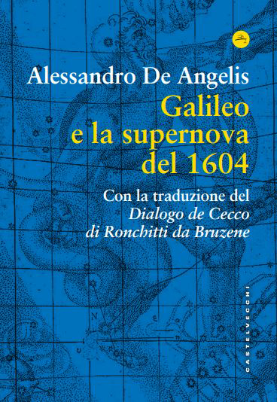
A few nice books not by me and three by me
(a personal selection)
(Translated into Portuguese)
(Translated into English)
(Translated into English
& French)

