Slide 1

alberto.mengoni@cern.ch
Bologna, 21-22 November 2024

Slide 2

News
2024 run >> almost completed (18 March – 25 November, 252 days, 36 weeks, ∼9 months)
Futura Working groups
  n_ACT@BDF completed, EOI submitted to CERN/SPSC (C Lederer-Woods) >>
  Detector development WP produced final report (N Patronis)
  Official request for beam-line modification for the n_TOF TRANS station submitted (O Aberle)
  images >> of n_TOF spallation target #2 autopsy released
  FRC meeting set for 5 December 2024, at 15:00 at CERN
  EURO-LABS general meeting held at CERN 27-30 October 2024
  NuPECC Long-Range plan 2024 document presented in Brussels >>
    fair representation of n_TOF (mentioned 23 times)

Slide 3
The End

Slide 4
2024 run: n_TOF-IT 1/3
11 ex, 3 dd/dt, 2 td
from mid-March through end-November 2024
reaction | motivation |  | n_TOF area
^{28,29,30}Si(n,γ) | isotopic abundances in pre-solar grains nucleosynthesis in massive stars | INTC-P-653 | EAR1 + EAR2
²⁴Mg(n,n’) | HPGe + LaBr3(Ce) detector test new reaction channel investigations | INTC-I-261 | EAR1
Ce(n,f) | search for new fission modes in light systems around Z=60 | INTC-P-665 | EAR1
^{166,167}Er(n,γ) | burnable neutron absorbers for nuclear technologies | INTC-P-656 | EAR1
²⁰⁹Bi(n,γ) | radiological burden associated to ²¹⁰Po inventory termination point of the s-process nucleosynthesis | INTC-P-675 | EAR2
¹⁴⁶Nd(n,γ) | s-process nucleosynthesis in AGB stars | INTC-P-671 | EAR2
⁸⁸Zr(n,γ) ☢️ | extremely large neutron absorption cross section radioactive sample with t_{1/2}= 83.4 d | INTC-P-693 | EAR2

Slide 5
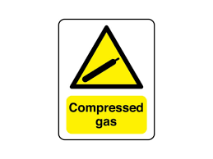
2024 run: n_TOF-IT 2/3
11 ex, 3 dd/dt, 2 td
from mid-March through end-November 2024
reaction | motivation |  | n_TOF area
^{92,97,98}Mo(n,γ) | multiple nucleosynthesis processes for different stable isotopes development of nuclear fuel for advanced nuclear reactors | INTC-P-569-ADD-1 | EAR1 + EAR2
²³⁸U(n,γ) ☢️ | key reaction for any nuclear technology applications | INTC-P-672 | EAR1
^{63,65}Cu(n,γ) | advanced nuclear technologies applications s-process nucleosynthesis about the iron peak | INTC-P-689 | EAR1
⁴⁰Ar(n,γ) | understanding neutron propagation in argon first capture measurement on a gas sample at n_TOF | INTC-I-256 | EAR2
⁴⁰K(n,p), (n,⍺) | s-process nucleosynthesis in massive stars radioactive heating of earth-like exoplanets | INTC-645 | EAR2

Slide 6
2024 run: n_TOF-IT 3/3
11 ex, 3 dd/dt, 2 td
from mid-March through end-November 2024
reaction | motivation |  | n_TOF area
¹²C(n,lcp) | neutrons from high-energy accelerators and cosmic rays radiation protection in proton radiation therapy centers | INTC-651 | EAR1
(n,cp) | GEMpix + nTD detector test | INTC-P-629 | EAR1 + EAR2
various | neutron beam filtering technique | INTC-P-623 | NEAR
11 experiments
3 detector test/development
2 technique development

Slide 7
The MArEX* initiative at n_TOF
⁴⁰Ar(n,γ) | understanding neutron propagation in argon first capture measurement on a gas sample at n_TOF | INTC-I-256 | EAR2
* Multiple Argon Experiments

Slide 8
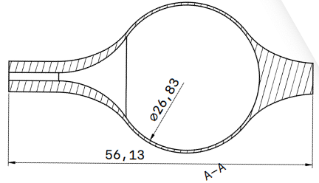
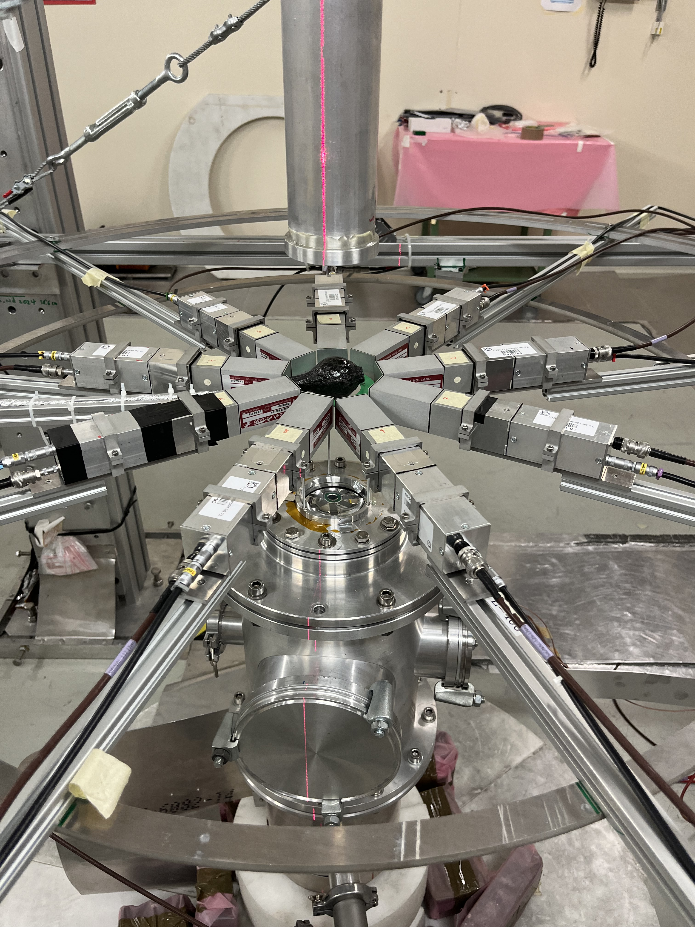
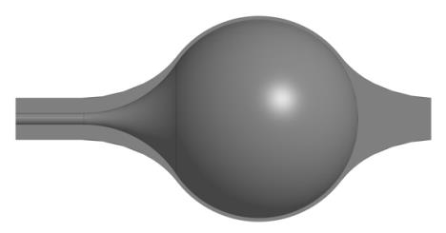
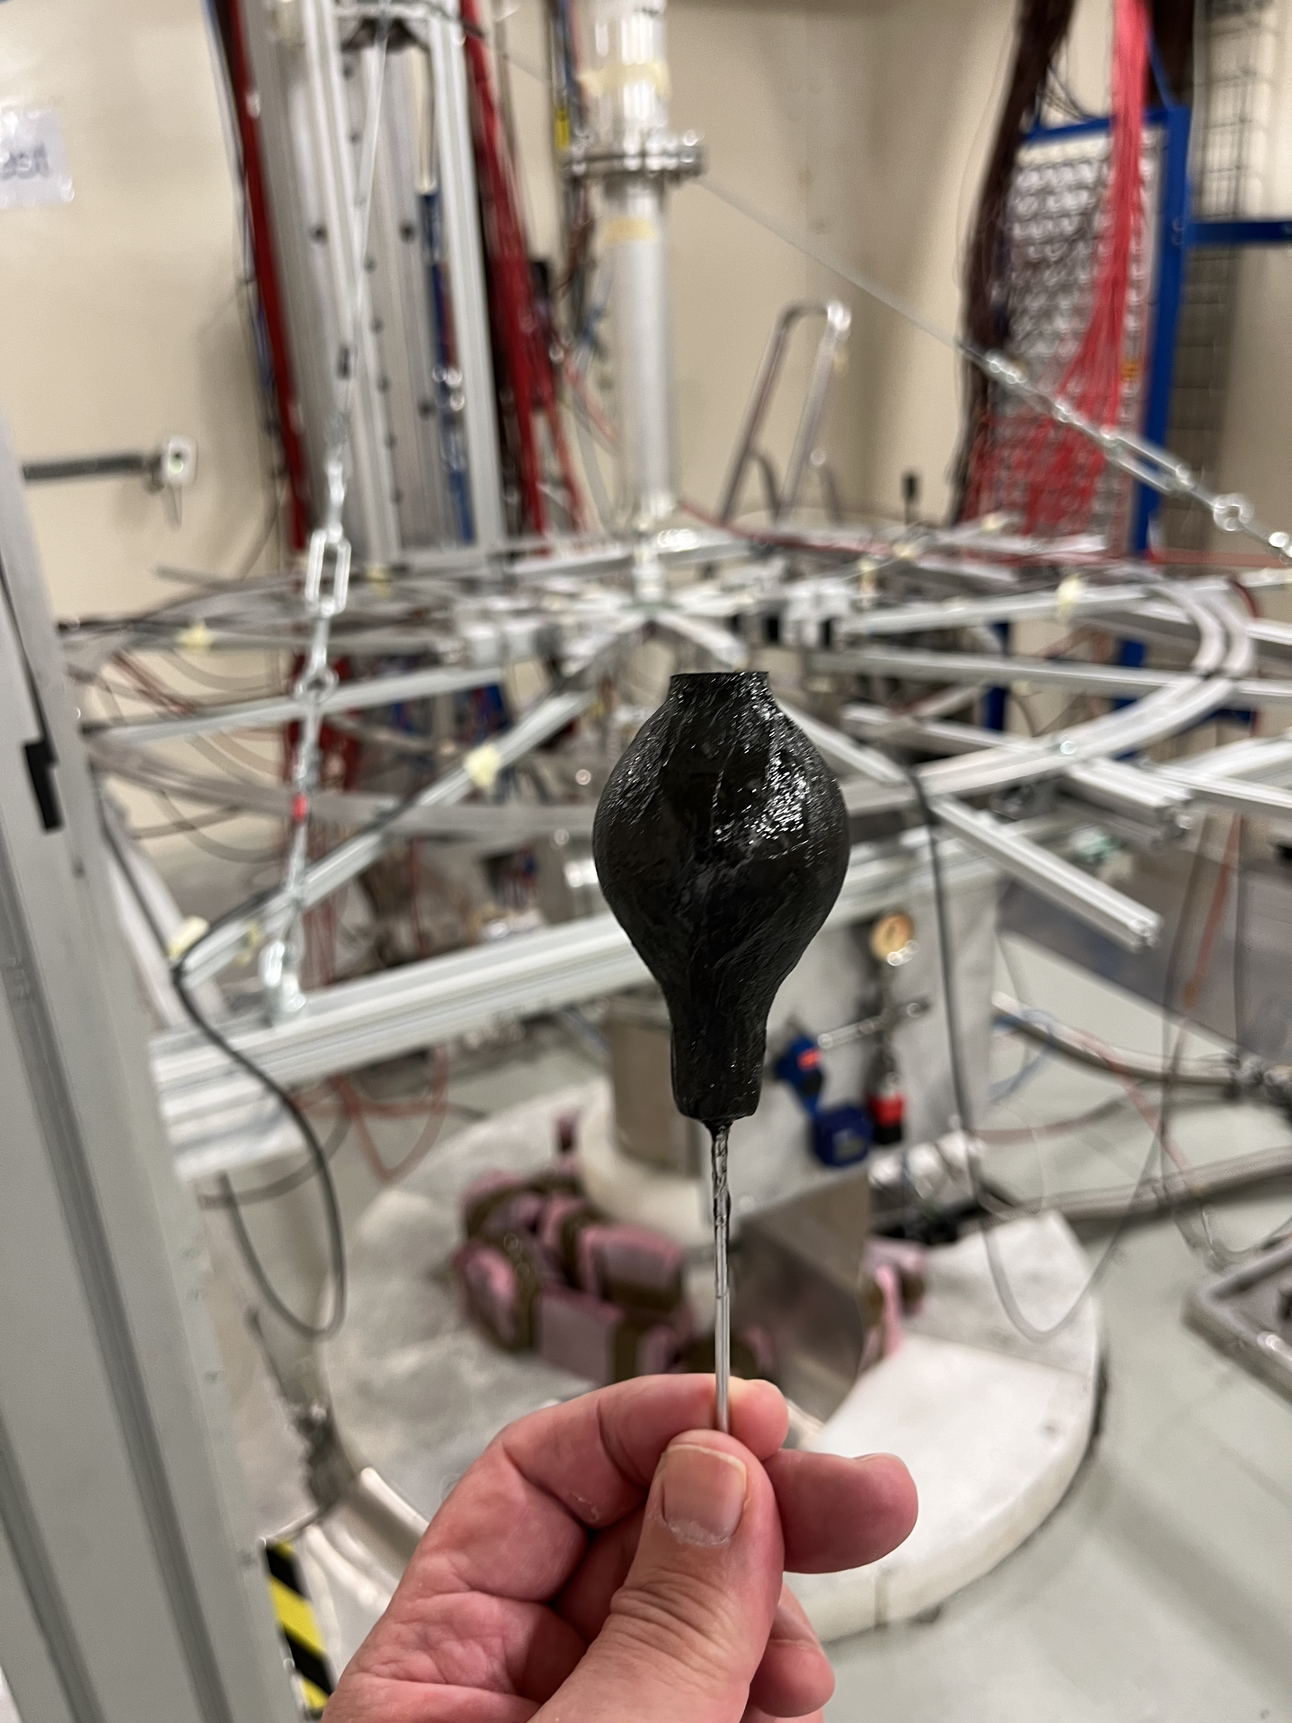
The MArEX* initiative at n_TOF
⁴⁰Ar(n,γ) | understanding neutron propagation in argon first capture measurement on a gas sample at n_TOF | INTC-I-256 | EAR2
First neutron capture measurement
on a gas target performed at n_TOF
200 bar Argon gas-cell developed
by the n_TOF Collaboration
full operation watched over by CERN
safety authorities (including RP)
* Multiple Argon Experiments

Slide 9
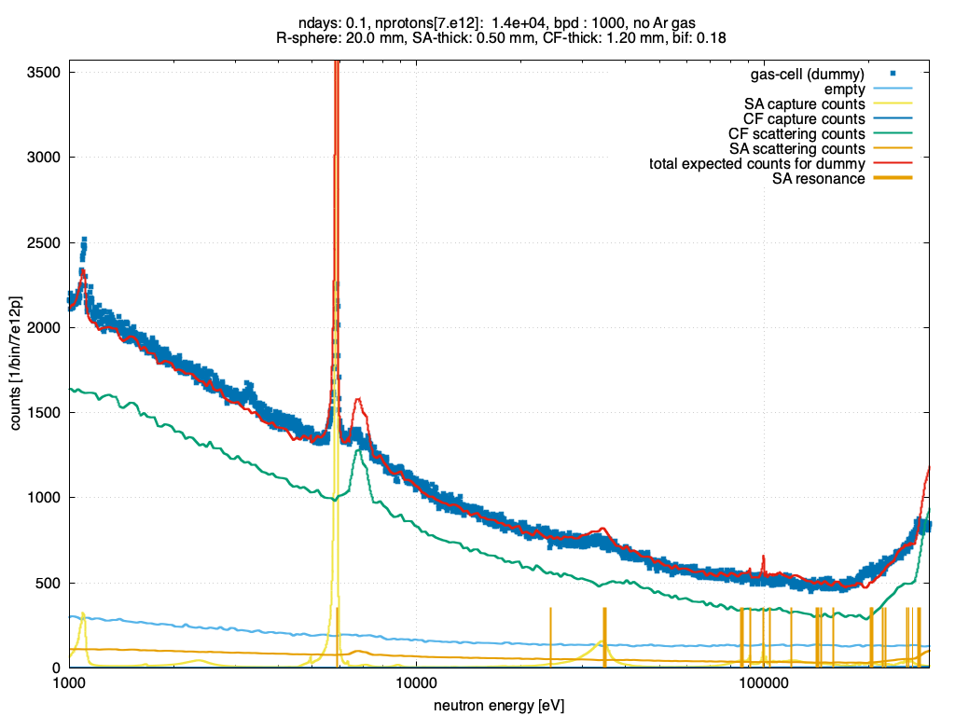
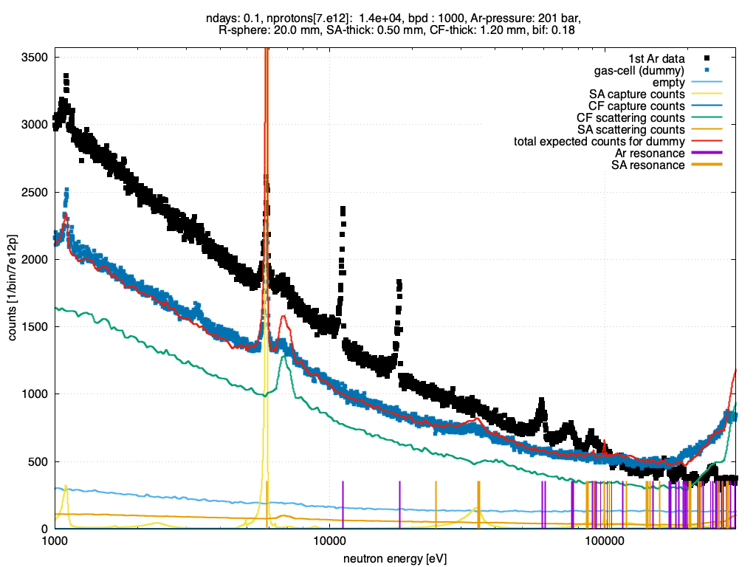
The MArEX* initiative at n_TOF
⁴⁰Ar(n,γ) | understanding neutron propagation in argon first capture measurement on a gas sample at n_TOF | INTC-I-256 | EAR2
⁴⁰Ar resonances
⁴⁰Ar neutron resonances clearly visible
* Multiple Argon Experiments

Slide 10
<< back

Slide 11


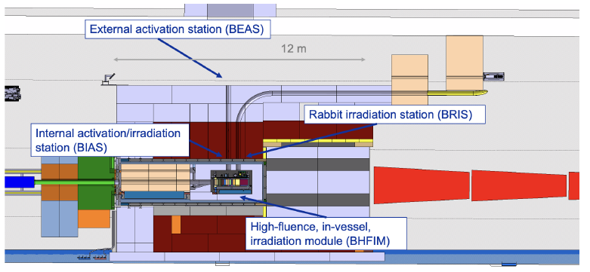
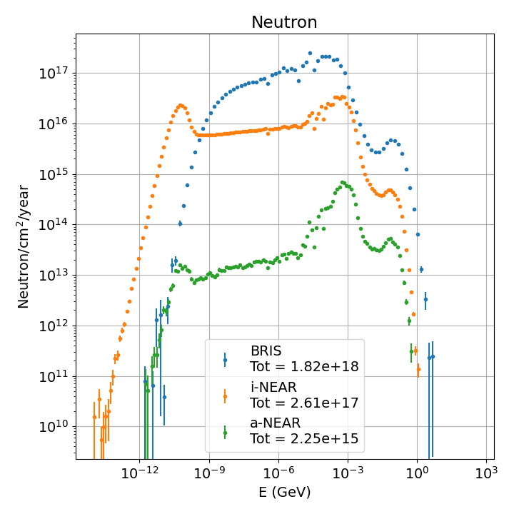
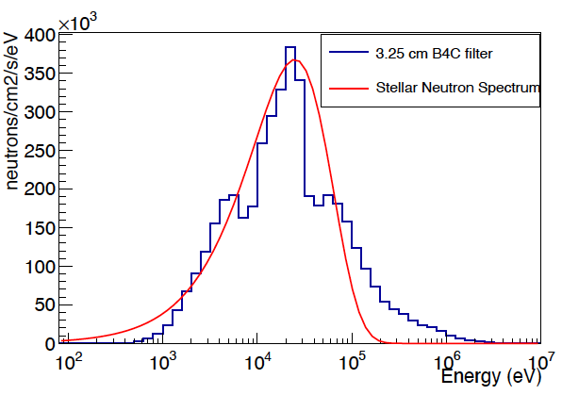
n_Act@BDF – Neutron Activation Station at the SPS Beam Dump Facility
CERN-SPSC-2024-027 / SPSC-EOI-023
from C Lederer-Woods et al.
Parasitic use for neutron cross section measurements
Unique installation providing ultra high neutron fluxes over a wide energy range for activation measurements – complementary to n_TOF capabilities
Proximity to ISOLDE – measurements on radioactive nuclei
World-first measurements of key reactions for nuclear astrophysics and nuclear applications
Possible Activation Station
Flux 3-4 orders of magnitudes higher than at present n_TOF NEAR
Filters create quasi- stellar neutron spectra

Slide 12
<< back

Slide 13
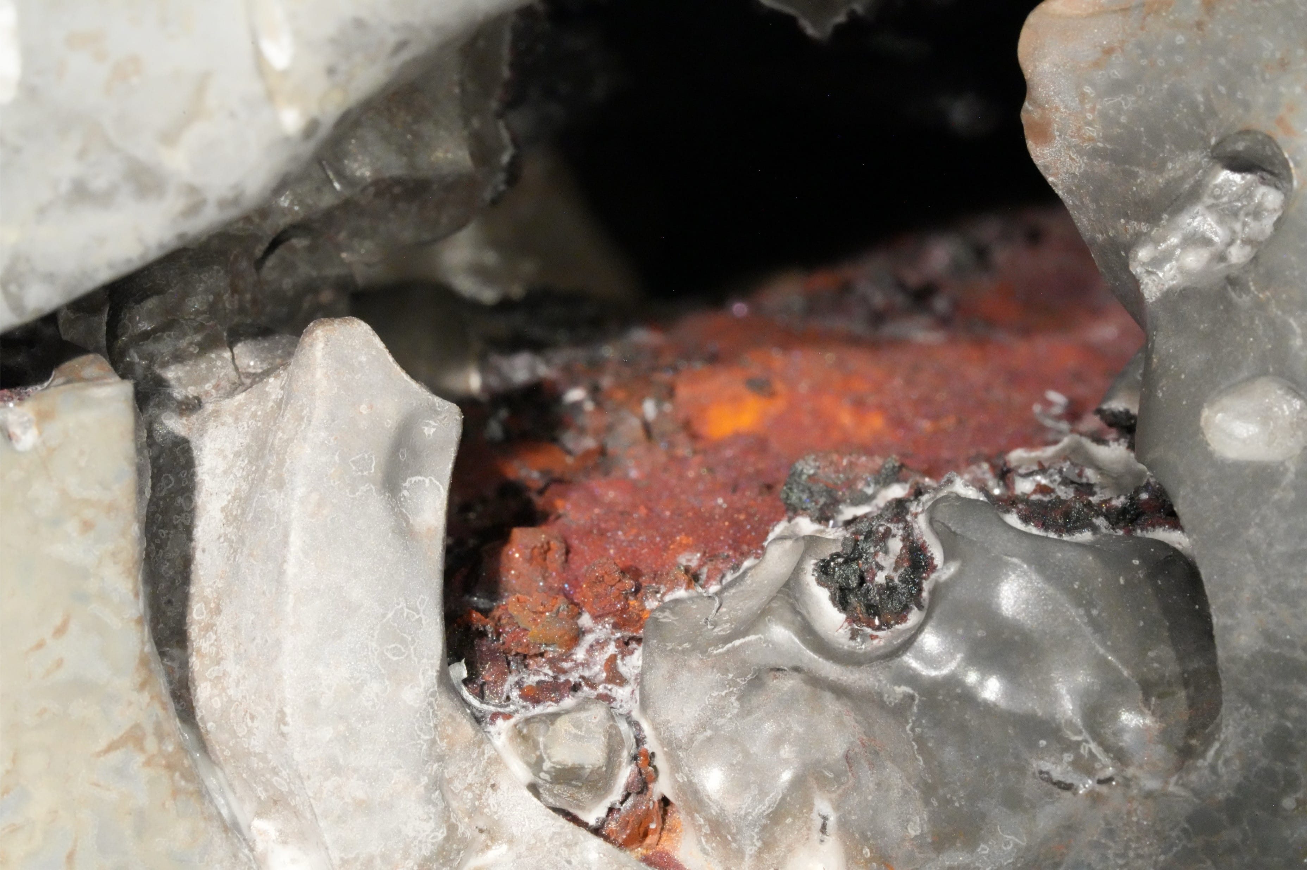
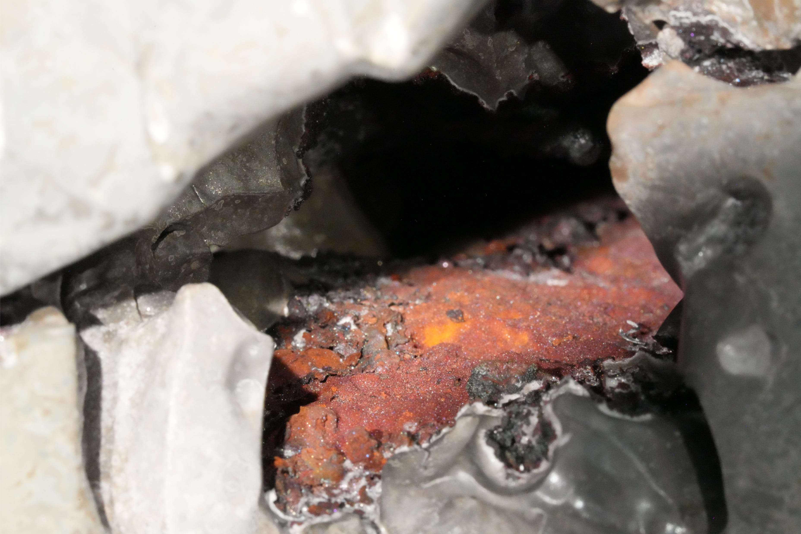
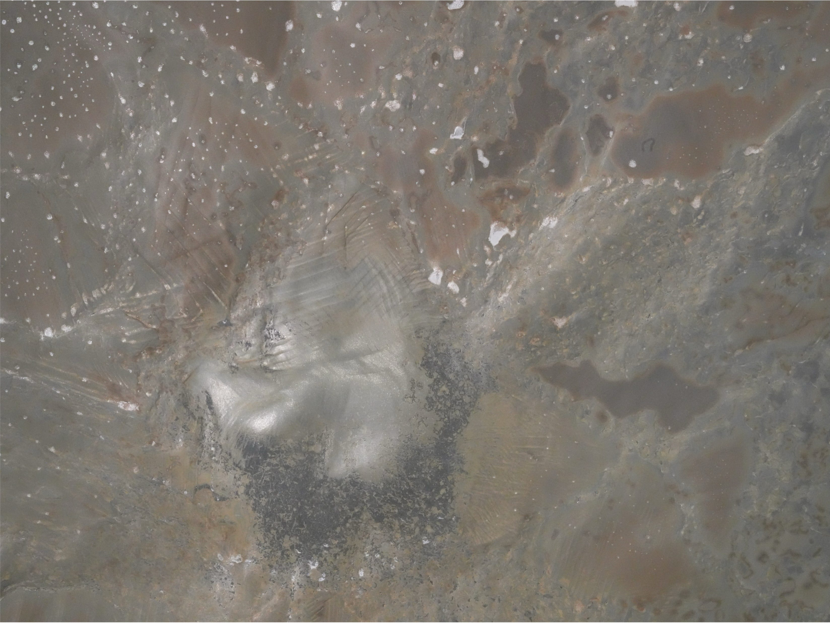
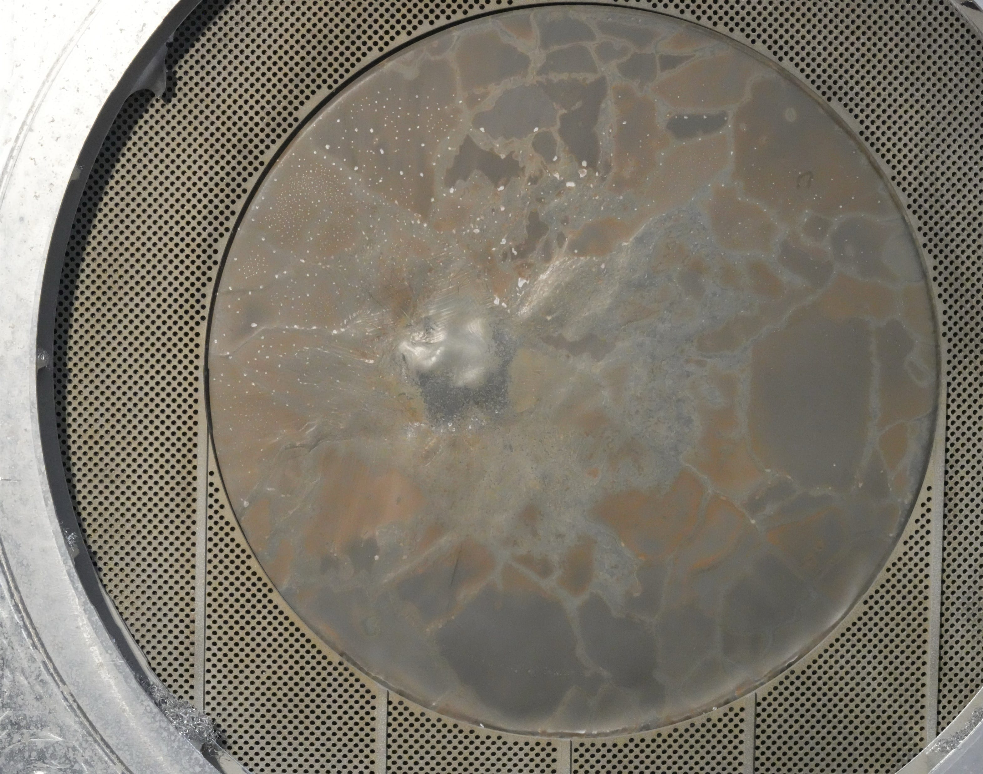
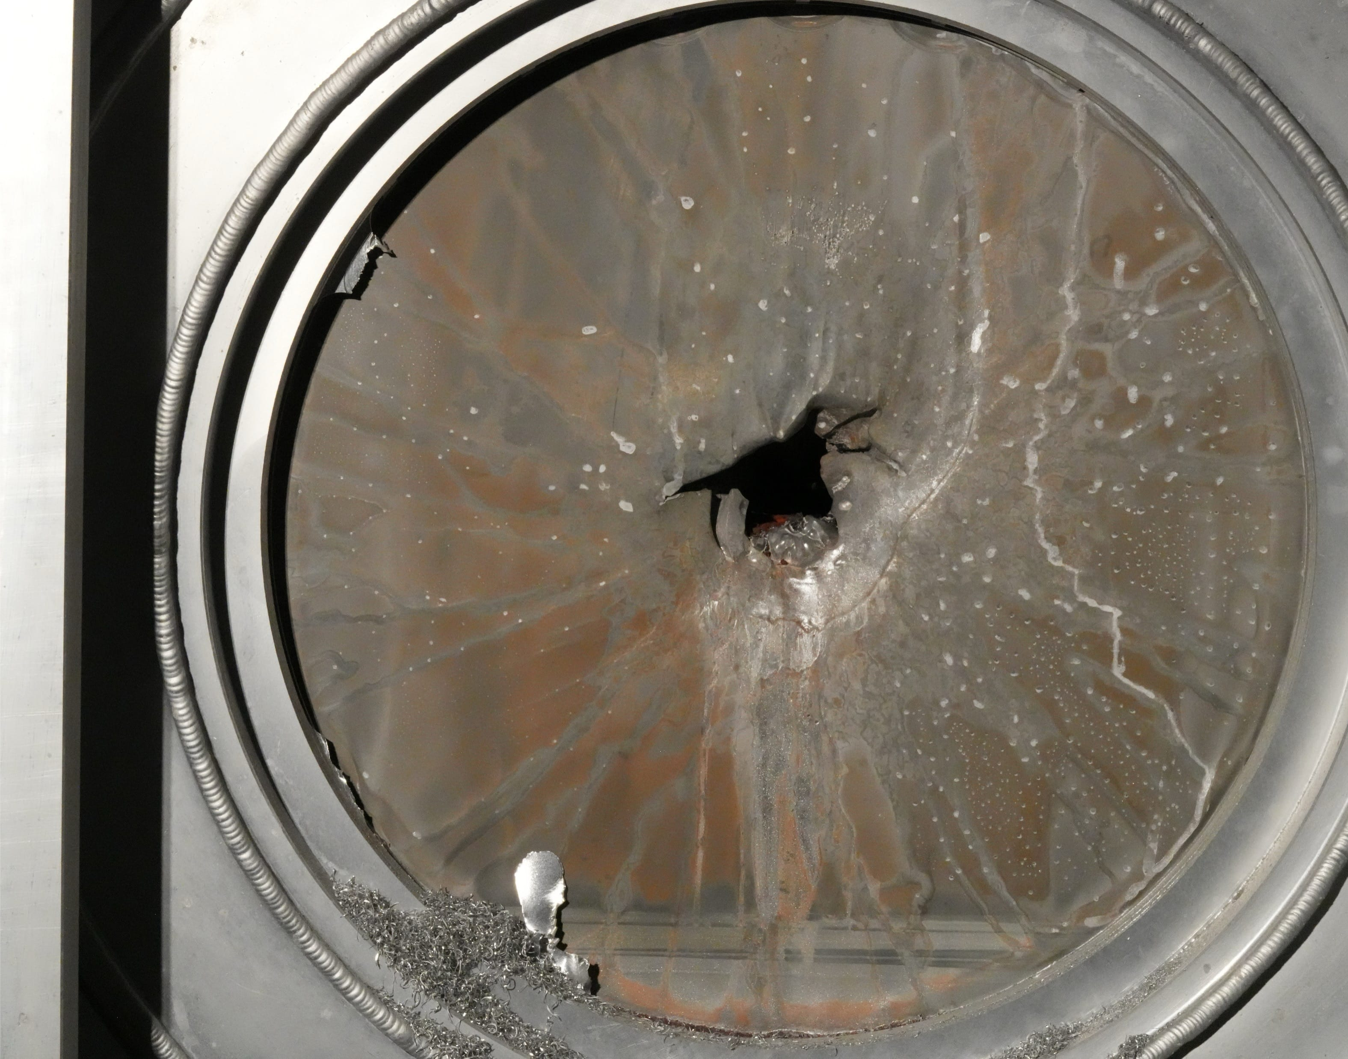

Slide 14
by Daniel Cano-Ott et al.
email of 30 October 2024

Slide 15
by Daniel Cano-Ott et al.
email of 30 October 2024

Slide 16
by Daniel Cano-Ott et al.
email of 30 October 2024

Slide 17
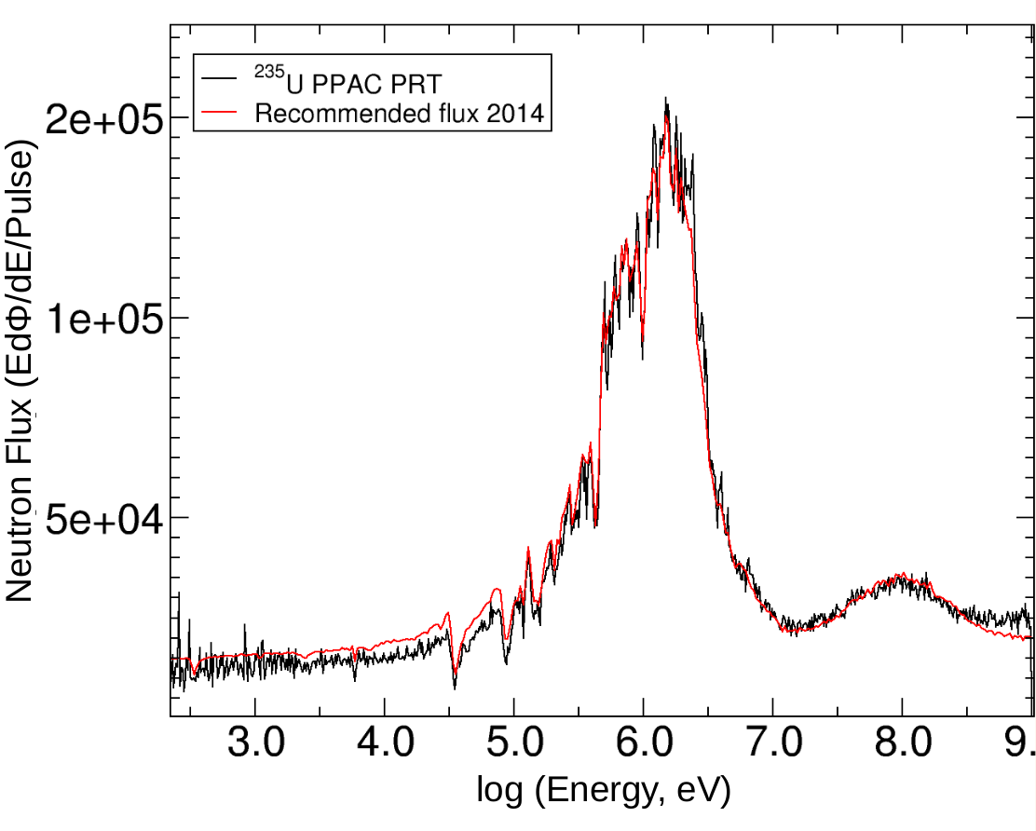
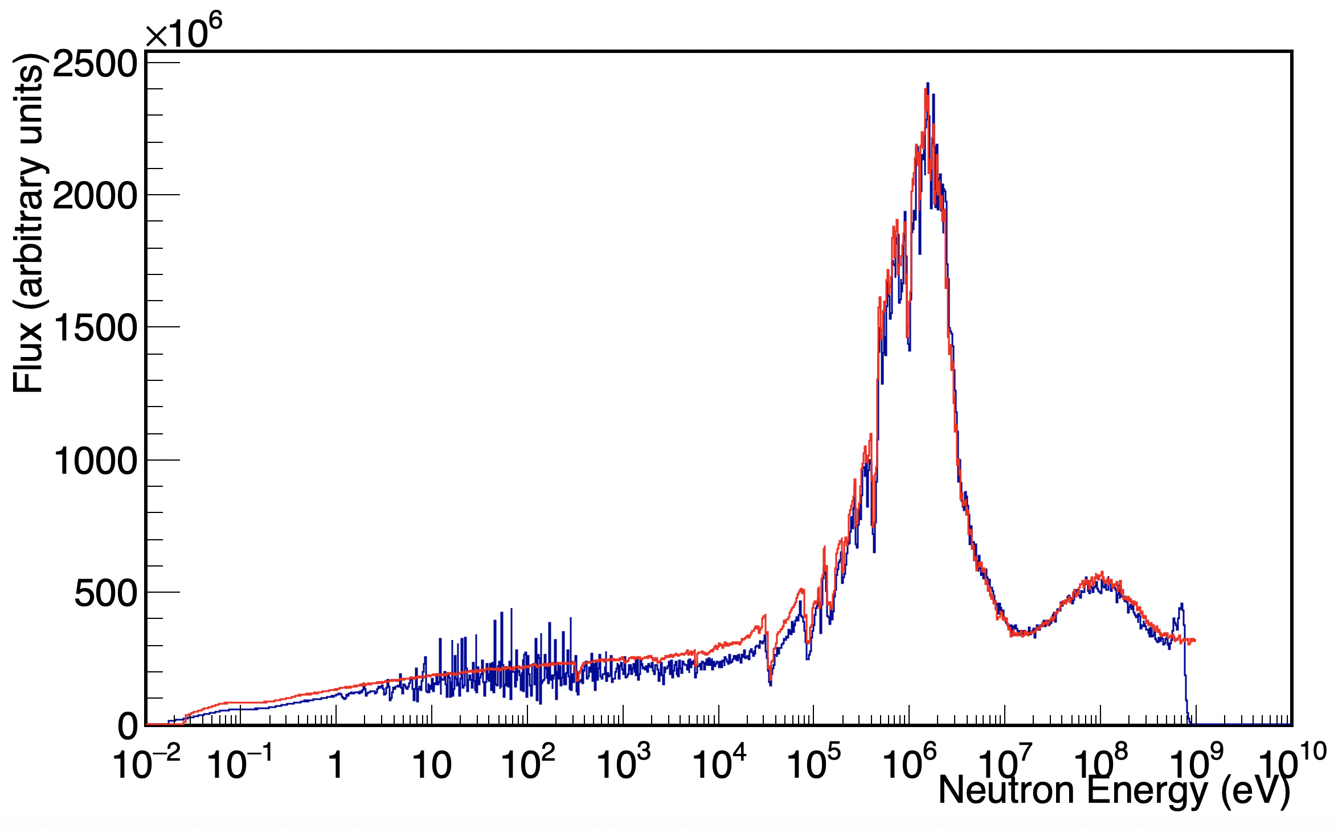
<< back
Dear all,
This is to confirm what Daniel obtained with the simulations.
You can find attached here two pictures where the 2014 evaluated flux is reported in red (for both the plots) together with the flux obtained in EAR1 in 2018 with the PPAC (U5, with the capture collimator) and the uMegas (by Veatriki with U5, with the fission collimator). As you can see, in both measurements we were not able to reproduce the shape obtained in 2014 with exactly the same trend found in the simulations, with less neutron produced for energy lower than about 1 MeV.
Have a nice weekend.
Cheers,
Alice
<< back

Slide 18
<< back

Slide 19
<< back
https://www.nupecc.org/lrp2024/Documents/nupecc_lrp2024.pdf

Slide 20
<< back

