Slide 1
Stilbene detectors: characterization, n+¹²C preliminary results and future developments
Musumarra, M.G. Pellegriti, D. Papanikolaou,
C. Massimi, R. Mucciola, R. Sahoo and N. Patronis
for the n_TOF collaboration
Meeting Nazionale n_TOF, Bologna 21/11/2024

Slide 2
OUTLOOK
1. Development motivations: (n,γ), (n,n) and (n,n’) reactions
2. LoI’s for PSTIL in-beam characterization @ n_TOF
3. PSTIL Structure and specs
4. Detector Characterization
5. Pulse Shape Discrimination (PSD)
6. Principal Component Analysis (PCA)
7. Preliminary results on ¹²C(n,n)¹²C measurement at EAR1
8. Summary of the activities in 2024
9. Status of the PSTIL set-up and Future developments
(2)
Papanikolaou Dimitrios/Pellegriti M. G.

Slide 3
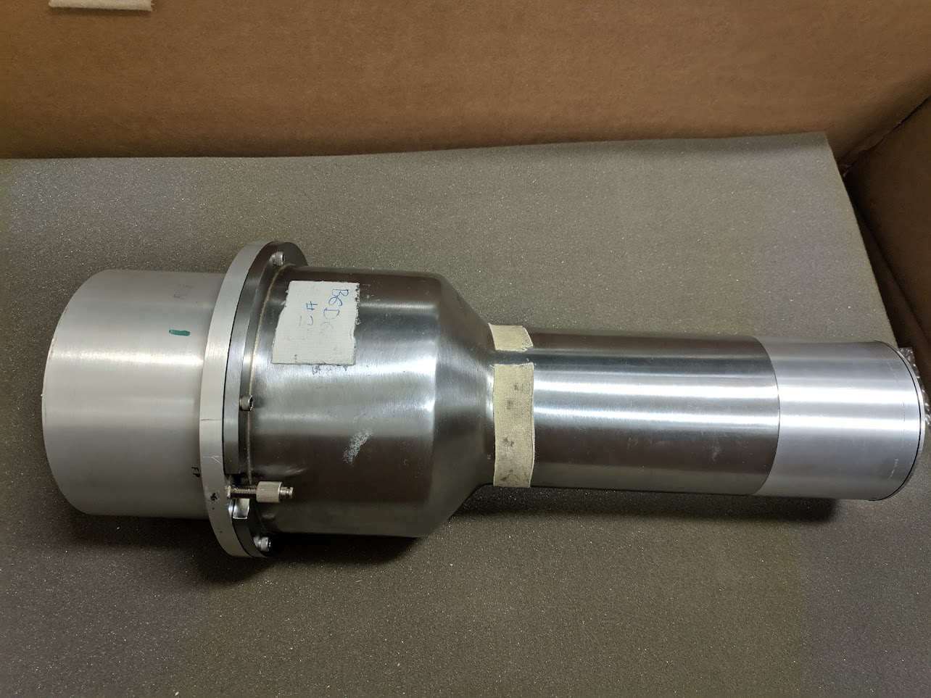
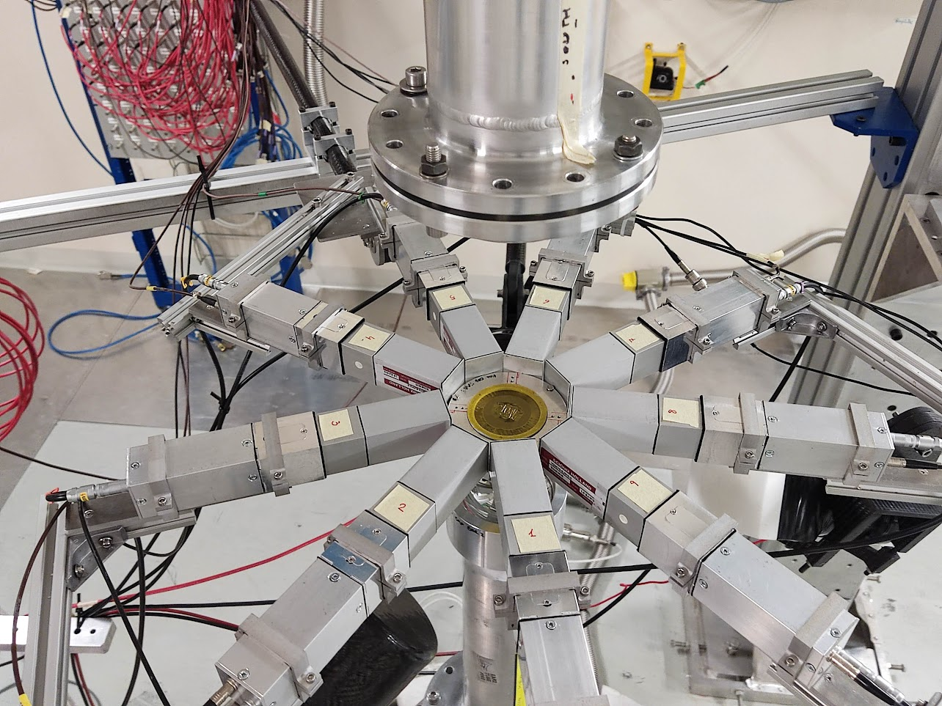
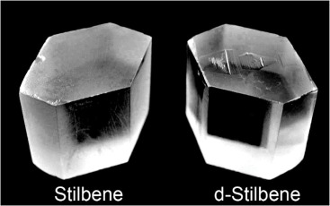
Motivation for developing the prototype: (n,γ) measurements
“Big” C₆D₆ Liquid scintillators
Compact array of small C₆D₆
Large & segmented C₆D₆
Solid organic scintillators
Read-outs/Power supplies
Solid
Higher density
No Chemical hazard
n/γ discrimination
(3)
Papanikolaou Dimitrios/Pellegriti M. G.

Slide 4
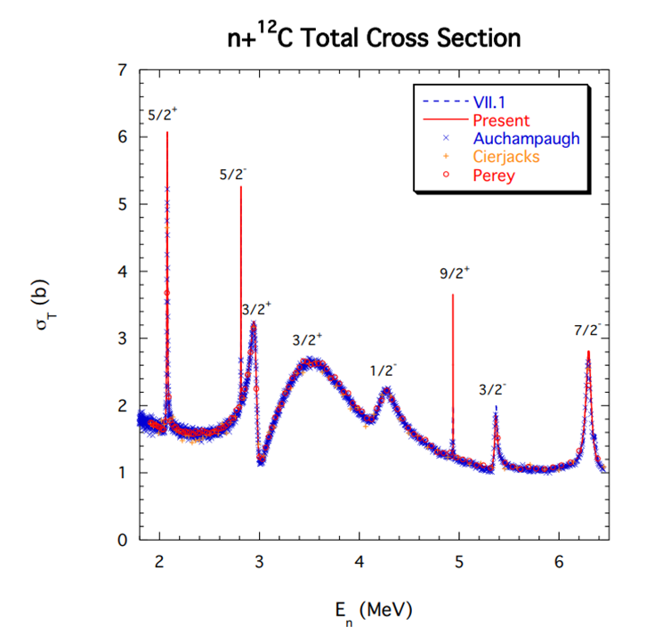
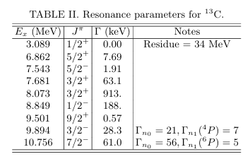
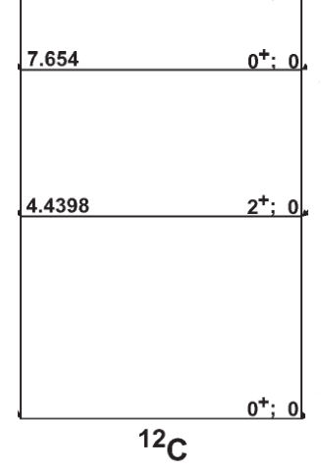
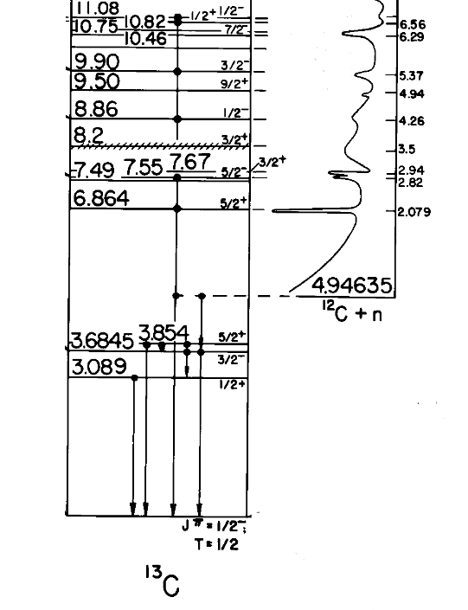
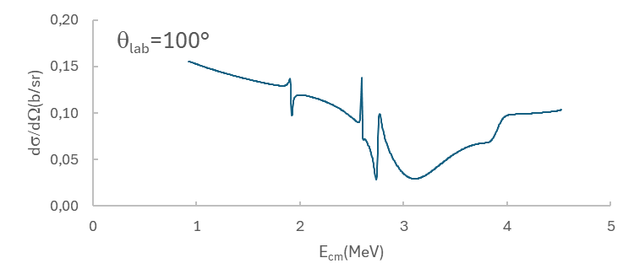
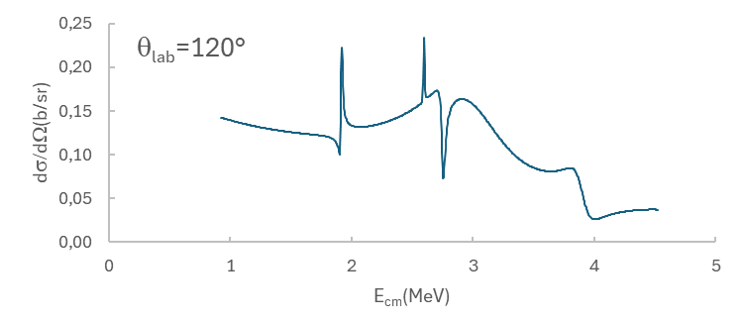
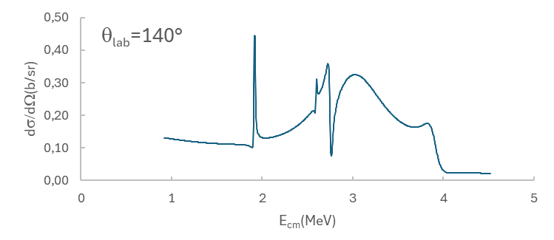
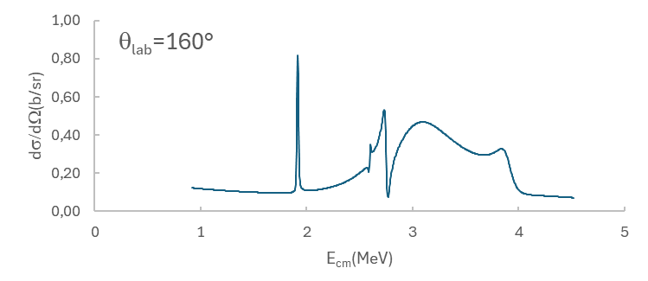
Motivation for developing the prototype: (n,n) and (n,n’)measurements
G.M. Hale, Nuclear Data Sheets 118 (2014) 165
¹²C(n,n)¹²C and ¹²C(n,n’)¹²C* benchmark
¹²C(n,n)¹²C
AZURE (R-matrix) calculations
(4)
Papanikolaou Dimitrios/Pellegriti M. G.

Slide 5
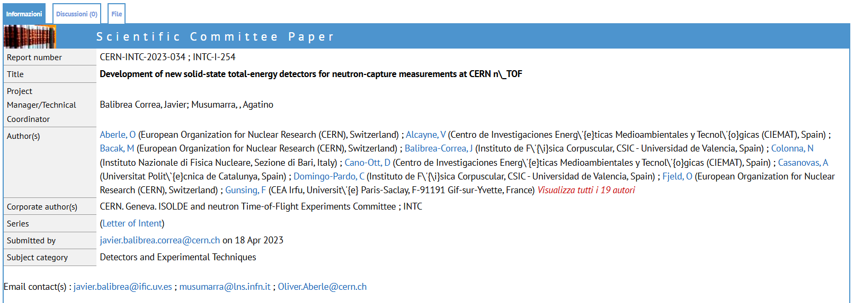
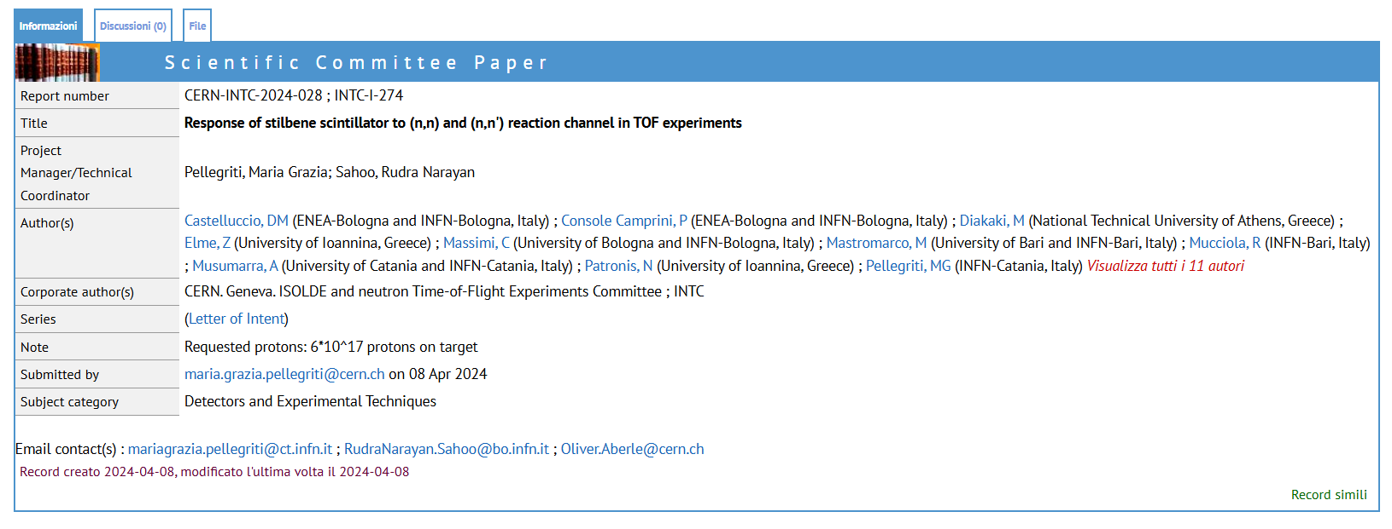
LoI’s for PSTIL in-beam characterization @ n_TOF
INTC
PSTIL 2023
EAR 2
INTC
PSTIL 2024
EAR 1
(5)
Papanikolaou Dimitrios/Pellegriti M. G.

Slide 6
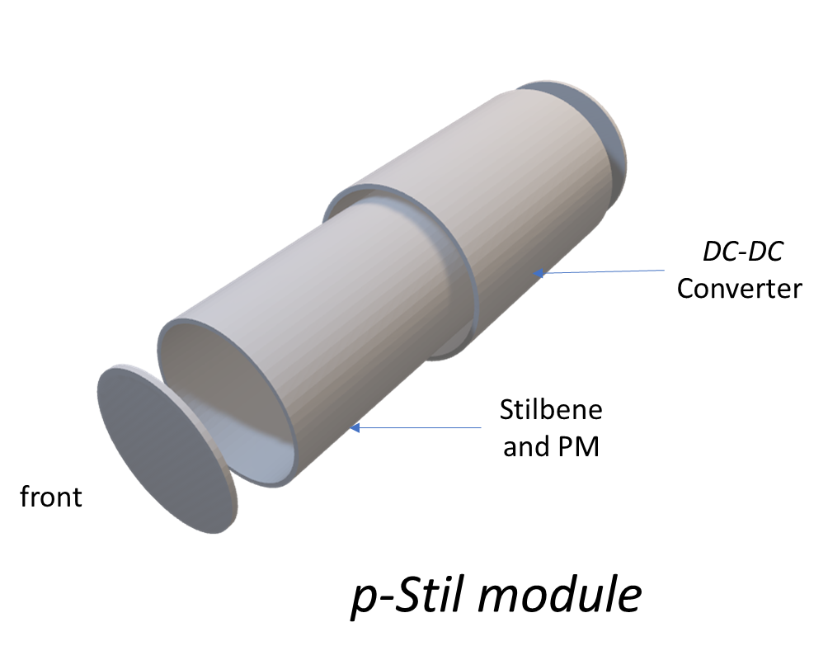
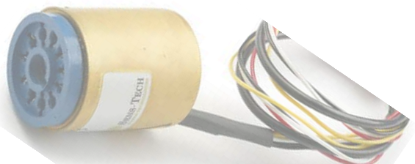
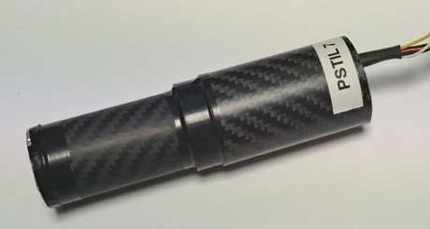
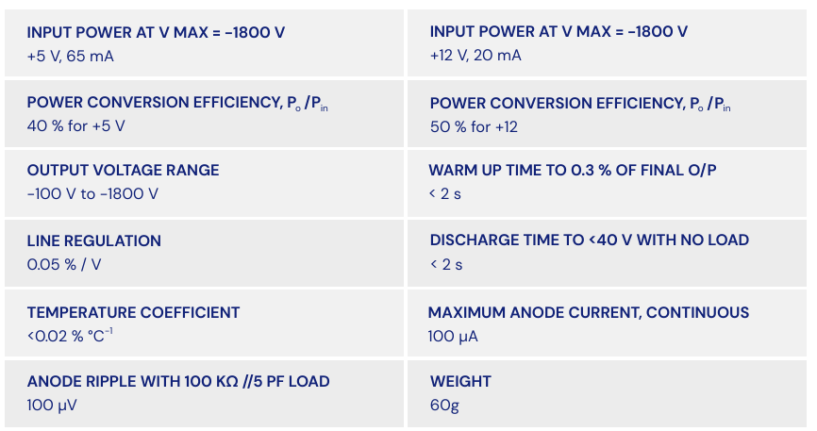
PSTIL structure and specs (Stilbene-cylinder 1’’x1’’ )
Development started on 2022
8 modules available 4 INRAD + 4 PROTEUS
Carbon Fibre housing
50 μm Al window
(6)

Slide 7
Contents
Detector Characterization (radioactive sources)
Pulse Shape Discrimination (PSD)
Principal Component Analysis (PCA)
Preliminary results on ¹²C(n,n)¹²C measurement at EAR1
Future Analysis
(7)

Slide 8
Detector Characterization
Detector Characterization
(8)
Papanikolaou Dimitrios/Pellegriti M. G.

Slide 9
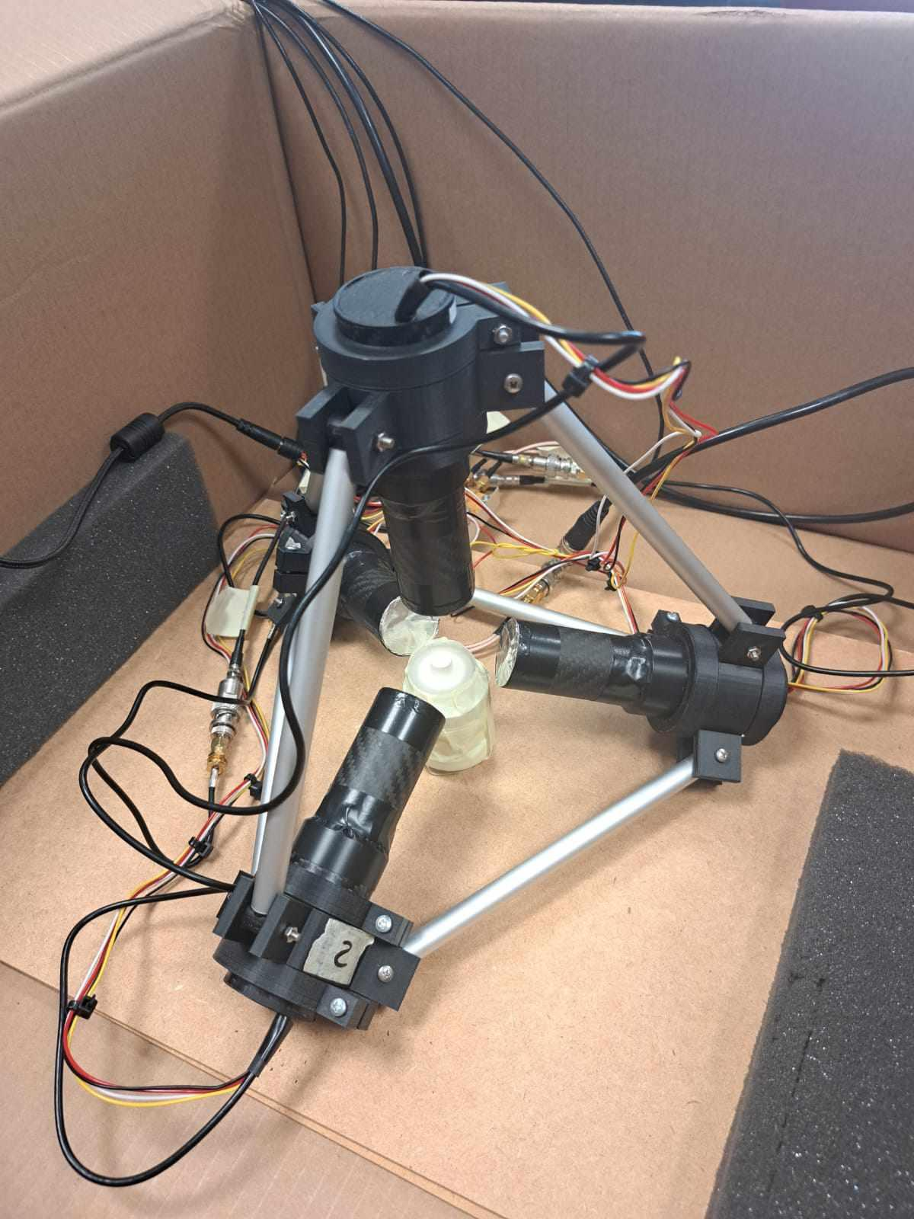
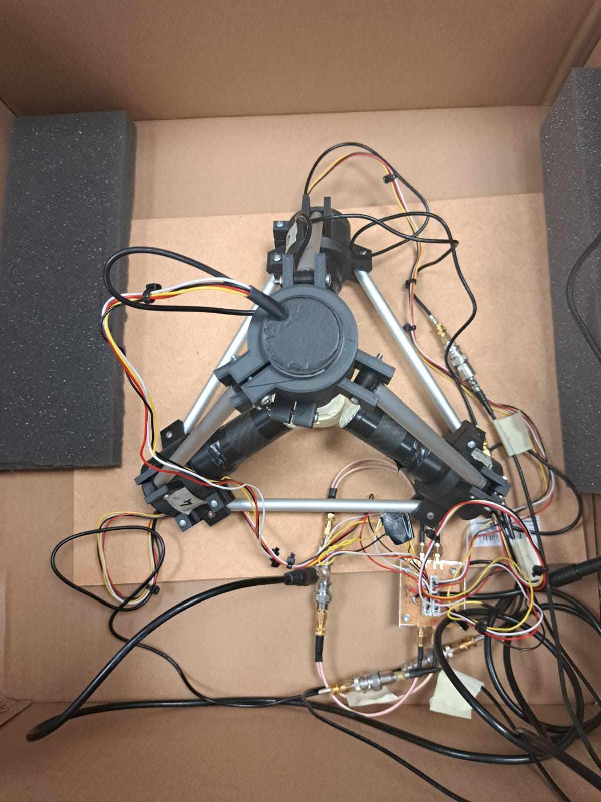
Experimental set-up used for characterization
Multi-Detector Array
Multi-Detector Array
pStil0 (PROTEUS)
pStil1-2-3 (INRAD)
**Developed at INFN-CT, Sezione di Catania**
Regular Tetrahydron base
Lightweight 3D-printed PLA holders
Thin hollow Al rods
Power Supply
Voltage Distributor (4 Channels)
source position
¹³⁷Cs, ⁶⁰Co or AmBe
(9)
Papanikolaou Dimitrios/Pellegriti M. G.

Slide 10
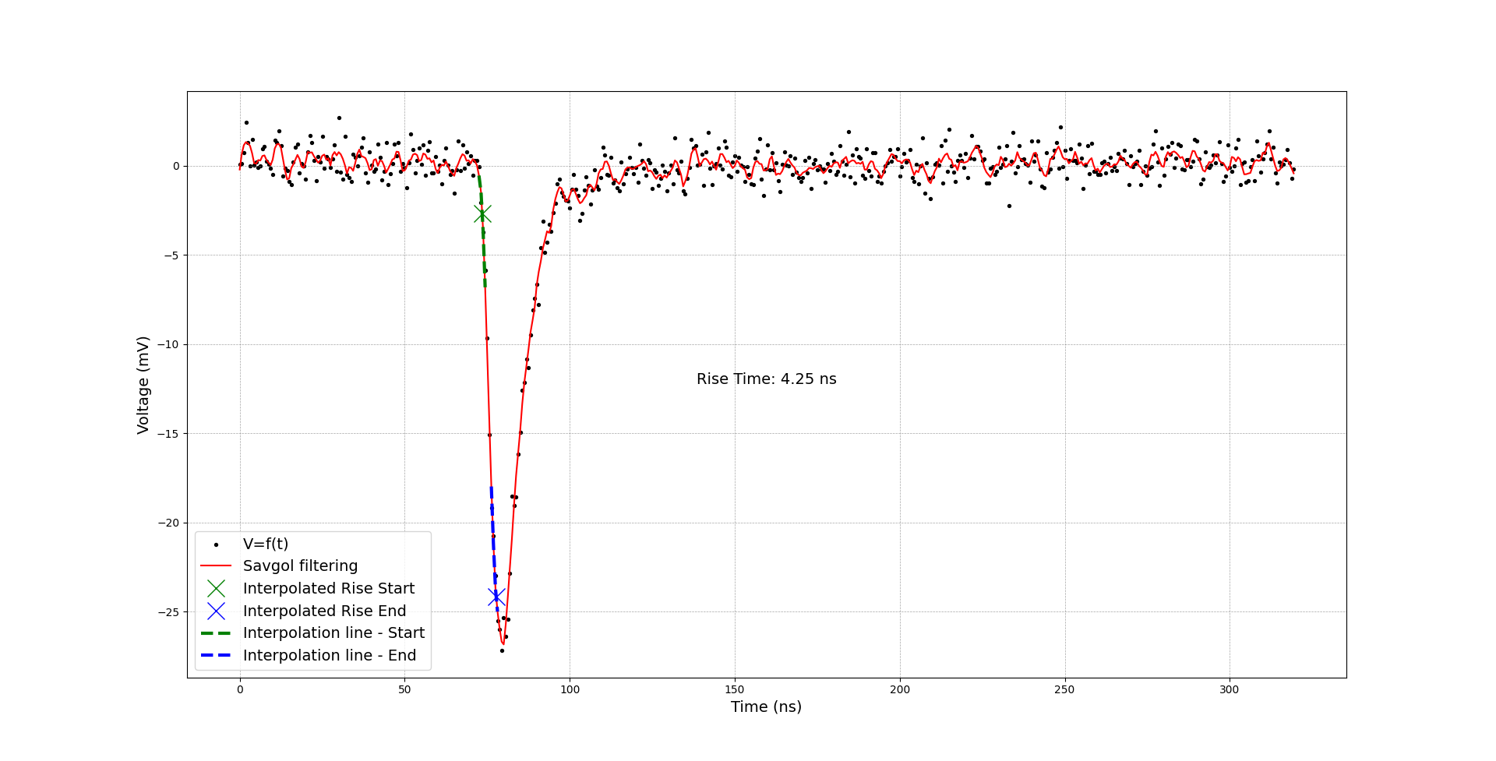
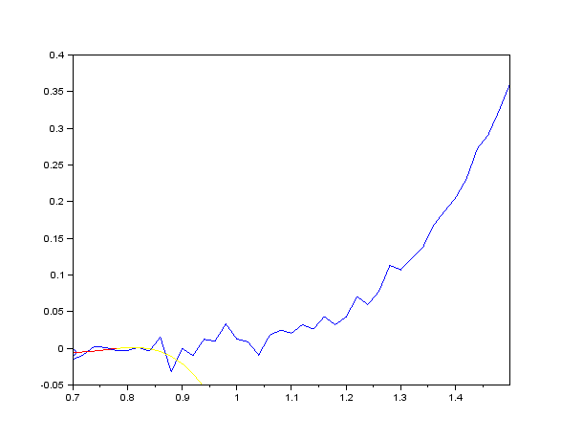
Detector Characterization: ¹³⁷Cs and ⁶⁰Co source
Rise/Fall time
Savitzky-Golay Filtering
Implementation of a signal smoothing process
10% - 90%
 | Rise Time (ns) | Fall Time (ns)
INRAD | 3.966 ± 0.003 | 14.13 ± 0.06
PROTEUS | 4.051 ± 0.002 | 14.43 ± 0.05
**Averaged for ~40000 events**
(10)
Papanikolaou Dimitrios/Pellegriti M. G.

Slide 11
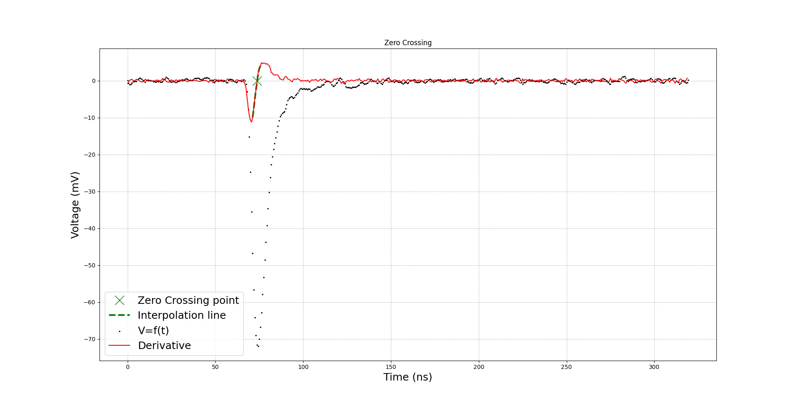
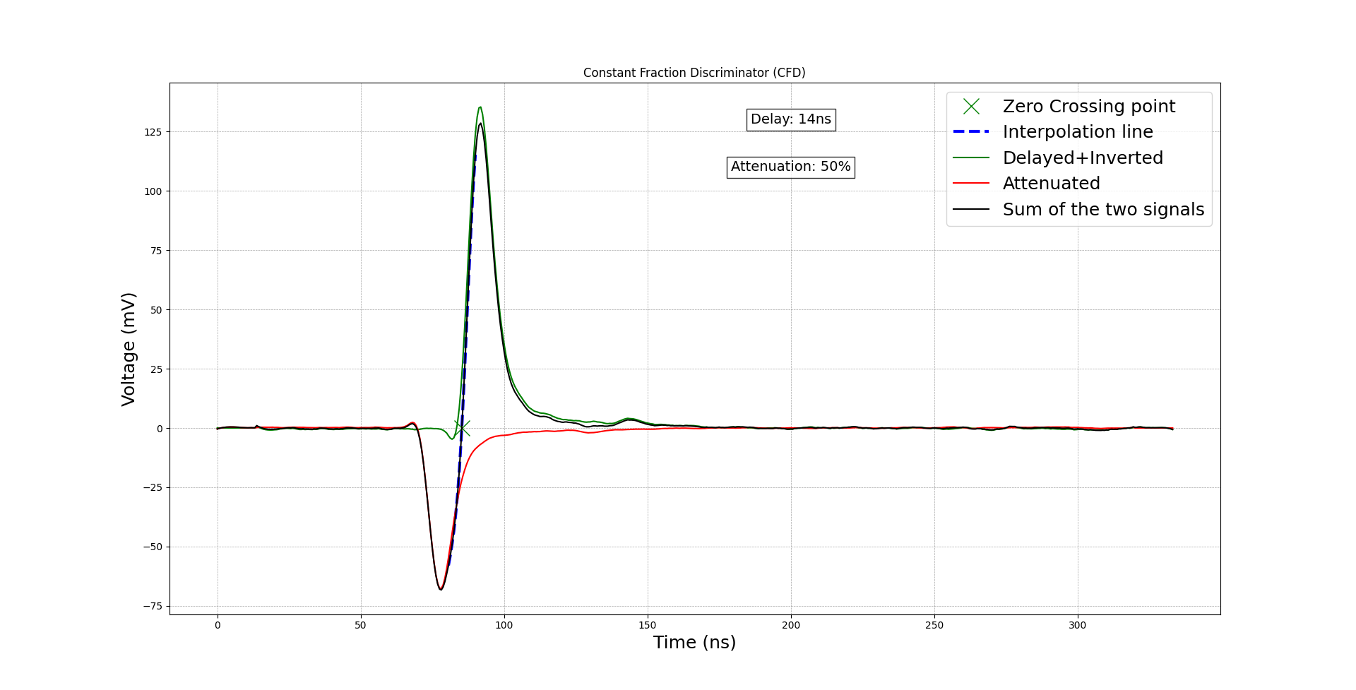
Detector Characterization
γ-γ Time Coincidence with ⁶⁰Co source
Time Pick-Off
Crossover Timing
Derivative method
Constant Fraction Discriminator (CFD) method
(11)
Papanikolaou Dimitrios/Pellegriti M. G.

Slide 12
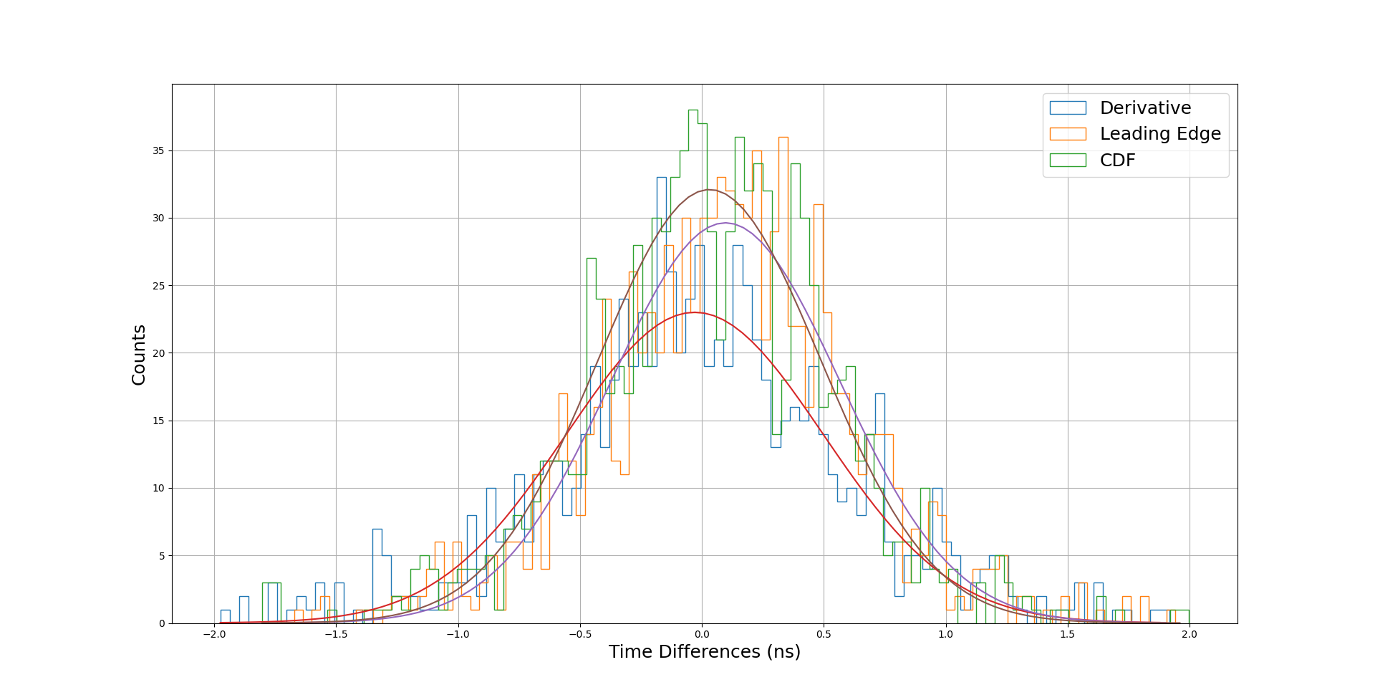
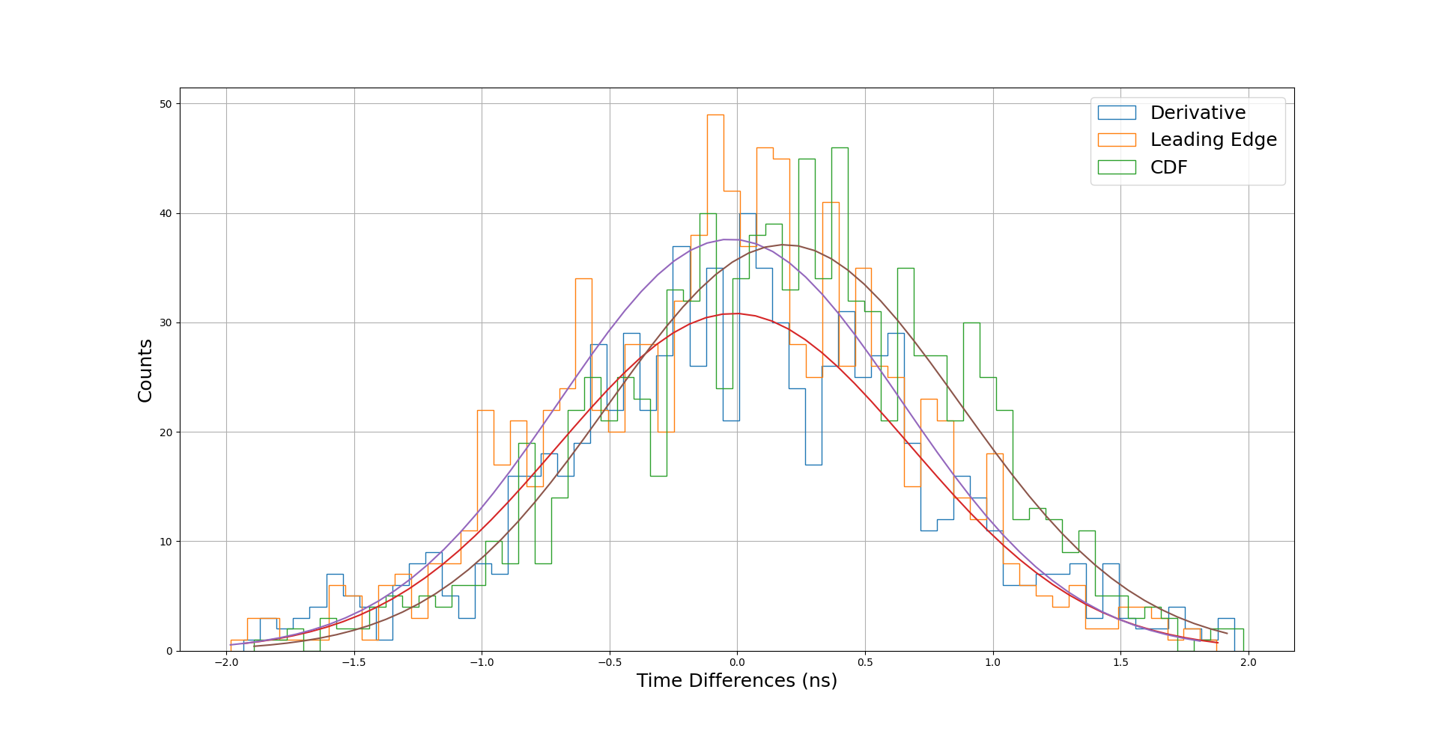
Detector Characterization
γ-γ Time Coincidence
Time Resolution
PROTEUS - INRAD
INRAD - INRAD
Time Resolution (ns)
 | INRAD - PROTEUS | INRAD - INRAD
Derivative | 0.74 ± 0.03 | 1.08 ± 0.02
Leading Edge | 0.78 ± 0.03 | 1.12 ± 0.02
CFD | 0.73 ± 0.03 | 1.13 ± 0.03
(12)
Papanikolaou Dimitrios/Pellegriti M. G.

Slide 13
Pulse Shape Discrimination (PSD)
Pulse Shape Discrimination (PSD)
(13)
Papanikolaou Dimitrios/Pellegriti M. G.

Slide 14
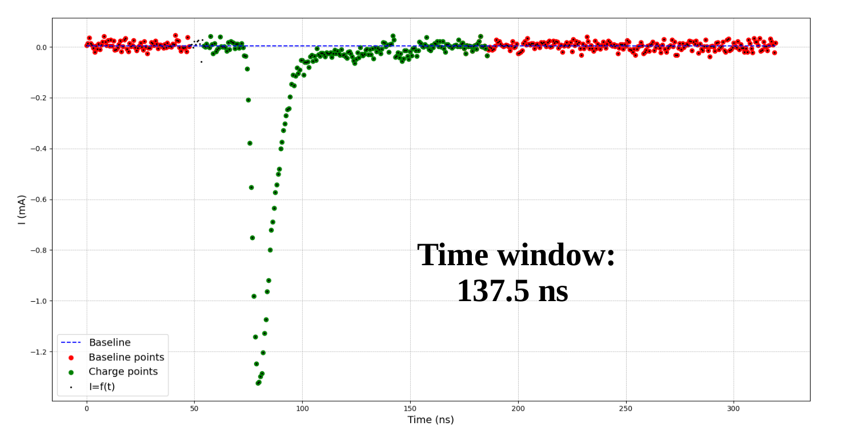
Pulse Shape Discrimination (PSD)
Methodology - Parameters
“Discrimination
Ratios”
Charge Integration
Method
(14)
Papanikolaou Dimitrios/Pellegriti M. G.

Slide 15
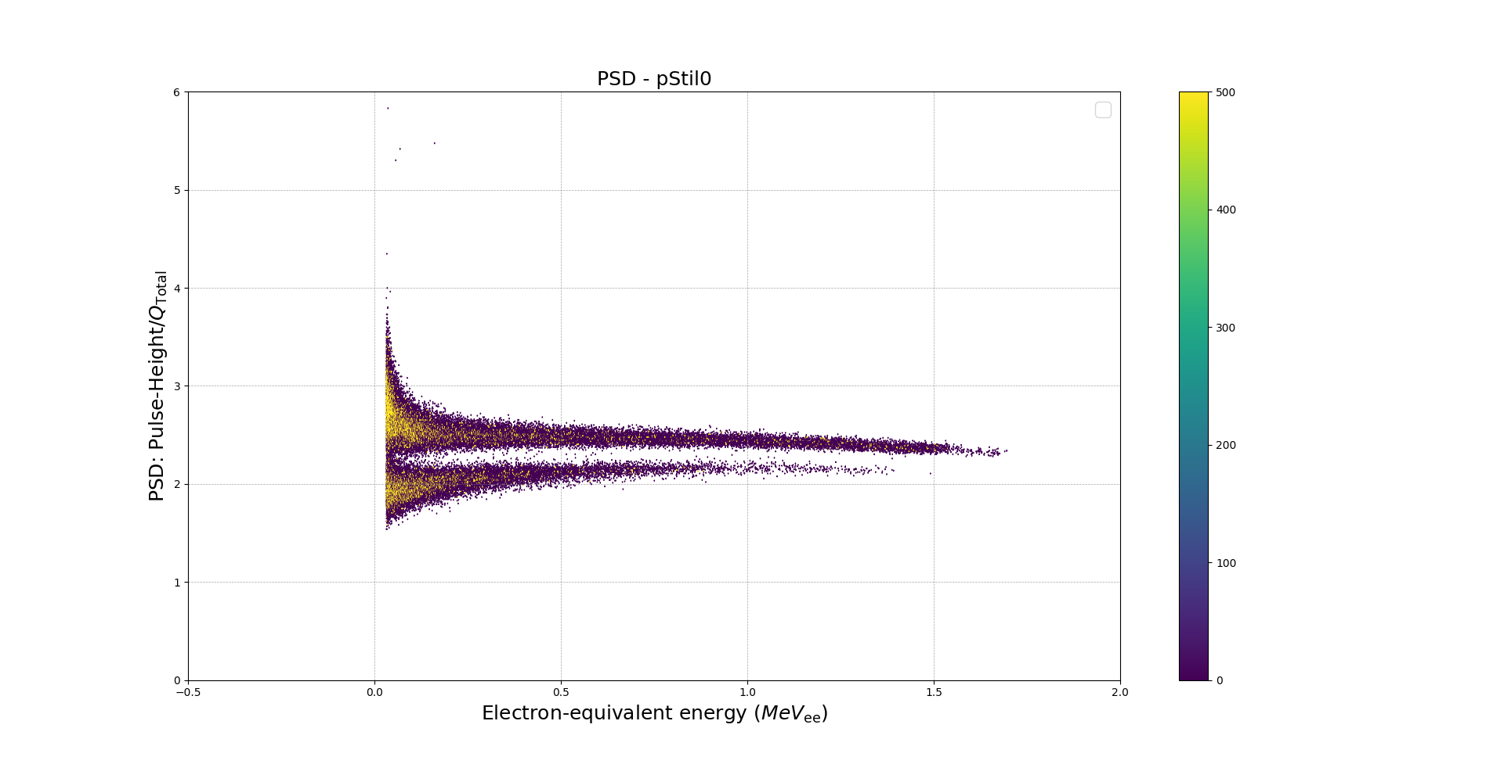
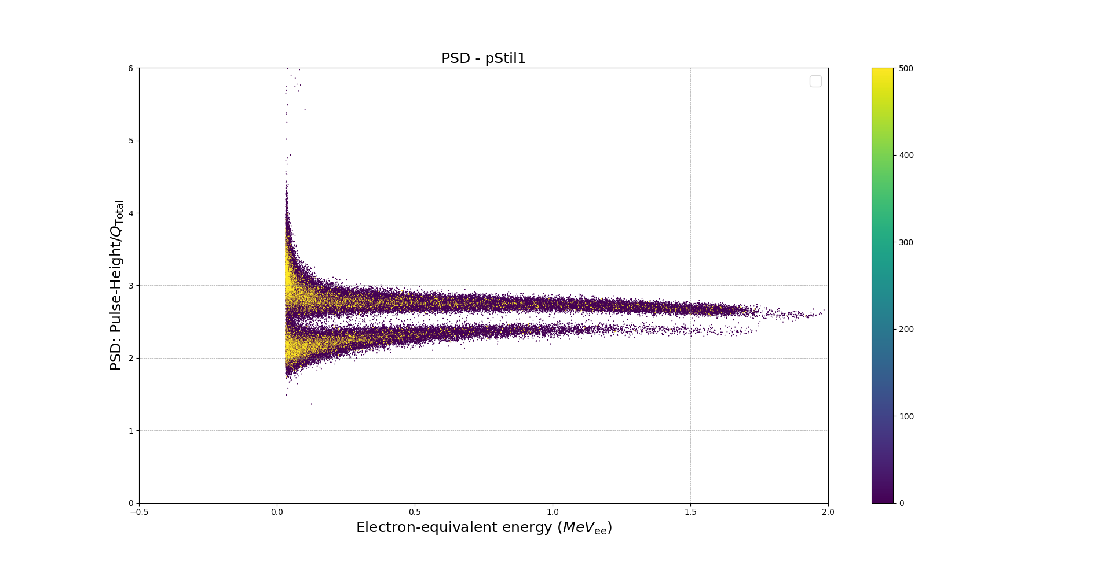
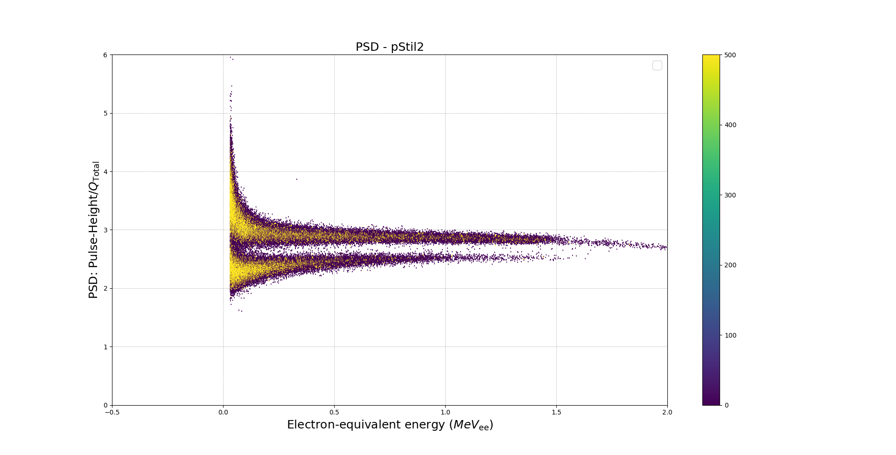
Pulse Shape Discrimination (PSD) - AmBe source
PSD Distributions
PROTEUS
INRAD
Using an ²⁴¹Am-Be source
**Provided by INFN-LNS**
INRAD
INRAD
-300 pC threshold to account for pile-up
(15)
Papanikolaou Dimitrios/Pellegriti M. G.

Slide 16
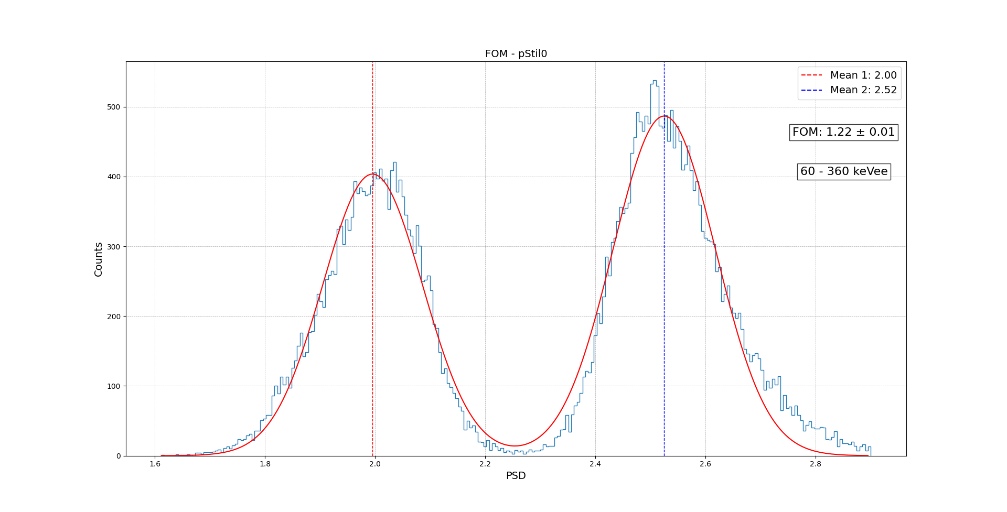
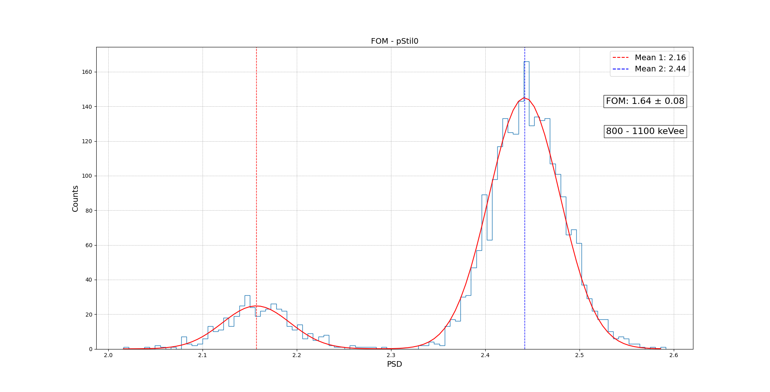
Pulse Shape Discrimination (PSD)
PSD FOM
Slicing the PSD Distributions
PSD FOM
 | 60-360 keVee | 800-1100 keVee
pStil0 - PROTEUS | 1.22 ± 0.01 | 1.64 ± 0.08
pStil1 - INRAD | 1.29 ± 0.01 | 1.69 ± 0.03
pStil2 - INRAD | 1.22 ± 0.01 | 1.86 ± 0.06
pStil3 - INRAD | 1.22 ± 0.01 | 1.60 ± 0.04
(60-360) keVee
(800-1100) keVee
(16)
Papanikolaou Dimitrios/Pellegriti M. G.

Slide 17
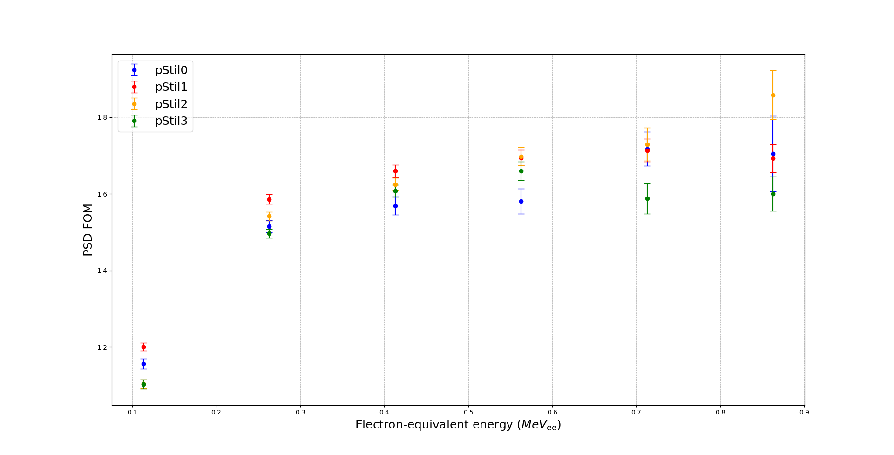
Pulse Shape Discrimination (PSD)
PSD FOM as a function of energy
Slicing the PSD Distributions
Difficult to comparatively assess the results!
Type of scintillator
QE of the PMT
Energy of the incident particles
Performance of electronics
**
Just accounting for the QE of a PMT, differences in FOM up to 30% can be introduced
**
(17)
Papanikolaou Dimitrios/Pellegriti M. G.

Slide 18
Principal Component Analysis (PCA)
Principal Component Analysis (PCA)
(18)
Papanikolaou Dimitrios/Pellegriti M. G.

Slide 19
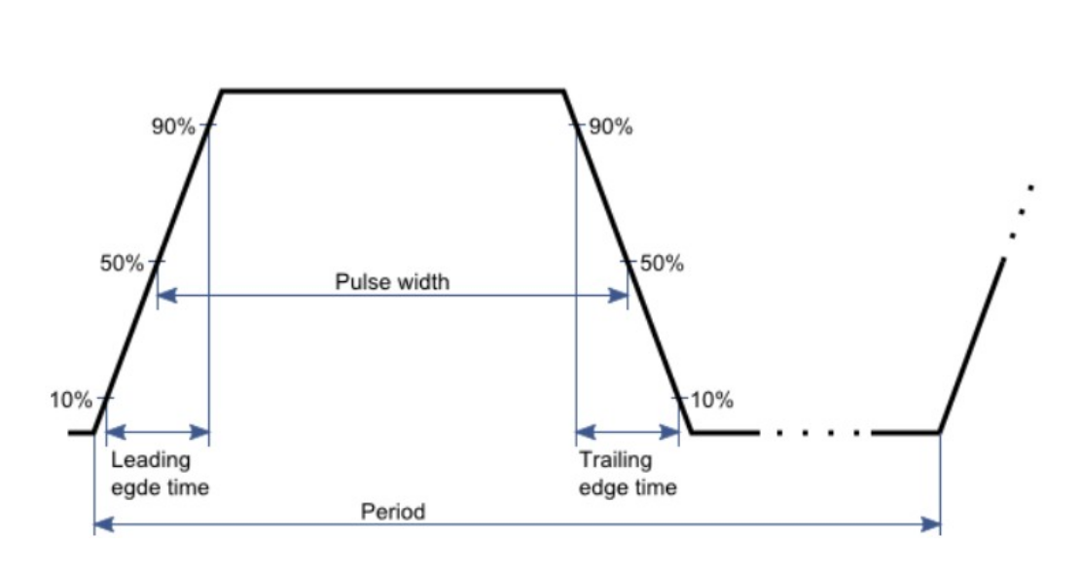
Principal Component Analysis (PCA)
So why PCA ?
5 Initial Parameters! ...
Pulse-height
Charge (short, long, tail)
Pulse-width
...
Pulse-width
**
A lot of missed opportunity
**
(19)
Papanikolaou Dimitrios/Pellegriti M. G.

Slide 20
Principal Component Analysis (PCA)
PCA – Scree Plots
% Variance
 | pStil0 | pStil1 | pStil2 | pStil3
PC1 | 87.0 | 85.7 | 85.0 | 85.3
PC2 | 10.0 | 11.0 | 11.5 | 11.3
SUM | 97.0 | 96.7 | 96.5 | 96.6
Lower the dimensionality from
5D to 2D !
Overall, more than 96% of the variation is preserved in the first two PCs
(20)
Papanikolaou Dimitrios/Pellegriti M. G.

Slide 21
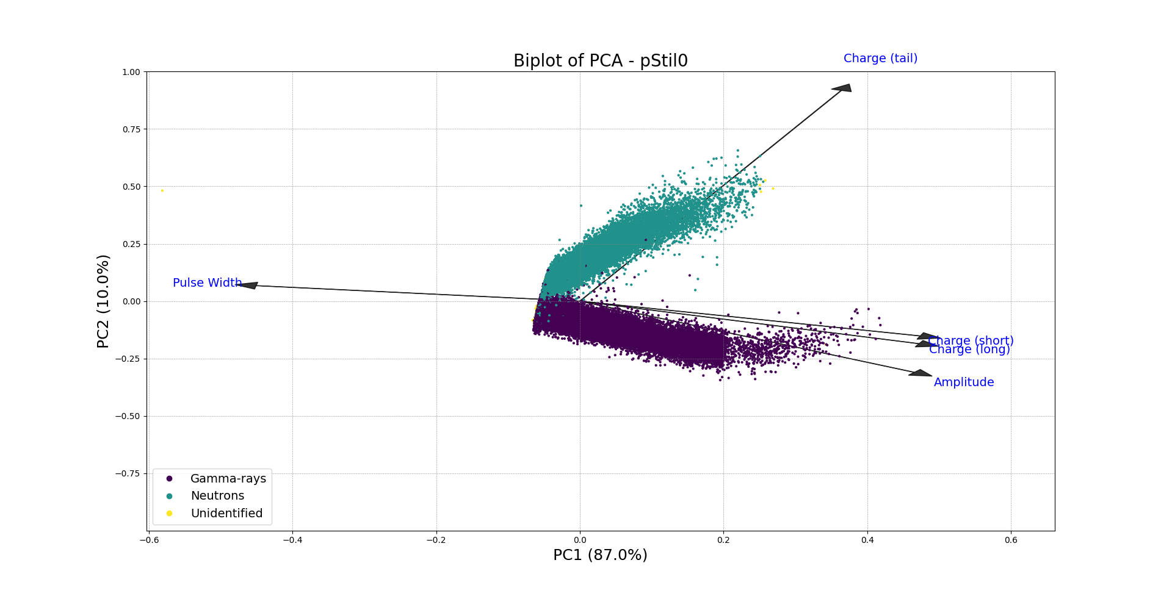
Principal Component Analysis (PCA)
PCA – Biplots
A biplot is another enhanced graphical representation used in PCA that displays both the PC scores of the observations and the loadings of the variables on the same plot
Scores represent the transformed coordinates of the observations in the new PC space
The position of each point indicates its projection of the original data point onto the PCs
(21)
Papanikolaou Dimitrios/Pellegriti M. G.

Slide 22
Principal Component Analysis (PCA)
PCA – Physical Interpretation
Principal Component 1
PC1
Pulse-height, Charge (short), Charge (long)
High positive loadings on PC1.
It suggests that PC1 represents the overall signal strength or energy deposited by the particle, as these parameters are directly related to the signal amplitude and integrated charge
Pulse-width
Negative loading on PC1.
Inversely correlated with the other variables on this component.
ToT → proportional to energy loss.
(22)
Papanikolaou Dimitrios/Pellegriti M. G.

Slide 23
Principal Component Analysis (PCA)
PCA – Physical Interpretation
Principal Component 2
PC2
Charge (tail)
High positive loading on PC2.
Reflects PSD contribution of slower signal components, confirming the basis of PSD by charge integration
Pulse-height and Charge (long)
Relatively small loadings on PC2, Suggesting they are equivalent for the purpose of discrimination, as expected
(23)
Papanikolaou Dimitrios/Pellegriti M. G.

Slide 24
Principal Component Analysis (PCA)
PCA – Physical Interpretation
Verifying the validity of an unsupervised technique for discrimination
(24)
Papanikolaou Dimitrios/Pellegriti M. G.

Slide 25
EAR1 – ¹²C Measurements
Preliminary results on ¹²C(n,n)¹²C measurement at EAR1
(25)
Papanikolaou Dimitrios/Pellegriti M. G.

Slide 26
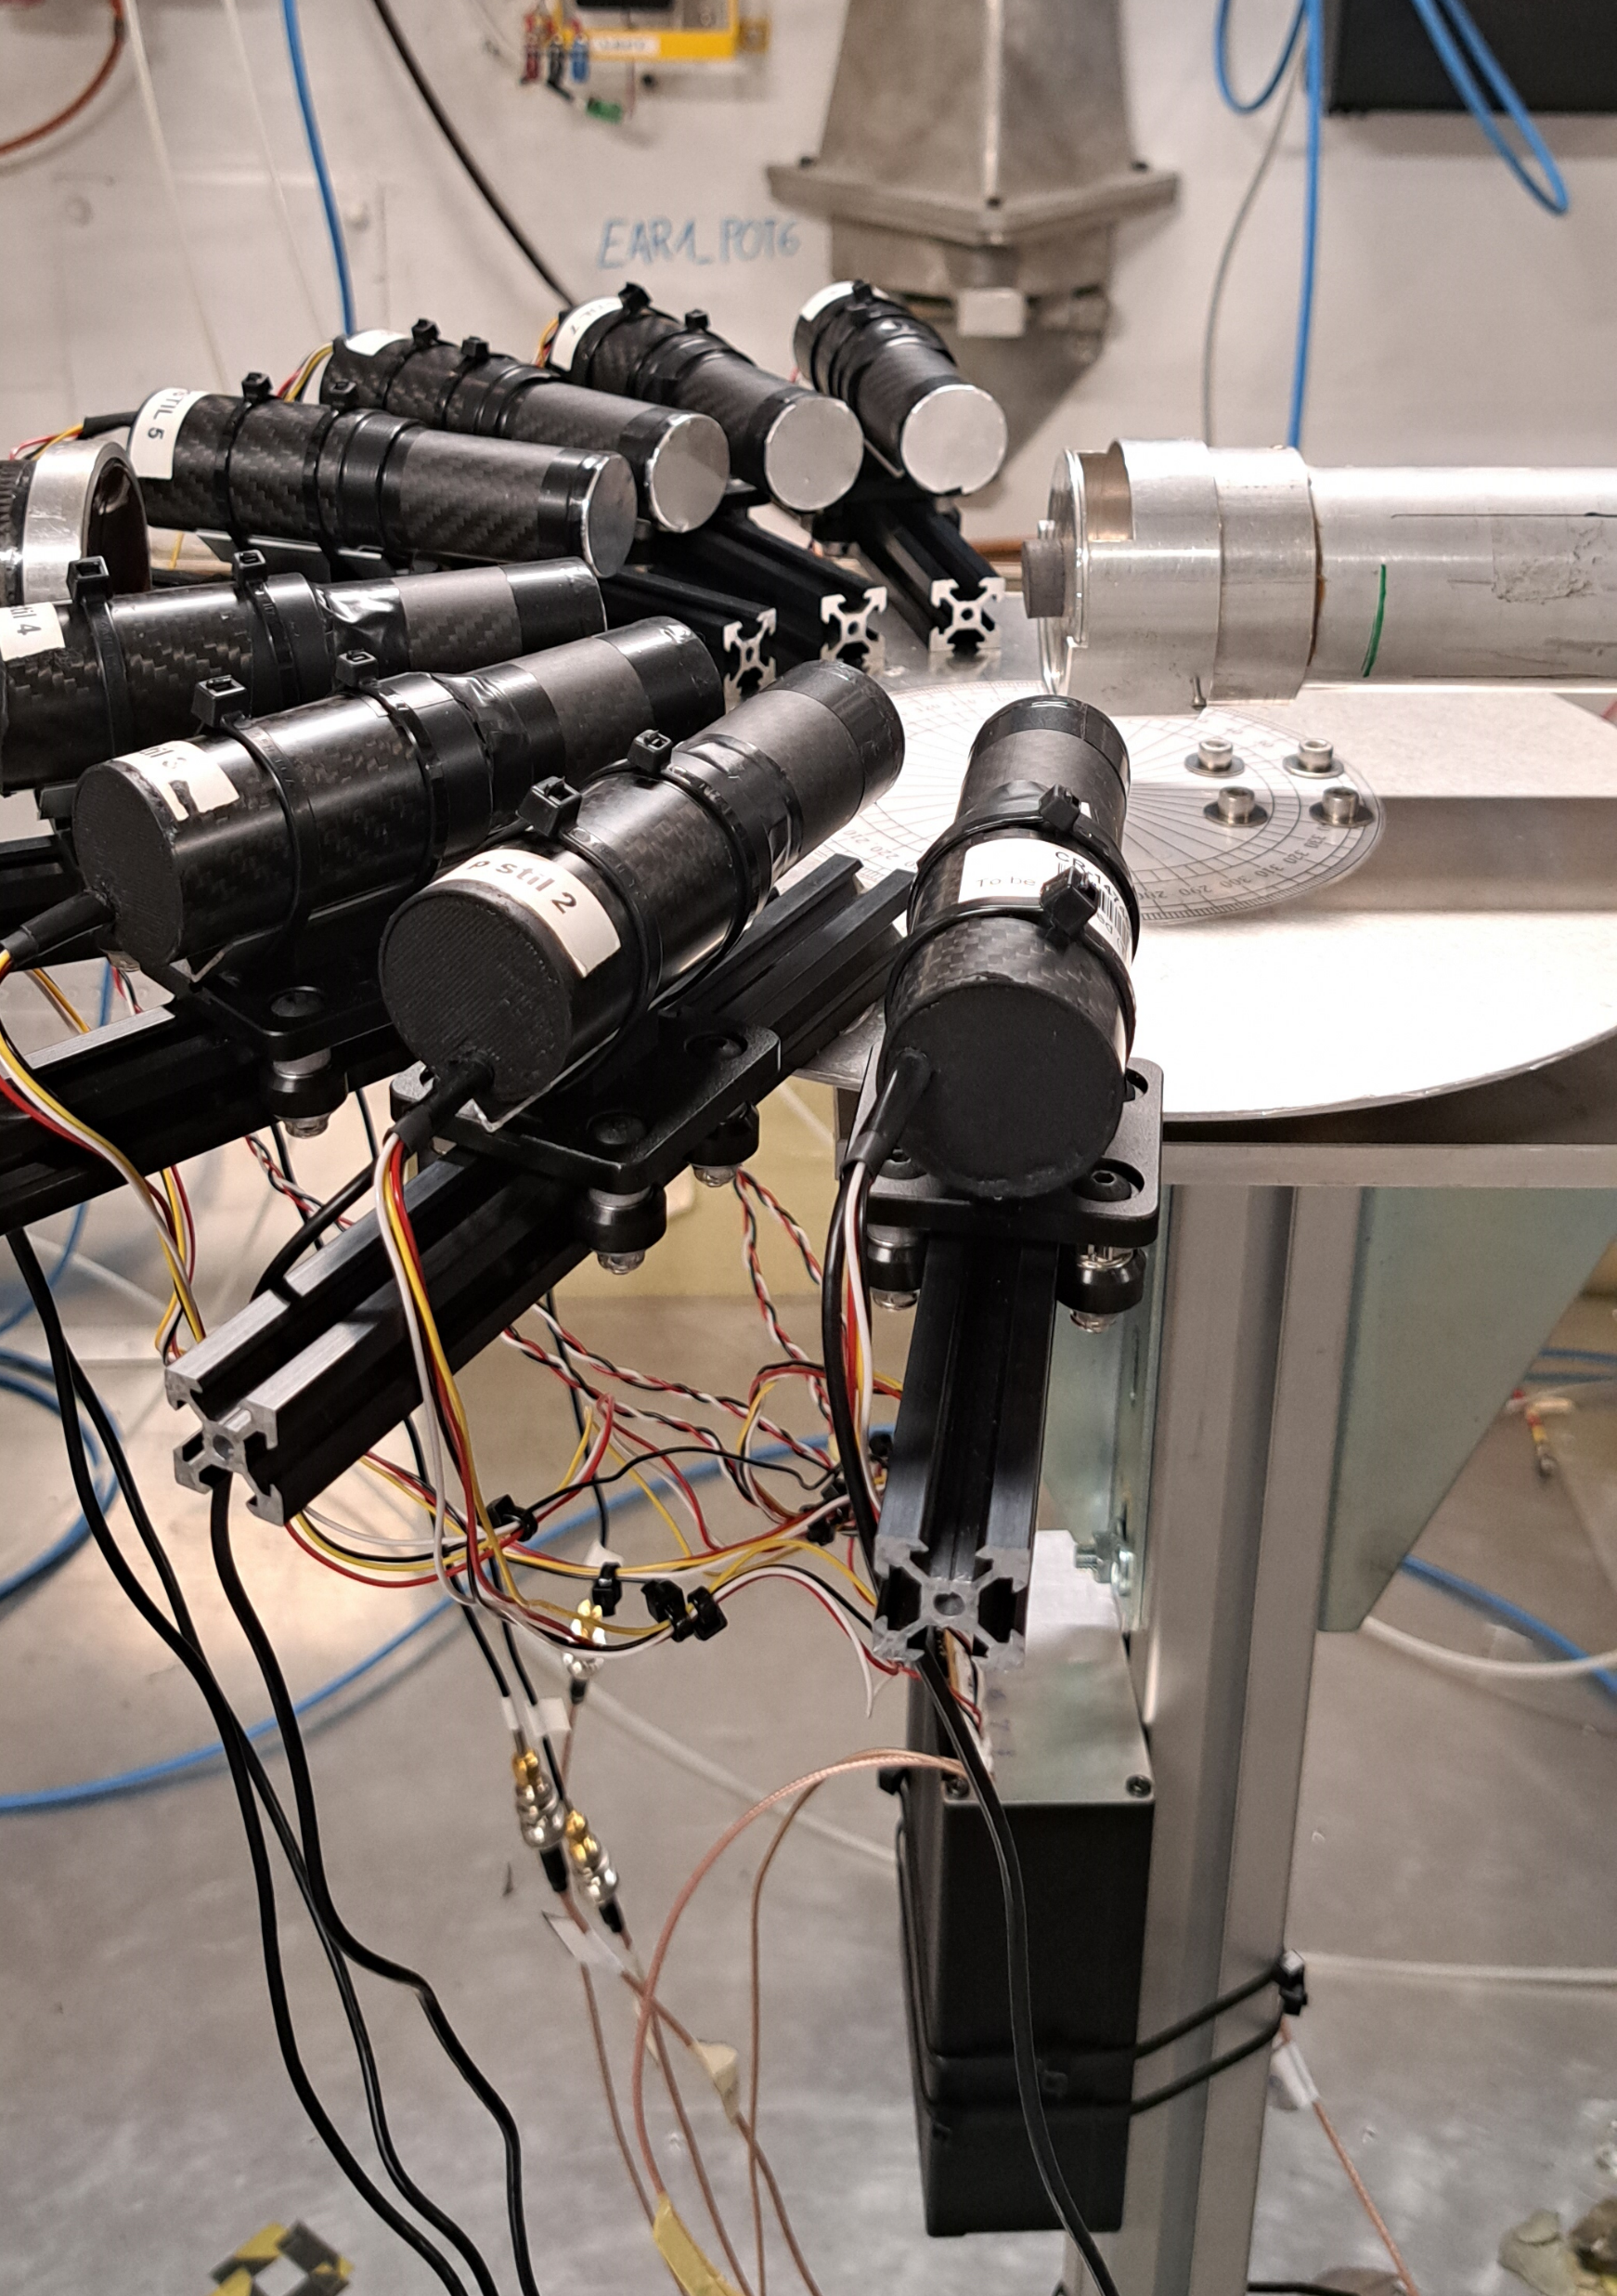
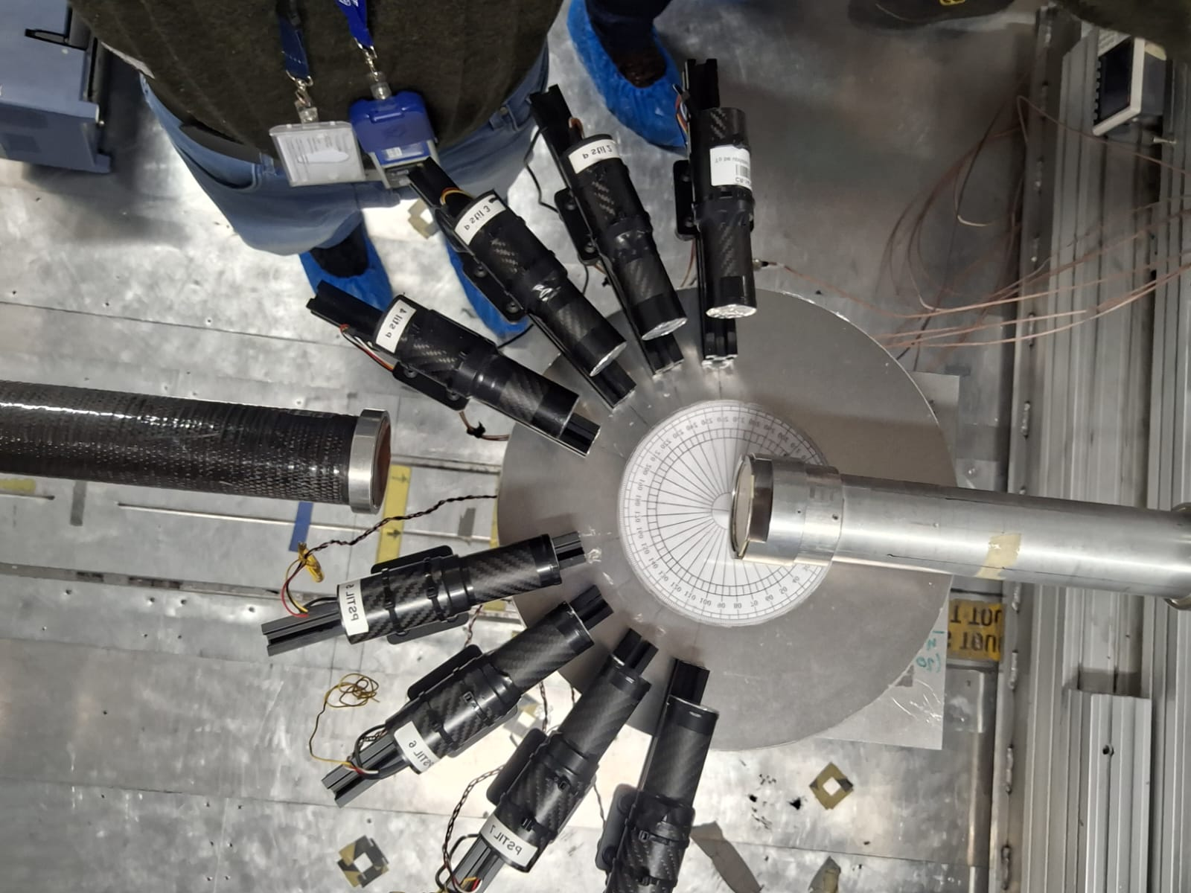
EAR1 – ¹²C Measurements
Experimental Set-Up
PSTIL set-up in EAR1 - October 2024
INRAD
2
1
3
4
d=12cm, ΔΩ=0.04sr
5
6
7
Det # | θ_{lab}
1 and 8 | 100°±6°
2 and 7 | 120°±6°
3 and 6 | 140°±6°
4 and 5 | 160°±6°
PROTEUS
8
New equalization/distribution box
(26)
Papanikolaou Dimitrios/Pellegriti M. G.

Slide 27
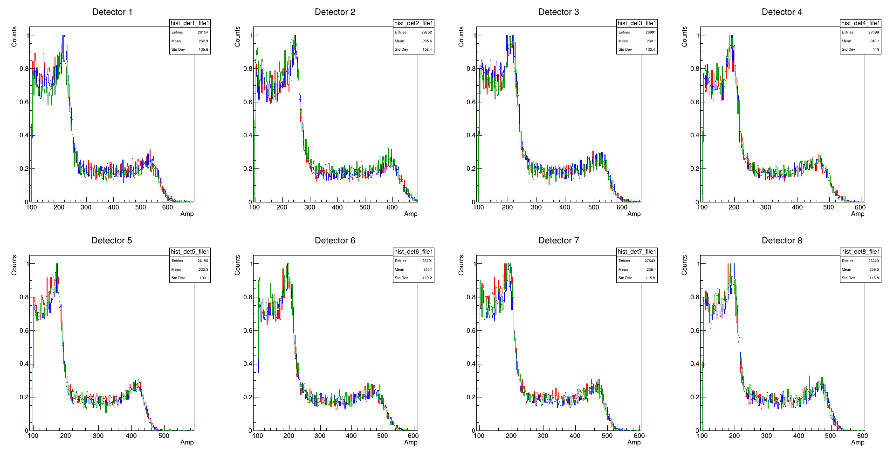
EAR1 – ¹²C Measurements
⁸⁸Y Stability Check
Stabilized Electronics – 3 runs
1st run
2nd run
3rd run
100º
120º
140º
160º
160º
140º
120º
100º
(27)
Papanikolaou Dimitrios/Pellegriti M. G.

Slide 28
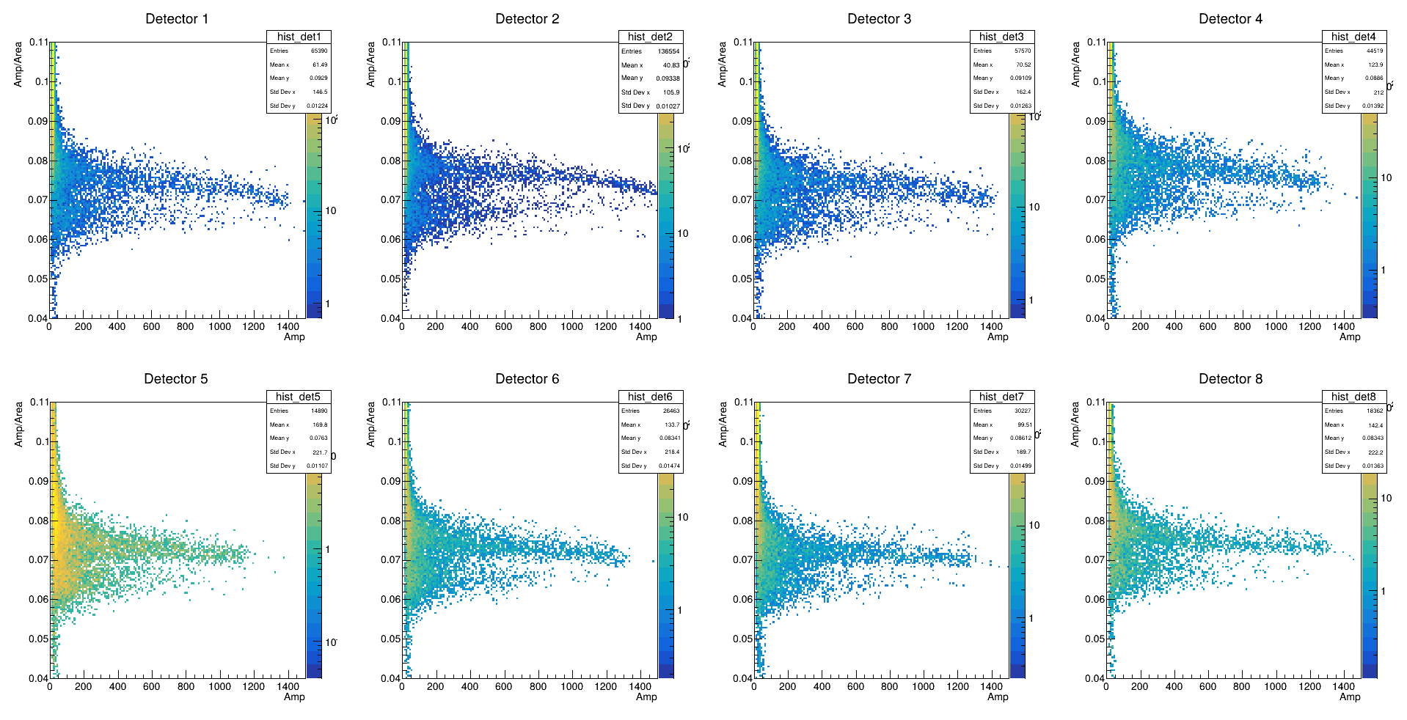
EAR1 – ¹²C Measurements /AmBe source
Filtering
Amp/Area filtering
amp/area: 0.074 threshold to select neutrons
+ pile-up rejection
100º
120º
140º
160º
Preliminary PSA is used
160º
140º
120º
100º
(28)
Papanikolaou Dimitrios/Pellegriti M. G.

Slide 29
EAR1 – ¹²C Measurements /AmBe source
Filtering
Amp/Area filtering
amp/area: 0.074 threshold to select neutrons
+ pile-up rejection
(29)
Papanikolaou Dimitrios/Pellegriti M. G.

Slide 30
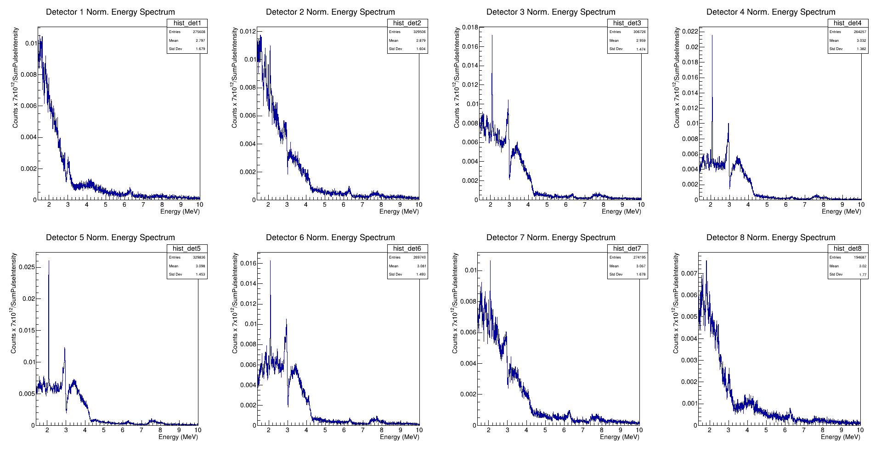
EAR1 – ¹²C Measurements
Spectra
Normalized ¹²C spectra
0.074 amp/area threshold
5keV Binning
No pile-up
tflash range
100º
120º
140º
160º
Preliminary PSA is used
160º
140º
120º
100º
(30)
Papanikolaou Dimitrios/Pellegriti M. G.

Slide 31
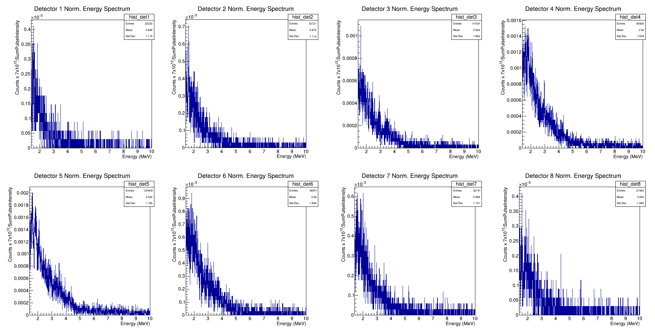
EAR1 – ¹²C Measurements
Spectra
Normalized Empty Spectra
0.074 amp/area threshold
5keV Binning
No pile-up
tflash range
100º
120º
140º
160º
Preliminary PSA is used
160º
140º
120º
100º
(31)
Papanikolaou Dimitrios/Pellegriti M. G.

Slide 32
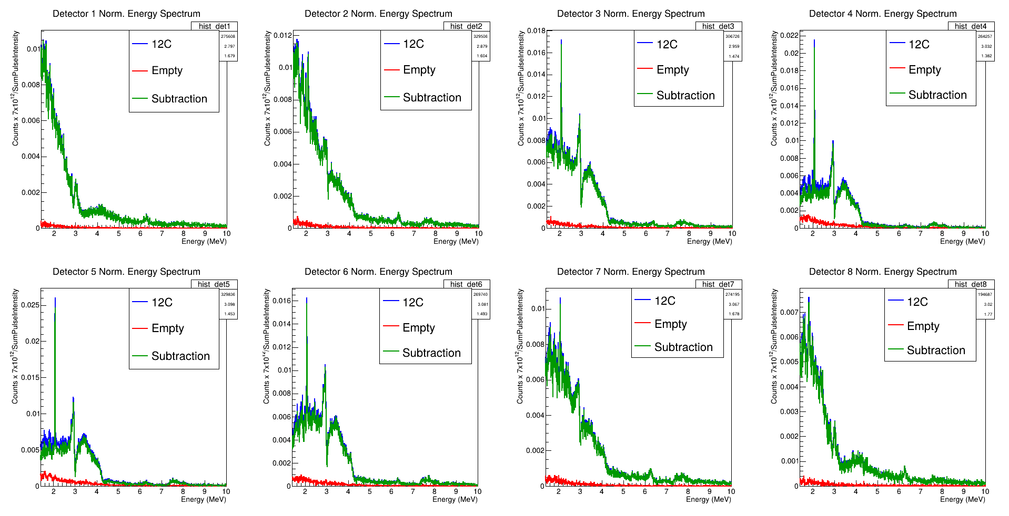
EAR1 – ¹²C Measurements
Spectra
Clean Spectra
0.074 amp/area threshold
5keV Binning
No pile-up
tflash range
100º
120º
140º
160º
Preliminary PSA is used
160º
140º
120º
100º
(32)
Papanikolaou Dimitrios/Pellegriti M. G.

Slide 33
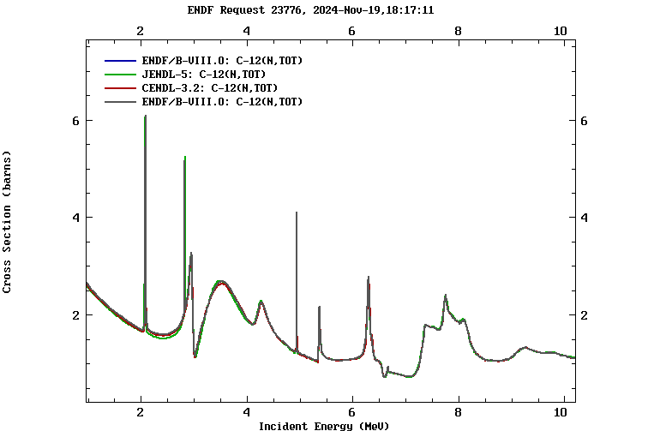
EAR1 – ¹²C Measurements
Spectra
Clean Spectra
0.074 amp/area threshold
5keV Binning
No pile-up
tflash range
(33)
Papanikolaou Dimitrios/Pellegriti M. G.

Slide 34
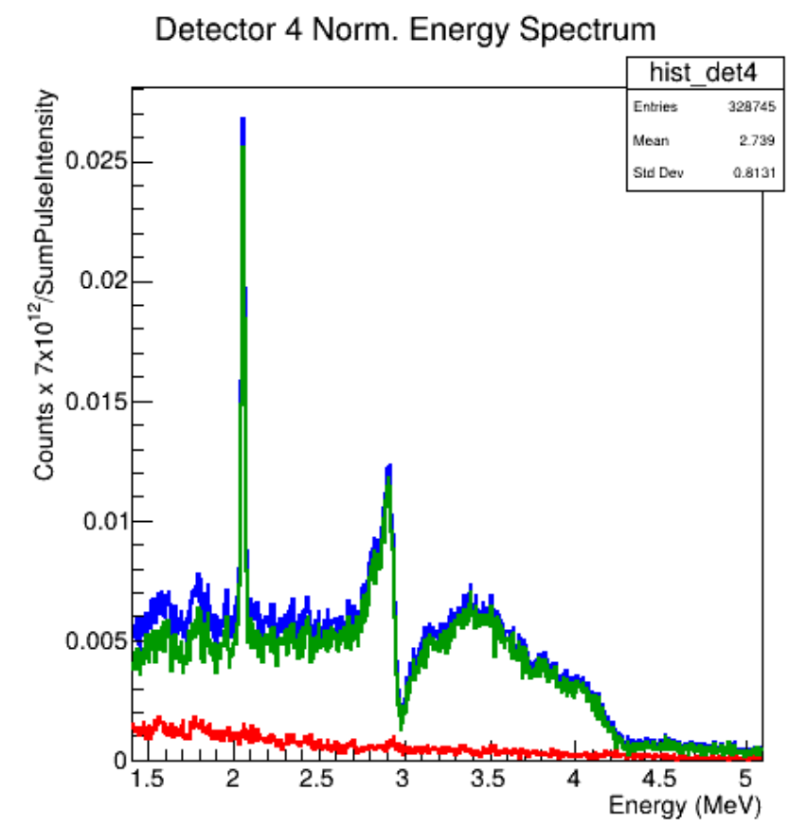
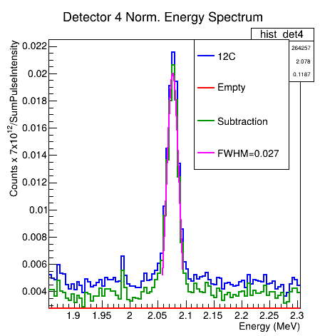
EAR1 – ¹²C Measurements
Spectra
Clean Spectra
0.074 amp/area threshold
5keV Binning
No pile-up
tflash range
preliminary estimation
R = (1.28 ± 0.04) %
(34)
Papanikolaou Dimitrios/Pellegriti M. G.

Slide 35
Future Analysis
Future Analysis
(35)
Papanikolaou Dimitrios/Pellegriti M. G.

Slide 36
Future Analysis
Fine tune the PSA. Find the best input parameters for discrimination.
Retrieve the flux of EAR1 and correct the normalized spectra.
Correct for areal density and neutron efficiency.
Compare with R-Matrix calculations.
(36)
Papanikolaou Dimitrios/Pellegriti M. G.

Slide 37
(37)
Papanikolaou Dimitrios/Pellegriti M. G.

Slide 38
Status of the PSTIL set-up and future developments
8 Modules ready and tested
ITEM | n. | PROVIDER | STATUS
1’’x1’’ crystal | 10 | PROTEUS | Expected to arrive at INFN-CT this week
PMT | 10 | Hamamatsu | Sub judice 2025
Power base | 10 | Sens-Tech | Sub judice 2025
→Mechanical arrangement for 18 modules and new target holder in carbon fiber (coll. Trieste)
→Ancillary detectors for (n,cp): small-volume, low-power.
One PSTIL module power: 5Vx50mA suitable for in-vacuum applications
→Ancillary detectors for (n,n’) measurements: coupling with LaBr3
(38)
Papanikolaou Dimitrios/Pellegriti M. G.

Slide 39
THANKS!

Slide 40
BACK-UP SLIDES

Slide 41
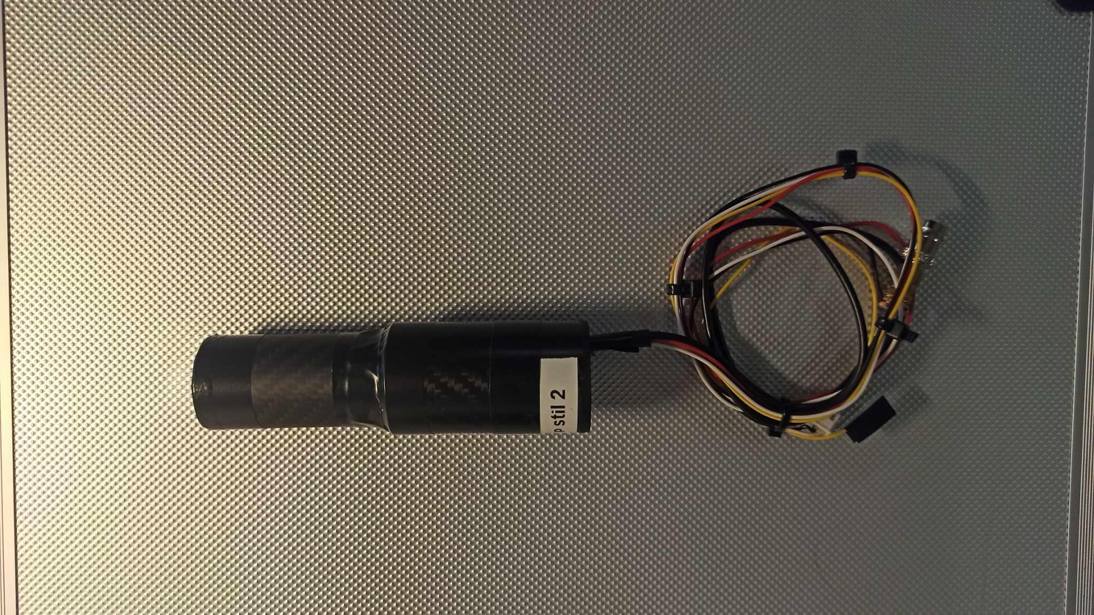
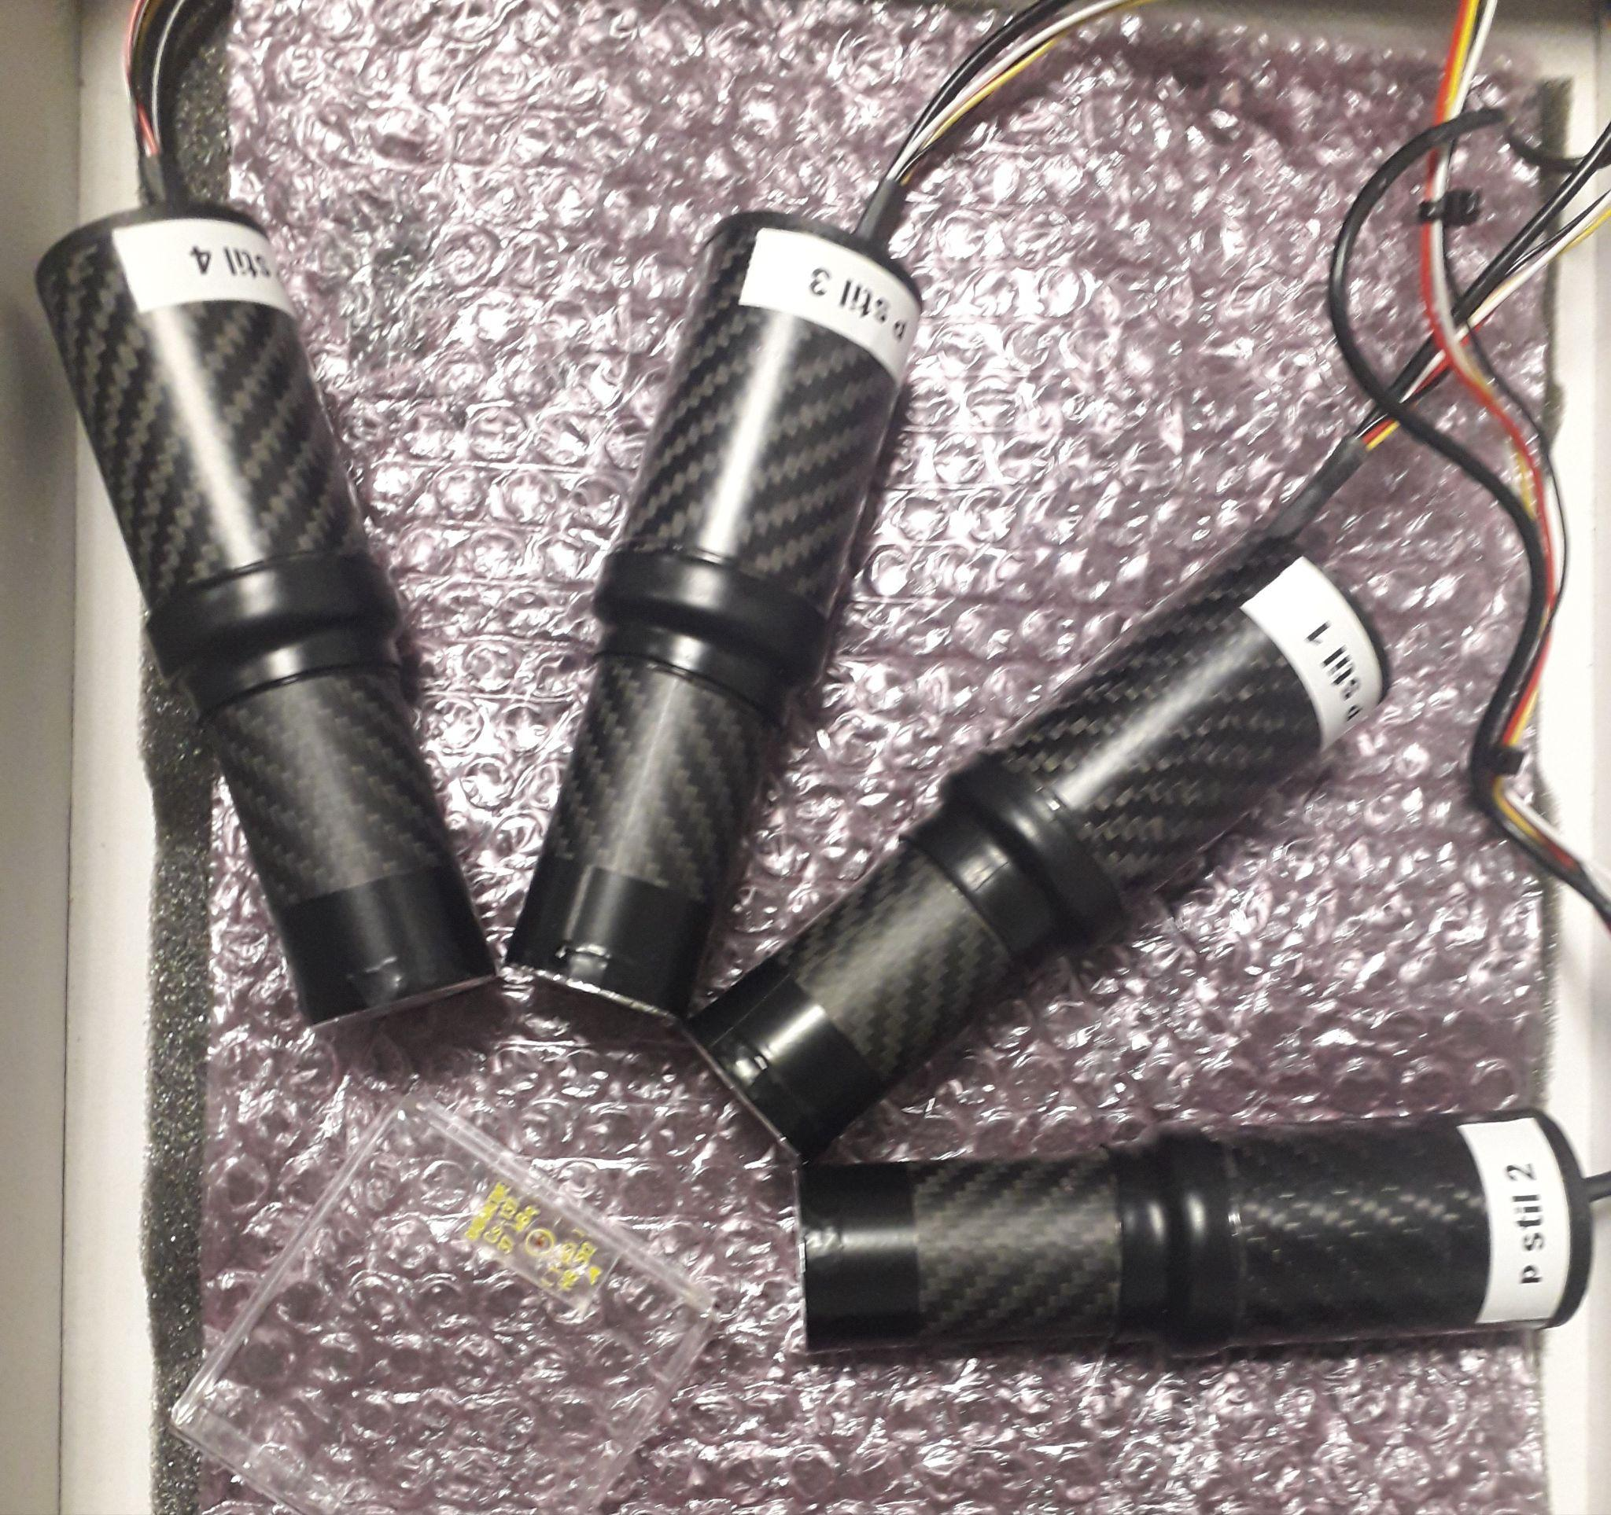
Experimental set-up
pStil Modules
Stilbene Detector Modules
(pStil)
Solid-State Organic Scintillators
Stilbene
Crystal
(C₁₄H₁₂)
**Developed at INFN-CT, Sezione di Catania**
PMT
**Currently used & tested at nTOF/CERN**
Al window
High counting rate with no HV needed
(x3) 1”x 1” cylindrical INRAD trans-stilbene detector
(x1) 1”x 1” cylindrical PROTEUS trans-stilbene detector
Carbon fiber housing
Aluminium cover in the front window
(41)
Papanikolaou Dimitrios/Pellegriti Maria G.

Slide 42
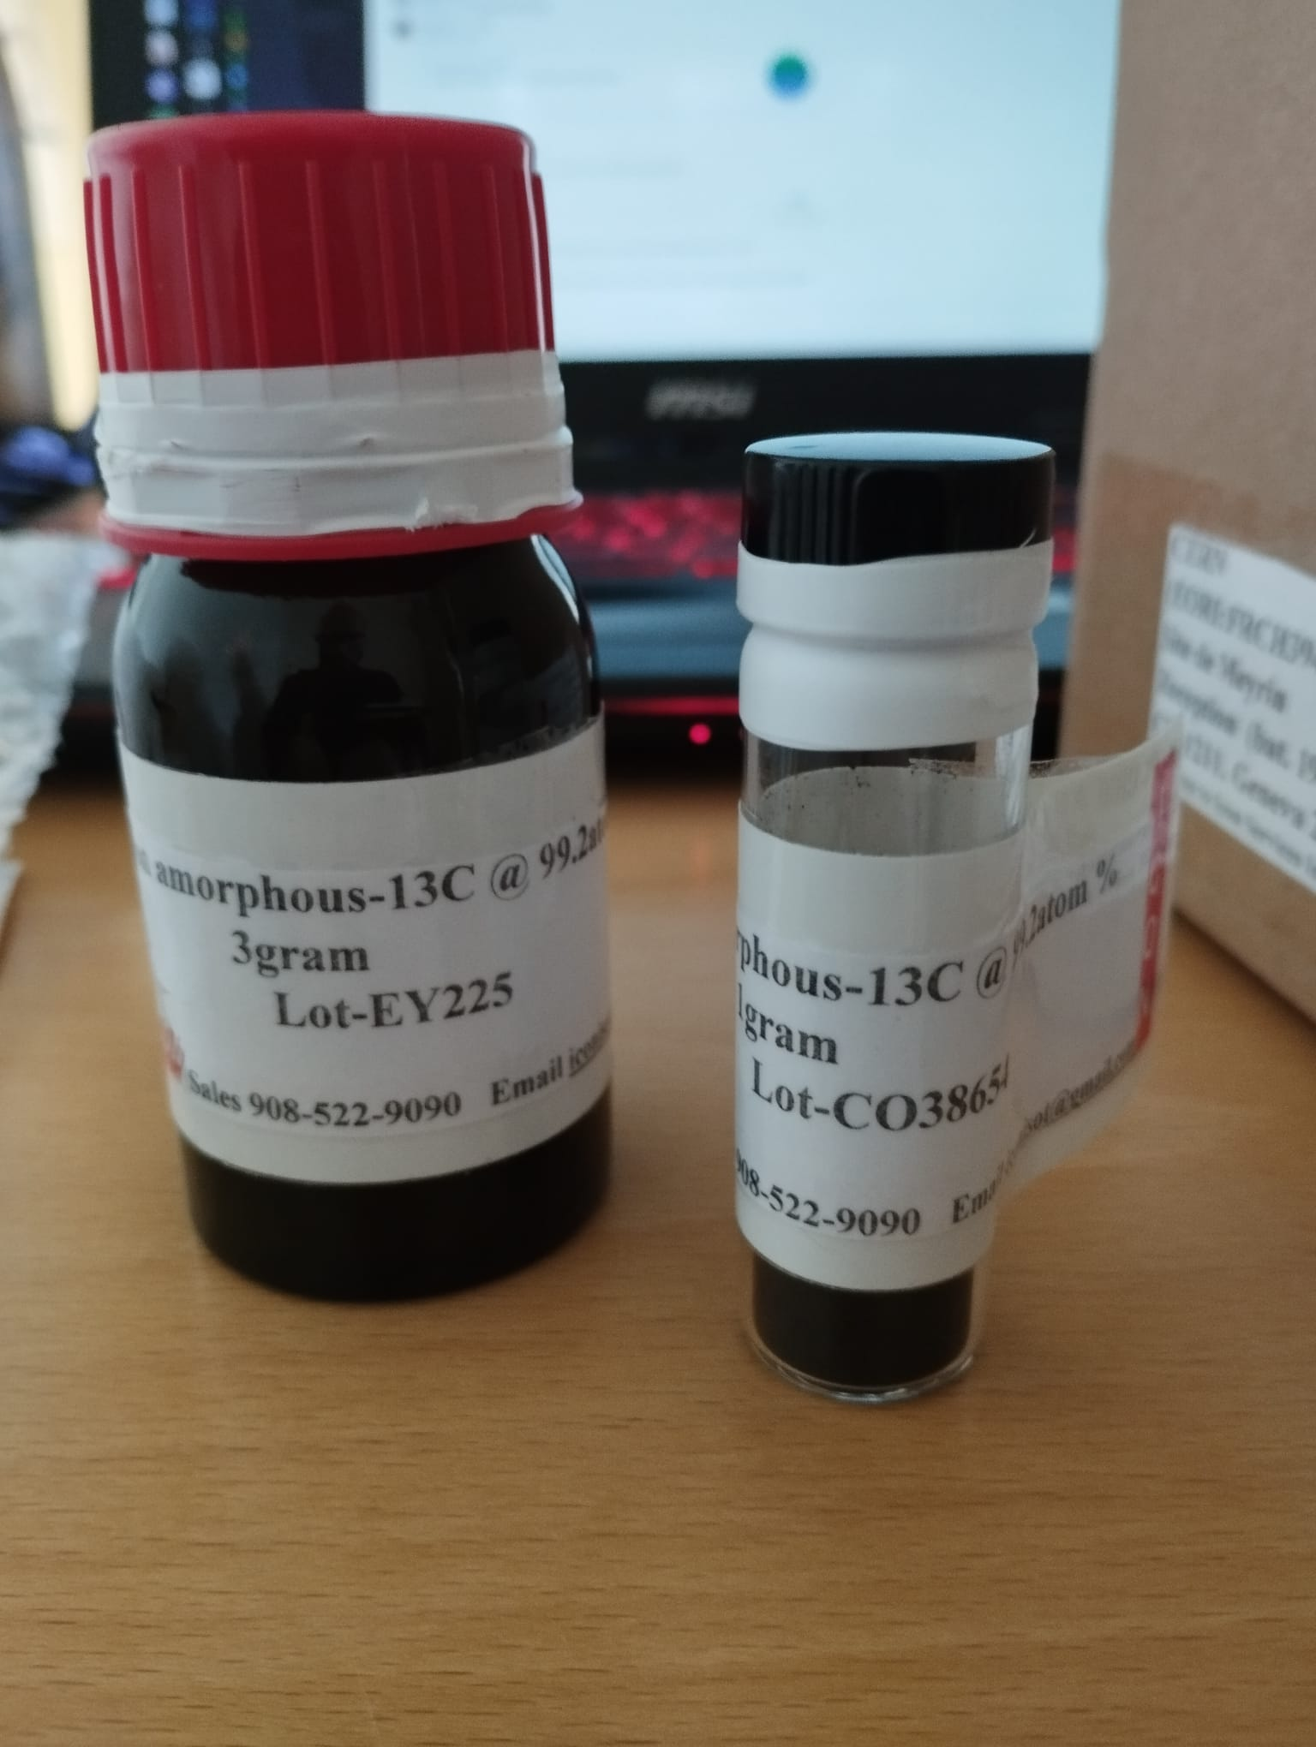
New targets: ¹³C and ¹²C target
¹²C for target preparation test @ CERN
99.2% enrichment
75 micron
(42)
Papanikolaou Dimitrios/Pellegriti Maria G.

Slide 43
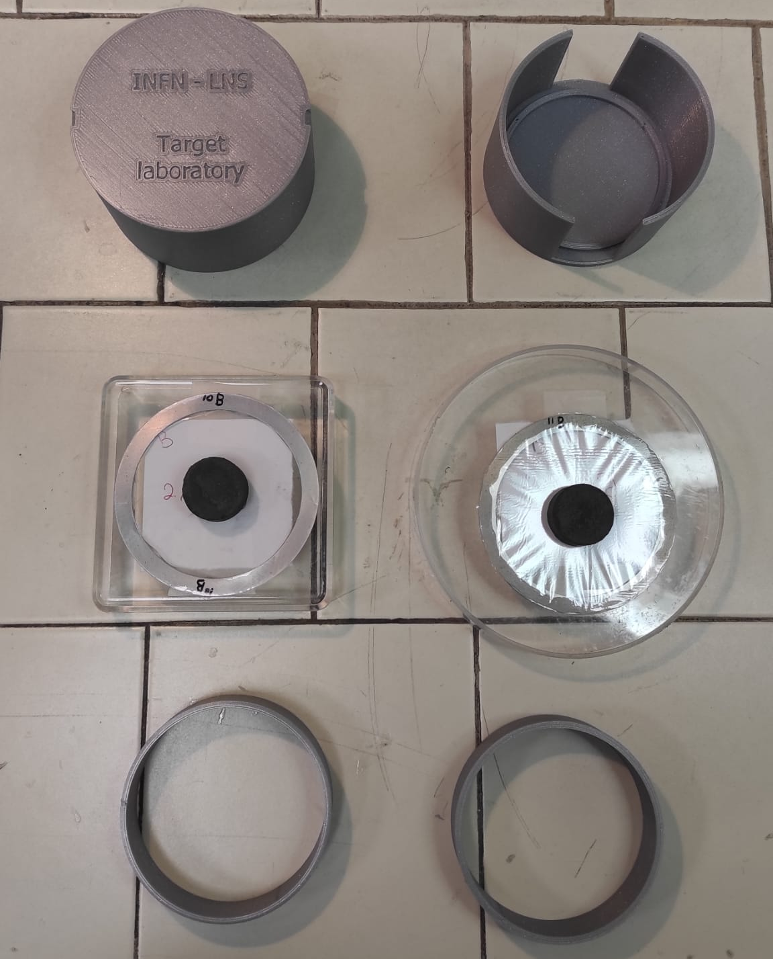
New Targets: ¹⁰B and ¹¹B target
Antonio Massara and Martina Ursino
(43)
Papanikolaou Dimitrios/Pellegriti Maria G.

Slide 44
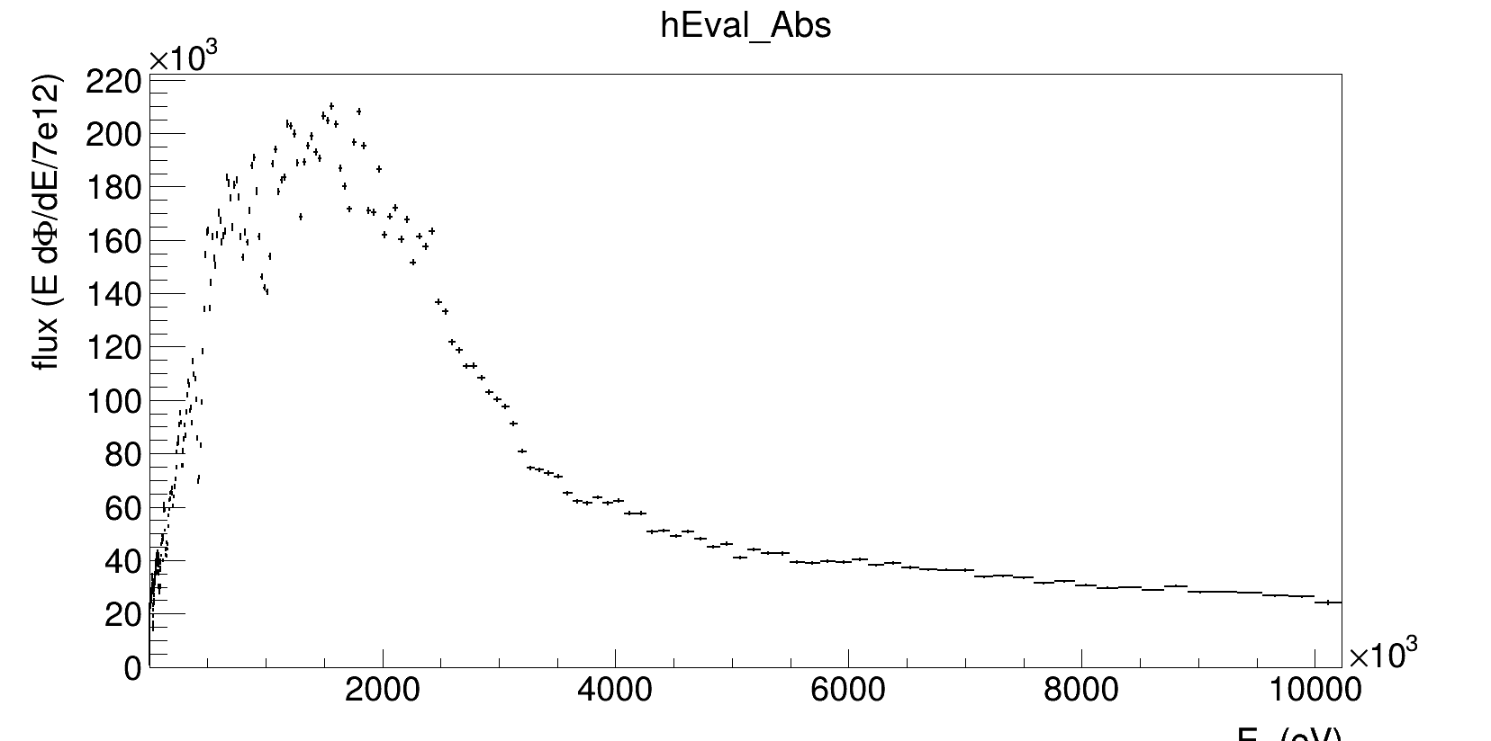
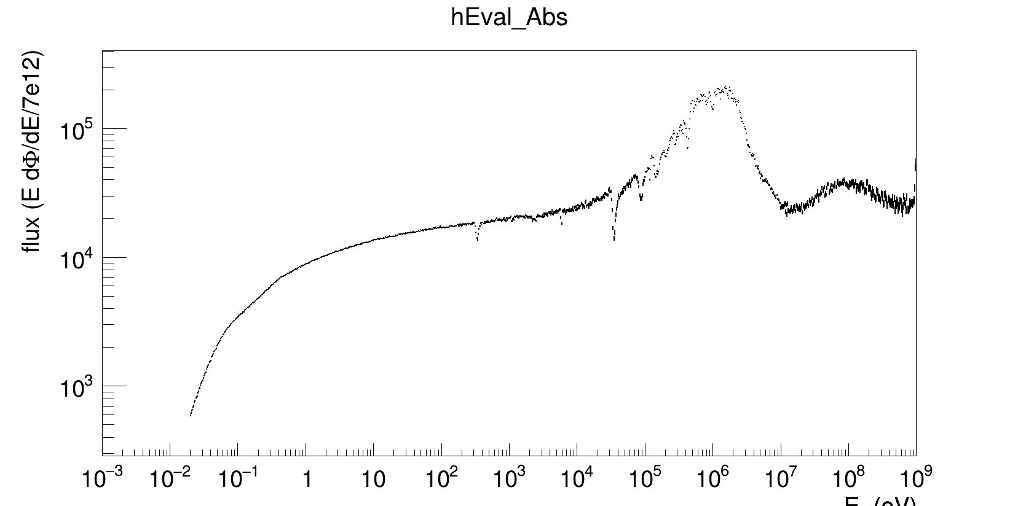
EAR1 Flux
Flux Distributions (in eV)
(44)
Papanikolaou Dimitrios/Pellegriti Maria G.

Slide 45
Beam interception function
Beam size vs neutron energy
(45)
Papanikolaou Dimitrios/Pellegriti Maria G.

Slide 46
EAR1 – ¹²C Measurements
Filtering
tflash filtering
tflash: ± FWHM x-values range for each detector
(46)
Papanikolaou Dimitrios/Pellegriti M. G.

Slide 47
EAR1 – ¹²C Measurements
Filtering
tflash filtering
tflash: ± FWHM x-values range for each detector
 | FWHM (ns) | σ (ns)
pStil1 - INRAD | 26.57 ± 0.02 | 11.28 ± 0.01
pStil2 - INRAD | 25.42 ± 0.02 | 10.79 ± 0.01
pStil3 - INRAD | 25.32 ± 0.02 | 10.75 ± 0.01
pStil4 - INRAD | 19.16 ± 0.02 | 8.14 ± 0.01
pStil5 - PROTEUS | 16.22 ± 0.02 | 6.89 ± 0.01
pStil6 - PROTEUS | 19.97 ± 0.02 | 8.48 ± 0.01
pStil7 - PROTEUS | 23.00 ± 0.02 | 9.77 ± 0.01
pStil8 - PROTEUS | 24.45 ± 0.02 | 10.38 ± 0.01
(47)
Papanikolaou Dimitrios/Pellegriti Maria G.

Slide 48
Detector Characterization
Simulated Detection Efficiency
Simulated Detection Efficiency using GEANT4 simulation toolkit
** Preliminary**
Isotropic
Point Source
(48)
Papanikolaou Dimitrios/Pellegriti Maria G.

Slide 49
Pulse Shape Discrimination (PSD)
Methodology – Pile-Up Regection
Higher counting rates can cause overlap between pulses
For a time window of 320ns and a rate of 1kHz
For ~10⁶ events we expect
~300-400 pile-up events
Peak Pile-Up
~95 pulses
*G. F. Knoll, Radiation Detection And Measurement, John Wiley and Sons, 2000
(49)
Papanikolaou Dimitrios/Pellegriti Maria G.

Slide 50
Principal Component Analysis (PCA)
So why PCA ?
5 Initial Parameters! ...
Pulse-height
Charge (short, long, tail)
Pulse-width
...
Pulse-width
**
A lot of missed opportunity
**
(50)
Papanikolaou Dimitrios/Pellegriti Maria G.

Slide 51
Principal Component Analysis (PCA)
PCA Concept
Data Standardization
Computing the Covariance Matrix
**
PCA is affected by the scales of the variables.
Normalizing the data to have a mean of 0 and a variance of 1
**
** Captures the correlations between pairs of variables **
Transforming the data
Sorting the Eigenvalues and Eigenvectors
Computing the Eigenvalues and Eigenvectors
**
Sorted in descending order.
The top k-eigenvalues and their eigenvectors are selected to form the PCs
**
**
The original data is projected onto the new PC axes
**
**
The eigenvectors (PCs) determine the directions of the new feature space, and the eigenvalues determine their magnitude (variance) along these new axes
**
(51)
Papanikolaou Dimitrios/Pellegriti Maria G.

Slide 52
Principal Component Analysis (PCA)
PCA – Scree Plots
“Elbow” Method
Kaiser-Guttman criterion
The value of k, defining an ‘elbow’ or ‘knee’ or ‘point of inflexion’ in the graph, is then taken to be the number of PCs to be retained
Considering eigenvalues. According to this rule, only the PCs with eigenvalues greater than 1 should be retained
Subjective methods
(52)
Papanikolaou Dimitrios/Pellegriti Maria G.

Slide 53
Principal Component Analysis (PCA)
PCA – Scree Plots
% Variance
 | pStil0 | pStil1 | pStil2 | pStil3
PC1 | 87.0 | 85.7 | 85.0 | 85.3
PC2 | 10.0 | 11.0 | 11.5 | 11.3
SUM | 97.0 | 96.7 | 96.5 | 96.6
Lower the dimensionality from
5D to 2D !
Overall, more than 96% of the variation is preserved in the first two PCs
(53)
Papanikolaou Dimitrios/Pellegriti Maria G.

Slide 54
Principal Component Analysis (PCA)
PCA – Loadings Plots
Graphical representation used in PCA to visualize the relationships between the original variables and the PCs
Mathematically speaking, loadings are the coefficients of the original variables in the linear combinations that define the PCs
For a given PC z_{k}, the loadings are given by the eigenvectors v_{k} is the eigenvector (loading) corresponding to the k-th PC
(54)
Papanikolaou Dimitrios/Pellegriti Maria G.

Slide 55
Principal Component Analysis (PCA)
PCA – Biplots – Target Groups
Custom class for the selection of indices, from the PSD distributions, corresponding to gamma-rays and neutrons
Flexible selection using the left mouse button
PSD + PCA
(55)
Papanikolaou Dimitrios/Pellegriti Maria G.

Slide 56
Principal Component Analysis (PCA)
PCA – Physical Implication
Energy Deposition
High positive loadings of pulse-height and charge parameters on PC1 indicate that this component captures the energy deposition characteristics of the particles
Signal Shape and Duration
Negative correlation of pulse-width with PC1 and its small positive loading on PC2 suggests that the pulse width is related to the pulse amplitude.
Anti-correlation could be associated to the fact that the pulse width is calculated at 50% of the signal (more investigation on that).
Tail Charge
Strong positive loading of charge (tail) on PC2 highlights the importance of the signal's tail in identifying slower processes or particles with extended interaction times
(56)
Papanikolaou Dimitrios/Pellegriti Maria G.

Slide 57
Principal Component Analysis (PCA)
PCA – Scree Plots
4 Detectors
(57)
Papanikolaou Dimitrios/Pellegriti Maria G.

Slide 58
Principal Component Analysis (PCA)
PCA – Loadings Plots
4 Detectors
(58)
Papanikolaou Dimitrios/Pellegriti Maria G.

Slide 59
Principal Component Analysis (PCA)
PCA – Biplots
4 Detectors
(59)
Papanikolaou Dimitrios/Pellegriti Maria G.

