Slide 1

alberto.mengoni@cern.ch
Bologna, 21-22 November 2024

Slide 2
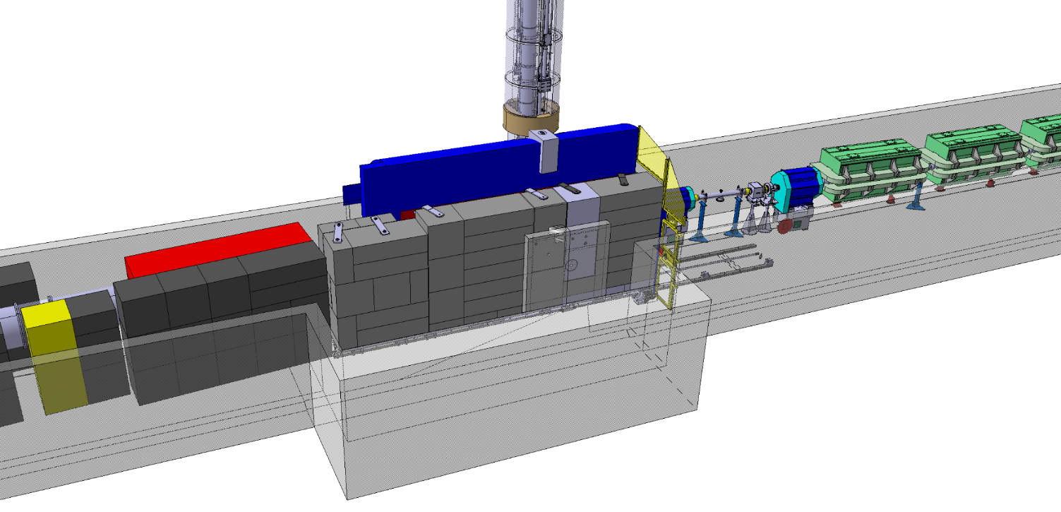



The NEAR Station
during the design studies of the new shielding around the target station the opportunity for a new near-target experimental area appeared
(NEAR station)
NEAR Station area
Measurements for technical and engineering developments
Irradiation of non-metallic materials + SEE (R2M & R2E projects) – up to 1MGy/year, mixed fields
Measurements of MACS by activation for nuclear astrophysics
Fusion-related measurements (cross sections, not irradiation)
Measurements of decay rates of long-lived isotopes

Slide 3
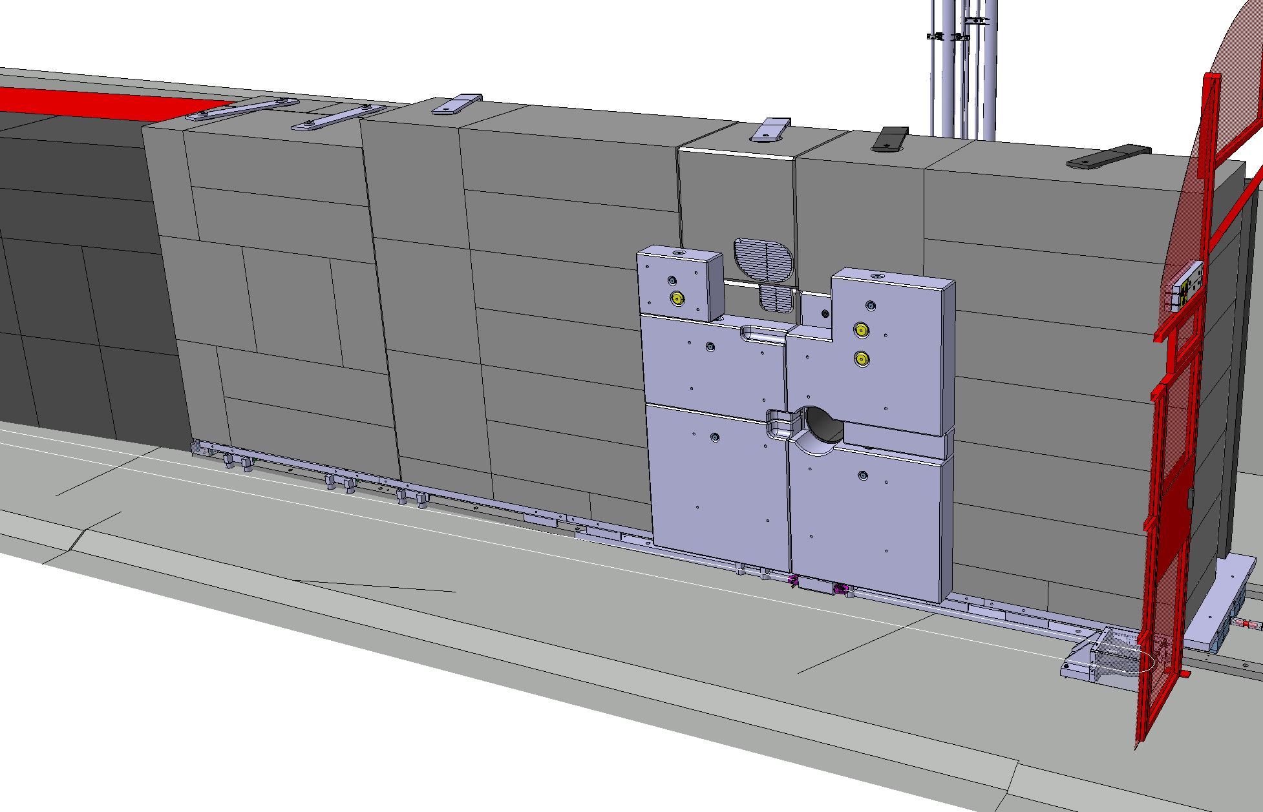
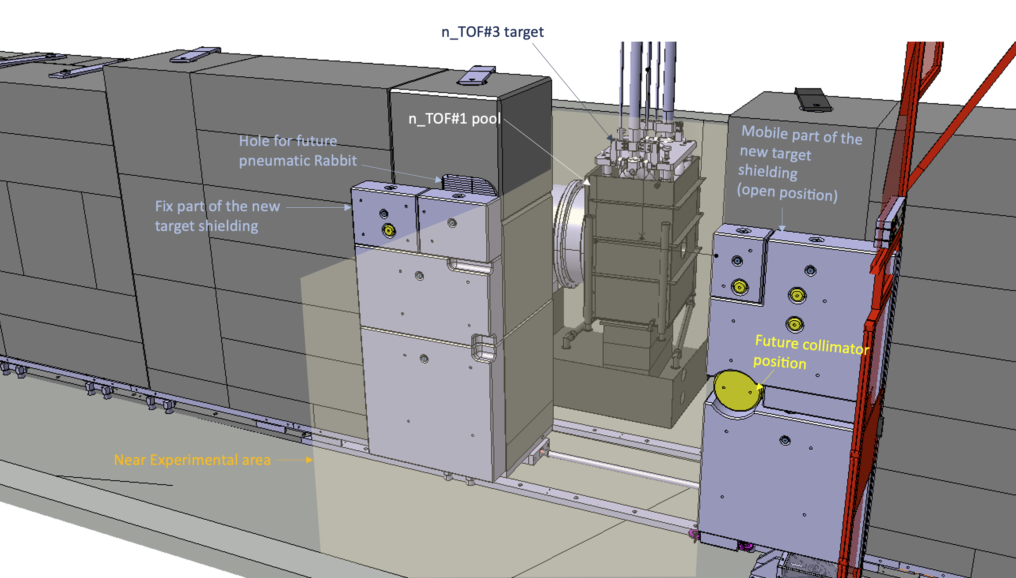
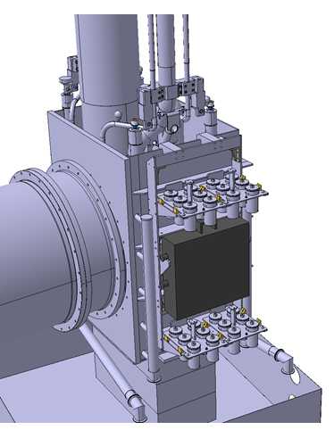
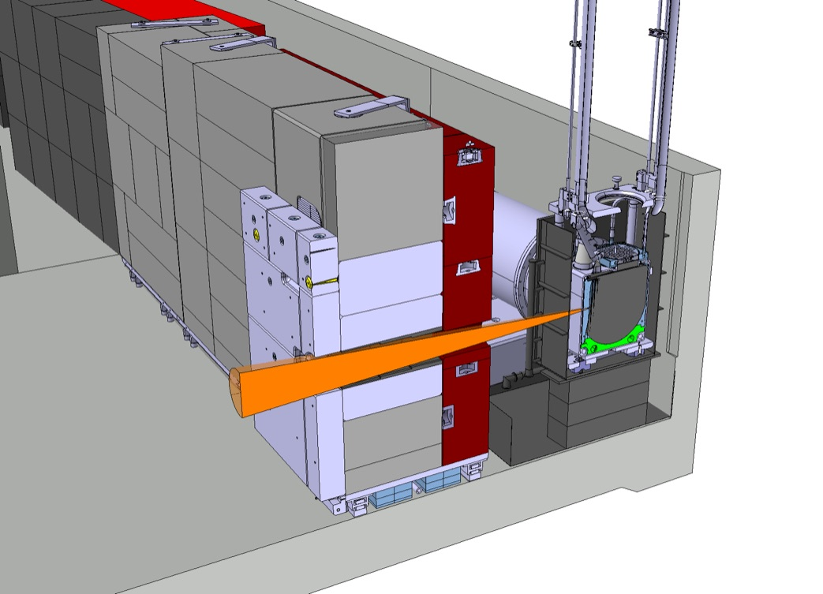
The NEAR Station
Closed configuration
Open configuration

Slide 4

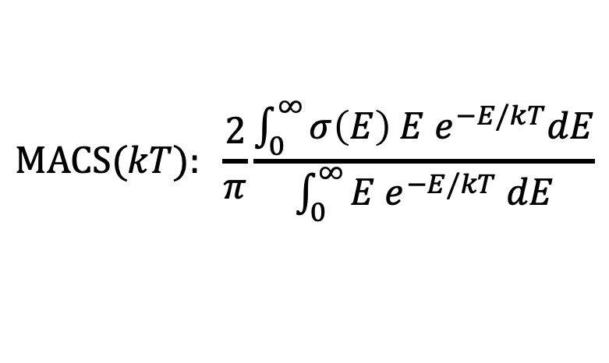
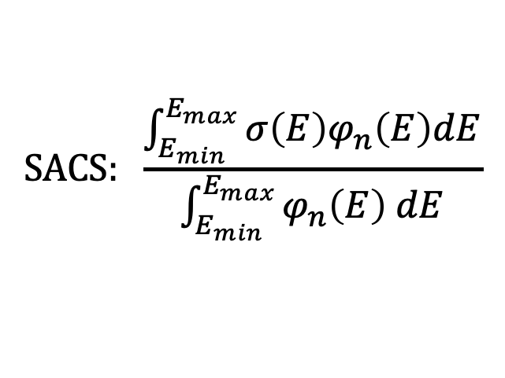
Activation & Filtering @NEAR
$$SACS: \frac{\int_{E_{min}}^{E_{max}}{σ\left(E\right)φ_{n}\left(E\right)dE}}{\int_{E_{min}}^{E_{max}}{φ_{n}\left(E\right) dE}}$$
$$MACS(kT): \frac{2}{π}\frac{\int_{0}^{∞}{σ\left(E\right) E e^{−E/kT}dE}}{\int_{0}^{∞}{E e^{−E/kT} dE}}$$

Slide 5
Activation & Filtering @NEAR

Slide 6
Activation & Filtering @NEAR
solved

Slide 7
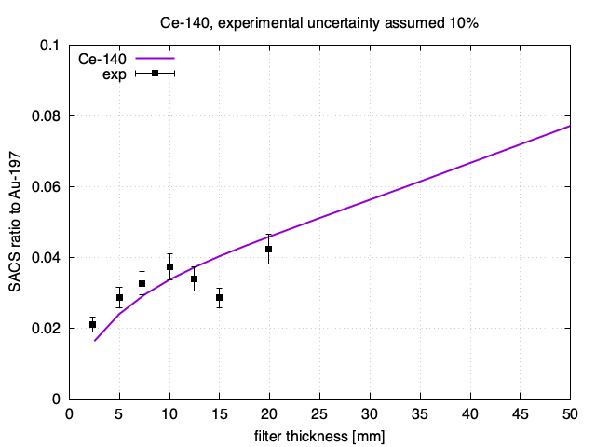
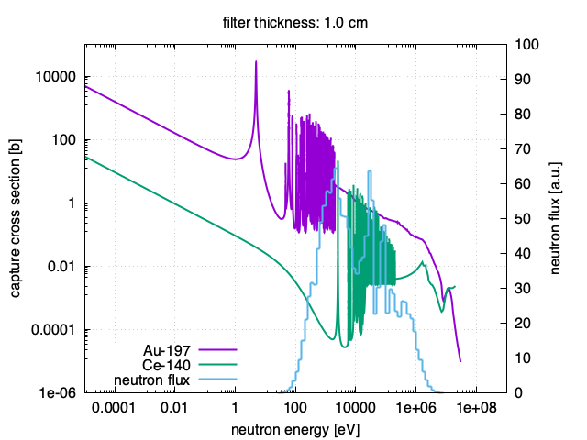
Activation & Filtering @NEAR

Slide 8
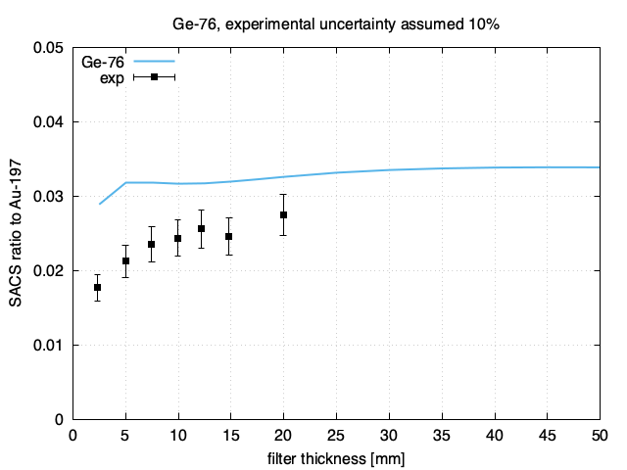
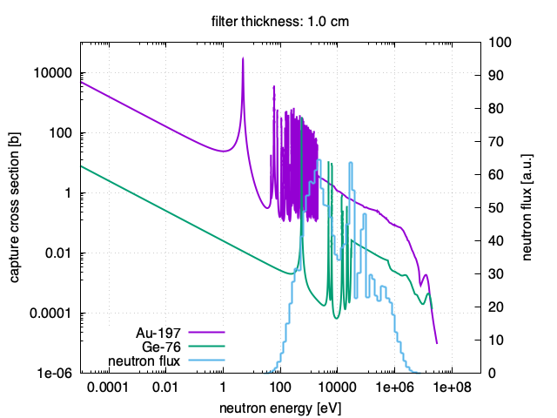
Activation & Filtering @NEAR

Slide 9
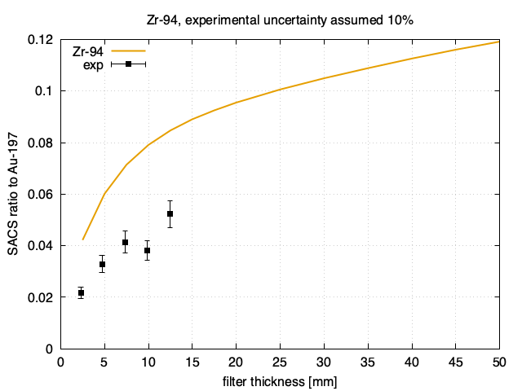
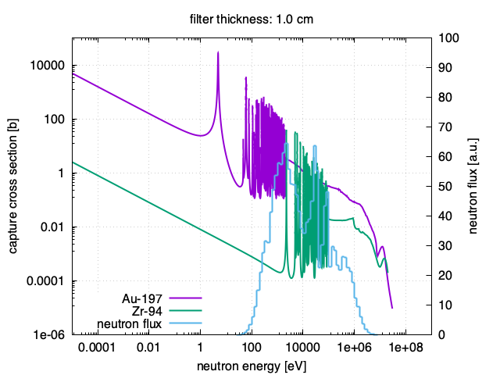
Activation & Filtering @NEAR

Slide 10
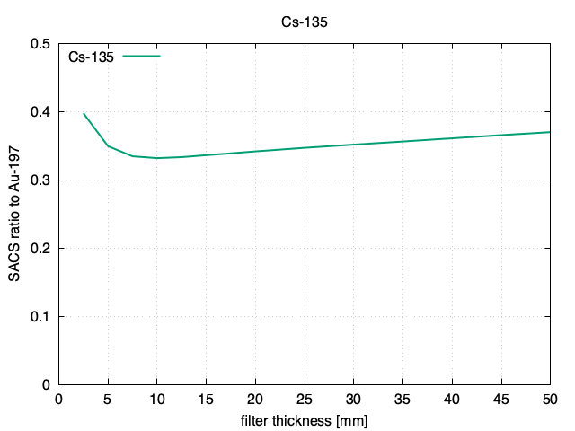
Activation & Filtering @NEAR

Slide 11
Activation & Filtering @NEAR
in 2020, we submitted the first LOI on the n_TOF NEAR station
A Mengoni and the n_TOF Collaboration, INTC-I-222, 2020
in 2022, we submitted a proposal for test measurement of the filtering technique
E Stamati, A Manna, G Gervino and the n_TOF Collaboration, INTC-P-623, 2022
more recently, we submitted a proposal for measurement of Cs-135 capture cross section by activation at NEAR
S Corollo, J Lerendegui and the n_TOF Collaboration, INTC-P-688, 2024
additional activities at NEAR on diamond detector testing, BG condition checks for NEAR Cycling, etc.
M Bacak, K Kaperoni, J Lerendegui et al. (from 2022 to 2024)
On filtering:
E Stamati (PhD student of Nikolas Patronis), started up the measurements in 2022 and continued in 2023
F “Fran” Garcia-Infantes continued in 2024
S Kopanos (PhD student of Rosa Vlastou), just started in October to take over and continue this activity

Slide 12
The End

Slide 13
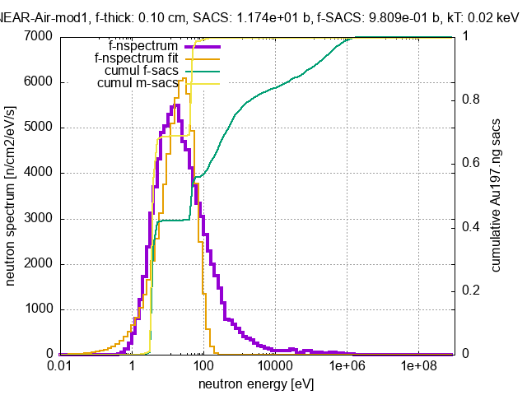
Filtering for the ¹⁹⁷Au activation

Slide 14
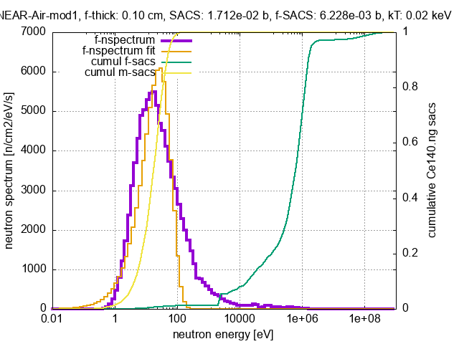
Filtering for the ¹⁴⁰Ce activation

Slide 15
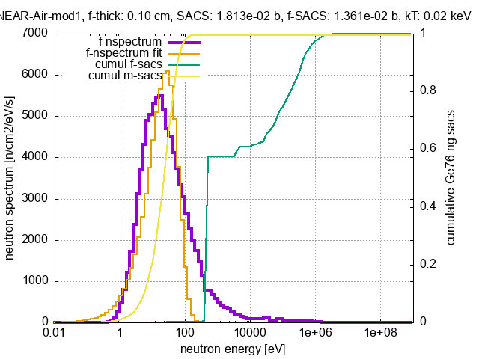
Filtering for the ⁷⁶Ge activation

Slide 16
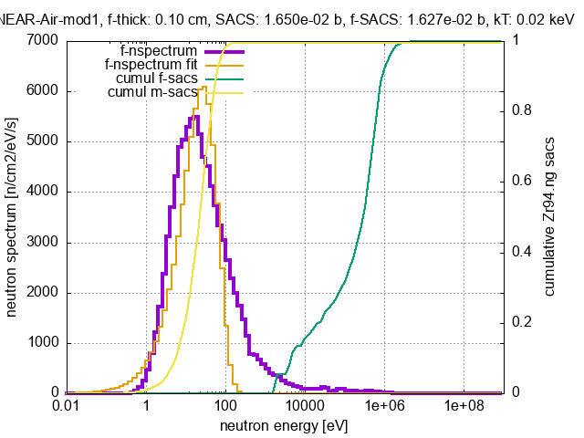
Filtering for the ⁹⁴Zr activation

