Slide 1
Introduzione alle misure di fisica delle alte energie:
La ricerca del bosone Z e del bosone di Higgs
Francesco Giuli
11/02/2025
Notes:
1

Slide 2
Outline
2
What is an “event”?
Z boson: production and decays
How one can identify the particles produced?
… in ATLAS
The “Particle Physics Giant”: the ATLAS detector
Example of a real analysis: signal and backgrounds
Hands-on session
Notes:
2

Slide 3
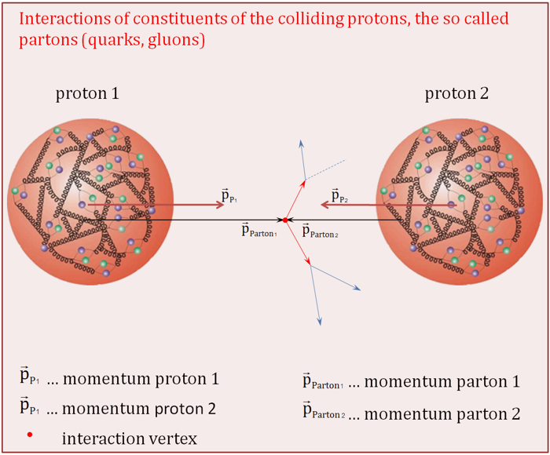
The event
3
Every time two beams (10¹¹ protons in each beam) collide in the Interaction Point (every 25 ns), on average we have about 40-50 primary vertexes
The rest of these collisions are not very interesting (pp → pp)
Protons collide with protons at high speed:
lots of energy (E₁+E₂ = mc² ) which can be used to create new particles
Sometimes a Z boson ( m = 91.2 GeV/c²) or a Higgs boson ( m = 125.1 GeV/ c²) is created

Slide 4
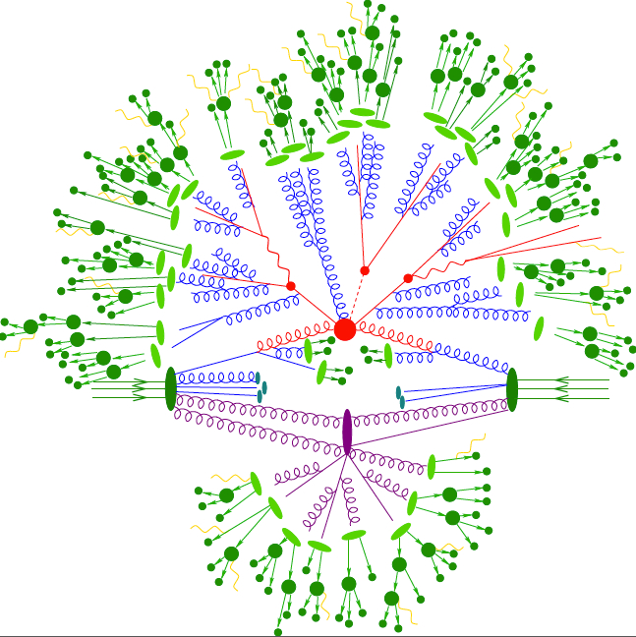
Things are a bit more complex…

Slide 5
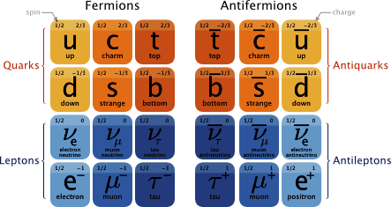
The Z boson
5
- Responsible for mediating the weak interaction (with the W boson)
- It is not a stable particle – lifetime 3x10⁻²⁵ (0.0000000000000000000000003s) →
no hope to measure the Z directly!
- Z bosons decay into a pair of fermion and anti-fermion

Slide 6
The Z boson
6
The possible decays are:
5 types of quark pairs (the top is too heavy to be produced)
A pair of taus
A pair of muons
An electon-positron pair
3 types of neutrinos
Quarks are not observed free in nature, they hadronise which means they produce a collimated “jet” of particles
Leptons have unique signature which we will explore
Taus are more complex, so we only look at muons and electrons
Neutrino do not interact* with matter, so they escape the detector
* they do interact, but the probability is so low we assume it is zero in ATLAS

Slide 7
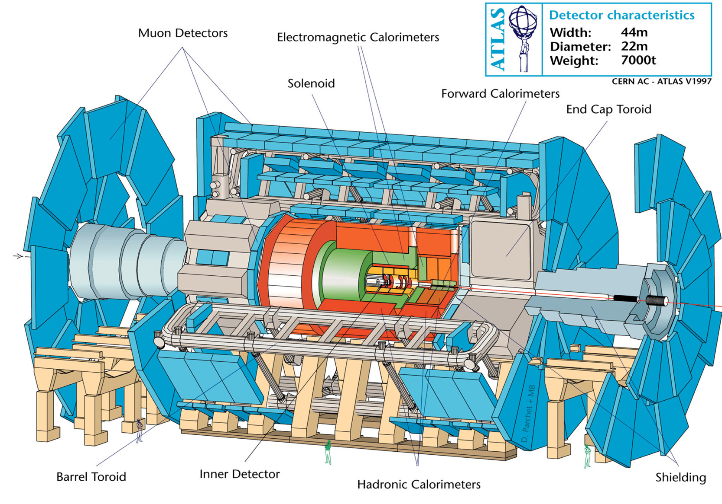
ATLAS
7
We surround the place where particles collide with a set of detectors.
Different types of particles leave different signals in the various detectors
Beam of protons
Beam of protons

Slide 8
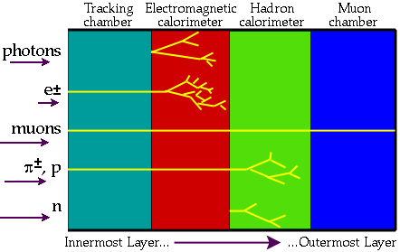
How particles interact with detectors
8

Slide 9
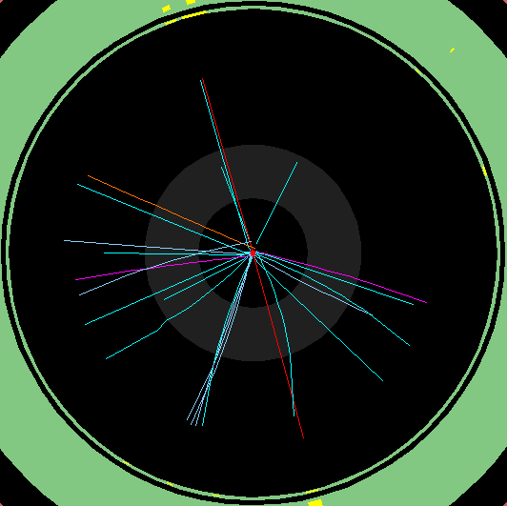
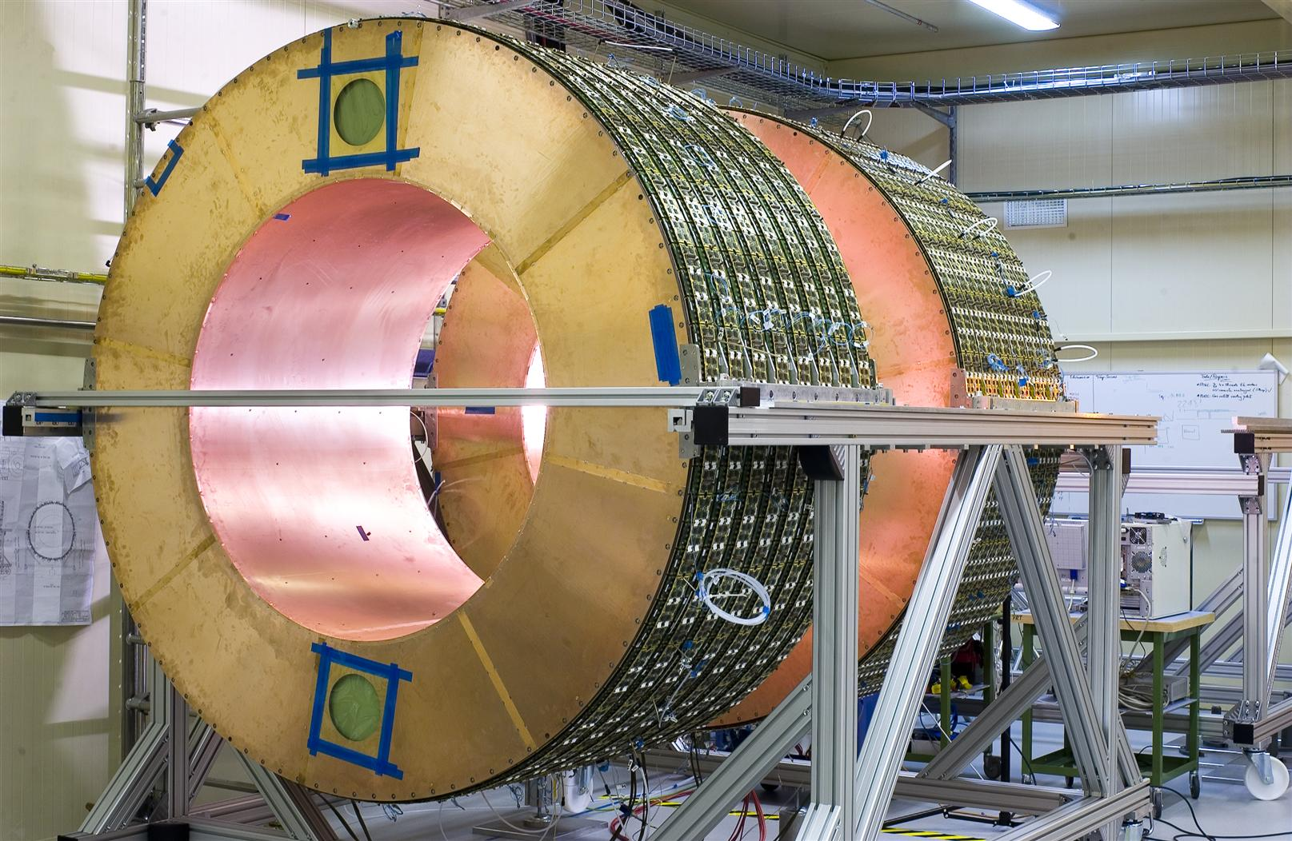
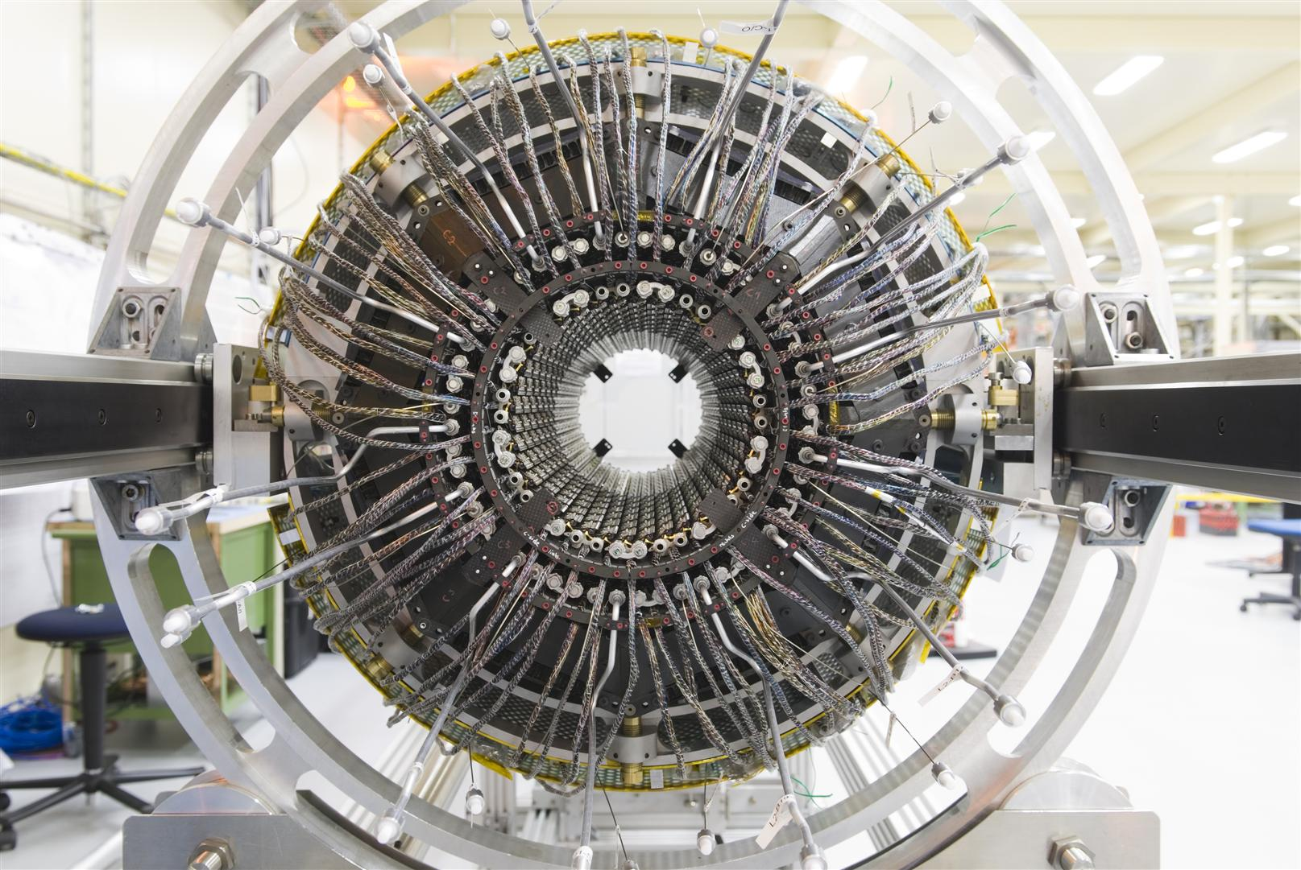
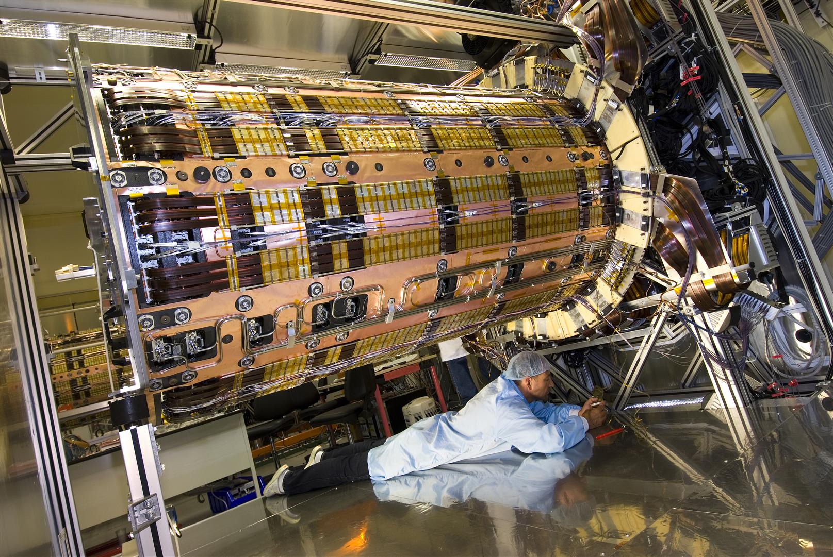
The Inner Detector (tracking detector)
9
the whole detector ”swims” in a magnetic field, that deflects charged particles’ trajectories
Amount of deflection depends on mass and speed
detects electrically charged particles traversing the detector
electrons, muons, protons, quarks (jets) ...
it is not sensitive to electrically neutral particles
photons, neutrons, neutrinos...

Slide 10
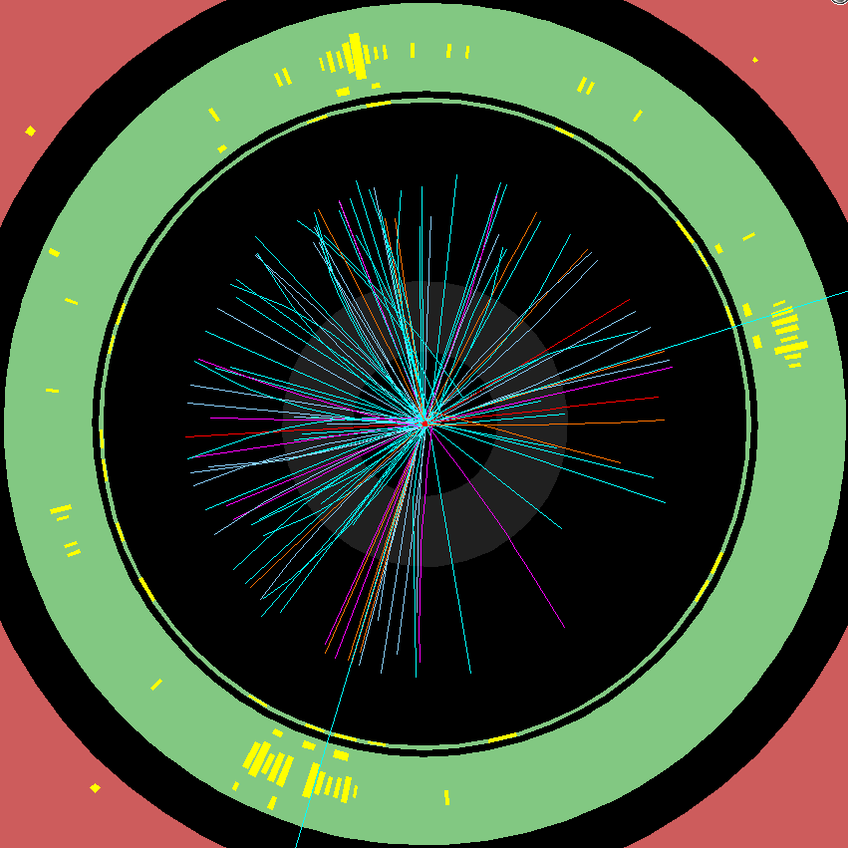
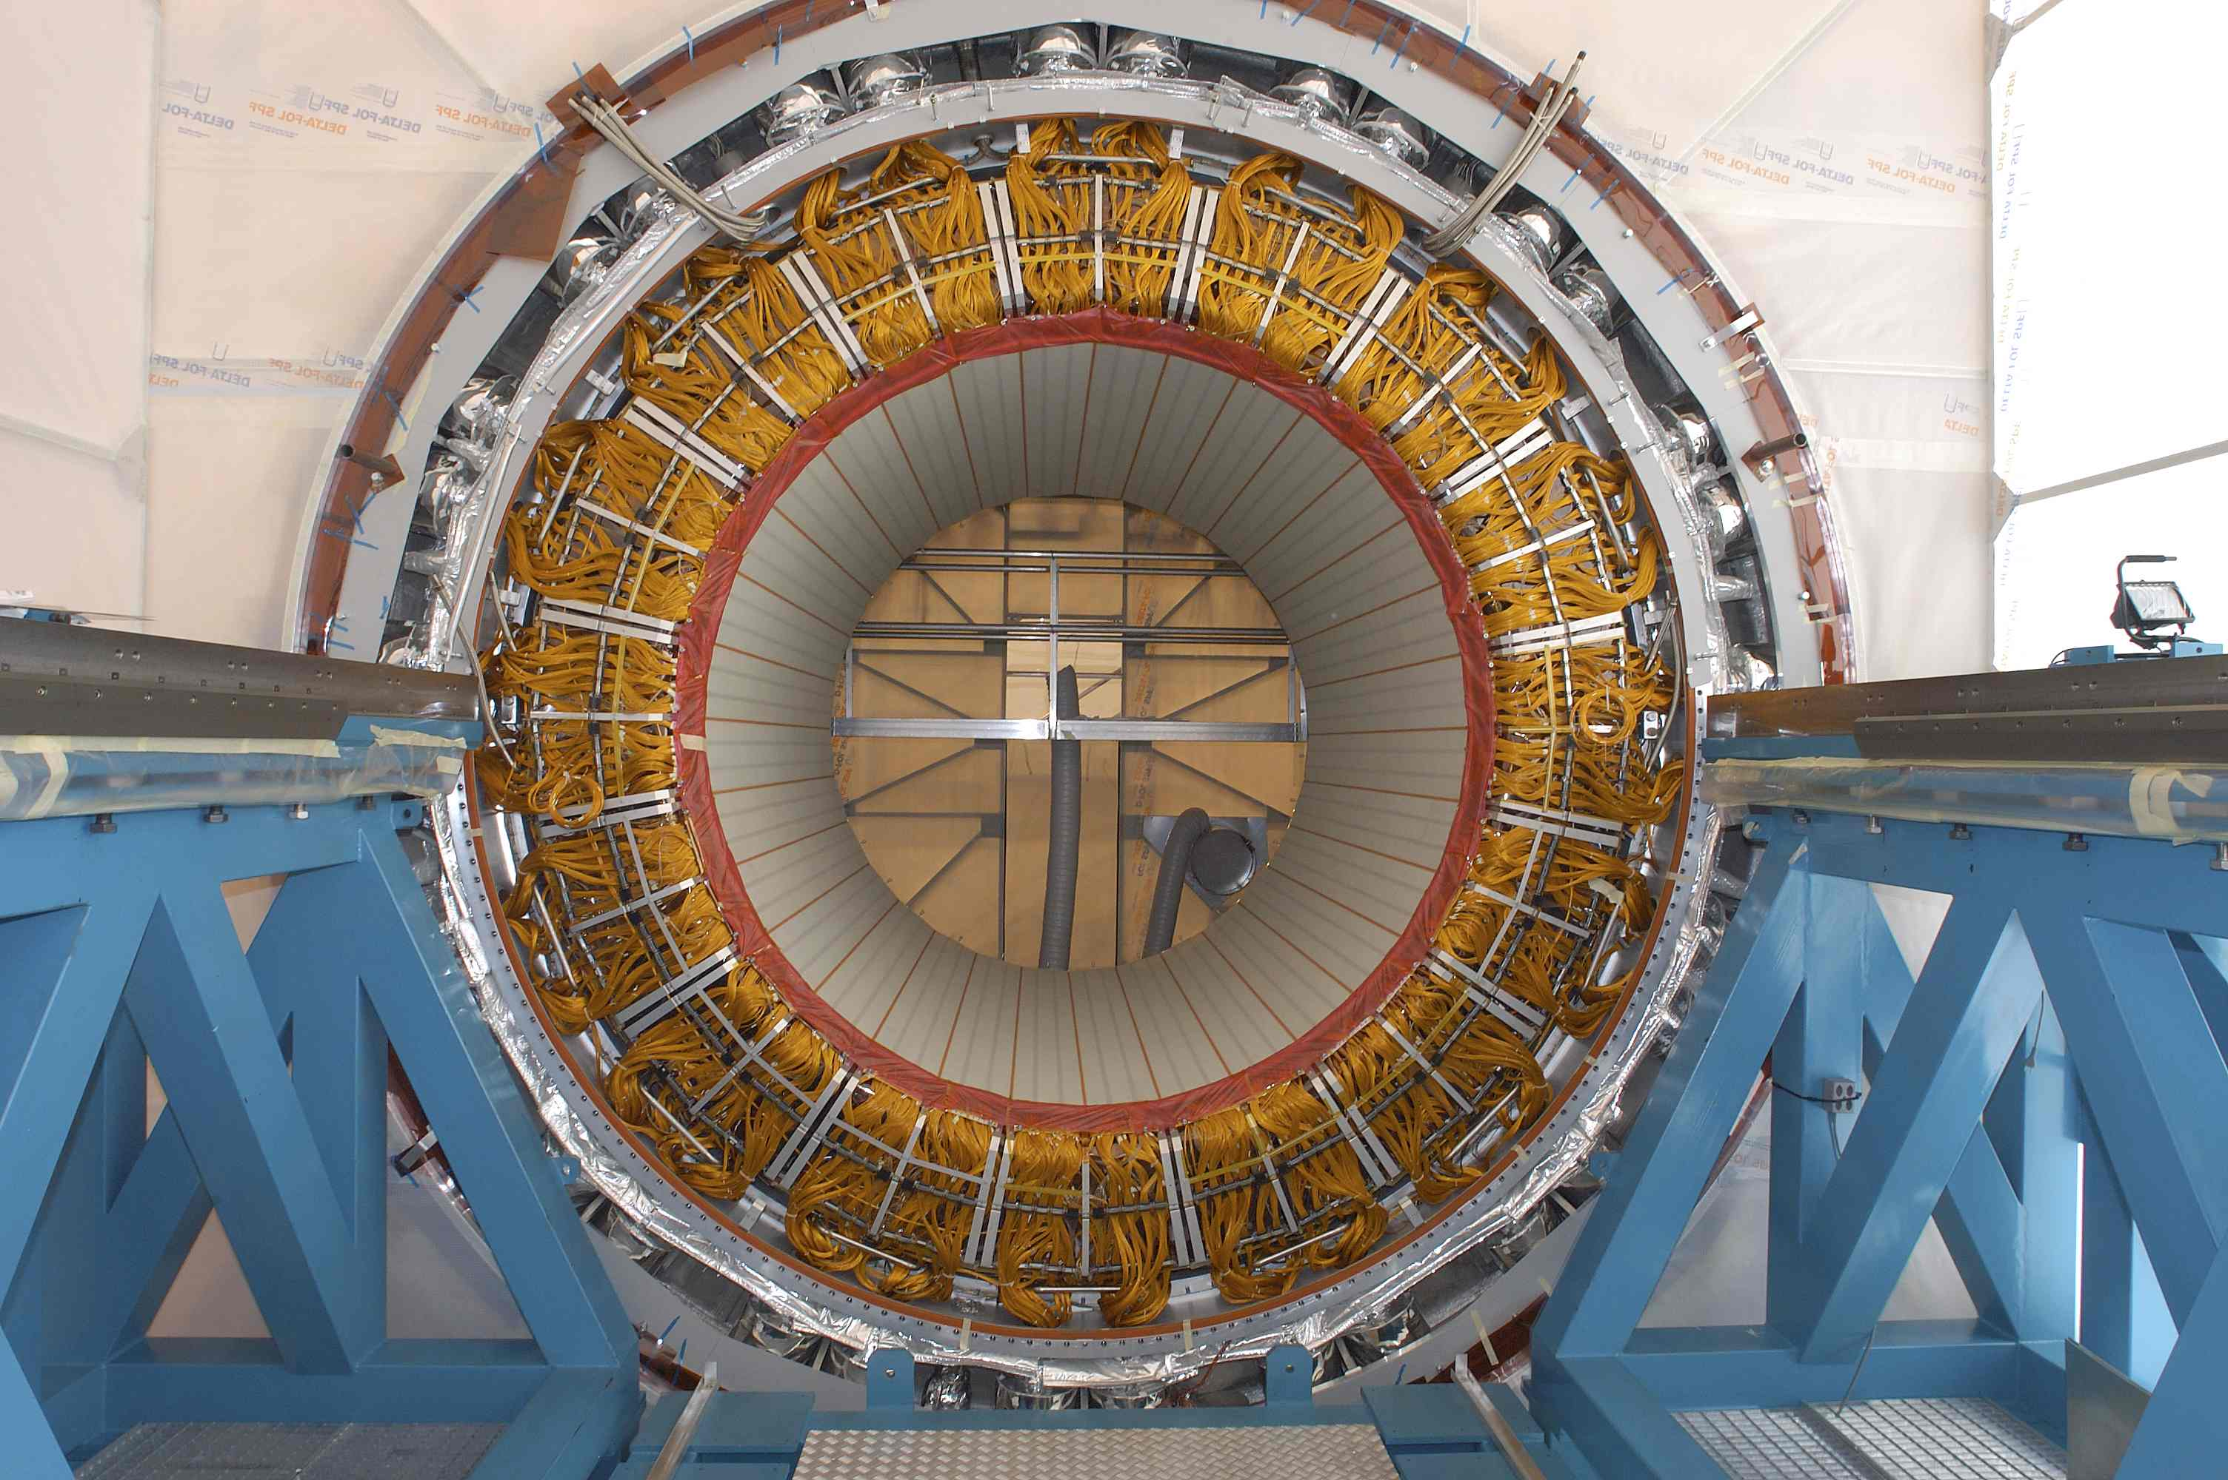
Electromagnetic calorimeter (ECAL)
10
detects all particles interacting electromagnetically
such as electron, positron, photon, …
these particles deposit energy in the ECAL and this energy is measured

Slide 11
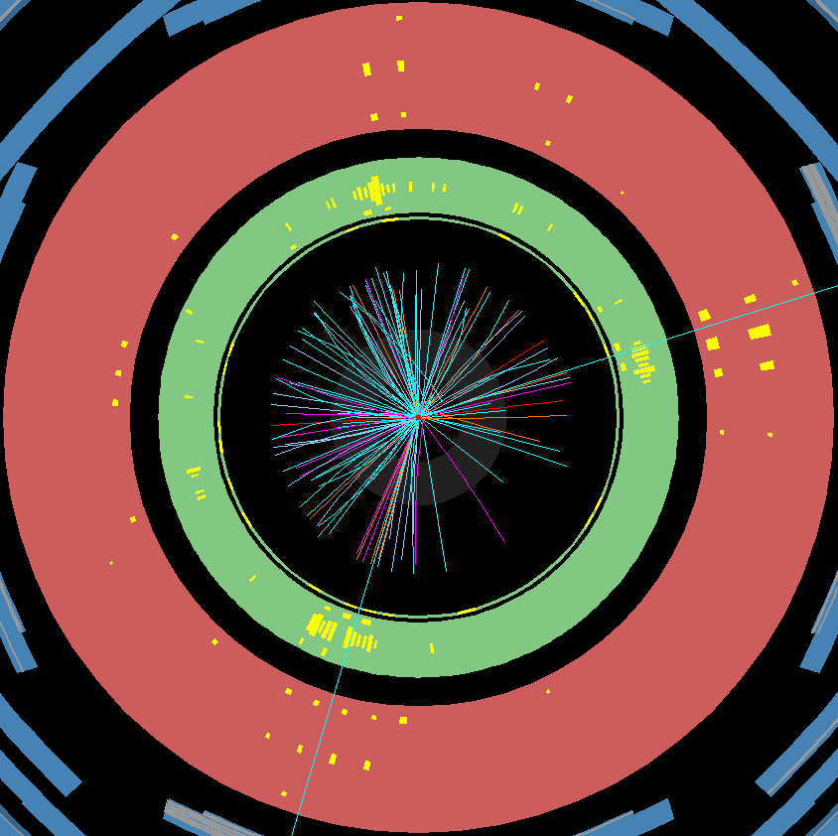
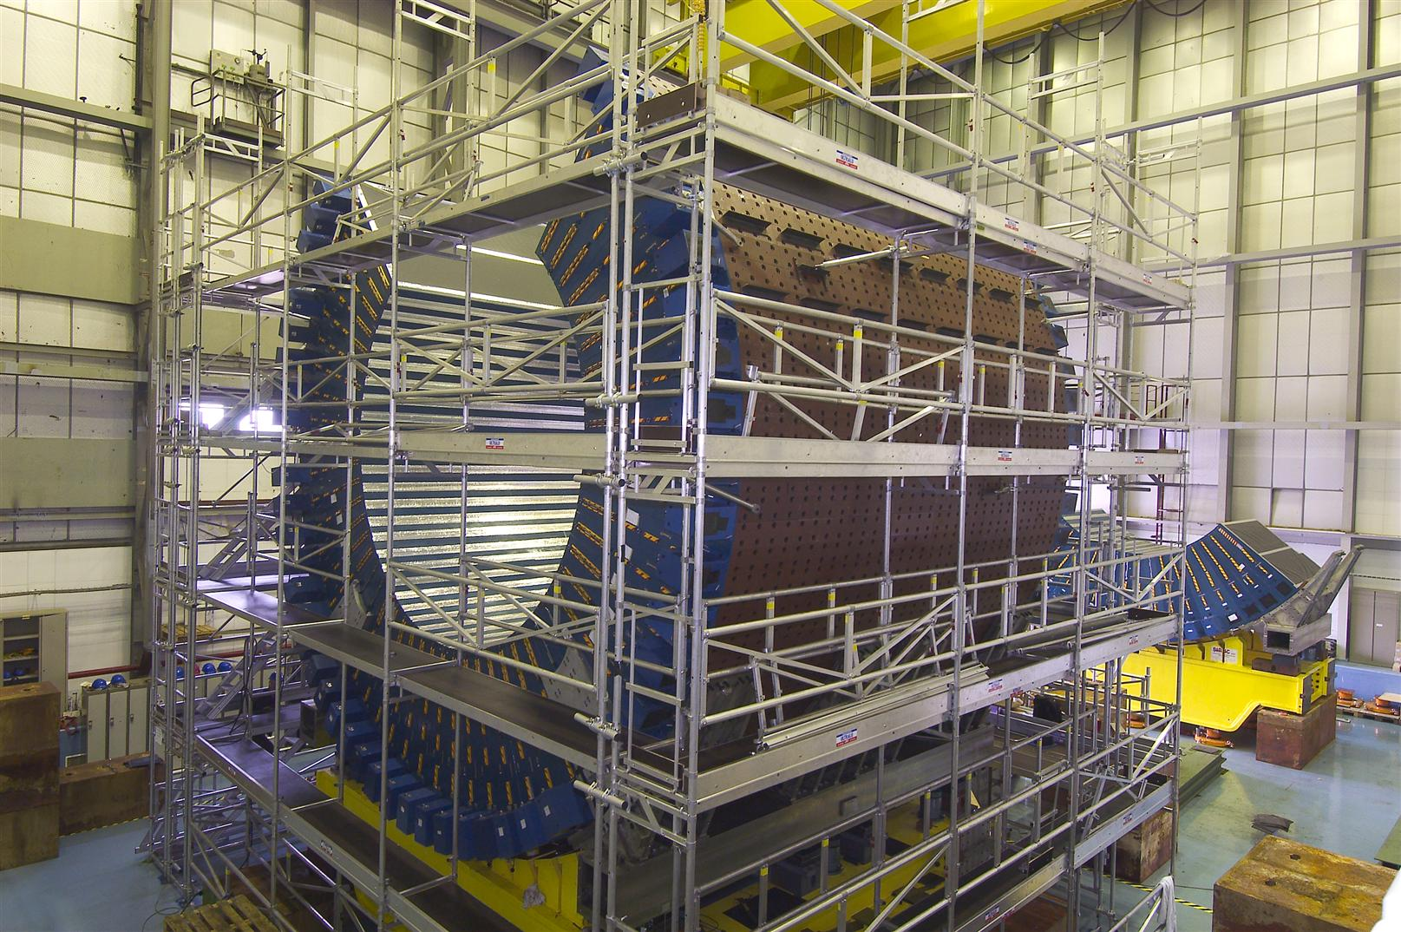
Hadronic calorimeter (HCAL)
11
detects particles subject to strong interactions
mainly particles made of various flavours of quarks (hadrons)

Slide 12
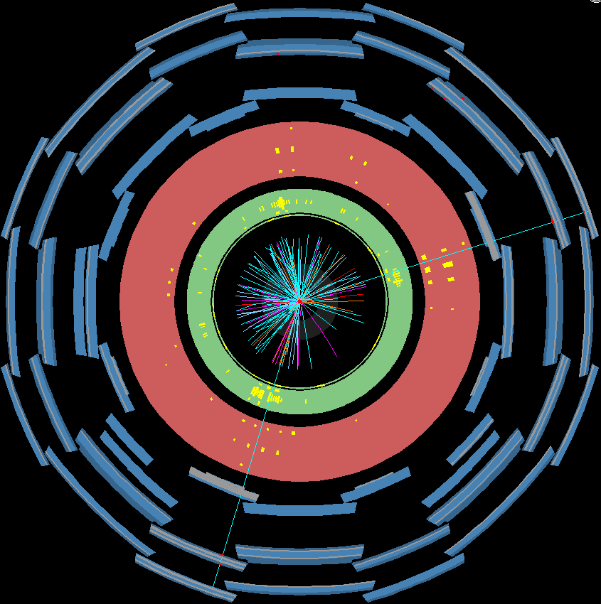
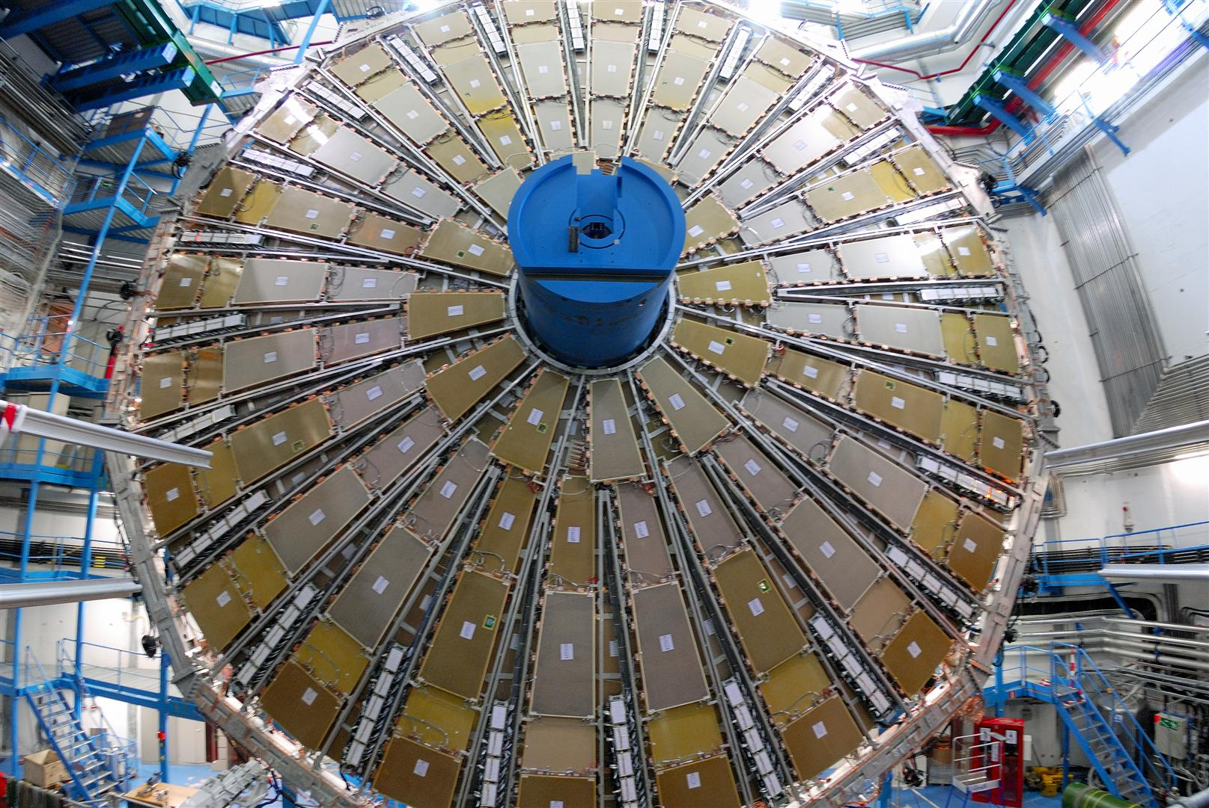
Muon spectrometer (MS)
12
is the outermost part of the detector
detects muons
a strong magnetic field deflects the muon’s trajectory allowing a measure of the momentum

Slide 13
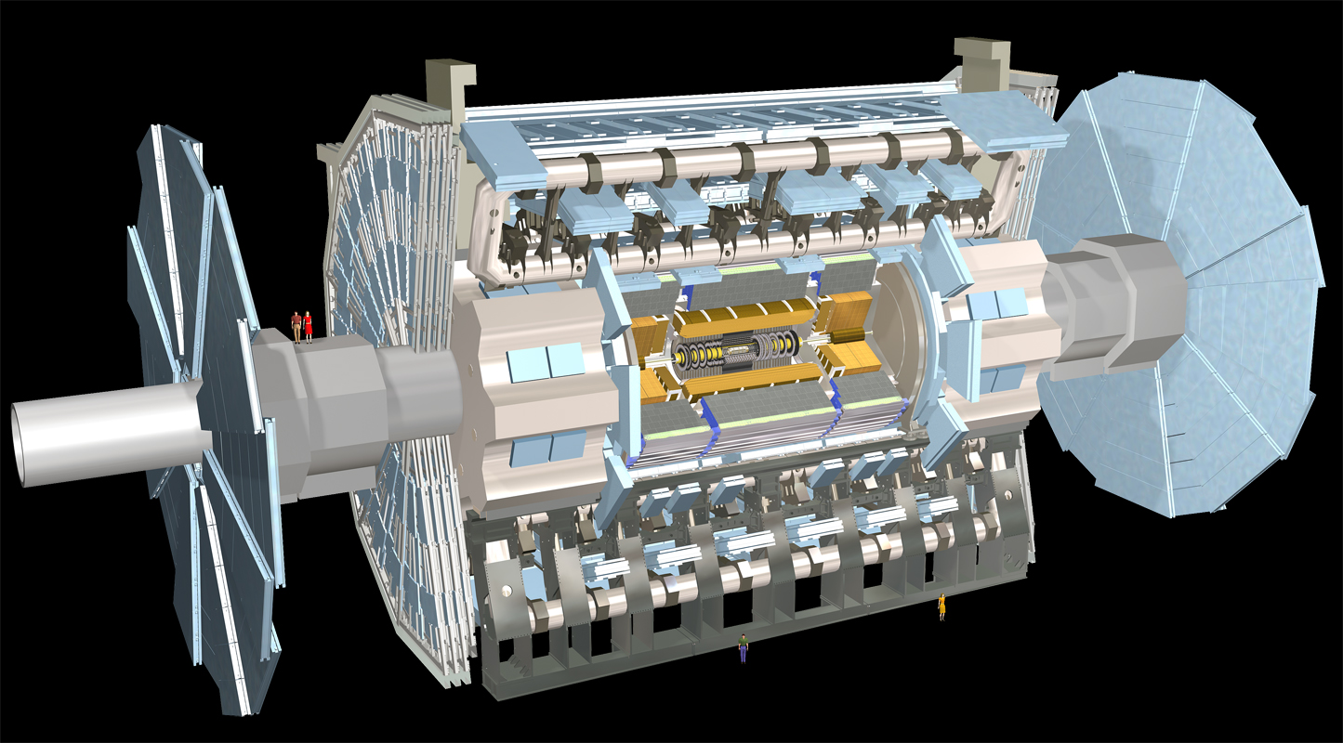
13
barrel
end-caps
In order to detect as many particles as possible after each collision, the detector is built such that it covers nearly the full solid angle

Slide 14
14
You will:
1. Get to know the ATLANTIS event display: a visualisation program for particle collisions in ATLAS
Identify particles in a detector
Identify a decay process
Find as many correct answers as possible? *
2. Work with real data from LHC
Identify decays of the Z boson from background
*: Can we answer this? What about for real data?
Notes:
Si her: grupperte/klassifiserte de forskjellige type partiklene i materiepartikler og kraftformidlende partikler. Leptonene og kvarkene hører til under materiepartiklene, mens fotonet gluonet, z og w partiklene tilhører de kraftformidlende partiklene. Fordi de forskjellige partiklene kjenner de forskjellige kreftene forskjellige oppfører de seg også forskjellig

Slide 15
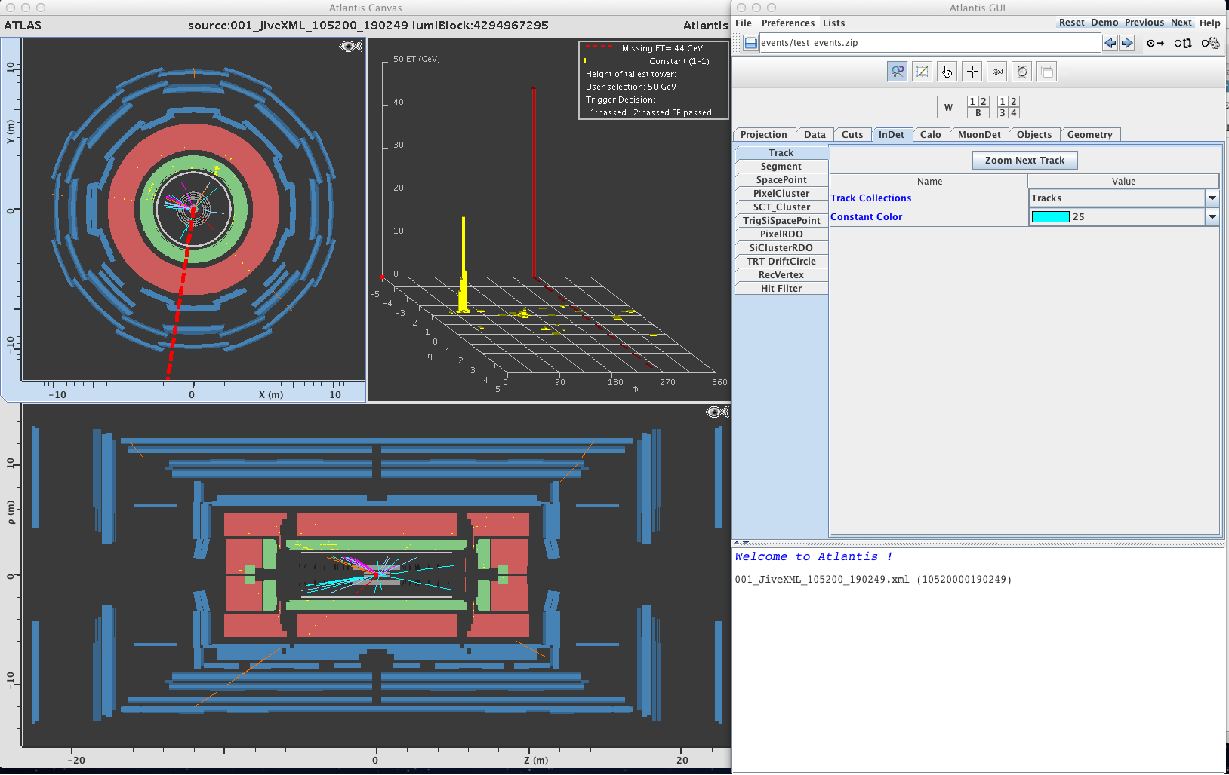
How it looks like…
15
Canvas Window
Control Window
Track Momentum Window

Slide 16
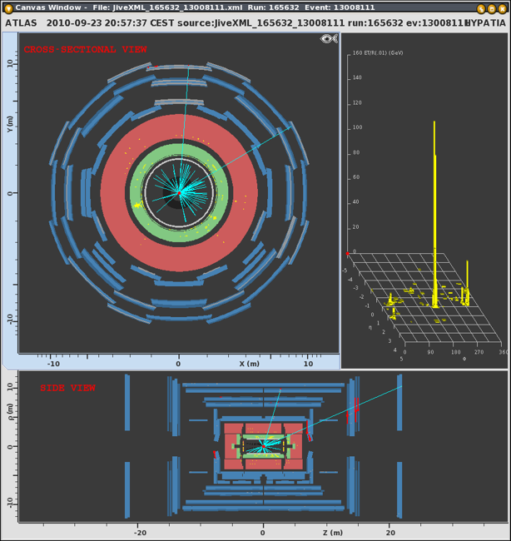
16
Detector views
Four sub-detector
types, depicted in
different colors

Slide 17
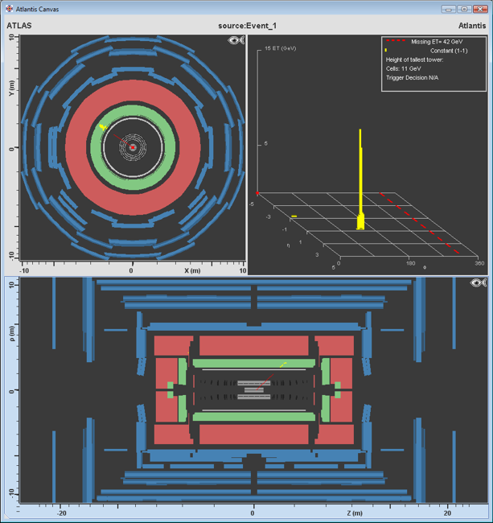
17
Electron
Electron clusters in the EM calorimeter look like yellow “towers” over a green background

Slide 18
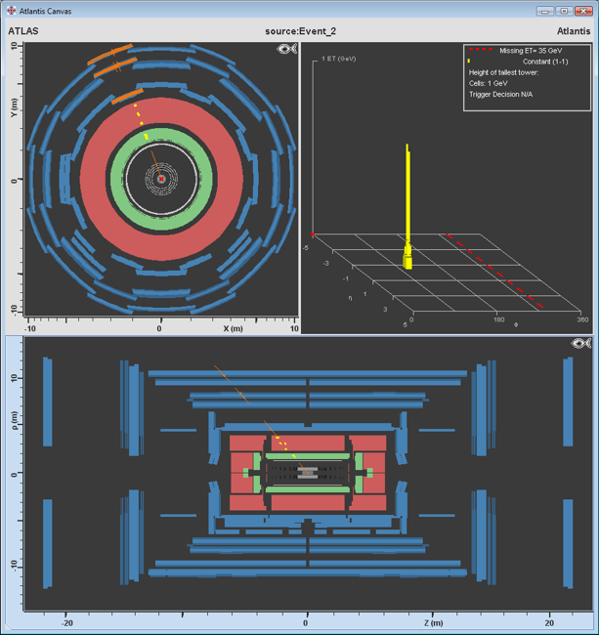
18
Muon
Muon chambers
that are hit are
colored orange
Some of the hits
in the outer
muon chambers
are due to
particles in the
cavern

Slide 19
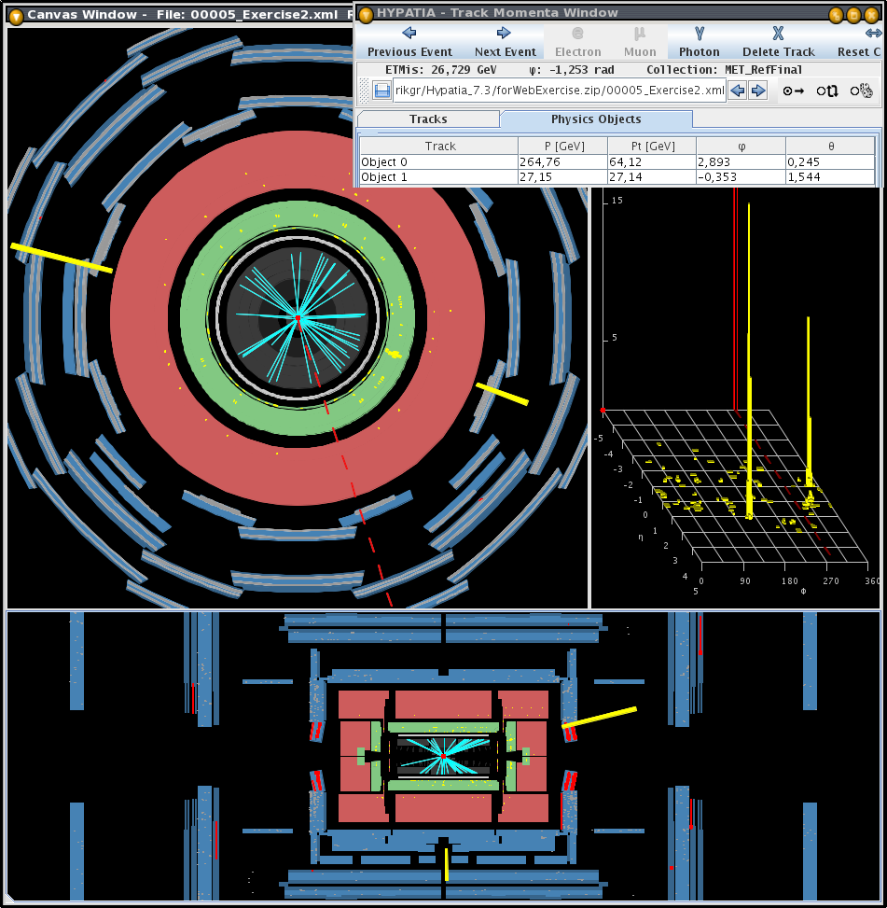
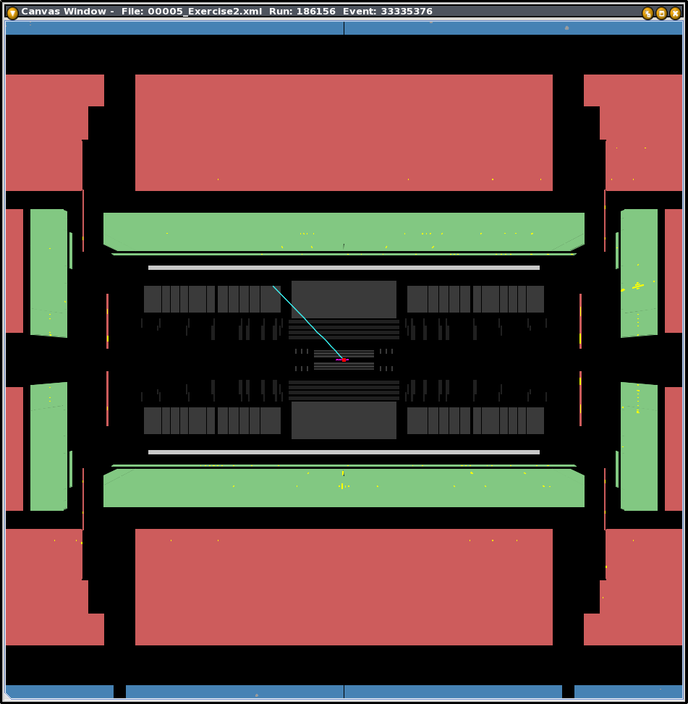
Photon
19
Electromagnetic calorimeter cells fired are
marked in yellow

Slide 20
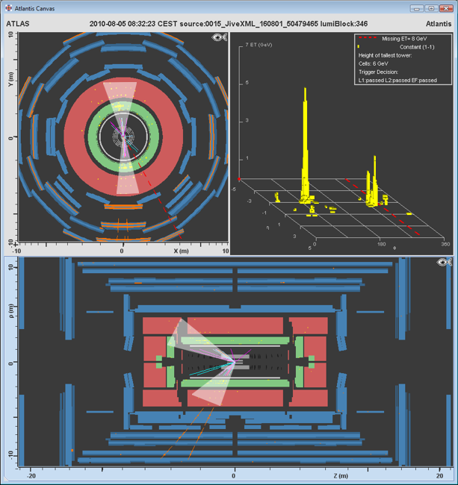
20
Jets of hadrons
A bundle of
several particles
flying in one
direction. It is the
result of quark
or gluons being
ejected.

Slide 21
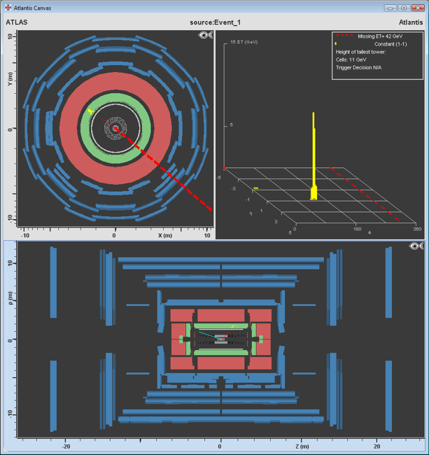
21
Neutrino
Neutrinos are
not directly
detected, but
inferred from
energy
imbalance
Indicated by
a dashed line,
thicker line
corresponds
to larger missing
energy

Slide 22
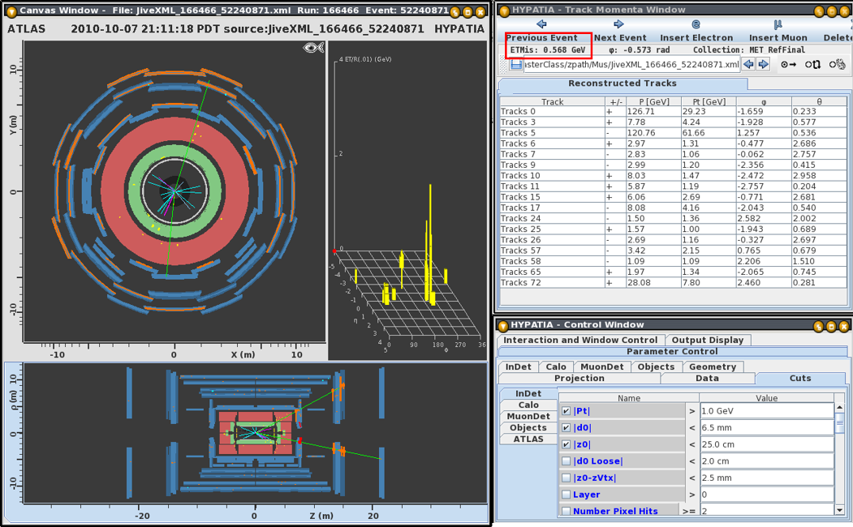
Signal: Z->μ⁺μ⁻
22

Slide 23
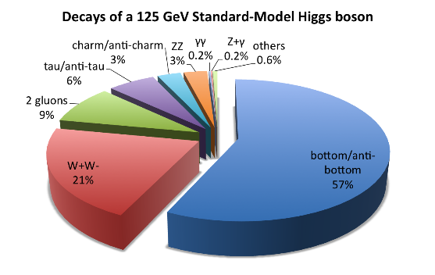
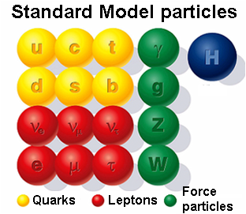
The Higgs Boson
23
- Responsible for the mass of all particles
- It is not a stable particle – lifetime 1.5x10⁻²² (0.00000000000000000000015s) →
no hope to measure H directly!
H bosons decay either into:
a pair of fermion and anti-fermion
a pair of gauge bosons (W⁺W⁻, ZZ, gg, γγ)
Today we are interested only in two decays: ZZ (and γγ, if you want)
Why these two decays and not the most probable one in bb?

Slide 24
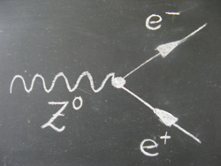
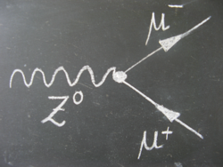
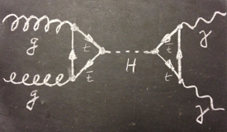
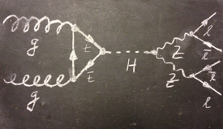
Signals summary
24
Z boson – electrically neutral mediator of the weak force
H boson – electrically neutral responsible of the mass of all elementary particles
Notes:
Si her: grupperte/klassifiserte de forskjellige type partiklene i materiepartikler og kraftformidlende partikler. Leptonene og kvarkene hører til under materiepartiklene, mens fotonet gluonet, z og w partiklene tilhører de kraftformidlende partiklene. Fordi de forskjellige partiklene kjenner de forskjellige kreftene forskjellige oppfører de seg også forskjellig

Slide 25
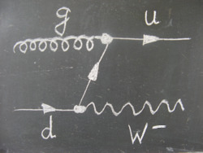
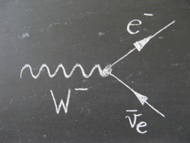
Background (fondo) events
25
In any pp collision, a lot of particles are produced! Not only Z and H…
But we reconstruct Z and H (signals) based on their decay products: muons, electrons and photons
All other physics processes producing muons, electrons and photons are called background events
How can we distinguish background events from signal events?
By looking at ALL particles we want in the final state!
Are they the same??

Slide 26
And now
26
Hands-on!

Slide 27
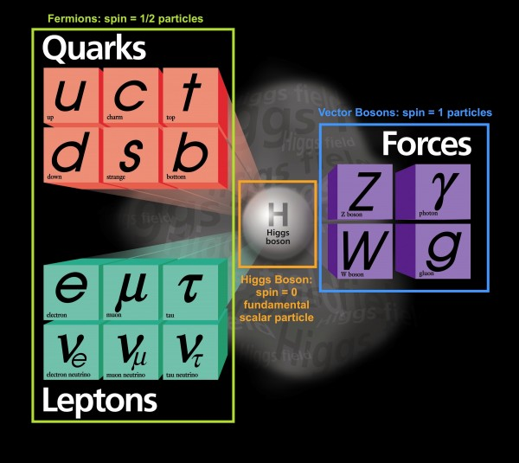
Reminder: the Standard Model
27
Which of these is stable (i.e. can travel for ~100m) ?

Slide 28
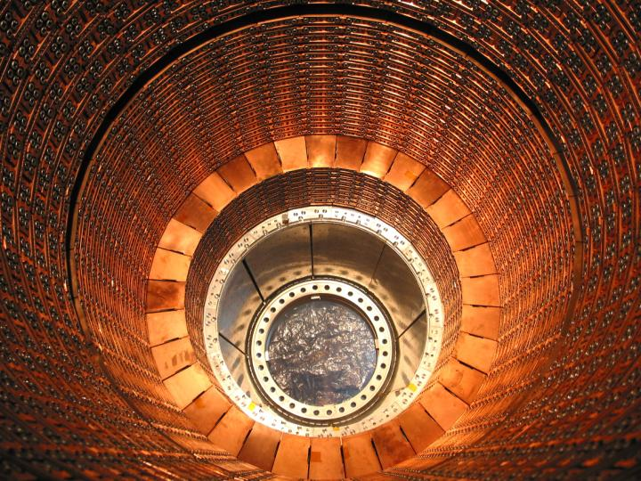
28

Slide 29
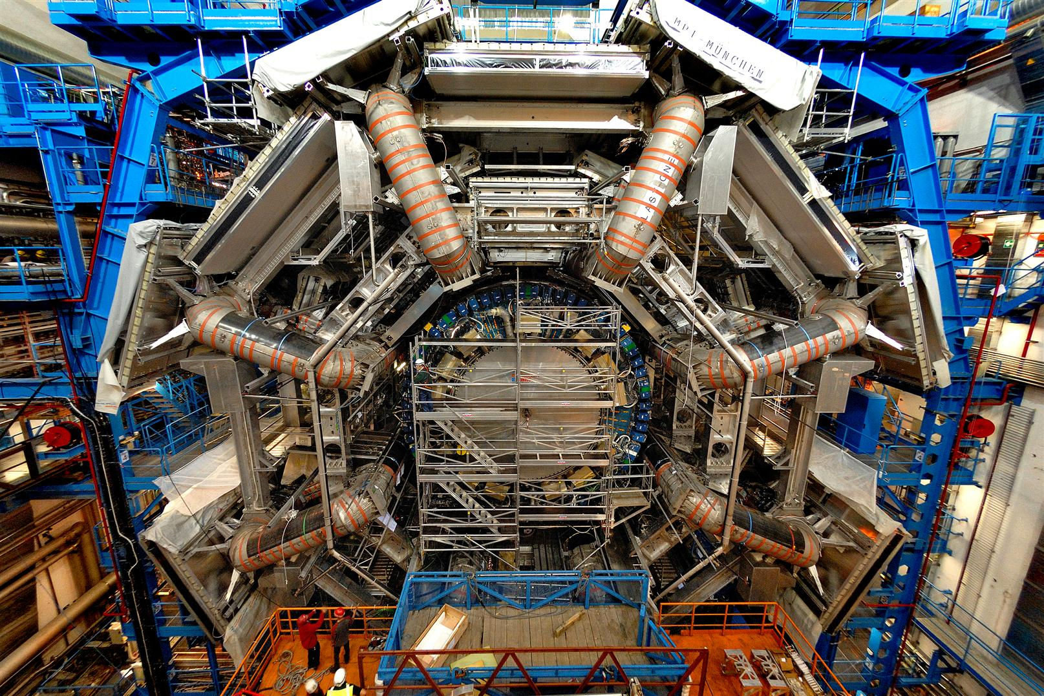
29

Slide 30
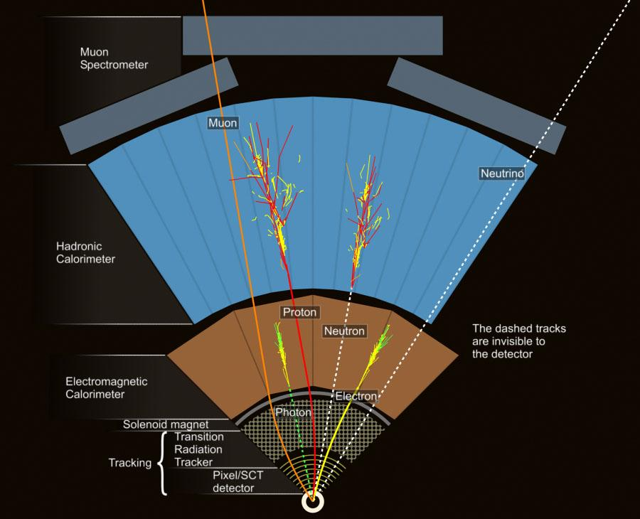
30

