Slide 1
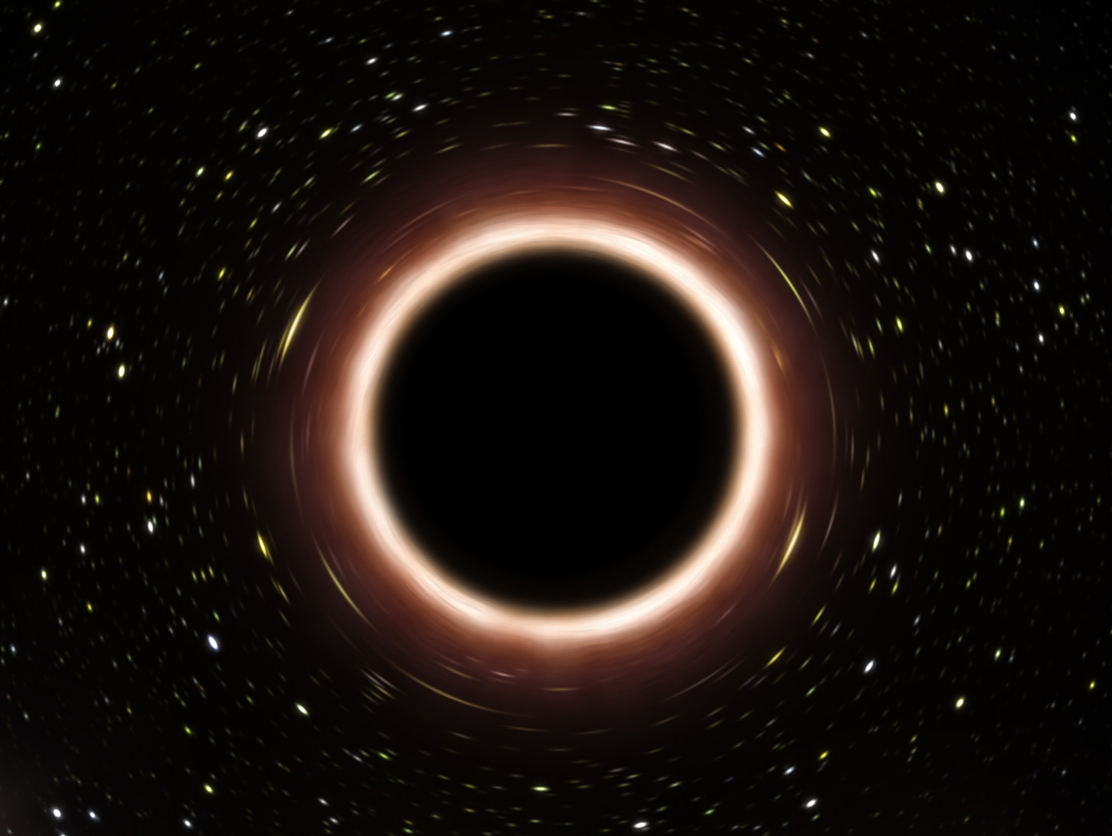
Harvesting information across the horizon
RQI-North 2025
Sijia Wang
María Rosa Preciado-Rivas
Robert Mann

Slide 2
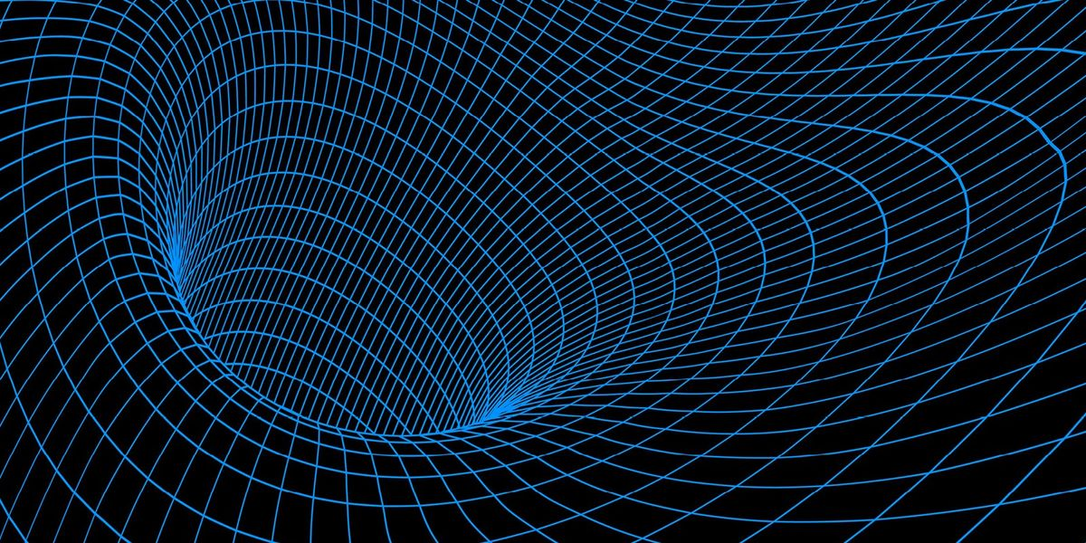
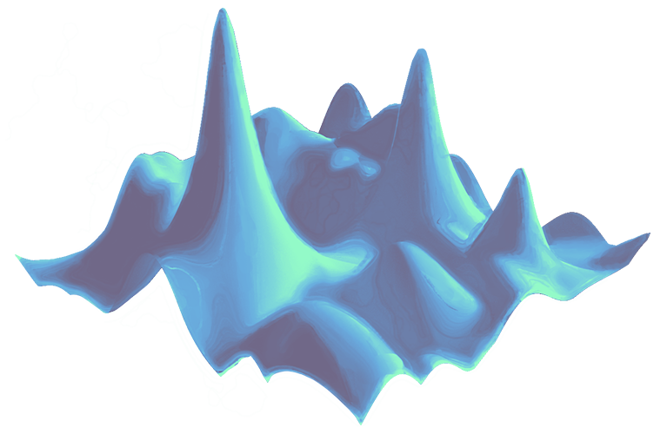




THE PARTICLE DETECTOR APPROACH
$$𝒫$$
$$τ$$
$$E$$
Unruh-DeWitt detector
Notes:
Remove additional animations on field

Slide 3






UDW DETECTORS IN BLACK HOLE SPACETIMES
Infalling detector
Correlation harvesting with detectors
$$\dot{𝒫}$$
$$ℰ$$
$$τ$$
$$r$$

Slide 4





SETUP
$$ℐ_{AB}$$
Tractable and gives insight into higher dimensions
MUTUAL INFORMATION
Switch on
Detector A
$$∆τ$$
$$τ_{A}$$
Detector B
Switch on
Static 2+1 BTZ black hole
$$T$$
Notes:
Add text for rationale

Slide 5








SETUP – BTZ METRIC AND THE QUANTUM VACUUM
BTZ Metric
Massless Scalar Field
Wightman Function
Notes:
Emphasize AdS3 behavior far from BH

Slide 6






SETUP – DETECTORS AND MUTUAL INFORMATION
Interaction Hamiltonian
Mutual Information
Final Density Matrix

Slide 7






SETUP – TRAJECTORIES AND COMPUTATIONS
Trajectories
Switching Functions
Transition Probability and Correlation

Slide 8






RESULTS
$$ℐ_{AB}$$
DECREASING
DECREASING TO INCREASING
INCREASING
$$τ$$
$M$ decreases
$Δτ$ decreases
$Δτ$ and $T$ increase proportionally

Slide 9




RESULTS – VARYING BLACK HOLE MASS
LARGE MASS ($M=1$)
MEDIUM MASS ($M=0.4$)
Mutual Information
TINY MASS ($M=0.01$)
SMALL MASS ($M=0.1$)
Detector Proper Time

Slide 10




RESULTS – VARYING BLACK HOLE MASS
LARGE MASS ($M=1$)
SMALL MASS ($M=0.1$)
Mutual Information
As $M$ decreases, correlation $𝒞$ grows faster than $𝒫$
TINY MASS ($M=0.01$)
Smaller black holes are statistically quieter
Detector Proper Time

Slide 11







“GLITCHES”
Geodesic separation can vanish
Glitches are indexed by $n$, the number of wrap-arounds
ASIDE:
GLITCH
Phys Rev D 110(6) 065013

Slide 12



“GLITCHES” – MASS EXAMPLE
GLITCHES IN $𝓟_{A}$
Term number, $n$
GLITCHES IN $𝓒$
Detector Proper Time

Slide 13
CONCLUSION
Exploratory simulation – interesting to see what is detected
Mutual information non-vanishing and non-monotonic
Even simple black holes affect correlations in the quantum vacuum

Slide 14
5/21/25

