Slide 1
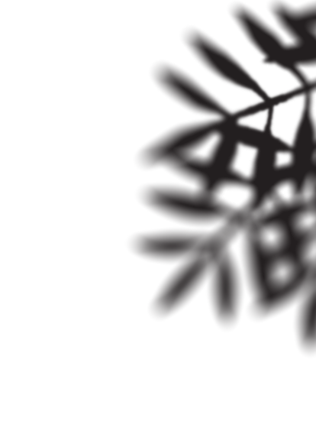
Modelling entanglement harvesting implementations in superconducting circuits
Adam Teixidó-Bonfill, RQI-N 2025, Naples
Work available on: arXiv:2505.01516 with Xi Dai, Adrian Lupascu, Eduardo Martín-Martínez

Slide 2
Introducing detectors and entanglement harvesting

Slide 3
UDW Detector: An Idealized Model
Unruh-DeWitt (UDW) particle detector [1,2]. For example, in 1+1D,
Coupling strength
Switching function
Smearing function
Interaction Hamiltonian:
Field:
Qubit gap
Monopole moment:
[1] W. G. Unruh, Notes on black-hole evaporation, Phys. Rev. D 14, 870 (1976)
[2] B. DeWitt, General Relativity: an Einstein Centenary Survey (Cambridge University Press,1980)

Slide 4
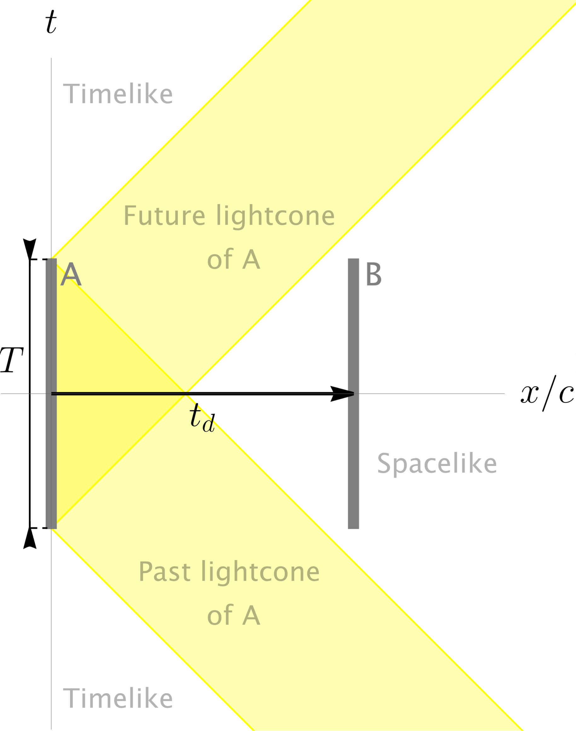
Entanglement Harvesting is a Prediction
Spatially separated detectors can entangle! [4]
Currently, a prediction! Experimental proposals:
Superconducting circuits [5]
Graphene [6]
Bose-Einstein condensates [7]
Non-linear crystals [8]
[4] B. Reznik, Entanglement from the vacuum, Found. Phys. 33, 167 (2003)
[5] C. Sabín, J. J. García-Ripoll, E. Solano, and J. León, Dynamics of entanglement via propagating microwave photons, Phys. Rev. B 81, 184501 (2010).
[6] J. S. Ardenghi, Entanglement harvesting in double-layer graphene by vacuum fluctuations in a microcavity, Phys. Rev. D 98, 045006 (2018)
[7] C. Gooding, A. Sachs, R. B. Mann, and S. Weinfurtner, Vacuum entanglement probes for ultra-cold atom systems, New J. Phys. 26 105001 (2024).
[8] F. Lindel, A. Herter, V. Gebhart, J. Faist, and S. Y. Buhmann, Entanglement harvesting from electromagnetic quantum fields (2023), arXiv:2311.04642

Slide 5
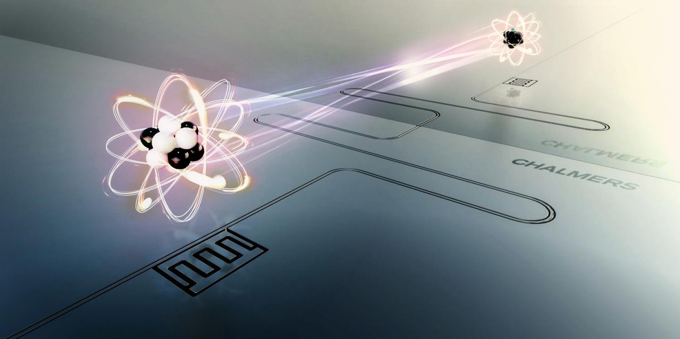
Why Superconducting Circuits?
Why are superconducting circuits a promising experimental RQI platform?
Can create “artificial atoms” that couple strongly to the electromagnetic field [9,10]
The coupling is tunable, demonstrated in [11]
Credit: Moa Carlsson and Lisa Kinnerud, Krantz NanoArt
[9] A. Frisk Kockum, A. Miranowicz, S. De Liberato, S. Savasta, and F. Nori, Nature Reviews Physics 1, 19 (2019).
[10] P. Forn-Díaz, L. Lamata, E. Rico, J. Kono, and E. Solano, Rev. Mod. Phys. 91, 025005 (2019).
[11] N. Janzen, X. Dai, S. Ren, J. Shi, and A. Lupascu, Phys. Rev. Res. 5, 033155 (2023).

Slide 6
Background: How to Implement Detectors in Superconducting Circuits?

Slide 7
Implementation Overview
SUPERCONDUCTING CIRCUIT
RQI PARTICLE DETECTOR
Superconducting Qubit
$$Ω$$
Detector
Tunable Coupling Loop
Switching Function
Superconducting Transmission Line
1D Quantum Field

Slide 8
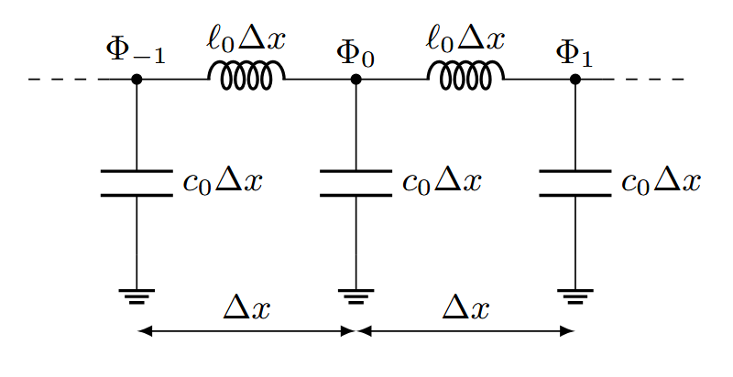
Modelling the Transmission Line
A transmission line is a long superconducting cable
$$Δx→0$$
1D Real Massless Scalar Quantum Field
Lumped circuit model of a resistance-less transmission line.
$Δx$ is a discretization length, $ℓ_{0}$ and $c_{0}$ respectively are the inductance and capacitance per unit length. $Φ_{i}$ is the flux at the i-th node, it equals the time integral of $V_{i}$, the voltage with respect to the ground.

Slide 9
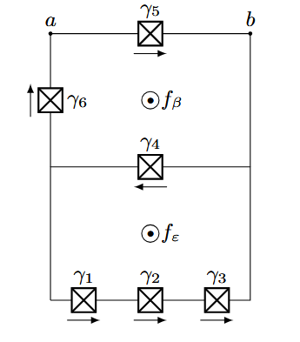
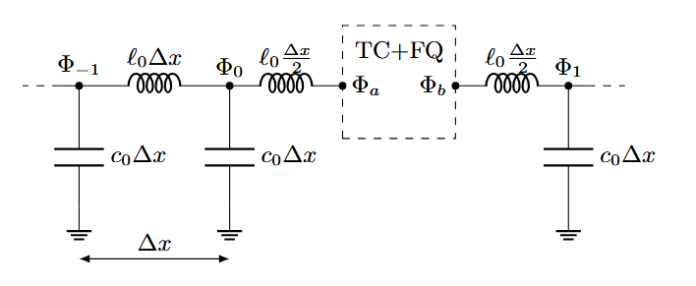
Coupling Tunably to the Transmission Line
The coupling is tuned via changing the external magnetic flux $f_{β}$
Tunable coupler
Flux qubit
Transmission line connected to the Tunable Coupler + Flux Qubit (TC+FQ)
Tunable Coupler + Flux Qubit (TC+FQ):
Loops with Josephson Junctions

Slide 10
Experimental Realization (Single Detector)
Scanning Electron Microscope image of the circuit, from:
[11] N. Janzen, X. Dai, S. Ren, J. Shi, and A. Lupascu. Phys. Rev. Research 5, 033155 (2023)
From uncoupled to “ultra-strong” coupling in nanoseconds. Ideal for entanglement harvesting.

Slide 11
Bridging Experiment and Theory Models

Slide 12
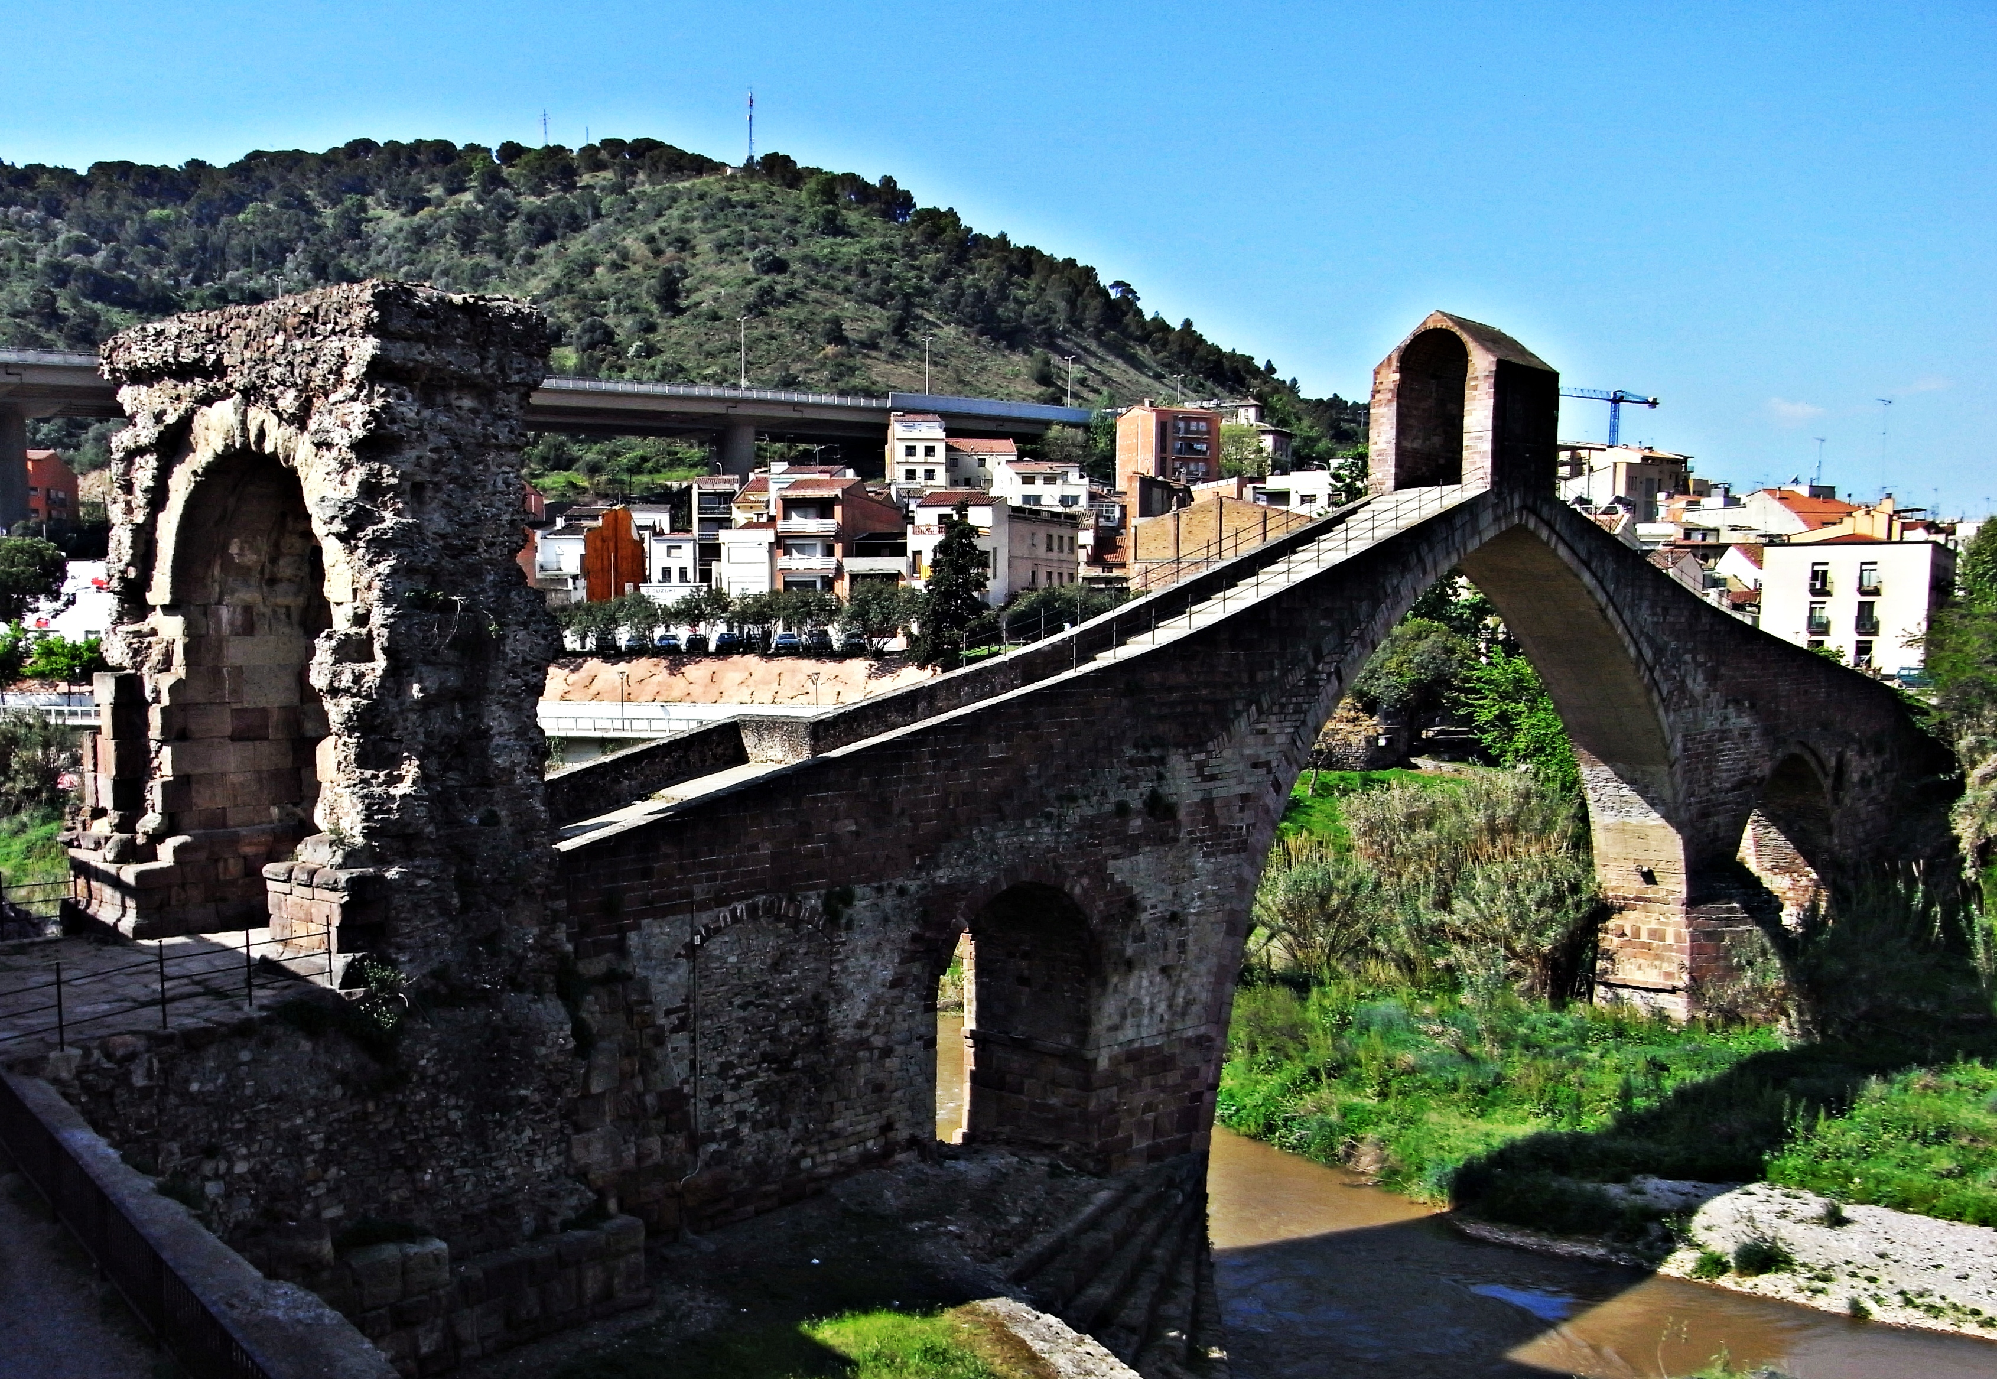
What Bridge do We Need?
Circuit model
Model resembling an UDW detector
Roman arch and “Pont del Diable” (Devil’s Bridge). Author: Jaume Meneses

Slide 13
How to Build the Bridge?
Circuit model
“Upgraded” UDW detector model
Continuum limit $Δx→0$
Approximations:
Two-level detector
Adiabatic approximation upon the free detector
Simplify the coupling: transversal

Slide 14
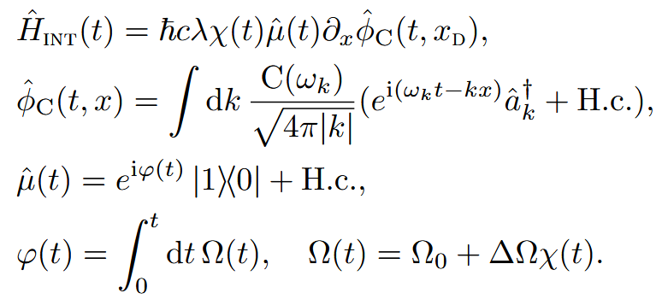
“Upgraded” UDW Detector Model with New Features to Match the Implementation
Result: The following detector model approximates the circuit model
Coupling to the field derivative
Coupling to a field with cutoff (limited spatial resolution ~smearing)
Variable (switching-dependent) energy gap

Slide 15
Consequences for Future Entanglement Harvesting Experiments

Slide 16
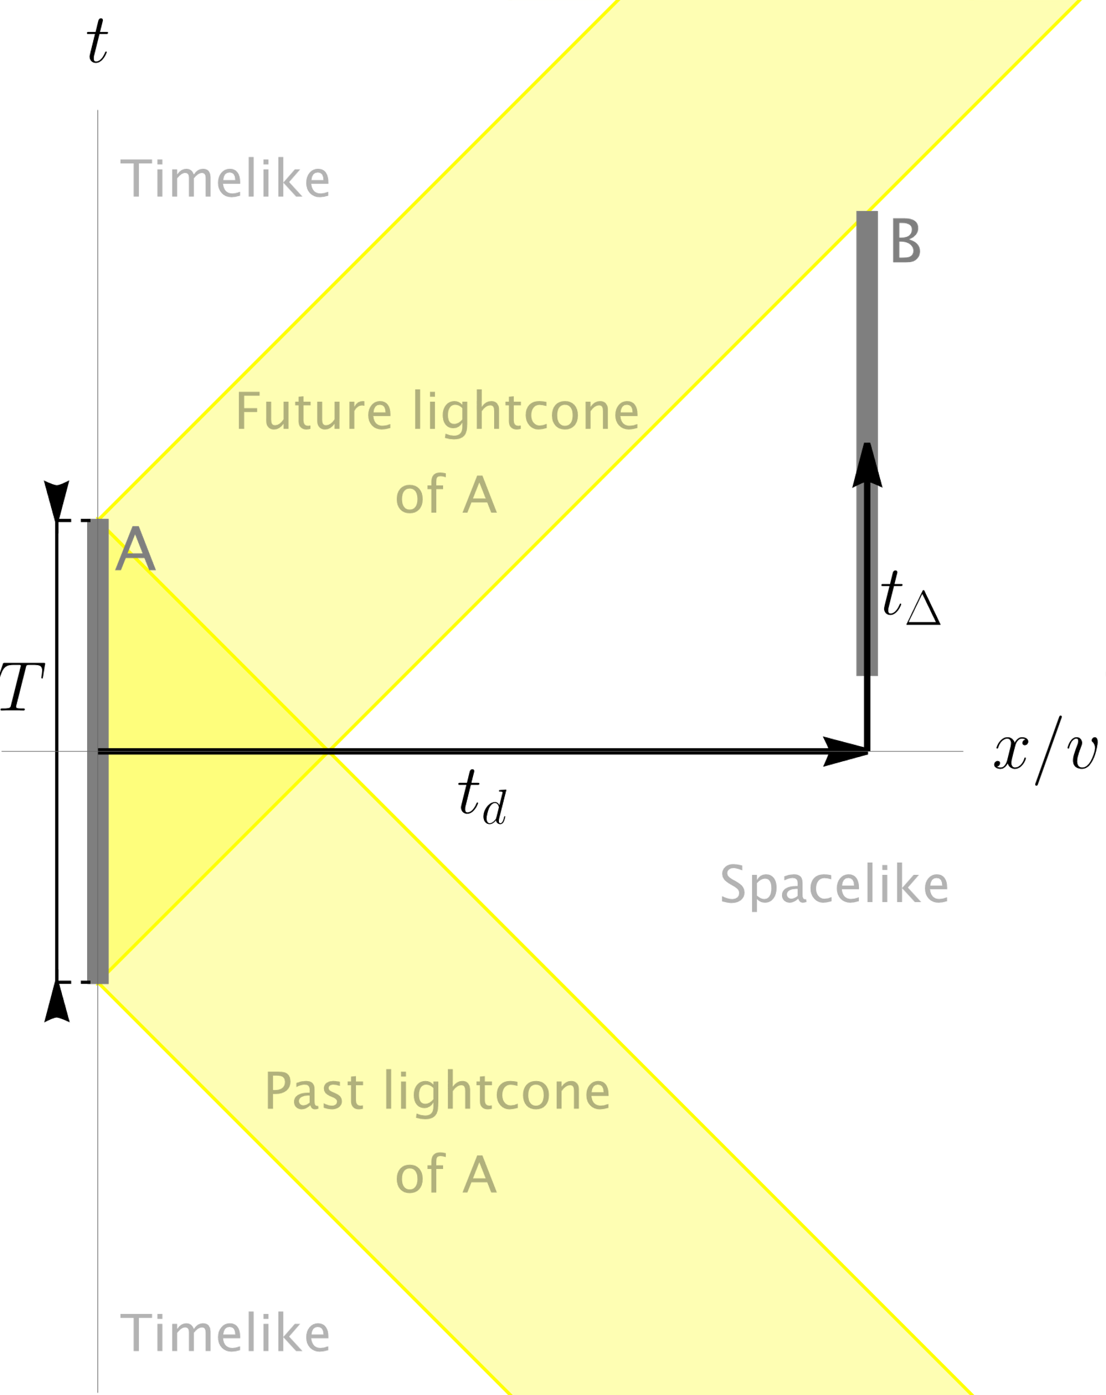
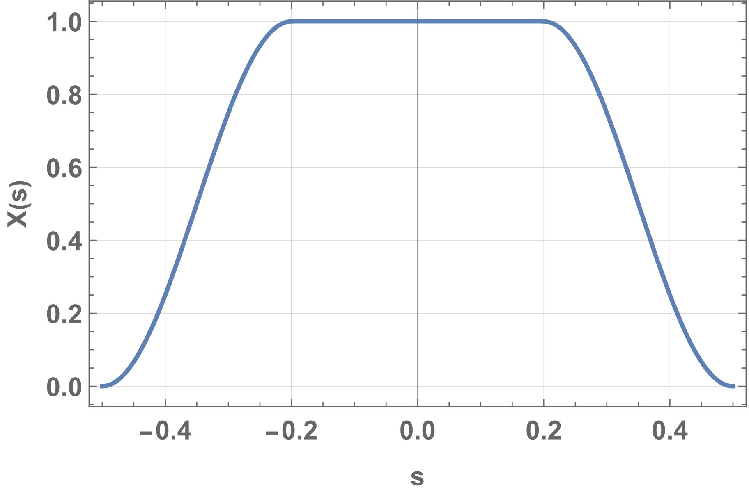
Choosing Model Parameters
Fixed parameters, match implementation:
Detector & field properties: $Ω_{0}, ΔΩ, t_{d} \& Ω_{cut} , v, Z_{0}$
Explorable parameters, freely tunable:
Initial detectors state: ground
Coupling strength. Choice: $λ=λ_{A}=λ_{B}$
Switching functions. Choice: $χ_{A}\left(t\right)=X\left(\frac{t}{T}\right), χ_{B}\left(t\right)=X\left(\frac{t−t_{Δ}}{T}\right)$
$$S_{f}$$
$T=$ Duration of the interaction
$t_{d}=$ Distance between detectors
$t_{Δ}=$ Delay between switchings
Switching function shape (compact, cosine ramps)

Slide 17
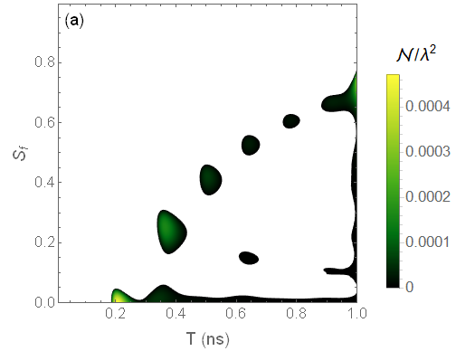
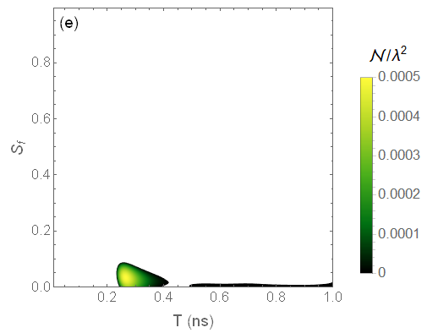
Gap Variation Reduces Spacelike Entanglement Harvesting from the Vacuum
$S_{f}$ (switch. shape)
$S_{f}$ (switch. shape)
No Gap Variation: $λ→0$, $ΔΩ→0$,
$\frac{Ω_{0}}{2π}=7.3 GHz$, $\frac{Ω_{cut}}{2π}=50 GHz$, $t_{d}=1 ns$, $t_{Δ}=T−t_{d}$.
With Gap Variation: $λ=−0.3$ , $\frac{ΔΩ}{2π}=−1.6 GHz$, $\frac{Ω_{0}}{2π}=7.3 GHz$, $\frac{Ω_{cut}}{2π}=50 GHz$, $t_{d}=1 ns$, $t_{Δ}=T−t_{d}$.

Slide 18
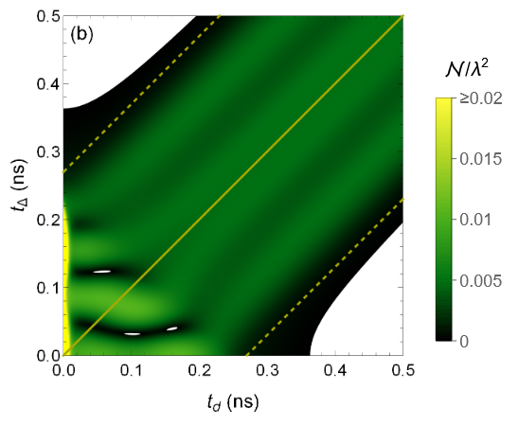
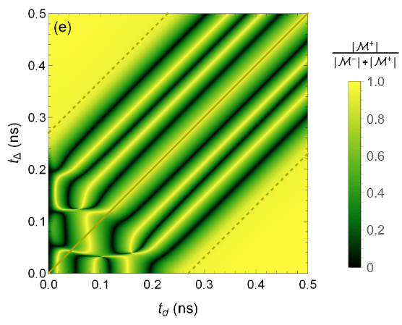
Indication that Entanglement can be Harvested in Causal Contact
Setup With Gap Variation: $λ=−0.3$ , $\frac{ΔΩ}{2π}=−1.6 GHz$, $\frac{Ω_{0}}{2π}=7.3 GHz$, $\frac{Ω_{cut}}{2π}=50 GHz$, $T=0.27 ns$, $S_{f}=0$.
Time
-like
Time
-like
Harvesting
Causal contact
Causal contact
Mix
Space
-like
Space
-like
Communication
Negativity, varying distance ($t_{d}$) and delay ($t_{Δ}$)
Estimator of entanglement source [12]
[12] E. Tjoa and E. Martín-Martínez, When entanglement harvesting is not really harvesting, PRD 104, 125005, (2021)

Slide 19
Conclusion

Slide 20
Summary and Outlook
Superconducting qubits can bring RQI to the lab.
We “upgraded” the UDW detector with superconducting implementations’ features (e.g. gap variation, derivative coupling).
Future steps:
Improve modelling accuracy, drop approximations. Allow: multiple energy levels, non-adiabatic free evolution, general couplings.
Experimentally verify entanglement harvesting.

Slide 21
For more details (and many more plots)
See the preprint, arXiv:2505.01516 :

