Slide 1


Simulating a superposition of spacetimes with optical media
I acknowledge that I have a stutter.
María Rosa Preciado-Rivas
in collaboration with Germain Tobar and Magdalena Zych
RQI North 2025

Slide 2
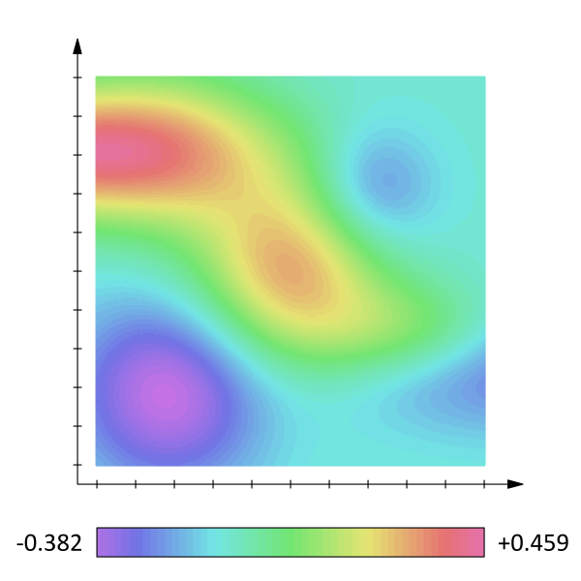

Introduction – Superposition of spacetimes in RQI
The approach in Relativistic Quantum Information is bottom-up or phenomenological.
Unruh-DeWitt detector
quantum field
superposition of spacetimes
Notes:
There are many approaches to build a theory of quantum gravity. They are not completely satisfactory, but they share the property that the laws of quantum physics are maintained. If gravity is quantum, then spacetime itself must be subject to the laws of quantum physics, meaning it can exist in quantum superpositions of classical states.
The approach in RQI is bottom-up or phenomenological.
It considers an Unruh-DeWitt detector coupled to a quantum field whose background spacetime is in a quantum superposition. The detector becomes entangled with the field’s and spacetime degrees of freedom. After tracing out the field and measuring the state of the metric, one is left with the response of the detector (or the probability that it will undergo transitions between its energy states). The detector decoheres or lose information to the other subsystems because it was entangled to them. This decoherence is considered a signature of the superposition of spacetimes.

Slide 3
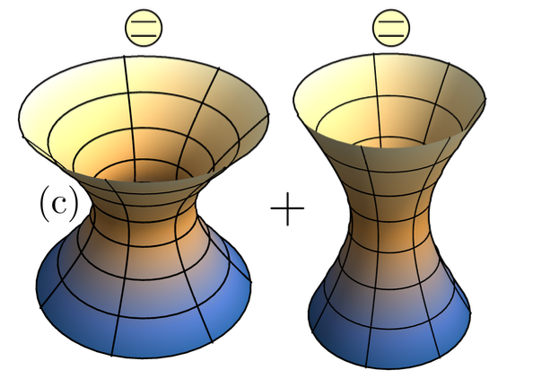
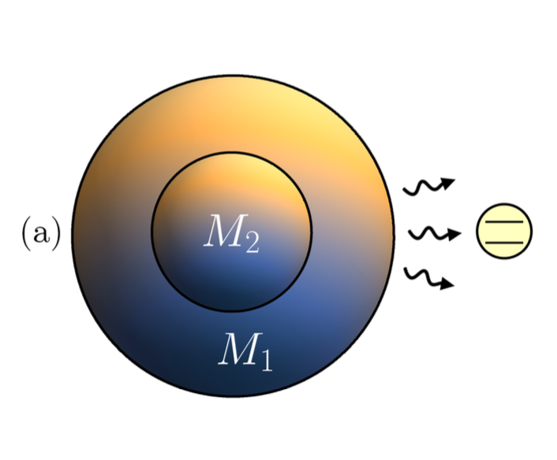
Introduction – Superposition of spacetimes in RQI
With the RQI approach, superpositions of spacetimes have been studied, including
characteristic lengths of identified Minkowski spacetime,
characteristic lengths of identified Rindler spacetime,
de Sitter curvatures, and
black hole masses.
Foo, Arabaci, Zych, & Mann, Phys. Rev. D 107, 045014 (2023)
Goel, Patterson, Preciado-Rivas, Torabian, Mann, & Afshordi, Phys. Rev. D 111, 025015 (2025)
Foo, Mann, & Zych, Class. Quantum Grav. 38, 115010 (2021)
Foo, Mann, & Zych, Int. J. Mod. Phys. D 31, 2242016 (2022)
Notes:
With this approach, superpositions have been studied, including characteristic lengths of identified Minkowski and Rindler spacetime, de Sitter curvatures, and black hole masses.

Slide 4
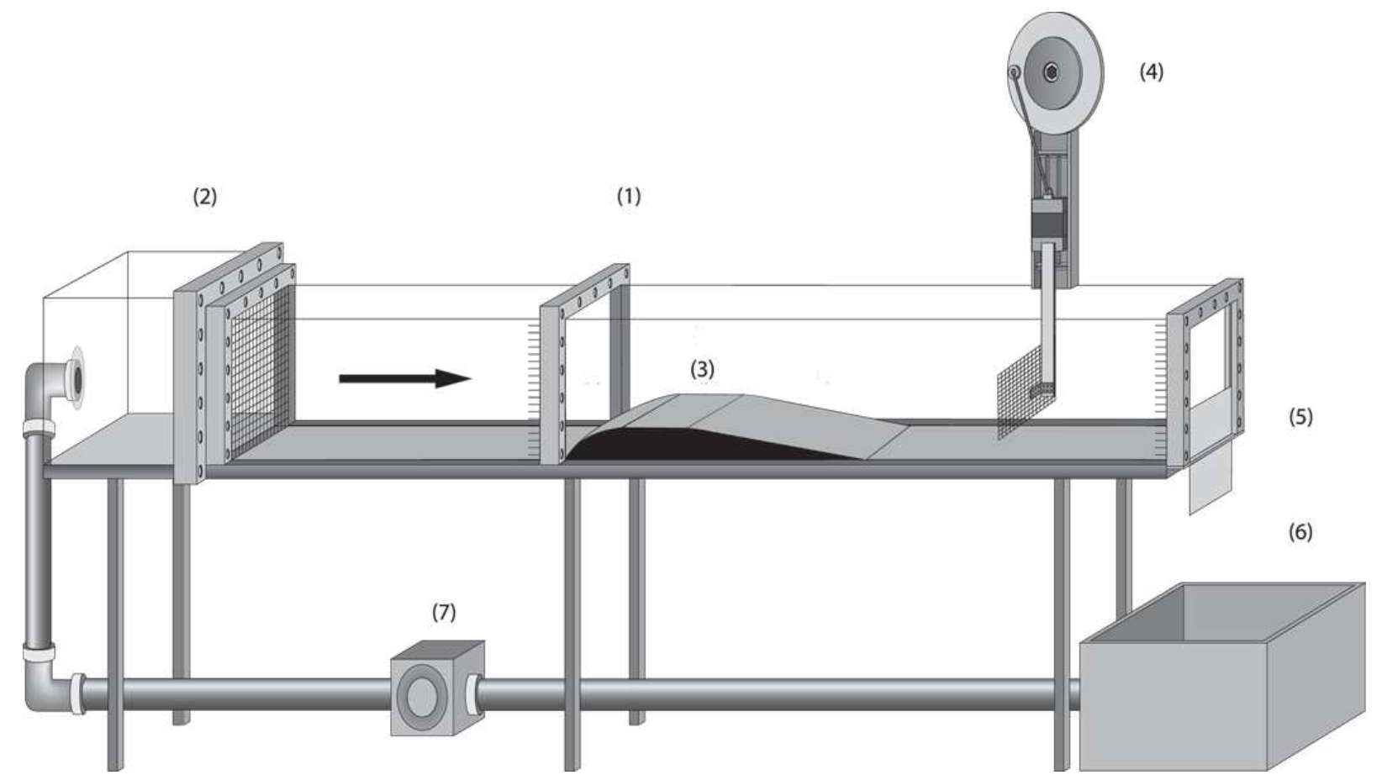
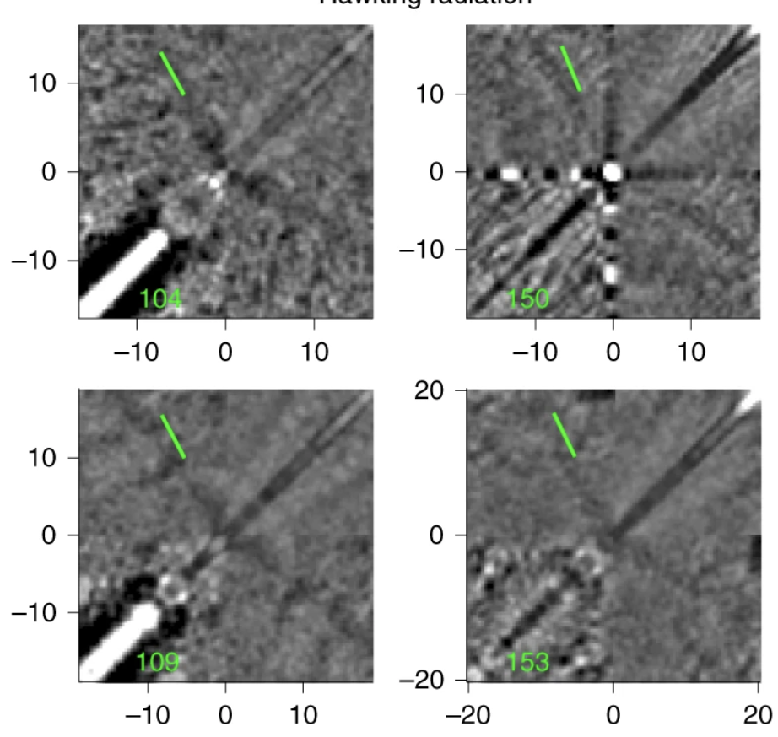
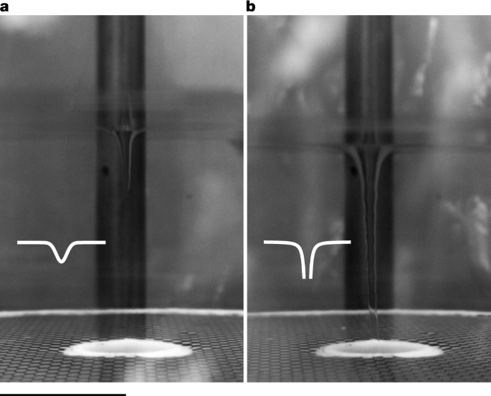
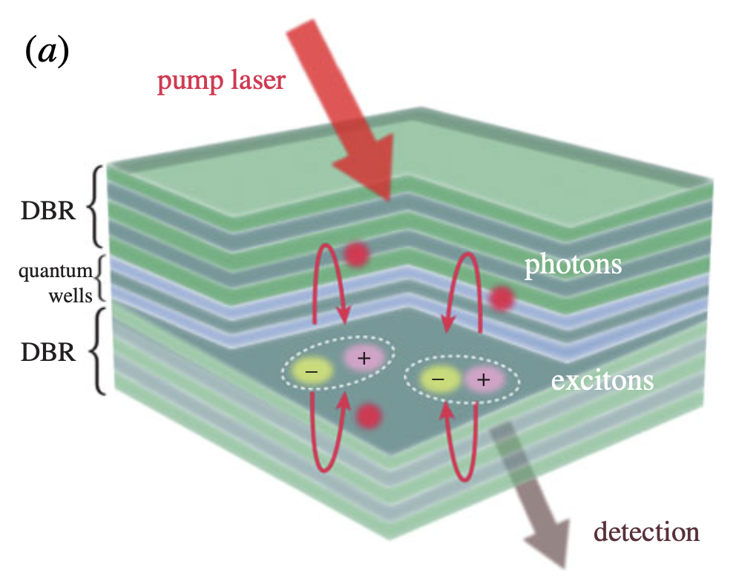
Introduction – Analogue gravity
Many analogue models have been formulated for classical spacetimes.
Classical models:
  Classical sound
  Sound in relativistic hydrodynamics
  Water waves (gravity waves)
  Classical refractive index
  Normal modes
Quantum models:
  Bose–Einstein condensates (BECs)
  The heliocentric universe
  Slow light
Weinfurtner, S. et al. Phys. Rev. Lett.106 021302, (2011)
Kolobov, V. I et al. Nat. Phys. 17, 362–367 (2021).
Barceló, C., Liberati, S. & Visser, M. Analogue Gravity. Living Rev. Relativ. 14, 3 (2011)
Jacquet, M. J. et al. Philosophical Transactions of the Royal Society A 378, 20190225 (2020)
Švančara, P. et al. Nature 628, 66–70 (2024)
Notes:
Now, shifting gears, ,Analogue gravity explores systems that mimic aspects of gravitational phenomena, allowing us to study phenomena like Hawking radiation and the nature of horizons in the lab.
Many classical and quantum models have been proposed or used for analogue gravity... and

Slide 5
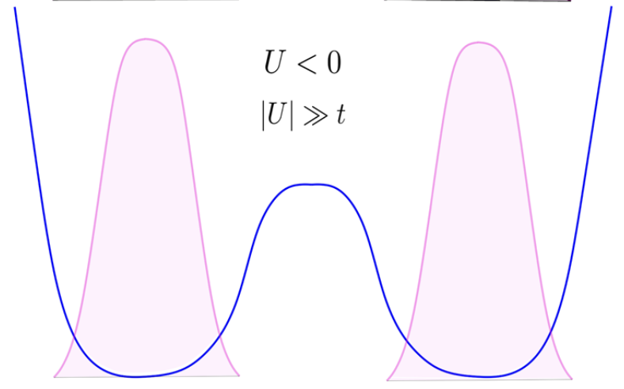
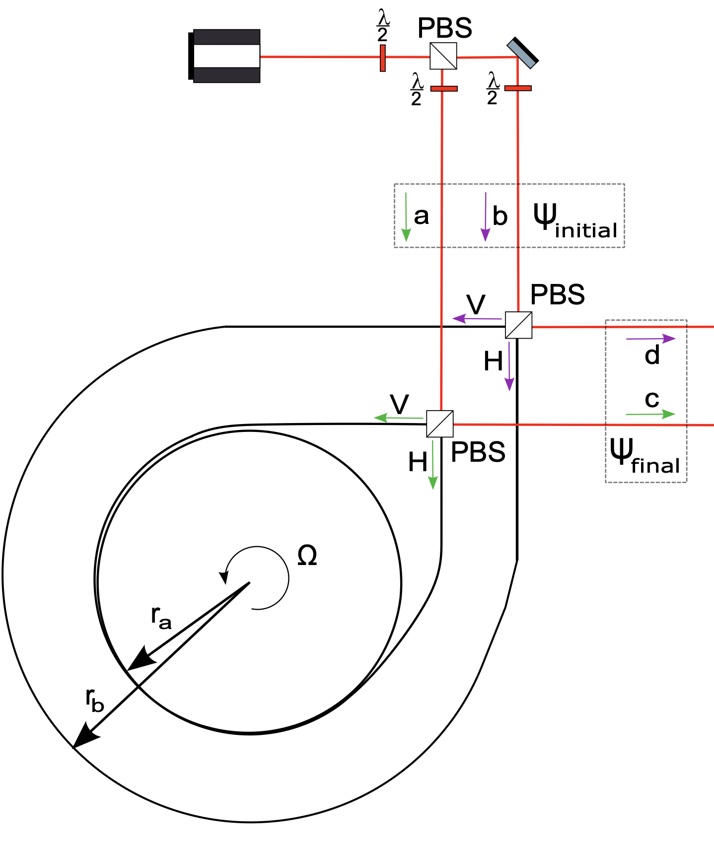
Introduction – Analogues of superposition of spacetimes
Bose–Einstein condensate in a double-well potential
Two rotating Sagnac interferometers
Superposition of particles being in one of the wells or the other
Originally designed to entangle photon path and polarization degrees of freedom, the resulting state can be interpreted as a superposition of the spacetimes (inside the fiber loops).
Very few analogue models for superposition of spacetimes have been proposed so far, leaving significant room for further exploration.
Barceló, C., Garay, L. J. & García-Moreno, G. Eur. Phys. J. C 82, 727 (2022)
Toroš, M., Cromb, M., Paternostro, M. & Faccio, D. Phys. Rev. Lett. 129, 260401 (2022)
Notes:
[Ans] there are also models that would serve as analogues of superpositions of spacetimes.
A first model considers a Bose–Einstein condensate in a double-well potential where they have a superposition of particles being in one of the wells or the other.
A second model considers Two rotating Sagnac interferometers. Originally designed to entangle photon path and polarization degrees of freedom, the resulting state can be interpreted as a superposition of the spacetimes (inside the fiber loops).
And that’s about it. Very few analogue models for superposition of spacetimes have been proposed so far, leaving significant room for further exploration.

Slide 6


A proposal for A.naRQI* (or analogues for RQI)
The permittivity of optical media effectively slows down light, $v= \frac{c}{\sqrt{ε}}$.
There is an established analogy between the electromagnetic field in an arbitrary spacetime and the electromagnetic field in an equivalent optical medium.
We want to use a superposition of permittivities to simulate a superposition of spacetimes.
Thompson, R. T. & Frauendiener, J. Dielectric Analog Space-Times. Phys. Rev. D 82, 124021 (2010).
*Coined by Cisco Gooding
Barceló, C., Liberati, S. & Visser, M. Analogue Gravity. Living Rev. Relativ. 14, 3 (2011)

Slide 7

Cavity with permittivity $ε_{i}$
One mode of the electromagnetic field
The Hamiltonian is
where
Electric field
Magnetic field
The dynamics of the mode depend on the cavity’s permittivity.
Maxwell’s equations
R. J. Glauber and M. Lewenstein, “Quantum optics of dielectric media”, Physical Review A 43, 467–491 (1991)
Notes:
We start small. We consider one mode of the electromagnetic field in a cavity with constant permittivity.

Slide 8
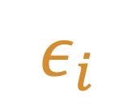

Cavity with permittivity $ε_{i}$
We quantize the Hamiltonian ,
and we can rewrite it as
$$ω$$
Usual harmonic oscillator...
where
with the number of excitations,
$$ε_{i}$$
with
…but the frequency is modified by the cavity’s permittivity.
R. J. Glauber and M. Lewenstein, “Quantum optics of dielectric media”, Physical Review A 43, 467–491 (1991)

Slide 9


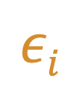

Bogoliubov transformations
One permittivity
$$ω$$
$$ω$$
Another permittivity
$$εi$$
Squeezing
$$εj$$
Squeeze operator
The squeezing depends on the permittivities.
R. J. Glauber and M. Lewenstein, “Quantum optics of dielectric media”, Physical Review A 43, 467–491 (1991)

Slide 10
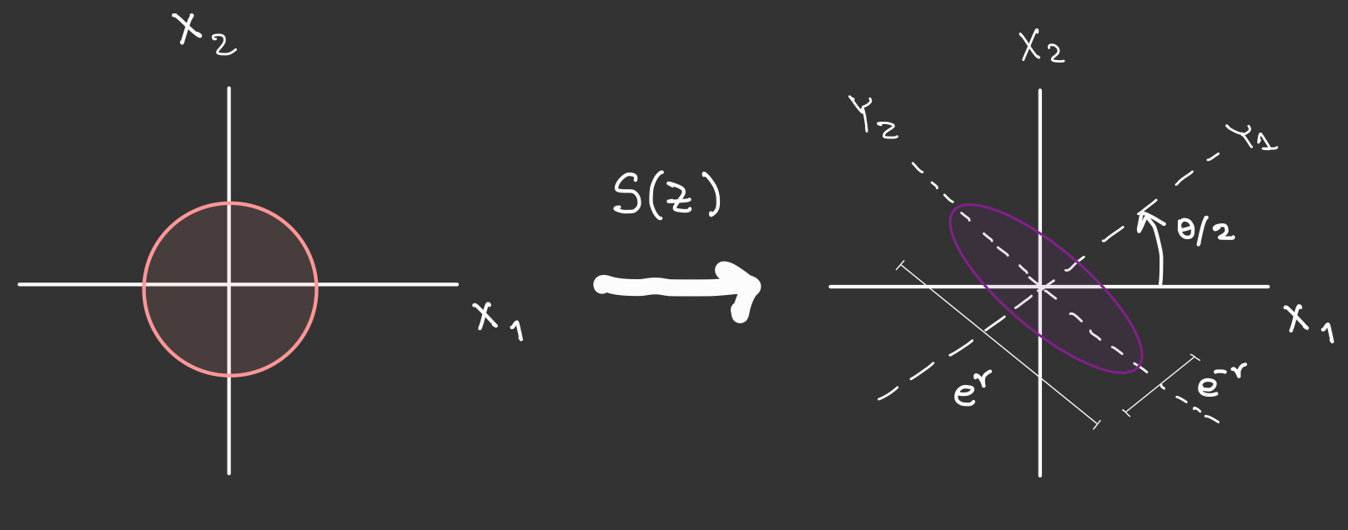



Squeezing
$$p$$
$$p$$
Symmetric fluctuations/uncertainty
$$q$$
$$q$$
The vacuum state of a cavity with one permittivity…
is a squeezed state in the cavity with a different permittivity.
Notes:
its fluctuations along both phase-space quadratures (q and p) are symmetric

Slide 11
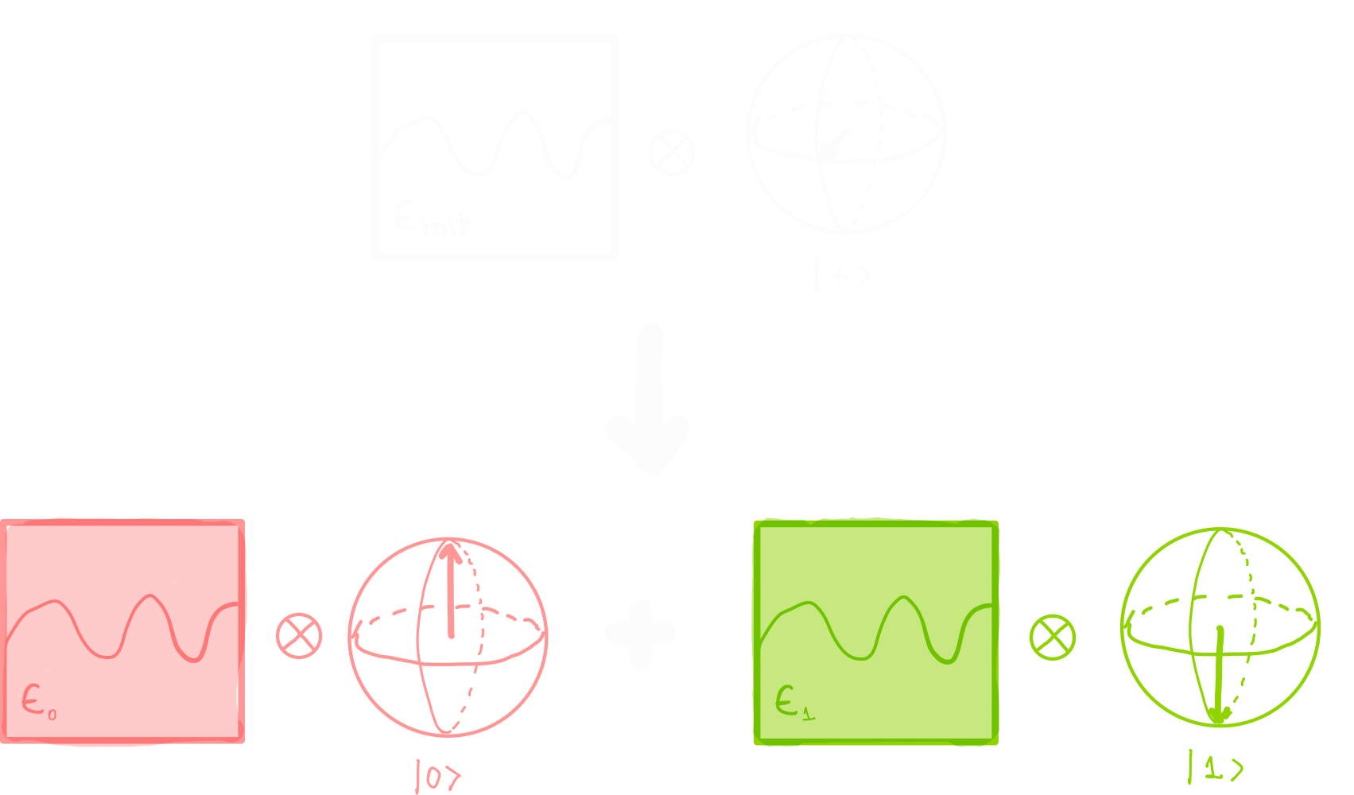
Quantum control
We “attach” a qubit to the cavity.
The evolution of the field—which is determined by the permittivity—depends on the state of the control qubit.
Superposition of permittivities

Slide 12

Quantum control
Measuring the control qubit along a superposition basis, the mode is left in a decohered state.
We investigate the mean and variance of the number operator wrt one of the permittivities ($ε_{0}$).
Superposition of squeezed states
depends on both permittivities.
Mean number of excitations…

Slide 13
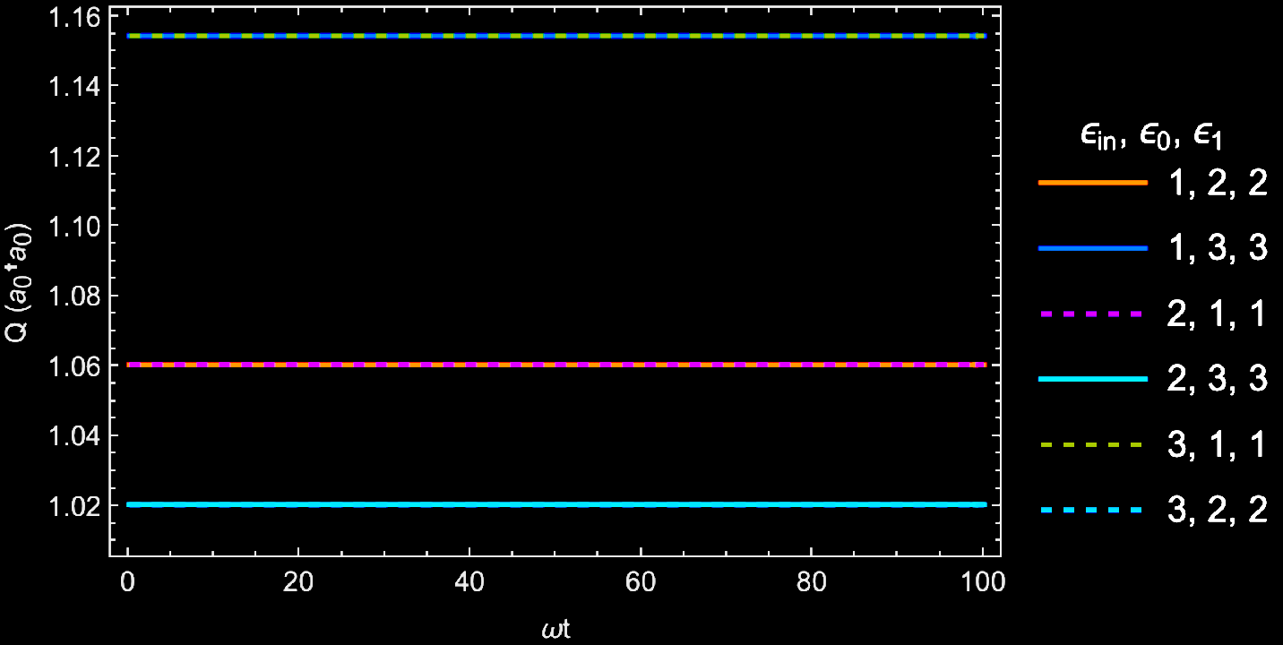
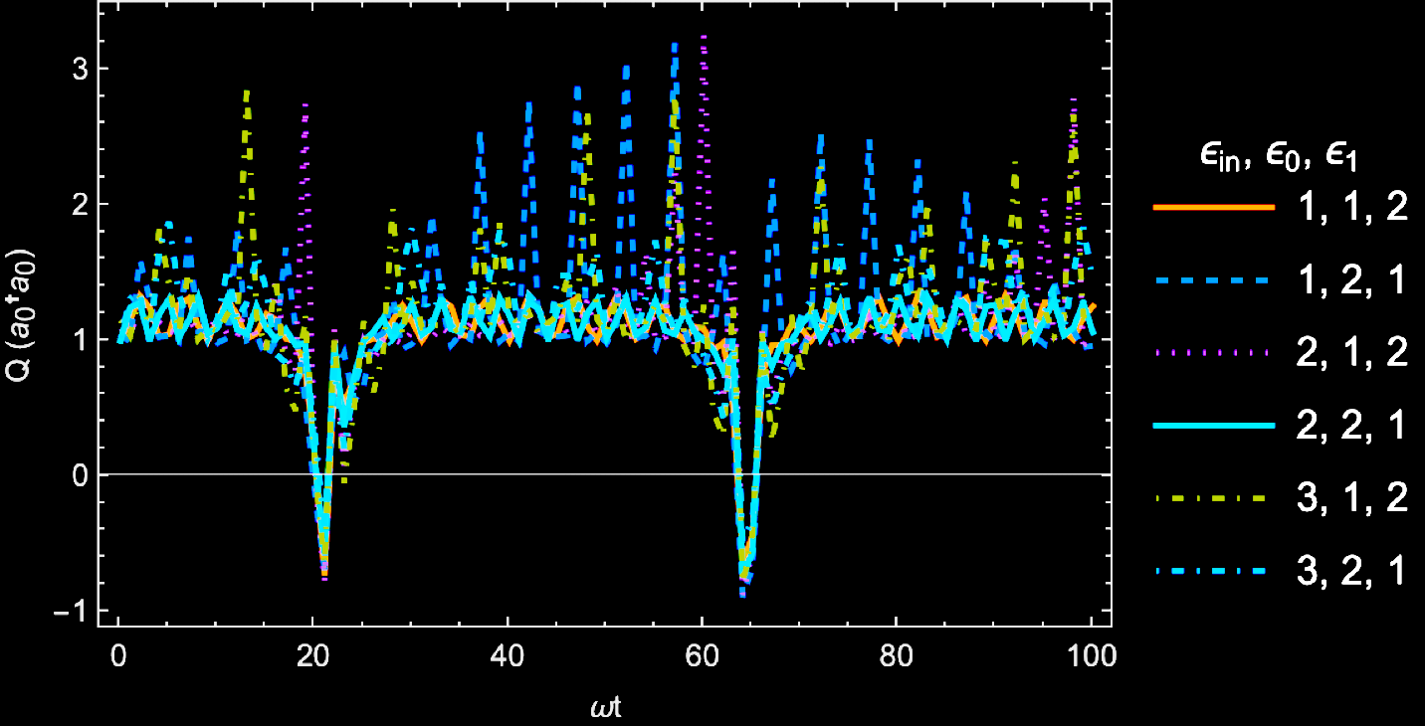

Mandel Q Parameter
No superposition
Superposition
Just a squeezed state, classical
Quantum for some $ωt$

Slide 14
Mandel Q Parameter
Azizi, A. Photon Antibunching from Superposed Squeezed Vacua via Quantum Interference. arXiv.2506.06397 (June 2025)
“Quantum superpositions of two single mode squeezed vacuum states with equal squeezing can, counterintuitively, lead to strong photon antibunching.”
Superposition

Slide 15
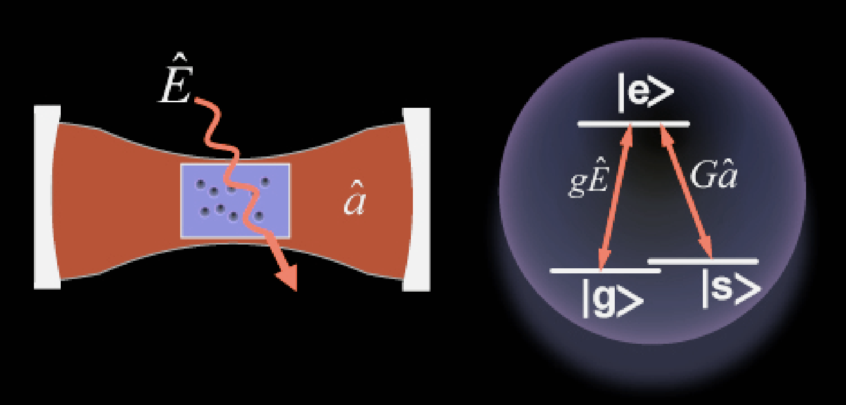
Experiment: Vacuum-Induced Transparency
Λ-type atoms
cavity
Theory: “The group velocity of a probe pulse in an ensemble of Λ-type atoms driven by a quantized cavity mode depends on the quantum state of the input probe pulse.”
They demonstrated experimentally that the transmission (and group velocity) of light through a medium may be controlled with few photons.
Nikoghosyan, G. & Fleischhauer, M. Photon-number selective group delay in cavity induced transparency. Phys. Rev. Lett. 105, 013601 (2010).
Tanji-Suzuki, H., Chen, W., Landig, R., Simon, J. & Vuletic, V. Vacuum-Induced Transparency. Science 333, 1266–1269 (2011).

Slide 16


Analogy

Slide 17
Acknowledgements
Joshua Foo for insightful discussions
Prof. Magdalena Zych, my supervisor Prof. Robert Mann, and the David Johnston International Experience Award for the support provided to visit Stockholm University, where I worked on this project
Thanks!

Slide 18
Useful relation 1
A squeezed vacuum state is simply a superposition of even number states.
Then, it is straightforward to compute the evolution of squeezed states.

Slide 19
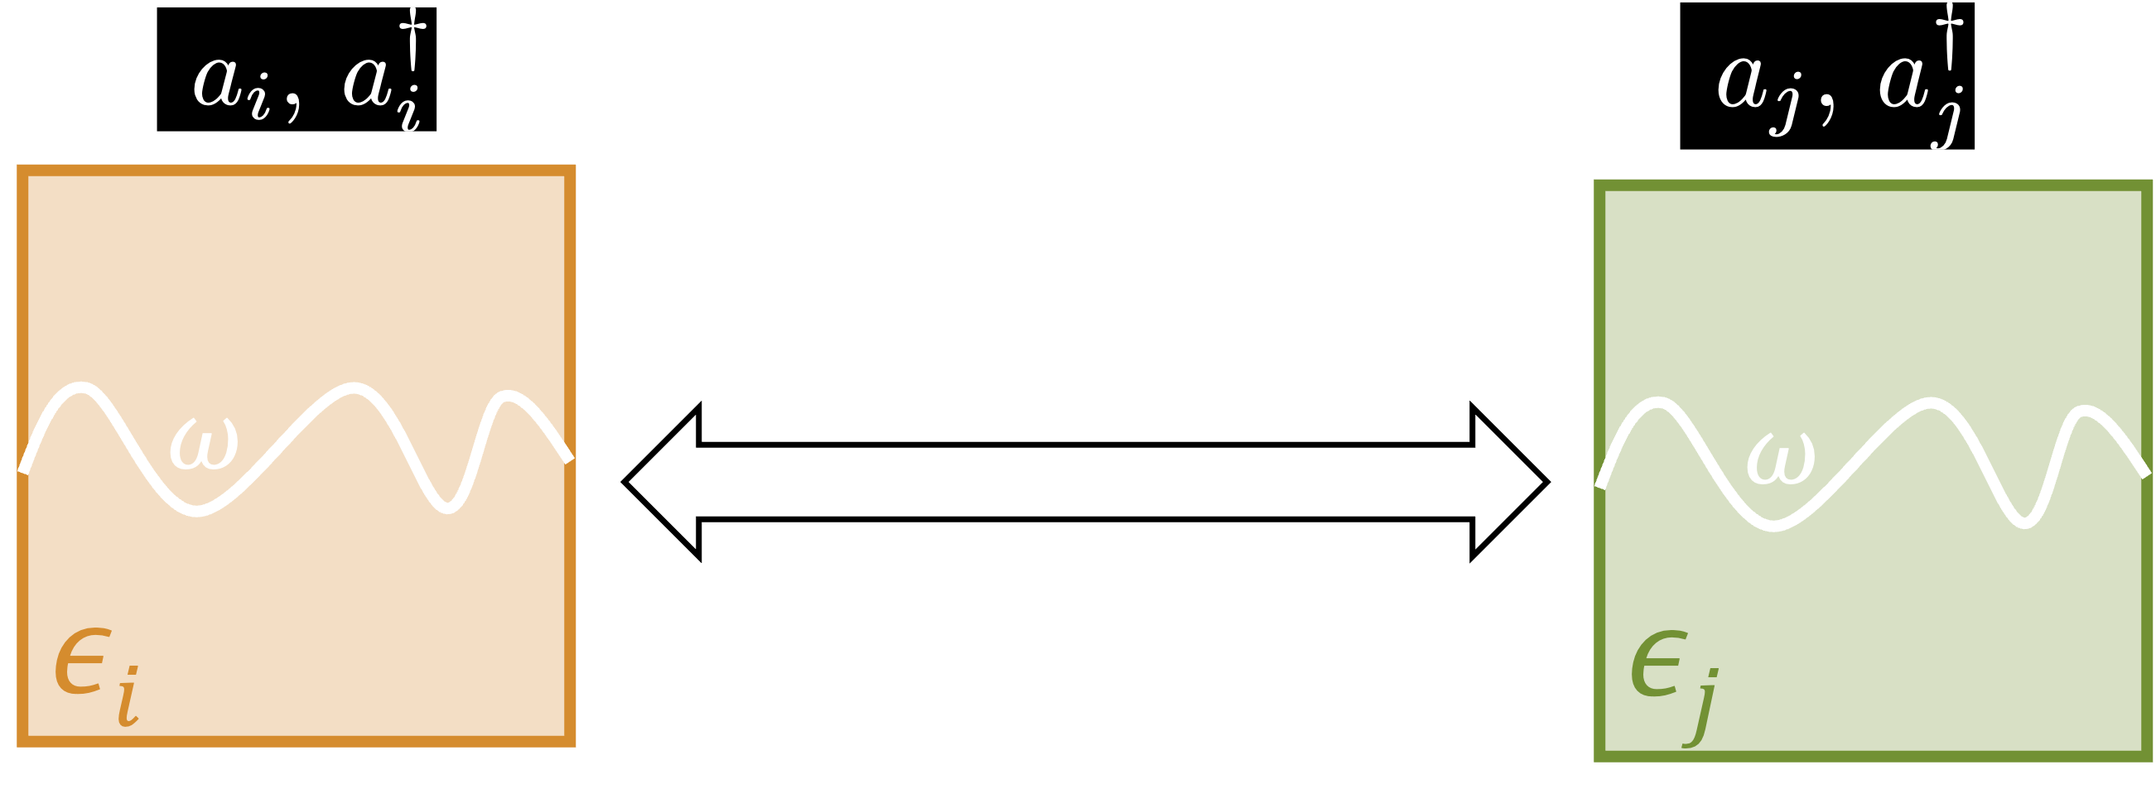

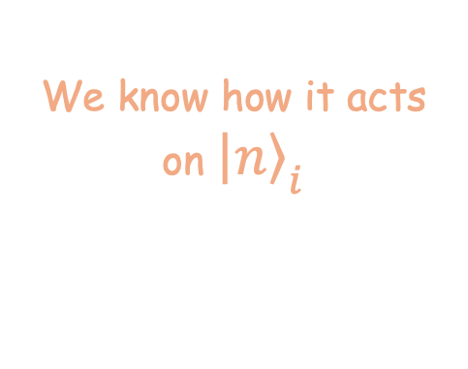
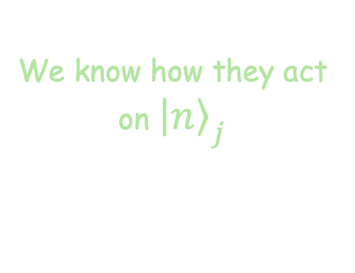
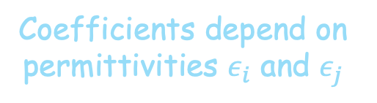
Useful relation 2
It is also (kind of) straightforward to calculate the evolution with $ε_{i}$ of the number states of $ε_{j}$
We know how they act on ${\left|\left.n\right\rangle \right.}_{j}$
We know how it acts on ${\left|\left.n\right\rangle \right.}_{i}$
Coefficients depend on permittivities $ε_{i}$ and $ε_{j}$

Slide 20
Quantum control
The state of the mode-qubit system
Measuring the control qubit along a superposition basis, and the mode is left in a decohered state.
Superposition of squeezed states

