Slide 1
LEP3:
a Higgs Factory in the LHC tunnel
Marco Zanetti
University of Padova and INFN

Slide 2
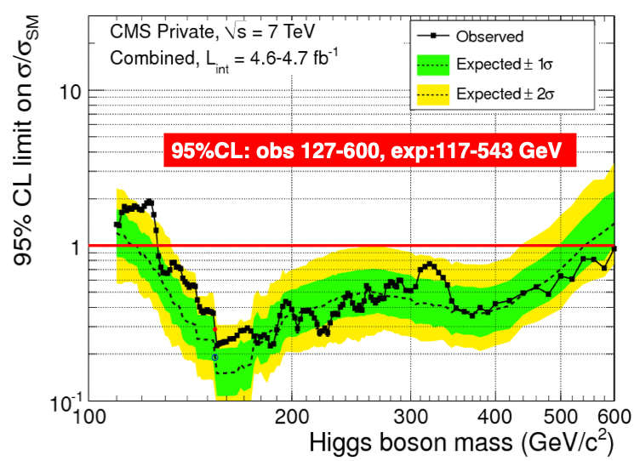
Historic introduction
Dec 2011
First year with a decent luminosity (5/fb) at 7 TeV.
CERN end of the year summary by CMS and ATLAS: Higgs “non-exlusion” around 115-127 GeV.
LEP2 top energy not far!
First LEP3 paper by Blondel&Zimmermann

Slide 3
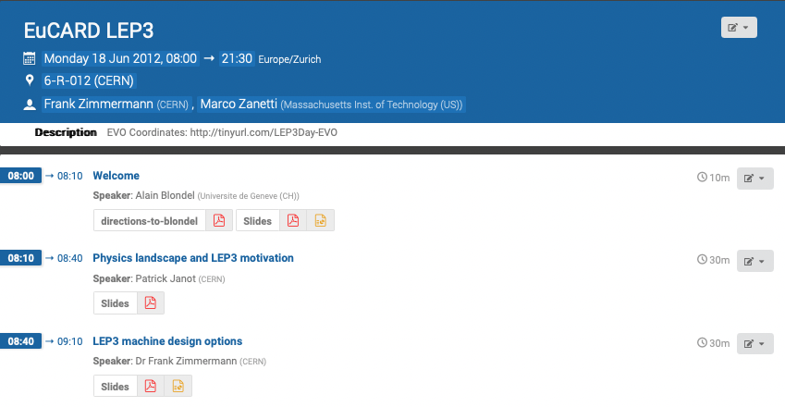
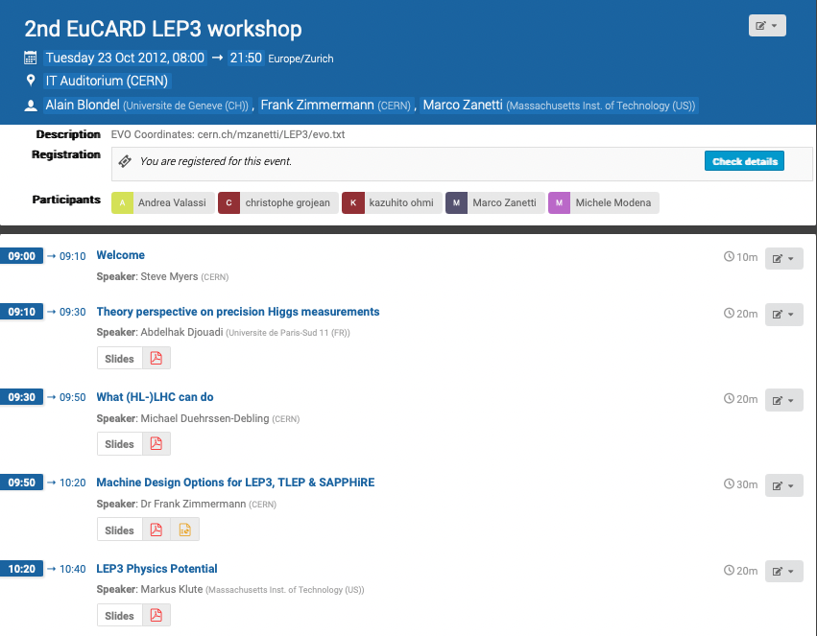
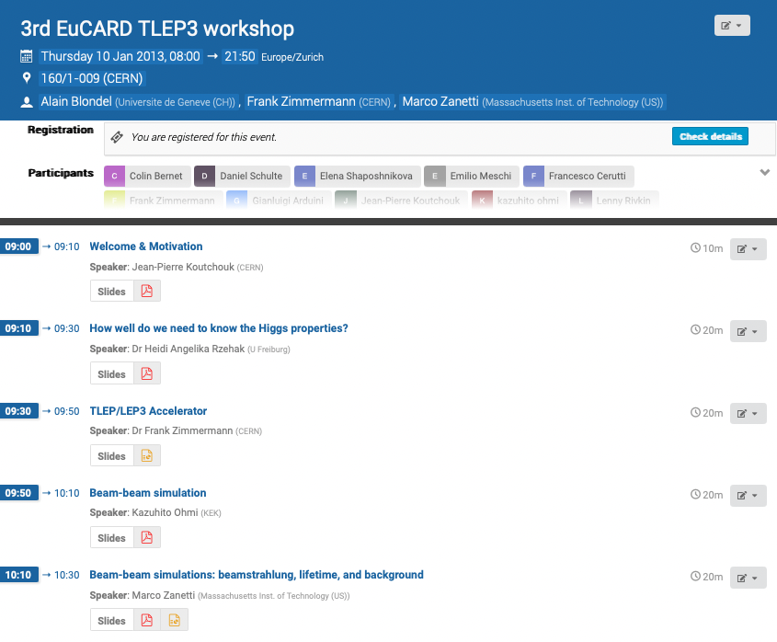
Historic introduction
From June 2012: semi-clandestine (T)LEP3 workshops (EuCARD)

Slide 4
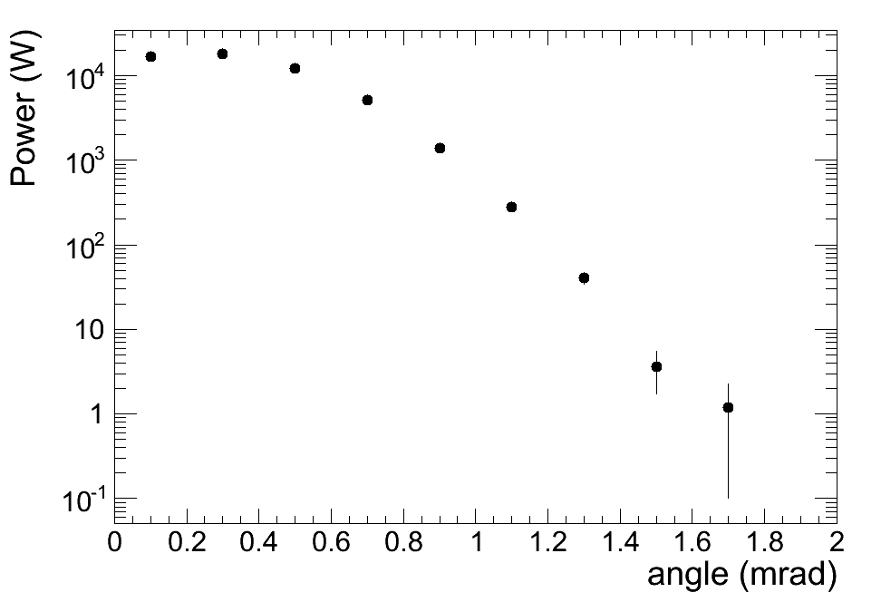
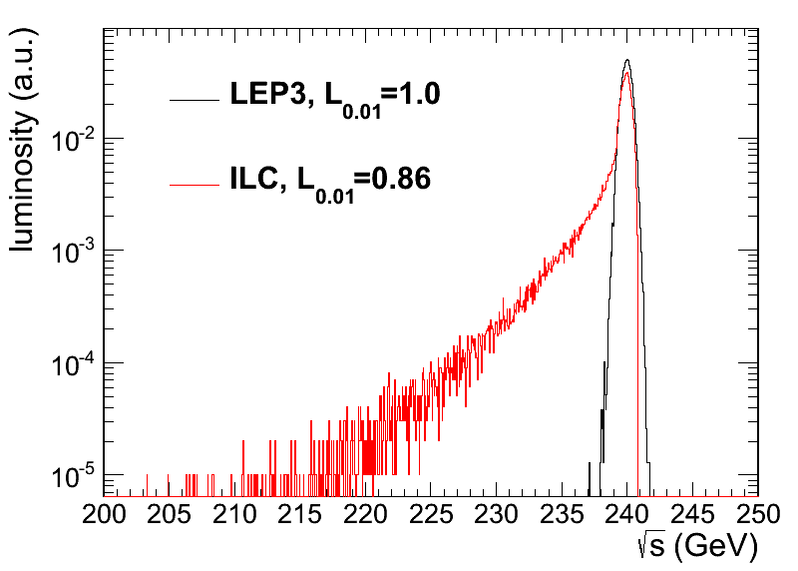
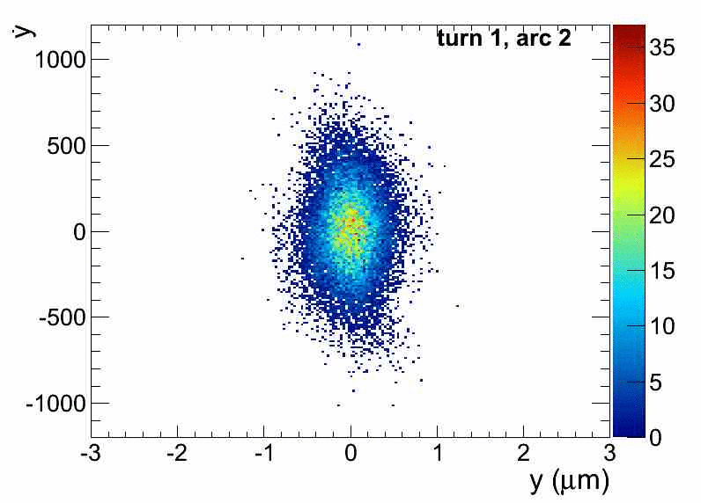
(my main personal contribution)
Beams crossing simulation at (T)LEP3
Beamstrahlung lifetime results (TLEP)
Luminosity profile
Power dissipation
Multi-turn simulation
(effort limited to that period)

Slide 5
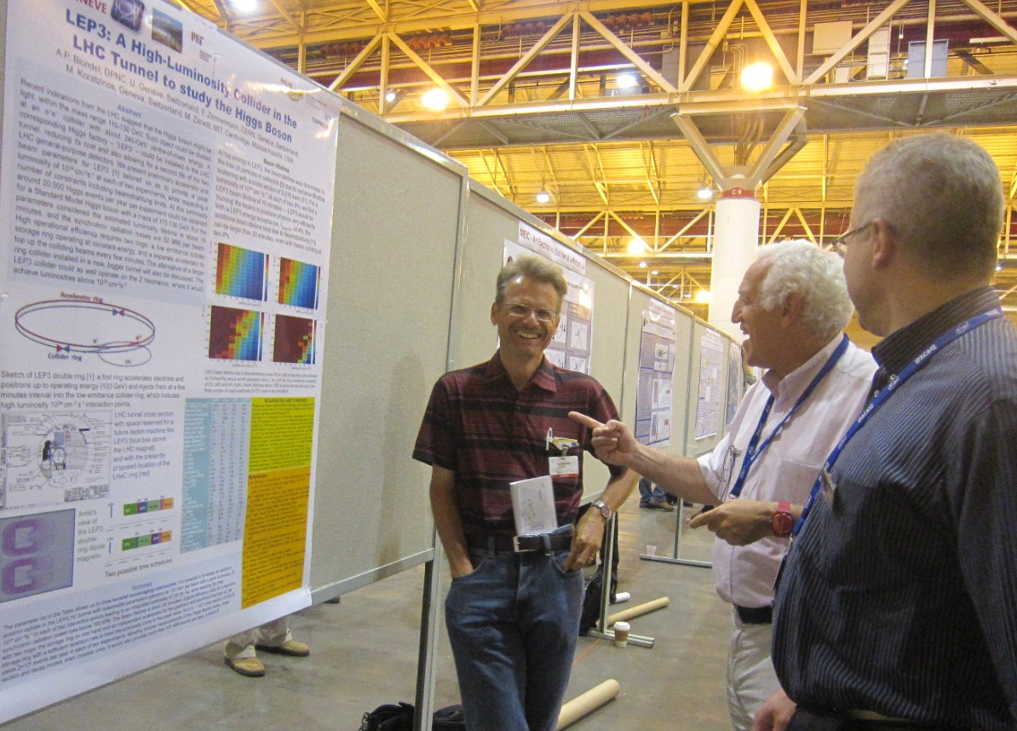
Historic introduction
Papers and conferences
LEP3 at IPAC12
Based on CMS full simulation!

Slide 6
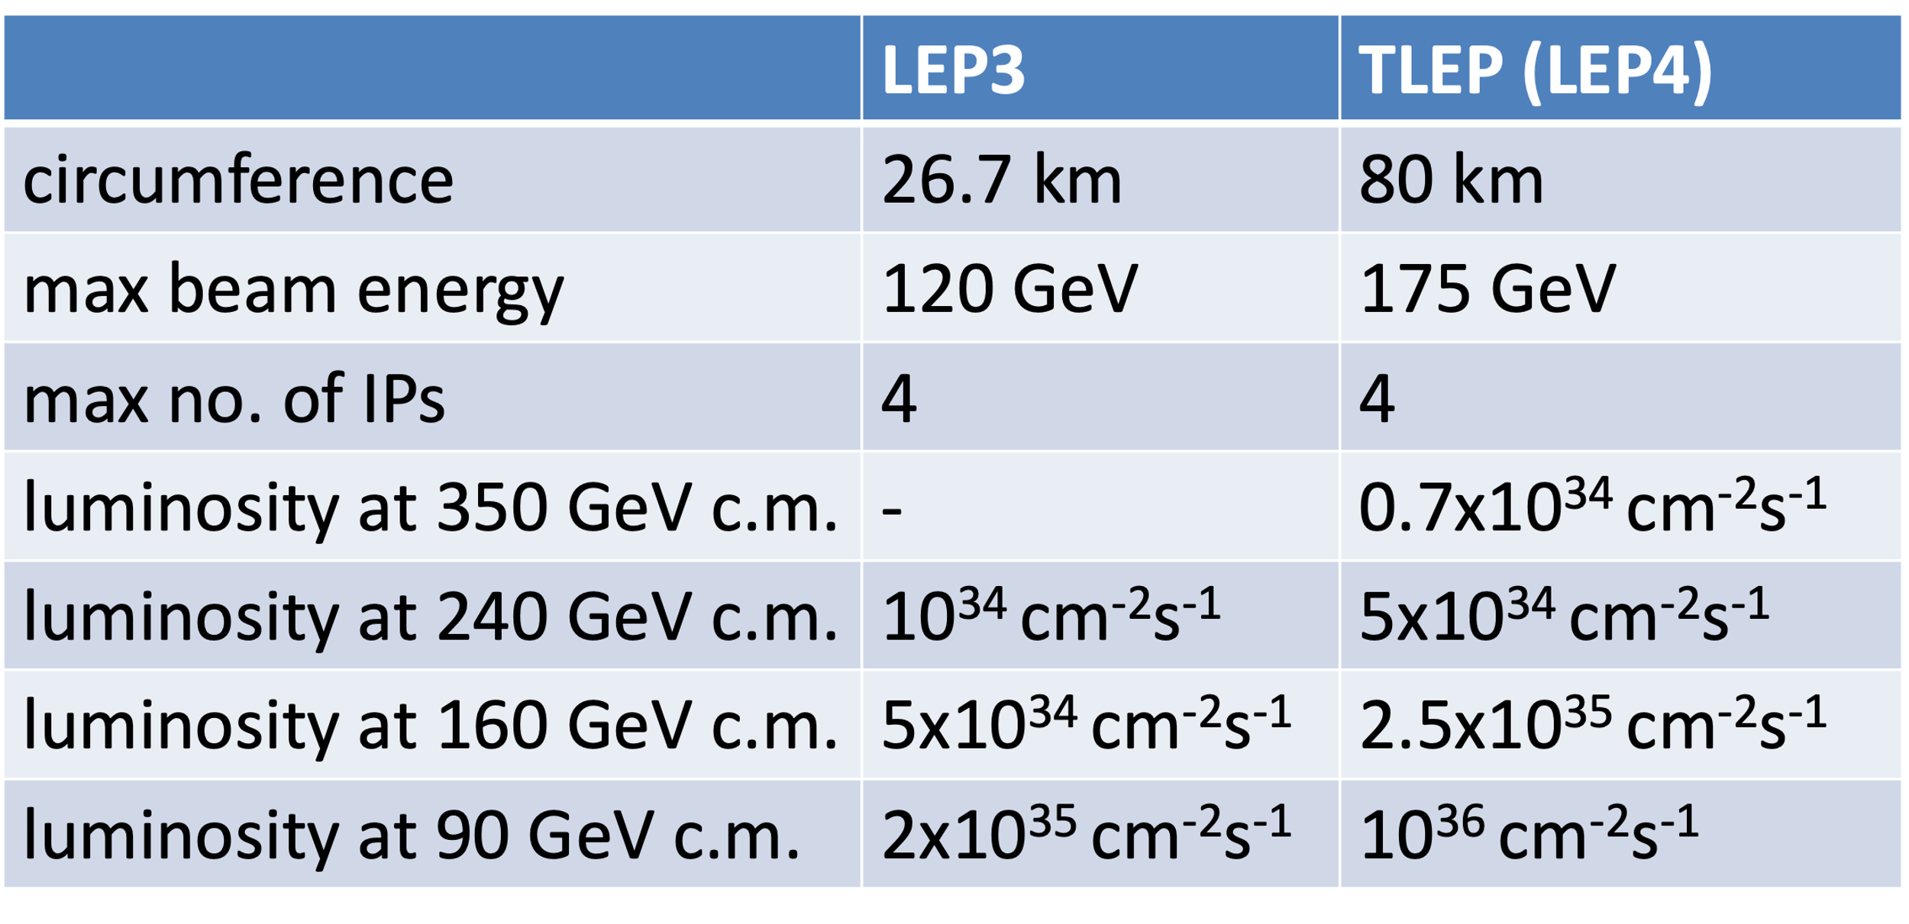
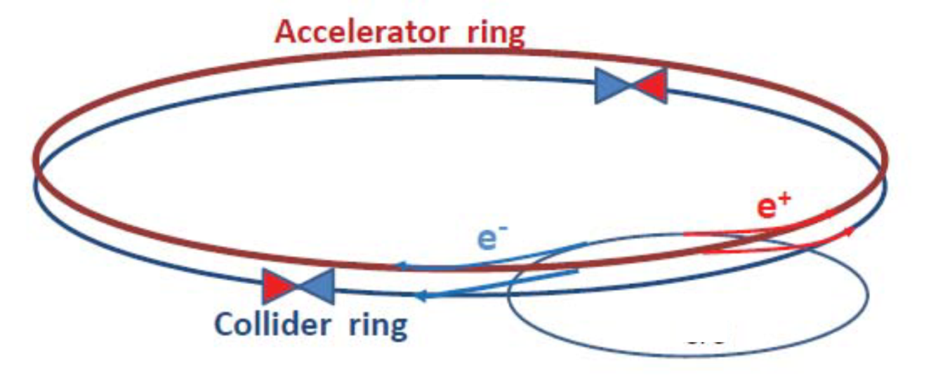
Results from back then
A lot of work done with little resources (and support)
top-up scheme, machine(s)/beam parameters, lattice, MDI, detector ideas, reach for Higgs and EW Physics, etc.
Note ratio of Lumi (1/5)
Prepared for and submitted to the Update of the European Strategy for Particle Physics (2012/13) and Snowmass
Outcome:
purse HL-LHC (expected by first half of this decade, ~10years delay for a ~10 years schedule)
prepare a sound proposal about the facility succeding LHC in time of the 3rd update (2018)

Slide 7
12 years after
FCC(ee) will be the recommended option by the next Strategy
This doesn’t mean the project will necessary be approved
“The guidance for the 2025 ESPP requests, in addition to the preferred option the inclusion of prioritised alternatives to be pursued if the chosen preferred option turns out not to be feasible or competitive.”
There is a clear consensus on the FCC staged physics program (Higgs/EW precision physics, direct Energy scale exploration). Other issues may affect its approval:
financial and human resources, time schedule, size/complexity
The fallback option should not be affected by those same issues, but at the same time purse the same physics programme
LEP3 is thus a natural choice as the next facility
concretely being considered (as option B) by a growing portion of the community
To be followed by a facility to explore $\sqrt{\hat{s}}$>10 TeV, e.g. a muon collider

Slide 8
(Updated) LEP3 main features
Inferior w.r.t FCCee, but reachable accuracy on Higgs and EW params possibly adeguate (?)
Not possible to get to the tt threshold
A lot can be taken from detailed studies conducted for FCCee
sevaral things are essentially radius-independent
Reasonable to assume performances to scale with lumi
beam energy calibration at WW needs to be addressed
Reusage of existing CERN facilities
but for a dedicated Linac as injector (as for FCCee)
Parameters worked out under the assumption of 50 MW/beam with 66% RF efficiency ➔200 MW (same as FCCee and current facilities)
Affordable cost, not crazy timeline
possible impact on HL-LHC long term schedule

Slide 9
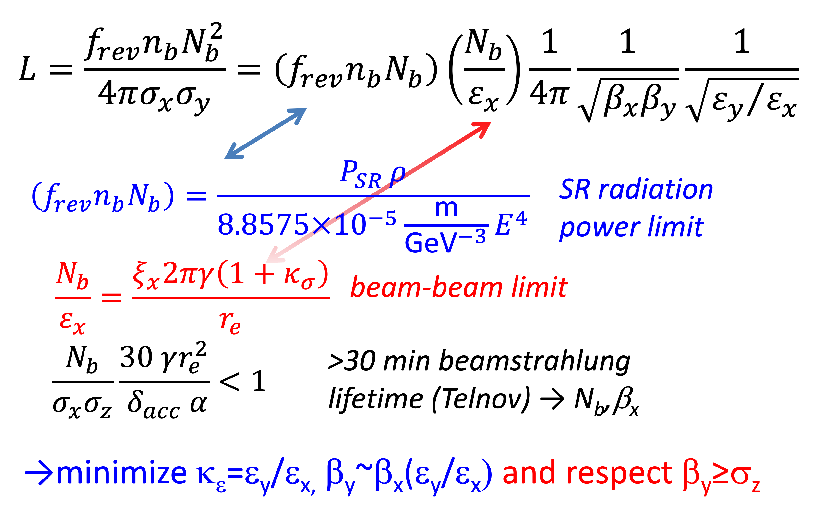
Lumi formulae and constraints
for reference, from Frank Zimmermann

Slide 10
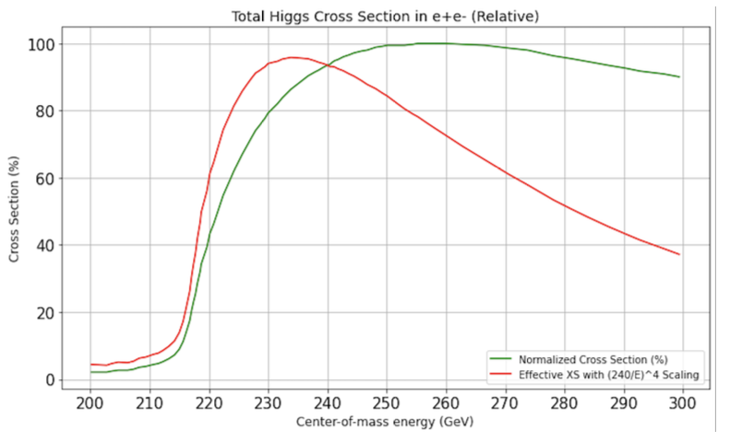
Lumi, Energy
Lumi: factor ~3.4 from FCC/LHC radii ratio, assume a conservative factor 5 for all energies. Same assumption on Hubner factor. A resonable statistcs for the main datasets:
8e11 Z boson at Z peak over 5 years of running
3e8 W boson pairs at WW threshold over 3 years of runnig
2e5 tagged Higgs boson over 5 years of running
For the Higgs case, at fixed 50 MW synchrotron loss, √s=230 GeV gives the same Higgs events as 240 GeV, if current is increased by (120/115)⁴.
only 12% increase w.r.t LEP2

Slide 11
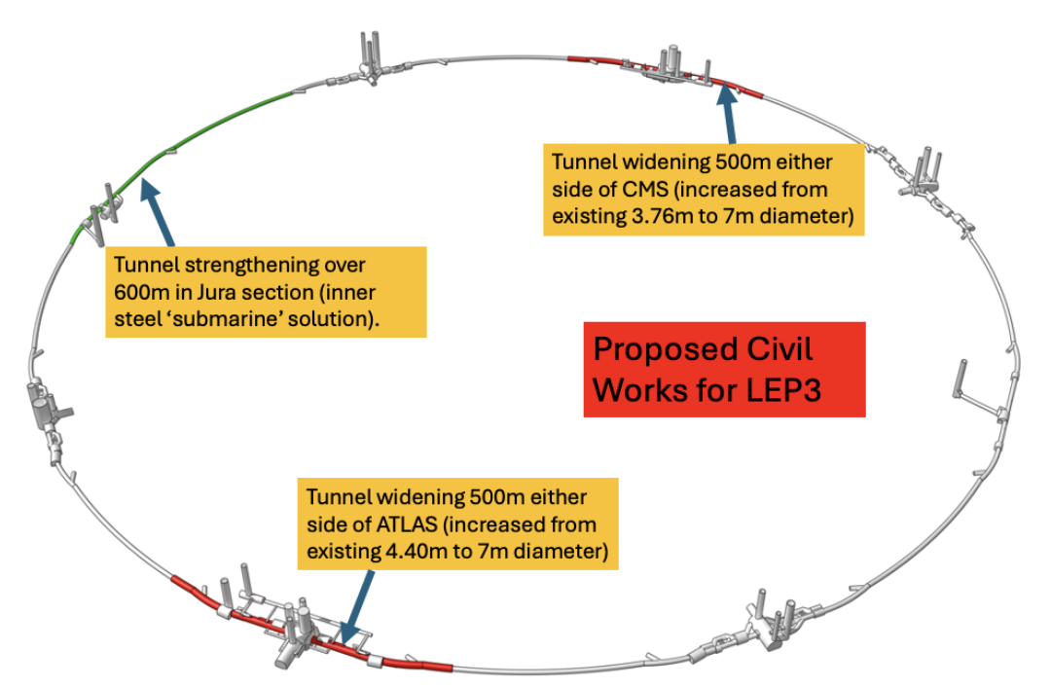
Tunnel
LEP/LHC, 8x: arc of 2.45km, straight section (LSS) of 560 m
cross section diameter: 3.8 m (arcs) – 4.2/5.2 m straight sections
Required RF power could probably fit in the LSSs (see later)
Civil engineering:
40 years old infrastructure, some parts need maintainance
High lumi acheived by crab-waist → large x-angle → likely need to widen the LSS cross section
possibly need of by-passes (avoidable, not preferred option)
Overall cost estimated: <200 MCHF

Slide 12
Injector
As for the FCCee, a dedicated Linac is preferred over the SPS as injector
Assume that the FCCee injection energy (20 GeV) can be reduced by the ratio of the circumerences, i.e. 10 GeV can be conservatively taken
Half of the length (and price) of the FCCee linac
Most of the transfer lines can be re-scoped/adapted, minimizing also the civil engineering

Slide 13
RF system
Scaling from LEP:
energy loss/turn @ √s=240 GeV: 6.4 GeV
energy loss/turn @ √s=230 GeV: 5.5 GeV
A total 6.2 GV to be installed, with the same margin as FCCee
“tt” FCCee cavities as possible baseline:
800 MHz, 0.5MW, 18.7 MV/m long cavities
Both for accelerator and collider
4 even LSSs to be used
2 for accelerator, 2 for booster
Same cavities for e+ and e-
Is there room enough? To be checked carefully. Preliminary studies:
About 40 6-cells made of 9m long cryomodules in each LSS
Including enough (1 per cell) 4m-long quads → ~420 m, leaving enough room for separation and recombination
Main item in the budget

Slide 14
Experiments
Possible baseline is 2 experiments: CMS and ATLAS revisited/adapted
same magnets at lower field
get rid of very forward subsystems (room for proper MDI, lumi monitors)
exploit all the R&D pursued for the FCCee detectors, especially for the central tracking and vertexing system; integrate PID
MDI needs to be studied in details, much can be taken from FCCee (?)
Booster beam pipe passing through the tracking system may be a reasonable option

Slide 15
Physics
Reasonable to assume Physics performances on Higgs coupling and EW parameters to scale with lumi w.r.t to what quoted for FCCee
instantaneous lumi: LEP/FCCee ~ 1/5 at all energies (but tt). Ratio of overall integrated lumi may be different (H factor, num of detectors, running time, etc.)
Can beam energy be improved w.r.t LEP? What’s its overall impact?
Detailed studies need to (are being) performed, including the input from HL-LHC results
Combination of the two not merely statistical
How precise is precise enough?
For the various physics objectives, at what point the measurements will become systematic limited?

Slide 16
Cost/Schedule
Studies are being conducted, extrapolating from current scenarii and FCC costing.
Overall LEP3 cost estimated around 3BCHF. This includes:
Accelerator: 2BCHF (1BCHF for RF); Injector/transfer lines: 300MCHF; Technical infrastructer: 300MCHF; Civil engineering: 200MCHF; LHC removal/LEP3 installation: 150MCHF
LEP3 requires the program of HL-LHC to be exploited
Flat inst lumi running may yield a reasonable end of operations once int lumi doubling time becomes too long (e.g. 6-7 years)
If HL-LHC stopped before 2040, LEP3 could be running in the first half of that decade
With such schedule LEP3 cost would be well within the standard CERN budget, allowing potentially other future oriented initiatives (e.g. muon collider demonstrator)

Slide 17
Conclusions
A backup option for FCC is needed. LEP3 is a reasonable proposal for that
Addresses the potential FCC showstoppers
although suboptimal, will yield results for the same Physics cases as FCCee
Leave room (time, budget, resources) for further development of the machine to probe directly the energy frontier
Worth considering preparing a document to be submitted as input to the strategy, work is being done in that sense
Whatever the fallback option, that will require further studies and adequate funding

