Slide 1
ICSC_progetto_comunicazione**
Spoke 2 - FUNDAMENTAL RESEARCH & SPACE ECONOMY
Closeout
General Meeting ,Catania December 2024

Slide 2
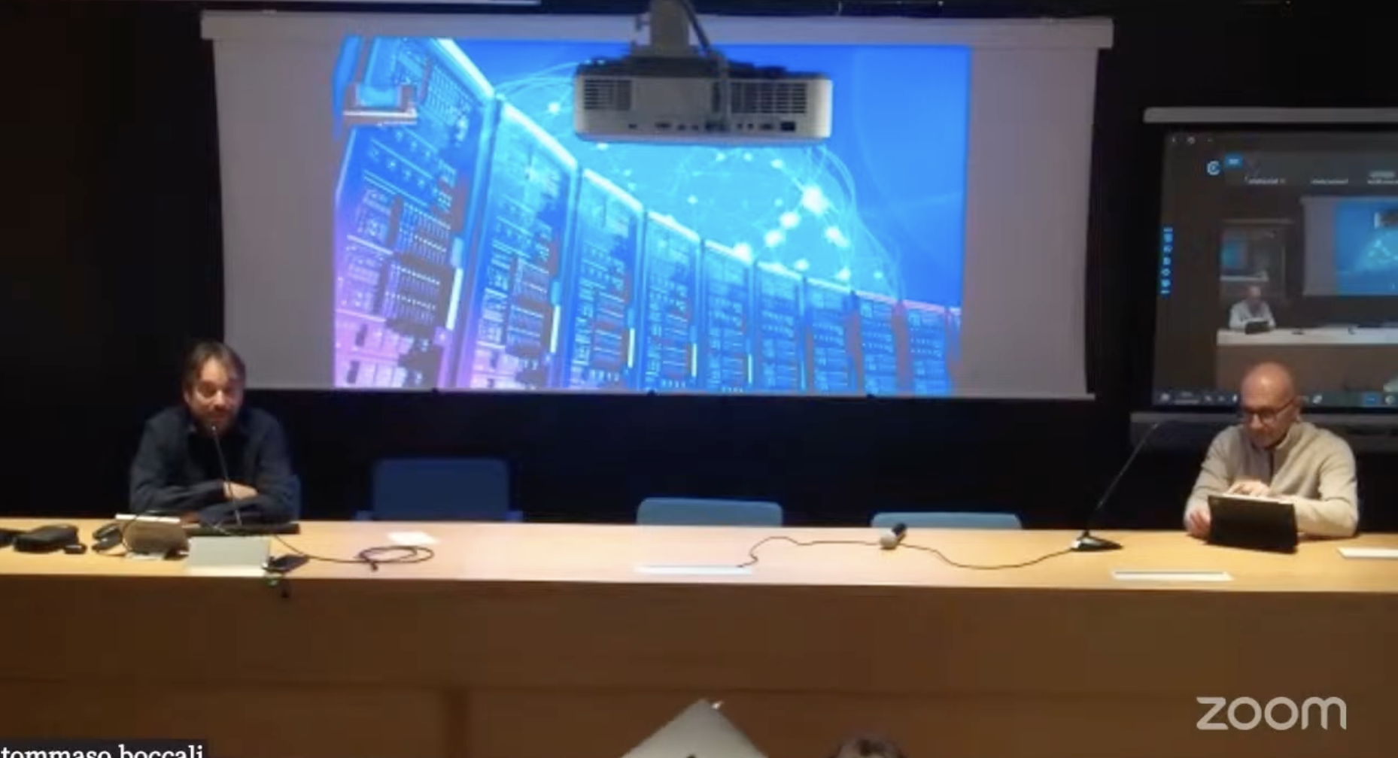
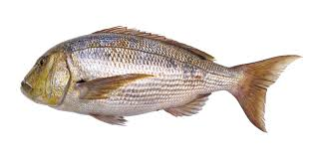
Two intense days – on three physical days
At moments too dense ? Probably
With respect to 2023 meeting (here)
2 round tables outside formal Spoke2:
Tuesday: with ICSC, the President, IFAB and Carlo (Industrial Board chair)
Wednesday: Spokes 0, 1, 3, 6, 10
A public event (room full + ~20 on Zoom + ~15 on Youtube)
Lightning talks
20 → 28 (and we had to deny a few at last moment)
Large improvement in the dinner
From Pizza to Dentice al Sale
https://www.youtube.com/live/cZp6mpma-OI
+

Slide 3
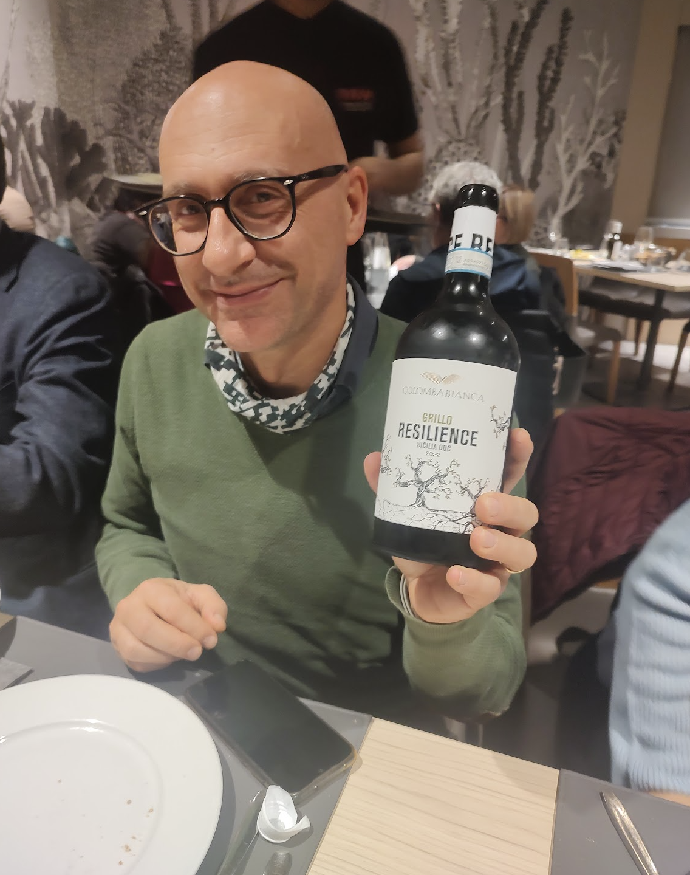
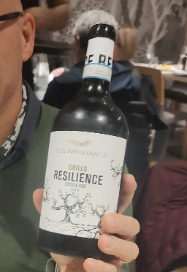
PNRR is always with us

Slide 4
The round tables #1
Very interesting discussion on the relationships
Between Spokes
Less than expected, due to no time availability remaining on Spokes
Between Spokes and Industries
Who gets the best people??? Well let’s form them … we will see later
This was a “problem” last year, things are generally getting better (not in all cases)
Future of the ICSC after PNRR
All quite cloudy, clearly there is a tension between moving more or less towards the productive system

Slide 5
The round tables #2
Spokes com from a different domain, with different experience / alignment with the productive system
In general “engineering” seems to be more at ease with these collaborations
At the low (hardware) and high (use cases) ends of the chain
Spokes 2+3 are less used, so initial problems but somehow now have a working system IG + OC
About Spoke to Spoke connections, all agree they are too feeble at the moment
Are we reinventing the wheel (similar wheels) in different spokes? (probably yes)
Could we do better? (probably yes)
After the round table discussion + chats later, we would like to try and have a meeting “as early as possible”
Idea #1: each Spoke bring / describes a result / technology expected to be interesting elsewhere, and see whether there is interest in adopting
Idea #2: each spoke brings a problem for which no solution was found internally, and asks for ideas
What could we bring as spoke 2????

Slide 6
The round tables #2
What is the future of ICSC?
General comment: depends on the funds! We heard recently numbers from 6 Meur/y (the fees) to 500 Meur/y (at the September ICSC meeting)
There is a proposed article in the financial law to give 150 Meur/y to the CNs (5), the PEs(14), the “Piano Complementare Salute” (?)
150 Meur each is probably < (<<) than 10 Meur/y per project

Slide 7
The Industrial Board vision
We received a very nicely written doc by the Industrial Board, with their ideas on the ICSC Future
Clearly the view of the industry is what you would expect
A shift towards the productive system needs
A shift towards higher TRL solutions (getting to the production level)
ICSC as a service provider
ICSC as a resource provider

Slide 8
What should be the Spokes’ vision?
We do not have one at the moment, and I am also not exactly sure we share the same vision
On my side: each partner in the ICSC must follow its internal priorities (== INFN must to its science!), and all the collaboration with other entities should exist only if there is mutual interest
The academic side cannot become the software house of the productive system, nor the ICSC infrastructure become “the Amazon for the productive system”
Claudio made very clear yesterday we are not equipped for the last point!
The center should remain devoted to R&D activities: pilots and PoCs are a perfect target; once a “product” is ready, it should be moved “elsewhere”
…

Slide 9
The next months (1 year)
We have a clear program for the next months (Aug 25 + the 4 months we just got as extension)
It was VERY nice to see that many KPIs are indeed already achieved (let’s call it “good strategy”?)
Clearly we should not lose the good pace
Innovation Grants and Open Calls are more problematic (they started much later)
Need more attention

Slide 10
Next events
Feb/march: 2nd reviewers’ meeting
We honestly do not expect problems
The material from this meeting is more than enough to prepare the presentation
~ Mid march:
Intermediate Milestone 10 review
We have generically promised status reports; also this should be not problematic
Final MS10 end-of-august
Move what not ready to MS11
September Elba Meeting

Slide 11
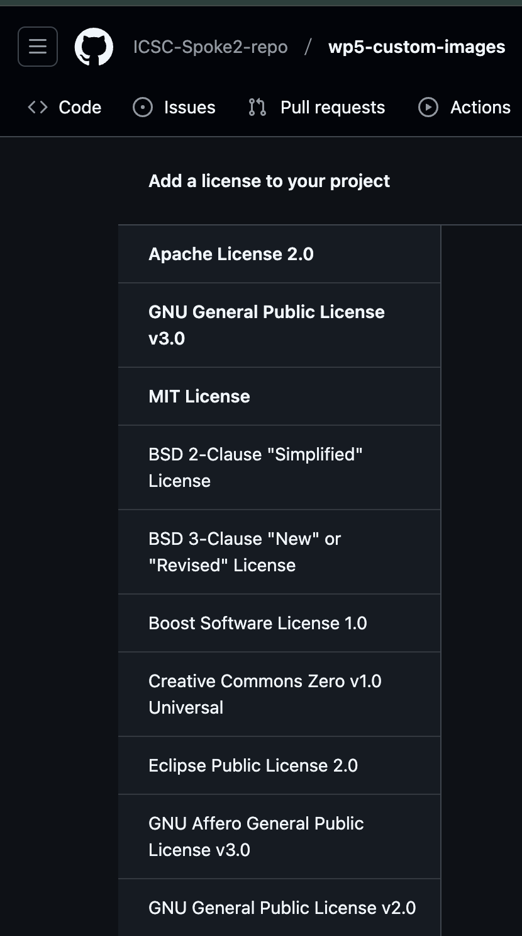
One interesting point raised - licenses
Should we use a standard licensing mode on our repo?
And if so, which one?
I studied a bit, and github offers standard licenses with “one click”
As CERN I am used to Apache 2.0
“use this software as you like”
GPL3 is also an option
You need to cite me
If you make modifications, also the modified version is GPL3
I will consult with the HUB, I hope we can simplify the thing as:
We propose ether ApacheV2 and GPL3, choose the one you want
For private repositories, not an issue until they become public
For forked repositories, obviously the master license holds

Slide 12
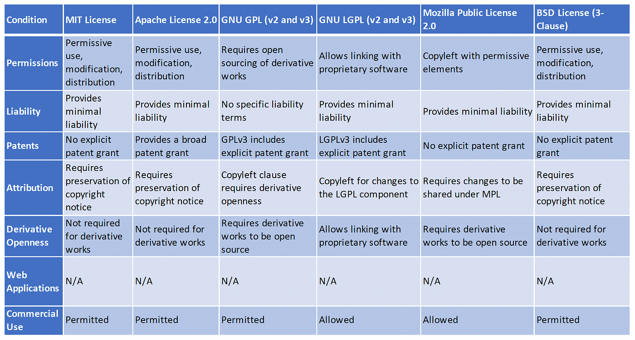

Slide 13
Q/A
Let’s start from the 7 questions on https://onlinequestions.org/ (code: 11122024)
Feel free to ask more questions now (Italian / English … all ok for this session)

Slide 14
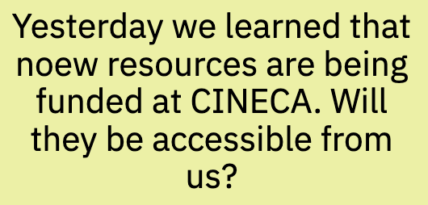
#1
2 types of resources at CINECA are expected:
LISA (Leonardo Improved Supercomputing Architecture)
Under finalization in these days
Some 150+ fat nodes
2x Intel CPU
8x Nvidia H100
3.2 Tbps per node (!!!)
Fast NVMe local disk
½ of LISA paid by ICSC
Hence we expect to be able to use it
BUT: operational > Summer 2025, so most probably for the “2nd phase of ICSC”

Slide 15
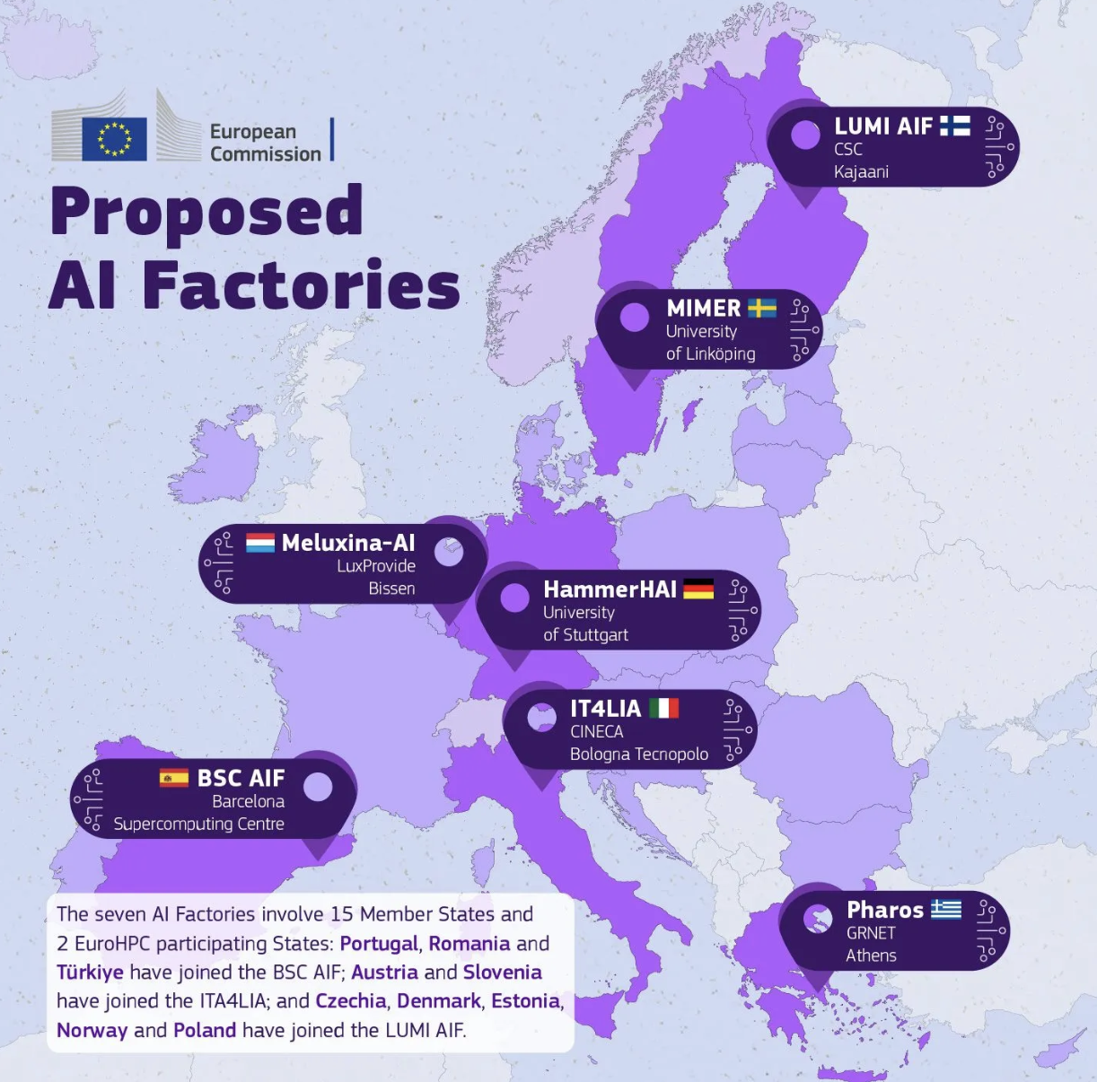
#1
We learned that CINECA/ICSC/Italy was granted the IT4LIA
430 Meur (½ paid by Italy, ½ by the EuroHPC JU)
Clearly, an even more AI oriented computer
I expect lots of Nvidia B100 GPUs, large connectivity (for LLMs), poor CPU performance
2027+ ? So a bit complex to see what will be the use scenario by then
Realistically, if ICSC will still exist, it will be a customer

Slide 16
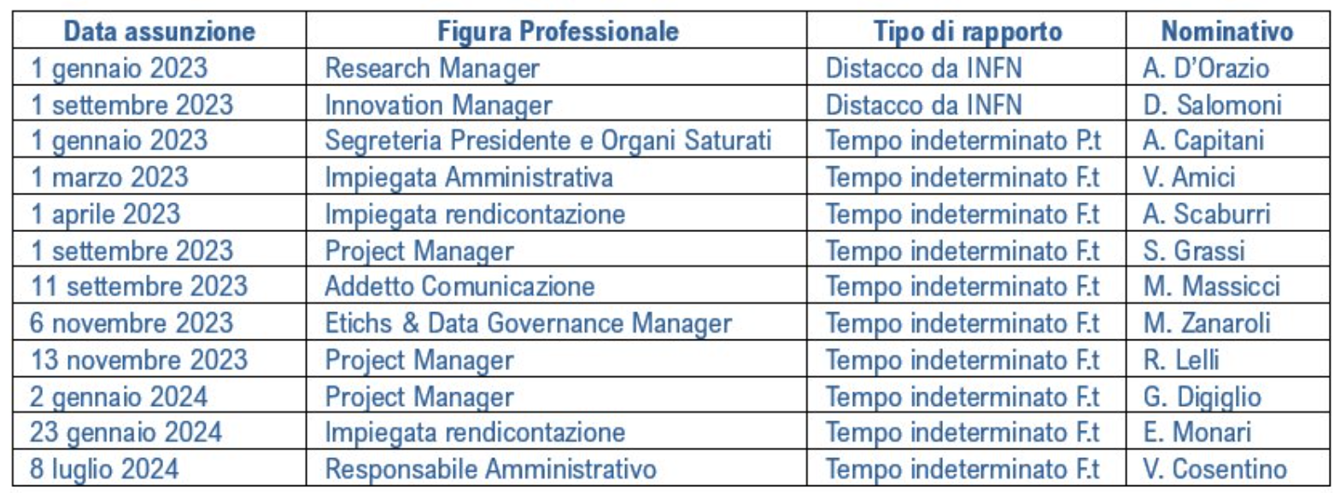
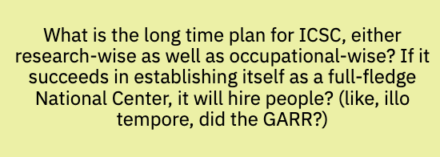
#2
Difficult question
Alessia told us 2 days ago that 10 “technical positions” are already in pipeline
This is very different wrt the current situation, where ICSC has hired directly just top level / adm staff

Slide 17
#3
Can I only say “good question!”?
It is clear we need to evolve our understanding of the future ICSC in the next (few) months
My personal feeling is that we can indeed write technical white books with “suggested solutions”
A white book on “how will Italy handle massive scientific / industrial computing” is more difficult at this point

Slide 18
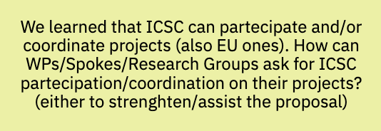
#4
This is probably one of the strongest ways to make sure ICSC will have a future: global recognition
The procedure is both top/down and bottom/up
I think everyone involved, if they see a possibility, should simply contact their Institution leader, and he/she can escalate to the Research/Innovation Manager and eventually the CdA (?)

Slide 19
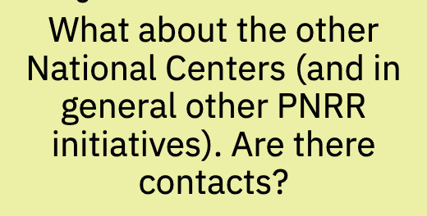
#5
My honest answer is ”less than I would have expected”
Initially there was the idea that ICSC would have been the “computing for all PNRR initiatives”, but eventually
Not for free (!)
All the initiatives I have seen have been more “Project X → CINECA” and not “Project X → ICSC”
I could be wrong, though!

Slide 20
#6
I think ”will be established” refer to the second phase, post PNRR (?)
My only answer is “it must be possible”, otherwise I do not see the point
About “weren’t part of ICSC” there was a limitation in # of participants for PNRR (which eventually led to some universities / EPRs to be left out)
When PNRR (money) is over, the limitation goes away
I think the answer will be yes, but I do not know HOW
Pay per use?
Fresh money from the MUR?
Annual fee covering some resource utilization?
In kind contributions?

Slide 21
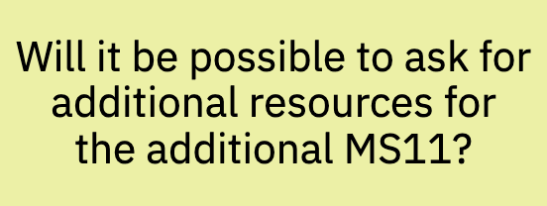
#7
Are we speaking of COMPUTING resources or other things ($$$), right?
Computing resources: my intention is to ask for “linear extrapolation” of the resources we already obtained
This does NOT prevent totally new requests to come
As said, I do not really think that in the PNRR/ICSC era we will be able to use LISA – but do we even have use cases which need LISA and for which Leonardo-GPU is not enough?

Slide 22
The questions I did NOT see …
Will my position be renewed / transformed /stabilized?
This depends entirely on the institution. I do not think there are general rules / indications.
… some more non written comments …

Slide 23
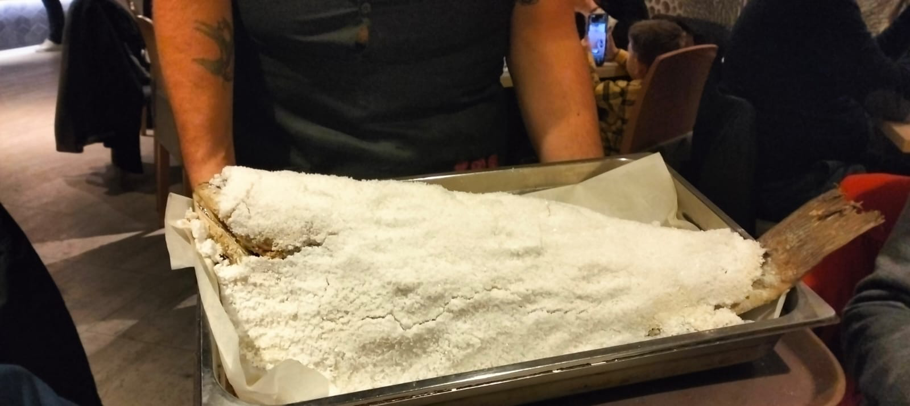
MANY MANY THANKS TO THE LOCAL TEAM!!!!!
Alessia:
GRAZIE!!!!!
Caffe / the / lunches perfect!
We finally got the picture of the Dentice!!!!
But the first picture was nore explicative …

