Slide 1
Deep learning applications for the analysis of Sentinel-2 satellite imagery
Gioacchino Alex Anastasi¹, Giuseppe Piparo², Virginia Strati³, Enrico Chiarelli³, Fabio Mantovani³, Irem N. Elek³, Kassandra G. C. Raptis³, Matteo Albéri³, Alessia ${\text{Tricomi}}^{1,2,4}$
1. University of Catania, Department of Physics and Astronomy
2. Istituto Nazionale di Fisica Nucleare (INFN), Catania section
3. Department of Physics and Earth Science, University of Ferrara & INFN, Sezione di Ferrara
4. Il Centro Siciliano di Fisica Nucleare e Struttura della Materia (CSFNSM), Catania
2nd ICSC Spoke2 meeting, Catania, 10-12 December 2024
ICSC Italian Research Center on High-Performance Computing, Big Data and Quantum Computing
Missione 4 • Istruzione e Ricerca

Slide 2
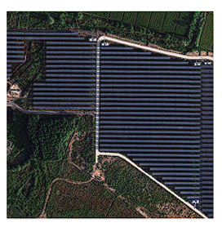
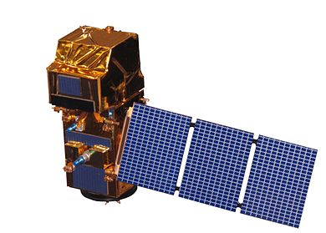
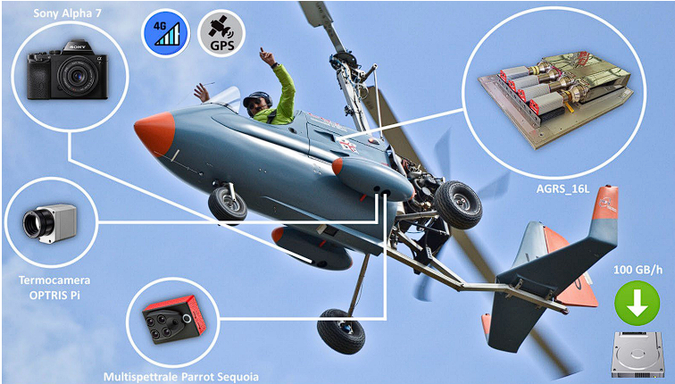
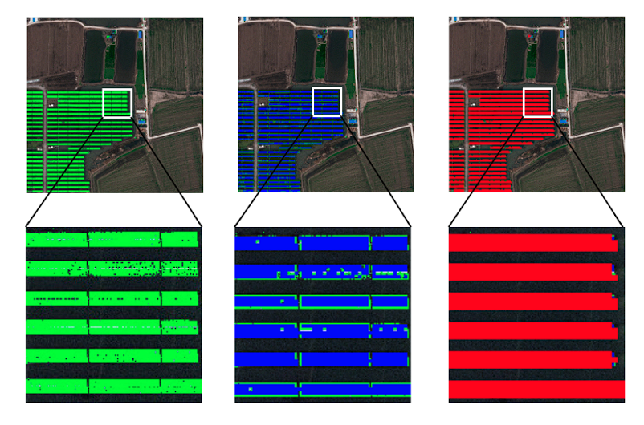
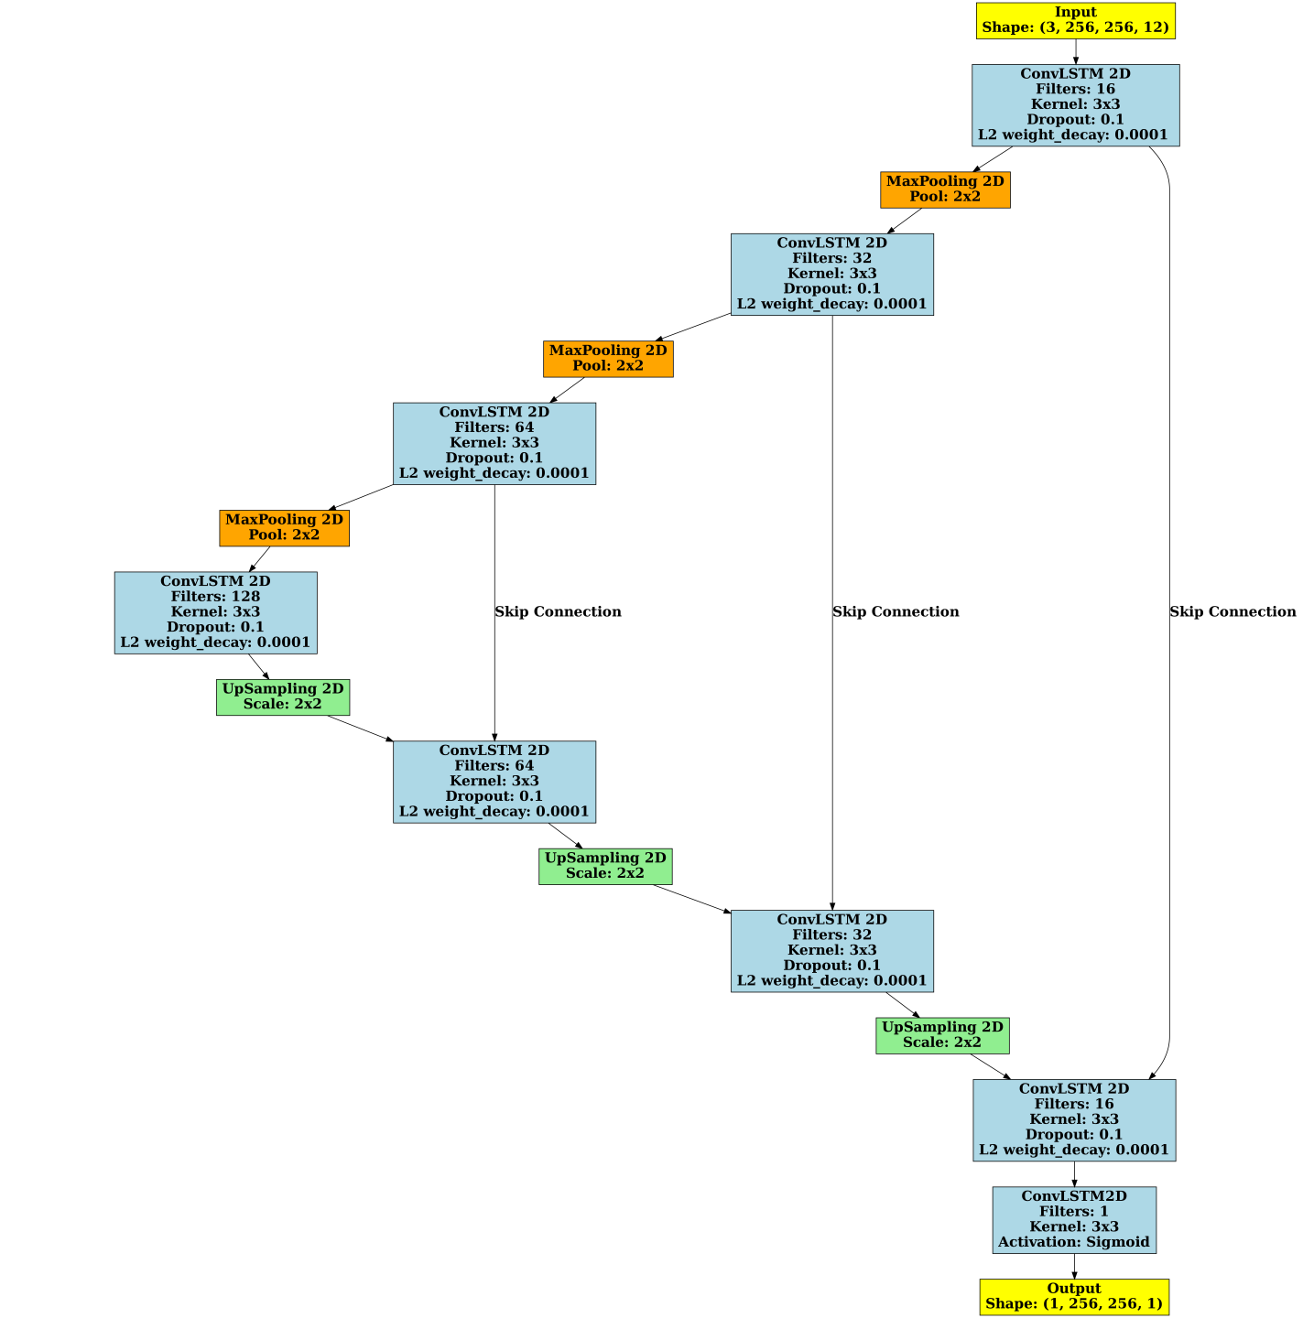
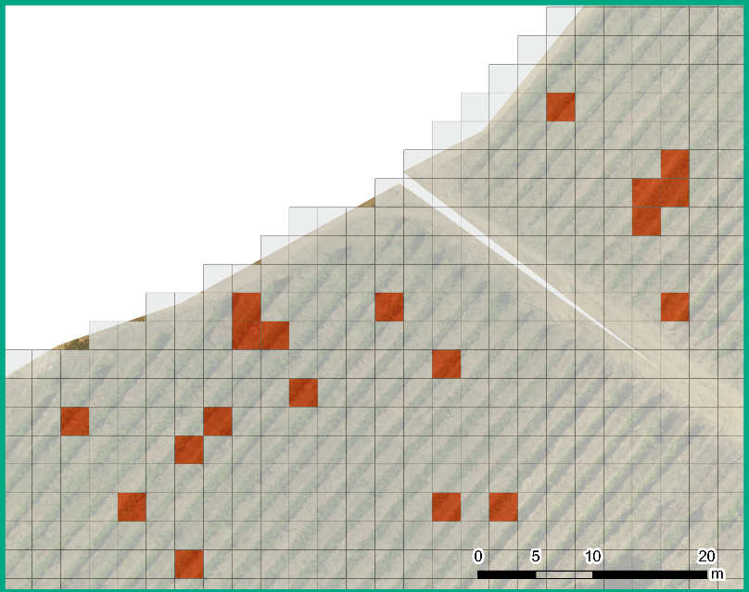
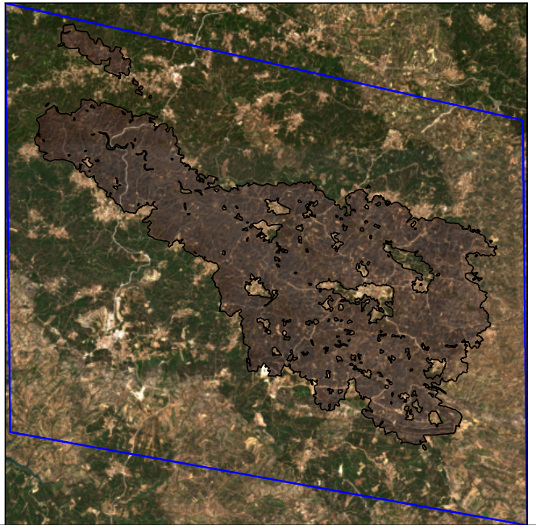
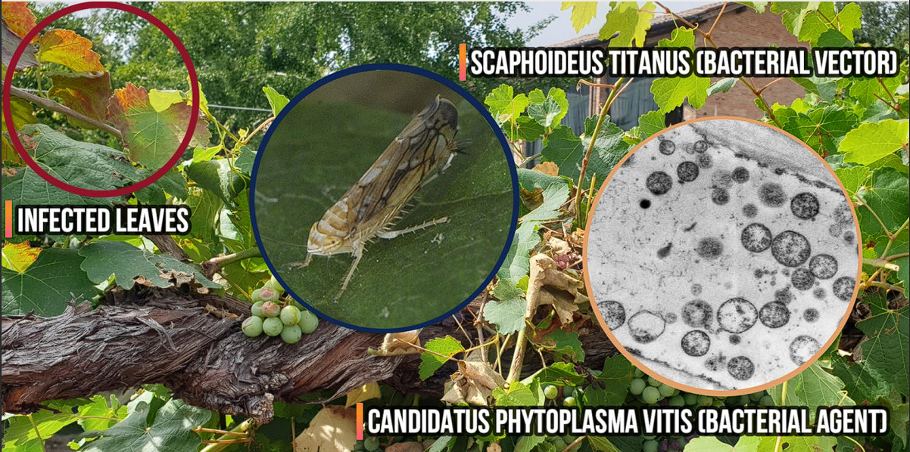
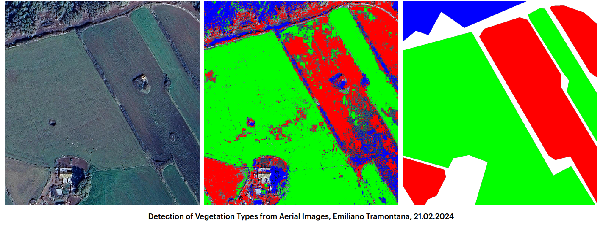
Flagship UC2.6.3 : AI algorithms for (satellite) imaging reconstruction
Development of modern applications to exploit remote sensing data in the context of “Space Economy”, i.e. the full range of activities that create value while exploring, researching, understanding, managing, utilizing space.
Flagship results fall into three distinct but interconnected lines of research.
High-resolution image processing based on spectral indexes for disease detection in vineyards
Deterministic learning algorithm for object identification
Deep Learning for satellite imagery analysis
2nd ICSC Spoke2 meeting, Catania, 10-12 December 2024
1

Slide 3
Segmentation of wildfire-affected areas using deep learning

Slide 4
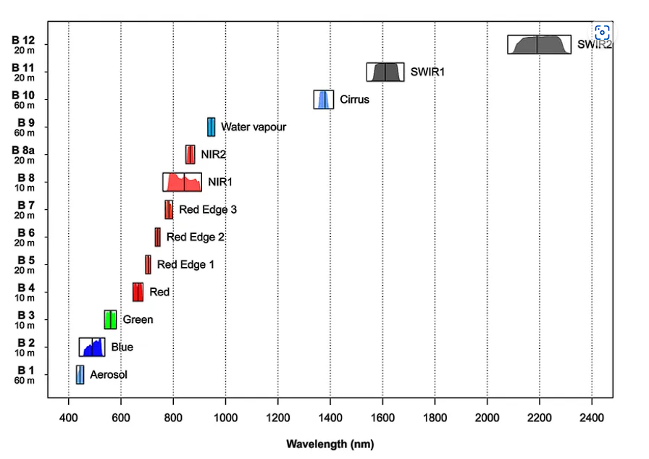
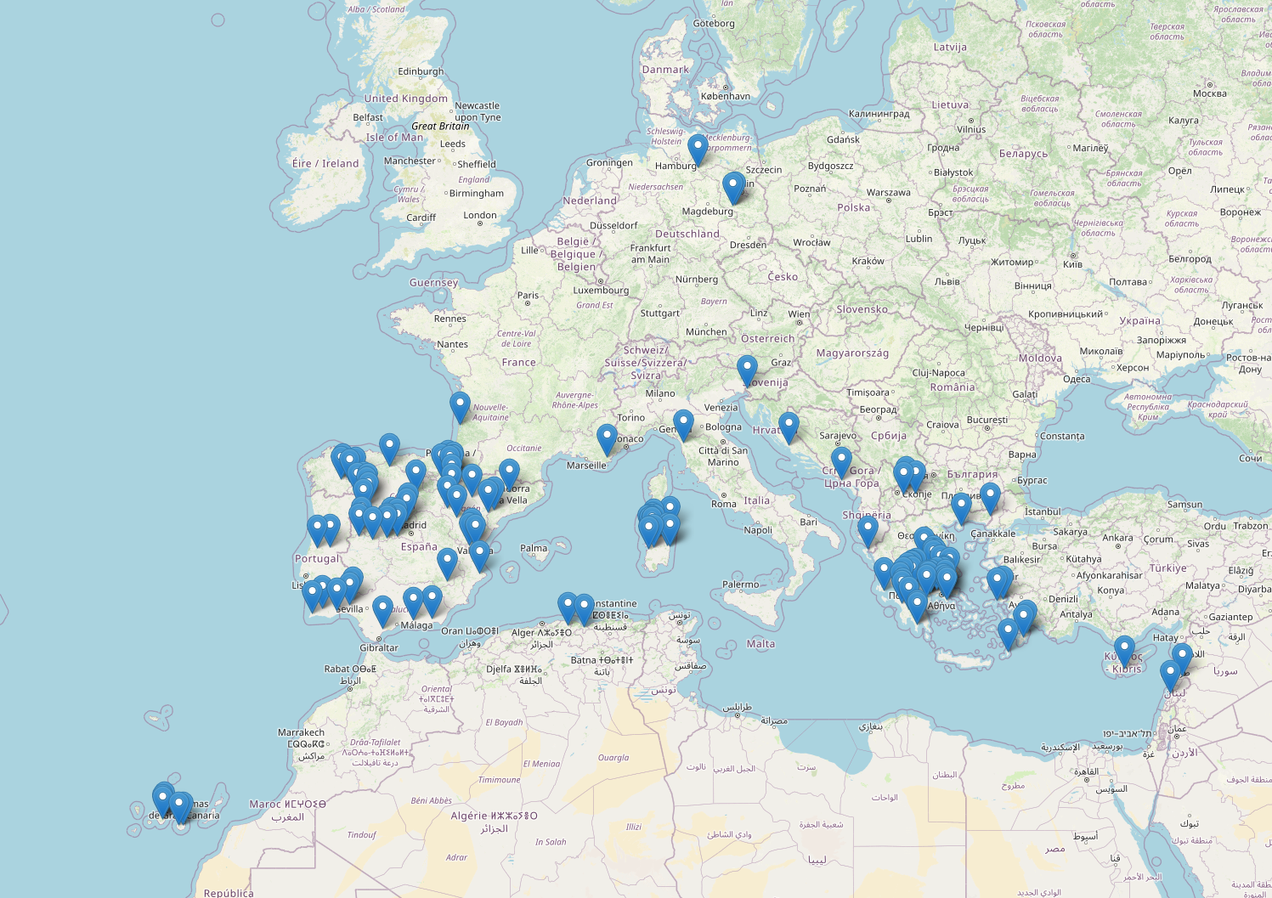
Case study and dataset
Detection and mapping of wildfire-affected areas analyzing the multispectral images from the Sentinel-2 satellites with deep learning techniques.
Target: provide new, powerful tools for large-scale environmental monitoring and disaster management (damage assessment, post-fire recovery, prevention).
DATASET
114 wildfires, recorded mainly in the Mediterranean area, from the Copernicus Emergency Management Service (EMS)
a temporal series of 3 images per event is used (one before, one during, one after the fire), each with a size of 2048x2048 pixels and a resolution of 10 m (see talk of G. Piparo on 11/12 for more details).
MAP OF FOREST FIRES
2nd ICSC Spoke2 meeting, Catania, 10-12 December 2024
2

Slide 5
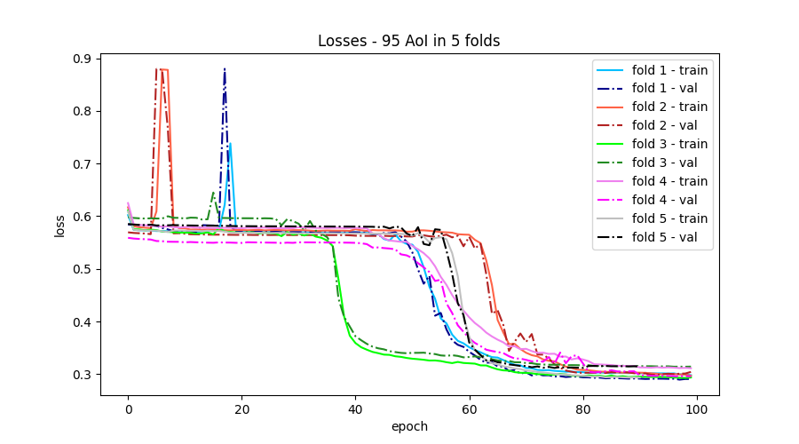
Model architecture and training
UNet-like model with Convolutional Long Short Term Memory (ConvLSTM) layers
Custom loss function, sum of binary cross-entropy, Dice-loss and Jaccard-loss terms
Input: patches of dimension 256x256 pixels containing at least 1% of burnt pixels
Data augmentation: random rotations of 90°,180°, 270° + mirroring
Output: binary mask of burnt pixels
To ensure the robustness of the model, a 5-fold cross-validation was performed using 95 event, achieving stable convergence and consistent accuracy across all folds.
Avg. train. loss: 0.303 ± 0.009
Avg. valid. loss: 0.286 ± 0.002
Avg. train. accuracy: 0.928 ± 0.008
Avg. valid. accuracy: 0.935 ± 0.002
2nd ICSC Spoke2 meeting, Catania, 10-12 December 2024
3

Slide 6
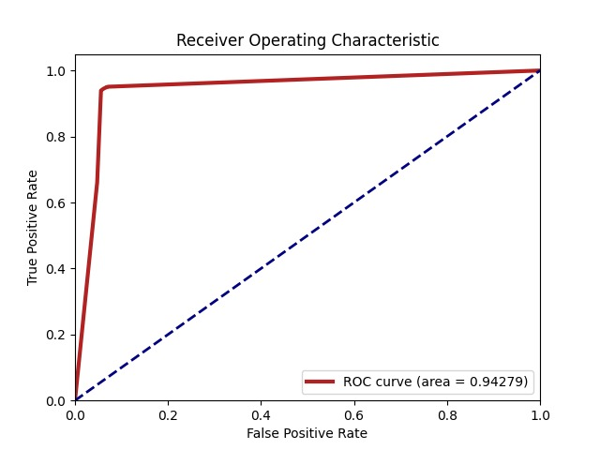
Results and performances
accuracy
loss
The loss and accuracy curves stabilize around 75-100 epochs, without overfitting.
The final, high values for the metrics (94% accuracy, 95% precision, recall and F1 score) indicate strong capability of the trained model in identifying burnt areas.
The ROC curve, with an AUC score close to 0.95, indicates high discriminatory power.
Dice (0.92) and Jaccard (0.86) scores confirm the effectiveness in segmenting burnt areas, with solid overlap between predicted and actually affected regions.
epochs
epochs
Metrics
Best Threshold | 0.4
Accuracy | 0.94
Precision | 0.95
Recall | 0.95
F1 Score | 0.95
Dice | 0.92
Jaccard | 0.86
see also G. Piparo, SIF 2024
2nd ICSC Spoke2 meeting, Catania, 10-12 December 2024
4

Slide 7
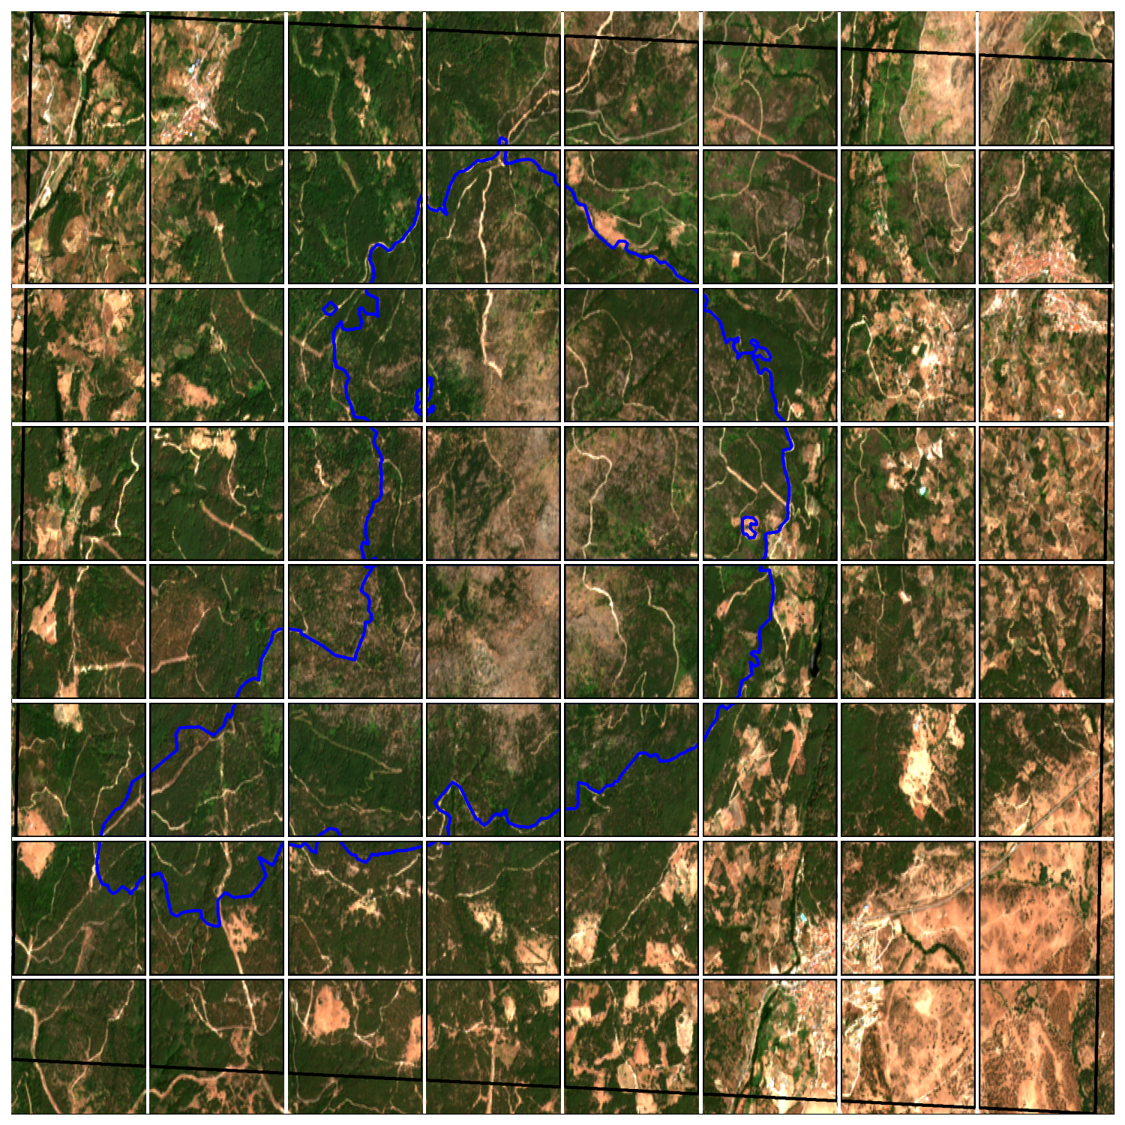
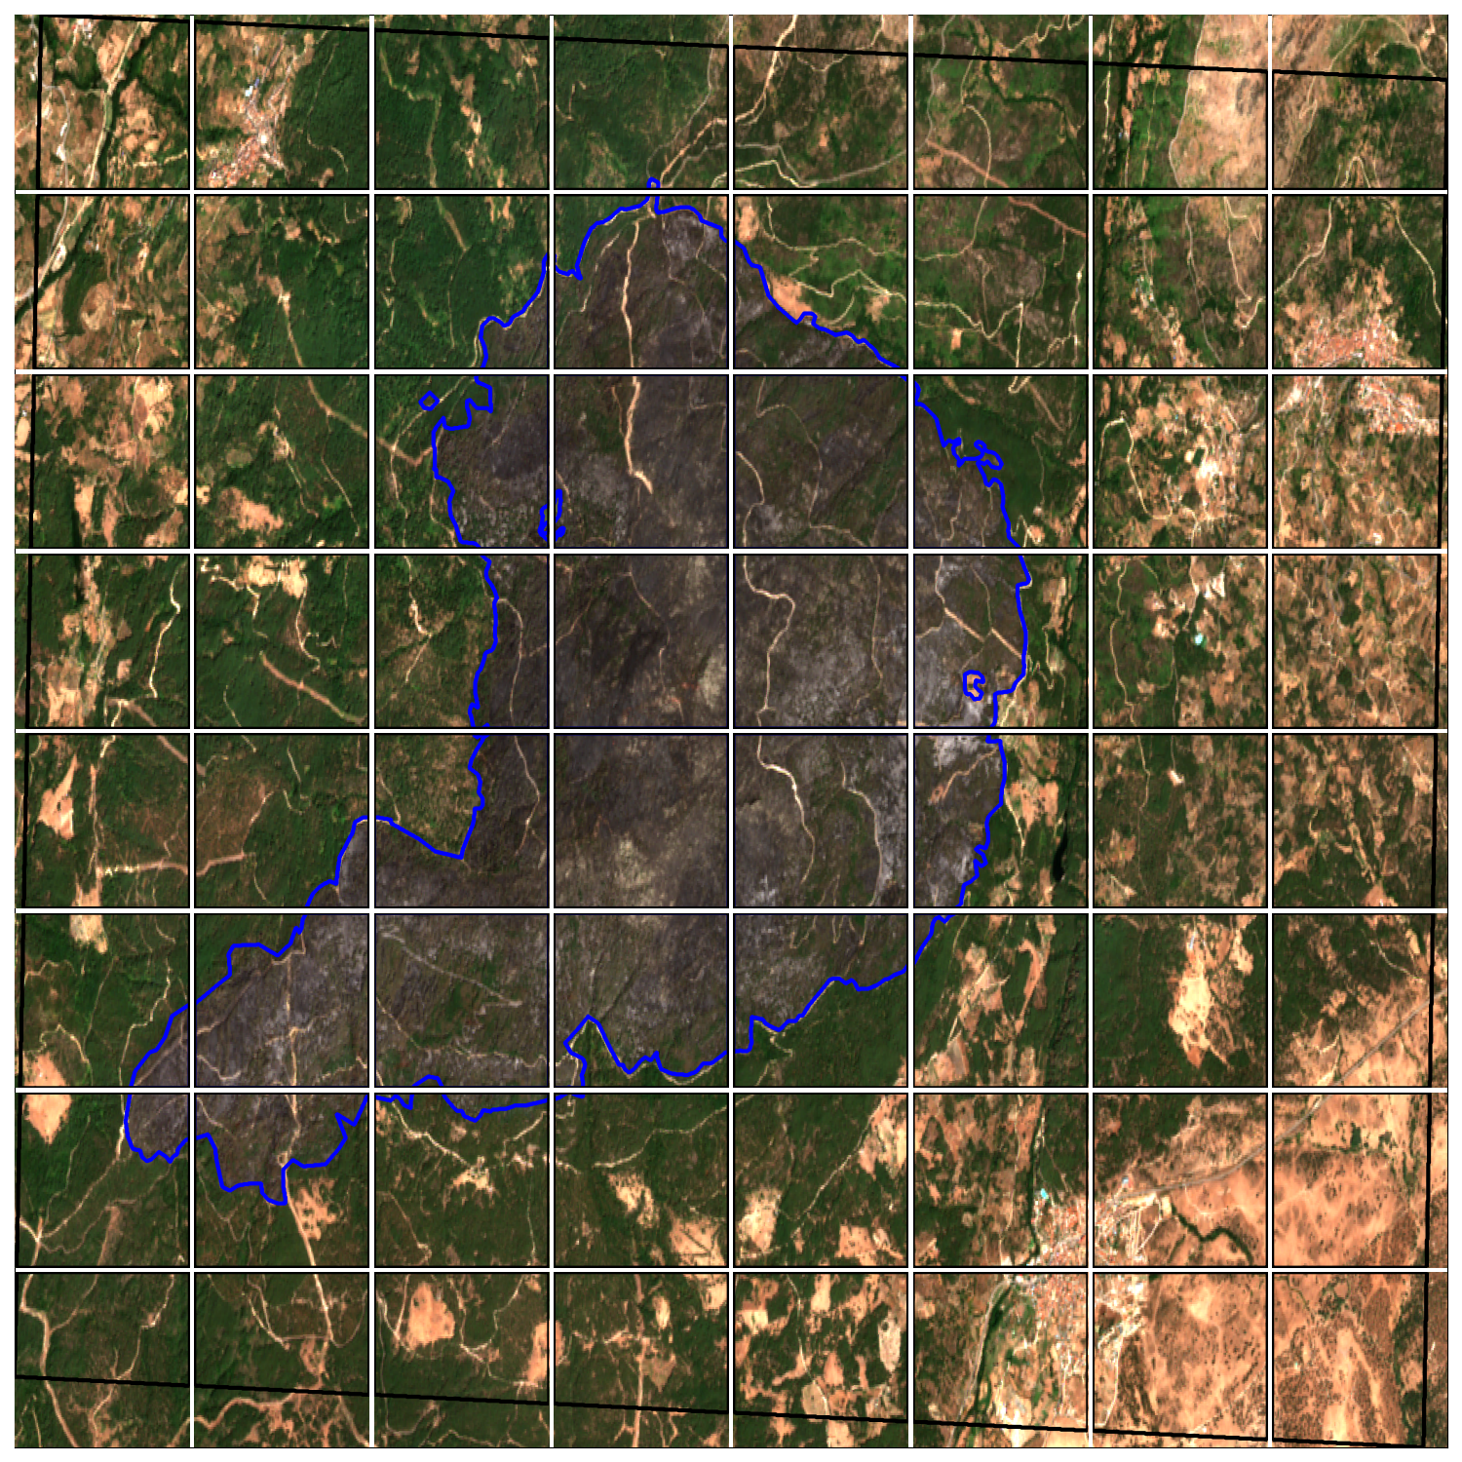
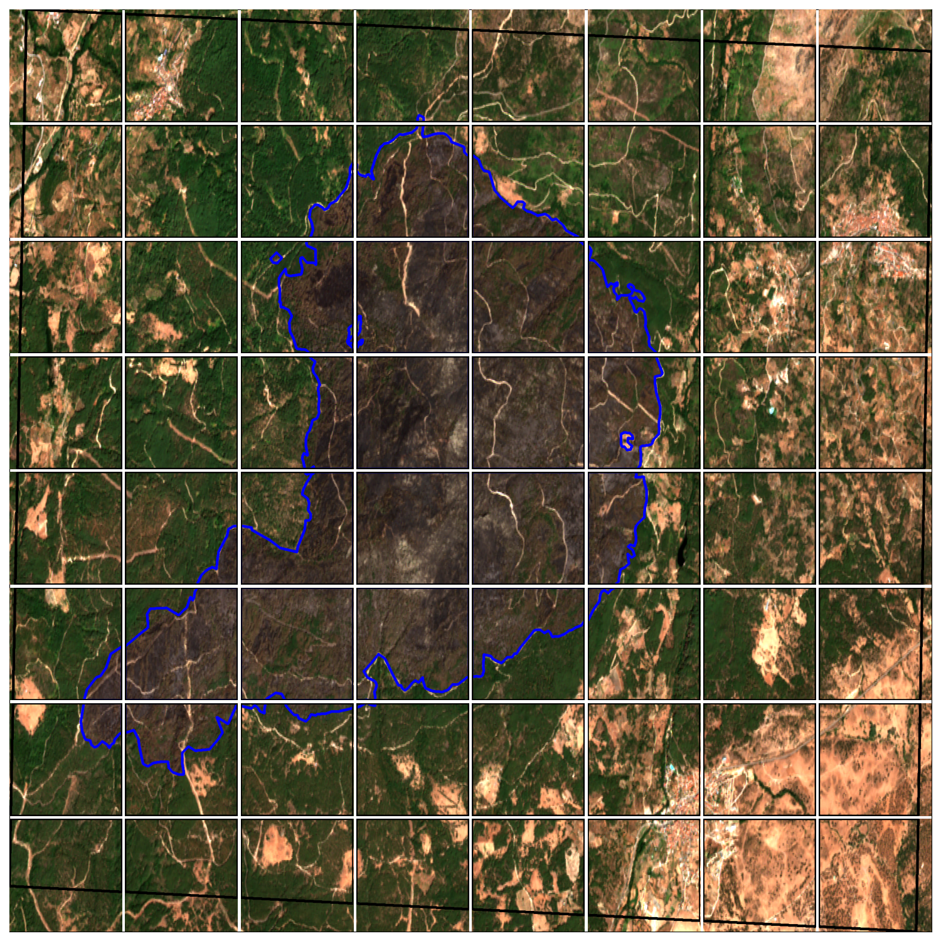
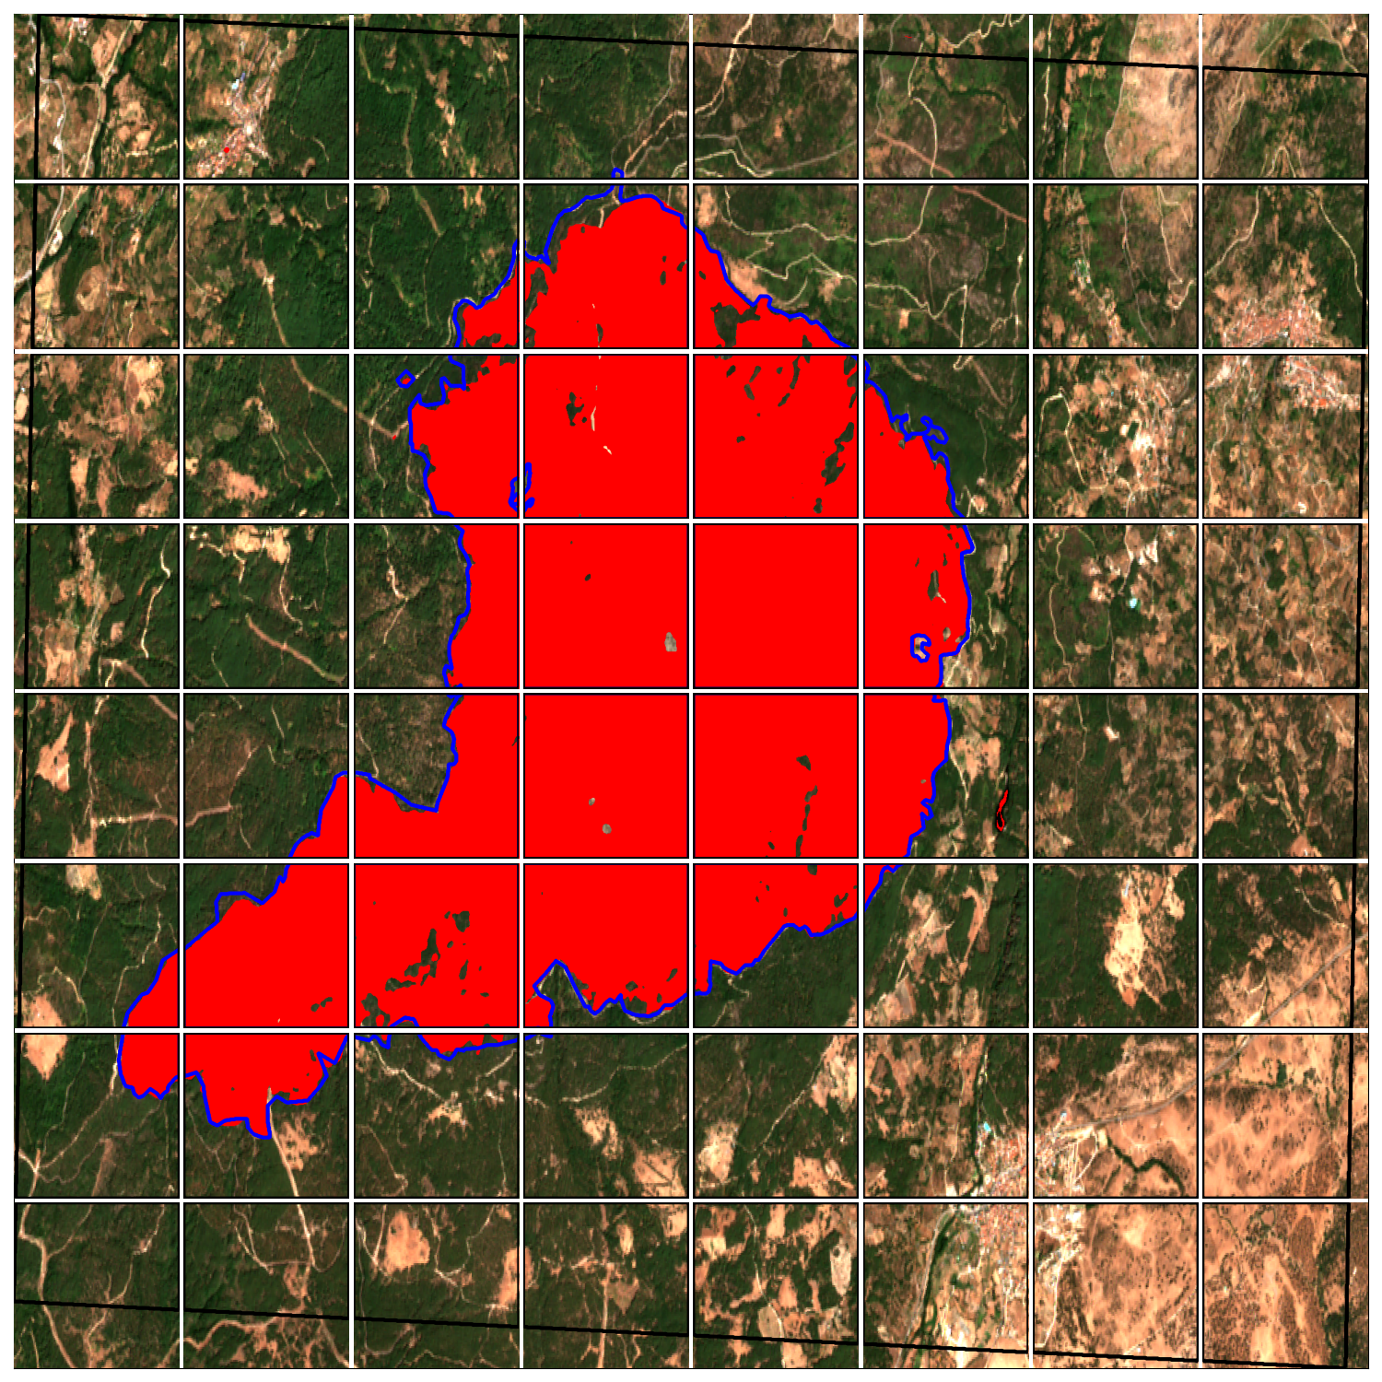
Results and performances
BEFORE FIRE
NEAR FIRE
AFTER FIRE
PREDICTION
2nd ICSC Spoke2 meeting, Catania, 10-12 December 2024
5

Slide 8
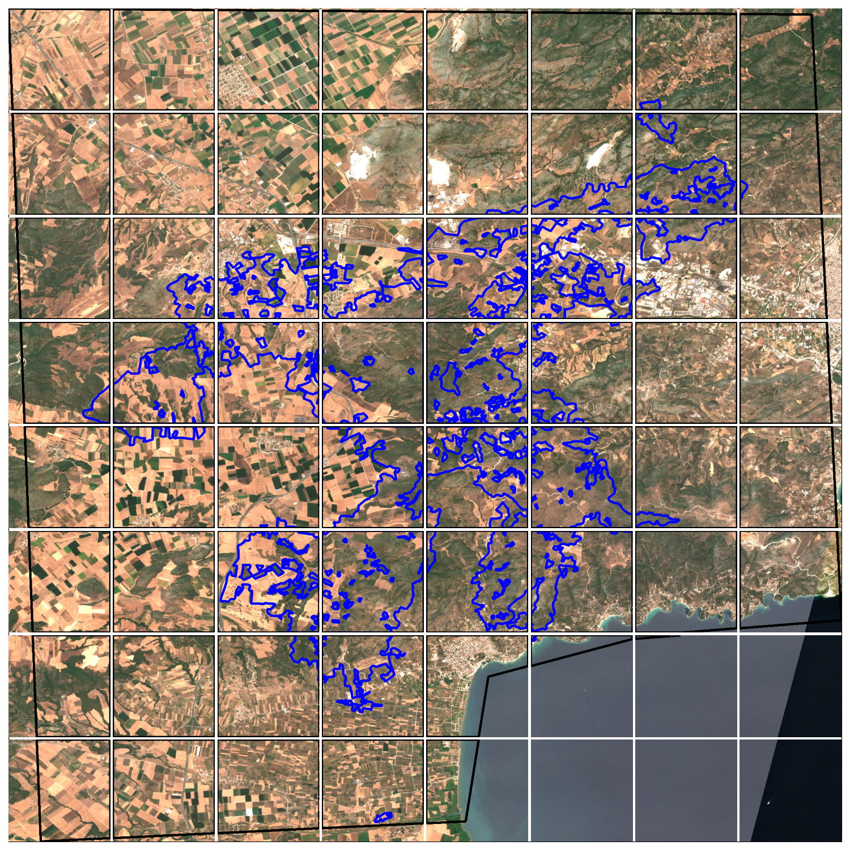
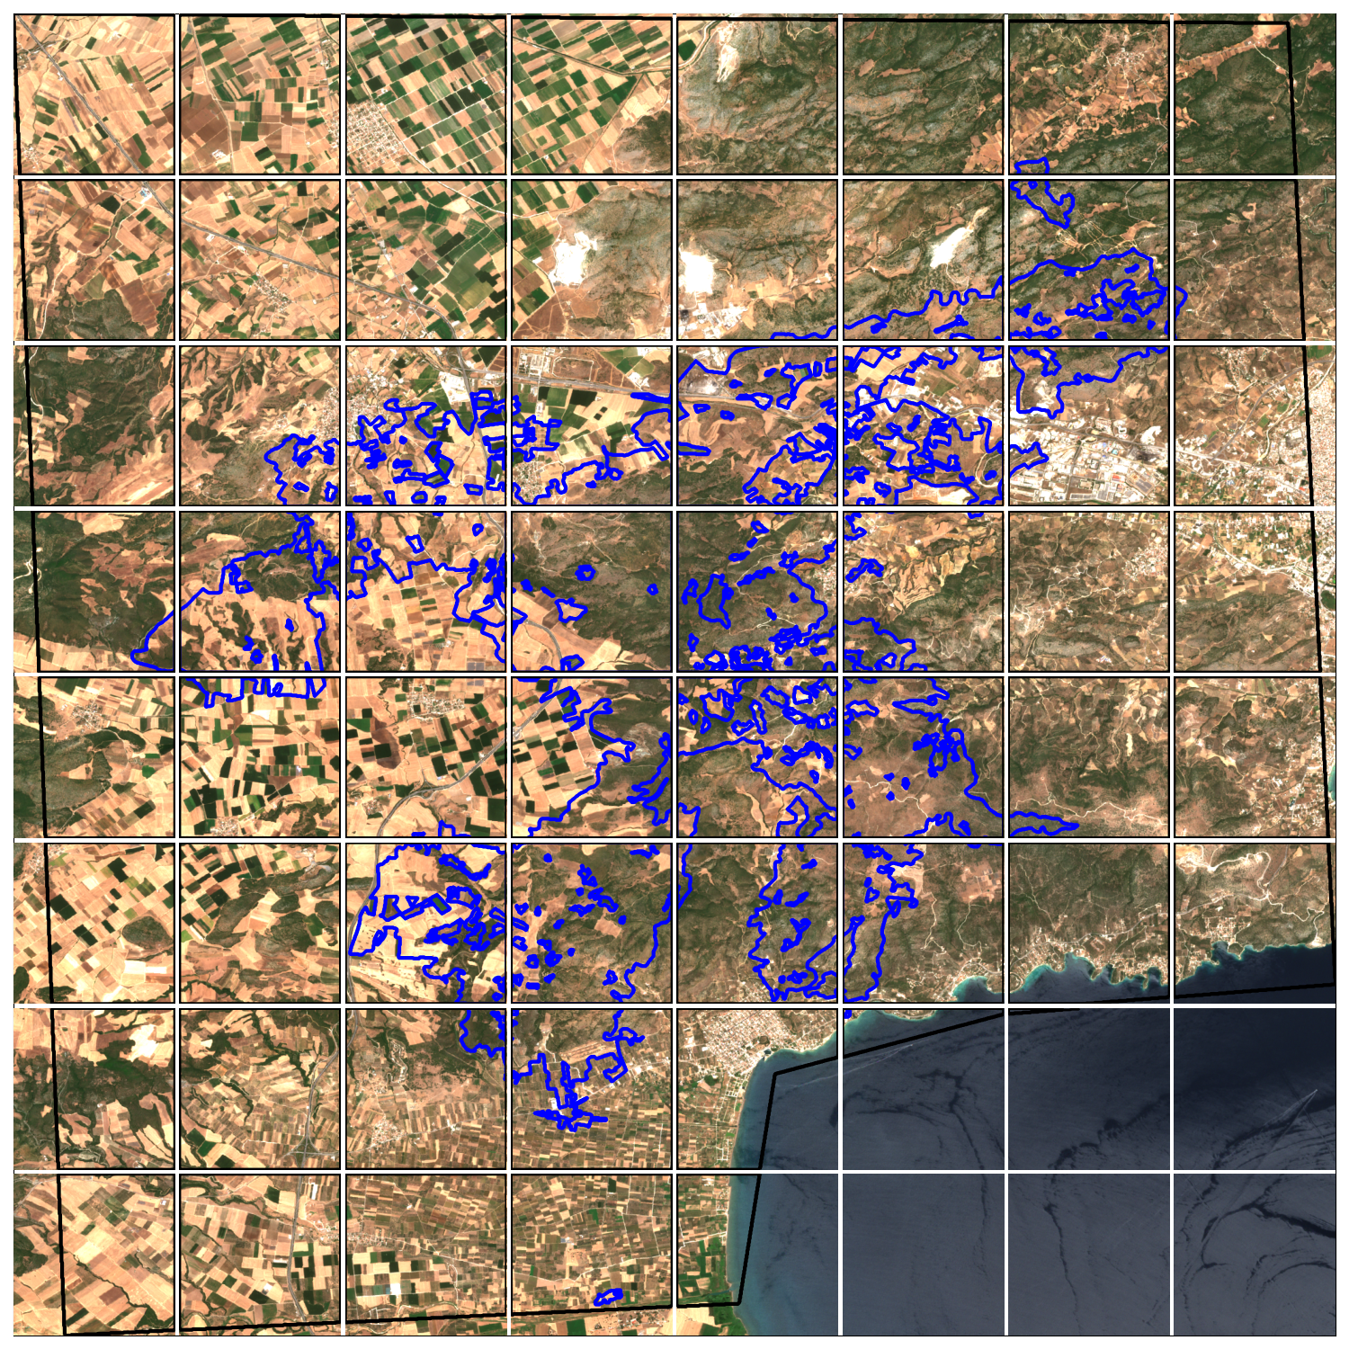
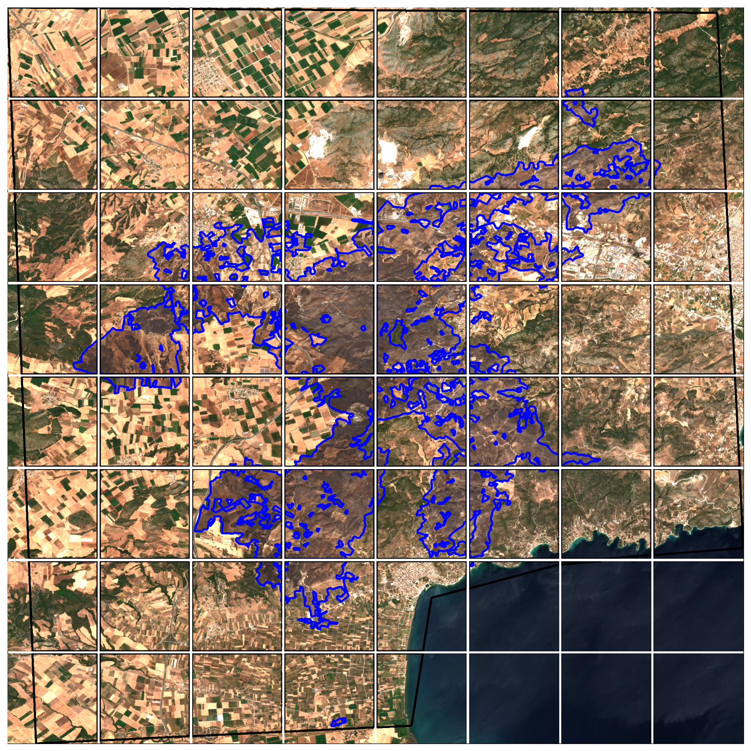
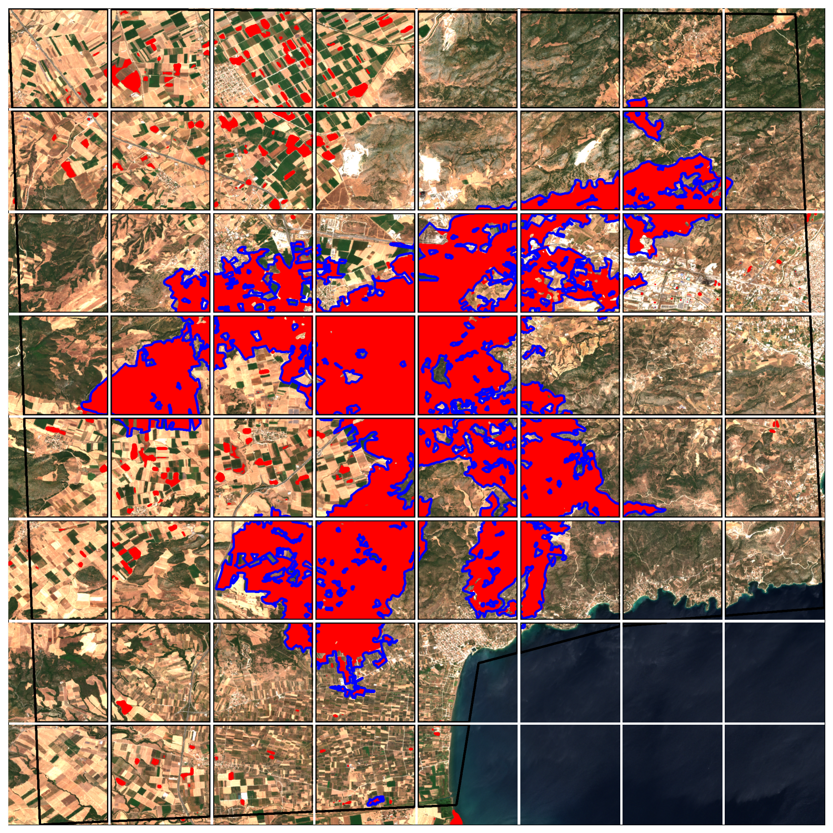
Results and performances
BEFORE FIRE
NEAR FIRE
AFTER FIRE
PREDICTION
2nd ICSC Spoke2 meeting, Catania, 10-12 December 2024
6

Slide 9
Computational resources
Before June ’24 :
2 Virtual Machines with 1 GPU A100 and 1 TB of disk space each provided by INFN-Catania Section
Shared within the Flagship UC2.6.3 :
100.000 core-hours on Leonardo Booster
100.000 core-hours on Leonardo DCGP
15 TB of disk space
Flagship activities have been migrated to Leonardo in the last few months, thus mainly tests have been carried out up to now.
Currently understanding how to target the requests for 2025.
CPU
GPU
2nd ICSC Spoke2 meeting, Catania, 10-12 December 2024
7

Slide 10
Early detection of vineyard diseases using satellite imagery and deep learning

Slide 11
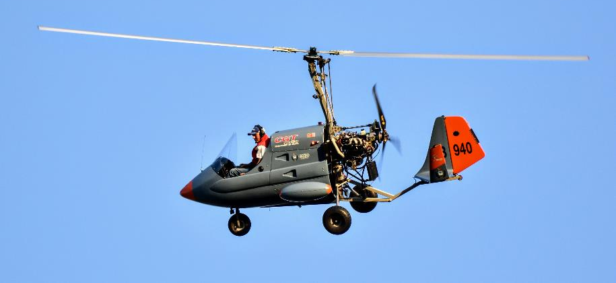
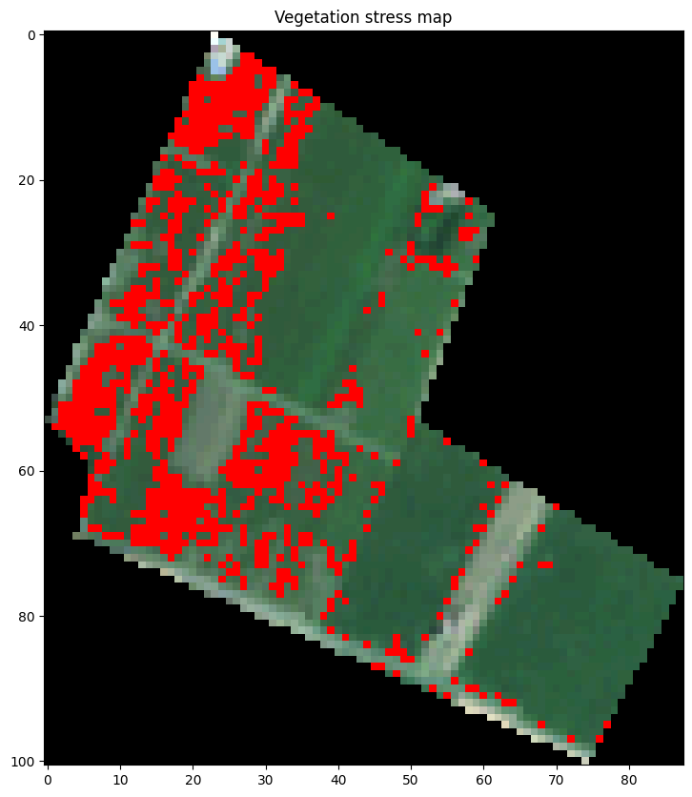
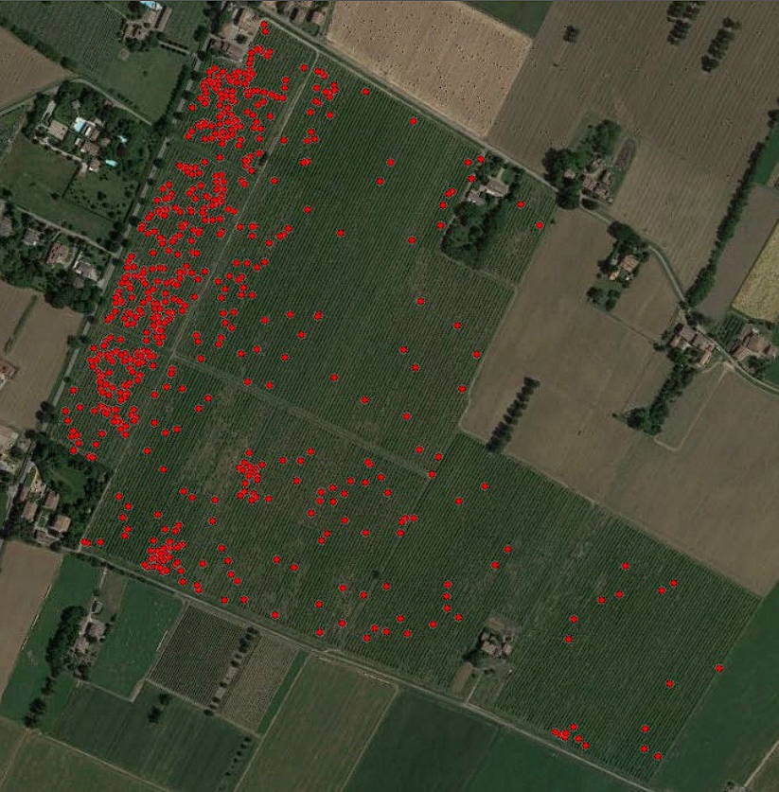
Case study
Early detection of vineyard diseases via remote sensing represents a significant improvement over traditional ground-based surveys.
Of course, lower resolution in satellite images w.r.t. those from aircrafts (10 m vs 1 cm) makes it almost impossible to obtain the same accuracy.
Idea : apply Clustering with k-means (N=3) on the vegetation indexes data to highlighting regions where the vineyard shows greater stress and compare them with the results of aircraft imagery.
Sentinel-2
Radgyro
2nd ICSC Spoke2 meeting, Catania, 10-12 December 2024
8

Slide 12
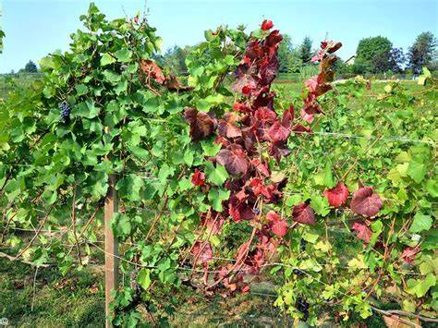
(Updated) Case study
The PERBACCO project aims to quantify the incidence of the diseases using airborne images to identify the change of color of the leaves
The last survey has been executed in the period 8-19 July ‘24 on about 2000 ha of vineyards in the Emilia-Romagna region
Proposal: deep learning application to recognize the presence of diseases on satellite images using the PERBACCO results as a target
Currently developing classification under 2 labels (0 –> no cases, 1 -> any disease severity) to later attempt regression (i.e. reconstruction of the severity level)
See talk of G. Piparo on 11/12 for more details on the dataset
Early warning system per la PrEvenzione della diffusione della flavescenza doRata BAsato sul monitoraggio multiparametriCo airborne delle COlture vinicole
Thanks to V. Strati for the help (and data access)
2nd ICSC Spoke2 meeting, Catania, 10-12 December 2024
9

Slide 13
Future prospects
The presented case studies demonstrate the potential of deep learning applications in the analysis of satellite and aerial images, from agriculture to environmental monitoring.
The computational resources and infrastructure provided by ICSC will allow more extensive experimentation and further refinement of these models.
Furthermore, cross-domain collaborations between the different activities are enabled, leading to innovative analyses, hopefully valuable in the Space economy context.
Thanks for the attention!
2nd ICSC Spoke2 meeting, Catania, 10-12 December 2024
10

Slide 14
Backup

Slide 15
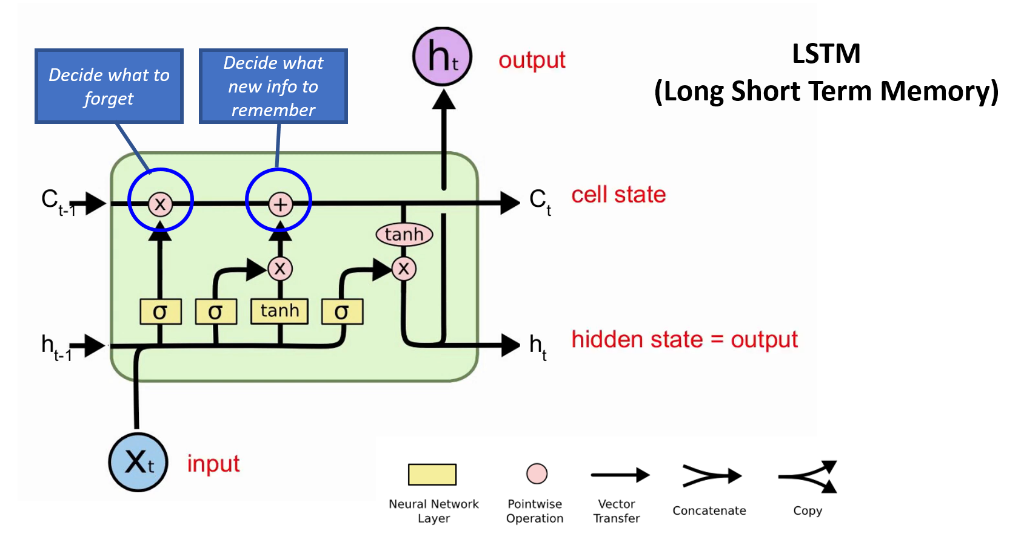
Long-short term memory
2nd ICSC Spoke2 meeting, Catania, 10-12 December 2024
11

Slide 16
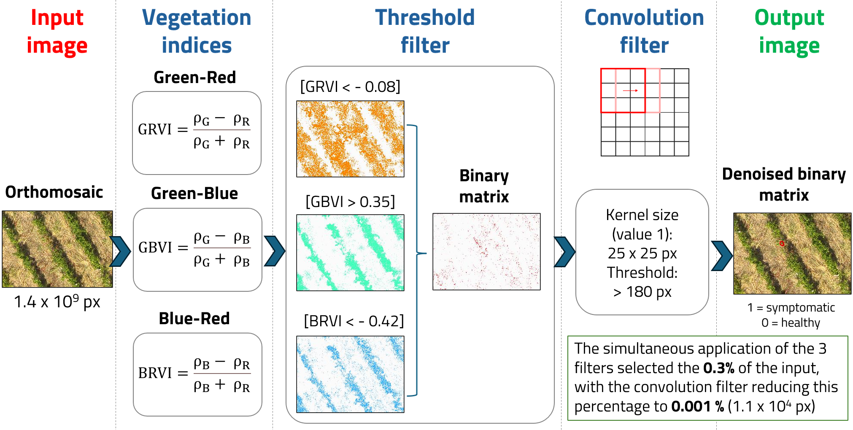
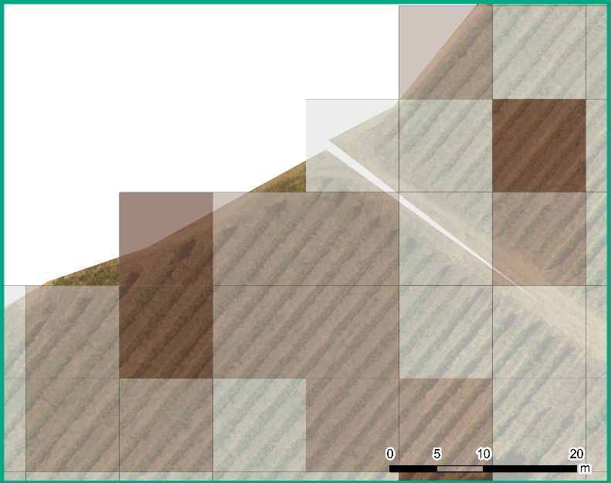
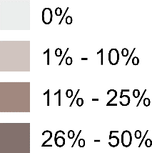
The analysis pipeline
V. Strati, EGU24-10773 (2024)
Instances map [2.5 m x 2.5 m]
Density map [10 m x 10 m]
2nd ICSC Spoke2 meeting, Catania, 10-12 December 2024
12

