Slide 1
Predictive Maintenance
R.Cornali for INFN-CNAF, INAF, UniBO, ENI
Spoke 2 Annual Meeting | Catania 10-12 Dec 2024

Slide 2
Predictive maintenance

Slide 3
What is predictive maintenance?
Equipment maintenance that leverages data analytics and condition monitoring.
Traditional maintenance strategies rely on scheduled inspections and reactive interventions.
Predict when maintenance is needed to schedule interventions at the most convenient times.
Advancements in technologies such as Internet of Things (IoT) and machine learning allowed this innovation.

Slide 4
What is the goal of predictive maintenance?
How?
Data are collected from the various sensors installed on the machinery.
Data are continuously analyzed to identify patterns and anomalies.
The main objectives are:
Optimize the performance of equipments.
Minimize the unplanned downtime and maintenance costs.

Slide 5
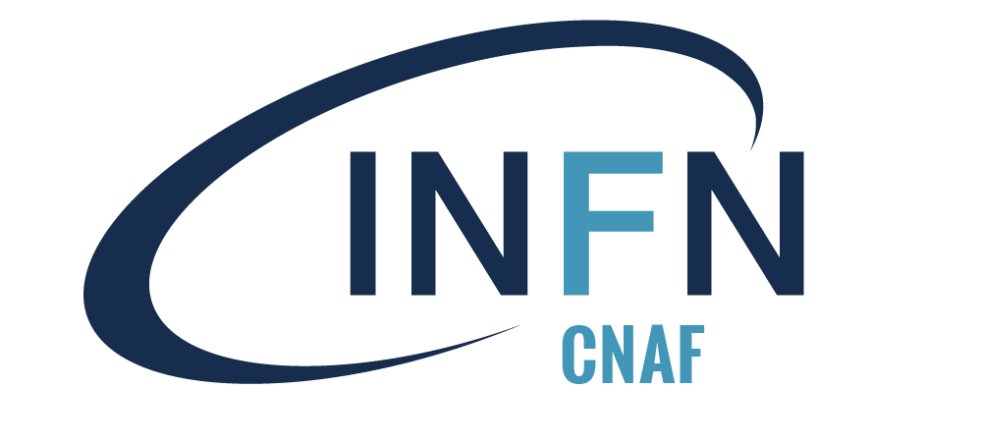
Research Framework
Innovation Grant: “Harnessing the Power of Artificial Intelligence for Predictive Maintenance of Industrial Plants”
Goals:
• Demonstrate the usability of AI-based techniques for predictive maintenance
• Modelling interdependencies in complex industrial apparatuses
Partners:
• ENI, UNIBO, INAF, INFN
Notes:
Industrial anomaly detection is the primary focus of the Spoke2 Innovation Fund, a collaborative research initiative in which INFN actively participates. Alongside INFN, the project includes partners such as INAF, the University of Bologna (UNIBO), and ENI.
ENI, Italy’s largest oil and gas company, operates numerous extraction plants worldwide and plays a pivotal role in the project. It has contributed sensor readings, apparatus data, technical expertise, and comprehensive guidelines to support the research.
The project’s objective is to explore and compare advanced AI-driven approaches for predictive maintenance. Specifically, it aims to develop solutions capable of modeling the intricate interdependencies among components of rotating machinery, such as those used extensively in ENI’s operations. This effort seeks to enhance the reliability and efficiency of industrial systems.

Slide 6
Case studies
Case study 1: We analyze signals from industrial rotating machines. Our aim is to predict anomalous instances.
Case study 2: We estimate the output of a liquefaction unit given a subset of the operational parameters. Then, we try to exploit data to improve the production process.

Slide 7
Case study 1: INAF

Slide 8
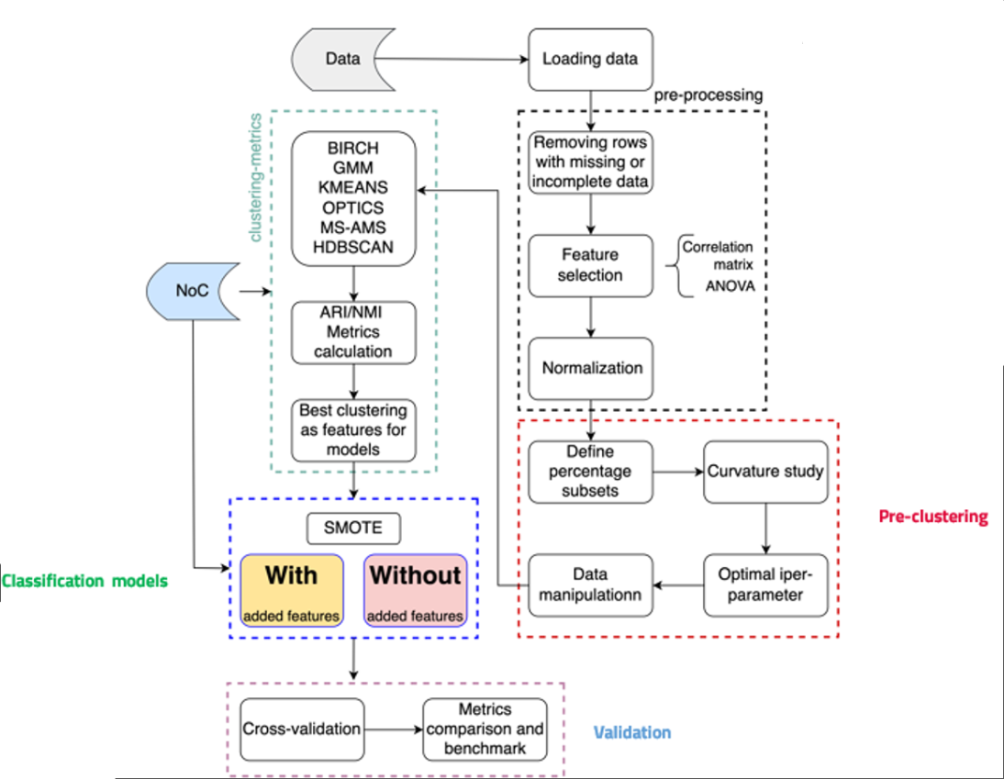
Hybrid clustering method
Data are pre-processed and clustered through a multistep pipeline.
The cluster labels are treated as features, and used to augment the data. This process seems promising in improving the robustness of regression and classification methods.
Different classification models are tested to classify the data between “standard condition” and “anomaly”.

Slide 9
Results
Adding the clustering features improved accuracy on average by 4.87%.
Pre-clustering reduced the training time of the classifiers, but the reduction wasn’t statistically significant.
Overall, data pre-clustering improved the classification results.

Slide 10
Case study 1: INFN-CNAF

Slide 11
Graph Neural Networks and GANs
The method is based on the “reconstruction error framework” for anomaly detection.
Time and spatial relationships in time series are modeled with a static graph. This choice can improve interpretability and model effectiveness.
Generative Adversarial Networks (GANs) are employed to obtain robust, regularized reconstructions.

Slide 12
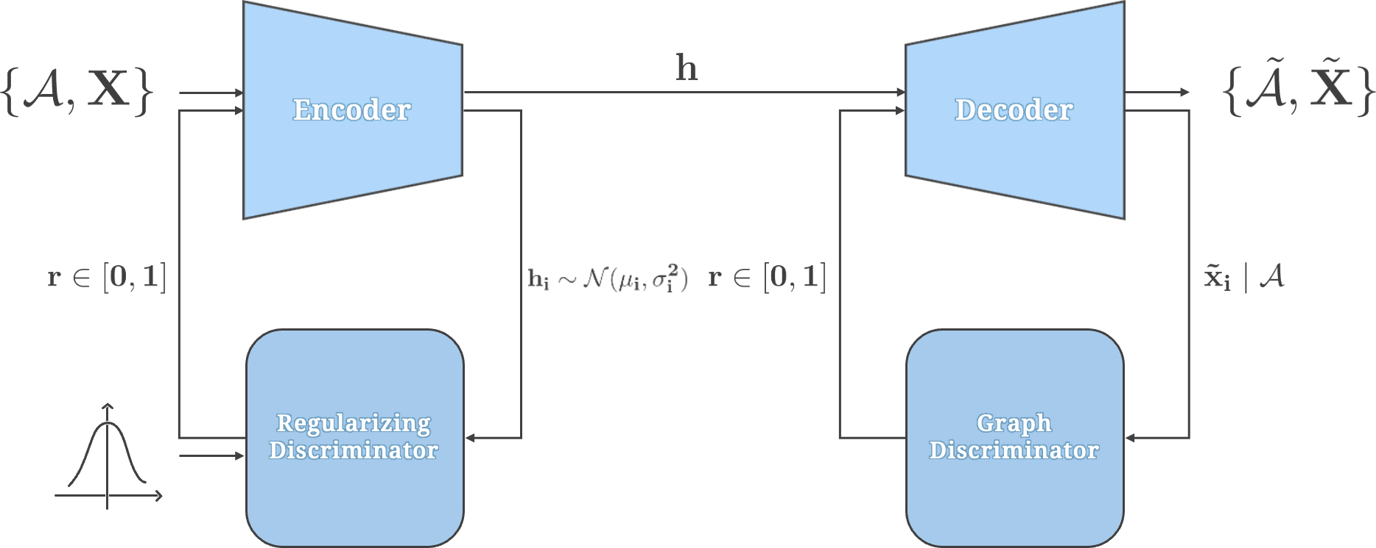
Proposed model
The model has three core elements: a graph autoencoder and two critics.
The graph encoder maps each node to a latent representation, the decoder reconstructs the nodes and edges from the latent representations.
One discriminator regularizes the latent space.
One discriminator judges the truthfulness of the reconstructed graphs.
Reconstruction errors and critic scores are used as anomaly measures.

Slide 13
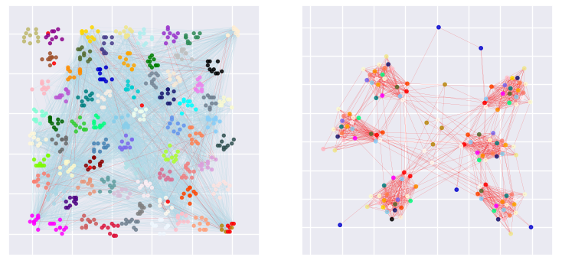
Open questions
The model has promising results, there are some open issues:
Implement a general, effective, and efficient graph structure.
Find an adequate thresholding and aggregation rule for the anomaly scores.
A graph representing a small time-interval, and a subgraph of anomalous connections.

Slide 14
Case study 2: INFN-CNAF

Slide 15
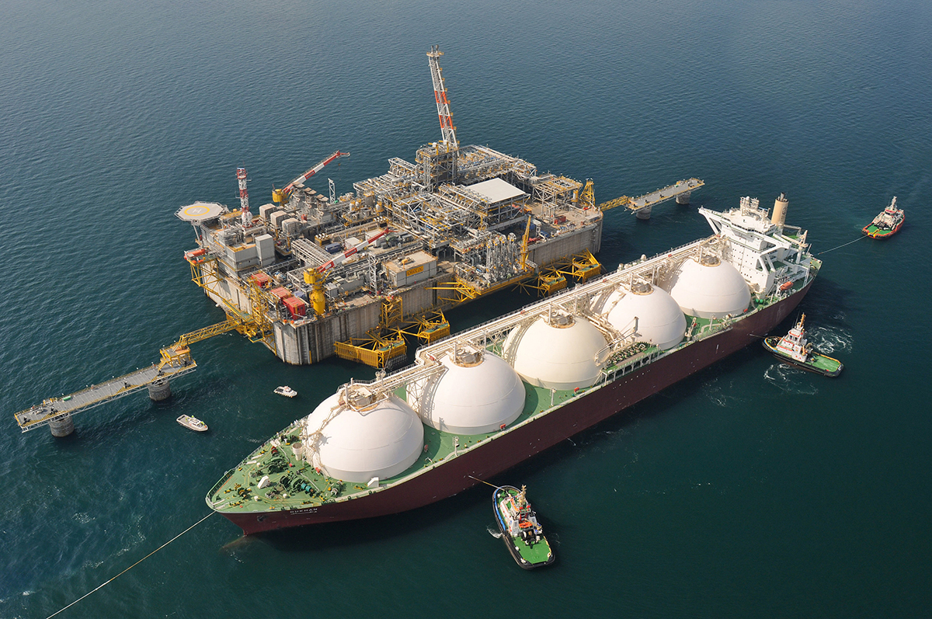
Open problems of case study 2
Challenges:
Exploit data from a LNG liquefaction plant to improve the choices of operational parameters.
Reduce the risks associated to the use of a machine learning algorithm in a control setting.
A gas liquefaction unit.

Slide 16
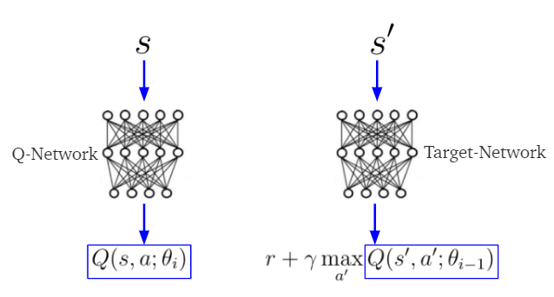
Reinforcement Learning solutions
Implement off-policy reinforcement learning to find a suboptimal policy.
Deep Q-learning finds a discrete policy.
Soft Actor-Critic finds a continuous policy.
Implement algorithms to improve the data efficiency.
Set policy constraints.
Deep Q-learning.

Slide 17
Thank you for the attention! Any questions?

