Slide 1


ICSC_progetto_comunicazione**
Spoke 2 - FUNDAMENTAL RESEARCH & SPACE ECONOMY
General Meeting ,Catania December 2024

Slide 2
The Spoke 2 of ICSC in one slide
1
2
ISTRUZIONE E FORMAZIONE, IMPRENDITORIALITÀ,
TRASFERIMENTO DI CONOSCENZE, POLICY, OUTREACH
FUNDAMENTAL RESEARCH
& SPACE ECONOMY
FUTURE HPC
& BIG DATA
Spoke Leader Institution: INFN
Co-Leader Institution: INAF
Academic Affiliates: 13 Universities+ 2 Public Research Institutions
Private Affiliates (via Innovation Grants): 6 Large Enterprises + 1 Small Enterprise
  Being formalize in these very days
3
4
ASTROPHYSICS & COSMOS OBSERVATIONS
EARTH
& CLIMATE
5
6
ENVIRONMENT
& NATURAL DISASTERS
MULTISCALE MODELING
& ENGINEERING APPLICATIONS
7
8
IN-SILICO MEDICINE
& OMICS DATA
MATERIALS &
MOLECULAR SCIENCES
9
10
DIGITAL SOCIETY
& SMART CITIES
QUANTUM COMPUTING

Slide 3
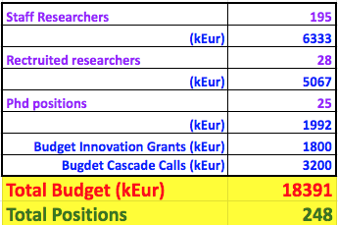

Slide 4

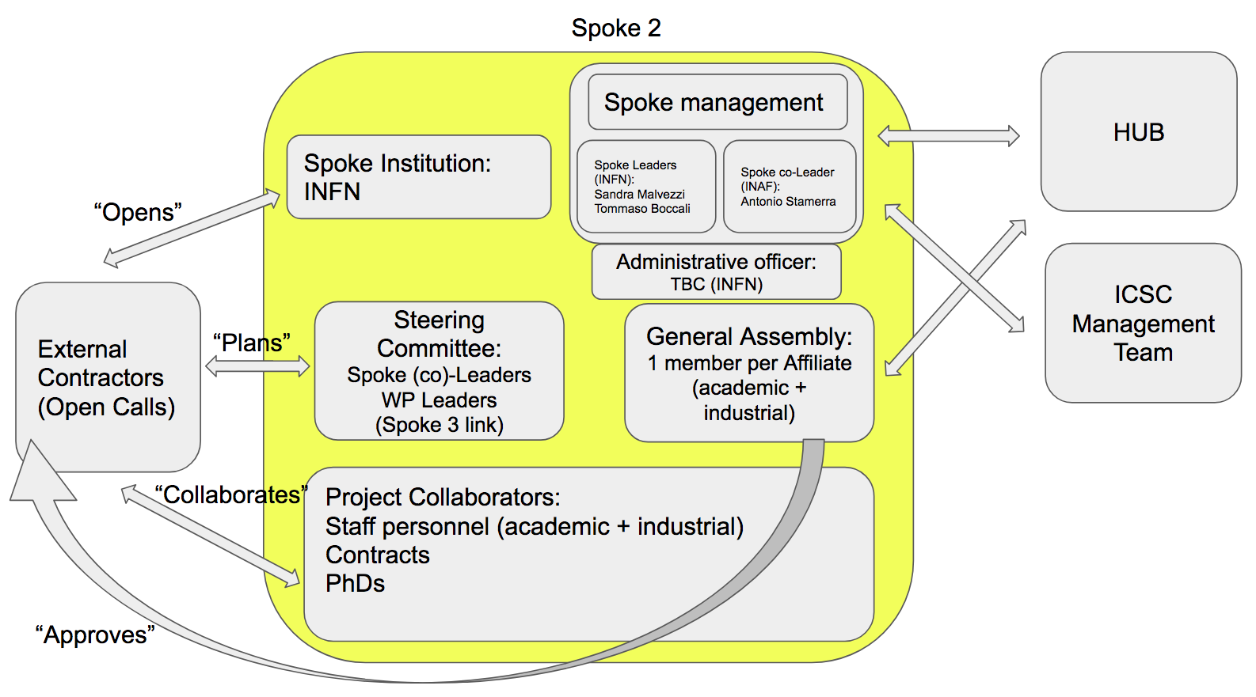
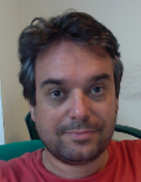

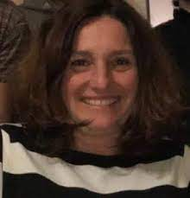
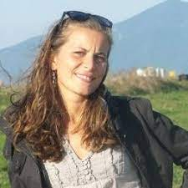
Spoke Organization
Spoke Leaders (INFN):
  Sandra Malvezzi (MIB)
  Tommaso Boccali (PI)
Spoke Co-Leader (INAF):
  Antonio Stamerra (OAR)
Financial Officer (INFN):
  Simona Petronici (PI)
  + team
Boards:
  Steering Committee: SLs, WPLs, WP3 link
  General Assembly: Affiliates

Slide 5
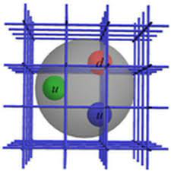
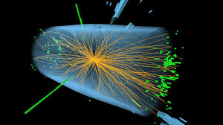
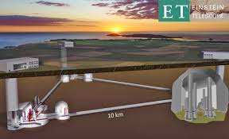
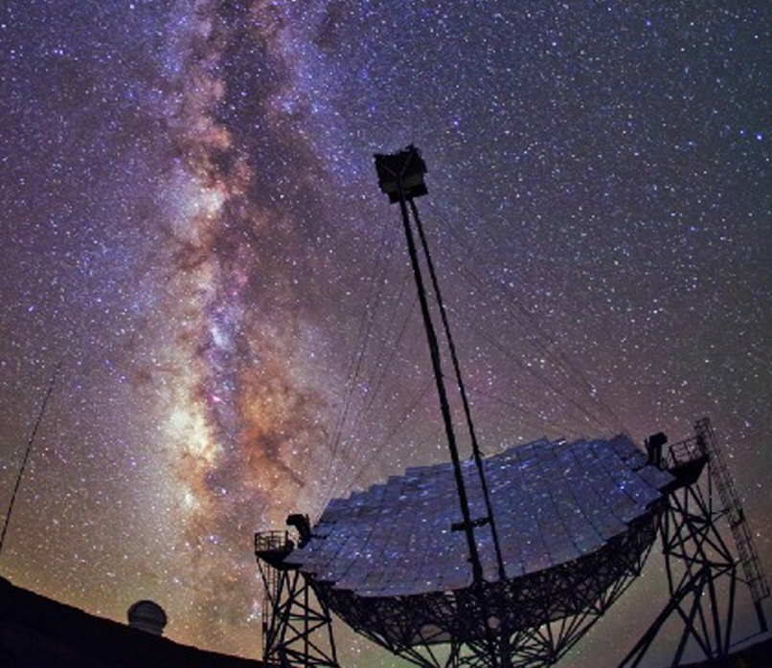
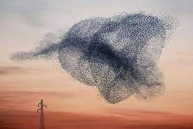
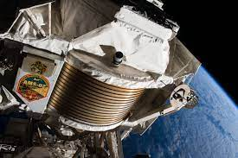
Who are “we?
5

Slide 6

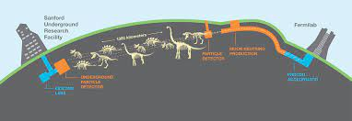
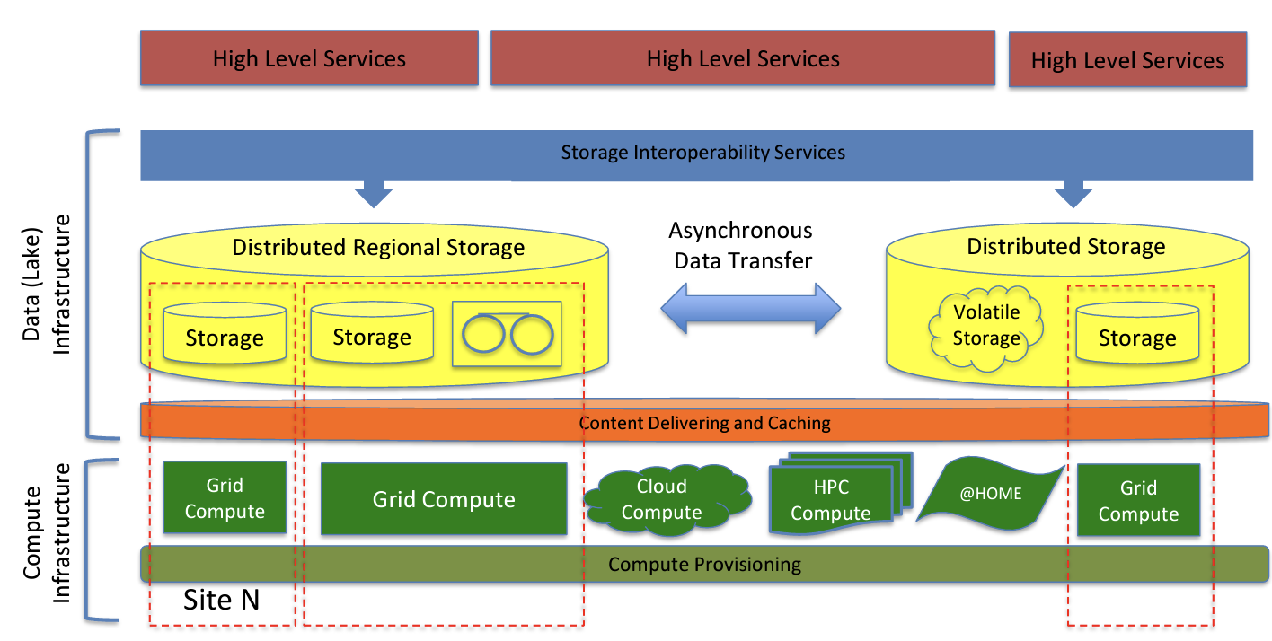

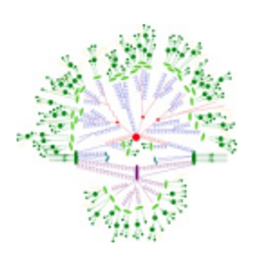
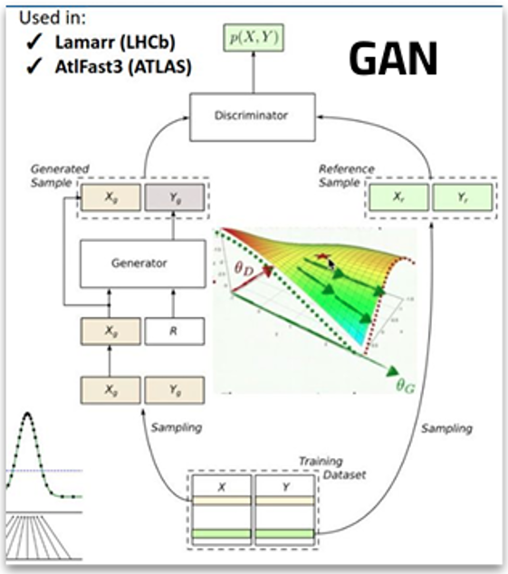
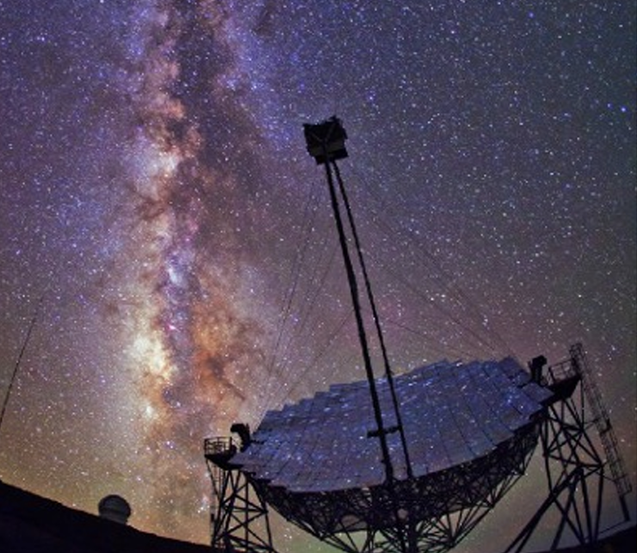


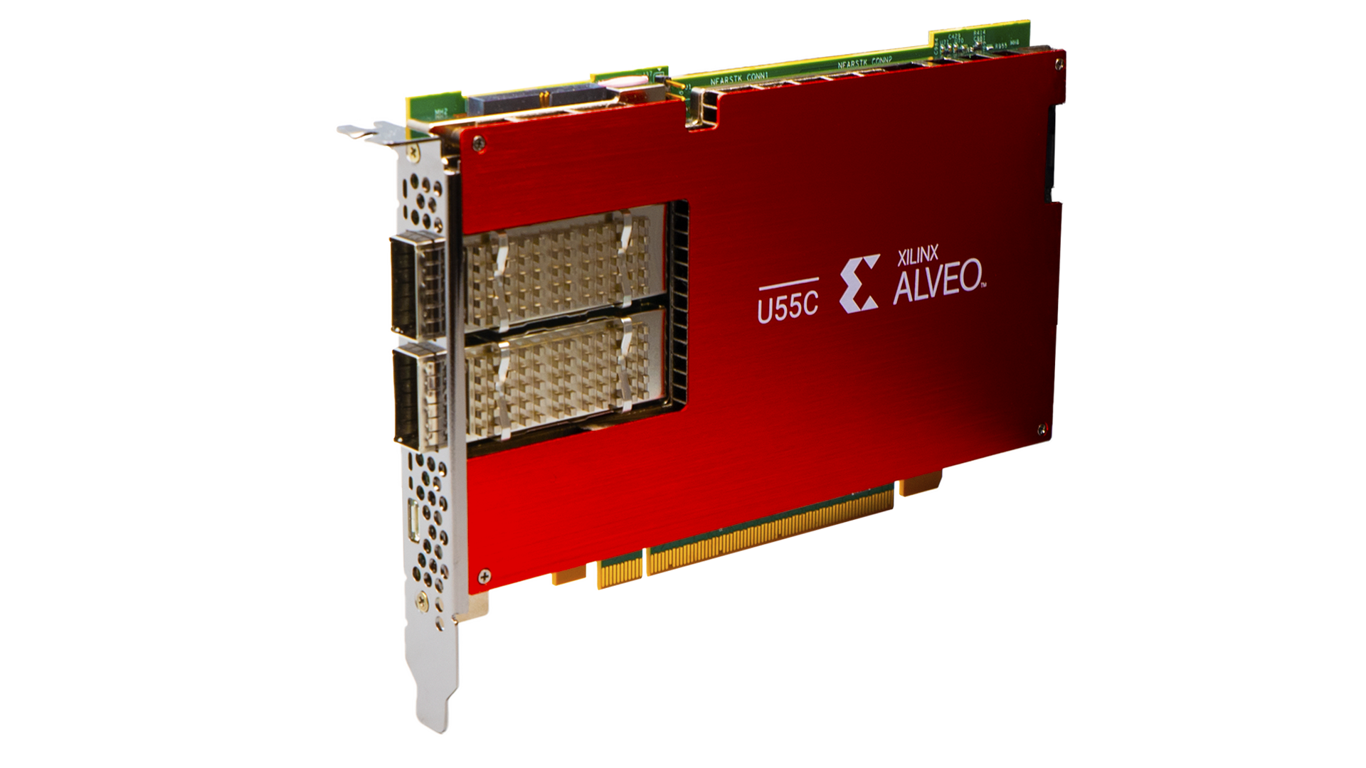



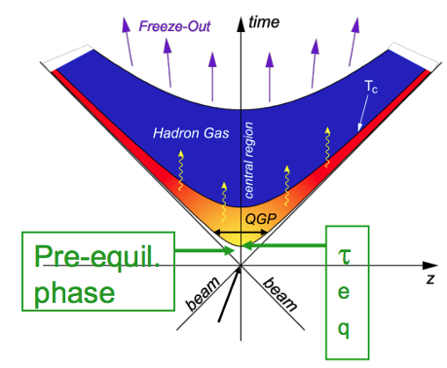


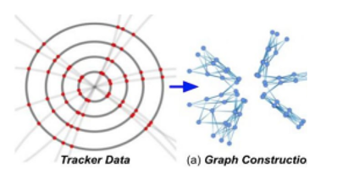
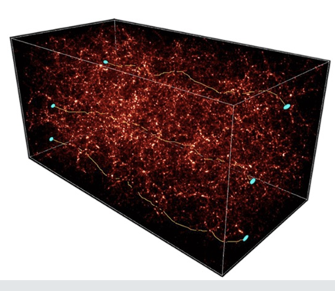

Work Package Structure
WP1: tools and algorithms for Theoretical Physics
WP2: tools and algorithms for Experimental Collider Physics
WP3: tools and algorithms for Experimental Astroparticle Physics and Gravitational waves
WP4: tools for porting / optimization on new architectures (low power, GPU, FPGA, …)
WP5: data management on the distributed CN infrastructure
WP6: cross domain initiatives, + space economy

Slide 7
Work Packages – the structure
  “technological” WPs: they harvest / investigate technical solutions in computing, on the infrastructure of the ICSC and beyond, and provide support / training for these; at the same time propose these to a larger audience, including industries
We defined 2 types of Work Packages:
  “scientific” WPs: they analyze the needs of the (sub-)domain, and pose open problems for which advanced computing solutions are needed
Has a need; searches for a solution
WP1/2/3
WP4/5/6
Has a technology; searches for a test use case

Slide 8
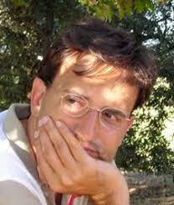
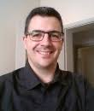
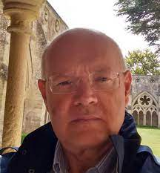
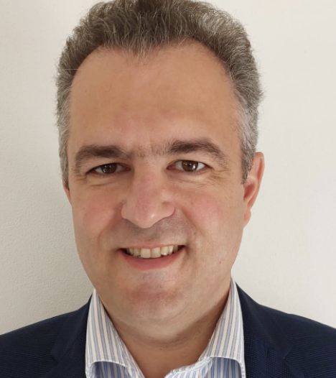
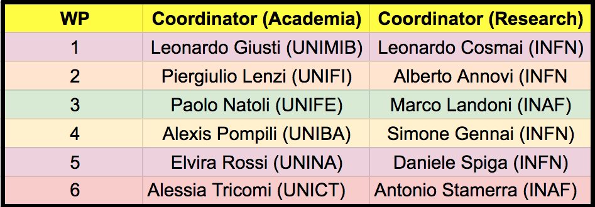
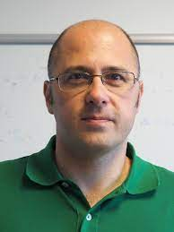
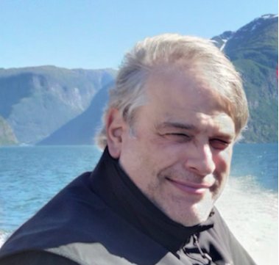
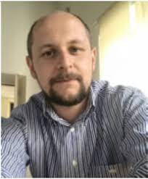
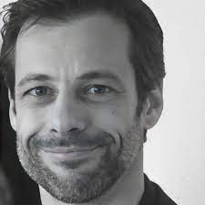
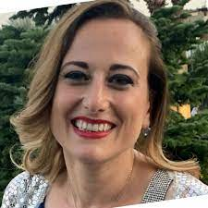
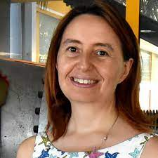
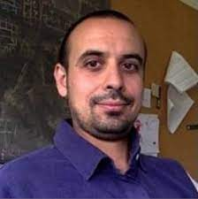
WP leaders
Strategy: in each WP, appoint one coordinator from Academia and one from Research Institutions
Alessio Tiberio (UNIFI)

Slide 9
Plan of Work
planning and identification: the first year of the project is dedicated to a landscape recognition for interesting state-of-the-art use case; its outcome is a work plan identifying the activities on which the core part of the project will be focusing - in particular, algorithms and services to be accomplished;
a realization phase, in which the actual development is performed via the staff/ hired personnel; the outcome is usable algorithms / services, documented (alpha/beta level) and ready to be tested on a larger scale;
a validation phase, in which the outcomes of the realization phase are verified in testbeds and proofs of concept, and benchmarked in order to assess their adherence to the specifications;
4. a wrap-up phase, in which results are analysed and consolidated in reports and white papers to be used as guidelines for similar use cases.
All the activities designed in the submitted project with a standard 4-phase plan over the three years
We are now in the crucial year: the realization phase
MS4,5
Y1
MS6
MS7
Y2
MS8
MS9
Y3
MS10

Slide 10
Timeline - new
Initial timeline:
  36 months: Sep 22 – Aug 25
  7 scientific milestones:
    M4,M5:Month8(2x), M6:Month12, M7:Month18, M8:Month22, M9:Month26, M10:Month36
  234 Targets (KPIs) on the academic side
New timeline:
  +4 months, up to Dec 25
  Added a M11:Month40
  No real additional targets, at some point we (or the HUB) will declare that we use the +4 months to deliver the same results

Slide 11
Activities – 4 main types
Scientific:
19 Flagship projects: they represent a category of studies; they have KPIs which are analyzed by the reviewers
O(10-30) Other projects: they happen in the WPs but ale loosely coupled, they are related to the Flagships but they have a much lower reporting structure; no KPIs
Collaboration with internal industries:
  11 Innovation Funds, 4 guided by Spoke2
  They also have KPIs!
External collaborations
  14 Academic and industrial
  They also have KPIs!

Slide 12
In one slide
Flagships:
  4 WP1, 5 WP2, 7 WP3, 3 WP6
  WP4 and WP5 share FSs with the other WPs
Innovation Funds
  4 ENI, 1 Leonardo, 2 Intesa, 2 IFAB, 2 Unipol/Leitha
14 Bandi a Cascata / Open Calls
  4xUNIGE, 1xUNISI, 1xUNIME, 1xUNIUD, 1xUNIROMA3, 1xMangrovia, 1xEarnext, 1xUNIPG, 1xUNISA, 1xUNIURB, 1xMARCONI

Slide 13
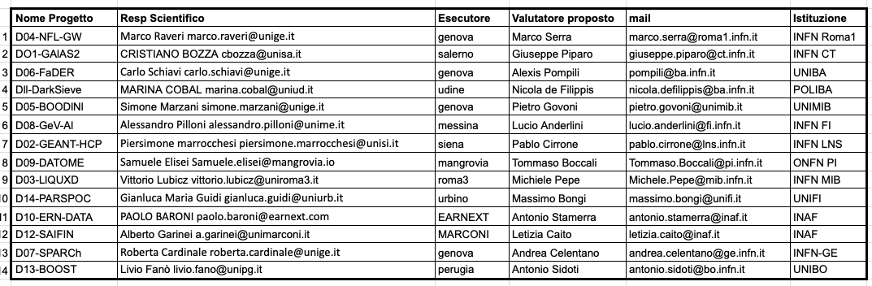
Budget
Standard Academic:
  INFN 2.56 Meur
  INAF 1.2 Meur
  All the others 0.74 Meur
Innovation Funds
  1.9 Meur in total, 140 kE industry
Open Calls
  3.1 Meur total
  Remodulation ~ -200 kE

Slide 14
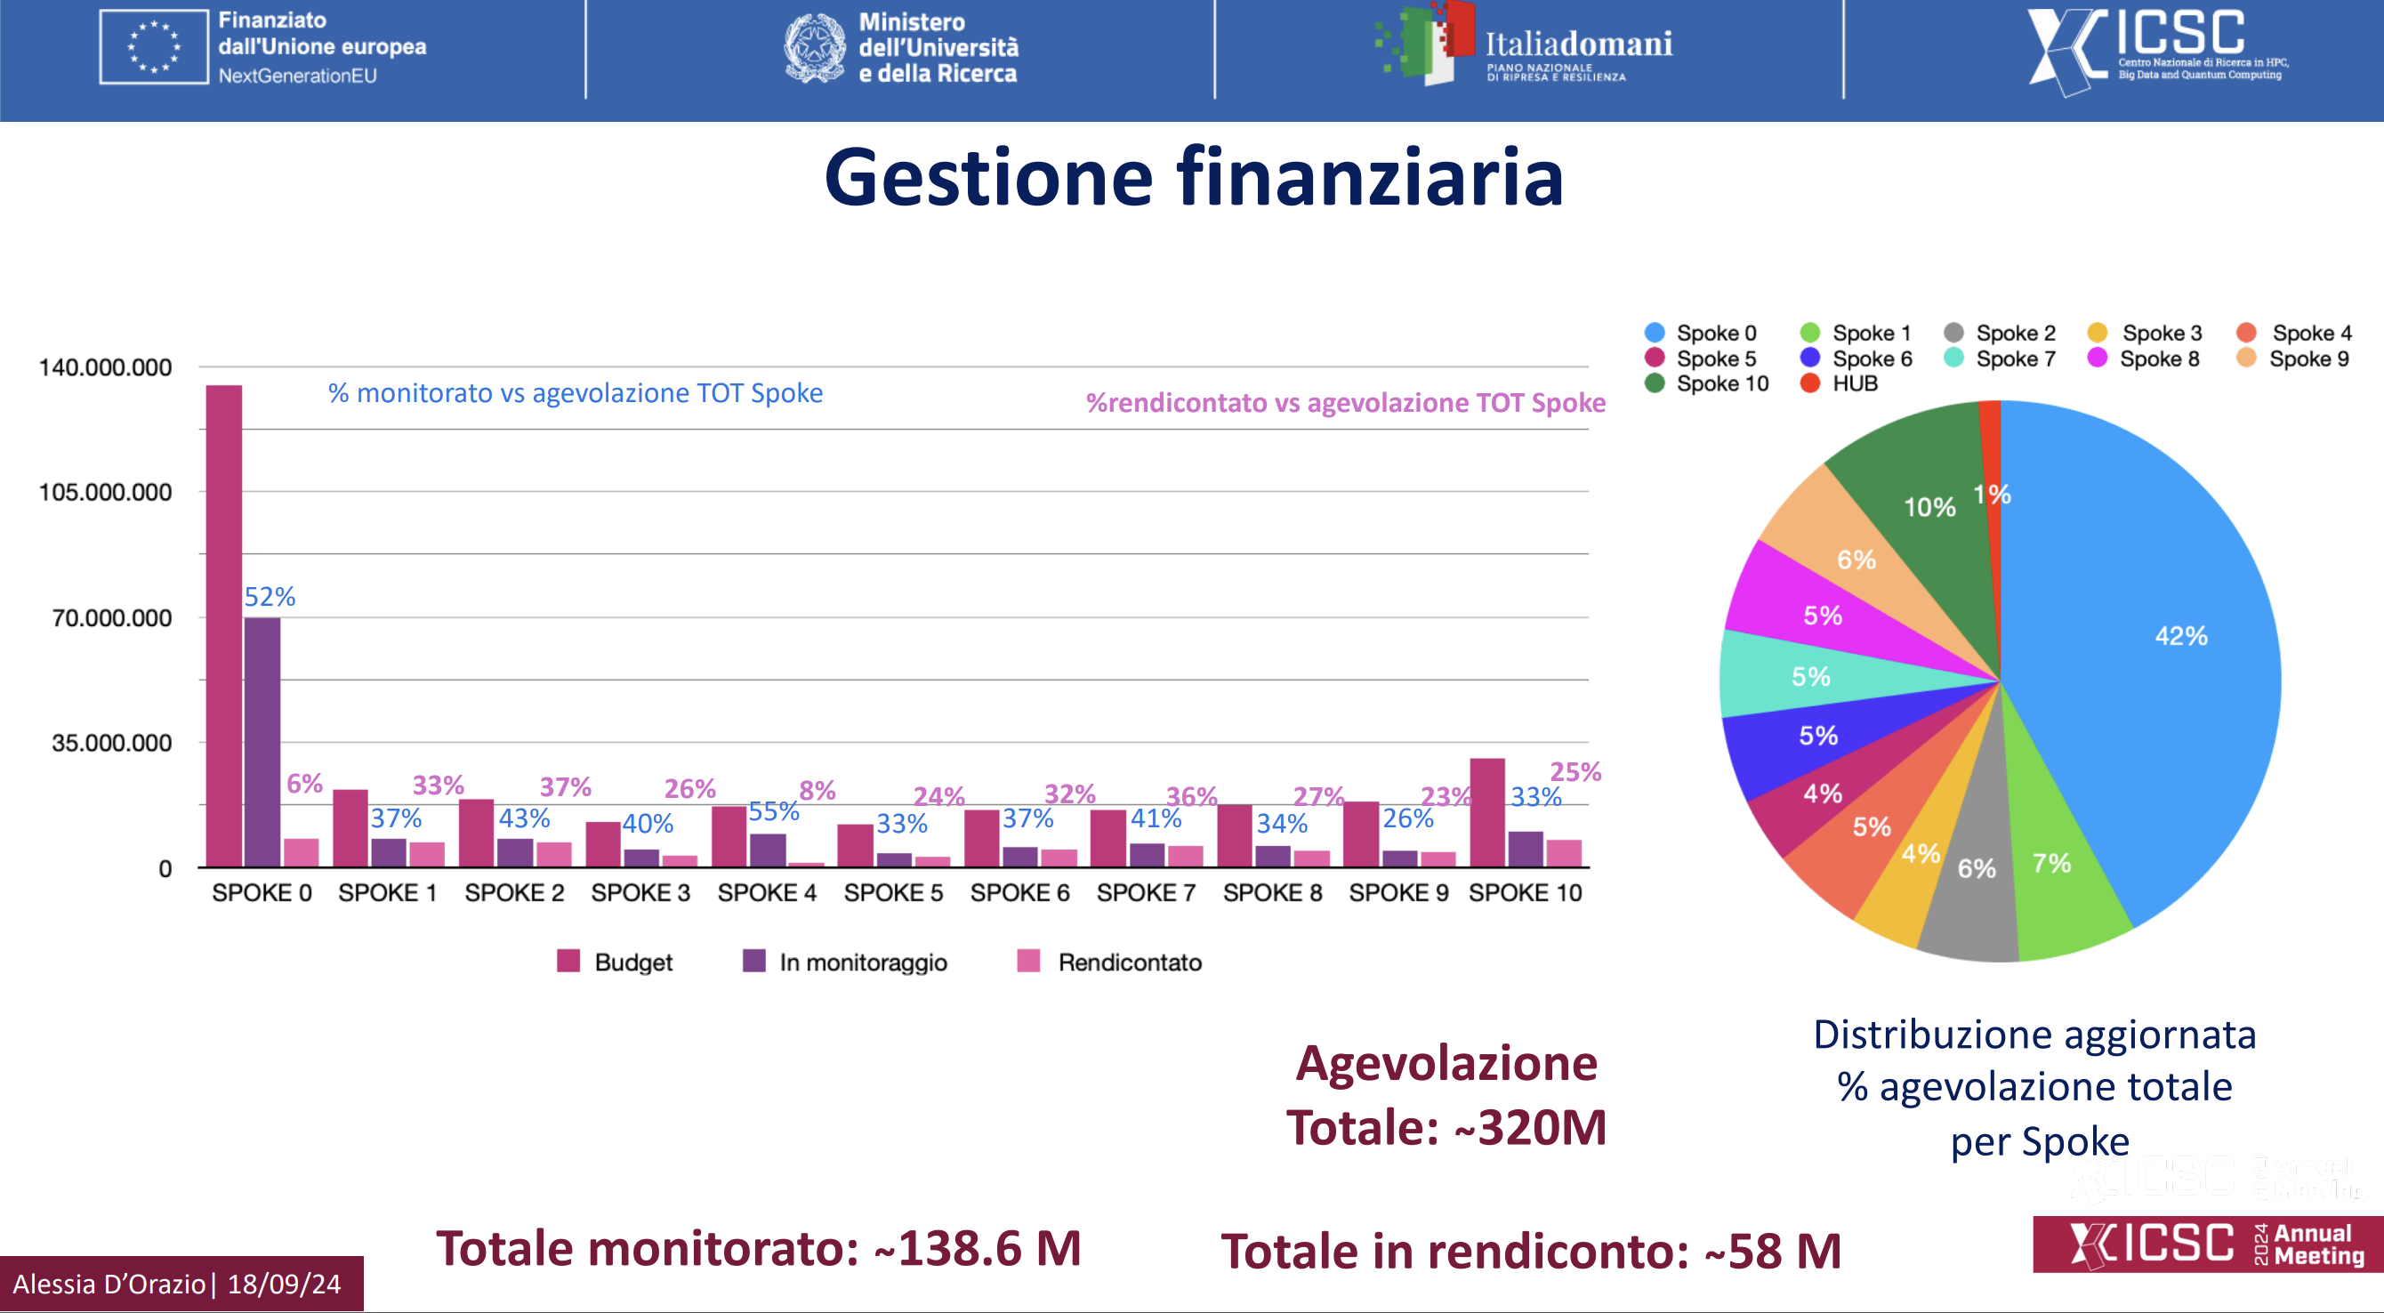

Are we spending money? (Alessia, September 2024)
43% of the budget in the
monitoring system
37% spent and accounted

Slide 15
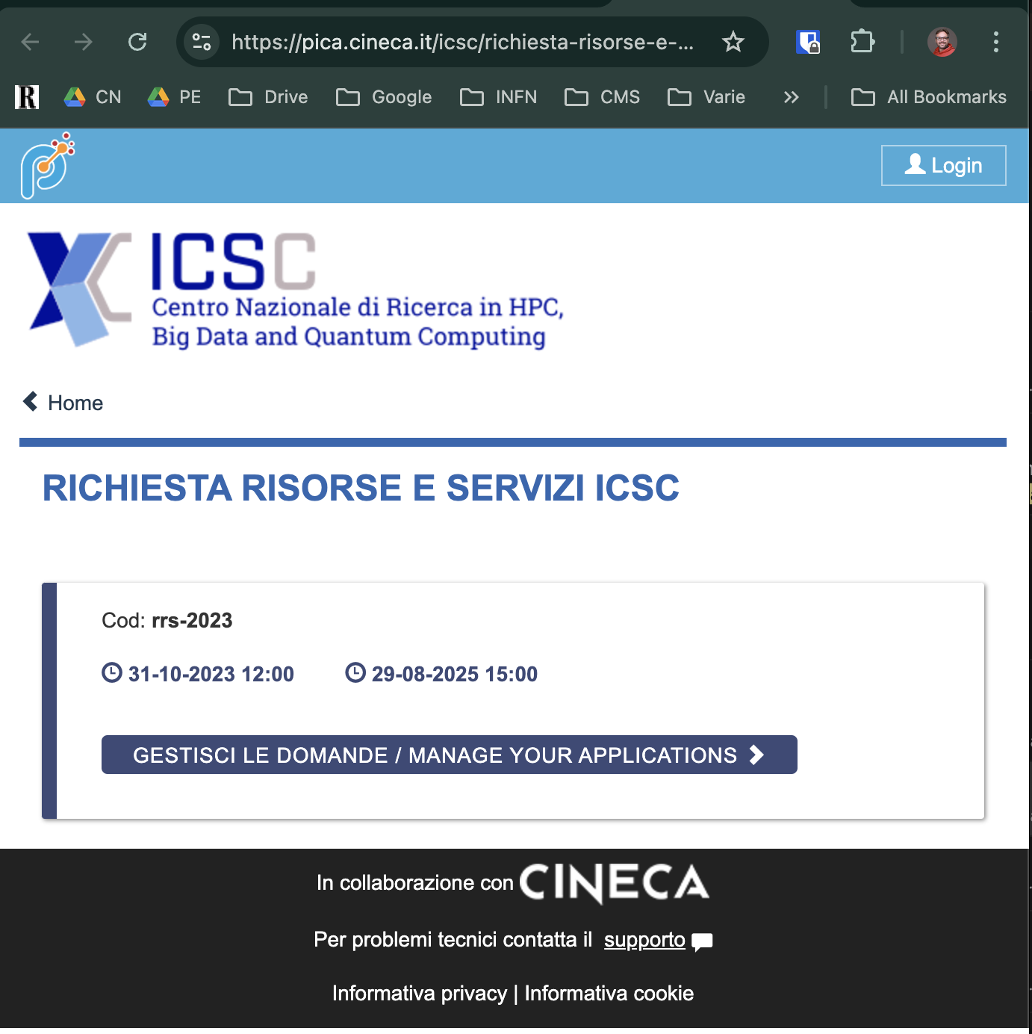
Utilization of the ICSC infrastructure
A portal to request for resources
(RAC)
ICSC is 50% infrastructure – our use cases can and should use it!
ICSC has:
  Supercomputing resources (Leonardo and Galileo and HPC Bubbles: CPU and CPU+GPU)
  Cloud resources (CINECA and INFN)
  GRID/BATCH resources (INFN)
  Storage (Disk and Tape, GRID and Cloud, POSIX and Object, accessible via multiple protocols)
  FPGA resources via a collaboration with TeRABIT
Accessible to all the 4 activity types

Slide 16
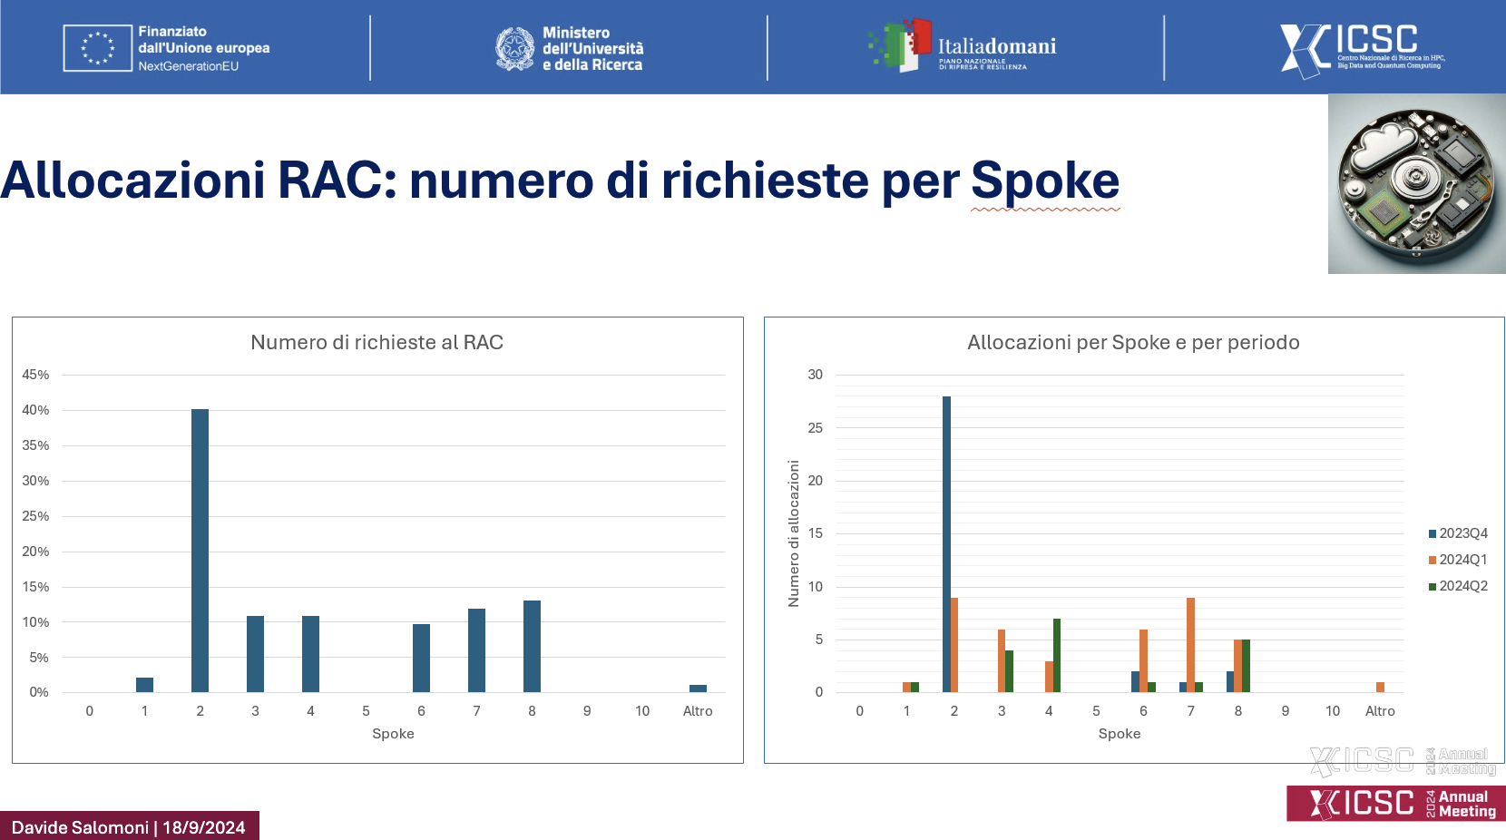
Resources granted so far
Spoke 2 RAC requests are 40% of the total
All approved for the moment! → a big thanks to the Spoke 2 submitters !
BUT: are we using them?
Startup phase not easy (getting account, accesses, ….)
Cloud use is even more difficult → high learning curve
For HPC and GRID resources much easier
(some projects are late so probably did not need …)
(in some cases we cut short by using other resources)
I expect that by the end of year ~80% will have started the process to use the resources
2025 will be the year of utilization!

Slide 17
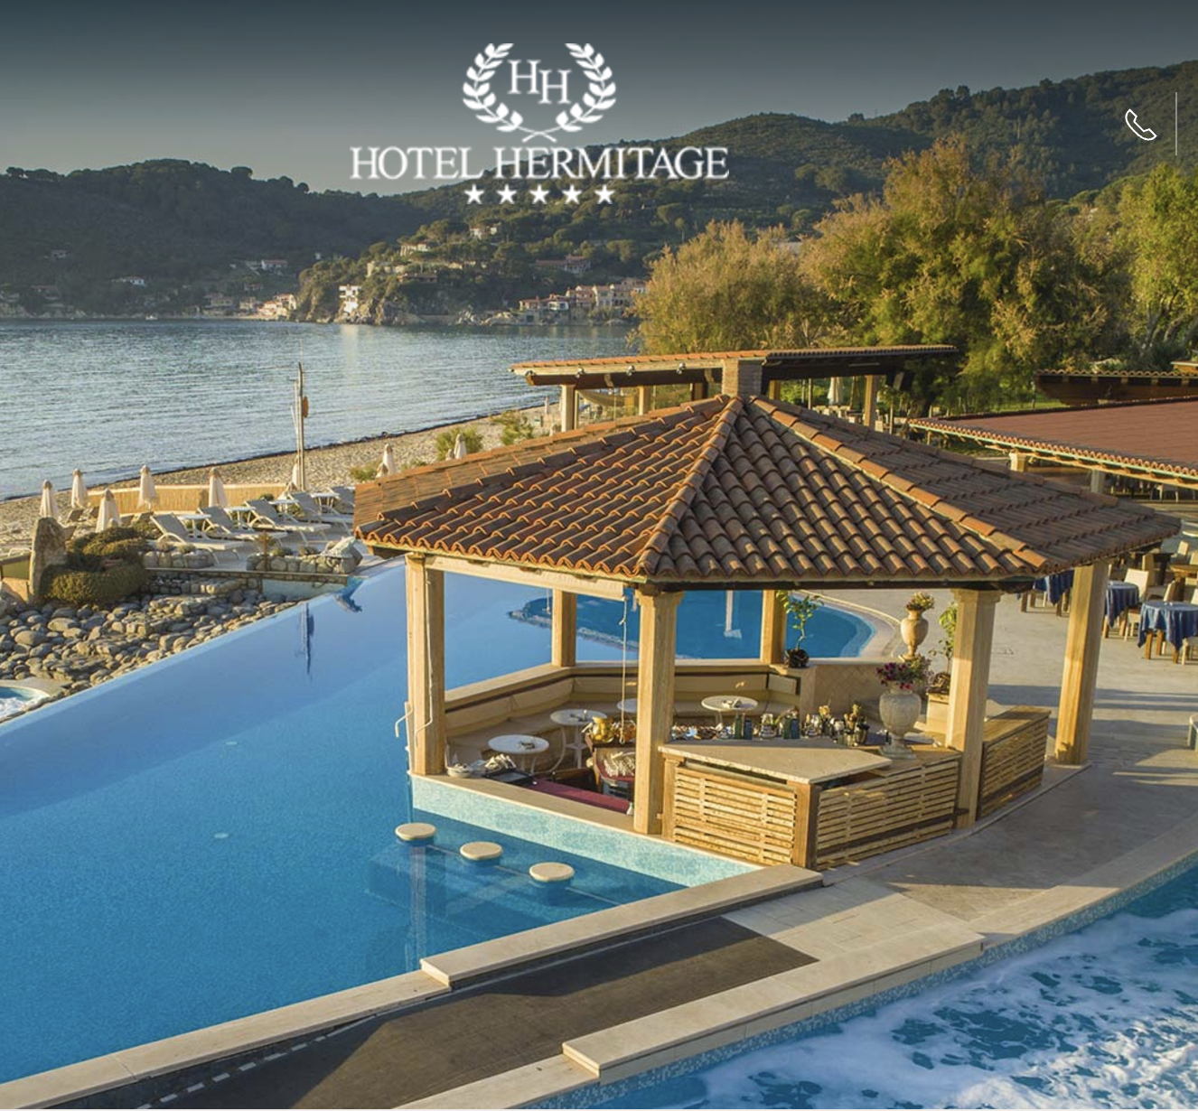
Meetings in 2025
Feb/March: a face to face meeting with the reviewers
  Had a first one in Oct 23: very (very!) pleasant atmosphere
September 2025 21st-26th: plenary ICSC meeting at Isola D’Elba
  Designed as the end-of-project meeting, but difficult to go there in December ☺
  Please plan to be there!

Slide 18
Spoke 2 Evaluations up to now
We got referee evaluation up to Milestone 8 included (Jun 2024)
MS7: “Spoke 2 – Milestone in progress, most tasks still being concluded but good progress has been made and it is expected that all tasks will be concluded as part ofmilestone 8. Group to be commended for the clarity of the reporting and the quality of research being done.”
MS8: “Spoke 2 – Milestone mostly achieved, with all targets reached except for a few with external interdependencies which caused some delays – this is being addressed and does not seem to present problems.”

Slide 19
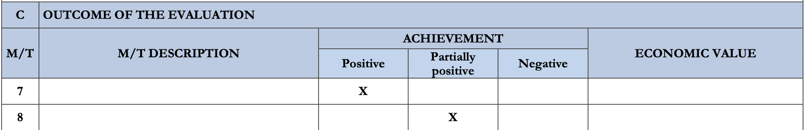
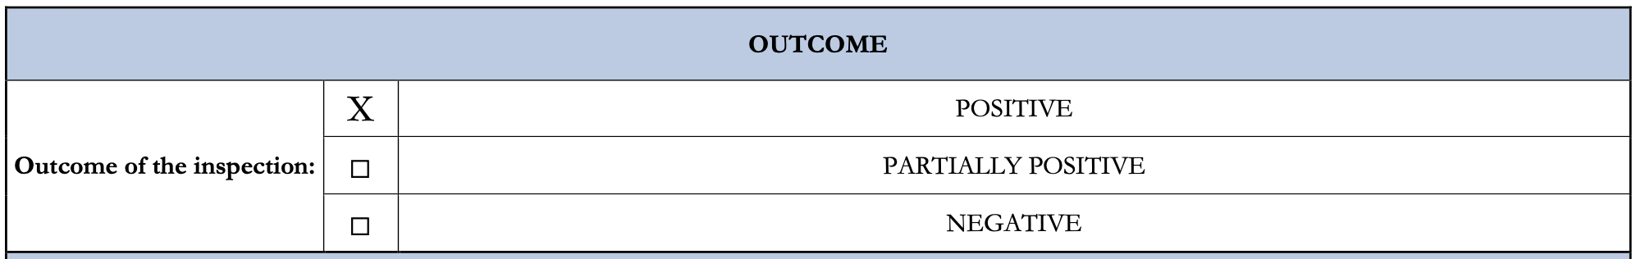
Some points raised by the referees, which concern also
Spoke 2
“We note that despite extensive recruitment efforts, around 20% of the positions have yet to be filled”
“For the innovation grants, we note that the balance of private partners is inhomogeneous across the spokes.”
” Although there are big overall plans for Open Data, the section on what has been done so far left blank”
“About climate change, the assessment of the environmental impact is debatable. We believe that the energy footprint of the data centres should be included in this assessment.”

Slide 20
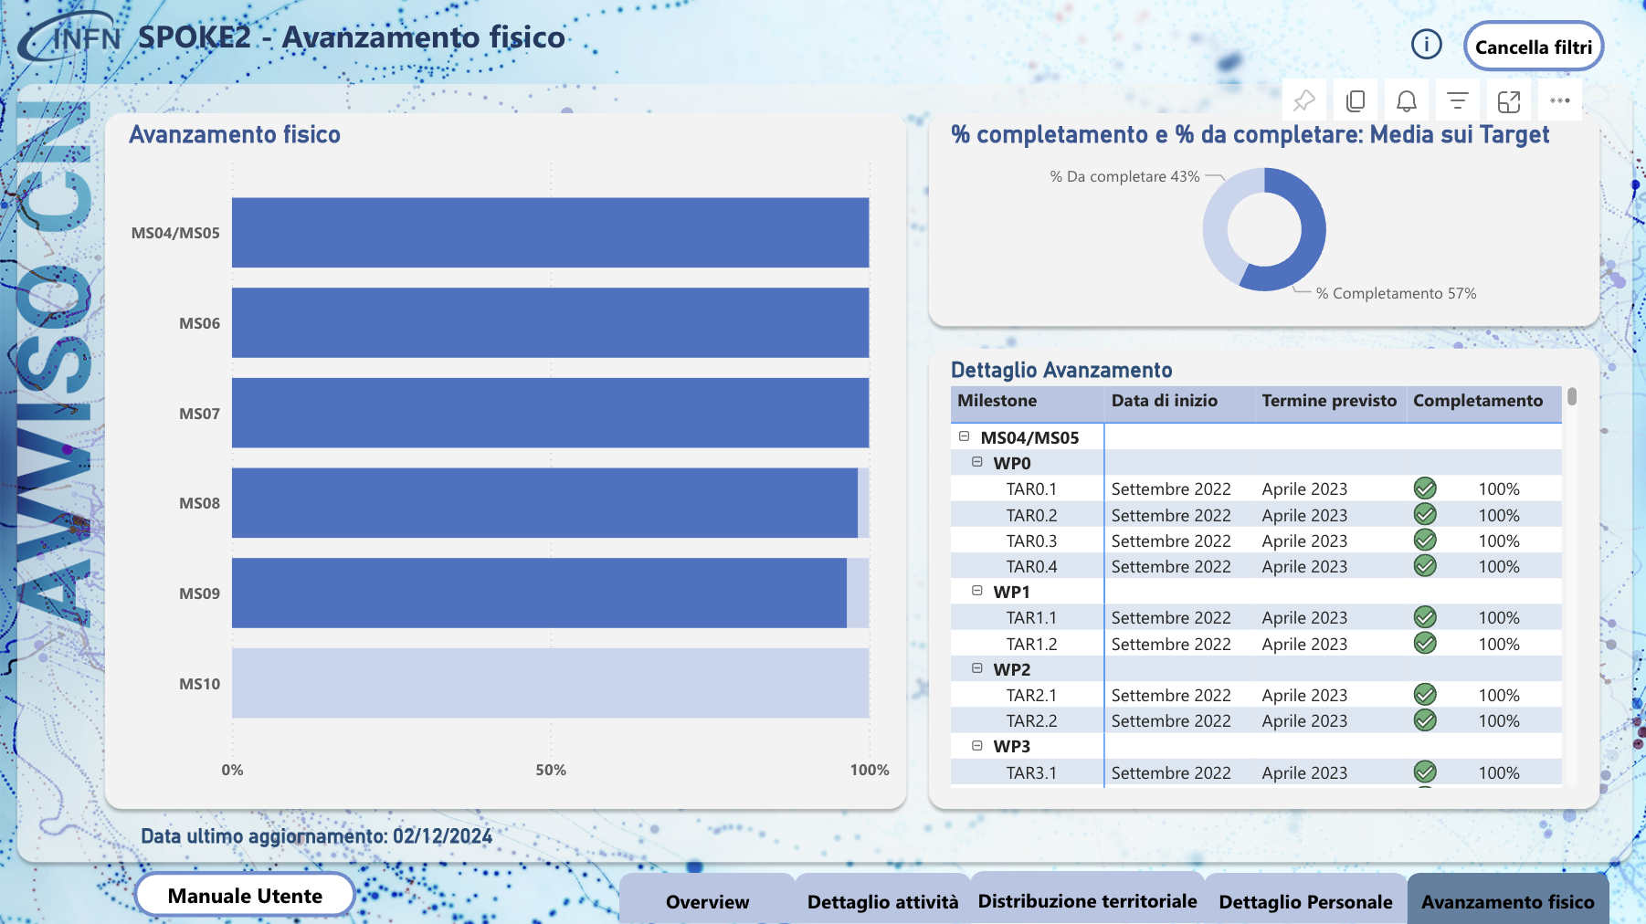
KPI monitor
Intellera (as INFN contractor) monitors the status of Spoke 2
TARgets extracted from the scientific reports at every milestone
  We completed 57% of the targets (compatible with the schedule: all the rest is in MS10 and 11)
  Completion level for those up to MS9 included: 98.9%

Slide 21
Pubs and confs
While they have been requested ”generically” also before, for MS9 a more precise accounting of Conferences and Papers have been requested
Reminder: a paper is a “Spoke2/ICSC paper” if
  An author signs as ICSC (rare)
  There is an ack’t at the end of the paper
Standard guidelines for papers and conference talks:
  Here
Up to MS9:
  411 papers (!)
    Big collaborations are important, but a level of ~60%
  122 conference talks (!)

Slide 22
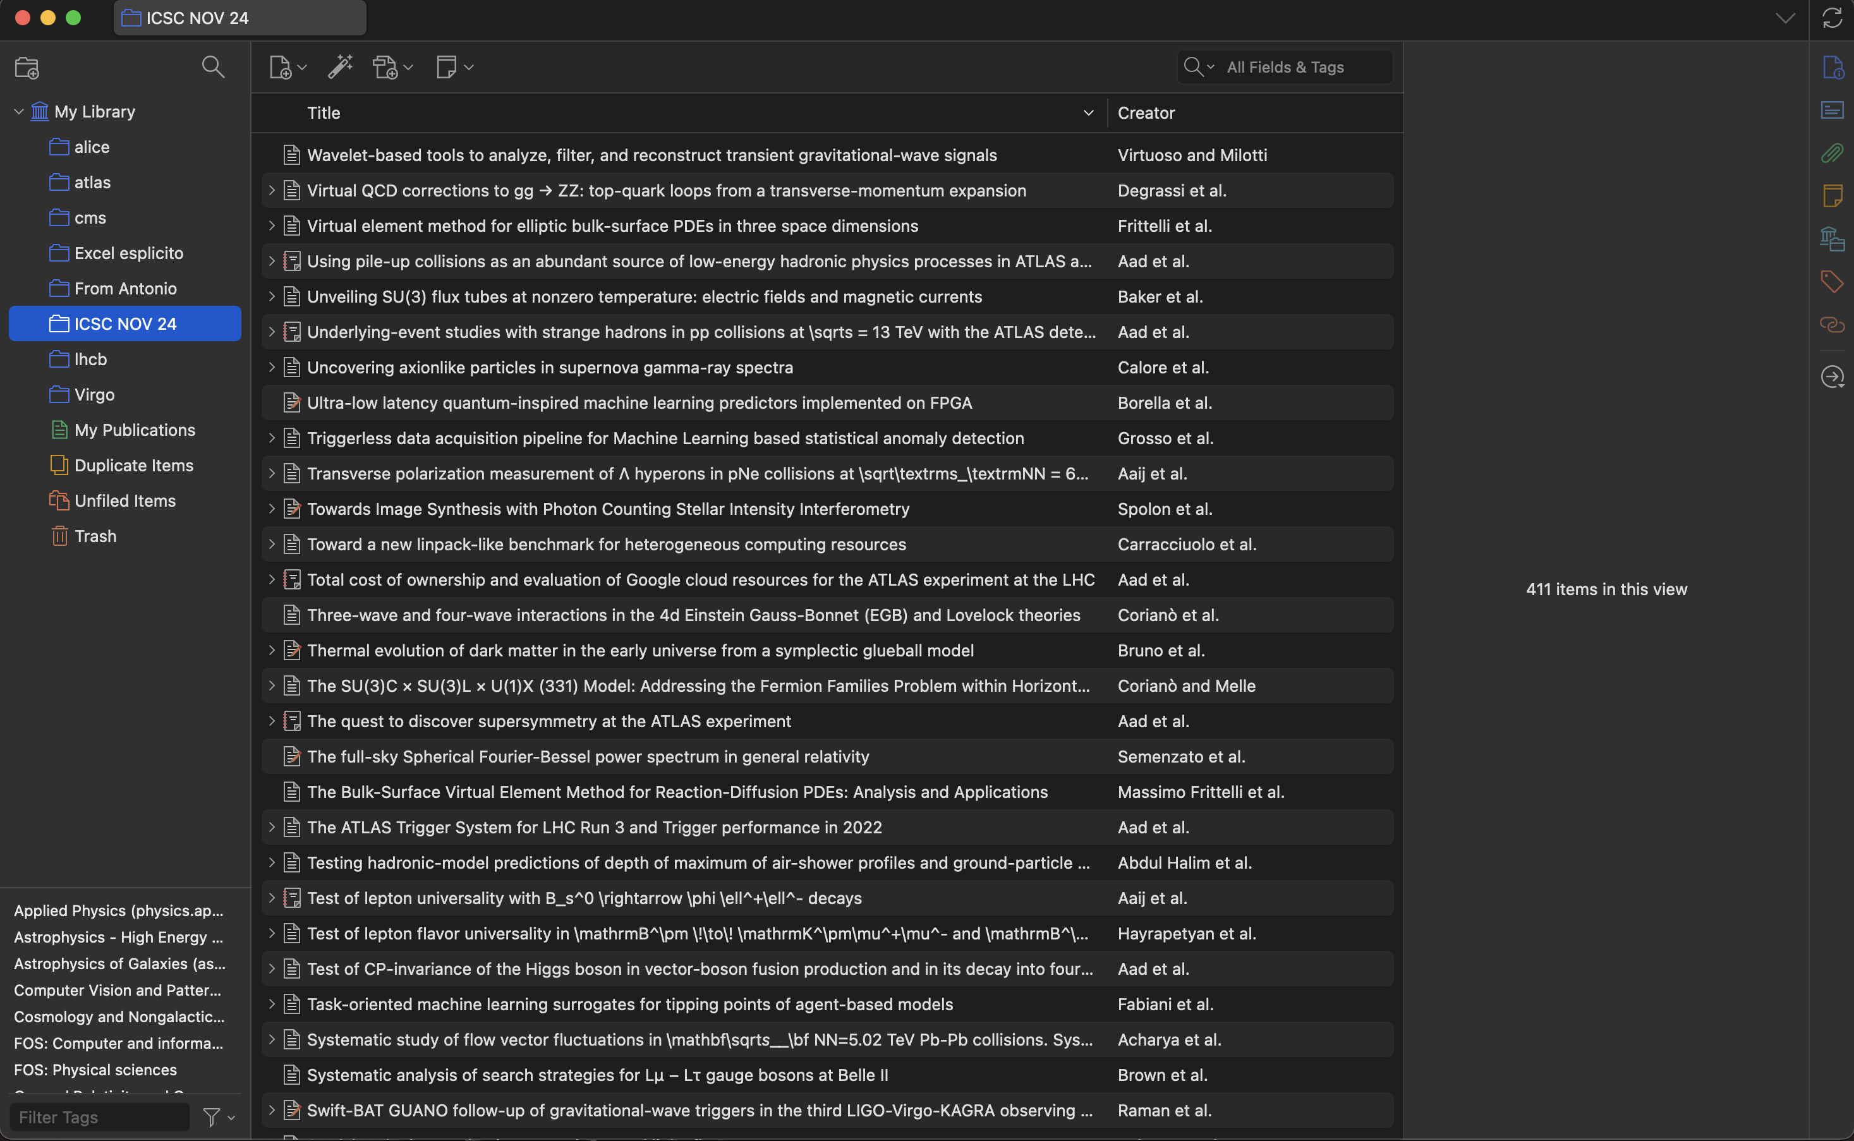
Spoke 2 Zotero
We prepared a Zotero dump in case you want to see it
  Just import it in Zotero, at this link
Honestly, impressive
Not showing numbers from other Spokes, but they are way lower

Slide 23
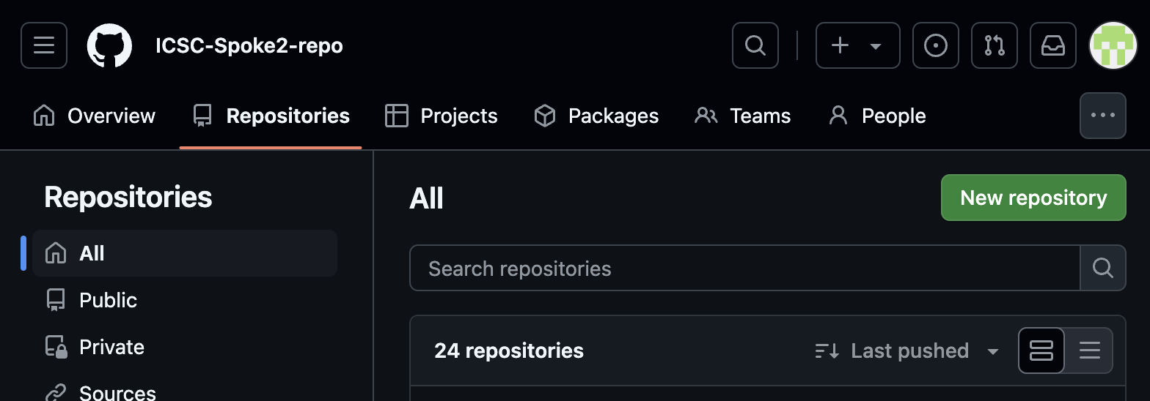
Spoke 2 GitHub
We have a Spoke2-wide GitHub
We never forces actively people to use it, still it has 24 repositories
If you have to start a repo from scratch, consider using this
Send me an email and I will create it for you!

Slide 24
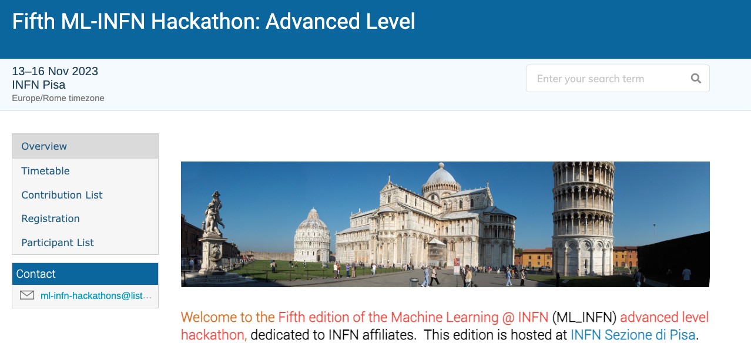
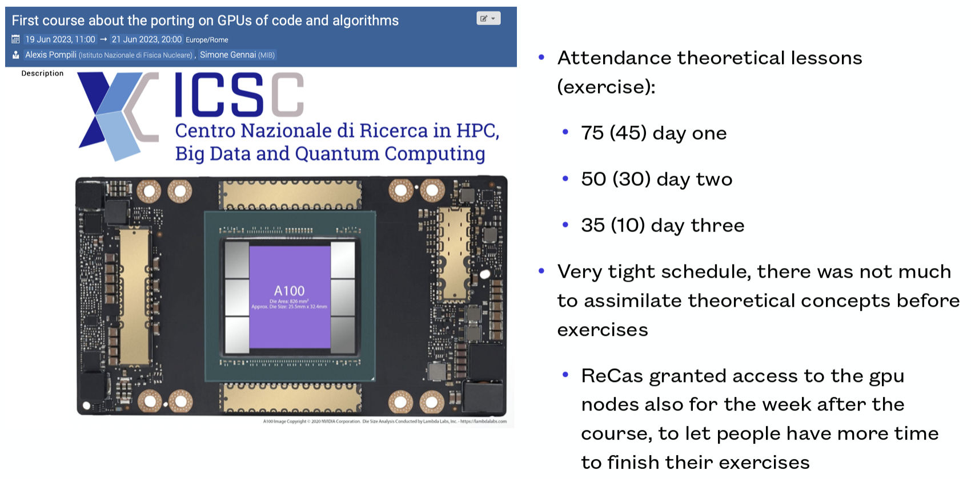


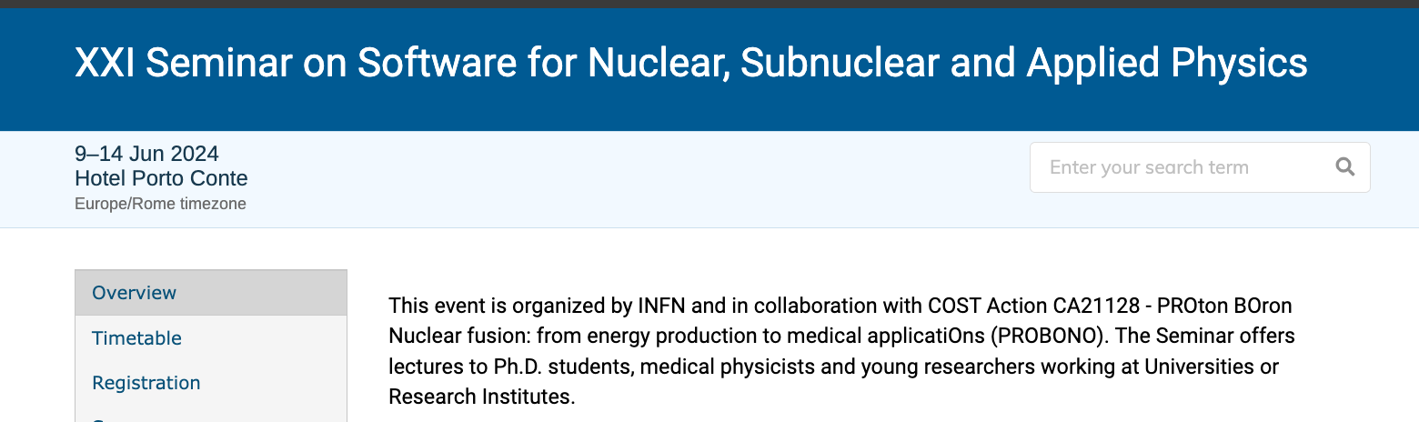

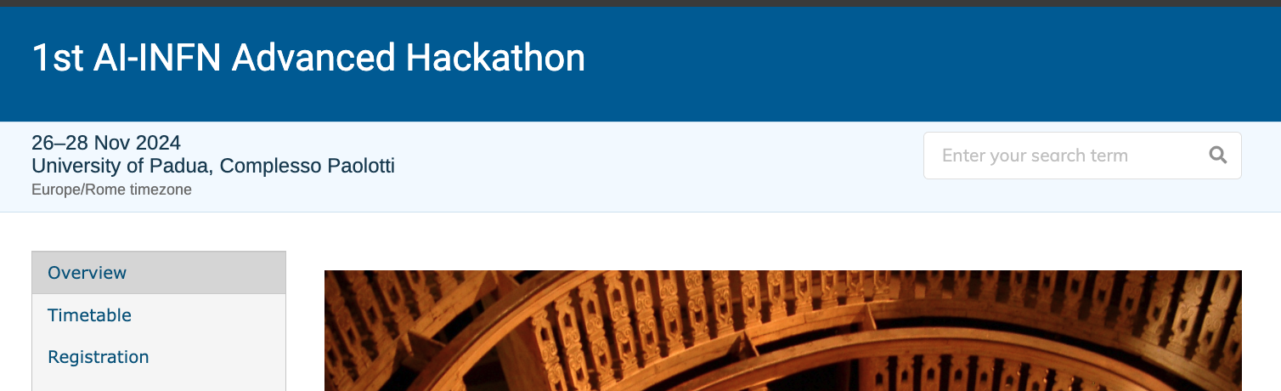
Schools etc
Lots os schools / WSs have been organized with ICSC/Spoke2 participation
This was a LOT appreciated by the reviewers
Let’s keep going!

Slide 25
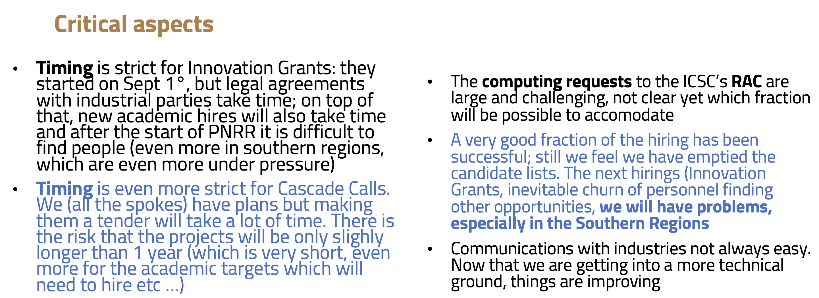

What is going “bad”(a.k.a. not perfectly ok)
Obviously things can always be done better!
Let’s start from a few points I presented at the October review
Some of them are resolved (also due to the +4 months)

Slide 26
Some other things not perfectly inline with initial expectations
“… & Space Economy” in the spoke name. We do have activities in WP6, but we were anticipating a stricter collaboration with the Space Economy system
  “it seems plans have changed”
“bureaucracy is killing us, but resist: it will be only in the first period!”
  Ehm, getting worse if possible ☺

Slide 27

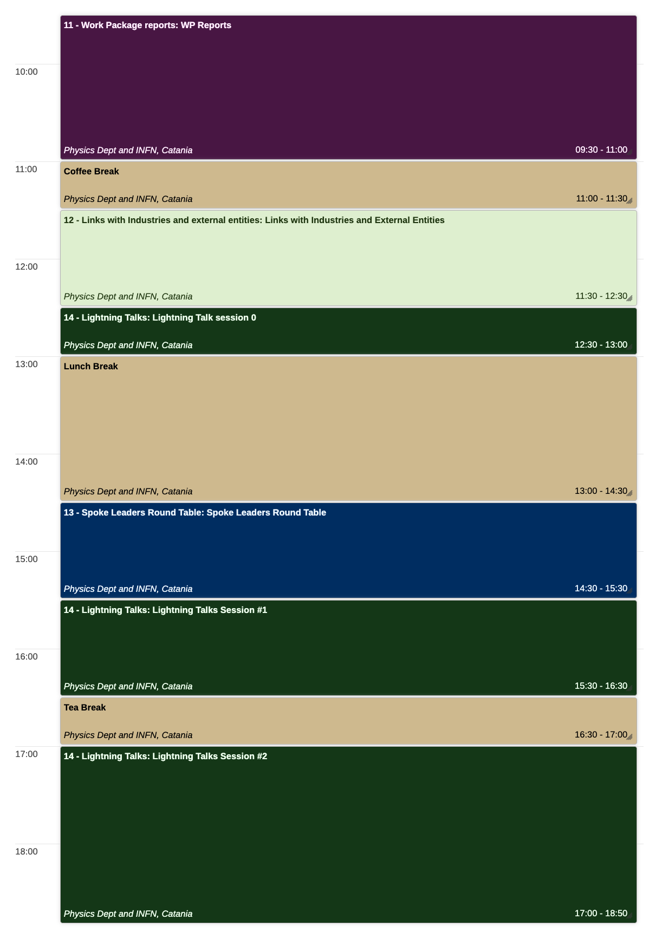
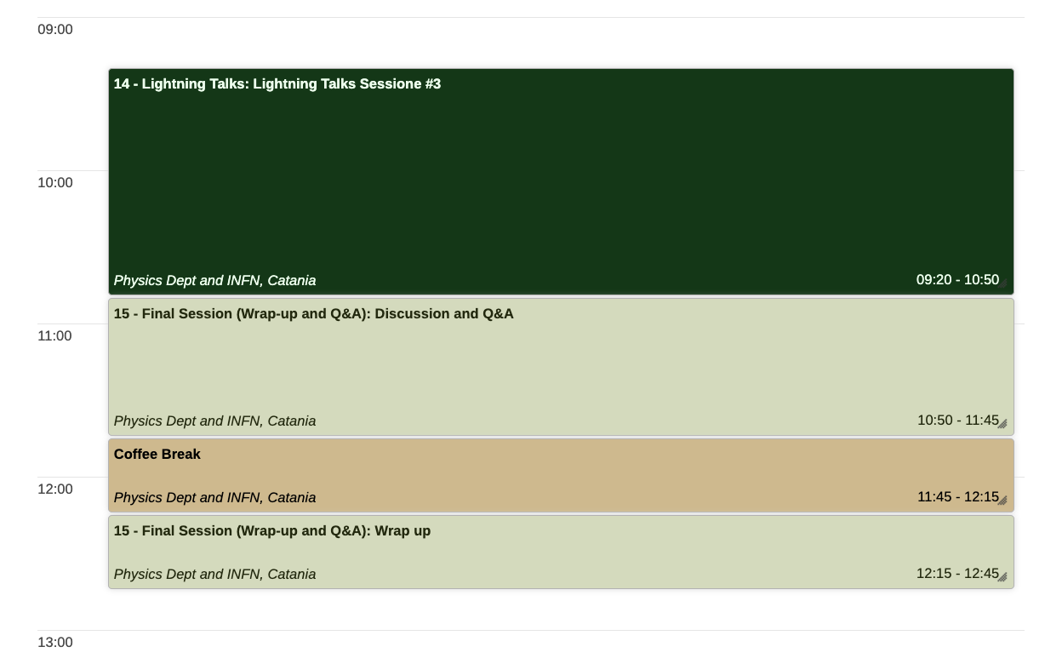
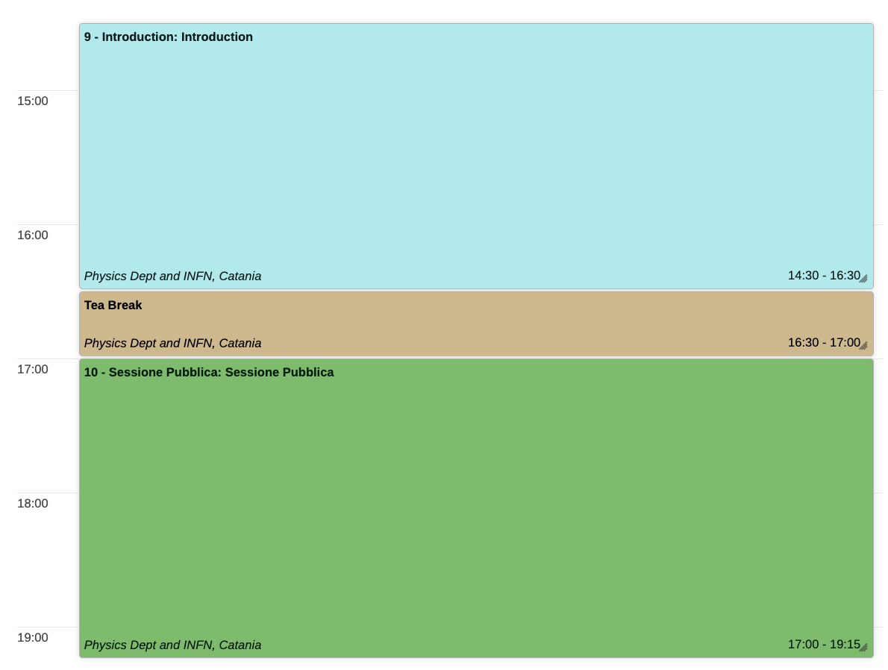
The meeting Agenda!
(https://agenda.infn.it/event/43778/)
Today
  Introduction and Public Session
Tomorrow
  WP session
  IF and OC
  Lightning talks!
Thu
  Lightning talks!
  Wrap up

Slide 28
Lightning talks
Success beyond expectations
  28 talks!
  At some point we wanted to limit / select / prioritize, but we decided that it is a good thing to show activities, and to let the young collaborators show their contributions
Please Please Please
  There are 10 min allocated per lightning talk, and should include some time for Q&A
  So make sure you stay in 8 min!

Slide 29

Online questions
Vote someone else’s question
In the last session, we want to (try and) answer to questions
Instead of a chaotic process, we have setup an OnlineQuestion table
Please connect to https://onlinequestions.org/ and insert code 11122024
Insert a new question / theme

Slide 30



The dinner tomorrow (Dec 11th)
Alessia has succeeded in negotianing an all-inclusive dinner tomorrow evening, for 45 Eur (self payed)
  It is a fish restaurant (we are in Catania!)
  Ristorante Le Tre Bocche, Via Ingegnere, 11, 95128 Catania CT
  Some 15 min by bus from the Meeting place, or 20 min on foot (gmaps)
Please tell us by this evening if you have changed your mind with respect to what is in the form

Slide 31


Dinner: so far!

Slide 32
Conclusions
No conclusions here!
We will try and have some on the third day
For the moment
  Enjoy the meeting!
  (please stay in the allocate time ;)

