Slide 1
Single-shot spectrometer with pointing angle correction for laser-driven electron beams featuring moderate pointing instability and transverse inhomogeneity
S. G. Vlachos
The ILIL team: F. Avella, F. Baffigi, G. Bandini, G. Benincasa, F. Brandi, G. Cristoforetti, M. Ezzat, A. Fregosi, L. Fulgentini, D. Gregocki, E. Hume, P. Koester, L. Labate, D. Palla, S. Piccinini, M. Salvadori & L. A. Gizzi.
EuPRAXIA-DN Camp I: Technologies, 7-8 April 2025, CNR-INO

Slide 2
LWFA shot-to-shot stability
Electron beam pointing $→$ Energy miscalculations.
(Horizontal mean deviation: $1.7 mrad$, Vertical mean deviation: $6.8 mrad$.)
The simple spectrometer:
Pixel value
$$ρ=\frac{\sqrt{E^{2}−{\left(mc^{2}\right)}^{2}}}{eBc}$$
$x\left(ρ\right)=\left(\frac{d}{2}+f\right)\left(\frac{d}{ρ}\right)$ ,
$$x(ρ,θ)$$
$B$: magnetic field strength, $e,m$: electron charge & mass, $c$: speed of light, $E$: electron energy

Slide 3
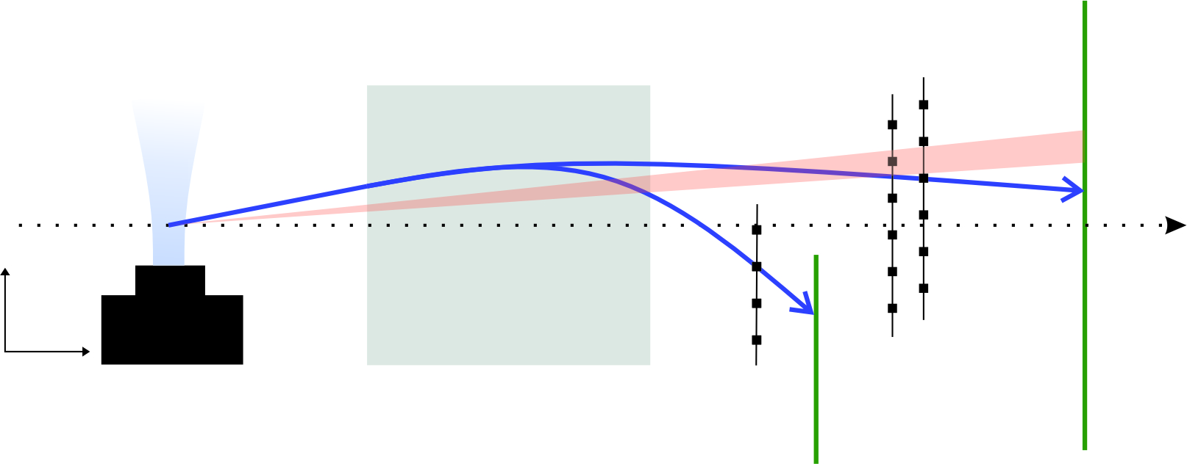
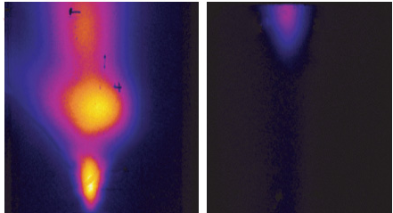
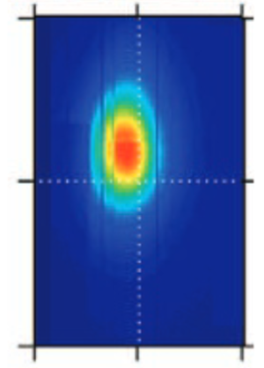
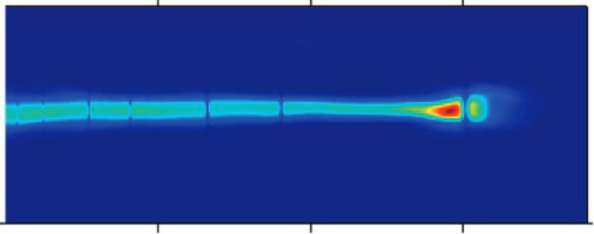
Possible solutions
$$L_{N}$$
$$L_{M}$$
$$L_{S}$$
Tungsten wires
⊙$B$
⊗$B$
X-rays
$$Δl$$
Laser axis
$$e^{−}$$
$$θ$$
$$Δh$$
$$e^{−}$$
$$y$$
$$a$$
$$e^{−}$$
⊙
$$x$$
$$z$$
Lanex 1
Lanex 2
PSL
pC/GeV sr (10⁹ )
0 100 200
0 4 8 12 16
σ_{y} [mrad]
$Δh=L_{G}\tan{θ}+R\left(\cos{θ}−\cos{α}\right)$
$Δh=Δl−L_{S}\tan{α}$
$L_{M}=R\left(\sin{α}−\sin{θ}\right)$
-4 0 4
-10 0 10
0.5 1 1.5 2
-10 0 10
$$Δh=L_{G}\tan{θ}+L_{M}\frac{\cos{θ}−\cos{α}}{\sin{α}−\sin{θ}}$$
E [GeV]
σ_{x} [mrad]
1. B. Pollock et. al.,in Particle Accelerator Conference (PAC 09) (2010), p. WE6RFP101.
3. X. Wang et al., Nat. Commun. 4, 1988 (2013).
2. A. A. Soloviev et al., Rev. Sci. Instrum. 82, 043304 (2011).

Slide 4
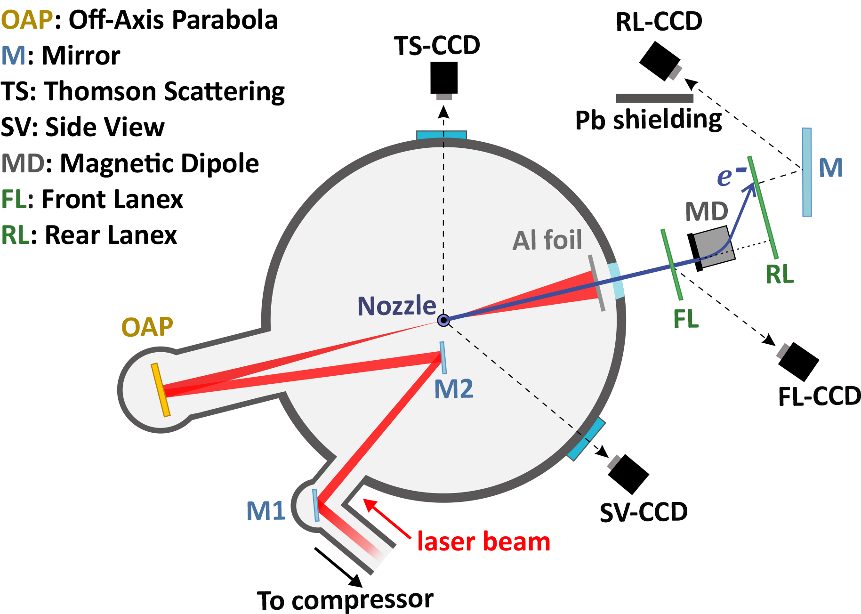
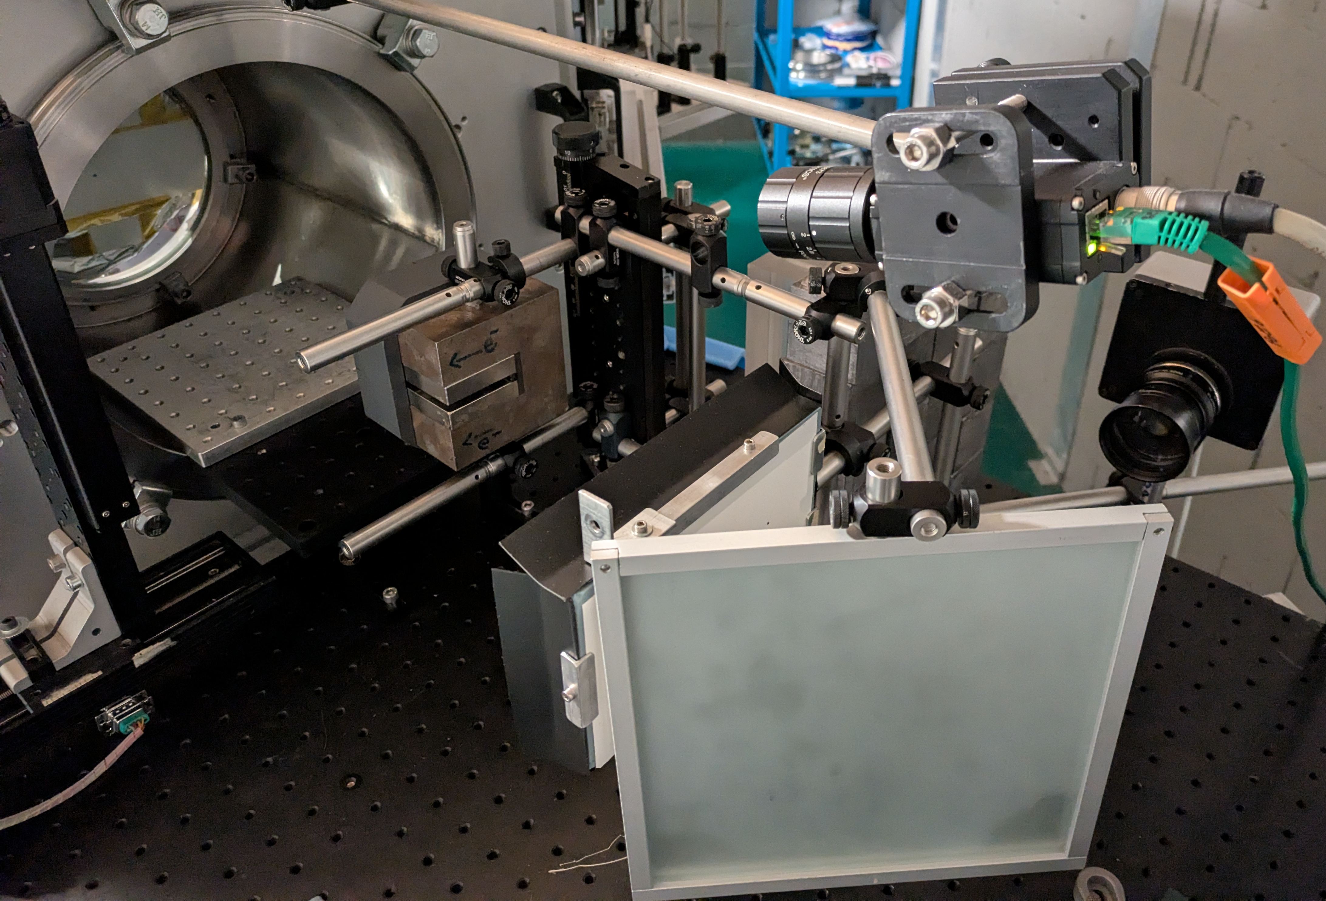
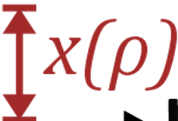
Spectrometer setup
$$θ$$
$$x(ρ,θ)$$
$$x\left(θ,ρ\right)=\left(\frac{a}{2}+b\right)\left(\frac{a}{ρ}\right)+\left[\left(a+b+c\right)+\left(\frac{a}{2}+\frac{3b}{2}\right){\left(\frac{a}{ρ}\right)}^{2}\right]θ+\frac{1}{2}\left[\left(\frac{3a}{2}+3b\right)\left(\frac{a}{ρ}\right)\right]θ^{2}$$
$x\left(ρ\right)=\left(\frac{d}{2}+f\right)\left(\frac{d}{ρ}\right)$
$B$: magnetic field strength, $e,m$: electron charge & mass, $c$: speed of light,
$E$: electron energy
H. J. Cha et al., Rev. Sci. Instrum. 83, 063301 (2012).

Slide 5
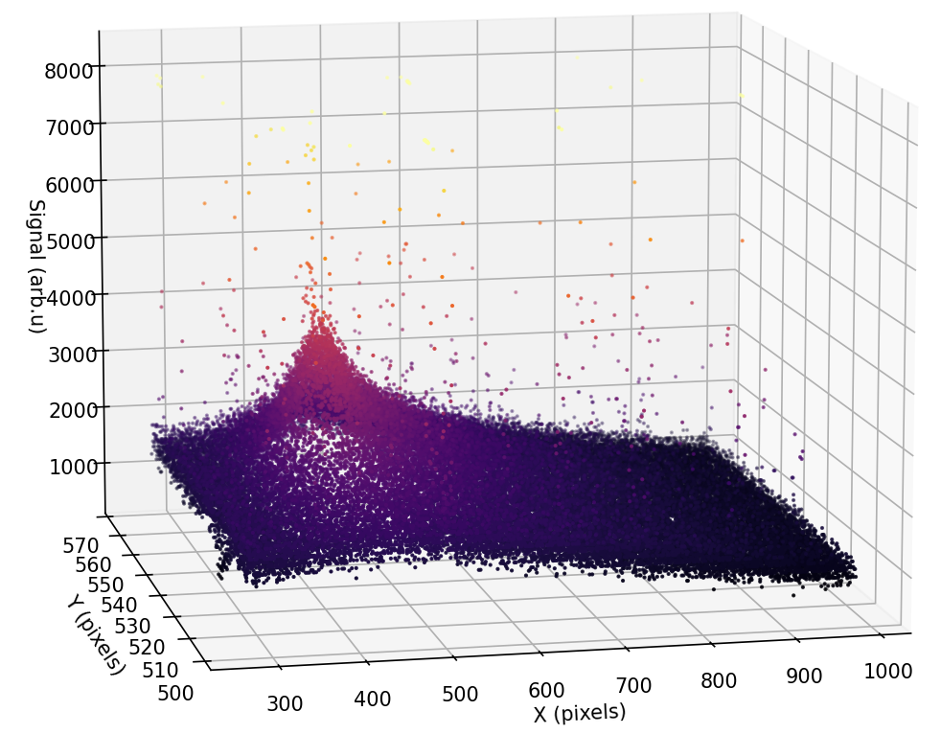
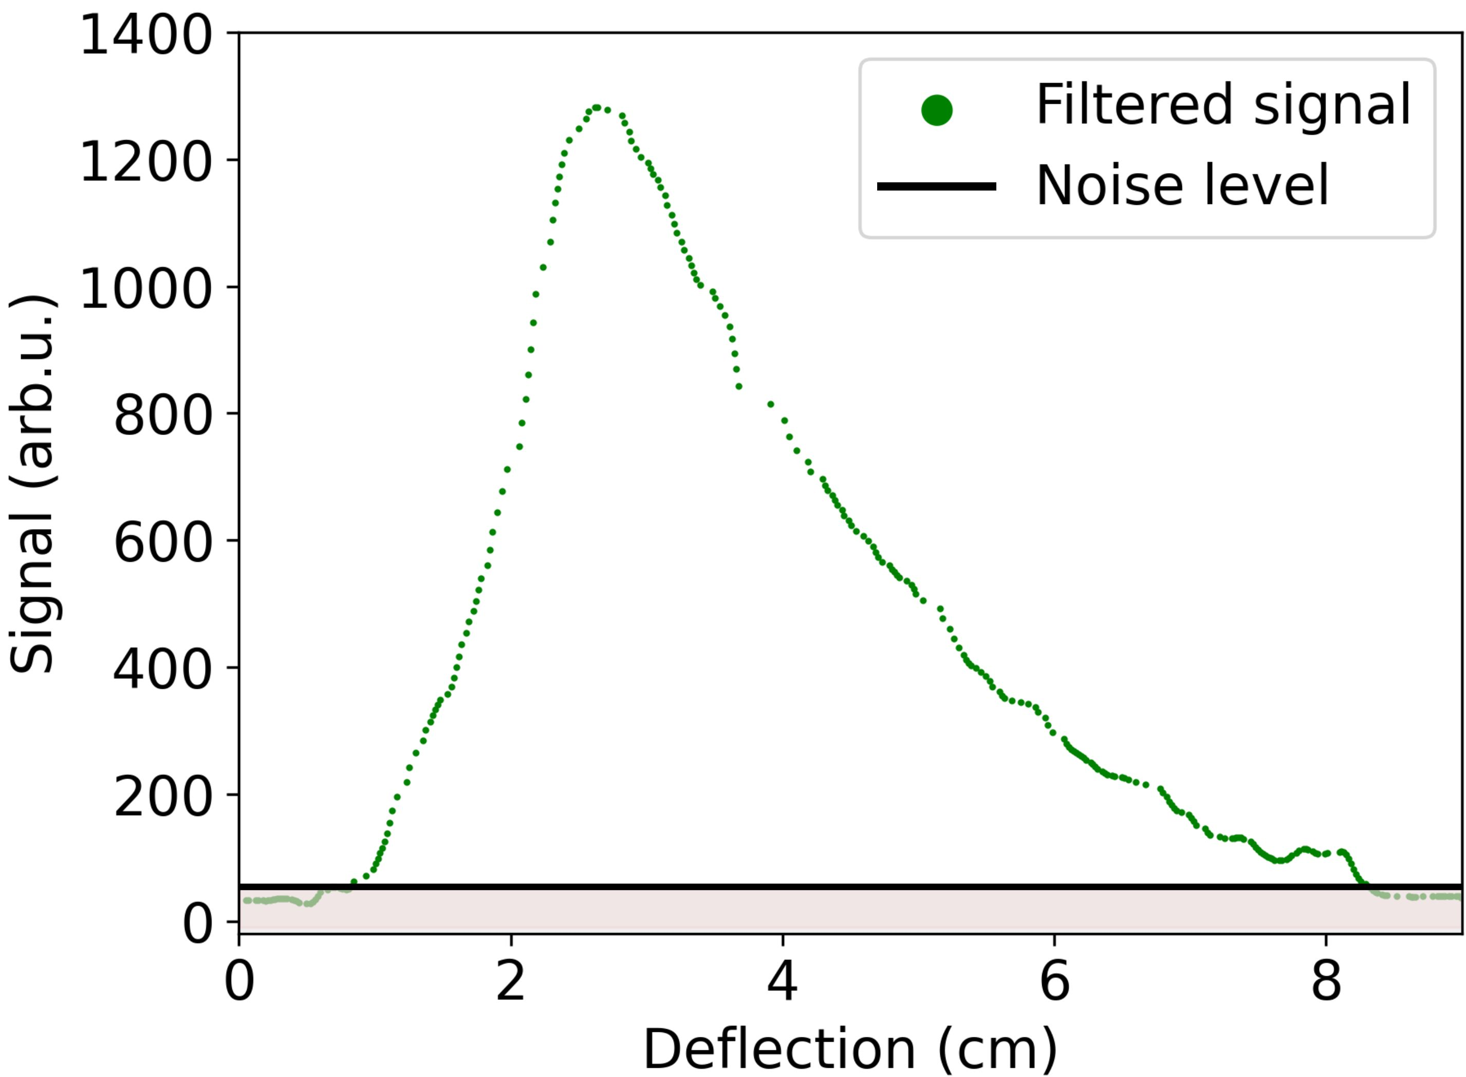
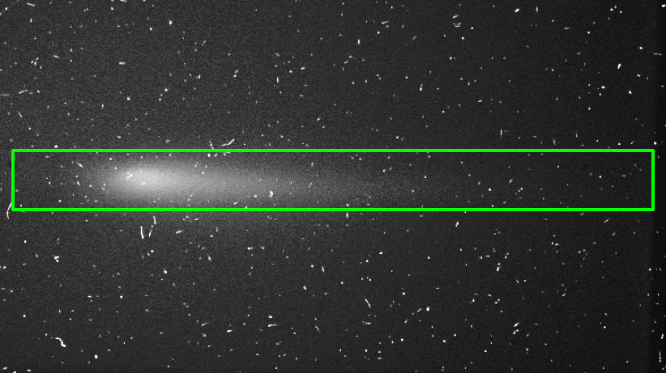
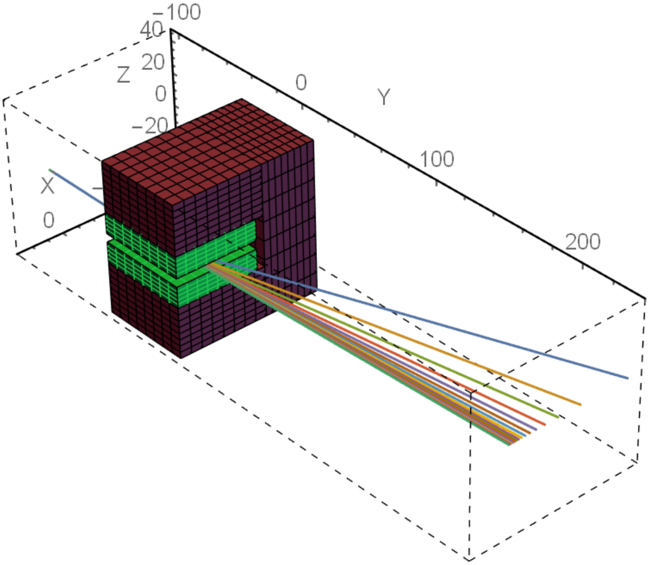
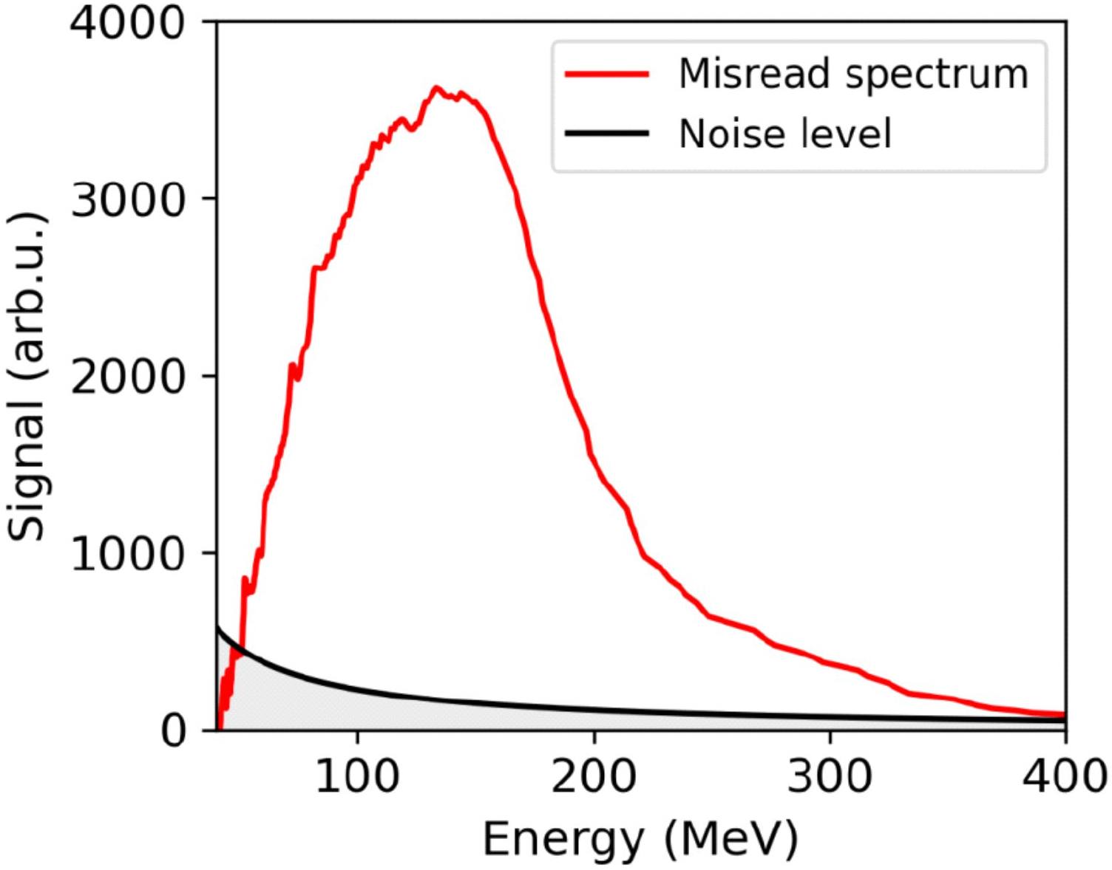
Rear Lanex analysis
$$f\left(x\right)$$
(mm)
(mm)
(mm)
$$S\left(E\right)=\frac{dx}{dE}f\left(x\right)$$
$$S\left(E\right)$$
$$E=\frac{C_{1}}{x}+C_{2}$$
$$x→$$
$C_{1},C_{2}:$ constants
O. Chubar, P. Elleaume, J. Chavanne, J. Synchrotron Radiat. 5, 481–484 (1998)

Slide 6
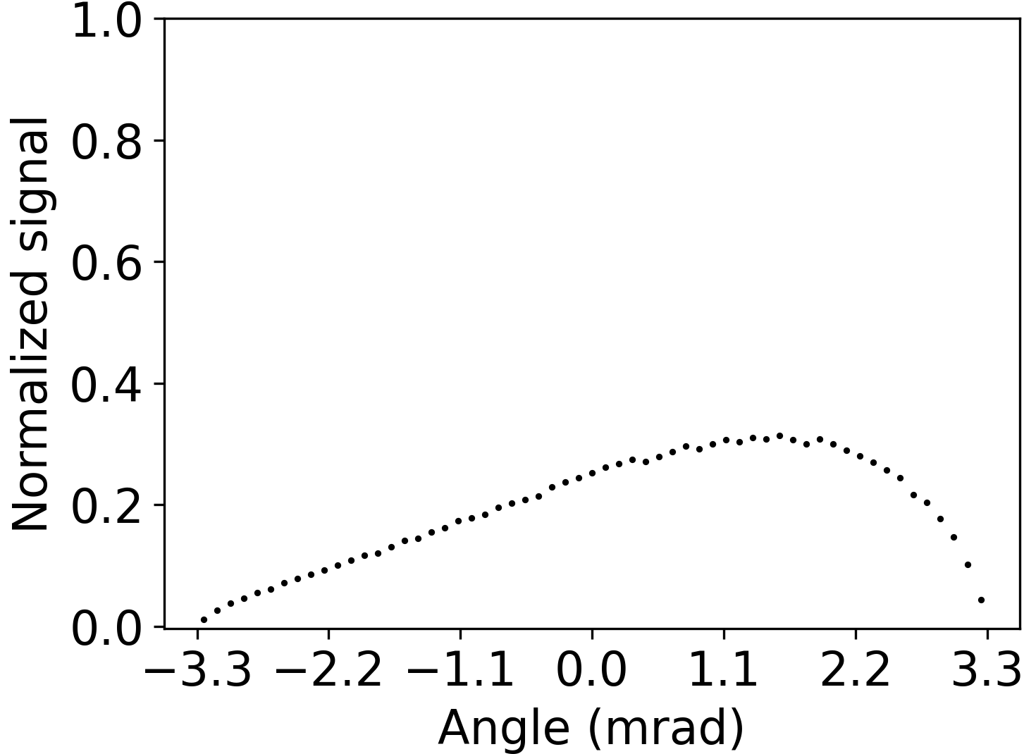
Front Lanex analysis
$$128 MeV$$
$$θ=0$$
$$140 MeV$$
$θ=−2 mrad$
$θ=1.4 mrad$
$$147 MeV$$
$$θ=0$$

Slide 7
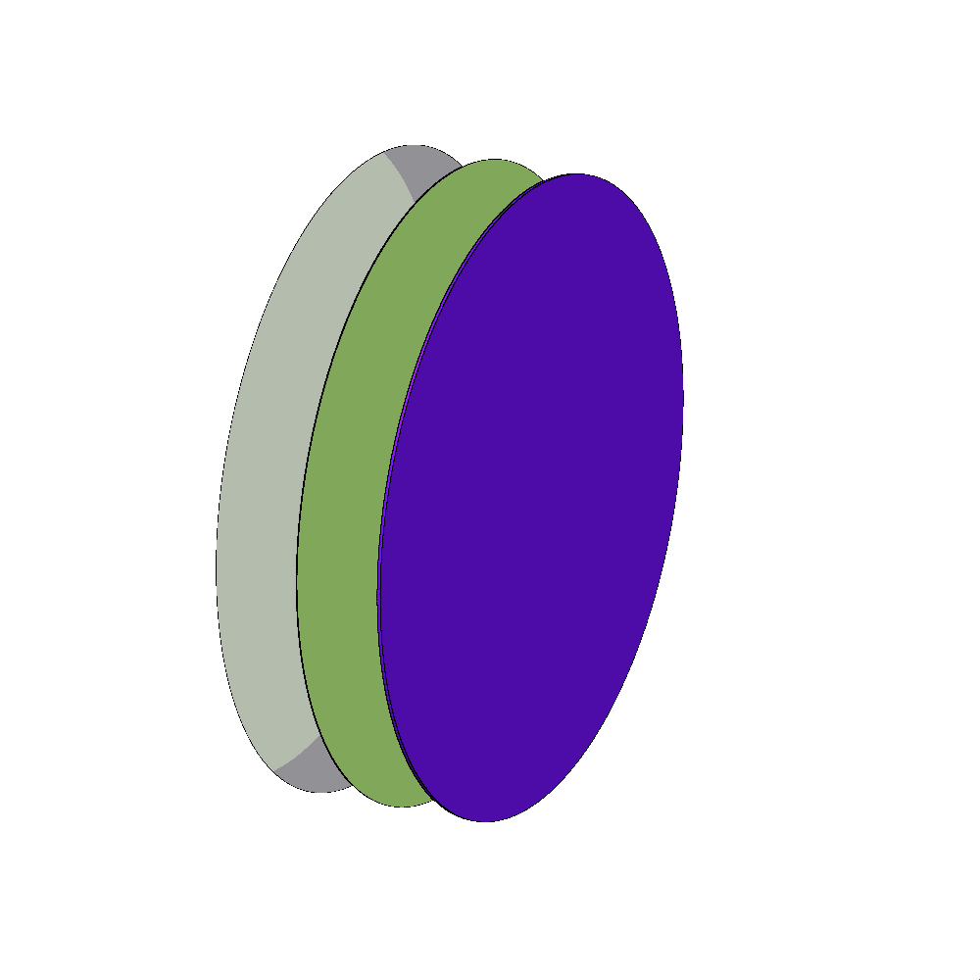
Lanex scattering - Fluka
Fluence measured at the exit of the Lanex and at the entrance of the collimator.
Monoenergetic pencil-like electron beams from $5 MeV−400 MeV$.
Statistical errors $<2\%$ except in the case of $5 MeV$ at $8\%$.
$$1 cm$$
$$1 cm$$
$$42 cm$$
Material characteristics
Name | Material | Density ($g/cm^{3}$) | Thickness ($μm$)
Lanex Regular (93% Phosphor) | $${Gd}_{2}O_{2}S:\left(1\%\right)Tb$$ | 7.35 | 380
Lanex Regular (7% Binder) | $${La}_{2}O_{2}S:\left(1\%\right)Tb$$ | 5.75
Mylar window | $${\left(C_{10}H_{8}O_{4}\right)}_{n}$$ | 1.40 | 75
Aluminum foil | Al | 2.69 | 13
Al
Mylar
Lanex
$$e^{−}$$
Fluence
detector
1. G. Battistoni, others, Ann. Nucl Energy. 82, 10–18 (2015).
2. C. Ahdida et al., Front. Phys. 9, 788253 (2022).
3. Donadon, André, Hugo, Gabrielle, Theis, Christian, Vlachoudis, Vasilis, EPJ Web Conf. 302, 11005 (2024).

Slide 8
2D electron fluence
Lanex exit
Collimator entrance

Slide 9
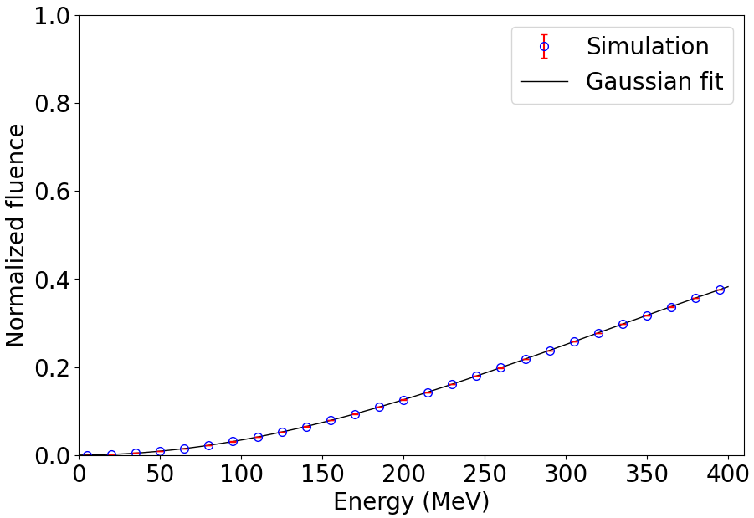
Scattering correction
Without scattering
With scattering
$$147 MeV$$
$$93 MeV$$

Slide 10
Conclusions
Pointing instability needs to be considered when measuring energy.
Scattering caused by the Lanex and the mylar window significantly alters the arriving charge.
Other spectrometers may remove front Lanex but are either slow, large or require $\sim GeV$ energies.
Our method:
- Compact, non-invasive, on-shot measurements of energy.
- Assumes electron trajectories are parallel.

Slide 11
Acknowledgements
Infrastructure Development
This work was supported by EuPRAXIA Advanced Photon Sources – EuAps (IR0000030, CUP I93C21000160006).
Advanced Photon Sources
Infrastructure Development
Laser Development
Research on biomedicine
This work was supported by the PNRR MUR project IR0000016-I-PHOQS, funded by the European Union – Next Generation EU.
This work was supported by the EU Horizon IFAST, under Grant Agreement No.101004730.
This work was supported by the PNRR MUR project ECS00000017-"Tuscany Health Ecosystem & the LPA – STAR project, funded by the European Union – Next Generation EU.

