Slide 1

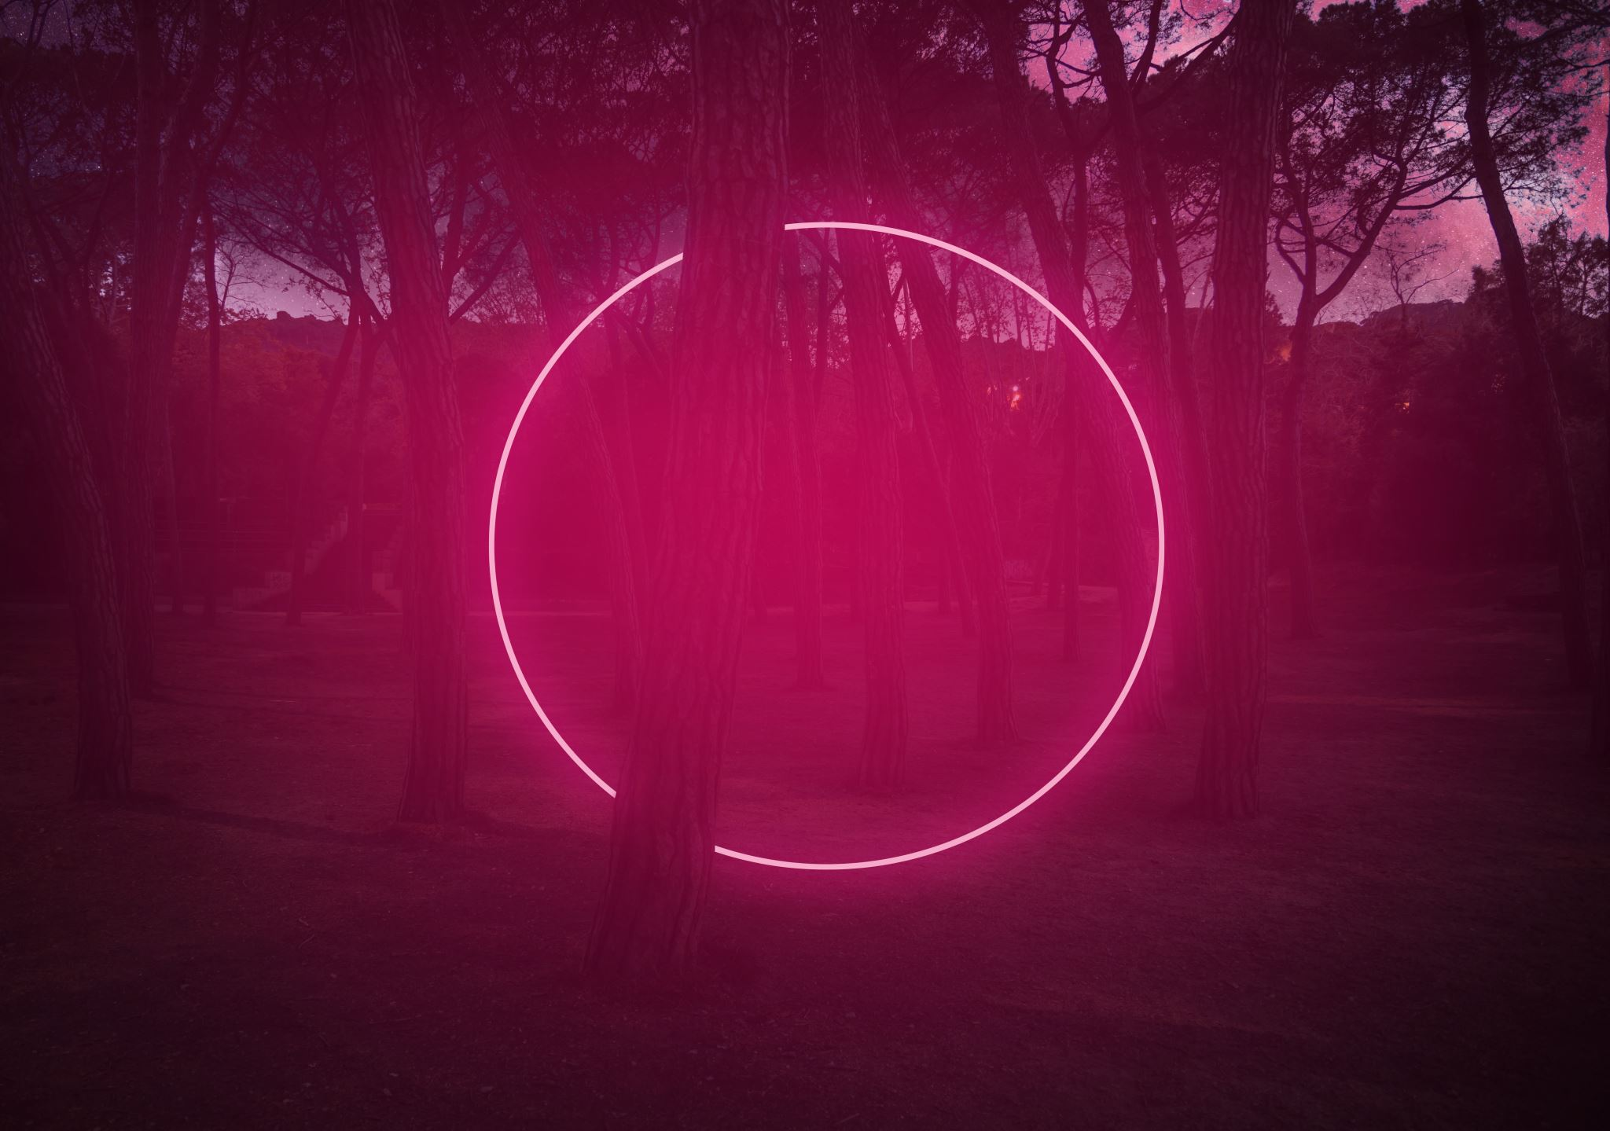
Dark Particles at the LHC
Giorgio Arcadi
University of Messina and INFN Catania

Slide 2
Theoretical setup
Portal Sector
Dark Sector (Including but not limited to DM)
Visible Sector
«Dark Particles»

Slide 3
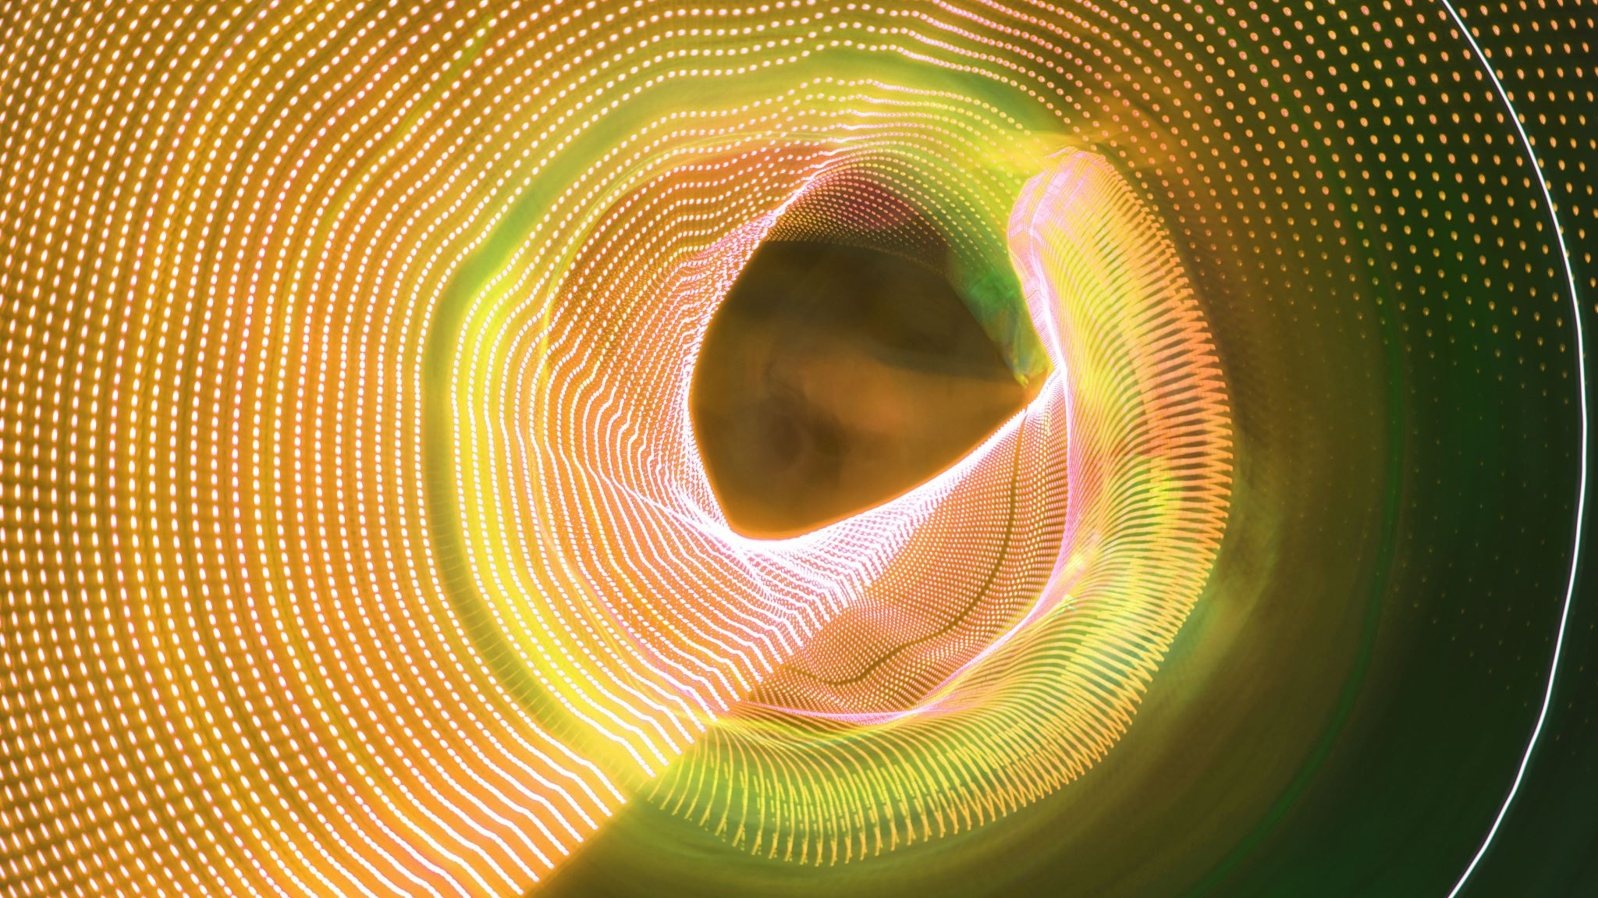
Invisible decays of the Higgs

Slide 4
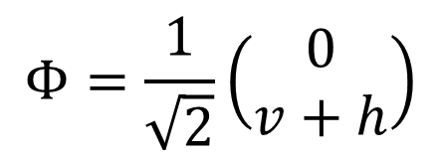
(Effective) Higgs portal
$$Φ=\frac{1}{\sqrt{2}}\left(\begin{matrix}0 \\ v+h\end{matrix}\right)$$
Portal interactions induced after EW symmetry breaking.
The effective Higgs portal has only two free parameters.
Giorgio Arcadi LDMA2025 Genova

Slide 5
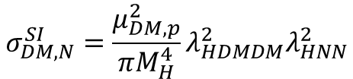

DM
DM
LHC DD vs Invisible H width correlation plot
$$σ_{DM,N}^{SI}=\frac{μ_{DM,p}^{2}}{πM_{H}^{4}}λ_{HDMDM}^{2}λ_{HNN}^{2}$$
N
N
DM
$$σ_{DM,N}^{SI}∝Br(H→DMDM)$$
H
DM
See e.g. also ATLAS, JHEP 11 (2015) 206
CMS Eur. Phys. J. C74 (2014) 2980
Giorgio Arcadi LDMA2025 Genova

Slide 6
Dark Matter from gauge symmetry
Mediator sector
Extended Higgs sector (SM+dark sector)
Visible sector
Dark sector
New gauge symmetry spontaneosly broken: massive vectors and new higgses.
SM states
T. Hambye and M. Tytgat, PLB683 (2010) 39-41
C. Gross, O. Lebedev, Y. Mambrini, JHEP 08 (2015) 158
G.A. , C. Gross, O. Lebedev, Y. Mambrini, S. Pokorski, T. Toma, JHEP 12 (2016) 081
Giorgio Arcadi LDMA2025 Genova

Slide 7
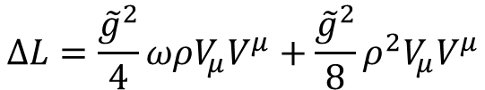

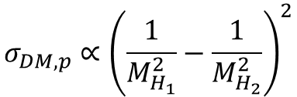


Vector DM from U(1)
$$L_{U(1)}=−\frac{1}{4}F_{μν}F^{μν}+{\left(D_{μ}φ\right)}^{†}\left(D^{μ}φ\right)−V(φ,H)$$
U(1) spontaneosly broken
Residual Z₂ symmetry
$$V_{μ}→−V_{μ}$$
$$ΔL=\frac{{\tilde{g}}^{2}}{4}ωρV_{μ}V^{μ}+\frac{{\tilde{g}}^{2}}{8}ρ^{2}V_{μ}V^{μ}$$
$$M_{V}^{2}=\frac{1}{2}{\tilde{g}}^{2}ω^{2}$$
$$σ_{DM,p}∝{\left(\frac{1}{M_{H_{1}}^{2}}−\frac{1}{M_{H_{2}}^{2}}\right)}^{2}$$
See also:
S. Baek et al. JHEP 05 (2013) 036
S. Baek et al. Phys. Rev. D90 (2014) 055015
The additional degree of freedom crucially alters the LHC correlation plot.
Giorgio Arcadi LDMA2025 Genova

Slide 8
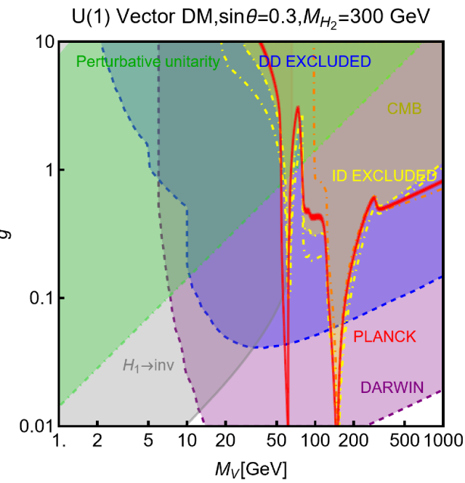
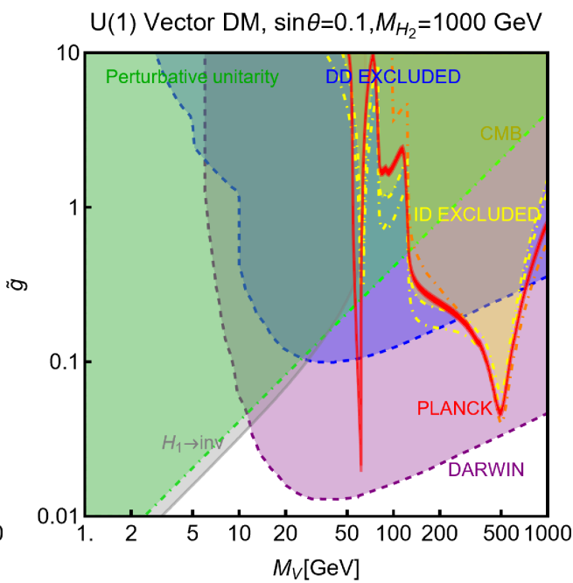
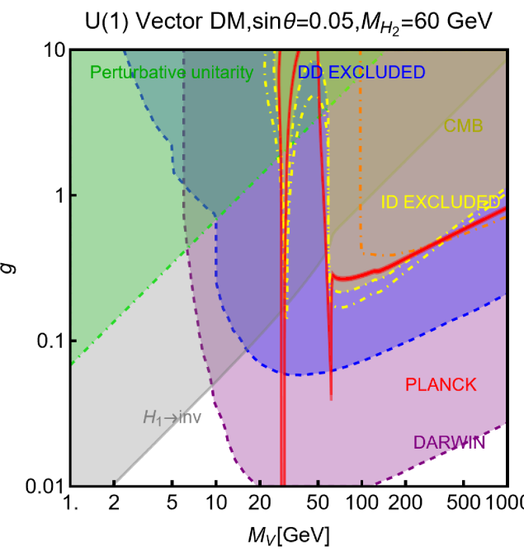
Vector DM from U(1)
$$L_{U(1)}=−\frac{1}{4}F_{μν}F^{μν}+{\left(D_{μ}φ\right)}^{†}\left(D^{μ}φ\right)−V(φ,H)$$
U(1) spontaneosly broken
Residual Z₂ symmetry
$$V_{μ}→−V_{μ}$$
$$ΔL=\frac{{\tilde{g}}^{2}}{4}ωρV_{μ}V^{μ}+\frac{{\tilde{g}}^{2}}{8}ρ^{2}V_{μ}V^{μ}$$
$$M_{V}^{2}=\frac{1}{2}{\tilde{g}}^{2}ω^{2}$$
Giorgio Arcadi LDMA2025 Genova

Slide 9
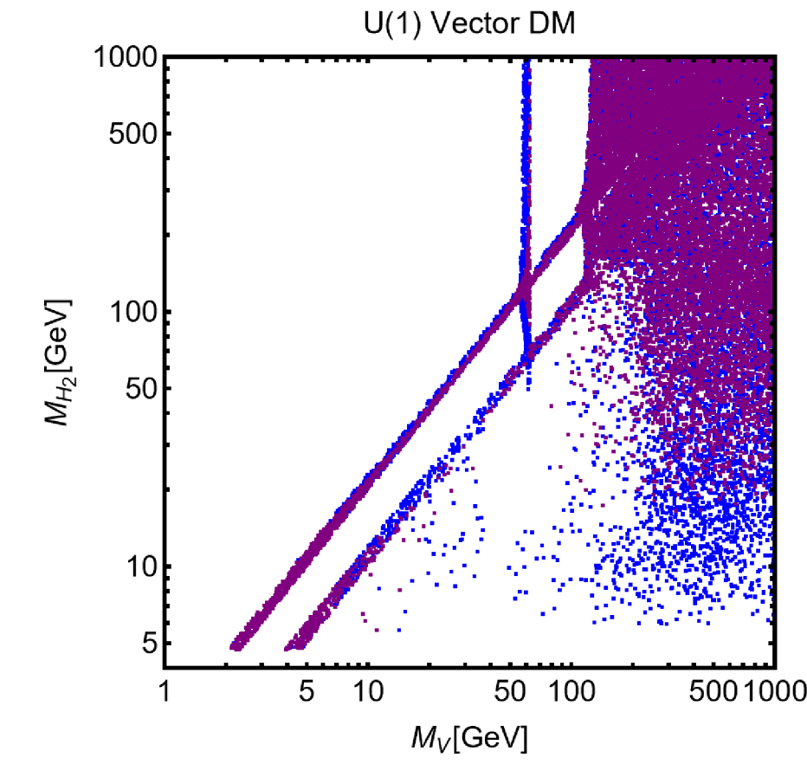


$ν$-floor
$$2.5\%≤Br\left(H→inv\right)≤11\%$$
XENONnT
EFT Portal
DARWIN
Giorgio Arcadi LDMA2025 Genova

Slide 10
Vector (and Scalar DM) from SU(3)
In a simplified limit we can define the following Lagrangian:
Giorgio Arcadi LDMA2025 Genova

Slide 11
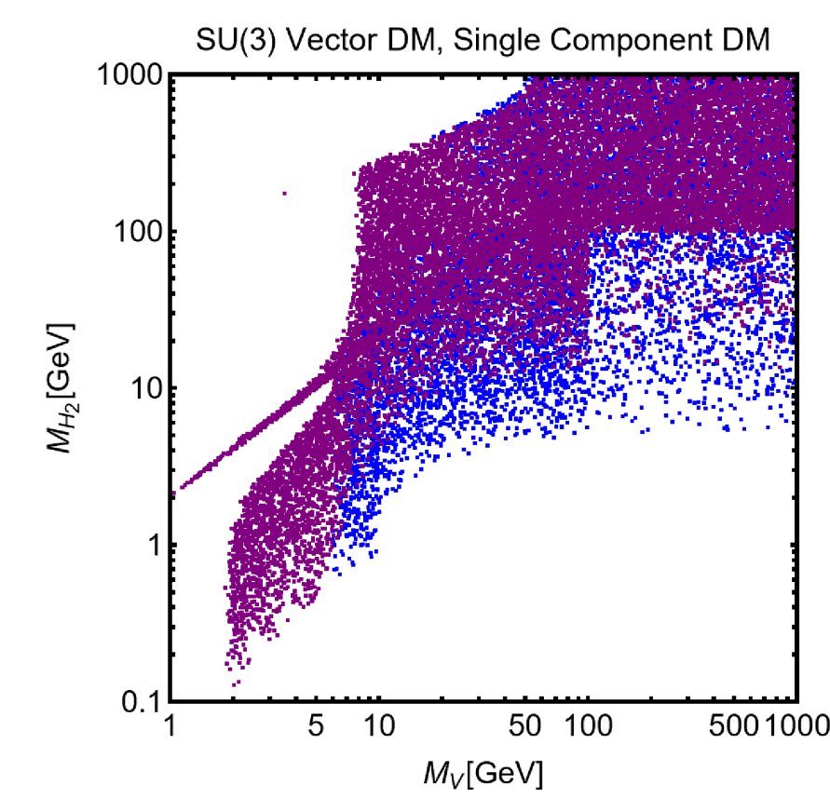
Giorgio Arcadi LDMA2025 Genova

Slide 12

Scalar Portals from Extended Higgs Sectors

Slide 13
Visible Sector
2 Higgs Doublet Sector
SM Singlet Mediator
Fermionic DM
Giorgio Arcadi LDMA2025 Genova

Slide 14
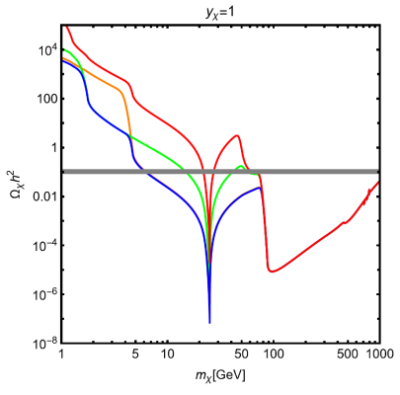
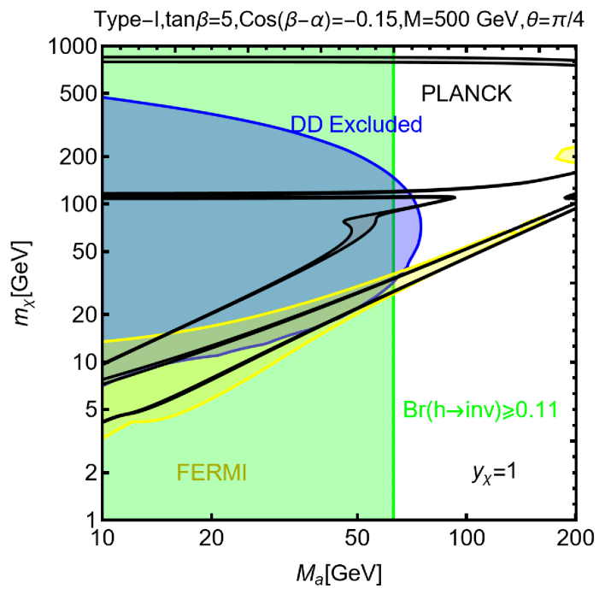
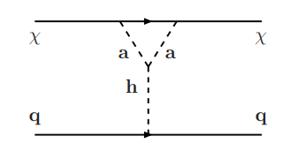
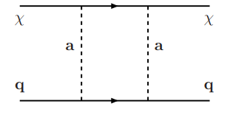




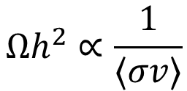


2HDM+a
$$L_{DM}=iy_{χ} \overline{χ}γ_{5}χa_{0}$$
$$iy_{χ}\left(a\cos{θ+A\sin{θ}}\right)\overline{χ}γ_{5}χ$$
$$\overline{χ}χ→a /A→\overline{f}f$$
$$⟨σv⟩$$
$$\overline{χ}χ→a /A→ha(A)$$
$$Ωh^{2}∝\frac{1}{⟨σv⟩}$$
$$\overline{χ}χ→a /A→a(A)a(A)$$
SI Induced at one-loop
Giorgio Arcadi LDMA2025 Genova

Slide 15
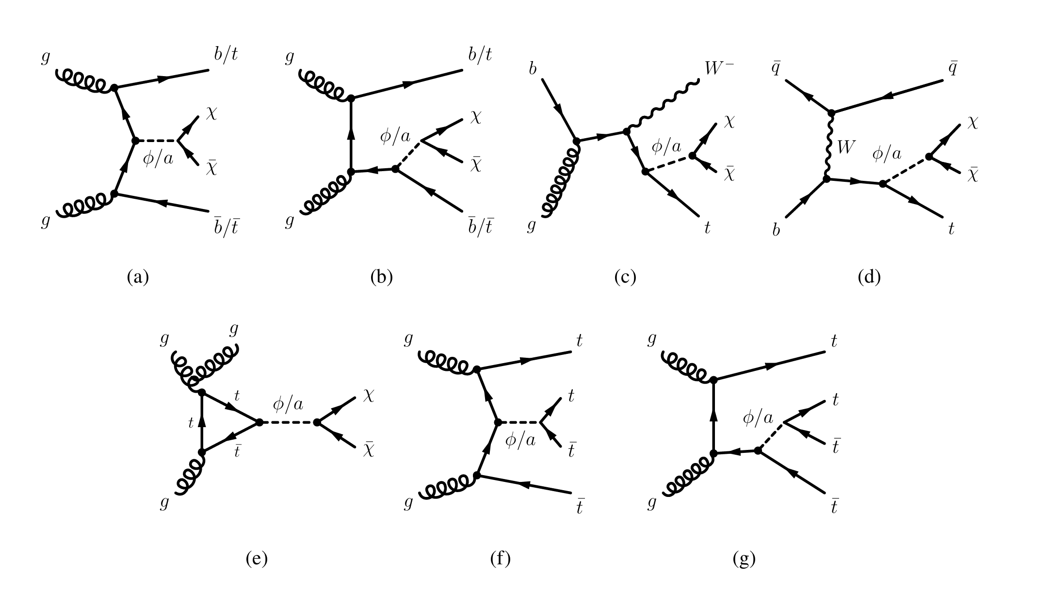
Giorgio Arcadi LDMA2025 Genova

Slide 16
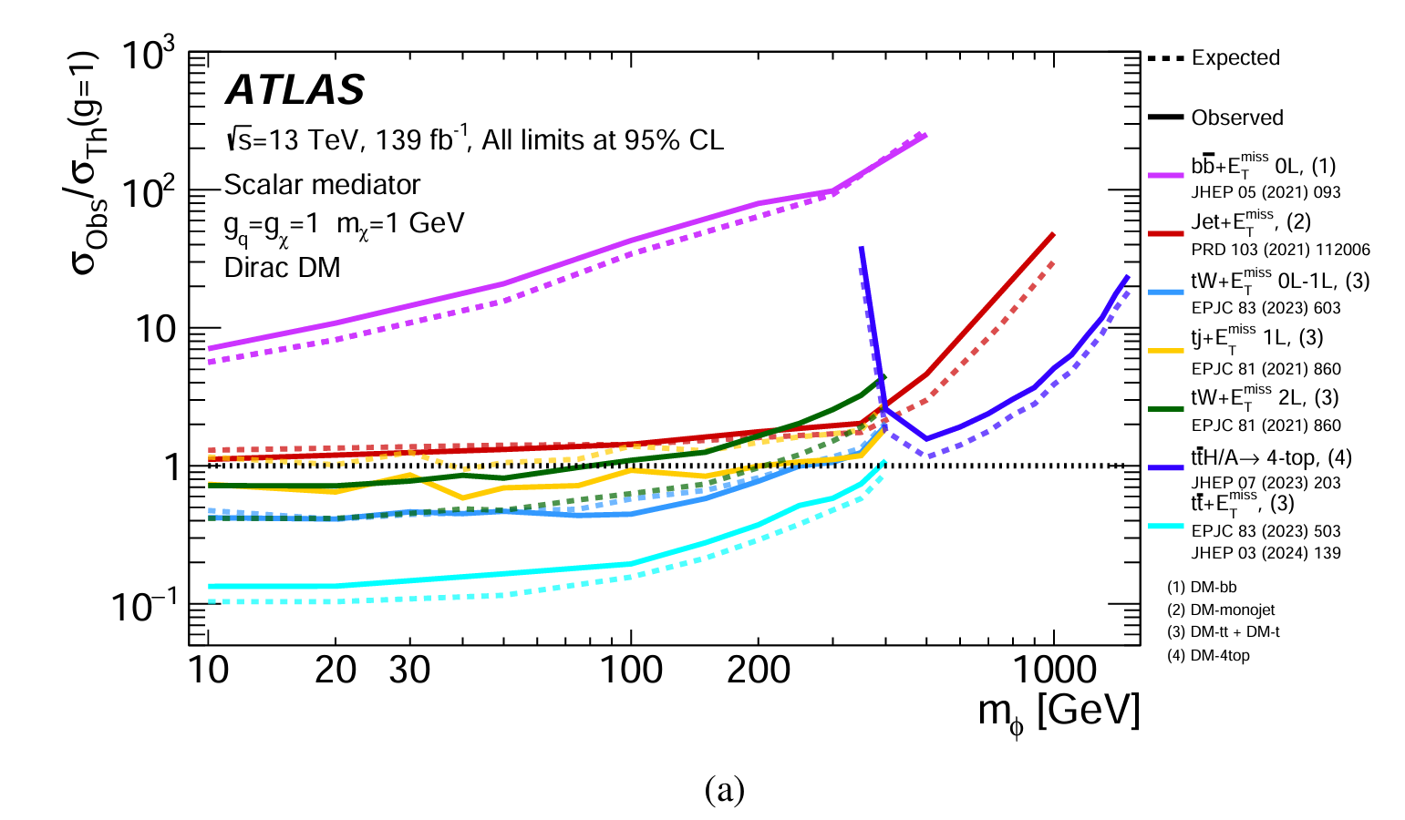
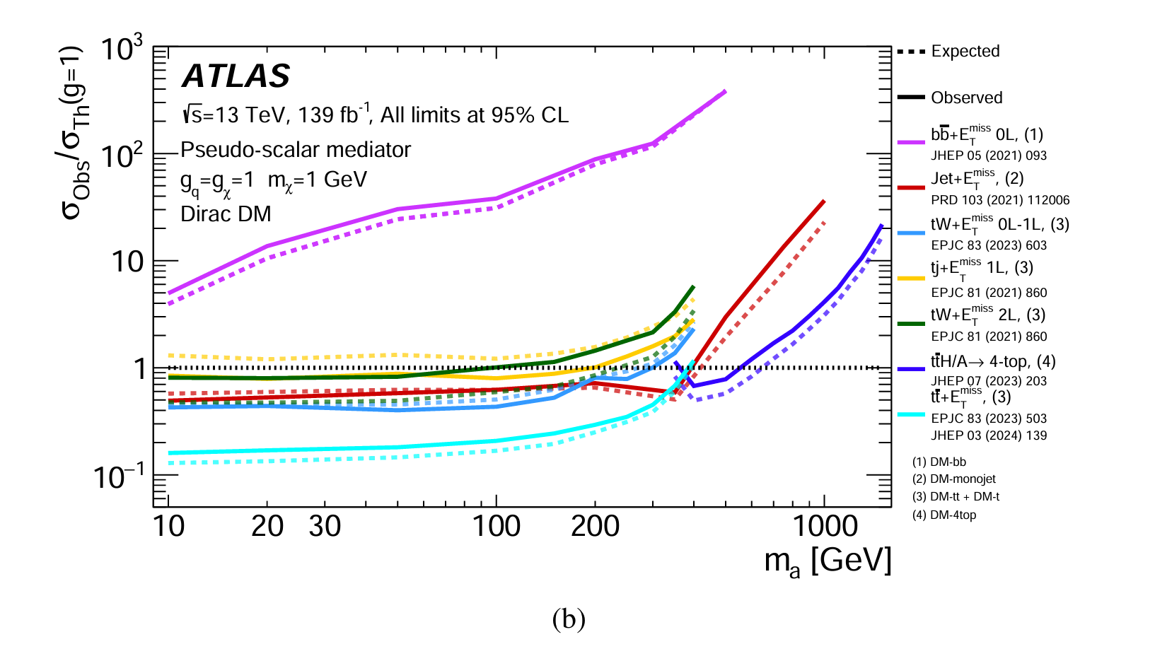
Giorgio Arcadi LDMA2025 Genova

Slide 17
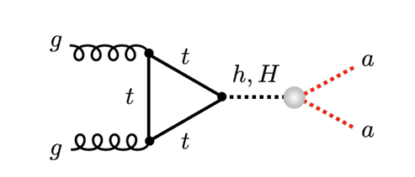
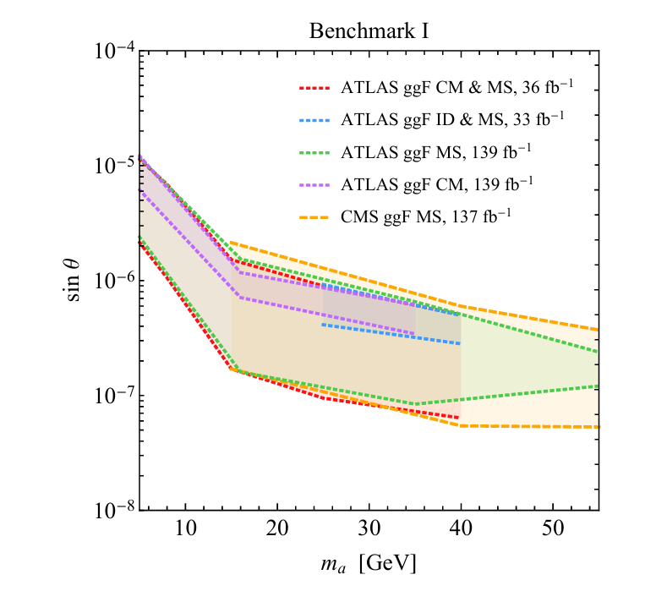
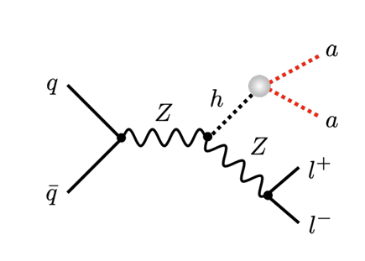
Displaced Decays for the pseudoscalar
U. Haisch and L. Schnell JHEP 04 (2023) 134
Giorgio Arcadi LDMA2025 Genova

Slide 18
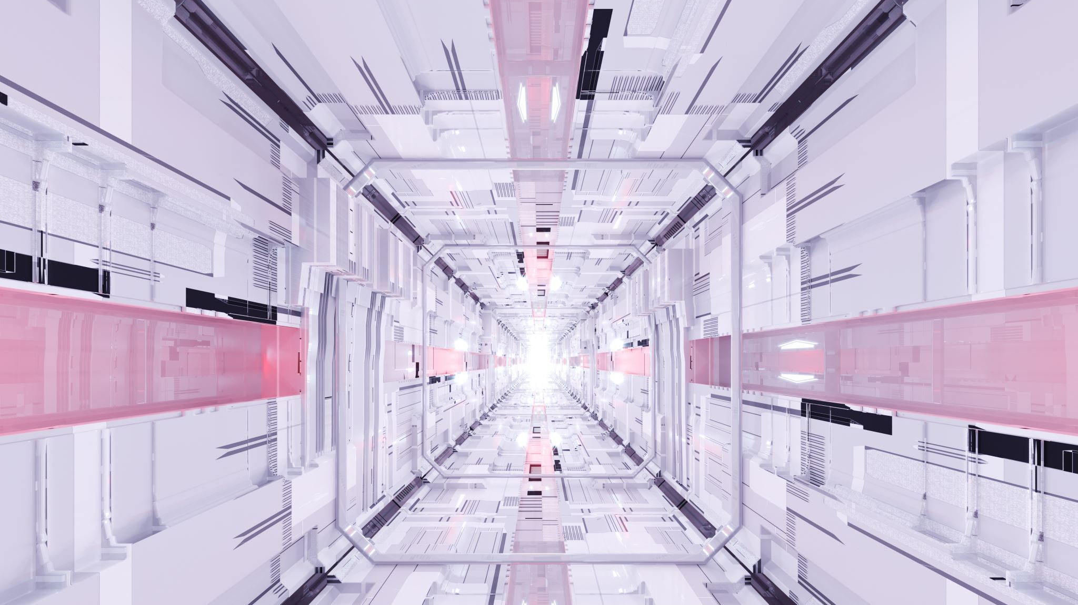
Spin-1 portal with
Dark Higgs Boson
M. Duerr, A. Grohsjean, F. Kahlhoefer, B. Penning, K. Schmidt-Hoberg, C. Schwaneberger JHEP 04 (2017) 143
see also
F. Kahlhoefer, K. Schmidt-Hoberg, T. Schwetz and S. Vogl, JHEP 02 (2016) 016, JHEP 09 (2016) 042.

Slide 19

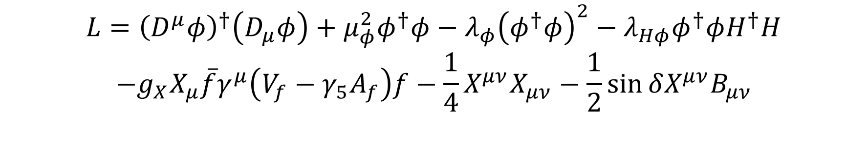
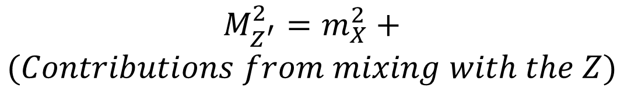
$$L={\left(D^{μ}φ\right)}^{†}\left(D_{μ}φ\right)+μ_{φ}^{2}φ^{†}φ−λ_{φ}{\left(φ^{†}φ\right)}^{2}−λ_{Hφ}φ^{†}φH^{†}H$$
$$−g_{X}X_{μ}\overline{f}γ^{μ}\left(V_{f}−γ_{5}A_{f}\right)f−\frac{1}{4}X^{μν}X_{μν}−\frac{1}{2}\sin{δX^{μν}B_{μν}}$$
$$M_{Z^{′}}^{2}=m_{X}^{2}+$$
$$(Contributions from mixing with the Z)$$
$$m_{X}=2g_{X}ω$$
Giorgio Arcadi LDMA2025 Genova

Slide 20


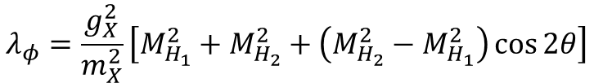
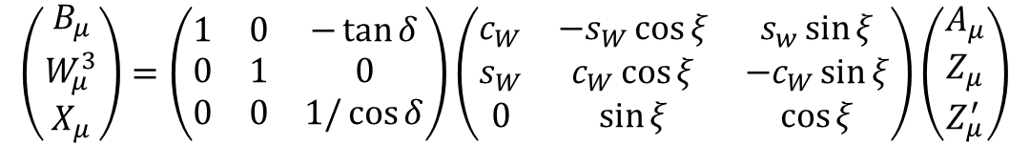

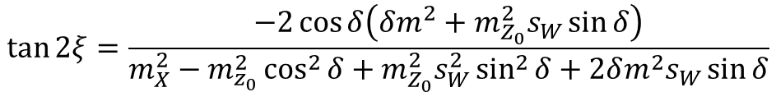
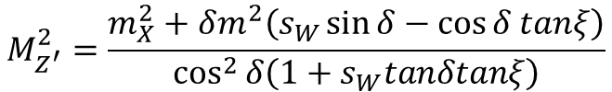
$$\left(\begin{matrix}B_{μ} \\ W_{μ}^{3} \\ X_{μ}\end{matrix}\right)=\left(\begin{matrix}1 & 0 & −\tan{δ} \\ 0 & 1 & 0 \\ 0 & 0 & 1/\cos{δ}\end{matrix}\right)\left(\begin{matrix}c_{W} & −s_{W}\cos{ξ} & s_{w}\sin{ξ} \\ s_{W} & c_{W}\cos{ξ} & −c_{W}\sin{ξ} \\ 0 & \sin{ξ} & \cos{ξ}\end{matrix}\right)\left(\begin{matrix}A_{μ} \\ Z_{μ} \\ Z_{μ}^{′}\end{matrix}\right)$$
$$M_{Z}^{2}=m_{Z_{0}}^{2}\left(1+s_{W}\tan{ξ\tan{δ}}\right)$$
$$\tan{2ξ=\frac{−2\cos{δ\left(δm^{2}+m_{Z_{0}}^{2}s_{W}\sin{δ}\right)}}{m_{X}^{2}−m_{z_{0}}^{2}\cos^{2}{δ}+m_{Z_{0}}^{2}s_{W}^{2}\sin^{2}{δ+2δm^{2}s_{W}\sin{δ}}}}$$
$$M_{Z^{′}}^{2}=\frac{m_{X}^{2}+δm^{2}\left(s_{W}\sin{δ−\cos{δ tanξ}}\right)}{\cos^{2}{δ\left(1+s_{W}tanδtanξ\right)}}$$
$$λ_{H}=\frac{1}{4v^{2}}\left[M_{H_{1}}^{2}+M_{H_{2}}^{2}+\left(M_{H_{1}}^{2}−M_{H_{2}}^{2}\right)\cos{2θ}\right]$$
$$λ_{φ}=\frac{g_{X}^{2}}{m_{X}^{2}}\left[M_{H_{1}}^{2}+M_{H_{2}}^{2}+\left(M_{H_{2}}^{2}−M_{H_{1}}^{2}\right)\cos{2θ}\right]$$
$$λ_{Hφ}=\frac{g_{X}}{m_{X}v}\left(M_{H_{1}}^{2}−M_{H_{2}}^{2}\right)\sin{2θ}$$
Giorgio Arcadi LDMA2025 Genova

Slide 21
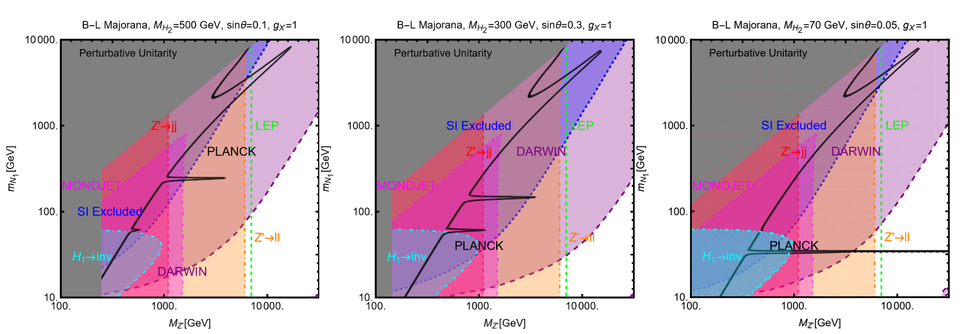
G.A. et al, arXiv: 2403.15860
Giorgio Arcadi LDMA2025 Genova

Slide 22
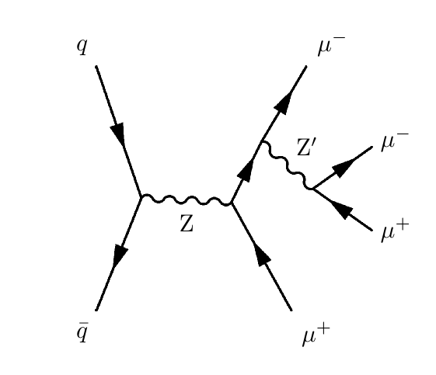
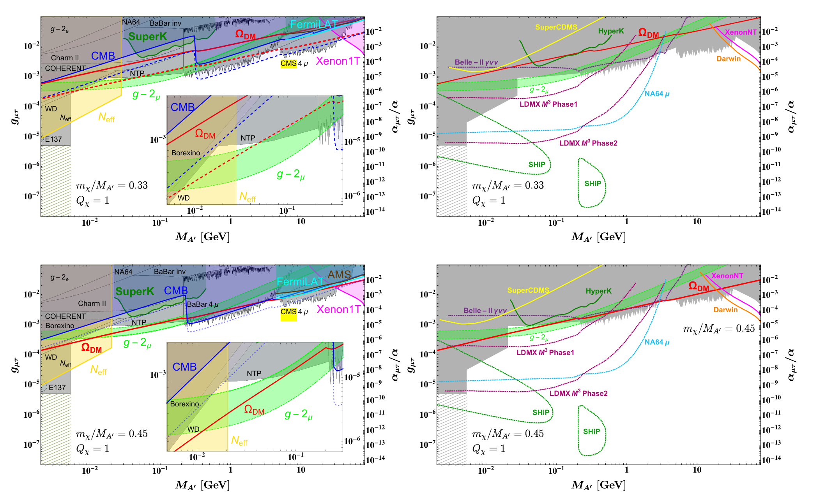
CMS Collaboration Phys.Lett.B 792 (2019) 345-368
P. Foldenauer Phys.Rev.D 99 (2019) 3, 035007
Giorgio Arcadi LDMA2025 Genova

Slide 23
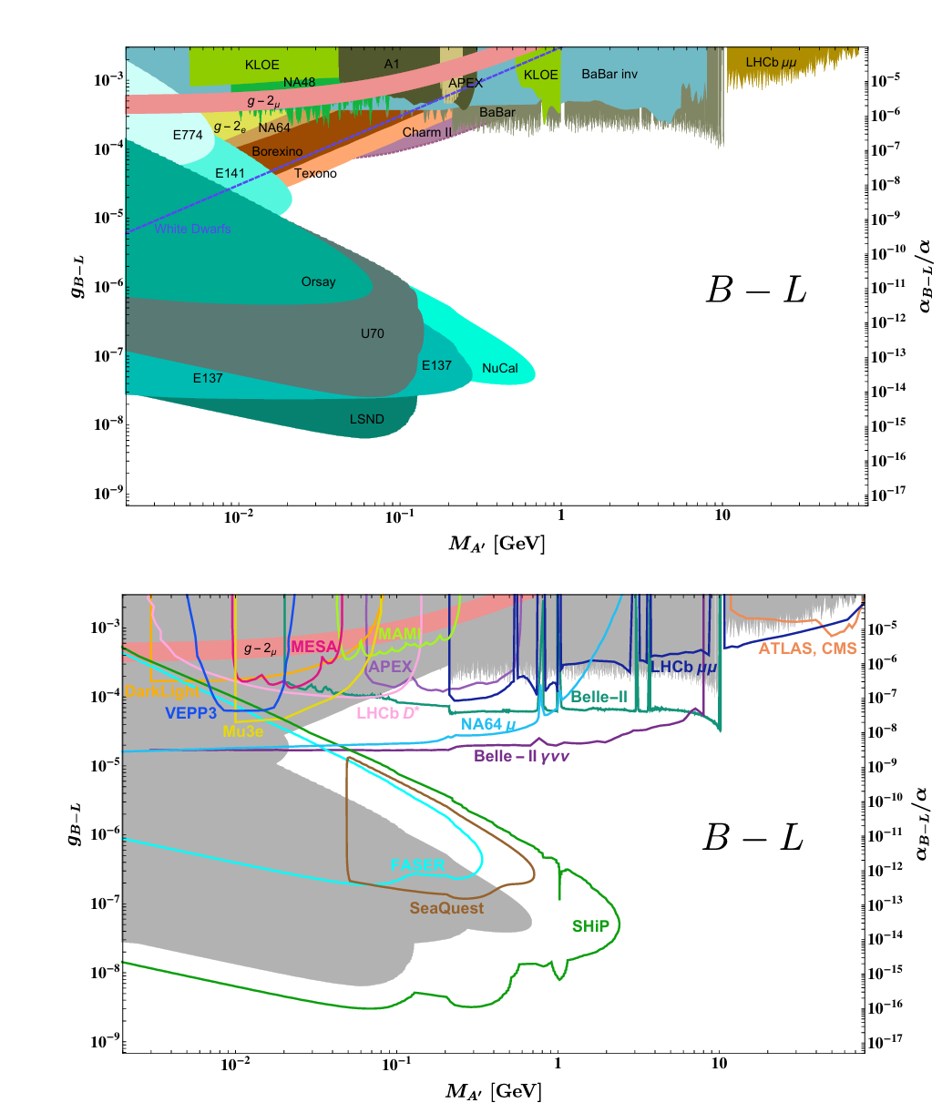
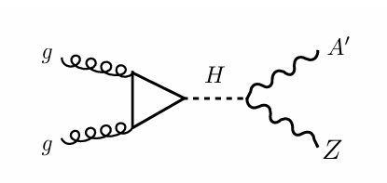
M. Bauer et al. JHEP 07 (2018) 094
Giorgio Arcadi LDMA2025 Genova

Slide 24
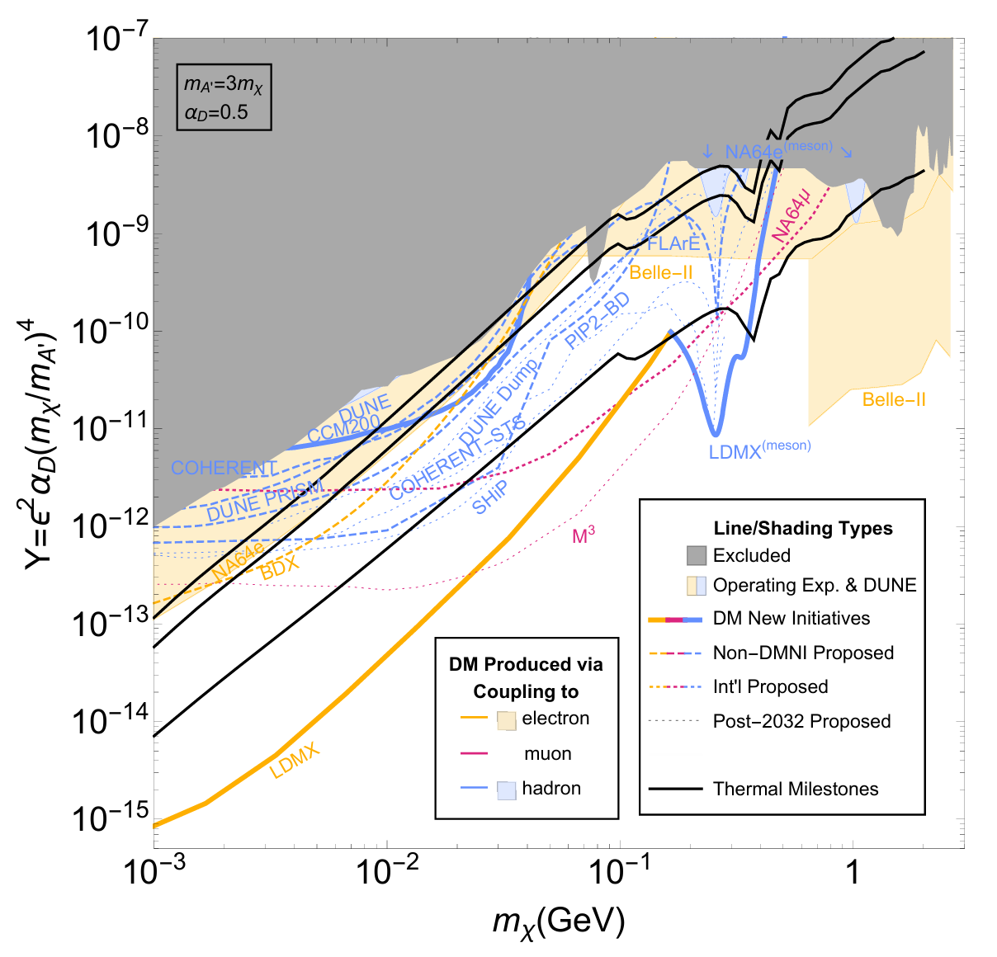
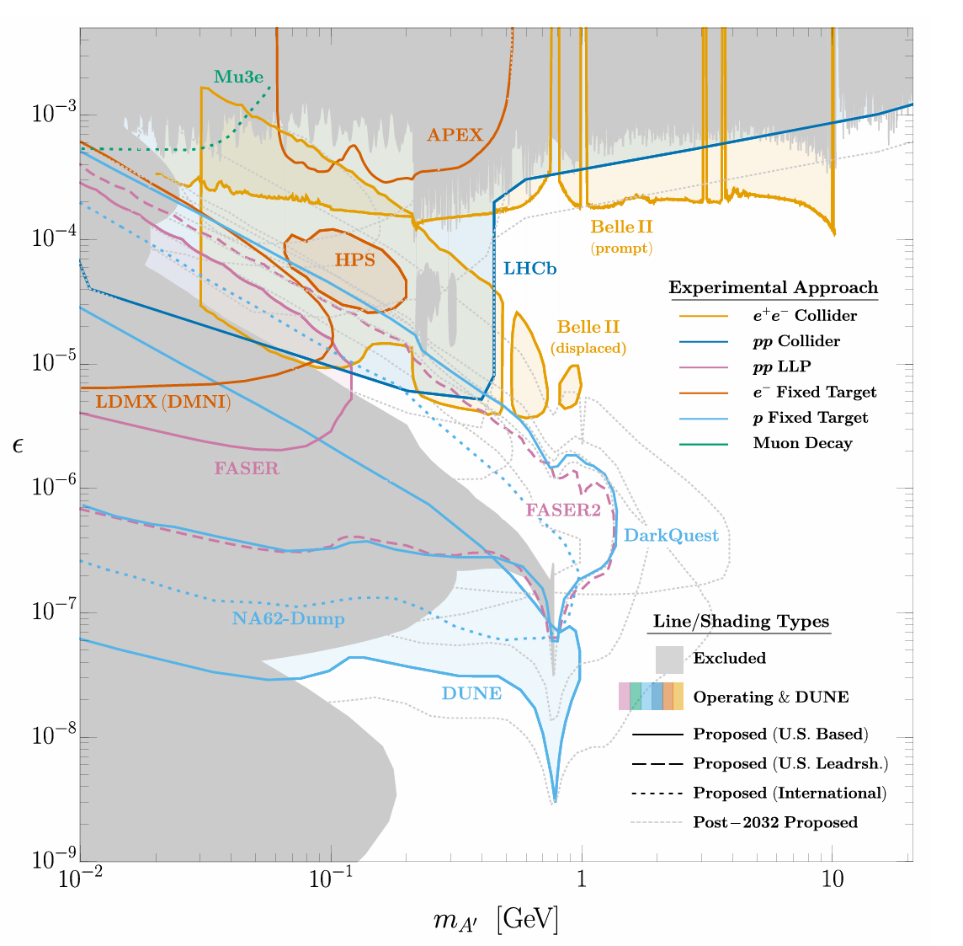

$$L_{Vector}=L_{SM}+L_{DS}−\frac{ε}{2\cos{θ_{W}}}F_{μν}^{′}B^{μν}$$
$$L_{DS}=−\frac{1}{4}F_{μν}^{′}F^{μν}+\frac{1}{2}m_{A^{′}}^{2}A^{′μ}A_{μ}+\overline{χ}γ^{μ}\left(∂_{μ}+ig_{D}A_{μ}^{′}\right)χ$$
Giorgio Arcadi LDMA2025 Genova

Slide 25
Light Dark Matter in Hidden Valley Models

Slide 26
Connector Sector
Vi
Hidden Valley:
Confining Dark Sector. DM made by light stable mesons
Visible Sector
Giorgio Arcadi LDMA2025 Genova

Slide 27
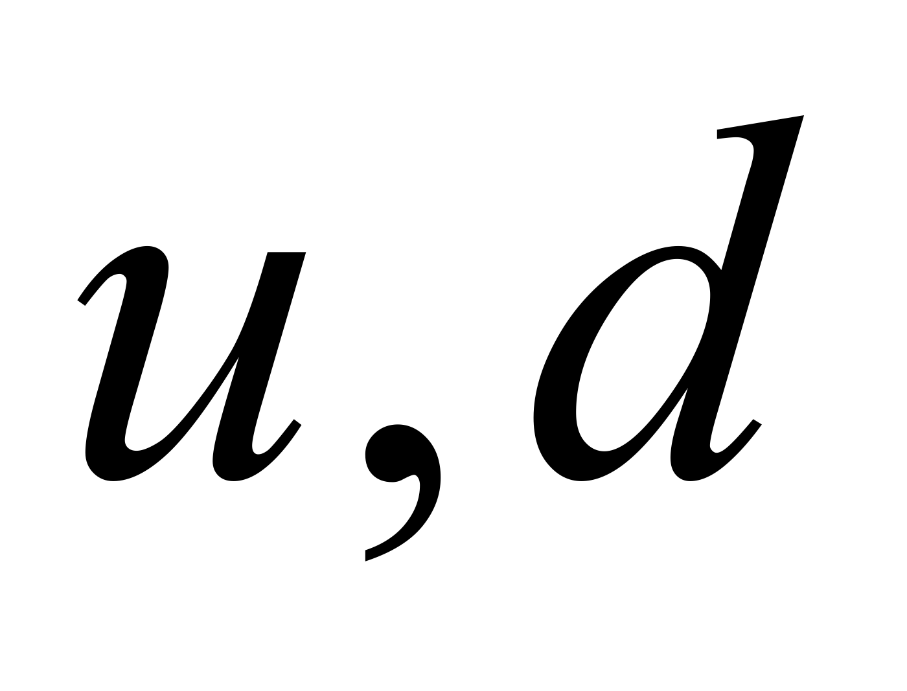
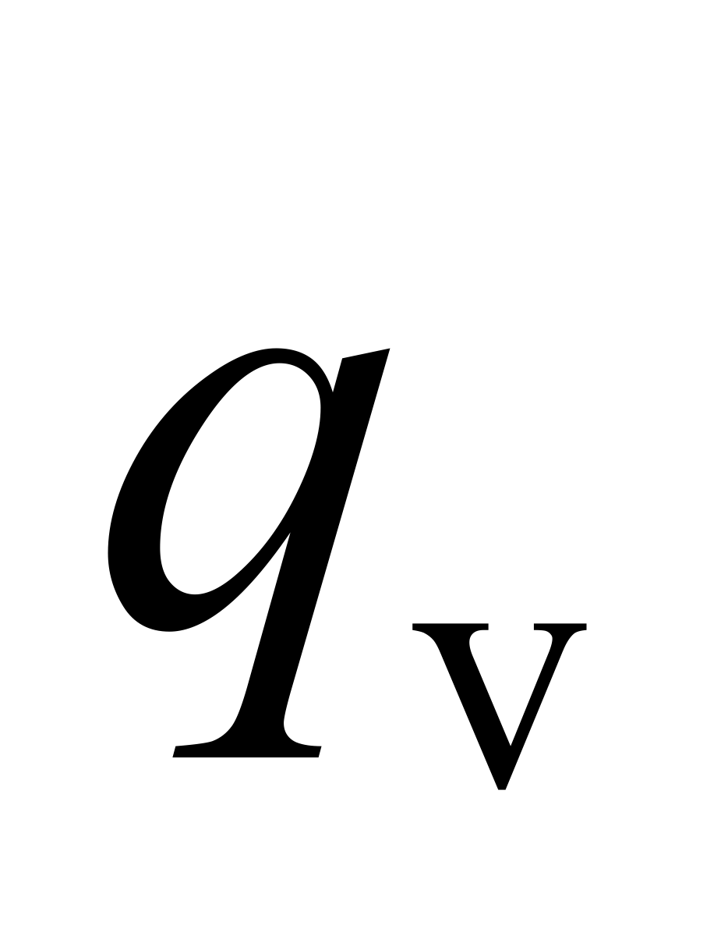
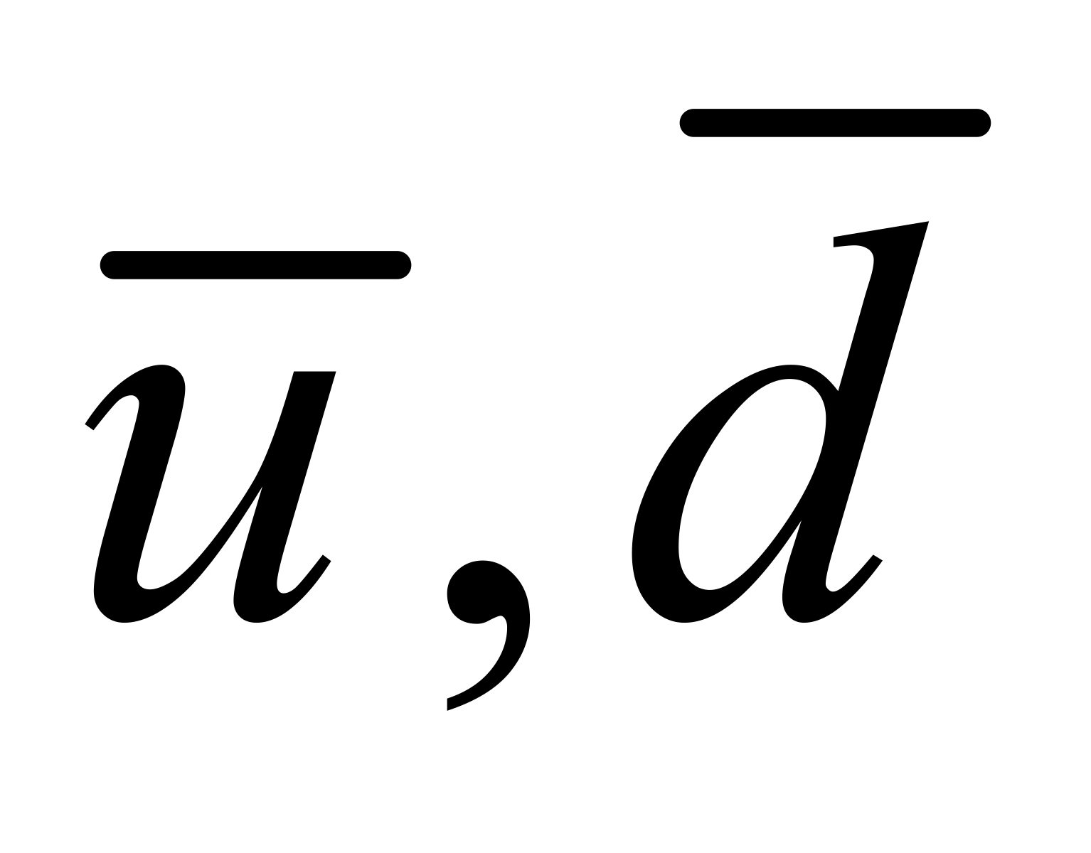
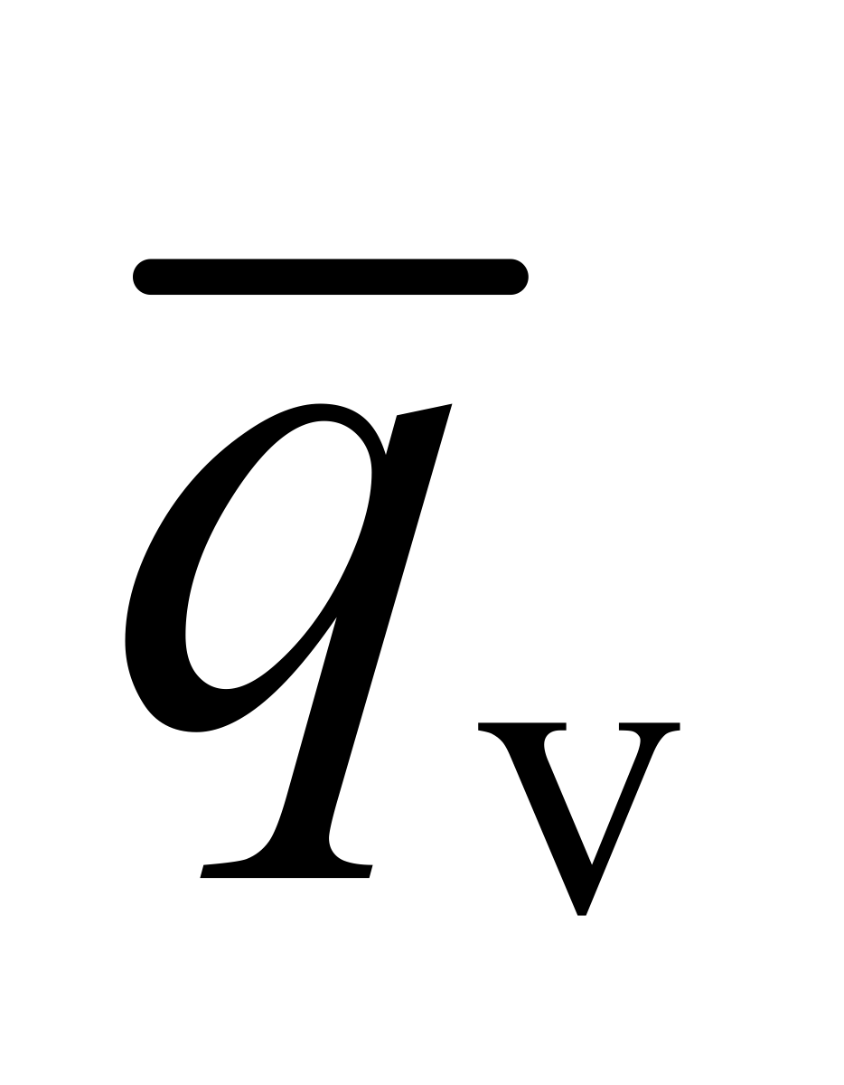
Shower of v-hadrons
Z’
Giorgio Arcadi LDMA2025 Genova

Slide 28
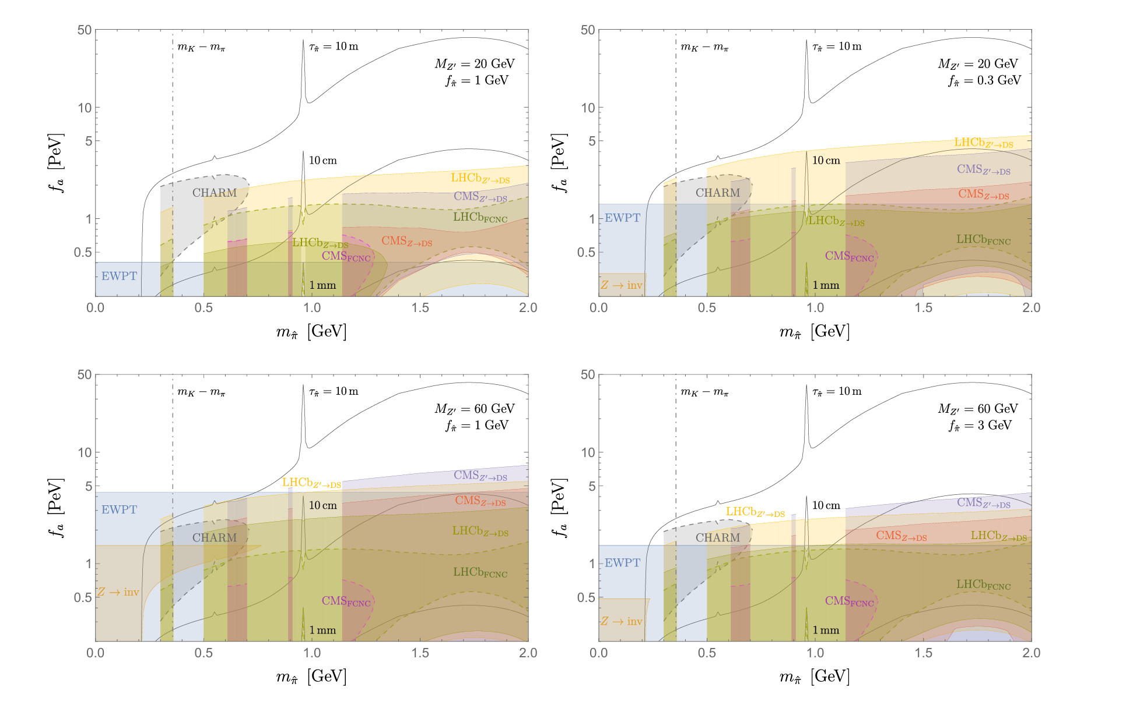
H. Cheng et al
JHEP 04 (2024) 081
Giorgio Arcadi LDMA2025 Genova

Slide 29
Conclusions
LHC is a valid complement to dedicated searches (Direct and Indirect Detection) of Dark Matter.
Potential for searches of light dark particles can be further exploited.
Giorgio Arcadi LDMA2025 Genova

Slide 30
Back up

Slide 31
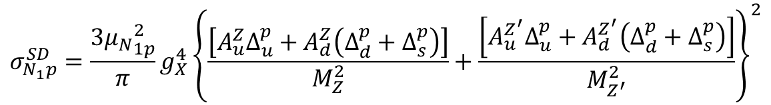

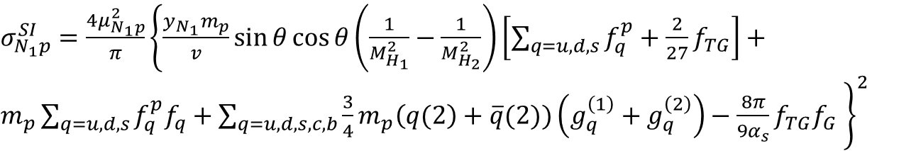

$$L_{DM}=−\frac{y_{N_{1}}}{2\sqrt{2}}ρN_{1}N_{1}−\frac{1}{2}g_{X}X^{μ}\overline{N_{1}}γ_{μ}γ_{5}N_{1}+\frac{1}{2}g_{X}^{2}X_{μ}X^{μ}(ρ^{2}+2ρω)$$
Majorana DM
$$\frac{y_{N_{1}}}{2\sqrt{2}}→g_{X}\frac{m_{N_{1}}}{m_{X}}$$
Relic density due to:
$N_{1}N_{1}→\overline{f}f, N_{1}N_{1}→ρZ^{′}, N_{1}N_{1}→Z^{′}Z^{′}, N_{1}N_{1}→ρρ$
In presence of $h/ρ$, $Z/Z′$ mixing we have
$$N_{1}N_{1}→ZZ, ZZ^{′}, Z^{′}Z^{′}, N_{1}N_{1}→W^{+}W^{−},N_{1}N_{1}→H_{1,2}H_{1,2}$$
$σ_{N_{1}p}^{SI}=\frac{4μ_{N_{1}p}^{2}}{π}{\left\{\frac{y_{N_{1}}m_{p}}{v}\sin{θ\cos{θ\left(\frac{1}{M_{H_{1}}^{2}}−\frac{1}{M_{H_{2}}^{2}}\right)\left[\sum_{q=u,d,s}{f_{q}^{p}+\frac{2}{27}f_{TG}}\right]}}+m_{p}\sum_{q=u,d,s}{f_{q}^{p}f_{q}}+\sum_{q=u,d,s,c,b}{\frac{3}{4}m_{p}\left(q(2\right)}+\overline{q}(2))\left(g_{q}^{\left(1\right)}+g_{q}^{\left(2\right)}\right)−\frac{8π}{9α_{s}}f_{TG}f_{G} \right\}}^{2}$
Direct Detection
$$σ_{N_{1}p}^{SD}=\frac{3{μ_{N}}_{1p}^{2}}{π}g_{X}^{4}{\left\{\frac{\left[A_{u}^{Z}Δ_{u}^{p}+A_{d}^{Z}\left(Δ_{d}^{p}+Δ_{s}^{p}\right)\right]}{M_{Z}^{2}}+\frac{\left[A_{u}^{Z^{′}}Δ_{u}^{p}+A_{d}^{Z^{′}}\left(Δ_{d}^{p}+Δ_{s}^{p}\right)\right]}{M_{Z^{′}}^{2}}\right\}}^{2}$$
Giorgio Arcadi LDMA2025 Genova

Slide 32
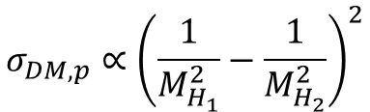
Consistency of the correlation plot for Higgs-to-invisible search
More realistic completion through mixing
$$σ_{DM,p}∝{\left(\frac{1}{M_{H_{1}}^{2}}−\frac{1}{M_{H_{2}}^{2}}\right)}^{2}$$
The additional degree of freedom crucially alters the LHC correlation plot.
Effective Higgs portal
See also:
S. Baek et al. JHEP 05 (2013) 036
S. Baek et al. Phys. Rev. D90 (2014) 055015
Giorgio Arcadi LDMA2025 Genova

Slide 33

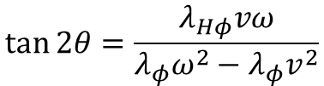
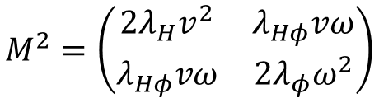
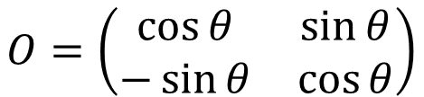
Mixing with a Dark Higgs
$$V\left(H,φ\right)=\frac{λ_{H}}{4}{\left|H^{†}H\right|}^{2}+\frac{λ_{Hφ}}{4}{\left|φ\right|}^{2}{\left|H\right|}^{2}+\frac{λ_{φ}}{4}{\left|S\right|}^{4}+\frac{1}{2}μ_{H}^{2}H^{†}H+\frac{1}{2}μ_{φ}^{2}{\left|φ\right|}^{2}$$
$$O^{T}M^{2}O=diag(M_{H_{1}}^{2},M_{H_{2}}^{2})$$
$$O=\left(\begin{matrix}\cos{θ} & \sin{θ} \\ −\sin{θ} & \cos{θ}\end{matrix}\right)$$
$$M^{2}=\left(\begin{matrix}2λ_{H}v^{2} & λ_{Hφ}vω \\ λ_{Hφ}vω & 2λ_{φ}ω^{2}\end{matrix}\right)$$
$$\tan{2θ=\frac{λ_{Hφ}vω}{λ_{φ}ω^{2}−λ_{φ}v^{2}}}$$
$$L_{φH,SM}=\frac{H_{1}\cos{θ+H_{2}\sin{θ}}}{v}\left(2M_{W}^{2}W_{μ}^{+}W^{−μ}+M_{Z}^{2}Z_{μ}Z^{μ}−m_{f}\overline{f}f\right)$$
Giorgio Arcadi LDMA2025 Genova

Slide 34
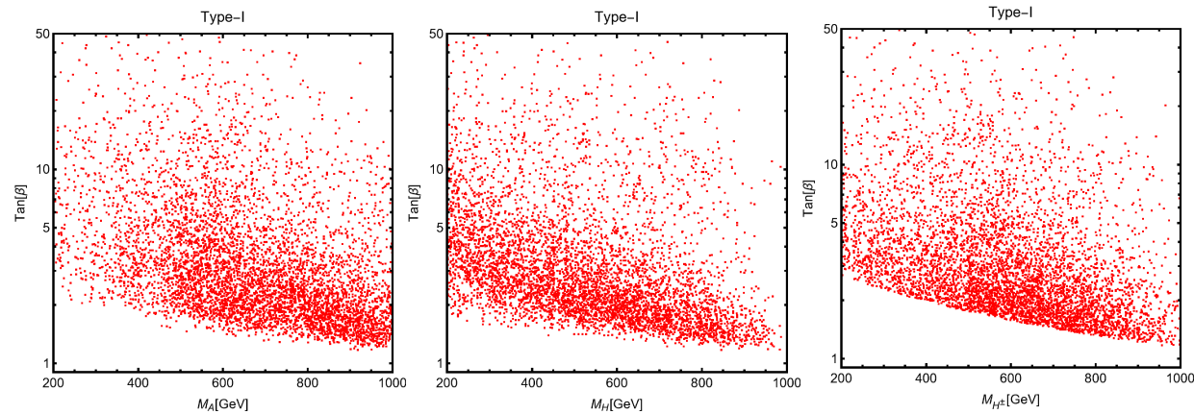
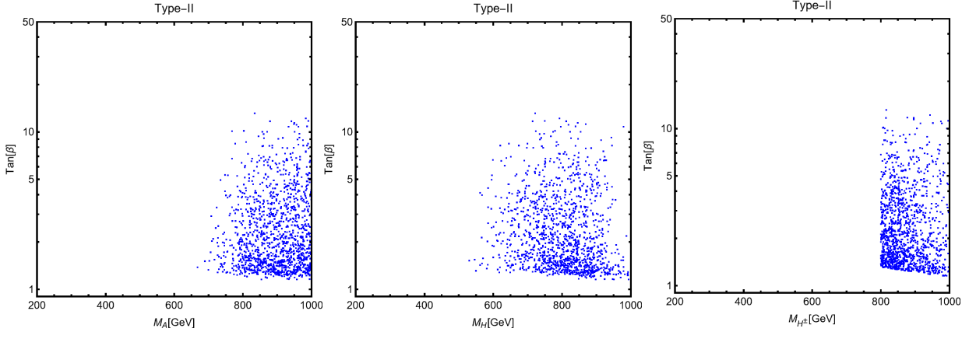
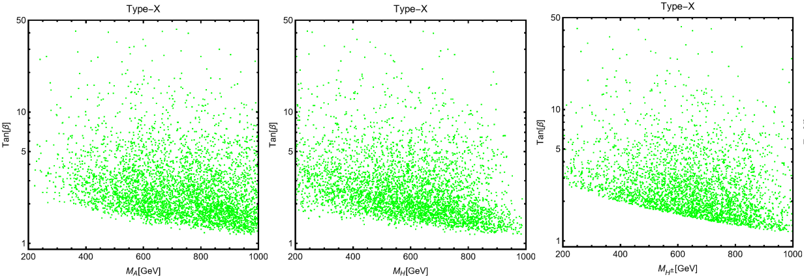

Giorgio Arcadi LDMA2025 Genova

