Slide 1
Overview of future accelerators
(with a CERN bias)
Massimo Giovannozzi
7 November 2024
With special thanks to: M. Beneditk, O. Brüning, P. Hermes, E. Métral, G. Perez Segurana, F. Zimmermann

Slide 2
Outline
HL-LHC
FCC-ee
FCC-hh
Physics Beyond Colliders (PBC)

Slide 3
A look at the medium-term schedule of the LHC

Slide 4
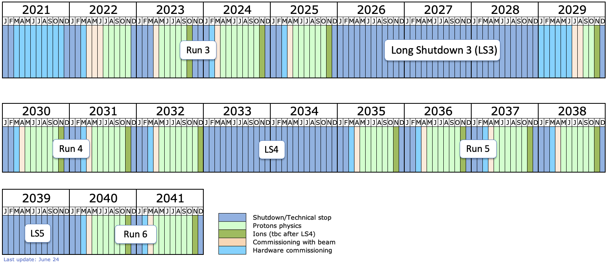
A look at the medium-term schedule of the LHC
LS4 will be one year shifted
Planned LS3 interventions still exceed LS3 length [47 months]
➔ Further Optimization needed!!!

Slide 5
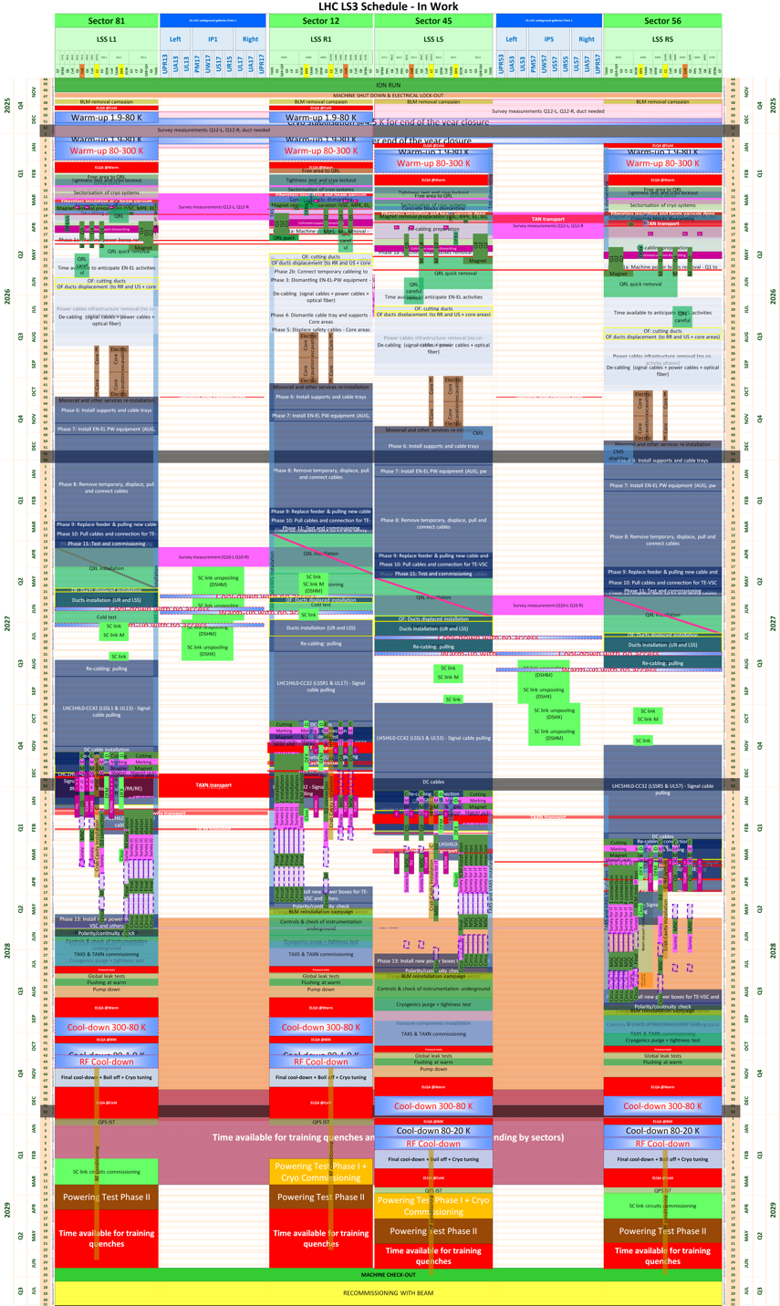
LS3 schedule
Q3 2026
LS3 Schedule – TCC October 2023
Warm-up and related tests
LSS dismantling after cryo lockout
Plus
Injector Complex
North Area Consolidation
ECN3
Experiments (+CO2 cooling)
…
Cabling dismantling
Core excavation (LHC side)
RB in September 2024
➔ New LS3 schedule!
Cabling installation
Long Shutdown 3 (LS3) is going to be very busy!
LSS installation
Triplet installation planned for Q4 2027 to Q4 2028
Crab Cavity installation planned for Q1 to Q2 2028
Cool-down, related test and HWC
Q3 2030
Q3 2029

Slide 6
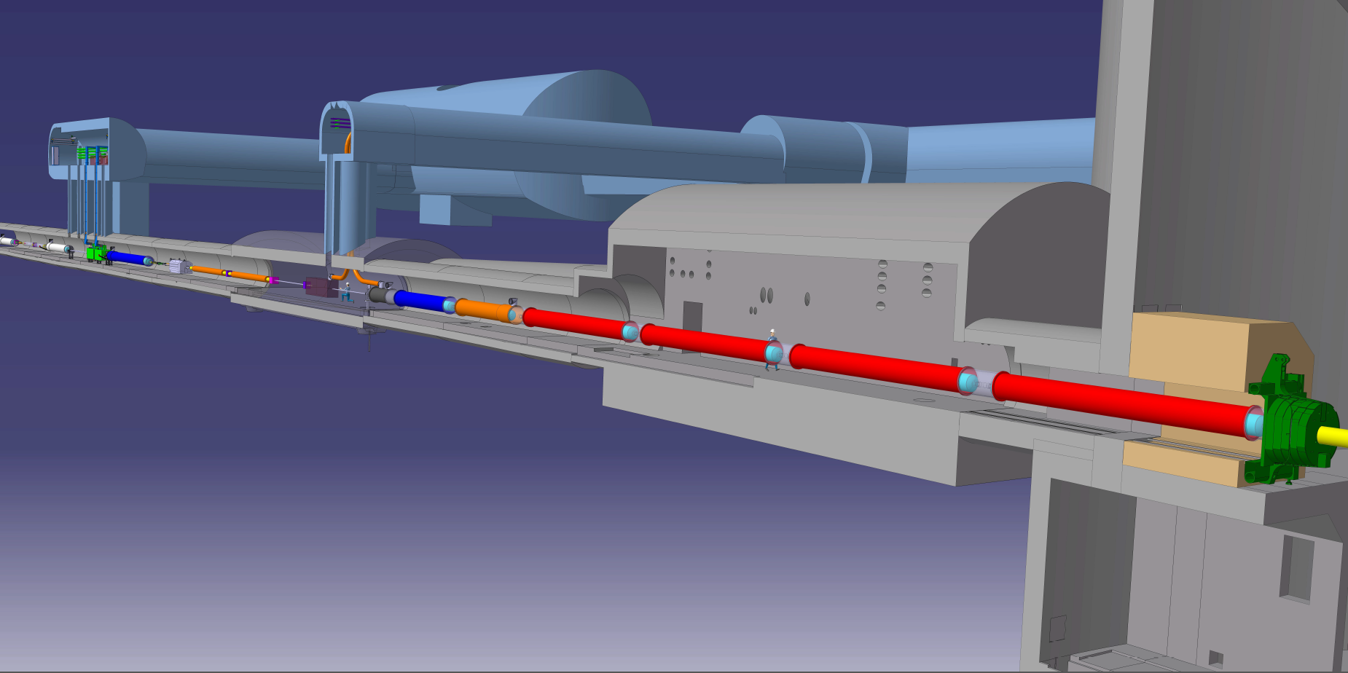








HL-LHC insertion region
Connection to LHC (UL)
Service gallery (UR)
UA Gallery
Service cavern
SC Links
Q4
Collimators
D2
Crab cavities
D1
CP
Q3
TAXN
DFM
DFX
Q2b
Q2a
Q1
TAXS
Lucio Rossi - HiLumi LHC to the CERN guides - Globe 26 February 2019

Slide 7
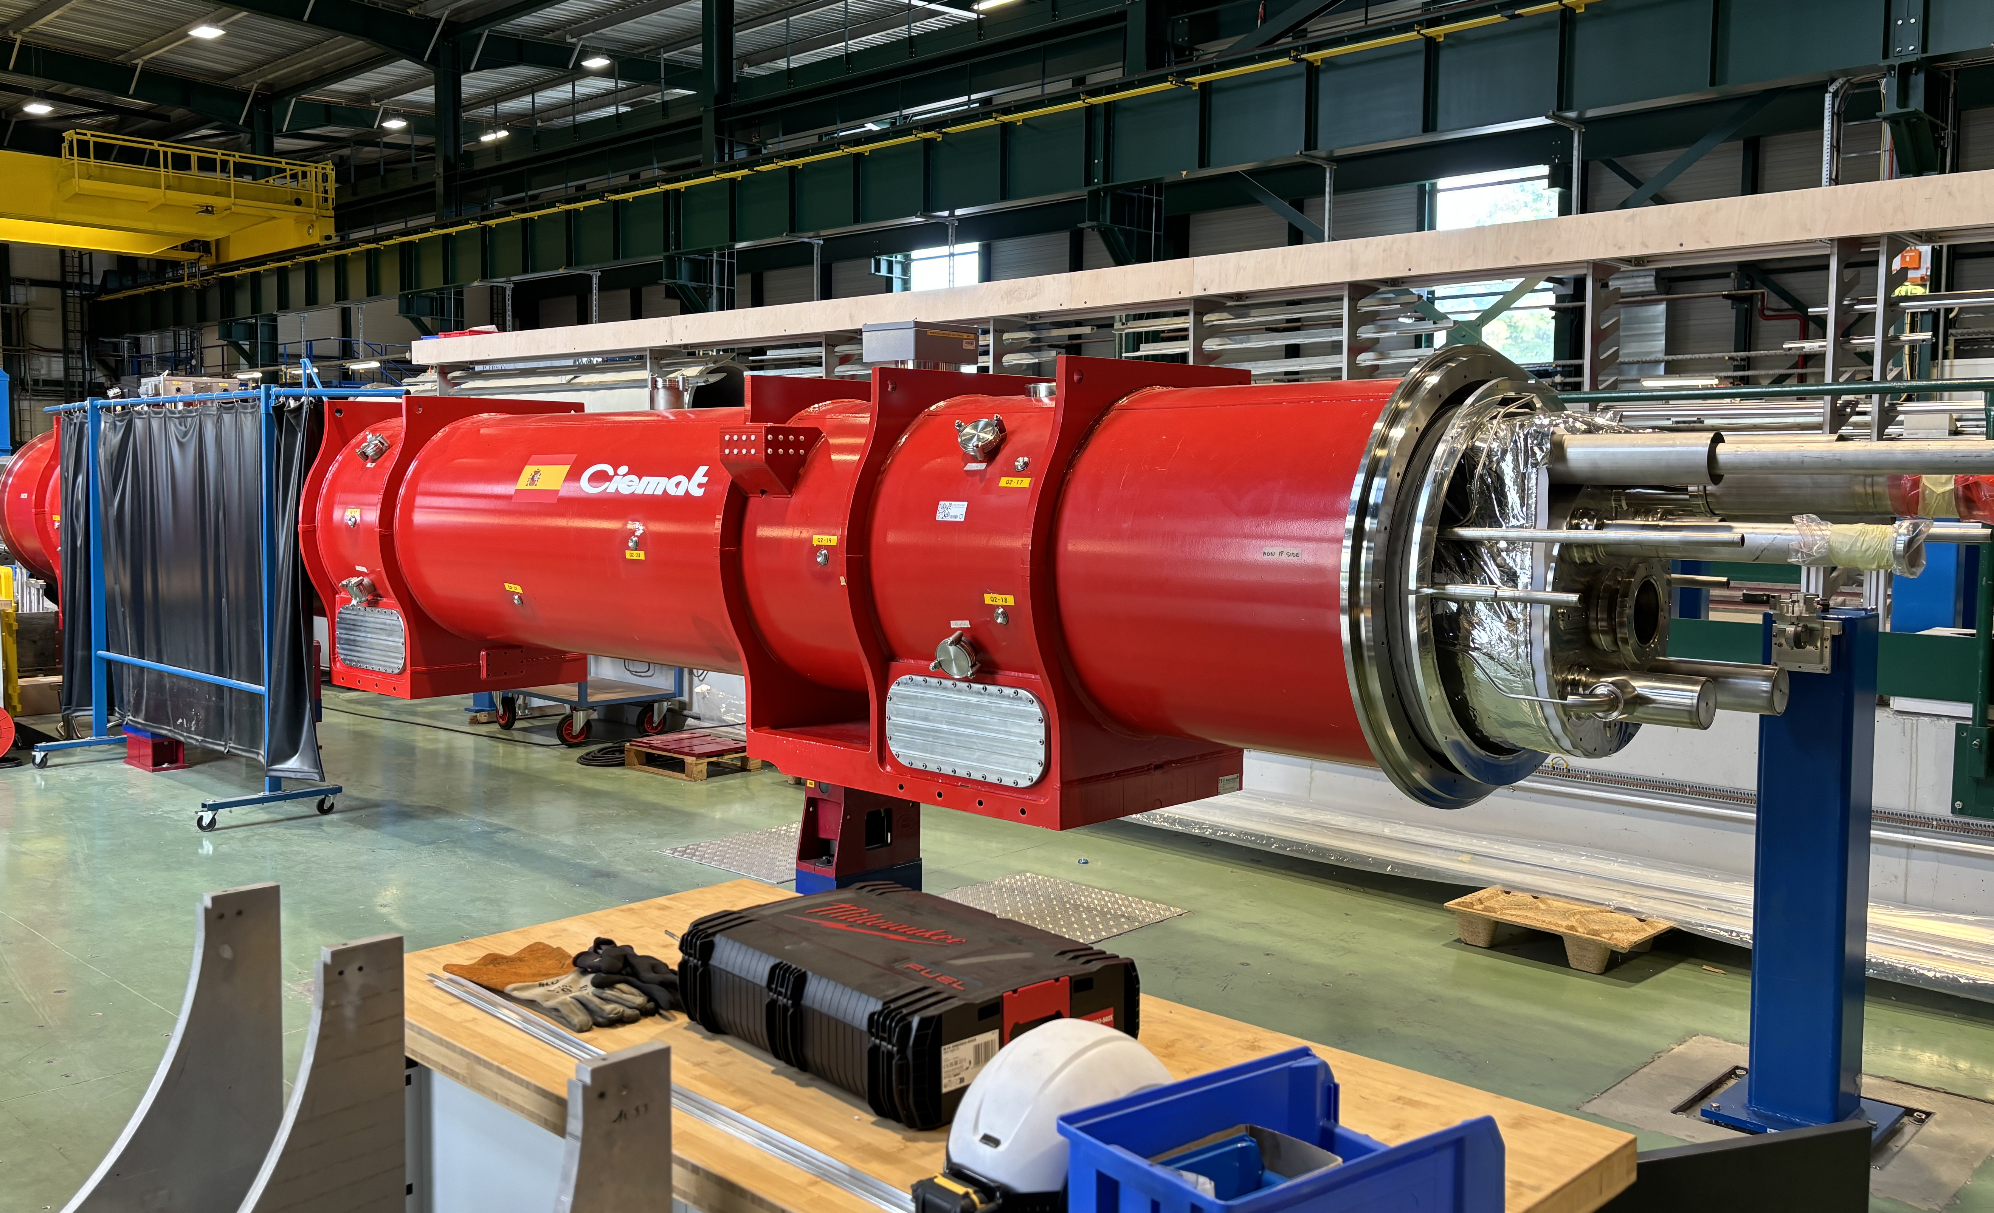
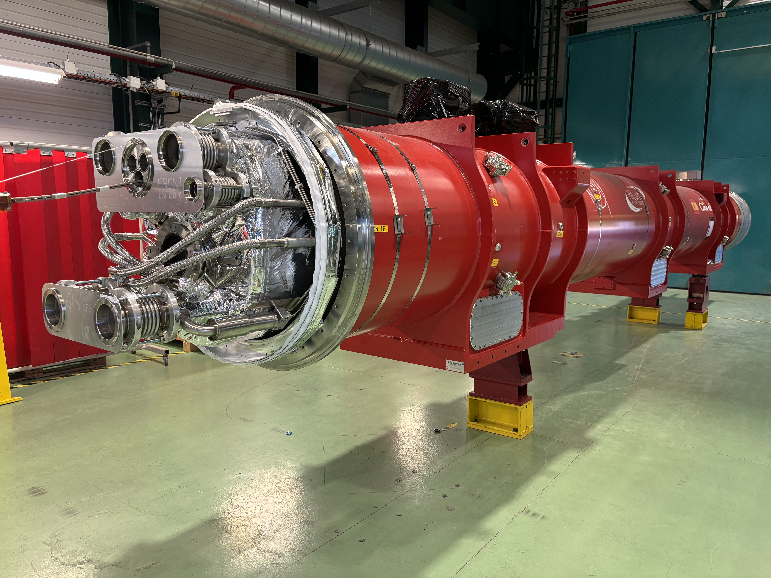
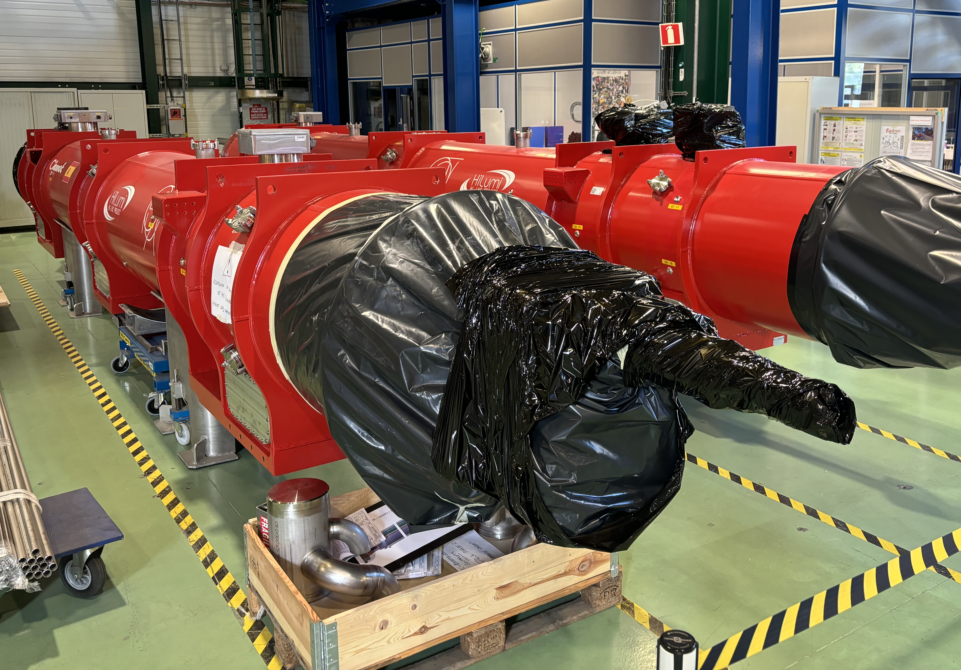
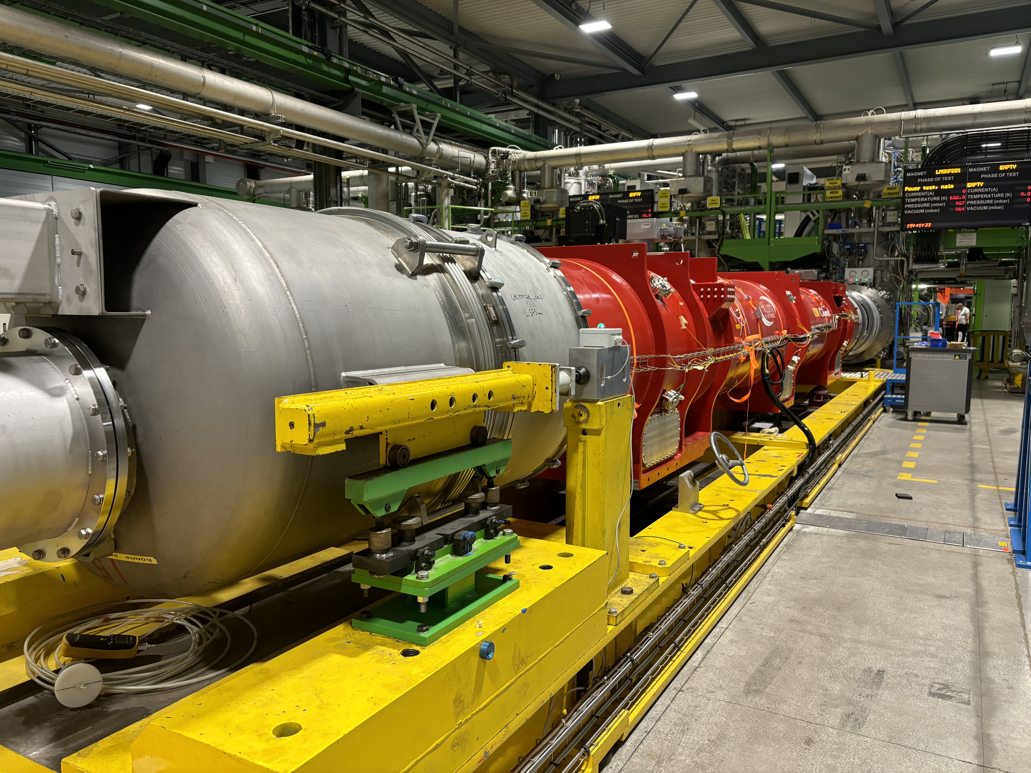
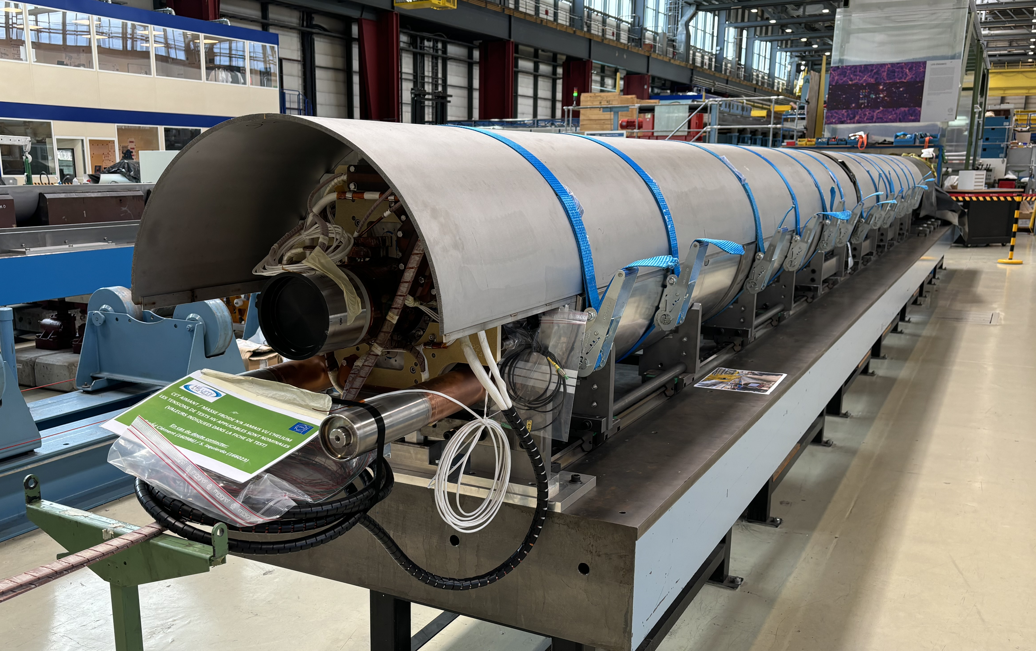
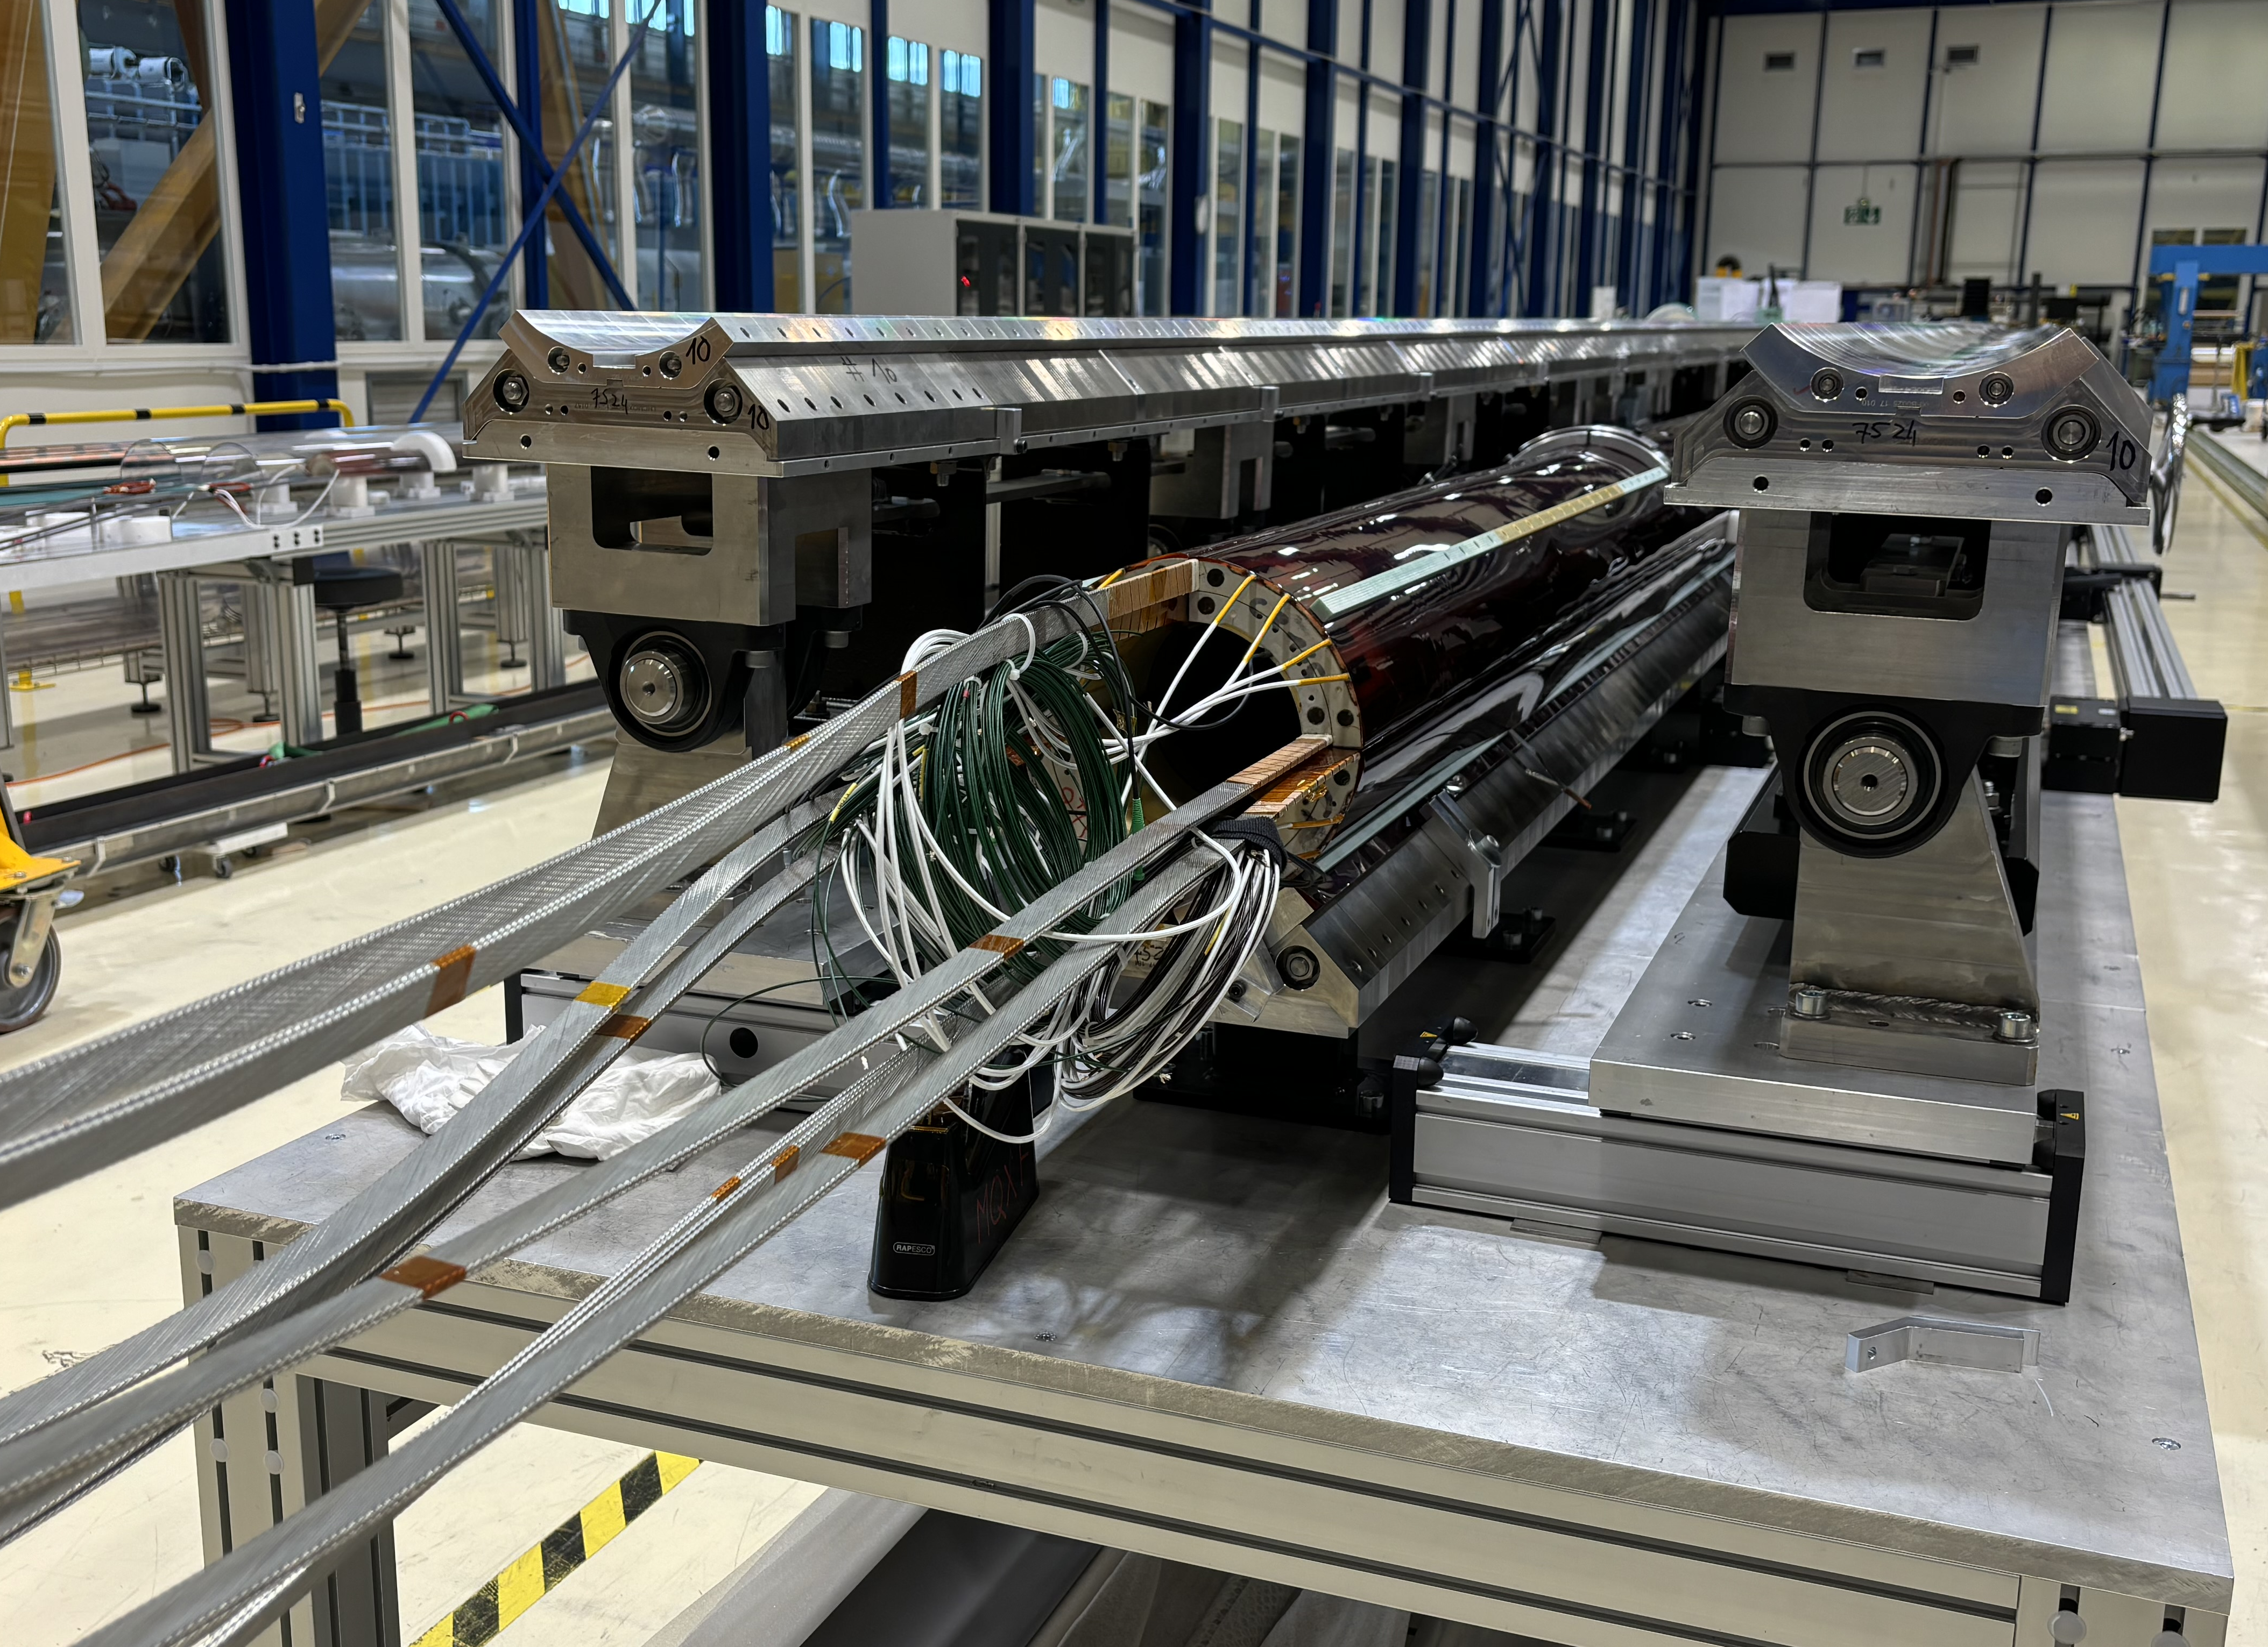
Magnet assembly at CERN
MQXFB03: tested and validated in Q2 config
MQXFB04: to be prepared for HL-LHC
MQXFBP2: being prepared for the HL-LHC string
MQXFBP3: ready for the HL-LHC string
MQXFB05: tested and validated
MQXFB06: ready to be welded
MQXFB07: coil pack assembly started

Slide 8
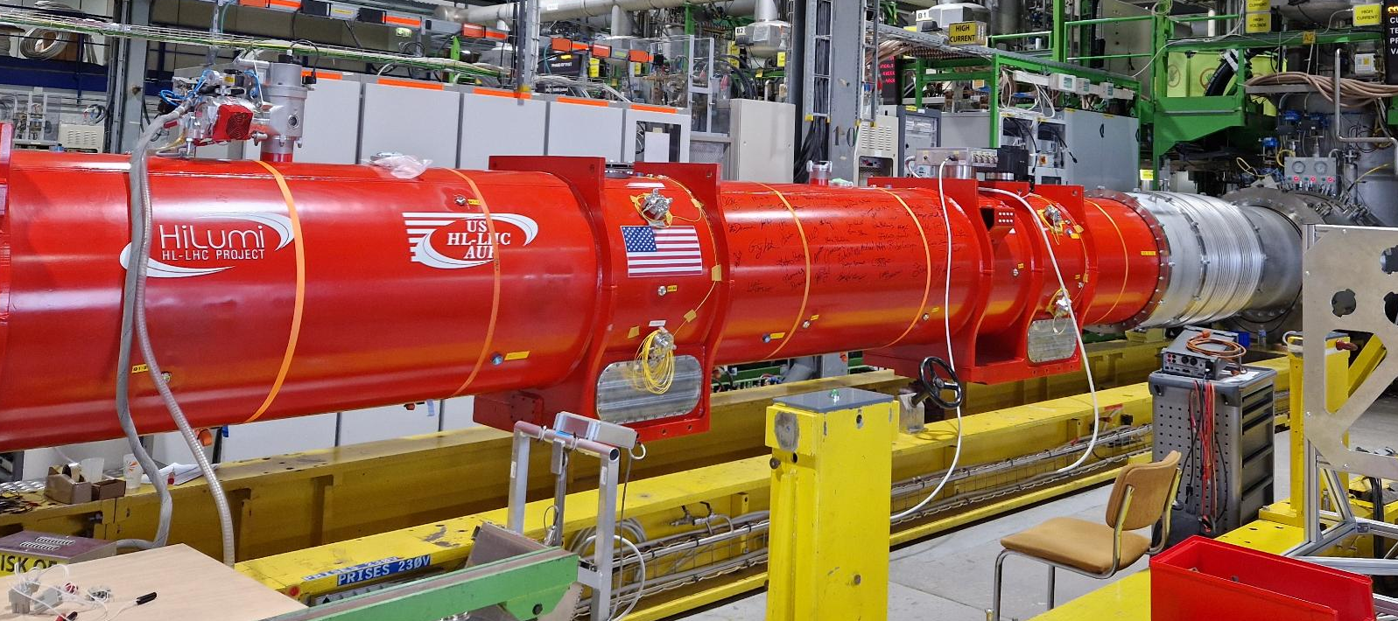
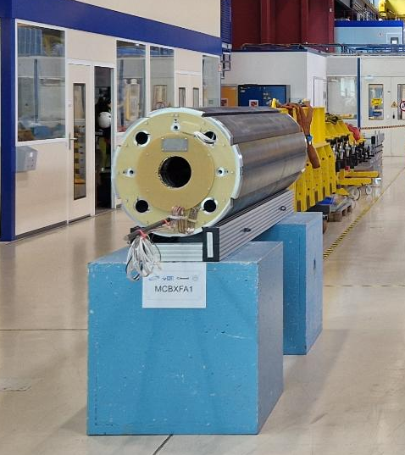
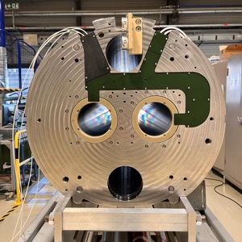
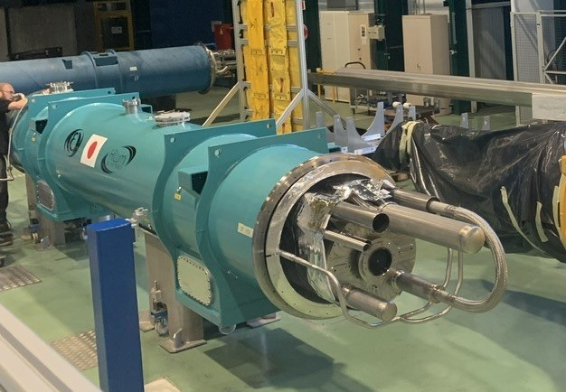
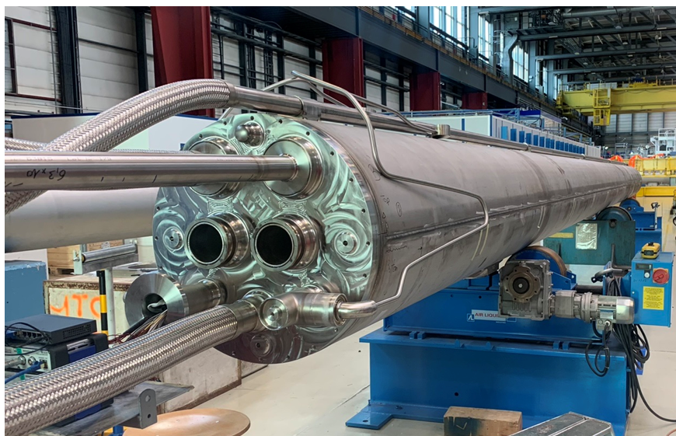
Other magnets
MCBRD - China
Q1/Q3 - USA
MCBXF - Spain
D1 - Japan
D2 - Italy

Slide 9
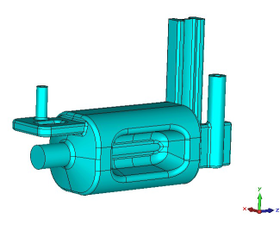
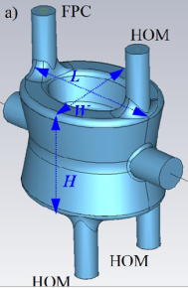
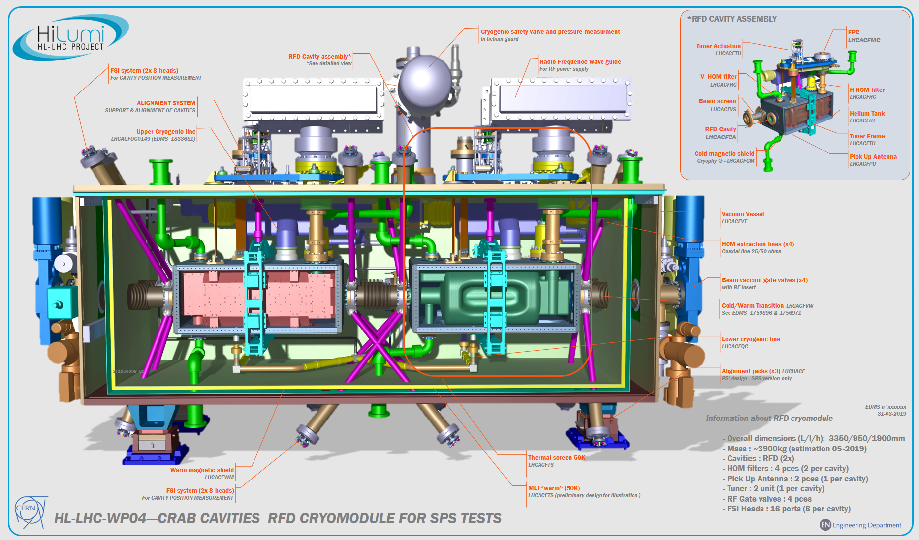
Crab cavities
RF Dipole: Waveguide or
waveguide-coax couplers
Two designs with different coupler concepts and for crossings in the vertical and horizontal planes
NB: this breaks the possibility to exchange crossing plane in IP1 and 5. Only one exchange considered!
Double ¼-wave: Coaxial couplers with
hook-type antenna
Current baseline:
4 cavities / IP / side
2 cavities within one common cryostat

Slide 10
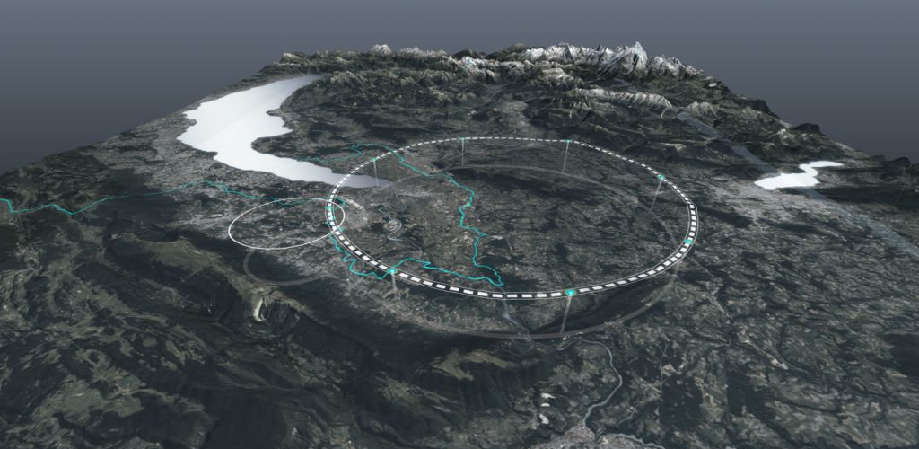
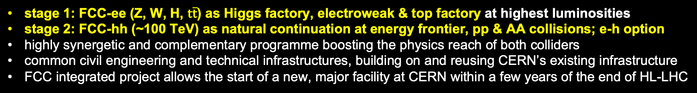
Future Circular Collider: a long-term programme
stage 1: FCC-ee (Z, W, H, $\text{t}\overline{\text{t}}$) as Higgs factory, electroweak & top factory at highest luminosities
stage 2: FCC-hh (~100 TeV) as natural continuation at energy frontier, pp & AA collisions; e-h option
highly synergetic and complementary programme boosting the physics reach of both colliders
common civil engineering and technical infrastructures, building on and reusing CERN’s existing infrastructure
FCC integrated project allows the start of a new, major facility at CERN within a few years of the end of HL-LHC
Documented in M. Benedikt, F. Zimmermann, M. Doser, S. Casalbuoni, 10.5281/zenodo.7675663

Slide 11
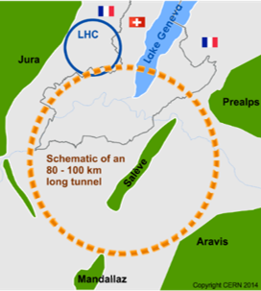
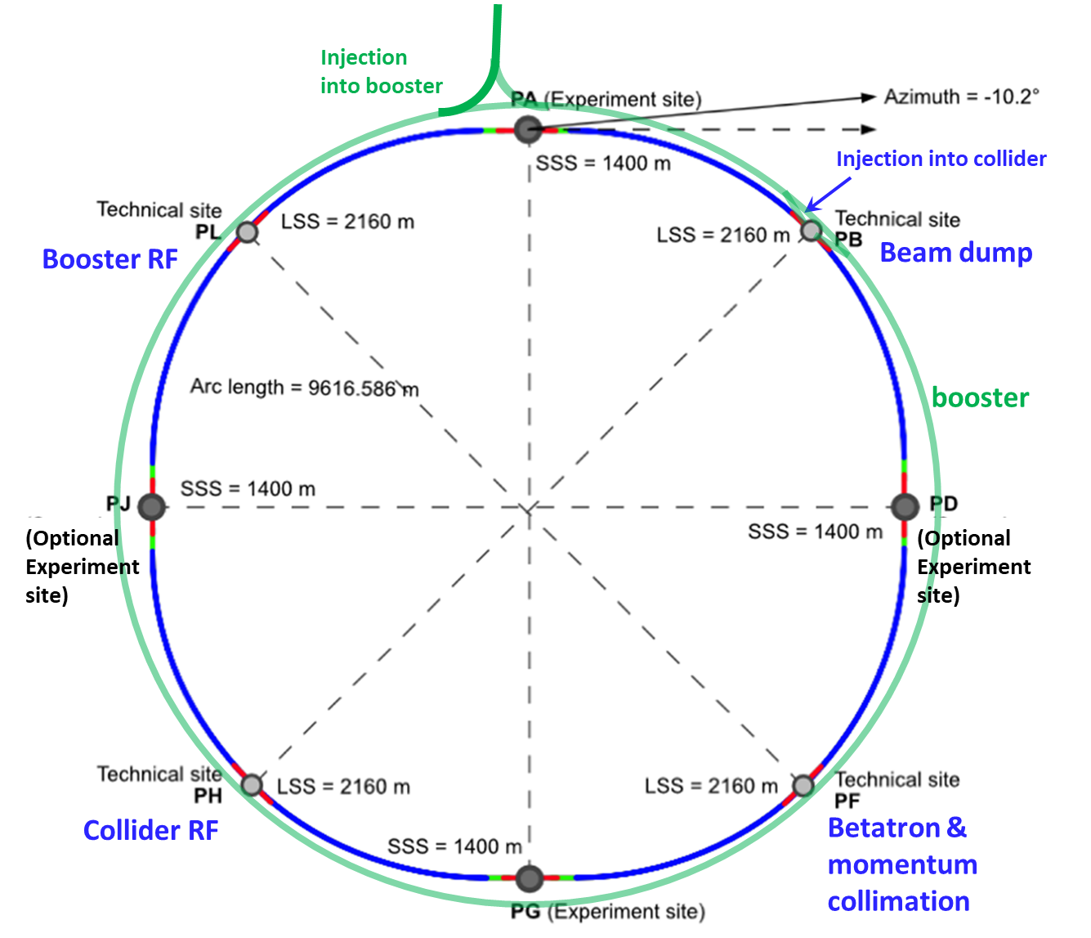
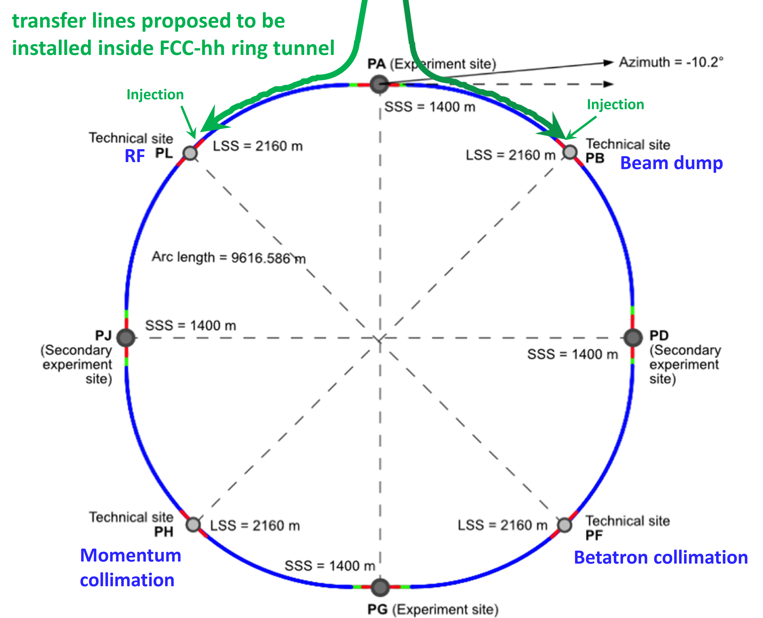
Future Circular Collider: a long-term programme
FCC-ee
FCC-hh
2020 - 2041
2048 - 2063
2074 - 2099

Slide 12
FCC-ee: Mid-term Review main ring parameters
Parameter | Z | WW | H (ZH) | ttbar
beam energy [GeV] | 45.6 | 80 | 120 | 182.5
beam current [mA] | 1270 | 137 | 26.7 | 4.9
number bunches/beam | 11200 | 1780 | 440 | 60
bunch intensity [10¹¹] | 2.14 | 1.45 | 1.15 | 1.55
SR energy loss / turn [GeV] | 0.0394 | 0.374 | 1.89 | 10.4
total RF voltage 400/800 MHz [GV] | 0.120/0 | 1.0/0 | 2.1/0 | 2.1/9.4
long. damping time [turns] | 1158 | 215 | 64 | 18
horizontal beta* [m] | 0.11 | 0.2 | 0.24 | 1.0
vertical beta* [mm] | 0.7 | 1.0 | 1.0 | 1.6
horizontal geometric emittance [nm] | 0.71 | 2.17 | 0.71 | 1.59
vertical geom. emittance [pm] | 1.9 | 2.2 | 1.4 | 1.6
horizontal rms IP spot size [μm] | 9 | 21 | 13 | 40
vertical rms IP spot size [nm] | 36 | 47 | 40 | 51
beam-beam parameter ξ_{x} / ξ_{y} | 0.002/0.0973 | 0.013/0.128 | 0.010/0.088 | 0.073/0.134
rms bunch length with SR / BS [mm] | 5.6 / 15.5 | 3.5 / 5.4 | 3.4 / 4.7 | 1.8 / 2.2
luminosity per IP [10³⁴ cm⁻²s⁻¹] | 140 | 20 | 5.0 | 1.25
total integrated luminosity / IP / year [ab⁻¹/yr] | 17 | 2.4 | 0.6 | 0.15
beam lifetime rad Bhabha + BS [min] | 15 | 12 | 12 | 11
Technical feasibility of changing operation sequences was assessed (e.g. starting at ZH energy)
Up to 4 interaction points:
robustness,
statistics,
possibility of specialised detectors
to maximise physics output
4 years
5 x 10¹² Z
LEP x 10⁵
2 years
> 10⁸ WW
LEP x 10⁴
3 years
2 x 10⁶ H
5 years
2 x 10⁶ tt pairs

Slide 13
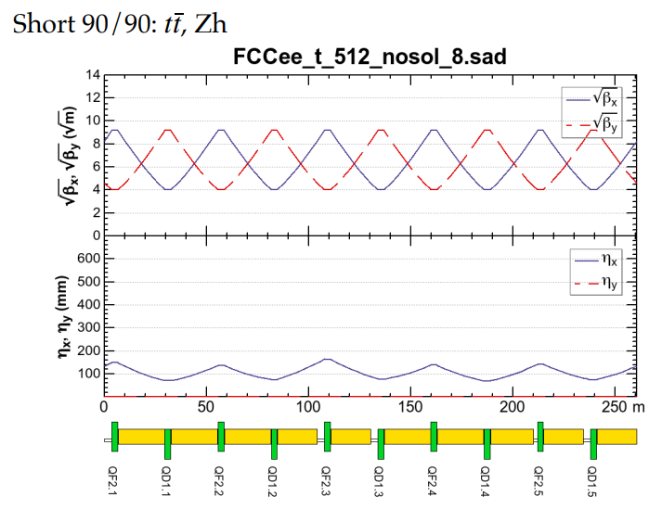
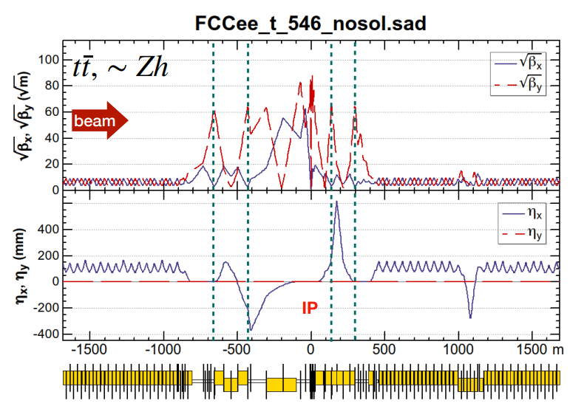
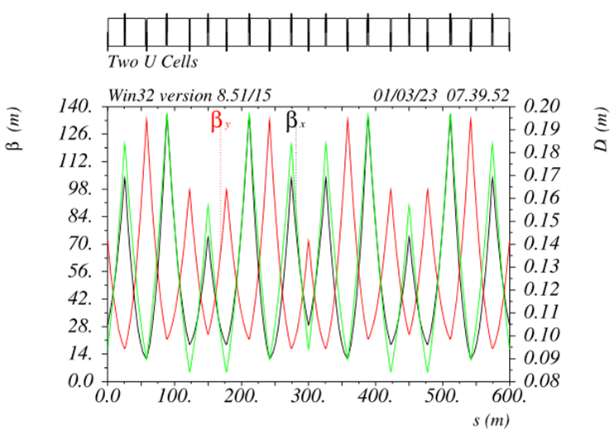
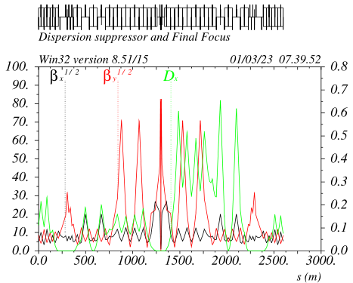
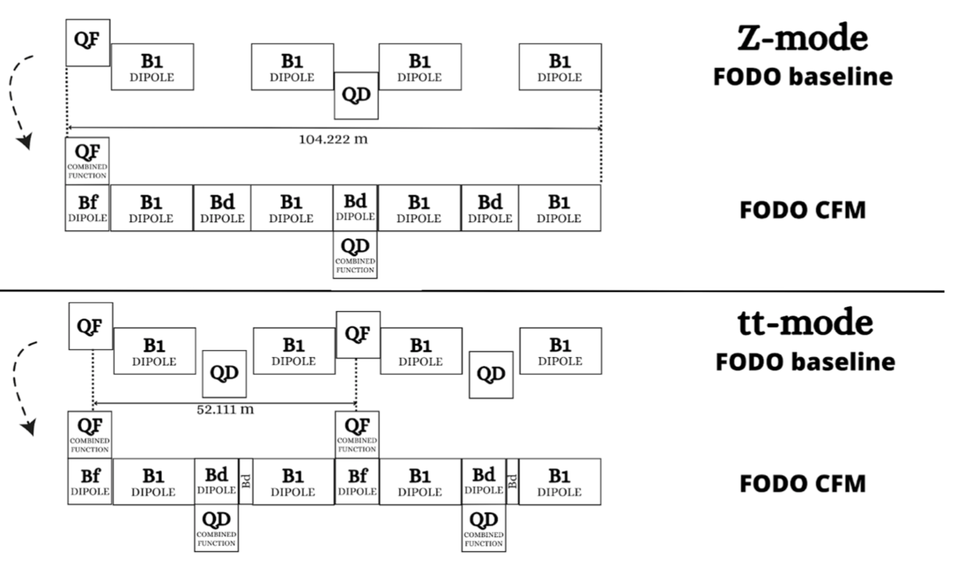
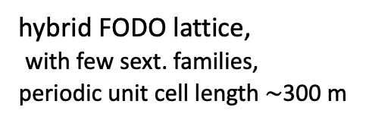
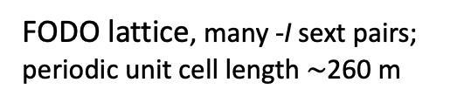
FCC-ee optics baseline and possible evolutions
regular arc
K. Oide
interaction region
K. Oide
optimisation goals:
reduced power consumption
lower SR energy loss
increased momentum acceptance
relaxed tolerances
larger dynamic aperture
simplified powering schemes
FODO lattice, many -I sext pairs; periodic unit cell length $\sim$260 m
“1.5” sext.s per final focus,
asymmetric
P. Raimondi
P. Raimondi
hybrid FODO lattice,
with few sext. families,
periodic unit cell length$\sim$300 m
5 sext.s per final focus, modular
C. Garcia,
R. Tomas, et al.

Slide 14
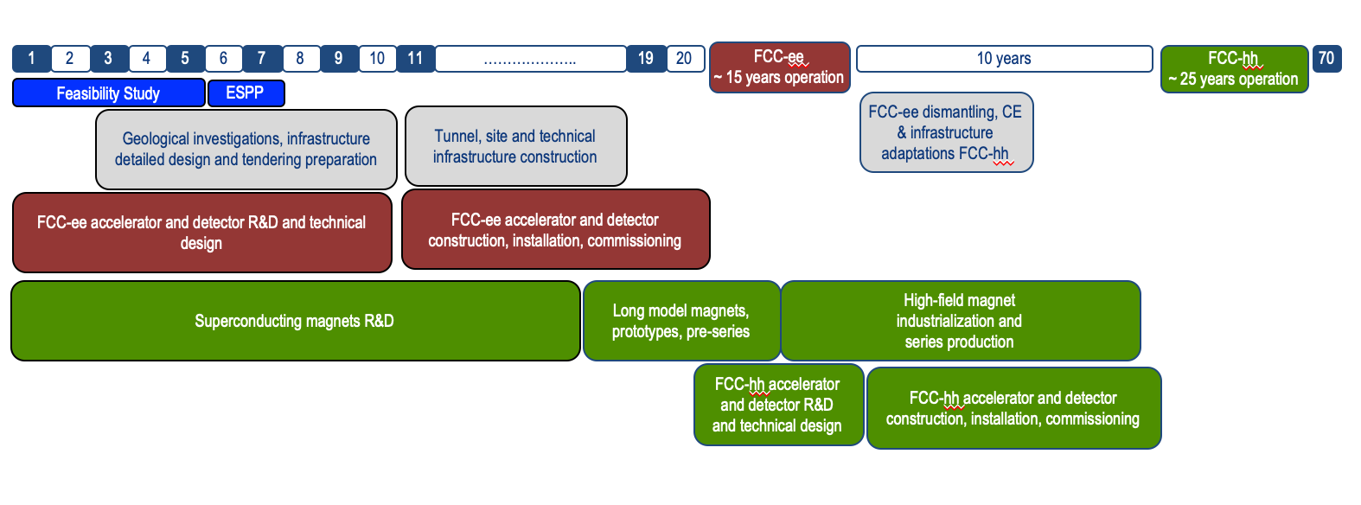
FCC schedule
FCC Conceptual Design Study started in 2014 leading to CDR in 2018
2021- 25:
Feasibility Study
2027/2028:
Project Approval by CERN Council
2032:
Start of construction
2041:
HL-LHC ends
~2045:
Operation of FCC-ee
~2070:
Operation of FCC-hh
“Realistic” schedule taking into account:
past experience in building colliders at CERN
approval timeline: ESPP, Council decision
HL-LHC runs until 2041
Can be further accelerated if more resources become available

Slide 15
FCC Feasibility Study Mid-term Review
Mid-term review setup and deliverables have been defined by CERN SPC
  The scientific and technical results be reviewed by the FCC FS Scientific Advisory Committee, augmented by additional experts as needed;
  The cost and financial feasibility, which will focus on the first-stage project (tunnel, technical infrastructure, FCC-ee machine and injectors), be reviewed by a committee including external experts;
The goal is to assess the progress of the study towards the final report.
Deliverables:
D1 : Definition of the baseline scenario
D2 : Civil engineering
D3 : Processes and implementation studies with the Host States
D4 : Technical infrastructure
D5 : FCC-ee accelerator
D6: FCC-hh accelerator
D7: Project cost and financial feasibility
D8: Physics, experiments and detectors
Documents:
Mid-term report (all deliverables except D7)
Executive Summary of mid-term report
Updated cost assessment (D7)
Funding model (D7)
Review process:
Oct 2023: Scientific Advisory Committee (scientific and technical aspects)
and Cost Review Panel (ad hoc committee; cost and financial aspects)
Nov 2023: SPC and FC
2 Feb 2024: Council
All deliverables met, no technical showstoppers

Slide 16




FCC timeline till start of construction
2024
2025
2026
2027
2028
2029
2030
2031
2032
2033
Feasibility Study
Pre-TDR Phase
TDR Phase
Construction →→→
FS Report
cost update
ESPPU
2025/26
pre TDR
cost update
TDR
cost update
Project
Decision
accelerator design, technical infrastructure design, R&D, towards TDR
engineering design →
Environmental Impact study & Authorization Process
Phase 1 Site Investigations
Phase 2 Site Investigations
CE Concept Design update
CE Tender Design
Construction Design
Start construction
Detector EOI submissions
FC³ formation, call for CDRs
Detector CDRs submitted to FC³

Slide 17
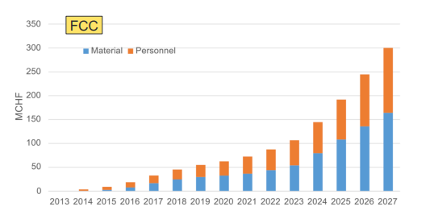
Recent decisions by CERN Council
February 2024: special Council meeting: successful Mid-Term Review;
March 2024: ESPPU schedule 2025/2026 approved with input by March 2025, conclusions mid 2026; compatible with “accelerated” FCC schedule
June 2024: approval of modified CERN Medium Term Plan (MTP), including more resources for FCC-FS completion and for FCC pre-TDR phase
Additional expenses in June 2024 MTP to prepare for CERN’s future
Future Circular Collider (FCC)
Additional resources for the Feasibility Study → 13 MCHF (until March 2025, when final report will be submitted)
Funding for “pre-TDR phase” → 82 MCHF (April 2025-end 2027)
Superconducting radiofrequency technology (SRF)
Ramp up R&D for future accelerators (until now 2.3 MCHF/year) → 9.7 MCHF (2025-2027)
cumulative FCC funding up to
end pre-TDR phase
w/o HFM & SRF

Slide 18
FCC-hh: Mid-term Review main ring parameters
parameter | FCC-hh | HL-LHC | LHC
collision energy cms [TeV] | 84 - 120 | 14 | 14
dipole field [T] | 14 - 20 | 8.33 | 8.33
circumference [km] | 90.7 | 26.7 | 26.7
arc length [km] | 76.9 | 22.5
beam current [A] | 0.5 | 1.1 | 0.58
bunch intensity [10¹¹] | 1 | 2.2 | 1.15
bunch spacing [ns] | 25 | 25 | 25
synchr. rad. power / ring [kW] | 1100 - 4570 | 7.3 | 3.6
SR power / length [W/m/ap.] | 14 - 58 | 0.33 | 0.17
long. emit. damping time [h] | 0.77 – 0.26 | 12.9 | 12.9
peak luminosity [10³⁴ cm⁻²s⁻¹] | ~30 | 5 (lev.) | 1
events/bunch crossing | ~1000 | 132 | 27
stored energy/beam [GJ] | 6.3 – 9.2 | 0.7 | 0.36
Integrated luminosity/main IP [fb⁻¹] | 20000 | 3000 | 300
Challenges:
high-field superconducting magnets: 14 - 20 T
power load in arcs from synchrotron radiation: 4 MW → cryogenics, vacuum
stored beam energy: ~ 9 GJ → machine protection
pile-up in the detectors: ~1000 events/xing
energy consumption: 4 TWh/year → R&D on cryo, HTS, beam current, …

Slide 19
Main changes in FCC-hh layout and optics since CDR
The main drivers
Placement studies
FCC-ee layout (the choice of having four symmetrical experimental IPs)
RF harmonic number to optimize transfer from injector
The main choices
Reduce the length of the ring circumference
Reduce the length of technical insertions
Displace radially the experimental IPs to match position of FCC-ee IPs
Reduce the number of access shafts
Four-fold symmetry
Re-organize functionalities of insertions
Locate transfer lines in ring tunnel
Parameter | Value
Collision energy cms [TeV] | 84.6 – 120.8
Dipole field [T] | 14(Nb₃Sn) - 20(HTS/Hybrid)
Circumference [km] | 90.66
Although some of the circumference reduction comes from technical insertion, lost ~6.5km of arcs.
Maximize dipole filling factor to maximize collision energy.

Slide 20
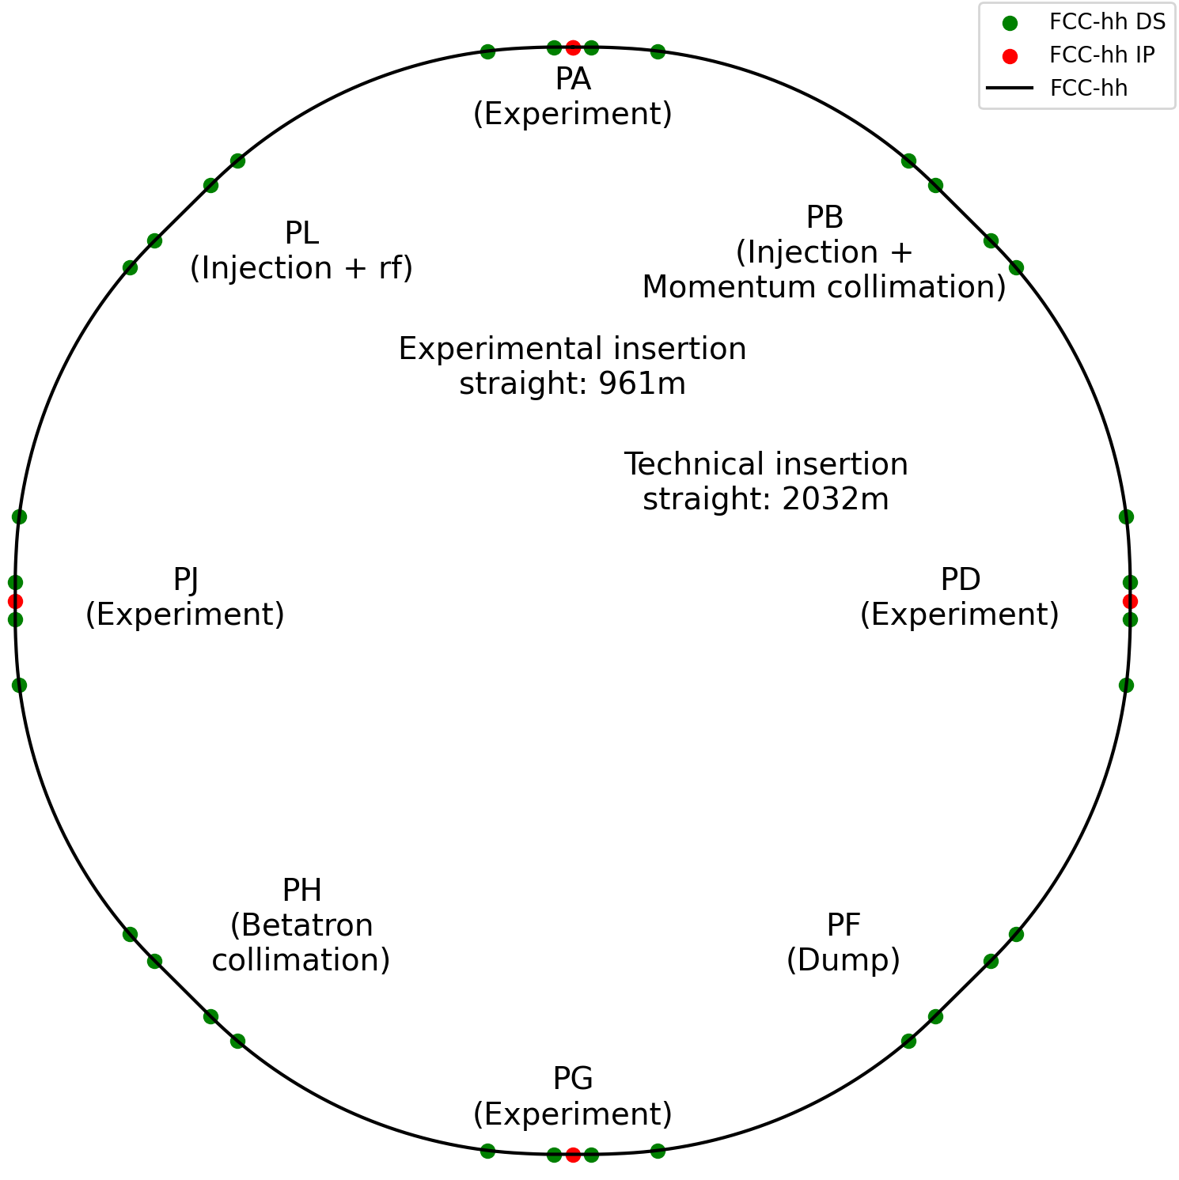
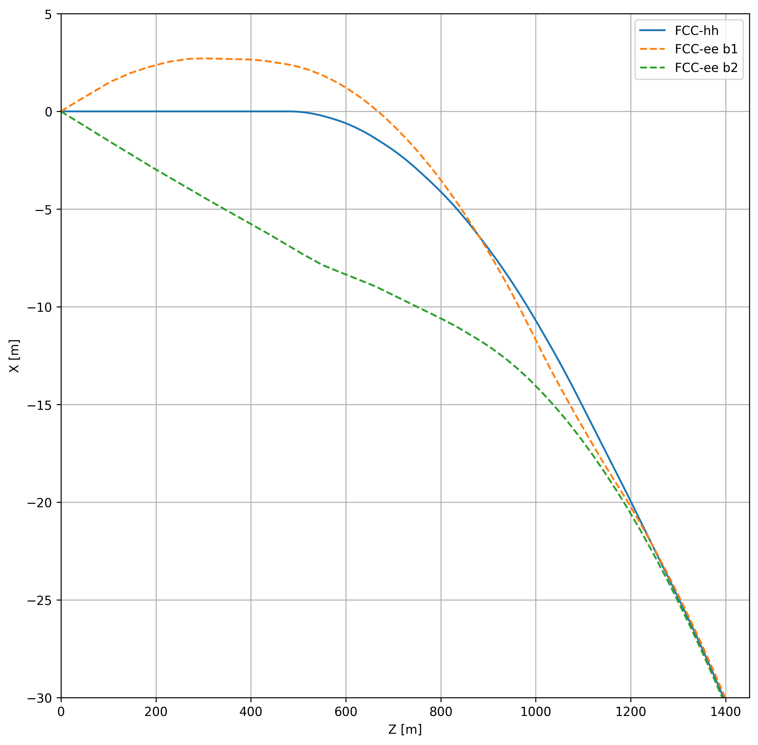
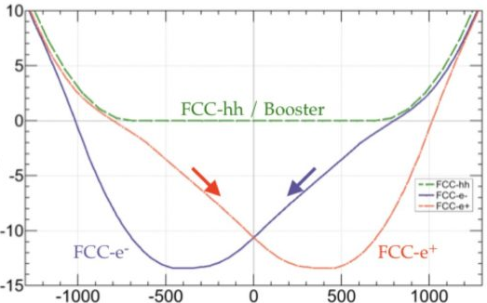
Main changes in FCC-hh layout and optics since CDR
Circumference: 97.75 km
Circumference: 90.66 km

Slide 21

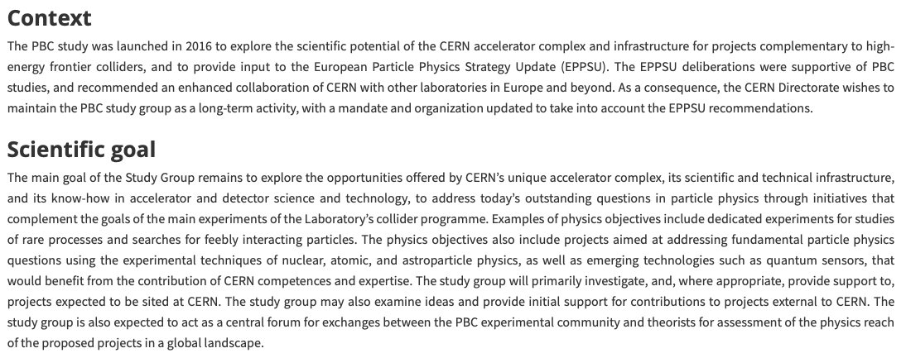
Physics Beyond Colliders (PBC)

Slide 22
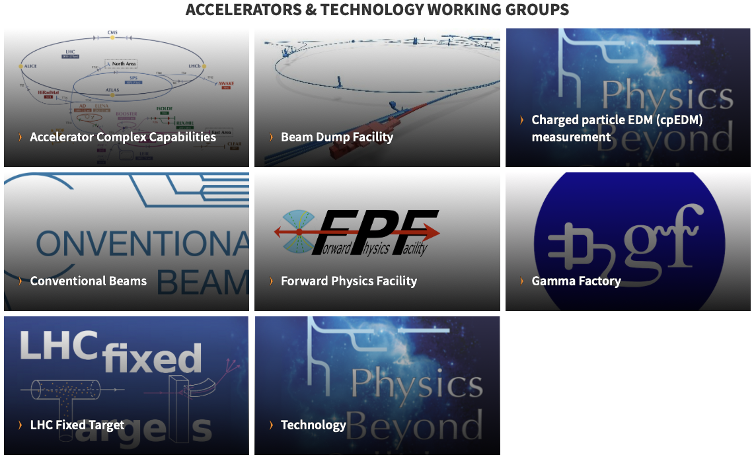
Physics Beyond Colliders (PBC)

Slide 23
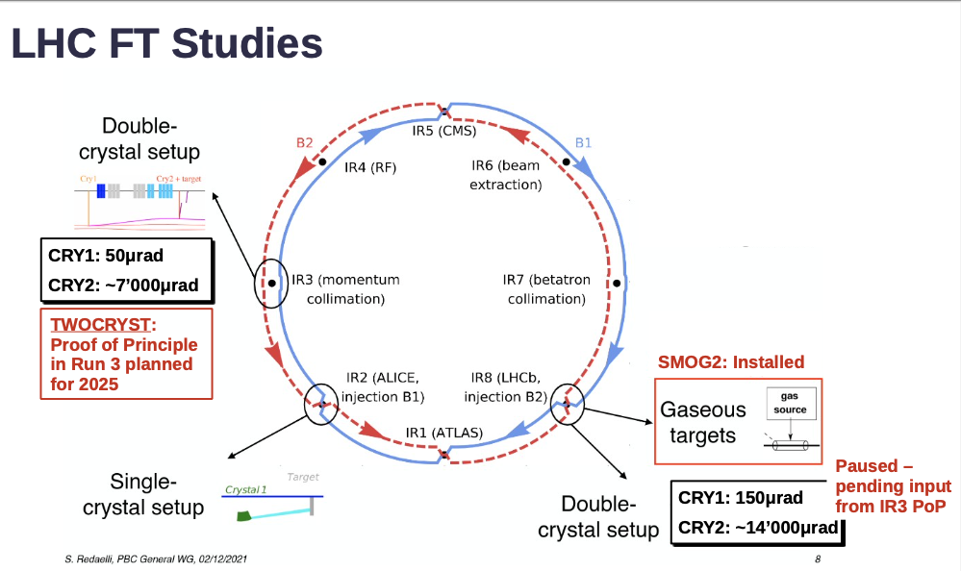
Physics Beyond Colliders (PBC)

Slide 24
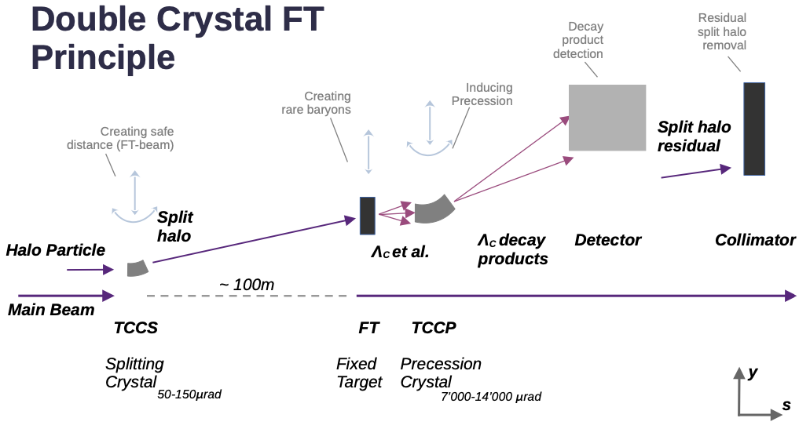
Physics Beyond Colliders (PBC)

Slide 25
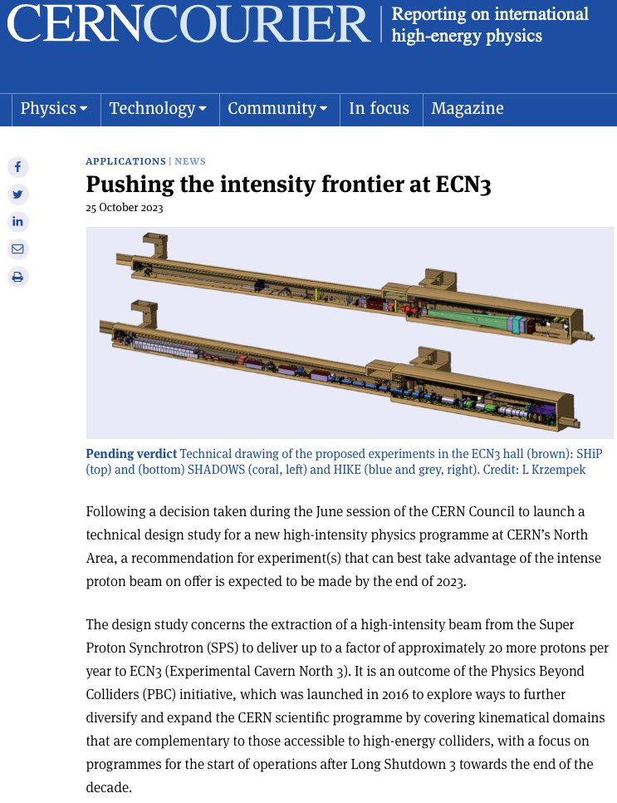
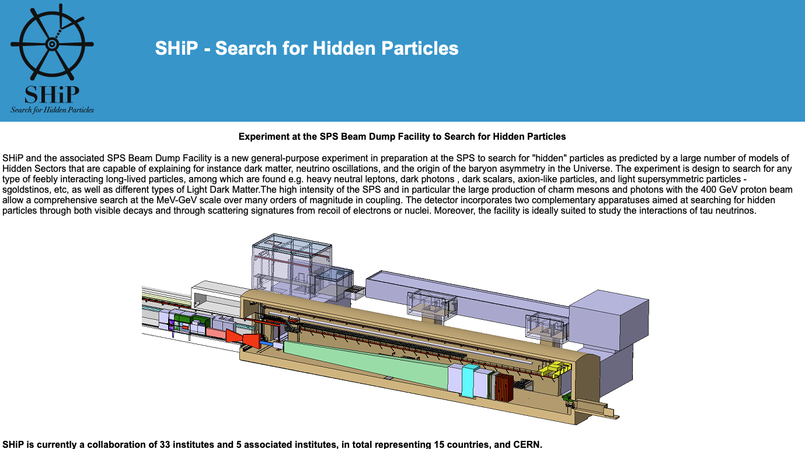
Physics Beyond Colliders (PBC)

Slide 26
Thank you for your attention

