Slide 1
DUNE Phase II @ BO
Sergio Bertolucci
Strategy Meeting
Bologna, November 7, 2024

Slide 2
The LBNF/DUNE vision is achieved by groundbreaking international partnerships
PIP-II
DOE LBNF/DUNE-US Project
Long Baseline Neutrino Facility – facilities with partner in-kind contributions
DUNE-US – U.S. contribution to the international DUNE experiment
International DUNE - partner contributions to the international DUNE experiment
LBNF and DUNE-US are one DOE Order 413.3B Project

Slide 3
DUNE in a slide
DUNE has unique capabilities that are competitive/complementary with Hyper-K and the global ν program:
Neutrino oscillations
Supernova physics
Atmospheric neutrinos
Solar neutrinos
BSM searches

Slide 4
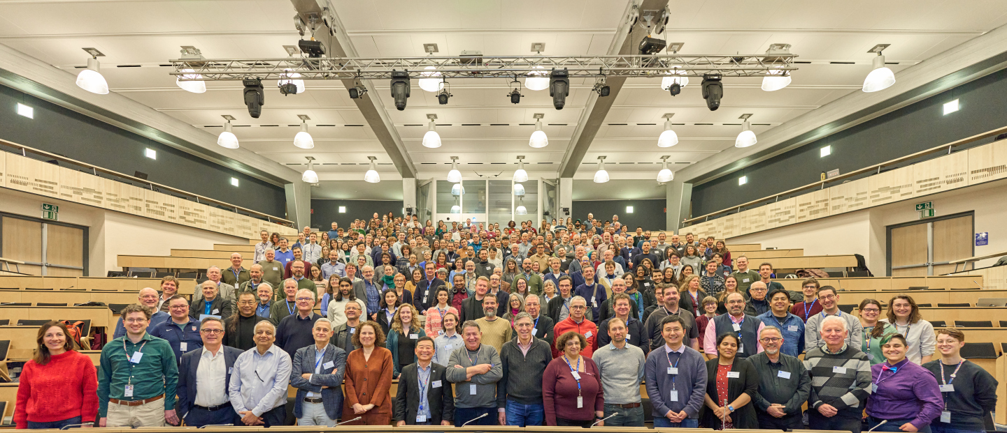
DUNE Jan 2024 Meeting
Total participants : 663 In person: ~370

Slide 5
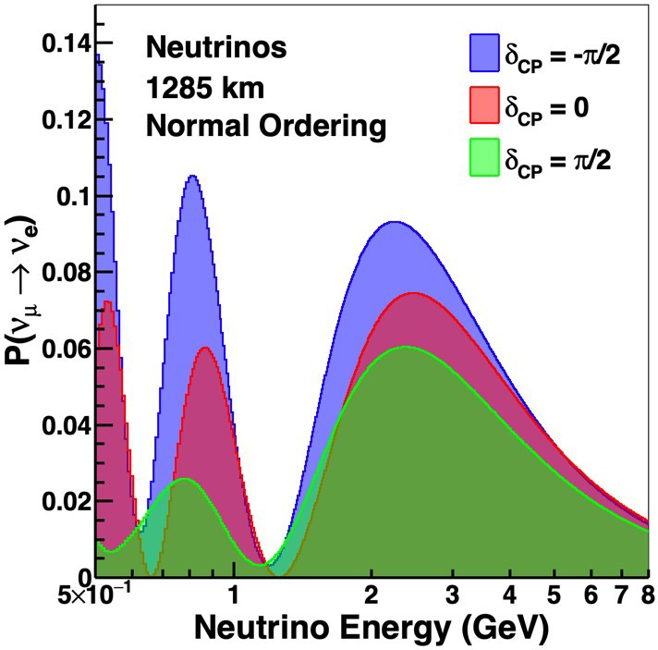
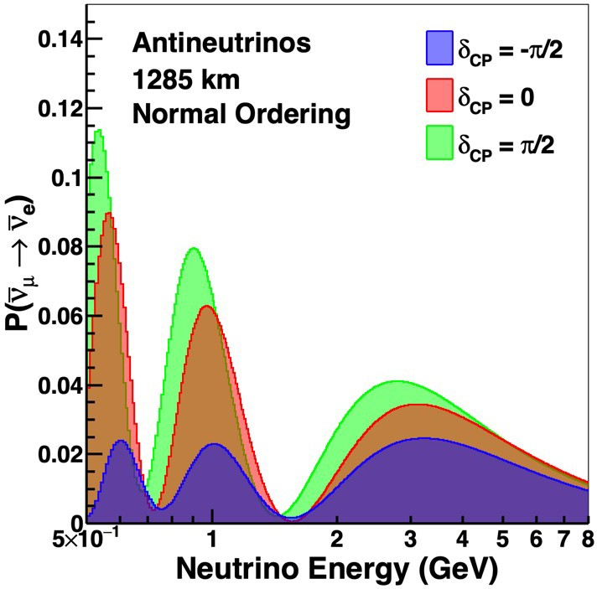
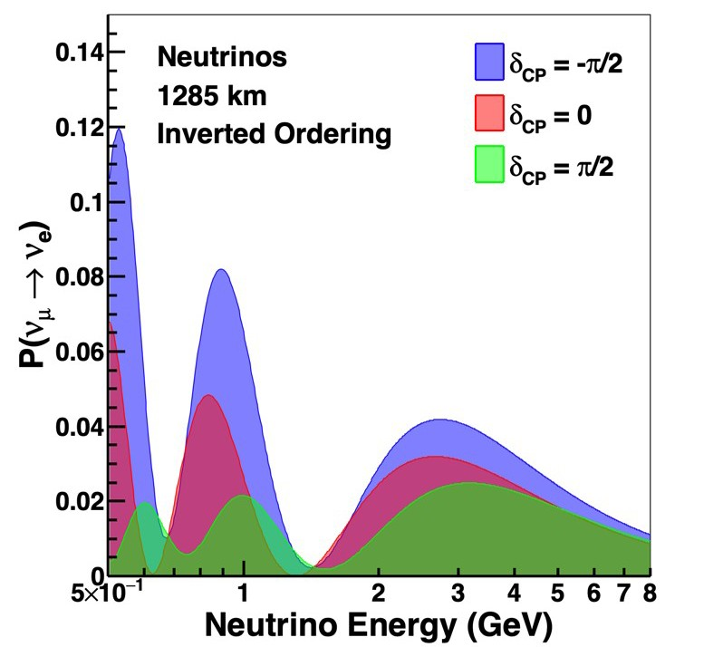
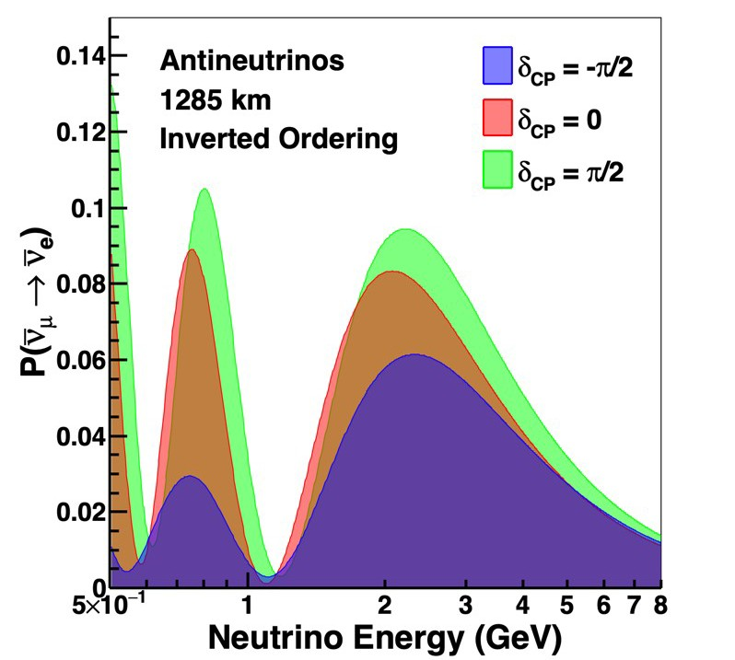
DUNE: large matter effect, broad neutrino beam
Large matter effect → CPV and mass ordering are totally non-degenerate
Spectral information resolves degeneracies between θ₂₃, θ₁₃, and δ_{CP}, and enables searches for non- standard oscillations
●

Slide 6
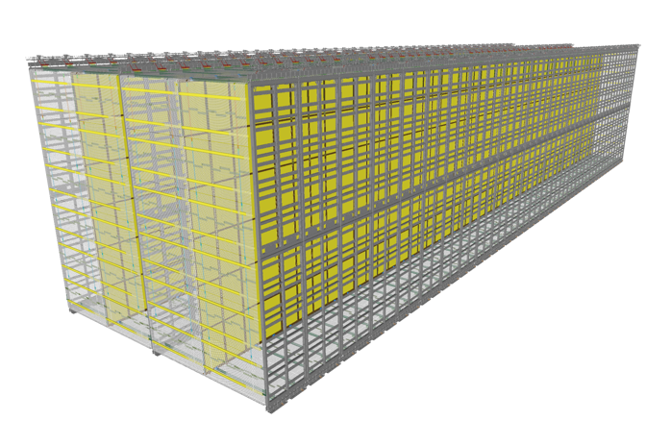
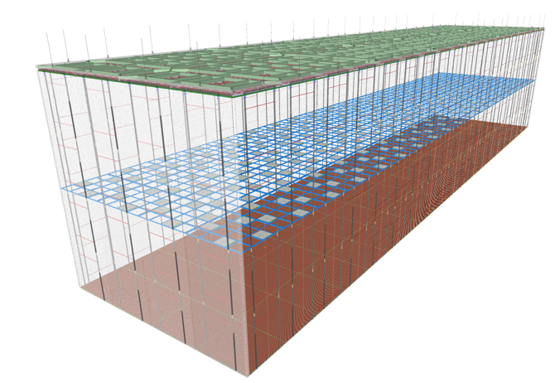
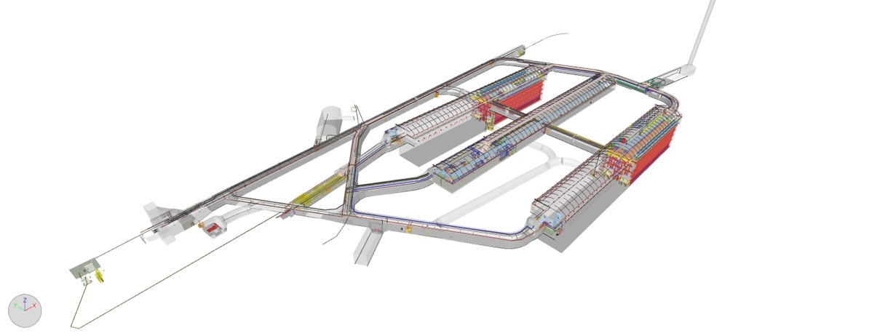
DUNE – Phase I Far Detectors (presentation by M. Nessi)
LBNF has provided caverns at SURF + most of the cryogenic infrastructures for 4 detector modules (each with a FV ≥ 10Kt) in Phase I
1st detector to be installed in NE cavern has horizontal drift (like ICARUS and MicroBooNE)
2nd detector will go into SE cavern and has vertical drift (capitalizing on elements of the dual phase development)
ν’s from FNAL
APA* Horizontal Drift
CRP** Vertical Drift
*Anode Plane Assemblies
Note : DUNE Science begins
when first FD is filled and turned on
and recording tracks
**Charge Readout Planes

Slide 7
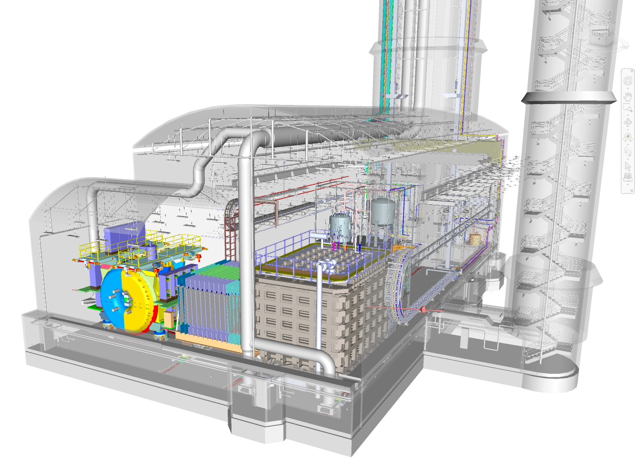
Phase I Near Detector Complex
ND-LAr (segmented LAr TPC)
TMS (magnetized muon spectrometer)
SAND (on axis magnetized spectrometer)
ND-LAr and TMS will move off-axis in order to scan over the spectrum of ν energies
SAND
TMS
NDLAr

Slide 10
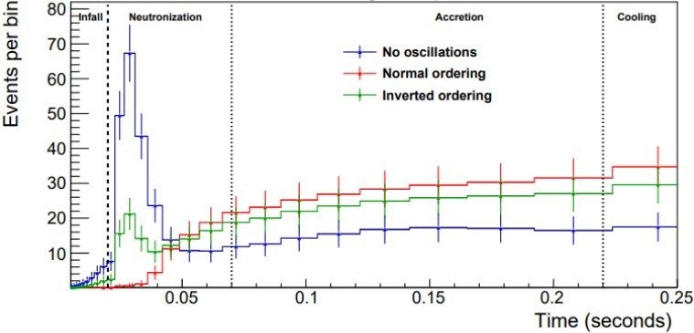
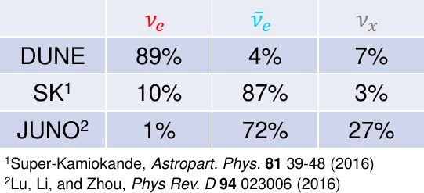
Supernova physics: measuring different neutrinos
10 kpc supernova burst
Time (and energy) profile of the flux is rich in supernova astrophysics
Flux contains ν_{e} and ν_{e} as well as a component of the other flavors (ν_{x})
Oscillations, including MSW effect, modify what we observe on Earth
It is important to have sensitivity to all three flux components
●
DUNE ν_{e}
●
●

Slide 11
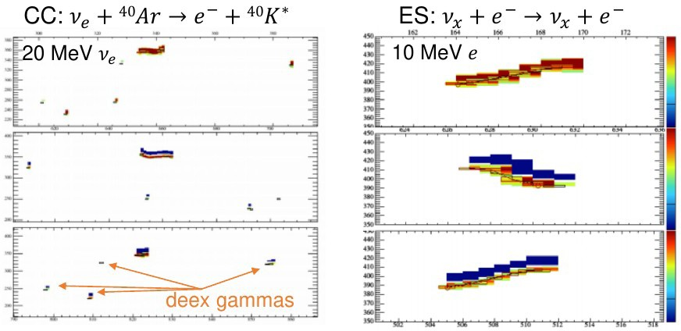
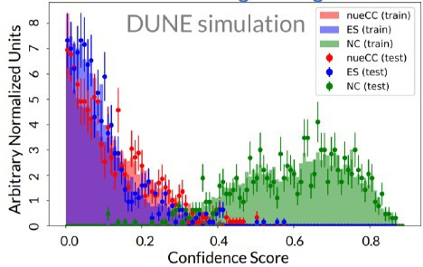
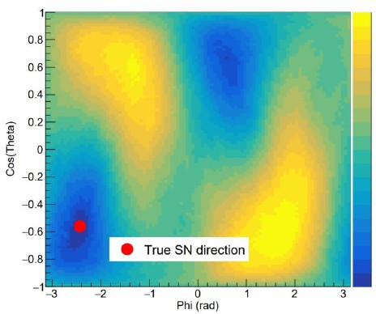
Supernova pointing in DUNE
●
DUNE has excellent efficiency to observe low-energy de-excitation photons
Allows separation of charged-current (isotropic) from elastic scattering (very forward)
Provides ~5° resolution
The neutrino signal will arrive ~hours before light, DUNE can predict the location of supernovae
●
●
●

Slide 12
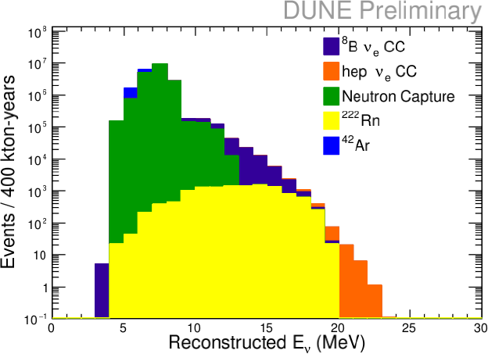
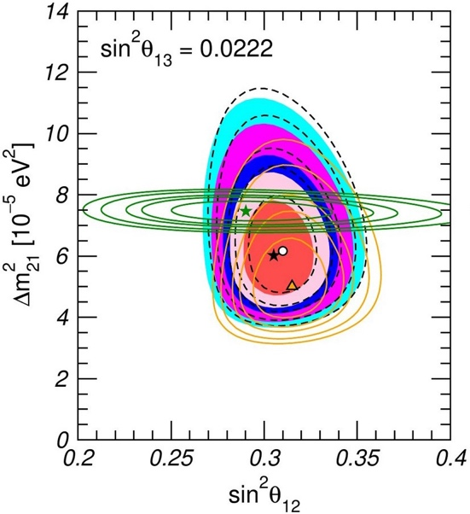
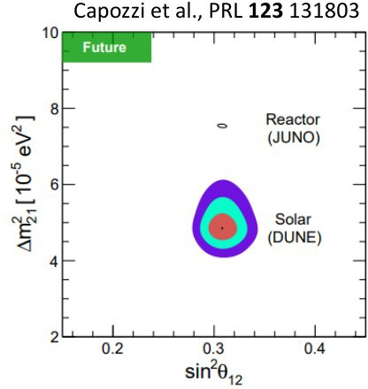
Solar neutrinos in DUNE
●
Despite large neutron background below ~10 MeV, DUNE can measure ⁸B solar flux and observe hep flux at
>5σ
JUNO is expected to greatly improve both 12 measurements
DUNE can improve on existing measurements with solar neutrinos, and probe longstanding tension (right plot is showing hypothetical DUNE result at old solar best fit point)
●
●
NuFit 5.2

Slide 13
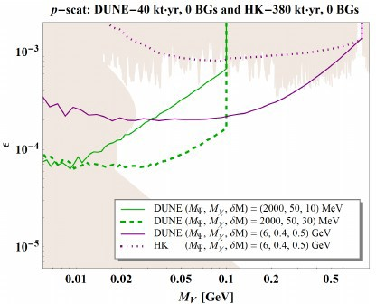
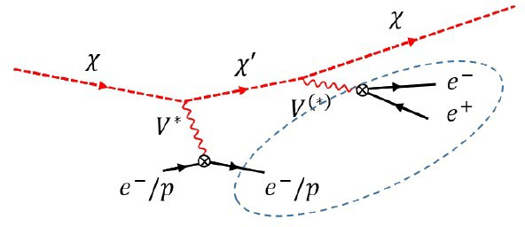
BSM complementarity: dark matter inelastic scattering
Due to its larger mass, Hyper- K will generally have superior sensitivity to any BSM signatures that it can detect
Inelastic dark matter scattering gives a signature of two low-energy electron tracks, and a detached low- energy electron or proton
DUNE can see all of these tracks, and the displacement
●
●

Slide 14
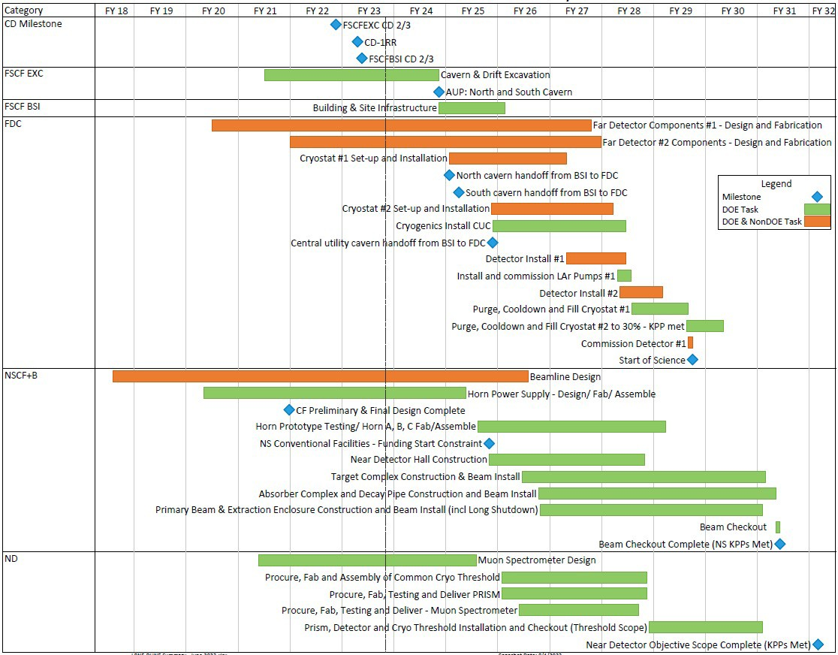
Think to the future, focus on the present: Phase I
Far Site
Notes:
Fiscal Year display
June 2023 reporting cycle
Based on “CD-1RR ESAAB” funding profile
Early completion
dates shown
Near Site
9
25 Sept 2023
R. Ray | LBN
F Update

Slide 15
P5 Recommendation 2
Rank-Ordered
CMB-S4, which looks back at the earliest moments of the universe to probe physics at the highest energy scales. It is critical to install telescopes at and observe from both the South Pole and Chile sites to achieve the science goals (section 4.2).
Re-envisioned second phase of DUNE with an early implementation of an enhanced 2.1 MW beam—ACE-MIRT—a third far detector, and an upgraded near-detector complex as the definitive long-baseline neutrino oscillation experiment of its kind (section 3.1).
An off-shore Higgs factory, realized in collaboration with international partners, in order to reveal the secrets of the Higgs boson. The current designs of FCC-ee and ILC meet our scientific requirements. The US should actively engage in feasibility and design studies. Once a specific project is deemed feasible and well-defined (see also Recommendation 6), the US should aim for a contribution at funding levels commensurate to that of the US involvement in the LHC and HL-LHC, while maintaining a healthy US on-shore program in particle physics (section 3.2).
An ultimate Generation 3 (G3) dark matter direct detection experiment reaching the neutrino fog, in coordination with international partners and preferably sited in the US (section 4.1).
IceCube-Gen2 for study of neutrino properties using non-beam neutrinos complementary to DUNE and for indirect detection of dark matter covering higher mass ranges using neutrinos as a tool (section 4.1).

Slide 16
DOE Response to P5 Report: DUNE
Note: The status of FD4 was not mentioned but FD4 is still a goal of DUNE collaboration which includes all non-US partners.

Slide 19
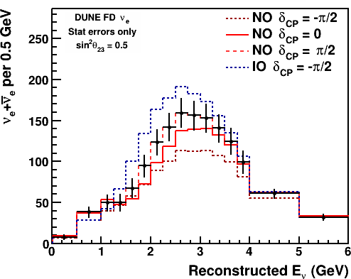
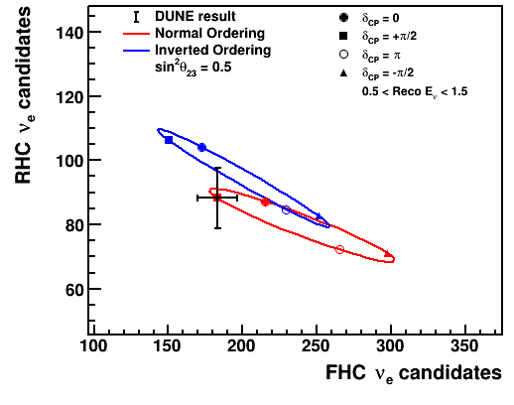
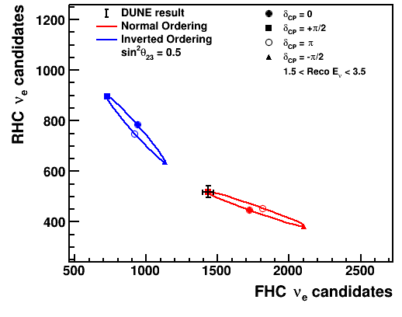
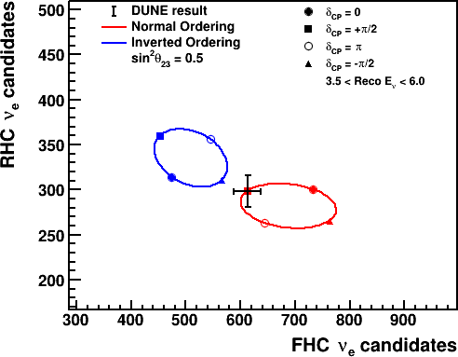
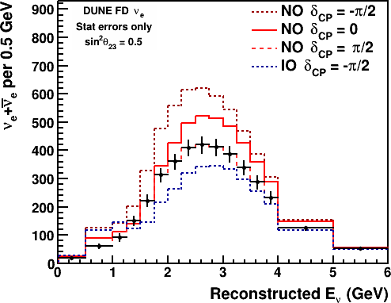
DUNE Phase II: precision measurements of oscillations
0.5 < E_{ν} < 1.5
1.5 < E_{ν} < 3.5
3.5 < E_{ν} < 6.0
RHC
This is what it will look like with DUNE Phase II
We are not just determining the mass ordering and establishing CP violation anymore, we are measuring δ_{CP}
●
FHC
●

Slide 20
DUNE is extremely sensitive to new physics
0.5 < E_{ν} < 1.5
1.5 < E_{ν} < 3.5
3.5 < E_{ν} < 6.0
●
If the three-flavor model is correct, oscillations depend only on L/E, and the data point will be at the same point on the same ellipse in every single energy bin
We can search for deviations across a broad range of L/E
●

Slide 21
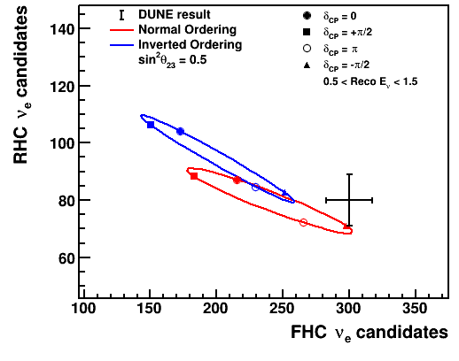
Example of definitive evidence of new physics
0.5 < E_{ν} < 1.5
1.5 < E_{ν} < 3.5
3.5 < E_{ν} < 6.0
We might see an anomaly only at low neutrino energy
In a narrow band-experiment where we only had the middle plot, one might conclude that everything is consistent with three flavors
Does this new physics depend on E rather than L/E? Is it matter dependent? Is it only present in the rapid oscillation region? DUNE cannot completely characterize the new physics, but DUNE + Hyper-K could probably answer all of these questions
DUNE’s large matter effect and broad L/E range are important unique features
●
●
●
●

Slide 22
INFN in DUNE

Slide 23
Anagrafica DUNE Italia
Gruppo | Ricercatori |  | Tecnologi
BO (23 PERSONE - 11.75 FTE) | 10.5 fte | 18 pers. | 1.25 fte | 5 pers.
FE (15 PERSONE - 5.55 FTE) | 5.1 fte | 12 pers. | 0.45 fte | 3 pers.
GE (8 PERSONE - 3.85 FTE) | 3.55 fte | 7 pers. | 0.3 fte | 1 pers.
LE (8 PERSONE - 3.8 FTE) | 3.6 fte | 7 pers. | 0.2 fte | 1 pers.
LNF (8 PERSONE - 2.2 FTE) | 0.9 fte | 4 pers. | 1.3 fte | 4 pers.
LNS (9 PERSONE - 2 FTE) | 1.7 fte | 8 pers. | 0.3 fte | 1 pers.
MI (9 PERSONE - 3.05 FTE) | 2.9 fte | 7 pers. | 0.15 fte | 2 pers.
MIB (21 PERSONE - 8.75 FTE) | 8.4 fte | 19 pers. | 0.35 fte | 2 pers.
NA (9 PERSONE - 4.2 FTE) | 3.8 fte | 8 pers. | 0.4 fte | 1 pers.
PD (5 PERSONE - 2 FTE) | 1.9 fte | 4 pers. | 0.1 fte | 1 pers.
PI (9 PERSONE - 1.45 FTE) | 0.8 fte | 6 pers. | 0.65 fte | 3 pers.
RM1 (3 PERSONE - 0.7 FTE) | 0.5 fte | 2 pers. | 0.2 fte | 1 pers.
RM2 (6 PERSONE - 2.7 FTE) | 2.7 fte | 6 pers.
TO (2 PERSONE - 0.6 FTE) | 0.5 fte | 1 pers. | 0.1 fte | 1 pers.
TOTALE (135 PERSONE - 52.6 FTE) | 46.85 fte | 109 pers. | 5.75 fte | 26 pers.

Slide 24
Near Detector

Slide 25
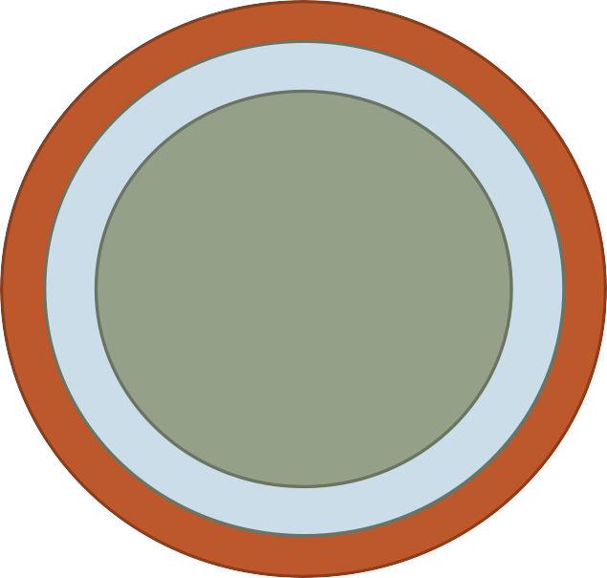
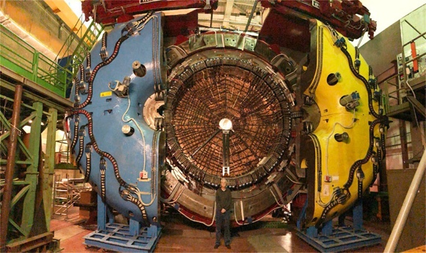
DUNE SAND
YOKE SC COIL
ECAL
ECAL + Magnet
STT/DC
GRAIN
DAQ
Software/Physics
ECAL - KLOE Lead Scintillating Fibers calorimeter (Barrell-23 ton Pb- + EndCaps)
TRACKER
GRAIN
TRACKER (STT) – 5 ton Straw-Tube tracker with “solid-H” target CH₂ and C interleaved slabs
GRAIN – 1 ton liquid Argon target with VUV imaging system (fully optical read- out)
SAND, a multipurpose detector with an high-performant ECAL, light-targeted tracker, LAr target, all of them in a magnetic field
Our first commitment: be ready to start installation in Fall 2028

Slide 26
SAND configuration
SAND will be permanently on-axis in a dedicated alcove
The schematic configuration is:
a Superconducting Solenoid Magnet
an Electromagnetic Calorimeter (ECAL)
in-kind from KLOE experiment
an Inner Tracker, including a thin active LAr target
Inner Tracker
Why SAND needs a dedicated tracker system inside the magnet?
Separation of neutrino and anti-neutrino fluxes (charge ID),
event-by-event reconstruction, neutron identification (with ECAL),
subtraction analysis to isolate free proton interactions.
a StrawTubeTracker (STT) providing a low density tracker with integrated thin targets as option A, in parallel we study an alternative solution substituting the STT with thin Drift Chambers.

Slide 27
A unique capability of the Tracker in SAND
“Solid” Hydrogen concept: (anti)ν-H from subtraction of CH₂ and C targets:
Exploits high resolutions & control of chemical composition and mass of targets in STT;
Allows for model-independent data subtraction of dedicated C (graphite) target from main CH₂ target;
Kinematic selection provides large H samples of inclusive & exclusive CC topologies with 80-95% purity and 75-96% eﬃciency before subtraction
A viable and realistic alternative to liquid H₂ detectors, a powerful tool for meeting the ND requirements

Slide 28
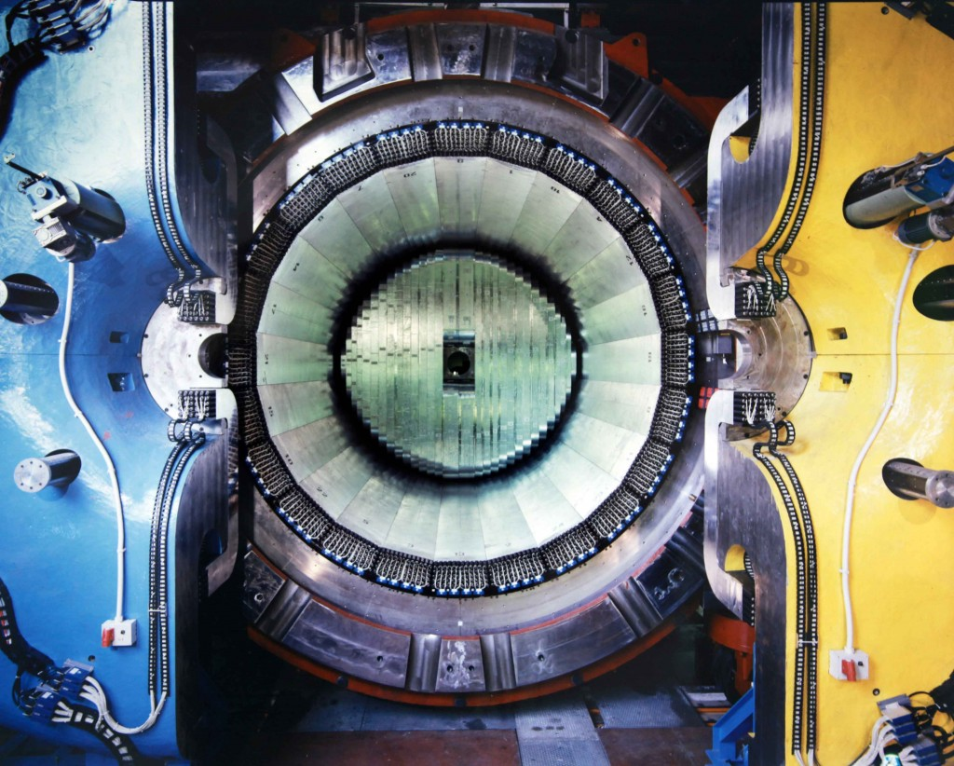
Supercond. Solenoid .6T
4π Pb-SciFi Calorimeter
43 m³ of space available
for a tracker

Slide 29
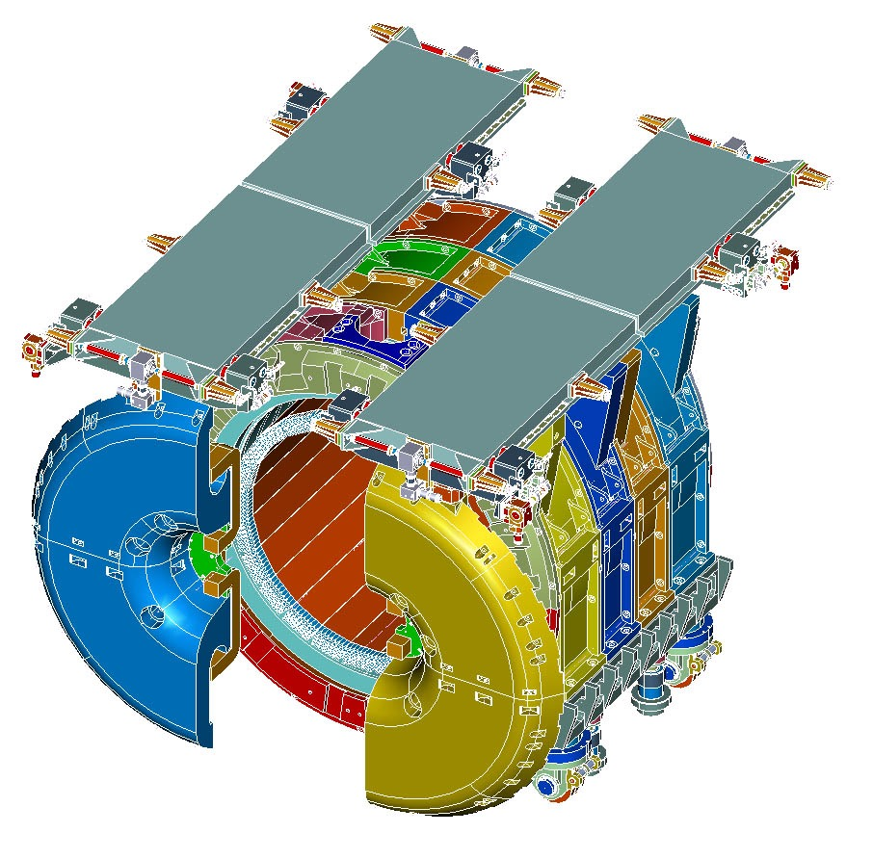

Slide 30
STT 1200X800 mm² prototype

Slide 31
Alternative STT design
A parallel study and development of a drift chamber-based tracker is underway as an alternative option.
What has been done so far:
Electric field simulations to optimize cell layout.
Preliminary mechanical design studies of the structure.
Simulation studies on the resolution response in muon momentum measurement
Small prototype built and tested
Design and test of a 1200X800 mm² prototype, to be compared with the straw tube proto. (in progress)
If the performances confirm the ability to achieve the same scientific objectives, there would be advantages in terms of system simplicity and number of channels.

Slide 33
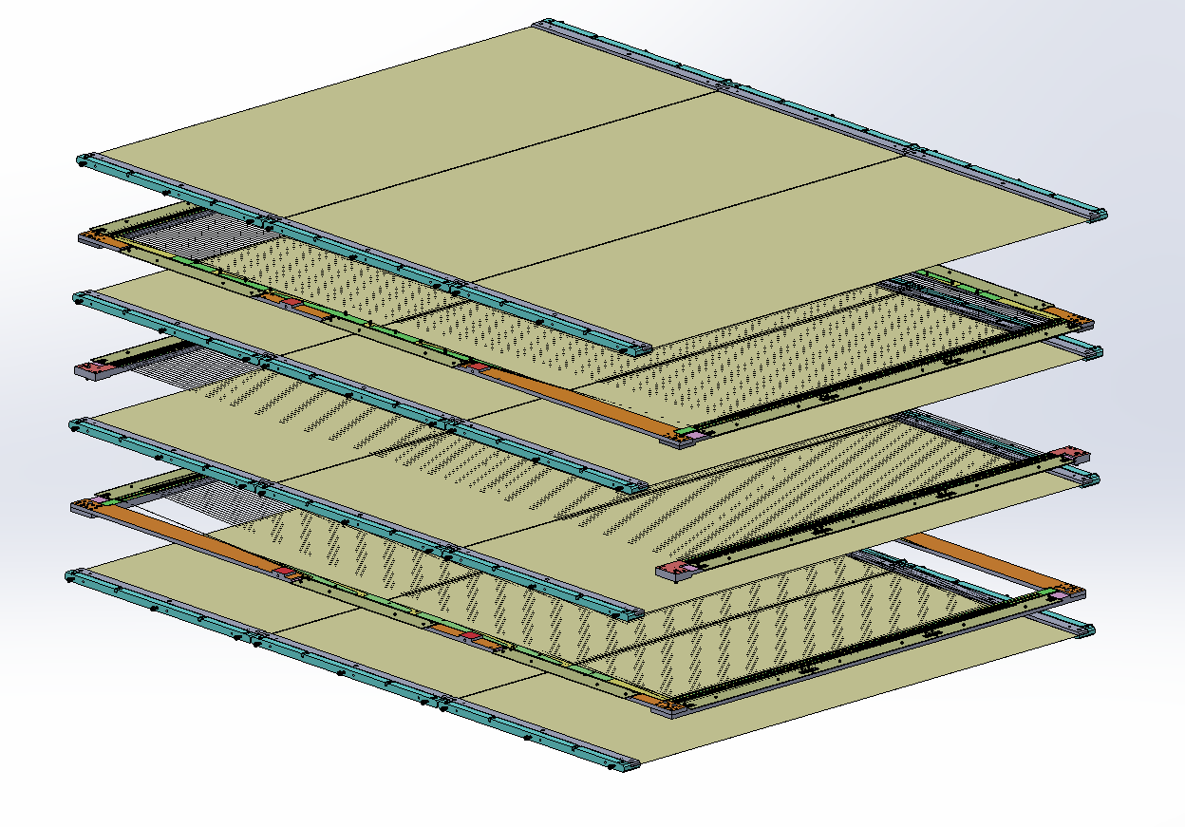
Layer Setup
Effective Measurement Area: 1200 x 800 mm
4 Mylar Layers
Distance between alternating layers: 6 mm
3 Wire Layers
Mylar Layer
Mylar Layer
-5° Wire Layer
Mylar Layer
0° Wire Layer
Mylar Layer
5° Wire Layer
Notes:
Superficie di misura efficace
Distanza tra gli strati alternati

Slide 34
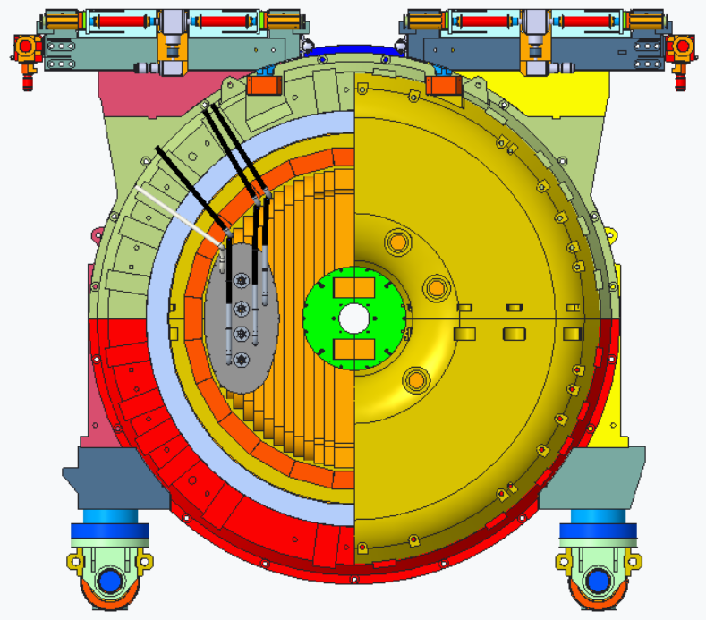
GRAIN cryostat
Internal vessel (Stainless Steel, 6 mm): designed and simulated (ready for tender)
External Vessel (CF-Al honeycomb-CF): feasibilty under investigation (tech and costs)

Slide 35
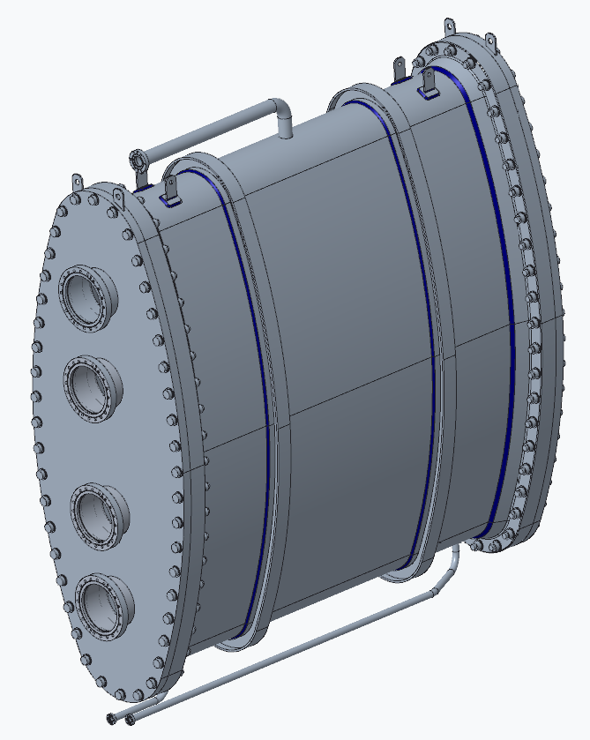
Inner vessel
All AISI 316L stainless steel
Design ready to be certify according to european standard EN 13445 European
body thickness 6 mm
cover thickness 30 mm
4 DN160 CF flanges per cover

Slide 36
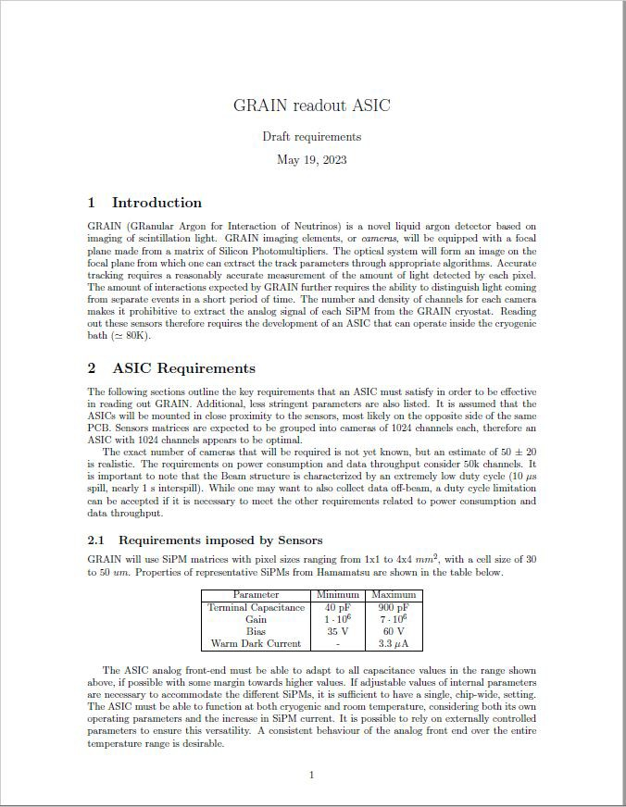
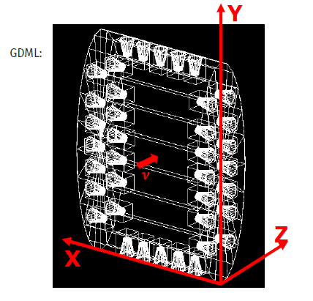
A new ASIC for GRAIN
We plan to implement imaging of tracks in LAr by means of cameras based on a 32x32 matrix of SiPMs where all 1024 channels are readout individually
Tens of cameras will cover the whole volume for a total of about 50k channels
We need a cryogenic ASIC that fits our requirements
The INFN group from Torino agreed to produce a new ASIC with 1024 channels
Much less output lines and simpler feedthrough

Slide 37
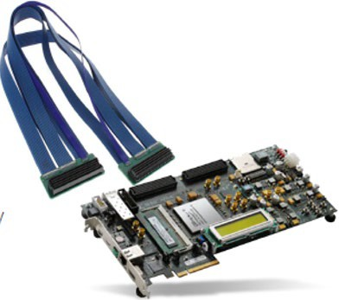
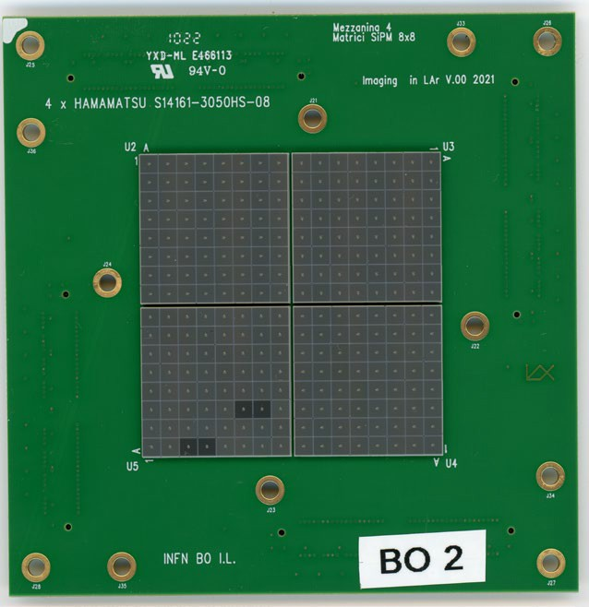
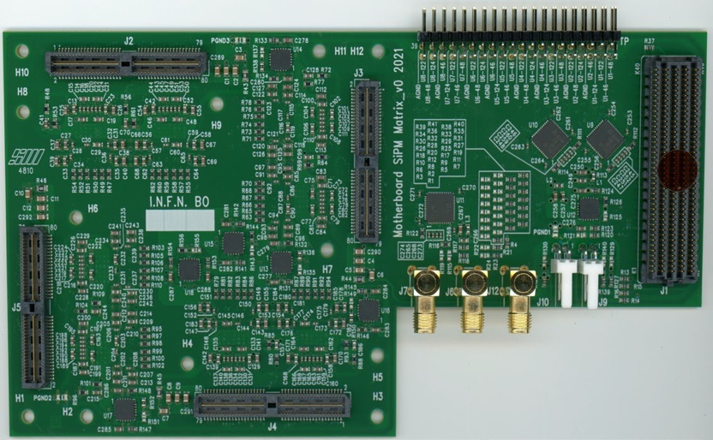
Demonstrator
Now we have one mother board with all the 8 ASICS wire bonding

Slide 38
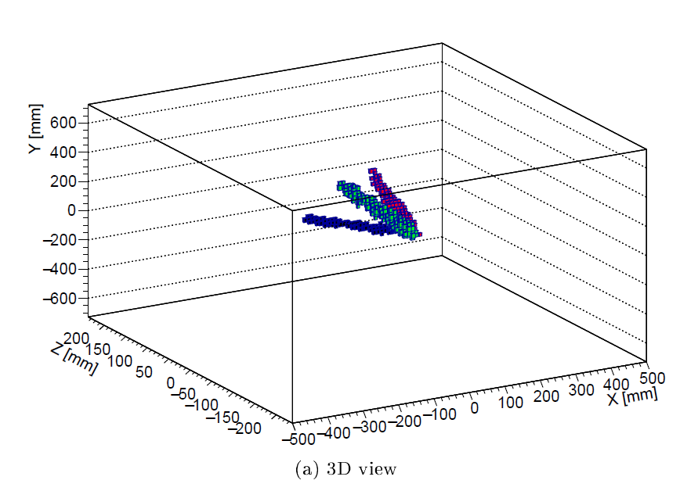
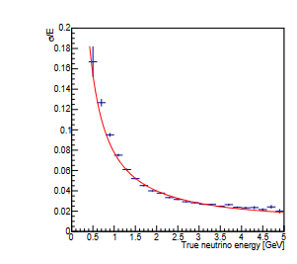
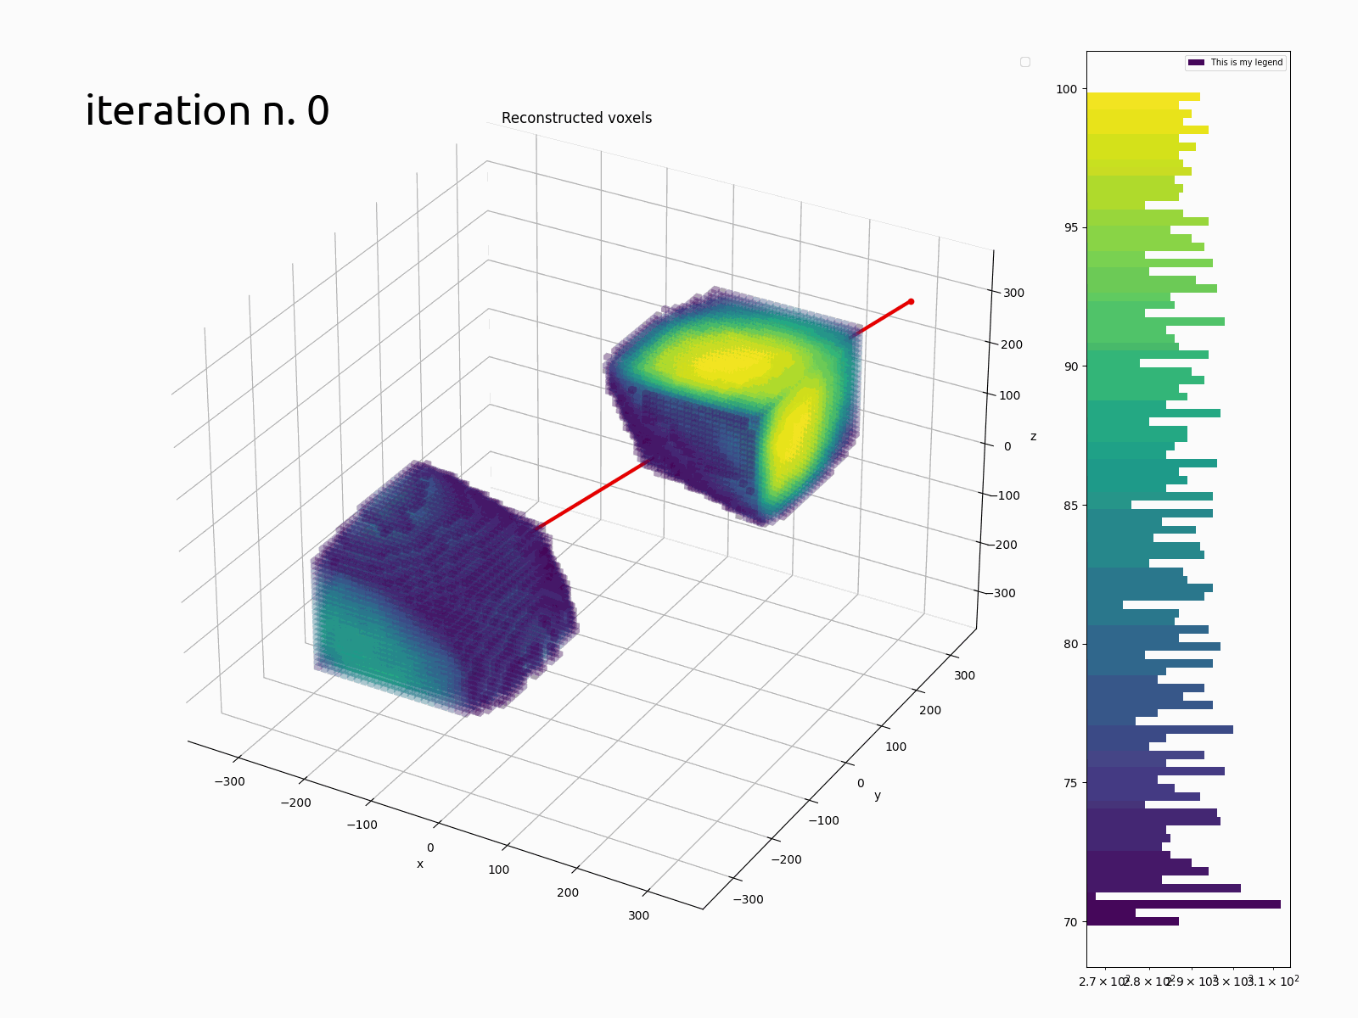
GRAIN
Bologna
Genova
Neutrino energy reconstruction with calorimetric technique
Tracks and event reconstruction using Hadamard mask or lens
3D reconstruction with lens
$$\frac{σ}{E}=\frac{8\%}{E}⊕ 1\%$$
3D backpropagation with mask

Slide 41
Bologna in DUNE Phase II
Our first priority is to deliver Phase I.
Nevertheless we are already performing R&D work to update SAND performances.
In particular, we have a CSN5 project (IBIS) to develop back-illuminated SiPM with FBK, which would allow to improve optical tracking in GRAIN (and could be used in Phase I if timely available)
We are also brainstorming (mostly during lunch breaks) how to integrate in GRAIN a pixelated TPC, with a combined readout of light and charge, leveraging on concurrent R&D within DUNE.
●

Slide 42
THANK YOU

