Slide 1
Riunione NA62 Italia Aggregation-free Particle Tracking
Leonardo Plini
National PhD student in Artificial Intelligence
INFN-LNF and Sapienza University of Rome
leonardo.plini@lnf.infn.it
Notes:
Good Afternoon everyone and thank you for giving me the opportunity to present my work here. I’m Leonardo Plini and I am a Phd student in Artificial Intelligence at Sapienza University of Rome and at Italian National Institute for Nuclear Physics at Frascati.
This is the project I developed under the supervision of Gemma Tinti and Tommaso Spadaro

Slide 2
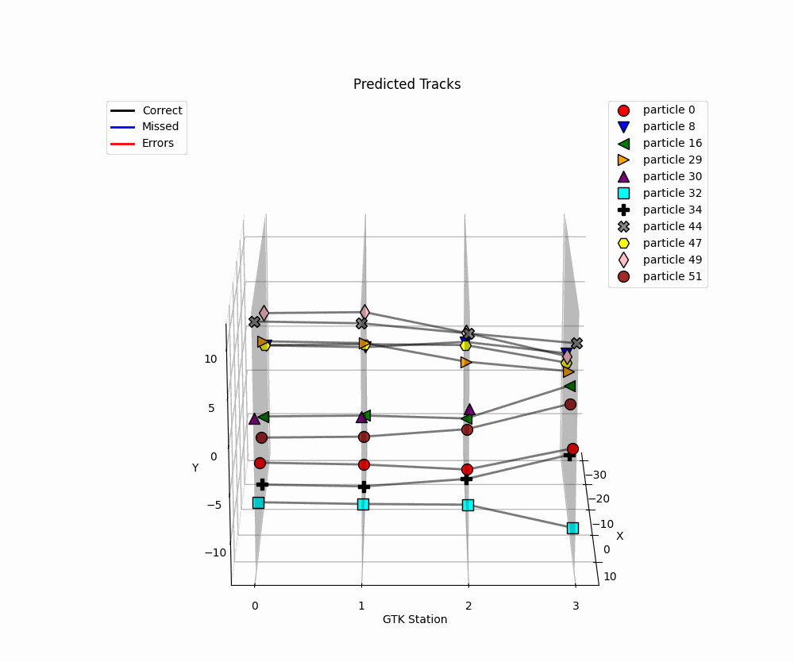
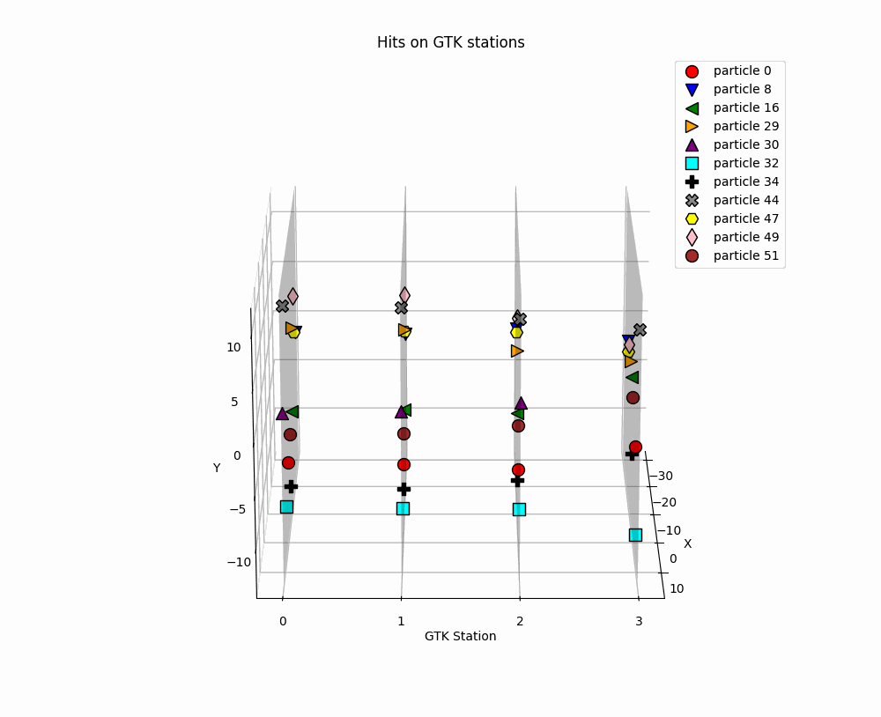
Particle Tracking
Notes:
Today, I will try to answer this question by means of Artificial Intelligence

Slide 3
Introduction: Aggregation
[ x₂, y₂, z, t₂]
[ x₁, y₁, z, t₁]
[ x_{new}, y_{new}, z, t_{new}]
Mean
X_{new} = mean (x₁,x₂)
Y_{new} = mean (y₁,y₂)
T_{new} = mean (t₁,t₂)
Notes:
Since in this phase we are interested in quantifying the ability of our architecture to retrieve the tracks, we wanna omit other sources of errors. For this reasons, using the monte carlo ground truth, every time that a particle left more than one hit on a single GTK station we grouped those hits using the mean of their time and position

Slide 4
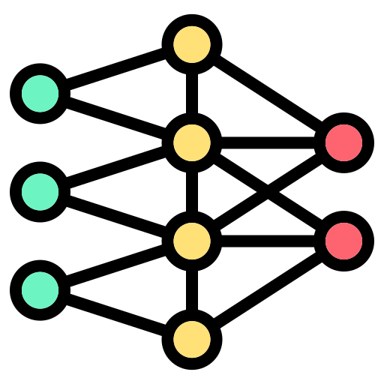
Proposal
Multi-Layer Perceptron
Transformer
Graph Neural Network
Notes:
Ok, now let’s get to the core of the presentation

Slide 5
Multi-Layer Perceptron
Transformer
Graph Neural Network
Notes:
Our proposal is threefold: Multi-Layer Perceptron, Transformer and Graph Neural Network. Let’s go in order of complexity trying to highlight what can we improve as we move to the next architecture.

Slide 6
Multi-Layer Perceptron
Admissible track combinations
Not admissible track combination

Slide 7
Multi-Layer Perceptron
Existence Score
1- Existence Score
[ x, y, z, time]
0.76 | 0.24
… | ...
... | …
0.13 | 0.87
0.94 | 0.06
Notes:
We use our Multi-Layer Perceptron to produce a binary vector where the first coordinate represents the existence score while the second represents 1-the existence score. On the basis of a threshold that we choose on the validation sample, we say that a track exists, if it is above the threhsold, or if it does not exists in the opposite case.

Slide 8
Multi-Layer Perceptron: results
MC kpinn Run012037 v3.5.3-v3.7.3 overlay
200156 events {-10 ns, +10 ns} wrt KTAG reference time
The models were implemented on an RTX 3060Ti Trio with 8 GB equipped with a Ryzen 7 3700X CPU
60% Train, 20% Validation, 20% Test
Training on Train Set
Hyper-parameters using Validation Set
Results on Test Set
True Track is composed of hits with the same kinepart
Efficiency =
$$\frac{\# correctly predicted tracks}{\# total true tracks}$$
Purity =
$$\frac{\# correctly predicted tracks}{\# total predicted tracks}$$
Fake Tracks =
$$\frac{\# wrongly predicted tracks}{\# total true tracks}$$
Efficiency | Purity | Fake Tracks
70.06 % | 92.3 % | 39.45 %
Notes:
We evaluated our method on the basis of 3 metrics. 1) The efficiency which is the number of correctly predicted tracks over the number of the total true tracks
2) The purity that is the ratio of correctly predicted tracks over the number of total predicted Trakcs
3) The fake tracks which is the ration of wrongly predicted tracks ver the total number of true tracks
Our results rely on the Monte Carlo Simulation highlighted in yellow and consider a time window of +-10 nanosecond with respect to the KTAG reference time. We splitted our dataset in 60 % training which is exsclusively used to train the model, 20% validation used to calibrate the hyperparameters like the threshold and 20% test to evaluate our model on unseen data.
Having this splits fixed, will allow for a fair comparison between the architectures we propose. The Multi Layer Perceptron reached a 70% efficiency with 92.3 purity and a fake tracks index of 39.5 % MC kpinn Run012037 v3.5.3-v3.7.3 overlay: è il MC che riproduce il kaone in un pione, neutrino, antineutrino . La Run012037 è del 2022 ( fra le varie run cambia l’intensità e in quella del 2022 è più alta). v3.5.3-v3.7.3 fa riferimento alla versione del software della generazione (v3.5.3), mentre la seconda (v3.7.3) è la versione della ricostruzione: solitamente, viengono fatte più implementazioni dell’algoritmo di ricostruzione che viene provato più volte sul sample prodotto con lo stesso algoritmo di generazione. Overlaid fa riferimento a tutte le altre particelle simulate che passano nell’esperimento simultaneamente alla particella di interesse che stiamo simulando.

Slide 9
Multi-Layer Perceptron: conclusion
Local awareness
Poor Performances
Big GPU memory needed to store all admissible combinations
Slow computations
Class Imbalance
Notes:
What are we missing? First, the architecture has only a local awareness: in fact, it considers single tracks without having a global knowledge of the sorrounding particles and this leads to poor performances. In addition, very big gpus memory are needed to store all the admissible combination for a single event given the combinatorial way in which we built the tracks. As a consequence, we have very slow computations. Last but not least, our problem definition leads to class imbalance. In fact, just a very small number of the admissible tracks are true and this makes the training of the architecture very challenging.

Slide 10
Multi-Layer Perceptron
Transformer
Graph Neural Network
Notes:
At the light of these considerations, we can introduce the Transformer architecture.

Slide 11
Transformer
If we have n hits per station, we will create:
n⁴ (GTK0-GTK1-GTK2-GTK3)
n³ (GTK0-GTK2-GTK3)
n³ (GTK1-GTK2-GTK3)
Total: n⁴+2n³
Local awareness
Global awareness with Transfomer
What if move the problem from tracks to edges?
Notes:
The MLP presented a local awareness and an increadible number of admissible tracks: if we have a n hit per station we will create n^4 +2n^3 number of admissible tracks. The transformer, on the other hand, has a global awareness of the event. In addition, if we move the problem from the tracks to the edges that connected single hits, we reduce the number of candidates to 16n^2 which is much smaller than the previous number of tracks.

Slide 12
Transformer
Binary Classification
The number of candidates we need to evaluate is (4n)² =16n² << n⁴+2n³
Notes:
Moving the problem to the edges means having a binary classification problem where we wanna know for each pair of hits if the connection between them exists or not.
AVOIDING SAYING EDGES, rather say connection between hits to avoid confusion

Slide 13
Transformer

Slide 14
Transformer
0.99 | 0.01
… | …
… | …
… | …
0.12 | 0.88
… | …
… | …
0.99 | 0.01

Slide 15
Transformer
0.99 | 0.01
… | …
… | …
… | …
0.12 | 0.88
… | …
… | …
0.99 | 0.01
Notes:
At this point, each pair of hits has a score of existence. However, we might want create single tracks for each particle.

Slide 16
Transformer
Max Edge selection
0.99
0.87
0.87
Notes:
In some cases the decision strategy is straighforward since we have already eliminated a connection between hits with the threshold. In other cases, however, the scenario is more challenging. In fact, a certain hit might have more than one exiting edge with an existence score above the threshold. We propose the Max Edge Selection to deal with this ambiguity: here just the edge with the max existence score is mantained while the other is omitted.

Slide 17
Transformer
Multi-Layer Perceptron
$$\frac{\# correctly predicted tracks}{\# total true tracks}$$
Efficiency | Purity | Fake Tracks
70.06 % | 92.3 % | 39.45 %
Efficiency =
Purity =
$$\frac{\# correctly predicted tracks}{\# total predicted tracks}$$
Transformer
Efficiency | Purity | Fake Tracks
95.95 % | 98.62 % | 1.22 %
Fake Tracks =
$$\frac{\# wrongly predicted tracks}{\# total true tracks}$$
Notes:
If we compare the performances of the transformer, we effectively see that we have a good jump in all the metrics reaching an efficiency around 96% with a 98.6 purity and only 1.22% of fake tracks

Slide 18
Transformer
Solved class imbalance
Global awareness
Efficient computations
Many computations to consider all the connections
Notes:
Ok, so in this case we solved the class imbalance given by the previos definition of the porblem. We also have an architecture with a global awareness that is pretty efficient. However, we are still considering all the possible connections every pair of hits. While we may wanna leverage as much as possible our physical knowledge.

Slide 19
Multi-Layer Perceptron
Transformer
Graph Neural Network
Transformer
Notes:
At this point we are ready to introduce our last and best architecture based on graph neural networks

Slide 20
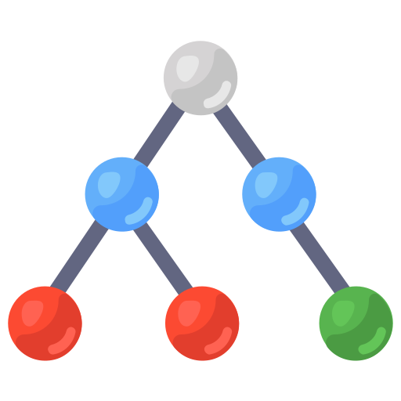
Graph Neural Network
Many computations to consider all the connections
Multi-Layer Perceptron
Graphs allow to decide the topology (e.g. the connections between nodes)
Transformer
Transformer
Notes:
As we have seen, the negative side of the transformers consists in the fact that many computation were unnecessary due the the fact that we were considering all the connection. Graph neural networks allow to definite the topology which represents the sets of connections between the nodes represented by the hits.

Slide 21
Graph Neural Network
Notes:
So, starting from our example, we can decide to build either a complete graph with all the connections or a sparse graph with only the connections we are interested into

Slide 22
Graph Neural Network
Complete Graph
Sparse Graph
Notes:
In the second case, the number of edges keeps decreasing to 4n^2 and in setups that consider more detectors this number might be a very different multiplicative factor. VALE LA PENA DIRE: in case of GNN it comes naturally to deal with different topologies while in case of transformer, even if in possible is principle, is not that straighforward.

Slide 23
Graph Neural Network
Notes:
So we consider our graph that is processed by means of a graph neural netwrok

Slide 24
Graph Neural Network
Multi
Classifier
0.99 | 0.01
0.13 | 0.87
… | …
… | …
… | …
0.99 | 0.01
Max Edge Selection
Notes:
As before, we eliminate the ambiguity using the max edge selection strategy we proposed

Slide 25
Graph Neural Network
Multi-Layer Perceptron
Efficiency | Purity | Fake Tracks
70.06 % | 92.3 % | 39.45 %
Efficiency =
$$\frac{\# correctly predicted tracks}{\# total true tracks}$$
Transformer
Efficiency | Purity | Fake Tracks
95.95 % | 98.62 % | 1.22 %
Purity =
$$\frac{\# correctly predicted tracks}{\# total predicted tracks}$$
Graph Neural Network*
Fake Tracks =
$$\frac{\# wrongly predicted tracks}{\# total true tracks}$$
Efficiency | Purity | Fake Tracks
94.78 % | 99.78 % | 0.21 %
* Direct, Fully-connected graph with Graph Convolutional Network and Multi-Classifier
Notes:
And these are the results. We opted for the thrreshold value that allows to reach an efficiency level above 94% and in this case the purity almost saturated to 100% and the fake tracks reached 0.21 %

Slide 26
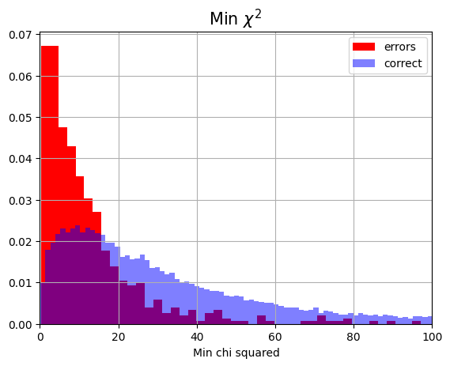
Graph Neural Network
Difficulty Score
$χ2$ = $\min_{k=0,1,2,3}{ }\min_{1≤i<j≤n}{\text{[}\text{(}\text{x} \text{i}\text{,}\text{k} \text{−}\text{x} \text{j}\text{,}\text{k}\text{)}\text{2}\text{ +(}\text{y} \text{i}\text{,}\text{k}\text{−}\text{y} \text{j}\text{,}\text{k}\text{)}\text{2}\text{+(}\text{t} \text{i}\text{,}\text{k}\text{−} \text{t} \text{j}\text{,}\text{k}\text{)}\text{2}] }$
Notes:
To have a general indication of the capabilities of our model we propose a qualitative study based the following difficulty score.
Intuitively, a prediction is more difficult when to hits are very near to each other and this can produce some confusion. If we consider the square distance in space and time and we take the mininum of this distance for an event we have a basic difficult score.

Slide 27
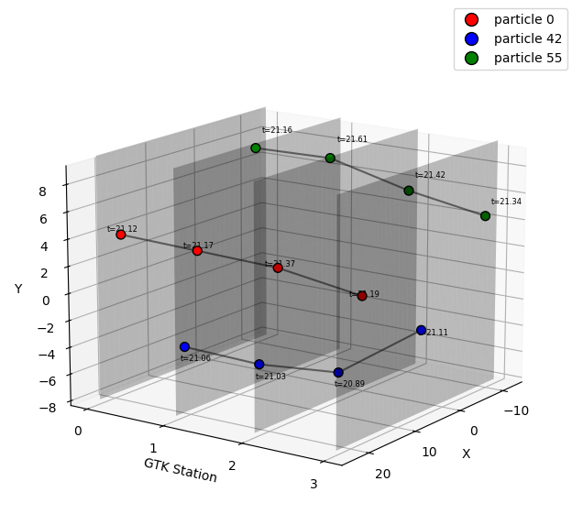
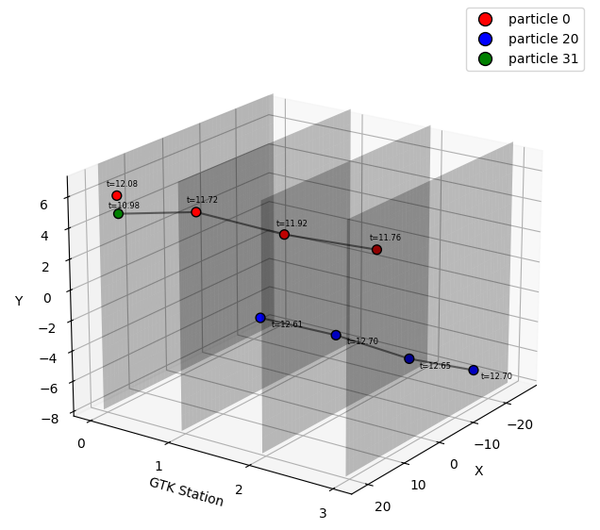
Graph Neural Network
Example of an error
Example of a good prediction
Notes:
Effectively, If we consider the normalized distribution of the score for correct sample and errors, we notice how the error have a smaller difficulty score compared to correct sample. This indicates that we are making mistakes when the prediction is actually difficult. This metric allows to have qualitative insights on our model to detect failure cases and guide the model design.

Slide 28
Graph Neural Network
Solved class imbalance
Global awareness
Computationally Efficient
Flexible Topology
Notes:
At this point we have an architecture and a problem definition with some nice properties. We solved the class imbalnce, we have a model with global awareness that is computationally efficient and allows for a direct control of the topology

Slide 29
What if we remove the aggregation constraint?
Notes:
At this point we have an architecture and a problem definition with some nice properties. We solved the class imbalnce, we have a model with global awareness that is computationally efficient and allows for a direct control of the topology

Slide 30
Introduction: Aggregation-free
[ x₂, y₂, z, t₂]
[ x₁, y₁, z, t₁]
[ x_{new}, y_{new}, z, t_{new}]
Mean
X_{new} = mean (x₁,x₂)
Y_{new} = mean (y₁,y₂)
T_{new} = mean (t₁,t₂)
Notes:
Since in this phase we are interested in quantifying the ability of our architecture to retrieve the tracks, we wanna omit other sources of errors. For this reasons, using the monte carlo ground truth, every time that a particle left more than one hit on a single GTK station we grouped those hits using the mean of their time and position

Slide 31
Introduction: Aggregation-free
[ x₂, y₂, z, t₂]
[ x₁, y₁, z, t₁]
[ x_{new}, y_{new}, z, t_{new}]
Mean
X_{new} = mean (x₁,x₂)
Y_{new} = mean (y₁,y₂)
T_{new} = mean (t₁,t₂)
Notes:
Since in this phase we are interested in quantifying the ability of our architecture to retrieve the tracks, we wanna omit other sources of errors. For this reasons, using the monte carlo ground truth, every time that a particle left more than one hit on a single GTK station we grouped those hits using the mean of their time and position

Slide 32
Clustering
We tryed 3 clusteiring algorithms and we evaluate the performances with Precision ( Pr), Recall (Re) and F1-score (F1):
No clustering: Pr= 95.04, Re=99.54 , F1 = 97.24
Recursive clustering based on a threshold in space and time:
Pr= 99.31, Re=99.90, F1 =99.61
3) Clustering based on a threshold in space and time: Pr= 99.39,
Re=99.91, F1=99.65
1
2
3
4
5
6
7
8
9
At the light of these small differences, we let our tracking algorithm to solve the entire problem without any prior clustering. This strategy avoids the definition of very specific metric and make the implementation comparable with the others.
Notes:
Since in this phase we are interested in quantifying the ability of our architecture to retrieve the tracks, we wanna omit other sources of errors. For this reasons, using the monte carlo ground truth, every time that a particle left more than one hit on a single GTK station we grouped those hits using the mean of their time and position

Slide 33
Aggregation-free
We can have cases where a particle has more than one hit on a single GTK station
We introduce a more robust definition of True Positive Tracks, False Positive Tracks and False Negatives Tracks
Notes:
Since in this phase we are interested in quantifying the ability of our architecture to retrieve the tracks, we wanna omit other sources of errors. For this reasons, using the monte carlo ground truth, every time that a particle left more than one hit on a single GTK station we grouped those hits using the mean of their time and position

Slide 34
Aggregation-free
We create a set of Admissible True tracks:
Blue particle: { (1-3-4), (1-3-5), (2-3-4), (2-3-5), (1-2-3-4), (1-2-3-5)}
Red particle: {(6-7-8-9),(6-7-9), (7-8-9)}
Given a prediction P of our algoritm we have 3 cases:
A) If P is in the set, we have a True Positive (e.g (1,2,3,4))
B) If P is not in the set, we have a False Positive (e.g. (1,2,3))
C) If we have a particle for which none of the predictions of our algorithm was in the set, we have a False Negative
1
2
3
4
5
6
7
8
9
Notes:
Since in this phase we are interested in quantifying the ability of our architecture to retrieve the tracks, we wanna omit other sources of errors. For this reasons, using the monte carlo ground truth, every time that a particle left more than one hit on a single GTK station we grouped those hits using the mean of their time and position

Slide 35
Aggregation-free: Results
Transformer
Efficiency =
$$\frac{\# correctly predicted tracks}{\# total true tracks}$$
Efficiency | Purity | Fake Tracks
95.95 % 95,62% | 98.62 % 99,03% | 1.22 % 0,94
Purity =
$$\frac{\# correctly predicted tracks}{\# total predicted tracks}$$
Graph Neural Network
Efficiency | Purity | Fake Tracks
94.78 % 96,44% | 99.78 % 99,30% | 0.21 % 0,68%
Fake Tracks =
$$\frac{\# wrongly predicted tracks}{\# total true tracks}$$
Notes:
And these are the results. We opted for the thrreshold value that allows to reach an efficiency level above 94% and in this case the purity almost saturated to 100% and the fake tracks reached 0.21 %

Slide 36
Future Works
We should deploy the architecture into the NA62 framework and evaluate the capabilities on real data
Notes:
Here, we showed how to use machine learning to track particles and we proposed 3 different and more powerful architectures created under the supervision of a physicist team trying to inject their knowledge in the architecture.

Slide 37
References
[14] I. Henrion, J. Brehmer, J. Bruna, K. Cho, K. Cranmer, G. Louppe, and G. Rochette. Neural message passing for jet physics. 2017. [15] J. Shlomi, S. Ganguly, E. Gross, K. Cranmer, Y. Lipman, H. Serviansky, H. Maron, and N. Segol. Secondary vertex finding in jets with neural networks. The European Physical Journal C, 81(6), June 2021. [16] J. A. Martinez, O. Cerri, M. Pierini, M. Spiropulu, and J. Vlimant. Pileup mitigation at the large hadron collider with graph neural networks, 2019. [17] E. Cortina Gil. et al. The beam and detector of the na62 experiment at cern. Journal of Instrumentation, 12(05):P05025, may 2017. [18] Rinella et al. The na62 gigatracker: a low mass high intensity beam 4d tracker with 65 ps time resolution on tracks. Journal of Instrumentation, 14(07):P07010–P07010, July 2019. [19] A. Tsaris and et al. The hep.trkx project: Deep learning for particle tracking. Journal of Physics: Conference Series, 1085(4):042023, sep 2018. [20] Exa.TrkX Collaboration. Exa.trkx. https://exatrkx.github.io/. [21] S. Caillou, P. Calafiura, S. Farrell, X. Ju, D. Murnane, C. Rougier, J. Stark, and A. Vallier. ATLAS ITk Track Reconstruction with a GNN-based pipeline. Technical report, CERN, Geneva, 2022. [22] X. et al. Ju. Performance of a geometric deep learning pipeline for hl-lhc particle tracking. The European Physical Journal C, 81(10), October 2021. [23] M. Kiehn and et al. The trackml high-energy physics tracking challenge on kaggle. EPJ Web of Conferences, 214:06037, 01 2019. [24] S. Thais and et al. Graph neural networks in particle physics: Implementations, innovations, and challenges, 2022. [25] V. Mikuni and F. Canelli. ABCNet: an attention-based method for particle tagging. The European Physical Journal Plus, 135(6):463, 2020. [26] R. Liu, P. Calafiura, S. Farrell, X. Ju, D. Murnane, and T. Pham. Hierarchical graph neural networks for particle track reconstruction, 2023. [27] G. DeZoort, S. Thais, J. Duarte, V. Razavimaleki, M. Atkinson, I. Ojalvo, M. Neubauer, and P. Elmer. Charged particle tracking via edge-classifying interaction networks. Computing and Software for Big Science, 5(1), November 2021
[1] B. Denby. Neural networks and cellular automata in experimental high energy physics. Computer Physics Communications, 49(3):429–448, 1988. [2] Alexander Radovic, Mike Williams, David Rousseau, Michael Kagan, Daniele Bonacorsi, Alexander Himmel, Adam Aurisano, Kazuhiro Terao, and Taritree Wongjirad. Machine learning at the energy and intensity frontiers of particle physics. Nature, 560(7716):41— 48, August 2018. [3] Bourilkov D. Machine and deep learning applications in particle physics. International Journal of Modern Physics A, 34(35):1930019, December 2019. [4] M. Feickert and B. Nachman. A living review of machine learning for particle physics, 2021. [5] M. Bronstein, J. Bruna, Y. LeCun, A. Szlam, and P. Vandergheynst. Geometric deep learning: Going beyond euclidean data. IEEE Signal Processing Magazine, 34(4):18–42, July 2017. [6] F. Scarselli, M. Gori, A. C. Tsoi, M. Hagenbuchner, and G. Monfardini. The graph neural network model. IEEE Transactions on Neural Networks, 20(1):61–80, Jan 2009. [7] T. Gaudelet and et al. Utilizing graph machine learning within drug discovery and development. Briefings in Bioinformatics, 22(6):bbab159, 05 2021. [8] F. Liu, S. Xue, J. Wu, C. Zhou, W. Hu, C. Paris, S. Nepal, J. Yang, and P.S. Yu. Deep learning for community detection: Progress, challenges and opportunities. In Proceedings of the Twenty-Ninth International Joint Conference on Artificial Intelligence, IJCAI-PRICAI- 2020. International Joint Conferences on Artificial Intelligence Organization, July 2020. [9] Z. Zhang, P. Cui, and W. Zhu. Deep learning on graphs: A survey, 2020.. [10] Z. Wu, S. Pan, F. Chen, G. Long, C. Zhang, and P. S. Yu. A comprehensive survey on graph neural networks. IEEE Transactions on Neural Networks and Learning Systems, 32(1):4–24, January 2021. [11] J. Zhou, G. Cui, S. Hu, Z. Zhang, C. Yang, Z. Liu, L. Wang, C.Li, and M. Sun. Graph neural networks: A review of methods and applications, 2021. [12] S. Farrell et al. Novel deep learning methods for track reconstruction, 2018. [13] X. Ju and et al. Graph neural networks for particle reconstruction in high energy physics detectors, 2020.

