Slide 1
Status of the 2024 run
R. Fantechi,R. Piandani
07/11/2024
NA62 Italia

Slide 2
Beam and data taking periods
Three main periods
Standard πνν run
1 week at low intensity (< 2*10¹¹ ppp)
12 days of dump run (~40*10¹¹ ppp)
Problems
Issues when switching on MNP33, intervention required
Before dump run, problem with the movement of TAX1. Position fixed for the πνν configuration
Since August the NA complex is running economy mode: if there is no extraction for a problem to be fixed in some time, all the magnets not in P0 survey are switched off
Apparently, no issues when restarting the magnets

Slide 3
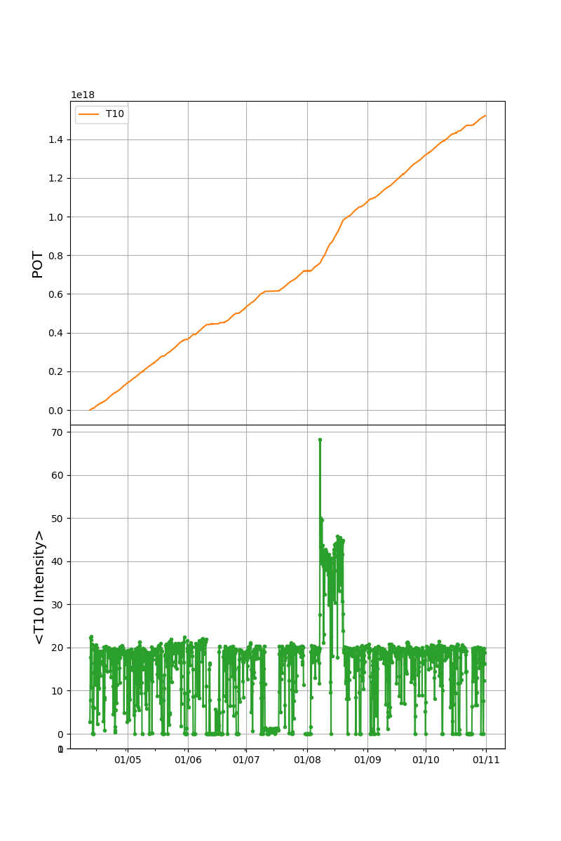
Data taking statistics (1)
Period start: Thu Apr 11 2024
Period end: Thu Oct 31 2024
Total SOBs: 942279
T4 non-empty bursts (>10e11): 748291 (79%) (81% 2023)
T10 non-empty bursts (>1e10): 734161 (98%) (96% 2023)
Average burst period: 18.3 s

Slide 4
Data taking statistics (2)
 | PNN | Low intensity | Dump
Non Empty bursts | 645935 | 22241 | 52177
Total runs | 523 | 16 | 47
Total runs saved | 510 | 15 | 41
Saved bursts | 604783 | 21722 | 50802
Total good runs | 495 | 15 | 39
Good bursts | 566233 | 20436 | 48984
Efficiency | 88% | 92% | 94%
Protons on T10 | 1.29*10¹⁸ | 2.7*10¹⁵ | 2.3*10¹⁷

Slide 5
Operations (1)
Chanti Felix
Well behaving after the initial troubles for the setup
Anti0
Smooth operations
Problematic tile replaced before the start of the run
Veto Counter
Smooth operation
GTK
Smooth operation
1 quarter of CHIP not working
KTAG
Smooth operation

Slide 6
Operations (2)
CHOD
Smooth operation
LAV,SAC and IRC
Smooth operation
Usual problems with HV system (Crate CPU and boards)
One problematic channel (tripping)
RICH
Smooth operation
TEL62 Saleve UP replaced
NewCHOD
Smooth operation
Sipm replaced before the start of the run

Slide 7
Operations (3)
MUVs
Smooth operation
Lkr
Smooth operation
Problems with fan tray concentrated at the end of the run
L0Calo
Smooth operation
New trigger conditions available
HASC
Smooth operation

Slide 8
Main issues (FIXED)
Big problem (beginning of May) with the timing system
First symptom: primitive time misalignment (no triggers or very few) fixed moving the fibers to a different LTU
After the fix problem with GTK (it was not restarting) fixed moving the fibers to a different LTU
After the fix of the GTK huge amount of TSM on LKr and MUV12 fixed moving the fibers to a different LTU
Plans to check properly the timing system (LTU+TTCEx) dureing the shutdown
CHANTI readout
Difficult transition from TEL62 to new TDC readout
Lot of work by CHANTI experts to debug and to have a working firmware and online monitoring from the CERN group

Slide 9
Main issues (PENDING)
PCfarm
Constantly crashing due to corrupted data coming from the detectors
Run Control
Memory saturation
Periodic restart of the project
Problems in updating of the run and burst number
Duplicated file to be removed
Communication with L0TP periodically not working
L0TP
Missing EoB packet (to be understood if really due to L0TP)

Slide 10
Main issues (PENDING)
TEL62 of KTAG1 constantly CHOKING to be replaced during the shutdown
TEL62RICHMULT not generating triggers and CHOKING
To be replaced??

Slide 11
TDAQ SPARES
2 TEL62 working (to e tested again)
4 TDCB working
1 TEL62 needs a new QDR chip (different with respect the others)
1 TEL62 showing constant rebooting (the one replaced on RICH): in lab no reboot
Other TEL62 with communication problems between PP-SL
3 possible TEL62 good spares + 12 TDCB from CHANTI

