Slide 1
The XH cryogenic detector system: overview and recent studies
A HPGe micro-strip sensor
Daniel Thacker [Physicist, STFC Graduate Programme]
High Precision X-ray Measurements 2025

Slide 2
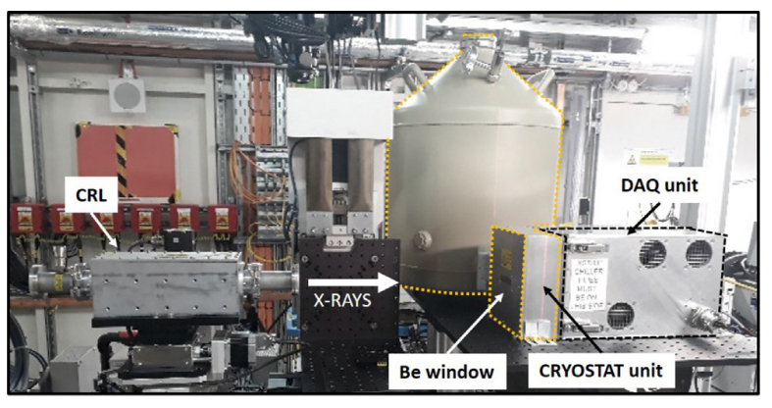
Contents:
Introducing the XH system:
Experimental application;
Cryostat unit;
DAQ unit;
Tests on cryostat unit:
Stress tests during development;
Recent vacuum studies on cryostat unit:
Experimental setup and procedure;
RGA spectra, vacuum logs and IV curves;
Future irradiation work;
Summary

Slide 3
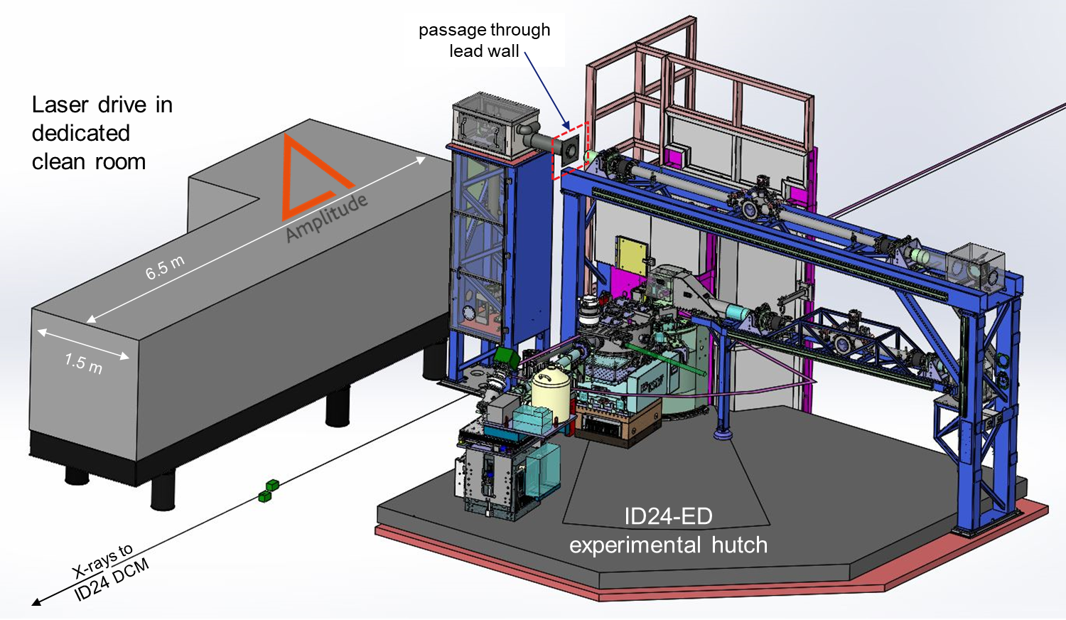
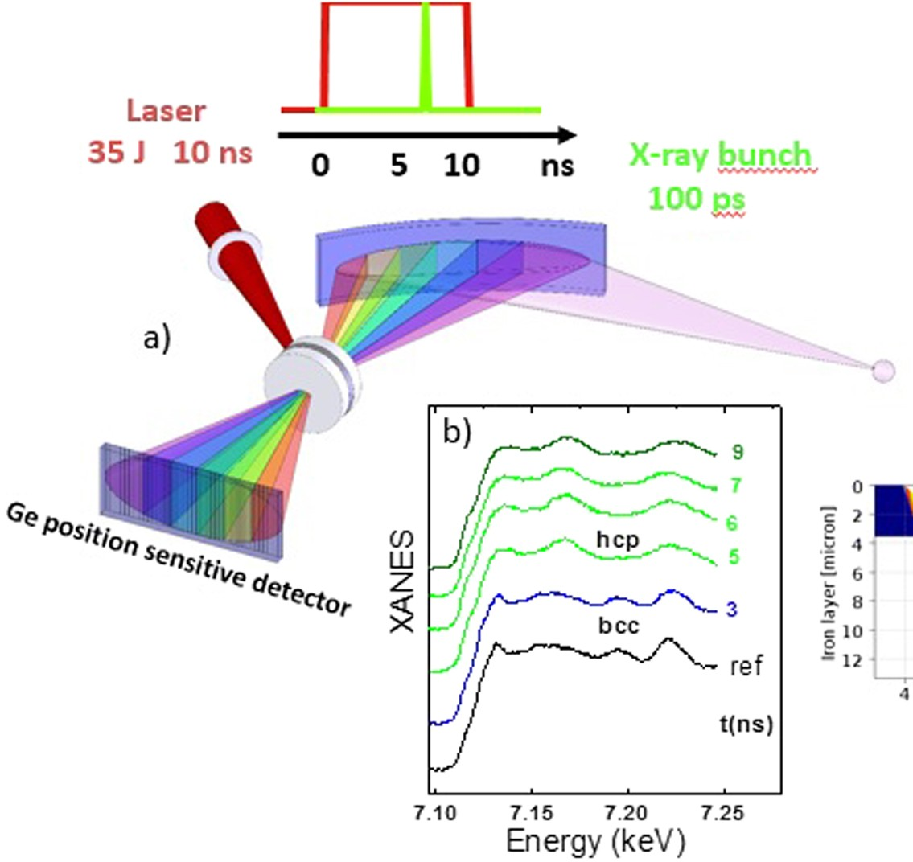
Experimental application
XH is a detector currently deployed at the High Power Laser Facility (HPFL) at ESRF-EBS ID24.
It is used in time-resolved Energy Dispersive X-ray Absorption Fine Structure (EXAFS).
EBS beams are combined with the high-power laser to perform dynamic compression experiments in the ns time-scale.
The extreme conditions of pressure and temperature created in the sample are used to study structure and properties of matter for solid state physics, materials and energy.
A representative case is the study of warm dense matter, relevant to the description of planetary interiors.
https://doi.org/10.1038/srep26402
Probing local and electronic structure in Warm Dense Matter: single pulse synchrotron x-ray absorption spectroscopy on shocked Fe

Slide 4
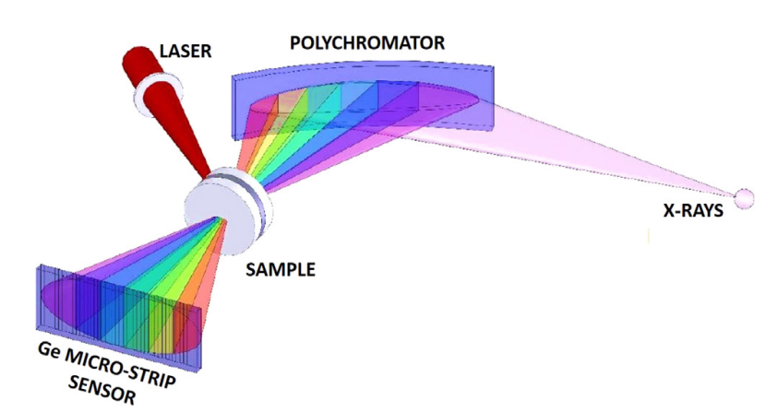
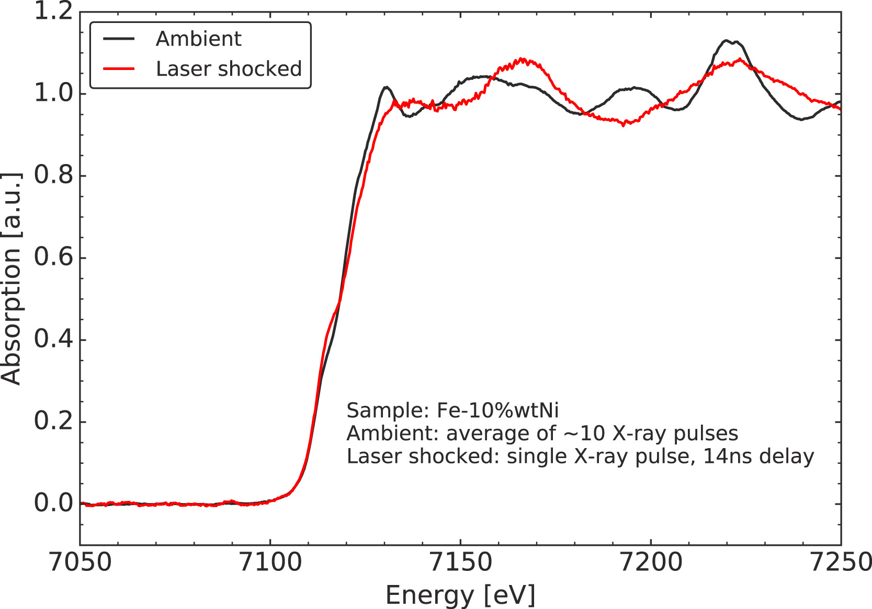
Experimental application
XH deploys an HPGe micro-strip sensor to detect the polychromatic transmitted pink beam.
A back-illuminated HPGe sensor, with 1024 strips and 50 µm pitch.
Each strip position corresponds to a different spectral component of the dispersed beam.
EBS provides bright X-ray pulses, reducing photon statical noise on single shot measurements – sample is destroyed during exposure.
https://doi.org/10.1016/j.nima.2020.164932

Slide 5
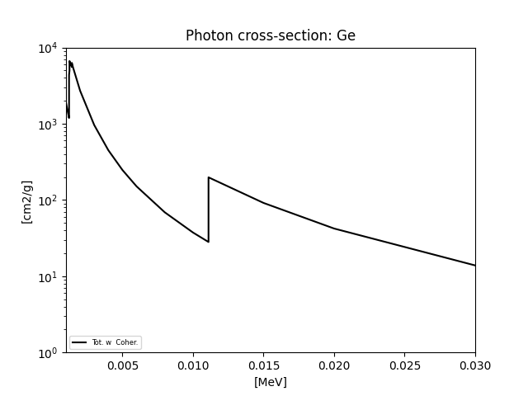
Experimental application
At ID24, the primary energy range is: 5-27 keV
The highest flux is expected at 7 keV with 4-bunch fill pattern: $39.6 ∗{10}^{6} γ$ / bunch (i.e. every 700ns, leading to ${5.6∗10}^{13}$ 𝛾 / s total).
Photons hit the detector over an area 50mm x 0.1mm.
w/o sample: $\sim 1∗{10}^{13} γ mm^{−2}{ s}^{−1}$ are transmitted to the HPGe sensor.
This creates a harsh radiation environment for the sensor.
704 ns
4-bunch

Slide 6
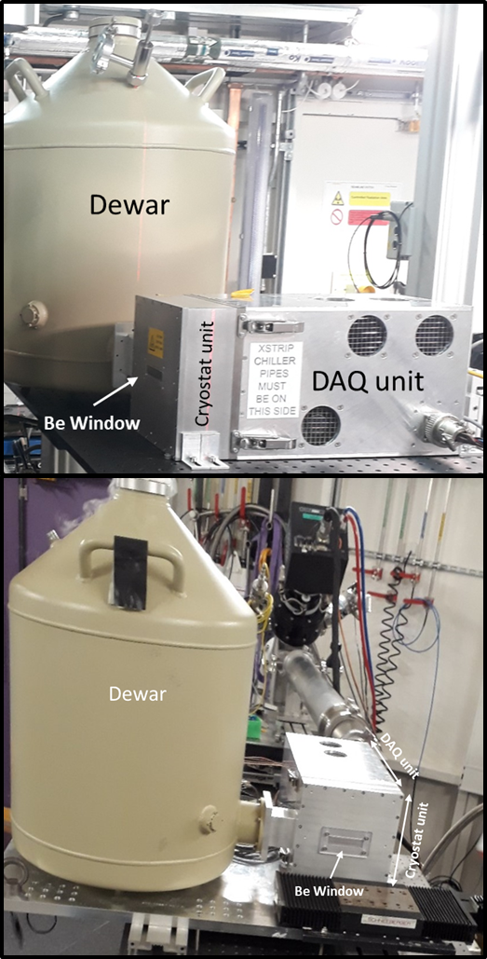
XH: cryogenic detector system
The system is made of two main units:
the cryostat unit
the data acquisition unit

Slide 7
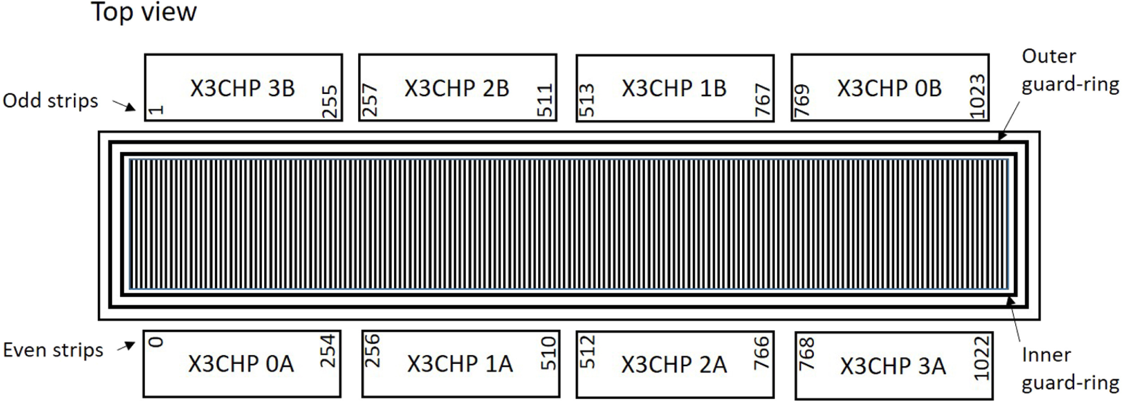
Cryostat unit
Liquid Nitrogen (LN2) Dewar:
30L, commercial off the shelve
Detector chassis and internal cooling mechanics:
Custom made
Be window for X-rays access
HPGe micro-strip sensor:
Procured from commercial supplier:
Mirion Technologies
1024 strips, 50 µm pitch, 1.5 mm thickness
Front-End electronics:
Custom made by STFC
X3CHIP, charge integrating
128 channels/ASIC
Outer and Inner guard ring

Slide 8
HPGe test pads
Test structures with a similar set-up to the strip sensor were also manufactured.
Capacitance – Voltage characteristics were assessed.
Sensor fully depletes at ~30V at 2 representative temperatures.

Slide 9
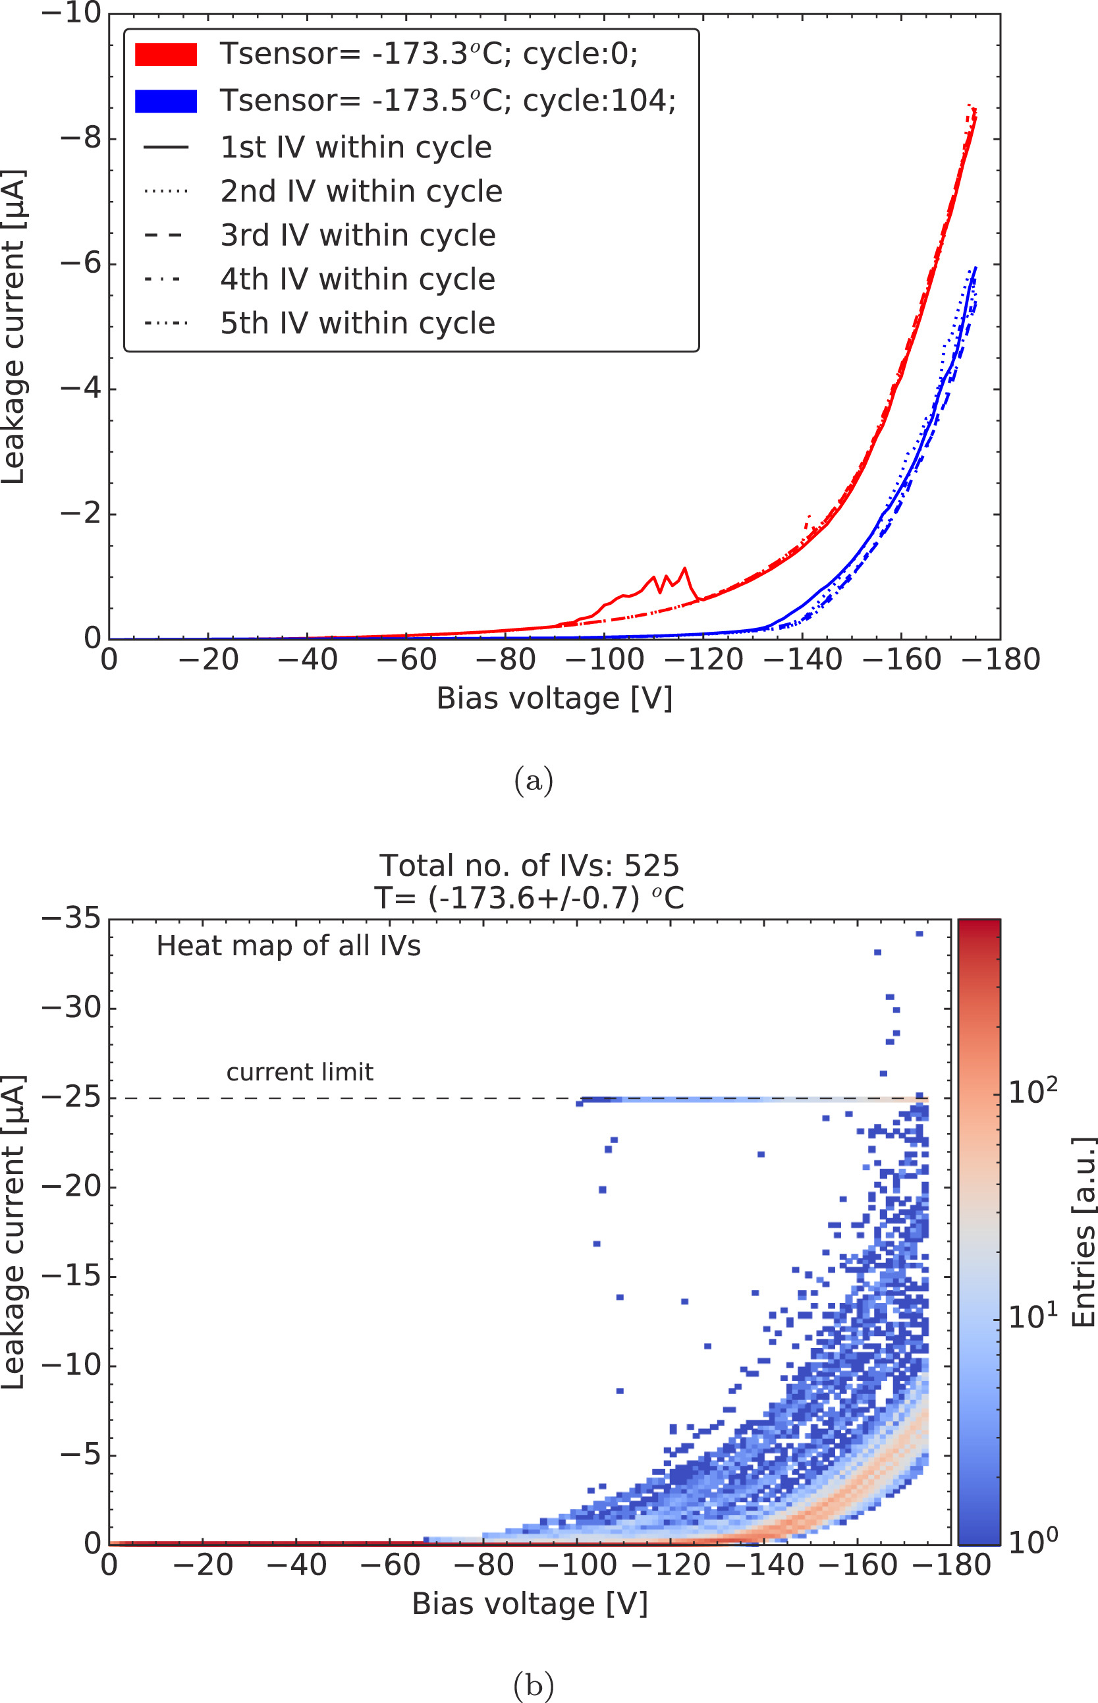
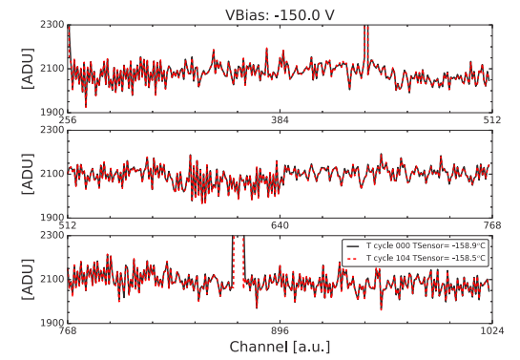
Stress tests on the cryostat unit
The cryostat unit was thermally cycled 105 times.
Average ΔT ~ 150 °C, Max ΔT 173°C
Sensor, electronics, interconnection were monitored at each iteration.
In total, 525 IV curves were taken within 105 temperature cycles (i.e. 5 IVs/Tcycle).
The system was ‘baked-out’ 25 times over the period.
Bakeout consisted of vacuum pumping the cryostat at ~+55°C for 4 days.
No evidence of failure detected at component of system level.
IVs always restored at baseline value after bakeout
No wire bonds detached
No front-end chip deteriorated
Not considered in the study,
mechanically damaged.

Slide 10
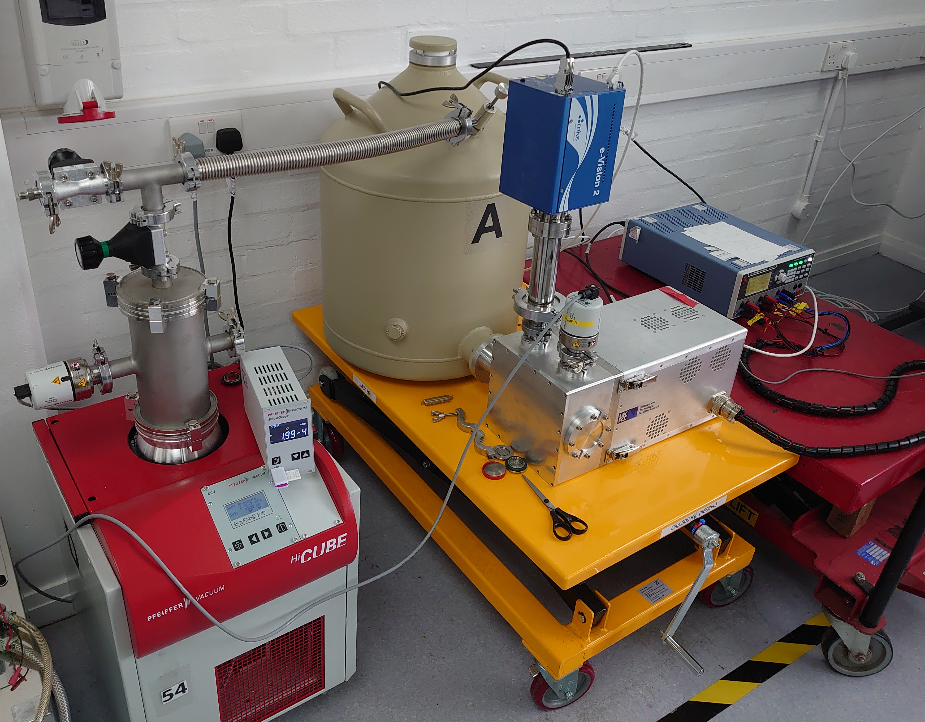
Vacuum studies on cryostat unit
The cryostat unit houses the HPGe sensor and the front-end electronics.
We are performing a set of measurements to characterise the vacuum deterioration inside the cryostat during long term operation.
Investigating the interplay between the internal outgassing effects and the surface current on the sensor.
A cryostat unit was equipped to measure vacuum.

Slide 11
Experimental set-up:
Dewar
Residual Gas Analyser
Pump
Vacuum gauge
Cryostat unit
DAQ

Slide 12
Procedure and timeline
Applied high operational current to the headboard and heated it with a PID controller to -50°C.
Continually took IVs, residual gas spectra and vacuum data within the ‘Thermal cycle’.
After 4 weeks of this, perform bakeout and repeat.
Warming + bakeout
Warming + bakeout
Thermal cycling 1
Thermal cycling 2
Thermal cycling 3
~4 weeks
~4 weeks
~4 weeks
13/01/25
~100 hour bakeout
~300 hour bakeout
04/06/25

Slide 13
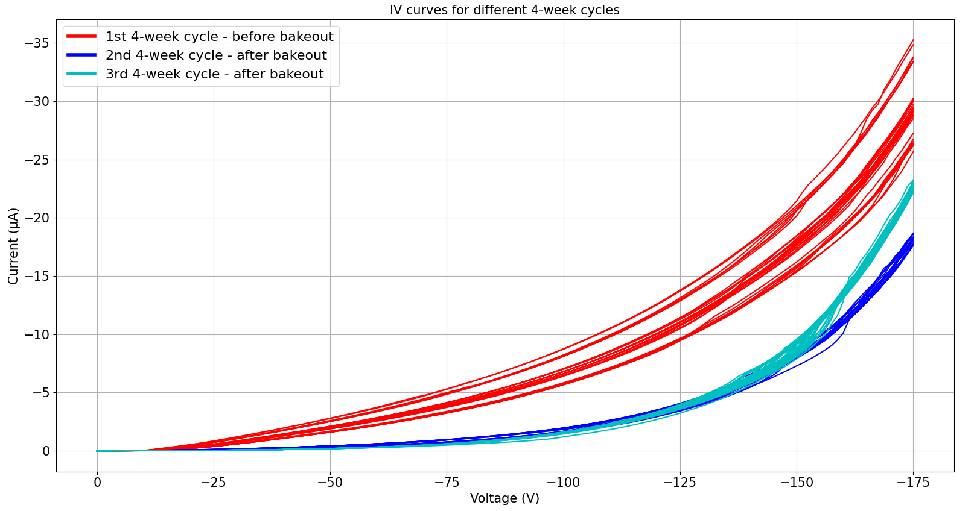
Pre and post-bakeout IV curves – at operational sensor temperature
Temperature of sensor mechanics: -155°C

Slide 14
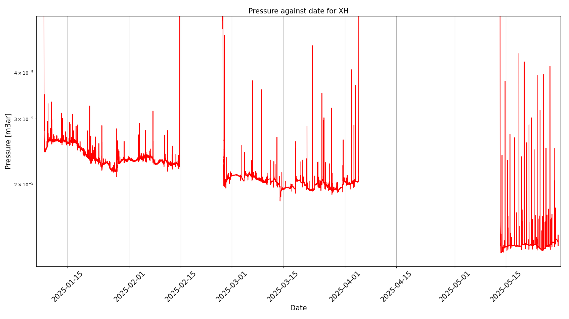
Thermal cycle 1: sensor mechanics at -155°C
Thermal cycle 2: sensor mechanics at -155°C
Cryostat handling + ~300 hour bakeout with sensor mechanics at +55°C
Thermal cycle 3: sensor mechanics at -155°C
~200 hour bakeout with sensor mechanics at +55°C
~0.6E-5 mBar

Slide 15
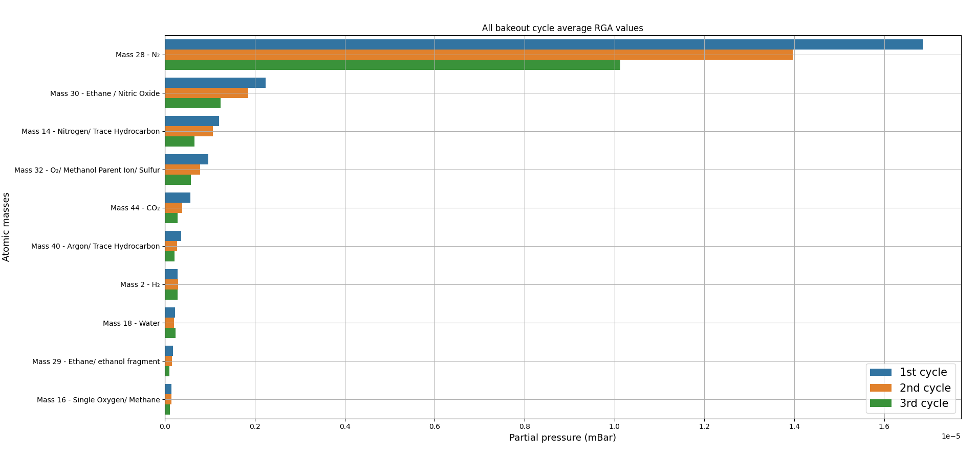
Residual Gas Spectra – Thermal cycle 1 and 3 averaged RGA values

Slide 16
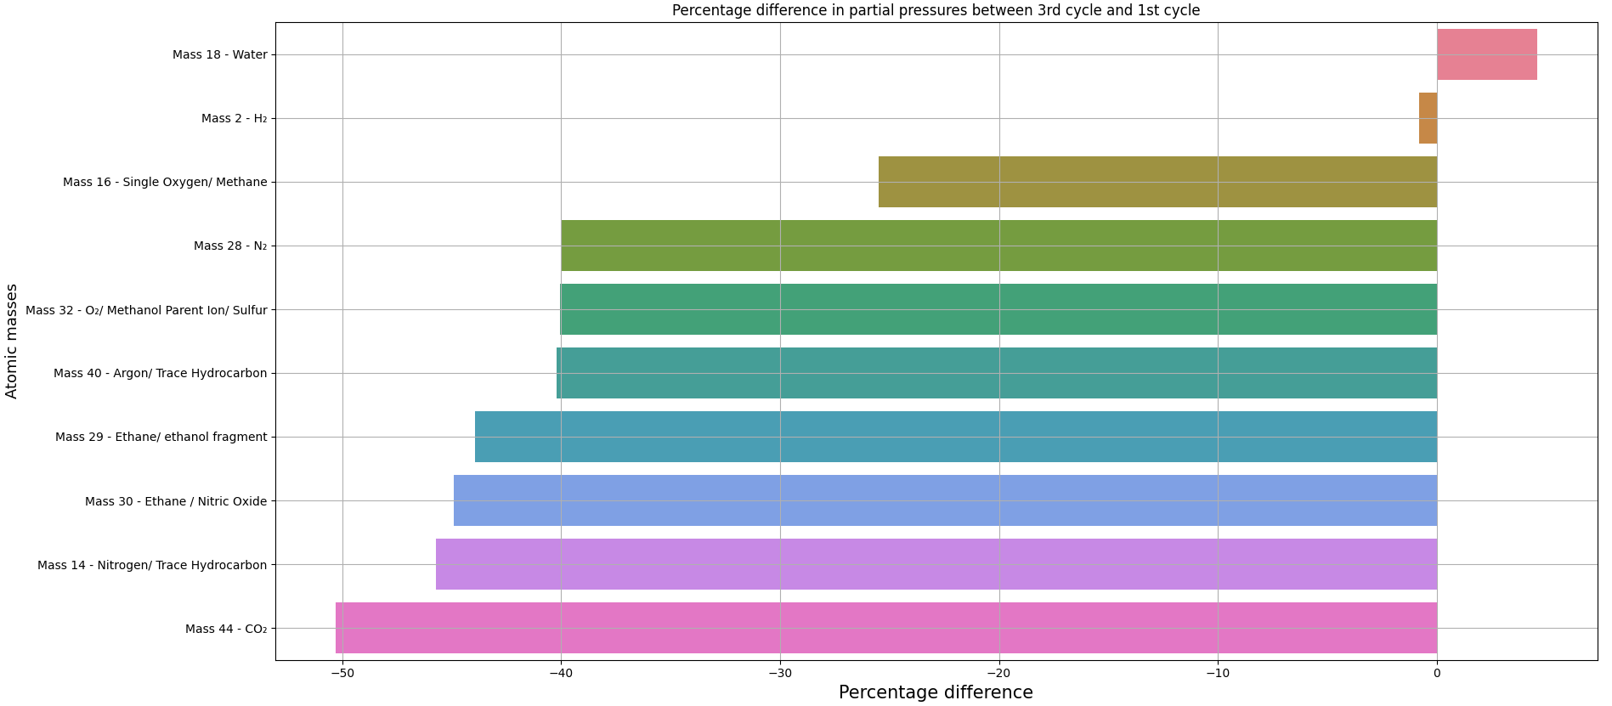
Residual Gas Spectra – Percentage difference between thermal cycle 1 and 3 averaged RGA values

Slide 17
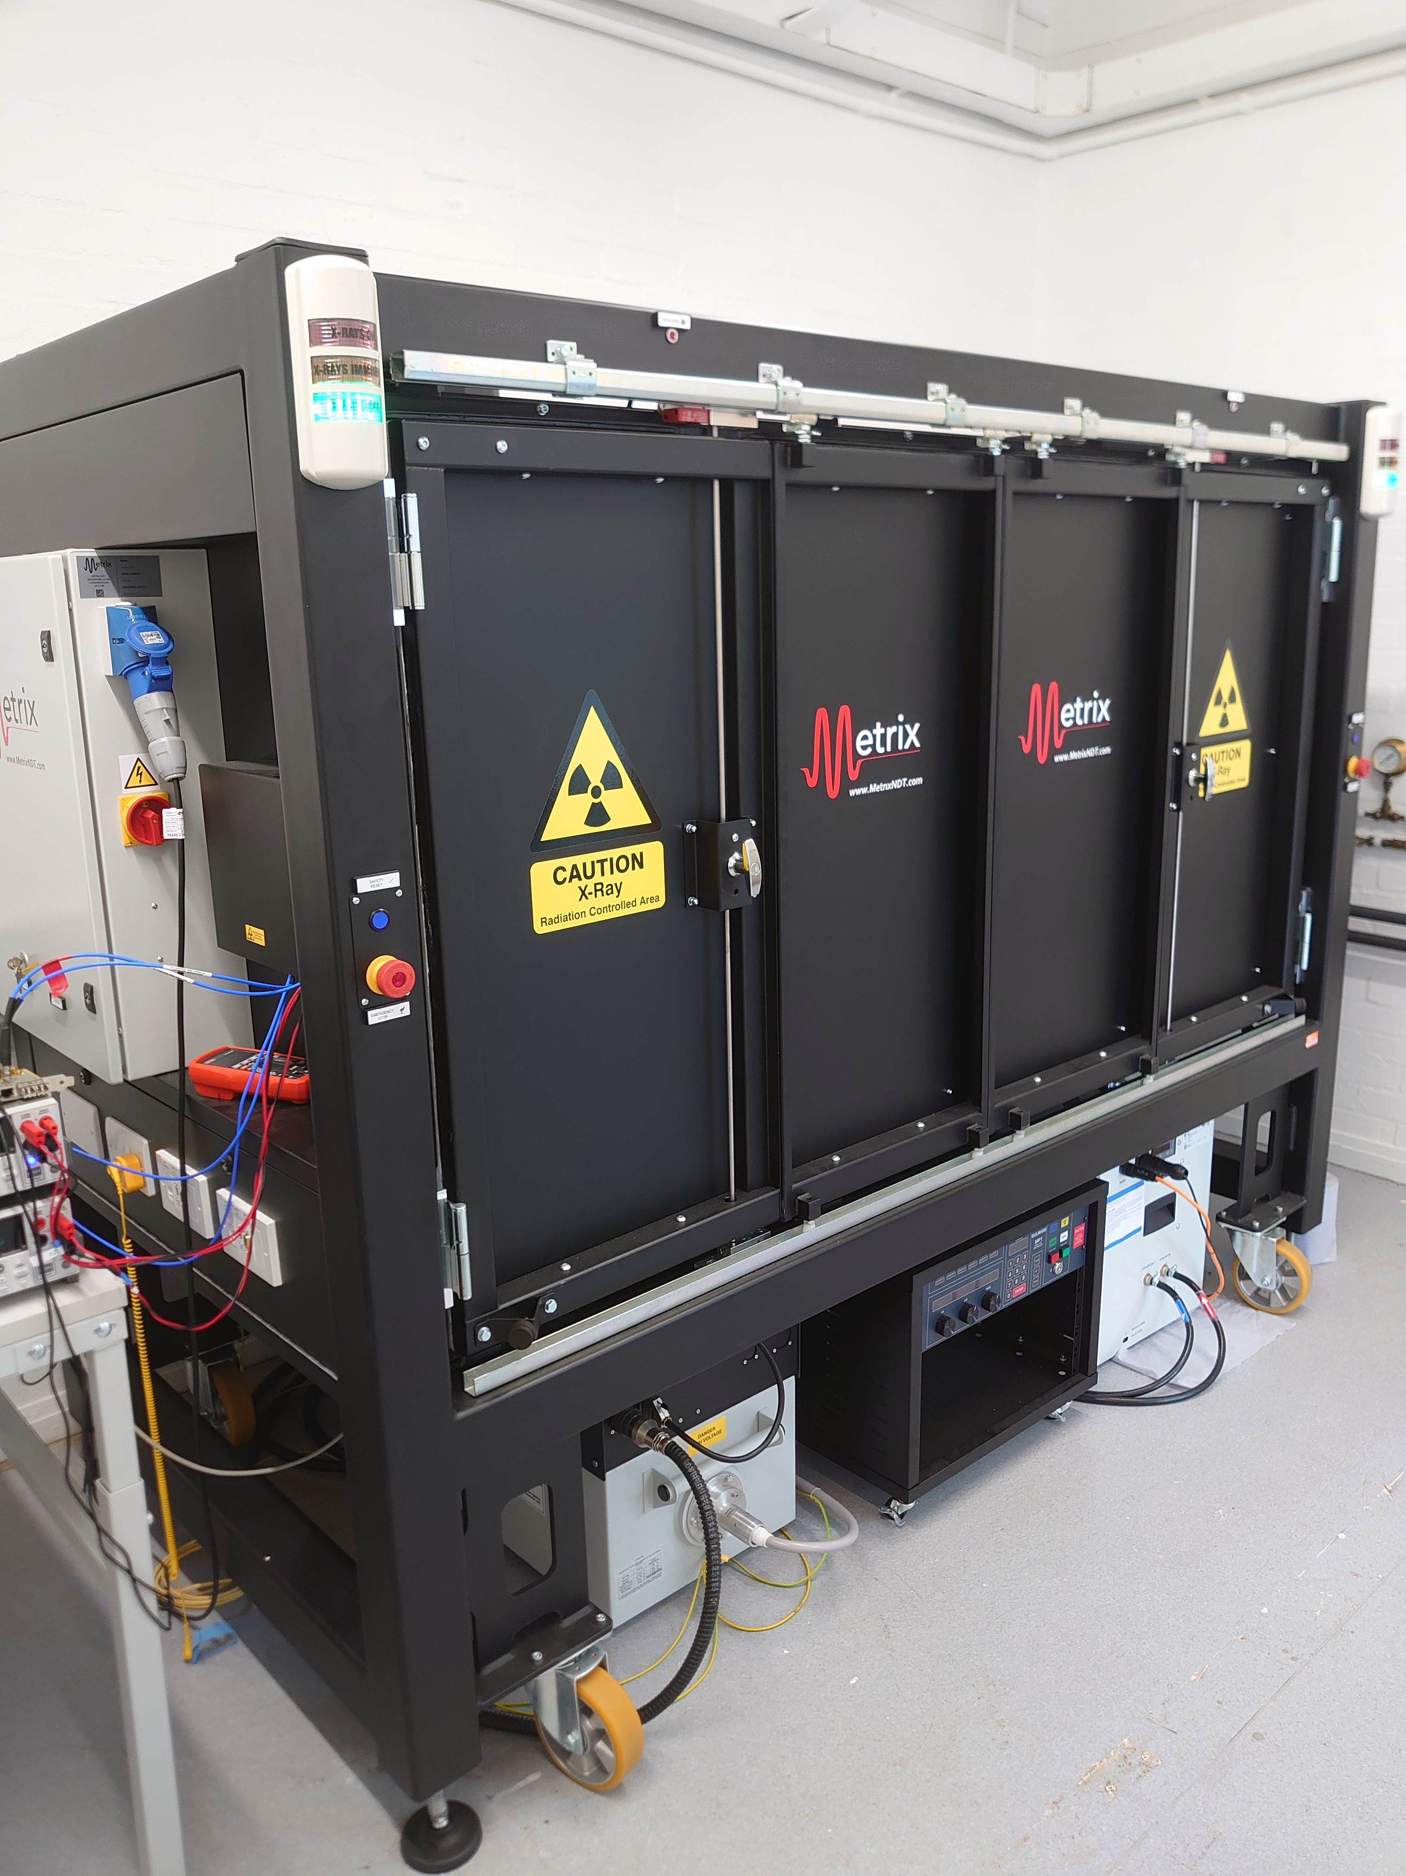
Future studies - irradiations:
The XH cryostat has been fitted with a beryllium window.
Daresbury Laboratory has an X-ray irradiation chamber which will be used to assess how the vacuum, residual gases and leakage current of the XH system perform under constant irradiation.
Irradiating at 20 keV and 20 mA for prolonged periods
Higher flux may be required at the ESRF.

Slide 18
Summary
XH is a HPGe microstrip sensor used for Energy Dispersive X-ray spectroscopy.
Installed at the ESRF HPLF beamline analysing extreme states of matter - operated in a radiation harsh environment.
The XH system was thermally cycled many times and remained consistent.
Bakeouts have a direct impact on detector leakage current and cryostat vacuum level.
Future research will assess radiation induced contamination of the sensor surface.

Slide 19
Back-up

Slide 20
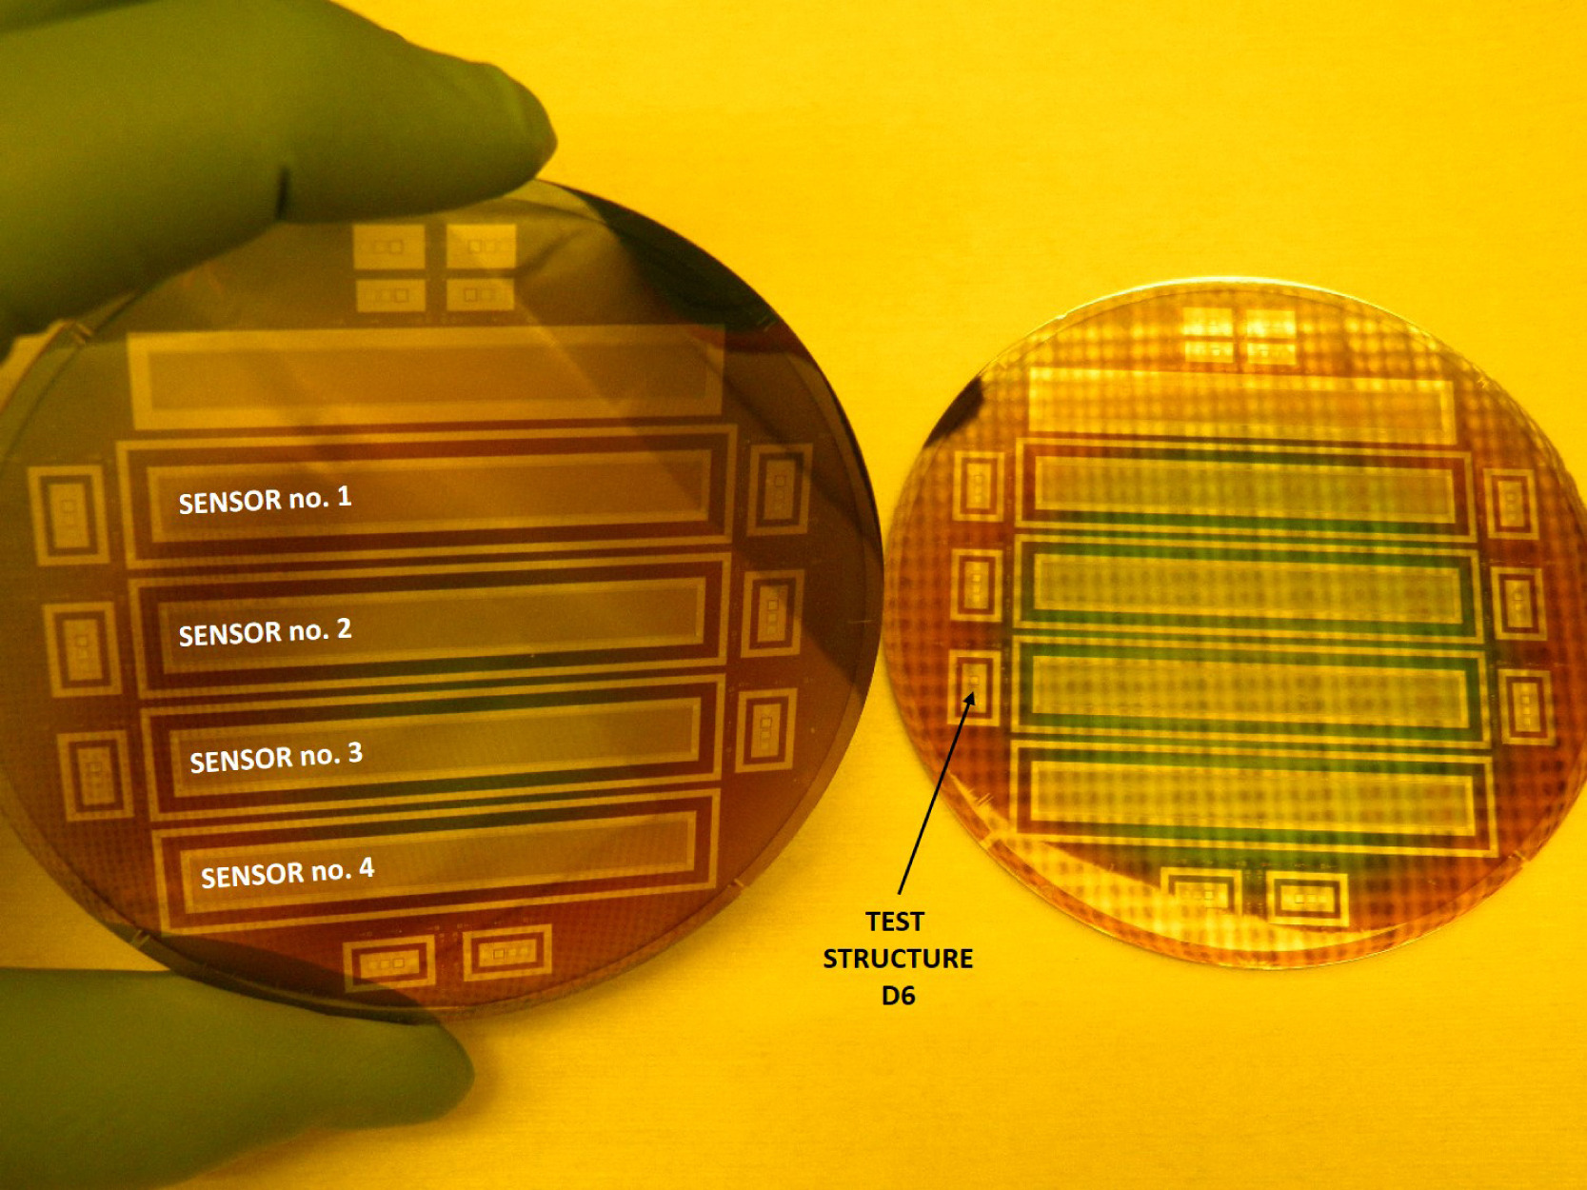
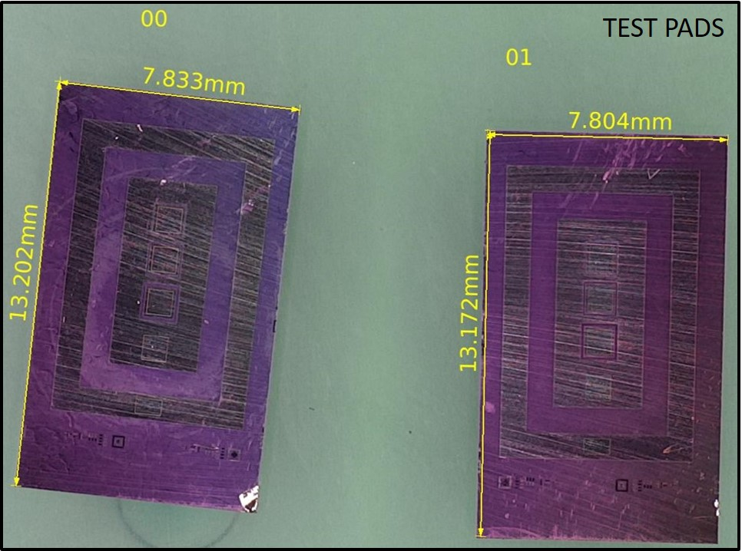
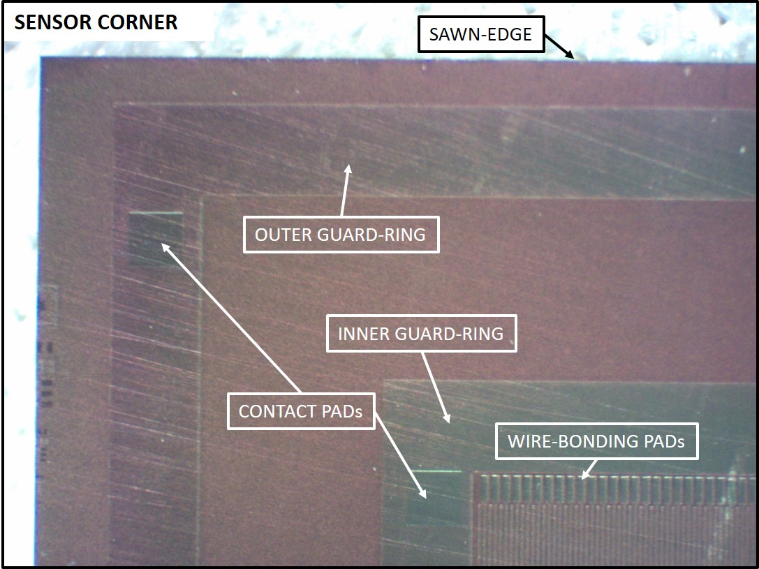
HPGe micro-strip sensor
90 mm diameter wafers manufactured by Mirion Technologies
Size: 1024 strips
Strip pitch: 50 um with 20um gap
Strip length: 5mm
Sensor thickness: 1.5mm
Two guard-rings
Interleaved wire-bonding pads
Back illuminated

Slide 21
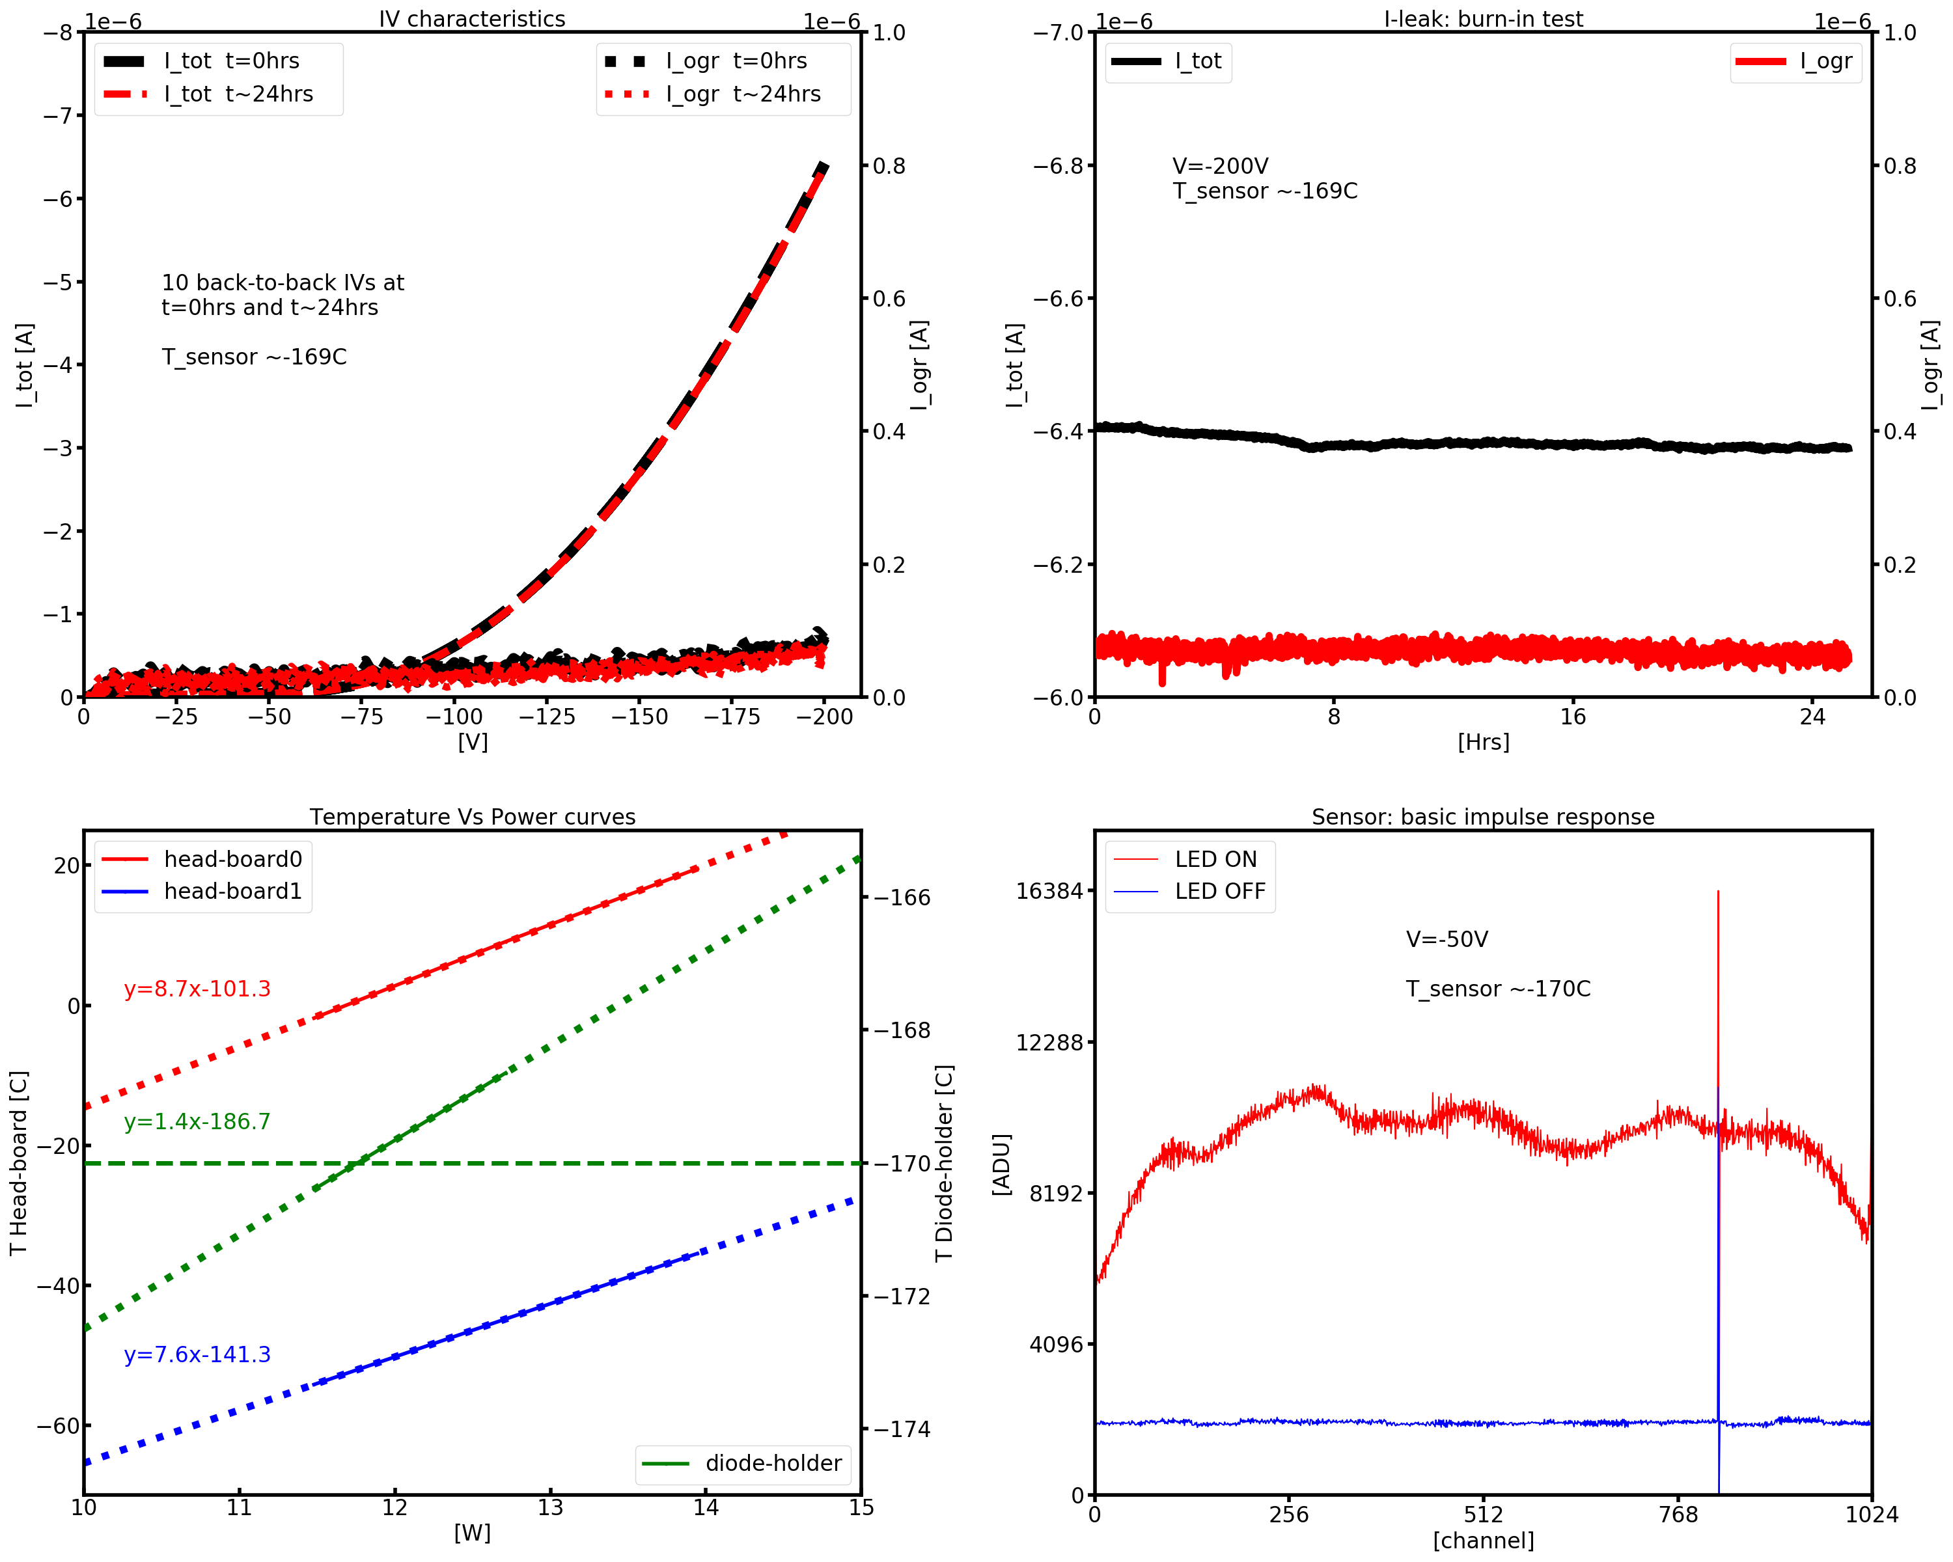
QC on cryostat unit: production version
We perform a series of quality control measurements on cryostat units to validate the performance of the unit.
IV characteristics:
10 IVs back-to-back up 200V
24hrs apart i.e. before after burn-in test
Leakage current burn-in test:
24 hrs at 200V
Temperature Vs Pwr:
Sensor temperature <-170 C @ ~12W front end power (i.e head-boards)
Visible light response:
Basic response test via an LED installed inside the cryostat

