Slide 1
16/06/2025 : Welcome to LNF and to Frascati

Slide 2
High Precision X-ray Measurements Series:
an established community
2018: 48 participants & 38 contributions
100 participants & 52 contributions (online)
72 participants & 60 contributions
78 participants & 52 contributions
30% Women
30% Talks by young researchers

Slide 3
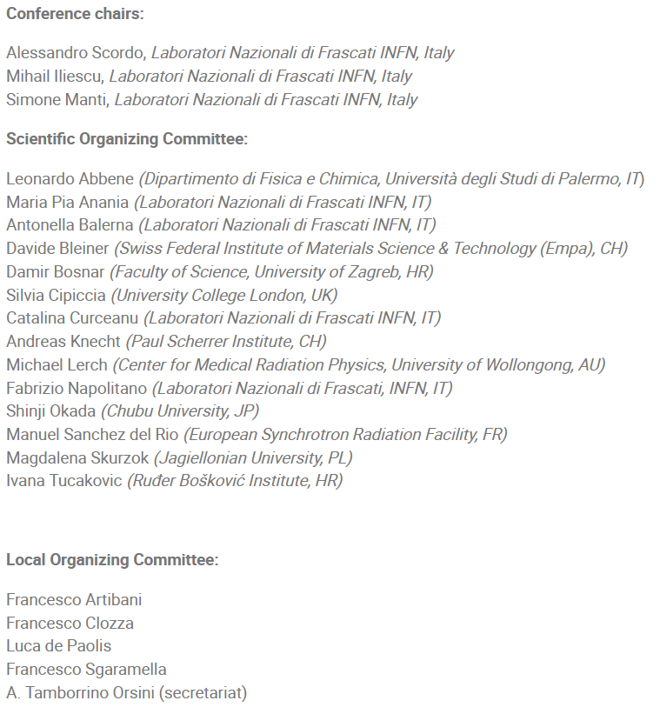
High Precision X-ray Measurements 2025:
Chairs and Committees

Slide 4
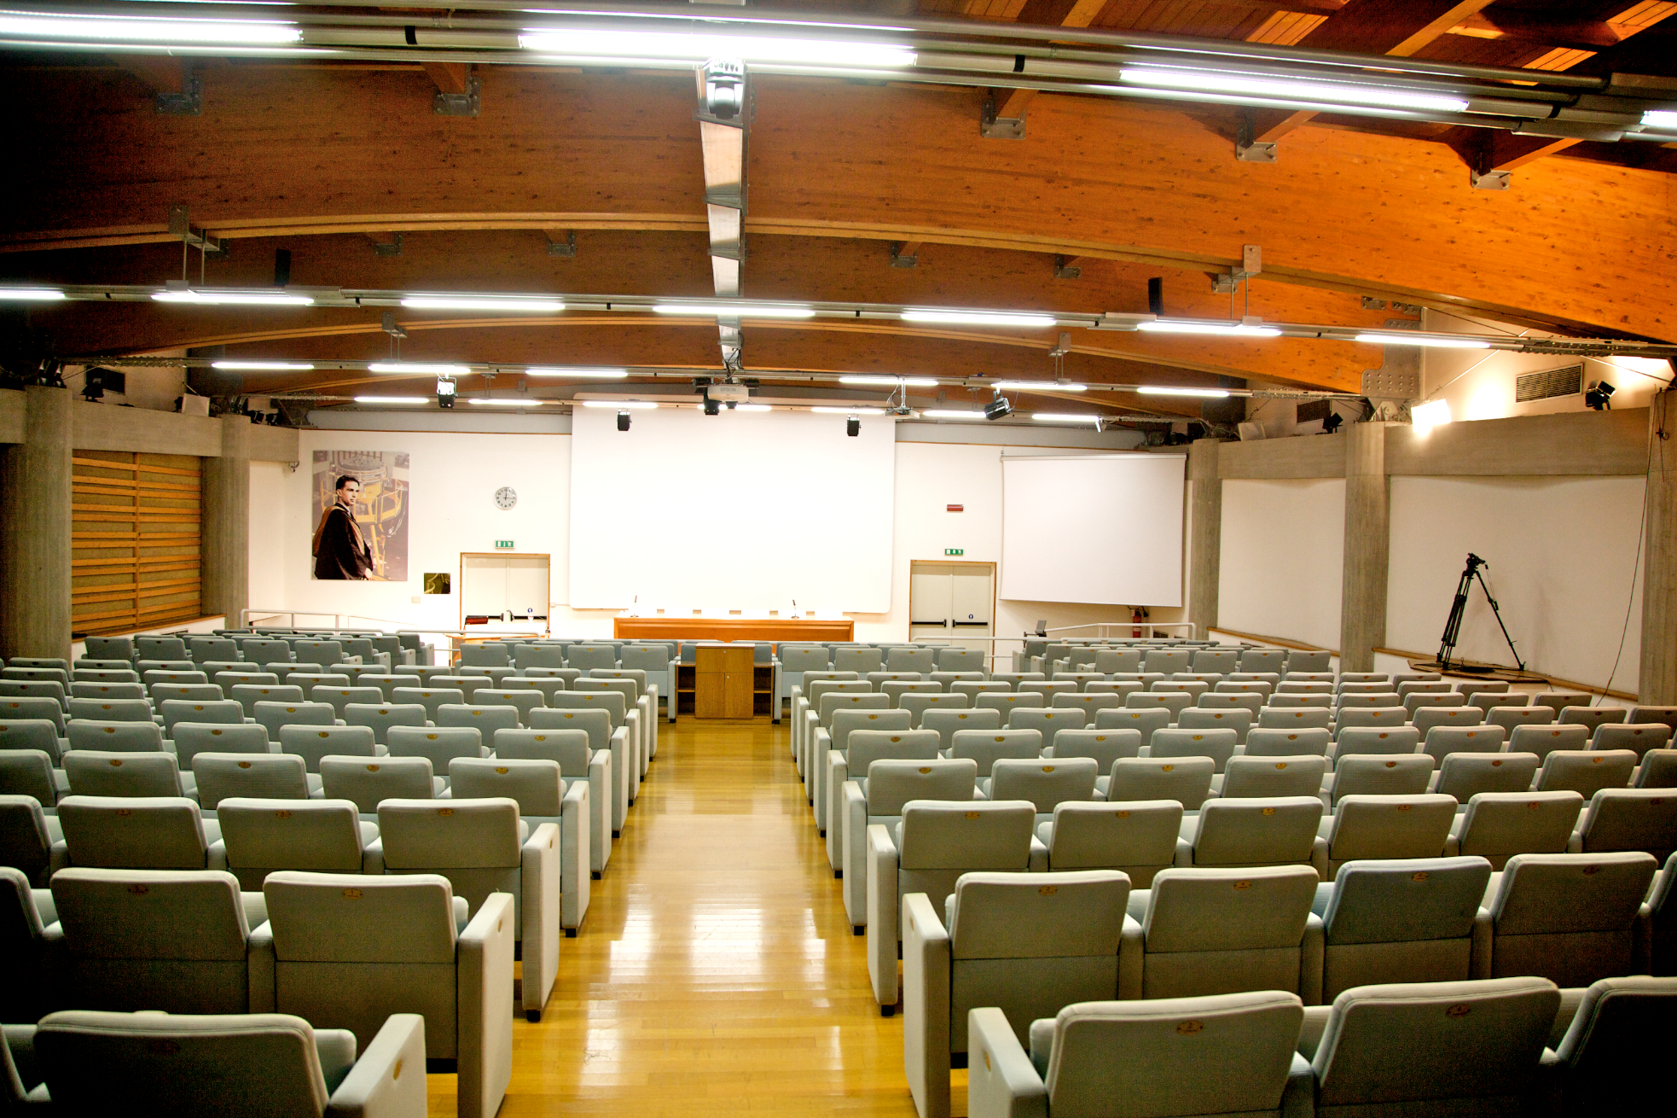
High Precision X-ray Measurements 2025:
Program
Sessions:
X-ray Applications
Beamlines and Facilities
Detectors and Detection Techniques
Fundamental Physics
Instrumentation
Talks length: 15’ + 5’
Invited talks length: 25’ + 5’
Several contributions → Tight schedule → please be in time (chairs...)!!!
Please, upload your slides in time for your talk

Slide 5
High Precision X-ray Measurements 2025:
Young Researcher Contest
For each participant, the final evaluation is a number from 0 to 10, resulting from the sum of 3 evaluation criteria:
1) Quality of the research (max 4 points)
2) Clarity and quality of the oral presentation (max 4 points)
3) Artistic quality and visual impact of the slides (max 2 points)
Speaker | Scheduled | Title
Abner Ivan Castro Campoy | 16/06/2025, 11:10 | The INFN Frascati facility for X-Ray dosimetry
Luigi Russo | 16/06/2025, 15:30 | Development of a direct-reading dosimeter for eye-lens dose estimation in medical radiology
Giorgio Finocchiaro | 17/06/2025, 11:10 | Space and time-resolved X-ray spectroscopy technique by CCD pinhole camera
Daniel Thacker | 17/06/2025, 13:10 | Outgassing and surface contamination studies for XH - a HPGe microstrip sensor
Aixeen Manuel Fontanilla | 18/06/2025, 12:40 | Characterizing Cerium Redistribution in PEM Fuel Cells Using an In-House X-ray Fluorescence System
Bianca Peri | 18/06/2025, 13:00 | AI Tools for Plasma Diagnostics by X-ray Imaging and Spectroscopy in the PANDORA Project Frame
Francesco Clozza | 19/06/2025, 10:40 | Precision X-ray Measurements with Silicon Drift Detectors in the SIDDHARTA-2 Experiment
Iurii Eremeev | 19/06/2025, 11:00 | Study of the excess noise and optimum operating conditions for LGAD detectors in high precision X-γ ray spectroscopy
Giorgio Dho | 19/06/2025, 12:40 | X-ray Polarimetry with Optical Time projection chamber within HypeX project
Hemanth Manikantan | 19/06/2025, 13:00 | Development of a Next-Generation Focal Plane Photoelectron Track X-ray Polarimeter with Timepix3 Readout
Francesco Artibani | 19/06/2025, 15:30 | Novel CZT Detectors for kaonic atoms spectroscopy
Kamila Kasperska | 19/06/2025, 15:50 | Studies of the absorption parameter 3γ/2γ in positronium decays
Luca Serafini | 19/06/2025, 11:20 | Enhanced time resolution with a room-temperature energy dispersive X-ray PIN photodiode detector for improved EDX-EELS coincidence measurements in an electron microscope measurements
Awarding Cerimony: Friday 20/06 13:00
Don’t miss it!!!

Slide 6
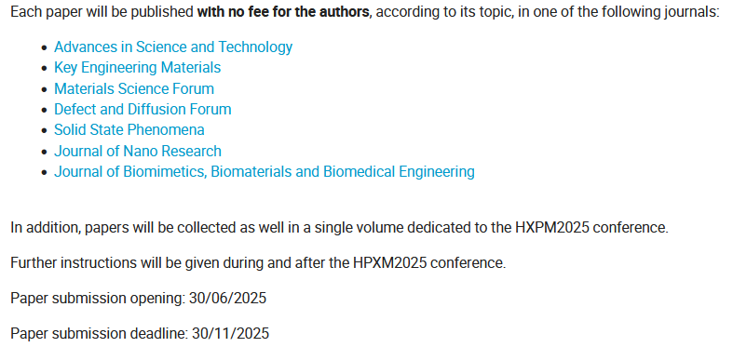
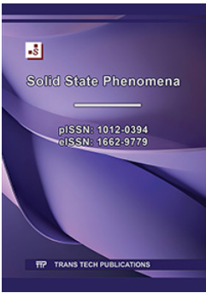
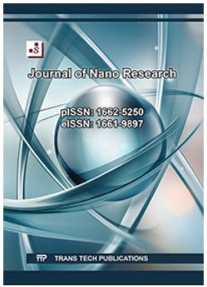
High Precision X-ray Measurements 2025:
Proceedings

Slide 7
High Precision X-ray Measurements 2025:
Sponsors
Sponsors will be present with permanent stands in the Entrance Hall
Please, visit them during the coffee breaks (not the sessions….)
Dedicated talks during afternoon sessions

Slide 8
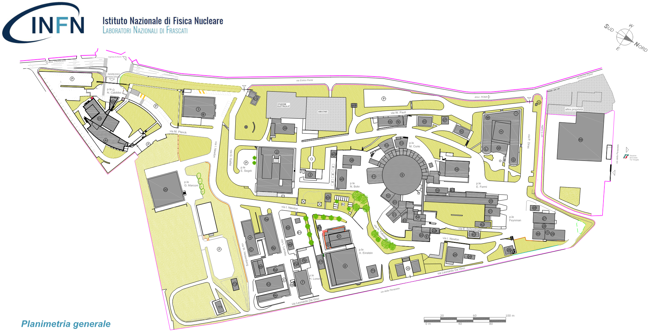
High Precision X-ray Measurements 2025:
Locations
Secondary Entrance (programmed openings)
Train Station
‘Tor Vergata’
Main Entrance (also with car)
LNF Canteen (lunches)
Entrance Hall
(Registration desk, sponsors, Coffee Breaks, LNF Shop)
Aula B. Touschek
(Sessions)

Slide 9
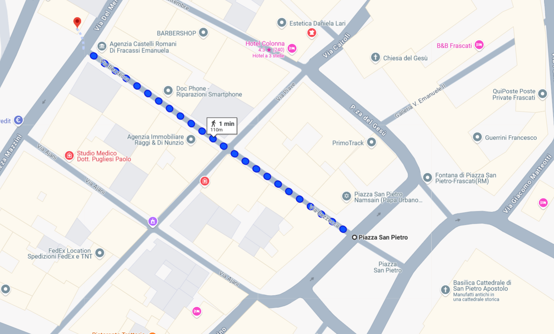
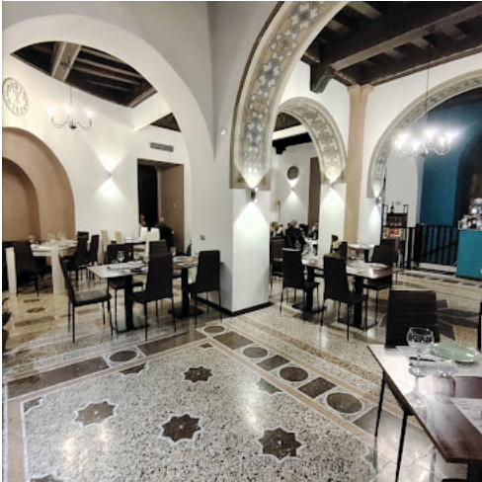
High Precision X-ray Measurements 2025:
Social Dinner
Ristorante Noah
L'insolita tradizione
Piazza Mazzini, 6, 00044 Frascati RM
Dinner will start SHARPLY at 19:30 to allow participants from Rome to take the last train from Frascati (22:36)
1 min. walking from main square (S. Pietro)

Slide 10
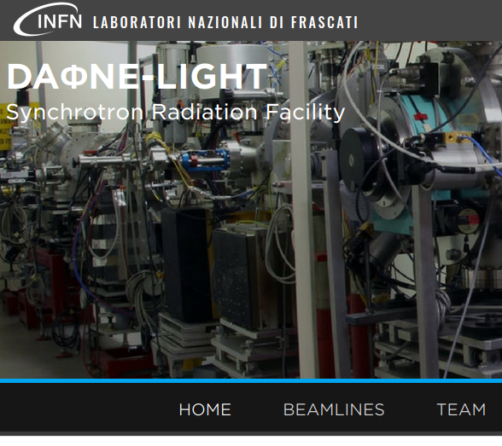
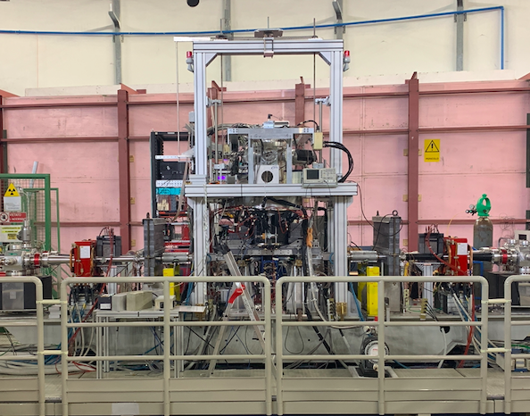
High Precision X-ray Measurements 2025:
Visit to LNF Facilities
Visit to EuPRAXIA
related facilities & laboratories
Visit to DAFNE-Light facilities & laboratories
Visit to DAFNE Collider & SIDDHARTA-2 experiment
Visits will take place on Thursday 19/06 at 09:00
Please, sign the foil on reservation desk
Meeting Point : Entrance Hall

Slide 11
High Precision X-ray Measurements 2025:
towards ENRICH COST ACTION
European Network for research and innovation in Radiation-based applications to address Increasing societal CHallenges
From HPXM2025 webpage:
“HPXM2025 will be also the first occasion to bring together the proponents of the ENRICH Cost Action, submitted for the 2024 call.”

Slide 12
High Precision X-ray Measurements 2025:
towards ENRICH COST ACTION
European Network for research and innovation in Radiation-based applications to address Increasing societal CHallenges
COST Actions provide financial support for:
- Meetings;
- Training Schools;
- Mobility of Researchers and Innovators
- Presentations at conferences organised by third parties;
- Dissemination and Communication Products;
A COST Action is an interdisciplinary research network that brings researchers and innovators together to investigate a topic of their choice for 4 years. COST Actions are typically made up of researchers from academia, SMEs, public institutions, and other relevant organisations or interested parties.

Slide 13
High Precision X-ray Measurements 2025:
towards ENRICH COST ACTION
European Network for research and innovation in Radiation-based applications to address Increasing societal CHallenges
Main Scope:
Build a broader and multidisciplinary community that exchanges information and expertise, covering fundamental physics, nuclear physics, astrophysics, medical physics, agrifood, and material science.
Working Groups
WG1: Management and Coordination
WG2: Technological Advancement
WG3: Software Advancement
WG4: Electronics and DAQ
WG5: Multidisciplinary and Societal Applications
WG6: Integration and Interchange
WG7: Mentoring, Training and Dissemination
MoU publication: 12/06/2025
https://www.cost.eu/actions/CA24131/
MC1 (Kick-Off): 15/09-30/10
Duration: November 2025-November 2029

Slide 14
High Precision X-ray Measurements 2025:
towards ENRICH COST ACTION
European Network for research and innovation in Radiation-based applications to address Increasing societal CHallenges
MoU publication: 12/06/2025
https://www.cost.eu/actions/CA24131/
MC1 (Kick-Off): 15/09-30/10

Slide 15
High Precision X-ray Measurements 2025:
…enough chatting!!!
Enjoy the conference!!!

