Slide 1
Oxford Instruments
X-Ray Technology
Markets & Applications
2025
Notes:
1

Slide 2
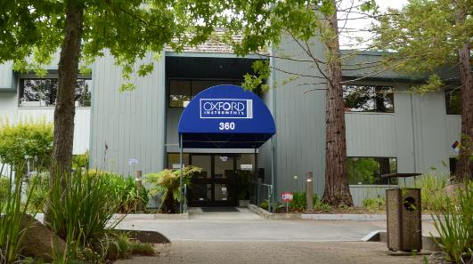
Introduction to X-ray Technology
Our solutions enable breakthrough R&D and high-volume OEMs in the global analytical, medical imaging, food quality & packaging inspection, and industrial NDT markets.
Located in Scotts Valley, CA
Founded in 1982
Approximately 70 employees
Engineering, R&D, and Manufacturing in CA near Silicon Valley

Slide 3
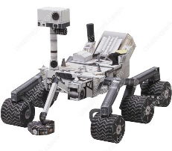
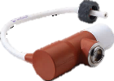
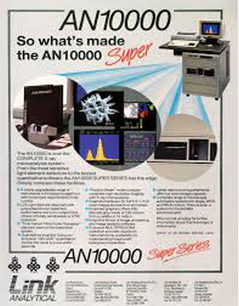
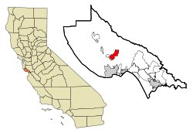
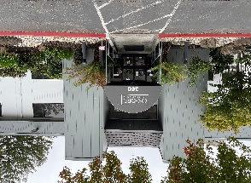
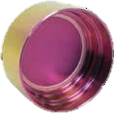
History of X-ray Technology
Enabled Mining Shovel Analysis
Ruggedized OIXT X-ray tube designed for harsh environments
Foundation of X-Tech
Initially offered x-ray tube for thickness gauging and XRF applications
Approached by GE to develop a high-performance dental type tube marking the expansion into imaging markets – PN90507
X-ray tube
Link Analytical acquired by Oxford Instruments; foundation of OIXT
X-ray tube developed in collaboration with NASA sent to Mars as part of Curiosity rover CheMin instrument
1982
1990
2002
2011
2021
1987
1995
2007
2018
X-Tech acquired by Link Analytical
Presented opportunities around minifocus analytical tubes, leading to tube development for key players in the analytical market
Moved to current location in Scotts Valley, CA (El Pueblo Road)
Release of Forte anti-corrosion window coating (was adopted by first Customer in 2019)

Slide 4
Markets Served
Imaging
Analytical
MIM
Medical
Imaging
Specimen radiography
Pre-clinical
Mini C-Arm Fluoroscopy
EIM
Electronics
Imaging
PCB drilling
Solder joint inspection
IIM
Industrial
Imaging
Plastics inspection
Agricultural & Packaging
Composites NDT
XFA
X-Ray Fluorescence Analysis
Elemental analysis
Metal & alloy sorting
Regulatory (RoHS/WEEE)
XFT
X-Ray
Thickness
Gauging
Rolled sheet thickness
Coating thickness
Electronics
XRD
X-Ray
Diffraction
Pharmaceutical
Biomedical
Semiconductor

Slide 5
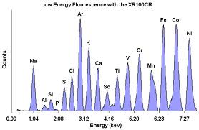
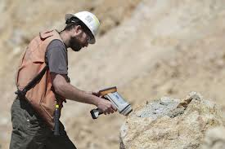
X-Ray Technology
Markets & Applications
Analytical Instrumentation - XRF
X-ray Fluorescence
Widely used for elemental analysis & chemical analysis, particularly in the investigation of metals, glass, ceramics and consumer products as well as for research in geochemistry, forensic science and archaeology
Our X-ray solutions & capabilities have been used in:
ED-XRF
HH-XRF
Thickness/Micro-spot
Low Energy Fluorescence

Slide 6
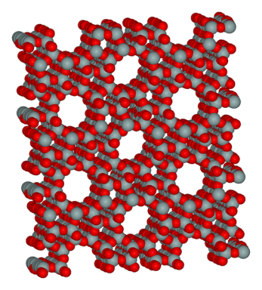
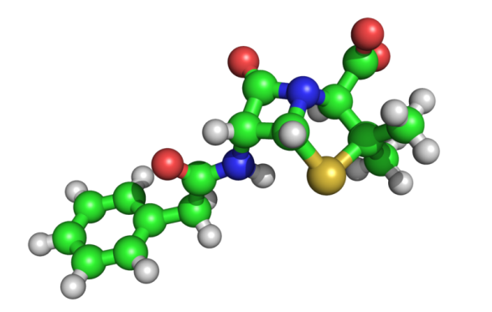
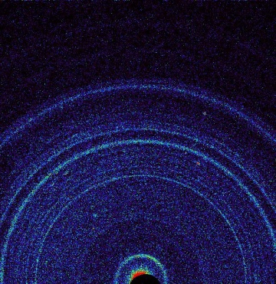
X-Ray Technology
Markets & Applications
Analytical Market Segment - XRD
X-ray Diffraction (XRD)
Used for characterizing the atomic structure of new materials and in discerning materials that appear similar
Can also discern the unusual electronic or elastic properties of a material, shed light on chemical interactions and processes, or serve as the basis for designing pharmaceuticals against diseases
Our X-ray solutions & capabilities have been used in:
Powder Diffraction
Single Crystal
X-ray crystallography (Diffraction) can locate every atom in a zeolite, an aluminosilitate with many important applications such as water purification.
First X-ray diffraction view of Martian soil
‒ CheMin analysis reveals feldspar, pyroxenenes, olivine and more at “Rocknest”
October 2012
Three-dimensional structure of penicillin, for which Dorthy Crowfoot Hodgkin was awarded the Nobel Prize in Chemistry in 1964. The green, white, red, yellow and blue spheres represent atoms of carbon, hydrogen, sulfur & nitrogen respectively.

Slide 7
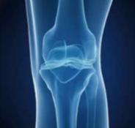
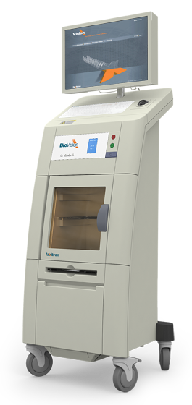
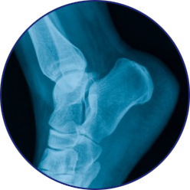
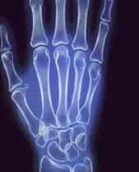
X-Ray Technology
Markets & Applications
Medical Imaging
X-ray technology designs and manufacturers low power X-ray solutions used in Medical Imaging applications to enable health care clinicians diagnosis and treatment of various medical conditions
Our X-ray solutions & capabilities have been used in:
Biopsy imaging
Extremity imaging
Bone densitometry

Slide 8
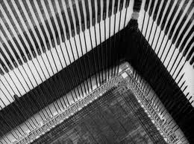
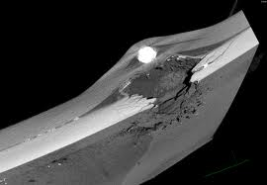
X-Ray Technology
Markets & Applications
Industrial Inspection
XT designs and manufacturers low power X-ray solutions for Industrial Inspection & non-destructive testing (NDT).
Our X-ray solutions & capabilities have been used in
Microfocus X-ray solutions for:
PCB & Electronics, and Battery Inspection
Component & Integrated X-ray solutions for:
Thickness Gauging, Product Inspection, Security applications (package) & Food Inspection

Slide 9
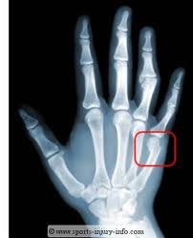
X-Ray Technology
Our Business Today
Oxford Instruments is globally recognized as a leader in the design and manufacture of X-ray tubes for Analytical Analysis, Medical Imaging/Radiography, and Industrial Inspection applications.
Our X-ray tubes are used in XRF Analyzers to ensure that consumer products meet strict safety and environmental requirements; particularly those associated with minimizing the concentration of lead in toys and other children’s products.
Our X-ray tubes are also used to detect and fight against breast cancer.
Our X-ray tubes are used to inspect printed circuit boards & advanced batteries for cellphones, iPads, and other consumer electronics.

Slide 10
X-Ray Technology
Products & Capabilities
X-ray Solutions & Offerings

Slide 11
X-Ray Technology
Product Solutions
Definitions:
Low power: ≤ 100 Watts (this is our main market space)
(Medium Power: 100W to 1kW)
(High Power: > 1kW)
Operating Range 4-90 kV
Current 1- 5 mA
Spot Size 12-20, 35, 70-200, 500-1000 microns
Targets W, Rh, Ti, Au, Ag, Pd, Mo, Cr
Notes:
X-ray crystallography is a method used for determining the atomic and molecular structure of a crystal, in which the crystalline atoms cause a beam of X-rays to diffract into many specific directions. By measuring the angles and intensities of these diffracted beams, a crystallographer can produce a three-dimensional picture of the density of electrons within the crystal. From this electron density, the mean positions of the atoms in the crystal can be determined, as well as their chemical bonds, their disorder and various other information.

Slide 12
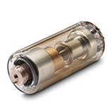
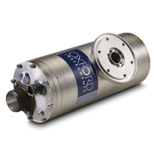
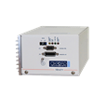
X-Ray Technology
Products & Capabilities
Our X-ray solutions range from individual X-ray tubes to integrated sources
4 to 90kV
Operating up to 250 Watts
Spot sizes down to 12µm
Glass Tubes
Potted Tubes
Power Supplies & Cables
Packaged Tubes
Microfocus Solutions
Integrated Solutions

Slide 13
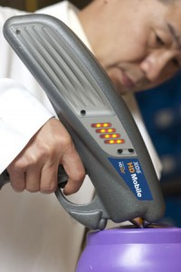
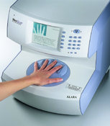
X-Ray Technology
Products & Capabilities
X-ray Tubes
Glass
Operates from 4-80kV
High flux and spot size stability
Focal spot sizes as small as 33µm
Wide range of target materials
Continuous operation
High performance, long life
Analysis: RoHs Compliance
Medical: Bone Densitometry
Industrial: Thickness Gauging

Slide 14
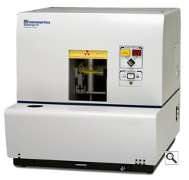
X-Ray Technology
Products & Capabilities
X-ray Tubes
Potted
Operate up to 40kV, 12W
Beryllium window
High flux and spot size stability
Focal spot sizes as small as 33µm
Wide range of target materials
Continuous operation
High performance, long life
Compact, insulated, lightweight package
Analysis: Particle Analysis
Medical: Specimen Radiography

Slide 15
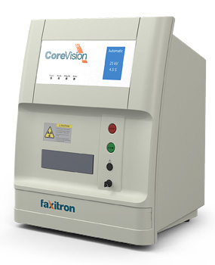
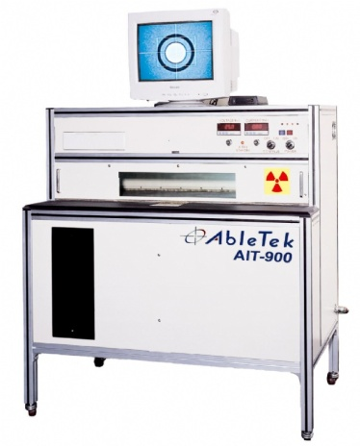
X-Ray Technology
Products & Capabilities
X-ray Tubes
Radiation Shielded
Operates from 4-50kV and up to 50W
High flux and spot size stability
Focal spot sizes as small as 33µm
Wide range of target materials
Fully shielded package
Plug and play operation
High performance, long life
Analysis: Fluorescence Spectroscopy
Medical: Specimen Radiography
Industrial: PCB Drilling

Slide 16
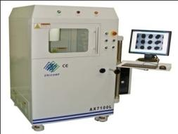
X-Ray Technology
Products & Capabilities
Microfocus X-ray Systems
Ultrabright 96000 Series
90kV, 80W microfocus X-ray source
High power
Small FOD (Focus-to-Object Distance and spot size
Advanced digital interface
Compact, lightweight design
Suitable for medical, industrial & analytical applications

Slide 17
X-Ray Technology
Products & Capabilities
OI X-ray technology has over 30-years experience delivering industry leading OEM X-ray solutions
Our designs range from highly custom X-ray tubes to integrated X-ray sources for use in a number of applications
Analytical Instrumentation
Medical Imaging
Industrial Inspection
Over 10,000 X-ray tubes shipped to date
Over 3,000 integrated sources shipped to date
Oxford X-ray Technology advantage
Reduced risk
Increased reliability
Lower total cost of ownership

Slide 18
X-Ray Technology
Products & Capabilities
Our Advantage
Our X-ray solutions are recognized worldwide and are often the preferred choice among leading analytical, medical and industrial OEM’s that demand outstanding quality & performance
High stability
High intensity flux
Small spot size
Repeatable, distortion free measurements
Robust, high quality design…long life

Slide 19
X-Ray Technology
Products & Capabilities

