Slide 1
DECTRIS Innovations
Shaping the Future of Synchrotron Detection Technologies
Carlo Amato, Valeria Radicci
On behalf of DECTRIS
High Precision X-Ray Measurements 2025
16–20 giu 2025 Laboratori Nazionali di Frascati INFN
www.dectris.com

Slide 2
Table of contents
1
DECTRIS
4
SELUN
2
DECTRIS R&D
5
Applications
3
6
PILATUS 4
Summary

Slide 3
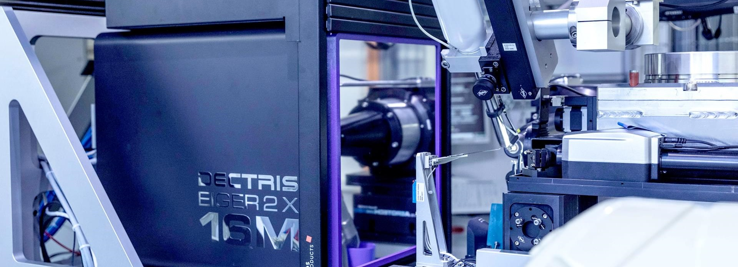
DECTRIS - Detecting the future
Our Purpose
is to serve present and future generations in mastering society’s most important challenges by enabling scientific and technological breakthroughs
Notes:
At DECTRIS, we develop and manufacture the most accurate high-performance, hybrid-pixel X-ray and electron detectors. Our goal is to advance scientific research all over the world.

Slide 4
High Tech Cameras for X-Ray and Electron Radiation

Slide 5
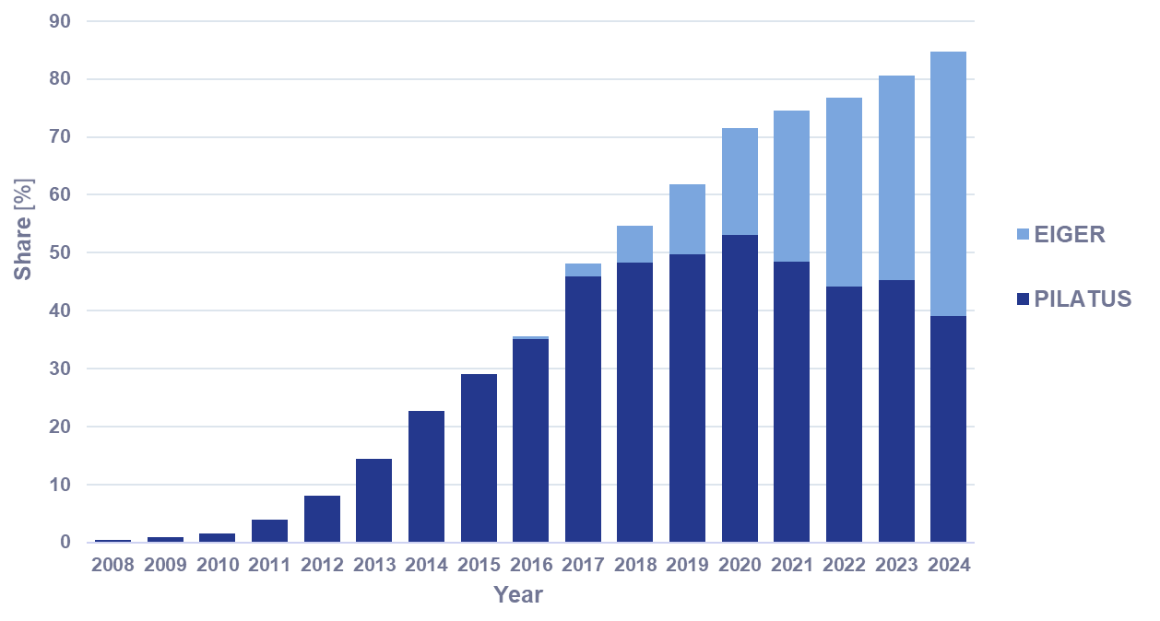
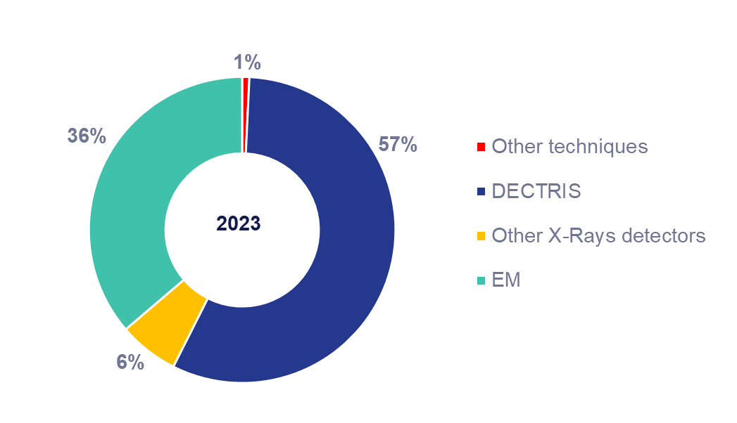
DECTRIS enabling scientific breakthroughs
DECTRIS detectors for Protein Crystallography
Protein Crystallography structures in PDB determined with DECTRIS detectors
SARS-COV2 protein structures in PDB determined with DECTRIS Detectors
DECTRIS accelerates modern drug development

Slide 6
Global Distribution & Service
Headquarters in Baden (Switzerland)
Subsidiaries in USA & Japan
Distributors in China, India, Taiwan
Founded: 2006
Employees: >190
ISO 9001:2015 certified

Slide 7
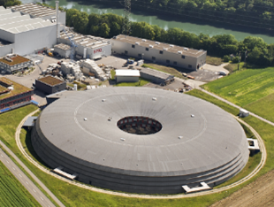
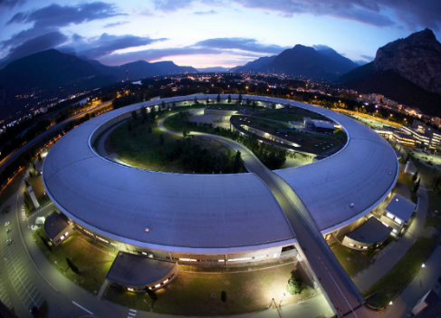
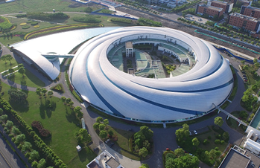
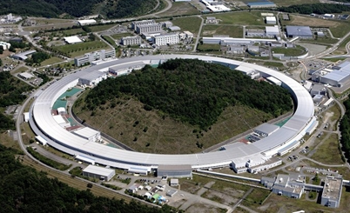
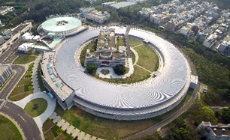
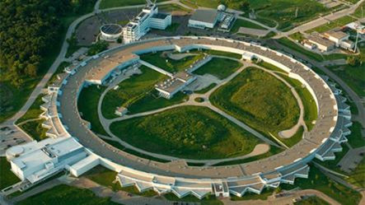
Synchrotron customers around the world
Large national and international research facilities
Cutting-edge basic and applied research
Users from different fields
Multiple beamlines per synchrotron
SLS - Switzerland
ESRF - France
SSRF - Shanghai
SPring-8 - Japan
NSRRC - Taiwan
APS - United States

Slide 8
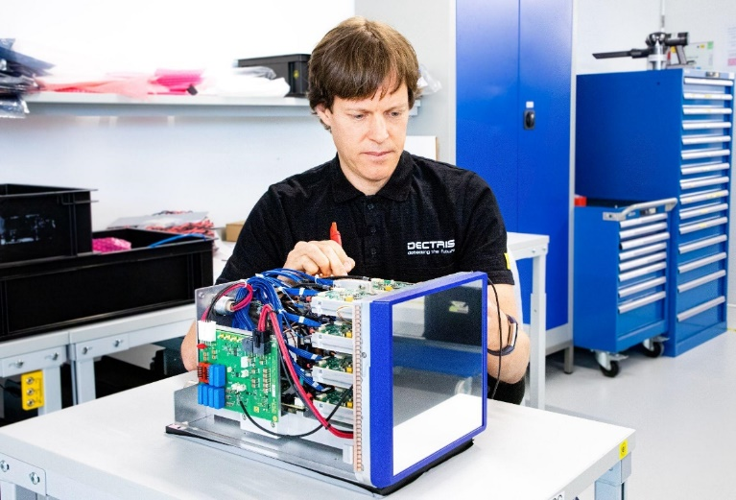
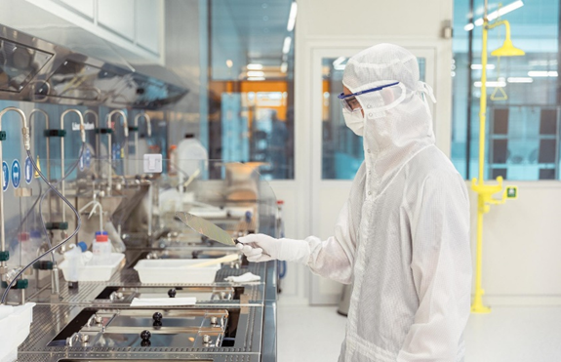
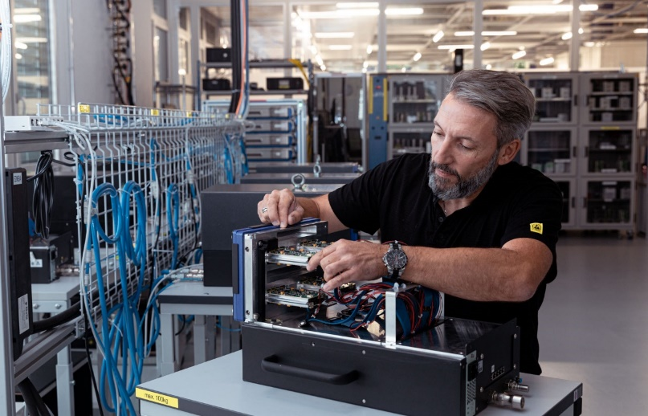
Designed and Made in Switzerland
Research Meets Industry
>65% employees with technical college or university degree, 50% of them have a Ph.D.
ASIC design & Sensor technology
Hardware/Firmware/Software development
1 000 m² Cleanroom
Photolithography
Microtechnology & Packaging
Components assembly and testing
ISO 14644-1
1 000 m² Assembly Hall
System assembly
Calibration
Service and repair

Slide 9
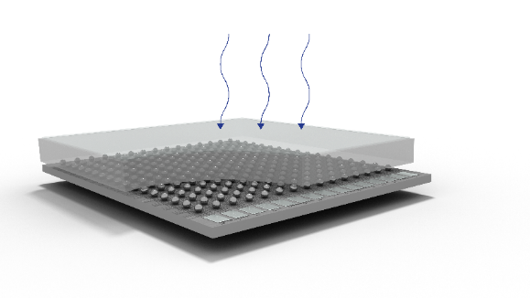
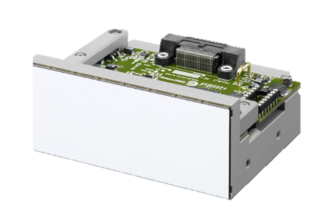
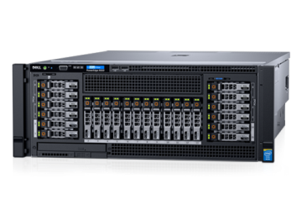
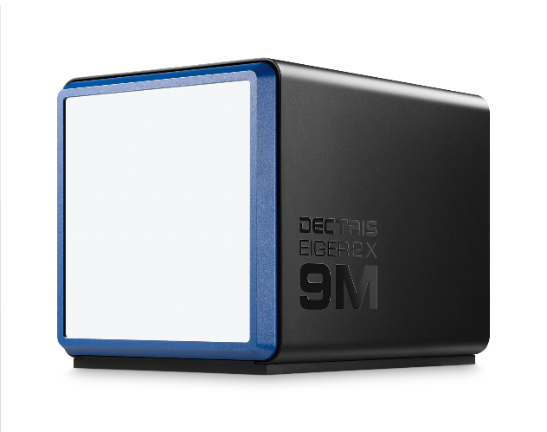
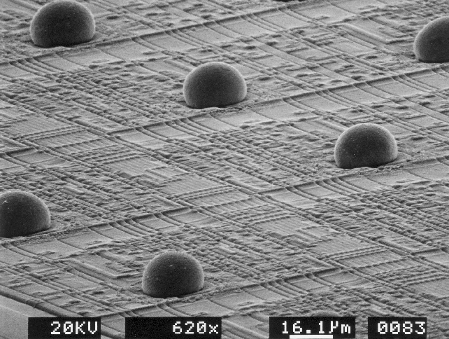
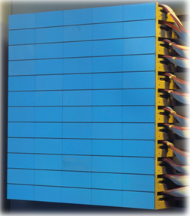
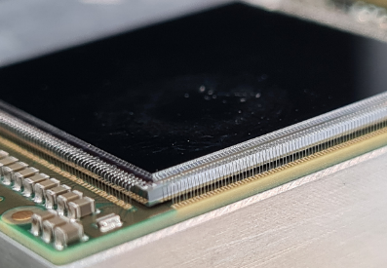
Our detector count photons / electrons
Sensor CdTe, CZT, GaAs or Si
Bump-bonding
Module / Electronics
Detector Control Unit
X-ray or e⁻
X x 10 Gbit/s fibers
ASIC Application Specific Integrated Circuit
Wire Bonding
Detector

Slide 10
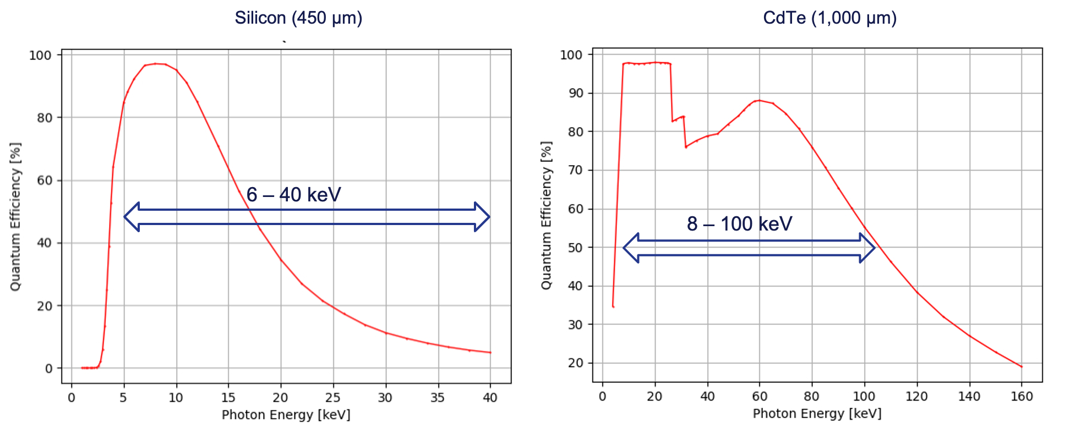
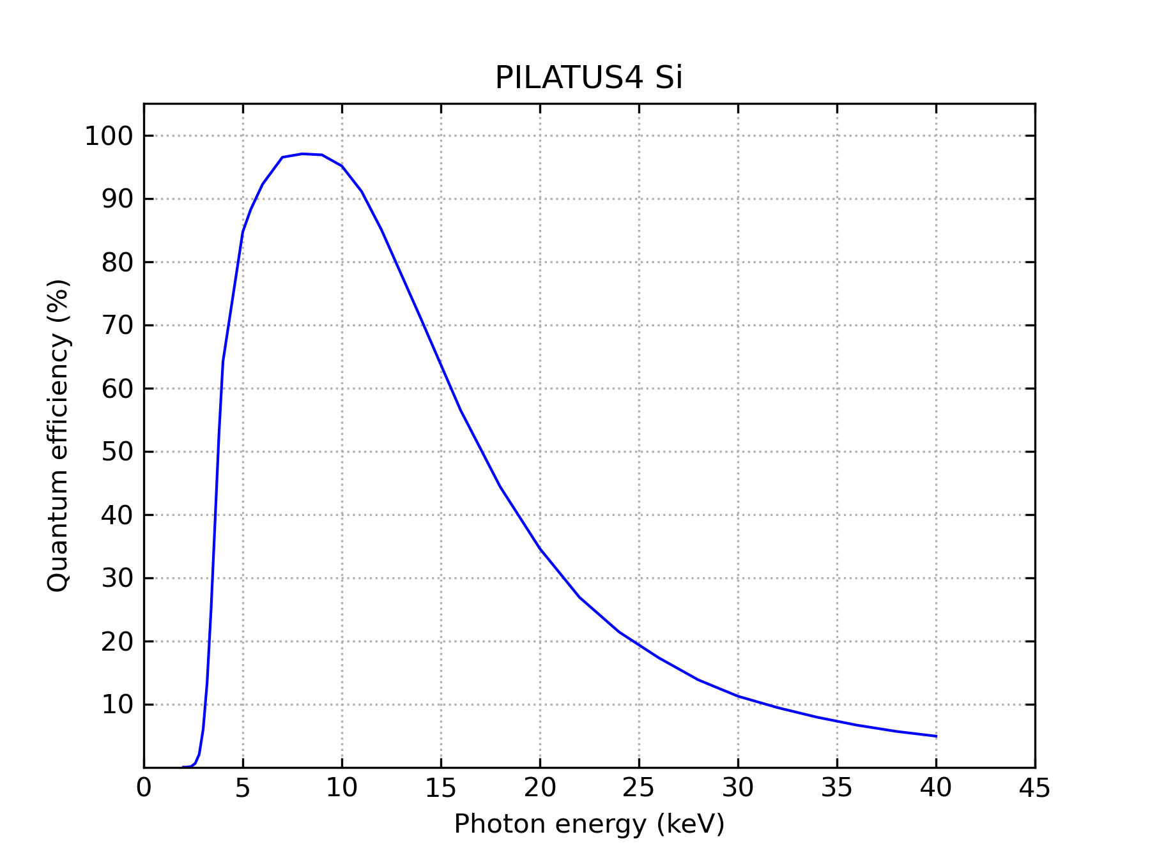
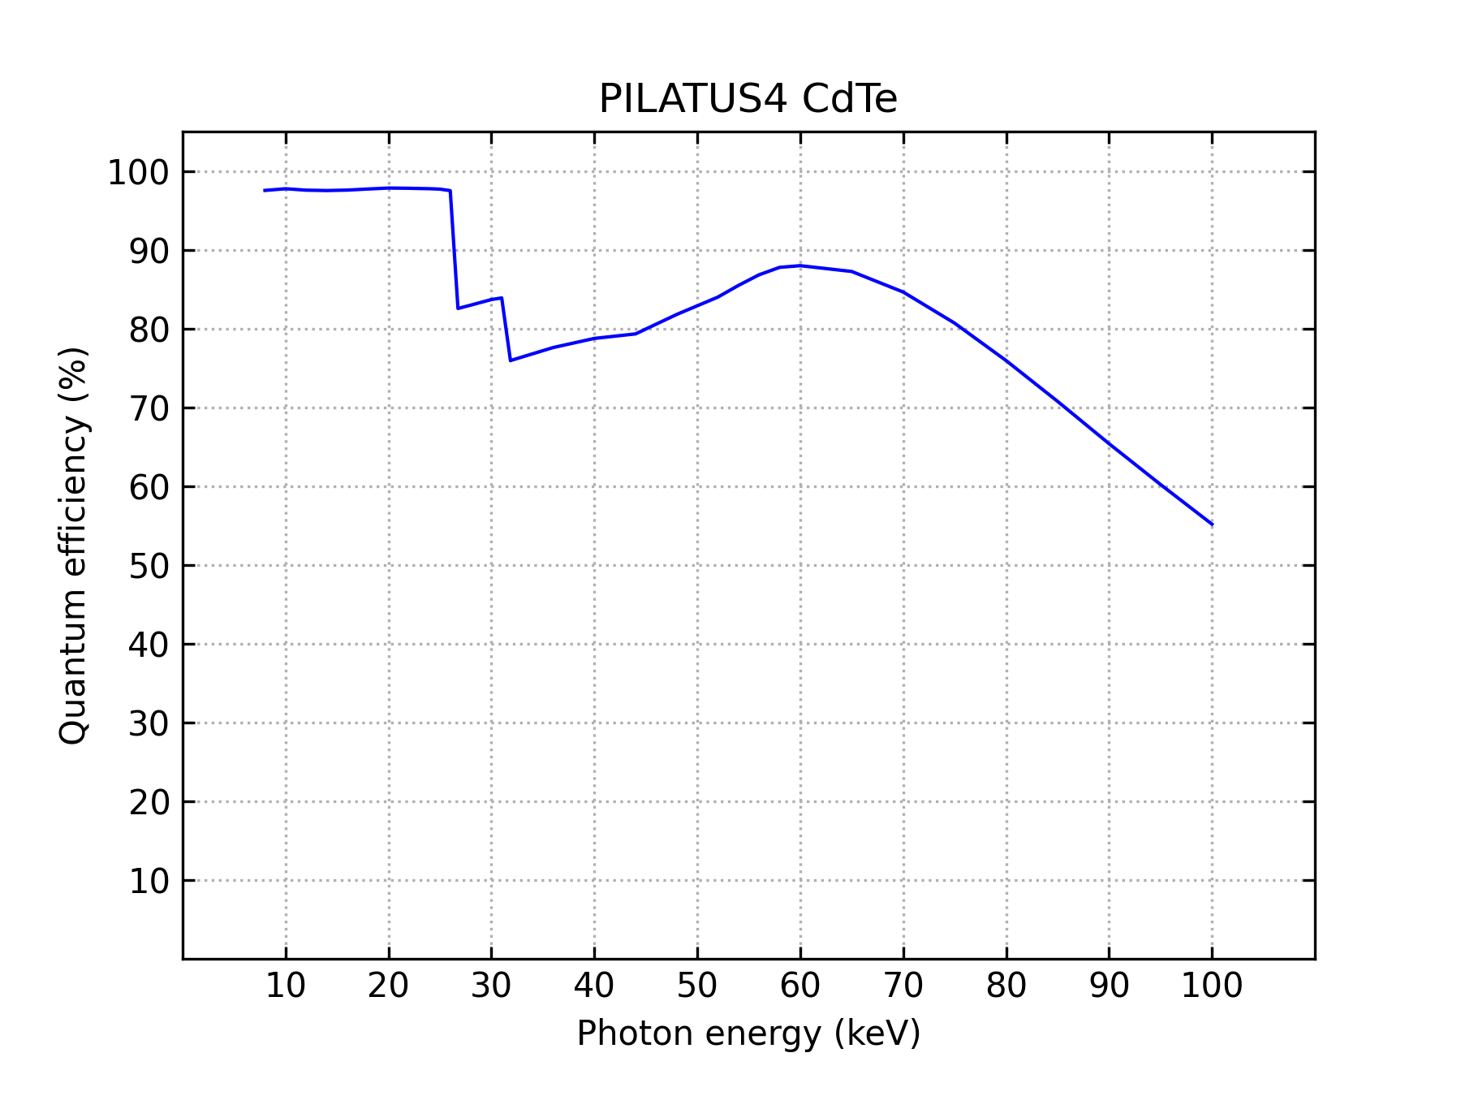
Quantum Efficiency Si and CdTe
Silicon: excellent sensitivity from 3-20 keV
Cadmium telluride: excellent for hard X-rays up to ~100 keV
Notes:
‹#›

Slide 11
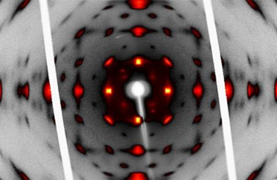
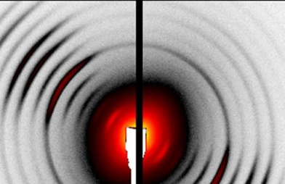
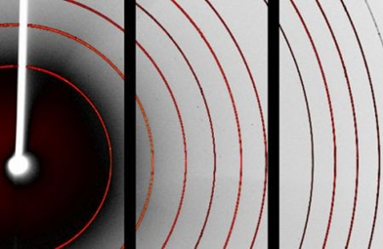
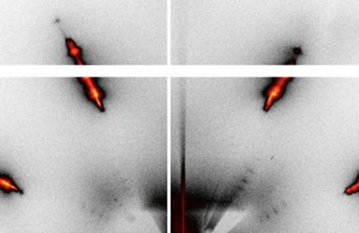
Applications
Macromolecular Crystallography
Chemical Crystallography
SAXS / WAXS
Powder Diffraction
Materials Science
Spectroscopy

Slide 12
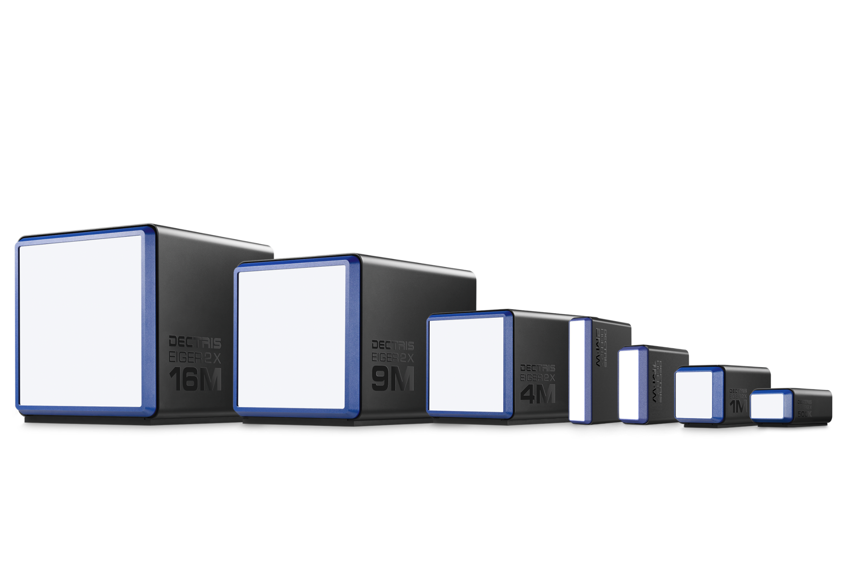
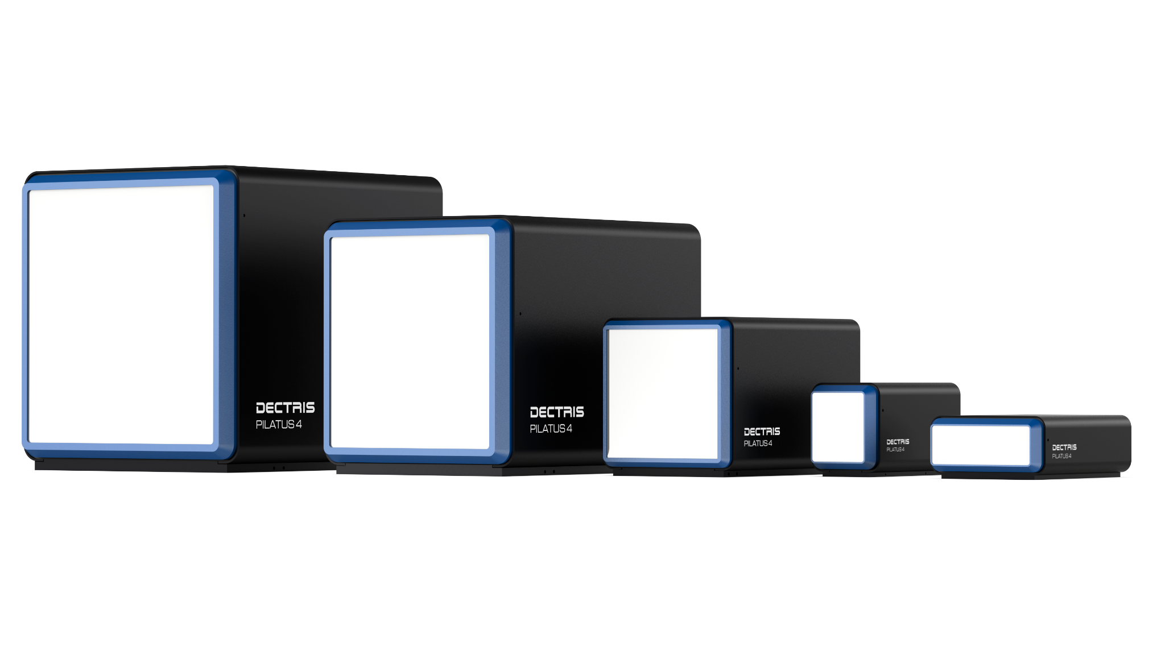
X-Ray Detectors for Synchrotron and Laboratory
EIGER2
75 um pixels
PILATUS4
150 um pixels

Slide 13
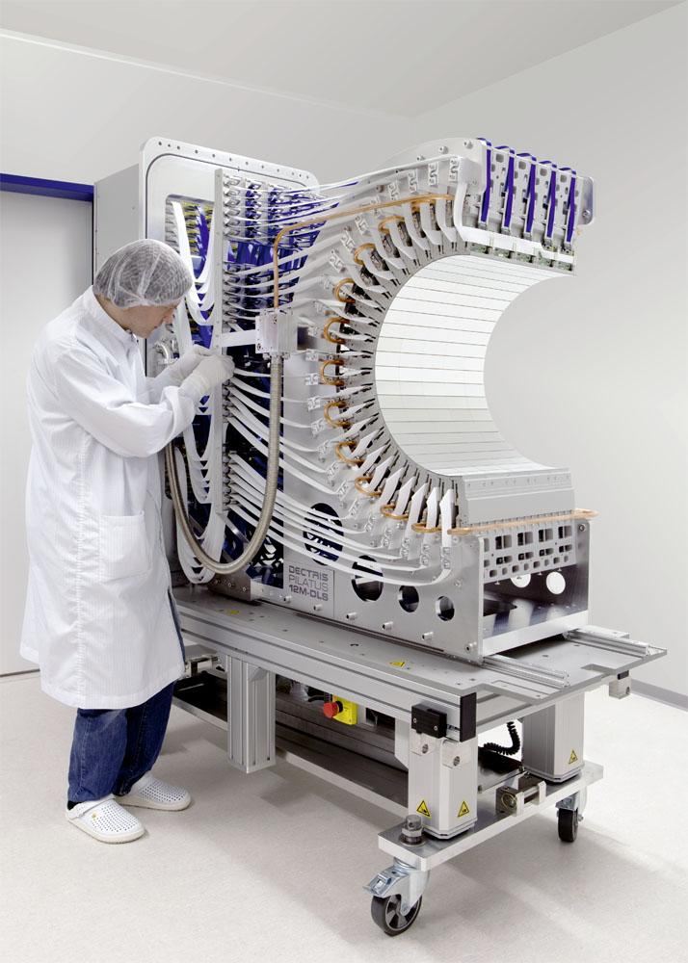
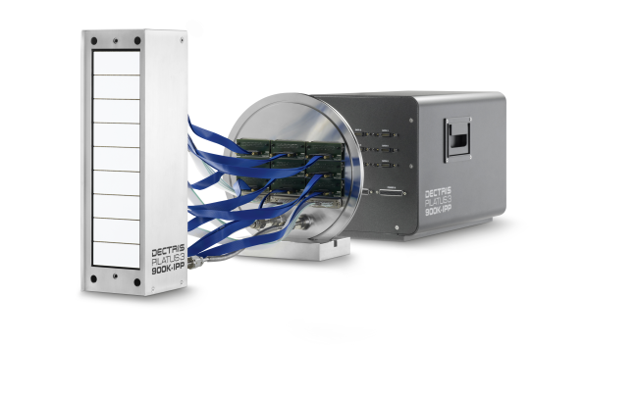
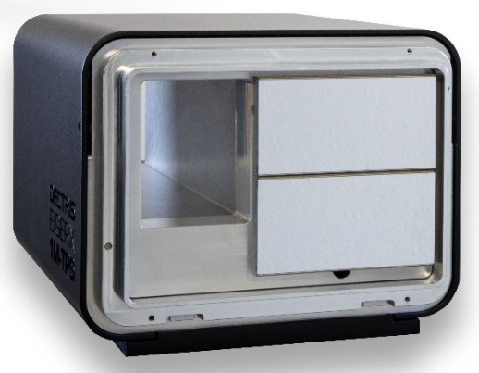
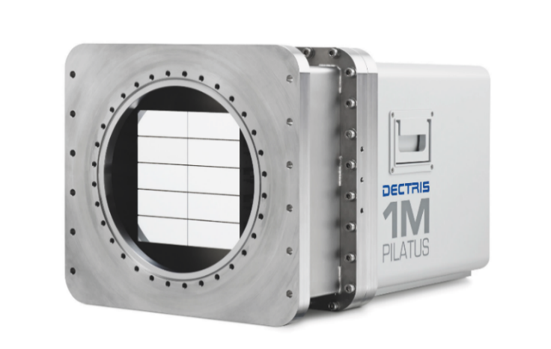
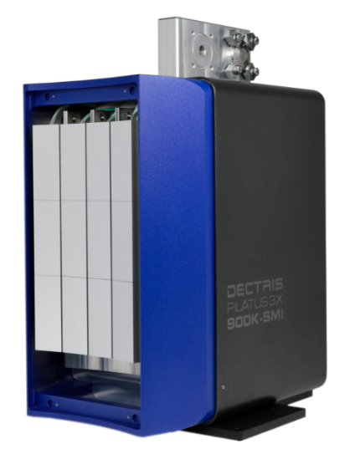
Specific Solutions
Fully Customized Systems

Slide 14
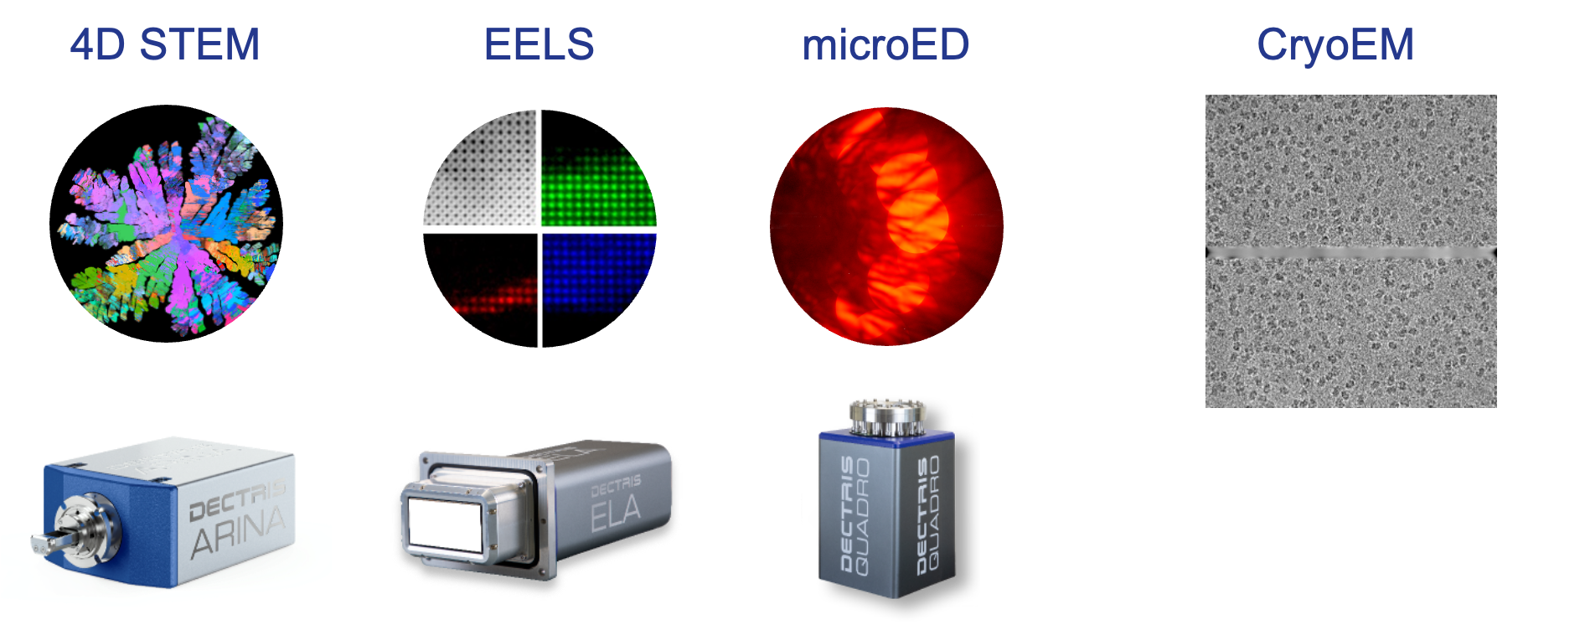
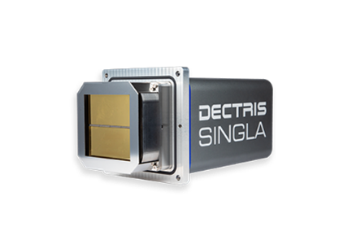
Electron Microscopy Detectors
Materials Science
Life Sciences
Notes:
EIGER2 also works in electron counting mode
Material science applications
ED, CBED
Precession ED, MicroED
Strain mapping
4D-STEM, Ptychography
In-Situ imaging
Holography
Magnetic mapping
Images
Top left: powder rings
Top right: atomic resolution MoS2
Bottom left: diffraction pattern of top right image
Bottom right: Convergent beam electron diffraction
EELS
Image shows the extremely high dynamic range that can be taken with a single acquisition
Link to paper showing the advantages of ELA

Slide 15
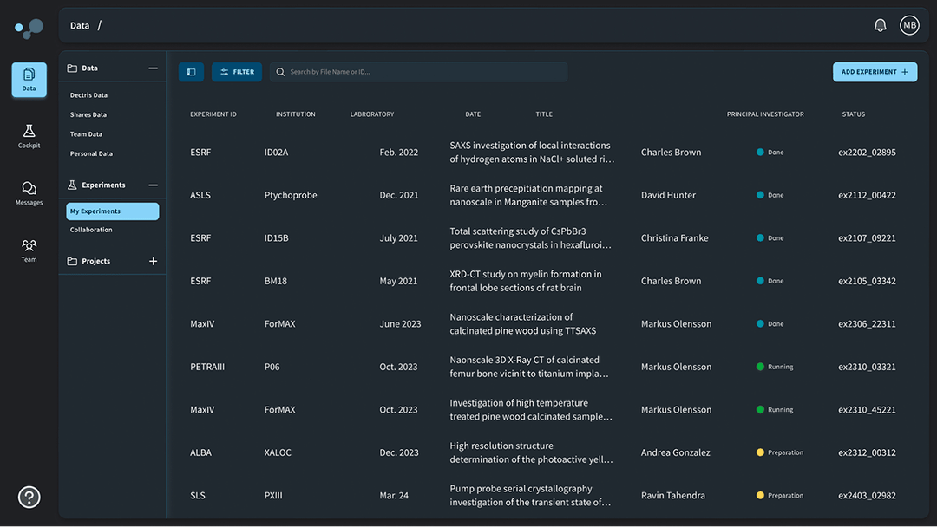
Don’t miss the online launch DECTRIS cloud for scientists on June 23!
Vendor
Agnostic
Community Driven
Analysis Toolbox
Technology
Independent
Built for Scientists
Globally
Accessible
An open platform empowering collaborative discovery
Notes:
Registration can be found here: https://www.dectris.cloud/newsroom/join-the-launch-dectris-cloud-for-scientists---sign-up-now

Slide 16
DECTRIS R&D
Requirements from Applications
DECTRIS R&D
Applications that use scanning (ptychography, XPCS), time resolution
Higher fluxes
Expand energy ranges:
higher energies, no polarisation
lower energies, high efficiency
Large area, high frame rate detector for powder diffraction
Difficulties with handling larger datasets
High Frame Rate detector development
Ultrafast frontend 10ns shaping time + retrigger time → count rates above 50 Mcps/s
Evaluation of CZT, LGADs
Detector with larger pixels, higher frame rate, and large area
Data reduction, data compression, DECTRIS CLOUD

Slide 17
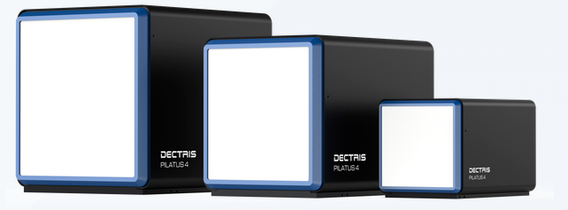
PILATUS 4
Specifications
Pixel size [um] | 150 x 150
Array size | up to 4M
Thresholds | 4
Frame rate (max) [Hz] | 2k / 4k (16/8bit)
Redout time | continuous (100ns)
Sensor material | Silicon | CdTe
Energy threshold range [keV] | 4 - 80
Count rate [ph/s/pixel] | 10 x 10^6
Active area [mm²]
4M 311x327 | 2M 233x244 | 1M 155x162
HIGH FRAME RATE - LARGE AREA
PILATUS4 high efficiency, large area for fast data collection
(e.g. a time resolved XRD and XRPD high energy powder diffraction, XRD-tomography)

Slide 18
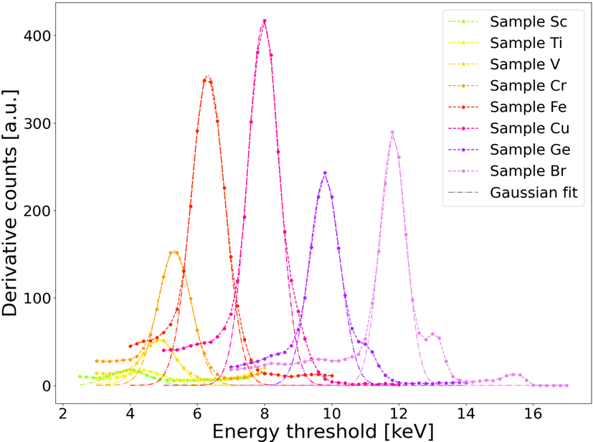
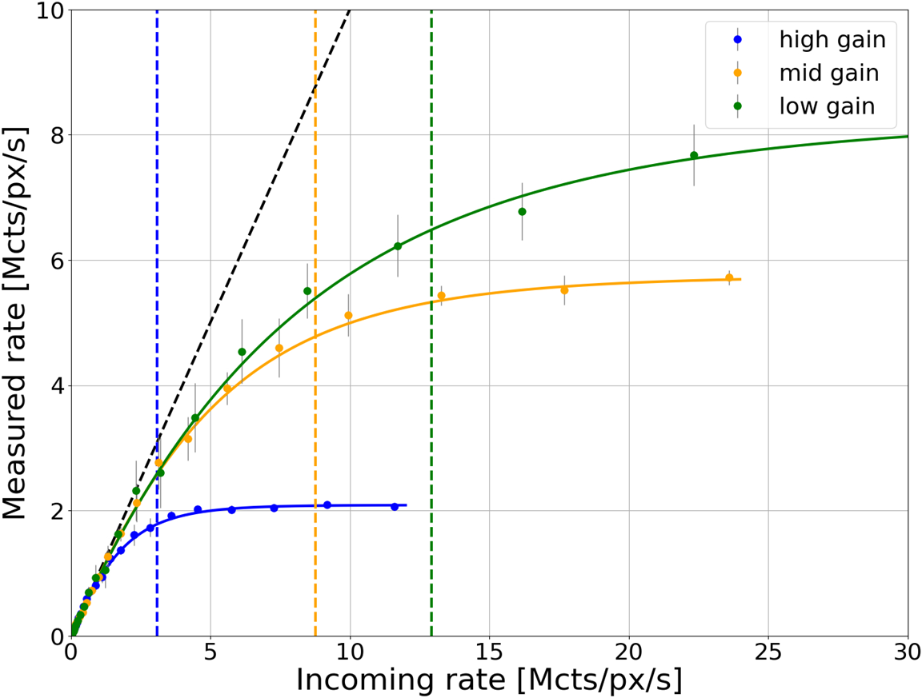
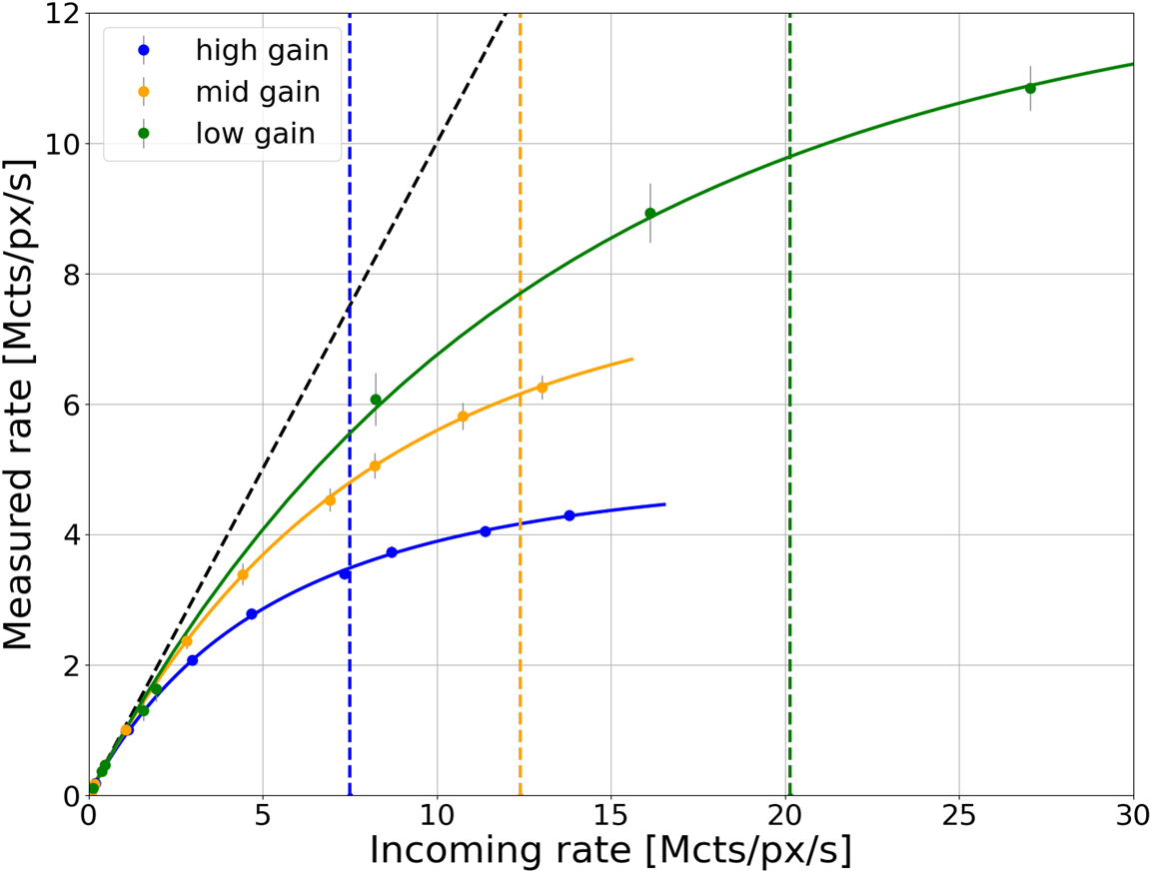
PILATUS 4 - Energy resolution Silicon and CdTe sensor
Spectra - Silicon sensor - High gain
Count rate - Retrigger enabled
Si
CdTe
Si
Resolution for CdTe → 1.2keV at 20keV
Resolution for Si → 1 keV at 8keV
Notes:
Energy resolution is evaluated from threshold scans, quantified by the Full Width at Half Maximum (FWHM) of a Gaussian peak fitted to the threshold-scan derivative
the frontend has different performance depending on the readout mode: hole/electron collection
High gain mode, suitable for the low energy regime, achieves the best energy resolution
Cutoff rate: is the maximum incoming rate which allows for a count rate correction

Slide 19
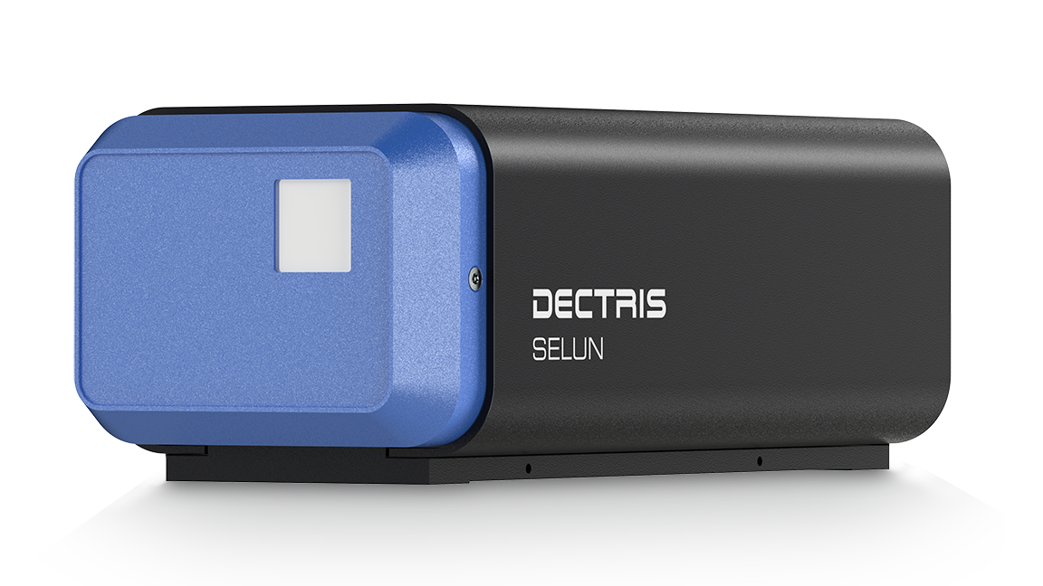
SELUN
Specifications
Pixel size [um] | 100 x 100
Array size | 192 x 192
Frame rate (max) [Hz] | 30k (full) 120k (2x2 binned)
Redout time | continuous
Sensor material | Silicon | CZT
Energy threshold range [keV] | 4 - 100
Count rate [ph/s/pixel] | > 60 x 10^6 | > 50 x 10^6
Active area [mm²]
20x20
HIGH FRAME RATE - HIGH FLUXES
SELUN enables experiments where a very fast acquisition of several frames with high intensity radiation is needed (e.g. ptychography)
Notes:
highlight fast and small

Slide 20
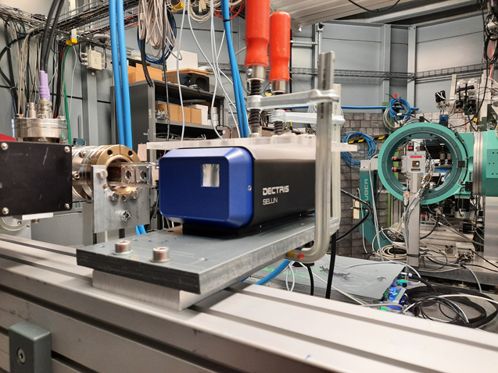
SELUN - test @ Synchrotron
Beam time @BESSY BAM beam line
Tested detector versions with both Silicon and CZT
several ASIC settings and different energies 8keV → 35keV
Collected spectra with monochromatic radiation for the qualification of the energy resolution
Characterized the count rate capabilities
@ different incoming fluxes measured with calibrated diodes

Slide 21
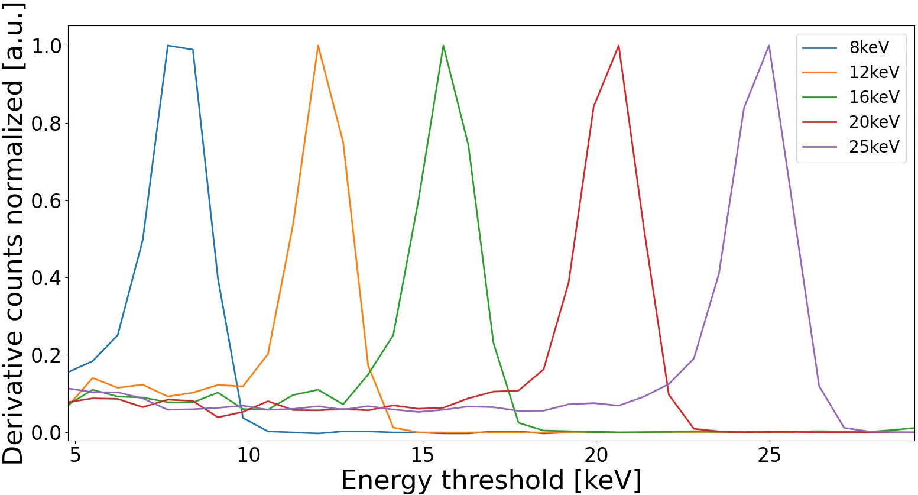
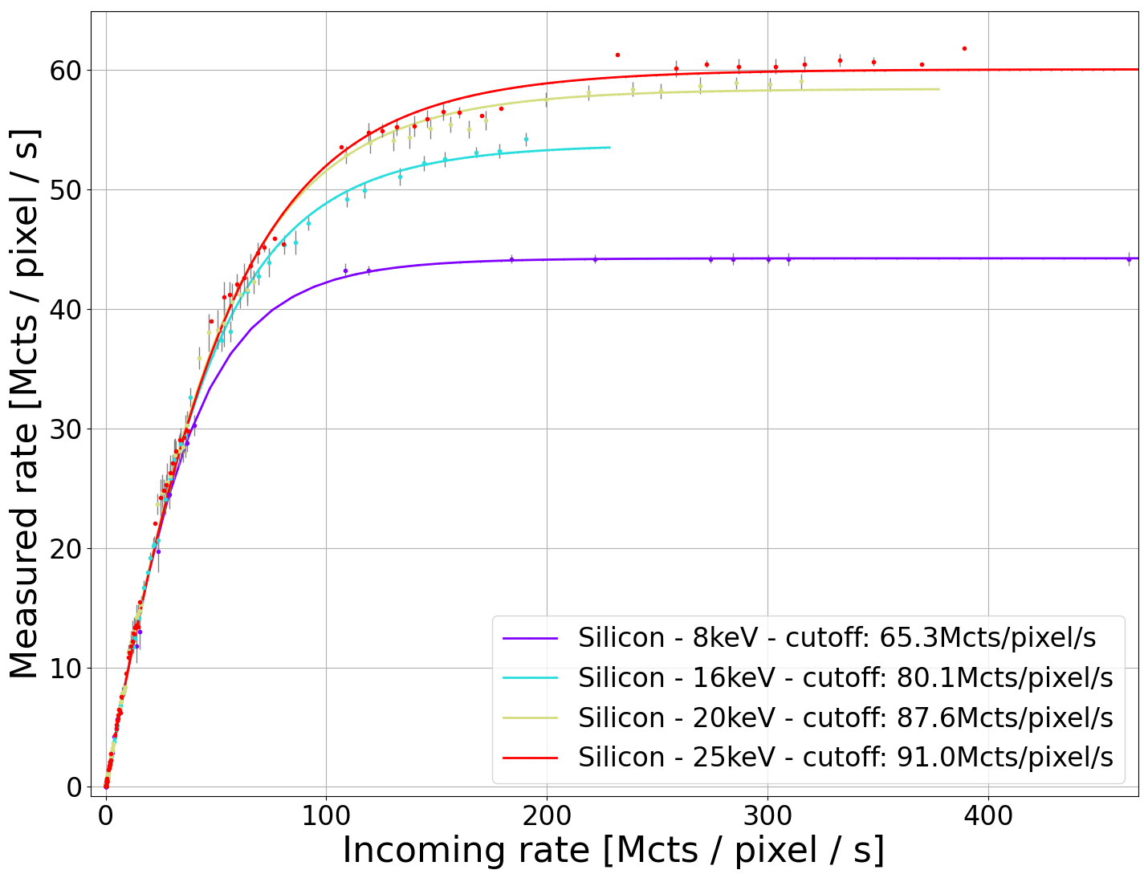
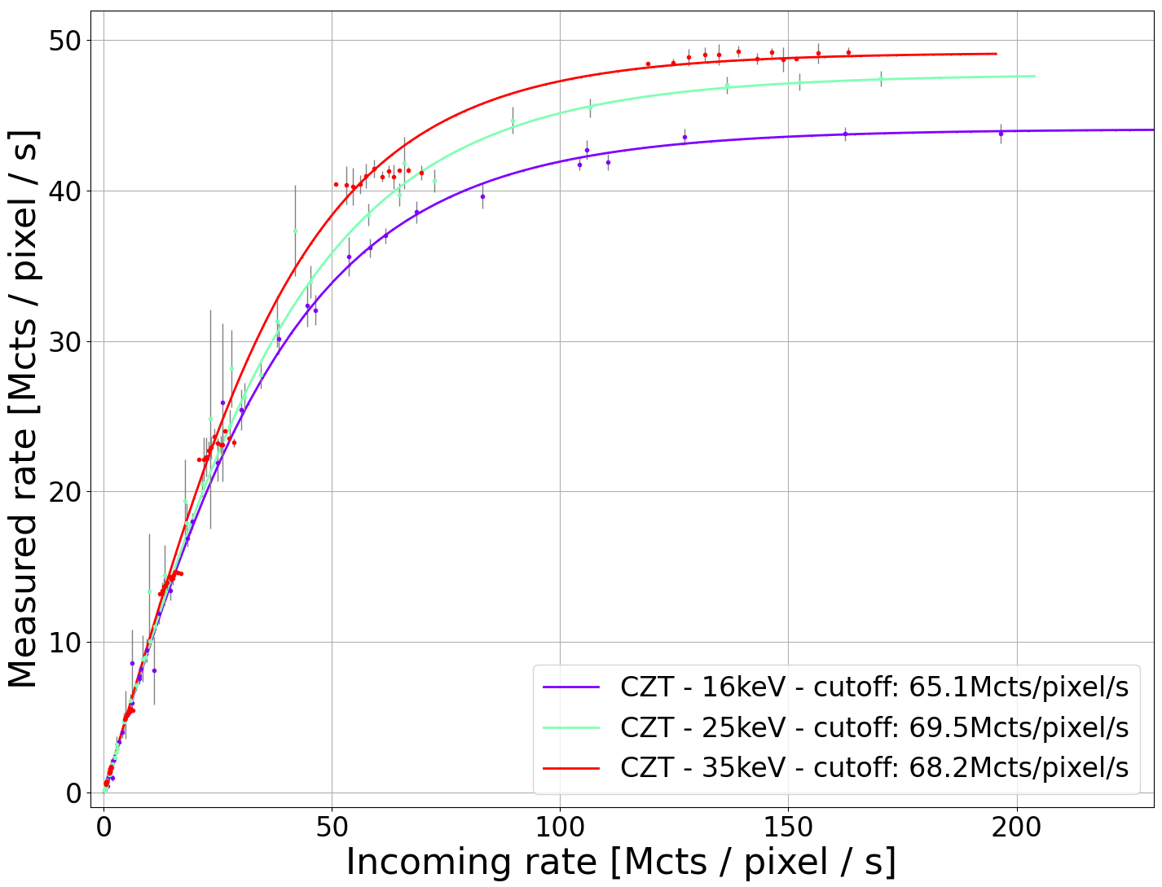
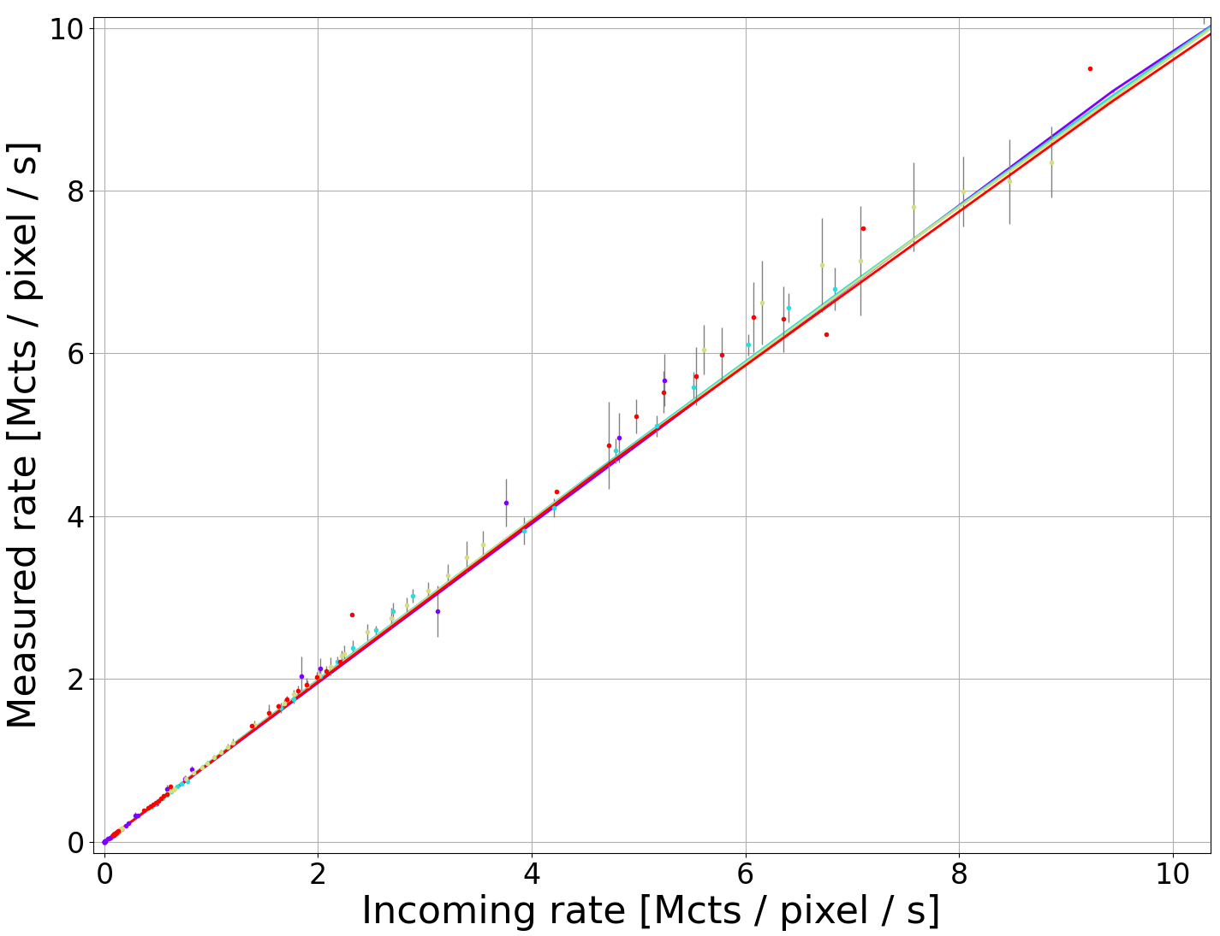
SELUN - Energy resolution Silicon and CZT sensor
Spectra - Silicon sensor
Count rate - Retrigger enabled
Si
CZT
Count rate linear up to 10 Mcts/px/s
Resolution for Si→ 1.8 keV at 8keV
All the cutoff >50Mcts/px/s,
max~90Mcts/px/sfor Si@25keV

Slide 22
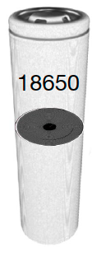
X-Ray Diffraction Computed Tomography (XRD-CT)
Measurement Principle:
Courtesy of S. Checcia, M. Di Michiel, ESRF ID15A
10’000 powder diffraction patterns/ slice.
Taken from: T.M.M. Heenan, et.al.Nature (2023)
Scanning experiment of Commercial Battery
45 keV Energy
cross sections from powder diffraction signals,
enabling chemical sensitivity in the slices
Bragg-Positions correlates with local Temp.
Mapping of Temp. during (dis-)charge
Inevitable trade off between spatial and time resolution
Taken from: T.M.M. Heenan, et.al.Nature (2023)

Slide 23
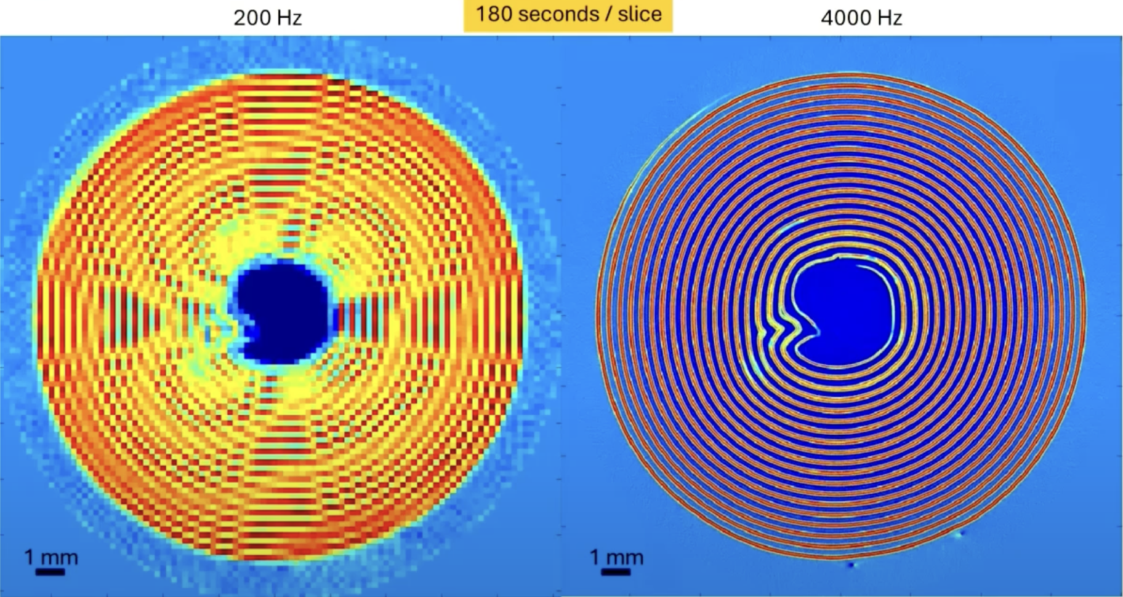
PILATUS4 – XRD-CT for Battery Research
PILATUS3
PILATUS4
PILATUS4 with 4 kHz enables:
8x increase of resolution (or)
20x decrease of scan time
Courtesy of S. Checcia, M. Di Michiel, ESRF ID15A
Notes:
follow the evolution / degradation of a battery, study the defect mechanisms with chemical sensitivity.

Slide 24
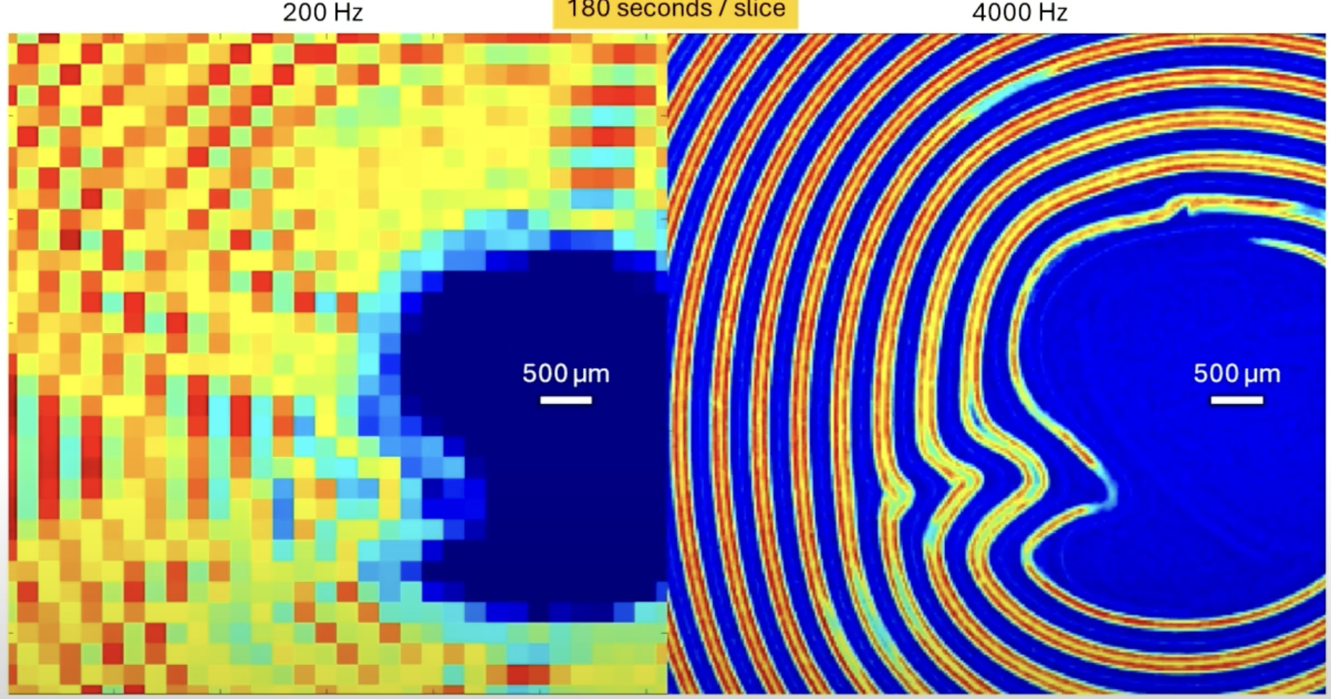
PILATUS4 – XRD-CT for Battery Research
PILATUS3
PILATUS4
PILATUS4 with 4 kHz enables:
8x increase of resolution (or)
20x decrease of scan time
Courtesy of S. Checcia, M. Di Michiel, ESRF ID15A

Slide 25
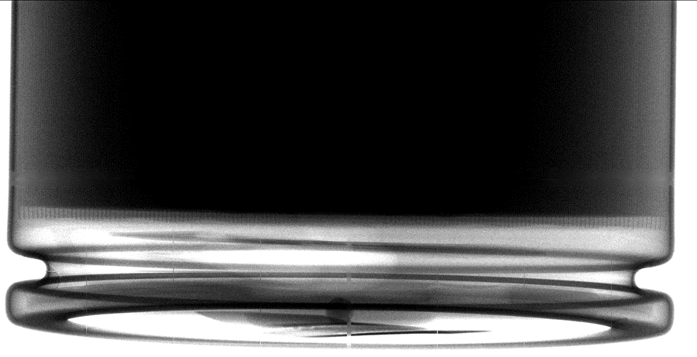
Fast micro-CT under 10 s (low statistics seconds CT)
Zoom-in partial 4680 battery CT
Effective pixel size of 24.39 μm
EIGER2 CdTe detector, 75 μm pixel
Overhang region visible even for thinner than EV cell, 60 μm layer thickness between anode and cathode

Slide 26
Can we go even faster? YES: Fast micro-CT 1 s
Reconstruction
X5 SLOWMO
1ms per projection
less than 60 photon through the thickest section
Zoom-in partial 4680 battery CT Effective pixel size of 24.2 μm

Slide 27
Multi-spectral k-edge fast micro-CT (mouse in-vivo)
PILATUS4 CdTe detector, 150 μm pixel, 4 energy thresholds
Iodine
Bismuth and bone
Soft tissue
Iodine
Bone and
calcified plaques
Soft tissue

Slide 28
Summary
Insights into DECTRIS
DECTRIS offers portfolio of HPC detectors
Diverse R&D initiatives tailored to application needs
Highlighted
Continuous kilohertz frame rates with zero loss
Rate Capabilities > 50Mcts/pixel/s
Successful R&D stories
PILATUS4 first deliveries in September 2024
SELUN official launch in August 2024 (SRI 2024)
DECTRSI CLOUD an open platform empowering collaborative discovery

Slide 29
DECTRIS CLOUD for Scientists Launch
Monday 23rd June
Register today!

Slide 30
Thank you for your attention!
DECTRIS Ltd.
5405 Baden-Dättwil
Switzerland
www.dectris.com

Slide 31
Hybrid pixel = sensor pixel + readout ASIC pixel
DECTRIS pushing the limits of hybrid-pixel detection technology
Sensor CdTe or Silicon
Hybrid after bump-bonding
X-ray or e⁻
Readout chip (CMOS ASIC)
Indium bump 18 μm
Notes:
Direct detection
X-rays or e⁻ directly converted to charge
Charge is captured in electric field
Sharp signal
Minimal signal loss and high quantum efficiency

