Slide 1

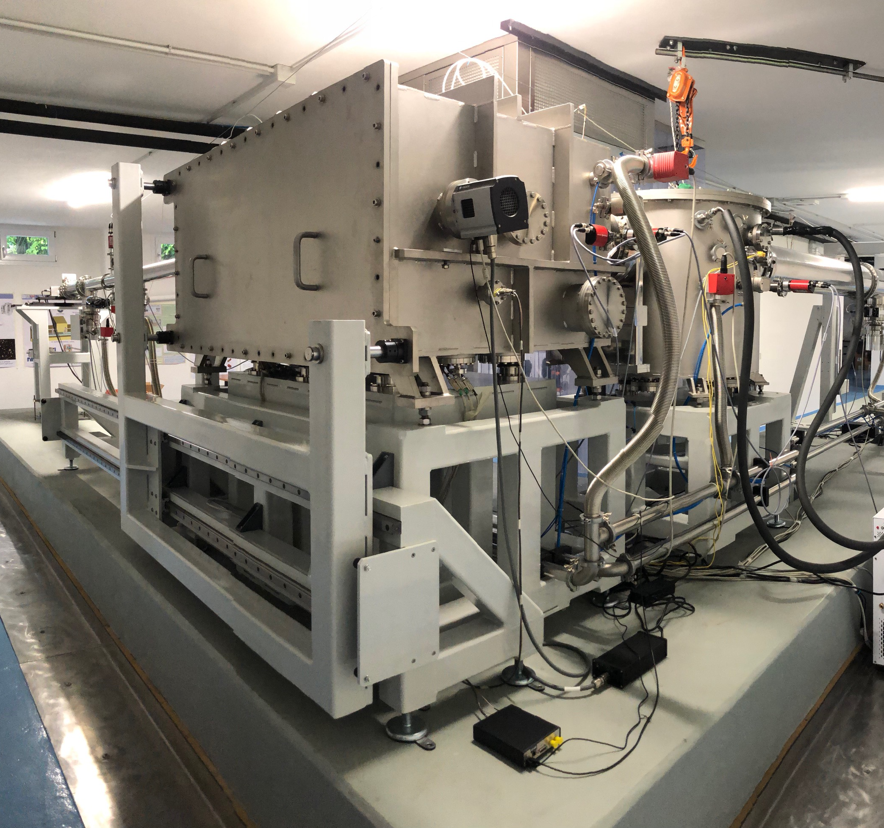










BEaTriX and beyond: an innovative compact X-ray calibration facility for astronomical optics enabling wide, collimated, and monochromatic beams
Davide Sisana, PhD student
on behalf of the BEaTriX (INAF-OAB) and in collaboration with IMEM-CNR and ESRF
High Precision X-Ray Measurements 2025, 16-20 June, LNF INFN

Slide 2
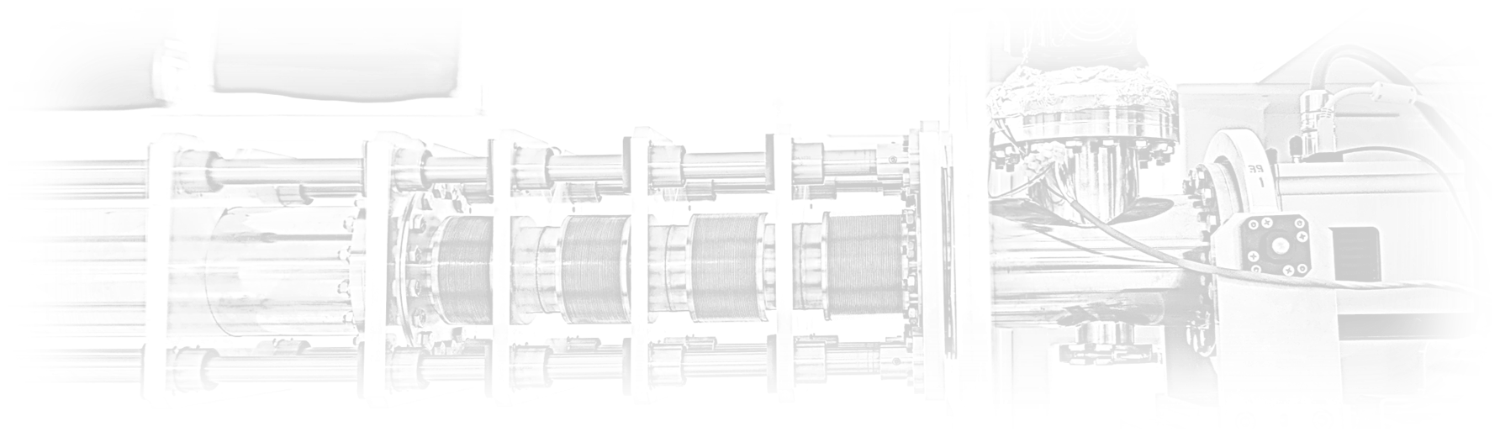


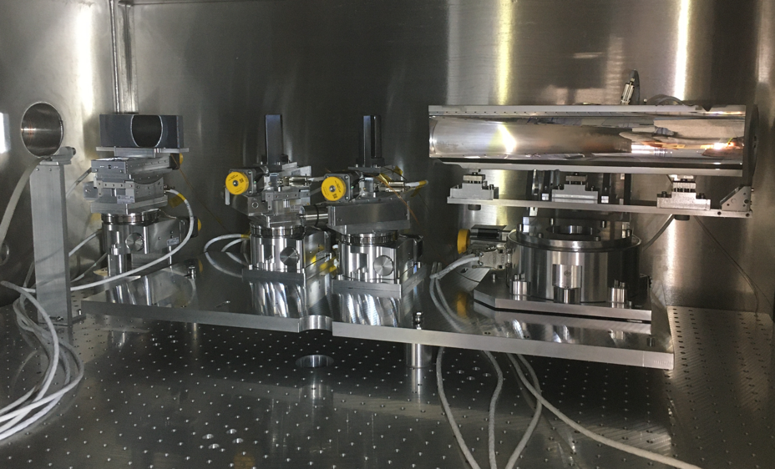
Outline
  Why BEaTriX
  Opto-mechanical design
  4.51 keV BEaTriX beamline
  1.49 keV BEaTriX beamline
  BEaTriX+
  Application beyond astronomy
June 16, 2025
High Precision X-Ray Measurements 2025, 16-20 June – BEaTriX, Sisana Davide – PhD student Politecnico di Milano/INAF-OAB
2

Slide 3
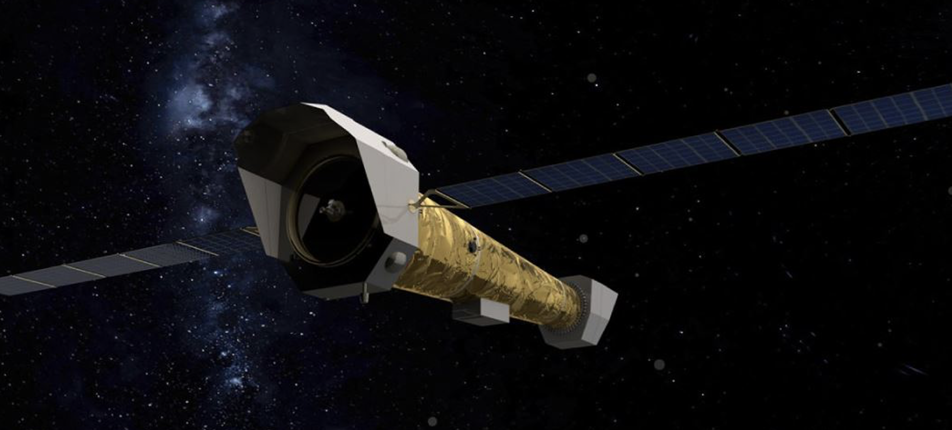

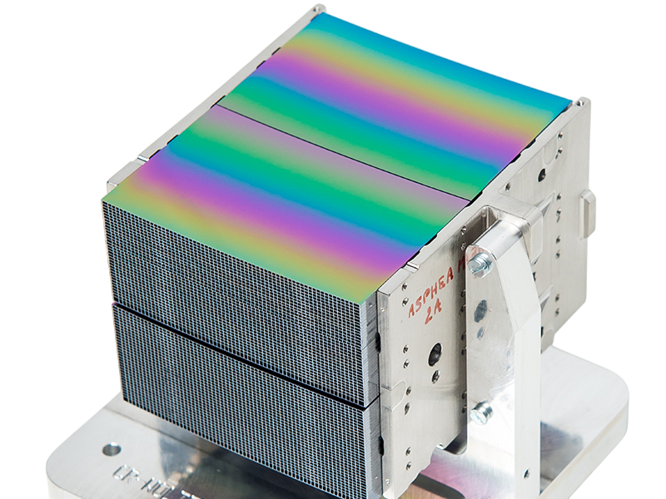
Why BEaTriX
Context
AIT facilities for NewAthena X-ray space observatory
The largest X-ray mirror for astronomy ever built - 2.4 m diameter primary mirror
0.3 – 12 keV energy bandwidth
Requirement
X-ray calibration facility to test (PSF and Effective Area) about 500 SPO MMs of NewAthena at a rate compatible with MM production (~ 3 MM/day)
Silicon Pore Optics technology
How to re-create astronomical X-ray source at an infinite distance?
June 16, 2025
High Precision X-Ray Measurements 2025, 16-20 June – BEaTriX, Sisana Davide – PhD student Politecnico di Milano/INAF-OAB
3

Slide 4
Why BEaTriX
Source at large distance
(PANTER, MSFC, …)
Large volumes in vacuum
Beam divergence
State of the art for conventional X-ray facilities
Critical aspects
Synchrotron source
(ESRF, ELETTRA, …)
Pencil-beam
PSF reconstruction
Innovative optical design
Beam Expander Testing X-ray facility
Compact system
Collimated beam
Wide beam
Monochromatic beam
9 x 18 m²
divergence < 2 arcsec
17 x 6 cm²
10⁻⁵ eV
BEaTriX
100 meters
June 16, 2025
High Precision X-Ray Measurements 2025, 16-20 June – BEaTriX, Sisana Davide – PhD student Politecnico di Milano/INAF-OAB
4

Slide 5

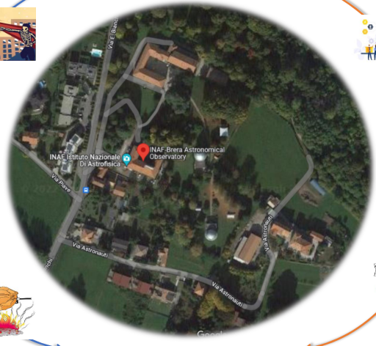

Where BEaTriX
INAF-Brera Astronomical Observatory (Merate)
Compact system
Collimated beam
Wide beam
Monochromatic beam
9 x 18 m²
divergence < 2 arcsec
17 x 6 cm²
10⁻⁵ eV
BEaTriX
June 16, 2025
High Precision X-Ray Measurements 2025, 16-20 June – BEaTriX, Sisana Davide – PhD student Politecnico di Milano/INAF-OAB
5

Slide 6
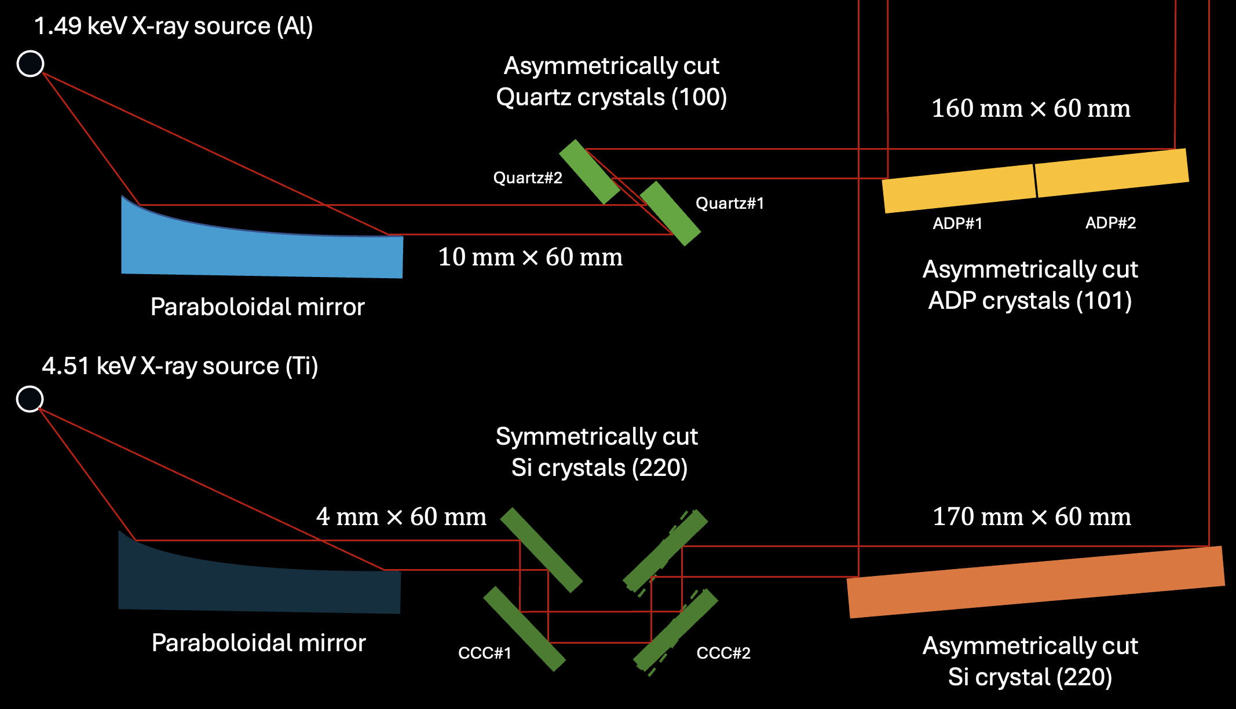
Optical layout at 4.51 keV
X-RAY SOURCE and COLLIMATING MIRROR
MONOCHROMATION STAGE
(by diffraction)
EXPANSION STAGE
(by diffraction)
Fluorescence at 4.51 keV
High brilliance: > 5 x 10¹¹ ph/s/sr
Spot size: 35 µm FWHM
Mirror surface quality: 2 arcsec
Tight monochromation
Low photoelectric absorption
Symmetrically cut Silicon crystal (220)
Asymmetrically cut
Silicon crystal (220)
X-ray source with Titanium anode
+
Paraboloidal mirror
(fused Quartz HOQ 310)
Coating: Cr + Pt
An X-ray source with a high brilliance is needed
High dispersive element, a tight monochromation is needed
June 16, 2025
High Precision X-Ray Measurements 2025, 16-20 June – BEaTriX, Sisana Davide – PhD student Politecnico di Milano/INAF-OAB
6

Slide 7
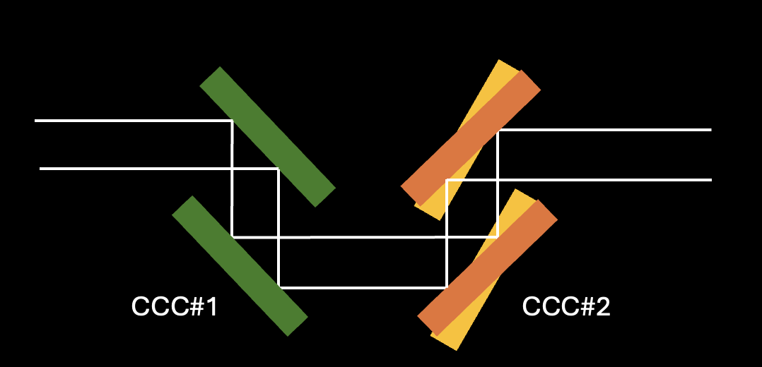
Optical layout at 4.51 keV
4.51 keV configuration
High flux
High collimation
June 16, 2025
High Precision X-Ray Measurements 2025, 16-20 June – BEaTriX, Sisana Davide – PhD student Politecnico di Milano/INAF-OAB
7

Slide 8
Optical layout at 1.49 keV
X-RAY SOURCE and COLLIMATING MIRROR
MONOCHROMATION STAGE
(by diffraction)
EXPANSION STAGE
(by diffraction)
Fluorescence at 1.49 keV
High brilliance: > 5 x 10¹¹ ph/s/sr
Spot size: 35 µm FWHM
Mirror surface quality: 2 arcsec
fused quartz HOQ 310
Rocking curve narrower than ADP one
Tight monochromation
Low photoelectric absorption
Large d-spacing
Asymmetrically cut Quartz crystal (100)
Asymmetrically cut ADP crystal (101)
X-ray source with Aluminum anode
+
Paraboloidal mirror
(fused Quartz HOQ 310)
An X-ray source with a high brilliance is needed
High dispersive element, a tight monochromation is needed
June 16, 2025
High Precision X-Ray Measurements 2025, 16-20 June – BEaTriX, Sisana Davide – PhD student Politecnico di Milano/INAF-OAB
8

Slide 9
Optical layout
June 16, 2025
High Precision X-Ray Measurements 2025, 16-20 June – BEaTriX, Sisana Davide – PhD student Politecnico di Milano/INAF-OAB
9

Slide 10
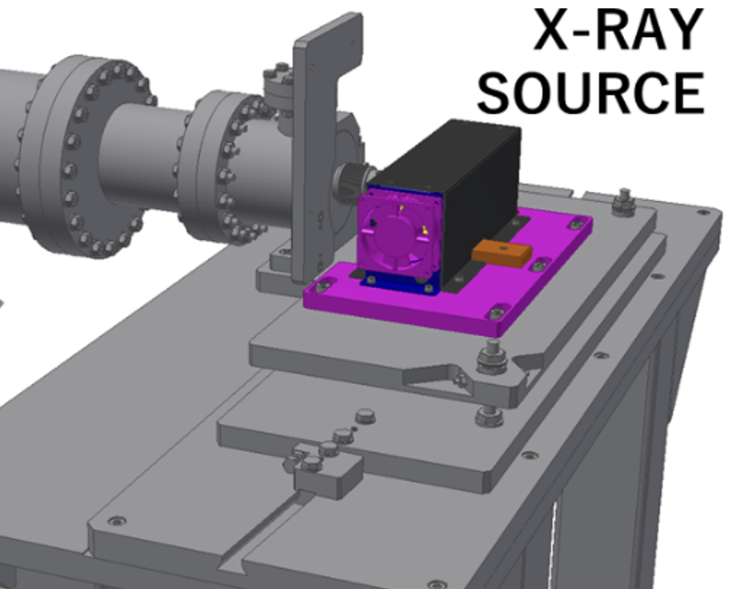
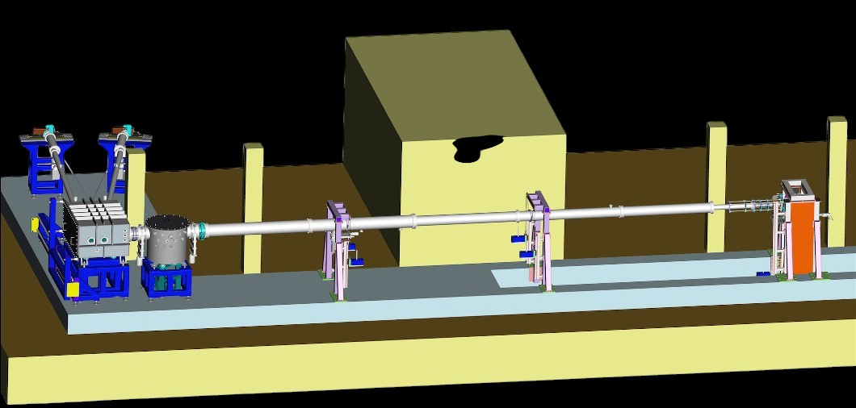
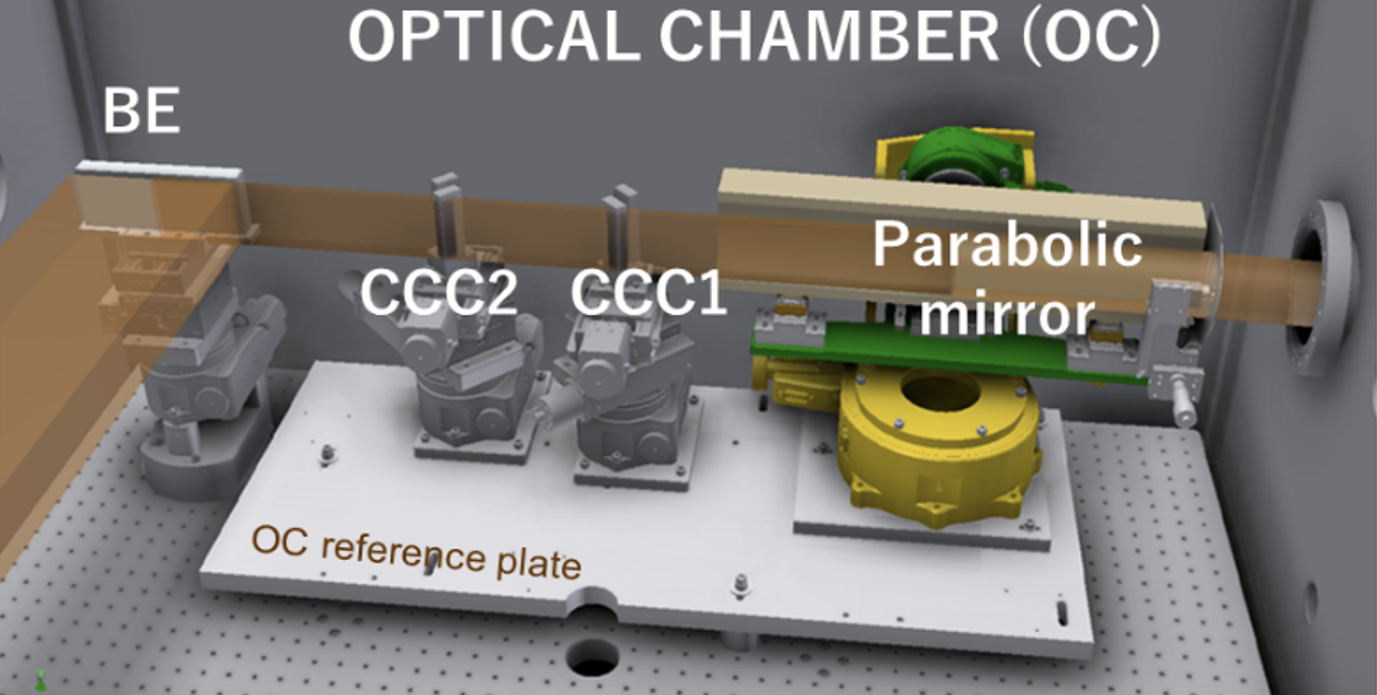
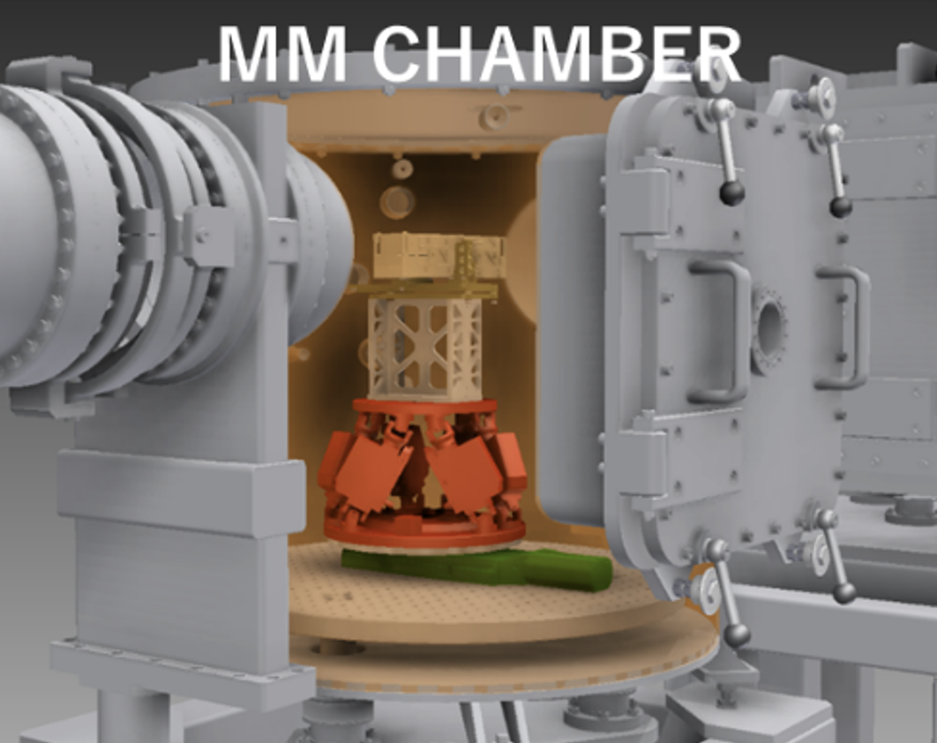
Mechanical design
1.49 keV
X-ray source
Long arm
(< 12 m)
Short arms
(< 5 m)
4.51 keV
X-ray source
Optical chamber
Experimental chamber
CCD detector
June 16, 2025
High Precision X-Ray Measurements 2025, 16-20 June – BEaTriX, Sisana Davide – PhD student Politecnico di Milano/INAF-OAB
10

Slide 11
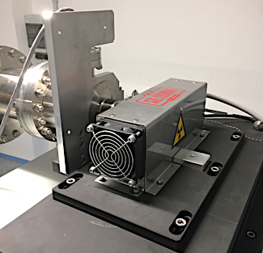
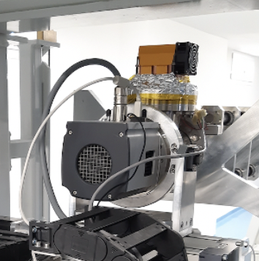

From design to reality
4.51 keV
X-ray source
Short arm
Long arm
CCD and cold finger
  Focal spot = 35 µm
  Flux = 10 ¹¹ ph/s/sr on Ti-K_{α}
Optical chamber
Beam expander
  Si (220) asymmetrically-cut
  Size: 27.6 mm
  Pixel: 13.5 µm
Chiller
Experimental chamber with hexapod and thermal box
Monochromators CCC
  Si (220) symmetrically-cut
Paraboloidal mirror
Coating: Cr + Pt
[Salmaso et al., Proc. SPIE 12181, 2022]
June 16, 2025
High Precision X-Ray Measurements 2025, 16-20 June – BEaTriX, Sisana Davide – PhD student Politecnico di Milano/INAF-OAB
11

Slide 12
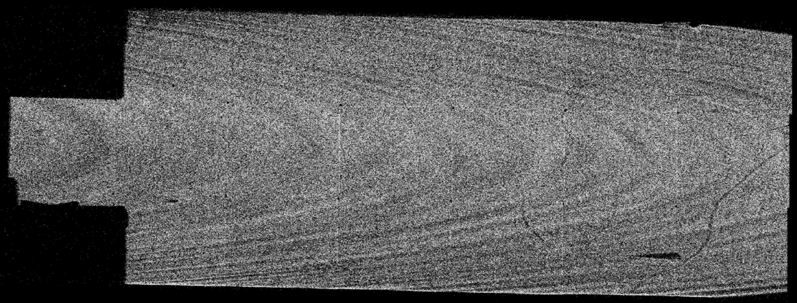
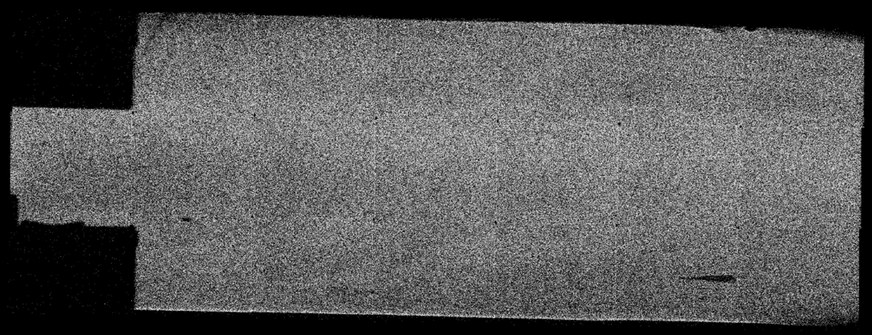
4.51 keV beamline – Performance
 | High flux | High collimation
2nd CCC rotation | 0 arcsec | 10 arcsec
Flux | 60 ph/s/cm² | 10 ph/s/cm²
HEW_{vertical} | < 2 arcsec
HEW_{horizontal} | 4 arcsec | 2.5 arcsec
Uniformity | Up to 95%
[ Basso et al, ‘’First light of BEaTriX, the new testing facility for the modular X-ray optics of the ATHENA mission’’, A&A 664, A173, 2022]
SDD detector for the optical element's alignment
After dithering of the beam expander (low-frequency)
170 mm
170 mm
60 mm
60 mm
June 16, 2025
High Precision X-Ray Measurements 2025, 16-20 June – BEaTriX, Sisana Davide – PhD student Politecnico di Milano/INAF-OAB
12

Slide 13
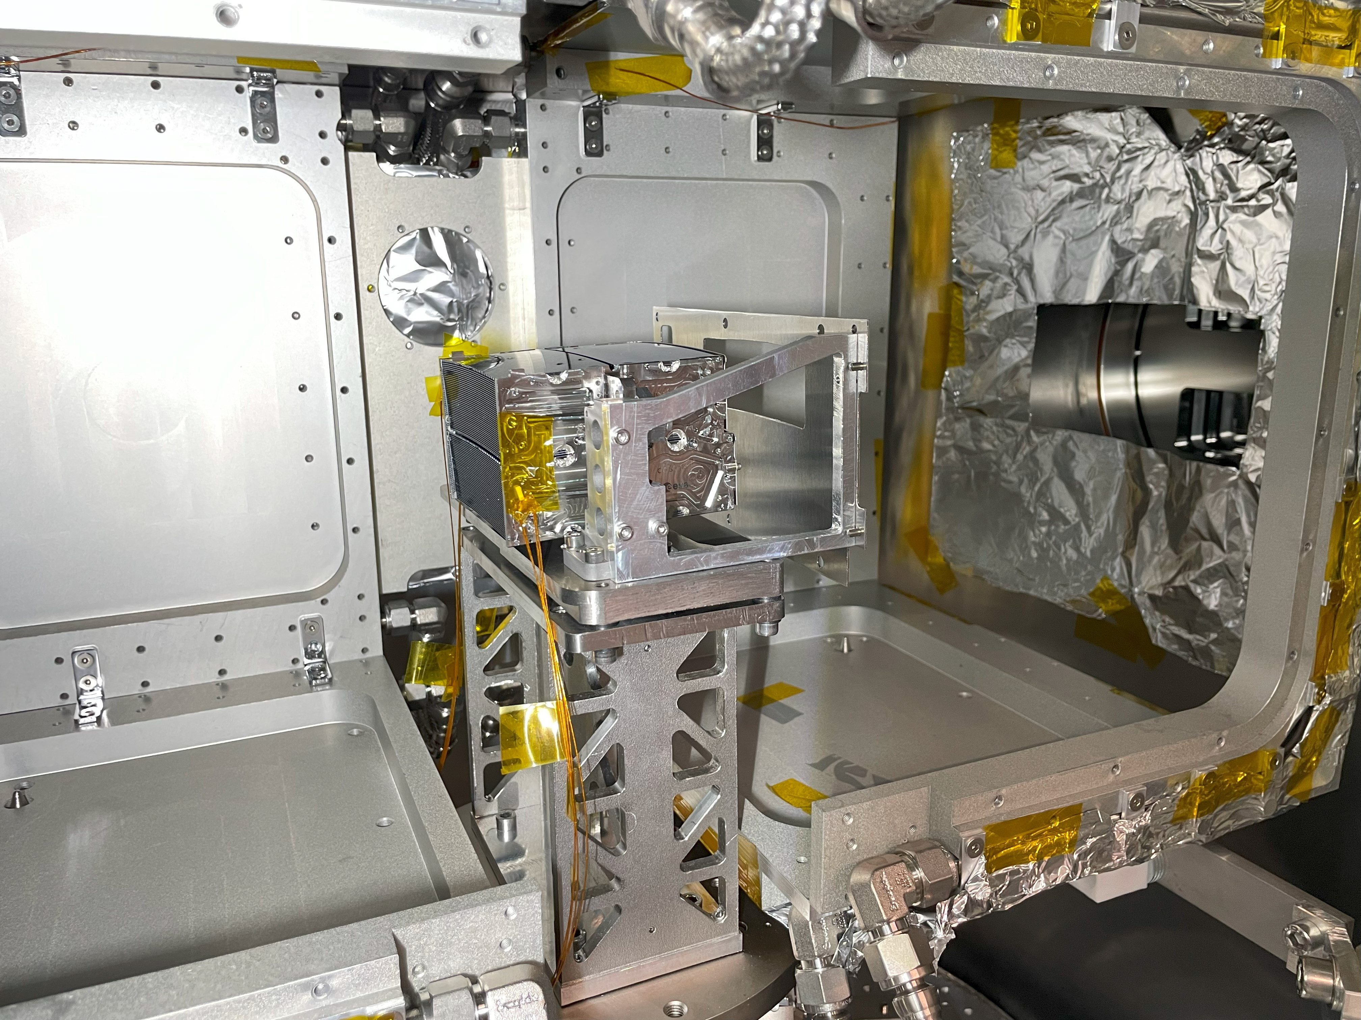
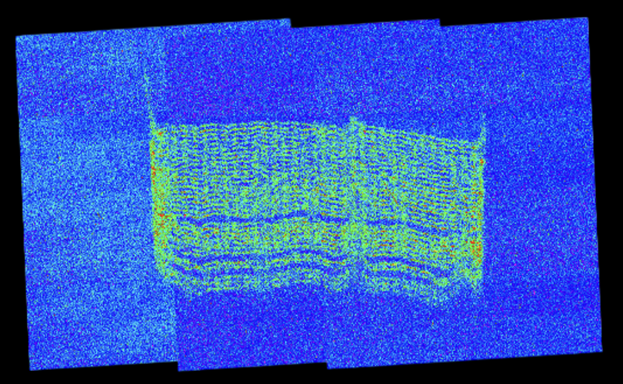
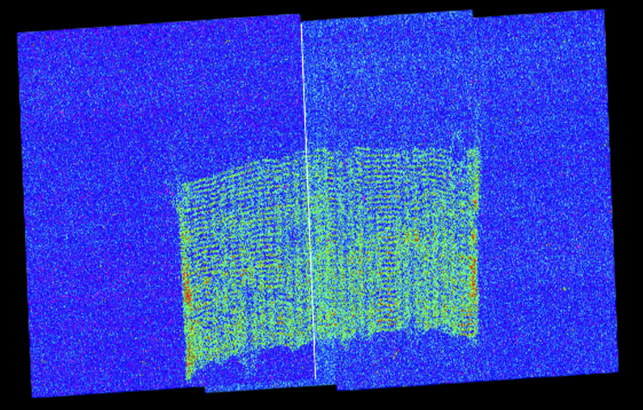
4.51 keV beamline – Experiments
Astronomical measurements: SPO MMs for NewAthena
Point Spread Function
Effective Area
Focal length
Thermal cycles
Straylight analysis
June 16, 2025
High Precision X-Ray Measurements 2025, 16-20 June – BEaTriX, Sisana Davide – PhD student Politecnico di Milano/INAF-OAB
13

Slide 14
4.51 keV beamline – Experiments
High collimation conf. for PSF
High flux conf. for Effective Area
To avoid double measurements:
high flux conf. + deconvolution
Requirement: 3 MM/day
Deconvolution
Deconvolution of the image with the BEaTriX X-ray beam
[Chauhan et al., Proc. SPIE 2025, in preparation]
June 16, 2025
High Precision X-Ray Measurements 2025, 16-20 June – BEaTriX, Sisana Davide – PhD student Politecnico di Milano/INAF-OAB
14

Slide 15
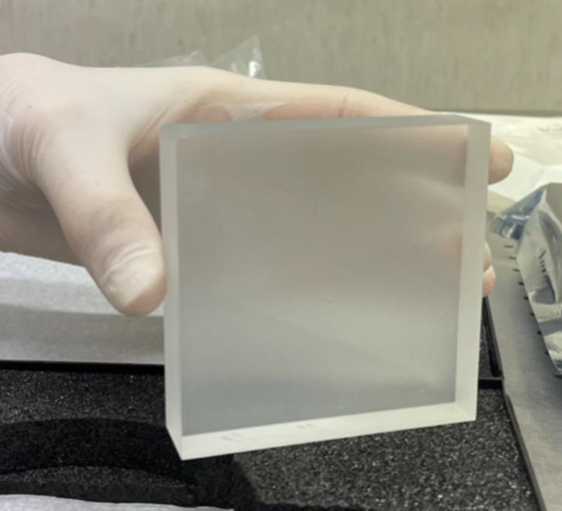
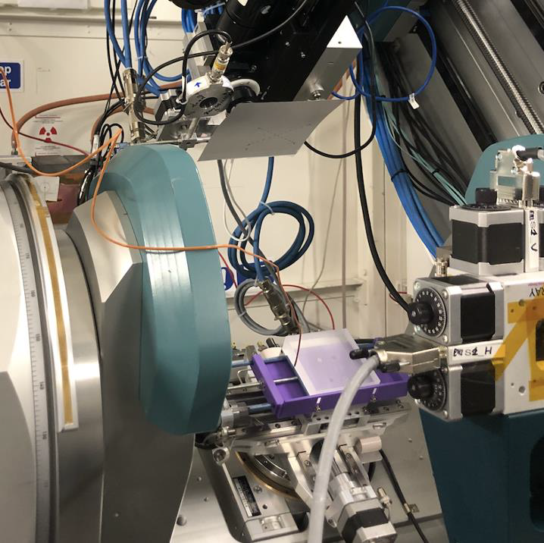
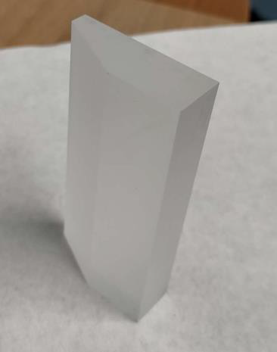
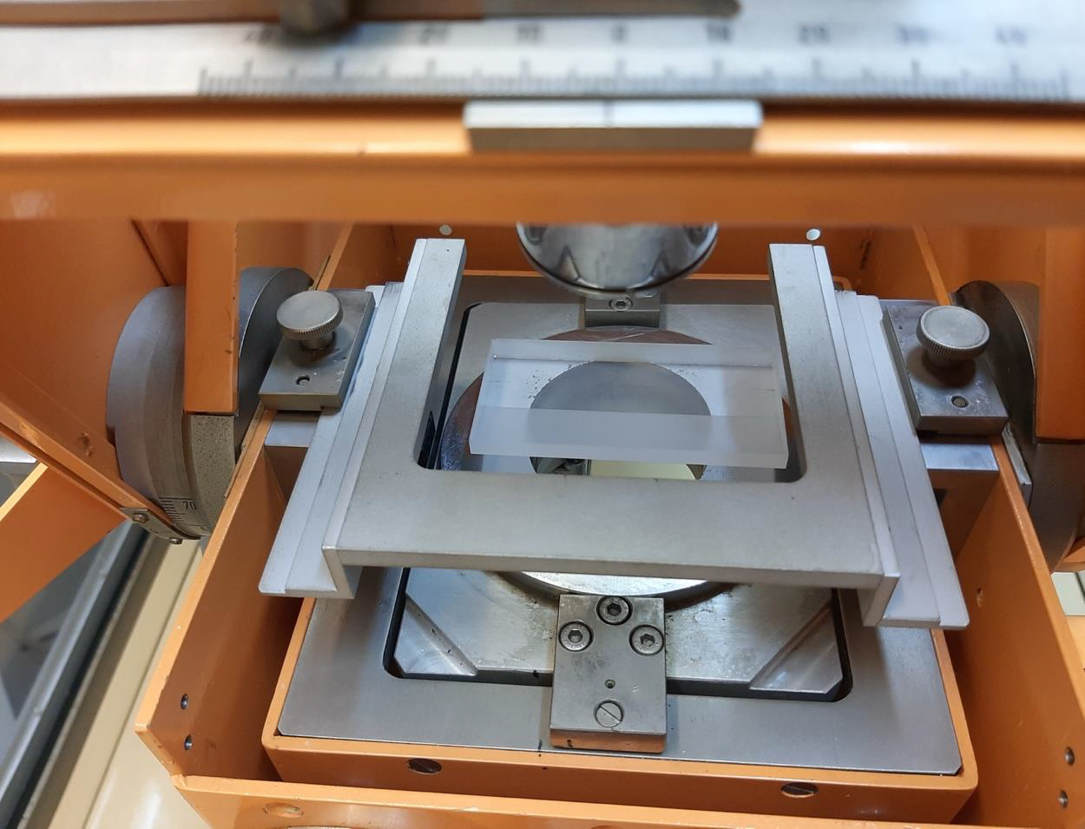
1.49 keV beamline – Crystals
Characterized at IMEM-CNR and ESRF synchrotron
80 x 80 x 20 mm³
Tested at PANTER facility, ready for the installation
Characterized at IMEM-CNR (Parma)
Under test at PANTER facility
80 x 30 x 15 mm³
June 16, 2025
High Precision X-Ray Measurements 2025, 16-20 June – BEaTriX, Sisana Davide – PhD student Politecnico di Milano/INAF-OAB
15

Slide 16
1.49 keV beamline – Crystals
Characterization of the crystals
Requirement on crystal planes RoC: 22 km
ADP is more challenging with respect to Si
Crystal planes with RoC of 22 km are difficult to be measured
RoCs out of specifications
June 16, 2025
High Precision X-Ray Measurements 2025, 16-20 June – BEaTriX, Sisana Davide – PhD student Politecnico di Milano/INAF-OAB
16

Slide 17
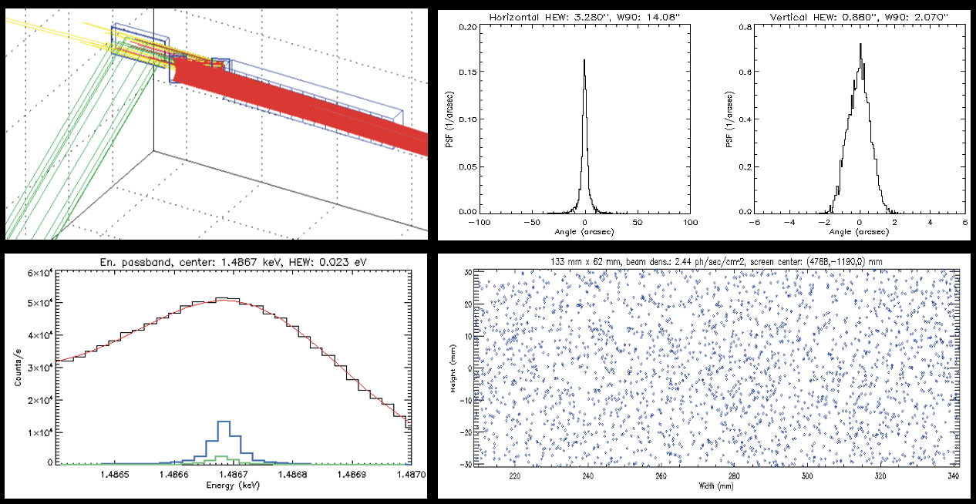
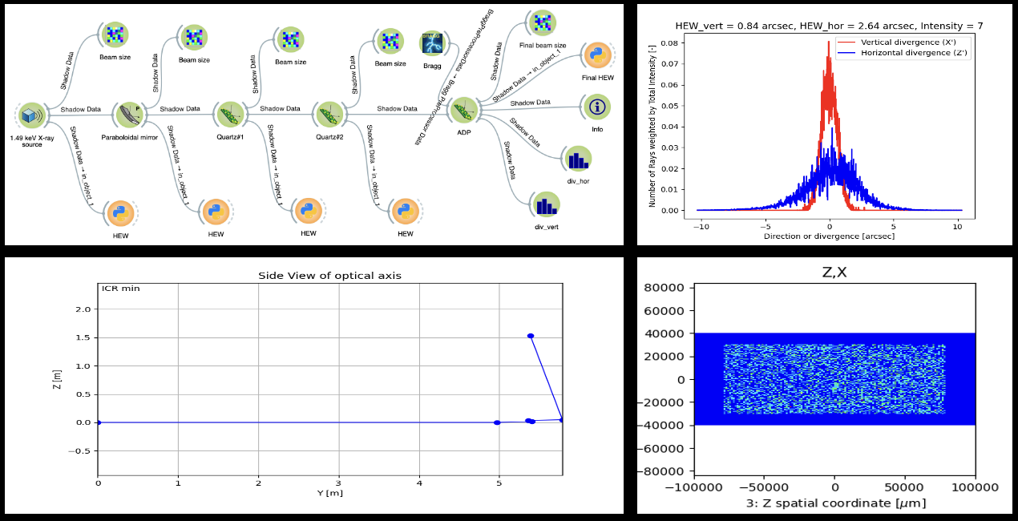
1.49 keV beamline – Simulations
How to improve the performance and to address the challenging aspects?
Simulations to evaluate the impact of the crystal planes RoC out of spec, both with Reference IDL code and OASYS-SHADOW4 software
[Spiga et al., Proc. SPIE ICSO 12777, 2023]
[in collaboration with Sanchez del Rio, ESRF]
June 16, 2025
High Precision X-Ray Measurements 2025, 16-20 June – BEaTriX, Sisana Davide – PhD student Politecnico di Milano/INAF-OAB
17

Slide 18
1.49 keV beamline – Simulations
How to improve the performance and to address the challenging aspects?
Parabola | Quartz#1 | Quartz#2 | ADP | OASYS-SHADOW4 |  | Reference IDL code
 |  |  |  | HEW_hor | HEW_vert | HEW_hor | HEW_vert
Ideal | Ideal | Ideal | Ideal | 2.81 arcsec | 0.87 arcsec | 3.21 arcsec | 0.87 arcsec
Ideal | Ideal | Ideal | RoC_h: 3.13 km RoC_v: 6.43 km | 5.98 arcsec | 1.16 arcsec | 7.73 arcsec | 1.70 arcsec
The main contribution on the HEW values is due to the crystal planes curvature
Bending system for ADP crystals
June 16, 2025
High Precision X-Ray Measurements 2025, 16-20 June – BEaTriX, Sisana Davide – PhD student Politecnico di Milano/INAF-OAB
18

Slide 19
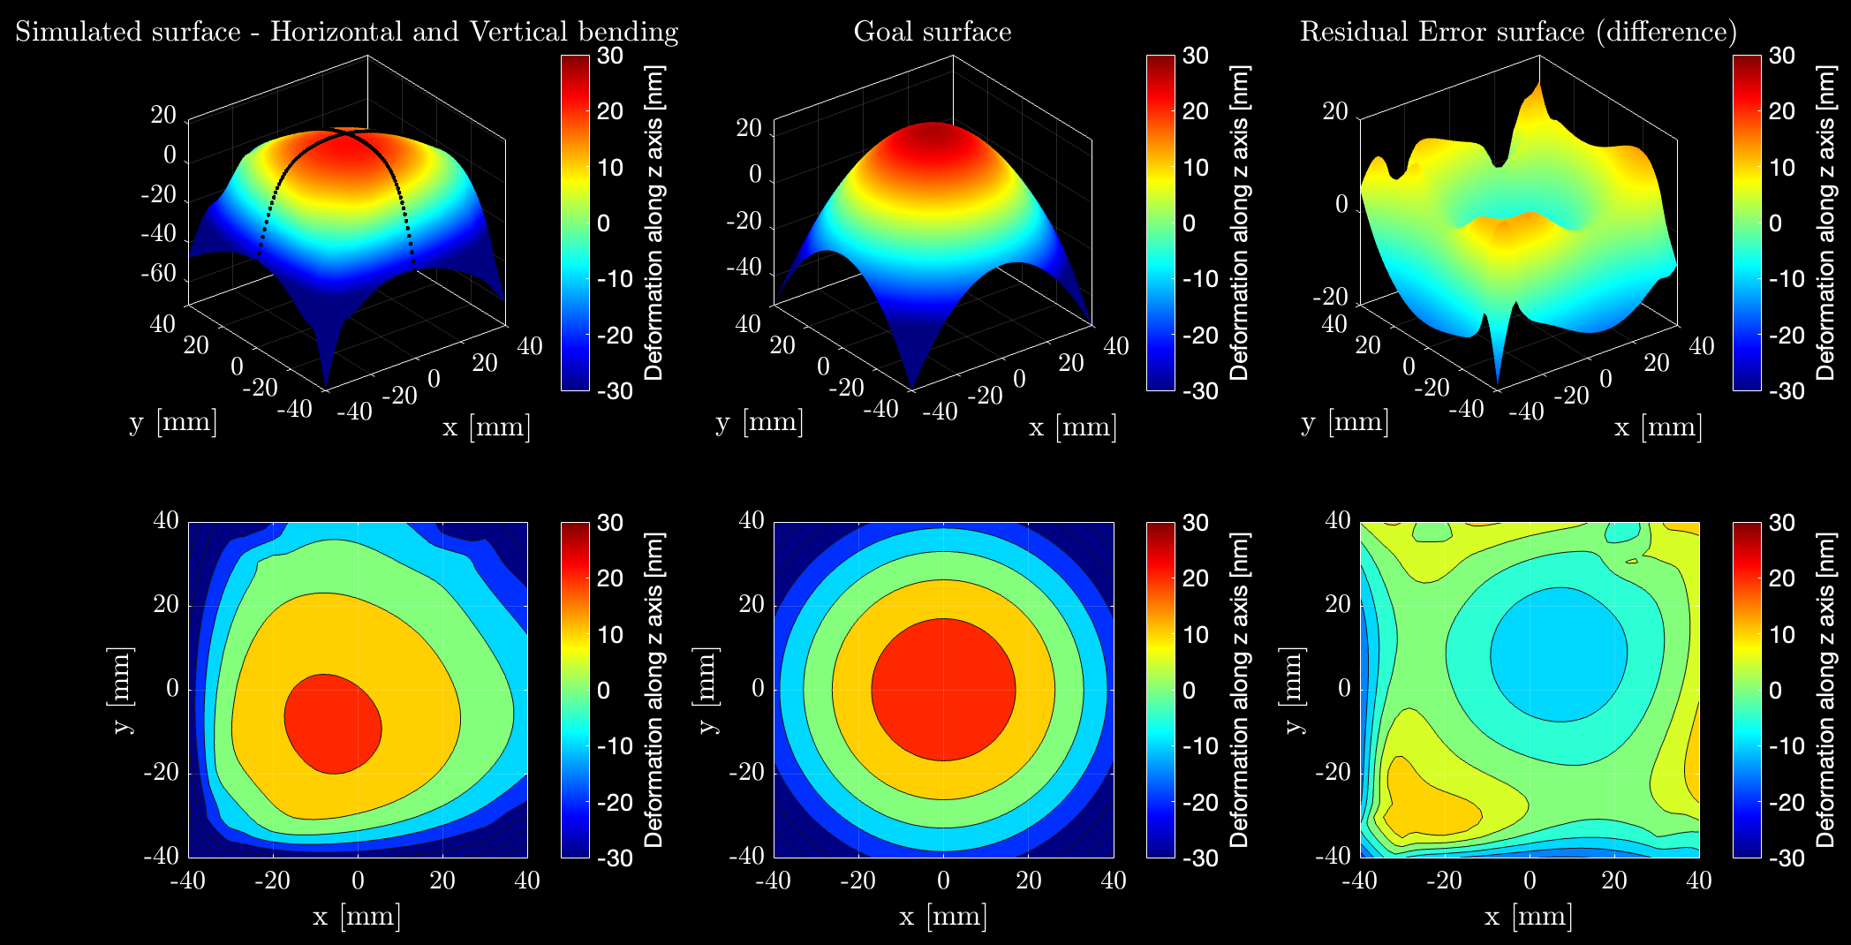
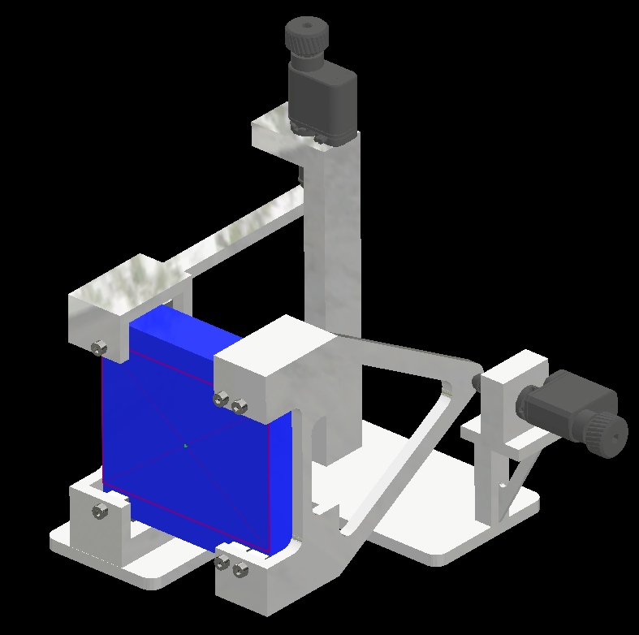
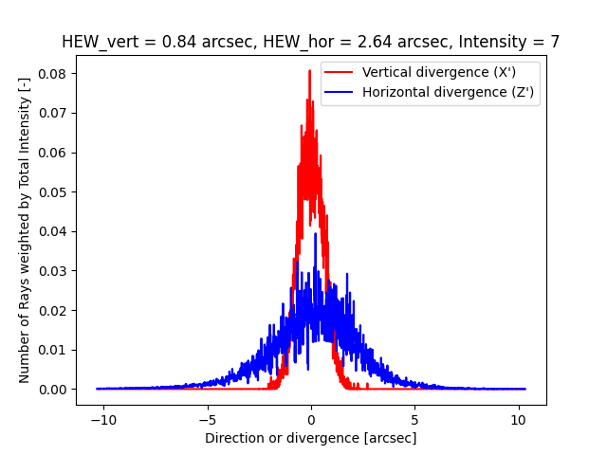
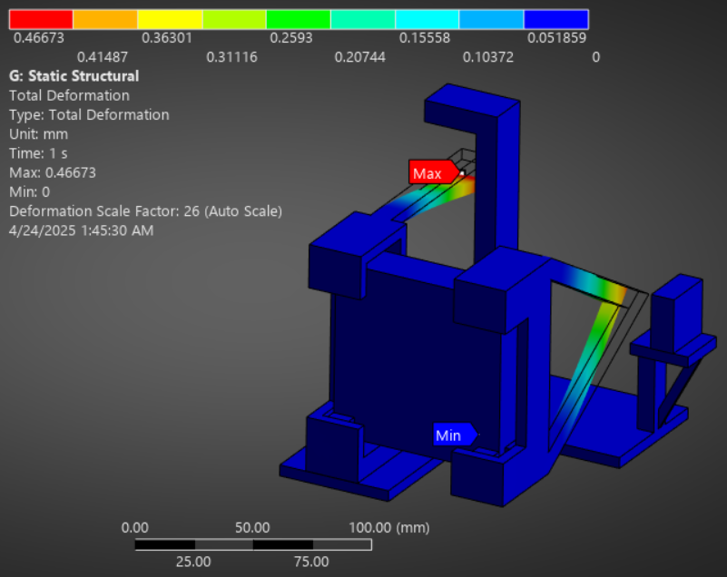
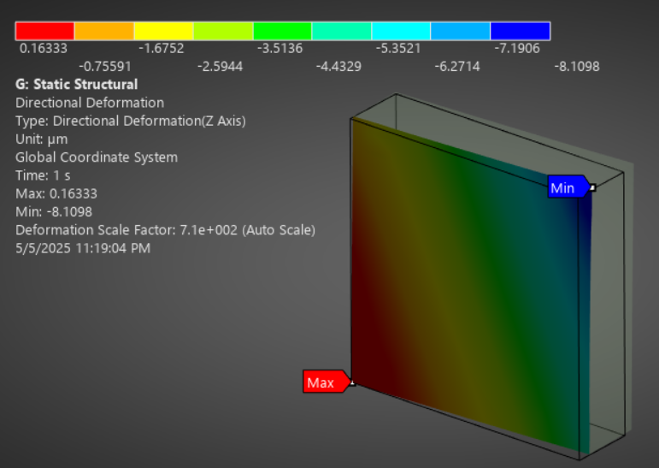
1.49 keV beamline – Bending system
Design of Concept: bending system for ADP crystal
IMEM-CNR and ESRF measurements
Matlab code
Surface reconstruction
Pseudo-inverse interaction matrix method
Mechanical design
Finite Element Analysis
OASYS-SHADOW4 simulations
HEW values
June 16, 2025
High Precision X-Ray Measurements 2025, 16-20 June – BEaTriX, Sisana Davide – PhD student Politecnico di Milano/INAF-OAB
19

Slide 20
1.49 keV beamline – Bending system
Proof of Concept: bending system for ADP crystal
The bending system design is frozen; the pieces are under production at INAF-OAB workshop
The system will be calibrated in optical wavelength at ZYGO interferometer at INAF-OAB promises
Final test: X-ray measurement at ESRF synchrotron
Installation in BEaTriX facility
Validation in laboratory
TRL 4
June 16, 2025
High Precision X-Ray Measurements 2025, 16-20 June – BEaTriX, Sisana Davide – PhD student Politecnico di Milano/INAF-OAB
20

Slide 21
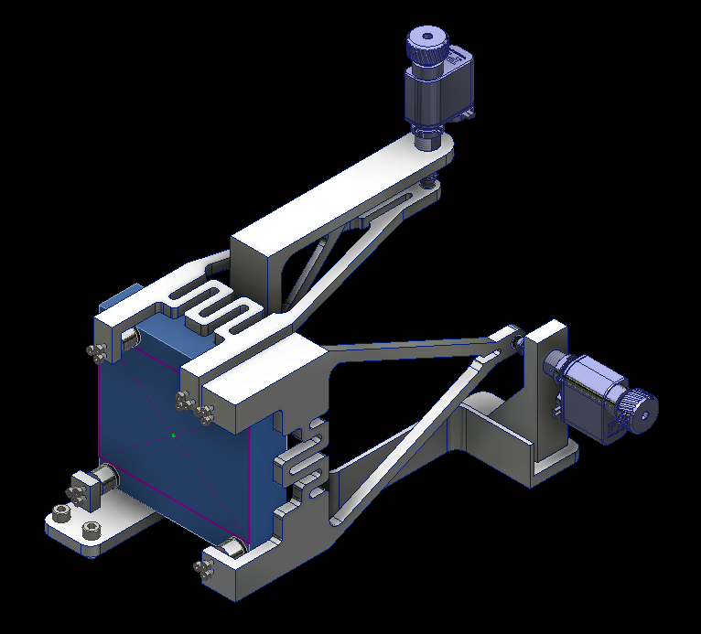
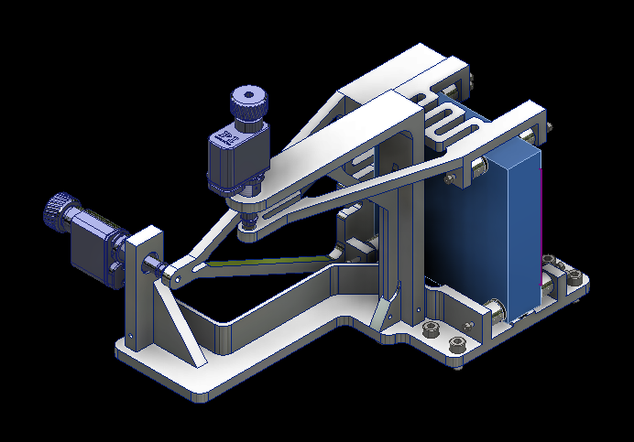
1.49 keV beamline – Bending system
Bending system for ADP crystal – Mechanical design
System to compensate the vertical RoC
Piezo motor
164 mm
System to compensate the horizontal RoC
155 mm
187 mm
ADP crystal
[Sisana et al., Proc. SPIE 2025, in preparation]
June 16, 2025
High Precision X-Ray Measurements 2025, 16-20 June – BEaTriX, Sisana Davide – PhD student Politecnico di Milano/INAF-OAB
21

Slide 22
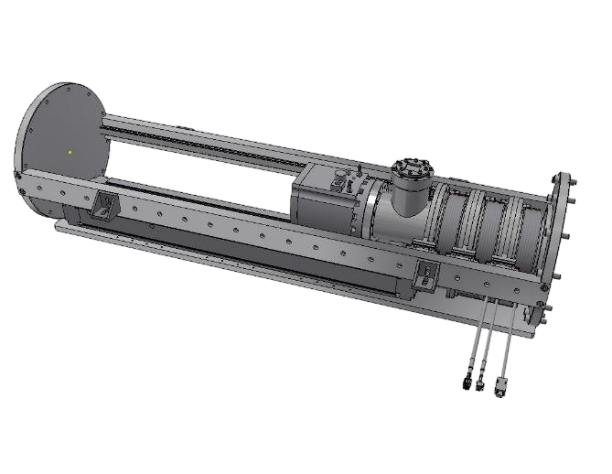
BEaTriX +
Detector tower moving
State of the art
3 possible focal length configurations
8 m
10 m
12 m
BEaTriX+
funded by INAF within “Potenziamento Laboratori Spaziali”
The long arm is replaced with shorter sections of 300 to 600 mm to enable the positioning of the detector, hosted in a stand-alone module, at any position in the range 1.5 – 13.7 m
Flexible focal length from 1.5 m to 13.7 m
June 16, 2025
High Precision X-Ray Measurements 2025, 16-20 June – BEaTriX, Sisana Davide – PhD student Politecnico di Milano/INAF-OAB
22

Slide 23
Application beyond astronomy
BEaTriX: X-ray lab-based imaging system enabling wide, collimated, and monochromatic beams
Beam properties | 4.51 keV | 1.49 keV
Size | > 150 mm x 50 mm
Collimation | < 2 arcsec | < 3.5 arcsec *
Monochromation | 35 meV | 23 meV
Polarization in the vertical plane | Linear | Partially linear (95%)
Experimental chamber size:
  750 mm diameter x 718 mm height
Thermal control during experiment:
  -15 °C to 55 °C
Flexibility on the CCD detector position:
  from 1.5 m to 12 m
* With the crystal planes RoCs in spec
June 16, 2025
High Precision X-Ray Measurements 2025, 16-20 June – BEaTriX, Sisana Davide – PhD student Politecnico di Milano/INAF-OAB
23

Slide 24
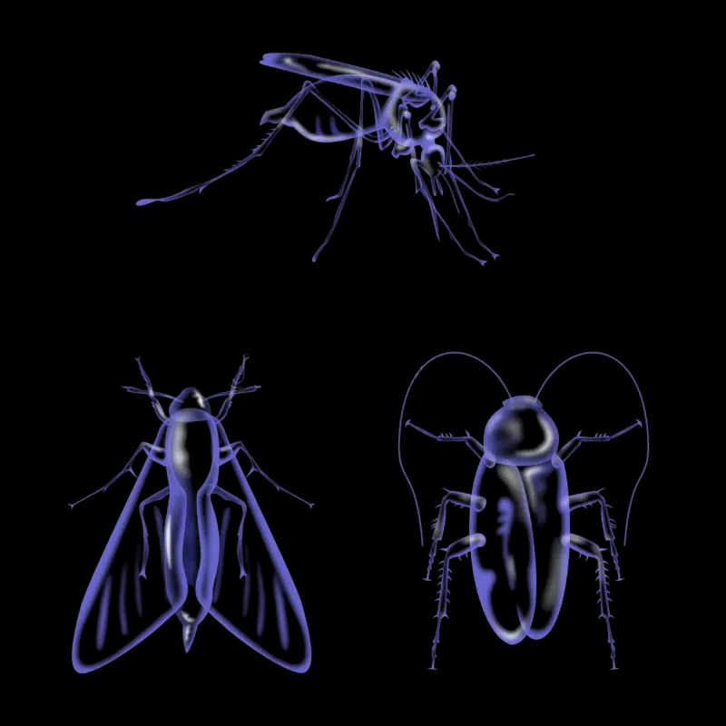
Application beyond astronomy
BEaTriX: X-ray lab-based imaging system enabling wide, collimated, and monochromatic beams
What suggestions do you have for making BEaTriX a facility also for your community?
Astronomy
Biological sample
(insects, fabrics, …)
Biomedical purpose
Add/built a high energy beamline using the same optical design of BEaTriX
Mammography (~ 25 keV)
…
June 16, 2025
High Precision X-Ray Measurements 2025, 16-20 June – BEaTriX, Sisana Davide – PhD student Politecnico di Milano/INAF-OAB
24

Slide 25
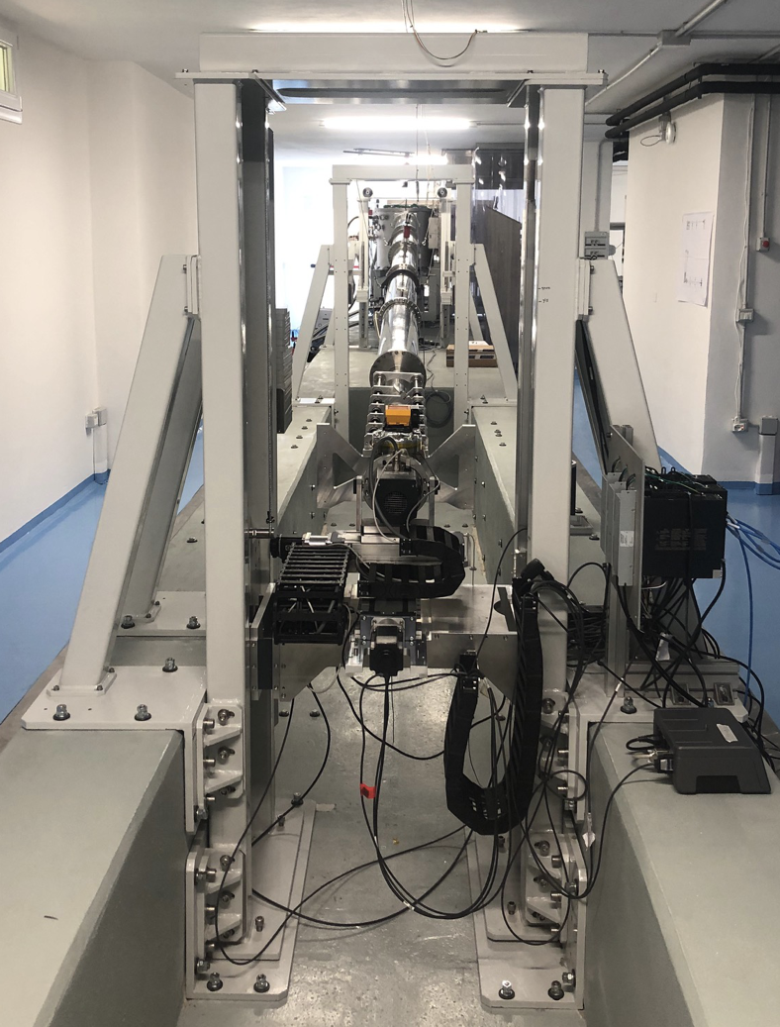

Thank you for your attention
About BEaTriX
Contacts:
davide.sisana@inaf.it (speaker)
bianca.salmaso@inaf.it (PM of BEaTriX)
High Precision X-Ray Measurements 2025, 16-20 June – BEaTriX, Sisana Davide – PhD student Politecnico di Milano/INAF-OAB

