Slide 1

Graphite crystal and Graphite optics as highly efficient Bragg filter and dispersive element
I. Grigoreva, G. Gudi
Optigraph GmbH
HPMX25, June 16-20, Frascati

Slide 2
Presentation agenda:
Anisotropic structure of Graphite Crystal
Well-Aligned Pyrolytic Graphite as a family of Graphite Crystals manufactured in different annealing conditions
Mosaic focusing & von Hamos geometry as a way to increase the efficiency and resolution of Graphite Crystal
Graphite Optics – unlimited shape possibilities
Quality control of Graphite Optics
Examples of Graphite Optics and its applications:
    Broadband filter for ED-XFA
    Dispersive element in laboratory XES and XAS
    Dispersive element for in situ plasma diagnostics
Notes:
First, I tell a few words about the crystal structure of Graphite and its peculiarities and describe how annealing conditions can affect the crystal properties.
Then I give a very short overview of focusing in mosaic crystal as a way to improve its performance
Next part gives you an impression about Graphite Optics and its features
At the end, I provide some examples of our Graphite Optics and its applications.

Slide 3
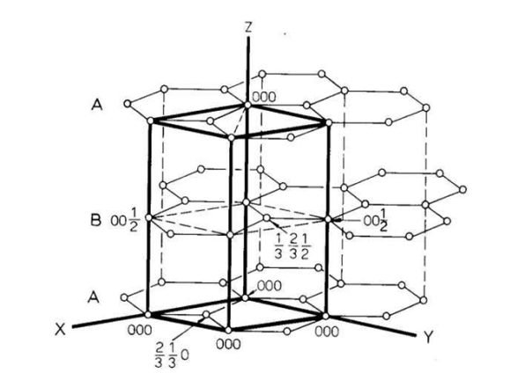
Crystal structure of Graphite Crystal
Graphite crystal is a mosaic crystal of a highly anisotropic structure, where crystallites are randomly oriented in C_C plane and are highly oriented in the perpendicular direction
Crystallographic structure within the crystallites consists of graphene-like carbon planes in which the carbon atoms are covalently bonded in a honeycomb structure.
Carbon planes are stacked together by van-der-Waals forces into a three-dimensional hexagonal unit cell.
In real material, the planes are additionally bound together by interlayer defects.
HPMX25, June 16-20, Frascati
Notes:
Graphite is a crystal of particularly high reflectivity. Being a mosaic crystal, it reflects a relatively wide energy window, since it provides crystallites located at the Bragg angle for a range of wavelengths.
The crystallites consist of a set of graphene layer stacked together by van-der-Waals forces. In a real material, the planes are additionally bound together by interlayer defects.

Slide 4
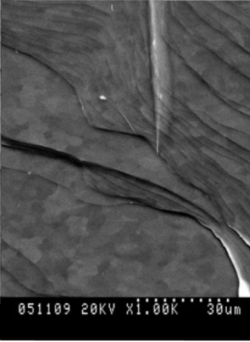
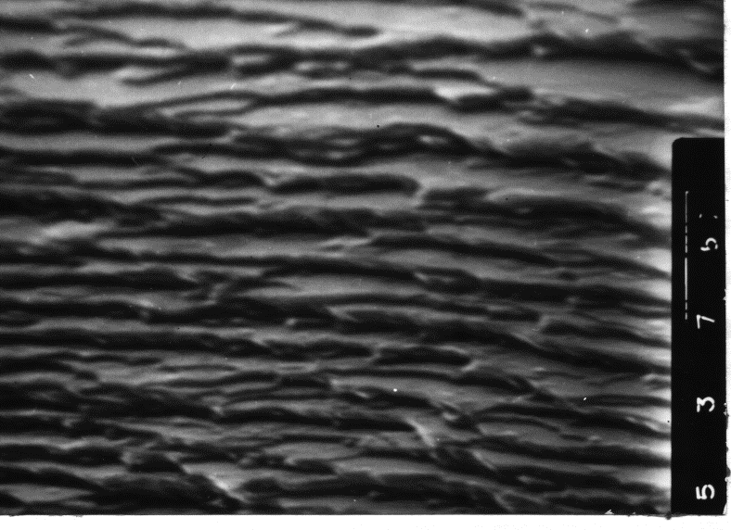
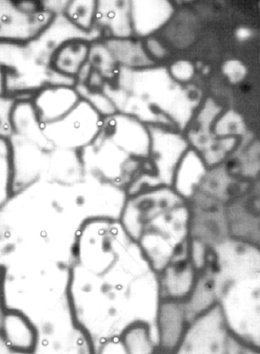
Crystallites and segregation in Graphite Crystal
Segregation of defects on grain boundaries in HOPG
Crystallites in HOPG by a Scanning Electron Microscopy
Crystallites in the direction perpendicular to C-C plane (after laser cut and etching of crystal edge)
Angular distribution of the C-axis of the crystallites is called Mosaic Spread (MS)
Acoustical Microscopy,
scale 1000 x 100 µm,
125 µm under the surface.
Crystallites in C-C plane
HPMX25, June 16-20, Frascati
Notes:
The material has a highly anisotropic structure, where crystallites are randomly oriented in direction of carbon planes and are highly orientated in the perpendicular direction
The angular distribution of the C-axis of the crystallites is called mosaic spread (MS) or mosaicity and is used as the only parameter characterizing graphite crystal.
However, depending on the annealing conditions crystals could differ from each other by their grain and defect structure and consequently by their mechanical properties and the minimum MS that could be achieved

Slide 5
Well-Aligned Pyrolytic Graphite as a family
(HOPG, HAPG_flex, HAPG & many other)
Properties within the family
similar
different
High purity carbon (99.999%)
Anisotropic structure and properties
Highest thermal conductivity in C-C plane (4 times higher than of Cu)
High electrical conductivity in (002) plane (ca. 2 x 10^6 S/m) and moderate ( ca. 5 x 10^2 S/m) in perpendicular direction
Outstanding thermal and radiation stability
Low chemical activity and ecological friendliness
Unique reflectivity of X-rays
Grain structure and number of defects
Interlayer distance (slightly)
Minimal achievable value of Mosaic Spread (MS): HOPG 0,4°/ HAPG film 0,06°
Mechanical properties: there are options with flexible and rigid films
Flexible films are used for Graphite Optics
HPMX25, June 16-20, Frascati
Notes:
Currently, we define HOPG, HOPG-flex and HAPG.
The well-known HOPG is a rigid crystal with minimal MS in the range of 0.4 degrees. HOPG_flex and HAPG are used mainly as thin flexible films for manufacturing Graphite Optics, and MS of individual films can reach 0.06 degrees.
Essentially, all these materials are different options of Highly Oriented PG. But since HOPG is a commercial name of the material obtained under certain annealing conditions, we prefer to call the entire family Well-Aligned Pyrolytic Graphite or Graphite Crystals.

Slide 6
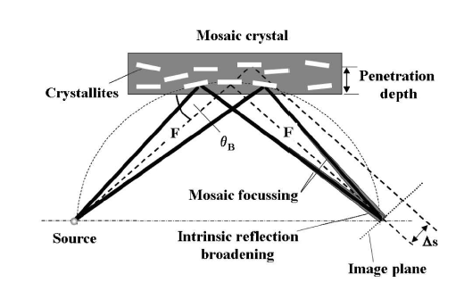
Mosaic focusing in Graphite Crystal
Energy smearing is determined by
geometrical aberration (mainly flat focusing errors and errors due to X-ray penetration into the mosaic crystal)
source size
Darwin width (intrinsic broadening)
Mosaic focusing enhances the intensity in the image plane as well as the spectral resolution. Although geometrical aberrations are influenced by the crystal mosaicity, a significant improvement in energy resolution can be observed
HPMX25, June 16-20, Frascati
Notes:
The unique reflectivity of Graphite Crystals can be additionally increased due to focusing.
In mosaic crystal, X-rays from a monochromatic point source reflect from the crystal and converge at a point located at the same distance from the crystal as the crystal from the source, before they diverge again. The effect called mosaic focusing enhances the intensity in the image plane as well as increases spectral resolution. In a real situation, there is energy smearing in the focal spot due to different factors. Although geometrical aberrations still are influenced by the crystal mosaicity, a significant improvement in energy resolution can be observed.
.

Slide 7
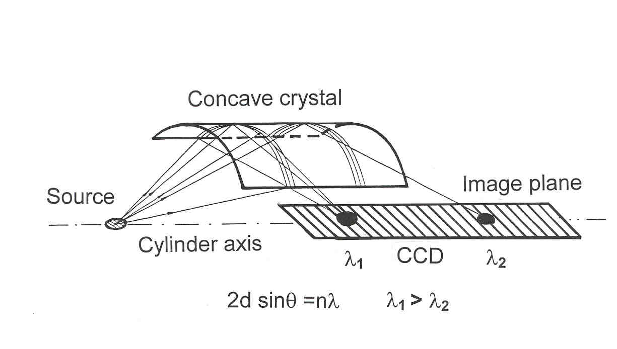
Classical von Hamos configuration
More about Graphite crystal/optics in von Hamos geometry in:
G.E.Ice, C.J.Sparks, Nucl. Instrum. Methods Phys. Res. A 1990, 291, 110–116
DOI:10.1016/0168-9002(90)90043-6
U. Zastrau et al., J. Instrum., 2012, 7 P09015.
DOI: 10.1088/1748-0221/7/09/P09015
U. Zastrau et al. J. Instrum., 2013, 8 P10006.
DOI: 10.1088/1748-0221/8/10/P10006
A. Scordo et al., Condens. Matter 2019, 4, 38,
DOI: 10.3390/condmat4020038
Cylindrically bent crystal combines mosaic focusing in diffraction plane with sagittal focusing. E/∆E is an order of magnitude better than expected from the crystal mosaicity
HPMX25, June 16-20, Frascati
Notes:
Sagittal focusing and mosaic focusing are combined in von Hamos configuration..
Here are links to the papers that discuss in details classic HOPG and GrO in von Hamos configuration, including the aberrations involved and the resolution achieved.
.

Slide 8
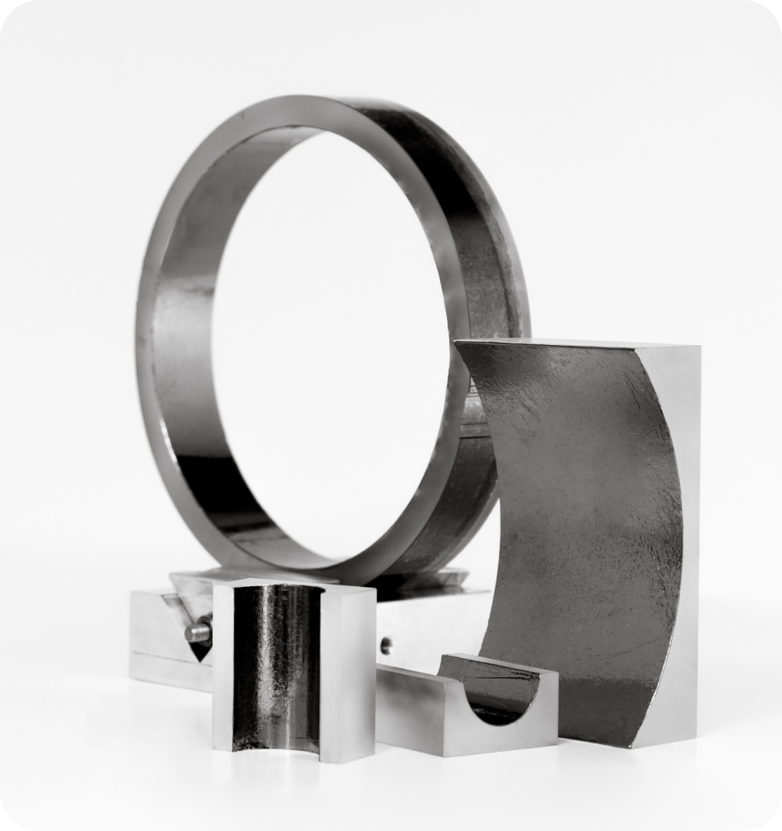
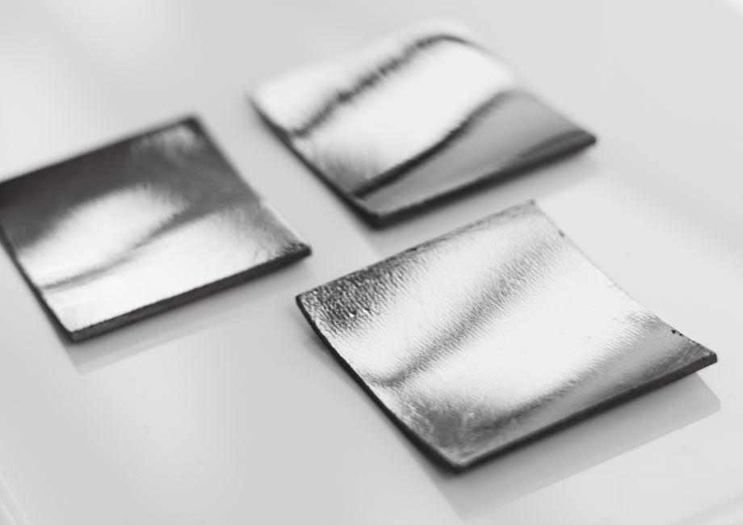
From bent HOPG to Graphite Optics
Manufactured by annealing under pressure at 3000°C on concave/convex dies
Manufactured by deposition of thin flexible films on required substrate at room temperature
Limited size of a very few cm2
Only 3 commercially available radii
Significant shape distortions
Crystal thickness of 1-2 mm
Size of several tens cm2
Unlimited set of shapes and radii
Precise geometry
Crystal thickness on request
Bending does not degrade the crystal resolution
HPMX25, June 16-20, Frascati
Notes:
Despite the very promising results spectrometers with classical HOPG were not in great demand. Classic HOPG is difficult to be manufactured in single and double curved shapes of precise and required radii. Graphite Optics gave a new breath of life to spectrometers with graphite crystals. Graphite Optics, manufactured by depositing thin flexible graphite crystals on a substrate of any required shape, can be easily adapt to the application and equipment.

Slide 9
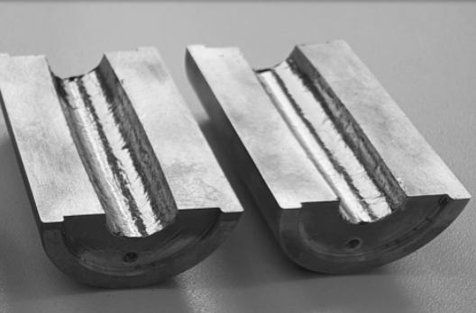
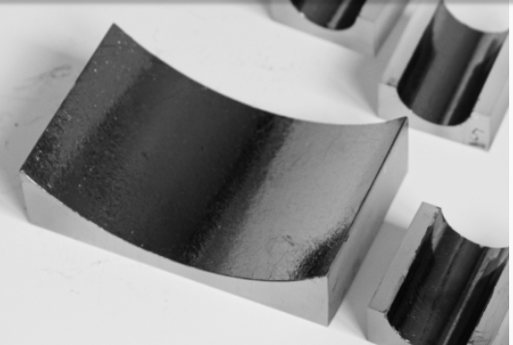
Graphite Optics
HOPG-OPTICS
The reflecting layer from a set of thin films of Flexible Highly Oriented Pyrolytic Graphite (HOPG_Flex)
Thickness of the reflecting layer from 30 µm to 300 µm on customer request
Mosaic spread (MS) from 0,4° to 1,2° depending on the layer thickness
Moderate resolution of several tens of eV
For application where reflectivity is a priority (X-ray Fluorescent Analysis and Plasma characterization)
HAPG-OPTICS
The reflecting layer from a monofilm of Highly Annealed Pyrolytic Graphite (HAPG)
Thickness of the reflecting layer from 3 µm to 100 µm on customer request
Mosaic spread (MS) from 0,06° to 0,3° depending on the quality of deposition surface
Resolution of several eV in von Hamos geometry. For the best efficiency, the theoretical optimization is needed
Used in high-efficient spectrometers for different applications, also with laboratory X-ray sources
HPMX25, June 16-20, Frascati
Notes:
Depending on the crystal used as a reflective layer, there are two types of GrO:
HOPG optics is produced by depositing thin films that adhere to the substrate and to each other up to a layer of several hundred microns. The optics has moderate resolution and increased integral reflectivity due to large MS and crystal thickness . This optics is mainly used for applications where reflectivity of the device has a priority over resolution.
In HAPG optics, the reflective layer is deposited as a single film of HAPG crystal, and the thickness of crystal layer is limited to 100 μm. The optics has a MS of about 0,1 degree and can provide resolution down to a few eV in von Hamos configuration, while keeping the excellent reflectivity compared with other mosaic crystals. Since there is a well-known trade-off between resolution and reflectivity, it is very helpful to optimize the thickness and geometry of the optics theoretically to the demands of the application prior to manufacturing.

Slide 10
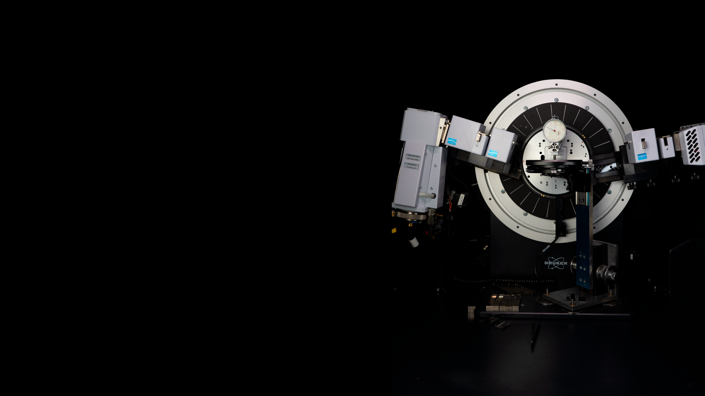
Laboratory & Quality control
Characterization parameters:
Mosaic Spread (MS)
Flat and slightly bent Graphite Optics and HOPG – diffractometer Bruker Advance ECO
Bent Graphite Optics – von Hamos Spectrometer
Optics of complex shape – flat “witness” on diffractometer Bruker Advance ECO
Film or Coating thickness – Mistral M1
(presentation of E. Blokhina, Bruker NANO)
HPMX25, June 16-20, Frascati
Notes:
Graphite Optics can be fully characterized in our laboratory
Next slides show you some examples of the optics we have produced in the past and describe very briefly the applications in which the optics was used. All slides include references to the articles of our customers where you can find more information.

Slide 11
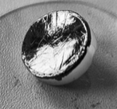
Graphite Optics as efficient bandpass filter in ED XRF
In excitation mode
Eliminates bremsstrahlung contributions from the source providing the lower background in the most interesting parts of the fluorescence spectrum
Increases considerably the intensity of the excitation line due to focusing from a large acceptance angle
Allows performing local XRF analysis with a sub-mm resolution of inhomogeneous and small objects
Ellipsoidal HOPG crystal
In detection mode
Cuts the energy window of interest reducing the high burden on detection system, which is of a special interest for samples with heavy or radioactive matrix
Enhances the fluorescence line of interest, collecting information from a large acceptance angle
Allows easy modification of the energy window
Ellipsoidal HOPG crystal
Suppressing background and undesirable spectral lines, collecting rays from a large spatial angle, the Graphite Optics significantly enhances the sensitivity of the method
HPMX25, June 16-20, Frascati
Notes:
GrO can be used as an efficient bandpass filter in Energy Dispersive X-rays Fluorescent Analysis (ED XRF).
Focusing from a large acceptance angle increases the intensity of the excitation line or in the detection mode collects the fluorescence lines of interest.
Monochromatization, cut the energy window of interest, suppressing the contribution of background and undesirable lines and reducing the load on the detection system.

Slide 12
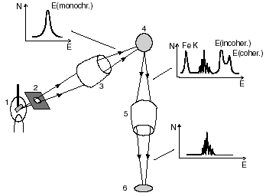
More about Graphite Optics for ED XRF
More about Graphite optics for ED XRF in:
Y. Kolmogorov, V. Trounova, X-Ray Spectrom., 2002, 31, pp.432-436 DOI:10.1002/xrs.603
B. Beckhoff et al. In book: Advances in X-Ray Analysis, 1994, pp.523-533, DOI: 10.1007/978-1-4615-2528-8 64
D. Wissman, J. Heckel, Spectroscopy, 2016, 31, 7, pp. 24-29
Simultaneous use of toroidal HOPG optics in the excitation and detection channels (Y. Kolmogorov, 2002)
HOPG optics with a reflection layer of a few hundreds µm as well as HAPG optics of a few tens µm of cylindrical, spherical, elliptical or toroidal shapes have been already manufactured and used
HPMX25, June 16-20, Frascati
Notes:
Graphite optics can be used in one mode only, for detection or for excitation, as well as in both modes simultaneously. The drawing is taken from the article of our customer, who used two HOPG toroids simultaneously to analyze geological samples.
Since in ED XRF usually a relatively wide energy window and high intensity are needed, the HOPG optics with a reflective layer of a few hundred microns is most often used. We have already manufactured a variety of shapes: cylinders, spheres, ellipsoids and toroids of very different sizes and radii.

Slide 13
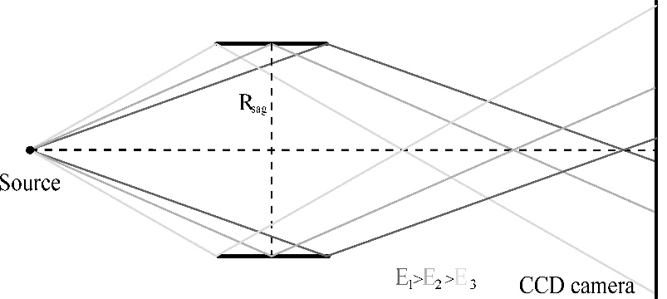
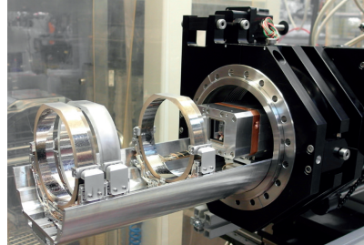
HAPG optics as efficient wavelength dispersive element
1. Chemical speciation by in lab-based X-ray Emission Spectroscopy (XES)
Full cylinder HAPG optics for implementation XES in laboratory
Rsag = 150 mm, meridional length of 30 mm, HAPG layer thickness of 40μm. A spectral resolving power of E/ΔE = 2000 in first order at 8 keV
(L.Anklamm et al., Rev. Sci. Instr. 2014, 85, 053110, DOI: 10.1063/1.4875986)
Rsag = 300 mm, meridional length of 20 mm, HAPG layer thickness of 20μm. A spectral resolving power of E/ΔE ≈ 4000 in second order at 2.3-10 keV (W.Malzer et al., Rev. Sci. Instr. 2018, 89, 113111 , DOI: 10.1063/1.5035171)
Rsag = 50 mm, meridional length of 20 mm, HAPG layer thickness of 40μm, a double crystals concept. A spectral resolving power from 850 for 1 crystal in first order up to 2800 for 2 crystals in first order
(I. Holfelder et al., Rev. Sci. Instr. 92, 2021, 123105, DOI: 10.1063/5.0061183)
Von Hamos scheme with a detector oriented perpendicularly to the cylinder axis
Spectrometer of a double crystal concept (I. Holfelder, 2021)
HPMX25, June 16-20, Frascati
Notes:
XES and XAS are powerful tools for studying the electronic configuration of molecules. The methods require X-ray beams of high intensity provided by synchrotron radiation facilities, but such facilities have a limited access.
The high efficiency of HAPG optics, combining excellent brightness with reasonable resolution in von Hamos geometry, allows to construct spectrometer for chemical speciation in laboratory.
To increase the effective solid angle a full cylinder HAPG optics were manufactured. The parameter of the optics aimed for different set-up are given on slide.

Slide 14
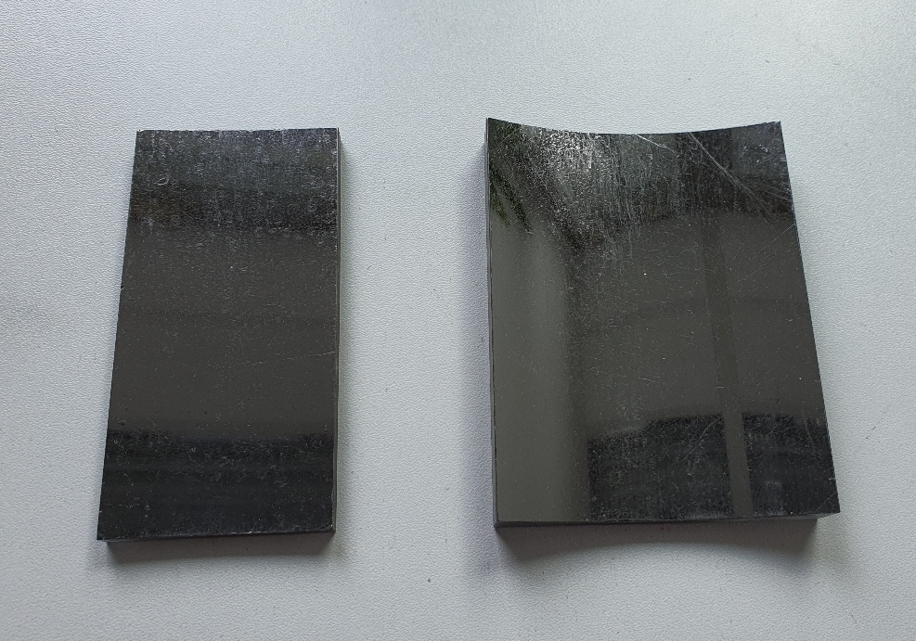
HAPG optics as efficient wavelength dispersive element
2. X-ray Absorption Fine Structure Spectroscopy (XAFS) in the laboratory
Cylindrical HAPG optics
Rsag = 100 mm, size 50x50 mm, HAPG layer thickness of 40 μm , MS≈0,1°. Energy band pass ΔE = 500 eV, spectral resolving power of E/ΔE ≈ 2000 in first order at 4-15 keV, for EXAFS and XANES (C.Schlesiger et al., J. Anal. At. Spectrom., 2015, 30, 1080–1085, DOI: 10.1039/c4ja00303a)
Rsag = 300 mm, size 50x50 mm, HAPG layer thickness of 20 μm, MS≈0,06° Energy band pass ΔE = 300 eV, spectral resolving power of E/ΔE ≈ 4000 in second order at 4-10 keV, for XANES (C.Schlesiger et al., J. Anal. At. Spectrom., 2020, 35, 2298-2304, DOI:10.1039/D0JA00208A)
Rsag = 100 mm, size 160×77 mm, HAPG layer thickness of 40 μm, MS≈0,1° Energy band pass ΔE = 2 keV, spectral resolving power of E/ΔE ≈ 1800 in first order at 4-10 keV, for EXAFS (C.Schlesiger et al., J. Anal. At. Spectrom., 2020, 35, 2298-2304, DOI:10.1039/D0JA00208A)
Two HAPG optics 100 mm long with Rsag=300 and 100 mm (for commercial XAFS set-up of HP-Spectroscopy GmbH)
Opportunity to perform XANES and EXAFS in the laboratory for diluted samples with analyte concentrations of a few weight percent or less in a reasonable time frame of minutes to hours
HPMX25, June 16-20, Frascati
Notes:
The next slide shows HAPG optics tailored to perform the extended X-ray absorption fine structure (EXAFS) and X-ray absorption near edge structure (XANES) spectroscopy at the von Hamos laboratory spectrometer. For each method the optimal optics was made.
The optics with bending radius of 300 mm and the thickness of crystal layer of 20 μm was produced for XANES . The optics provided spectral resolving power E/ΔE of about 4000, and energy bandpass of around 300 eV.
For EXAFS measurements, the optics has bending radius of R = 100 mm and crystal layer of 40 μm. The optics spectral resolving power was E/ΔE ≈ 1800 and energy bandpass of ΔE = 2 keV.
.

Slide 15
Features of HAPG optics as dispersive element
High efficiency in focusing and dispersing X-rays allows the implementation of XES and XAS methods, which typically required synchrotron radiation, using a laboratory-based source
Moderate resolution means that the details within the spectrum might not be as fine as with
higher resolution techniques
Wide bandpass enables simultaneous capture of a wide range of X-ray energies and significantly reduces measurement time
Large Solid Angle of Detection ca. 1 msr provides opportunity to analyze dilute samples efficiently
Resolving power E/ΔE of up to 4000 can be achieved depending on the spectrometer construction
Energy Range of approximately 2.3 - 10 keV
Wide set of available shapes and sizes ensures easy tailoring of the optics to the method and set-up requirements
HPMX25, June 16-20, Frascati
Notes:
This slide summarizes the features of HAPG-optics as wavelength dispersive element
High efficiency of the Optics helps to transfer typical SR method into lab,
but due to moderate resolution the details of spectrum might be not as fine as in classical SR approach
Wide bandpass enables to obtain the whole spectrum of interest in one shot
Large solid angle of detection provides good sensitivity and opportunity to analyze dilute samples
Resolving power E/ΔE of up to 4000
Wide set of available shapes and sizes ensure easy tailoring of the optics to the task

Slide 16
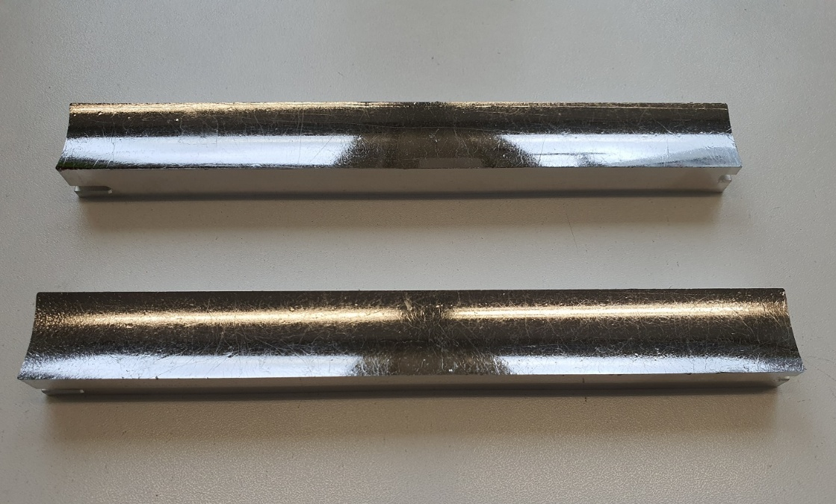
Graphite optics for plasma diagnostics
Graphite optics is used as dispersive element in X–ray Thomson scattering (XRTS) spectrometer - a powerful in situ plasma diagnostics tool allowing to infer key plasma parameter as temperature, density, ionization degree and structure factors
Key features of Graphite Optics for plasma application:
Large acceptance angle: efficient signal collection
Unique reflectivity: minimum losses of intensity
Wide band pass: possibility to obtain the whole spectrum in one shot
Unique stability: operates in the vicinity of plasma source
More information in:
T. Döppner et al., Rev. Sci. Instrum. 2014, 85, 11D617
DOI: 10.1063/1.4890253
T. Döppner et al., Rev. Sci. Instrum. 2016, 87, 11E515 DOI: 10.1063/1.4959874
Th. Gawne et al. (2024). Journal of Applied Physics, 2024, 136 (10) DOI: 10.1063/5.0222072
Conical HAPG optics for plasma analysis
HPMX25, June 16-20, Frascati
Notes:
Graphite optics is an essential part of spectrometers used for X–ray Thomson scattering (XRTS) analysis - a powerful method of in-situ plasma diagnostics that allows inferring key plasma parameters such as temperature, density, ionization, and structure factors.
Over the last 10 years, Optigraph has produced for our plasma-customers cylinders, two-section cylinders and cones of various radii and sizes. Depending on the scientific task, HOPG optics with thick 300um layer, as well as thin HAPG optics of 20 µm have been used.
In addition to the advantages mentioned earlier for other applications, such as
unique reflectivity,
large acceptance angle,
the decisive advantages of the optics for plasma diagnostics are
The ability to obtain the entire spectrum of interest in a single shot and
a unique ability to operate close to plasma source, where all other crystals are destroyed or lose their performance.

Slide 17
CONCLUSION
Graphite Optics provides a monochromatic or quasi-monochromatic beam with the required spectral properties, divergence and dimensions and serves as important optical elements in many X-ray spectroscopic techniques.
The optics can be used as:
efficient broadband filters, significantly enhancing the sensitivity of analytical instrumentation for energy dispersive techniques
efficient wavelength dispersive elements, helping to transfer high-energy resolution methods, which typically use a synchrotron radiation source, to a laboratory X-ray tube
It keeps the performance in extreme conditions of high temperature and radiation load
HPMX25, June 16-20, Frascati
Notes:
Graphite Optics provides a monochromatic or quasi-monochromatic beam with the required spectral properties, divergence and dimensions.
The optics can be used as: - broadband filters significantly enhancing the sensitivity of analytical instrumentation for energy dispersive techniques
- efficient wavelength dispersive elements, helping to transfer high-energy spectroscopy methods from Synchrotron to Lab.

Slide 18
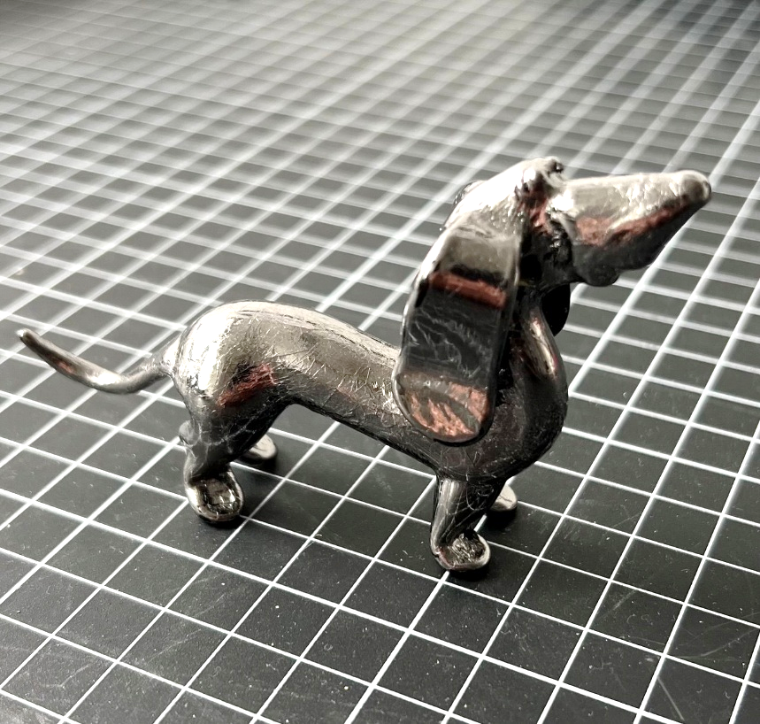
Thank you for your attention!
„Fancy Graphite optics“ – a glass toy is covered with 10 µm HOPG film to show the complexity of the shape that can be realized in Graphite Optics
Dr. Inna Grigoreva
info@optigraph.eu

