Slide 1


Betatron X-ray Radiation in the EuPRAXIA Advanced Photon Source Project
Federica Stocchi
University of Rome Tor Vergata & INFN-LNF
On behalf of SPARC_LAB & EuAPS collaborations

Slide 2
Outline
Laser WakeField Acceleration
X-ray Betatron Radiation
EuPRAXIA Advanced Photon Source project @LNF
Applications
Outlook

Slide 3
Outline
Laser WakeField Acceleration
X-ray Betatron Radiation
EuPRAXIA Advanced Photon Source project @LNF
Applications
Outlook

Slide 4
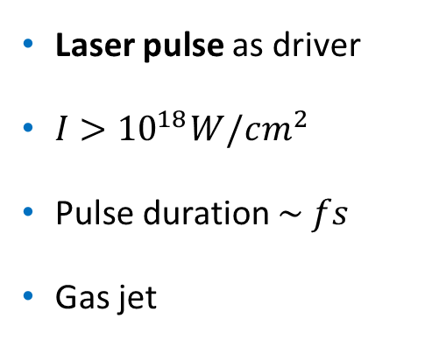
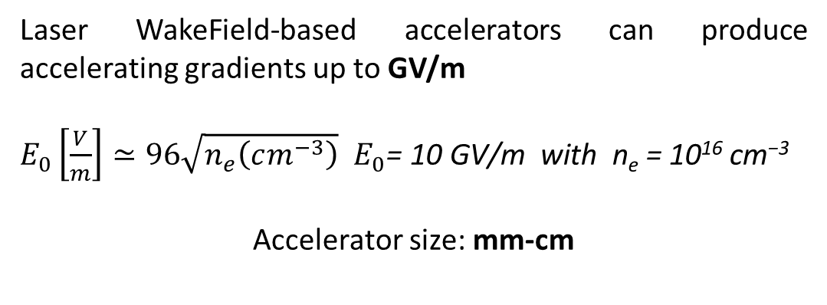
Laser WakeField Acceleration
A plasma-based accelerator is a compact X-rays source
How is the betatron radiation produced in the laser-driven configuration?
Laser WakeField-based accelerators can produce accelerating gradients up to GV/m
$E_{0}\left[\frac{V}{m}\right]≃96\sqrt{n_{e}\left(cm^{−3}\right)}$ $E_{0}\text{= }\text{10 }\text{GV}\text{/}\text{m} \text{with} \text{n}\text{e}\text{ = 10}\text{1}\text{6} \text{cm}\text{−3}$
Accelerator size: mm-cm
Laser pulse as driver
$I>{10}^{18}W/cm^{2}$
Pulse duration $\sim fs$
Gas jet

Slide 5
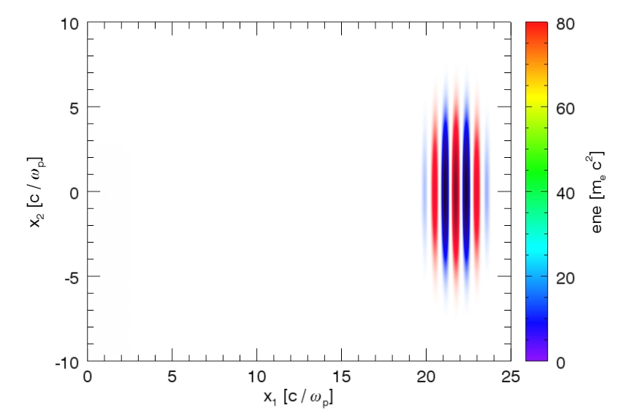
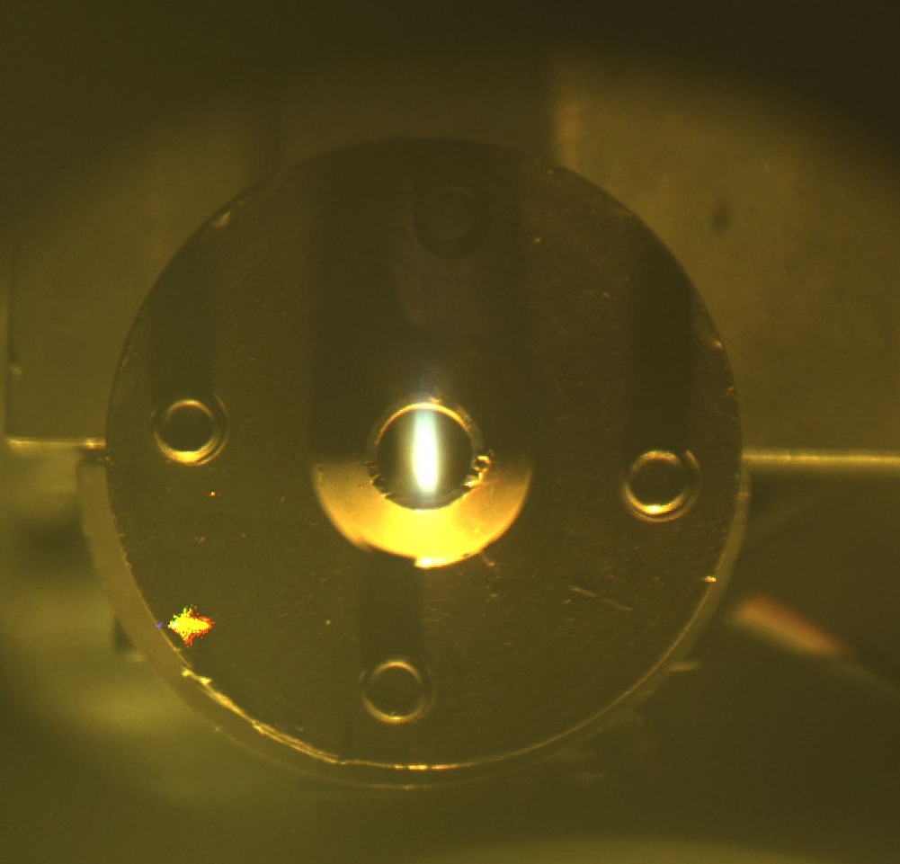
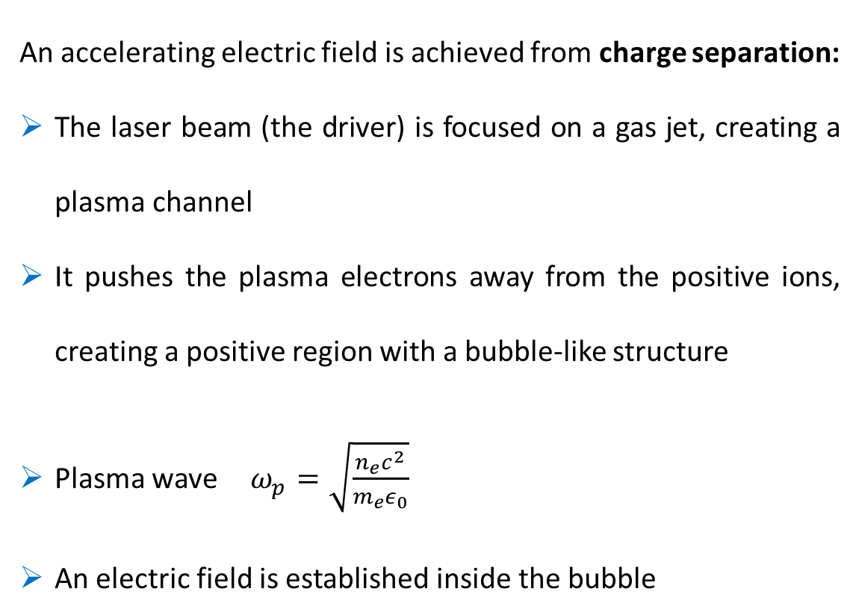
Laser WakeField Acceleration
An accelerating electric field is achieved from charge separation:
The laser beam (the driver) is focused on a gas jet, creating a plasma channel
It pushes the plasma electrons away from the positive ions, creating a positive region with a bubble-like structure
Plasma wave $ω_{p}=\sqrt{\frac{n_{e}c^{2}}{m_{e}ε_{0}}}$
An electric field is established inside the bubble
Courtesy J. Vieira, R. Fonseca/GoLP/IST Lisbon
Plasma channel of 3 mm from LWFA

Slide 6
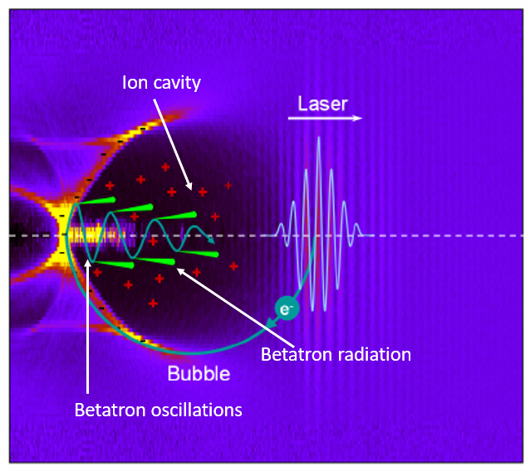
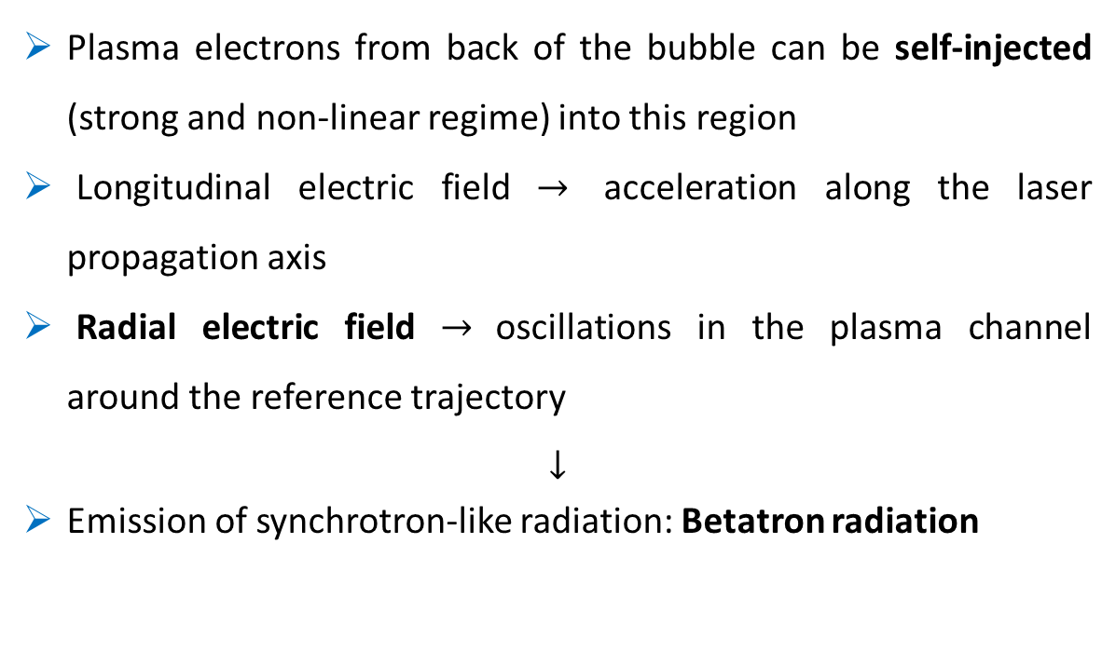
Laser WakeField Acceleration
Plasma electrons from back of the bubble can be self-injected (strong and non-linear regime) into this region
Longitudinal electric field $→$ acceleration along the laser propagation axis
Radial electric field $→$oscillations in the plasma channel around the reference trajectory
$$↓$$
Emission of synchrotron-like radiation: Betatron radiation

Slide 7
Outline
Laser WakeField Acceleration
X-ray Betatron Radiation
EuPRAXIA Advanced Photon Source project @LNF
Applications
Outlook

Slide 8
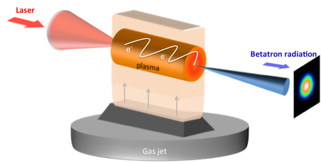



X-ray Betatron Radiation
Betatron radiation vs Synchrotrons and FELs
X-ray betatron radiation
Broad energy spectrum from soft to hard X-rays
Critical energy of some keV : $E_{c}∝γ^{\frac{7}{4}} n_{e}$
High peak brilliance
$$B_{β}≈{10}^{20}⋅\frac{dN_{γ}}{0.1\% BW⋅s⋅mm^{2}⋅mrad^{2}}$$
$N_{ph}∝N_{e}N_{β}K → {10}^{9}$photons/pulse with betatron strength parameter $K=γk_{β}r_{β}$
fs bunch length
Micron source size
Spatially coherent
Synchrotrons
Broad energy spectrum
$E_{c}∝γ^{3}$
Tens of hundreds of microns source size
10s of ps bunch length
High peak brilliance
$B_{sync}≈{10}^{21}⋅\frac{dN_{γ}}{0.1\% BW⋅s⋅mm^{2}⋅mrad^{2}}$
FELs
Monochromatic radiation
fs bunch length
Spatially coherent
High peak brilliance

Slide 9
Outline
Laser WakeField Acceleration
X-ray Betatron Radiation
EuPRAXIA Advanced Photon Source project @LNF
Applications
Outlook

Slide 10



EuPRAXIA Advanced Photon Source
EuAPS: EuPRAXIA Advanced Photon Sources project
Supported by PNRR fundings
Collaboration among INFN, CNR, University of Tor Vergata
Milestone of the EuPRAXIA project
  Laser-driven X-ray betatron radiation source @INFN-LNF
  High repetition rate laser @CNR-INO Pisa
  High power laser @INFN-LNS
Milano
Pisa
Frascati/Roma Tor Vergata
Potenza
Catania
EuAPS@LNF
Where | Target
INFN-LNF | Plasma Source
INFN-LNF | Synchronization
INFN-Mi | Simulation & Data Analysis
CNR-Potenza | Photon Diagnostics
Tor Vergata | End User Station
CNR-Montelibretti | Photon Time Diagnostics

Slide 11
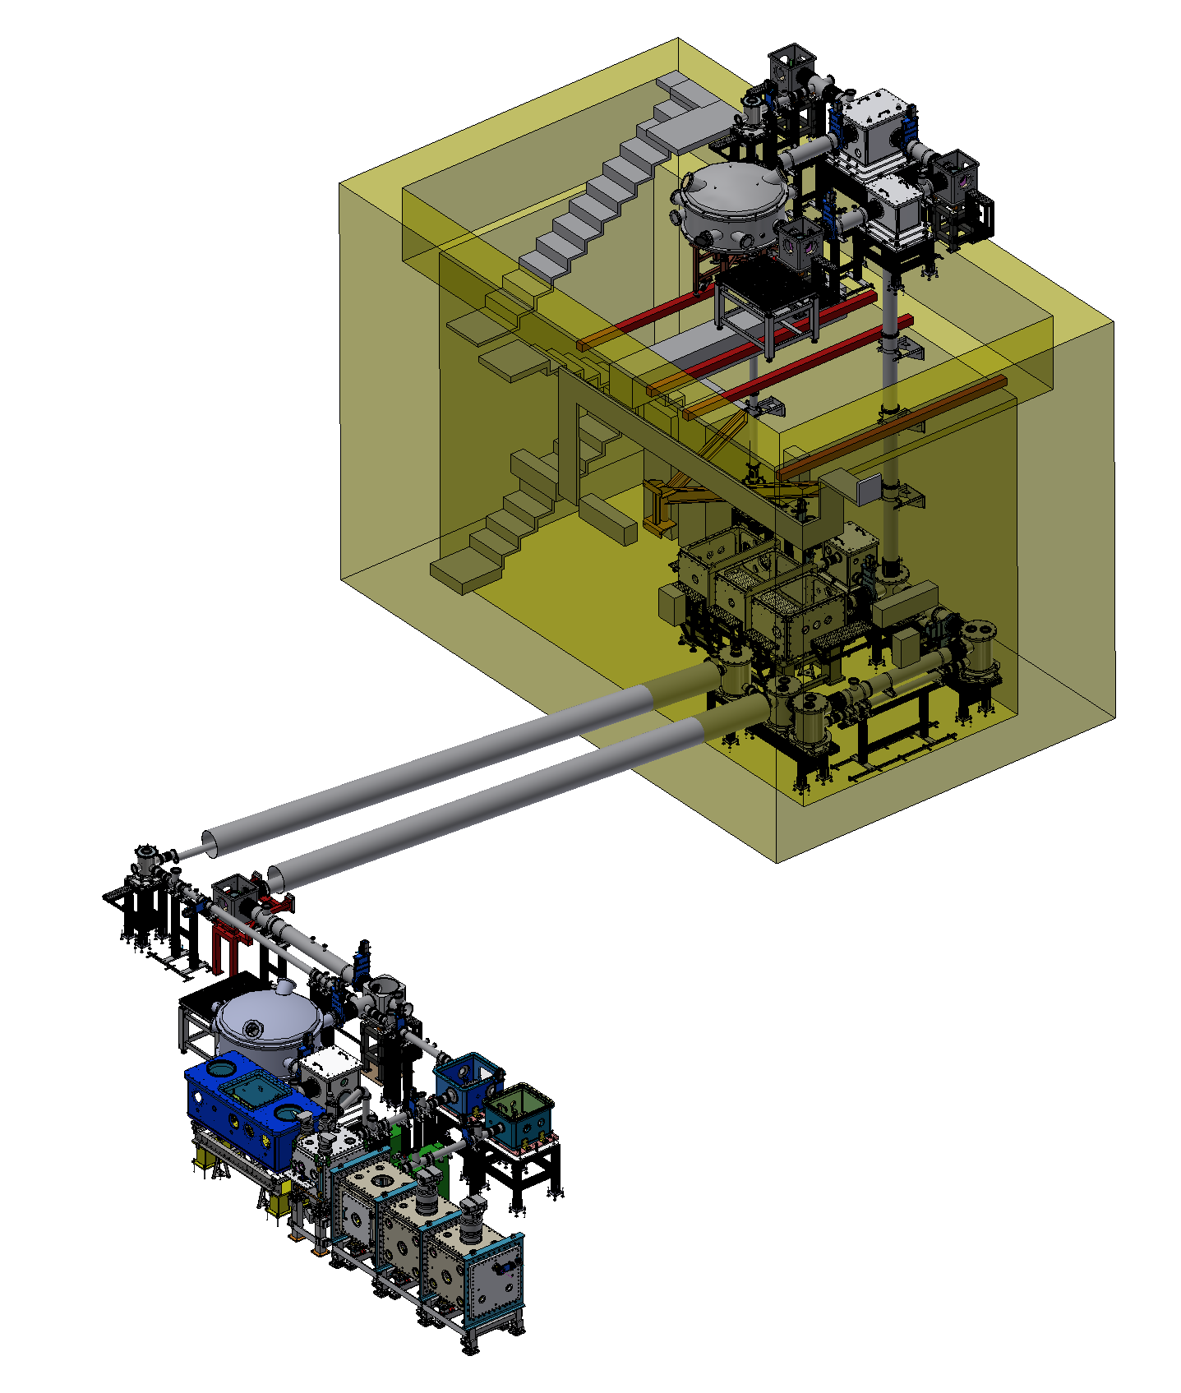
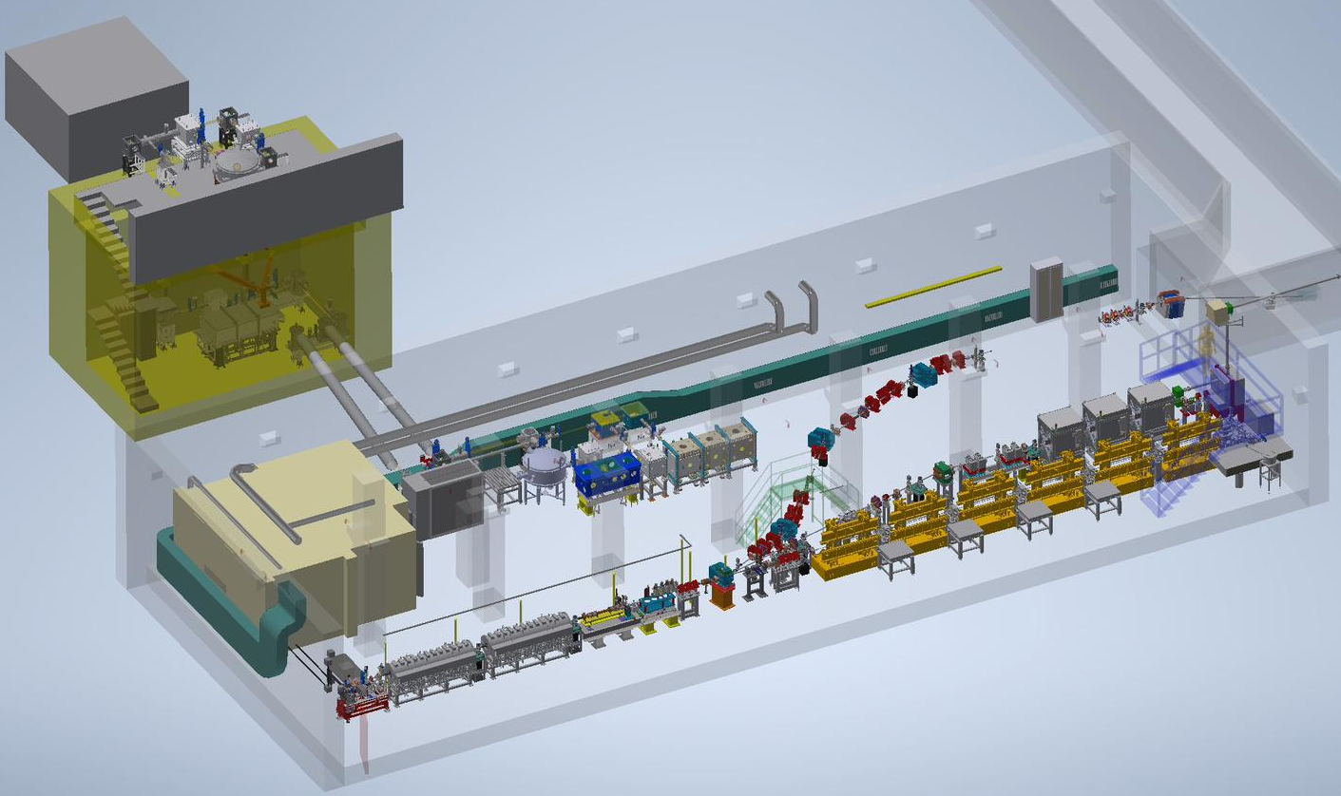
EuPRAXIA Advanced Photon Source
SPARC_LAB facility
FLAME laser
SPARC bunker
M. Ferrario, et al. NIM B 309 (2013), 183-188

Slide 12
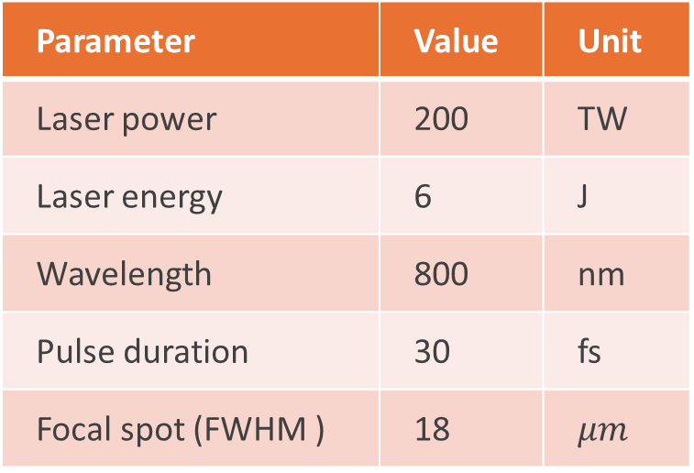
EuPRAXIA Advanced Photon Source
SPARC_LAB facility
Ti:Sa FLAME laser system
FLAME laser
Parameter | Value | Unit
Laser power | 200 | TW
Laser energy | 6 | J
Wavelength | 800 | nm
Pulse duration | 30 | fs
Focal spot (FWHM ) | 18 | $$μm$$
Probe pulse with some mJ of energy and 40 fs temporal length
SPARC bunker
M. Ferrario, et al. NIM B 309 (2013), 183-188
M. Galletti, F. Stocchi, et al. Appl.Sci (2024), 14, 8619

Slide 13
EuPRAXIA Advanced Photon Source
SPARC_LAB facility
EuAPS beamline
SPARC bunker
M. Ferrario, et al. NIM B 309 (2013), 183-188

Slide 14
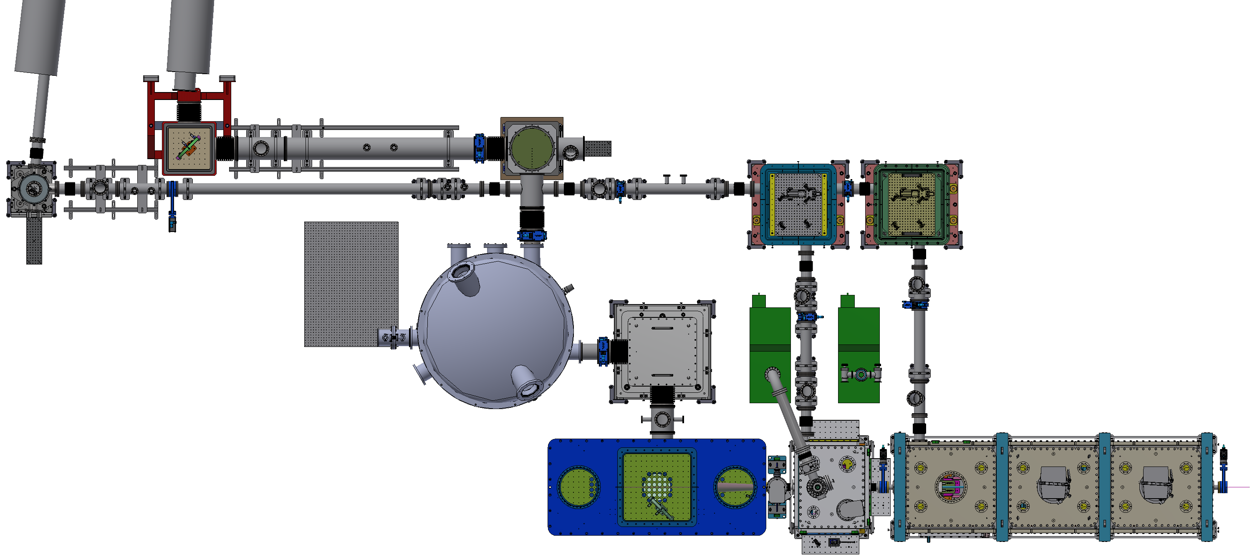
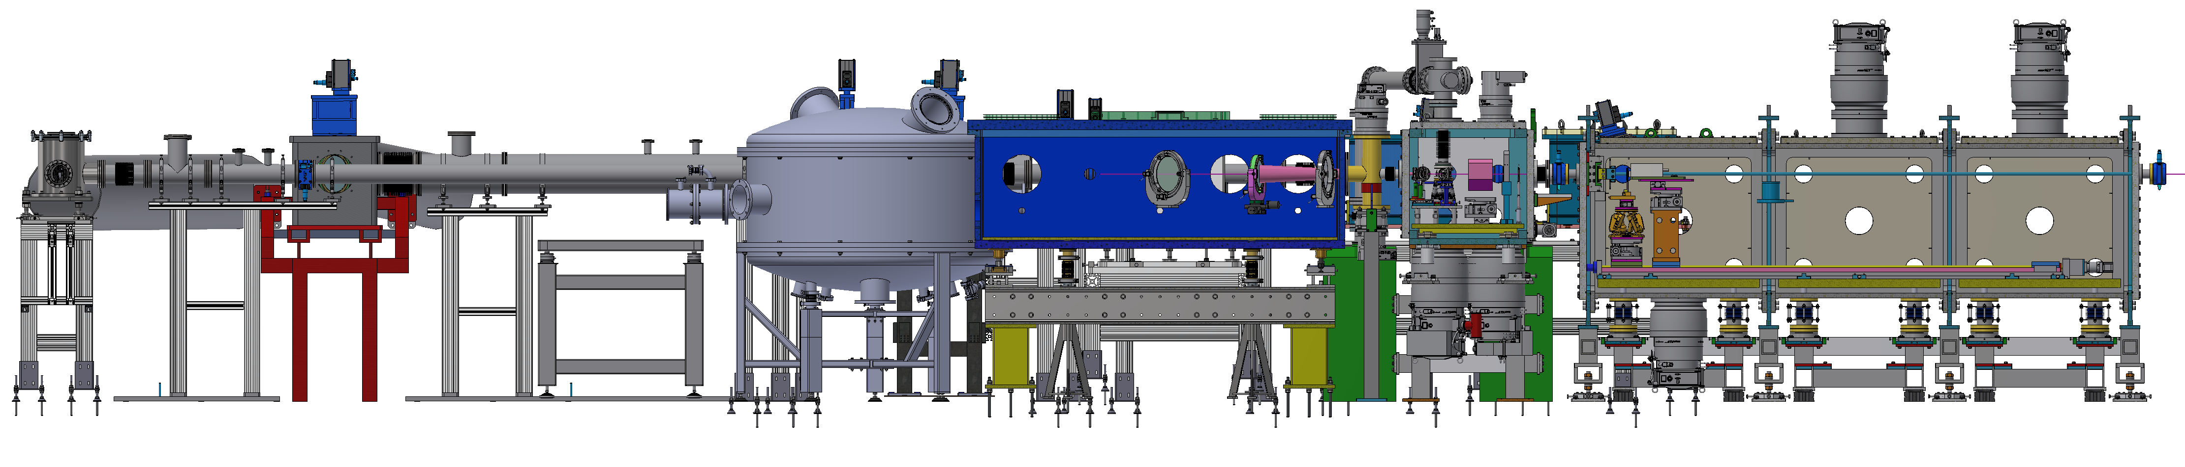
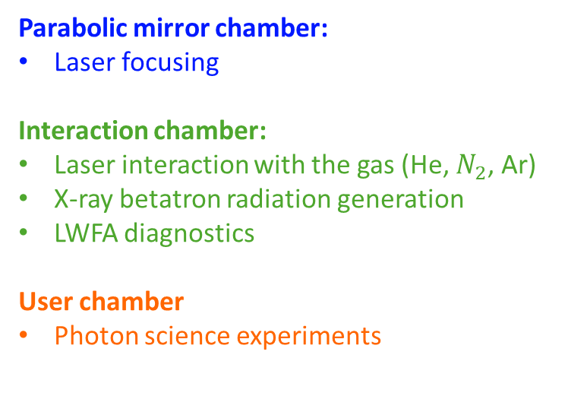
EuPRAXIA Advanced Photon Source
Parabolic mirror chamber:
Laser focusing
Interaction chamber:
Laser interaction with the gas (He, $N_{2}$, Ar)
X-ray betatron radiation generation
LWFA diagnostics
User chamber
Photon science experiments
Probe laser beam
Main laser beam
Top view
3 m
Courtesy of S. Lauciani

Slide 15
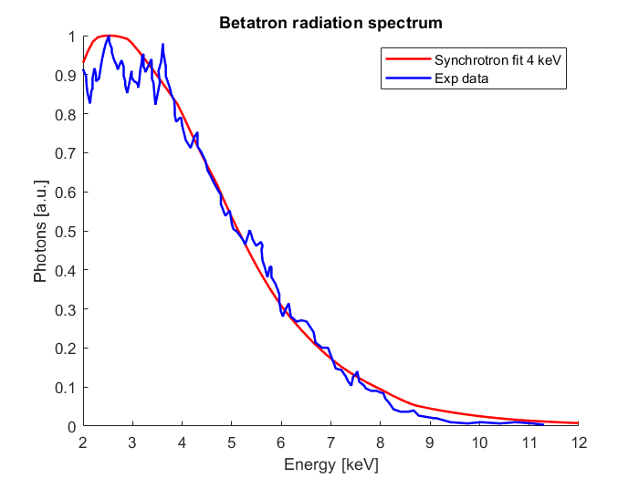
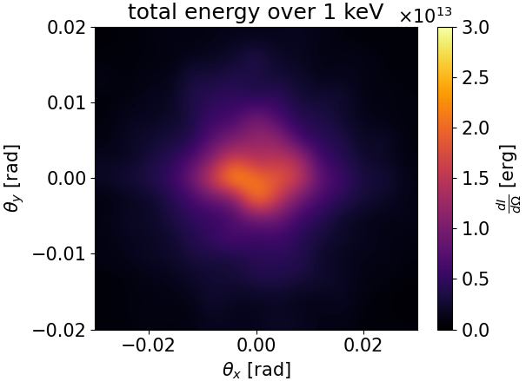
EuPRAXIA Advanced Photon Source
Expected parameters
8
Parameter | Value | Unit
Photon Critical Energy | 1 -10 | keV
Pulse duration | 10-50 | fs
Number of Photons/pulse | 10⁷-10⁹
Repetition rate | 1 | Hz
Beam divergence | 3-20 | mrad
Electron Beam Energy | 100-500 | MeV
Plasma Density | 10¹⁸-10¹⁹ | cm⁻³
Simulation of radiation spot
by A. Frazzitta
M. Galletti, et al. Appl.Sci 14, (2024), 8619
A. Curcio, et al. Nucl. Instr. Meth. Phys. Res. B , 42 (2017)
A. Curcio, et al. Phys. Rev. Accel. Beams, 20, (2017)

Slide 16
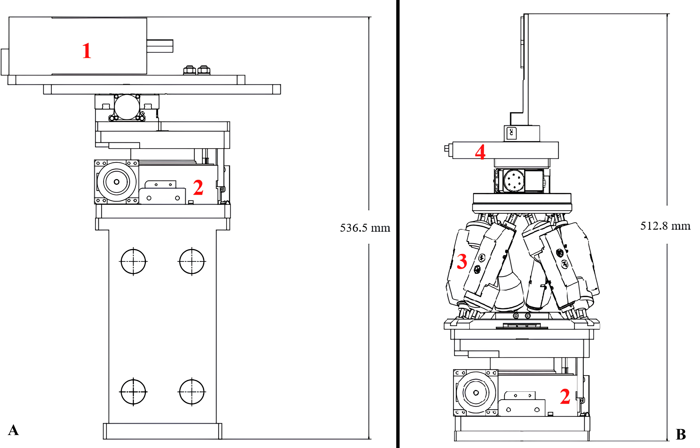
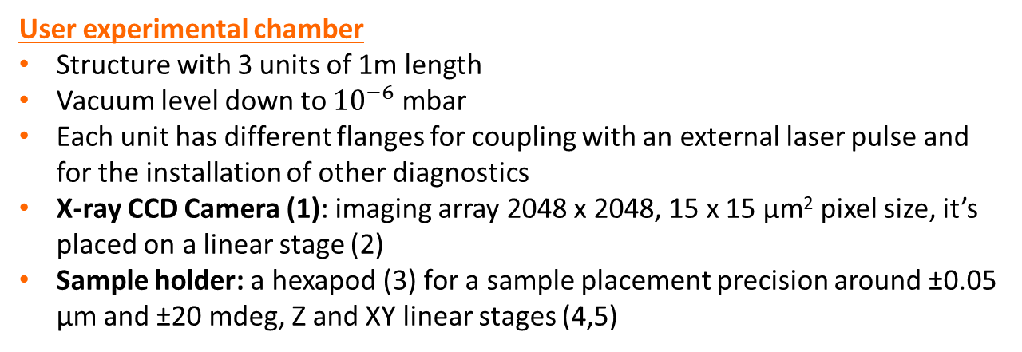
EuPRAXIA Advanced Photon Source
User experimental chamber
Structure with 3 units of 1m length
Vacuum level down to ${10}^{−6}$mbar
Each unit has different flanges for coupling with an external laser pulse and for the installation of other diagnostics
X-ray CCD Camera (1): imaging array 2048 x 2048, 15 x 15 µm² pixel size, it’s placed on a linear stage (2)
Sample holder: a hexapod (3) for a sample placement precision around ±0.05 µm and ±20 mdeg, Z and XY linear stages (4,5)
5
F. Galdenzi, et al. Condens. Matter 9, 30, (2024)

Slide 17
Outline
Laser WakeField Acceleration
X-ray Betatron Radiation
EuPRAXIA Advanced Photon Source project @LNF
Applications
Outlook

Slide 18
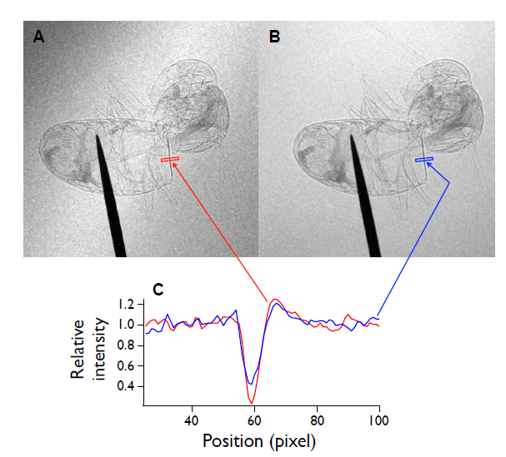
Applications
Phase Contrast Imaging
Possible applications (in ascending order of complexity):
Static imaging
Static X-ray absorption spectroscopy
Static X-ray emission spectroscopy
Time-resolved pump-probe X-ray absorption spectroscopy
Time-resolved pump-probe X-ray emission spectroscopy
Time-resolved imaging
1 shot
13 shots
Contrast 68%
Stellato, F., et al. “Plasma-Generated X-ray Pulses: Betatron Radiation Opportunities at EuPRAXIA@SPARC_LAB”.
Condens. Matter (2022), 7, 23.
S. Fourmaux, et al. "Single shot phase contrast imaging using laser-produced Betatron x-ray beams," Opt. Lett. 36, 2426-2428 (2011)

Slide 19
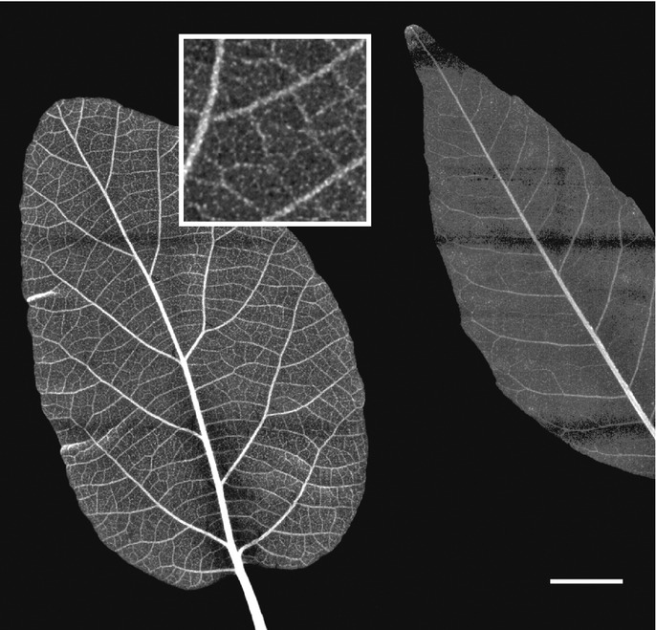
Applications
Broad energy spectrum → X-ray spectroscopy
Spatial coherence → X-ray phase contrast imaging
Pulse duration tens of fs → Time-resolved experiments
High brightness → High photon flux and small source size → Fast processes
EuAPS Pilot Experiment: Green Science
X-ray imaging of leaves (and wood) aiming at the (tens of) microns resolution
Experiments performed with the broad radiation spectrum filtered by different materials to obtain difference maps emphasizing the presence of heavy metal contaminants → pollution control
Reale et al. - MIDIX Soft X-rays microradiography
Courtesy F. Stellato

Slide 20
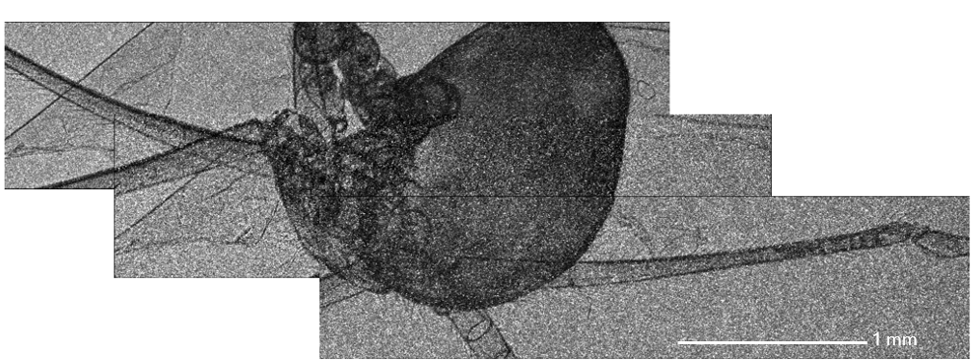
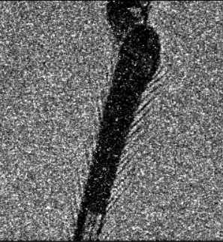
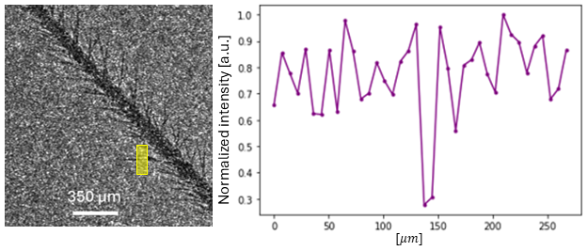
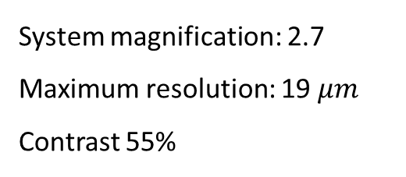
Applications
System magnification: 2.7
Maximum resolution: 19$μm$
Contrast 55%

Slide 21
Outline
Laser WakeField Acceleration
X-ray Betatron Radiation
EuPRAXIA Advanced Photon Source project @LNF
Applications
Outlook

Slide 22
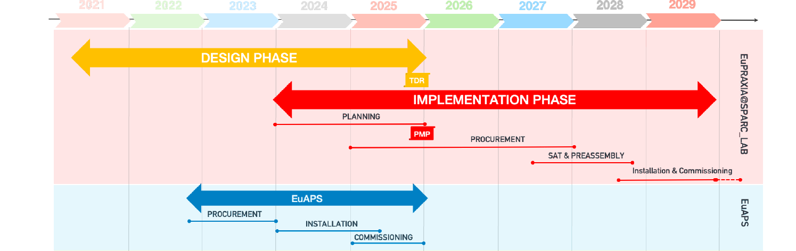
Timelines
OPPORTUNITY FOR USERS!
OPERATION
Courtesy A. Falone
THANK YOU FOR YOUR ATTENTION!

